Slide 1
Multiscale Structure and Evolution of Earl (2010) during Rapid Intensification
Robert Rogers¹, Paul Reasor¹, Jun Zhang², Stephen Guimond^{3,4}
¹NOAA/AOML Hurricane Research Division
²University of Miami/CIMAS
³University of Maryland/Earth System Science Interdisciplinary Center
⁴NASA Goddard Space Flight Center

Slide 2
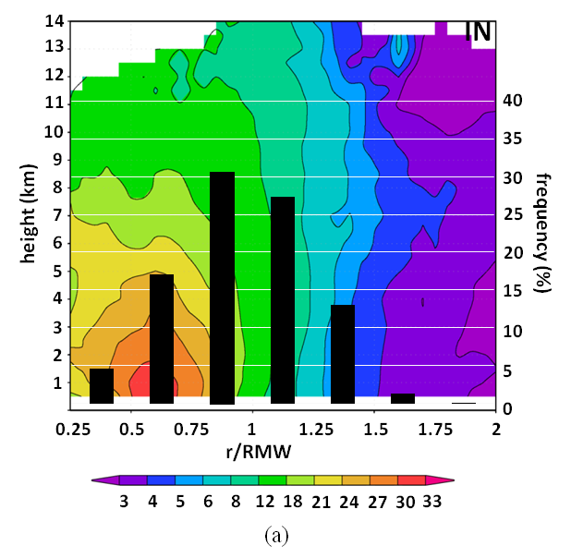
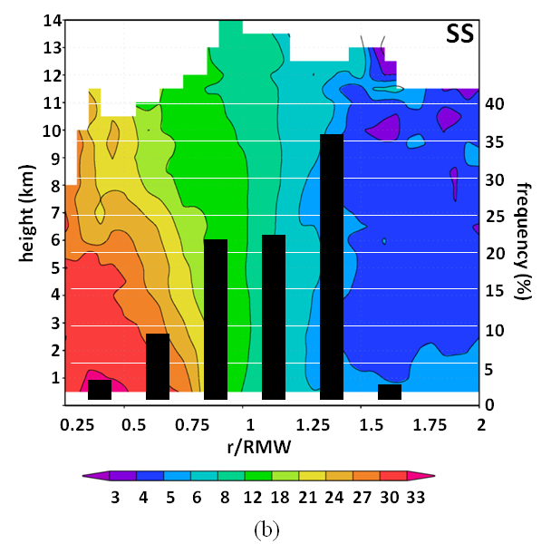
Motivation
Rapid intensification (RI) remains challenging research, forecasting problem
Recent research has focused on subsynoptic-scale factors (e.g., vortex, convective, boundary layer) and their role in RI
Airborne Doppler composites have identified key vortex- and convective-scale differences between intensifying (IN) and steady-state (SS) hurricanes
  deeper inflow, weaker outer-core vorticity, greater azimuthal coverage of precipitation
  more convective bursts, distribution peaked inside 2-km radius of maximum wind (RMW)
Radial distribution of convective bursts (%) and axisymmetric vorticity (shaded, x 10⁻⁴ s⁻¹)
Rogers et al., MWR, 2013
- What are primary inner core structures associated with Earl’s RI?
- What governs the radial distribution of convective burst activity relative to the RMW?

Slide 3
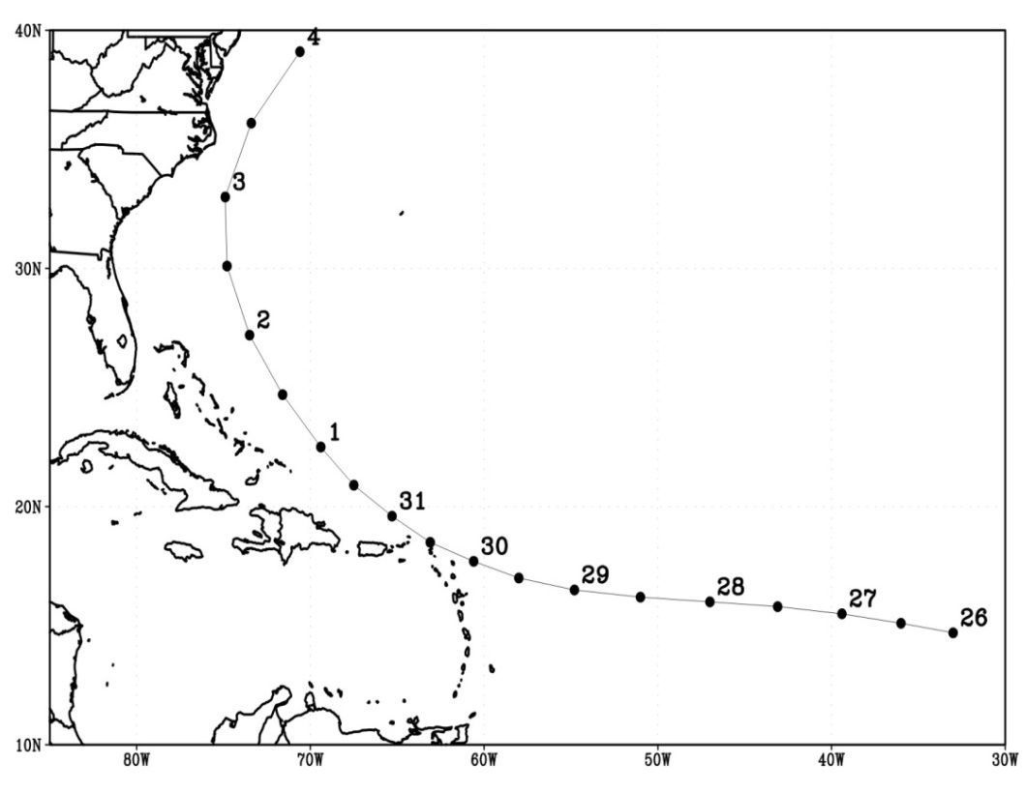
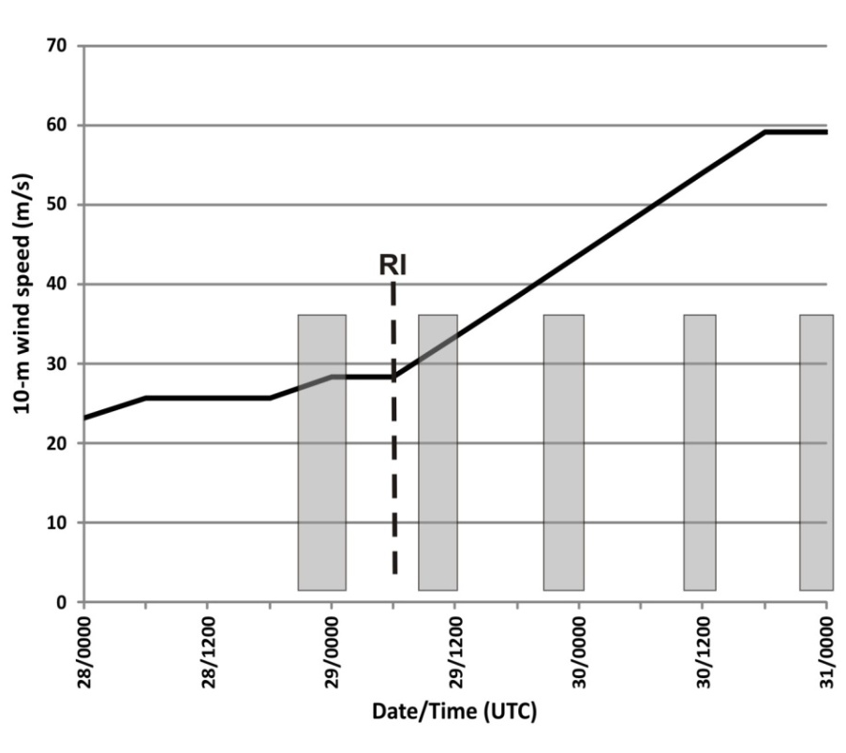
Hurricane Earl (2010)
Long-lived TC developed in eastern Atlantic, underwent RI near Leeward Islands
Intensified from 25 m s⁻¹ tropical storm to 60 m s⁻¹ hurricane in 36 h
RI onset at 06 UTC August 29
Sampled by NOAA P-3’s, G-IV; NASA DC-8, Global Hawk; Air Force C-130’s as part of NOAA IFEX and NASA GRIP Field Campaigns
Moderate (8 m s⁻¹) northeasterly shear at RI onset, shear weakened by 3rd P-3 flight
Focus here on inner-core structure as revealed by airborne Doppler and dropsondes
Track
Intensity
On station times for P-3 flights
Portion covered by P-3 flights considered here

Slide 4
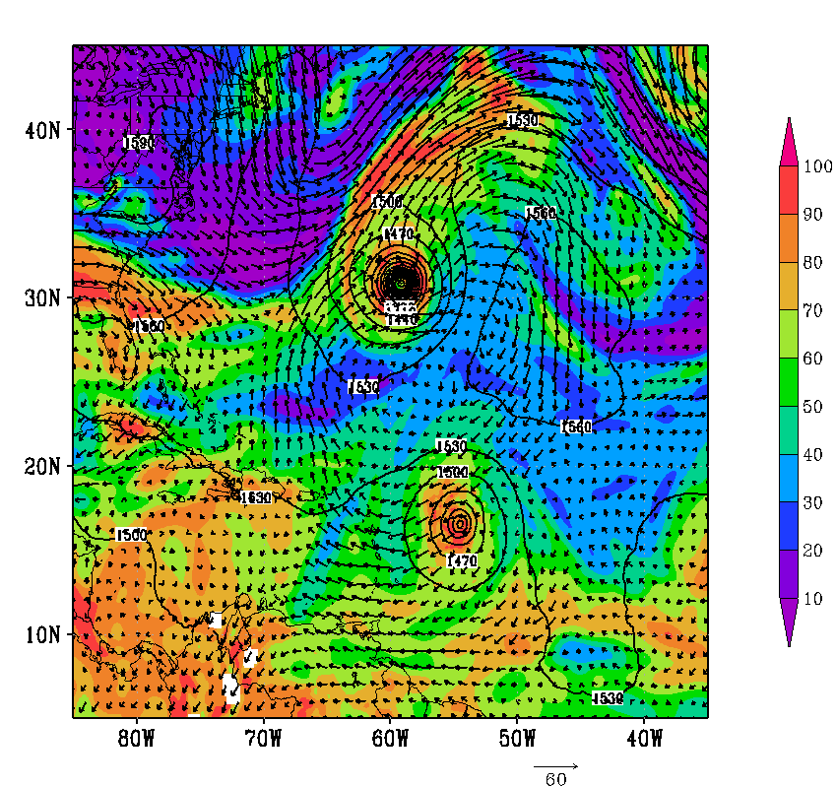
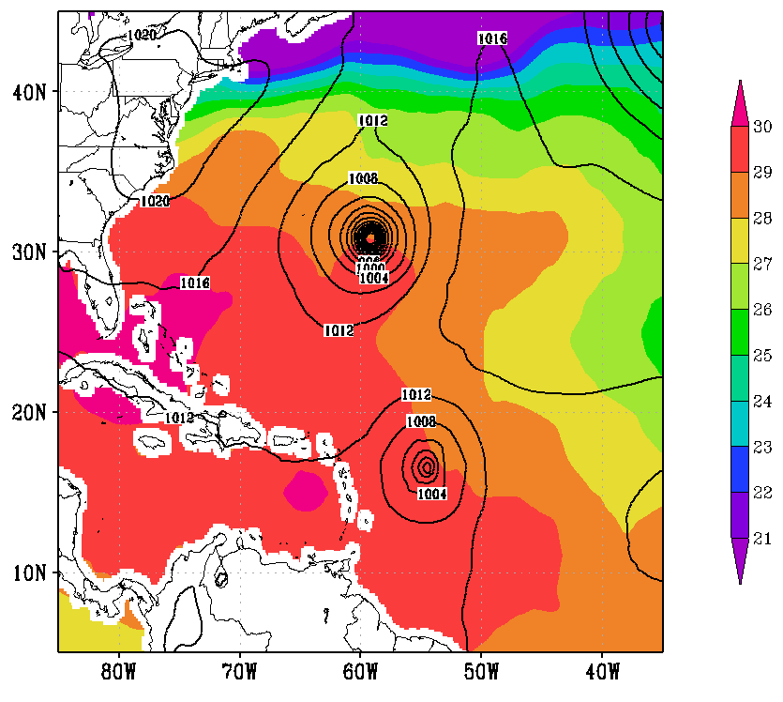
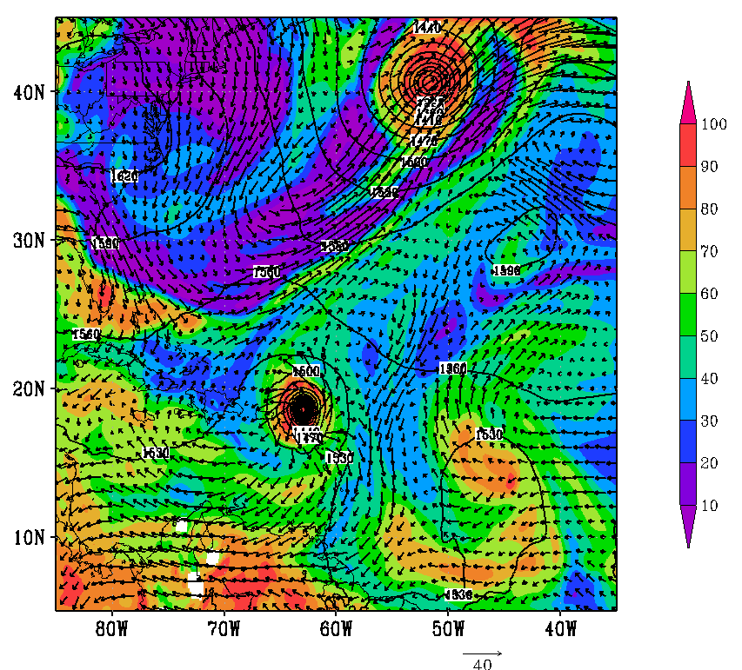
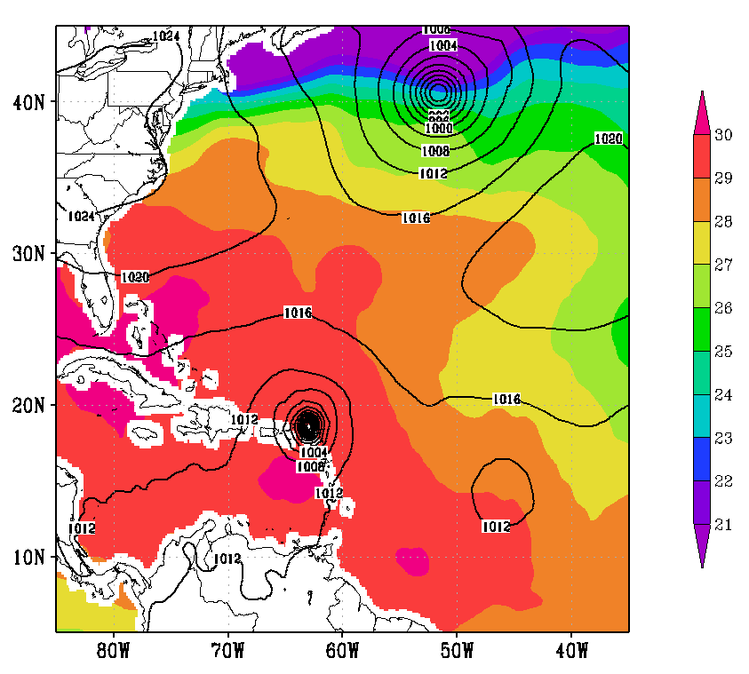
Large-scale environment
700 hPa RH (shaded, %), 850 hPa height (contour, m), 200 hPa flow (vector, m s⁻¹)
GFS SST (shaded, deg C), MSLP (contour, hPa)
Danielle
Earl
Northeasterly shear early from interaction with Danielle
Dry air in environment, but not near core
Break in low-level ridge for Earl to move through
Stays over warm SST
00 UTC 29 August
00 UTC 29 August
Danielle
Earl
12 UTC 30 August
12 UTC 30 August

Slide 5
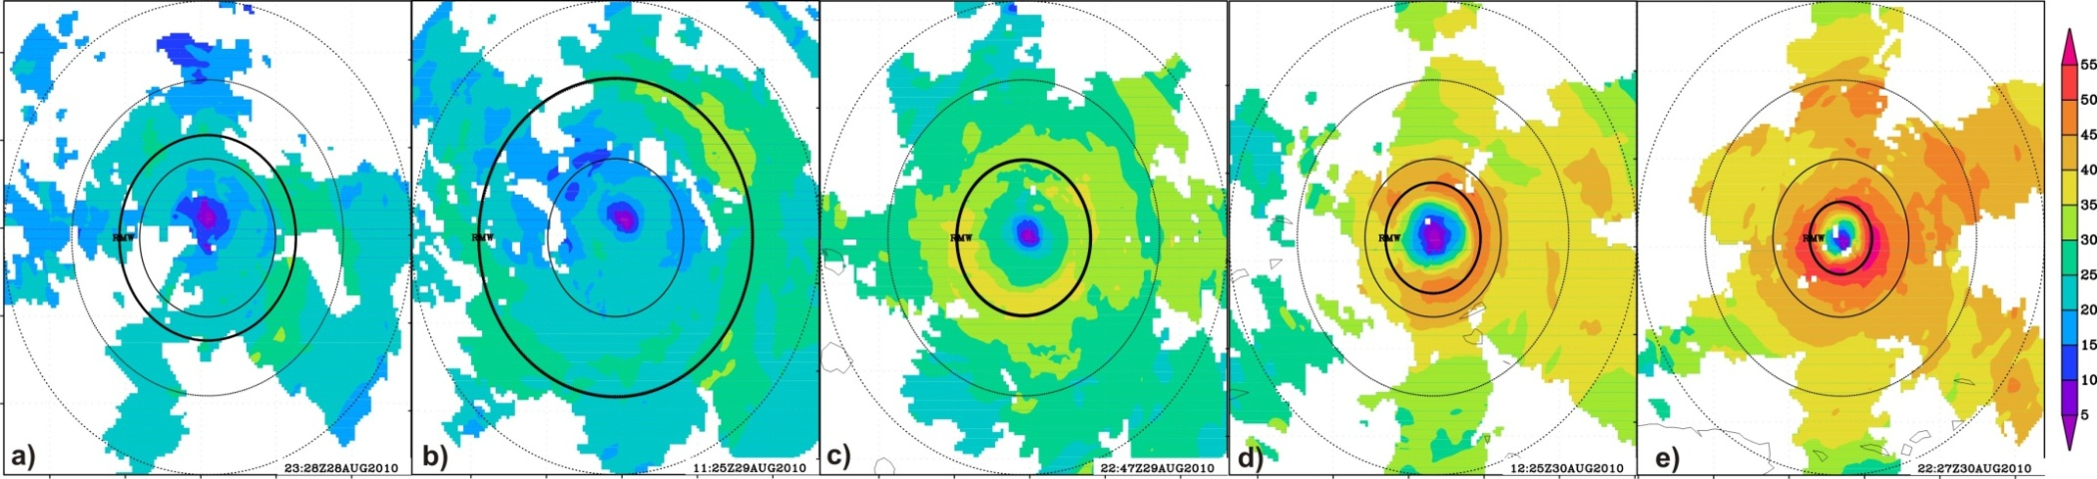
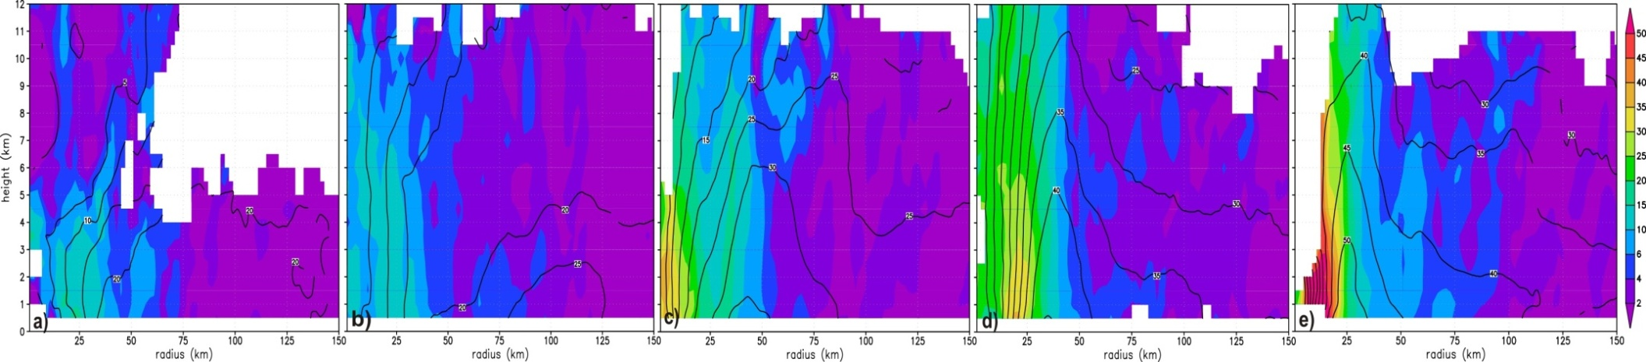
Vortex-scale evolution
Storm-relative wind speed at 2 km altitude (shaded, m s⁻¹)
55
50
45
40
35
-100
-50
0
50
100
30
25
20
15
10
5
00 UTC Aug 29
12 UTC Aug 29
00 UTC Aug 30
12 UTC Aug 30
00 UTC Aug 31
-100
-50
0
50
100
-100
-50
0
50
100
-100
-50
0
50
100
-100
-50
0
50
100
-100
-50
0
50
100
distance (km)
distance (km)
distance (km)
distance (km)
distance (km)
Radius-height plot of axisymmetric vorticity (shaded, x 10⁻⁴ s⁻¹) and tangential wind (contour, m s⁻¹)
12
11
50
10
45
9
40
8
35
height (km)
30
7
25
6
20
5
15
4
10
3
6
2
00 UTC Aug 29
12 UTC Aug 29
00 UTC Aug 30
12 UTC Aug 30
00 UTC Aug 31
4
1
2
0
25
50
75
100
125
150
25
50
75
100
125
150
25
50
75
100
125
150
25
50
75
100
125
150
25
50
75
100
125
150
radius (km)
Early stage
radius (km)
radius (km)
radius (km)
radius (km)
Late stage
Two stages of Earl’s RI:
Early stage – shallow symmetric vortex, broad RMW, RI onset in moderate shear
Late stage – deep symmetric vortex, contracting eyewall, majority of intensification in low shear

Slide 6
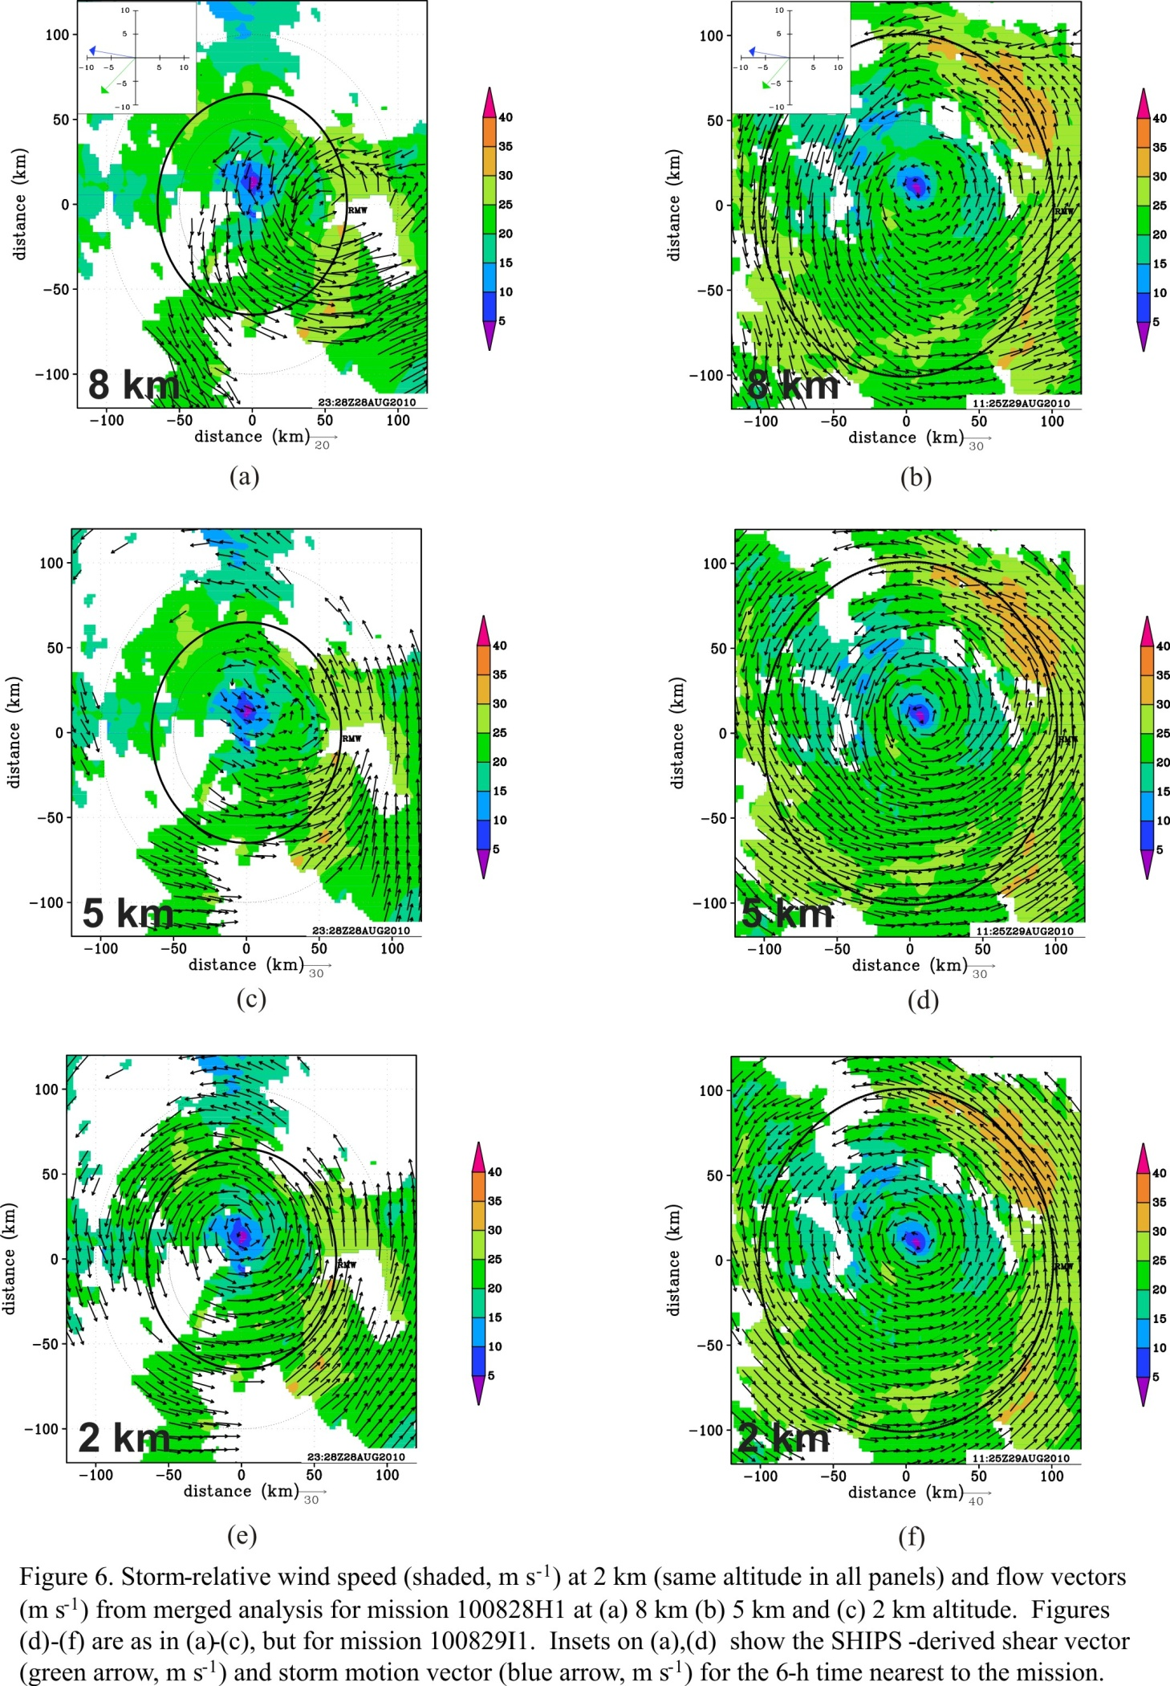
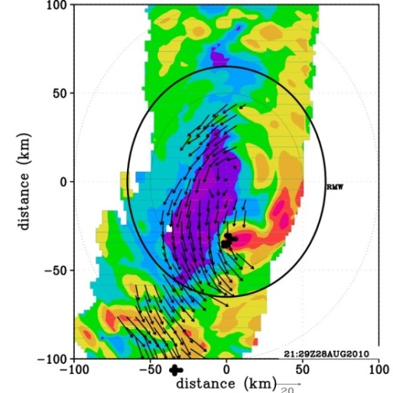




Early Stage of RI: Convective bursts and vortex alignment
2-km wind speed (shaded, m s⁻¹) and 8-km wind vectors (m s⁻¹)
2-km reflectivity (shaded, dBZ), wind vectors (m s⁻¹) and convective burst points from tail Doppler radar
motion
shear
00 UTC Aug 29
21:29 UTC Aug 28
22:54 UTC Aug 28
01:25 UTC Aug 29
Flight 1
Flight 1
Reflectivity (shaded, dBZ) from lower fuselage radar at ~ 3 km
motion
100
shear
47
45
50
42
40
37
distance (km)
35
32
0
30
27
25
22
20
-50
17
15
12 UTC Aug 29
dBZ
-100
-50
21:29 UTC Aug 28
-50
22:54 UTC Aug 28
01:25 UTC Aug 29
0
50
-100
0
50
100
Flight 2
-100
100
distance (km)
-100
-50
0
50
100
Flight 1
distance (km)
distance (km)
Displaced circulation center
Convective bursts tracking around storm left of shear vector
Notes:
Circulation center at 8 km ~50 km displaced southeast of 2-km center during first mission, left of shear
Convective bursts evident inside RMW, tracks around left of shear side of storm during first mission
See talks 5D.3 (Stevenson) and 5D.6 (Susca-Lopata) for further discussion of this stage of Earl’s RI

Slide 7
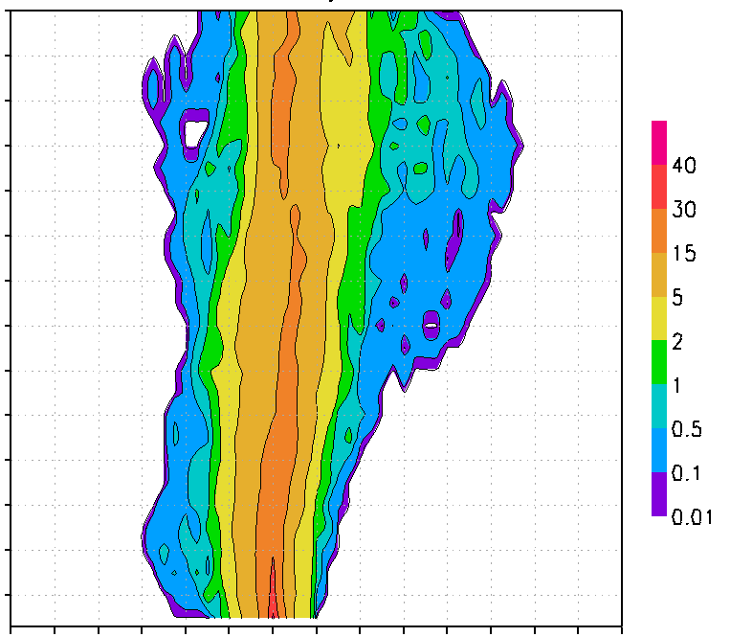
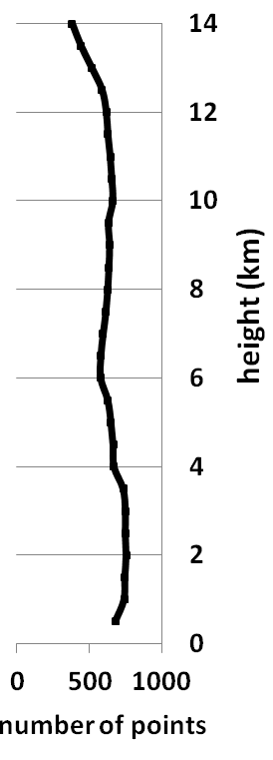
Early Stage of RI: Convective bursts and vortex alignment
Contoured frequency by altitude diagram (shaded, %) for upshear left quadrant across eyewall during first flight
-12
14
13
12
11
10
9
height (km)
8
7
6
5
4
3
2
1
-12
-10
-8
-6
-4
-2
0
2
4
6
8
10
12
14
16
vertical motion (m/s)
Updrafts > 10 m/s above 10 km altitude
Strong downdrafts (~-6 m/s) in lower troposphere

Slide 8
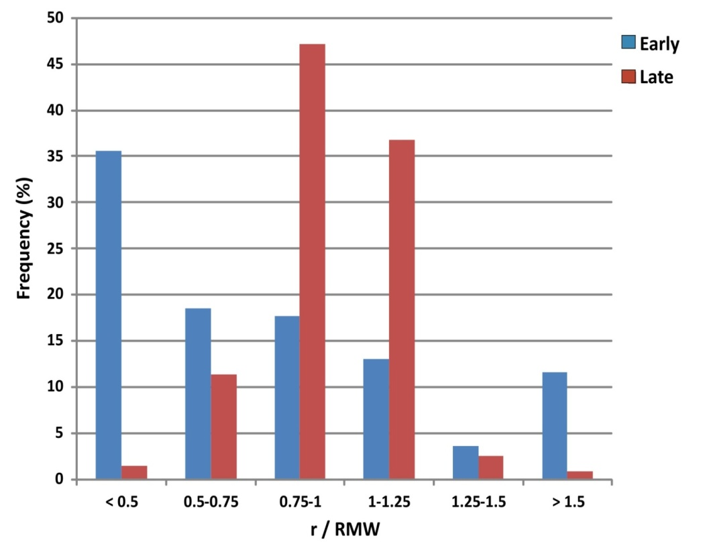
Late Stage of RI: Convective bursts located inside RMW
Radial distribution of convective bursts for early and late stages of RI
2-km RMW
Bursts located near center during early stage, but sizable portion across broad radial band
More concentrated inside RMW during late stage
What governs the radial distribution of convective burst activity relative to the RMW?
What governs the radial distribution of convective burst activity relative to the RMW?
Boundary layer convergence peaked inside RMW for IN cases, outside RMW for SS cases
Outer-core inertial stability lower, and radial inflow deeper, for IN vs. SS cases
Updraft cores slope less from vertical for IN cases, more for SS cases

Slide 9
1. Boundary layer convergence peaked inside RMW
Boundary-layer profiles of axisymmetric fields from dropsondes during late stage of Earl’s RI
Centered at
00 UTC Aug 30
r / RMW
r / RMW
(divergence)
Low-level supergradient flow inside RMW
Convergence peaked below 0.5 km altitude inside RMW
Limited dropsonde data for SS cases

Slide 10
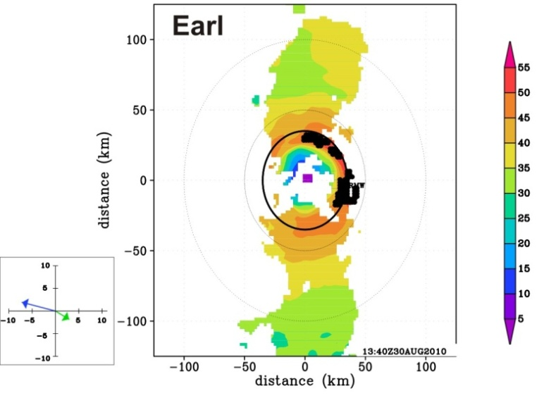


2. Inertial stability, inflow depth differences
Consider two examples: Earl 2010 (RI) and Gustav 2008 (SS)
Wind speed at 2 km (shaded, m/s) and burst locations
Radial distribution of convective bursts
RMW
13:40 UTC Aug 30 2010
shear
motion
both storms ~ 50 m/s hurricane, RMW of ~35 km
burst distribution peaked inside RMW for Earl, outside RMW for Gustav
22:26 UTC Aug 31 2008
shear
motion

Slide 11
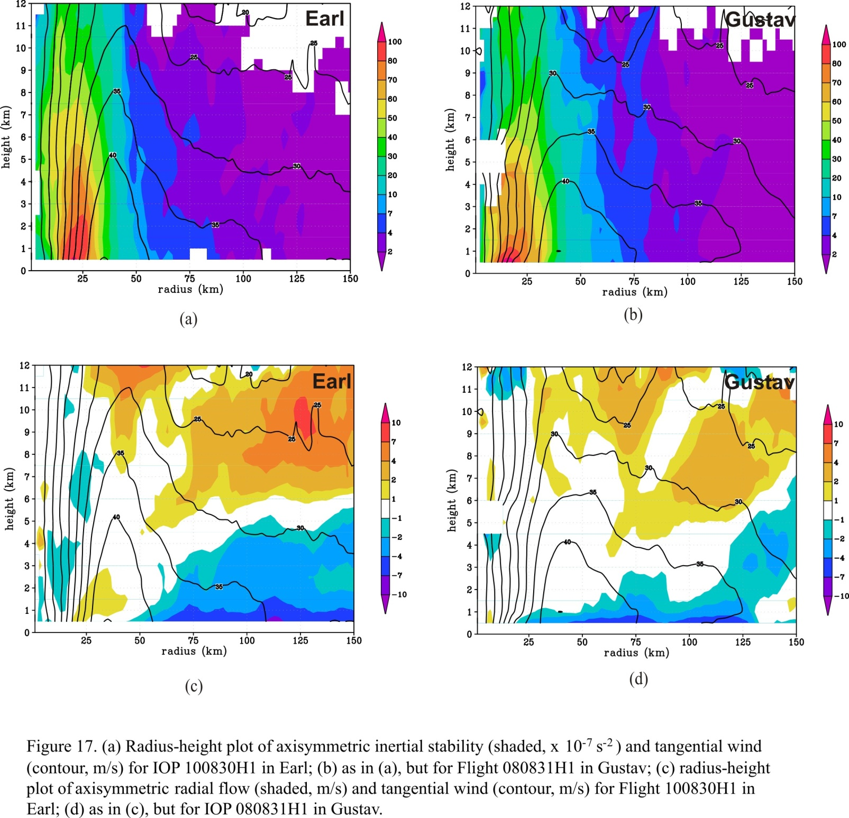
2. Inertial stability, inflow depth differences
Axisymmetric inertial stability (I², shaded, x 10⁻⁷ s⁻²) and tangential wind (contour, m s⁻¹)
12
12
11
11
10
100
10
100
9
80
9
80
8
70
8
70
7
60
7
60
height (km)
50
height (km)
50
6
40
6
40
5
30
5
30
4
20
4
20
3
10
3
10
2
7
2
7
1
4
1
4
0
12 UTC Aug 30 2010
2
00 UTC Sep 1 2008
2
25
50
75
100
125
150
0
25
50
75
100
125
150
radius (km)
radius (km)
Axisymmetric radial flow (shaded, m s⁻¹) and tangential wind (contour, m s⁻¹)
12
12
11
11
10
10
10
10
9
7
9
7
8
4
8
4
7
7
height (km)
2
height (km)
2
6
1
6
1
5
-1
5
-1
4
-2
4
-2
3
-4
3
-4
2
-7
2
-7
1
-10
1
-10
0
25
50
75
100
125
150
0
25
50
75
100
125
150
radius (km)
radius (km)
Lower outer-core inertial stability for Earl than for Gustav
Deeper inflow layer for Earl than Gustav

Slide 12
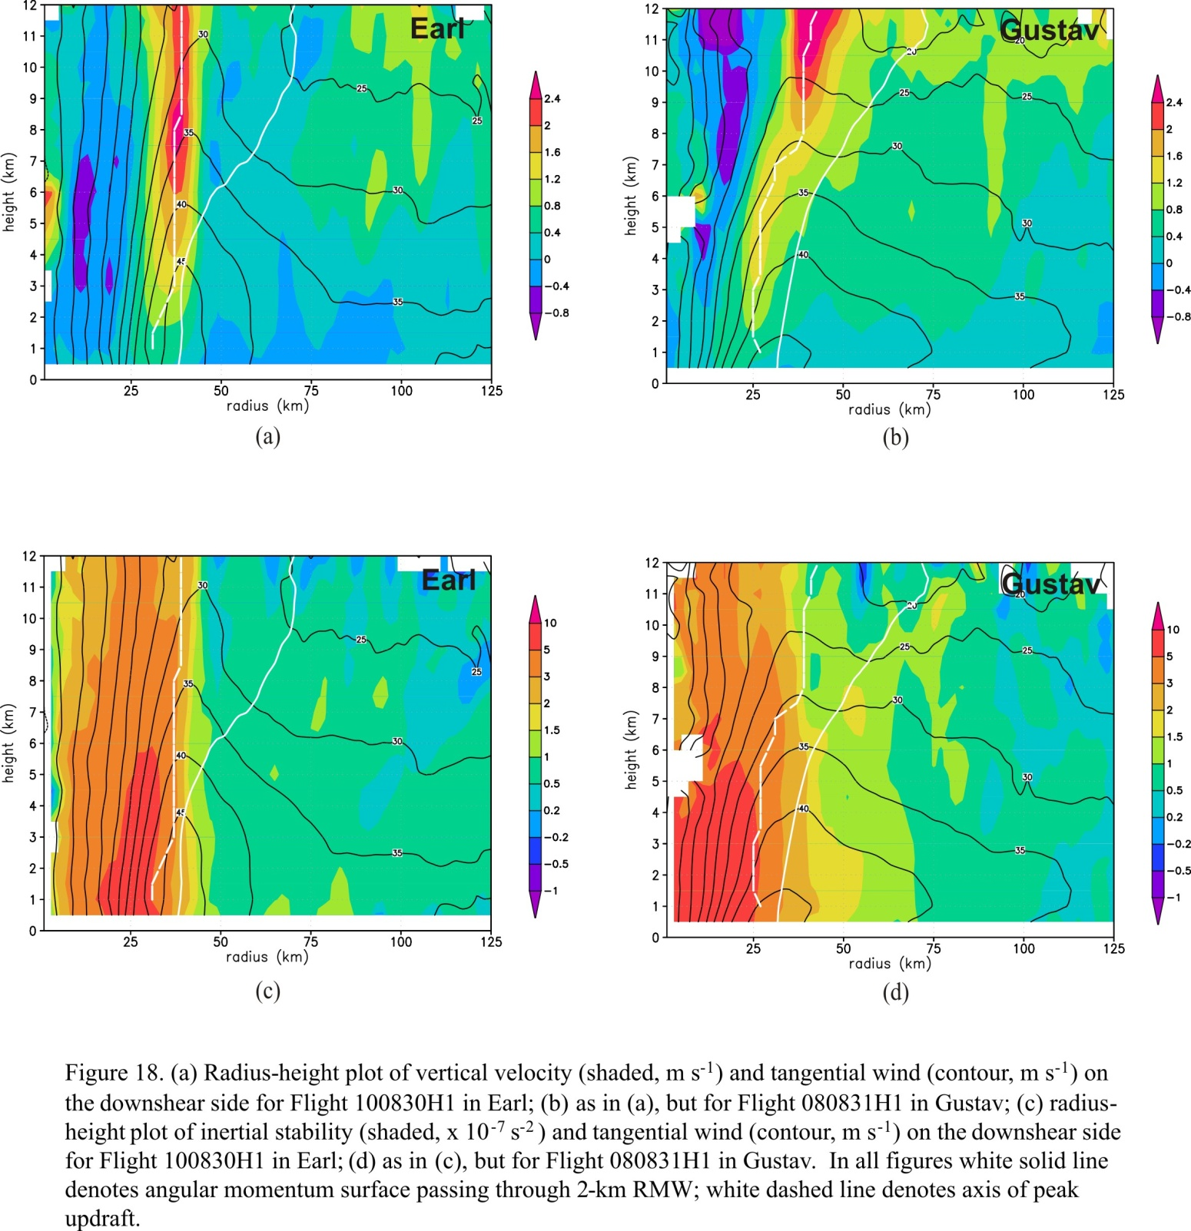
3. Updraft slope differences
Downshear vertical velocity (shaded, m s⁻¹) and tangential wind (contour, m s⁻¹)
12
12
11
peak w
11
10
10
peak w
9
M surface
2.4
9
M surface
2.4
8
2
8
2
7
1.6
7
1.6
height (km)
1.2
height (km)
1.2
6
0.8
6
0.8
5
0.4
5
0.4
4
0
4
0
3
-0.4
3
-0.4
2
-0.8
2
-0.8
1
12 UTC Aug 30 2010
1
00 UTC Sep 1 2008
0
25
50
75
100
125
0
25
50
75
100
125
radius (km)
radius (km)
Downshear inertial stability (I², shaded, x 10⁻⁷ s⁻²) and tangential wind (contour, m s⁻¹)
12
12
11
11
10
peak w
10
10
peak w
10
9
5
9
M surface
5
8
M surface
3
8
3
7
2
7
2
height (km)
1.5
height (km)
1.5
6
1
6
1
5
0.5
5
0.5
4
0.2
4
0.2
3
-0.2
3
-0.2
2
-0.5
2
-0.5
1
12 UTC Aug 30 2010
-1
1
00 UTC Sep 1 2008
-1
0
25
50
75
100
125
0
25
50
75
100
125
radius (km)
radius (km)
Updraft core originates inside RMW for both cases
Slope of updraft core departs from M surface for Earl, parallels M surface for Gustav
Peak heating inside local RMW for Earl, outside for Gustav
Relationship consistent with composite slope results from Hazelton et al. (2014)
Notes:
Updraft core originates from PBL inside RMW for both cases
Slope of updraft core departs signficantly from M surface for Earl, closer to M surface for Gustav
Updraft core inside local RMW, in high inertial stability regime for Earl, outside local RMW for Gustav
Relationship consistent with composite slope results from Hazelton et al. (17C.7, Fri. 3:00 pm talk)

Slide 13
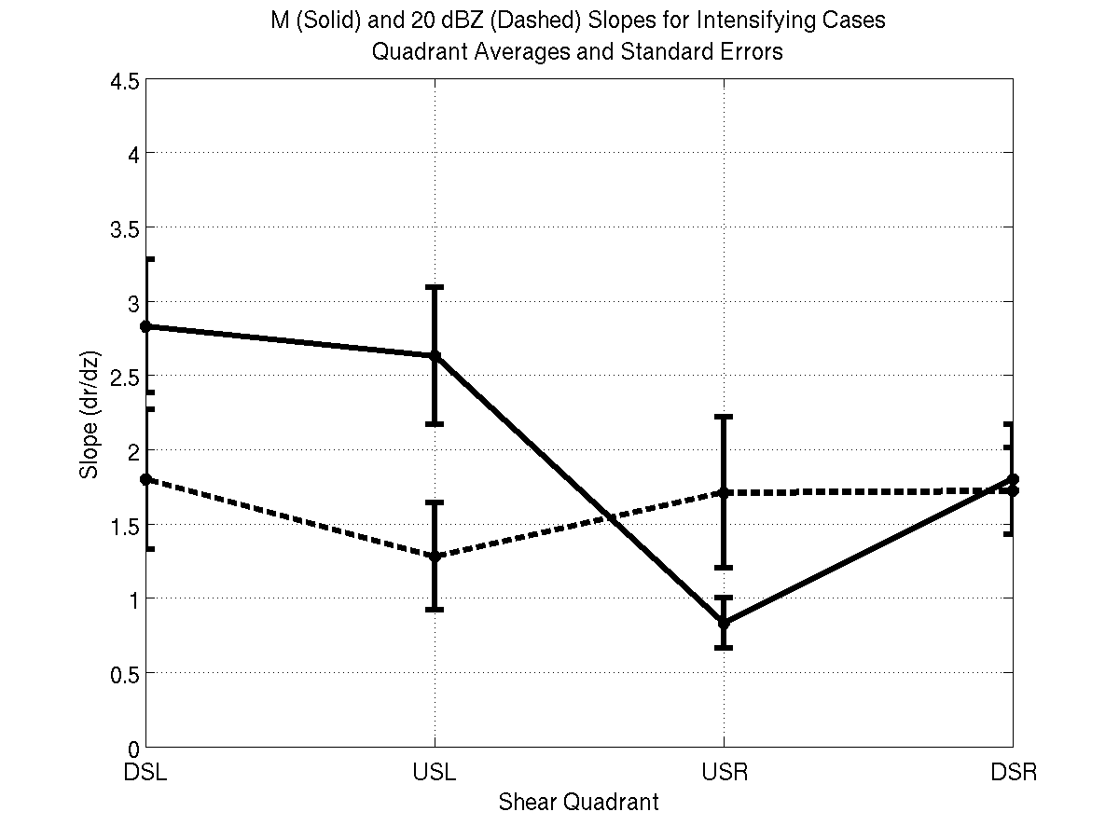
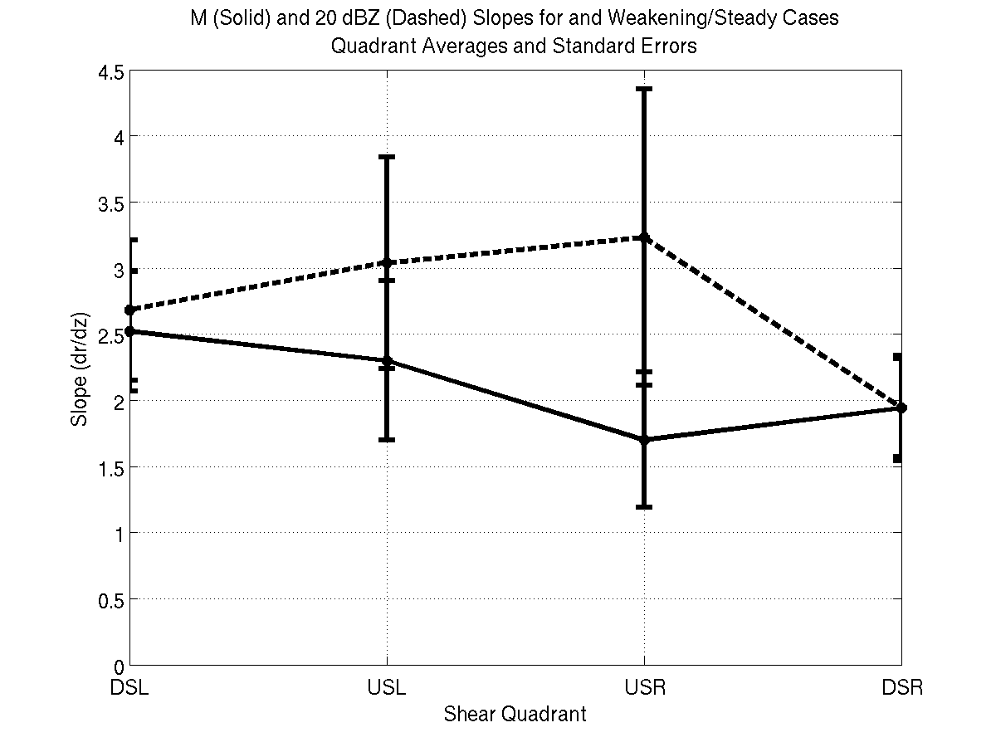
Comparison with slopes from composites
36 Missions in 15 different TC’s
Slopes of reflectivity (dashed) and M (solid) as a function of shear-relative quadrant
4.5
Intensifying
4.5
Steady-state
4
4
3.5
3.5
dBZ
slope (dr/dz)
3
M
slope (dr/dz)
3
2.5
2.5
M
2
2
1.5
dBZ
1.5
1
1
0.5
0.5
DSL
USL
USR
DSR
DSL
USL
USR
DSR
Shear-relative quadrant
Shear-relative quadrant
Schematic of slope differences left of shear
(Adapted from Hazelton et al. 2014)
Intensifying
Steady-state
M
M
20 dBZ
20 dBZ
RMW_{2km}
RMW_{2km}

Slide 14
Summary
Earl’s RI occurred in two stages
  early stage: vortex aligned in moderate shear with convective bursts likely playing a role in alignment
  late stage: RMW contracted with convective burst activity concentrated inside RMW
  Three mechanisms explored to explain this radial distribution of convective bursts
    PBL convergence
    outer core inertial stability and inflow depth
    slope differences in updraft
Future work
Causes of differences in updraft slope for different cases – buoyancy of inflowing air?
Acquire additional datasets from NOAA aircraft, especially outside RMW
  dropsonde measurements for PBL convergence, buoyancy calculations
  buoyancy retrievals from Doppler
  Analyze datasets from new instruments/platforms
    HIWRAP on Global Hawk
Numerical model simulations of RI vs. non-RI
Notes:
Three mechanisms explored to explain this relationship
PBL convergence – maximized inside RMW for Earl, inadequate data in other cases
outer core inertial stability and inflow depth – RI case (Earl) showed lower I, deeper inflow, than SS case (Gustav). Stronger secondary circulation and intensification via enhanced angular momentum import.
slope differences in updraft – Slope of updraft core departs significantly from M surface for Earl, closer to M surface for Gustav. Updraft inside local RMW for Earl, in higher I regime, compared with Gustav, which is outside local RMW aloft.

Slide 15
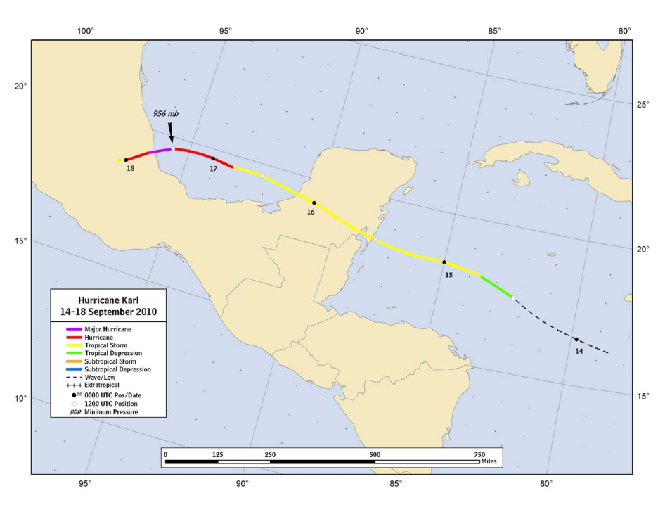
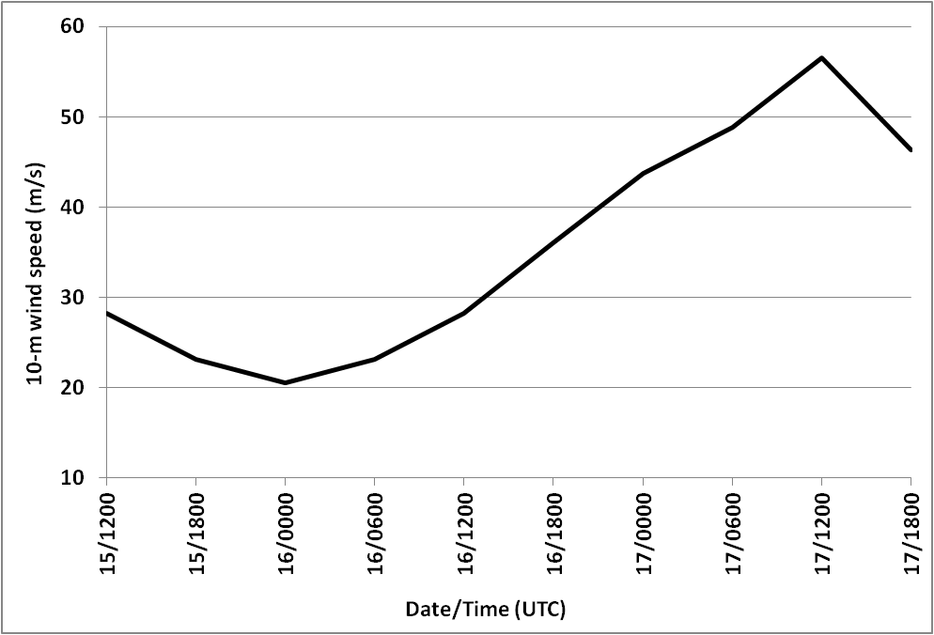
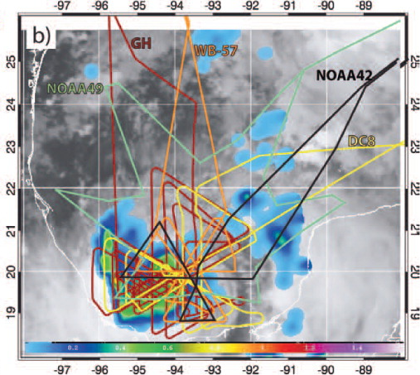
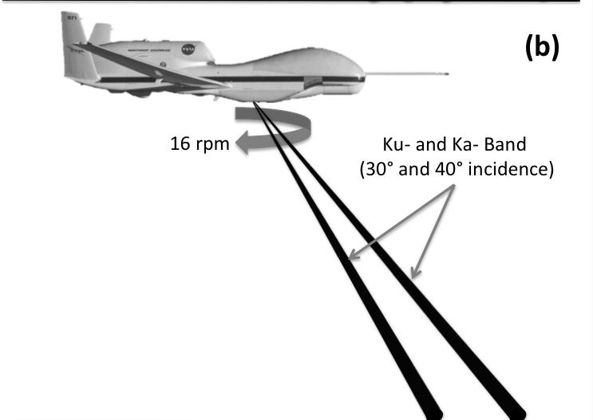
A rapid intensifier sampled by HIWRAP: Karl (2010)
Track
Intensity
on station time for GH
aircraft on station time
on station time for P-3
Flight tracks (Braun et al. 2013)
HIWRAP sampling geometry (Guimond et al. 2014)
GOES IR 0110 UTC 17 Sept
SSM/I rain rate 0113 UTC 17 Sept

Slide 16
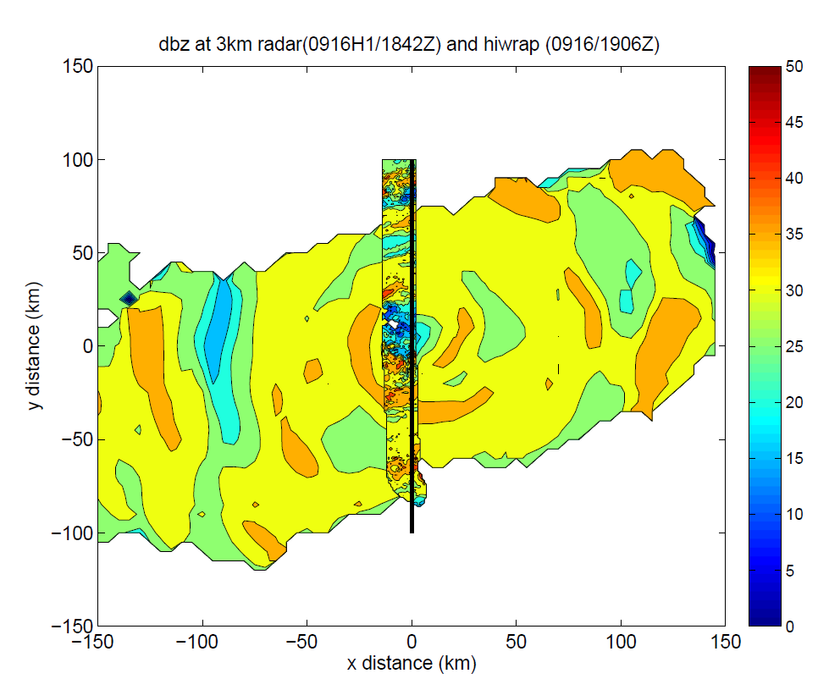
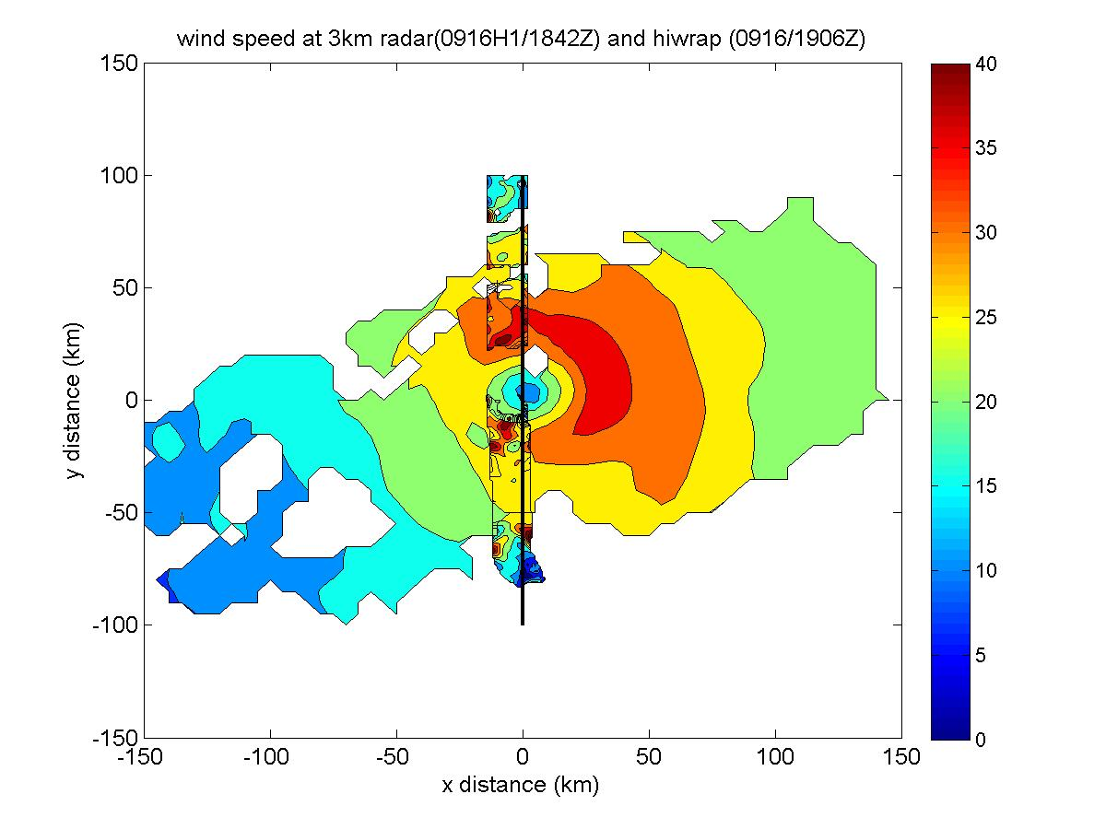
Comparison of P-3 and HIWRAP swaths
3 km reflectivity (dBZ) for HIWRAP and P-3 TDR
3 km wind speed (m/s) for HIWRAP and P-3 TDR
*Note: P-3 TDR has ~1.5 km along-track sampling, analysis is 5 km spacing
HIWRAP has ~600 m along-track sampling, analysis is 1 km spacing
Qualitatively reasonable agreement, despite significant resolution differences

Slide 17
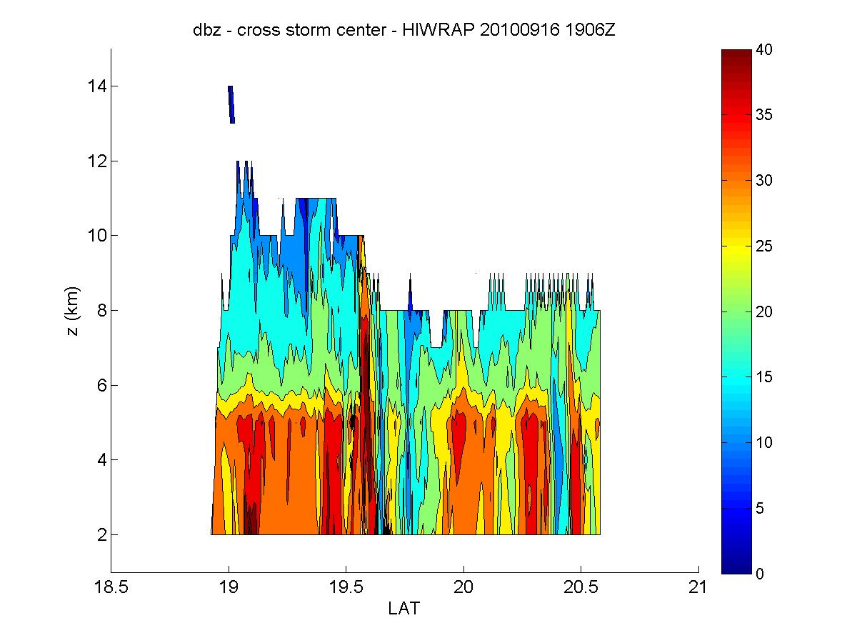
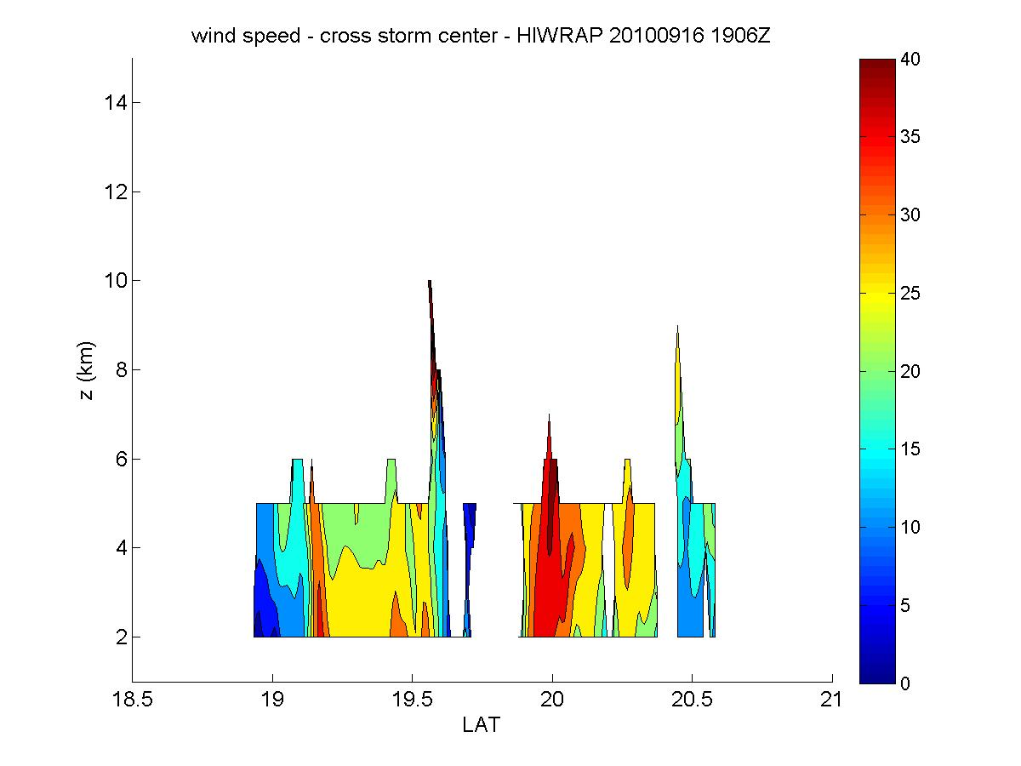
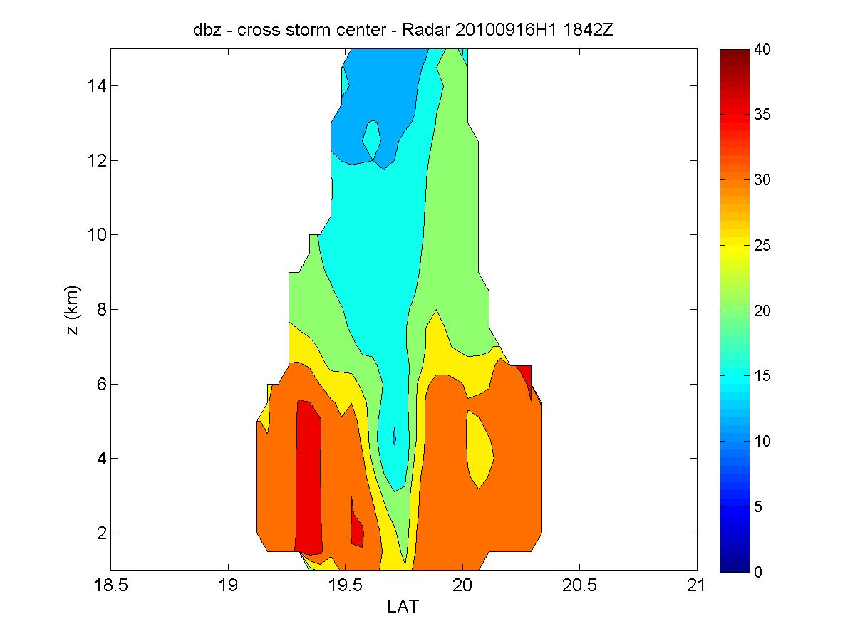
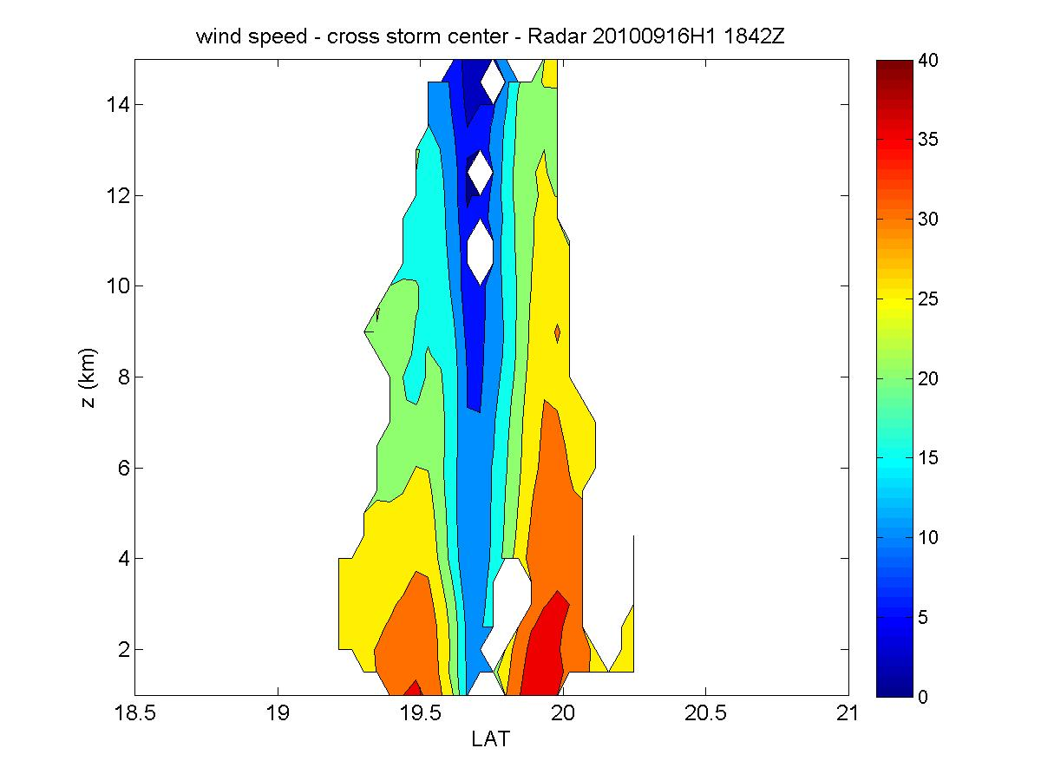
Comparison of P-3 TDR and HIWRAP swaths
reflectivity (dBZ)
wind speed (m/s)
1906 UTC
HIWRAP
1906 UTC
HIWRAP
1842 UTC
TDR
1842 UTC
TDR
Both instruments show strongest rain on south side, generally stratiform distribution, strongest winds on north side
One tower noted in HIWRAP reflectivity field
Caution needed for HIWRAP since section taken near edge of swath, where uncertainties large (Guimond et al. 2014)

Slide 18
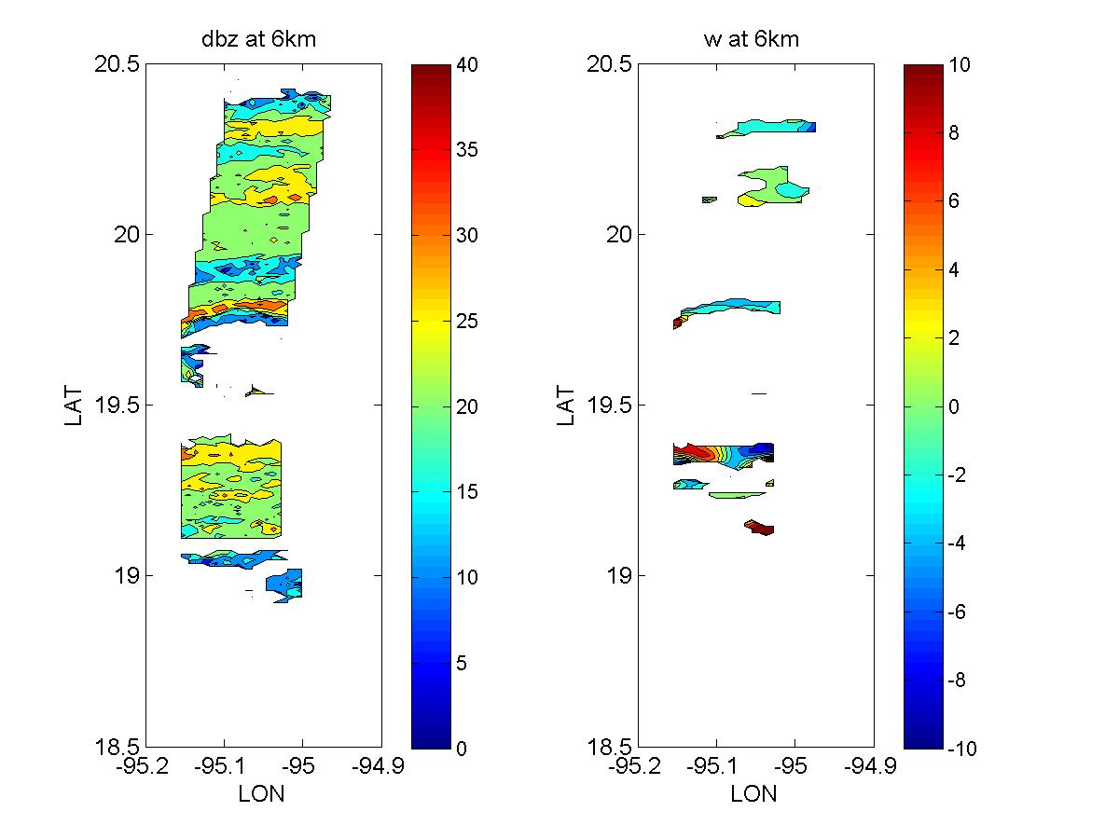
Possible convective bursts from HIWRAP?
0737-0752 UTC 17 Sept
6 km reflectivity (dBZ)
6 km vertical velocity (m/s)
Vertical cross sections of w, ws, dBZ
convective burst?
vertical velocity (m/s)
RMW
wind speed (m/s)
reflectivity (dBZ)
HIWRAP appears to identify a region of strong updrafts in mid troposphere on south side of center
area located inside RMW
limited coverage above 6 km may necessitate new parameters for identifying convective bursts

