Slide 1
Understanding Hurricane Sandy's Track and Intensity Changes
Frank Marks, Hua Chen, & Sundararaman Gopalakrishnan
NOAA/AOML Hurricane Research Division
20 May 2014
Notes:
Hurricane Sandy 28 October 2012

Slide 2
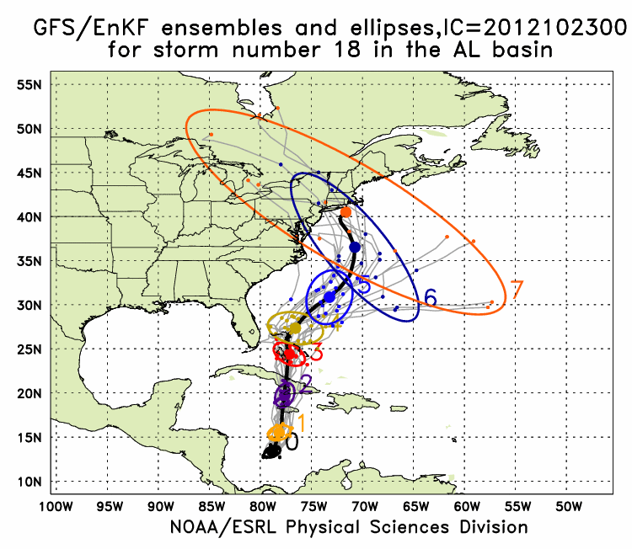
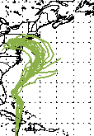
Track:
GFS/EnKF & HWRF
GFS/EnKF T382 20 member ensemble
HWRF
12Z 23 October – 00Z 29 October
Observed
Observed
http://www.esrl.noaa.gov/psd/forecasts/gfsenkf/ens/
http://www.emc.ncep.noaa.gov/gc_wmb/vxt/
Notes:
Model data available at: http://www.esrl.noaa.gov/psd/forecasts/gfsenkf/ens/
Global Ensembles:
80-member T254 GFS ensembles cycled every 6-h continuously from 1 August to current time
Look at 20 members of the 80 member ensemble
Left panels shows plots of the deterministic operational HWRF tracks starting at 1200 UTC 23 October to 0000 UTC 29 October

Slide 3
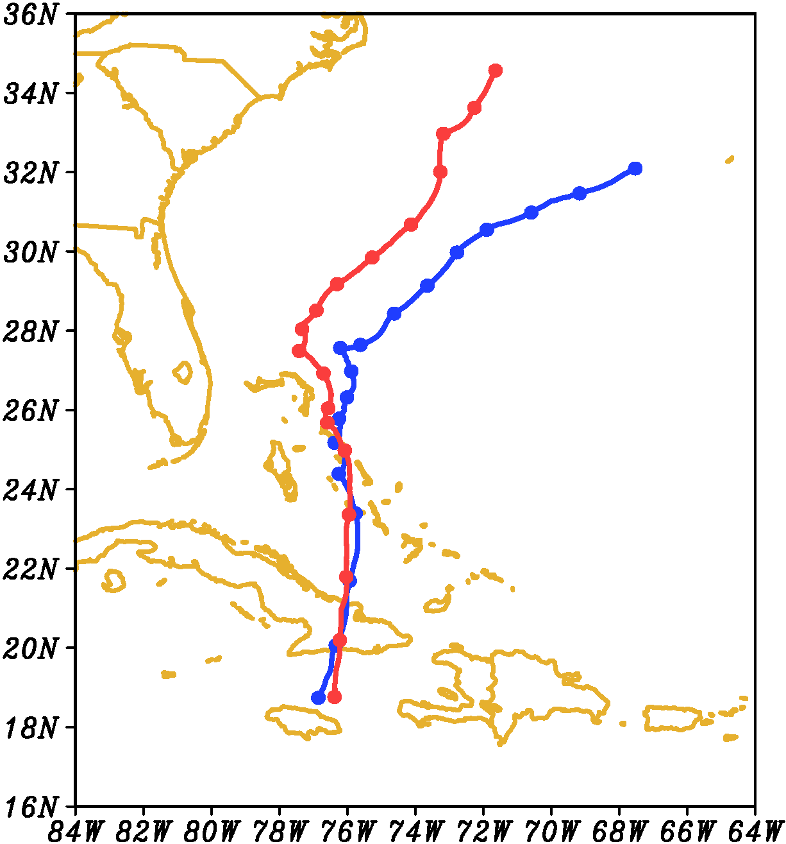
HWRF Track
Start 00Z 25 October
96 h
00Z 24 October
(blue)
00Z 25 October
(red)
Tracks very similar to 36 h
(12Z 26 October)
96 h
72 h
72 h
48 h
48 h
24 h
24 h
00:00 OCT25
Notes:
Red track had much lower error, very close to real Sandy track

Slide 4
HWRF 500/200 hPa
500 hPa
200 hPa
Init: 00Z 24 October
Init: 00Z 24 October
00Z 24 – 00Z 25
00Z 24 – 00Z 25
Init: 00Z 25 October
Init: 00Z 25 October
24 h: 00Z 26 October

Slide 5
Track
Start 00Z 25 October
00Z 24 October
00Z 25 October
36 h: 12Z 26 October
18 h: 18Z 25 October
Notes:
Images from: http://www.nhc.noaa.gov/verification/verify5.shtml

Slide 6
Vertical Wind Shear
36 h: 12Z 26 October
22 m s⁻¹
23 m s⁻¹
18 m s⁻¹
18 h: 18Z 25 October
00Z 25OCT
Notes:
Shear increases from WSW changing to SSW: 5 m/s at 0 h to 18 m/s at 18 h; to 21 m/s at 24 h

Slide 7
Vortex Tilt
2-8 km Altitude
00Z 26Oct
12Z 26Oct

Slide 8
Potential Vorticity
2-8 km Altitude
Init: 00Z 24 October
Init: 00Z 25 October

Slide 9
R-Z Mean Tangential Wind
Init: 00Z 24 October
Init: 00Z 25 October

Slide 10
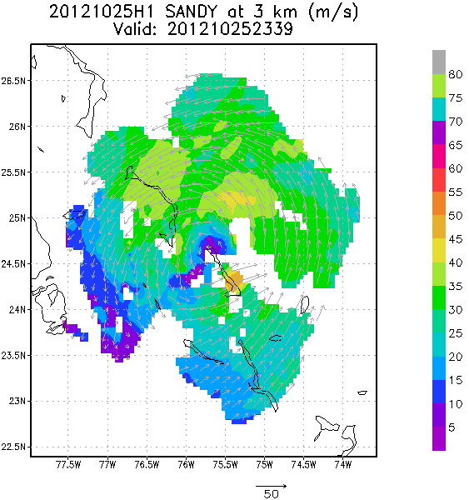
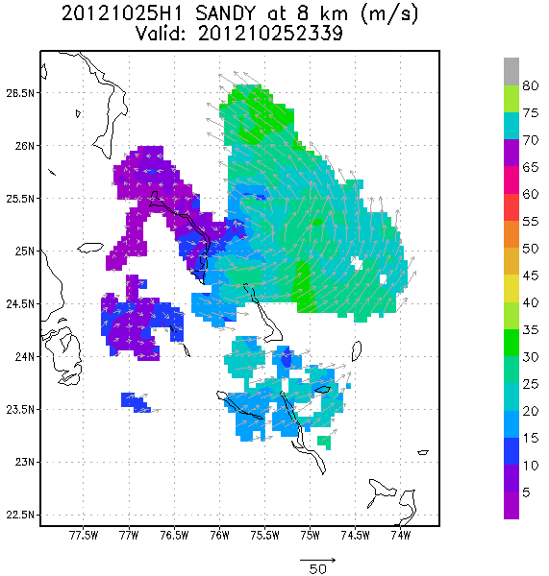
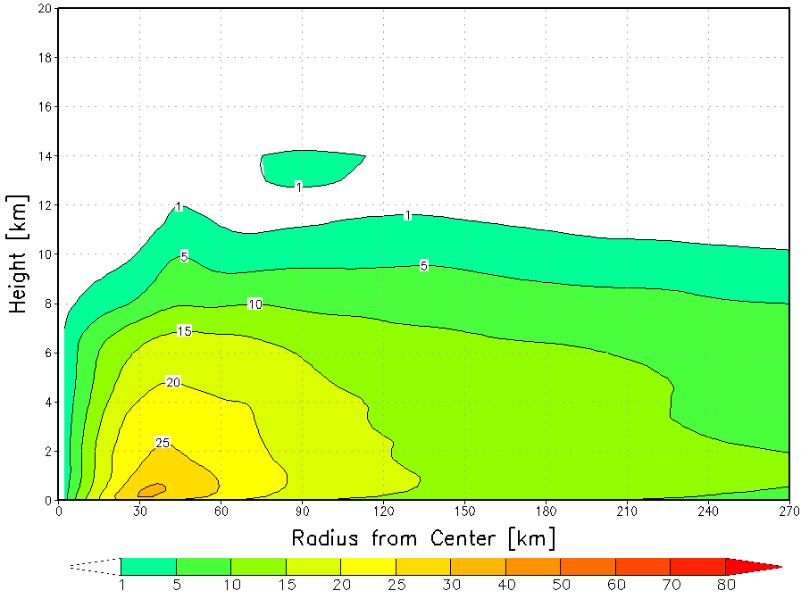
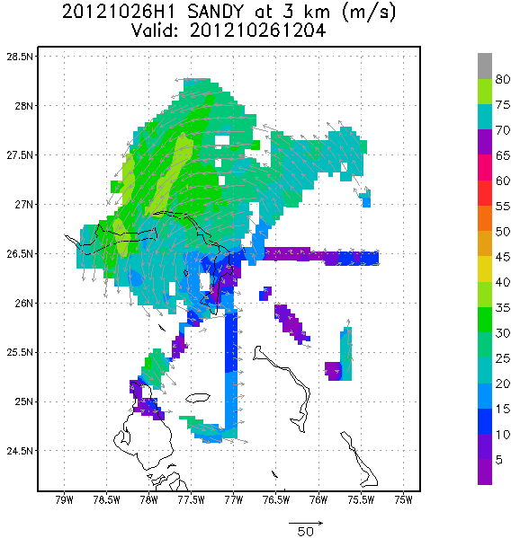
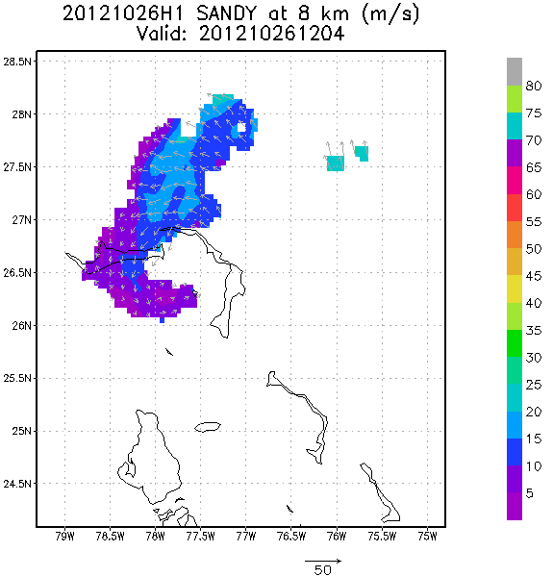
TDR Analyses
00Z 26 October
12Z 26 October
Notes:
http://www.nws.noaa.gov/om/assessments/pdfs/Irene2012.pdf
http://www.nhc.noaa.gov/data/tcr/AL182012_Sandy.pdf

Slide 11
Layer Means
22 m s⁻¹
22 m s⁻¹
16 m s⁻¹
16 m s⁻¹
10 m s⁻¹
5 m s⁻¹
10 m s⁻¹
5 m s⁻¹
10 m s⁻¹
5 m s⁻¹
10 m s⁻¹
5 m s⁻¹
33 h (09Z 26 October)
33 h (09Z 26 October)
15 h (15Z 25 October)
15 h (15Z 25 October)
Init: 00Z 24 OCT
Init: 00Z 25 OCT
850-200mb shear
Notes:
m/s

Slide 12
Summary
Two HWRF simulations initialized 24 h apart have similar tracks and intensity until 06Z 26 October
  Large scale similar at 500 hPa, but 200 hPa trough over GOM further east and stronger in early run
  Early run has stronger, slower storm, while later run storm further north
  Shear over both storms identical from SW at ~20 m s⁻¹
Track and intensity differences result of differences in vortex-shear interaction
  Both storms interact with very strong sheer from 18Z 25 to 12Z 26 Oct.
  Storm with track closer to observed became shallower (as observed), altering steering flow from SSW to SSE
  Change in steering led to track bifurcation

Slide 13
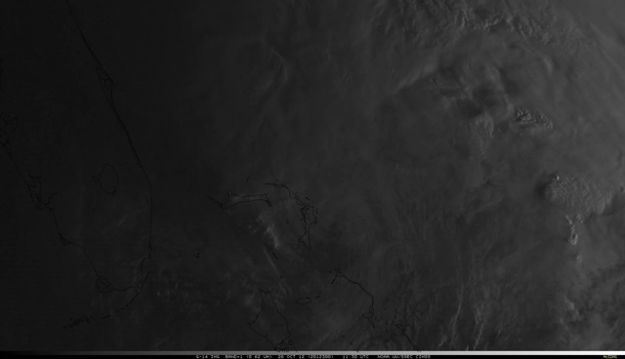
Questions?
Notes:
VIS satellite loop1030-1500Z 26 October

