Slide 1
Asymmetric Hurricane Boundary-layer Structure Relative to Wind Shear from Dropsonde Composite
Jun Zhang
AOML/HRD IRR, 16 April 2014

Slide 2
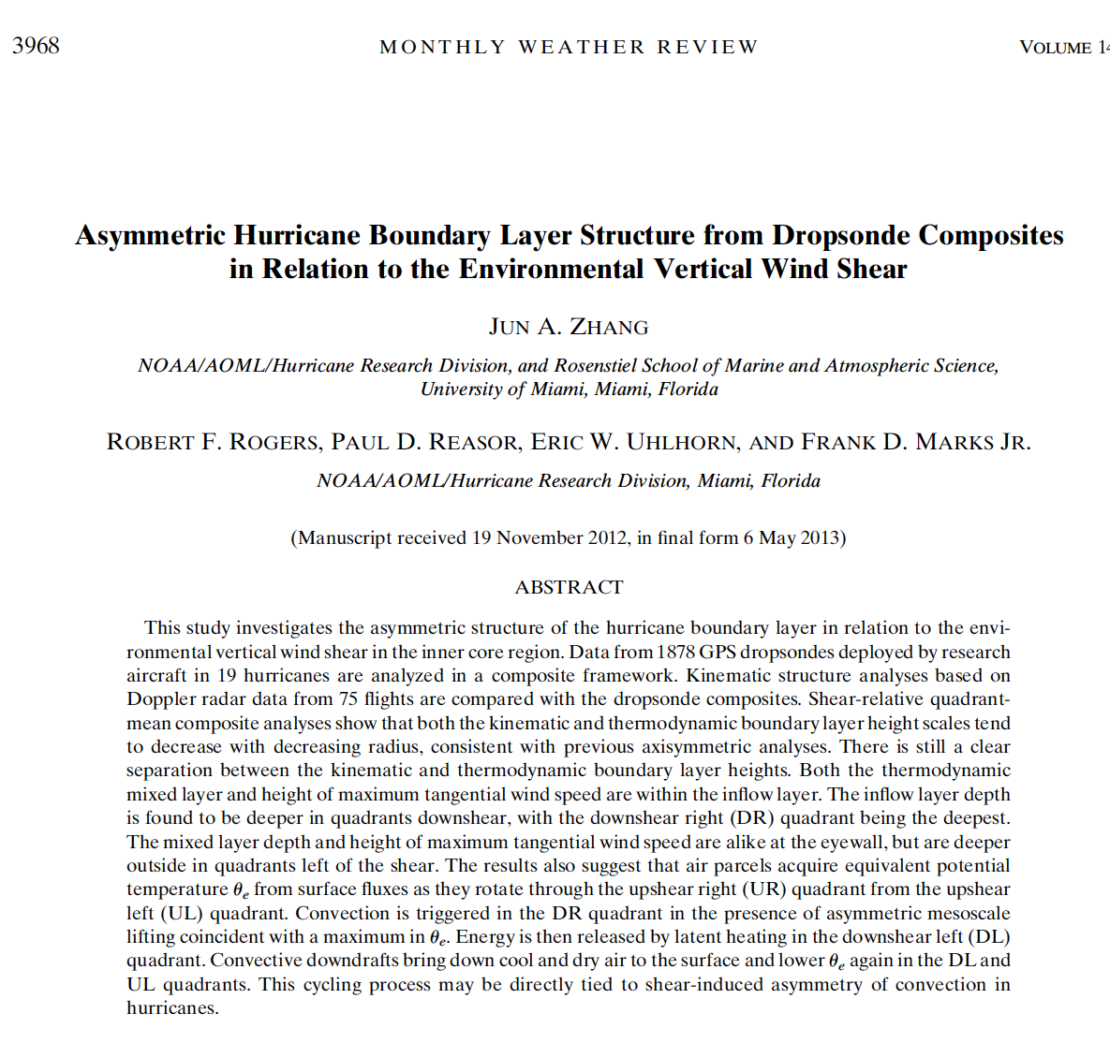

Slide 3
Acknowledgement
Many thanks to all the scientists and crew members who participated HRD’s field programs in the last two decades and helped collecting the dataset!! In particular, thanks to Neal Dorst, Kathryn Sellwood, Sim Aberson and Michael Black for maintaining the dropsonde data base.
Without your help this work would not be possible.

Slide 4
Statement of problem
Vertical shear of the environmental wind is one of the most important factors influencing tropical cyclone intensity and intensity change (e.g., Kaplan et al. 2010).
Mechanisms of shear-induced intensity change include warm core ventilation (e.g., Tang and Emanuel 2010, 2012), balanced-dynamical response of the vortex tilting (e.g., Jones 2000, Reasor et al. 2004), asymmetric organization of eyewall mesovorticies (e.g., Braun et al. 2006; Braun and Wu 2007), and so on.
Boundary layer processes are crucial to hurricane intensification and weakening (e.g., Emamuel 1986; 1995; Smith et al. 2009; Riemer et al. 2010, Molinari et al. 2013).
However, how the boundary layer structure, especially, the thermodynamic structure, varies as a function of azimuth with respect to the shear direction is not well documented.

Slide 5
Objectives
Investigate the asymmetry of the characteristic boundary layer height scales in four quadrants relative to the shear direction;
Investigate the possible connection between the shear-induced asymmetry of convection and low-level thermodynamic structure.
We take advantage of HRD’s unique database of GPS dropsonde and Doppler radar observations from multiple storms.

Slide 6
Why study the boundary layer height? no consensus

Slide 7
PBL height scales from dropsonde composites
(J. Zhang, Rogers, Nolan, and Marks, 2011 MWR)
h _{inflow} – inflow depth
h_{vmax}- height of the maximum tangential wind speed (Vt)
Z_{i} - mixed layer depth from the virtual potential temperature profile
Ri_{cr}-critical Richardson number defined as buoyancy to shear forcing
Flux – momentum flux from CBLAST-hurricane experiment
Max V_{t} in storm relative coordinates occurs well within the inflow layer and within the frictional boundary layer associated with strong inflow that arises in part because of the departure from gradient wind balance.
Notes:
This figure needs a bit of work still in my opinion:
1. ‘Flux needs to be defined.
2. RI needs to be defined.
3. Z_i needs to be defined.
Need to make main point clearer. Max V_t in storm rel coordinates occurs well within the inflow layer and within the frictional boundary layer associated with strong inflow that arises in part because of the departure from gradient wind balance.
7

Slide 8
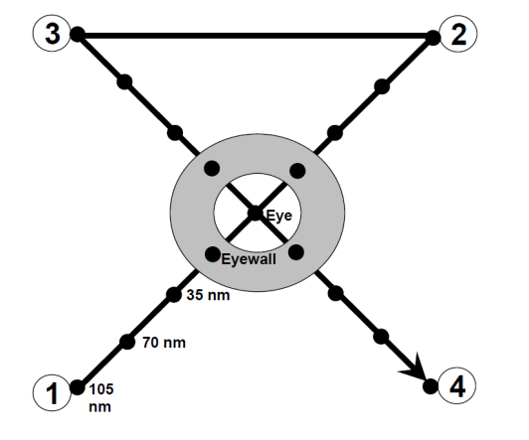
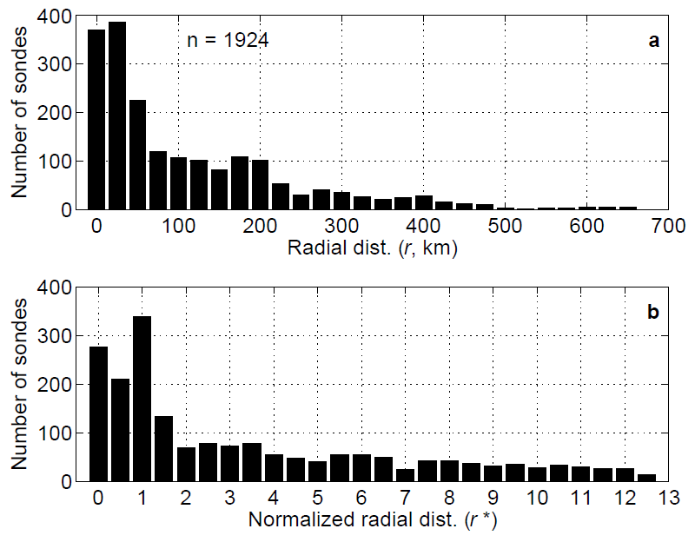
An improved dropsonde dataset Zhang and Uhlhorn (2012)

Slide 9
Parametric model output of surface Inflow angle J. Zhang and Uhlhorn (2012)
Notes:
the largest storm-relative inflow angles (< –50°) are found in the fastest
moving storms (> 8 m s-140 ) at large radii (> 8 times the radius of maximum wind) in the
right-front storm quadrant, while the smallest inflow angles (> –10°) are found in the
fastest moving storms in the left-rear quadrant.

Slide 10
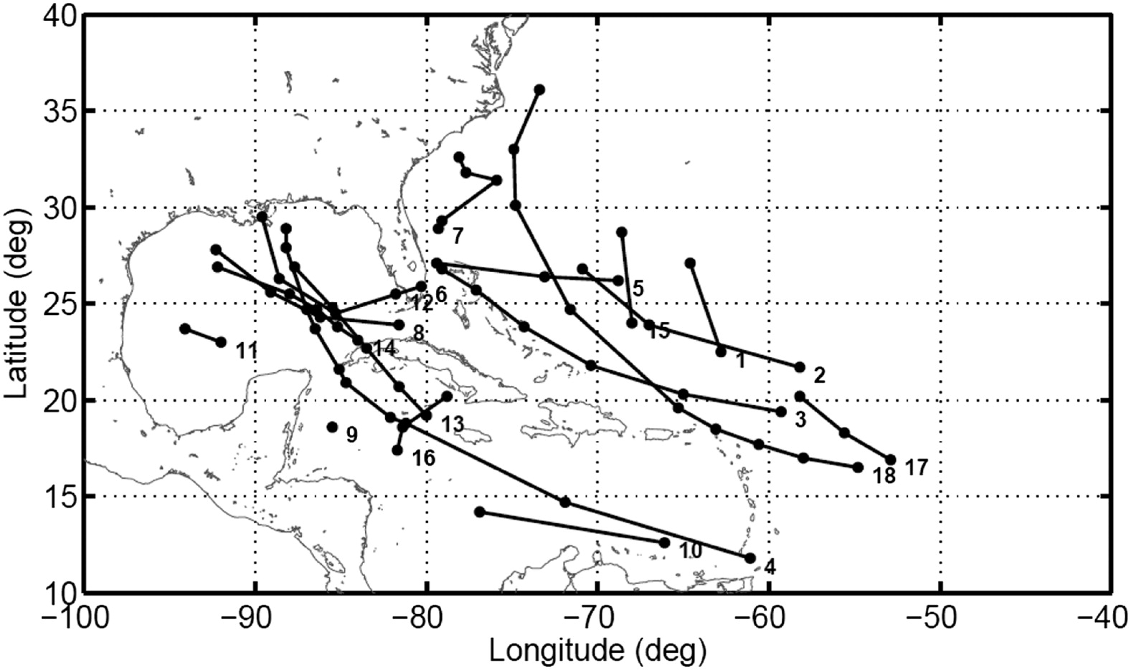
Observational Dataset
Dropsonde from 208 flights in 18 storms
Doppler radar data from 75 flights in 19 storms (Reasor et al. 2013)
Radar data are post-processed using the automated quality control process following Gamache (2005)
Dropsonde data are quality-controlled using ASPEN

Slide 11
Storm and shear statistics J. Zhang et al. (2013)
Shear data are from the SHIPS model – Courtesy to John Kaplan

Slide 12
Composite Methodology
The data are grouped as a function of the radius to the storm center (r) that is normalized by the radius of the maximum wind speed (RMW), i.e., r* = r / RMW.
The center positions have been determined using the flight-level data to fix the storm center using the algorithm developed by Willoughby and Chelmow (1982).
Values of RMW are mainly determined using the SFMR surface wind data. When there is no radar data available, the RMW is determined from the flight-level data.
When compositing the data, the radial bin width is 0.2 r* for r* < 2, and 0.4 r* for r* > 2. The data are also bin-averaged vertically at 10 m resolution.

Slide 13
Shear-relative Tangential Wind
black dashed line – height of maximum tangential wind
DL
DR
UL
UR
The heights of maximum tangential wind speed in the four shear-relative quadrants are alike at the eyewall, but are deeper in quadrants left of the shear in the outer radii.

Slide 14
Shear-relative Radial Wind
Contour – radar ; Shading – dropsonde; white line – inflow layer depth
DL
DR
UL
UR
The inflow layer depth is deeper in quadrants down shear than upshear. The downshear right (DR) quadrant has the deepest inflow layer

Slide 15
Shear-relative thermodynamic BL height
black line θ_{v} –θ_{v150} = 0.5K
black line dθ_{v} /dz = 3K/km
The mixed layers depths in the four shear-relative quadrants are alike at the eyewall, but are deeper in quadrants left of the shear in the outer radii.

Slide 16
Conceptual model for shear-relative PBL heights
h _{inflow} – inflow layer depth
h_{vmax}- height of the maximum tangential wind speed (Vt)
Z_{i} - mixed layer depth from the virtual potential temperature profile
This result confirms the axisymmetric conceptual model of hurricane boundary layer height given by J. Zhang et al. (2011 MWR) in that:
All three boundary layer height scales tend to decrease toward storm center;
The height of maximum tangential wind and mixed layer depth are within the strong inflow layer.

Slide 17
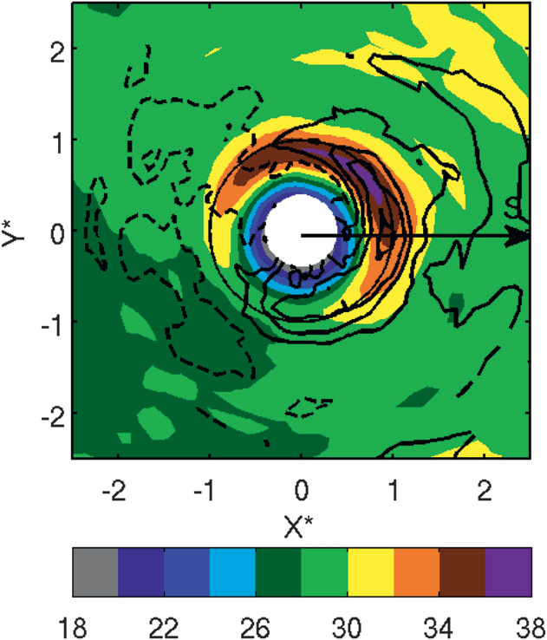
Shading – radar reflectivity
Contour – vertical velocity
Question:
Is there any connection between low-level thermodynamic structure and the shear-induced asymmetry of convection ?
Reasor et al. 2013

Slide 18
Shear-relative boundary-layer thermodynamic structure

Slide 19
Shear-relative boundary-layer thermodynamic structure

Slide 20
Shear-relative boundary-layer thermodynamic structure

Slide 21
Asymmetry of Convection and BL thermodynamics
Shading– wavenumber (0+1) component of θ’_{e} at 50 m; contours (left) - radar reflectivity at 1.5 km;
contour s (right) - vertical velocity at 1.5 km; thick black contours - downdraft; gray contours - updraft
DL
DR
DL
DR
UL
UR
UL
UR
The near surface equivalent potential temperature (θ_{e} ) is correlated more with the vertical velocity than the radar reflectivity above the boundary layer;
In the eyewall region, the increase in near surface θ_{e} from the UL to DR quadrant can be explained by boundary layer recovery process through surface enthalpy fluxes.

Slide 22
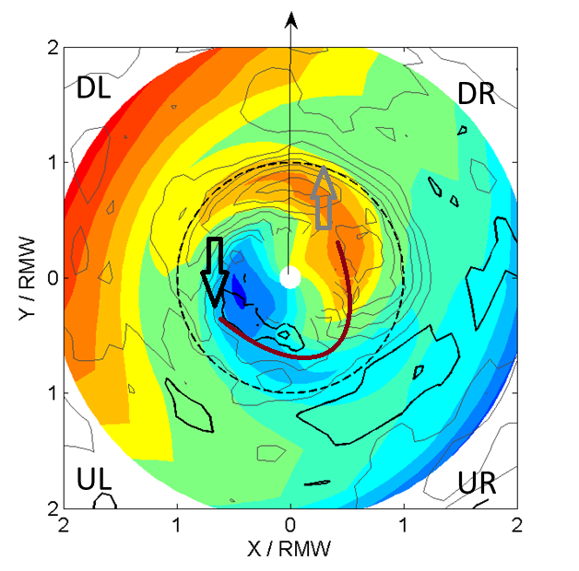
A paradigm of energy cycling process tied to shear-induced asymmetry of convection
As air parcels rotate from the upshear left (UL) quadrant to the downshear right (DR) quadrant, they acquire equivalent potential temperature (θ_{e}) from surface fluxes ;
Convection is triggered in the DR quadrant in the presence of asymmetric mesoscale lifting coincident with the θ_{e} maximum.;
Energy is then released by latent heating in the downshear left (DL) quadrant;
Convective downdrafts bring down cool and dry air to the surface and lower θ_{e} again in the DL and UL quadrants.
Energy released
Convection triggered
Primary downdraft
Flight-level data above the boundary layer from Eastin et al. (2005) support our paradigm .

Slide 23
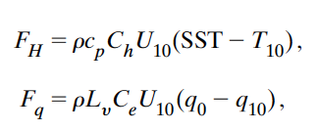
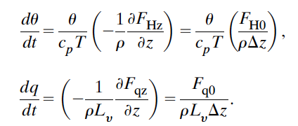
Boundary layer recovery calculation
Back of the envelope calculation showed that surface fluxes can support 4 K of change in θ_{e} near the surface which is enough for the boundary layer recovery.

Slide 24
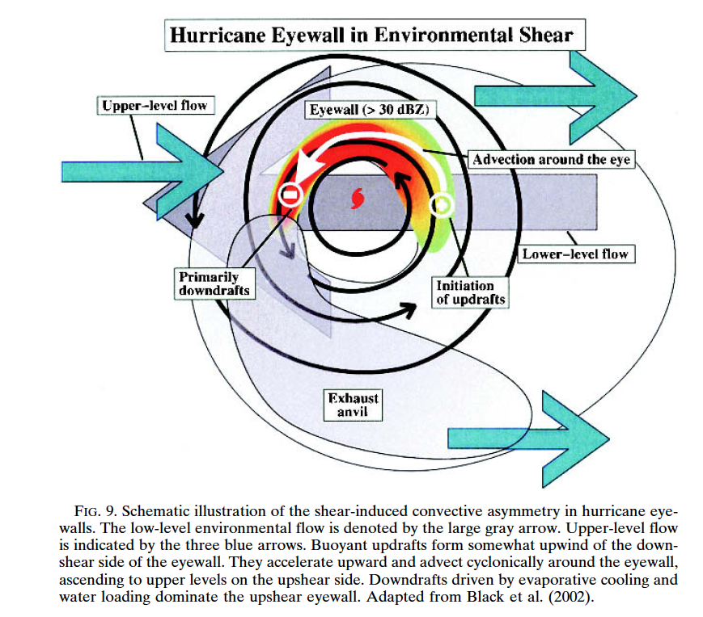
Eastin et al. (2005)

Slide 25
Summary
Both the kinematic and thermodynamic boundary-layer height scales relative to the shear direction tend to decrease with decreasing radius, consistent with previous axisymmetric analyses.
There is still a clear separation between the kinematic and thermodynamic boundary-layer heights in the asymmetric (shear-relative) framework.
The inflow layer depth is found to be deeper in quadrants down shear, with the downshear right (DR) quadrant being the deepest.
The mixed layer depth and height of maximum tangential wind speed are alike in the eyewall region, but are deeper in quadrants left of the shear in the outer radii.
The results suggest also a paradigm of energy cycling process in the eyewall region which may be tied to shear-induced asymmetry of convection in hurricanes.

Slide 26
Future work
Understand why boundary layer height asymmetry is tied to the environmental vertical wind shear;
Improve the inflow angle model by adding a shear component;
Investigate asymmetric boundary layer structure relative to storm motion;
Investigate asymmetric boundary layer structure relative to the vortex tilt;
Test the conceptual model for shear induced asymmetry and boundary layer thermodynamics using numerical model simulations;
Continue model (HWRF) evaluation work using the dropsonde composites.

Slide 27
Model evaluation using dropsonde composite
HWRF2011
HWRF2012
after PBL physics upgrade
Dropsonde composite
J. Zhang et al. (2011)
Model deficiency was detected through model evaluation against observations.
Observation based physics upgrade leads to improvement of modeled structure.

Slide 28
Evaluation of surface inflow angle in HWRF simulations
The simulated inflow angle is much closer to observations using HWRF with improved vertical eddy diffusivity (K_{m}) than that without correction.

