Slide 1
A Study on the Asymmetric Rapid Intensification of Hurricane Earl (2010) Using the HWRF Modeling System
Hua Chen and Sundararaman Gopalakrishnan
Hurricane Research Division
AOML/NOAA

Slide 2
Motivation
Asymmetric intensification
Very good forecast from operational HWRF
Comprehensive observation

Slide 3
Track, Intensity and RMW verification
18Z31AUG
18Z26AUG
RI onset

Slide 4
Environmental Factors
VWS (ms⁻¹)
RI onset

Slide 5
Storm Structure Verification
Lower Fuselage reflectivity
HWRF model reflectivity
Pre-RI
RI

Slide 6
Storm Structure Verification
Lower Fuselage wind
HWRF model wind
Pre-RI
RI
Shading: WSPD at 2-km altitude; Stream line: 8-km altitude; Black circles: every 50 km

Slide 7
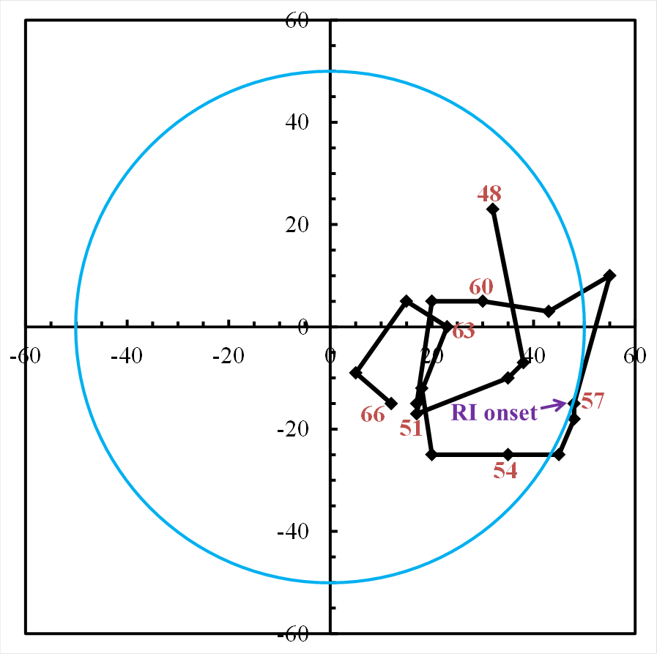
Hourly Hodograph of Vortex Tilt
Vortex alignment is the result of RI!
Green arrow: shear direction; Blue circle: 50-km radius
Notes:
Tilt is defined as the displacement between 2-km circulation center and 8-km circulation center

Slide 8
Questions about RI of Earl
How does it happen?
Why it happens?
Why it happens at that time?

Slide 9
Shading: temperature anomaly
00Z27
00Z28
00Z29
00Z30
00Z31

Slide 10
Questions about RI of Earl
How does it happen?
Why it happens?
Why it happens at that time?

Slide 11
CB stratified by radius
RI onset
RI onset

Slide 12
CB stratified by shear-oriented quadrants
RI onset
CB number within 200-km radius
RI onset

Slide 13
CB stratified by shear-oriented quadrants
RI onset
Mean down motion with 50km radius
and 0-12 km altitude
RI onset
Notes:
Vmax is divided by 6 to fit in the scale on the left

Slide 14
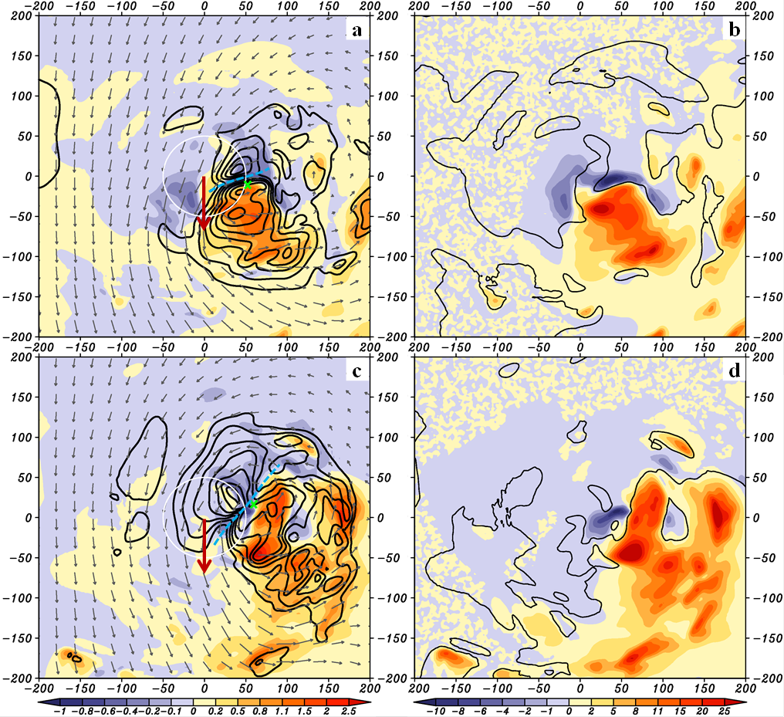
54-55h
54-55h
57-58h
57-58h
Shading: vertical motion
Contour: θ’
Shading: dibatic heating k/h
Contour: zero vertical motion

Slide 15
Time series of temperature tendency and horizontal temperature advection between 8-14 km within 15-km radius

Slide 16
Questions about RI of Earl
How does it happen?
Why it happens?
Why it happens at that time?

Slide 17
RI onset

Slide 18
RH averaged within 400 km x 400 km x 14 km

Slide 19
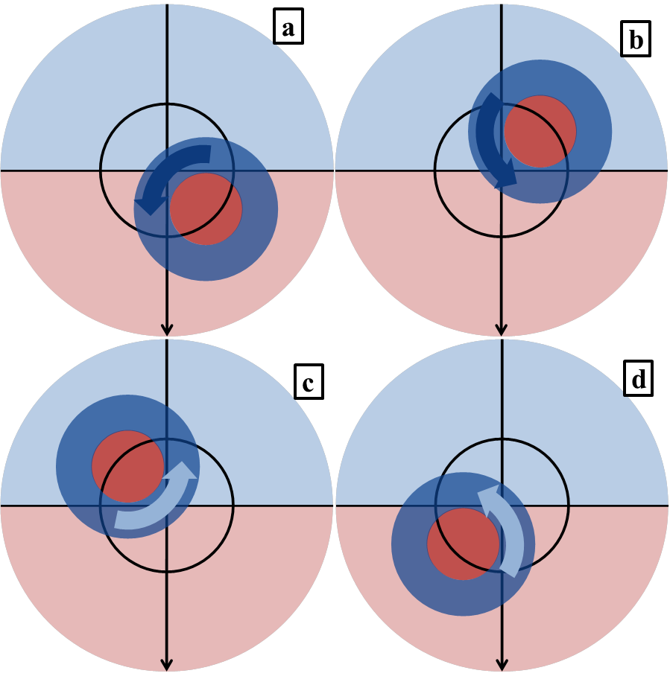
How, Why and When
Light shading: mesoscale vertical motion
Dark shading: convective scale vertical motion

Slide 20
Conclusions
HWRF model reproduces intensity, track as well as storm structure reasonably well;
Vertical alignment is the result of RI instead of trigger;
DSL and USL convection are more favorable for RI;
Horizontal advection plays an important role in developing upper level warm core when the vortex is tilted;

Slide 21
Questions?

