Slide 1
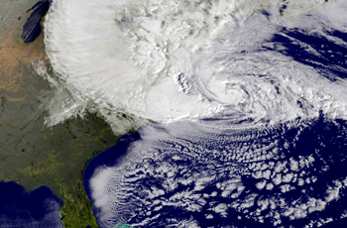
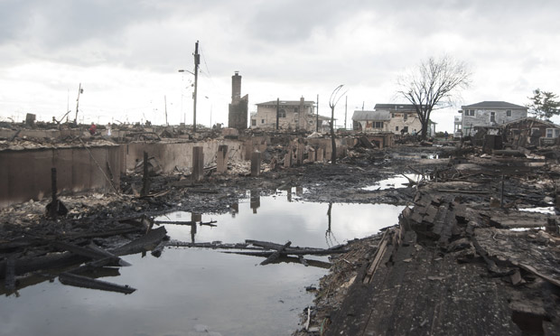
Tropical cyclones: Their Natural Variability and Response to Climate Change
Ray Bell
Supervisors: Prof. P.L. Vidale, Dr. Kevin Hodges, Dr. Jane Strachan
Thanks to Tropical Group, High Resolution Climate Group,
Hilary Weller and Eric Guilyardi
Notes:
This is a whistle stop tour of 3 years of PhD work into 1 hour. In this talk, I have erred on the side of simple. I apologise if it’s too simple for some but I hope everyone can follow along. I also apologise if I skips something, it’ll be due to time. I’ll try my best to get through all my slides
Hurricane Sandy – Merged with an ETC.
Associated damage in Breezy point, New York

Slide 2
PhD
How does the El Niño Southern Oscillation (ENSO) influence global tropical cyclone activity?
What is the role of the eastern tropical Pacific on
tropical cyclone activity associated with different
types of El Niño.
What is the response of tropical cyclones to climate
change?
Notes:
Background – CC work first.
A word of warning to PhD students don’t worry if you’re PhD isn’t set in stone you’ll find your way

Slide 3
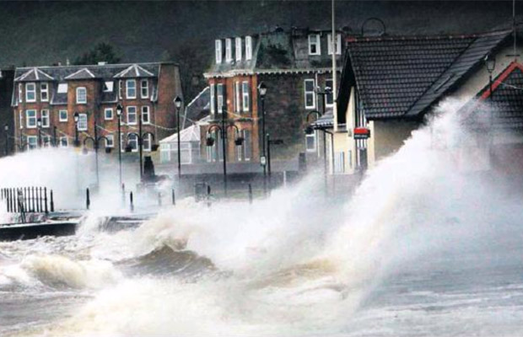
I live in Reading, why should I
care about tropical cyclones?
Large social-economical impacts
Katrina (2005) killed at least 1,833. Damage to oil refineries and caused price of gas to soar in the US.
Sandy (2012) caused $68bn of damage and killed at least 286 people
Haiyan (2013) caused at least 6,268 fatalities
Extratropical transition
Hurricane Katia (2011) caused £100 million of damage in the UK
Notes:
I live in Reading, why should I
care about tropical cyclones?
Is what the man on the #17 bus may ask me if I tell him I’m doing a PhD on TCs and CC
And I would tell him…

Slide 4
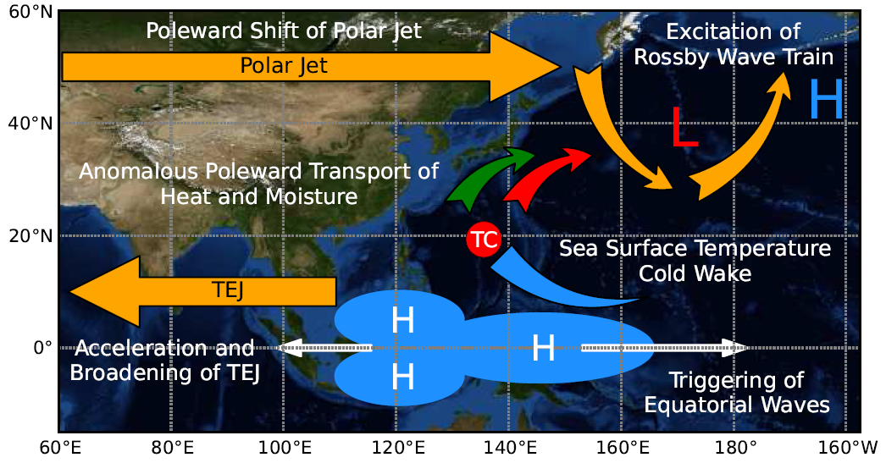
I live in Reading, why should I
care about tropical cyclones?
Schenkel (2012)
Notes:
Schematic from a friend who I met at a hurricane conference in Florida. His name is Ben Schenkle from FSU.
TCs remove heat and moisture from the ocean and help drive Ocean circulation

Slide 5
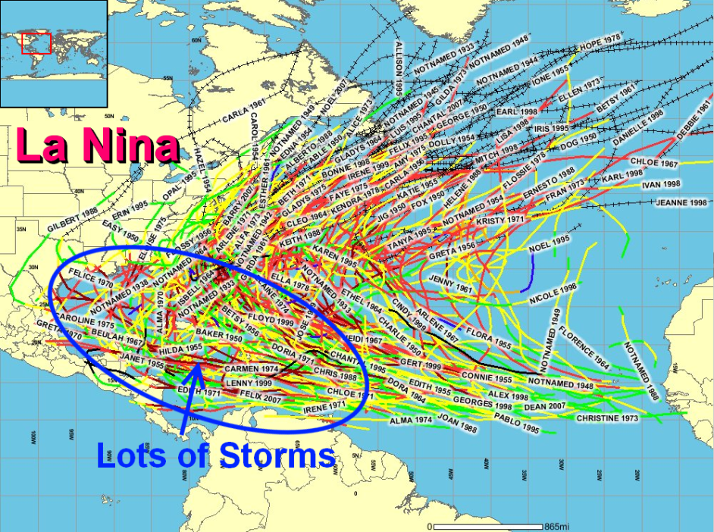
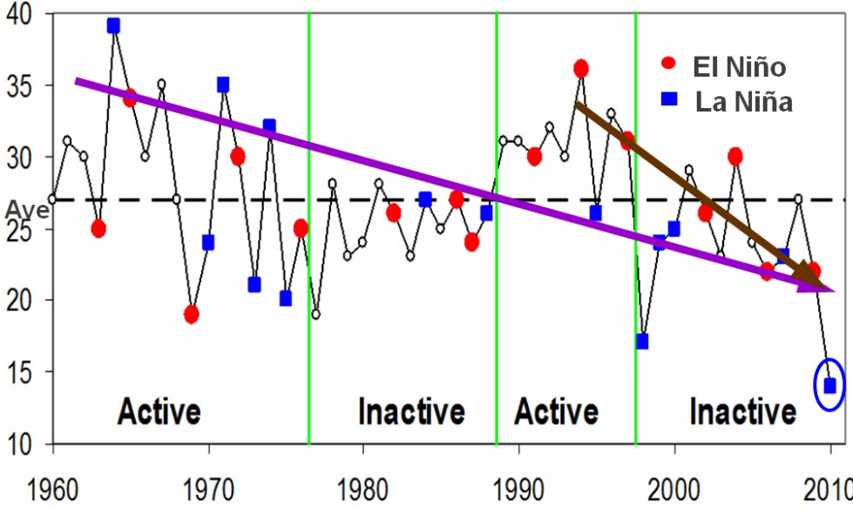
The ENSO-Tropical Cyclone Teleconnection
http://www.pgm-blog.com/2010/06/
Western North Pacific
Chan (2013)
Notes:
Hopefully you’re all up to scratch with TC theory.

Slide 6
Introduction
Motivation
It is important to evaluate the ability of GCMs to simulate realistic ENSO associated TC teleconnections for seasonal forecasting and before predictions are made for TCs and climate change using GCMs (Mori et al. 2013).
Lack of studies on simulated ENSO-TC teleconnection worldwide.
Research Objectives
What are the advantages and shortcomings of the simulated ENSO-TC teleconnection?
Are the key mechanisms well represented in the simulation?

Slide 7
The ENSO-Tropical Cyclone Teleconnection:
Global Tropical Cyclone Teleconnection
NCEP (‘50-’05)
GPI. Camargo (2007)
ENSO-Tropical Cyclone Teleconnection in Climate Models
Shaman and Malony (2011) – Large scale fields in CMIP3 models in the North Atlantic
- ‘Vertical wind shear was poorly simulated’
GFDL CM2.5
50 km atmosphere
and 25 km ocean
Kim et al (2013)
Notes:
GFDL 50 km atm and 25 km ocean

Slide 8
The ENSO-Tropical Cyclone Teleconnection:
Tropical Cyclone Teleconnection
A lot of observational research on a regional scale
North Atlantic (Gray, 1984)
Western North Pacific (Chan, 1985)
Australian region (Nicholls, 1979)
North Atlantic Teleconnection – One Chain of mechanisms
Increase upper
tropospheric westerlies over the North Atlantic
El Niño
Weaken Walker circulation
Increase vertical
wind shear
Decrease of TCs

Slide 9
Idealised GCM simulation
HiGEM
UK’s High-Resolution Global Environmental Model (Shaffrey et al, 2009)
HiGAM: AMIP (atmospheric model forced with observed SST and sea ice) 1979-2002 (Strachan et al, 2013)
HiGEM 1.1 Present-day integration 150 yrs
N144
1.25ºx0.83º, ∆x_{50N} = 90 km
AMOC (Hodson and Sutton, 2012)
Blocking (Scaife et al, 2012)
Extratropical cyclones (Catto et al, 2011)
1/3º ocean model
Notes:
TCs and naturally variability and climate change is a hard problem. Need as high resolution as possible for many years. Compromise between resolution and integration time.

Slide 10
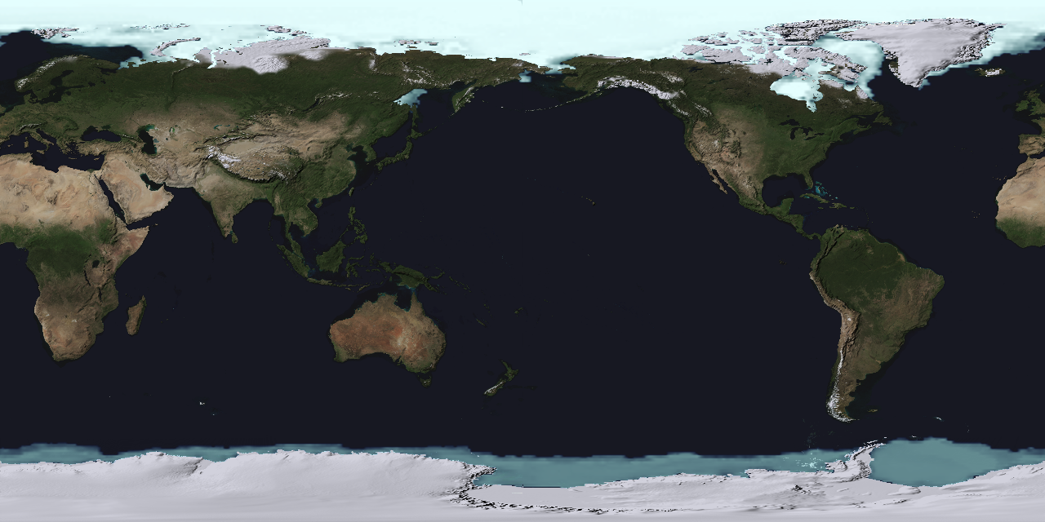
Tracking Algorithm (TRACK)
A 20 year time-slice of GCM simulated tropical storms
Bengstton
et al (2007);
Strachan
et al (2013)
1) Locate and track all centres of high relative vorticity ⇒ 35000/yr
2) Apply a 2-day filter to the tracks ⇒ 8000 storms / yr
3) Analyse vertical structure of storm for evidence of warm-core (tropical storm structure) ⇒ 120 storms / yr
Notes:
Developed by the legend that is Kevin Hodges who supervises an absurd amount of students and still is fantastic at giving feedback.

Slide 11
Present-day TC Climatology
HiGEM:
Good distribution of TCs
Too many in SH (strong SPCZ)
Too few in NAtL (cool SST and strong VWS)
Lack of recurvate in WNP (cool SST)
See Strachan et al (2013): assessment of HiGAM interannual variability and intraseasonal variability. Bell et al (2013): evaluation of HiGEM and response to climate change
Notes:
Track density - # of storms/5º radial cap
Difficult to directly compare a present-day coupled model integration to observations so we bridge our understanding by using a re-analysis dataset.
Differences between IBTrACS and ERA-Interim
Large of recurvature (cool SST bias)
Too many in SH (follow large ppt biases)
Too few in NAtl (large vws and cool SST bias)

Slide 12
Present-day TC intensity
Roberts et al (2014) JClim

Slide 13
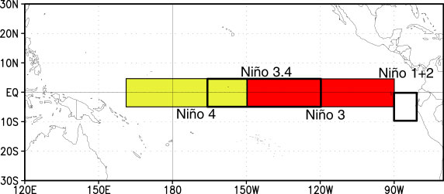
ENSO Composites
Niño-3.4 normalised SST anomaly for DJF >1 El Niño; DJF <1 La Niña
NH TCs prior to event
IBTrACS (1979-2010); ERA-Interim (1979-2010)
7 El Nino years (82-83, 86-87, 91-92, 94-95, 97-98, 02-03, 09-10)
6 La Nina years (84-85, 88-89, 98-99, 99-00, 07-08, 10-11)
HiGEM (150 years): 31 El Ninos; 25 La Ninas
HiGAM AMIP (1979-2002) : 6 El Ninos; 4 La Ninas
Notes:
Composites to increase robustness of results

Slide 14
HiGEM: ENSO simulation
Shaffrey (2009)
Notes:
STD NINO3 HadISST (55-05) = 0.84K, HiGEM=0.89K.
More power in HiGEM at 4 years.
HiGEM doesn’t capture the teleconnection of El.
HiGEM is top left, HadGEM below that

Slide 15
HiGEM: ENSO simulation
Shaffrey (2009)
Notes:
STD NINO3 HadISST (55-05) = 0.84K, HiGEM=0.89K.
More power in HiGEM at 4 years.
HiGEM doesn’t capture the teleconnection of El.
HiGEM is top left, HadGEM below that

Slide 16
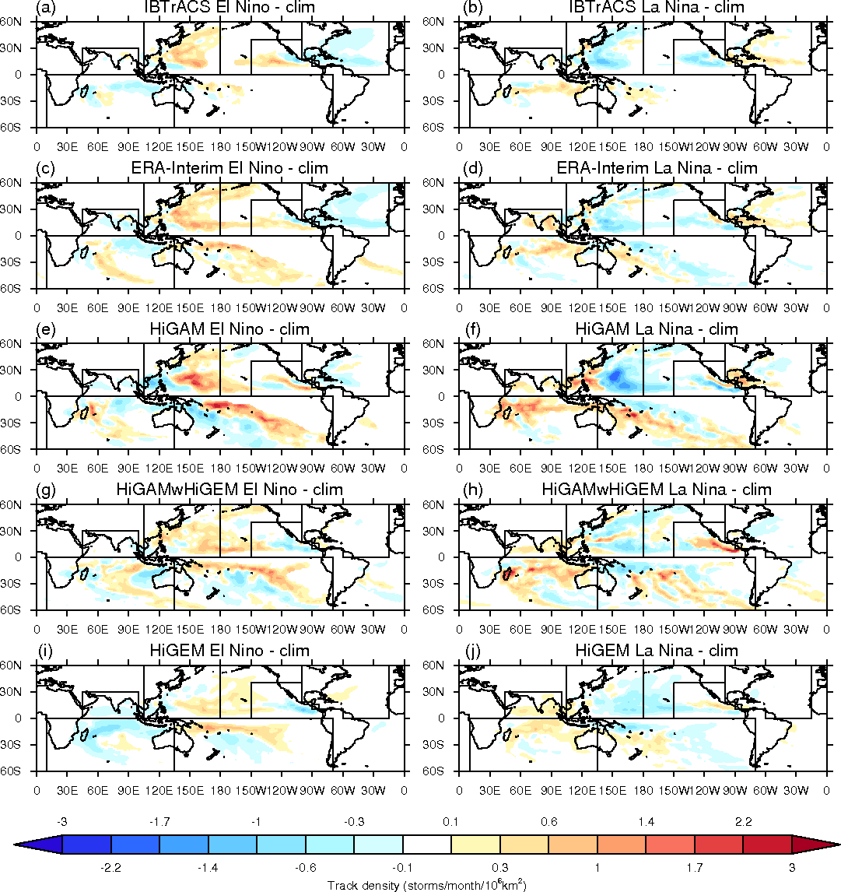
ENSO-TC Location
Match well
Over
pronounce
variability
Notes:
Confidence in tracking algorithm
Explain HiGAM results later
Have match time period in HiGEM and doesn’t really change

Slide 17
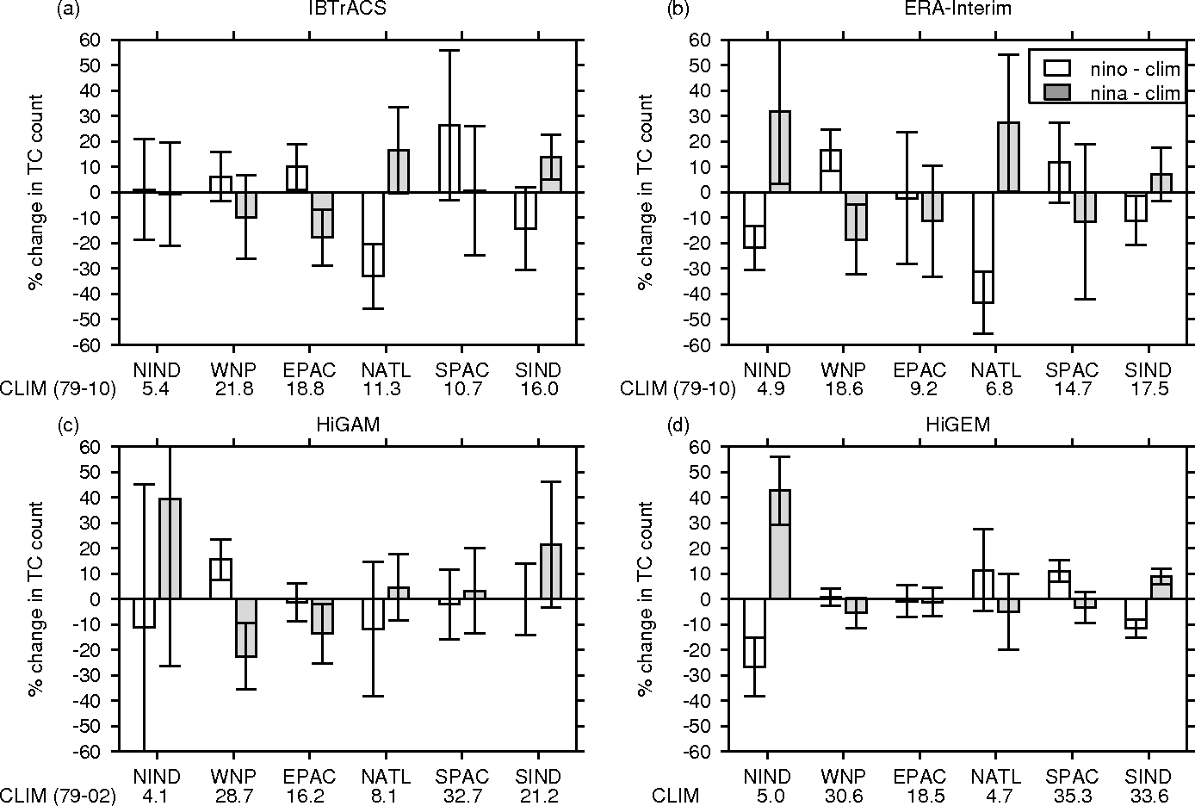
ENSO-TC Frequency
Greater variability in ERA-Interim vs IBT
Small var. of NATL TCs
Small var. and wrong sign of NATL TCs

Slide 18
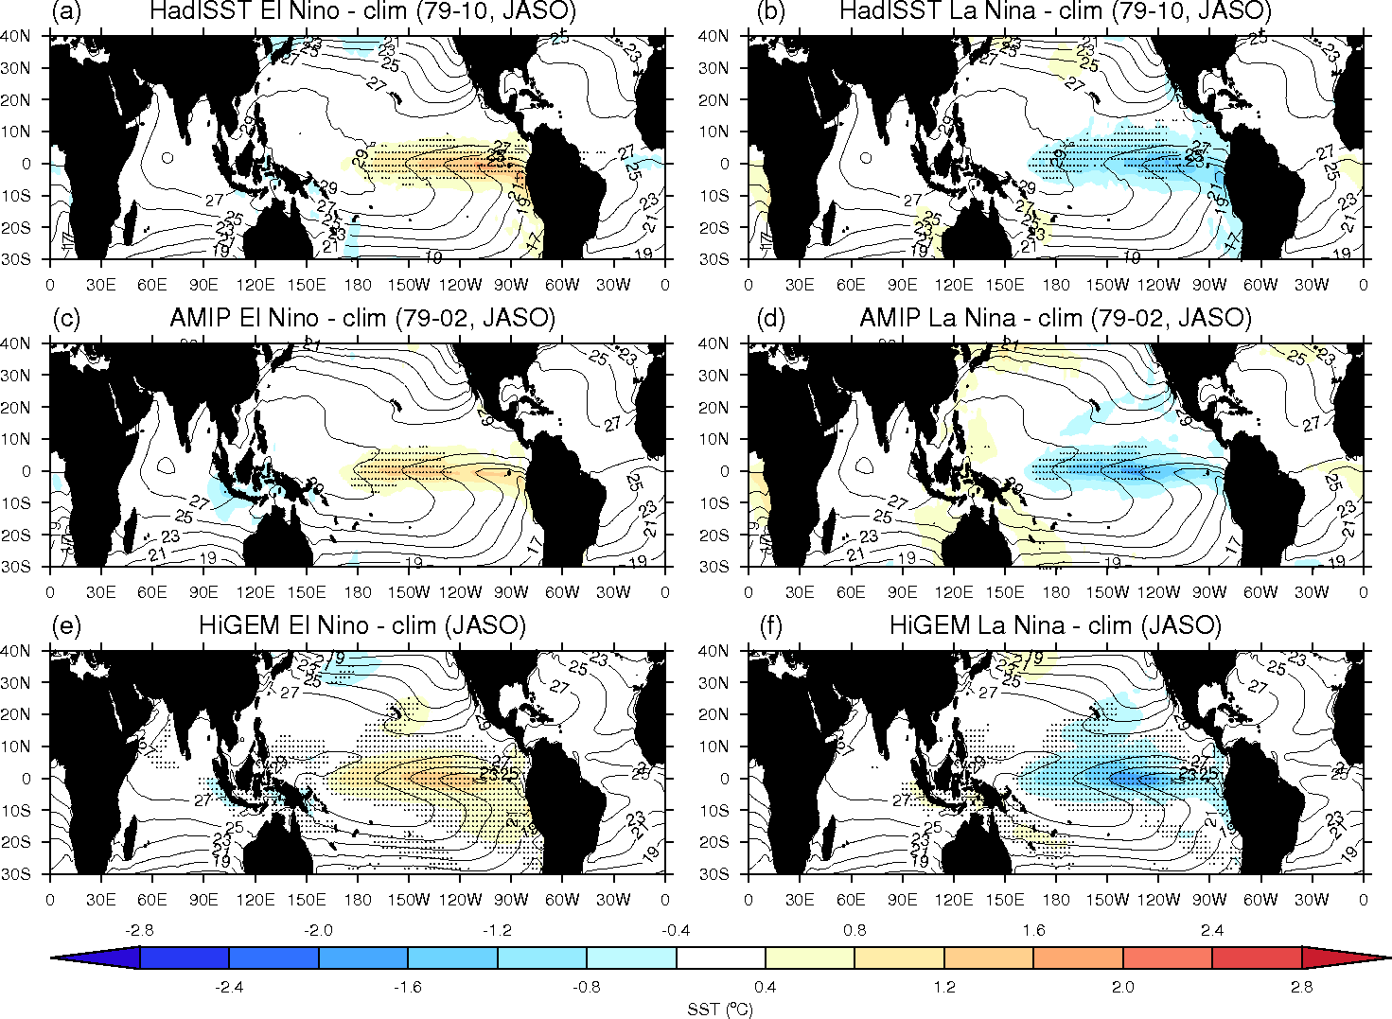
ENSO-SST
SSTs extend
too far
west.
Lack of
warming near
Peru coast.
(see
Guilyardi
et al, 2009
Notes:
Stippling is p < 0.001 students t-test
AMIP SST don’t have meridional extend in SST
HiGEM SSTs extend too into WPAC like most climate models.
NO warming near Samerican coast.

Slide 19
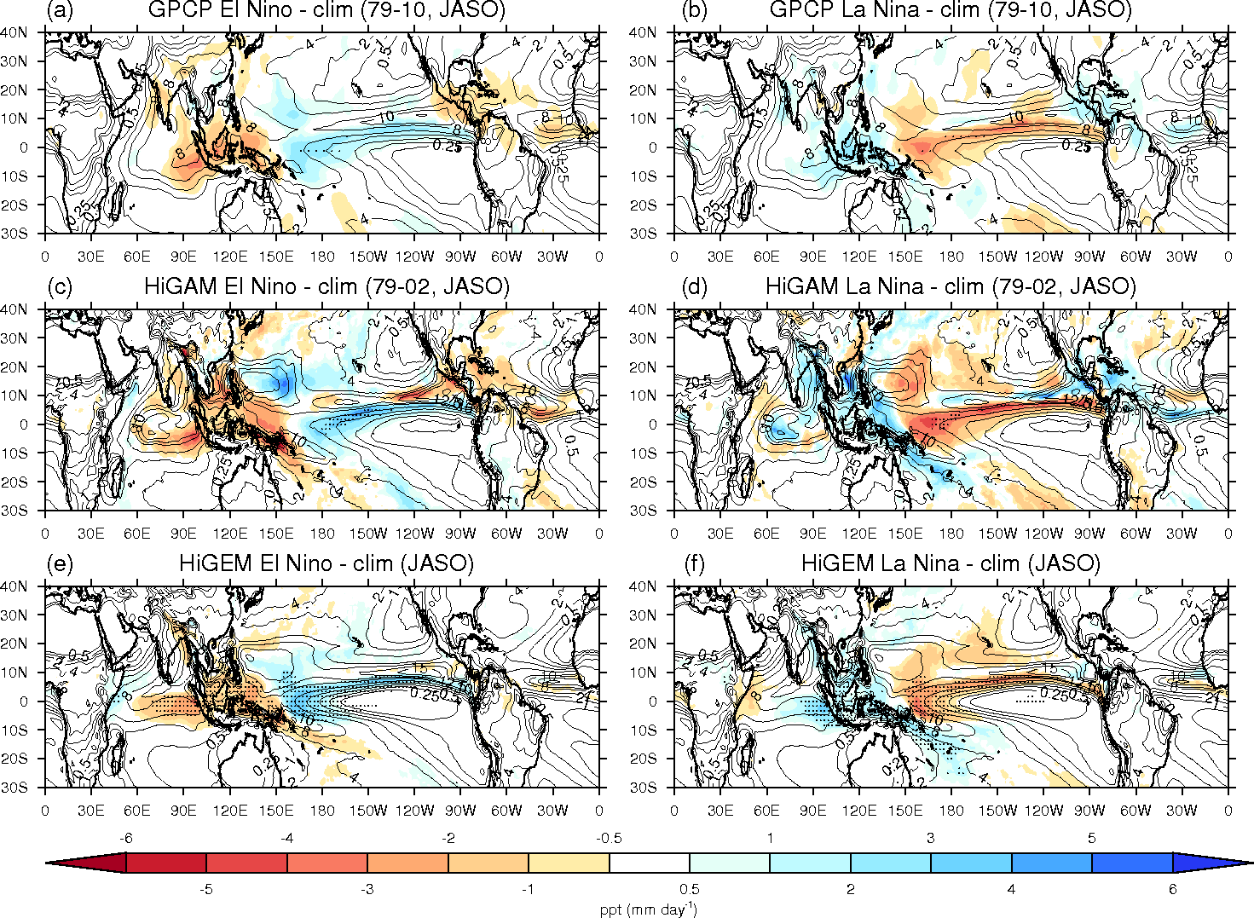
ENSO-ppt
Stronger
signal
No
teleconnection
In Caribbean
Notes:
Stippling is p < 0.001 students t-test
AMIP SST don’t have meridional extend in SST
HiGEM SSTs extend too into WPAC like most climate models.
NO warming near Samerican coast.

Slide 20
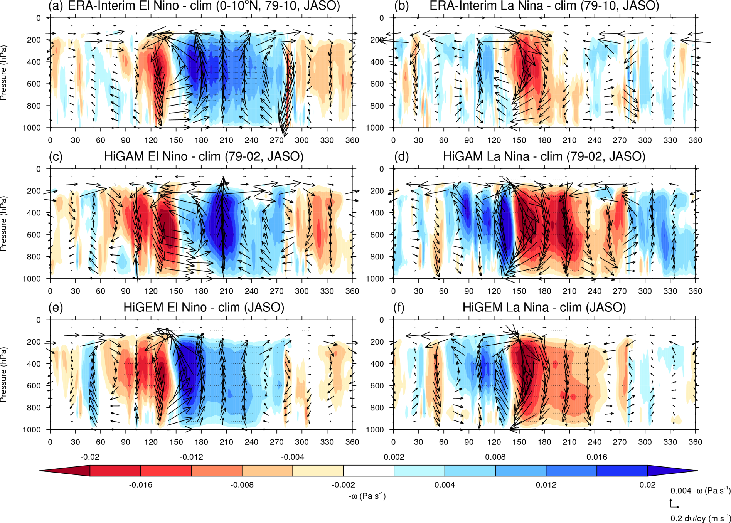
ENSO-Walker circulation
Convection
shifts
Westward as
SSTs extend
further west
Lack of
upper-level
westerlies
Notes:
Explain plot: Height-longitude cross section of Walker Circulation 0-10oN, July-October
The colors show mean ascent (-w) and the vectors are mean ascent and a change in the velocity potential with respect to longitude. Stippling shows where changes have a p-value < 0.0001 using a student’s t-test.
Region of convection shifted westwards.
No shift in upper-level flow

Slide 21
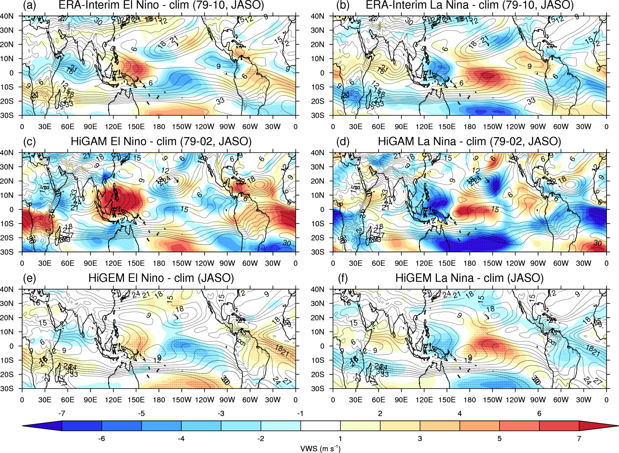
ENSO-vertical wind shear
Di-pole
partly explain
See-saw of
Activity NATL-
EPAC (aiyyer
& Thorncroft,
2006)
Over
Pronounce in
WPAC
Lack of VWS
dipole
Notes:
Strong HiGAM vws comes from lack of meridional ENSO-SST
VWS & Precipitation response is stronger in HiGAM which will drive a stronger circulation due to lack of atmospheric feedbacks, therefore an infinite source of heat

Slide 22
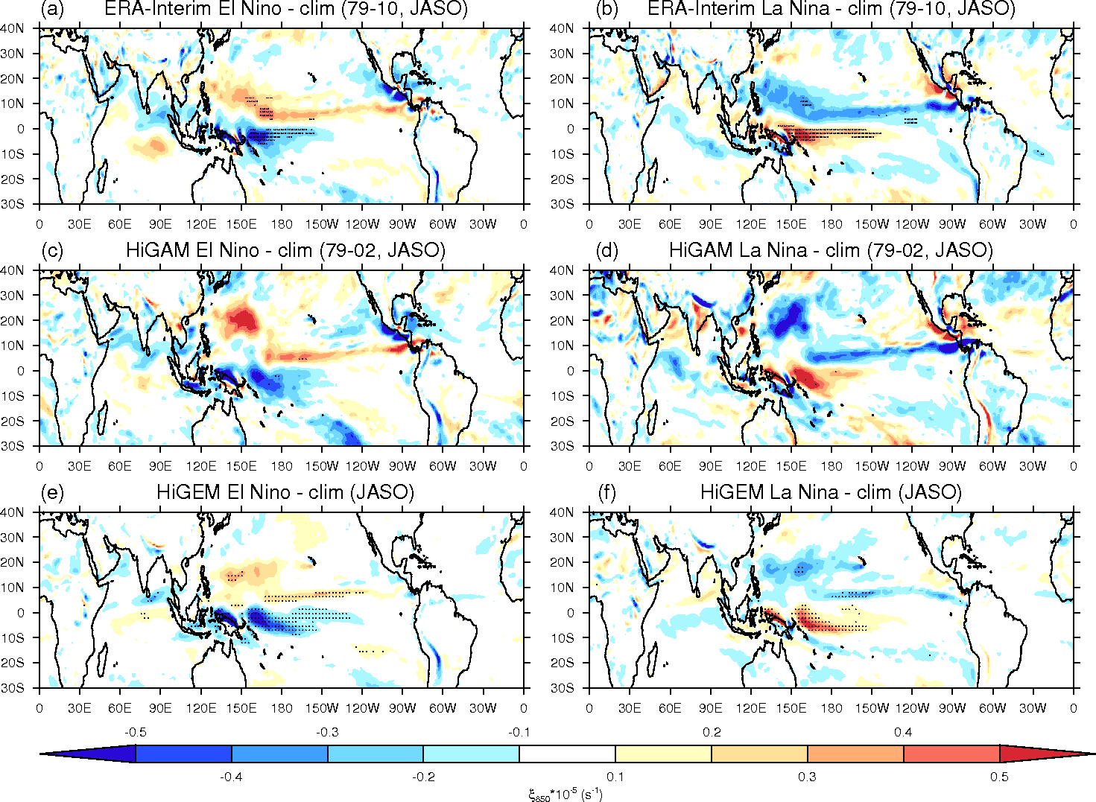
ENSO-relative vorticity
Good
spatial
pattern
Weaker.
No change
around
C.America
Notes:
Strong HiGAM vws comes from lack of meridional ENSO-SST
VWS & Precipitation response is stronger in HiGAM which will drive a stronger circulation due to lack of atmospheric feedbacks, therefore an infinite source of heat

Slide 23
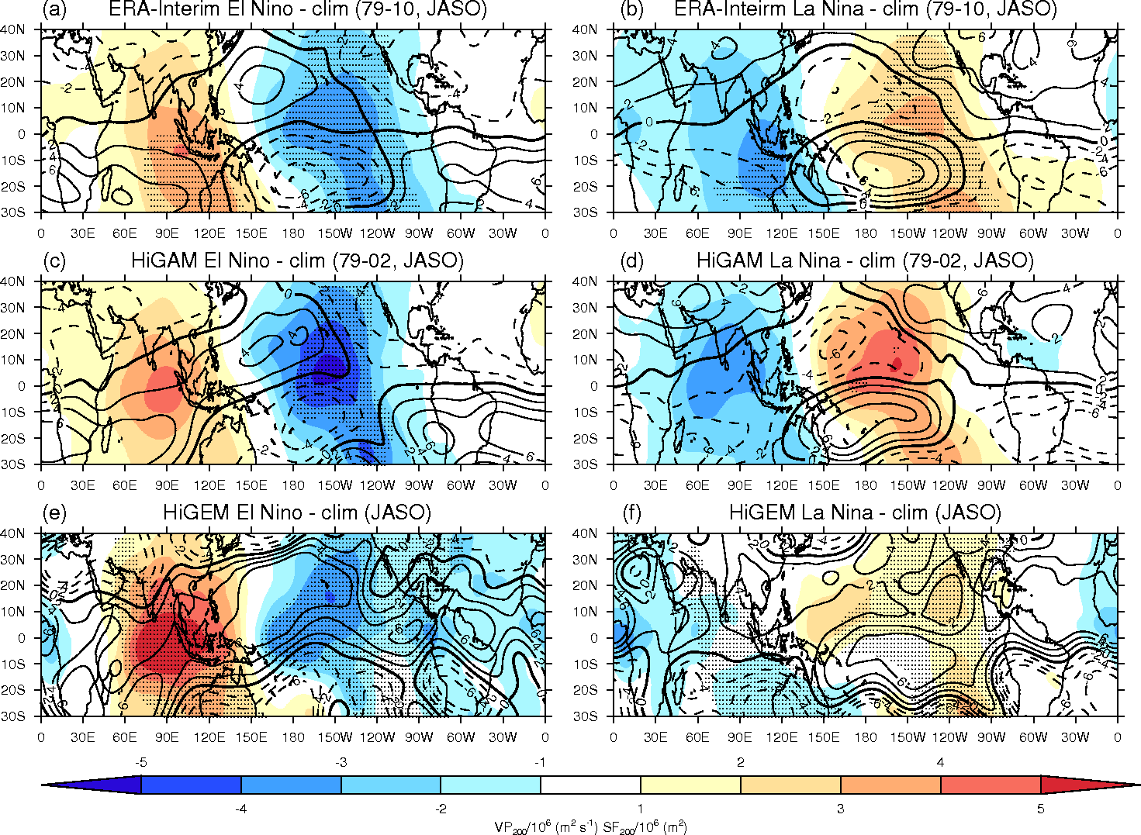
ENSO-upper level circulation
Divergence
not
constrained
To CPAC
Causes inc. TC
In NATL during
El Niño
Notes:
Strong HiGAM vws comes from lack of meridional ENSO-SST
VWS & Precipitation response is stronger in HiGAM which will drive a stronger circulation due to lack of atmospheric feedbacks, therefore an infinite source of heat

Slide 24
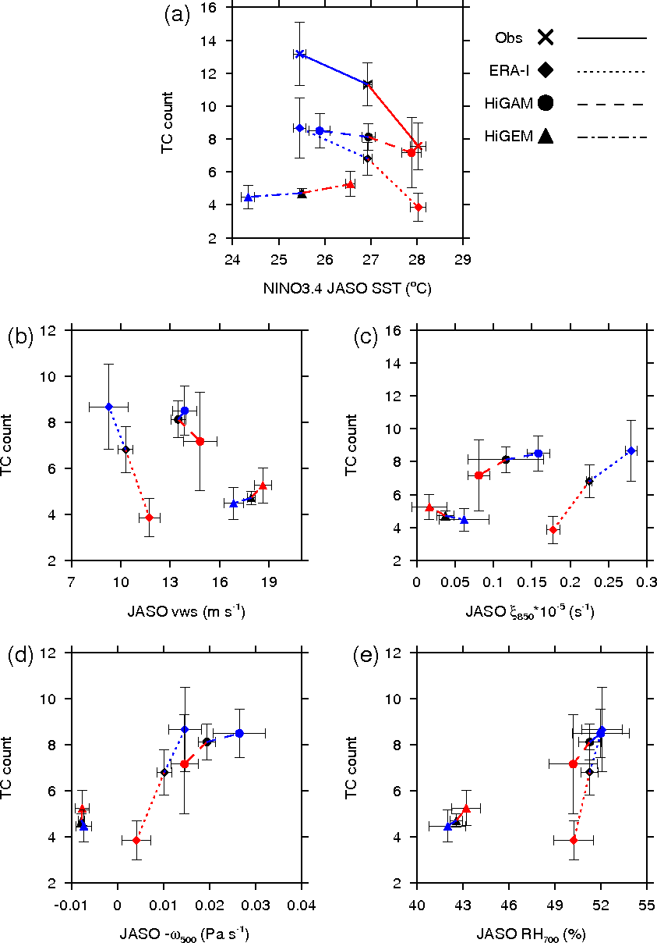
Thermodynamic vs. Dynamic influences:
North Atlantic
Cool trop SST
bias in
HiGEM
JASO
275-340ºN, 10-20ºN
Average
Niño-3.4 SST
TC
Count
Too high
mean-state
VWS
RH is well
captured in
HiGAM.
VWS is most
Important
(Carmargo,
2007)
VWS
Vor₈₅₀
-ω₅₀₀
RH₇₀₀
Notes:
Error bars are 90% confidence intervals
Different datasets.
Blue is La Nina and Red is El Nino
HiGAM and HiGEM simulate too many TCs.
Large ppt biases in this region but not does not link with TC activity
HiGAM simulates RH better and captures TC variability better than HiGEM. RH relates to vws. vws from meridional extent of SST

Slide 25
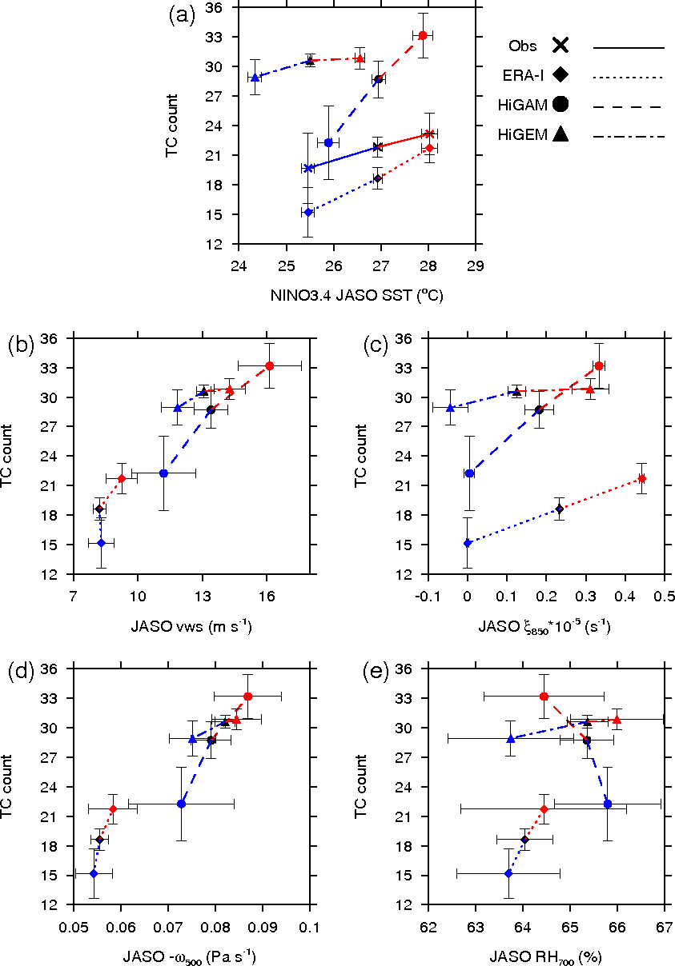
Thermodynamic vs. Dynamic influences:
Western North Pacific
VWS is not important
Vor. explains
ENSO var.
(Carmargo,
2007)
TC
Count
Large mean ascent
causes
too many
TCs
VWS
Vor₈₅₀
-ω₅₀₀
RH₇₀₀
Notes:
Error bars are 90% confidence intervals
Different datasets.
Blue is La Nina and Red is El Nino
HiGAM and HiGEM simulate too many TCs.
Large ppt biases in this region but not does not link with TC activity
HiGAM simulates RH better and captures TC variability better than HiGEM. RH relates to vws. vws from meridional extent of SST

Slide 26
Discussion
Errors in atmospheric teleconnections stem from: mean-state SST biases; spatial pattern of ENSO associated SST.
ENSO-TC teleconnection is good west of PAC in HiGEM
Larger variability of ENSO-TC teleconnection in HiGAM without presence of air-sea feedbacks: Larger source of heat and stronger circulation
El Niño SST
shifted
west
Walker circulation
Shifted westward
Upper-tropospheric westerlies do not reach into NATL
No change in VWS
No change in TCs (HiGEM)
Notes:
Error bars are 90% confidence intervals
Different datasets.
Blue is La Nina and Red is El Nino
HiGAM and HiGEM simulate too many TCs.
Large ppt biases in this region but not does not link with TC activity
HiGAM simulates RH better and captures TC variability better than HiGEM. RH relates to vws. vws from meridional extent of SST

Slide 27
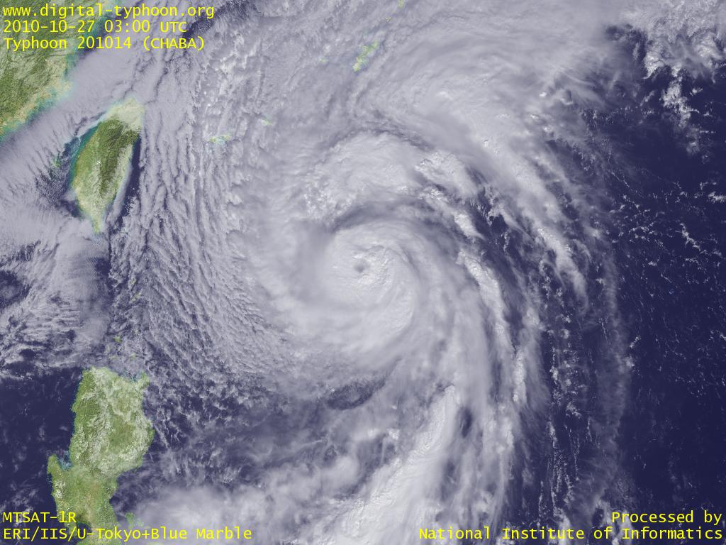
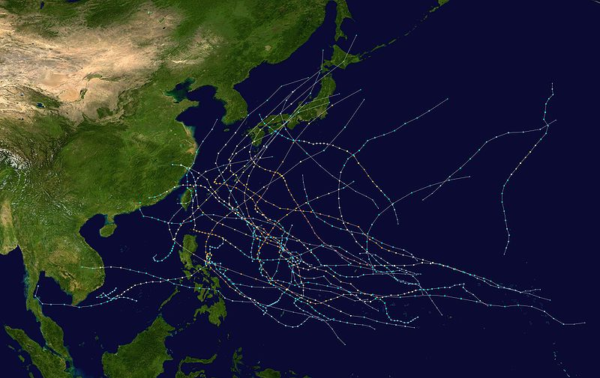
The role of the eastern tropical Pacific on tropical cyclone activity associated with different types of El Niño
Typhoon Chaba (910 hPa)
2004 Western North Pacific TC season (CP-EN year)
10 typhoons made landfall
Notes:
Hope everyone understands the influence ENSO has on global tropical cyclone activity
Focus on WNP as the North Atlantic was rubbish in the last section
HiGEM was rubbish and HiGAM is better in that region

Slide 28
Introduction
Motivation
There is a small sample of observed Central Pacific El Niños within the reliable TC record.
Investigate the relationship of different types of El Niño and tropical cyclone activity in the Western North Pacific in a climate model.
Research Objectives
What is the role of the eastern tropical Pacific on tropical cyclone activity associated with different types of El Niño?

Slide 29
Different types of El Niño
Various definitions:
e.g. Kug et al (2009) EP-EN NINO3 > NINO3std & CP-EN NINO4 > NINO4std
Kao and Yu (2009) combined regression–EOF
Ren and Jin (2011) new Niño indices, piecewise linear combination of the Niño3 and Niño4 indices
Kug and Ham (2011) EP-EN DJF SSTa norm NINO3 > 1 & NINO3>NINO4
CP-EN DJF SSTa norm NINO4 > 1 & NINO4>NINO3
Distinctly different types of ENSO, or whether there is one type of ENSO with variability in its location?
Notes:
C and 2 (2013) on right modified indices
Wang: 5-month running means of SST anomalies in the Nino3 region exceed 0.5 °C (−0.5 °C) for more than 6 months and the maximum SST anomalies are located in the eastern Pacific

Slide 30
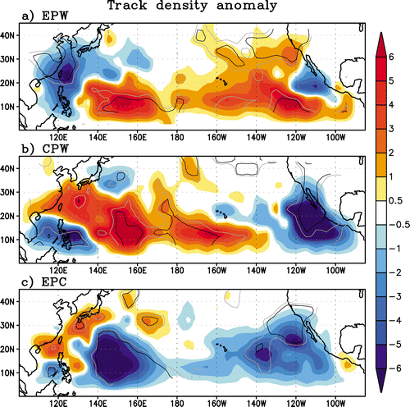
Different types of El Niño:
Previous work – TC response
Kim et al 2011
Very few years of observations
4 CP-EN events; 8 EP-EN events
Notes:
Good TC global records since 1970s onwards…
Increase in TCs to S.E.Asia
study EPW 1951, 1957, 1965, 1972, 1976, 1982, 1987, and 1997
CPW (1953, 1991, 1994, 2002, and 2004)

Slide 31
Different types of El Niño:
Previous work – Mechanisms
EP
CP
Kim et al (2011)
Wang et al (2013)
Anomalous
drying
Anticyclonic anomaly
Notes:
Anti cyclone over Japan
Wang: 5-month running means of SST anomalies in the Nino3 region exceed 0.5 °C (−0.5 °C) for more than 6 months and the maximum SST anomalies are located in the eastern Pacific

Slide 32
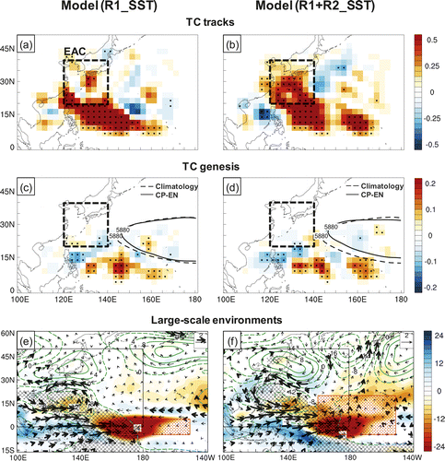
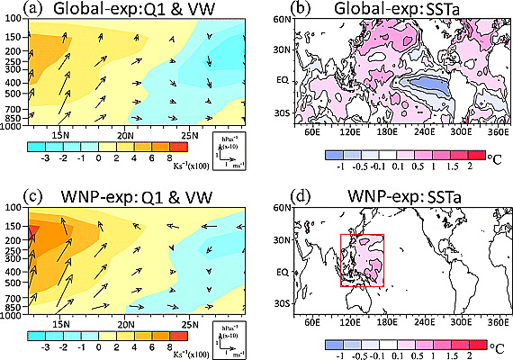
Modelling tropical cyclone activity associated with different types of El Niño: previous work
Hong et al (2012)
Jin et al (2013)
ECHAM5, T42
6-member ensemble
Global-exp and WNP-exp, observed global monthly SSTA pattern (CP-EN minus EP-EN) and local SSTA pattern in WNP
WRF RCM with 50-km horizontal
CP-EN minus EP-EN
Local SST is important
Remote SST is important
Notes:
Hong (-) No TC changes. CP minus EP experiment. Hard to de-linate response
Jin (-) 3 ensembles. Regional model. Are the results really that different?

Slide 33
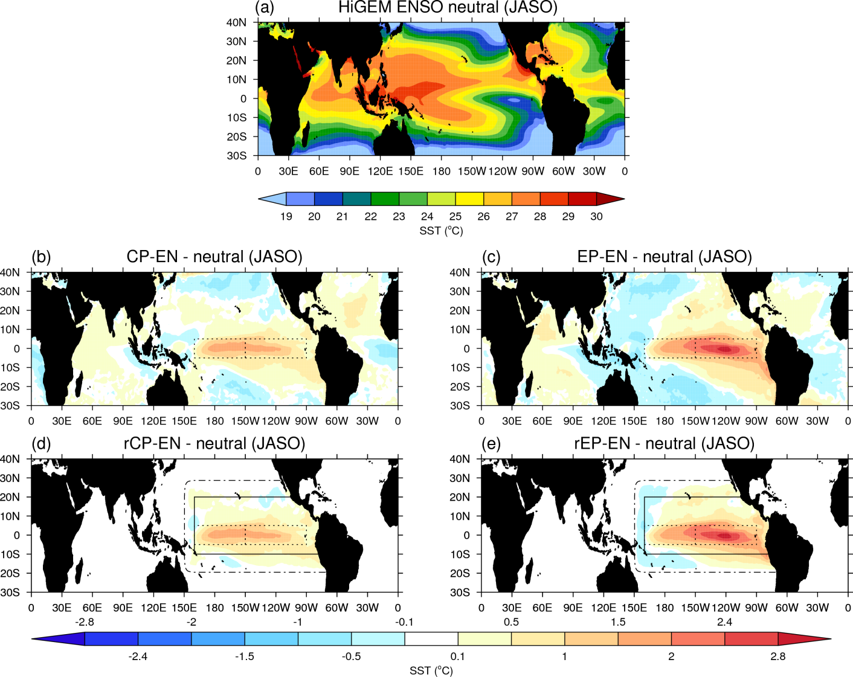
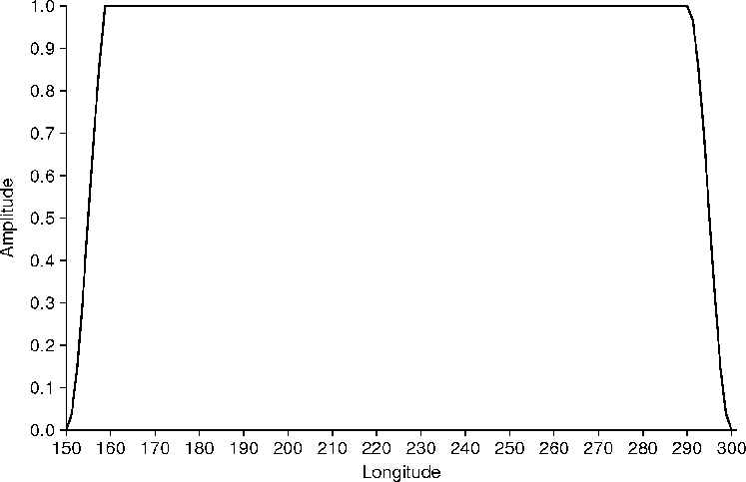
Different types of El Niño:
El Niño experiments (HiGEM SSTs)
Kug and Ham (2011) EP-EN ASO SSTa norm NINO3 > 1 & NINO3>NINO4
CP-EN ASO SSTa norm NINO4 > 1 & NINO4>NINO3
Composite of 5 strongest events
Tukey filter
Experiments
Based on
Spencer
et al (2004)
Notes:
Thanks to Hilary Weller and Eric Guilyardi for discussions on this
Note differences in amplitude
CP-EN shows slight warming in WNP
17 EP-EN
22 CP-EN

Slide 34
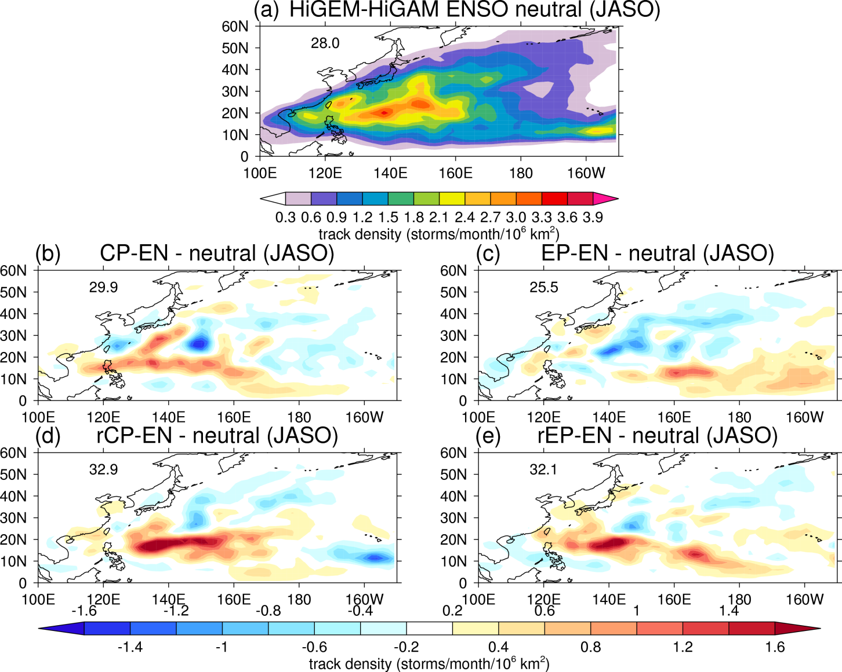
Different types of El Niño:
TC Response
Force HiGEM SSTs on HiGAM; 10 ensembles for each experiment; March -> December
Zonal westward track
TCs shift eastwards
Enhance
pattern
Change of
sign
Notes:
Everyone can remember the eastwards shift from the last section

Slide 35
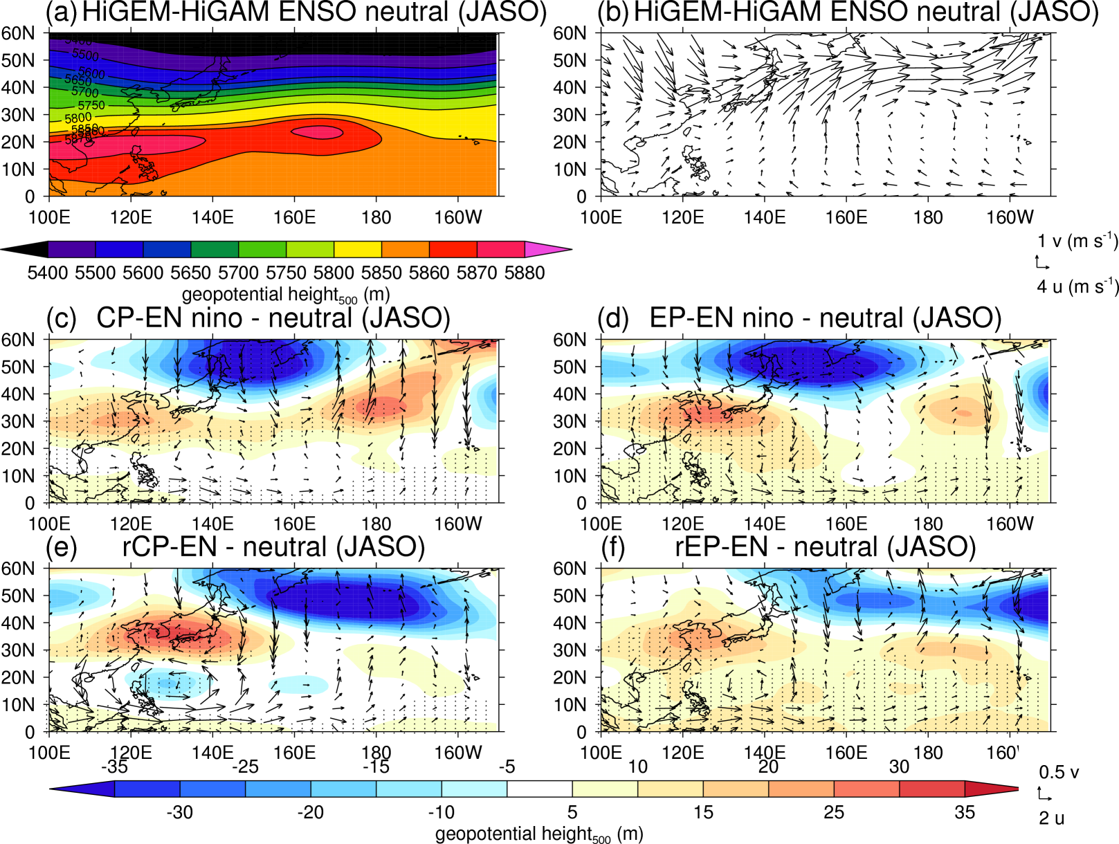
Different types of El Niño:
Geopotential Height and Steering Flow
Geopotential
height
Steering
flow
Anti-cyclone
Cyclone
shifted
eastwards
Cyclone
Notes:
rCP-EN enhance TC reponse
SF not important in EP-EN

Slide 36
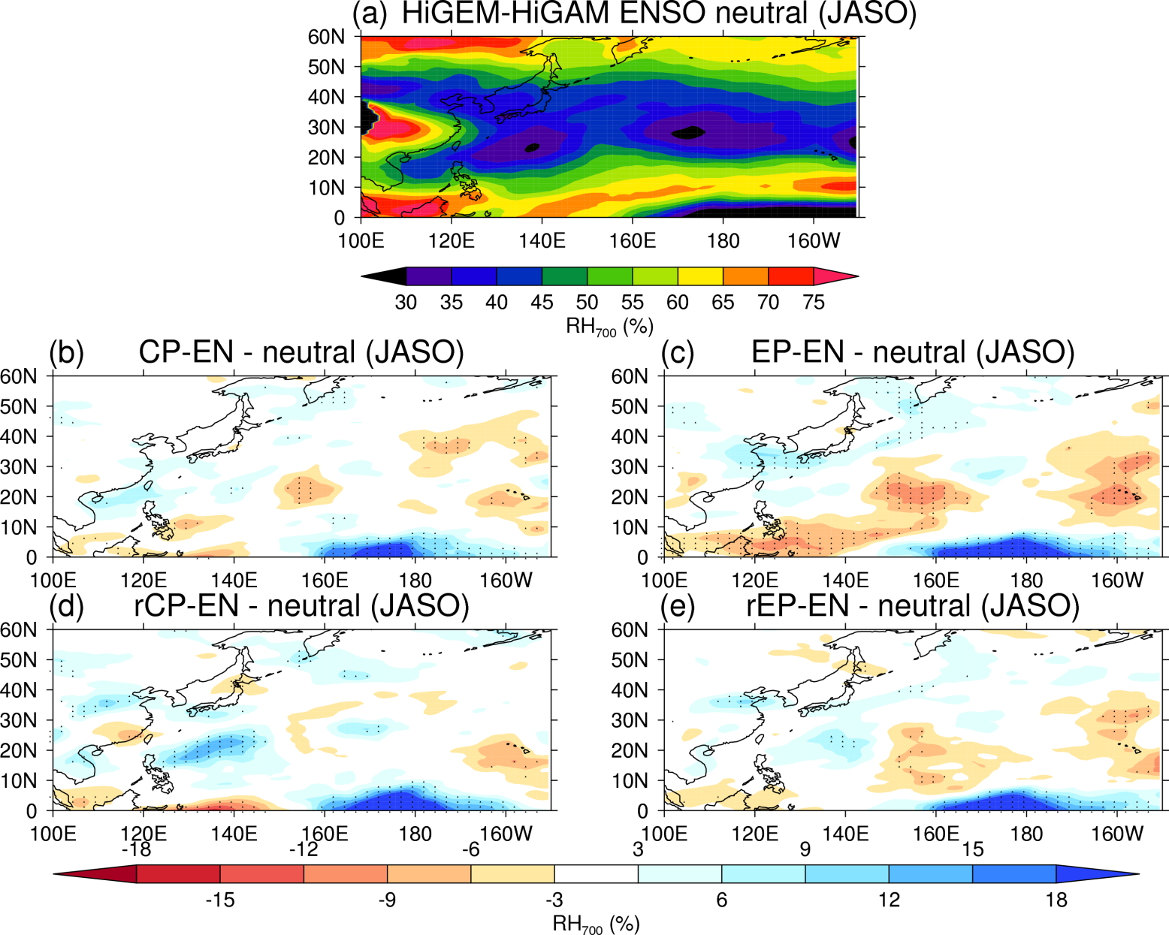
Different types of El Niño:
Relative Humidity
TCs increase
in this region
Notes:
Relative humidity at 700 hPa
EP-EN have stronger local cooling. Important for thermodynamic control on TCs.

Slide 37
Discussion
For the CP-EN, both the global and remote SST experiments increase TC activity in South East Asia. The changes arise due to atmospheric teleconnections from the eastern tropical Pacific.
For the EP-EN, local SST cooling is important reducing tropical cyclone activity via thermodynamic
The rCP-EN and rEP-EN show some similarities. Both simulate a cyclonic anomaly to the east of the Philippines. For the rCP-EN, this is shifted westwards.
Notes:
Error bars are 90% confidence intervals
Different datasets.
Blue is La Nina and Red is El Nino
HiGAM and HiGEM simulate too many TCs.
Large ppt biases in this region but not does not link with TC activity
HiGAM simulates RH better and captures TC variability better than HiGEM. RH relates to vws. vws from meridional extent of SST

Slide 38
Tropical Cyclones and Climate Change
Notes:
Now we have a good understanding of tropical cyclones and a dominant mode of natural variability we will investigate TCs and CC

Slide 39
Introduction
Motivation
Interest in tropical cyclones and climate change for future adaption.
Research Objectives
What are the controlling mechanisms causing tropical cyclone changes?

Slide 40
Tropical Cyclones and Climate Change: What’s Expected?
Many models predict a decrease in the future numbers 6-34% by 2100 (Knutson et al, 2010)
- More so in SH
Camargo et al (2013) found no clear change in CMIP5 models
Tory et al (2013) decreases varying between 3 and 15 %
Emanuel (2008) downscaled CMIP3 models showed a decrease
Emanuel (2013) downscaled CMIP5 models showed an increase
Models disagree on a regional scale
Increase in Central Pacific is robust (Li et al, 2010)
Increase in maximum tropical cyclone intensity 2-11% globally by 2100 (Knutson et al, 2010)
Notes:
Enough gimmicks, time for some science.
This slide has changed somewhat since my qou vadis talk, which relates to the uncertainty around this topic
More so in SH as SSTs don’t increase as much
Emanuel (2013) TCs are seeded into large-scale climate conditions
Model resolution is important for intensity and ocean coupling is also important

Slide 41
Tropical Cyclones and Climate Change: Forcing Factors
Reduction in convective mass flux (Held and Zhao, 2011)
Increase in vertical wind shear over Main Development Regions (Vecchi and Soden, 2007)
- E.g. weaker Walker circulation increases vertical wind shear over NAtl
Pattern of SST increase (Murakami et al, 2013)
Explains regional TC changes
Reduction in convective mass flux reducing vorticity (Sugi, unpublished?)
P=Mq; q increase 7%/K according to Clausius –Clapeyron; P increase ~3%/K as constrained by global energy budget
M decreases
Vertical wind shear is
more effective
Upper-troposphere
is drier
Less detrainment out
of moist convective systems
Notes:
In Equator upper-trop is well mixed; Tang and Neelin (2004) troposphere warms. Inc. Stability. Warm free trop T dynamics. (weak horizontal T gradient)

Slide 42
Tropical Cyclones and Climate Change: Forcing Factors
Emanuel (2013)
Changes in TC follow changes in GPI
TC intensity = f(surface enthalpy fluxes) = saturation enthalpy of the sea surface and the moist static energy of the subcloud layer.
Increase it net surface radiative flux ->increase in enthalpy jump at the sea surface, enabling TCs to become more intense
Decrease in TC freq due to increase in saturation deficit of the free troposphere
Notes:
In Equator upper-trop is well mixed; Tang and Neelin (2004) troposphere warms. Inc. Stability. Warm free trop T dynamics. (weak horizontal T gradient)

Slide 43
Idealised GCM simulations
HiGEM
UK’s new High-Resolution Global Environmental Model (Shaffrey et al, 2009)
HiGEM 4xCO₂ 30 yrs
HiGEM Transient 2% CO₂/yr 70 yrs
1.25ºx0.83º, ∆x_{50N} = 90 km
HiGEM 2xCO₂ 30 yrs
HiGEM CTRL ~5x30 yrs
1/3º ocean model
HiGEM 1.1 CTRL 150 yrs
Notes:
Idealised stabilised simulations

Slide 44
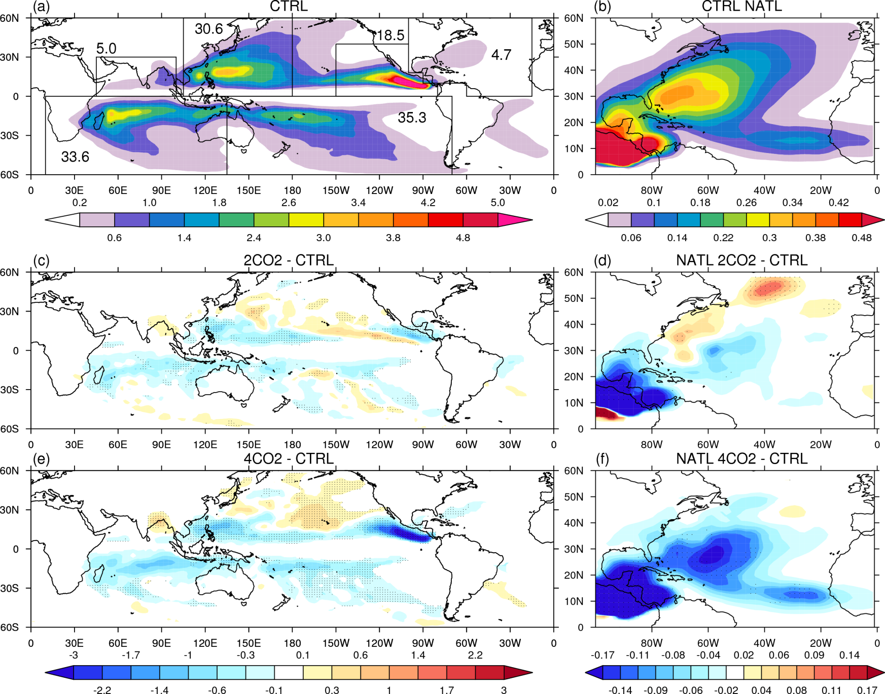
Tropical Cyclones and Climate Change: Tropical Cyclone Location
Robust
decrease
In WNP
Increase in
CPAC
Notes:
Top panel I showed previously in the first section
Stippling is outside of 5x30 year variability

Slide 45
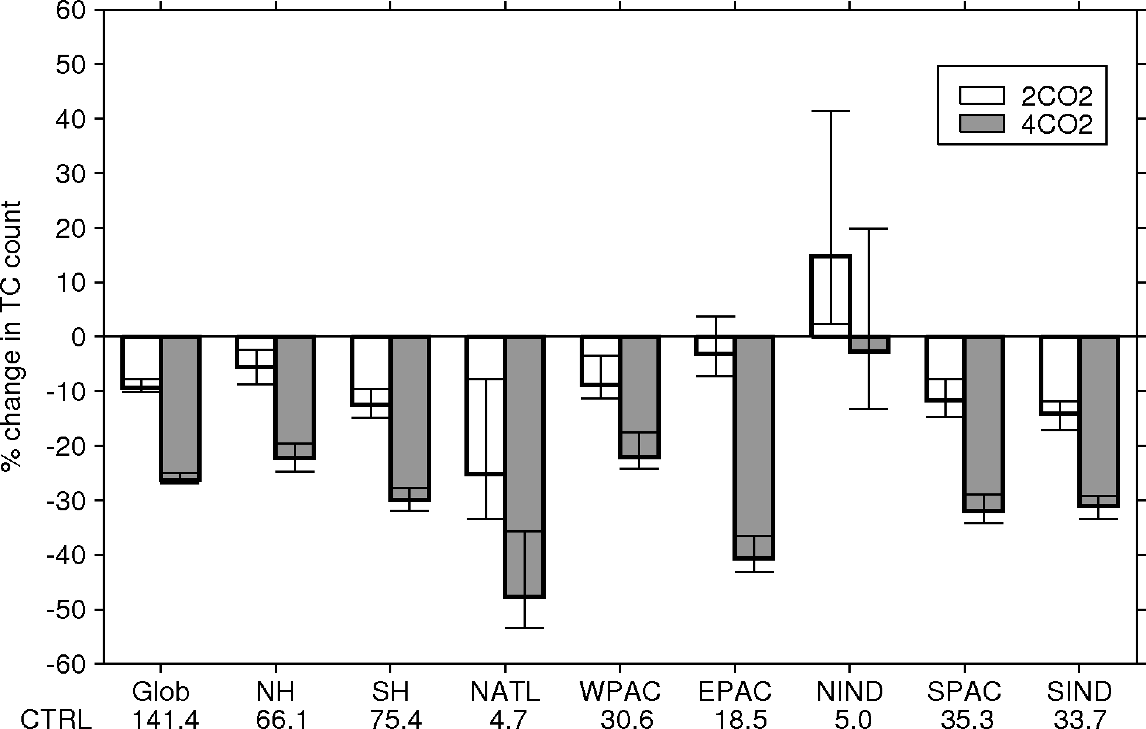
Tropical Cyclones and Climate Change: Tropical Cyclone Frequency
Notes:
Stippling is outside of 5x30 year variability

Slide 46
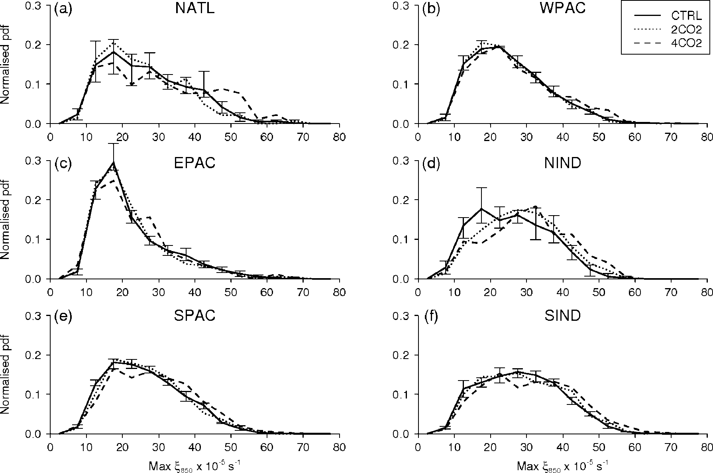
Tropical Cyclones and Climate Change: Tropical Cyclone Intensity
Increase in tropical cyclone intensity in 4CO2 only
Notes:
Stippling is outside of 5x30 year variability

Slide 47
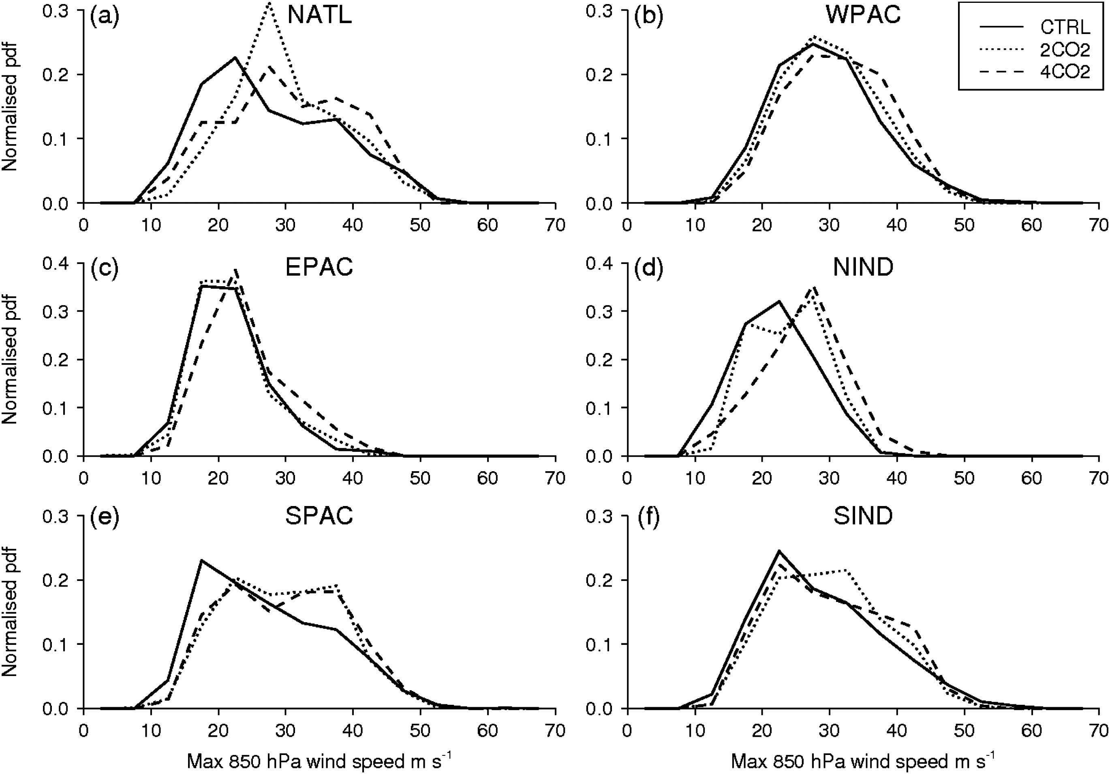
Tropical Cyclones and Climate Change: Tropical Cyclone Intensity. HiGEM-HiGAM time-slice
Increase in tropical cyclone intensity increase in 2CO2.
Also ∝ Resolution

Slide 48
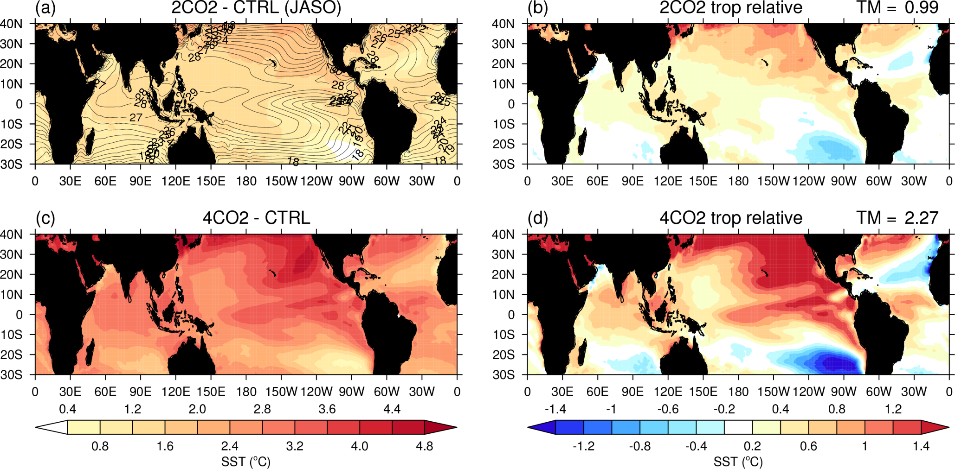
Tropical Cyclones and Climate Change: SST Changes
Warming in NAtl is less than the rest of the tropics, relates to decrease of TCs
Notes:
No stippling as significance found everywhere.

Slide 49
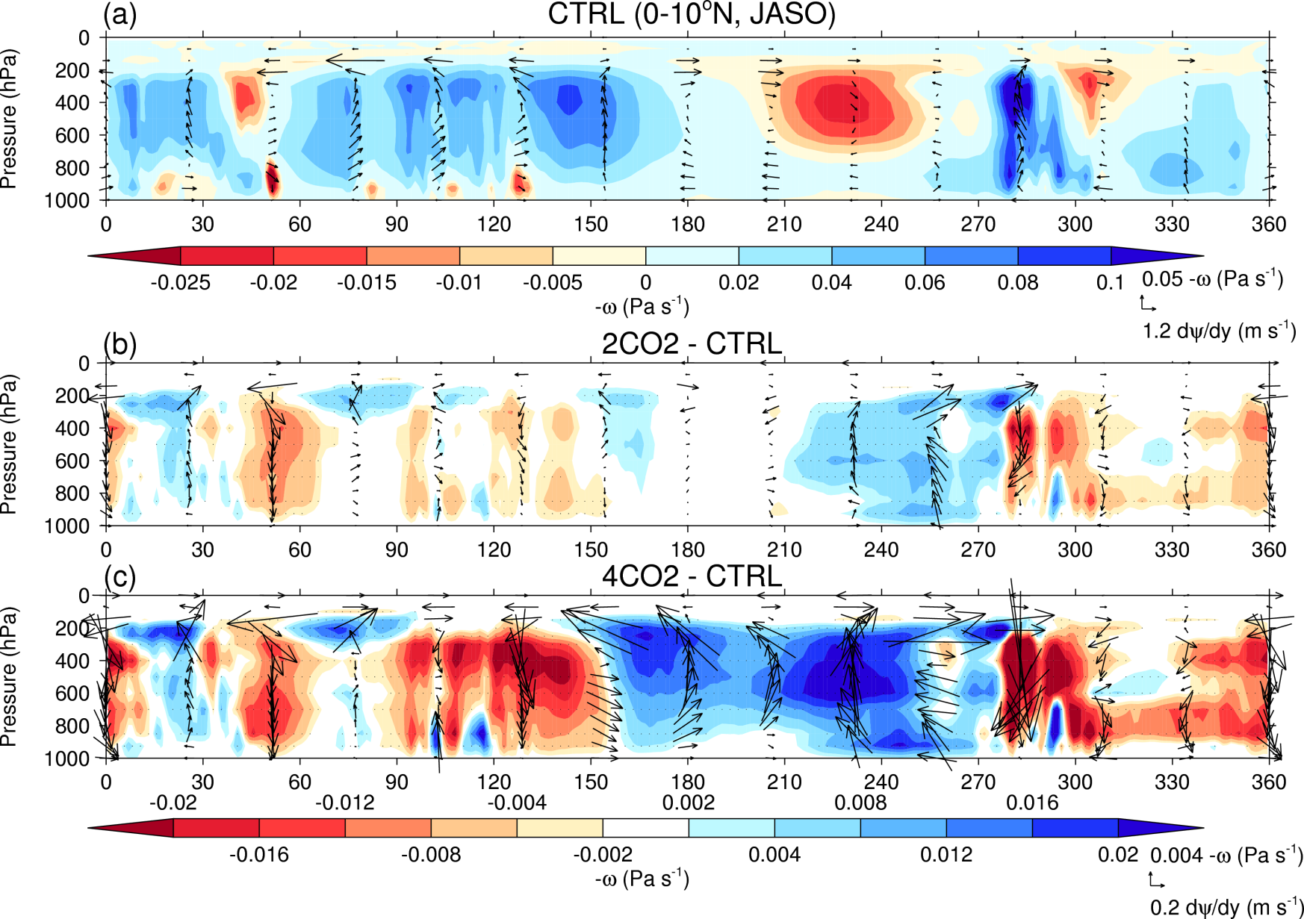
Tropical Cyclones and Climate Change: Walker circulation changes
Increase in vertical wind shear
Anomalous
descent in WNP
Anomalous
ascent in CPAC
Notes:
Explain plot again. Colour is omega. Vector are omega and a change in vel pot with respect to latitude
Stippling is outside of 5x30 year variability
Subsidence in North Atlantic

Slide 50
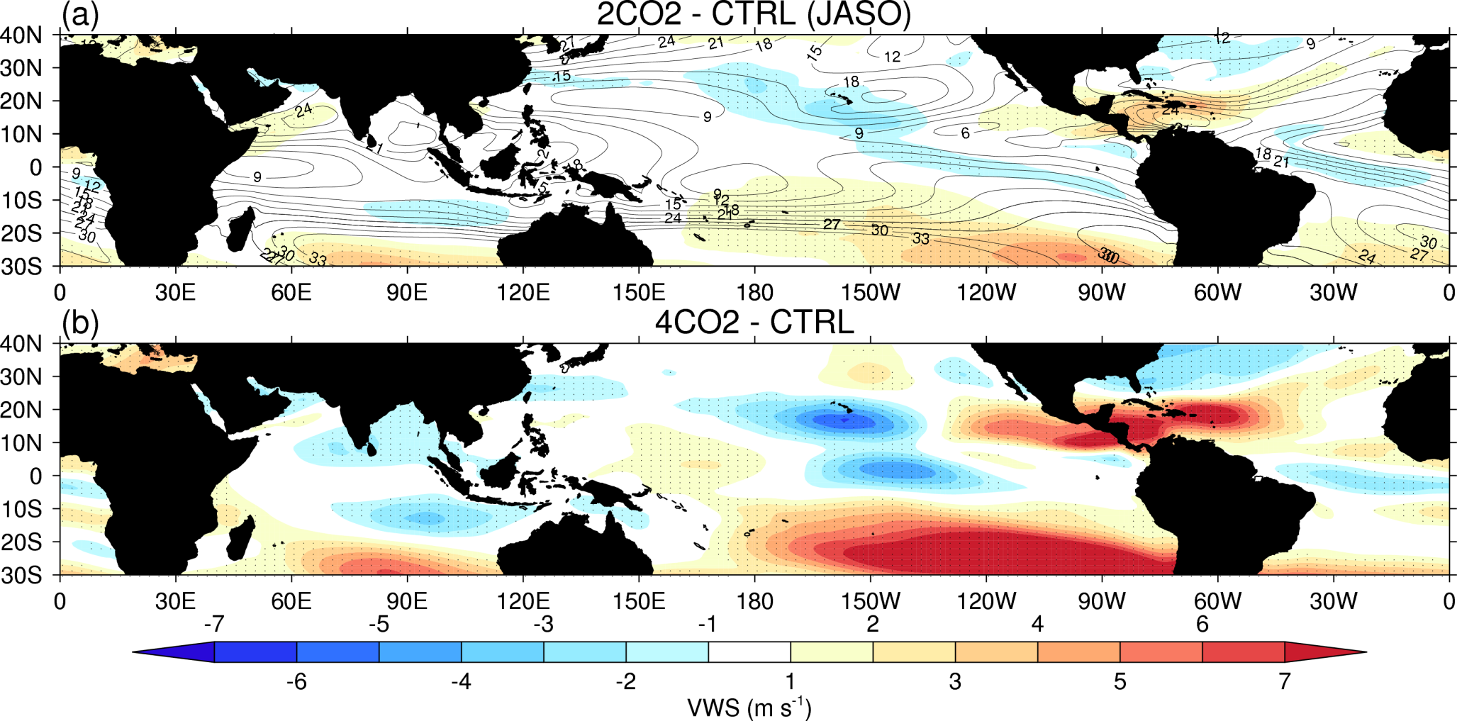
Tropical Cyclones and Climate Change: Vertical wind shear changes
Notes:
Stippling is outside of 5x30 year variability

Slide 51
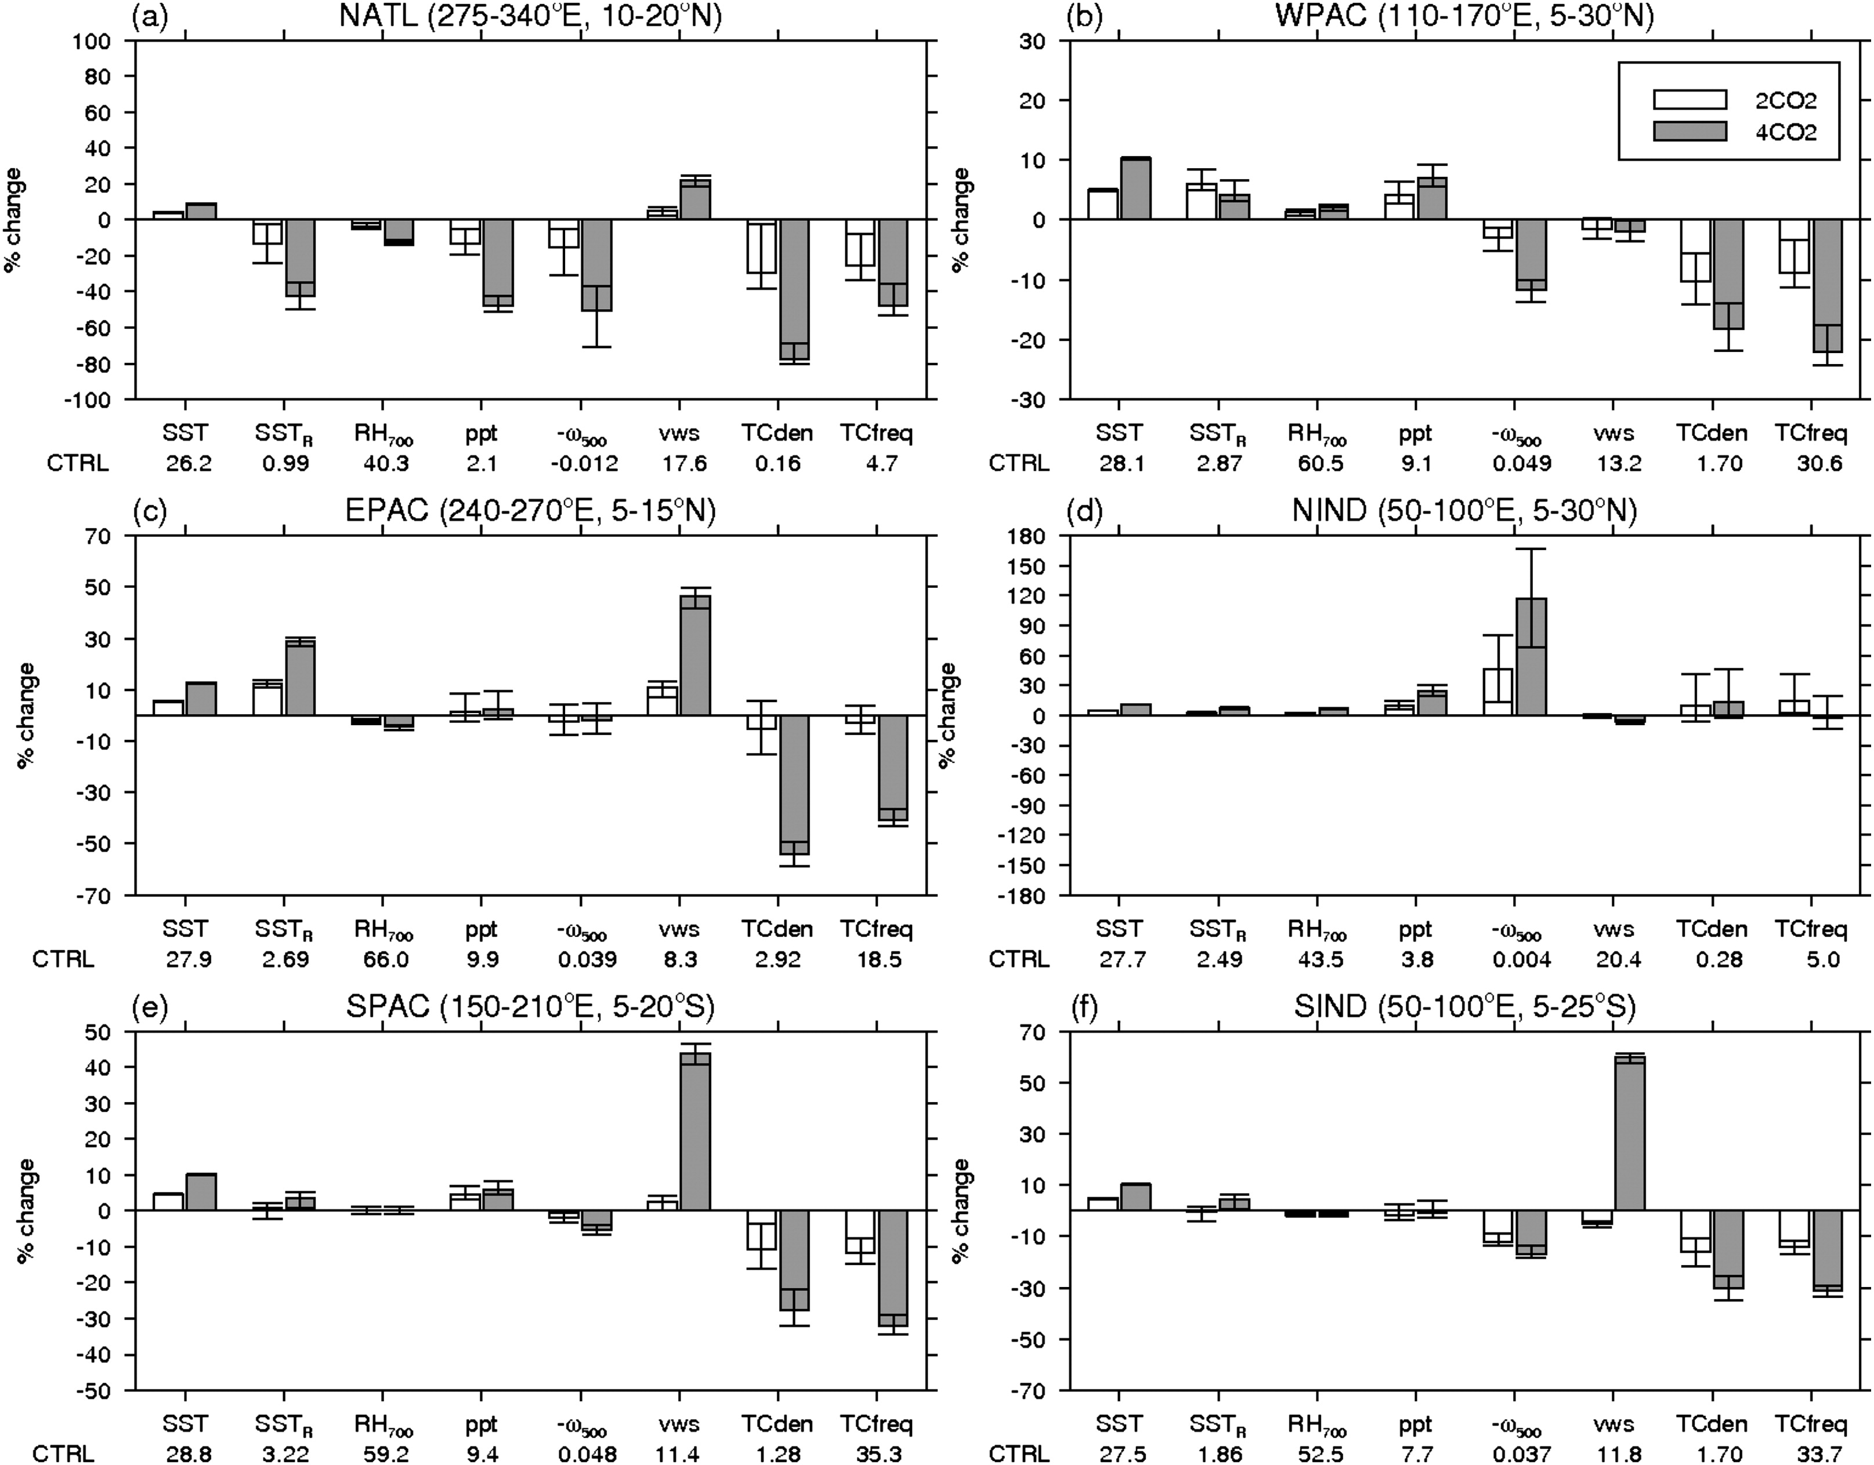
Tropical Cyclones and Climate Change: Thermodynamics vs. Dynamics

Slide 53
Tropical Cyclones and Climate Change: Thermodynamics vs. Dynamics - NATL
Notes:
% Change of large-scale parameters
Error bars are max and min of each 30 years.
Omega changes best match the TC changes

Slide 54
Tropical Cyclones and Climate Change: Thermodynamics vs. Dynamics - WNP
Notes:
% Change of large-scale parameters
Error bars are max and min of each 50 years.
Omega changes best match the TC changes

Slide 55
Conclusions
The ENSO-Tropical Cyclone Teleconnection
HiGEM captures the shift of TCs in the Pacific and Indian Oceans; does not capture expected response in North Atlantic.
ENSO-SSTs extend too far west; no upper-level response into North Atlantic.
Likely related to atmospheric resolution and it’s control on the mean-state
Different types of El Niño
HiGEM-HiGAM CP-EN experiments simulate an increase in TCs towards S.E. Asia.
eastern tropical Pacific SST is important for CP-EN response; Local SST cooling in the West Pacific is important for EP-EN response
Tropical Cyclones and Climate Change
Tropical cyclone become less frequent with climate change and more intense (only in 4CO2 in the couple simulations)
Change in TCs explained by changes in ω₅₀₀. Other parameters important for regional changes.

Slide 56
References
Bell, R.J., Strachan, J., Vidale, P.L., Hodges, K. and Roberts, M. (2014) Simulation of the Global ENSO-Tropical Cyclone Teleconnection by a High-Resolution Coupled General Circulation Model. J.Clim (early online release)
Roberts, M. Vidale, P. L. Bell, R. and Hodges, K. (2013) Sensitivity of tropical cyclone simulation to SST forcing. U.S. CLIVAR VARIATIONS. Vol 11(3), p12-17.
Bell, R.J., Strachan, J., Vidale, P.L., Hodges, K. and Roberts, M. (2013) Response of tropical cyclones to idealized climate change experiments in a global high resolution coupled general circulation model. J.Clim. Vol 26(20), p7966-7980.
Current work at Reading
UPSCALE project (Mizielinski et al, 2014; Robert et al, 2014) – AGCM ensembles at different resolutions down to 25km.
Working towards 25km atmosphere coupled with 1/12º ocean.

