Slide 1
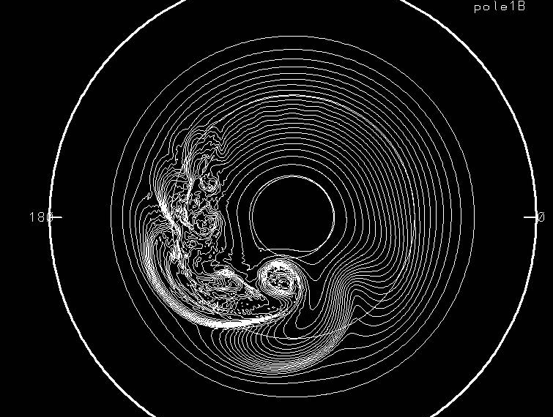
Multi-scale Interactions in Global Simulations of Baroclinic Instability
Hurricane Research Division, National Oceanic and
Atmospheric Administration, Oct. 3, 2013
J.M. Prusa¹
¹Teraflux Corporation, Boca Raton, FL; jprusa@bellsouth.net

Slide 2
Why Study Baroclinic Dynamics?
• Baroclinic instability is the most important form of instability in the atmosphere, as it is responsible for mid-latitude cyclones (Houghton, 1986)
• J. Charney (J. Meteor 1947), E. Eady (Tellus 1949),
and J. Smagorinsky (MWR 1963)
• Baroclinic wave breaking radiates gravity waves, which act to restore geostrophic balance (Holton, 2004) –> multi-scale physics
• Good AGM test case for multi-scale interactions
Notes:
QUITE SIMPLY …
2. OFFERS OPPORTUNITY FOR multi-wave scale interactions

Slide 3
Multiscale Model Prerequisites?
• Scalability to petascale/exascale computing ( >> 10¹² flops).
What other qualities?
OBVIOUS:
• retain single scale (eg., mesoscale, planetary, …) model qualities such as conservative property, low dispersion error, and so on …
• atmospheric and ocean applications:
hydrostatic -> nonhydrostatic
NOT OBVIOUS? Model has to “allow” mutiscale interaction between larger and smaller scales
➔ how to handle aliasing, i.e. grid noise?

Slide 4
less obvious, cont.
“TURBULENCE” CLOSURE:
• Large Eddy Simulation (LES): may be based upon 3D, isotropy, homogeneity, etc.; and as a result may generate dissipation terms that are not consistent with turbulence (Piotrowski et. al JCP 2009).
hyperviscosity: may suppress intermittency (Novikov – conjecture, Proceedings Monte Verita, 1993), thus altering multi-scale interactions; observed that resulting 2D cascades very sensitive to parameter settings (Gkioulekas & Tung J. Low Temp Phys 2006)
• high-resolution models have nonlinear leading order dissipation terms that are consistent with turbulent flow (Rider, IJNMF 2006)
→ offer effective resolutions of 3-5 Δx, vs. ~10 Δx commonly accepted criterion
Notes:
Note hyperviscoisy may have 2p or der Laplacian (ultraviolet dissipation) and -2m order inverse Laplacian (infrared dissipation); m,p integer

Slide 5
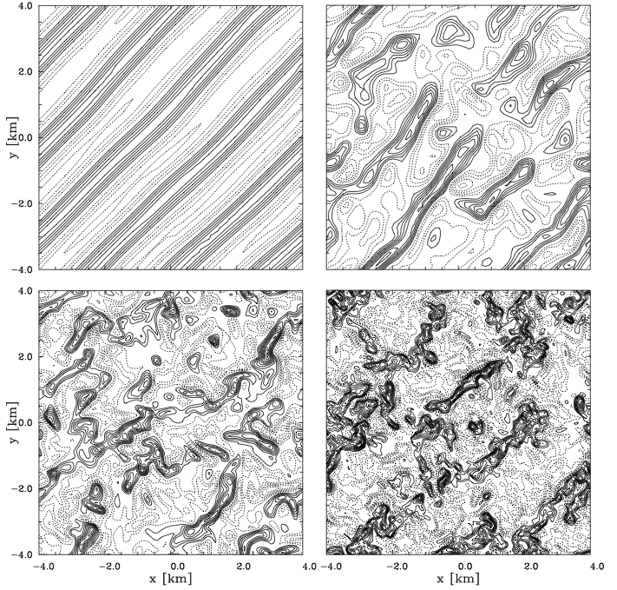
Effect of filtering on Convection? LES–TKE
Classical problem of flow over a heated plane : dry ABL
example
• Realizability of
Thermal Convection: (Piotrowski et.al, JCP 2009)
At low resolution, TKE method (upper LEFT) leads to regular convective structures that are not physical.
Vertical wind at 4 hr & 450 m; 8 x 8 km xy domain. Δx,y = 250, 125, 63, and 31 m, respectively, upper left to lower right.
Notes:
Figure shows that coarsest solution, which still has ~ 8 nodes per wave, is roll like instability vs cellular structures seen at finer resolutions.
With ILES, even coarsest resolution will show cellular rather than roll like structure – as long as grid can resolve it.

Slide 6
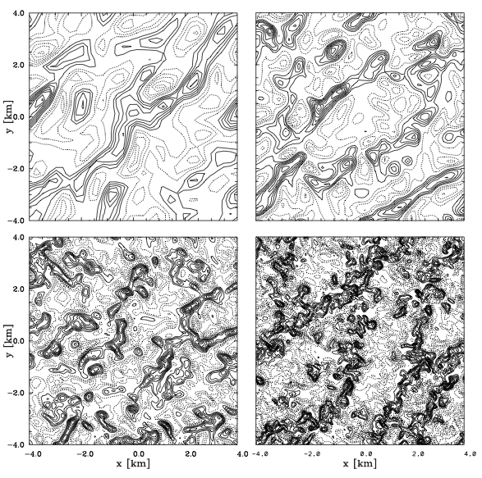
Convection simulation without explicit filtering:
ILES option
Detail of w(x,y) at same time and height as LES–TKE simulation.
Upper left –
Δx, Δy = 250m;
Upper Right – 125
Lower left – 62.5
Lower right – 31.2
ILES with non-oscillatory schemes can generate physical fine scale features that scale to ~ Nyquist wavenumbers.
Notes:
1. No cellular convection regime appears to exist. Right away, solutions appear to show similitude in turbulent structures.
2. With ILES, coarsening of finest resolution result to lower resolution of coarser grid simulations DO look like actual simulations.

Slide 7
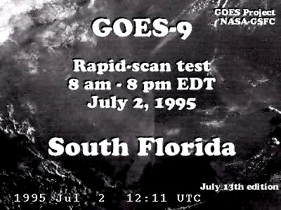
Multiple scale interaction: DOF ~ 10²⁸
→ explosive growth of small disturbances!

Slide 8
EULAG Model Features
(Prusa, Smolarkiewicz, and Wyszogrodzki, Comp & Fluids 2008)
• demonstrated scalability to thousands of PE’s
• Grid Adaptivity (GA) via continuous remapping of coordinates
• Semi-Langragian (SL) or fully conservative Eulerian advection
• implicit treatment of gravity waves via implicit integration of potential temperature perturbation
• Nonhydrostatic (vertical motions significant) deep moist anelastic equations (Lipps-Hemler JAS, 1982)
• Preconditioned Krylov solver (conjugate residual) solver for elliptic pressure equation.
Notes:
NFT works by maintaining “convexity” of flow; NOT flux limiting.
2. Pressure equation generated via exact projection of momentum equations onto continuity. Allows conservation to round off error.
3. Implicit theta integration increase accuracy of gravity waves. Generally, working with perturbation fields allows subtraction of known balances from equations and improves convergence/accuracy.
4. Default anelastic is lipps-hemler.

Slide 9
FEATURES, cont.
• Non-oscillatory Forward in Time (NFT) integration algorithm, helps to preserve monotonicity and eliminates nonlinear instability, default 2nd order in space and time.
• turbulence closure options: Direct Numerical Simu-lation (DNS), LES, or Implicit Large Eddy Simulation (ILES). ILES produces dissipation nonlinearly – just enough locally to avoid oscillations (uses limiters based upon the convexity of the flow).
→ conservative NFT Eulerian integration scheme MPDATA (Smolarkiewicz, IJNMF 2006) together with ILES closure option make EULAG a high resolution model.
Notes:
NFT works by maintaining “convexity” of flow; NOT flux limiting.
2. Pressure equation generated via exact projection of momentum equations onto continuity. Allows conservation to round off error.
3. Implicit theta integration increase accuracy of gravity waves. Generally, working with perturbation fields allows subtraction of known balances from equations and improves convergence/accuracy.
4. Default anelastic is lipps-hemler.

Slide 10
JW Baroclinic Instability Test
(Jablonowski and Williamson, QJRMS 2006)
Idealized dry global baroclinic instability test
• Balanced initial state with prescribed environmental profiles
• Gaussian perturbation in zonal wind introduced to seed a perturbation to “grow” baroclinic instability
• Instability grows linearly for first 6 days. Characterized by (i) distinct baroclinic waves, and (ii) amplitudes that grow exponentially in time
• Nonlinear effects strong at 8 days and wave breaking after 10 days
Notes:
Baroclinic instabilities grow by converting PE associated with mean horizontal Grad(T) required for thermal wind balance (Holton, p 229) … into perturbation KE
Initially seeded disturbance is barotropic, 1 m/s at 40 deg. N and 40 deg. Long.

Slide 11
Consistency of anelastic modes with compressible modes (AK2009)
BAROCLINIC WAVES: β-plane modal analysis
______________________________________
Red line λ = 4000 km which is known to be ~ gravest mode for Earth’s atmosphere
Notes:
H is density scale height.
Various correspond to vertical wavelength (depth) of baroclinic wave.

Slide 12
Balanced initialization given in JW is not correct for EULAG
• The geostrophically balanced IC of JW is not balanced for EULAG’s anelastic equation set → necessary to modify at least one of specified environmental profiles.
• A good match in linear regime will not occur unless the parameters controlling the waves (mean wind at steering level, thermal wind, f, β, H, N, ...) for the balanced anelastic model also match those of JW initialization.
• A 2-layer baroclinic instability model (Holton, Dynamic Meteorology 2004) establishes the linear wave growth to be sensitive to 3 parameters − the mean wind <u_{e}>, thermal wind u_{T}, and static stability σ.
Notes:
Use JW temperature fields exactly as prescribed, although need to convert it into potential temperature and expressed in terms of physical altitude.
Invert geopotential to find pressure vs. altitude (done approximately).
However, zonal wind is determined from compatibility conditions (basically a thermal wind type equation) which require balance for anelastic equation set.
The “balanced” zonal wind is about 5% stronger than the JW specification.

Slide 13
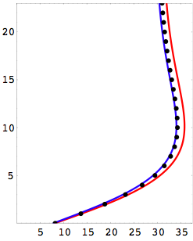
2-layer model (Holton 2004), cont.
The thermal wind effect is secondary on phase speeds, but dominates disturbance growth rates.
, where
Env. zonal wind
JW
z (km)
balanced
balanced &
matched
If D < 0, then D^{1/2} = iζ and
τ = 1/(k ζ) is the growth rate
u_{e} (ms⁻¹)
Notes:
The balanced initialization for EULAG results in phase speeds about 5% too fast, using u00 = 35 m/s as per JW prescription. However, this balanced profile does not match the mean zonal wind of JW. When u00 is reduced 5%, then the mean wind for EULAG’s zonal wind profile matches that for JW and so do the resulting phase speeds!
Lambda(sigma) is wavenumber like term arising from environmental stability: lambda^2 = f0^2/(sigma * dp^2); and sigma = -RT_o / p_o dThe/dp
Estimated time scales for growth are ~ 2.0 days, vs 1.5 in EULAG results. Growth ~ - const * u_T and ~ sigma

Slide 14
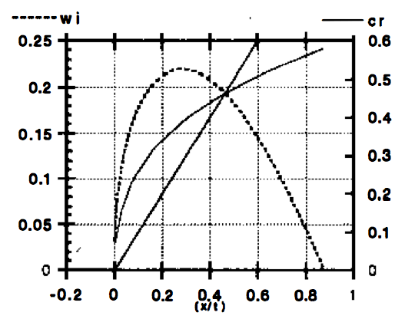
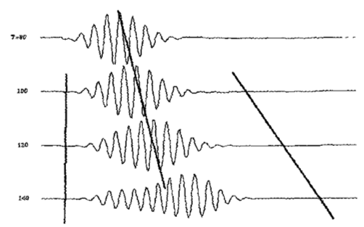
Baroclinic WAVE PACKET growth (Pierrehumbert and Swanson, Ann. Rev. Fluid Mech. 1995)
β*= 0.5
u(0)=0
• Charney problem in zonally unbounded domain
• Superposition of many normal modes using delta function
• Method of stationary phase (t → ∞) : 3 distinguished rays
Notes:
1st disguished ray given by point of MAXIMUM growth. This define wave packet CORE.
Other two are leading and trailing edges. Here trailing edge is stationary (not true in general).
NOTE group velocity > phase speed at leading edge → leading edge goes faster and faster (up to jet speed).

Slide 15
Baroclinic Instability Test:
EULAG simulations
Horizontal Grid: uniform zonal and global
grid size | resolution | machine | cores | WC/day | ε(p)
128 x 64 | 2.8º | Bassi-NERSC | 16 | 1.2 min | 3.e-5
256 x 144 | 1.4º | Hopper-NERSC | 144 | 5 min | 1.e-5
512 x 240 | 0.7º | Hopper-NERSC | 480 | 20 min | 3.e-6
1024 x 480 | 0.35º | Hopper-NERSC | 1920 | 40 min | 3.e-6
“ | “ | “ | “ | 90 min | 3.e-7
Vertical Grid: same for all simulations –
47 nodes distributed with exponential stretch, highest resolution of 200 m at ground, increasing with a scale height of 10.2 kms, top at 23 km (rigid lid).
Notes:
epsilon(p) is pressure convergence – needs to increase with grid size in order to maintain high accuracy
Note problem size ~ 8x greater from one grid to next one below.
Required CPU CPU time also increases ~ 8x from one grid to next larger one, provided epsilon is SAME. → strong scaling
In practice, however, need to increase level of convergence with grid size in order to maintain high accuracy; readily gauged by contamination of flow in Southern hemisphere.
Note decreases in epsilon → DOUBLE required CPU time.
Note Bassi ~ 2x speed of Hopper.

Slide 16
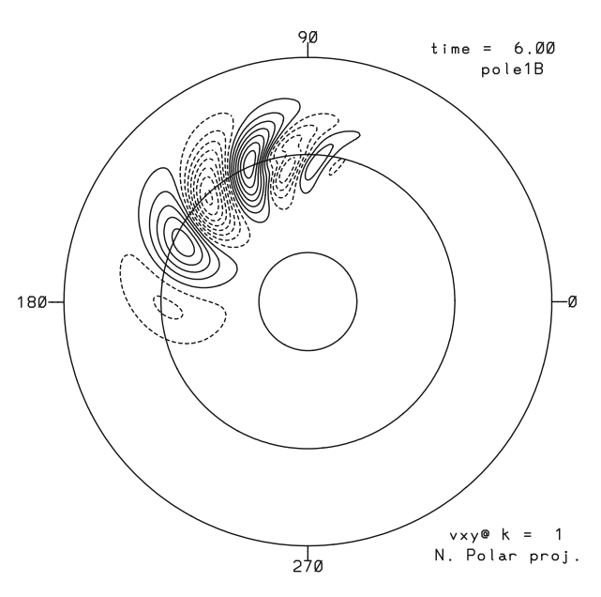
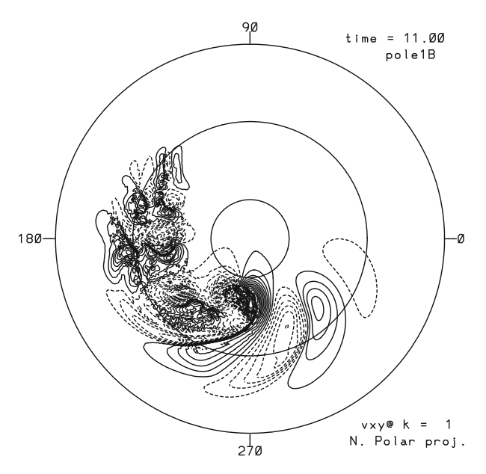
Baroclinic Instability Test: Linear and wave-breaking regimes (Jablonowski and Williamson, QJRMS 2006)
EULAG: Meridional surface wind 11 d (global 0.7º resolution)
(mx, mn, cnt)=(6, -6, 0.8) ms⁻¹
(mx, mn, cnt)=(40, -40, 3) ms⁻¹
Notes:
Latitude circles @ 15, 45, 75 degrees.
LEFT: linear baroclinic wave regime: highly regular well defined DISPERSIVE wave train. Wave speed is westward RELATIVE TO MEAN ZONAL WIND; with longer waves having faster relative westerly motion.
RIGHT: nonliinear breaking baroclinic wave regime: leading edge of wave packet still linear but packet core is undergoing breaking with generation of extreme gradients limited by numerical resolution followed by wake region of broken waves in trailing portion of wave packet.

Slide 17
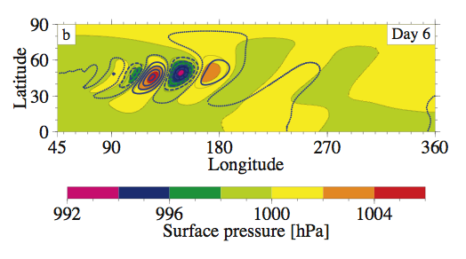
Surface Pressure Comparisons @ 6 days
Color fill- JW results using CAM FV dycore
Blue dots/dashes – EULAG 1.4 deg. res.
mean difference : 110 ± 65 kms
→ 0.2 ms⁻¹
Δc_{x}/c_{x} ~ 1.0%
wave packet core: 4 kms → 0.01 ms⁻¹ → Δc_{x}/c_{x} ~ 0.001%
@ 8 days (not shown):
mean difference : 140 ± 120 kms
→ 0.2 ms⁻¹. Wave packet core: again negligible!
Increasing resolution: 0.7 and 0.35 deg → decreases dispersion relative to JW results, more so at trailing edge
Notes:
UPPER RIGHT: FV dycore resolution is 0.5 x 0.625 degrees (colors). EULAG results at 1.4 x 1.4 degrees (BOLD blue solid & dashed contours). EULAG matches FV phase speed and amplitude in wave packet core. In particular the delta in wave speed is 0.1 m/s ~ 1%.
LOWER RIGHT: Effects of grid resolution on EULAG results show numerical dispersion effects are negligible in wave packet core.
Grid dependent resolution effects on dispersion do not fully account for differences between EULAG and JW at wave packet edges.

Slide 18
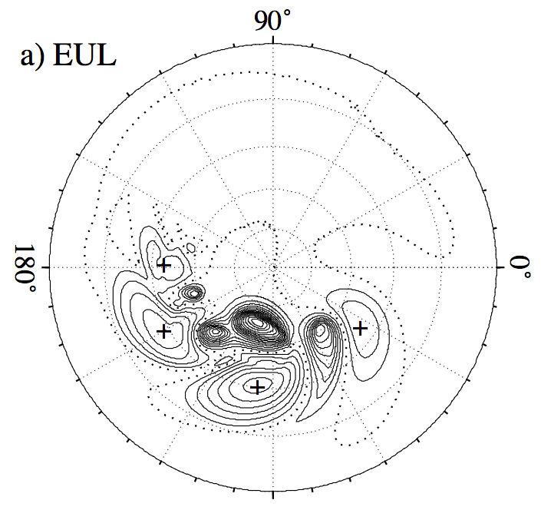
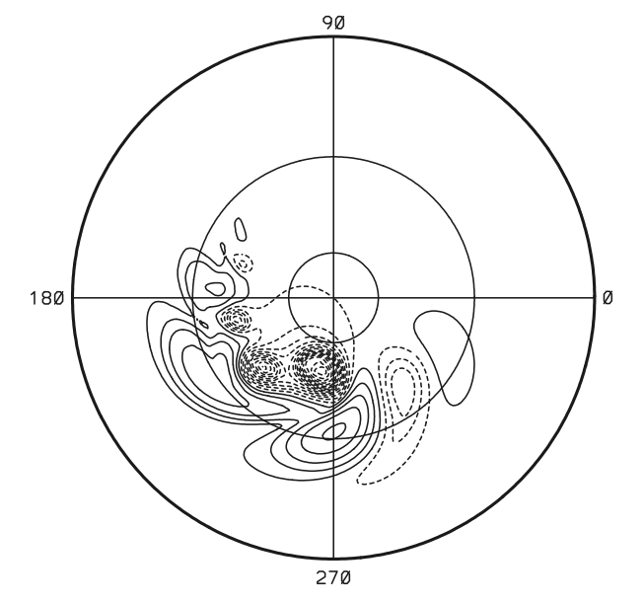
Surface Pressure @ 11 days; cnt = 5 hPa
JW results using CAM
Eulerian spectral dycore (T172)
EULAG results using
Eulerian advection (0.7º)
-75 hPa
- 76 hPa
23 hPa
30 hPa
mean difference : 525 ± 375 kms; (max, min) = (1275, 125) kms
in past 3 days, Δc ≈1.5 ms⁻¹ → Δc_{x}/c_{x} ~ 8%
Notes:
DEEP WAVEBREAKING REGIME
1. LEFT: JW Eulerian spectral dycore resolution with T172 equivalent 0.7 x 0.7 degree resolution (NYQ = mode 256).
2. RIGHT: EULAG 0.7 x 07 degree resolution result.
GOOD AGREEMENT: Amplitude of major HI’s and LO’s as well as locations of major LO’s. Only location of one of major HI’s is a good match (near 270 deg. Long.).
LESS AGREEMENT: Other HI’s showing deltas upward of 20 deg. long. with EULAG more advanced. EULAG wake region more developed. Leading HI and LO in JW results near 120 deg. long. greatly attenuated in EULAG results. Note proximity to wake region.
SUMMARY: DIFFERENCES between EULAG and JW exist, but there is broad agreement in a number of major features and overall global structure of flow.

Slide 19
15 (0.36º resolution)
mean difference : 1000 ± 400 kms; (max, min) = (1700, 650) kms
Notes:
DEEP WAVEBREAKING REGIME at 15 days – COMPARISON with MPAS
TOP: EULAG 0.35 x 0.37 degree resolution result.
2. BOTTOM: MPAS with unknown resolution (appears at least equal to EULAG’s). Note mean diff = 1000 kms vs. mean difference = 320 kms @ 9 days → diff in phase speeds of 1.3 m/s ~ 7%.
Good overall agreement on morphology of field. Amplitudes of major HI’s show reasonably good match ( EULAG ave @ -7%); vs LO’snot as good (EUL ave @ + 25% for 2 greatest LO’s, but 2. and 2.7x greater for 3rd and 4th LO’s). EULAG’s locations of major LO’s and easternmost HI’s ~ 20 deg. advanced, decreasing to ~ 10 deg for westernost HI.
4. Note that EULAG wake region more QUIESCENT.
SUMMARY: DIFFERENCES in details exist, but there is broad agreement in the number of major features and overall global structure of flow.

Slide 20
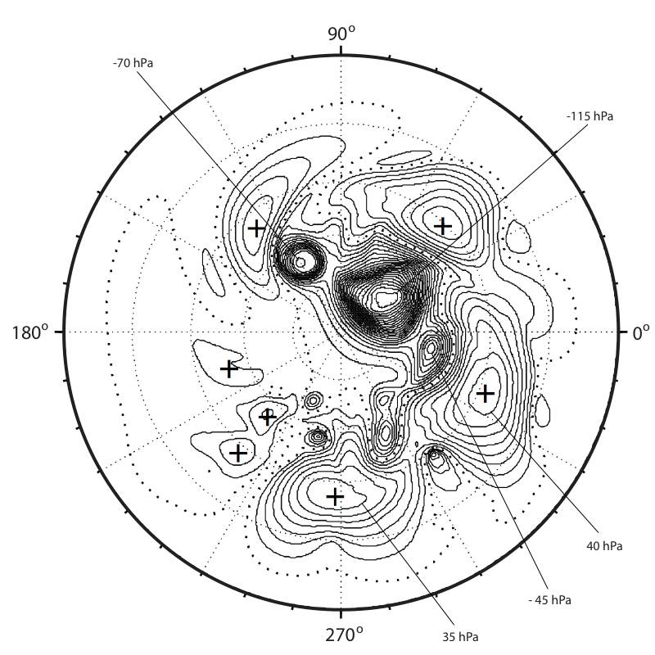
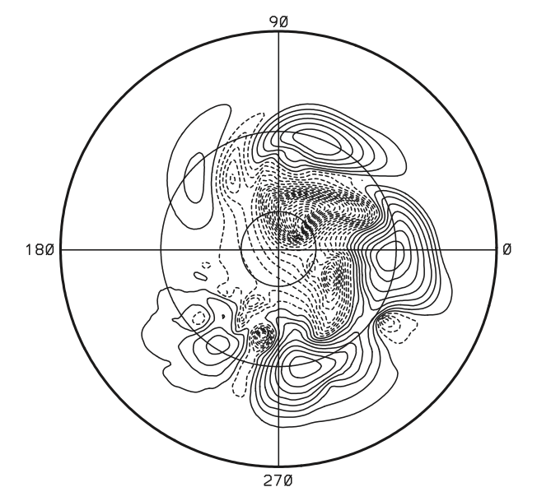
Surface Pressure @ 16 days; cnt = 5hPa
JW results using CAM
Eulerian spectral dycore (T172)
EULAG results using
Eulerian advection (0.7º)
-11 hPa
32 hPa
-111 hPa
35 hPa
9 hPa
20 hPa
42 hPa
- 62
hPa
-25 hPa
- 20 hPa
41 hPa
mean difference : 1300 ± 400 kms; (max, min) = (1800, 400) kms
→ in past 5 days, Δc ≈1.8 ms⁻¹ → Δc_{x}/c_{x} ~ 9%
Notes:
DEEP WAVEBREAKING REGIME
1. LEFT: JW Eulerian spectral dycore resolution with T172 equivalent 0.7 x 0.7 degree resolution (NYQ = mode 256).
2. RIGHT: EULAG 0.7 x 07 degree resolution result.
GOOD AGREEMENT: Amplitude of major HI’s and LO’s as well as locations of major LO’s. Only location of one of major HI’s is a good match (near 270 deg. Long.).
LESS AGREEMENT: Other HI’s showing deltas upward of 20 deg. long. with EULAG more advanced. EULAG wake region more developed. Leading HI and LO in JW results near 120 deg. long. greatly attenuated in EULAG results. Note proximity to wake region.
SUMMARY: DIFFERENCES between EULAG and JW exist, but there is broad agreement in a number of major features and overall global structure of flow.

Slide 21
EULAG Surface Potential
Temp. @ 16 days
0.35 deg. Resolution
1.4 deg. Resolution
lower resolution shows a more disturbed wake...
Notes:
KEY thing is to note difference in WAKE REGION: 135 -> 180 deg. longitude. HI RES is MUCH more QUIESCENT.

Slide 22
EULAG 0.7º simulation @ 11 days : small waves in wake
Surface θ – (max,min) = (309, 230) K
w @ 7.5 kms altitude –
(max,min) = (0.014, -0.016) ms⁻¹
Notes:
environmental properties controlling baroclinic wave propagation are mean wind, thermal wind, and stability – determined via elementary 2-layer model (Holton 2004). All 3 environmental properties affect phase speed but mean wind is dominate factor.

Slide 23
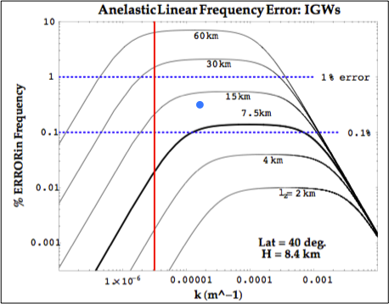
Consistency with compressible modes (AK2009)
Gravity wave modes: f-plane ______________________________________
red line @
2000 km
blue dot @
400 km
purple line @
25 km
(grid resolution)
Notes:
One day period from 277.0 to 278.0 days.
Expanded time interval for packet evolution requires movement in longitude!
Delta(w) = 1 cm/s

Slide 24
Small waves – XZ slices of w @ 50º N
1.4º
0.7º
0.35º
Notes:
Richardson extrapolation -> (200, 6) km for horizontal and vertical wavelengths. Periods very fast ~ 15 min.
0.35 deg. solution is very close to “converged” vs. Richardson extrapolation.

Slide 25
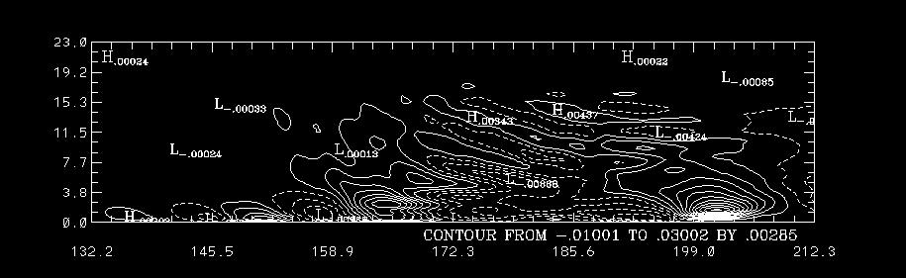
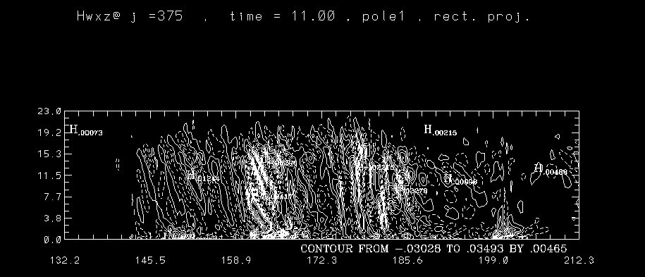
Low-Pass wxz with 400 km filter: 11 d @ 50.1º lat.
High-Pass wxz with 400 km filter: 11 d @ 50.1º lat.
Notes:
Low-Pass upper wavefield has horizontal wavelength of 900 kms with vertical wavelength of 4 kms,
with a period >> 15 min.
High-Pass wavefield has horizontal and vertical wavelengths of 200 and 6 kms, respectively, with
period ~ 15 min.

Slide 26
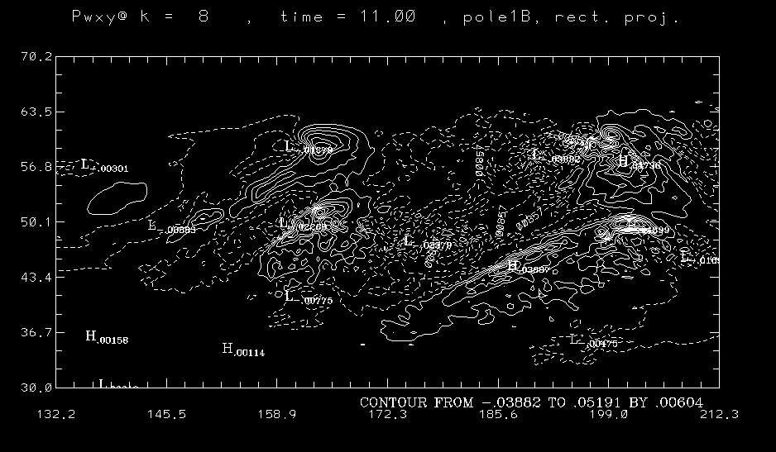
Vertical wind – wxy : 11 d @ 1.5 km alt.
Notes:
This is vertical wind minus local average in layer just above surface, k=8.
It is in the region of strongest vertical winds in troposphere (does get matched by mid stratosphere).
Total amplitude ~ 9.1 cm/s

Slide 27
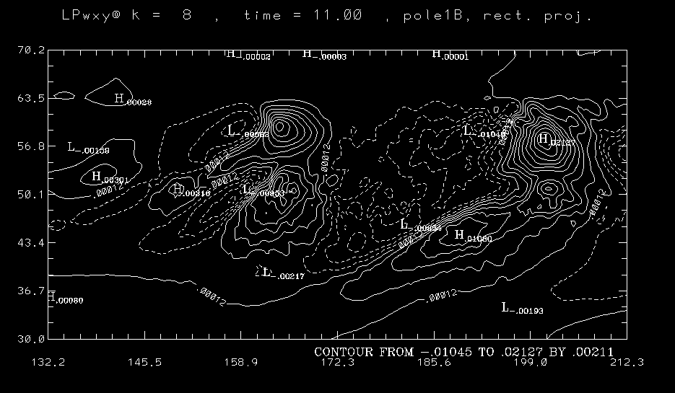
Low-Pass wxy with 400 km filter: 11 d @ 1.5 km alt.
Notes:
Low-pass field captures local synoptic structure.
Again, based upon wP field.
Accounts for 35% of total vertical wind amplitude (31% renormalized).

Slide 28
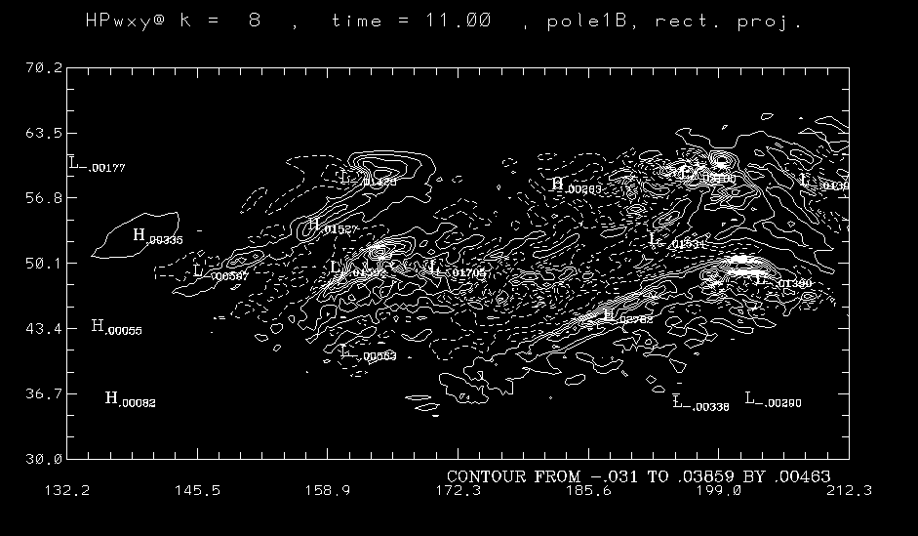
High-Pass wxy with 400 km filter: 11 d @ 1.5 km alt.
Notes:
High-pass vertical wind, based upon local perturbation wxy.
Captures a range of smaller and larger waves.
Accounts for 77% of total vertical wind amplitude (69% renormalized).

Slide 29
Eddy Fluxes associated with synoptic scales vs. small waves: XZ slices @ 50º N, 130º – 210º longitude; 0.35º resolution.
full field
high-pass
low-pass
(400 km filter)
mult = 1 day
upper absorber
boundary
K
m/s
m/s
Notes:
Eddy fluxes give ACCELERATIONS of field due to interaction with another field (vertical wind; eg, m/s^2 or K/s).
When mulitipled by 1 day, then results show changes after one day (eg, m/s or K). Note net surface changes
of ~ 1 K, and 1 m/s per day.
2. Note upper GW absorber at z > 15 km.
3. High-Pass eddy flux is negligible except near surface → Low-pass structures account for all of eddy flux
in this region. This is key inference. High-pass eddy flux is generally opposed to low-pass flux near surface.
u’w’ eddy flux shows strongest response from smaller scale gw’s (high-pass). In this case, small scale wave
interactions account for the bulk of the acceleration of zonal wind near the surface.
4. th’w’ eddy flux shows that low-pass flux dominates even in near surface region. v’w’ is intermediate.

Slide 30
Summary
• Linear wave regime ( ≤ 8 days): excellent agreement with JW (2006) in regards to phase speeds and amplitudes. Differ-ences in wave packet mean speed are negligible (<< 1%).
Wavebreaking regime (> 9 days): comparison is still quite good in terms of general morphology, but EULAG baroclinic wave packet now moves faster than that of JW by up to 9% (by 16 days). EULAG results show very high surface gradients in winds and potential temperature fields.
Wake region at trailing edge: 0.7 and 0.35 deg. simulations show ubiquitous small scale gravity wave activity. Wake becomes more quiescent with the appearance of these waves.
Eddy flux: 0.35 deg. simulations – small scale gravity waves act to oppose large scale synoptic motions; effect is strongest on zonal wind.
Notes:
environmental properties controlling baroclinic wave propagation are mean wind, thermal wind, and stability – determined via elementary 2-layer model (Holton 2004). All 3 environmental properties affect phase speed but mean wind is dominate factor.

Slide 31
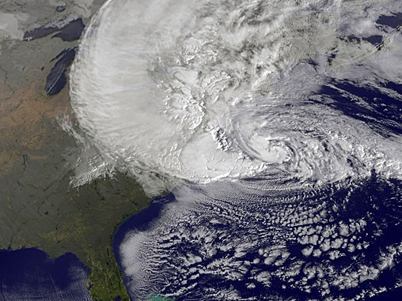

Slide 32
Remarks
Yet to be completed: Detailed diagnostics for larger inertio- and smaller scale “nonhydrostatic” gravity waves (following methodology in Prusa and Gutowski, Acta Geophy., 2011).
• Small scale gravity waves: These waves generate small eddy-stress amplitudes compared to the synoptic structures; yet they appear to manifest in the long term to modify the large scales in the JW baroclinic instability test case.
Consequences? The simulations suggest that small scale GW’s near the grid resolution may impact:
1. Long term predictions, and
2. Downscaling for Regional Models.
Notes:
environmental properties controlling baroclinic wave propagation are mean wind, thermal wind, and stability – determined via elementary 2-layer model (Holton 2004). All 3 environmental properties affect phase speed but mean wind is dominate factor.

Slide 33
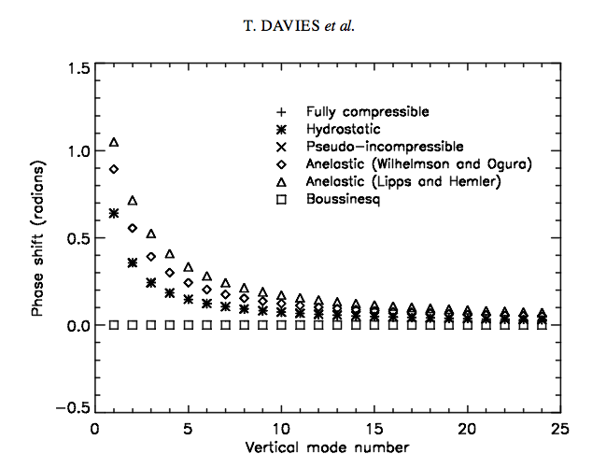
Linear Modal Analyses of sound-proof models:
• Davies et al, QJRMS 2003 – 2D normal mode f-plane, isothermal analysis used to rigorously examine sound-
proof systems:
(i) “merit for small-scale motions
is well recognized”
(ii) Anelastic not good for amplitudes and height scales of external plane-tary modes, nor for finite amplitude
Lamb (acoustic) waves
(iii) Anelastic introduces phase error for deep wave modes
• Arakawa and Konor (MWR 2009) – analysis of Davies et al. extended to β-plane with similar conclusions.
Notes:
1. Bannon: piezotropic exponent (ie, rev. adiabatic expansion) for anelastic 1/(1-Gam*R/g) where Gam = lapse rate. For Gam = 10K/km, then exponent = 1.4 =cp/cv=gam, but for 7 and 0 K/km it is 1.25 and 1.
2.Bannon: anelastic system DOES have isentropic compressibility = rho^-1 x drho/dp (basic state variables). CANNOT rewrite in terms of sound speed… so use gam*R*T = g*H_rho instead.
3. Davies et al., FIGURE - compressible, hydrostatic, and psuedo incompressible all same; anelastic shows significant phase errors for deep waves; error independent of zonal wavelength.
4. NOT RECOMMENDED for NWP or climate simulation at ANY SCALES.

Slide 34
AK 2009 modal equations:
Dispersion equation for 2D β-plane approximation, assuming static, isothermal environment (AK 2009):
ω = - βk /{k² ⁺ f_{o}² [ c_{s}⁻² + H M ² (κg)⁻¹]}
where ;
• Requisite parameters: (β, f_{o}, c_{s}, κ, H) <– environment
Anelastic model: c_{s} → ∞ and μ → 1 / 2H define phase error = 1-ω_{an} /ω_{com}
Notes:
Static stability is essentially ~ N²
Mu gives “correction” for density stratification.

Slide 35
Presentation Synopsis:
1. Brief overview of computational model : EULAG
2. Define baroclinic test problem
3. Initialization/setup of model
4. Results and Discussion:
(a) baroclinic instability: comparisons with
published literature
(b) generation of smaller scale gravity waves
(c) effect of gravity waves on baroclinic waves
Notes:
Static stability is essentially ~ N²
Mu gives “correction” for density stratification.

Slide 36
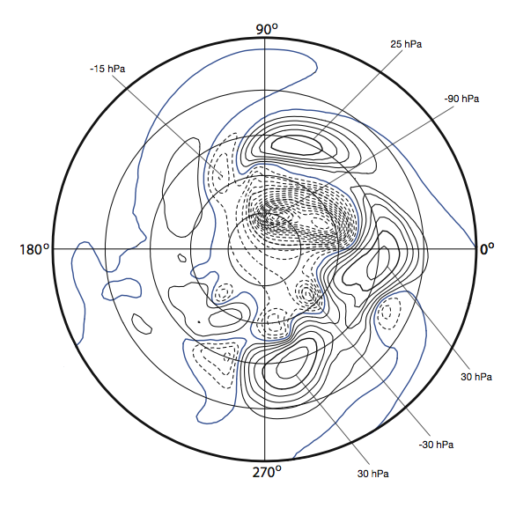
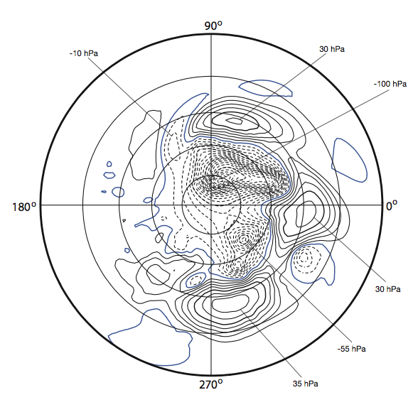
Surface Pressure @ 16 days : effect of numerics?
EULAG results (1.4º) using
Semi-Lagrangian advection
EULAG results (1.4º)
using Eulerian advection

Slide 37
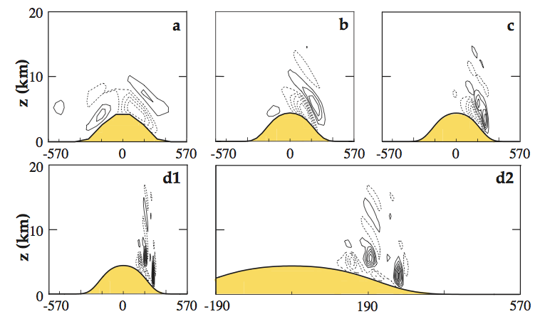
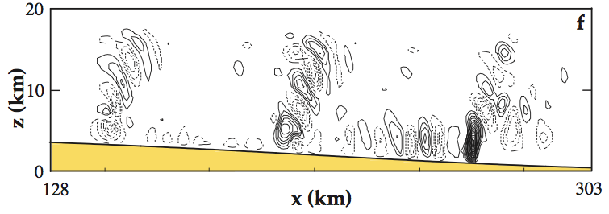
Nonhydrostatic effects: l_{x} ≤ 10 kms?
• Nonhydrostatic Effects in Flow over an Idealized Andes Orography (Prusa and Gutowski, IJNMF 2005)
frame Δx w_{ext}
km ms⁻¹
a 122 0.1
b 50 0.2
c 20 0.4
d 7 1.1
e 2.5 2.7
f 0.89 6.0
Regional Simulations of orographic GW’s using environmental profiles generated by global HS simulations. Increasing resolution shows scaling w_{ext} ~ Δx⁻¹ .
Notes:
Static stability is essentially ~ N²
Mu gives “correction” for density stratification.

Slide 38
Example: Gravity Wave Breaking
(Prusa et al, JAS 1996)
EULAG IS A HIGH RESOLUTION MODEL
(potential temperature)
← u_{o} = - 25 ms⁻¹
traveling gaussian pulse
→
Notes:
u_o = -25 m/s, constant stability with N ~ 0.02 1/s,
forcing with small amplitude disturbance at tropopause that is proxy for traveling squall line
Traveling squall line parameters: xm = - 30 km; c= + 7 m/s; amp = 200 m, sx = 2 km; stime = 1 hr.
Grid size is 625 m dx,dz. Timestep = 5s???

Slide 39
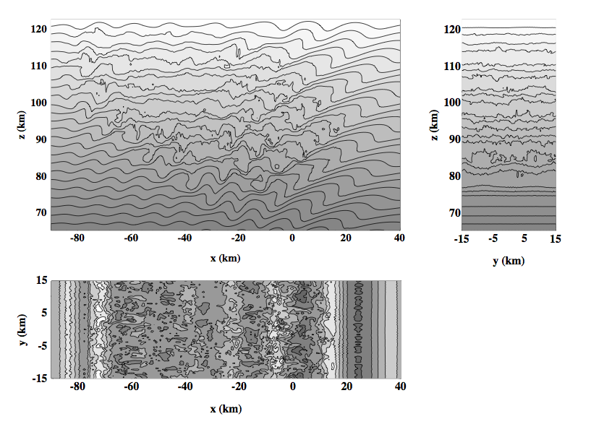
Examples
ILES does NOT need Homogeneity... Isotropy...
Breaking Gravity Waves @ 155 min depicted by potential temperature.
(Smolarkiewicz and Prusa, Chapter 8 Turbulent Flow Computation, Kluwer Academic Publishers, 2002)
Notes:
3D simulation @ 380 m resolution. 240 km domain.
Non traveling gaussian proxy, but same spatial and time scales as for 2D case.

Slide 40
Reverse cascade forcing of < u >
high resolution, cont.
Initial domain averaged zonal wind is -25 ms⁻¹
Profiles shown every 5 min.
150 min
OBS: meridional flow near mesopause is opposite of what is expected from rad. cooling → requires forcing of 10-20 ms⁻²/day
z km
125 min
Model results for EP flux divergence → ~ 2 cm s⁻² over 1 hr duration of maximum wavebreaking: APPEARS SUFFICIENT!
< u > ms⁻¹
Notes:
Summer polar mesopause (~ 90 kms) is ~ 30K colder than it would be if in radiative equilibrium.
Much of winter polar atmosphere temperature > than that of radiative equilibrium throughout middle atmosphere
above from MIDDLE ATM DYN (AHL 1987), p9.
This requires reversal of meridional flows at higher levels...
ILES + mpdata → high resolution models yield leading order dissipation terms that are consistent with turbulence (Rider, IJNMF 2006)

Slide 41
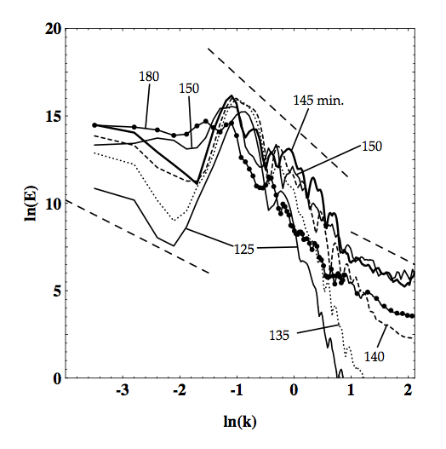
→ Multiple scale interactions up- and downscale
Power Spectra of breaking gravity waves in upper atmosphere:
left side: ln(k) = -4 →
340 km (n ~ 115)
right side: ln(k) = 2.1 is Nyquist wavenumber
→ λ_{nyq} = 760 m
(Prusa et al. Int. J. Math. Comput. Sci. 2001)
→ downscale
-3
-5/3
-5/3
upscale ←
λ_{x} ~ 17 km
Notes:
Note transition in downscale energy transfer at ln(k) = +1 → k = 2.7 km^-1 → lx = 2.3 km = critical buoyancy wavenumber
Downscale of critical wavenumber the slope = -5/3 suggesting classical 3D inertial subrange (realistically speaking, ~ 2 km seems bit big?
Upscale of critical wavenumber the slope = -3 suggesting quasi-2D cascade (NOTE 2D simulations show ONLY – 3 slope downscale of energy injection point.
Downscale of energy injection point slope ~ -5/3 suggesting revered enstrophy cascade. Recall Gage & Nastron spectra show -3 in mesocale so this CANNOT be physical mechanism behind that.

