Slide 1
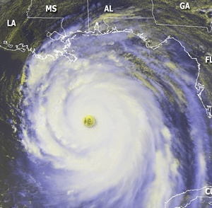
Joint Action Group for Tropical Cyclone Research (JAG/TCR)
and
Working Group for Tropical Cyclone Research (WG/TCR)
Dr. Frank Marks (NOAA) and Dr. Ron Ferek (Navy)
Co-Chairs, Working Group for Tropical Cyclone Research (WG/TCR)

Slide 2
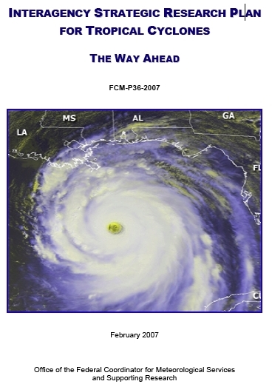
History of JAG/TCR
February 2005: Federal Coordinator formed Joint Action Group for Tropical Cyclone Research (JAG/TCR)
February 2007: JAG/TCR culminated with publication of Interagency Strategic Research Plan for Tropical Cyclones: The Way Ahead
Highlights of Interagency Plan
Chapter 4 summarizes operational tropical cyclone forecast and warning centers (TPC/NHC, CPHC, JTWC) needs:
Table 4-1: Operational Priorities of TC Forecasting & Warning Centers
Chapter 5 presents research priorities to meet those needs
Table 5-1: Research Priorities in Atmospheric and Ocean Science
Notes:
2

Slide 3
History of WG/TCR
Key Finding / Recommendations
Chapter 6 recommended TC research coordination that would:
Monitor and update operational needs of the tropical cyclone forecast and warning centers (Table 4-1)
Monitor and update research priorities (Table 5-1)
Develop a multiagency research implementation plan that outlines specific strategies to address all the operational priorities (Working Group for Tropical Cyclone Research (WG/TCR)
October 2008: First meeting of WG/TCR
Notes:
3

Slide 4
WG/TCR Objectives / Tasks
Keep Tables 4-1 and 5-1 updated
Map agency meteorological research efforts against TC research needs and operational priorities
Analyze / compare results
Develop interagency implementation strategy
Leverage agency existing plans / resources to ensure priorities are addressed
Update information at IHC
Notes:
4

Slide 5
Man-years by Agency
2008 Snapshot
(Total Man-years: 211)
2010 Snapshot
(Total Man-years: 296)
2012 Snapshot
(Total Man-years: 240)
+40%
-19%
+14%

Slide 6
Total Support by Agency
2008 Snapshot
Total: $50,155K
2010 Snapshot
Total: $76,658K
2012 Snapshot
Total: $54,931K
Field Experiments: IFEX, TCS-08
Field Experiments: PREDICT, GRIP, IFEX, ITOP &
Research Computer System (HFIP)
Field Experiments: IFEX, HS3 &
Research Computer System (HFIP)
HFIP
Cuts to HMA &
UAS R&D
HFIP
NOAA Total
$23,936
NOAA Total
$16,990
+53%
-28%
+10%
Notes:
HMA – Hurricane Mitigation Alliance: NOAA earmark to FIU focused on storm surge R&D

Slide 7
Analysis of Tropical Cyclone R&D
Three snapshots that captured R&D activities
Represents the spectrum of R&D across the community
Research influenced by ops priorities; provides mechanism for essential feedback
Intensity change #1 operational priority
Research (basic and applied) is still required, as this is a very difficult and complex problem
With HFIP and four major field experiments, R&D increased markedly in 2010 snapshot compared to 2008 snapshot
Deltas between 2008 and 2010 not only reflect HFIP, but changing emphasis of field experiments
HFIP cuts and fewer major field experiments resulted in a sharp decrease in R&D from 2010 snapshot to 2012 snapshot
Deltas between 2010 and 2012 not only reflect HFIP cuts & less emphasis on field experiments, but reduced emphasis on NOAA UAS and Surge R&D.

Slide 8
Analysis of Tropical Cyclone R&D
WG/TCR has a process to:
Keep the operational priorities updated
Assess and evaluate how research is contributing to those priorities
Allow research managers to make informed decisions for future investments
Facilitate interagency collaboration and coordination
Starting to see interesting results from R&D (HFIP)
Raises awareness of the importance of R2O
WG/TCR preparing mid-course assessment of coordination efforts

Slide 9
QUESTIONS?

