Slide 1


Advancing Tropical Cyclone Forecasts Using Ocean Observations
Frank Marks
NOAA/AOML Hurricane Research Division
23 October 2013
Notes:
NOAA P-3 and G-IV aircraft

Slide 2
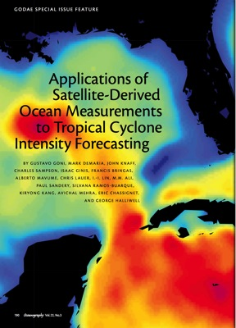
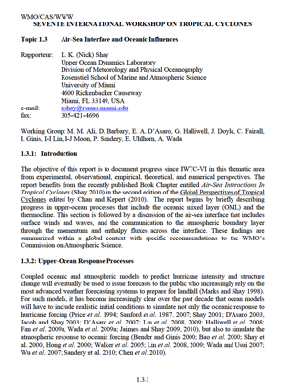

Excellent References
Goni et al 2009: Applications of satellite-derived ocean measurements to tropical cyclone intensity forecasting. Oceanogr., 22, 176-183
Shay 2010: Air-sea interface and oceanic influences (Chapter 1.3). Topic Chairman and Rapporteurs Report for Tropical Cyclone Structure and Structure Change, IWTC-7, WMO TMRP, Geneva, Switzerland
Lin et al 2012: Ocean heat content for tropical cyclone intensity forecasting and its impact on storm surge. Nat. Hazards, 66, 1481-1500

Slide 3
Early Studies:
Palmen (1948), Fisher (1956), Perlroth (1962, 1965) - importance of sea temperatures of 26ºC on TC intensity and air-sea heat and moisture transfer.
Perlroth (1968) related upper ocean thermal structure between the surface and 200-foot levels using historical analyses:
90% reached hurricane status when ΔT < 7ºF (~4ºC);
4% reached hurricane status when ΔT > 15ºF (~8ºC).
Important for two reasons:
  Stratification (i.e. cooling and vertical mixing); and
  Currents (i.e. warm current advection)
Nick Shay UM/RSMAS

Slide 4
Motivation and Background
Ocean Heat Content (OHC)
Minimum sea surface temperature threshold for hurricane formation: SST >26°C (Palmen, 1948)
Leipper (1972) introduced Ocean Heat Content
  Integrated thermal energy from surface to 26° isotherm
Empirical approach to estimate OHC from satellite altimetry (Shay and Brewster, 2010)
Ocean thermal structure is important feedback mechanism (Chang and Anthes, 1978)
Warm core eddies inhibit mixing and provide deep energy source for hurricanes (Shay et al 2000; Jaimes and Shay 2009)
26°
SST
OHC
MLD
D26
Nick Shay UM/RSMAS

Slide 5
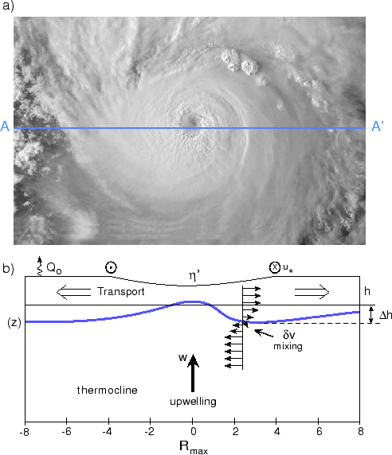
TC – Ocean Response
Idealized ocean response cartoon that includes upwelling due to the divergence of the wind-driven current in the surface mixed layer, current shear central for mixing, SST cooling and, potential feedback
to the storm.
Leaman (1976)
Nick Shay UM/RSMAS

Slide 6
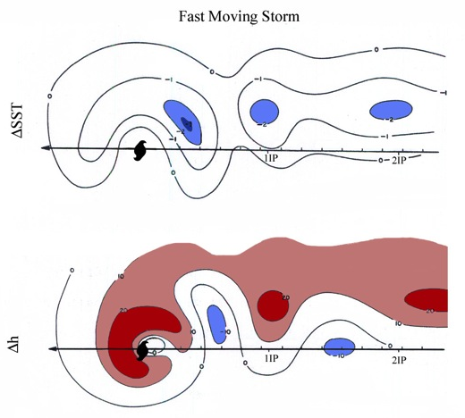
Conceptual Model of OML
Cooling and Deepening
SST cooling (ΔSST) and OML depth change (Δh) relative to the path of a hurricane in Inertial Periods (IP) for fast-moving storms (> 4 m s⁻¹ ) based on AXBT and AIRT data
X
Black (1983)
P. Black, AOML/HRD

Slide 7
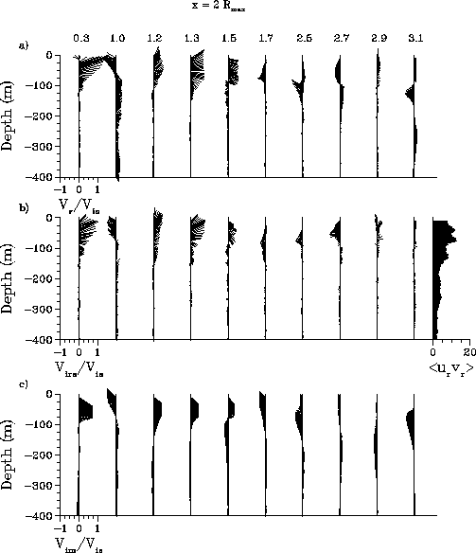
Evolution of SST and OML depth
SST
OML
V(z,t)
Evolution of the SST and OML depth response (left panels) and normalized current structure along 2R_{max} (right panel) from Gilbert measurements (Shay et al 1992).
Nick Shay UM/RSMAS, P. Black, AOML/HRD

Slide 8
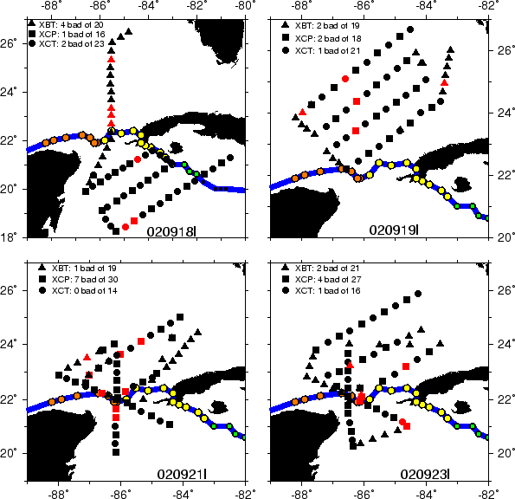
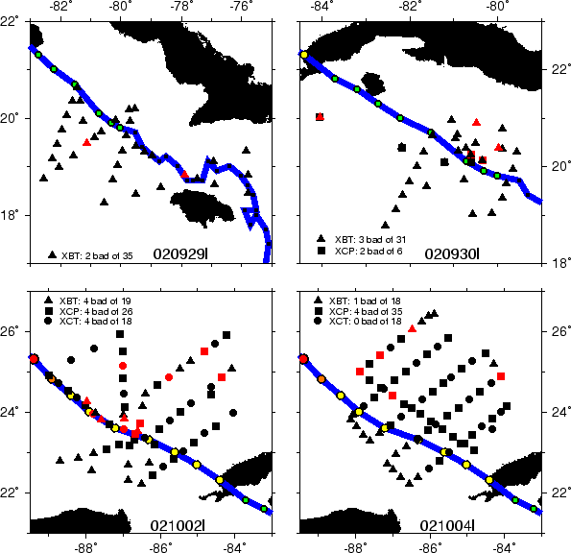
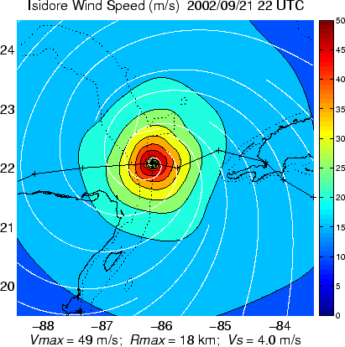
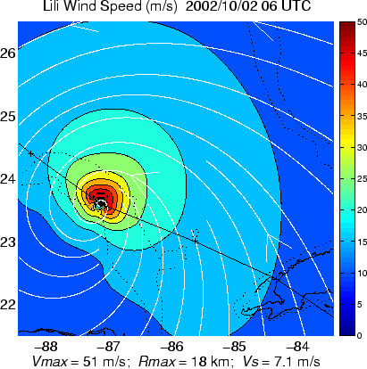
NSF/NOAA Experiments
AXCP/AXCTD/AXBTs (2002)
Isidore Lili
2002
Nick Shay UM/RSMAS, E. Uhlhorn, AOML/HRD

Slide 9
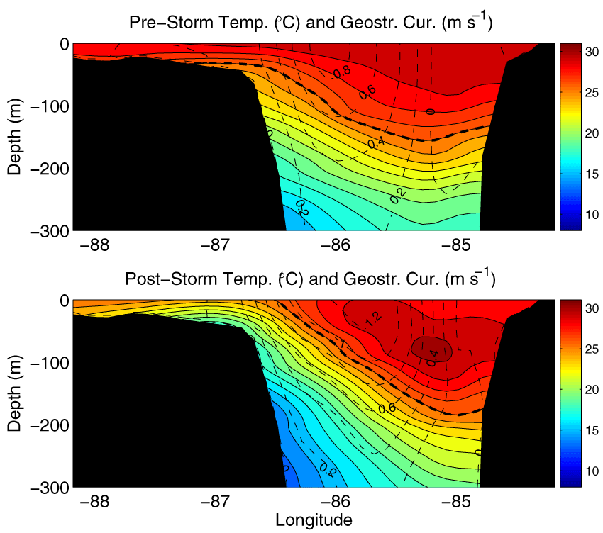
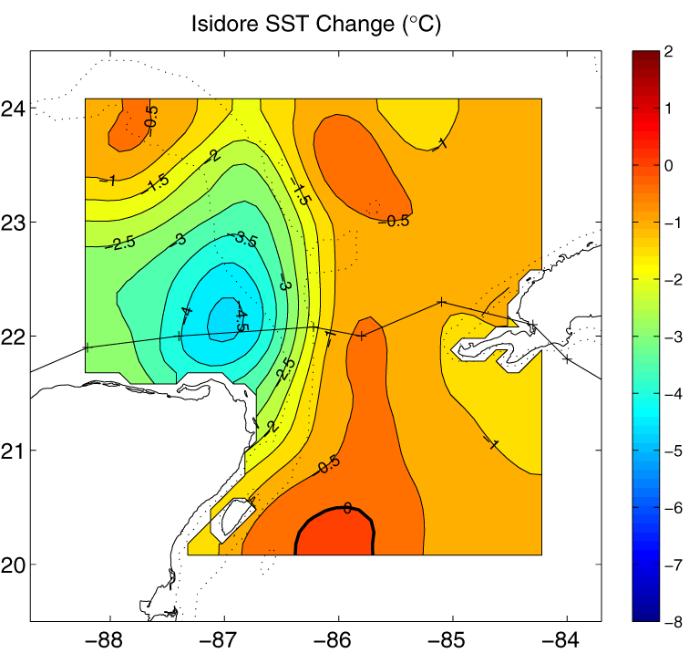
T(x,z) and V(x,z) Section SST Change along 22ºN
NSF/NOAA Experiments
AXCP/AXCTD/AXBTs (2002)
>4.5ºC
<1ºC
Isidore & Lili 2002
Nick Shay UM/RSMAS, E. Uhlhorn, AOML/HRD

Slide 10
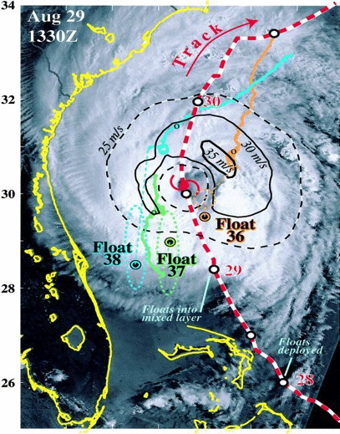
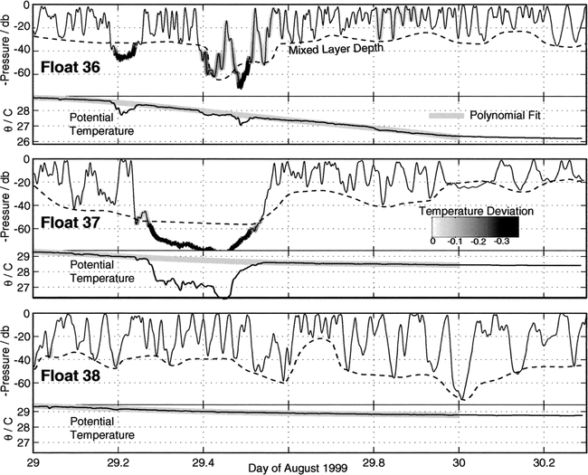
Hurricane Dennis Mixed Layer Floats:(D’Asaro 2003)
E. D’Asaro U. Washington/APL

Slide 11
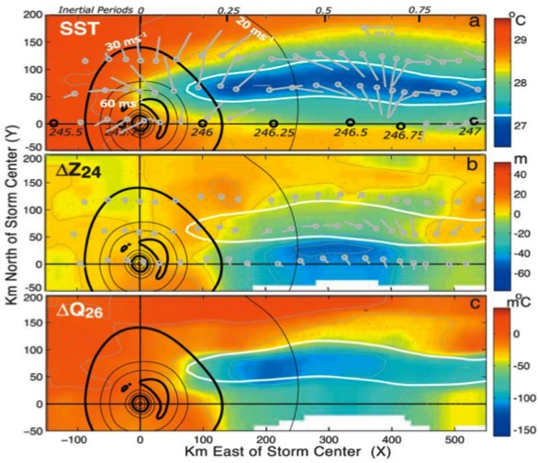
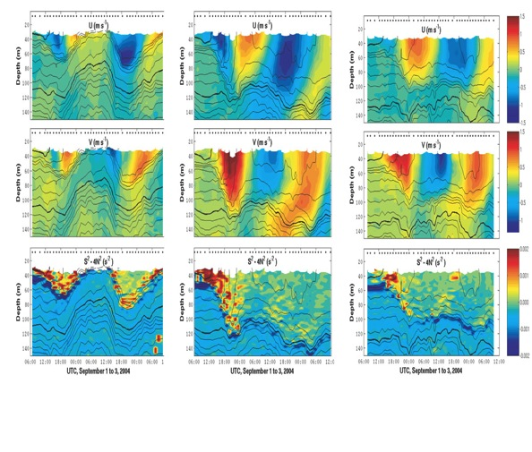
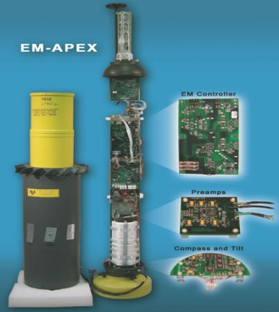
EM APEX Floats Deployed in Frances (2004): ONR CBLAST
0 Rmax
1 Rmax
2 Rmax
Sanford et al (2006)
P. Black, T. Sanford, E. D’Asaro, CBLAST High-wind Upper Ocean Team

Slide 12
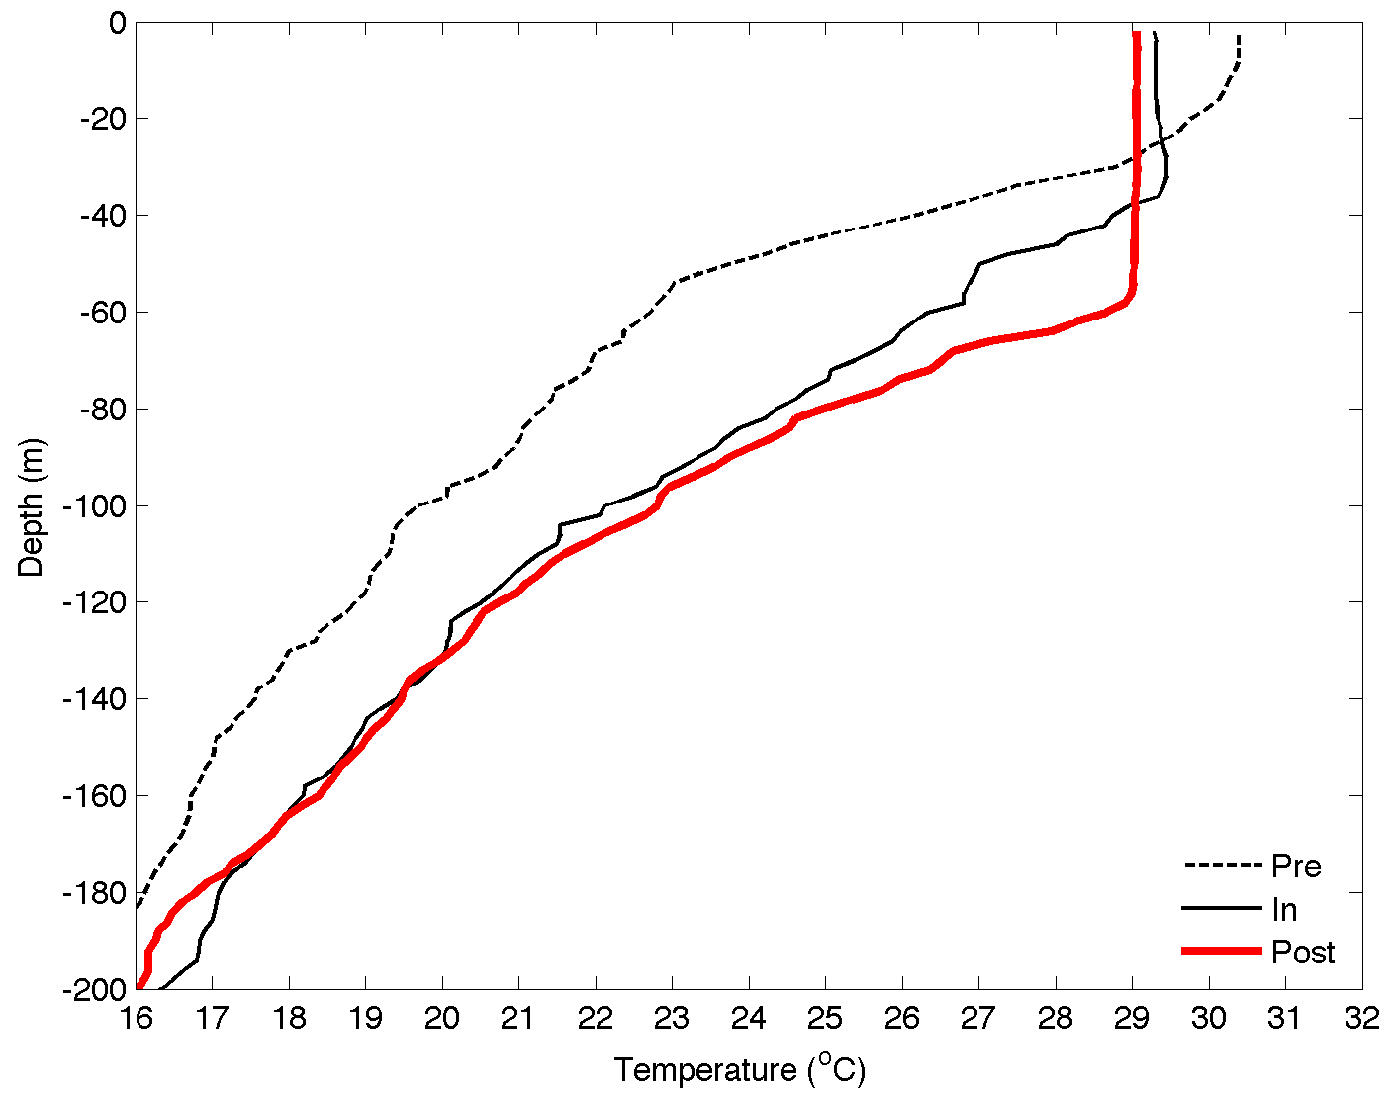
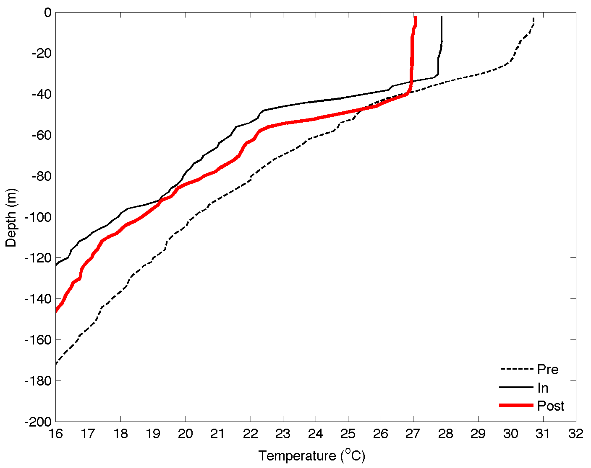
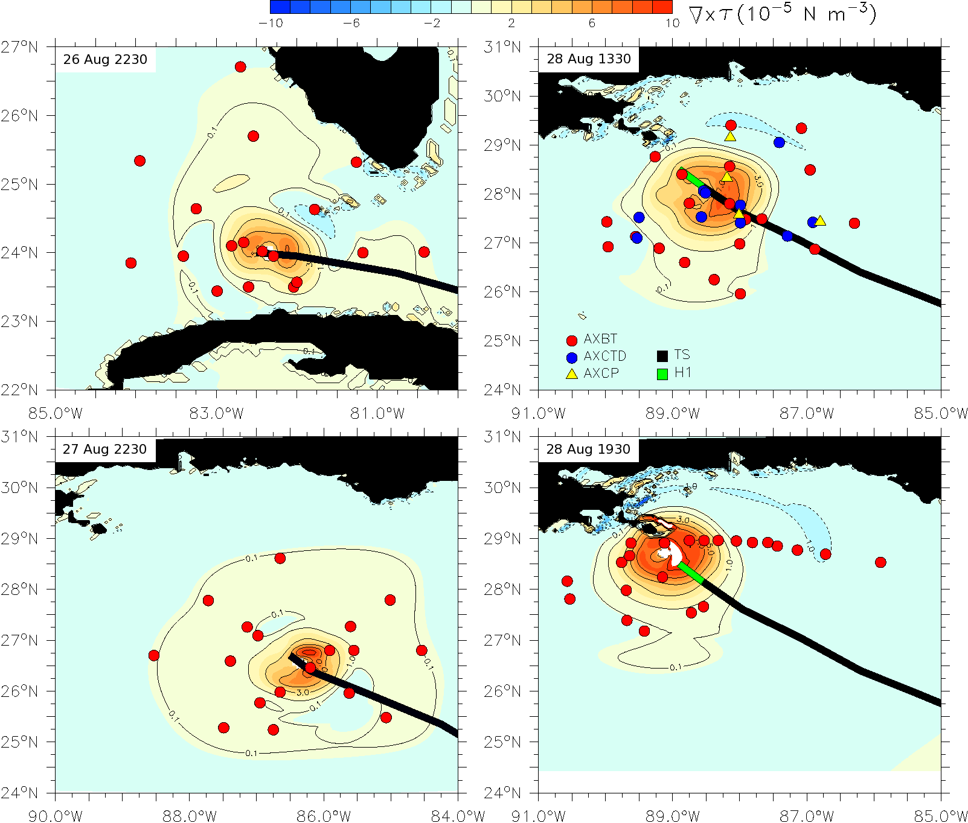
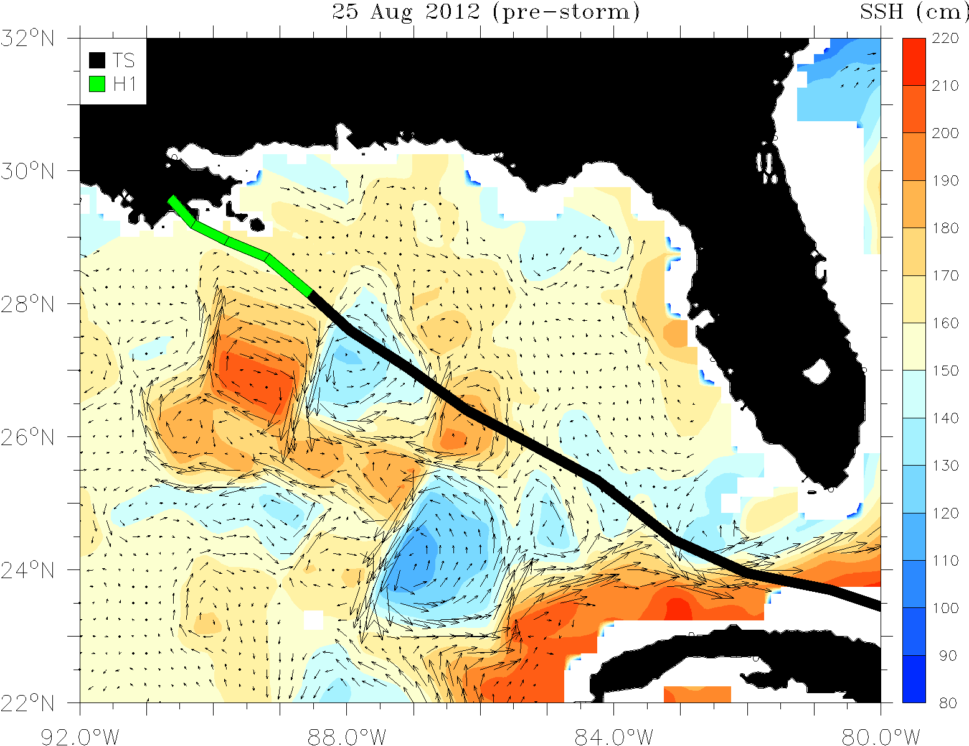
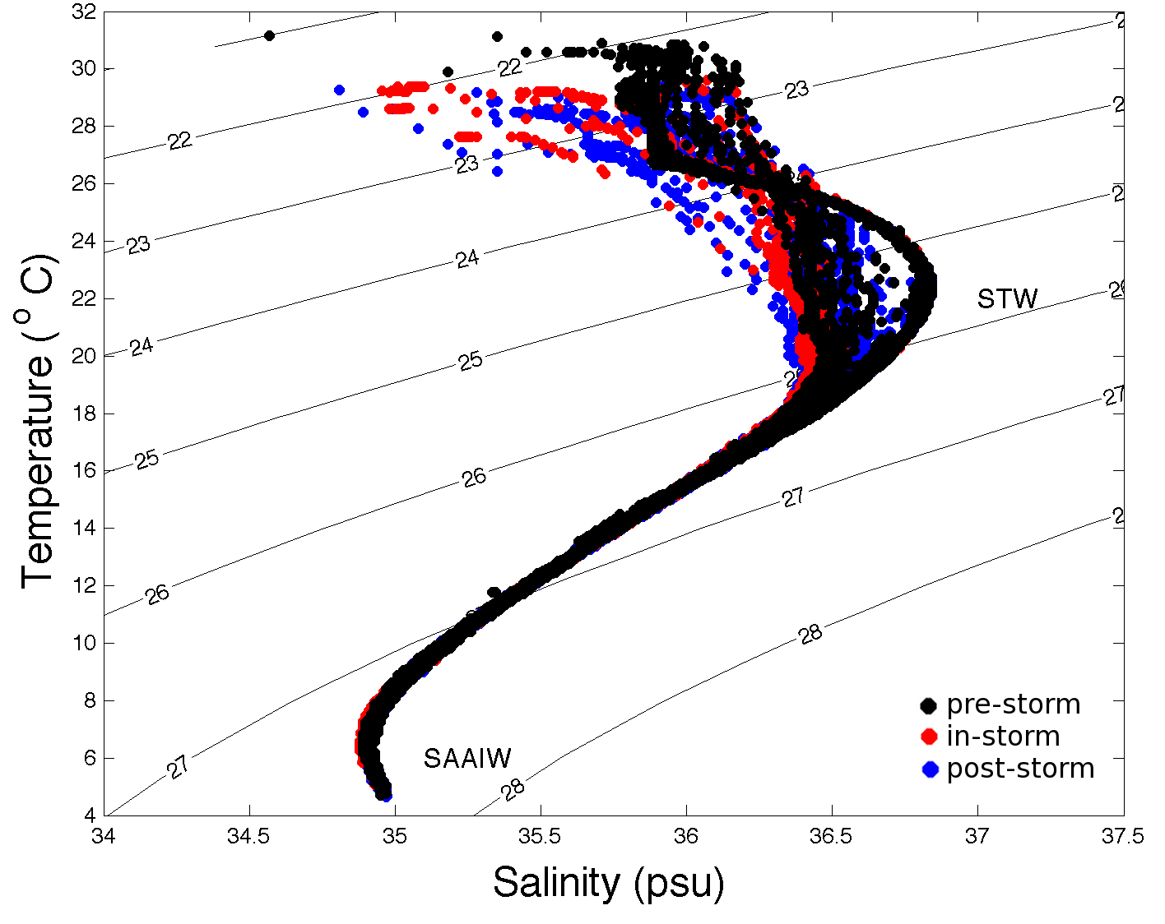
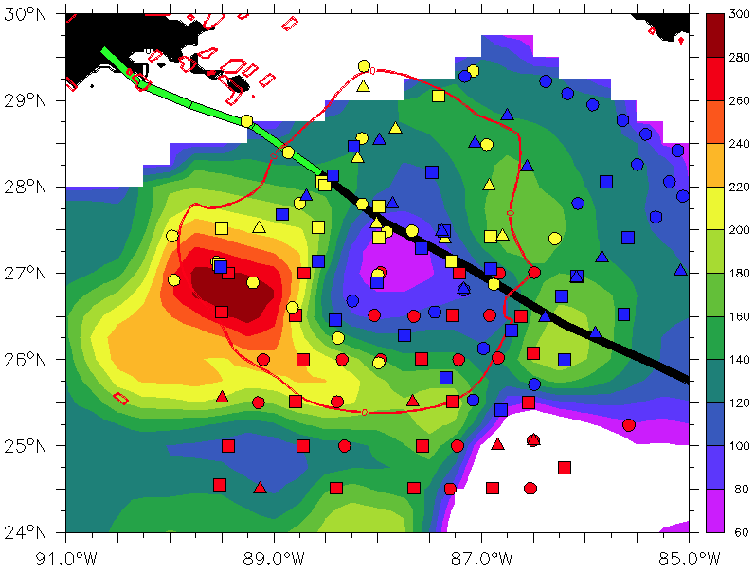
HFIP & NSF Experiments
AXCP/AXCTD/AXBTs (2012)
Downwelling
Water mass evolution during Isaac
Upwelling
TC impact on upper ocean effect of Hurricane Isaac (2012)
Nick Shay UM/RSMAS, E. Uhlhorn, AOML/HRD, R. Lumpkin AOML/PhOD
Notes:
Drifter array in Gustav and Ike were placed by AFRC WC-130 ahead of storm. Gustav array still functioning when Ike was crossing Gulf. Also deployed AXBT grid post-Gustave which proved to be pre-Ike, followed by in storm Ike AXBT drops and post-Ike array. Revealed warm eddy and cold eddy left behind from Gustav interactions with Loop current.
Upper right picture shows sea-height anomaly (color) with superposition of Ike track and radii of hurricane (red circle) and storm force (yellow circle )winds. Black curly lines are tracks of Gustav drifters and circles are planned deployment locations for Ike drifters and floats. Thin black line shows P-3 track during pre-Ike AXBT pattern. Dropped over 300 AXBTs in Gustav and Ike.

Slide 13
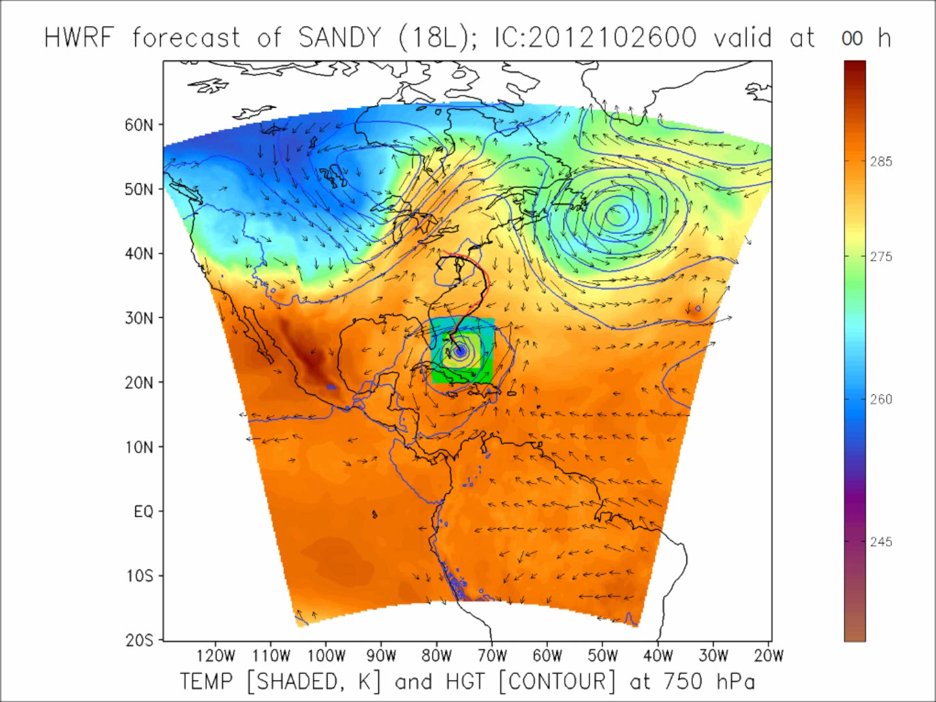
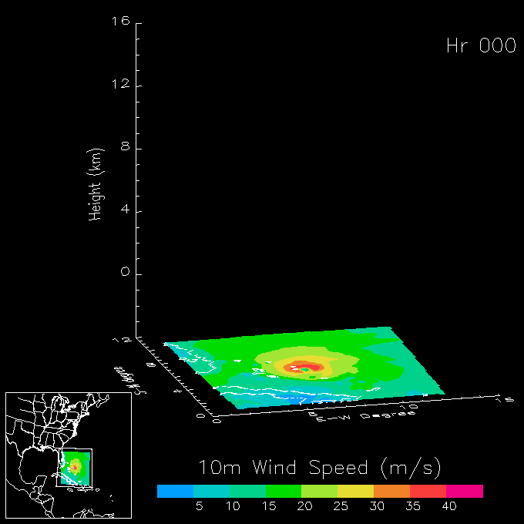
Regional Model Development:
HWRF
HWRF operational (27/9/3 km)
  Advanced nesting algorithm with resolution to 3 km
  Viable operational pathway with transition to operations
  Pathway to improved structure and intensity predictions
  Initialization algorithm at 3 km resolution
http://www.emc.ncep.noaa.gov/gc_wmb/vxt/
HWRF Model Team - Gopal, X. Zhang (HRD), V. Tallapragada, S. Trahan (EMC)
Notes:
Demo 2011 season; Not only we have improved the products but also added a suite of NOAA HWRF systems at different configurations.
Example of Hurricane Dora 2004 (initialized at 18Z on 18 July 2011)
Top left: 10-m wind swath for 126 h forecast
Bottom left: time-height cross section of mean wind over 3 km nest centered on storm
Top right: storm-relative vertical wind shear on 3-km nest for 24 h and 30 h forecast – note decreasing NE shear over center
Bottom right: SHIPS type predictors for regional model
Overlay: moving 3-km inner nest showing 10-m wind evolution
Model products available at: http://storm.aoml.noaa.gov/realtime

Slide 14
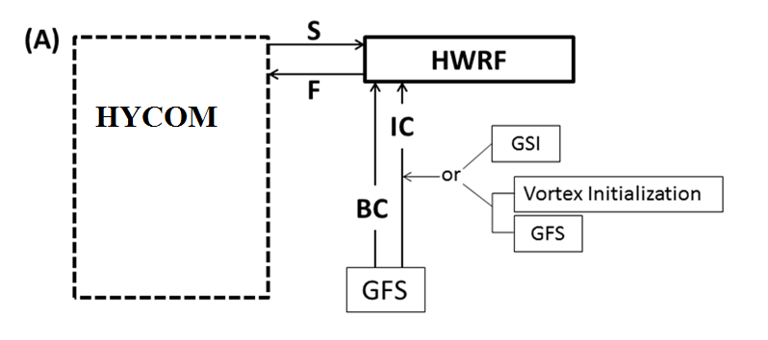
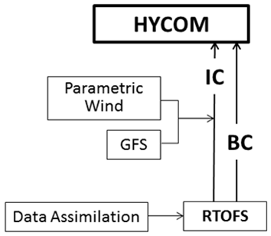
Improved Models & Data:
HYCOM-HWRF (HY-HWRF)
  HYCOM:
    IC/BC – real-time & data assimilated fields
    Δx/Δy=9 km
    32 hybrid layers
    Relatively finer resolution of MLD - 1 m, 4 m, …
    KPP mixing
Hyun-Suk Kim (EMC)
Notes:
See papers: Zhang et al (2011) - http://www.agu.org/pubs/crossref/2011/2011GL048469.shtml
Aksoy et al (2012) - http://dx.doi.org/10.1175/MWR-D-11-00212.1

Slide 15
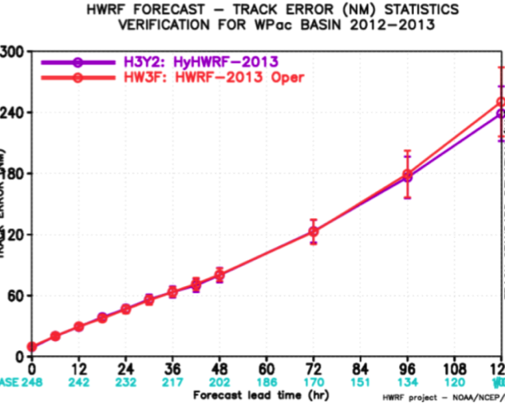
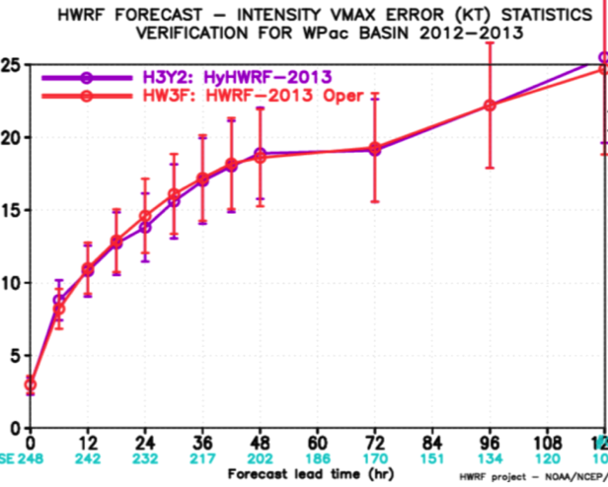
Improved Models & Data:
HYCOM-HWRF (HY-HWRF)
2012:
Guchol (05W), Talim (06W), Saola (10W), Tembin (15W), Bolaven (16W), Sanba (17W), Jelawat (18W)
2013:
Yagi (03W), Rumbia (06W), Soulik (07W), Cimaron (08W)
Track Error (nm)
Intensity Error (kt)
Typhoon Forecasts for 2012-2013: Intensity (248 cases)
Hyun-Suk Kim (EMC)
Notes:
See papers: Zhang et al (2011) - http://www.agu.org/pubs/crossref/2011/2011GL048469.shtml
Aksoy et al (2012) - http://dx.doi.org/10.1175/MWR-D-11-00212.1

Slide 16
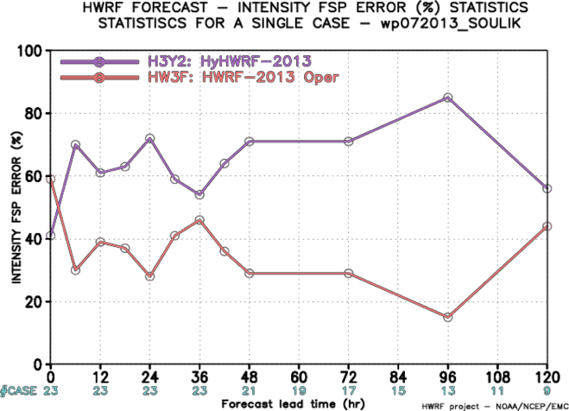
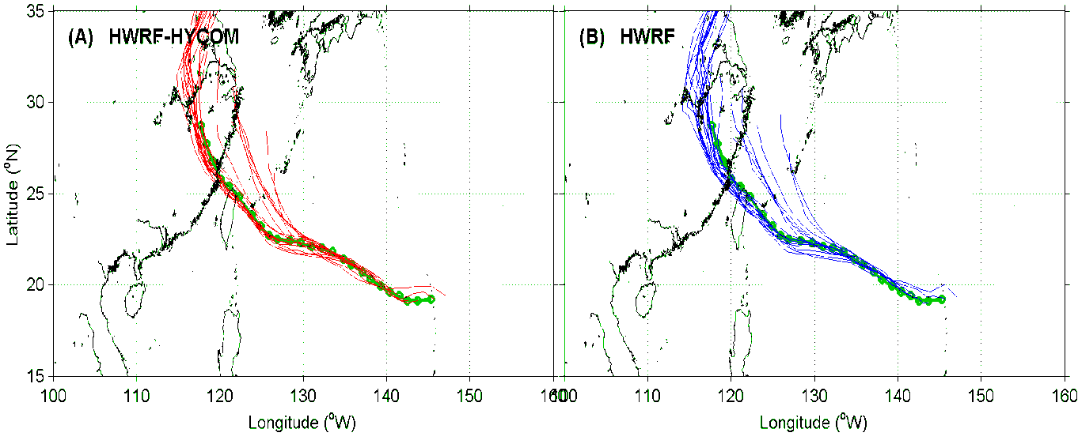
Improved Models & Data:
HYCOM-HWRF (HY-HWRF)
Soulik 07W
Hyun-Suk Kim (EMC)
Notes:
See papers: Zhang et al (2011) - http://www.agu.org/pubs/crossref/2011/2011GL048469.shtml
Aksoy et al (2012) - http://dx.doi.org/10.1175/MWR-D-11-00212.1

Slide 17
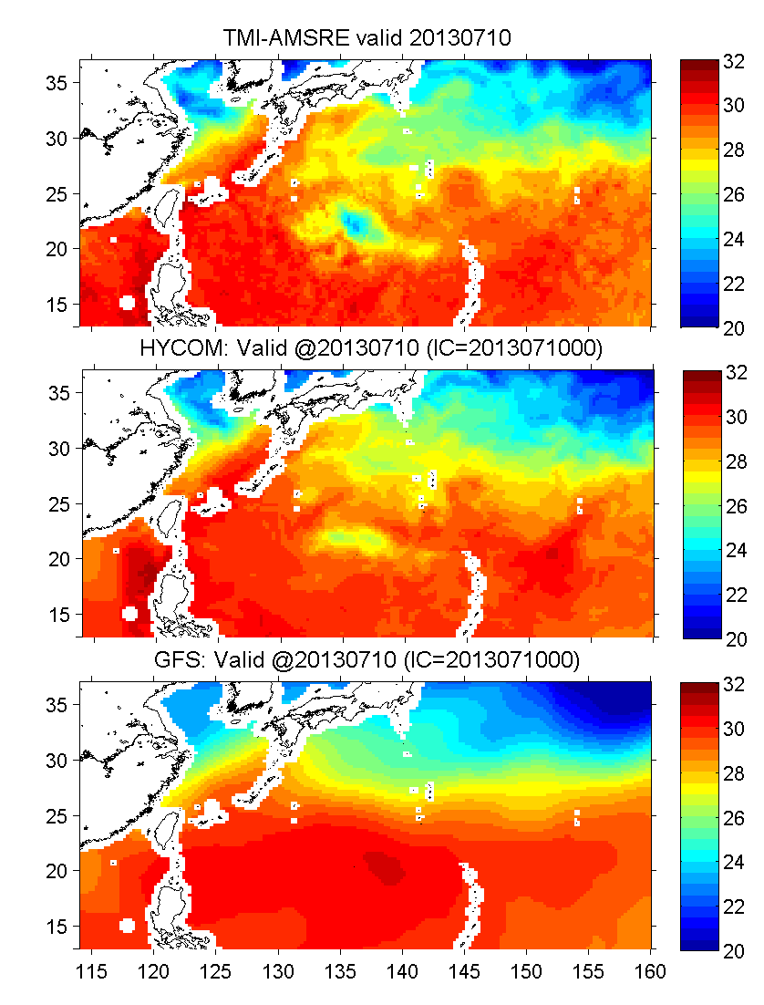
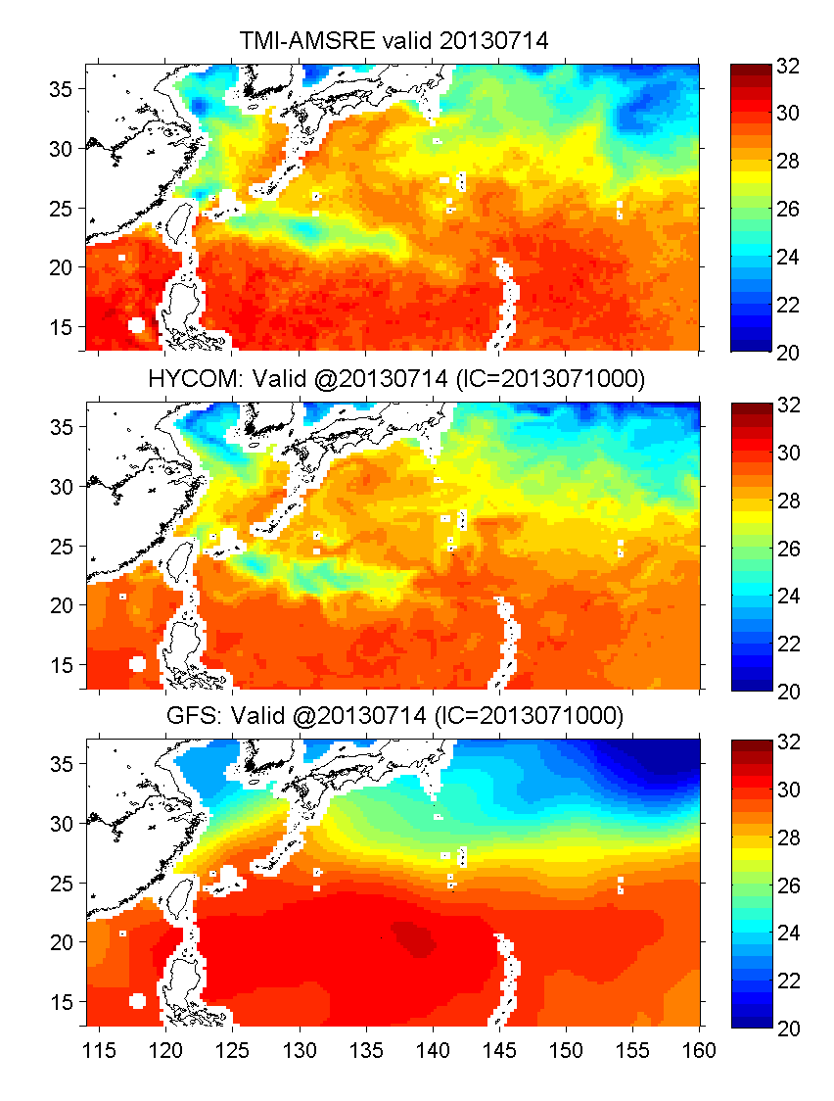
Improved Models & Data:
HYCOM-HWRF (HY-HWRF)
Obs.
HYCOM
GFS
Soulik 07W
Hyun-Suk Kim (EMC)
Notes:
See papers: Zhang et al (2011) - http://www.agu.org/pubs/crossref/2011/2011GL048469.shtml
Aksoy et al (2012) - http://dx.doi.org/10.1175/MWR-D-11-00212.1

Slide 18
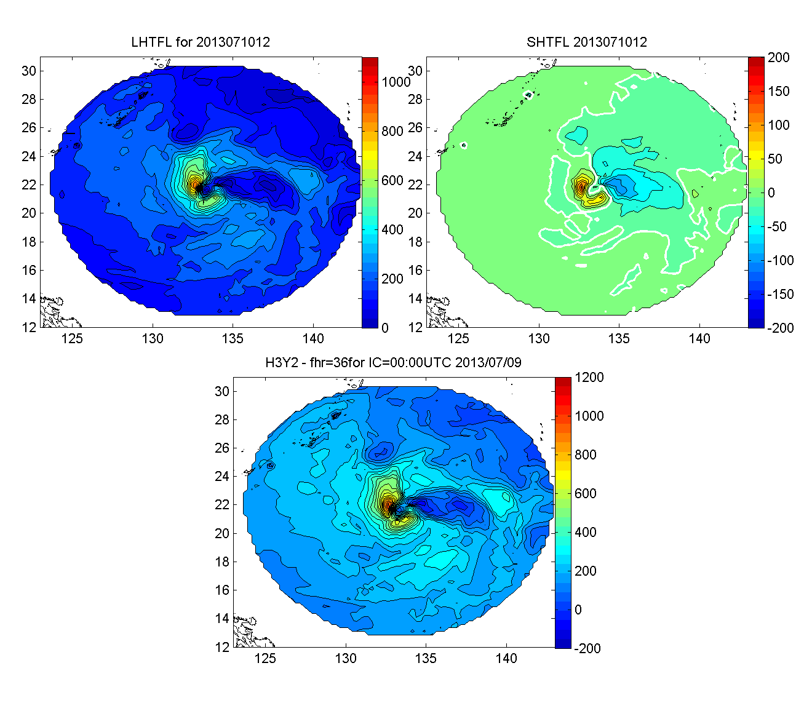
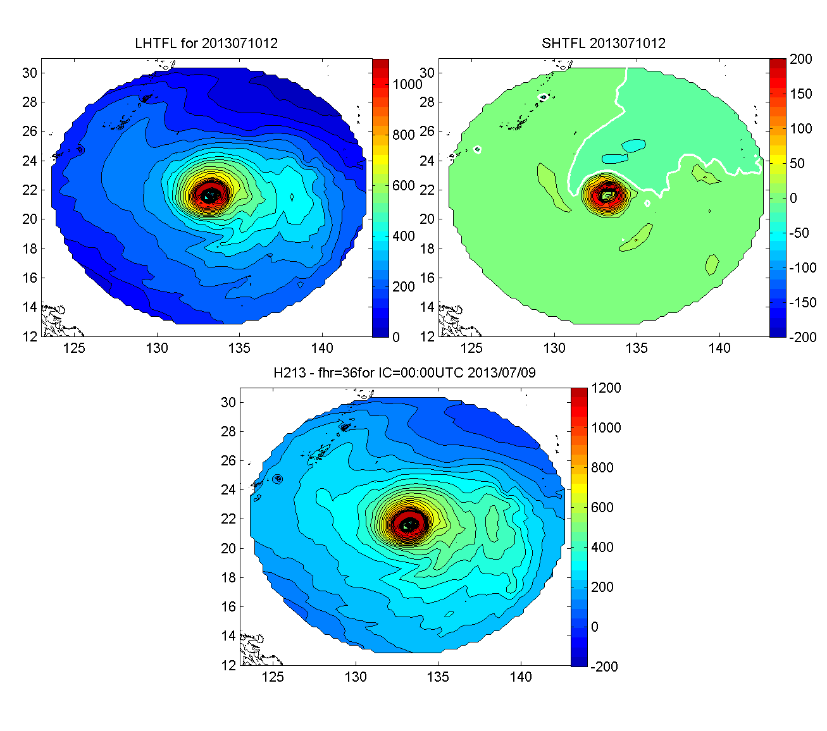
Improved Models & Data:
HYCOM-HWRF (HY-HWRF)
HWRF-HYCOM HWRF
LH
SH
LH
SH
Soulik 07W
C=6 m s⁻¹
Total
Total
1-2. Storm size and asymmetric wind pattern
Hyun-Suk Kim (EMC)
Notes:
See papers: Zhang et al (2011) - http://www.agu.org/pubs/crossref/2011/2011GL048469.shtml
Aksoy et al (2012) - http://dx.doi.org/10.1175/MWR-D-11-00212.1

Slide 19
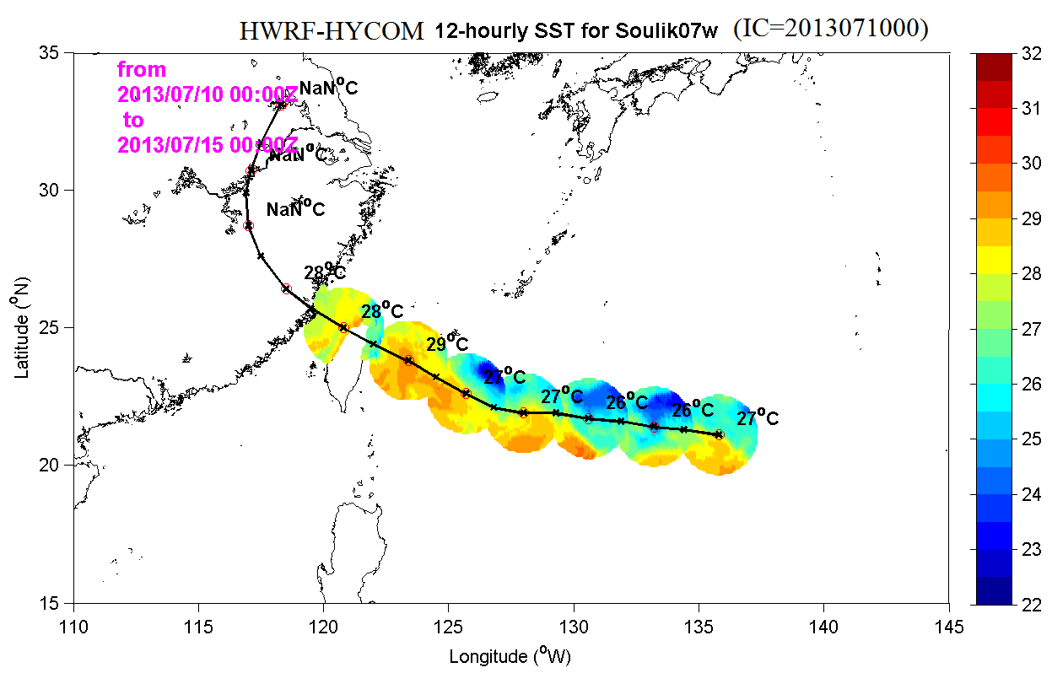
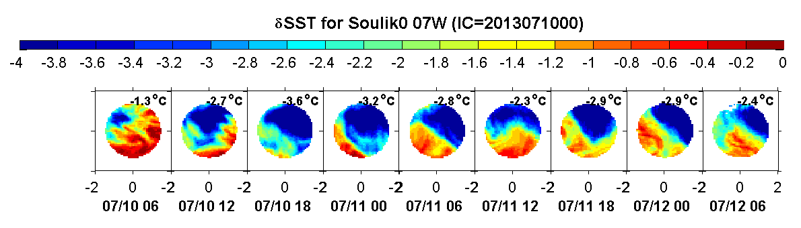
Improved Models & Data:
HYCOM-HWRF (HY-HWRF)
Soulik 07W
SST footprint at 12-h intervals w/
areal means.
SST cooling at time of storm passing
(=SST_{storm}– SST_{init})
Hyun-Suk Kim (EMC)
Notes:
See papers: Zhang et al (2011) - http://www.agu.org/pubs/crossref/2011/2011GL048469.shtml
Aksoy et al (2012) - http://dx.doi.org/10.1175/MWR-D-11-00212.1

Slide 20
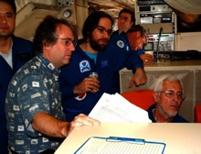


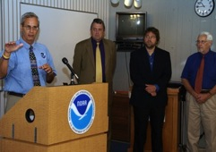

HFIP Keys to Success
  Partnership: NOAA Research working closely with:
    NOAA Operations (EMC, NHC, AOC)
    Federal & Academic Partners (NASA, NCAR, NRL, NSF, ONR)
  More integrated use & support of Testbeds
  Blend traditional approach and HFIP (applied) research activities
  Manpower (diversity) to evaluate model performance with hurricane data sets is a critical need
CBLAST
IFEX/RAINEX
IFEX/TCSP
IFEX/PREDICT/GRIP
Hybrid-DA Workshop

Slide 21
Questions?

