Slide 1


Advancing Tropical Cyclone Forecasts Using Observations
Frank Marks
NOAA/AOML Hurricane Research Division
22 October 2013
Notes:
NOAA P-3 and G-IV aircraft

Slide 2



Excellent References
Dorst, N. M., 2007: The National Hurricane Research Project: 50 Years of Research, Rough Rides, and Name Changes. Bull. Amer. Meteor. Soc., 88, 1566–1588.
Aberson, S. D., M. L. Black, R. A. Black, R. W. Burpee, J. J. Cione, C. W. Landsea, and F. D. Marks, 2006: Twenty-five years of tropical cyclone research with the NOAA P-3 aircraft. Bull. Amer. Meteor. Soc., 87, 1039–1055.

Slide 3
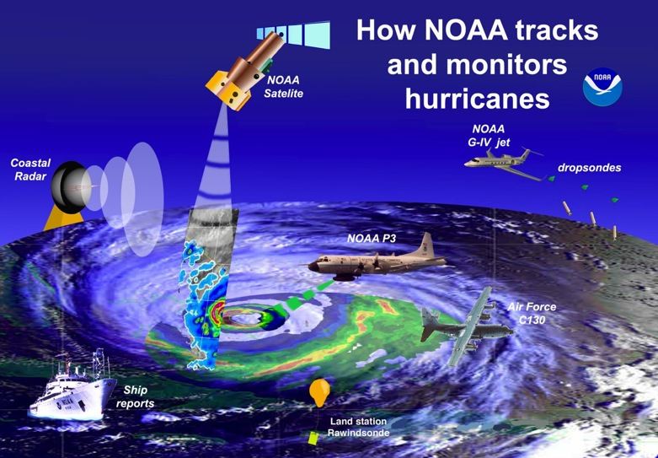
U.S. TC Observing Network

Slide 4
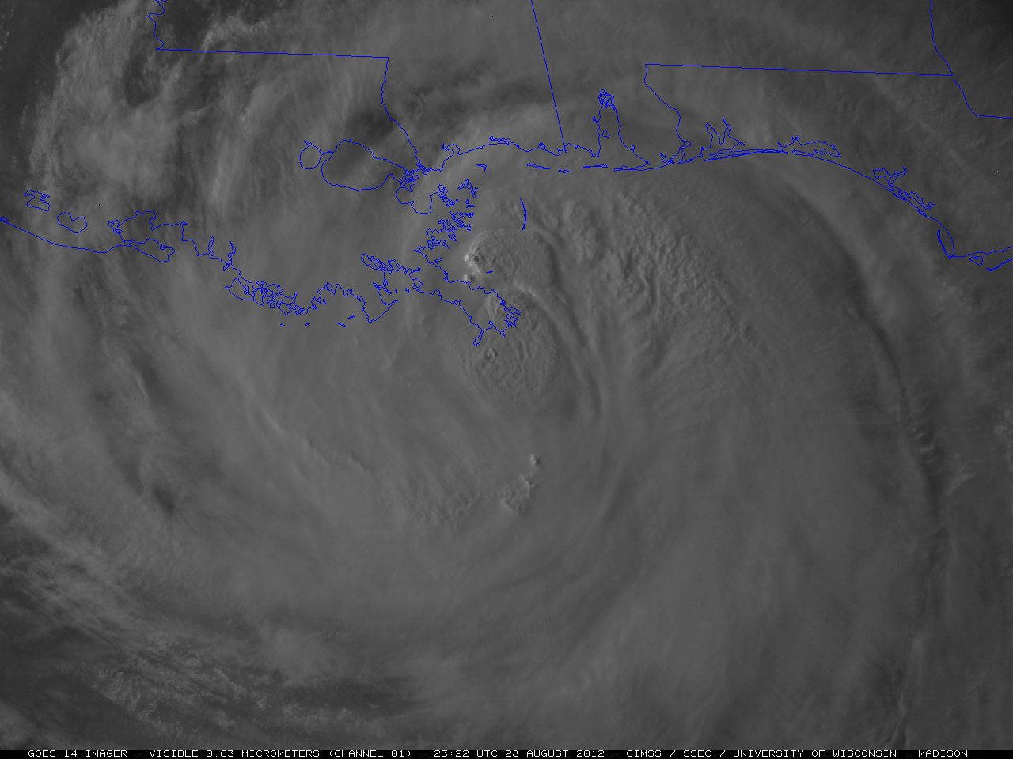
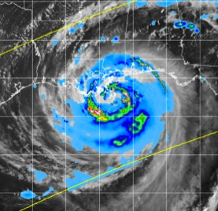
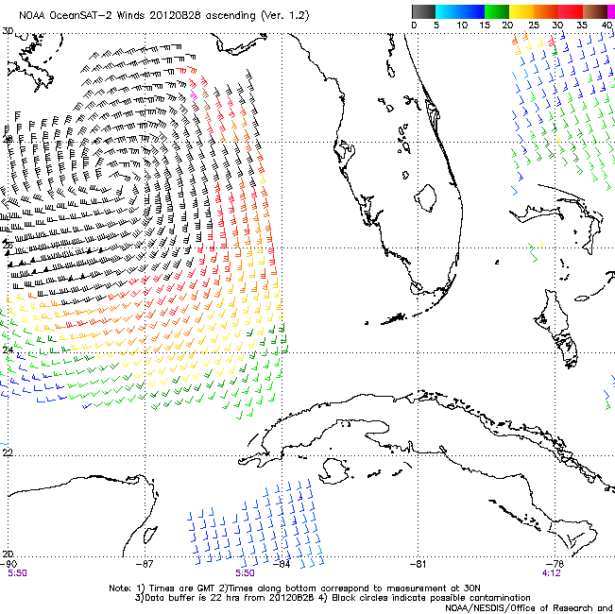
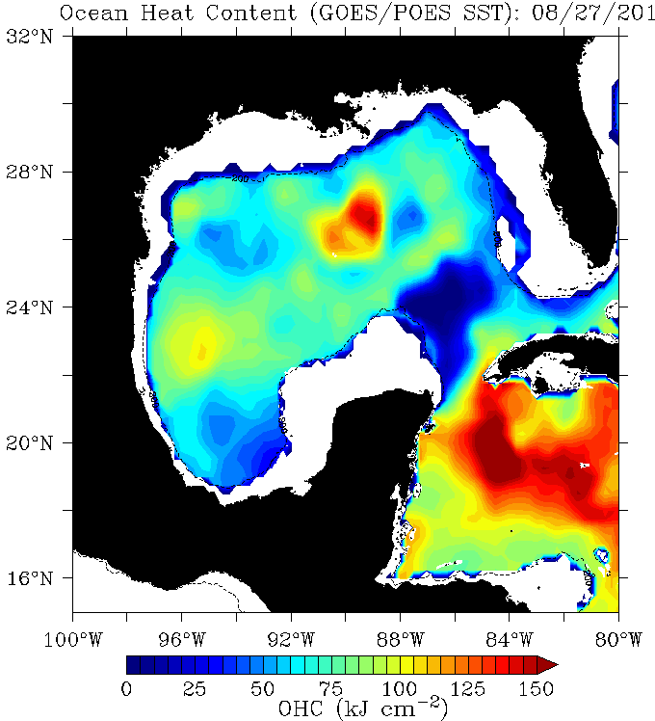
Satellite Tools:
GOES Imagery
  convective evolution
  eye structure
SSM/I and TRMM
  Rainfall
  wind speed
Scatterometry
  wind fields
Altimetry
  OHC
Notes:
UL: TRMM rain Tropical Storm Isaac 2012
UR: Visible image from Tropical Storm Isaac 2012
LL: OHC product for GOM Tropical Storm Isaac 2012
LR: OSCAT wind vectors from Tropical Storm Isaac 2012

Slide 5
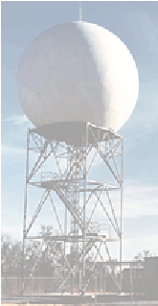
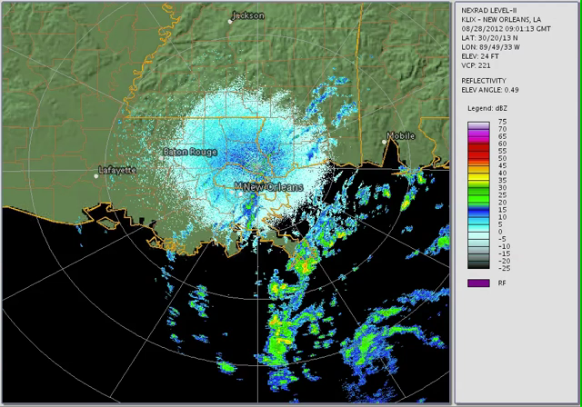
Land based Tools: Radar
Reflectivity
  Tracking
  Rainfall
Velocity
  Tracking
  Windfield
ABL structure
  VAD mean profiles
  horizontal structure
Hurricane Isaac,
0900 Z 28 August – 2230Z 29 August 2012
Notes:
Hurricane Isaac LIX WSR-88D animation 09 UTC 28 August to 2230 UTC 29 August
Stage IV rain accumulation (144 h) 00 UTC 25 August – 23 UTC 31 August 2012

Slide 6
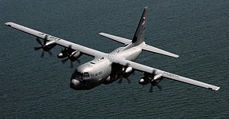
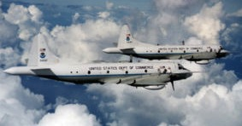

Aircraft Tools
10 USAF Reserves C-130Js
2 NOAA P-3s
1 NOAA Gulfstream-IV
USAF 53WRS: $30M per year
NOAA: ~$1M per year

Slide 7
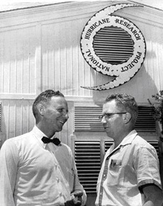
National Hurricane Research Project
1956-1960
Study hurricane formation
Study hurricane structure and dynamics
Seek means for hurricane modification
Seek means for improvement of forecasts
NHRP, 1959
NHRP used two WB-50s and a WB-47 aircraft, provided and operated by U.S. Air Force Air Weather Service.
Weather Bureau supplied instrumentation, and NHRP participated in missions in 1956-1958 hurricane seasons.
Notes:
UR - Bob Simpson and Cecil Gentry outside the Research Operations Base, West Palm Beach, FL, 1956. [Source: NOAA.]
Simpson, R. H., 1998: Stepping Stones in the Evolution of a National Hurricane Policy. Wea. Forecasting, 13, 617–620.
doi: http://dx.doi.org/10.1175/1520-0434(1998)013<0617:SSITEO>2.0.CO;2

Slide 8
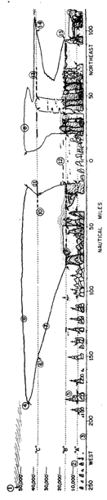
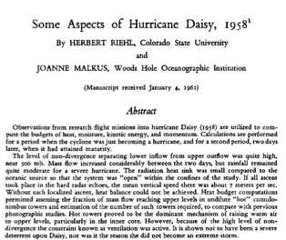
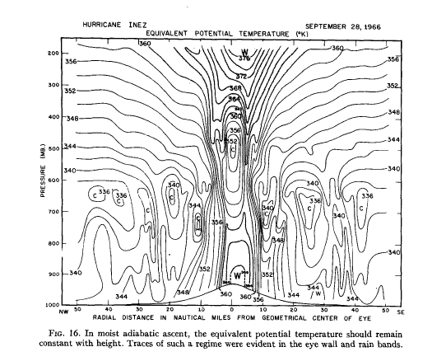
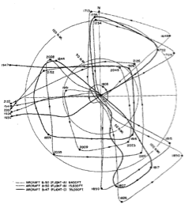
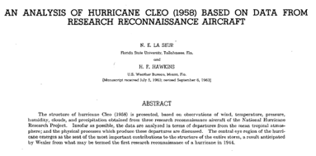
NHRP Discoveries
Notes:
UR - Riehl, H., and J. S. Malkus, 1961: Some aspects of Hurricane Daisy 1958. Tellus, 13, 181–211.
BR - N. E. LaSeur and H. F. Hawkins, “An Analysis of Hurricane Cleo (1958) Based on Data From Research Reconnaissance Aircraft,” Monthly Weather Review, vol. 91, No. 10, 0ct.-Dec. 1963, pp. 694-709. doi: http://dx.doi.org/10.1175/1520-0493(1963)091<0694:AAOHCB>2.3.CO;2

Slide 9

NOAA WP-3Ds (1976-today)
Notes:
See Jorgensen, David F., 1984a: Mesoscale and Convective-Scale Characteristics of Mature Hurricanes. Part I: General Observations by Research Aircraft. J. Atmos. Sci., 41, 1268–1286.
doi: http://dx.doi.org/10.1175/1520-0469(1984)041<1268:MACSCO>2.0.CO;2
For information on WP-3D instrumentation

Slide 10
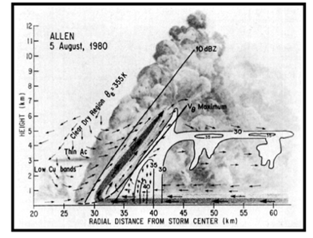
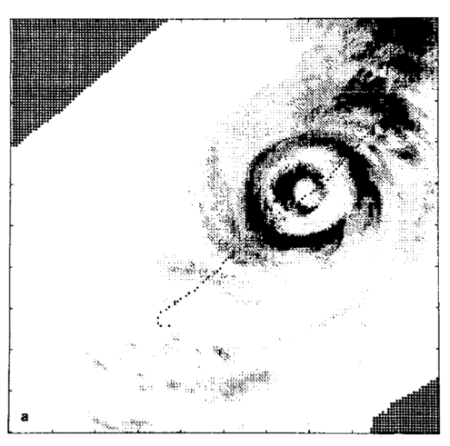
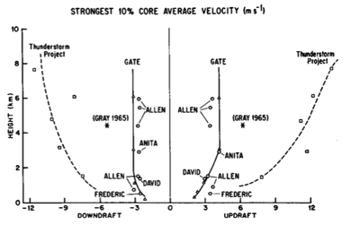
Inner core structure
Jorgensen (1984)
Weak updrafts & little supercooled water
Eyewall Replacement
Willoughby et al (1982)
Jorgensen et al (1985)
Notes:
UL – Fig. 19, Jorgensen, David P., 1984b: Mesoscale and Convective-Scale Characteristics of Mature Hurricanes. Part II. Inner Core Structure of Hurricane Allen (1980). J. Atmos. Sci., 41, 1287–1311.
doi: http://dx.doi.org/10.1175/1520-0469(1984)041<1287:MACSCO>2.0.CO;2
LL – Fig. 8, Jorgensen, David P., Edward J. Zipser, Margaret A. LeMone, 1985: Vertical Motions in Intense Hurricanes. J. Atmos. Sci., 42, 839–856.
doi: http://dx.doi.org/10.1175/1520-0469(1985)042<0839:VMIIH>2.0.CO;2
R – Fig. 5, Willoughby, H. E., J. A. Clos, M. G. Shoreibah, 1982: Concentric Eye Walls, Secondary Wind Maxima, and The Evolution of the Hurricane vortex. J. Atmos. Sci., 39, 395–411.
doi: http://dx.doi.org/10.1175/1520-0469(1982)039<0395:CEWSWM>2.0.CO;2

Slide 11

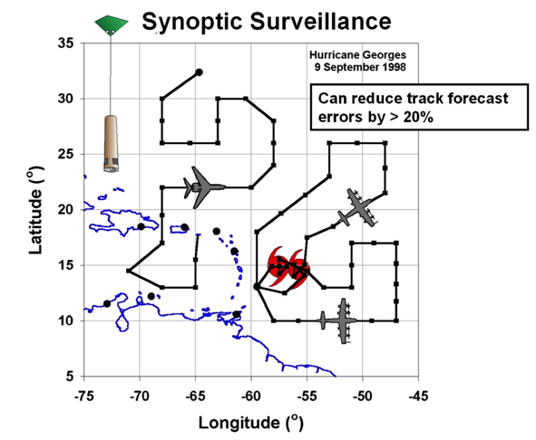
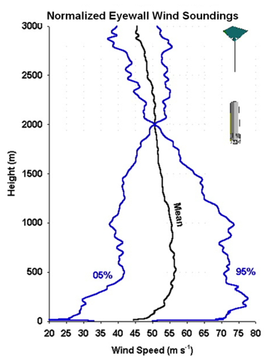
GPS Dropwindsondes
S. Aberson, AOML/HRD, J. Franklin NHC

Slide 12
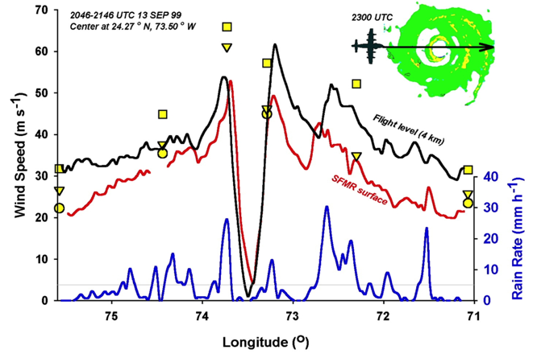
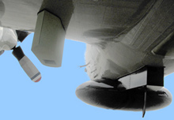
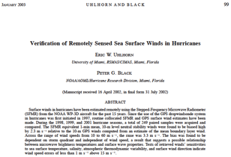
Stepped Frequency Microwave Radiometer (SFMR)
E. Uhlhorn, AOML/HRD

Slide 13
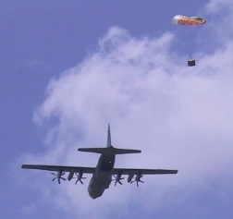

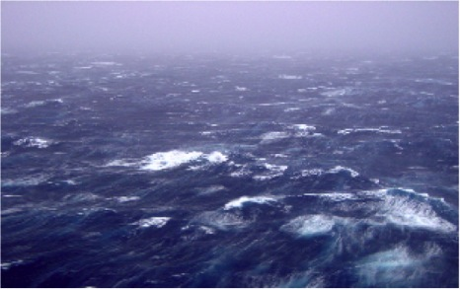
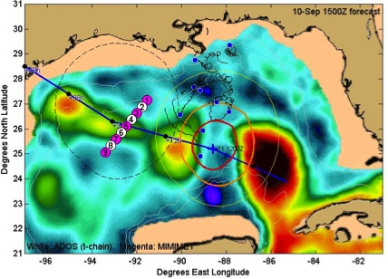
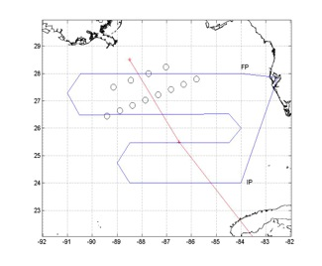
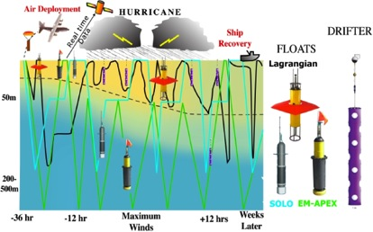
Airborne Oceanography:
TC impact on upper ocean effect of Hurricanes Gustav and Ike (2008)
Targeted upper ocean observations
CBLAST
Waves from 200’ in Isabel
Nick Shay UM/RSMAS, E. Uhlhorn, AOML/HRD, R. Lumpkin AOML/PhOD
Notes:
Drifter array in Gustav and Ike were placed by AFRC WC-130 ahead of storm. Gustav array still functioning when Ike was crossing Gulf. Also deployed AXBT grid post-Gustave which proved to be pre-Ike, followed by in storm Ike AXBT drops and post-Ike array. Revealed warm eddy and cold eddy left behind from Gustav interactions with Loop current.
Upper right picture shows sea-height anomaly (color) with superposition of Ike track and radii of hurricane (red circle) and storm force (yellow circle )winds. Black curly lines are tracks of Gustav drifters and circles are planned deployment locations for Ike drifters and floats. Thin black line shows P-3 track during pre-Ike AXBT pattern. Dropped over 300 AXBTs in Gustav and Ike.

Slide 14

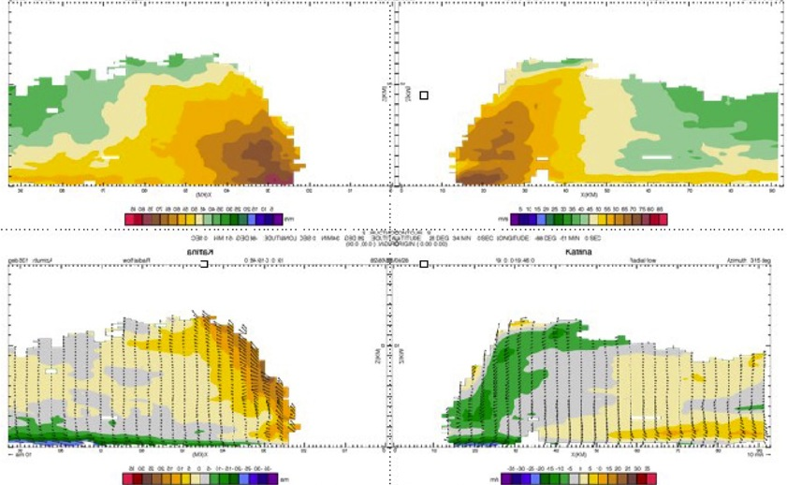
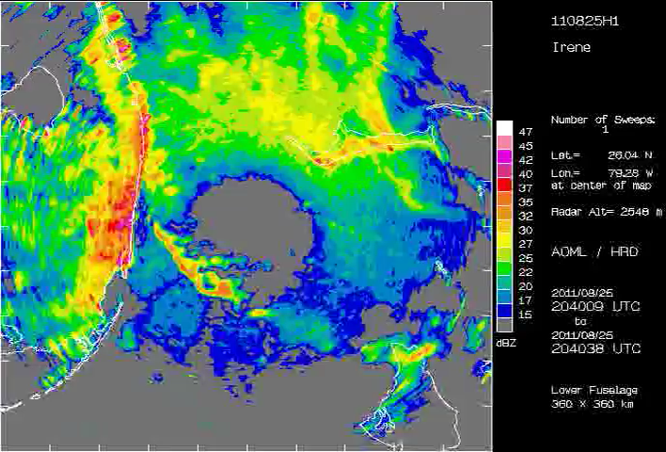
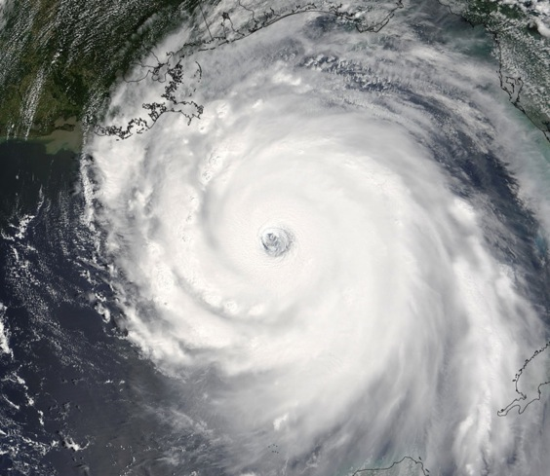
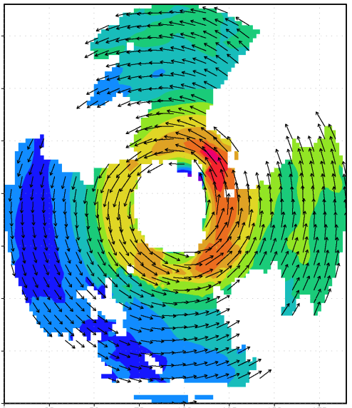

Airborne Doppler Radar
Airborne Doppler-analyzed wind field Hurricane Katrina, 28 September 2005
V_{q}
150
100
distance (km)
V_{r}, w
50
0
0
50
100
150
distance (km)
John Gamache, AOML/HRD
Notes:
Doppler Analyses from Hurricane Katrina 28 August 2005
For more background on airborne Doppler radar observations in hurricanes:
Marks, F. D., 2003: State of the Science: Radar View of Tropical Cyclones. Radar and Atmospheric Science: A Collection of Essays in Honor of David Atlas, Edited by R. M Wakimoto and R. C. Srivastava, Meteorological Monographs, 52, AMS, Boston, MA, 33-74.

Slide 15

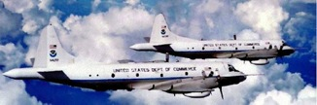

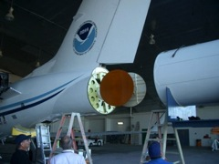

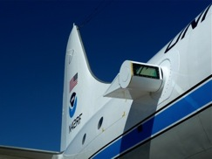
Improved Use of Observations:
Intensity Forecast Experiment (IFEX)
In-situ
  Wind, press., temp.
Expendables
  Dropsondes
  AXBT, AXCP, buoy
Remote Sensors
  Doppler Radar
  SFMR/HIRAD
  WSRA
  Scatterometer/profiler
  UAS - LALE
Improve prediction of TC intensity change by:
  collecting observations through the TC life cycle
  developing and refining measurement technologies
  improving understanding of physical processes important in TC intensity change
NASA Global Hawk
G-IV Tail Doppler Radar
ONR DWL
R. Rogers, S. Murillo, P. Reasor (AOML/HRD)
Notes:
UR image depicts dropsonde profiles in eyewall of Hurricane Guillermo (1997)
LR image is Doppler Wind Lidar profiles from TCS-08
See IFEX paper (Rogers et al 2006): http://dx.doi.org/10.1175/BAMS-87-11-1523
HRD IFEX website: http://www.aoml.noaa.gov/hrd/HFP2011/index.html

Slide 16
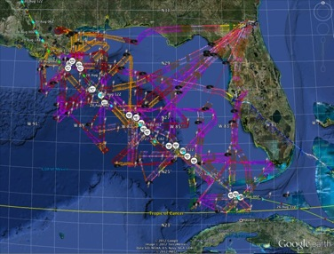
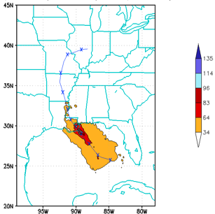
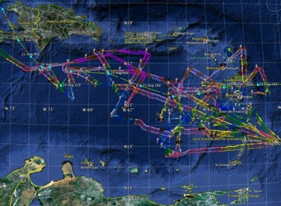
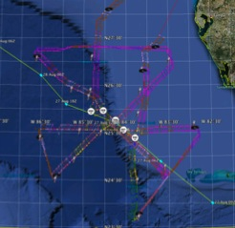
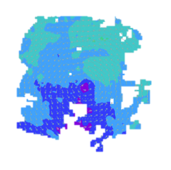
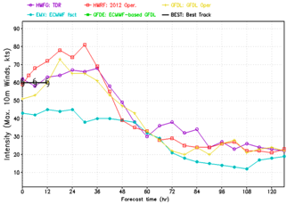
Collect observations over life-cycle: Isaac 2012
4 P-3 Flights
22 August – 24 August 2011
HWRF/GSI
20120827 12UTC
Doppler data transmitted in real-time for assimilation into HWRF
5 P-3 Flights
26 August – 28 August 2011
4 missions from 22-24 Aug 2012 and 5 missions from 26-28 Aug 2012 at 12 h Doppler sampling (HEDAS/GSI) & 6 G-IV missions
Sampled Isaac as a tropical storm to hurricane at landfall
HWRF/GSI
20120827 12UTC
Aberson, Aksoy, Gamache, Gopal (AOML/HRD), Tong (EMC)
Notes:
Map shows flight tracks for all of the NOAA missions (color coded are the flight level winds for the P-3 missions, dropsonde symbols denote G-IV patterns)
Flight track plots courtesy of Tropical Atlantic - http://tropicalatlantic.com/recon/
Model data available at: http://storm.aoml.noaa.gov/realtime

Slide 17
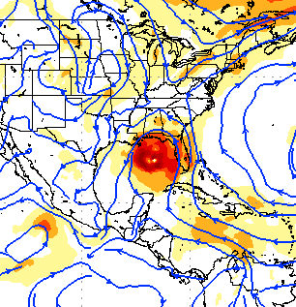
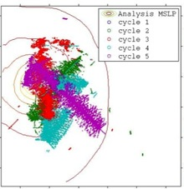
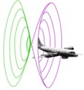
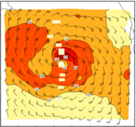
Collect observations over life-cycle: Initialize models
Synergy of high resolution forecast and airborne observations
P-3 and G-IV QC Doppler observations
Data assimilation
Improving initial condition in storm core region
Improving high resolution regional forecast
Wind intensity at 10 m
Hurricane Isaac (2012)
F. Zhang (PSU), Aberson, Aksoy, Gamache, Gopal (AOML/HRD)
Notes:
See papers: Zhang et al (2011) - http://www.agu.org/pubs/crossref/2011/2011GL048469.shtml
Aksoy et al (2012) - http://dx.doi.org/10.1175/MWR-D-11-00212.1

Slide 18
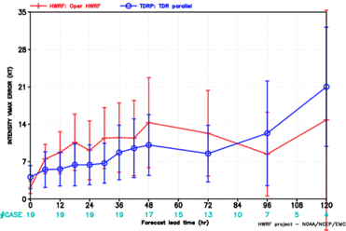
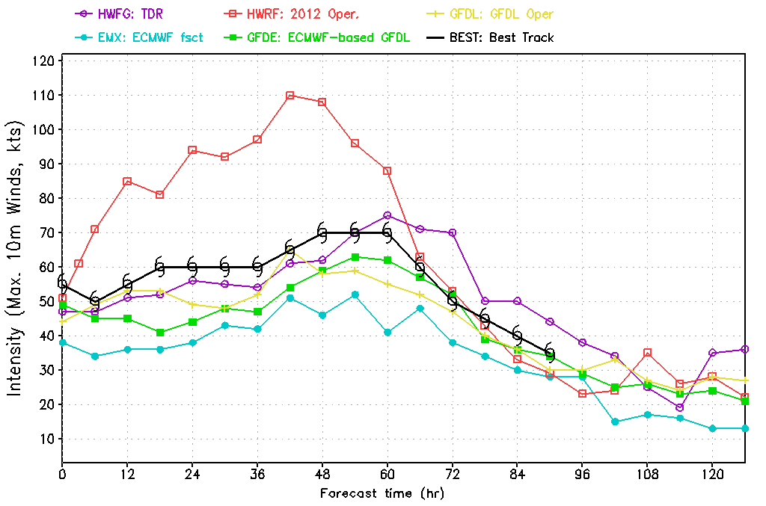
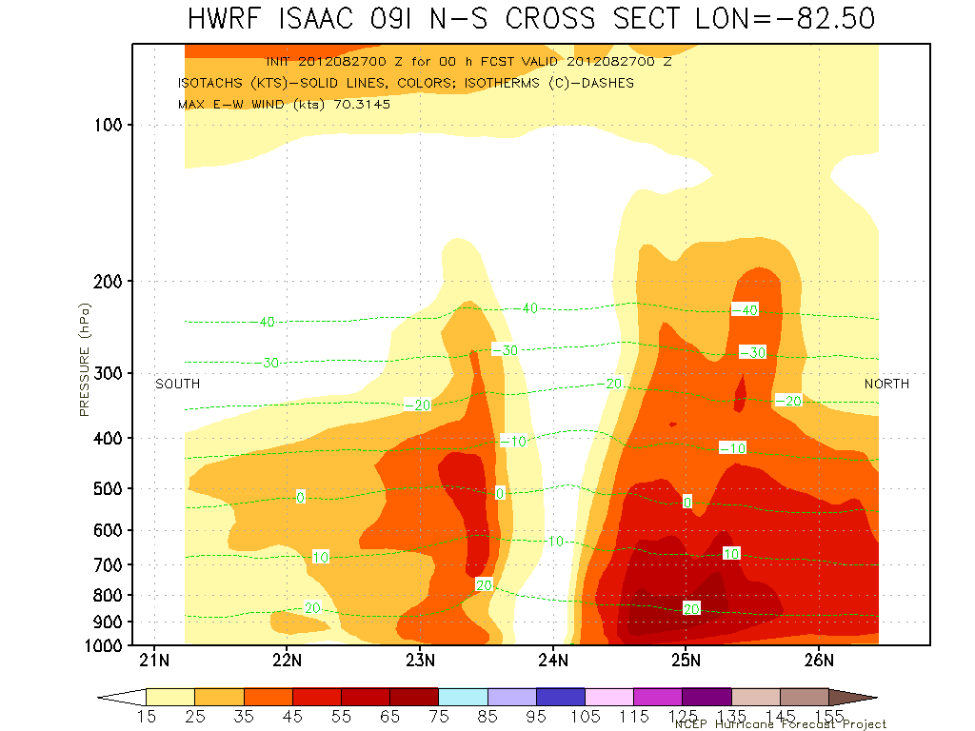
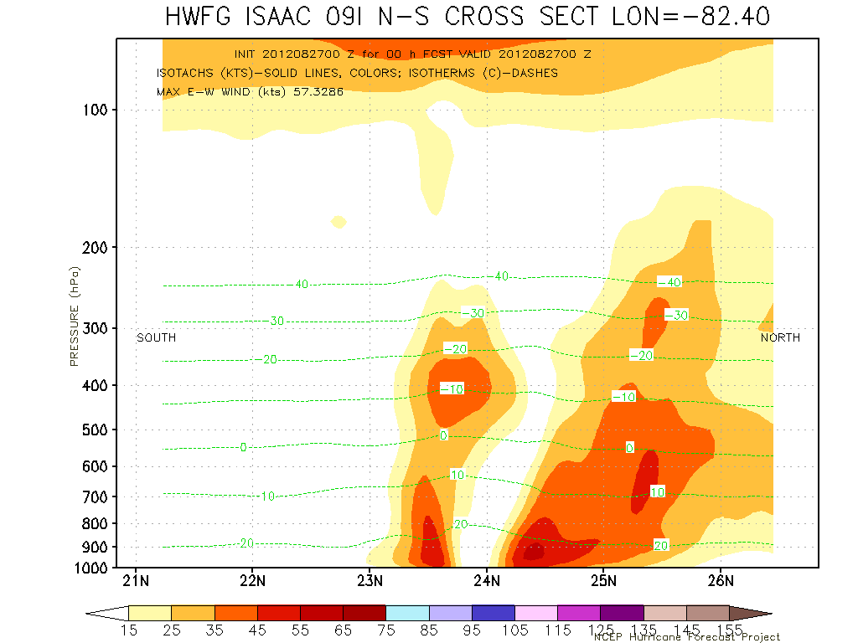
Collect observations over life-cycle: TDR Data impact
Intensity Errors
Isaac (2013)
OPER HWRF
OPER HWRF
HWRG TDR
HWRG TDR
Vertical cross section at initial time
S
No Doppler
N
S
With Doppler
N
Isaac (2013)
HWRF Model Team - V. Tallapragada, M. Tong, S. Trahan (EMC)

Slide 19
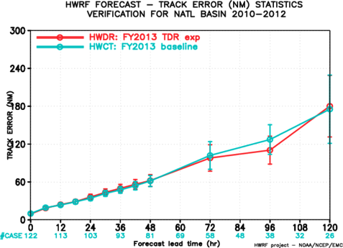

Collect observations over life-cycle: TDR Data impact
Results from TDR DA Experiments (2010-2012)
Intensity errors
Track errors
-4% 18% 14% 9% 9% 21% 6%
Assimilation of TDR positively improved intensity forecasts by about 10-20%
HWRF Model Team - V. Tallapragada, S. Trahan, Y. Kwon (EMC)

Slide 20




Develop & refine measurement technology: HS3 (2012-2014)
“Environmental” G-H
Hurricane Nadine
“Over-Storm” G-H
HS3 Teams – S. Braun (NASA/GSFC)

Slide 21






Improve understanding of TC structure & intensity: Ocean’s Role
Downwelling
Water mass evolution during Isaac
Upwelling
TC impact on upper ocean effect of Hurricane Isaac 2012)
Nick Shay UM/RSMAS, E. Uhlhorn, AOML/HRD, R. Lumpkin AOML/PhOD
Notes:
Drifter array in Gustav and Ike were placed by AFRC WC-130 ahead of storm. Gustav array still functioning when Ike was crossing Gulf. Also deployed AXBT grid post-Gustave which proved to be pre-Ike, followed by in storm Ike AXBT drops and post-Ike array. Revealed warm eddy and cold eddy left behind from Gustav interactions with Loop current.
Upper right picture shows sea-height anomaly (color) with superposition of Ike track and radii of hurricane (red circle) and storm force (yellow circle )winds. Black curly lines are tracks of Gustav drifters and circles are planned deployment locations for Ike drifters and floats. Thin black line shows P-3 track during pre-Ike AXBT pattern. Dropped over 300 AXBTs in Gustav and Ike.

Slide 22














Improve understanding of TC structure & intensity: RI
HWRF runs
Observations
12
Doppler
RMW: 65
IS_{av} : 3.5
11
Doppler-derived wind speed (shaded, m s⁻¹) at 2 km altitude
10
wind speed (m s⁻¹)
9
(a)
00 UTC 29 Aug
(b)
12 UTC 29 Aug
(c)
00 UTC 30 Aug
8
(d)
12 UTC 30 Aug
(e)
00 UTC 31 Aug
height (km)
7
6
5
4
I
II
III
3
2
1
0
0
20
40
60
80
100
120
140
160
180
12
12
radius (km)
11
Exp.2612
RMW: 44
IS_{av} : 1.8
11
Exp.2618
RMW: 56
IS_{av} : 3.9
Axisymmetric relative vorticity (shaded, x 10⁻⁴ s⁻¹) and tangential wind (contour, m s⁻¹)
10
10
12
(f)
9
9
(i)
(j)
11
height (km)
8
(g)
(h)
height (km)
8
10
7
7
9
6
6
8
height (km)
5
5
7
6
4
4
5
3
3
4
2
2
3
2
1
1
1
0
0
0
0
20
40
60
80
100
120
140
160
180
0
20
40
60
80
100
120
140
160
180
0
20
40
60
80
100
120
140
160
180
0
20
40
60
80
100
120
140
160
0
20
40
60
80
100
120
140
160
180
0
20
40
60
80
100
120
140
160
180
180
radius (km)
radius (km)
radius (km)
0
20
40
60
80
100
120
140
160
180
radius (km)
radius (km)
(b)
Notes:
Hurricane Earl 2010 WP-3D missions and Doppler wind analyses during RI

Slide 23









Outreach
Our blog
http://noaahrd.wordpress.com
HRD Web page
http://www.aoml.noaa.gov/hrd
Facebook
http://www.facebook.com/noaahrd
Twitter
http://twitter.com/#!/HRD_AOML_NOAA
Tweets from the eye
Tweets from the eye
Visiting scientist program
Visiting scientist program

Slide 24
Questions?

