Slide 1
Latest Developments in NOAA’s Hurricane Forecast Improvement Project
Frank Marks
NOAA/AOML Hurricane Research Division
7 May 2013
Notes:
Hurricane Earl 2 September 2010

Slide 2
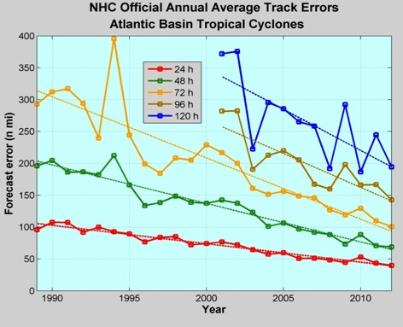
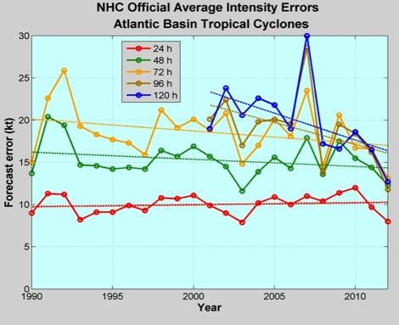
Good – track forecast improvements
Current Capabilities
Not so Good – Modest intensity gains
Some intensity gains since 2008, especially at >48 h
Errors cut in half over past 15 years
10-year improvement - As accurate at 48 hours as we were at 24 hours in 2000
24-48h intensity forecast off by 1 category
Off by 2 categories perhaps 5-10% of time
http://www.nhc.noaa.gov/verification/verify5.shtml
Notes:
Images from: http://www.nhc.noaa.gov/verification/verify5.shtml

Slide 3
Current Capabilities
Storm Size: Progress is difficult to measure due to inadequate observations
Storm Surge: Accurate within ±20% when track, intensity, and size known
Lead Time: Lead time was extended from 3 to 5 days in 2001
Precipitation: Modest annual improvements; forecast patterns match observations when track error is low
New/Improved Products: Refined cone graphic, wind speed probabilities, graphical tropical weather outlook, and probabilistic storm surge
Social/Behavioral Science: In its infancy

Slide 4
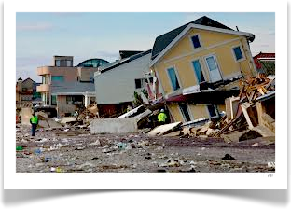
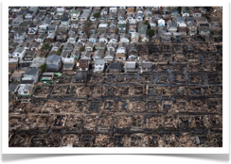
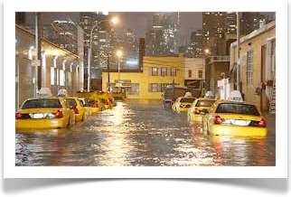
Improvements still needed!
NOAA’s National Weather Service (NWS) mission is to fulfill this commitment through building a Weather Ready Nation.
NWS must contribute to hazard resiliency by continually assessing and improving its services to Nation.
Hurricane Sandy (2012):
    159 (72 along US East Coast) deaths
    ~$50 Billion damage
    Major infrastructure losses
    Power lost to 8.5 million
http://www.nhc.noaa.gov/data/tcr/AL182012_Sandy.pdf
Notes:
http://www.nhc.noaa.gov/data/tcr/AL182012_Sandy.pdf

Slide 5
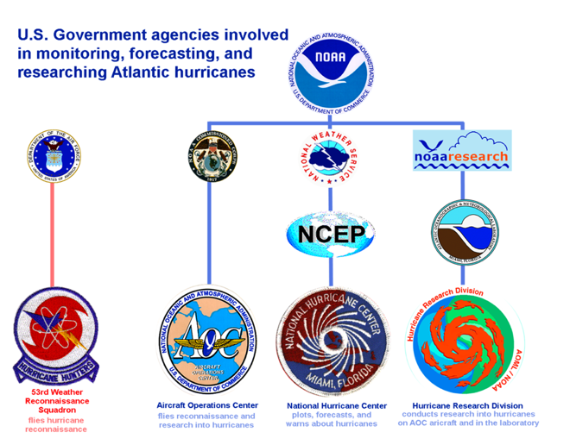







Federal Hurricane Team
2012 Snapshot
Total: $51,494K
HFIP
NOAA Total
$16,990
http://www.ofcm.gov/ihc13/
Notes:
Operations: $300M/year (NOAA & DoD)– observing, forecasting, instrumentation (satellites)
Research: 2008: $50M/year (16%), 2010: $76M (25%) – leveraged across multiple agencies
Manyears: 2008: 211, 2010: 279

Slide 6

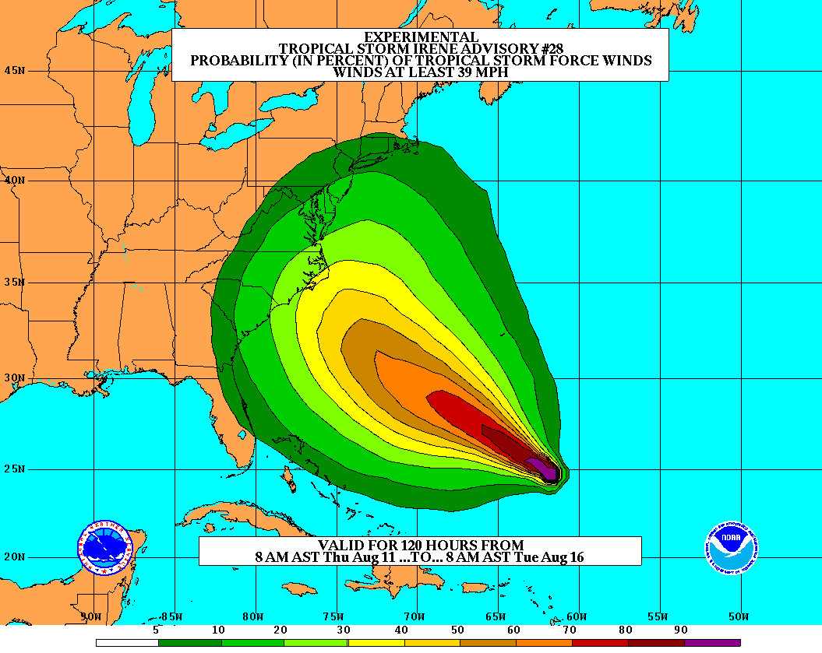
Goals
Improve Forecast Accuracy
  Hurricane impact areas (track) – 50%
  in 10 years
  Severity (intensity) – 50% in 10 years
  Rapid intensity change detection
Extend forecast reliability out to 7 days
Quantify, bound and reduce forecast uncertainty to enable risk management decisions
http://www.hfip.org/
Notes:
http://www.nrc.noaa.gov/HFIPDraftPlan.html
HFIP Team
Frank Marks, research lead
Ed Rappaport, operations lead
Fred Toepfer, project manager
Robert Gall, development manager
Mark DeMaria
Chris Fairall
Jim McFadden
Daniel Melendez
HFIP executieve oversight board:
OAR AA/Robert Detrick, co-chair
NWS AA (acting)/Laura Furgione, co-chair
NCEP/Louis Uccellini,
NHC/Rick Knabb,
NESDIS/Mark DeMaria,
NOS/Jesse Feyen,
AOML/Bob Atlas
PPI/Paul Doremus
NMFS/Bonnie Ponwith,
NOS/Liz Scheffler,
NMAO-PM Aircraft/Mike Devany
OFCM/Sam Williamson
Executive Secretariat: OAR/Brian Orndorff and NWS/Nasheema Lett
http://www.hfip.org/

Slide 7

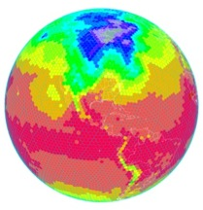
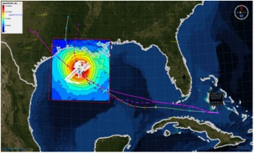
HFIP Activities
Traditional Hurricane Research Activities:
Observations, analysis, database, & instrument R&D (IFEX)
Statistical-dynamical model development
Advances in operational models (Stream 1)
New HFIP Research Thrusts:
Experimental global and regional hurricane model development (Stream 2)
Data assimilation techniques and observing system strategy analysis development (Stream 1 & 2)
Model evaluation tool development (Stream 1.5)
Application and tool development for forecasters
D1
D2
Partnership: NCEP, AOC, AOML, ESRL, GFDL, DTC, USWRP, NESDIS/STAR
http://www.hfip.org/documents/
Notes:
http://www.hfip.org/documents/
Two Stream Approach to HFIP developments:
Stream 1– Operational Transition and Implementation
Stream 2 – Advanced Technology Demonstration
Unconstrained by near-term availability of operational computing
Uses both NOAA’s and computing resources from major supercomputing centers for testing and evaluation.
Emphasis is on high resolution global and regional models run as ensembles
Real-time or near real time runs during hurricane season
Stream 1.5 (JHT-like)
NHC Forecaster Defined.
Subset of Stream 2 that forecasters see as particularly promising or provides demonstrated capability
Will be configured to run in real-time and products made available to NHC.

Slide 8
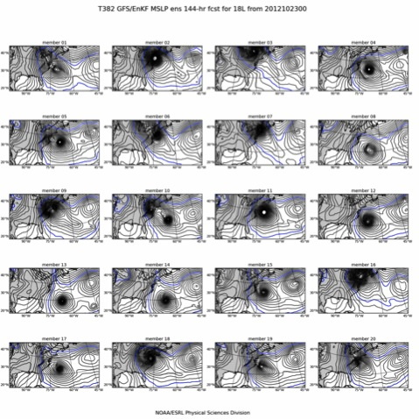
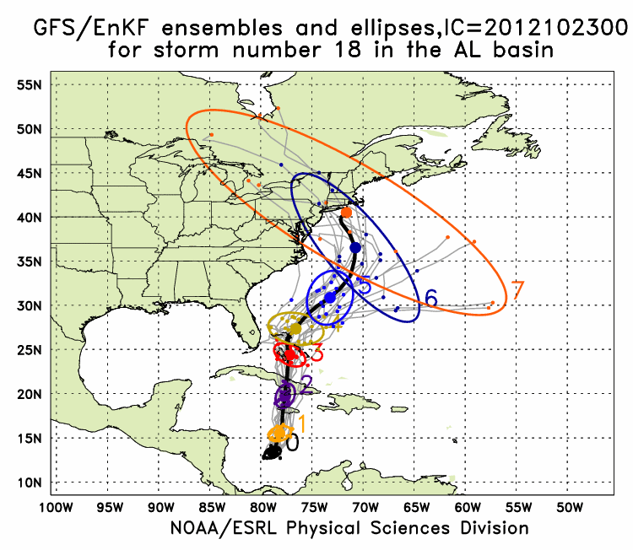
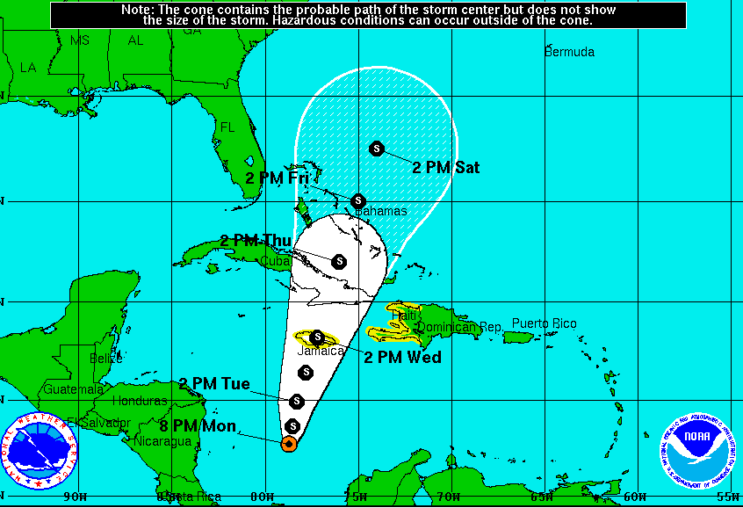
Global Model Development – GFS/EnKF
Sandy (18L) – init 00Z 23 October
GFS/EnKF T382 20 member ensemble
7-Day forecast – 20 member ensemble
Observed
http://www.esrl.noaa.gov/psd/forecasts/gfsenkf/ens/
Global Model Team - Tom Hamill & Jeff Whitaker (ESRL)
Notes:
Model data available at: http://www.esrl.noaa.gov/psd/forecasts/gfsenkf/ens/
Global Ensembles:
80-member T254 GFS ensembles cycled every 6-h continuously from 1 August to current time
Look at 20 members of the 80 member ensemble
Left panels shows ellipse plot of 20 members at each forecast time – ellipse shape shows the spread along/across track
Right panel show surface pressure post stamp images of 20 members

Slide 9
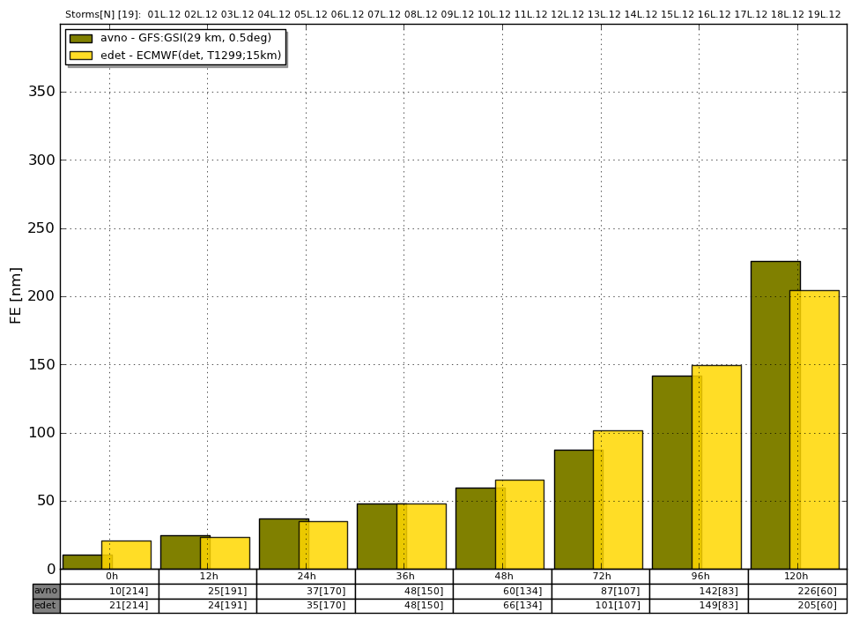
Global Model Development
Track Error
2012 GFS versus ECMWF
Global Model Team – Mike Fiorino (ESRL)
Notes:
Track Error of Models (2010-2011) (% Improvement over HFIP baseline – average track error for three years of operational model guidance errors for 2006-2008 when HFIP began)
purples are the operational regional models
Greens represent the operational GFS and the HFIP GFS at lower resolution than the operational GFS but with ENKF data assimilation of central pressure
Yellows (ECMWF) and browns (UKMET) are two of the better global models
Orange is the best multi-model ensemble track guidance used by NHC
Dark orange is the Official NHC forecast error
Note that the HFIP GFS/EnKF model which is at ¼ the spatial resolution of ECMWF is competitive and also exceeds the 20% improvement goal of HFIP for 5 years.

Slide 10
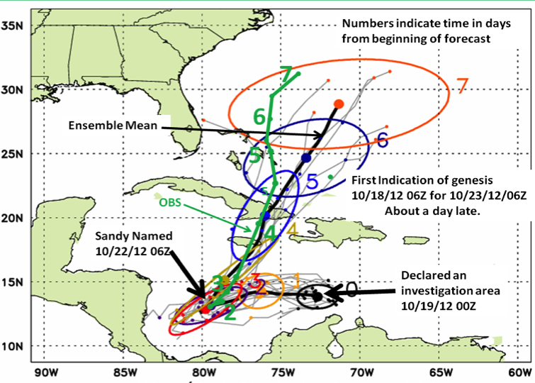
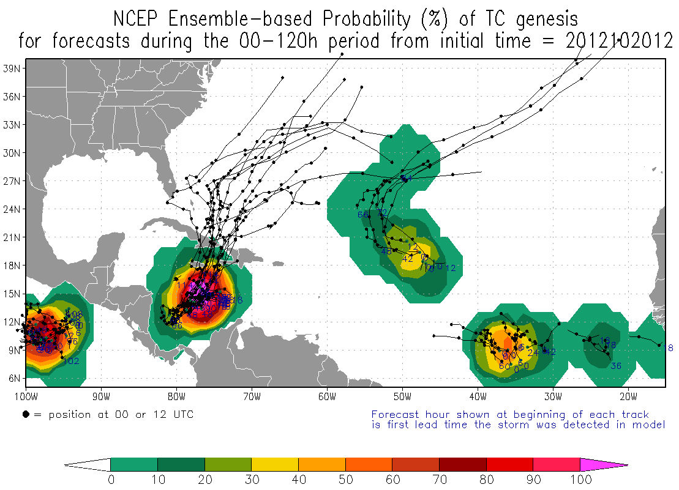
Global Model Development – Ensemble – Genesis
Global Model Team - Tom Hamill & Jeff Whitaker (ESRL)
Notes:
In the case of Irene new tools to forecast genesis developed by HFIP using the HFIP global model ensembles from GFS/EnKF (30 members) and FIM (10 members) were able to detect and track the system that formed into Irene 5 days before it was named by NHC and 2 days before NHC declared it an INVEST area
Thin black lines are the disturbance tracks from each of the ensemble members, the small black dots the location of each of the ensemble members at 24 h intervals after the initial time, and the colored ellipses enclose 75% of the ensemble positions. Note that the ellipses elongate along track (reflecting speed uncertainty) in the early forecasts, and elongate perpendicular to the track (reflecting uncertainty in the storm turn to the N at the later forecast times. At day 3 & 4 when the storm was named the uncertainty is the least.
The solid green line is the observed Best Track from NHC starting when the storm was named.
Model data available at: http://www.esrl.noaa.gov/psd/forecasts/gfsenkf/ens/

Slide 11
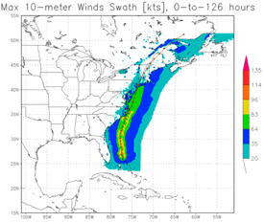
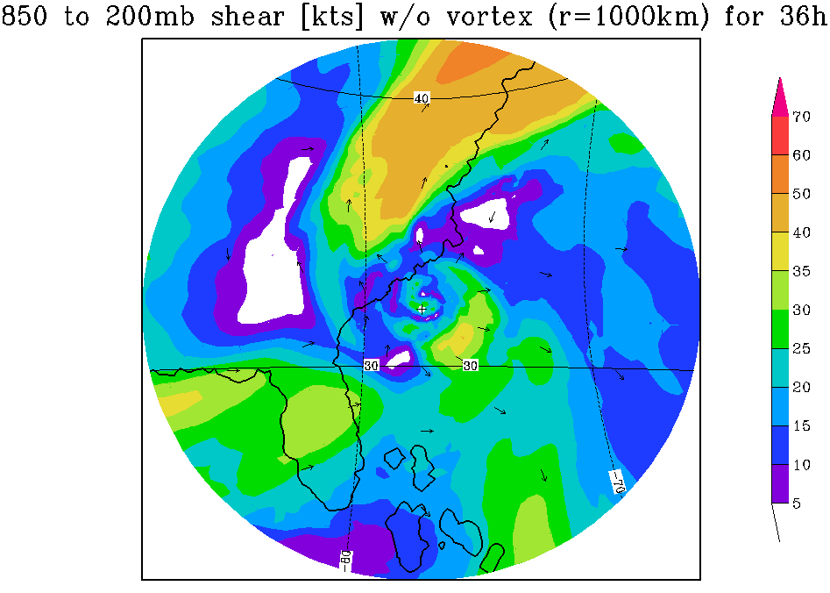
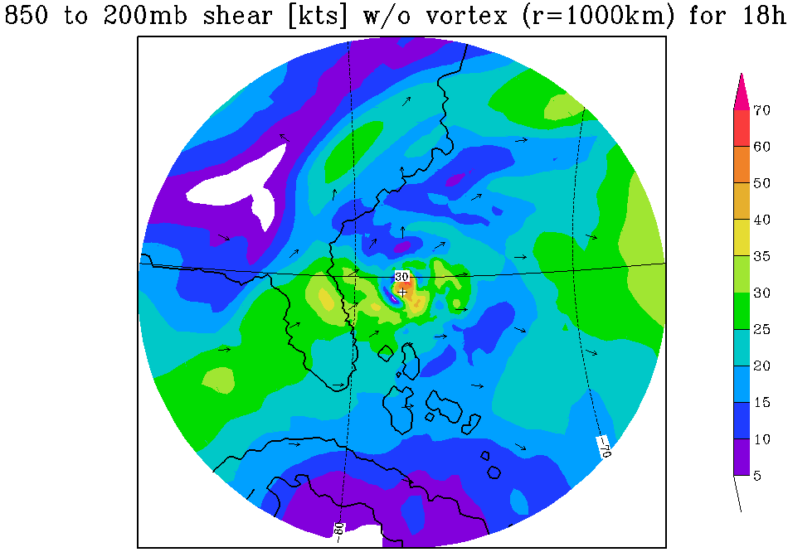
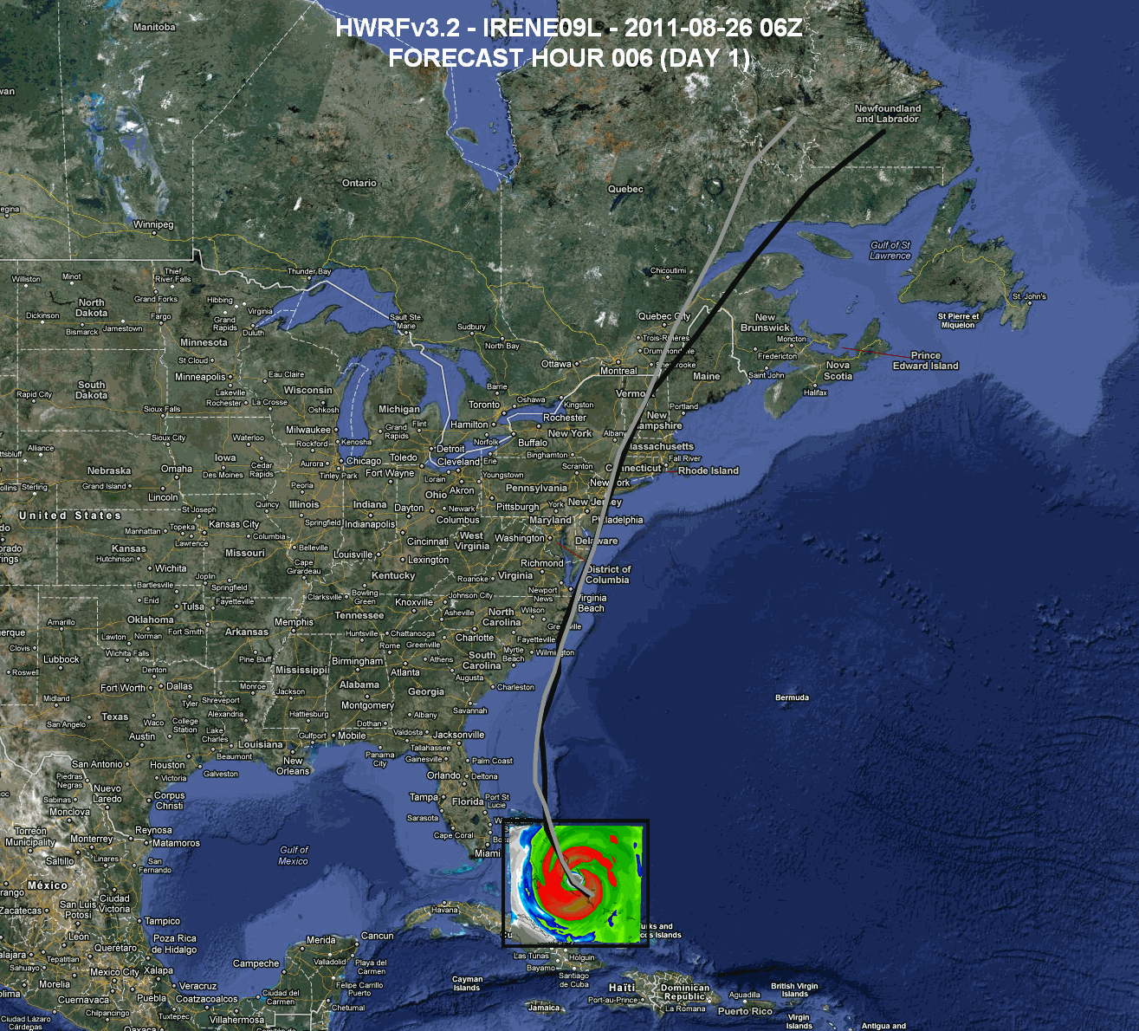
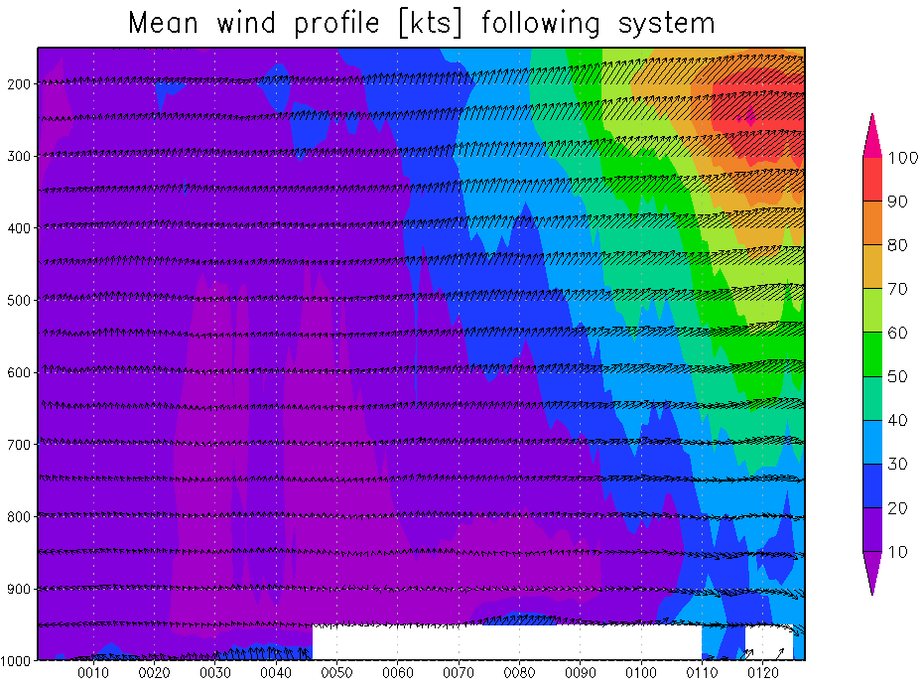
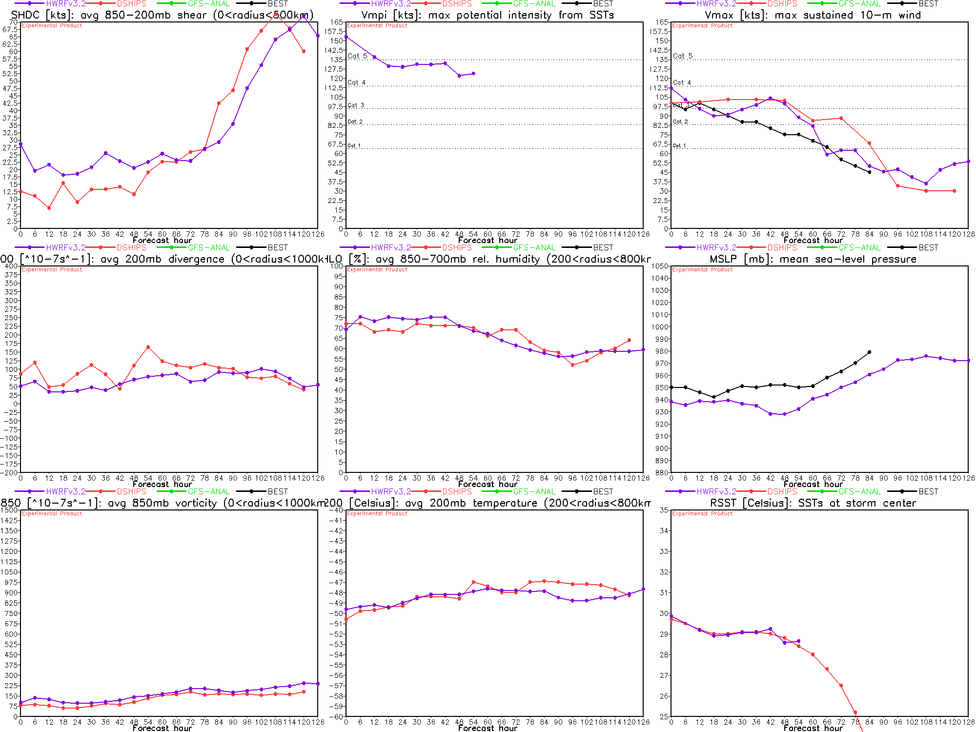
Regional Model Development: HWRF
http://www.emc.ncep.noaa.gov/gc_wmb/vxt/
HFIP operational (27/9/3 km)
  Advanced nesting algorithm providing resolutions to 3 km
  Viable operational pathway & potential transition to operations
  Pathway to Improved structure and intensity predictions*
  Extension of initialization algorithm down to 3 km resolution
19 main products; e.g.,
  Synthetic microwave imagery
  SHIPS predictors
  Shear and Steering
  Time-height cross-sections
  Swaths (wind and rainfall)
https://storm.aoml.noaa.gov/realtime
HWRF Model Team - Gopal, X. Zhang (HRD), V. Tallapragada, S. Trahan (EMC)
Notes:
Demo 2011 season; Not only we have improved the products but also added a suite of NOAA HWRF systems at different configurations.
Example of Hurricane Dora 2004 (initialized at 18Z on 18 July 2011)
Top left: 10-m wind swath for 126 h forecast
Bottom left: time-height cross section of mean wind over 3 km nest centered on storm
Top right: storm-relative vertical wind shear on 3-km nest for 24 h and 30 h forecast – note decreasing NE shear over center
Bottom right: SHIPS type predictors for regional model
Overlay: moving 3-km inner nest showing 10-m wind evolution
Model products available at: http://storm.aoml.noaa.gov/realtime

Slide 12
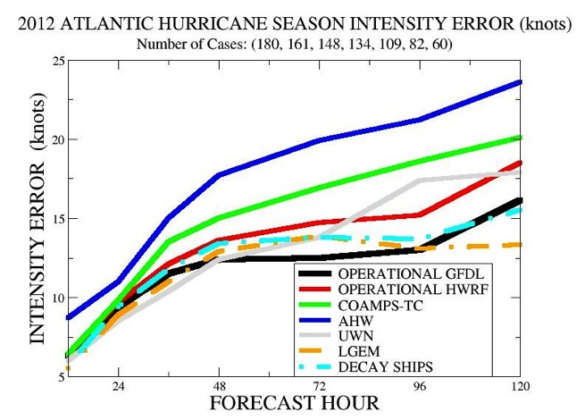
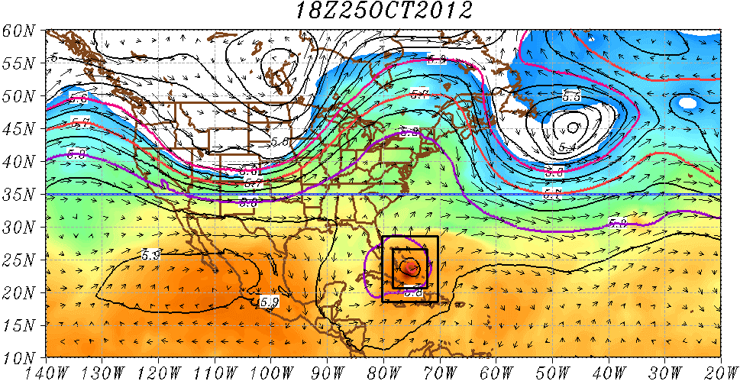
Regional Model Development: HWRF
Experimental HWRF real-time demo simulations
(http://storm.aoml.noaa.gov/hwrfxprojects/?projectName=BASIN)
2012 HWRF
HWRF Model Team - Gopal, X. Zhang (HRD), V. Tallapragada, S. Trahan (EMC)
Notes:
• As the new models are developed to deal with intensity and structure we need to develop new metrics for model and forecast evaluation beyond the traditional minimum central pressure and peak surface wind. The NWS metric of the peak 1-min sustained surface wind anywhere is not as meaningful anymore. A model or forecast could be correct on those parameters for the wrong reason. Customers want to know more about the impacts to expect and that means structure and size matter. Proposed new metrics are structure (radii of 35, 50, 65 kt, and radius of maximum wind in different quadrants) and rapid intensification (FAR vs POD). They need to be tested and improved with data as well as model output.

Slide 13
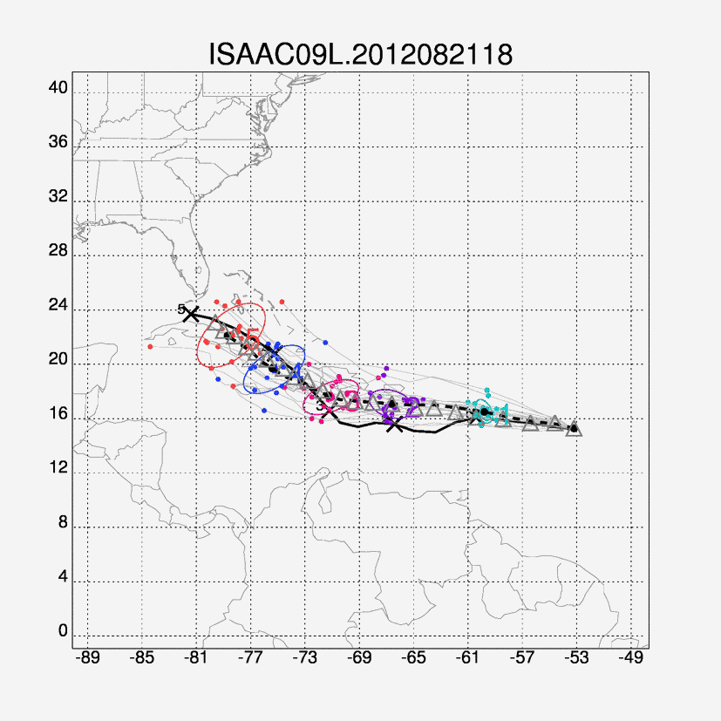
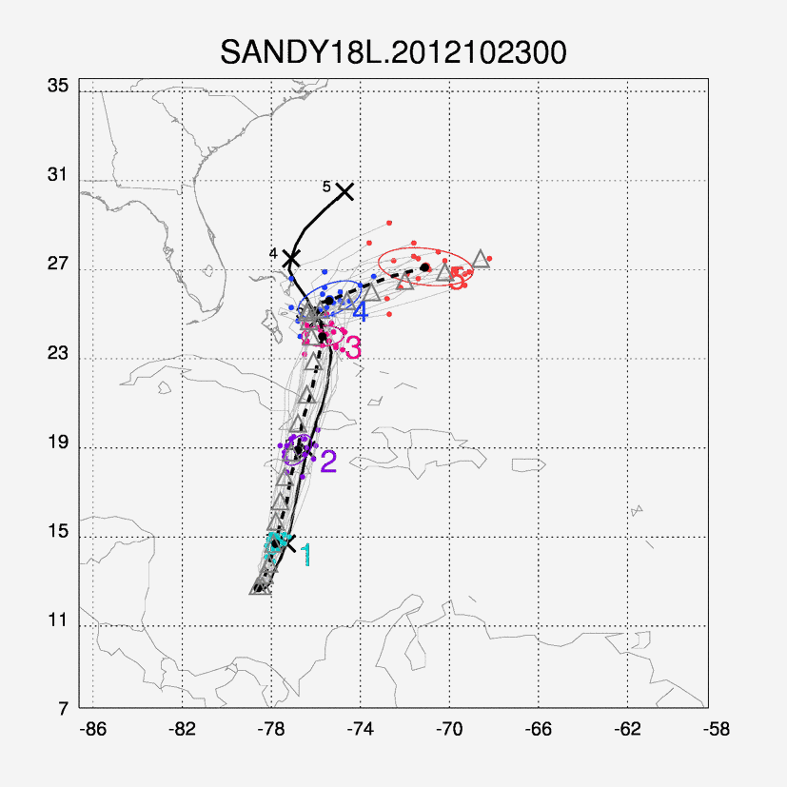
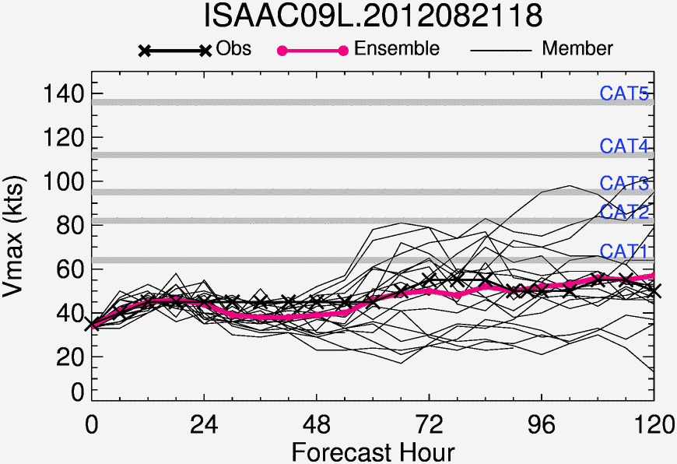
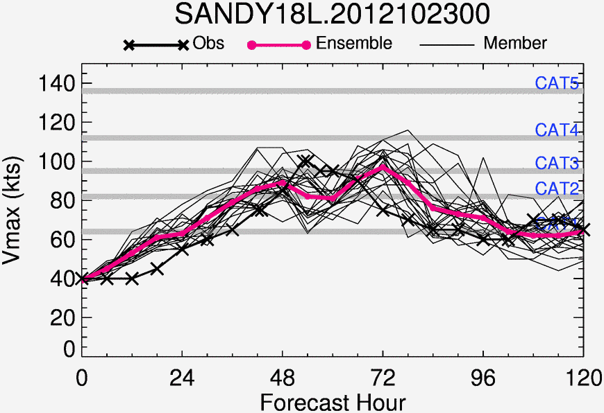
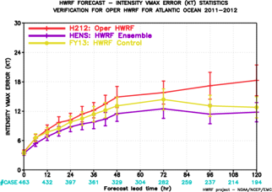
Regional Model Development: HWRF Ensembles
Hurricane Ensemble Prediction System based on Stochastic Convective Trigger (vortex scale) and GEFS initial conditions (large-scale) perturbations
Based on latest FY2013 HWRF configuration (fully coupled system)
Further improvements to track and intensity forecast skill
HWRF Model Team – Z. Zhang & V. Tallapragada (EMC)

Slide 14
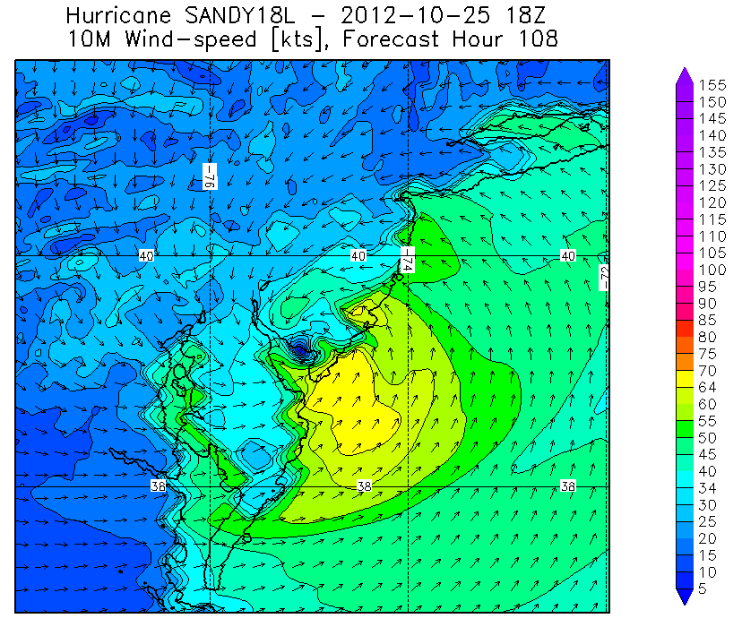
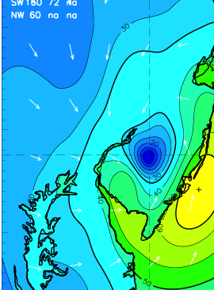

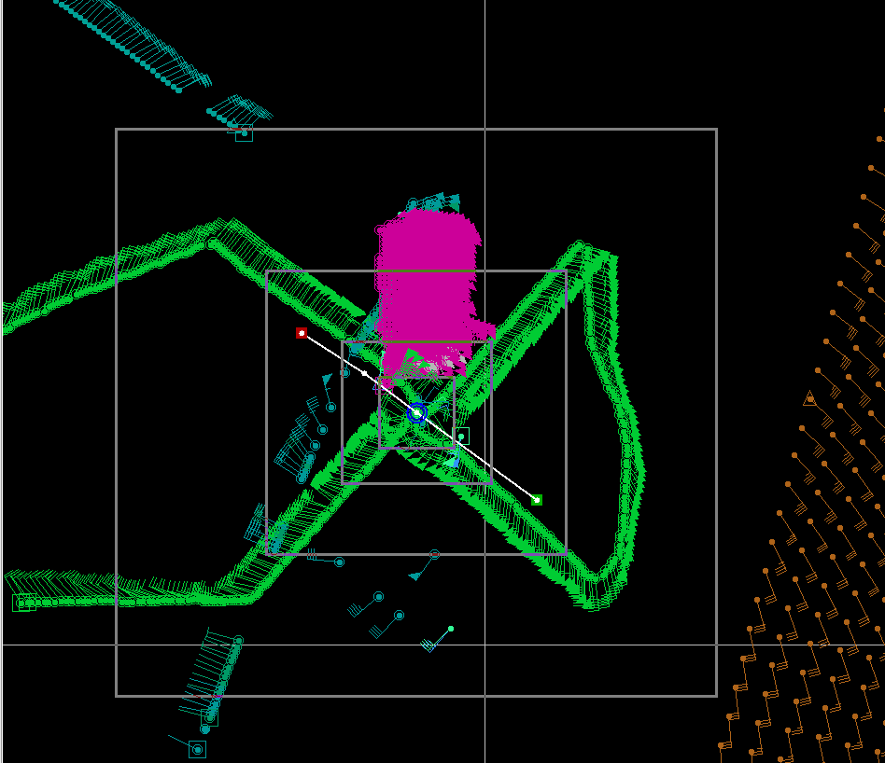
Regional Model Development:
Model evaluation: Wind Structure
Data Coverage
H*Wind 10m winds
HWRF 10m winds
HWIND analysis
HWRF Forecast (108 h)
HWRF Model Team - Gopal, X. Zhang (HRD), V. Tallapragada, S. Trahan (EMC)
Notes:
• Surface wind field work is mainly supported through a NOPP that Hans Graber controls (collaboration between UM, USACE, HRD, and Vince Cardone’s Ocean Weather). HRD receives support to provide them near real-time surface winds to drive their surge and wave models. HRD also receives support for these wind fields from the USACE, particularly for the production of wind fields for past storms to use for model testing. Finally, some of the support comes from the development of a wind model for the State of Florida CAT model effort in collaboration with FSU, FIU, and UF.

Slide 15
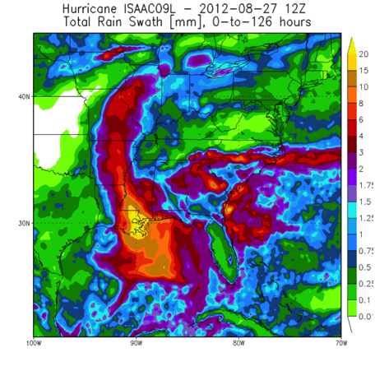
Regional Model Development:
Model evaluation: Rainfall
Stage IV rain accumulation (144 h)
HWRF rain accumulation (120 h)
HWRF Model Team - Gopal, X. Zhang (HRD), V. Tallapragada, S. Trahan (EMC)

Slide 16
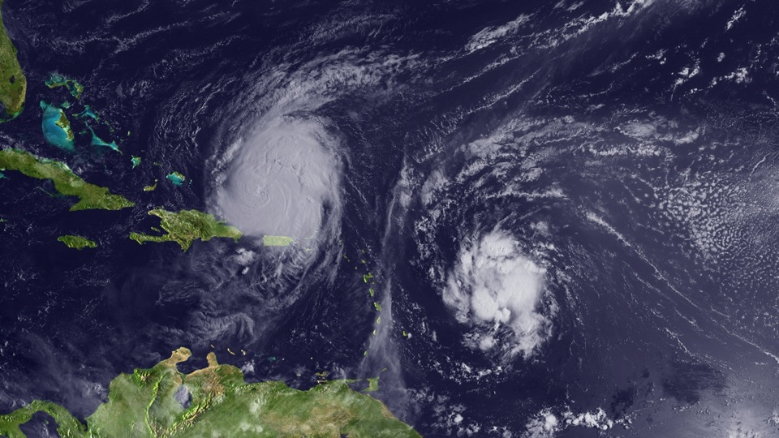
Regional Model Development: What Next?
Earl
Fiona
HWRF Model Team - Gopal, X. Zhang (HRD), V. Tallapragada, S. Trahan (EMC)
Notes:
Current regional hurricane model strategy is developed from GFDL model approach developed in 1977 – one forecast run per storm. So if there is two storms operations needs resources for two complete model runs. Not only inefficient, but causes issues with initialization when two storms are in the outer next interacting. Current storm occurrence climatology suggests that more that 50% of the time there is two storms active at the same forecast time.

Slide 17
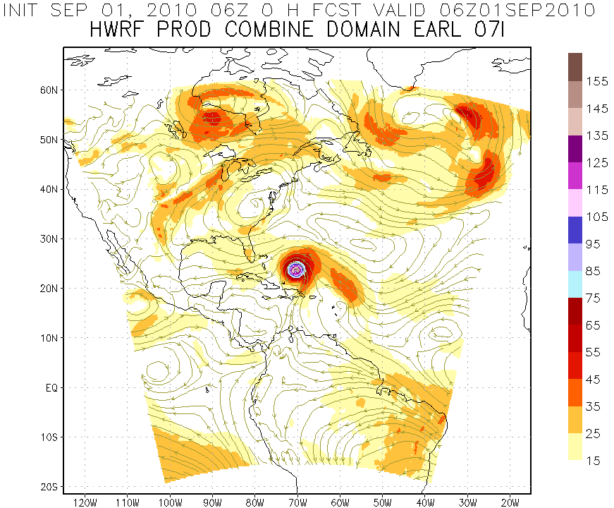
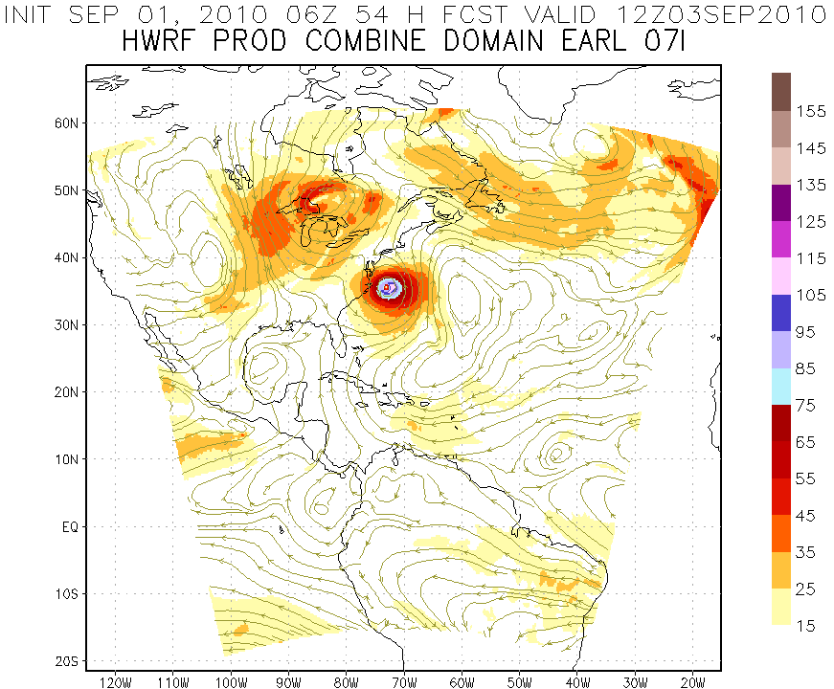
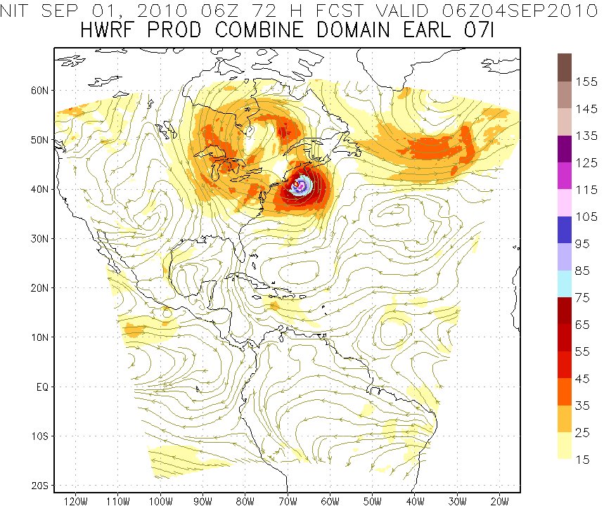
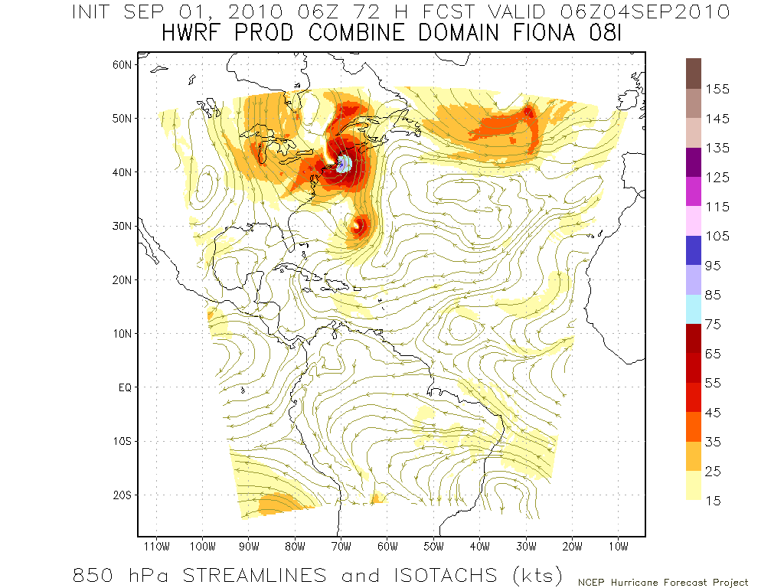
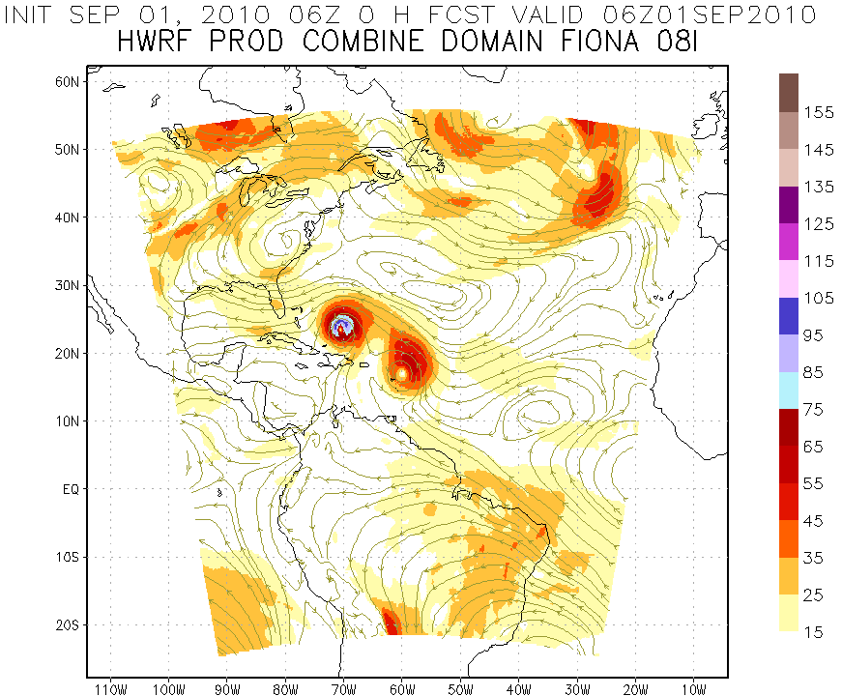
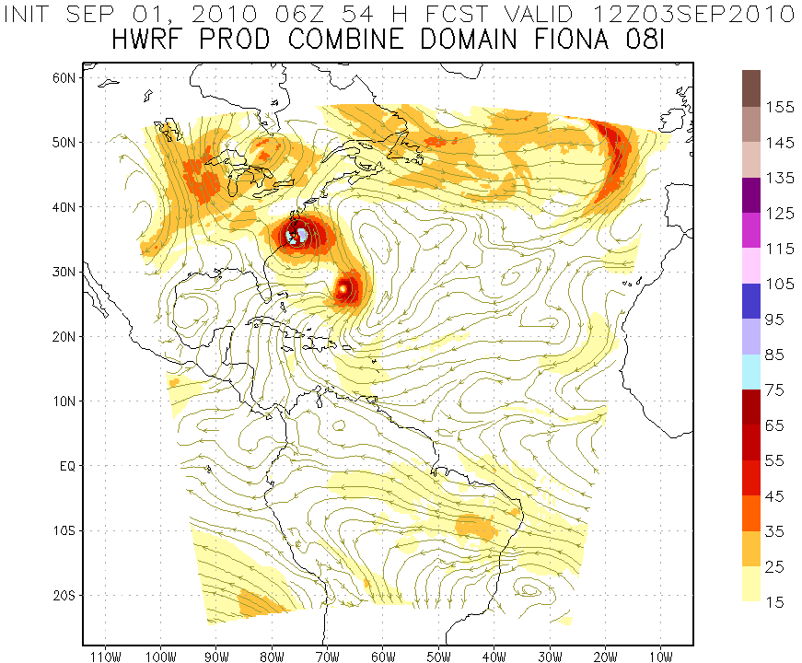
Regional Model Development: Storm-storm interactions?
Earl
Earl
Earl
Fiona
Initialize Earl Vortex
850hPa Streamlines and Isotachs (kts)
Earl
Earl
Earl
Fiona
Fiona
Fiona
Initialize Fiona Vortex
http://www.emc.ncep.noaa.gov/gc_wmb/vxt
Notes:
Example of initialization problem hen two storms are in the same outer nest for each initialization time. Forecast performance depends on which storm initialization you look at. In this case when initializing for Earl the forecast looks similar to best track. However, forecast initialized for Fiona at the same time looks nothing like reality with Fiona remaining a weak hurricane and has Earl making landfall in the outer banks.

Slide 18
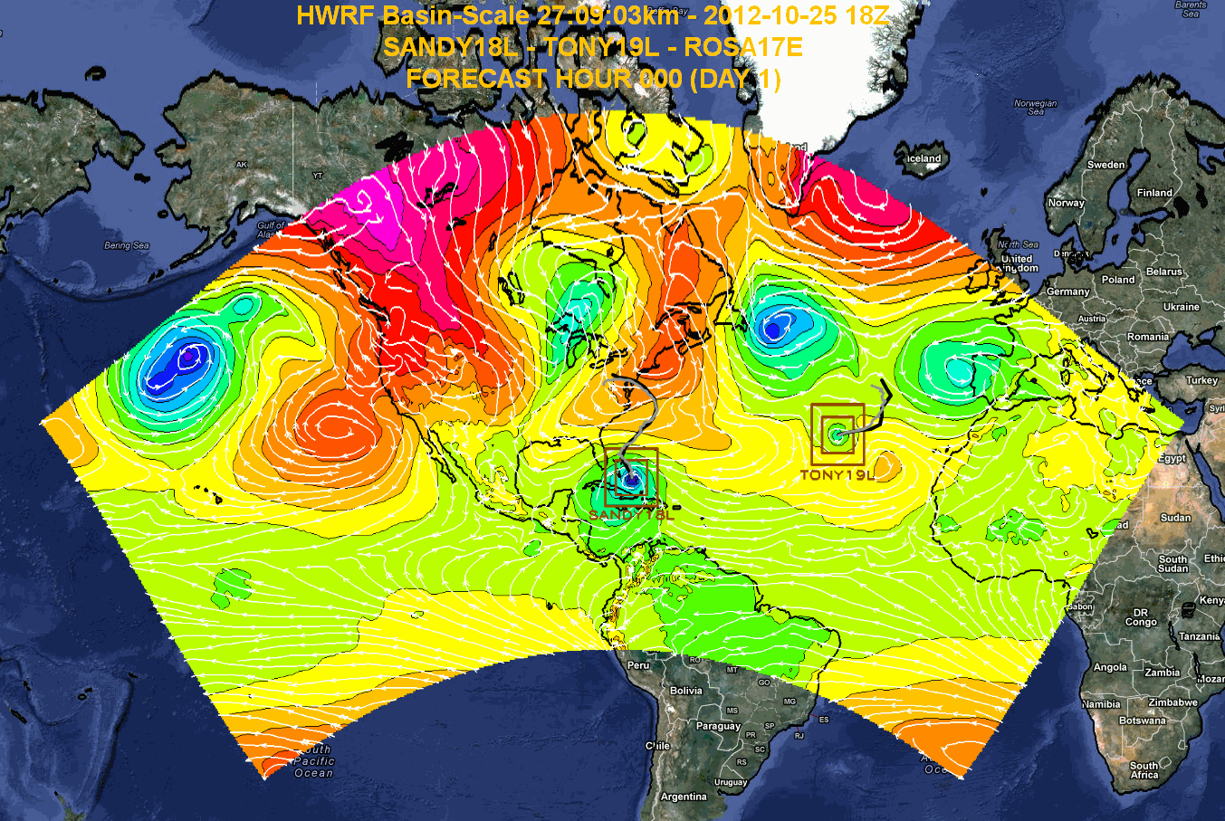

Regional Model Development: HWRF Basin-Scale
HWRF Model Team - Gopal, X. Zhang, T. Quirino (HRD), V. Tallapragada (EMC)
Notes:
Earl and Danielle forecast initialized at 0000Z 27 August 2011
Large “basin-scale” domain is at 27 km resolution with inner nest at 9-km using operational HWRF as the basis. Outer domain covers the EPAC and ATL TC development regions with one domain which remains fixed from cycle to cycle.
18

Slide 19


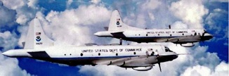
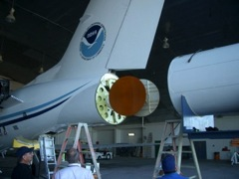
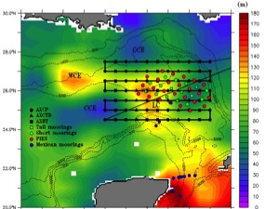

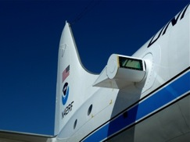
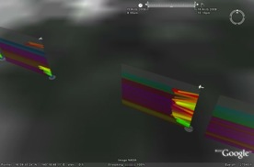
Improved Use of Observations:
HFIP & Intensity Forecast Experiment (IFEX)
In-situ
  Wind, press., temp.
Expendables
  Dropsondes
  AXBT, AXCP, buoy
Remote Sensors
  Doppler Radar
  SFMR/HIRAD
  WSRA
  Scatterometer/profiler
  UAS - LALE
Improve prediction of TC intensity change by:
  collecting observations through the TC life cycle
  developing and refining measurement technologies
  improving understanding of physical processes important in TC intensity change
GALE UAS
NASA Global Hawk
G-IV Tail Doppler Radar
AXBT profiles of Loop Current
ONR DWL
DWL profiles from TCS-08
R. Rogers, S. Murillo, P. Reasor (AOML/HRD)
Notes:
UR image depicts dropsonde profiles in eyewall of Hurricane Guillermo (1997)
LR image is Doppler Wind Lidar profiles from TCS-08
See IFEX paper (Rogers et al 2006): http://dx.doi.org/10.1175/BAMS-87-11-1523
HRD IFEX website: http://www.aoml.noaa.gov/hrd/HFP2011/index.html

Slide 20


Future Aircraft Observations
IFEX & HS3:
IFEX 2012
  NOAA aircraft flew ~282 h (18 P-3 and 12 G-IV missions)
  Highlights include Isaac, Leslie, & Sandy
  For details see: http://noaahrd.wordpress.com/category/ifex-discussion
IFEX 2013
  2 NOAA WP-3D, G-IV – 150 flight hours (1 June-30 November)
  Crews available 2/day missions starting July based from Tampa, FL
  Interact with NASA during their HS3 field campaign
HFIP real-time model demonstration
S. Murillo, P. Reasor (AOML/HRD)

Slide 21
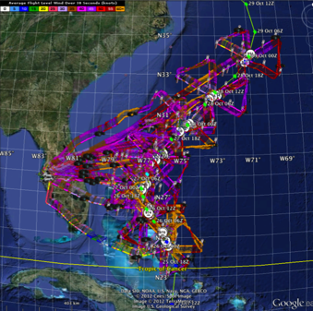
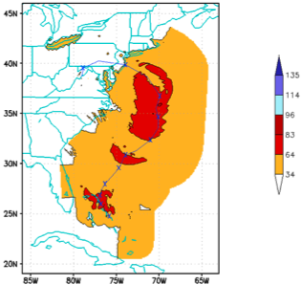
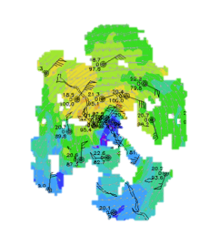
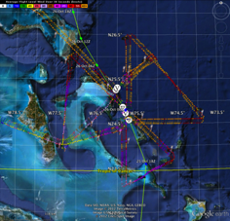
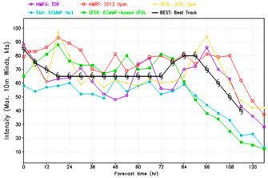
Improved Models & Data:
IFEX 2012: Sandy
4 P-3 Flights
22 August – 24 August 2011
TDR-Experiment: Doppler data transmitted in real-time for assimilation into HWRF
HWRF/GSI
20121026 00UTC
7 WP-3D TDR missions from 00 UTC 26 – 12 UTC 29 September 2012 at 12 h Doppler sampling (HEDAS/GSI)
3 G-IV missions (1 G-IV TDR mission)
Sampled Hurricane Sandy from passage N of Cuba to landfall
HWRF/GSI
20121026 00UTC
Aberson, Aksoy, Gamache, Gopal (AOML/HRD), Tong (EMC)
Notes:
Map shows flight tracks for all of the NOAA missions (color coded are the flight level winds for the P-3 missions, dropsonde symbols denote G-IV patterns)
Flight track plots courtesy of Tropical Atlantic - http://tropicalatlantic.com/recon/
Model data available at: http://storm.aoml.noaa.gov/realtime

Slide 22



Improved Models & Data:
IFEX 2012: Sandy
Real-time P-3 Tail Doppler Composite at 3 km altitude
m/s
Flight 20121025H1
Flight 20121027H1
Flight 20121028H1
S. Murillo, P. Reasor (AOML/HRD)
Notes:
Colors denote Doppler winds and station codes denote dropsondes
West-east vertical cross section of wind speed (shaded, m/s).

Slide 23




Improved Models & Data:
Assimilation of data into models
Synergy of high resolution forecast and airborne observations
P-3 and G-IV QC Doppler observations
Data assimilation
Improving initial condition in storm core region
Improving high resolution regional forecast
Wind intensity at 10 m
Hurricane Sandy (2012)
F. Zhang (PSU), Tong (EMC), Aberson, Aksoy, Gamache (AOML/HRD)
Notes:
See papers: Zhang et al (2011) - http://www.agu.org/pubs/crossref/2011/2011GL048469.shtml
Aksoy et al (2012) - http://dx.doi.org/10.1175/MWR-D-11-00212.1

Slide 24




Improved Models & Data:
Impact of airborne Doppler radar
Intensity Errors
Isaac (2013)
OPER HWRF
OPER HWRF
HWRG TDR
HWRG TDR
Vertical cross section at initial time
S
No Doppler
N
S
With Doppler
N
Isaac (2013)
HWRF Model Team - V. Tallapragada, M. Tong, S. Trahan (EMC)

Slide 25


Improved Models & Data:
HWRF 2013 Implementation
2010-2012 Atlantic Track Verification
>20% improvement
~10% improvement
Intensity errors
Track errors
HWRF Model Team - V. Tallapragada, S. Trahan, Y. Kwon (EMC)

Slide 26
HFIP Success to Date
HFIP focused research efforts within NOAA & interagency partners
HFIP defined solution to transition research into operations with Stream 1.5 products available to NHC forecasters in real-time
  Transitioned global hybrid DA system and 3-km HWRF into operations this season
HFIP making significant progress – 5-year goals within reach
  Global ensembles providing 20% improvement in track guidance
  Improved model initialization and higher resolution models, along with inner core data shows significant (20-40%) improvement in intensity
  3-5 day lead-time hurricane genesis product
http://www.hfip.org/documents/reports2.php
Notes:
http://www.hfip.org/documents/reports2.php

Slide 27





Keys to Success
  Partnership: NOAA Research working closely with NOAA Operations, and Federal & Academic Partners (NASA, NSF, ONR, NRL, NCAR)
  More integrated use & support of Testbeds (JHT, DTC, JCSDA)
  Blend traditional hurricane and HFIP research activities
  Manpower (diversity) to evaluate model performance with hurricane data sets is a critical need
CBLAST
IFEX/RAINEX
DOTSTAR
IFEX/TCSP
IFEX/PREDICT/GRIP

Slide 28









Outreach
Our blog
http://noaahrd.wordpress.com
HRD Web page
http://www.aoml.noaa.gov/hrd
Facebook
http://www.facebook.com/noaahrd
Twitter
http://twitter.com/#!/HRD_AOML_NOAA
Tweets from the eye
Tweets from the eye
Visiting scientist program
Visiting scientist program

Slide 29
Questions?

