Slide 1
TC Eyewall Slope as Determined by Radar Reflectivity Data: Composites and Case Studies
Andrew T. Hazelton
NOAA AOML Hurricane Research Division Seminar
7/25/13

Slide 2
Outline
Background
  -Motivation
  -Previous analysis of eyewall slope
Data and Methodology
- Datasets used and slope calculations
Results
  - Composite relationships
  - Common asymmetries
Conclusions
Future Work/Current Work at HRD

Slide 3
Background

Slide 4
Motivation
Typical metrics for looking at tropical cyclones focus on things like track and intensity.
Recent studies have questioned the utility of maximum wind speed, given inherent observational uncertainties (Marks and Vukicevic 2012, Landsea and Franklin 2013).
Such metrics do not specifically analyze important inner-core structural changes, which are related to both intensity change and eventual storm impacts.
Over the past several years, it has become clear that a better understanding of TC structure is critical for forecasting (both of intensity and eventual impacts).

Slide 5
Motivation
One potentially important aspect of inner-core TC structure is eyewall slope.
Eyewall slope seems to be connected to the structure of the warm core of a TC (Shapiro and Willoughby 1982, Schubert and McNoldy 2010).
There is still some uncertainty about variation in eyewall slope, both from storm to storm and even within a given TC.
Better understanding of eyewall slope and its variation will potentially lead to improved understanding of the processes that are responsible for changes in inner-core structure, specifically the TC secondary circulation.

Slide 6



Prior Work: Sawyer-Eliassen Balanced Model
The Sawyer-Eliassen balanced model for TCs describes a theoretical basis for the slope of momentum surfaces in a TC within an axisymmetric, 2-D framework (Shapiro and Willoughby 1982).
The solution of the response of the TC secondary circulation to sources of heat and momentum can be described in terms of three main parameters:
B
N
W
I
Static Stability
(1)
Inertial Stability
(2)
Baroclinicity
(3)

Slide 7
Prior Work: Sawyer-Eliassen Balanced Model
Baroclinicity is the term that describes eyewall slope. It is simply a statement of thermal wind balance.
θ is potential temperature, r is radius from the center, L is angular momentum.
If there is a radial temperature gradient (∂θ/∂r < 0) then momentum must decrease in the vertical – i.e., momentum surfaces must slope.
(3)

Slide 8
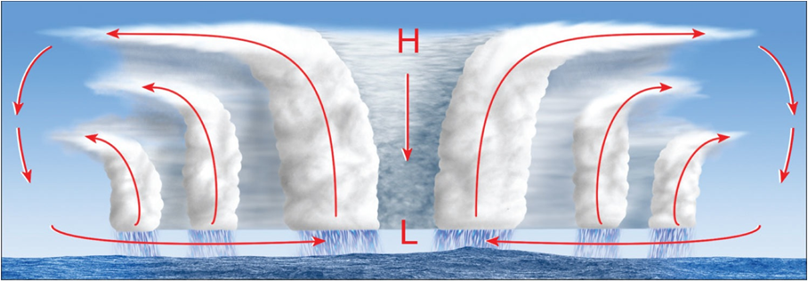
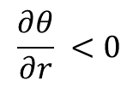
Prior Work: Sawyer-Eliassen Balanced Model
(3)
W

Slide 9
Previous Work
There has been some previous work on the topic of eyewall slope, mainly focusing on the radius of maximum wind.
Shea and Gray (1973): RMW slope from simultaneous TC flights at different altitudes. Found a relationship between RMW slope and TC intensity, as well as a relationship between eye size and RMW slope.
Stern and Nolan (2009): Airborne Doppler Radar velocity data to analyze RMW slope for 7 different hurricanes. No correlation between slope and intensity.
Rogers et al. (2012): RMW slope for 40 flight legs into 8 storms: average slope of 27.9 °.

Slide 10
Previous Work
There have been a few other studies looking at different metrics of eyewall slope.
Radar reflectivity is one useful metric:
1. It can be used as a proxy for the updraft without having to accurately observe vertical velocity in all parts of a TC.
2. Reflectivity also can show the eyewall updraft better than RMW, which is derived from the horizontal wind field.
Jorgensen (1984) and Marks (1985) analyzed the slope of the 10 dBZ surface for Hurricane Allen in 1980.
Corbosiero et al. (2005) looked at slope of the 10 dBZ contour for two flight legs into Hurricane Elena as part of a study of that TC’s structure.

Slide 11
Current Study
In this study, we analyze eyewall slopes based on radar reflectivity data for 15 different Atlantic hurricanes from 2004-2011.
This study use the 20 dBZ surface to calculate eyewall slope.
Different dBZ values tested → 20 dBZ was most robust for approximating the strong gradient of reflectivity between the eyewall updraft and the clear air/high clouds in the eye.
No other study has performed a climatology of eyewall slopes based on radar reflectivity.
In addition, this study will quantify asymmetries in slope that have been only briefly treated by previous analyses.

Slide 12
Current Study
We investigate whether this measure of eyewall slope is similar to others (such as RMW slope), by looking at relationships with storm structure and intensity.
As mentioned previously, the slope of a dBZ surface is likely a fundamentally different measure, although it may be related to other slope measures.
We seek to answer the following questions:
1. What is the distribution of eyewall slopes over a multi-year climatology?
2. How does eyewall slope (as measured by a reflectivity surface) relate to the intensity of TCs, on both a climatological and individual storm scale?
3. How is eyewall slope related to structural changes within the TC inner- core region?

Slide 13
Data and Methodology

Slide 14
Data Used
Radar data: research flights by the NOAA Hurricane Research Division (HRD) and the NASA GRIP field campaign.
The HRD data (which comprised most of the cases analyzed) has a vertical resolution of 0.5 km.
123 flight legs into 15 different storms.
The slopes were then averaged around the six-hourly “Best Track” times (0000 UTC, 0600 UTC, 1200 UTC, 1800 UTC) for comparison with TC location and intensity.

Slide 15
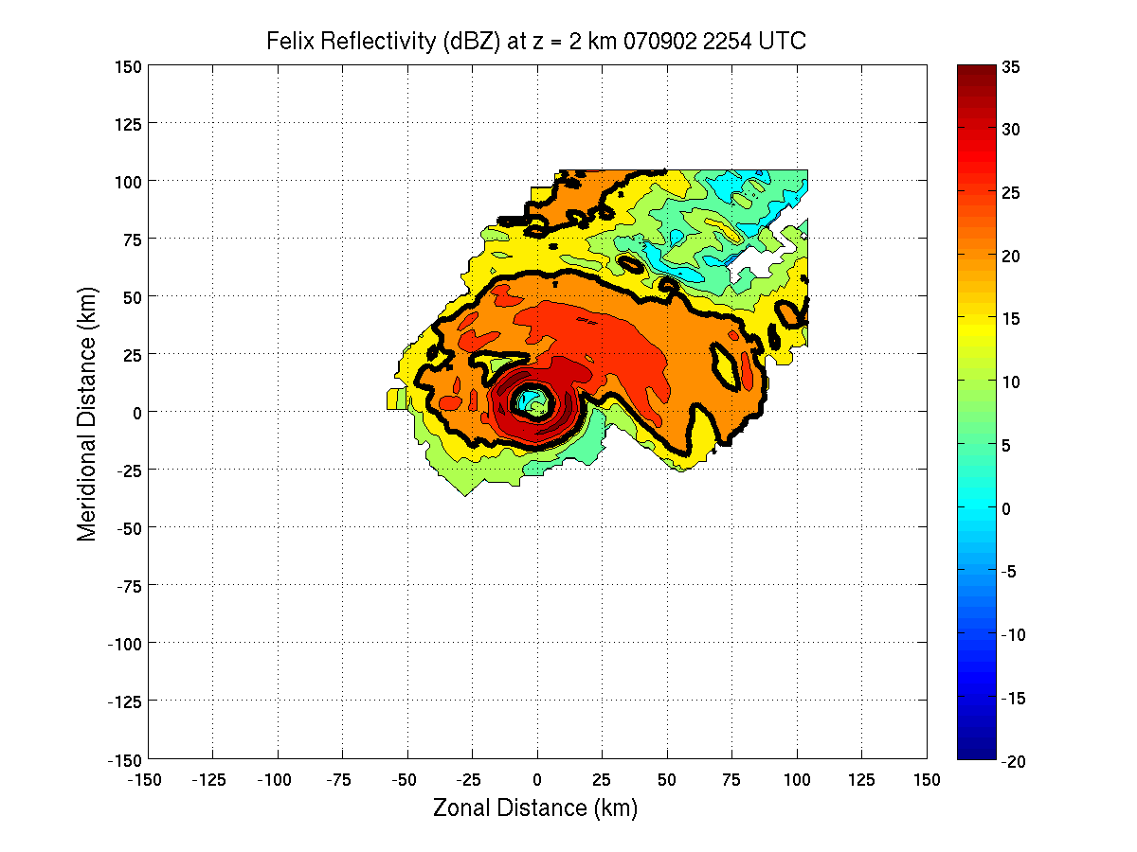
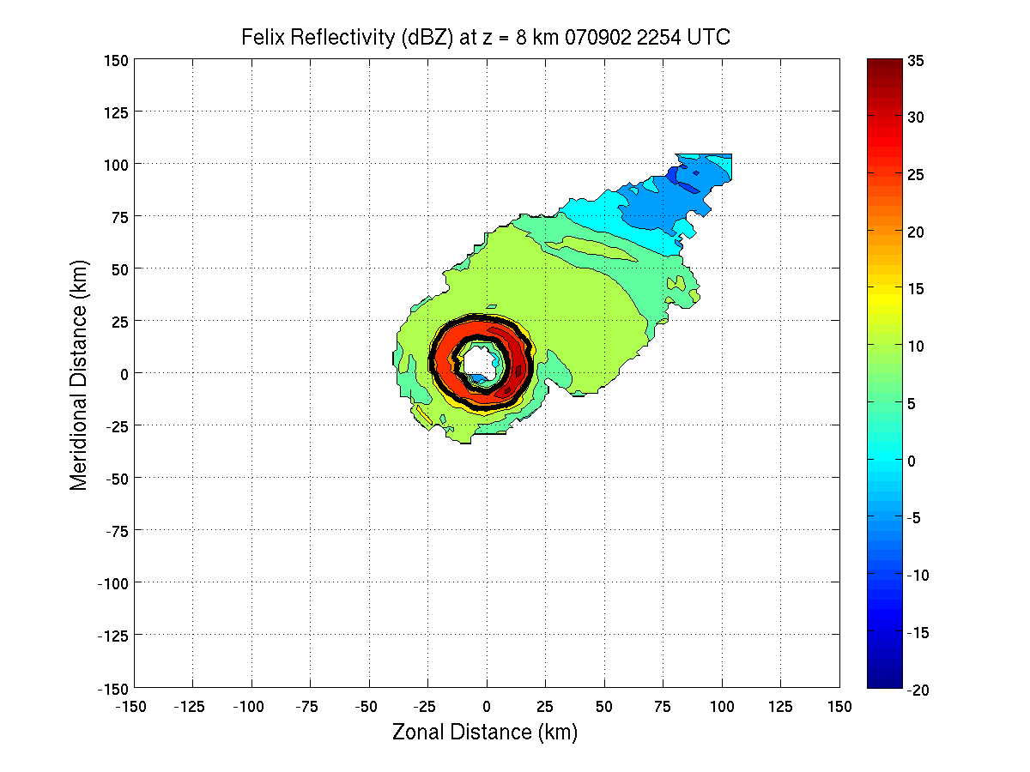
Data Used
A couple of example radar images from the HRD data, one at z = 2 km, and one at z = 8 km:
Felix at z = 2km
Felix at z = 8km
-Note how the eye is larger at z = 8 km, another sign of a sloping eyewall.

Slide 16
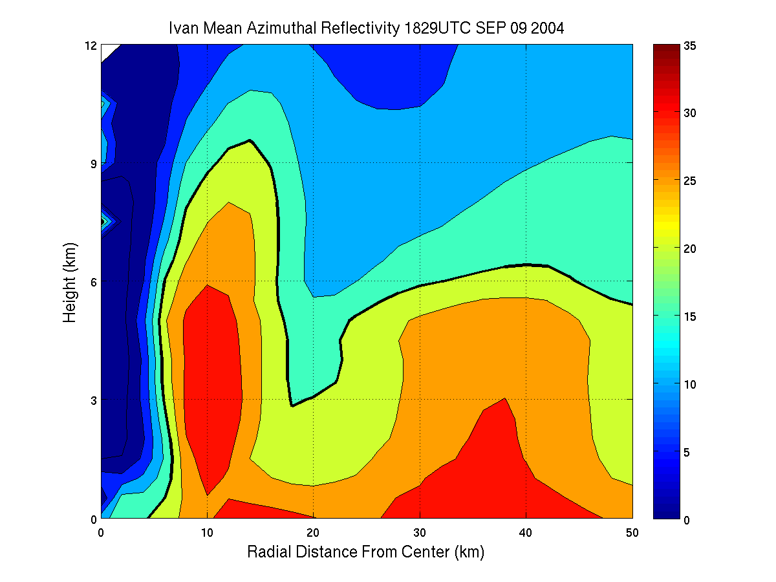
Slope Calculation
-Radius vs. height cross-section of radar reflectivity
-The vertical distance is given by the vertical level, and the horizontal distance is calculated from the storm center.
-Least squares linear regression determines the slope.
-Slope is calculated every 5° azimuthally, then the slopes are averaged to give an azimuthal average for each time.
Height (km)
0 3 6 9 12
0 10 20 30 40 50
Radial Distance From Center (km)

Slide 17
Slope Definition
15 °
30 °
-Slope in ° from vertical
-Negative slopes tilt inward with height
-0° is perfectly upright
-15 °
45 °
60 °
Z
(km)
Eye
75 °
r
(km)

Slide 18
Results
a. Slope Composites and Mean Relationships

Slide 19
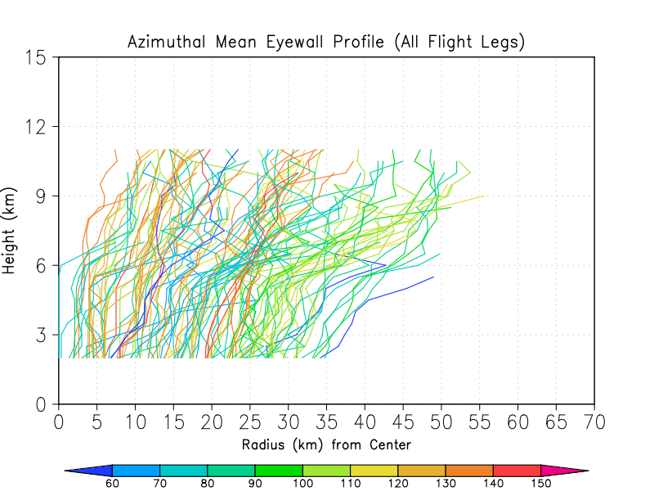
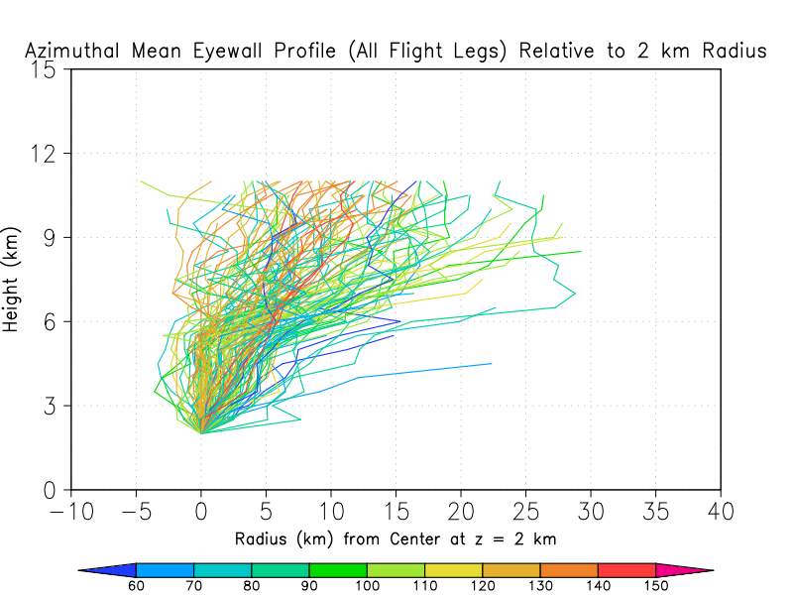
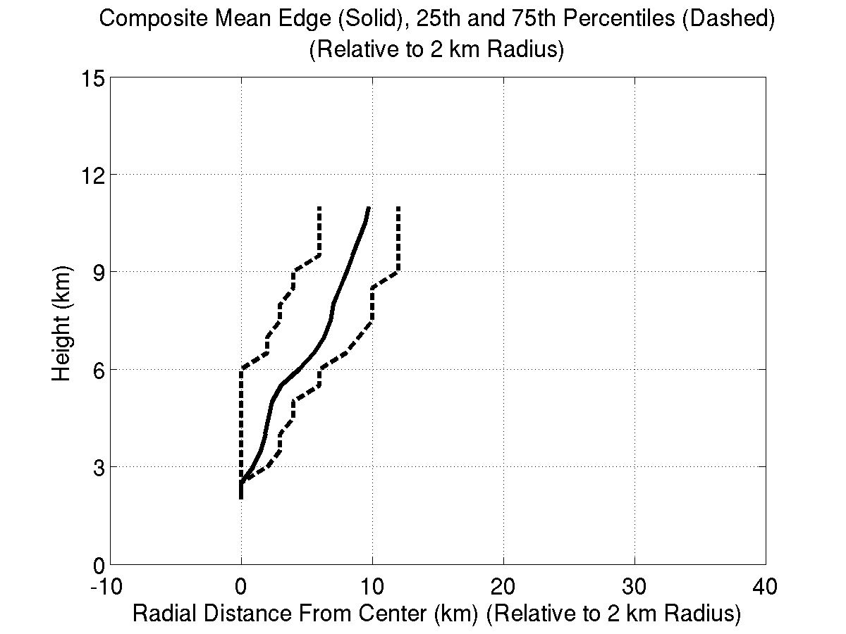
Slopes from All Flight Legs
-Eyewall (20 dBZ contour) profiles from radar dataset.
-Now we show the profiles with the distance relative to the eye radius at 2 km (determined by 20 dBZ threshold at z = 2 km).
-Note the possible connection between slope and intensity.
-The bottom figure shows the mean profile (solid) and 25th and 75th percentiles (dashed).
TS Cat 1 Cat 2 Cat 3 Cat 4 Cat 5
TS Cat 1 Cat 2 Cat 3 Cat 4 Cat 5

Slide 20
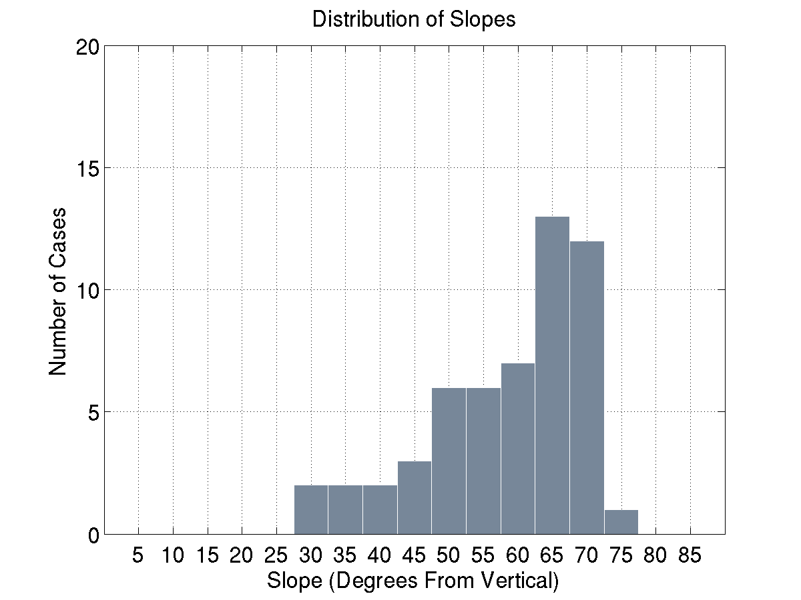
Slope Distribution
-Peak in the distribution around 65°.
-Range between about 25° and 75°.
-No vertical eyewalls
-No horizontal eyewalls
-Mean higher than RMW slope from Stern and Nolan (2009) and Rogers et al. (2012).

Slide 21
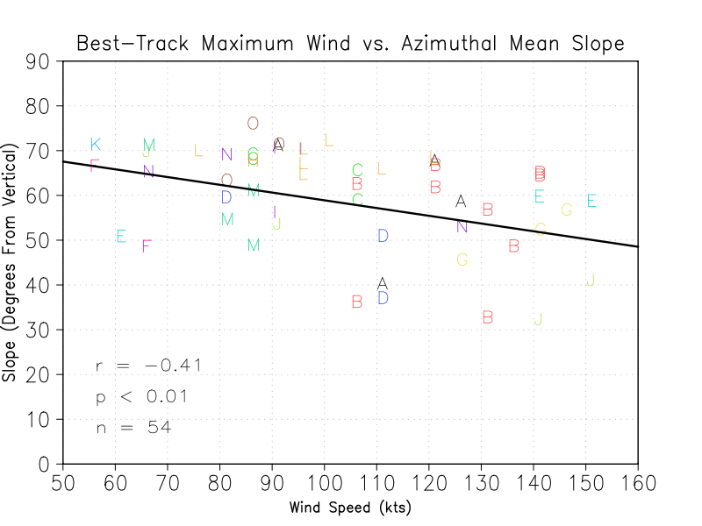
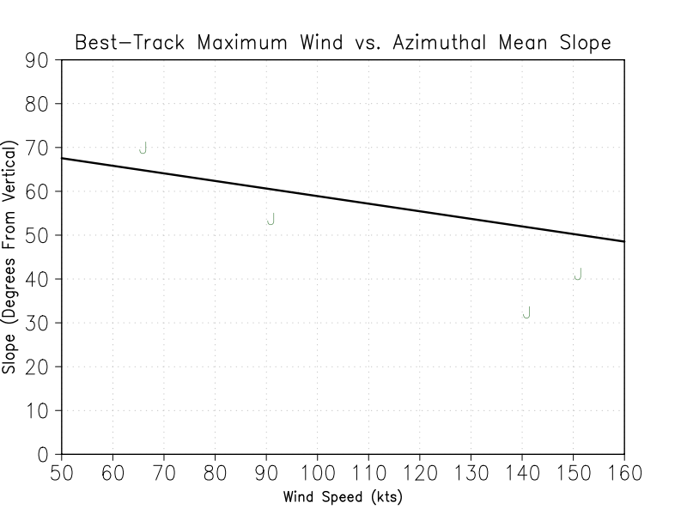
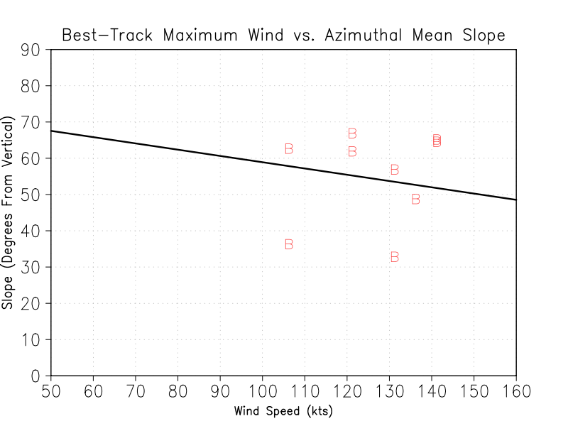
Slope vs. Intensity
-Statistically significant mean relationship between eyewall slope and TC intensity.
-Differs from results for RMW slope from Stern and Nolan (2009).
-Letters randomly assigned to different storms.
-Some storms were fairly close to the mean relationship.
-Other storms showed significant deviation.
Ivan (2004)
Felix (2007)

Slide 22
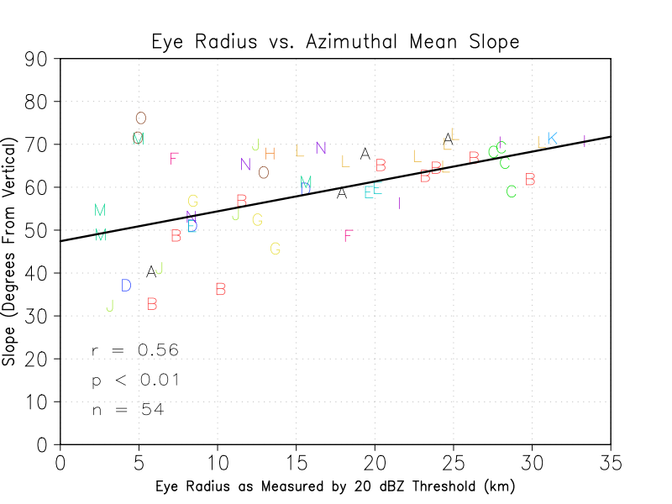
Slope vs. Eye Size
-Statistically significant mean relationship between eyewall slope and eye size.
-Once again, letters correspond to different storms.
-Note the bifurcation in slopes for smaller eyes.
-This is possibly due to the effects of eyewall replacement cycles .
-Examples from each group: Ike and Felix

Slide 23
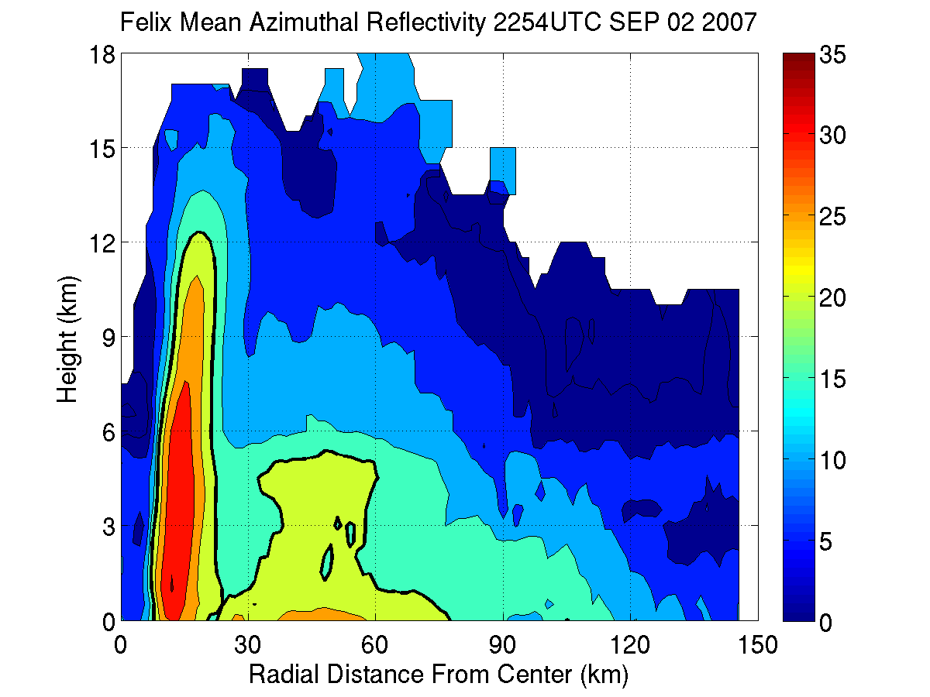
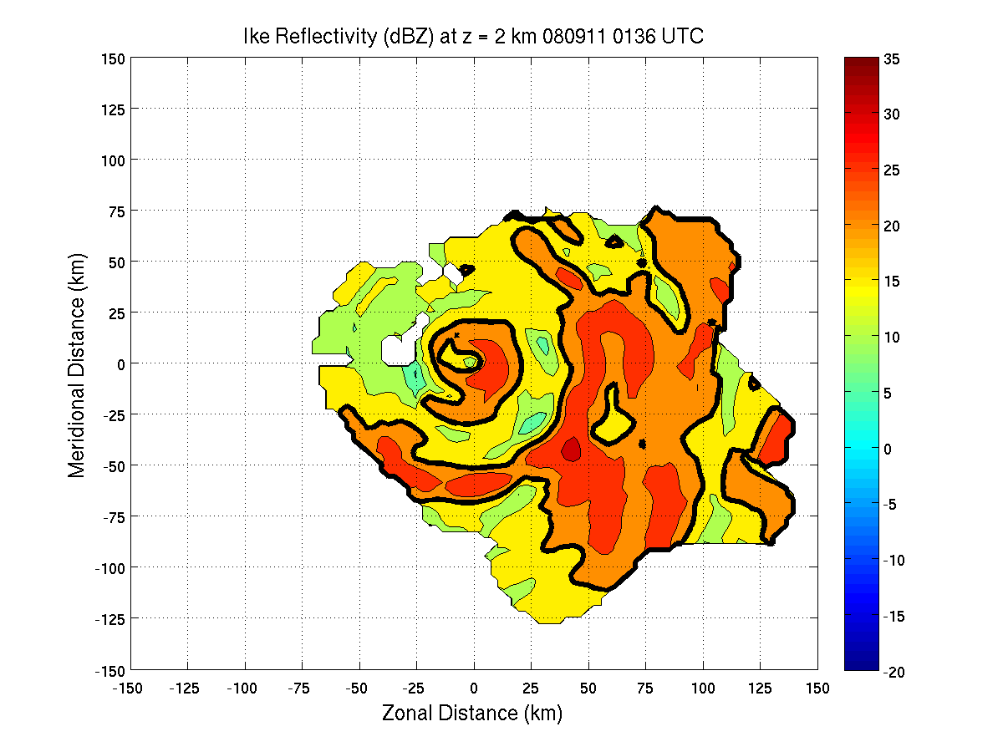
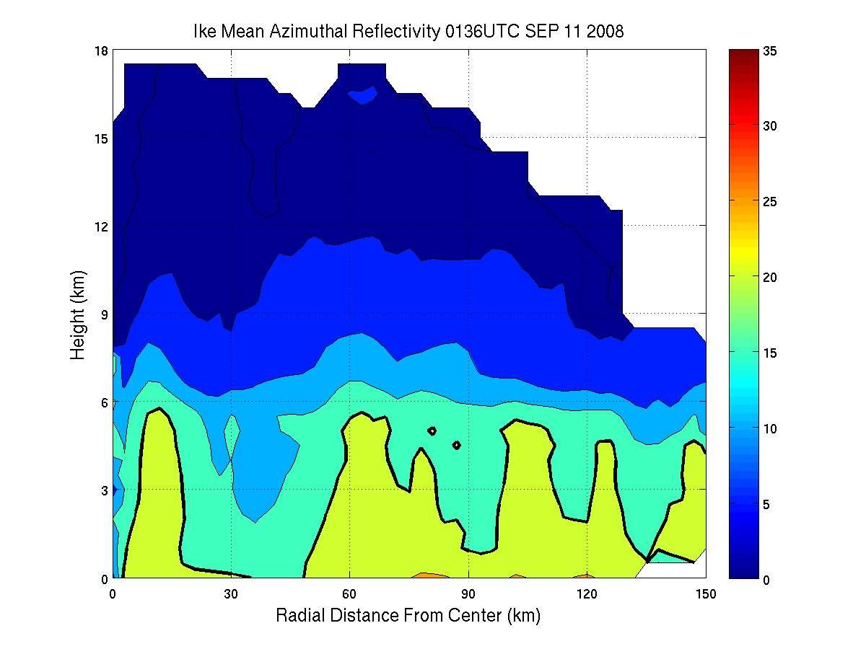
Slope vs. Eye Size
Felix Horizontal View
Felix Vertical View
Ike Horizontal View
Ike Vertical View
N-S Distance From Center (km)
-150 -100 -50 0 50 100 150
N-S Distance From Center (km)
-150 -100 -50 0 50 100 150
Height (km)
0 3 6 9 12 15 18
Height (km)
0 3 6 9 12 15 18
-150 -100 -50 0 50 100 150
E-W Distance From Center (km)
0 30 60 90 120 150
Radial Distance From Center (km)
-150 -100 -50 0 50 100 150
E-W Distance From Center (km)
0 30 60 90 120 150
Radial Distance From Center (km)
-Small eye, sloped eyewall, secondary eyewall(s)
-Small eye, upright eyewall

Slide 24
Summary of Composite Results
Slopes range from 30°-75°; 60°-65° being most common.
Stronger storm typically means more upright eyewall overall, although not for all storms.
Smaller eye typically means more upright eyewall, although some storms with secondary eyewalls break from this.
→ This tells us what slope is like in a mean, climatological sense, and shows some storm to storm variation, but how does slope vary within a storm?

Slide 25
Results
b. Common Asymmetries

Slide 26
Lower Slope vs. Upper Slope
-Note how the upper part of the eyewall is more sloped than the lower part.
-This example is from Hurricane Ivan (2004).
-We separated slope into a lower layer (2-6.5 km) and upper layer (6.5 – 11 km) for all cases analyzed.
-74% of cases had a higher upper slope than lower slope.
-Mean Lower: 46.1 (± 1.80) °
-Mean Upper: 56.3 (± 1.74) °
Height (km)
0 3 6 9 12
0 10 20 30 40 50
Radial Distance From Center (km)
-Warm core strongest at upper levels in TCs.

Slide 27
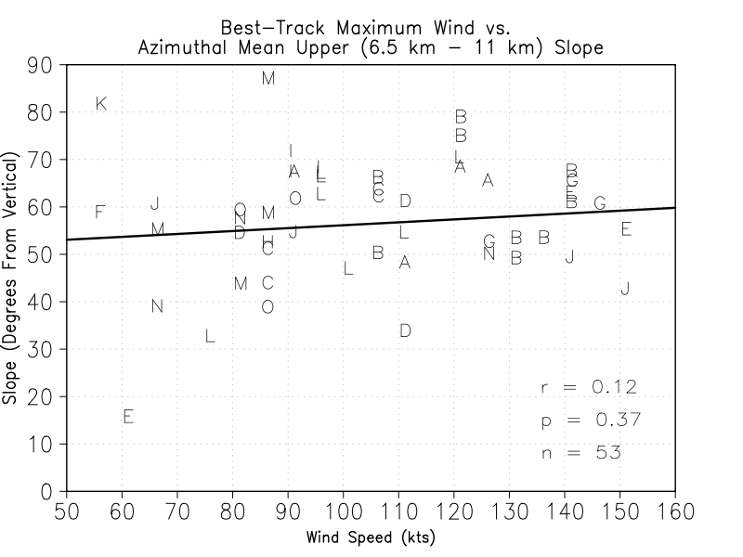
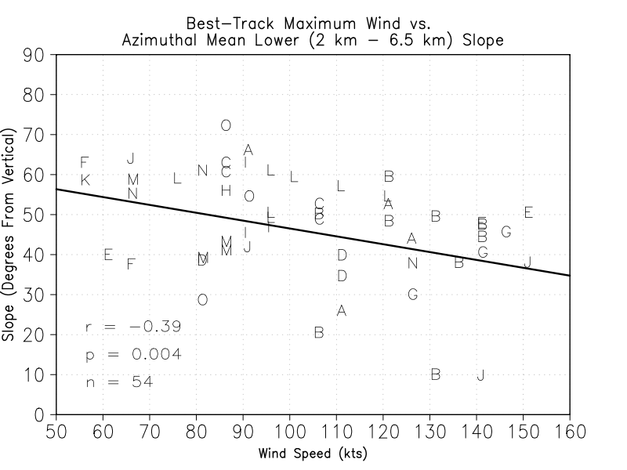
Lower Slope vs. Upper Slope
-Upper slope shows none
-Lower slope shows correlation with intensity

Slide 28
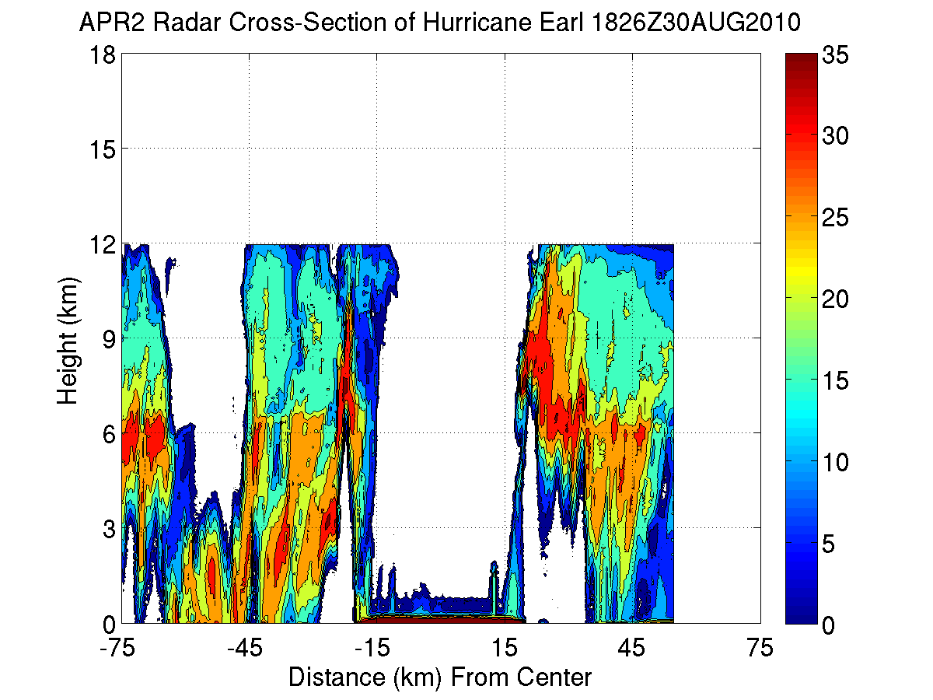
Cross-Eyewall Asymmetry
-This example is from Hurricane Earl (2010).
-South eyewall slopes more than north eyewall, and north eyewall slopes inward.
-It turns out that the vertical wind shear was from the north at this time.
-Many of our cases showed an asymmetry due to shear.
-Downshear slope was greater than upshear slope in 60% of cases, with an average slope difference of 10.3°.
N
Shear
S

Slide 29
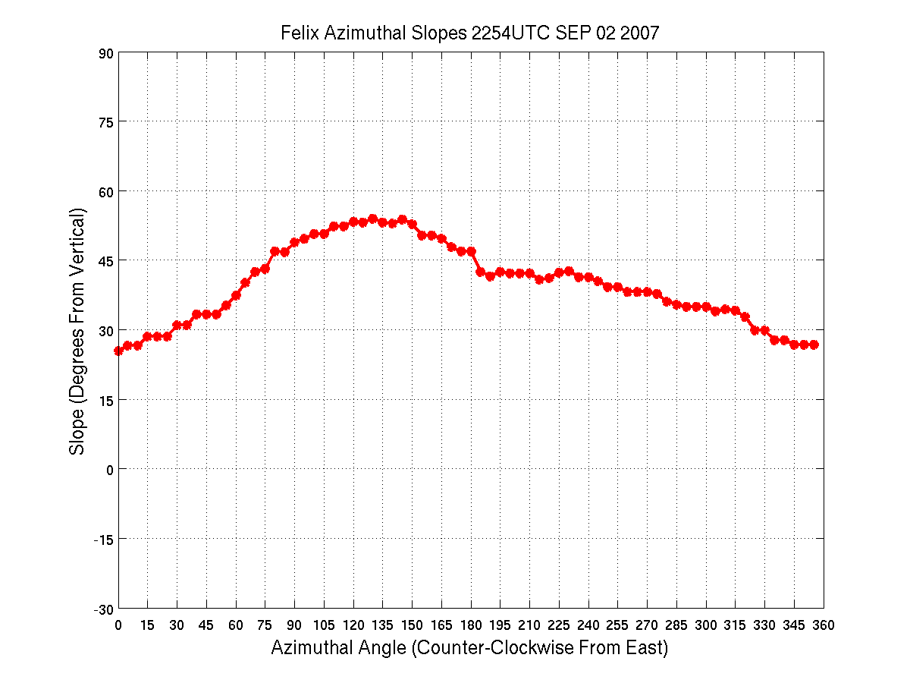
Azimuthal Variance in Slope
-This figure shows the azimuthal variance in slope for one pass through Hurricane Felix.
-Slope range of about 30°
-Most of our cases showed similar or even greater azimuthal variation in slope.
-Cross-eyewall asymmetry was due to shear, but other factors likely cause this variation.
Slope (Degrees From Vertical)
-30 -15 0 15 30 45 60 75 90
0 45 90 135 180 225 270 315 360
E N W S E
Azimuthal Angle
(Counter-Clockwise from East)

Slide 30
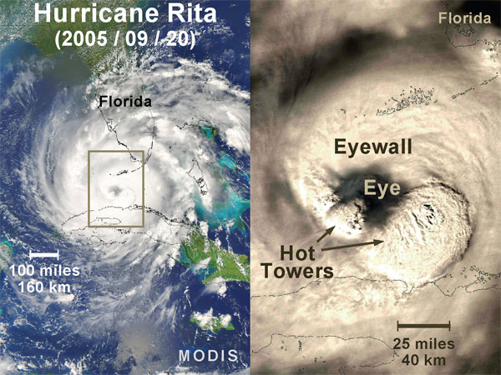
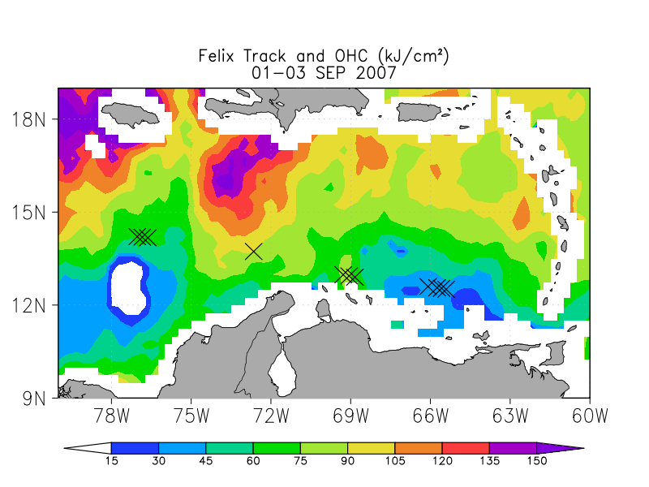
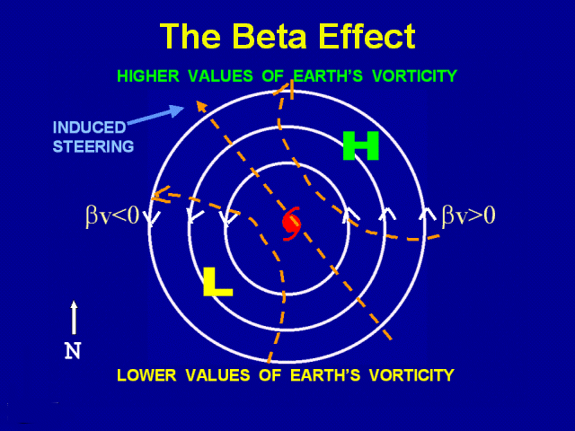
Azimuthal Variance in Slope
-Asymmetries due to beta effect
-Beta affect due to advection of earth’s vorticity by TC circulation.
-Since the circulation weakens with height, beta effect changes with height, causing natural vortex tilt.
-Convective asymmetries, including shear-induced (Reasor et al. 2013).
-Gradients in ocean temps
-Changes in surface heat flux.
-Changes in instability/CAPE which could affect strength of eyewall updraft.
www.nasa.gov
www.wunderground.com

Slide 31
Summary of Asymmetries
Eyewall is more slope at upper-levels, consistent with theory.
Lower-level slope more correlated with intensity.
Eyewall tends to slope more on the downshear side.
Large azimuthal variation, reasons for this are a topic for future study.

Slide 32
Conclusions
Eyewall slope is a commonly observed feature in TCs, and there is a wide range of slopes observed.
There is an apparent connection between eyewall slope and TC intensity, as well as size and slope.
We see three main asymmetries:
1. Vertical change in slope
2. Differences in slope across the eye due to shear
3. Variation in slope all around the eyewall, which merits further investigation.

Slide 33
Future Work
Analyze slope in a shear-relative framework and see how shear-induced convective asymmetries affect slope (also using metrics other than just reflectivity).
Investigate factors other than shear that affect azimuthal asymmetries in slope, such as SST/Ocean Heat, other convective asymmetries, natural vortex tilt due to Coriolis gradient, etc.
Use slope as a metric for analyzing modeled TC structure (for example, in HWRF) vs. observed structure.

Slide 34
Current Analysis at HRD
Make use of the higher-quality (higher resolution) research composites to investigate the azimuthal asymmetry in slope, particularly with regards to shear.
Look at asymmetries in reflectivity slope, as well as the slope of the RMW and the M surface that corresponds with the RMW at lower levels.
Investigate relationship between slope and intensity in the context of strengthening vs. weakening or steady-state TCs.

Slide 35
Shear-Relative Slope
We examine the slope in a shear-relative sense by separating the radar passes into shear-relative quadrants, similar to the methodology of Reasor et al. (2013).
Deep-layer shear comes from the SHIPS database.
The four quadrants analyzed are Downshear Left (DSL), Upshear Left (USL), Upshear Right (USL), and Downshear Right (DSR).

Slide 36
Cases Examined
There are 75 cases in the radar database. We sorted them doing the following:
-Removing all non-hurricanes (Vmax < 31 m/s)
-Removing all cases within 50 km of land
-Removing cases where there was a clear secondary eyewall (because this causes discontinuities between dBZ slope and RMW/M slope)
-Removing cases with little data coverage in one or more quadrants (for a homogeneous dataset).
After applying these filters, we have 37 cases

Slide 37
Cases Examined
The data from the 37 cases was composited, with the radial dimensions relative to the radius of maximum wind: r* = r/RMW_{2km} .
The slopes were calculated for each shear quadrant, and for the azimuthal mean.
In order to convert r* from the composite data to km for the slope calculation, r* was multiplied by the sample-average RMW mean of 35.9 km.

Slide 38
Preliminary Results: RMW Slope
Here is a plot of RMW slope vs. shear quadrant:
-RMW most upright upshear left and upshear right.
-More tilted downshear left and downshear right.

Slide 39
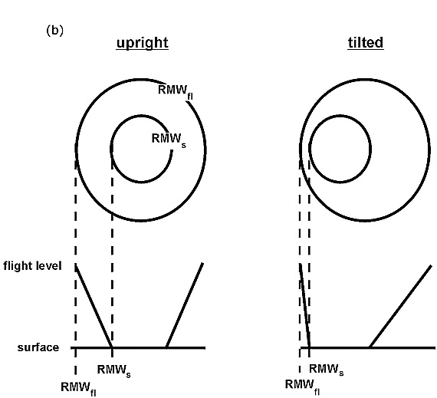
Slope in Shear-Relative Quadrants
-Consistent with the findings of Rogers and Uhlhorn (2006) using flight level and SFMR data.
-They found that the vortex of Rita became tilted with time due to vertical shear, and induced an along-tilt asymmetry in RMW slope.

Slide 40
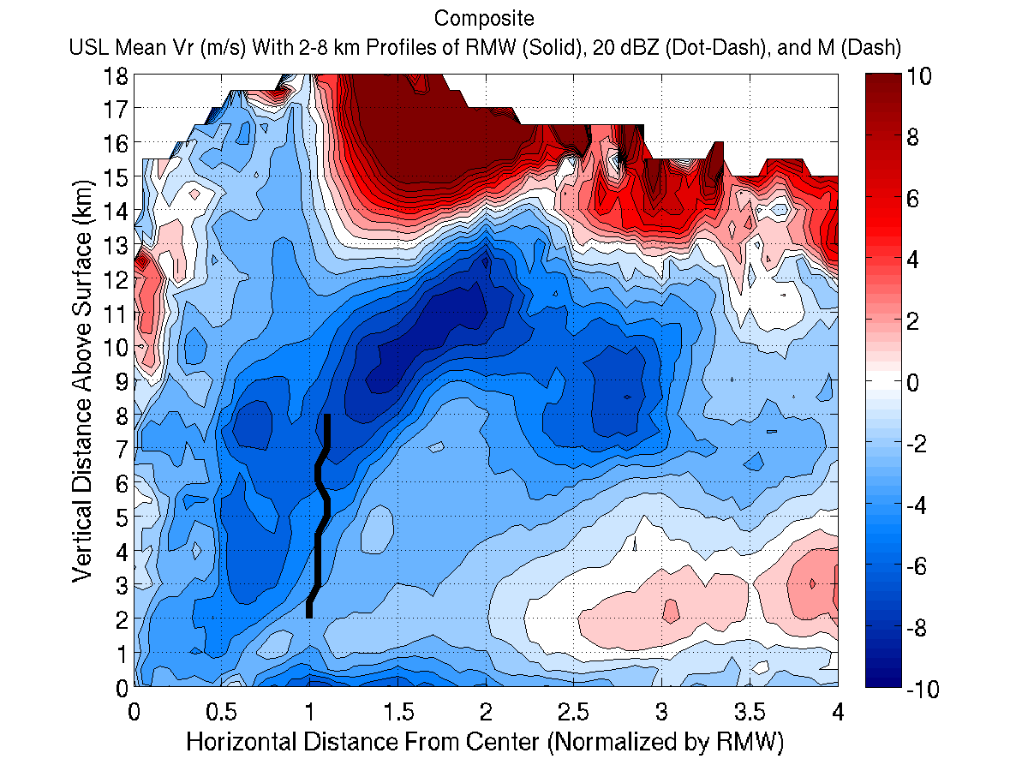
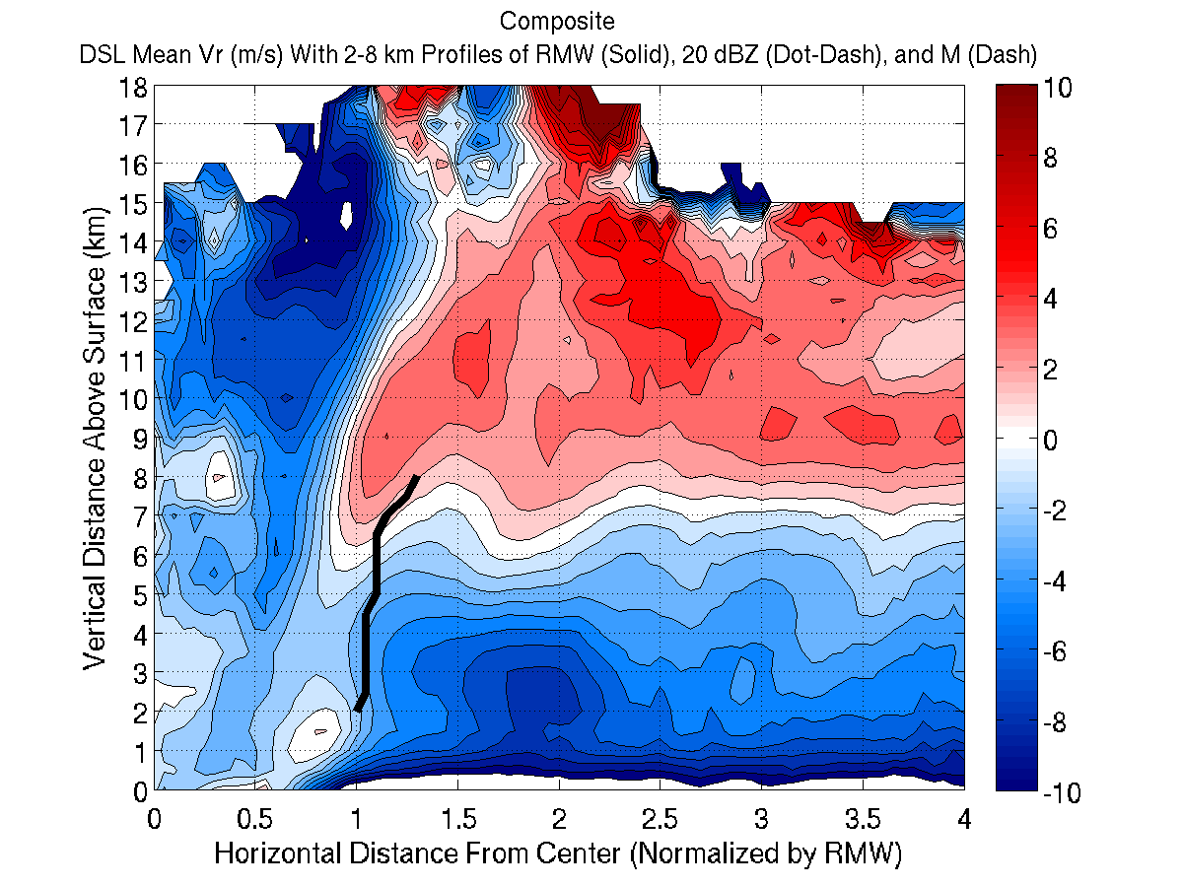

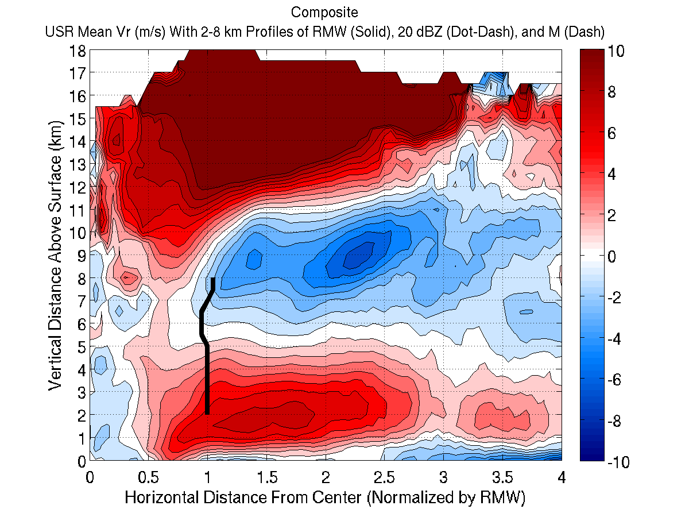
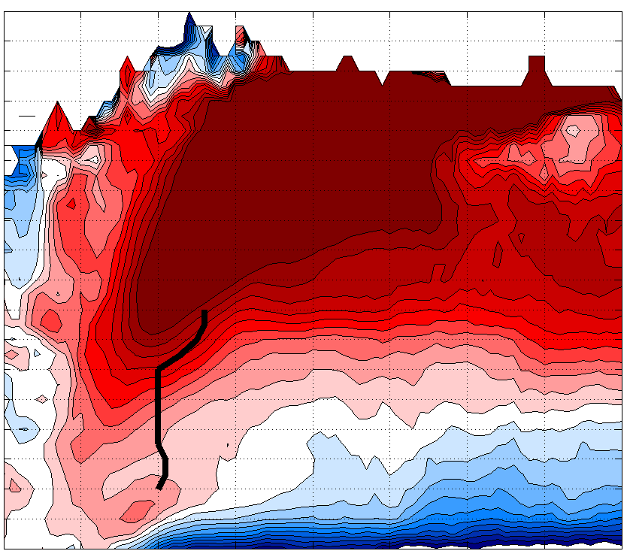
RMW Slope
18
18
17
17
DSL
-Plots of radial wind speed (m/s)
in each quadrant
-Slope of the RMW is overlain in the solid black line.
16
16
15
15
14
14
13
13
12
12
11
11
10
10
z (km)
z (km)
9
9
8
8
7
7
6
6
5
5
4
4
3
3
2
2
1
1
0
1
2
3
4
0
1
2
3
4
r* = r/RMW_{2km}
r* = r/RMW_{2km}
18
18
17
USR
17
DSR
16
16
15
15
14
14
13
13
12
12
11
11
10
10
z (km)
z (km)
9
9
8
8
7
7
6
6
5
5
4
4
3
3
2
2
1
1
0
1
2
3
4
0
1
2
3
4
r* = r/RMW_{2km}
r* = r/RMW_{2km}

Slide 41
Inflow/Outflow and RMW Slope
-Schematic showing observed inflow/outflow pattern and RMW slope in each quadrant:
USL
DSL
8 km
8 km
2 km
2 km
USR
DSR
8 km
8 km
2 km
2 km

Slide 42
Preliminary Results: M Slope
-USR is still upright, and DSL is still comparatively sloped.
-DSR is most upright for M surfaces, however.
-This could be due to the convective generation in the downshear region (e.g. Rogers et al. 2003, Davis et al. 2008)?

Slide 43
Preliminary Results: dBZ Slope
-Less variance in dBZ slope.
-Most upright DSL, possibly due to a combination of convective generation downshear and rotation of convection generated DSR.
-Upright USR, more sloped DSR possibly related to vortex tilt as discussed earlier.

Slide 44
Ongoing Work at HRD
Continue to investigate shear-relative asymmetries in slope, and look for physical explanations.
Analyze shear-relative slope in individual cases.
Compare the different slope metrics in individual cases, and look for differences between intensifying storms and steady-state or weakening storms.
Look at other HRD datasets (e.g. flight-level and SFMR) to compare with radar-observed structure in terms of eyewall slope.

Slide 45
Questions?

Slide 46
Results
c. Case Studies

Slide 47
Case Studies
Next, we will show two case studies:
Felix, which fits closely to the mean slope-intensity relationship.
Ivan, which shows the effects of secondary eyewalls on slope.

Slide 48
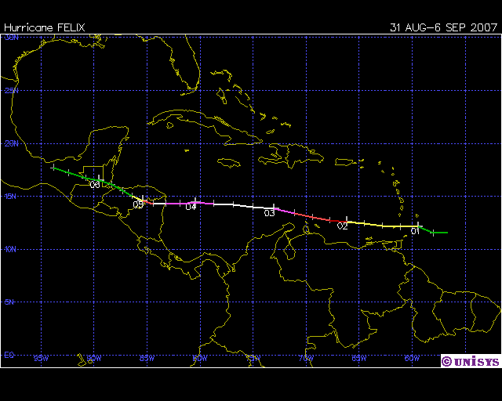
Hurricane Felix (2007)
www.weather.unisys.com

Slide 49
Hurricane Felix (2007)
-Felix started out with a relatively shallow, tilted eyewall as a minimal hurricane.
-As the storm strengthened, the eyewall became much more upright and vertically developed.
Slope: 71°
Intensity: 65 knots
Slope: 48°
Intensity: 90 knots
Slope: 40°
Intensity: 150 knots

Slide 50
Hurricane Felix (2007)
Remember that Felix fit closely to the “mean” slope-intensity relationship.
Felix was a classic case where the storm strengthened, the eyewall contracted, and the eyewall became more upright as the storm strengthened.

Slide 51
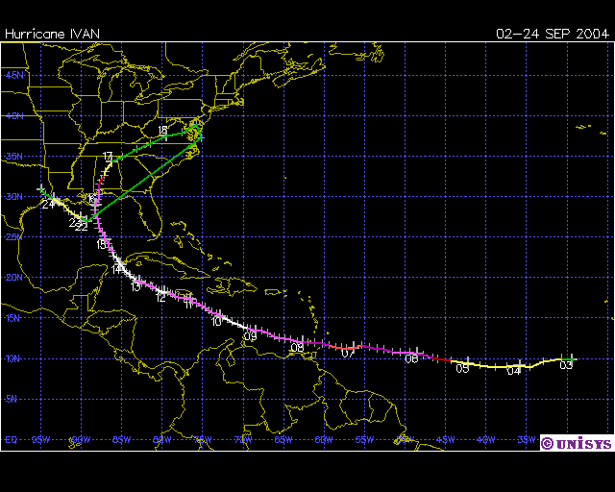
Hurricane Ivan (2004)
www.weather.unisys.com

Slide 52
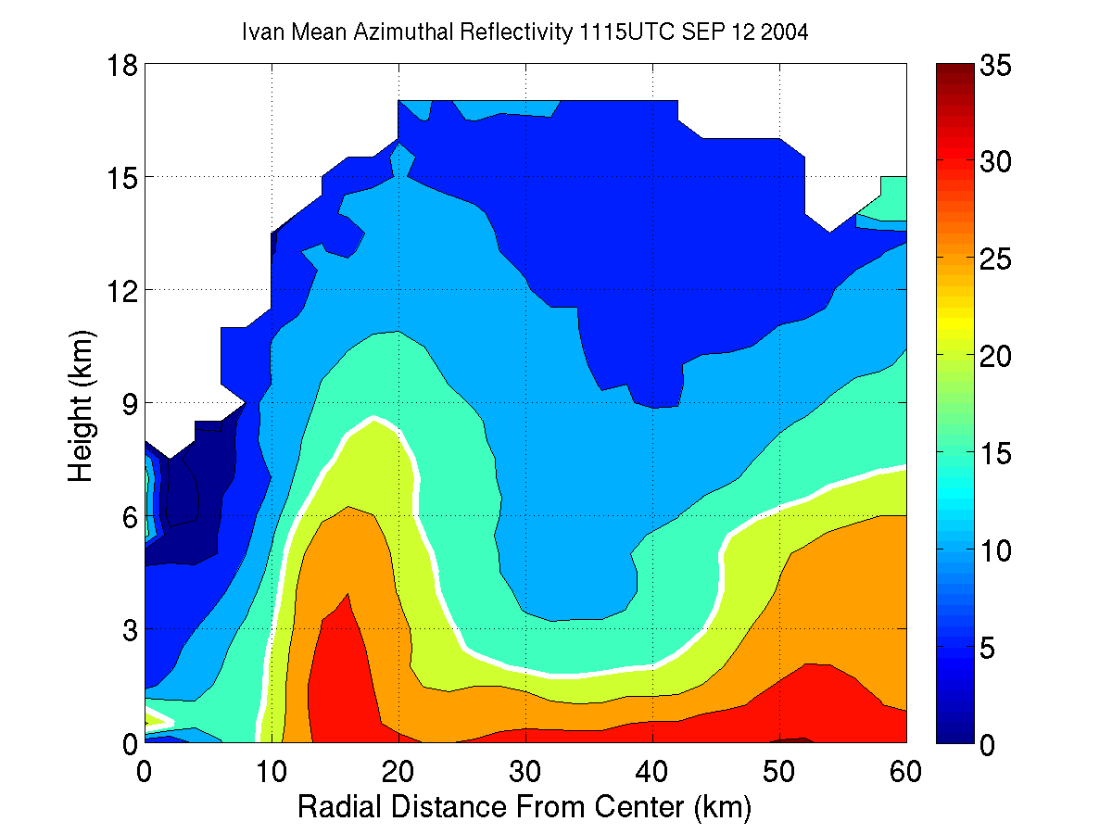
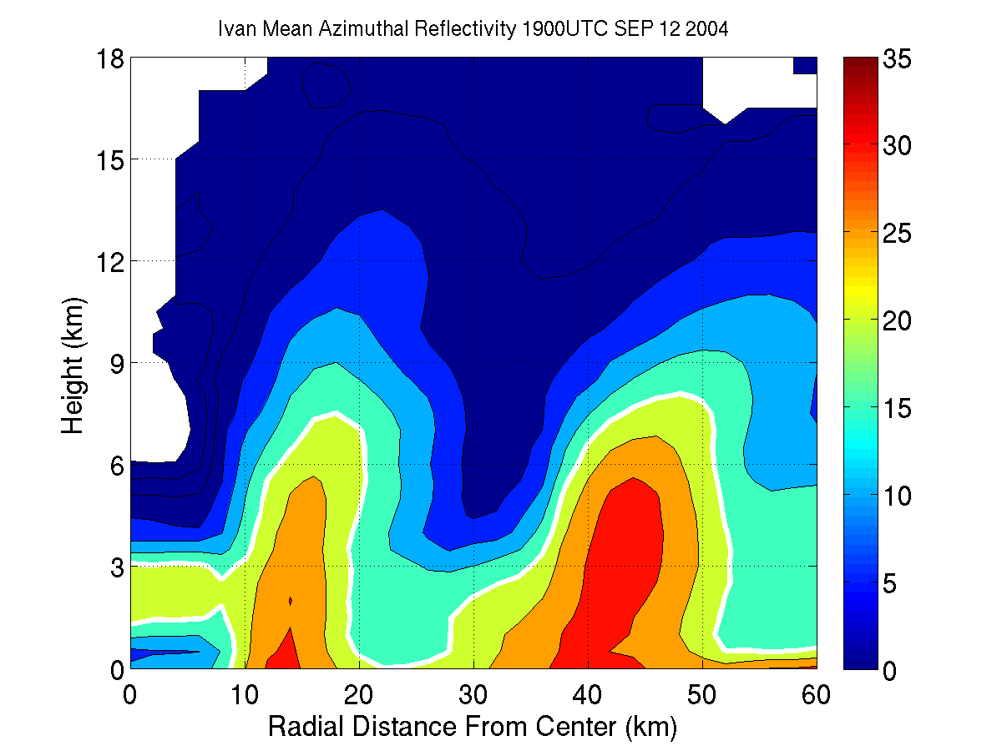
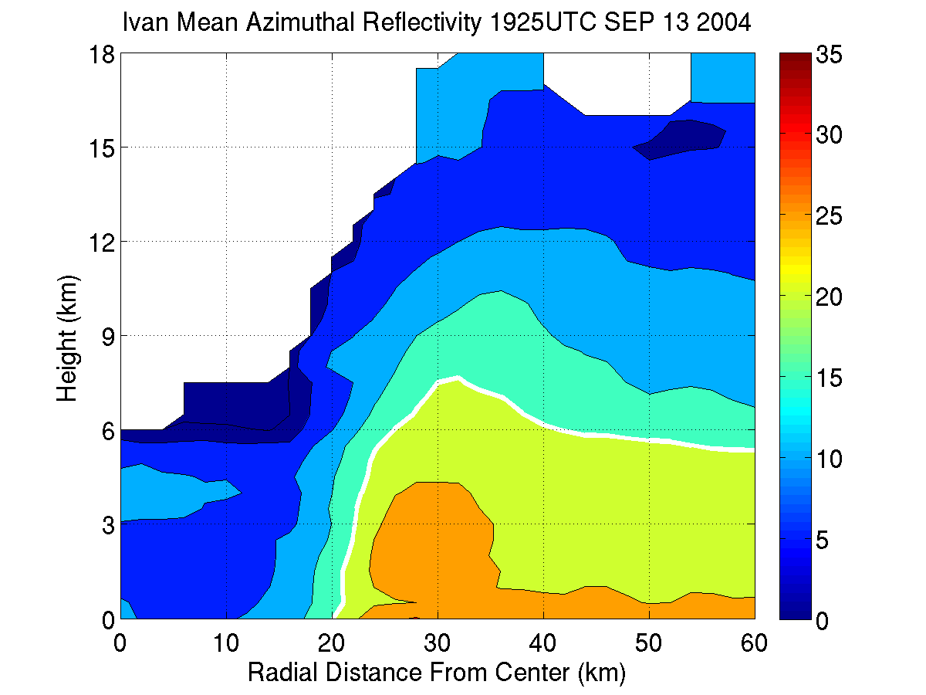
Hurricane Ivan (2004)
-Focus on an eyewall replacement cycle on September 12-13
-1115 UTC Sep 12: comparatively upright eyewall with a small eye, secondary eyewall was starting to form.
-1900 UTC Sep 12, the outer eyewall has contracted and grown, inner eyewall weaker and more tilted, eye size stayed the same.
-1925 UTC Sep 13, inner eyewall gone, “new” eyewall in place, much wider eye, intensity unchanged.
Slope: 57°
Intensity: 135 knots
Slope: 61°
Intensity: 140 knots
Slope: 40°
Intensity: 135 knots

Slide 53
Hurricane Ivan (2004)
-This figure illustrates the changes in slope and intensity throughout Ivan’s life (focus area in red box).
-The EWRC weakened the inner eyewall updraft, causing the slope to increase significantly.
-Wind did not respond for 12-24 hours.

Slide 54
Hurricane Ivan (2004)
-Ivan did not show the classic pattern of the eyewall contracting and becoming more upright as the storm strengthened.
-Secondary eyewalls caused a more complex size-slope and intensity-slope pattern to be seen in Ivan.

