Slide 1
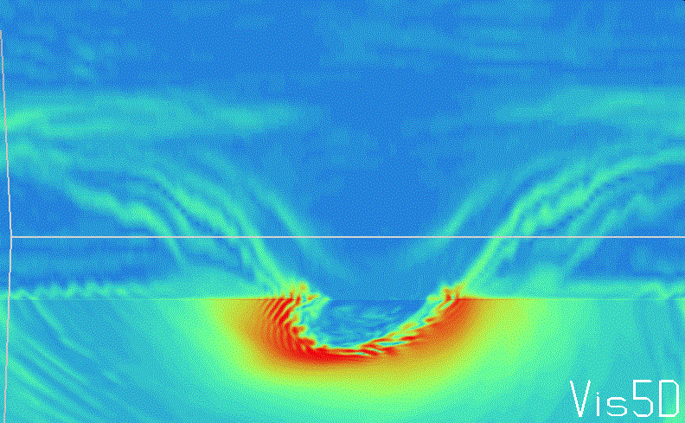
Instabilities in the hurricane inner core, boundary layer, and outflow simulated with the University of Wisconsin-Madison Nonhydrostatic Modeling System
Zachary Gruskin and Gregory J. Tripoli
University of Wisconsin – Madison
6/27/2013 – AOML/HRD

Slide 2
Contents
Boundary layer rolls in outer hurricane vortex
Boundary layer rolls near base of eyewall
Eyewall inner-edge instabilities
Mesovortices in the eye
Eyewall outer-edge instabilities
Outflow instabilities
Observational evidence of instabilities seen in UW-NMS
Developing a non-dimensional chaos parameter to understand instabilities

Slide 3
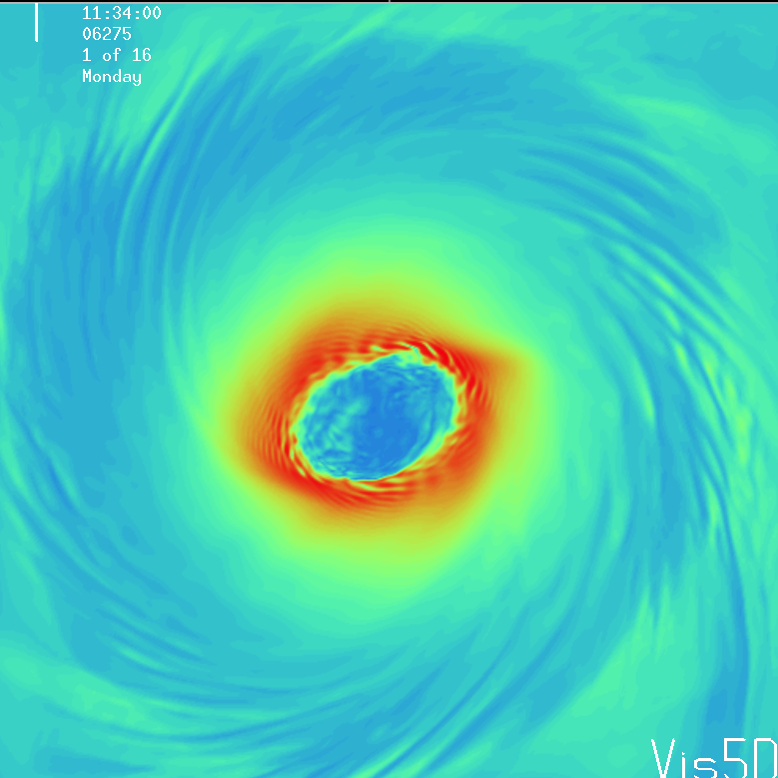
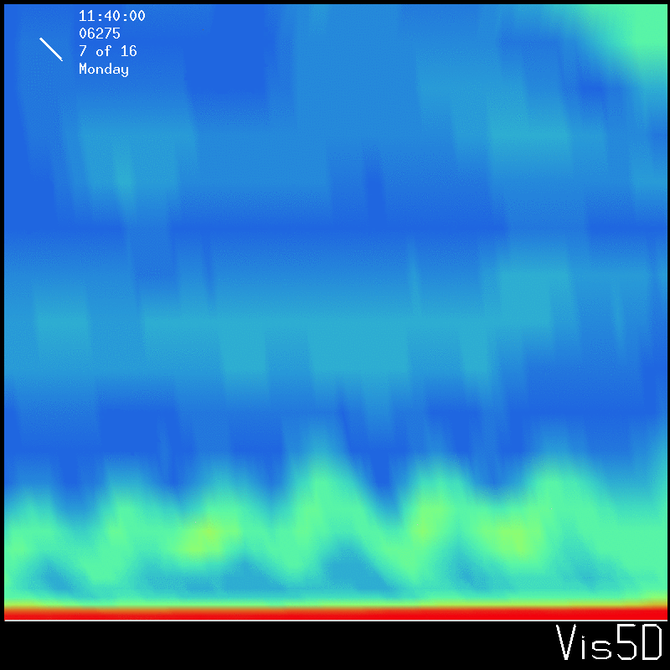
Outer vortex boundary layer rolls
Roll-like structures are ubiquitous in the boundary layer of the outer vortex of the simulated hurricane.
2-3 km deep and 5-10 km wide
200 m Total Vorticity
Total Vorticity
vertical cross-section

Slide 4
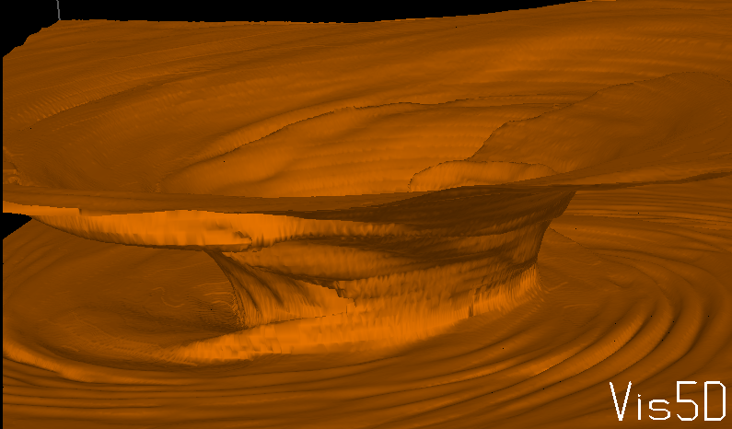
Theta-e isosurface

Slide 5
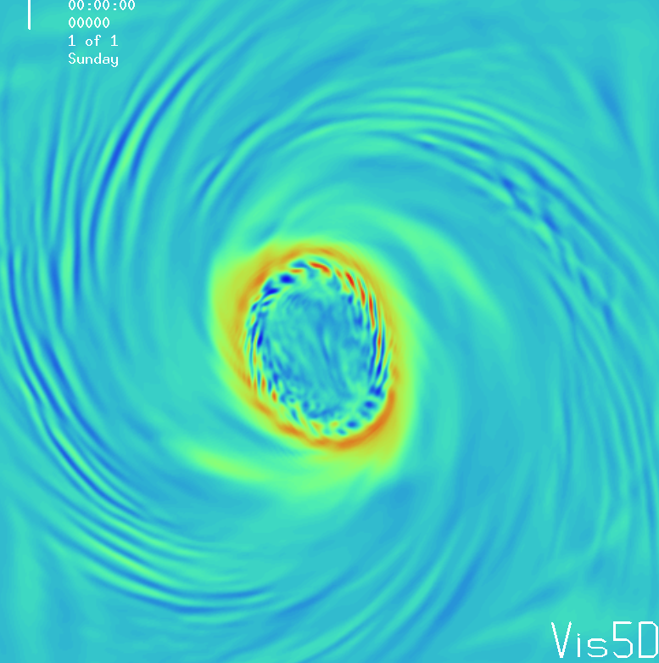
Rolls enhance vertical fluxes of momentum and heat. Without rolls the inflow layer would likely have a higher concentration of vorticity and theta-e.
This may have implications on the overall hurricane structure since ultimately most of the boundary layer is turned upwards at the base of the eyewall. Perhaps the eyewall would be more narrow and intense if rolls weren’t present (needs further experiments).
Rolls may also enhance wind induced surface heat exchange (WISHE).
1 km Vertical Velocity

Slide 6
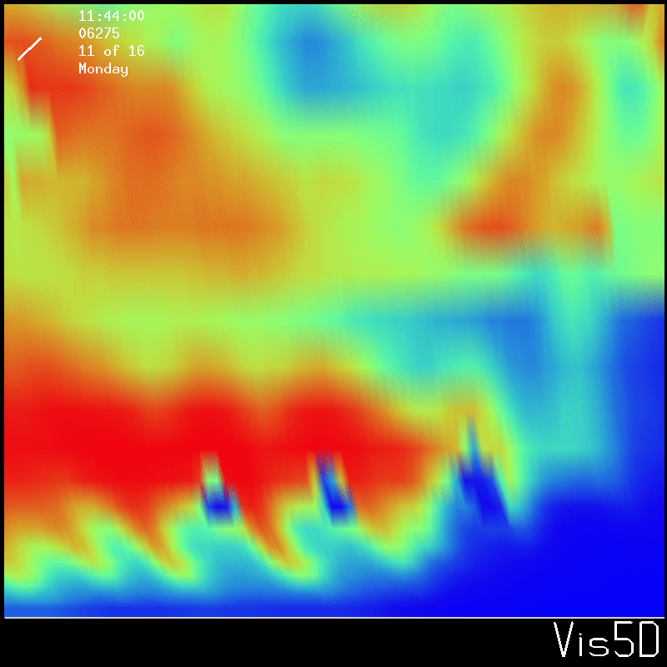
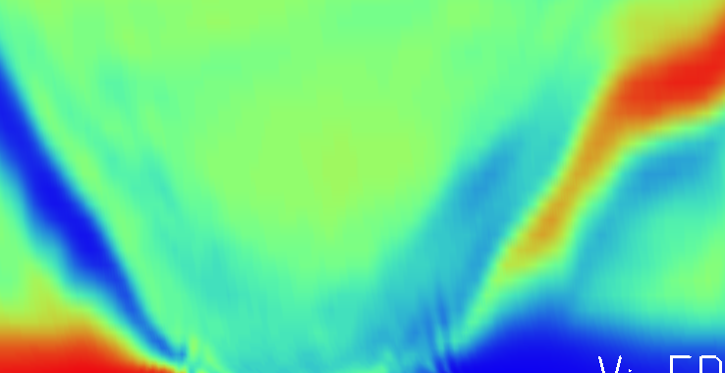
The rolls are forming in an environment of strong inflection point instability in the tangential and radial wind, as well as above a convectively unstable layer near the ocean surface. It seems appropriate to describe them as a hybrid of both Rayleigh-Bernard and inflection point instability.
Brunt-Vaisalla frequency vertical cross-section
Radial wind vertical cross-section

Slide 7
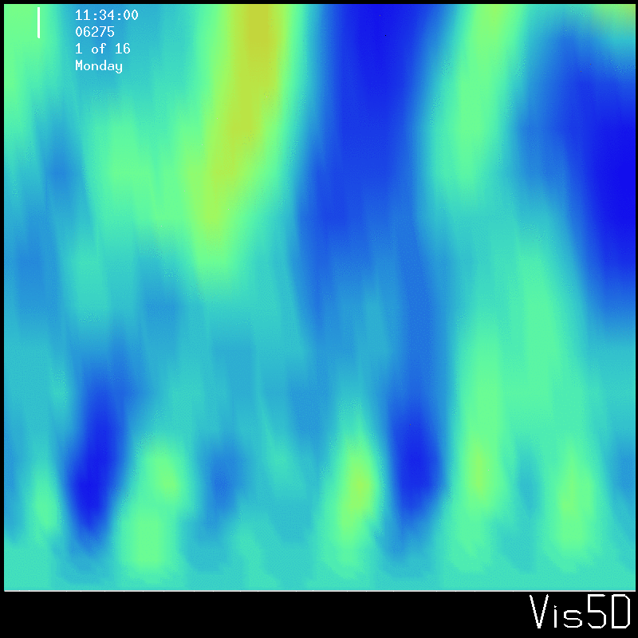
Gravity waves in the outflow layer appear to interact with the boundary layer rolls. These gravity waves extend from the lower troposphere to the stratosphere.
Vertical Velocity
vertical cross-section

Slide 8
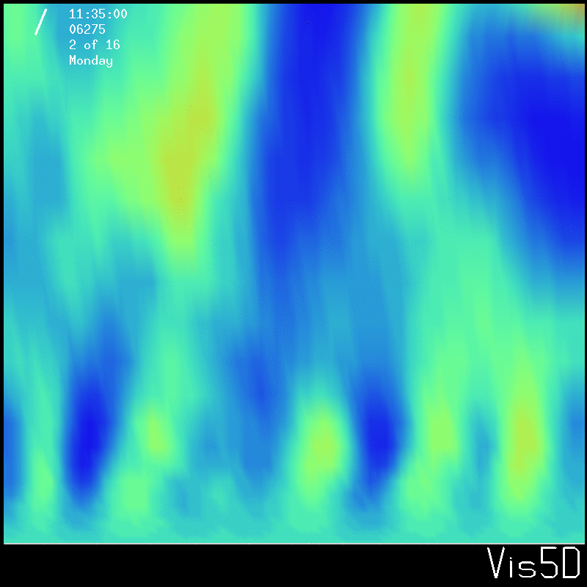

Slide 9
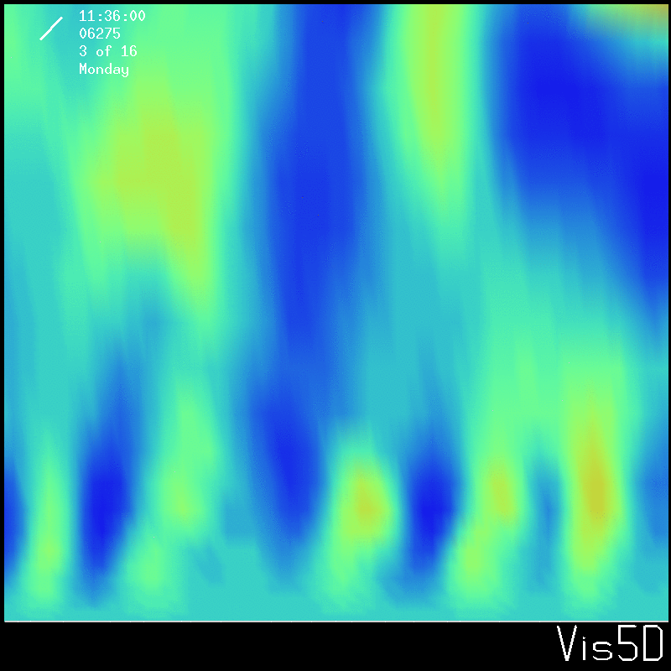

Slide 10
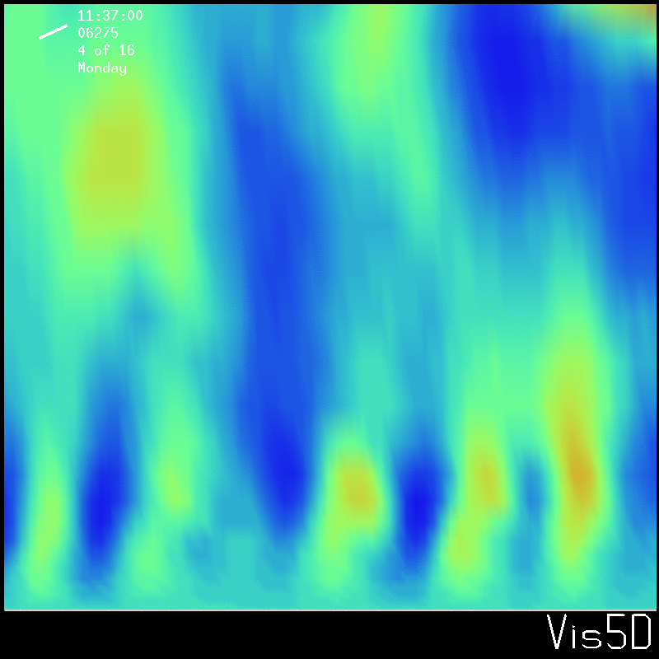

Slide 11
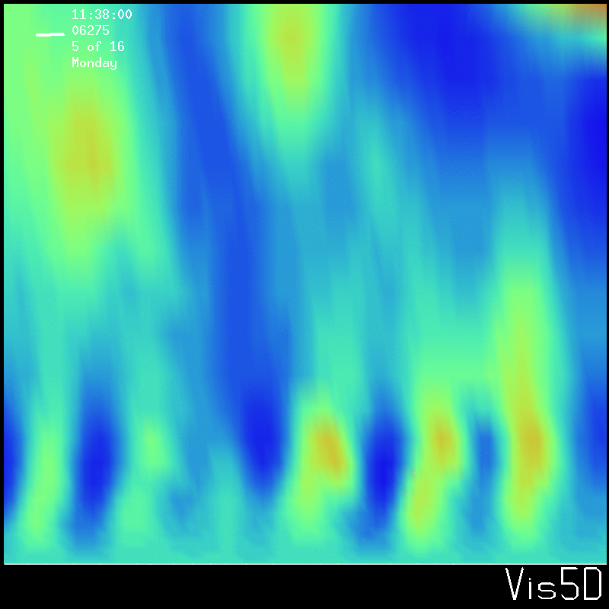

Slide 12
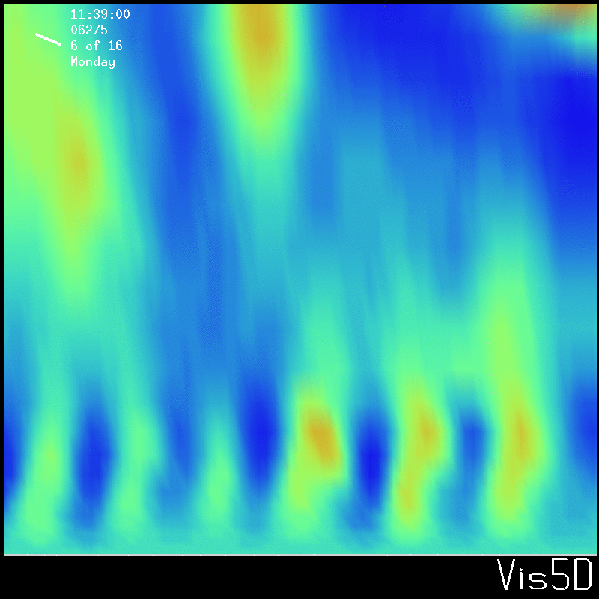

Slide 13
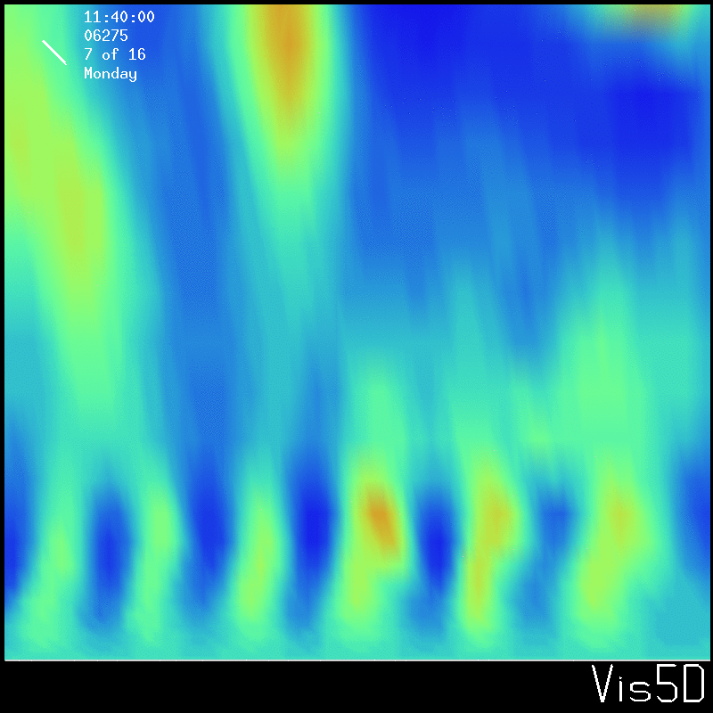

Slide 14
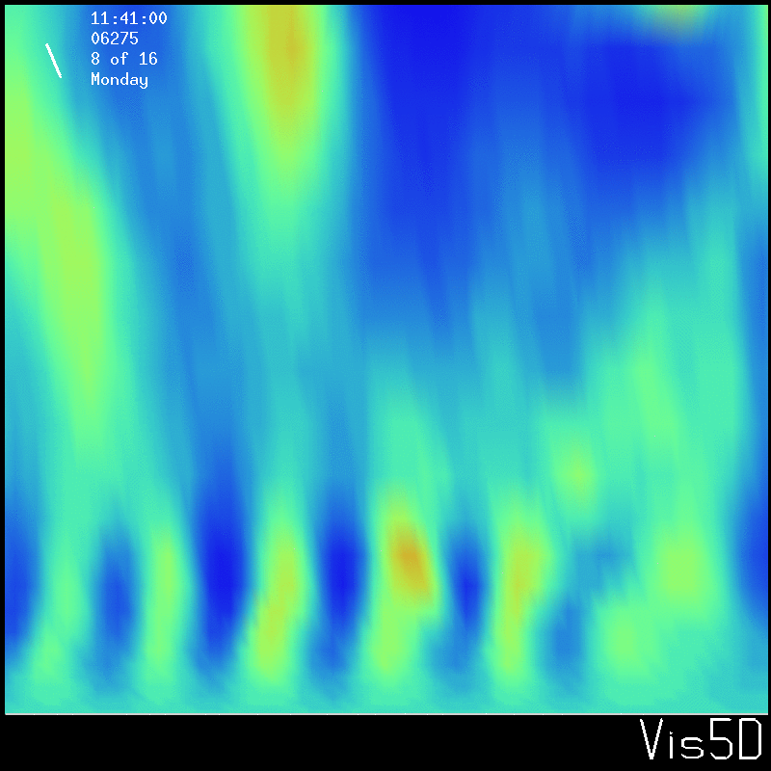

Slide 15
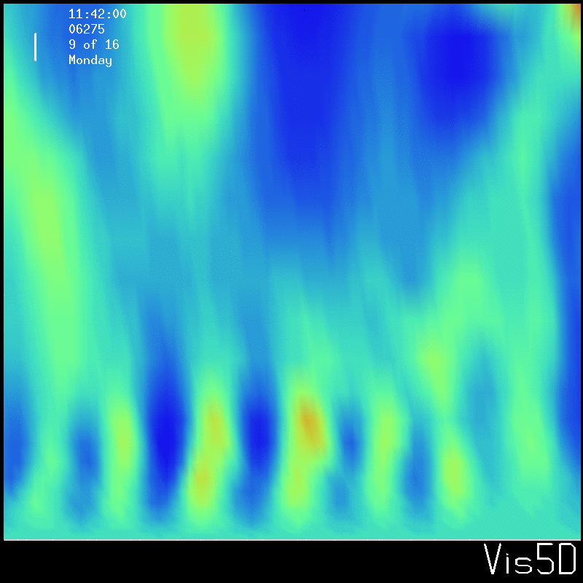

Slide 16
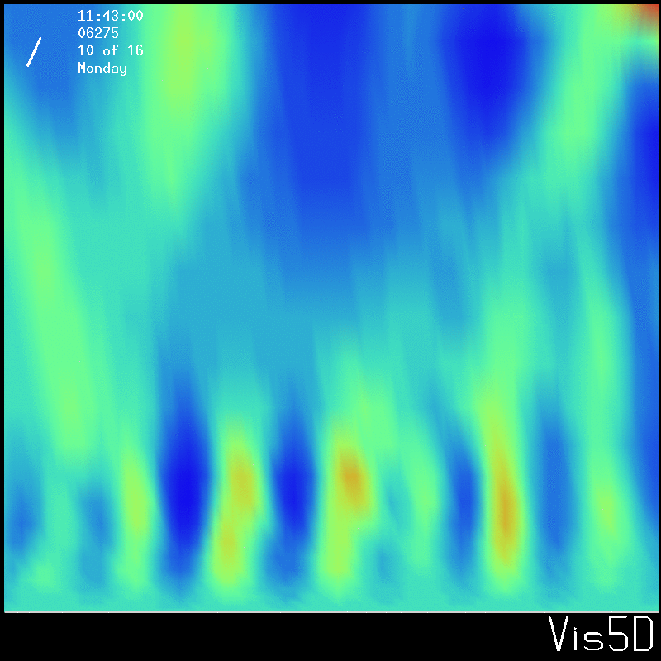

Slide 17
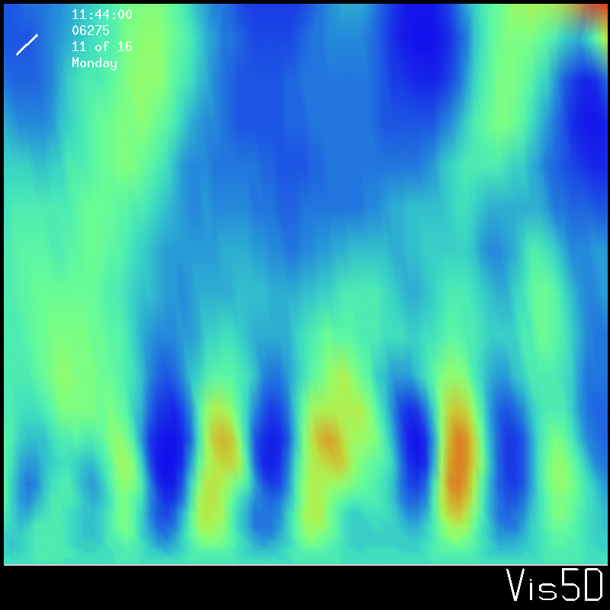

Slide 18
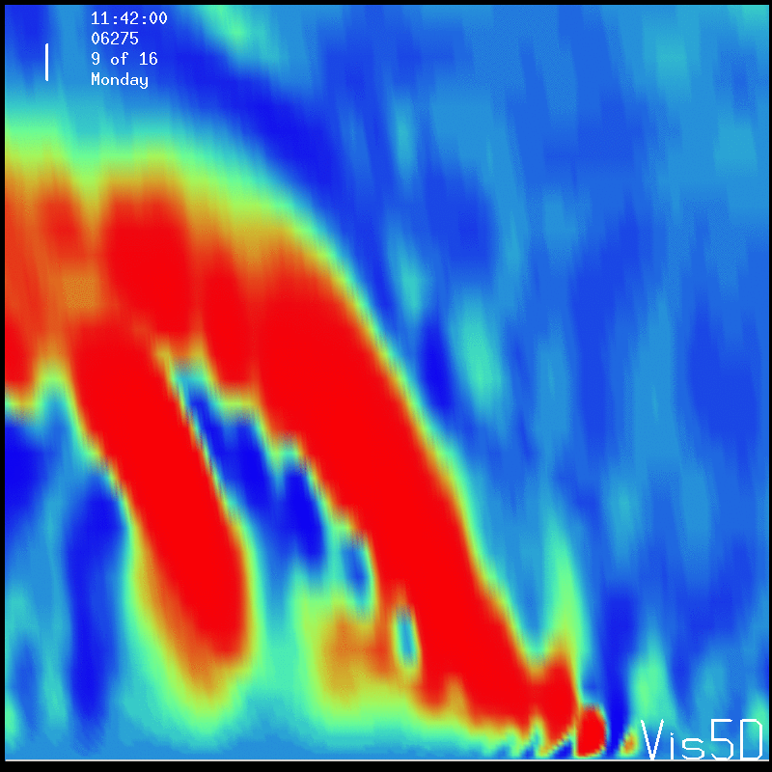
This interaction may enhance flux between the inflow and outflow layer.
There seems to be a preferred location for roll-gravity wave interaction, leading to a quasi-permanent updraft radially outward of the eyewall. This may be related to secondary eyewall formation.
The outer vortex rolls rarely make it past this secondary updraft max, suggesting they are disrupted by it.
Vertical Velocity vertical cross-section

Slide 19
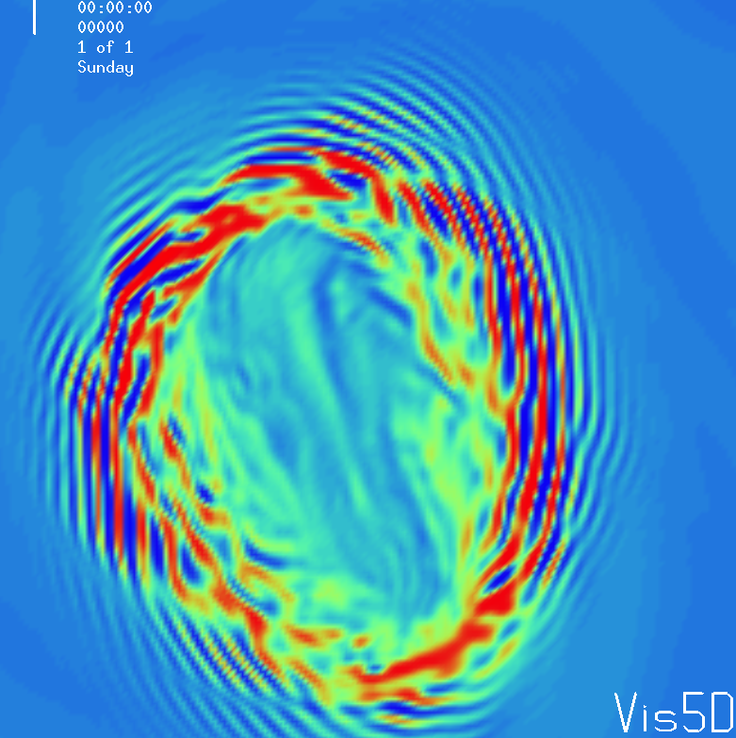
Boundary layer rolls near base of eyewall
Roll-like structures that are 1-3 km wide and about 2 km deep are evident near the base of the eyewall.
These rolls spiral anti-cyclonically inwards and are nearly parallel to the local vertical wind shear, strongly suggesting they are inflection point instability.
200 m Vertical Vorticity

Slide 20
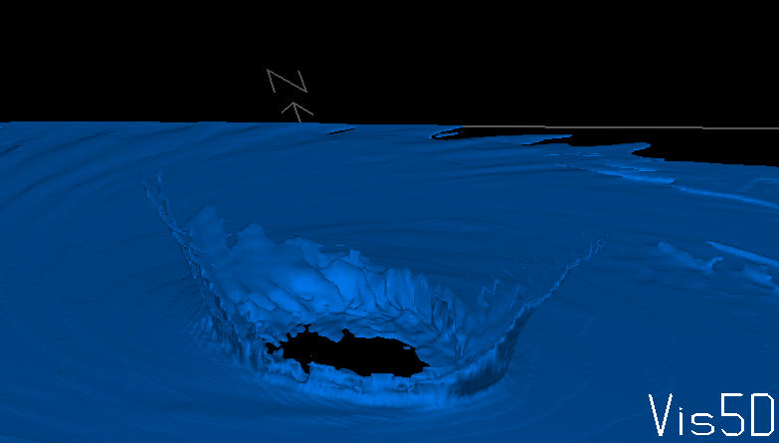
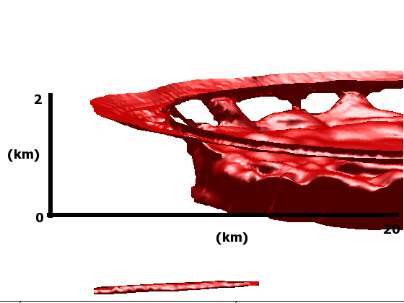
The rolls spiral inwards to the base of the eyewall, at which point they’re turned upwards.
This leads to the formation of a vortical plume which contains high theta-e boundary layer air. These plumes also entrain high theta-e air from below the subsidence inversion in the eyewall, possibly leading to the most vigorous convection in the hurricane.
Theta-e isosurface
Total vorticity isosurface

Slide 21
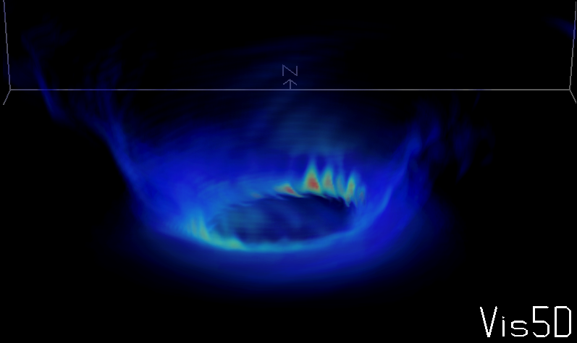
The instabilities also contain air rich in turbulent kinetic energy (TKE) emanating from the boundary layer. Thermalization of this TKE may enhance the plumes.
TKE volume

Slide 22
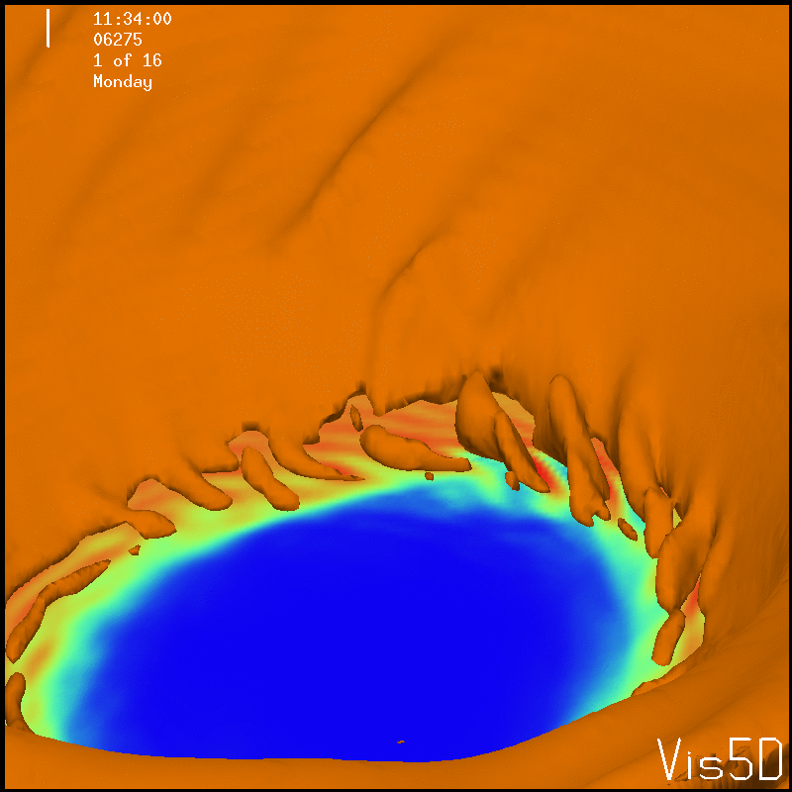
The strongest winds in the hurricane eyewall occur in association with the instabilities on the inner edge of the eyewall. Could this explain some of the damage patterns in landfalling hurricanes?
Surface wind and
W isosurface

Slide 23
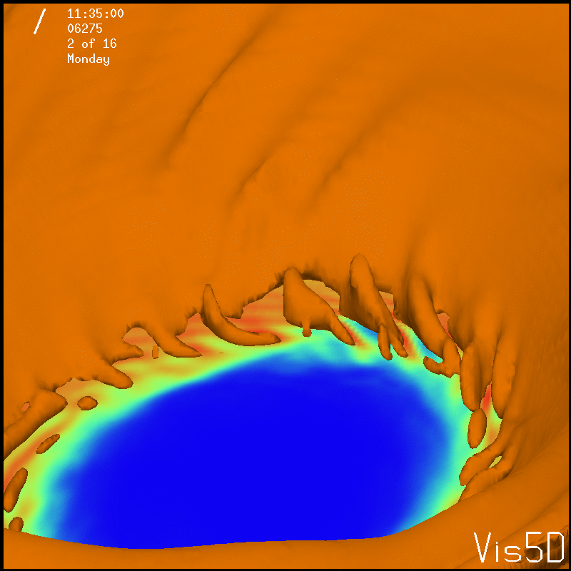

Slide 24
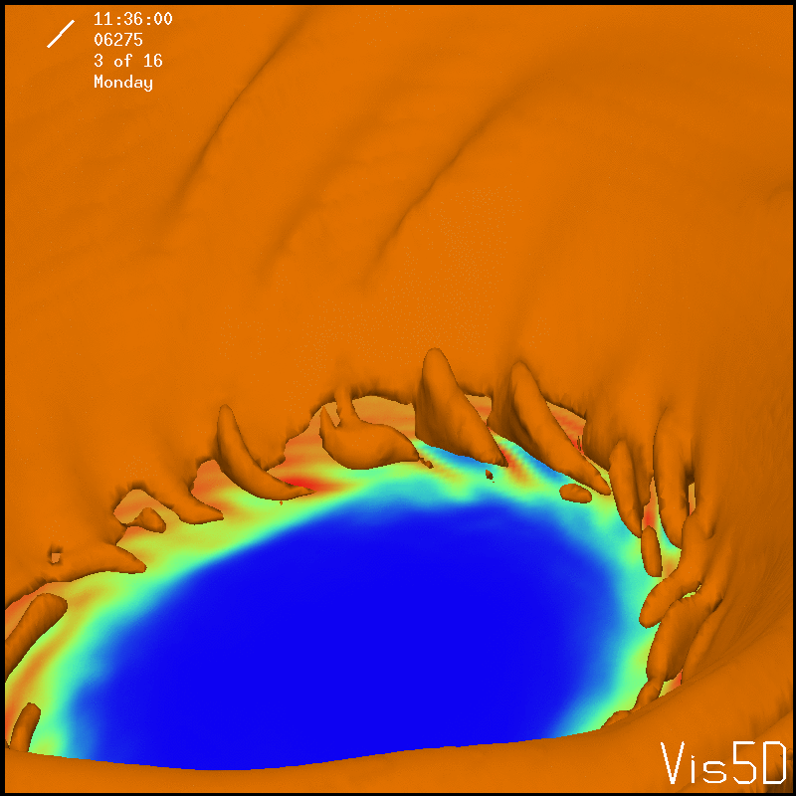

Slide 25
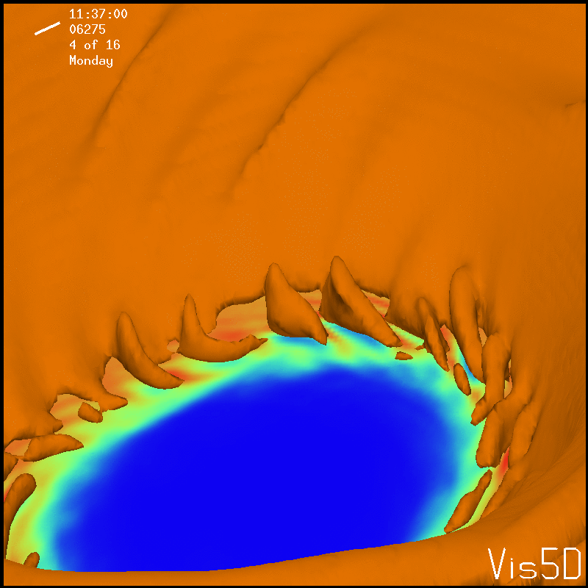

Slide 26
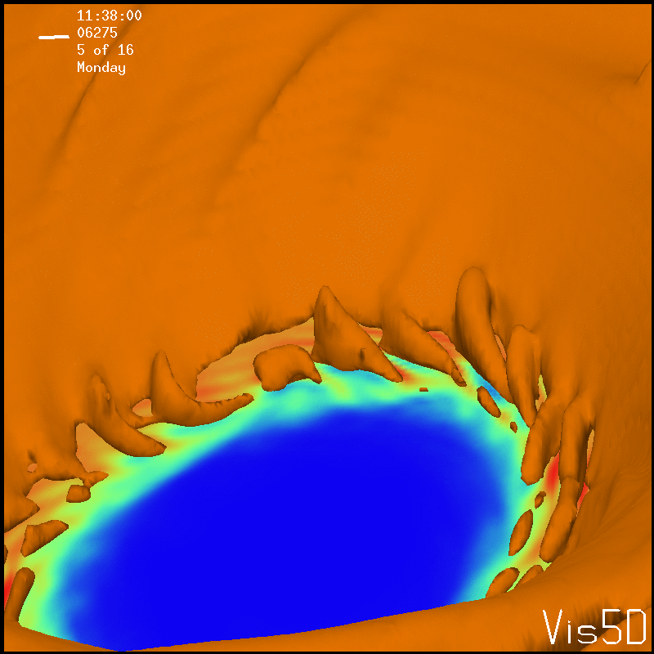

Slide 27
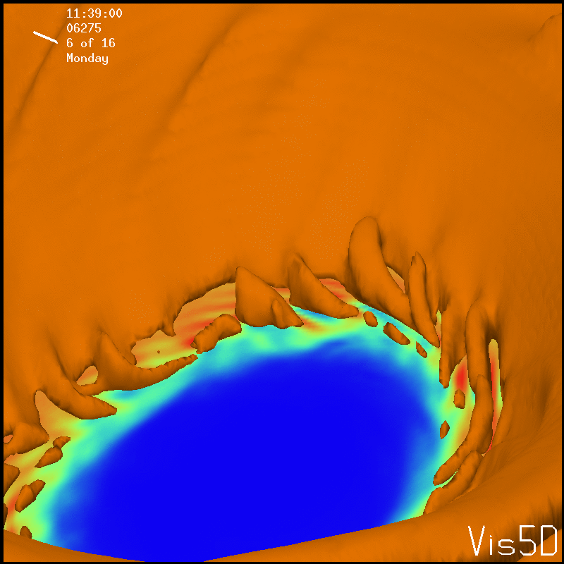

Slide 28
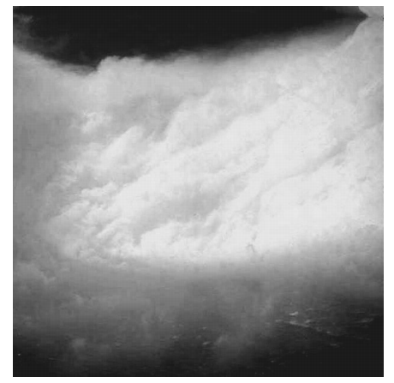
The instabilities on the inner edge of the eyewall rise cyclonically below the tangential wind max and anti-cyclonically above.
The instabilities seen in the UW-NMS are similar to structures photographed in hurricane Hugo.
(Figure from Marks 2008)

Slide 29
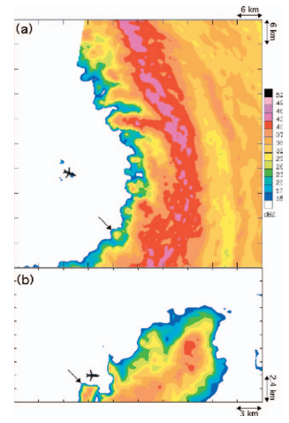
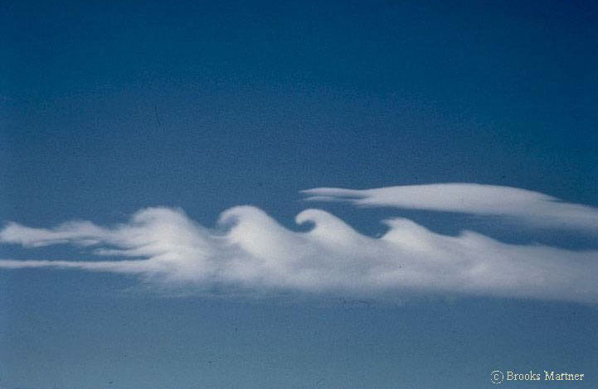
Structures on the inner-edge of the eyewall are likely associated with the barotropic mixing process between the high vorticity eyewall annulus and the low vorticity eye.
The inner-edge instabilities resemble Kelvin-Helmholtz waves.
(Cloud with KH waves over Wyoming
photographed by Brooks Martner)
(Figure from Aberson 2006)

Slide 30
Eye Mesovortices
Mesovortices are apparent in the UW-NMS in the eye below the subsidence inversion.
These mesovortices arise from the barotropic mixing process associated with inner-edge instabilities.
Inner-edge instabilities inject filaments of vorticity into the eye which coagulate and axisymmetrize into mesovortices on the order of 10 km across.
Complex interactions occur between the mesovortices and inner-edge instabilities.

Slide 31
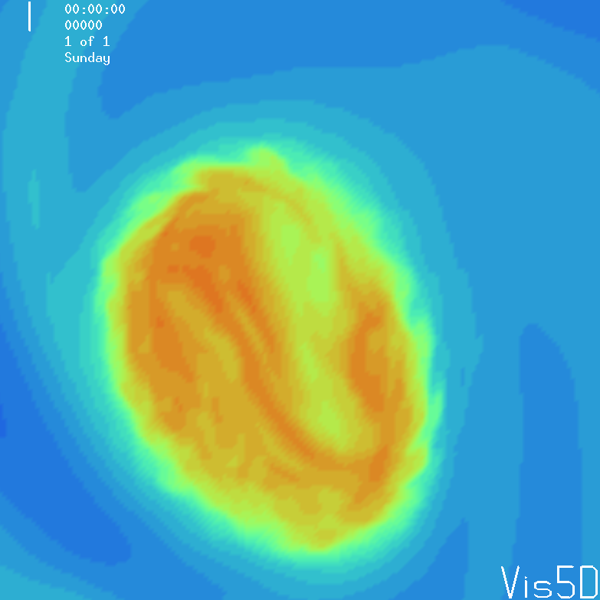
Mesovortices are associated with theta-e maxima, due to convergent flow in the mesovortices and possibly WISHE. They contain the highest theta-e in the hurricane.
When a mesovortice is re-ingested into the eyewall it may lead to a brief convective “turboboost”.
200 m Vertical Vorticity
200 m Theta-e

Slide 32
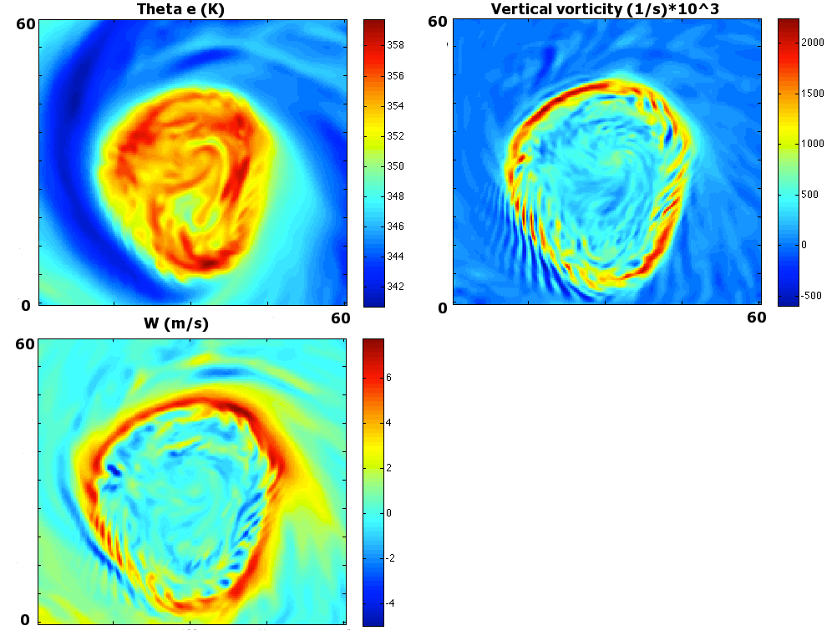

Slide 33
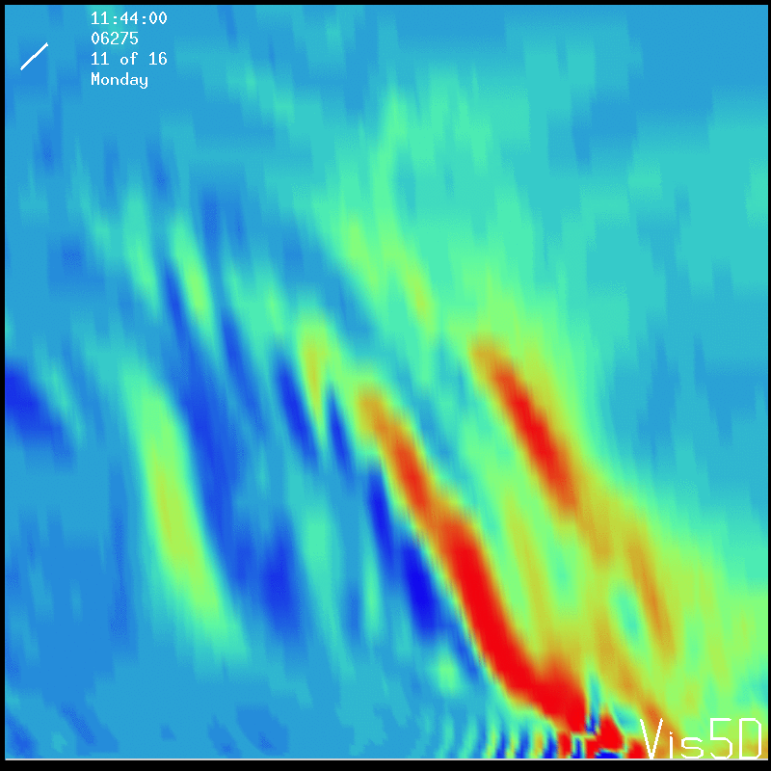
Instabilities on the outer-edge of the eyewall
Instabilities also arise on the outer-edge of the eyewall, likely due to barotropic mixing. They have a larger wavelength and weaker amplitude than inner-edge instabilities.
Vertical Vorticity
Vertical cross-section

Slide 34
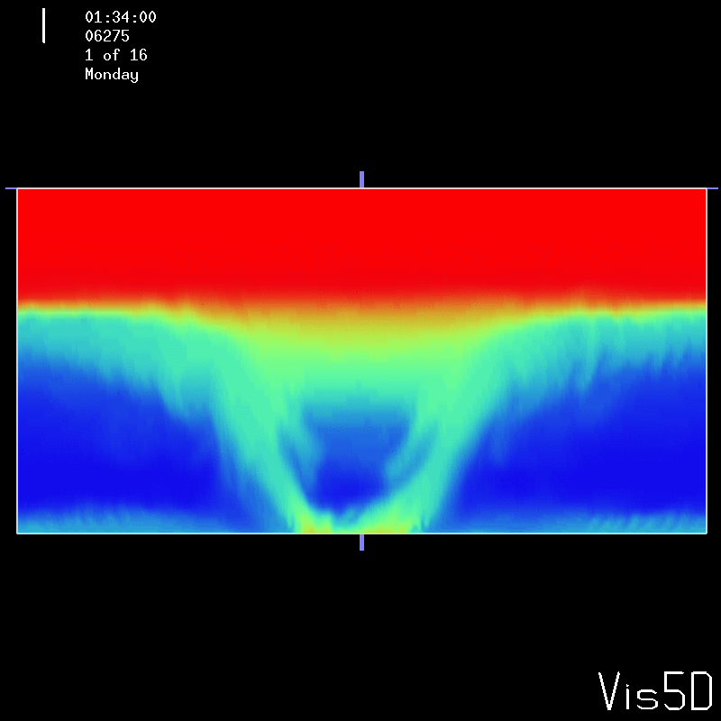
The instabilities propagate upwards and continue into the outflow layer. They transition from a barotropic instability propagating on the eyewall momentum gradient to an inertial-gravity wave propagating long the stable layer associated with the outflow.
Theta-e vertical cross-section

Slide 35
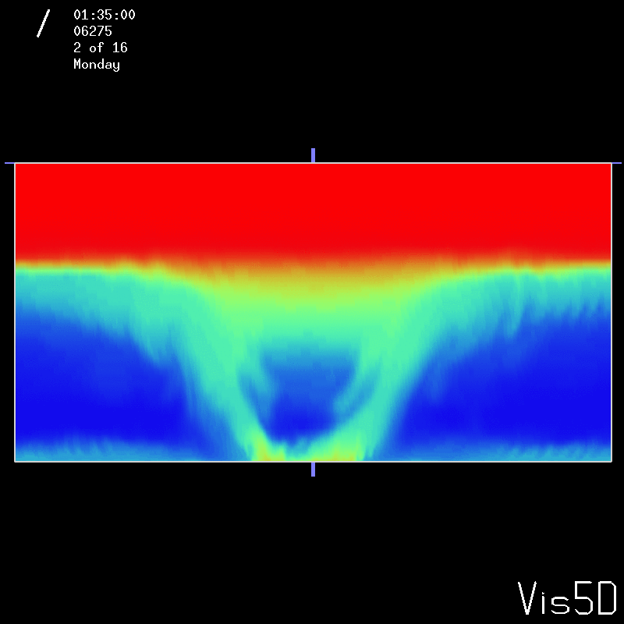

Slide 36
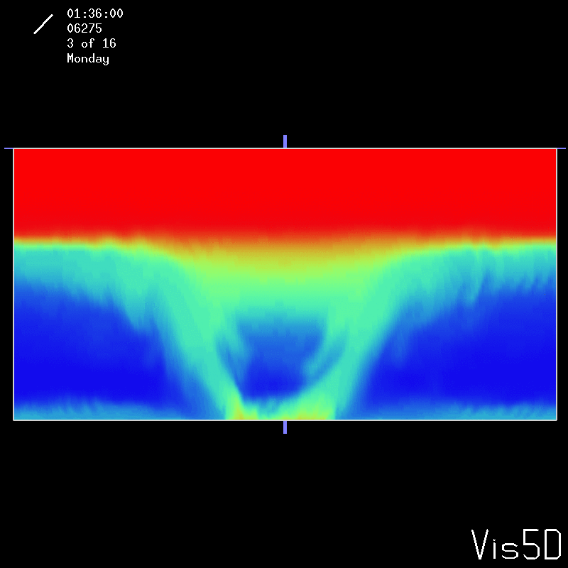

Slide 38
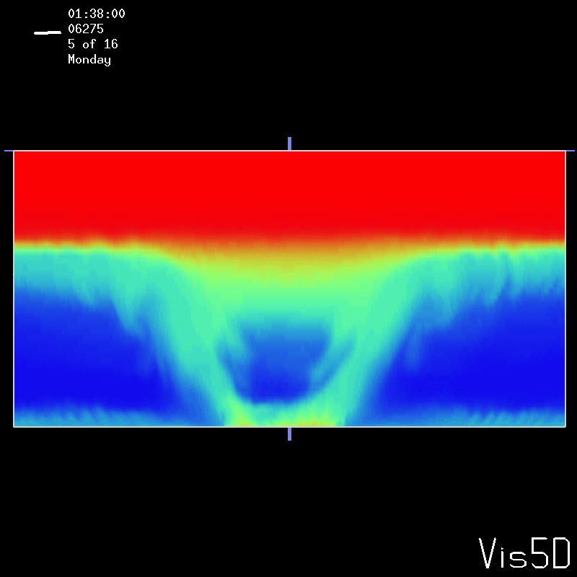

Slide 39
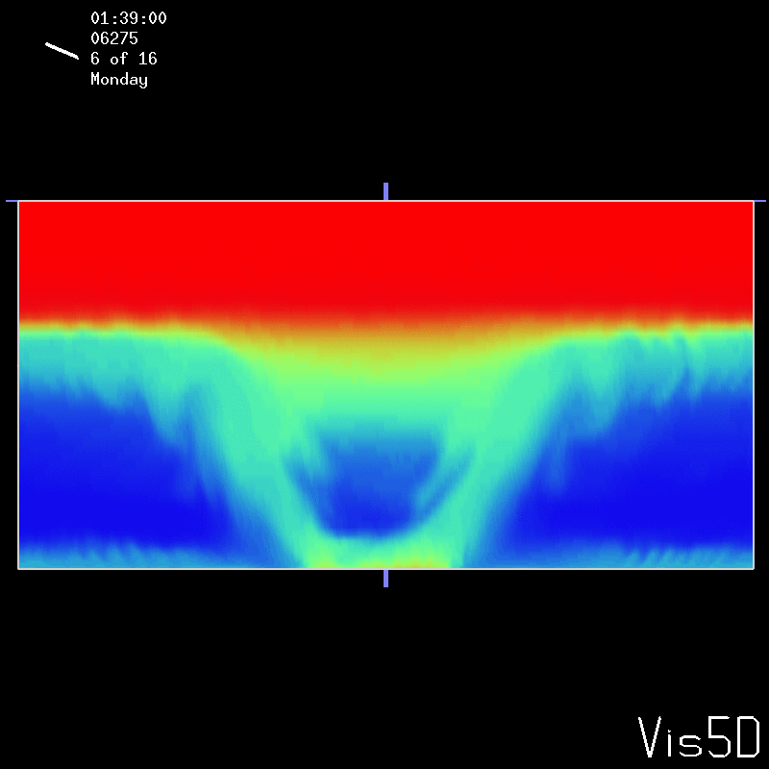

Slide 40
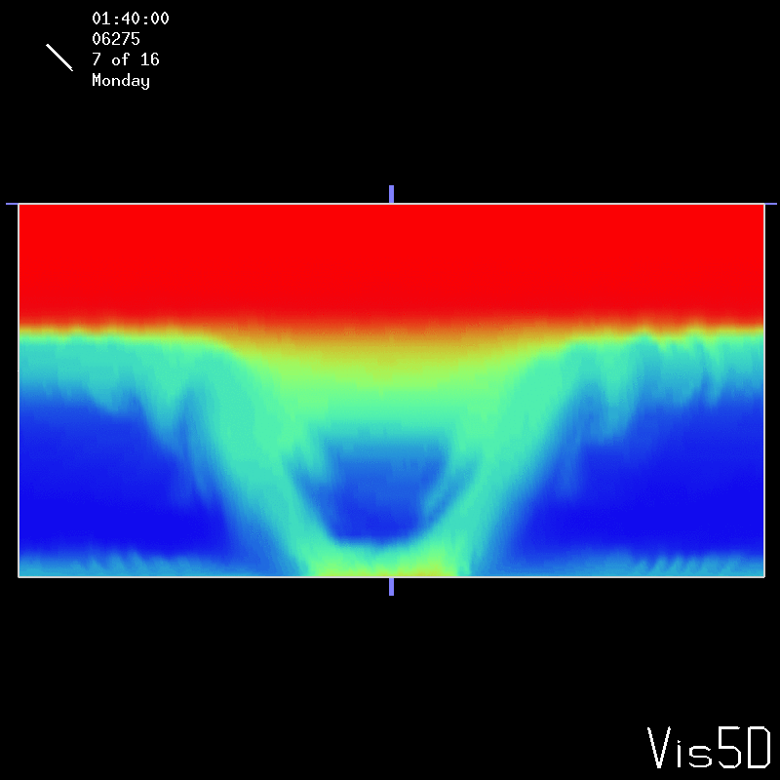

Slide 41
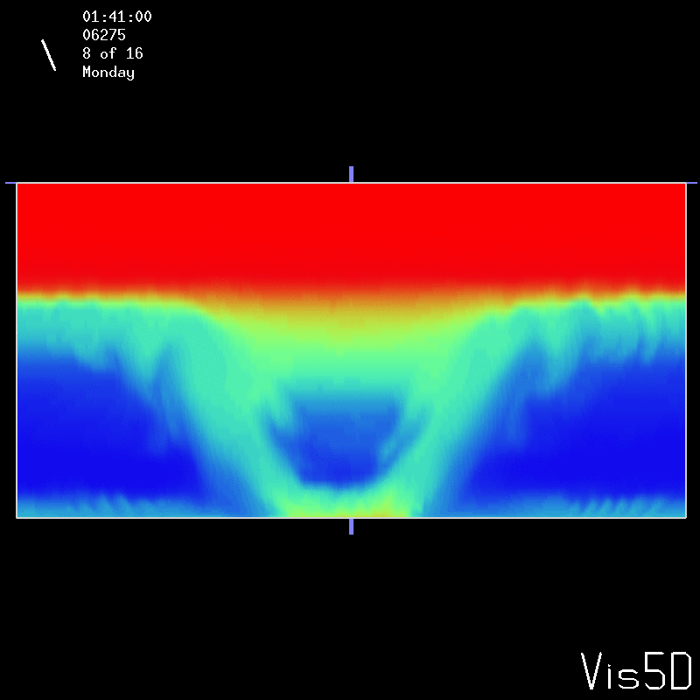

Slide 43
The instabilities appear as outward propagating rings in the outflow, possibly related to the satellite rings studied by Jason Dunion.
The rings maintain amplitude as they propagate, perhaps this is partially due to them inducing a small tropopause fold, which through geostrophic adjustment enhances the instability circulation.

Slide 44
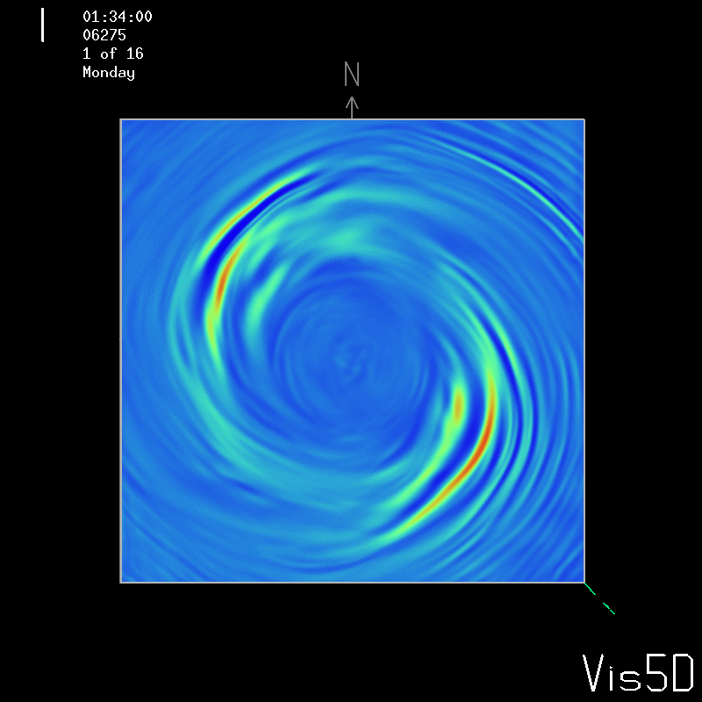

Slide 45
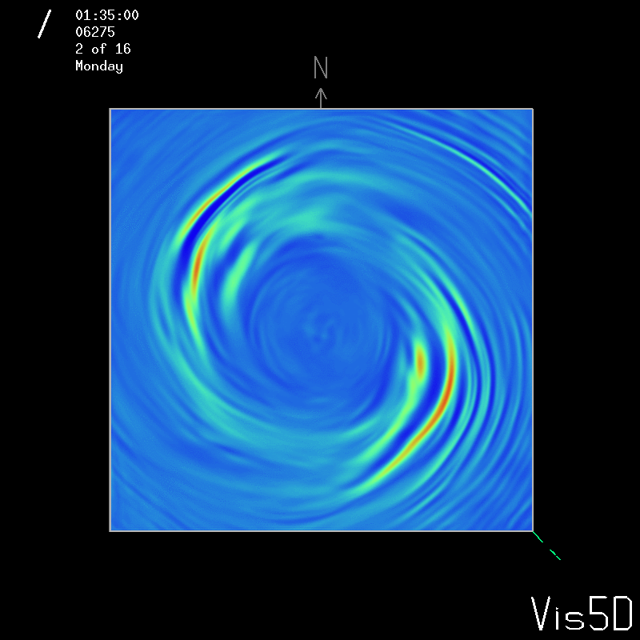
12 km vertical velocity

Slide 46
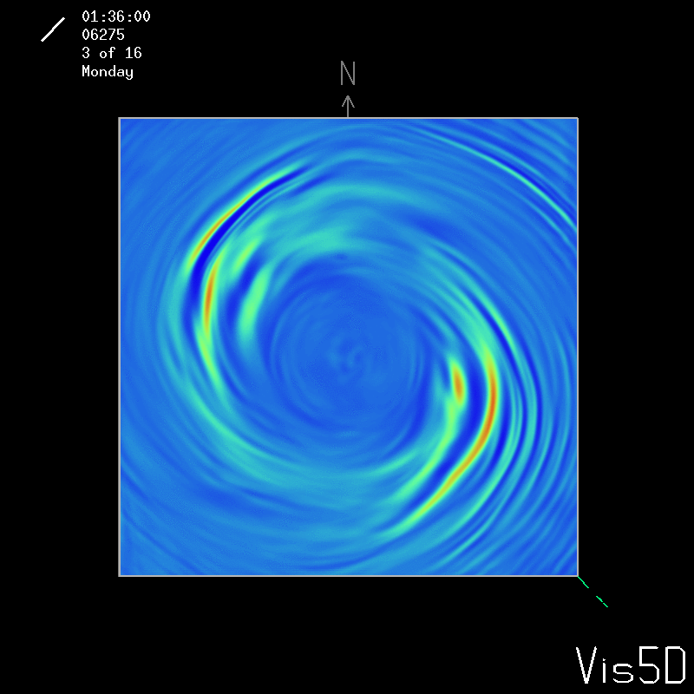

Slide 47
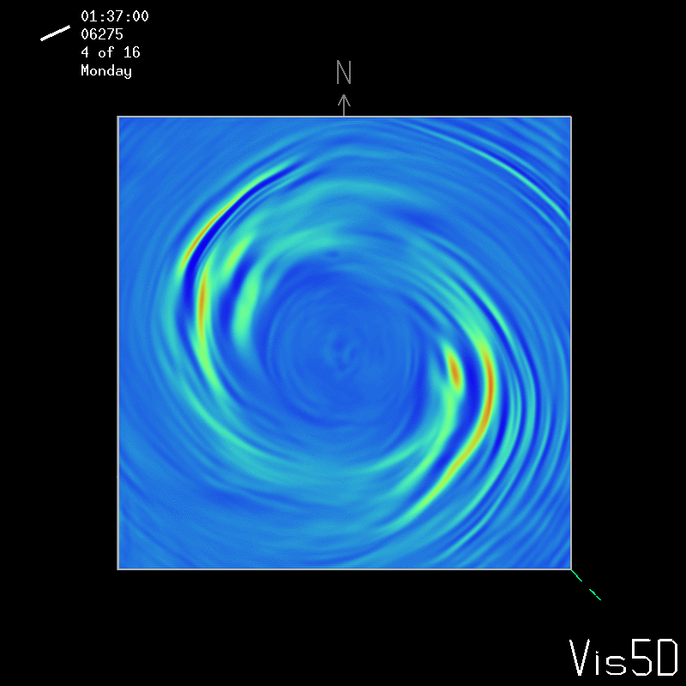

Slide 48
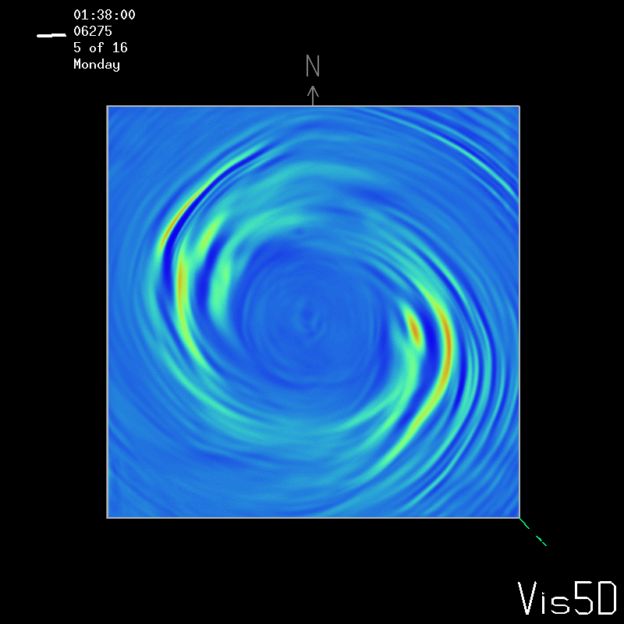

Slide 49
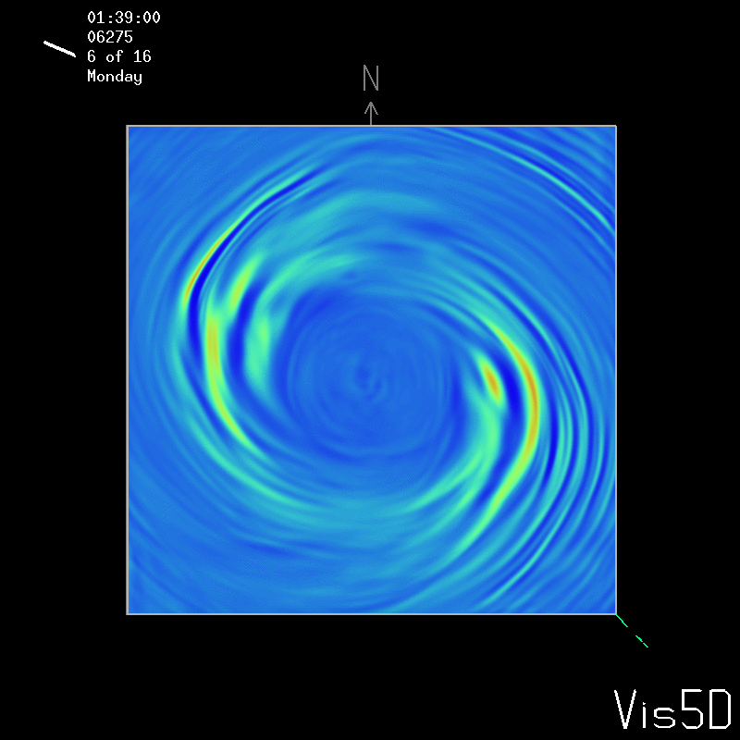

Slide 50
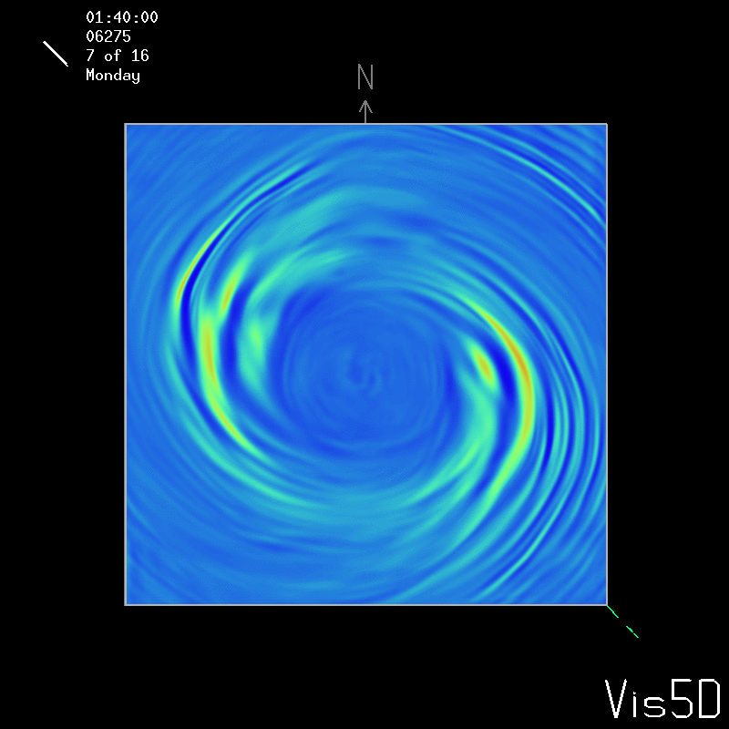

Slide 51
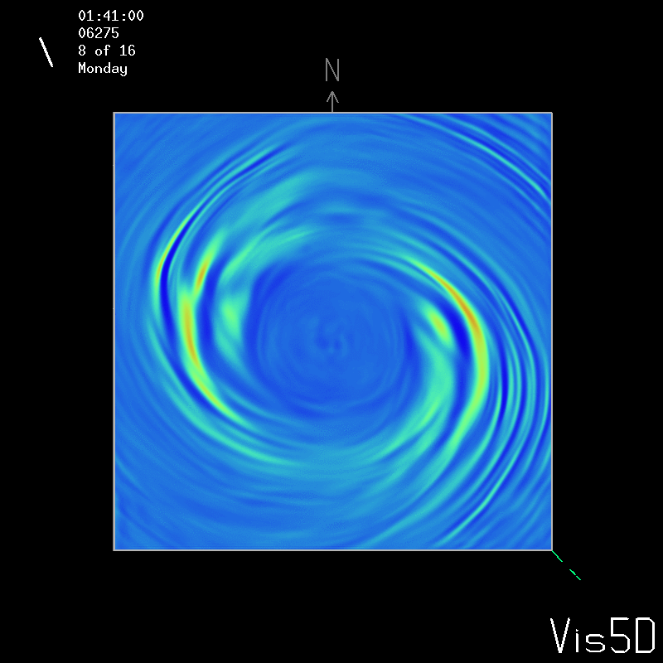

Slide 52
Observational evidence of instabilities
High resolution surface observations are necessary to resolve the 1-10 km instabilities seen in the UW-NMS.
Fortunately the Texas Tech University Hurricane Research Team focuses on collecting high resolution data from landfalling hurricanes, and has allowed me to use data from Isabel and Ivan.
Wind speed data is recorded at a frequency of 10 Hz.
The data is detrended and then a fast fourier analysis is performed.
WSR-88D radar data from the time of landfall is used to help calculate the wavelength of the instabilities detected with the fast fourier analysis.

Slide 55
Development of a non-dimensional chaos parameter
Instabilities observed in and around the inner core of a hurricane are similar to instabilities that arise when the potential vorticity sheet associated with other vigorous fluid vortices is perturbed, including tornadoes, mesoscale convective vortices, polar lows, and strong mid-latitude cyclones.

Slide 56
These vortices are vastly different when it comes to scale and detail, but fundamentally they have a primary circulation consisting of the swirling tangential winds and the radial secondary circulation, with a sheet of horizontal vorticity associated with the boundary layer being ingested upwards like a high speed photo of a milk splash.
Perhaps a non-dimensional parameter can be developed which would determine the regimes of instabilities that would arise in such a vortex.
This would give a much deeper understanding of the range of instabilities possible in a hurricane like vortex, as well as the conditions they occur under, which may help improve intensity change forecasts.

