Slide 1
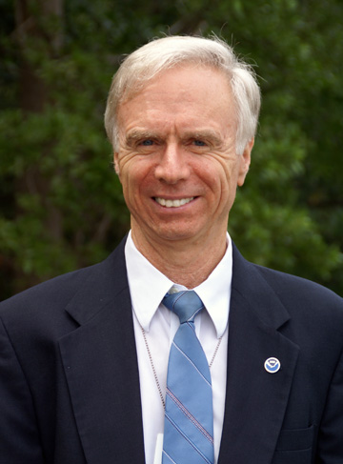
Scientist2Scientist
Speaker
Bob Atlas
Director, AOML
Notes:
[Sandy MacDonald]
Dr. Robert Atlas is the former Head of the NASA Data Assimilation Office and Chief Meteorologist at NASA's Goddard Space Flight Center (GSFC), and joined NOAA in 2005 as the Director of NOAA’s Atlantic Oceanographic and Meteorological Laboratory in Miami, Fla. Some of the areas he focuses his current research on include the prediction, movement and strengthening of hurricanes. Bob has worked with both satellite data and computer models as a means to study these hurricane behaviors.
And now, I’ll turn it over to Bob.
[Bob Atlas] – Thank you for the introduction Sandy, and thank you all for joining us
SEGUE: As the director of AOML, let me take the opportunity to introduce some of the great science we do here at AOML.

Slide 2
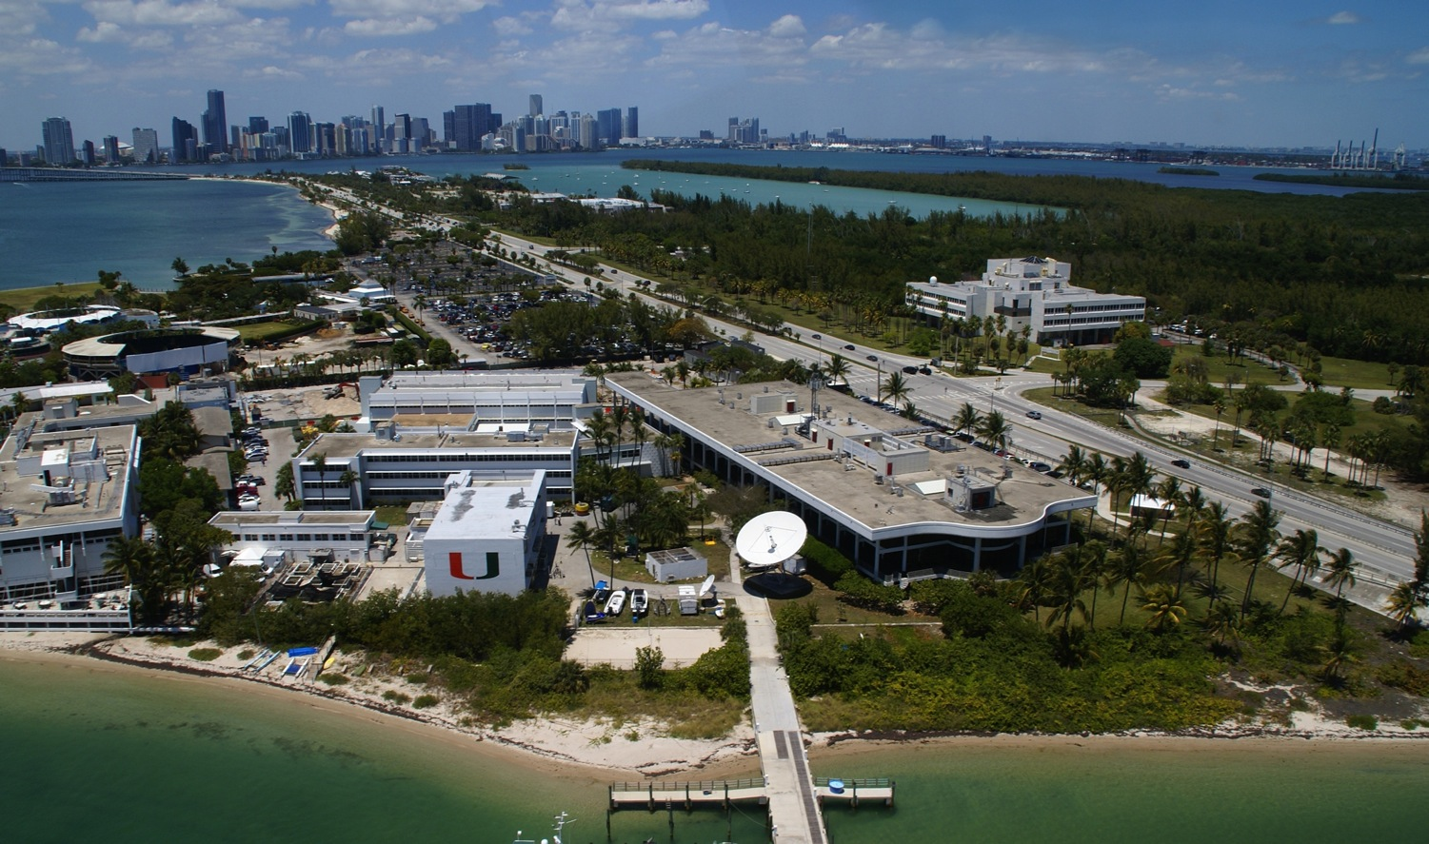
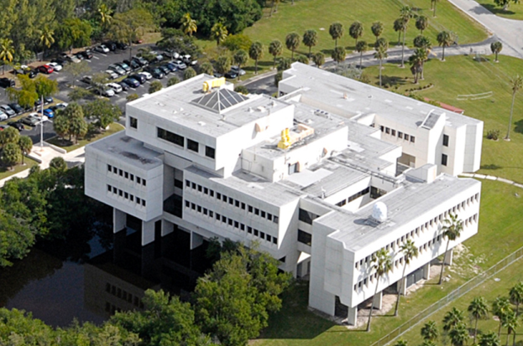
AOML Overview
AOML
Notes:
[Bob Atlas]
AOML is located directly off shore from downtown Miami and is co-located with NOAA’s Southeast Fisheries Science Center and the University of Miami’s Rosenstiel School for Marine and Atmospheric Science. Oceanic and atmospheric monitoring of the Gulf of Mexico, the wider Caribbean, and the Atlantic Ocean have been a focus of AOML activities for more than three decades.
From an organizational perspective, AOML is comprised of three research divisions: The Physical Oceanography Division, the Ocean Chemistry Division, and the Hurricane Research Division, which is the focus of the talk today. We are probably the most diverse of the OAR laboratories, and that diversity fosters interdisciplinary research that spans all of our themes.
AOML research encompasses hurricane observation and modeling, oceans and climate, the global impacts of increased carbon dioxide and ocean acidification, ocean and human health studies, and the ocean’s influence on regional rainfall and hurricanes.

Slide 3
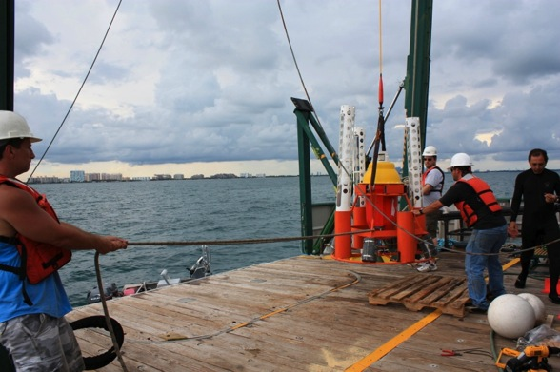
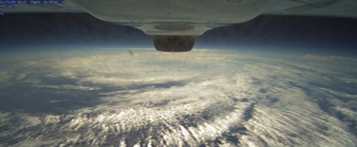
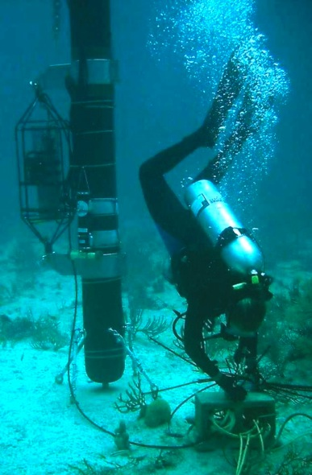
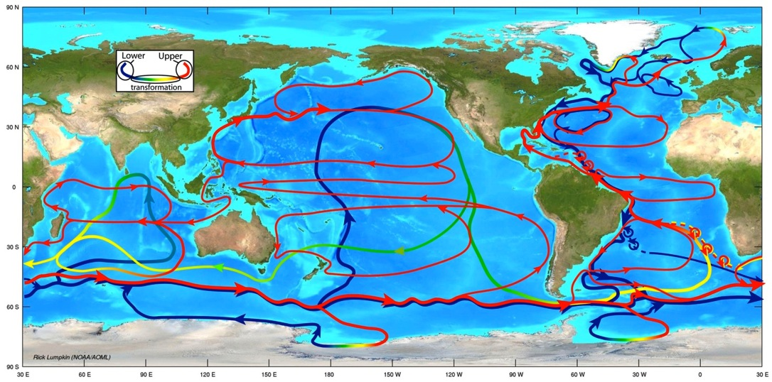
AOML Overview
Notes:
[Bob Atlas]
AOML is also a major partner in the collection and interpretation of oceanographic data collected via ships, satellites, aircraft, drifting buoys, and floats. We maintain the US Argo Data center and the Global Drifter Program, providing the resulting ocean current data, products and research using these observations to the global community.
Our physical oceanographers also contribute to our understanding of the ocean’s role in climate. Techniques vary from shipboard-conducted process studies, models, long-term continuous time series, to satellite-derived products.
An example of the collaboration I referred to earlier is our research on the relationship between oceans and severe weather such as trends in hurricane and tornado activity.
AOML’s coastal ocean and ecosystem research focuses on quantifying the impact of human activities and management decisions on the health of tropical and subtropical coastal ecosystems.
This research covers:
regional coastal management efforts;
land-based sources of pollution to coastal waters;
the relationship between oceans and human health; and
the status and health of coral reef ecosystems worldwide
And of course, we house the bulk of OAR’s hurricane research efforts, but I’d like to let Frank give you a picture of his division’s efforts.

Slide 4
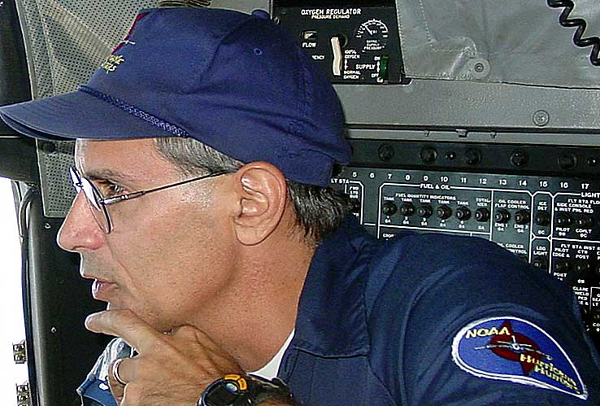
Speaker Introduction
Dr. Frank Marks, Jr.
Director, HRD/AOML
Notes:
[Bob Atlas]
Dr. Frank Marks has been a Meteorologist with the Hurricane Research Division at AOML since 1980, and Director since 2003. Frank’s most recent effort has been the development of the NOAA Hurricane Forecast Improvement Project (HFIP) which he has led since 2007.
Frank became a Fellow of the American Meteorological Society in 2000 and I was very proud to see him receive the AMS Verner E. Suomi Medal in 2011.
Frank received a B.S. in Meteorology from Belknap College and both an M.S. and Sc.D. in Meteorology from the Massachusetts Institute of Technology.
Frank’s research interests include analyzing meteorological remote sensing data sets, particularly in tropical cyclones. He has published more than 80 refereed articles, book chapters, and reports on these topics.
Much of his research has been conducted on board NOAA’s flying laboratories, the P-3 Orion hurricane hunter aircraft. Frank has completed over 400 eyewall penetrations on the P-3 aircraft, including the fateful flight into Hurricane Hugo that provided the data for the research we will hear about today.

Slide 5

2010 OAR Outstanding Scientific Paper
Structure of the Eye and Eyewall of Hurricane Hugo (1989)
Frank D. Marks
Peter G. Black
Michael T. Montgomery
*Robert W. Burpee
*CIMAS
Monthly Weather Review (2008)
Notes:
[Bob Atlas]
Frank co-authored the analysis of this unique data set that earned a 2010 OAR Outstanding Paper Award.
This paper provides the first observational evidence to support a number of recent hypotheses put forward from theoretical, experimental, and model studies of the evolution of the hurricane vortex undergoing rapid intensity change.
The observations serve as the basis for understanding the processes that drive intensity change, and how those processes are represented within numerical models. In fact, they have already been used by those developing the next generation of regional hurricane models, which Frank will also touch on today.
I’d like to take this opportunity to thank Frank and all of his colleagues in our Hurricane Research Division for their willingness to regularly fly into these storms. We should not take the risk that they assume with each flight lightly. Without the datasets collected from the P-3 aircraft, we would not have many of the advances in forecasting that we have seen in recent years.
And now I’ll turn it over to Frank.
[Frank Marks]
Thank you Bob for that introduction….

Slide 6
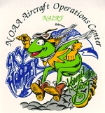
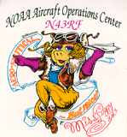
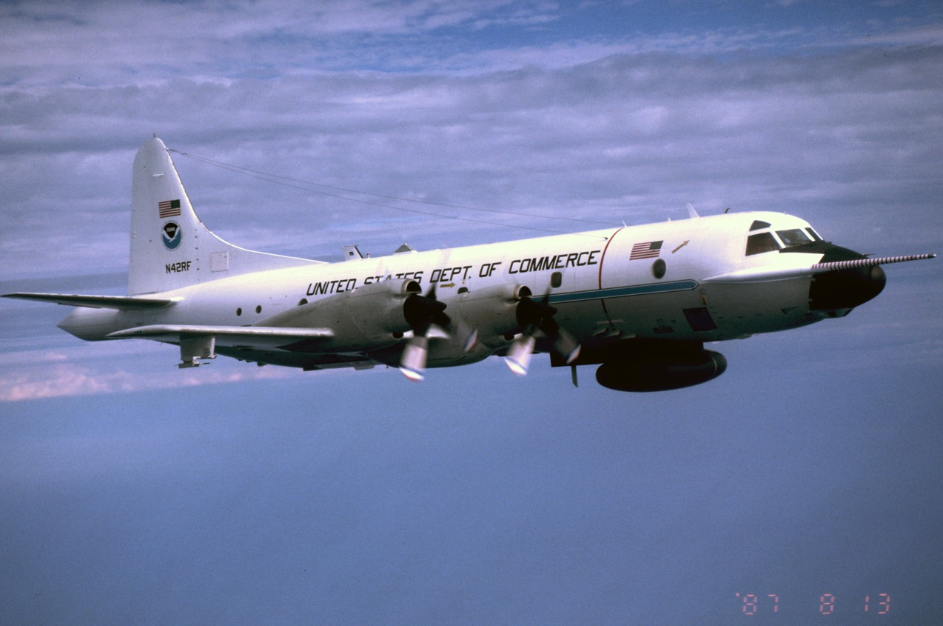
NOAA WP-3D:
Hurricane Hunters
Notes:
NOAA maintains two WP-3D 4-engine turbo prop aircraft used for meteorological, air quality, and oceanographic research. These aircraft were procured by NOAA in 1974 and have been operating since 1976. They are the primary hurricane research platforms flying in more than 175 named storms. These aircraft are equipped with standard 1-Hz flight-level meteorological measurements of pressure, temperature, humidity, and wind, as well as surface wind speed estimates from SFMR, vertical profiles of thermo and wind via dropwindsondes, upper ocean thermal and currents via AXBT/CTD/CP, and with two radar systems: (1) lower fuselage radar that provides a plan view of precipitation within 200 nm of the aircraft; and (2) tail Doppler radar which provides 3-D wind measurements within 50 nm of the aircraft.

Slide 7
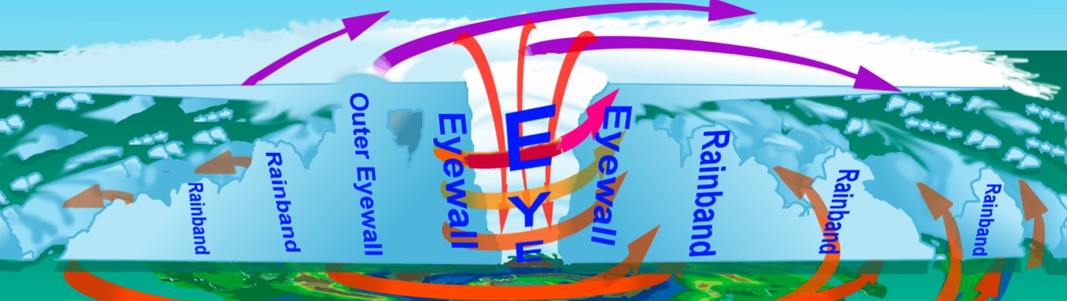
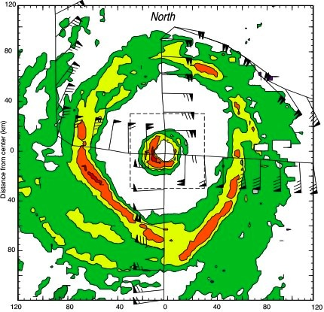

Hurricane 101:
18 km
Eye
Eyewall
Notes:
Hurricanes are intense low pressure systems that primarily occur in tropical regions around the globe. They are considered warm core, meaning that the strongest winds are at near the ground. Their precipitation is characterized by spiral rainbands extending from near the surface to 60000 ft surrounding a clear region at the center called the eye. The eye is usually surrounded by central ring of heavy rain referred to as the eyewall. When taking observations in hurricanes the aircraft usually fly radially in and out of the eye in a Fig. 4 pattern at altitudes <10000 ft to estimate the radial wind structure and provide estimates of storm location for NHC. For research purposes we can also sample the 3-D wind structure of the storm with the airborne Doppler radar and using dropwindsondes.

Slide 8

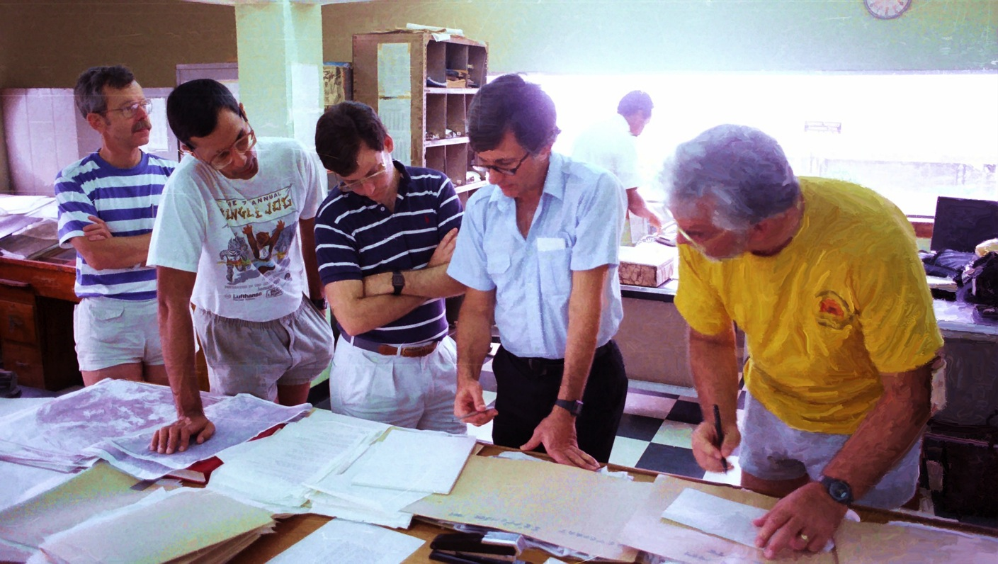
The best laid plans….
Willoughby
Marks
Franklin
Burpee
Bogert
Barbados weather office (September 1989)
Notes:
As Hurricane Hugo approached the Leeward Islands we were operating the two P-3s from Barbados. We were trying to execute one of our planned research patterns to estimate the storms energy budget which called for one P-3 to sample the inner core within 100 km of the center at as low an latitude as possible to get good thermodynamic observations near the PBL where most of the energy exchange occurs while sample the winds with the Doppler radar. The second P-3 was to sample the environment surrounding the storm using dropwindsondes in concentric rings at 150 and 200 km radius.

Slide 9

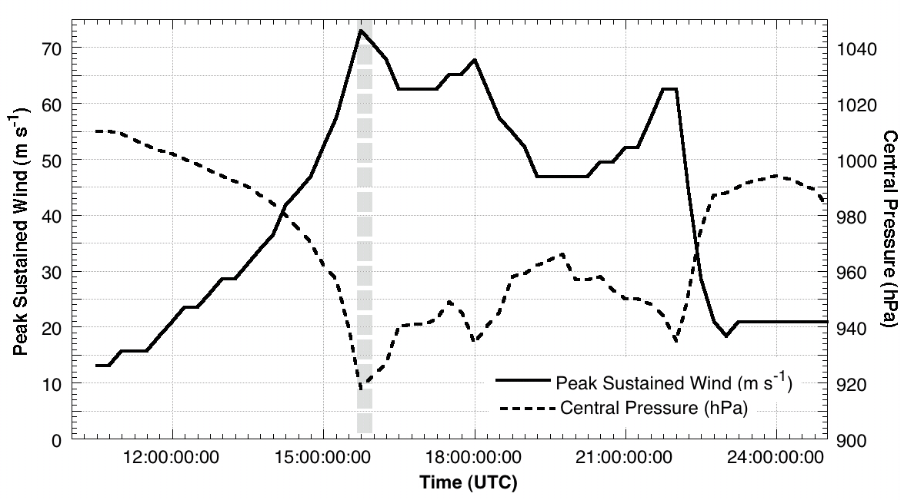
Background to disaster:
Notes:
Storm strengthened to a hurricane on 13 September 2000 km east of Lesser Antilles and moving toward WNW at 7-8 m s⁻¹
Experiment called for ≤CAT3, tried the experiment 3 times (latest in Gabrielle 10-days prior to Hugo), strong desire to get it done!
Before take-off (1530 UTC), HRD scientists were unaware that satellite meteorologists at NHC were estimating that Hugo’s minimum surface pressure decreased from 957 to 938 hPa from 0600 to 1400. An objective, infrared satellite intensity scheme estimated a deepening rate ~6.3 hPa h⁻¹ over 3.5 h.

Slide 10
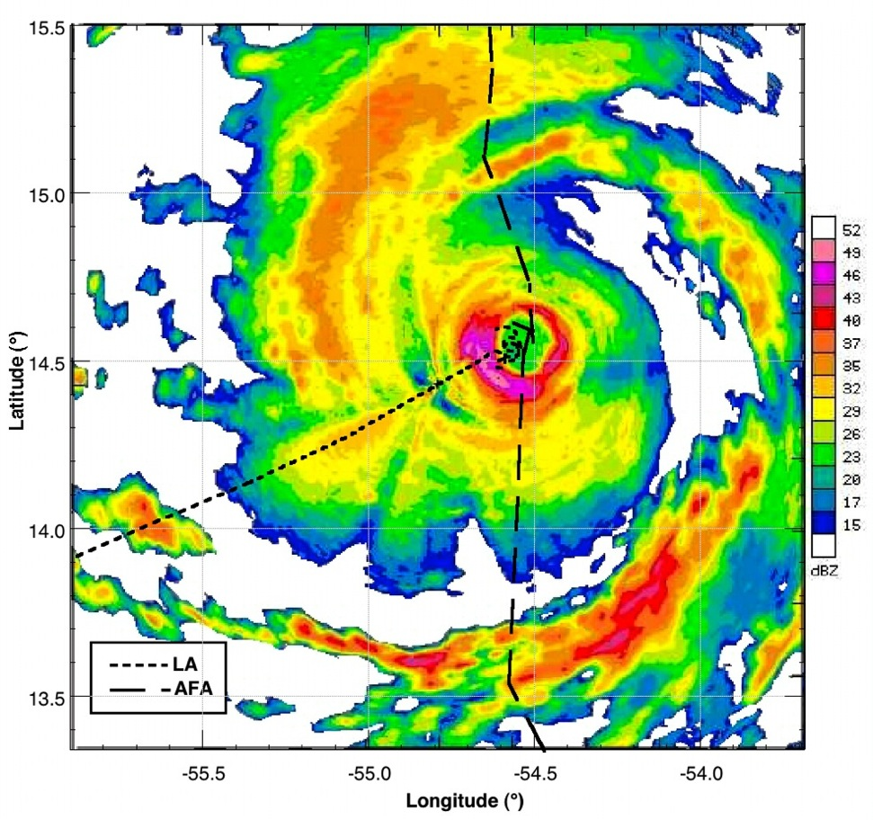
The Approach:
Notes:
LF radar depicted large-scale radar structure revealing eyewall was very intense, with large areas of reflectivity >46 dBZ, usually <0.5% of area in eyewall
Expanded view of radar reflectivity shows eyewall reflectivity was a maximum at ~12 km radius, and radius of low reflectivity in eye 6-7 km.
Peak reflectivity was >50 dBZ in SW quadrant near where N42RF penetrated eyewall.

Slide 11
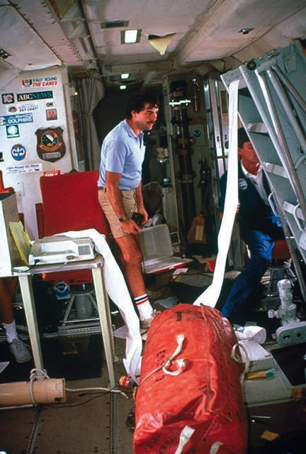
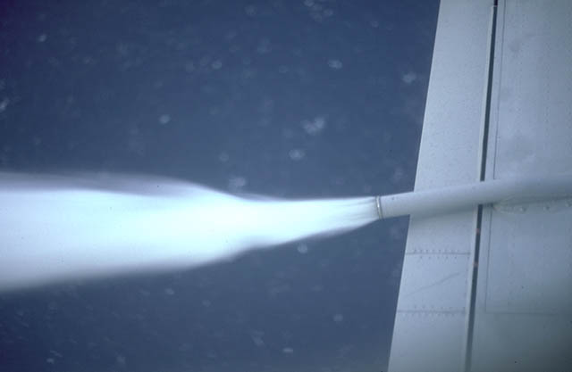
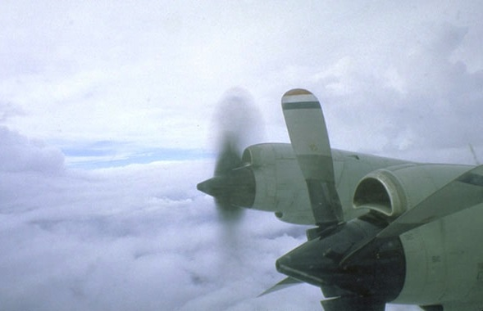
Bump in the Night:
http://www.wunderground.com/resources/education/hugo1.asp
#3 engine
Notes:
N42RF encountered severe turbulence in 3 updraft/ downdraft couplets.
During last couplet, N42RF’s inside right engine became overheated and pilot shut it down.
Having reached eye, crew found itself 270 m above an angry looking sea surface, surrounded by strong eyewall, and needing a safe way out.
Pilots decided to orbit in eye, dump fuel, clean up plane and climb slowly to not overheat 3 working engines.
After 58 min, AFRC found safe way out through NE side and N42RF followed it through eyewall.

Slide 12
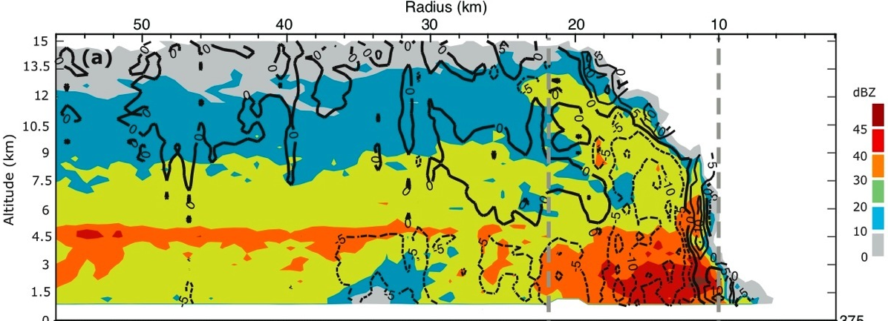
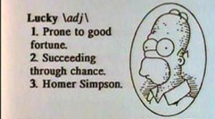
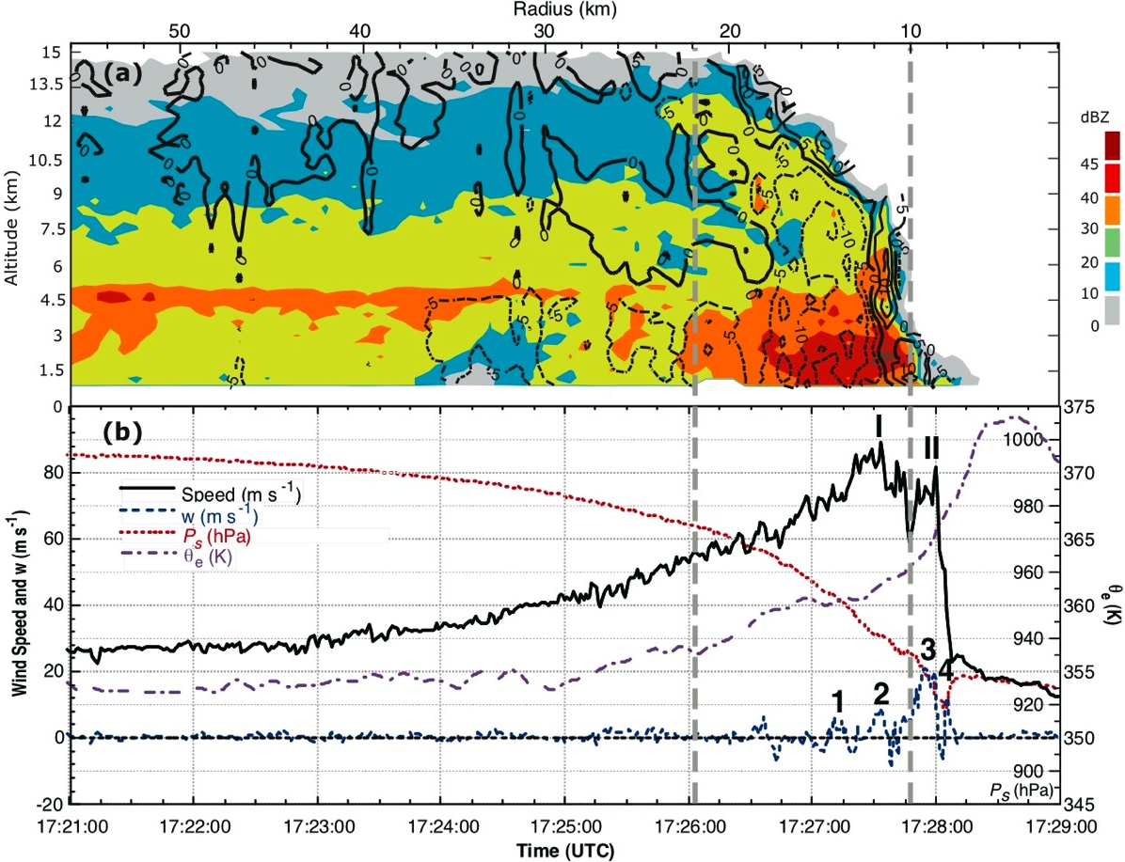

Serendipity:
Eyewall
Eye
CAT5
CAT4
CAT3
CAT2
CAT1
Notes:
N42RF hit 3 distinct up/downdraft couplets and a 4th updraft from 172710-172806:
6 m s⁻¹ updraft & -6 m s⁻¹ downdraft;
9 m s⁻¹ updraft & -10 m s⁻¹ downdraft; and
21 m s⁻¹ updraft & -8 m s⁻¹ downdraft, and finally
12 m s⁻¹. At end engine out!!!
2 peaks in flight-level wind:
89 m s⁻¹ coincident with 2nd couplet, followed by decrease to 60 m s⁻¹,
82 m s⁻¹ coincident with 3rd couplet. In 3 s wind dropped from 82 m s⁻¹ to 25 m s⁻¹ & shifted direction from 340° to 25°. At end engine out!!!
Magnitude of peak up & downdrafts in highest 2-3%

Slide 13
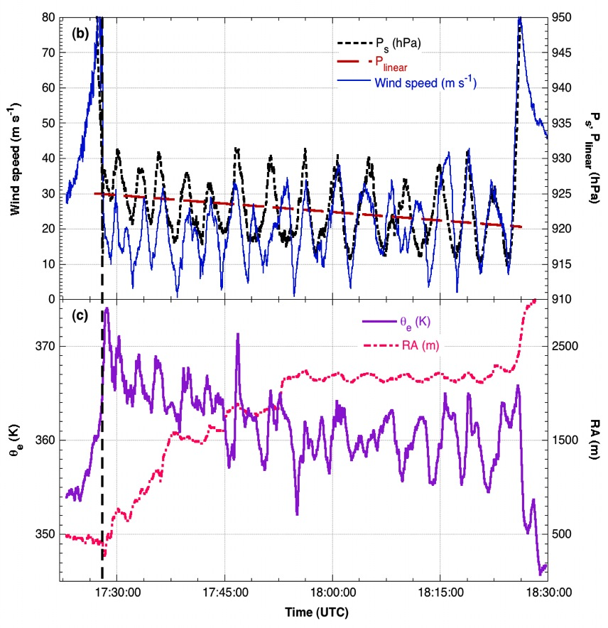
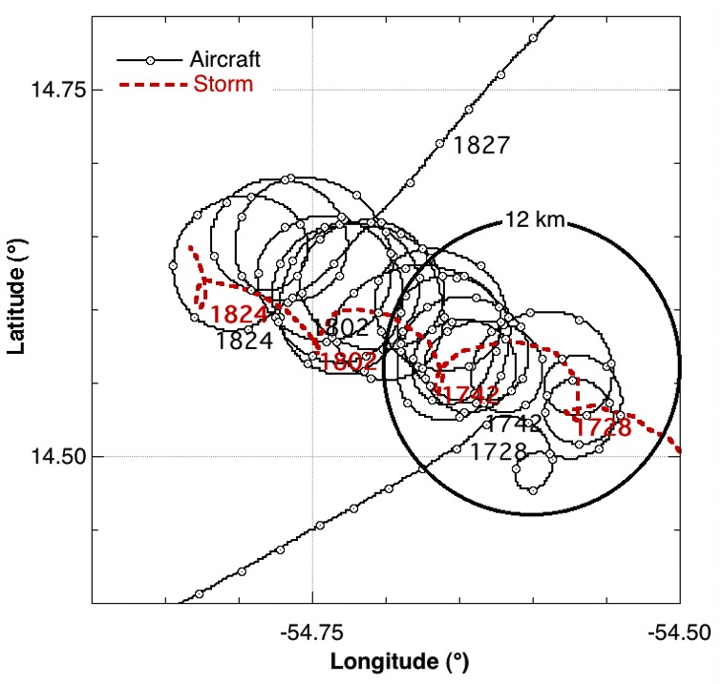
In the eye:
Notes:
15 orbits climbing in eye for 58 min
Pressure, wind, and θ_{e} oscillations 3-4 minute apart of 7-12 hPa, 10-15 m s⁻¹ and 5-10 K.
Pressure deepened 5 hPa h⁻¹

Slide 14
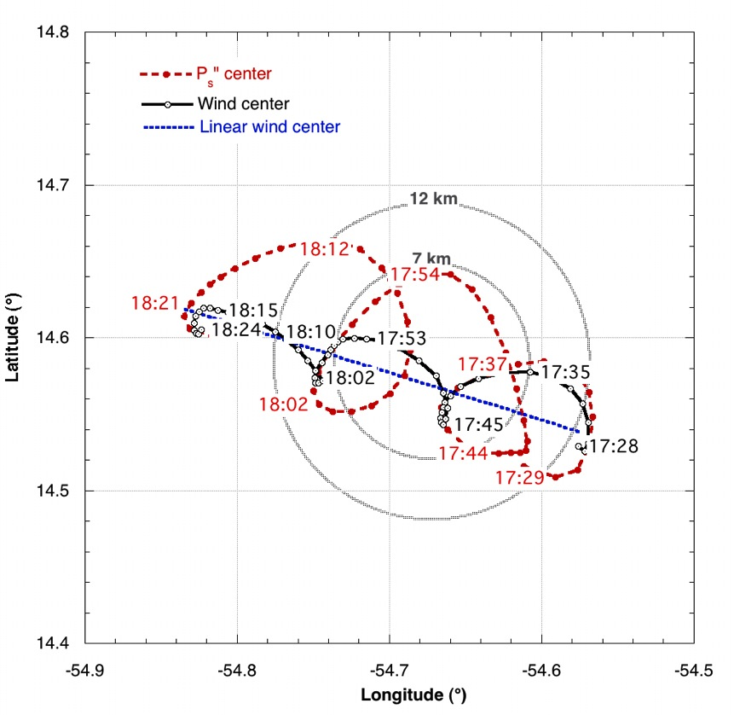
Storm Centers:
Notes:
Pressure & wind center exhibited trochoidal oscillation with 3 orbits.
Pressure center orbited at larger radius.
Centers orbited each other with 19 minute period.
Pressure centers displaced 2.3 km.
Pressure periodicity similar, but out of phase with wind.
Center tracks made by interpolating minima location between orbits
Refined pressure center track by removing radial variation

Slide 15
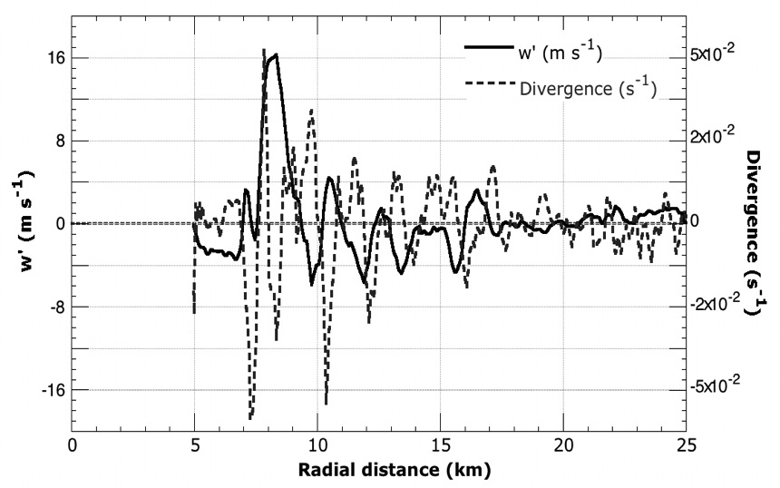
Boundary layer:
Turbulent Kinetic energy (TKE)
Notes:
Boundary layer structures?
Vorticity filaments from mixing process, deformed by shear of mean vortex.
Divergence & drafts correlated
Filaments present at similar altitudes in landfalling storms
Explains dropsonde observations of low-level jets in eyewall
Lorsolo, S., J. Zhang, F. D. Marks, J. F. Gamache, 2010: Estimation and Mapping of Hurricane Turbulent Energy Using Airborne Doppler Measurements, Mon. Wea. Rev., 138, 3656–3670.

Slide 16
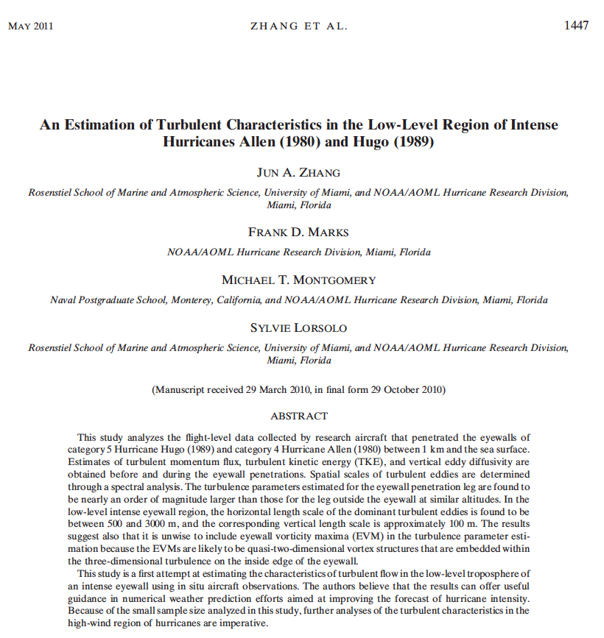
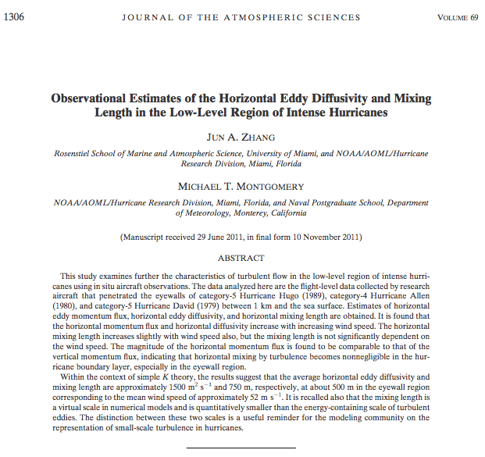
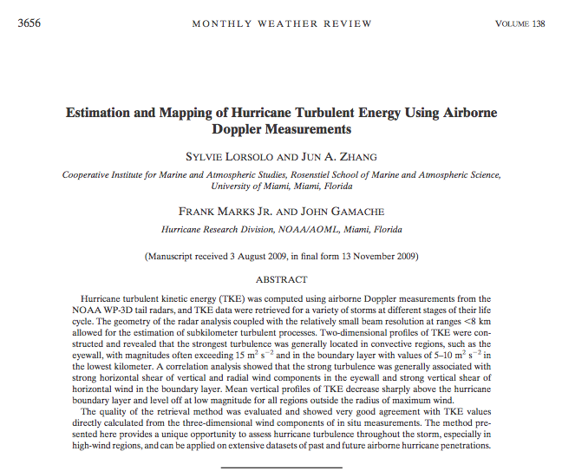
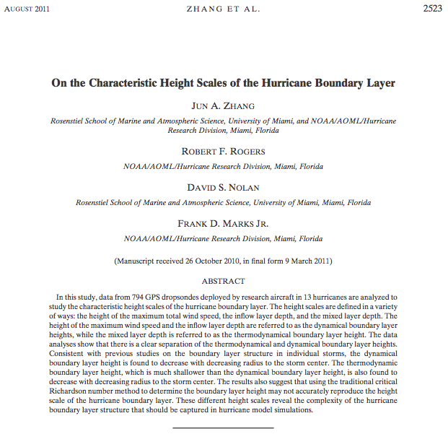
Boundary layer:
Notes:
Zhang, J., F. D. Marks, M. Montgomery, and S. Lorsolo, 2011: An estimation of turbulent characteristics in the low-level region of intense Hurricanes Allen (1980) and Hugo (1989), Mon. Wea. Rev., 139, 1447-1462.
Zhang, Jun A., Michael T. Montgomery, 2012: Observational Estimates of the Horizontal Eddy Diffusivity and Mixing Length in the Low-Level Region of Intense Hurricanes. J. Atmos. Sci., 69, 1306–1316.
Lorsolo, S., J. Zhang, F. D. Marks, J. F. Gamache, 2010: Estimation and Mapping of Hurricane Turbulent Energy Using Airborne Doppler Measurements, Mon. Wea. Rev., 138, 3656–3670.
Zhang, J., R. Rogers, D. Nolan, F. D. Marks, 2011: On the characteristic height scales of the hurricane boundary layer. Mon. Wea. Rev., 139, 2523-2539.

Slide 17
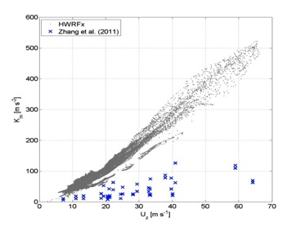
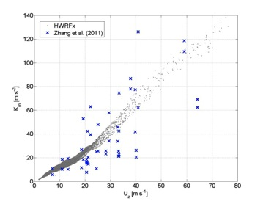
HWRF Boundary Layer
Vertical Eddy Diffusivity:
Original Formulation
Latest Formulation
Original GFS Scheme
Modified GFS Scheme
Gopalakrishnan et al. (2012)
Notes:
Zhang, J., F. D. Marks, M. Montgomery, and S. Lorsolo, 2011: An estimation of turbulent characteristics in the low-level region of intense Hurricanes Allen (1980) and Hugo (1989), Mon. Wea. Rev., 139, 1447-1462.
Gopalakrishnan, S. G., F. D. Marks, Jr, J. A. Zhang, X. Zhang, J.-W. Bao and V. Tallapragada, 2012: A Study of the Impacts of Vertical Diffusion on the Structure and Intensity of the Tropical Cyclones Using the High Resolution HWRF system. (accepted).
17

Slide 18
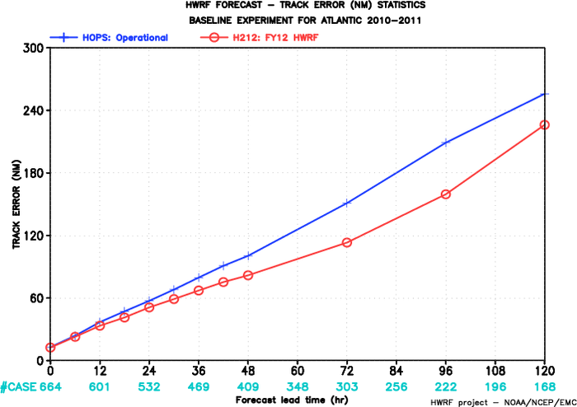
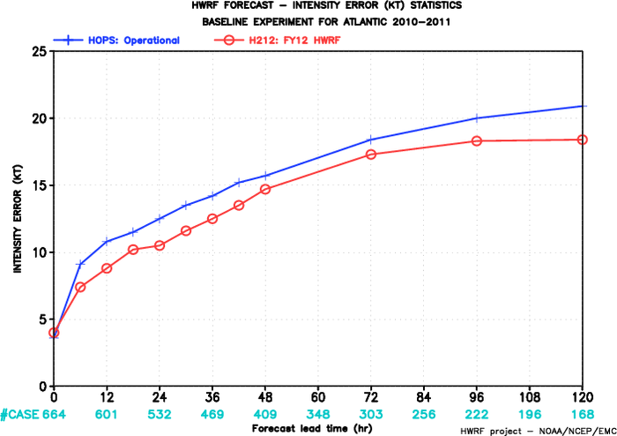
HWRF Improvements
2010-11 ATL Track Errors (nm)
2010-11 ATL Intensity Errors (kt)
11% 19% 25% 24% 12%
15% 7% 5% 9% 12%
HOPS: 2011 HWRF
H212: 2012 HWRF
Courtesy of Dr. Vijay Tallapragada, NCEP/EMC
Notes:
NCEP retrospective runs for 2010-2011:
Comparison of 2011 Operational HWRF (blue lines) and the 2012 Operational HWRF implementation (red lines)
Track error (nm) on left (ordinate)
Intensity error (kt) on right (ordinate)
Forecast lead time (h) abscissa
Number of cases in cyan
% improvement at 24, 48, 72, 96, & 120 h (red)
Courtesy of Dr. Vijay Tallapragada, NCEP/EMC HWRF team lead
18

Slide 19
Conclusions
Unprecedented observations of boundary layer structure in rapidly intensifying hurricane:
  1st quantitative documentation of boundary layer processes in extreme winds.
  1st direct evidence of mechanisms that effect hurricane intensity change, e.g., intense vortical structures; lateral mixing in eyewall; trochoidal oscillation.
Led to new paradigm for TC intensification
Led to improved boundary layer physics in HWRF
  Key to transition of 3-km HWRF to operations
Notes:
First direct evidence supporting presence of intense vortical structures along inner edge of eyewall
Trochoidal oscillation of eye

Slide 20

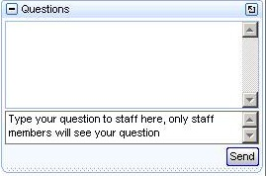
To Ask a Question
To Ask a question
  You may need to click the orange arrow in upper right corner
  Expand the + next to Questions
  Type your question in the box, and click send
Notes:
[Sandy MacDonald]
Thank you Frank! Just to remind people, if you’d like to ask a question here’s how to do it.
SEGUE: We’ll start with questions people have already submitted…

Slide 21
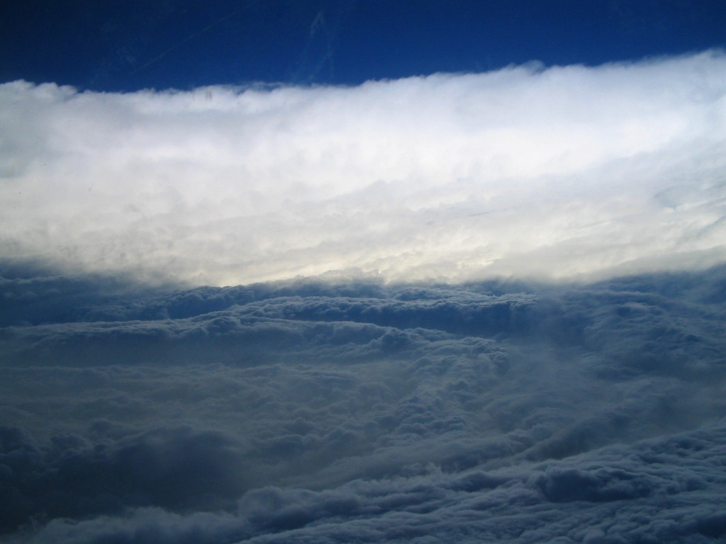
Q&A Session
"It was God's stadium...an almighty bowl of tranquility surrounded by epically vast stands of wind-packed white cloud climbing all about us, unbroken, smoothly towering taller than mountains. The sea writhed beneath it, spume-streaked, and the sky stared down blank and empty above.
`I must say,' came a quiet voice from the cockpit, `this is definitely impressive.'" - Inside the Hurricane by Pete Davies
Notes:
Hurricane Katrina (2005)

Slide 22
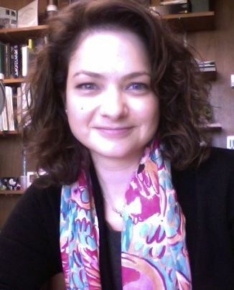
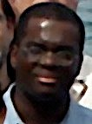
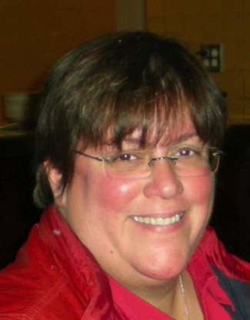
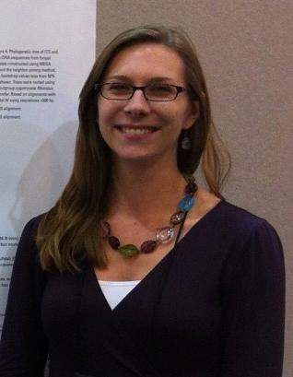
Thank You!
The “Wizards” Behind the Curtain
Russell St. Fleur
Erica Rule
Communications
Alejandra Lorenzo
Julie Galkiewicz
OAR Communications
SILVER SPRING, MD
Notes:
[Sandy MacDonald]
There were some additional people working behind the scenes to help put this webinar together.

Slide 23
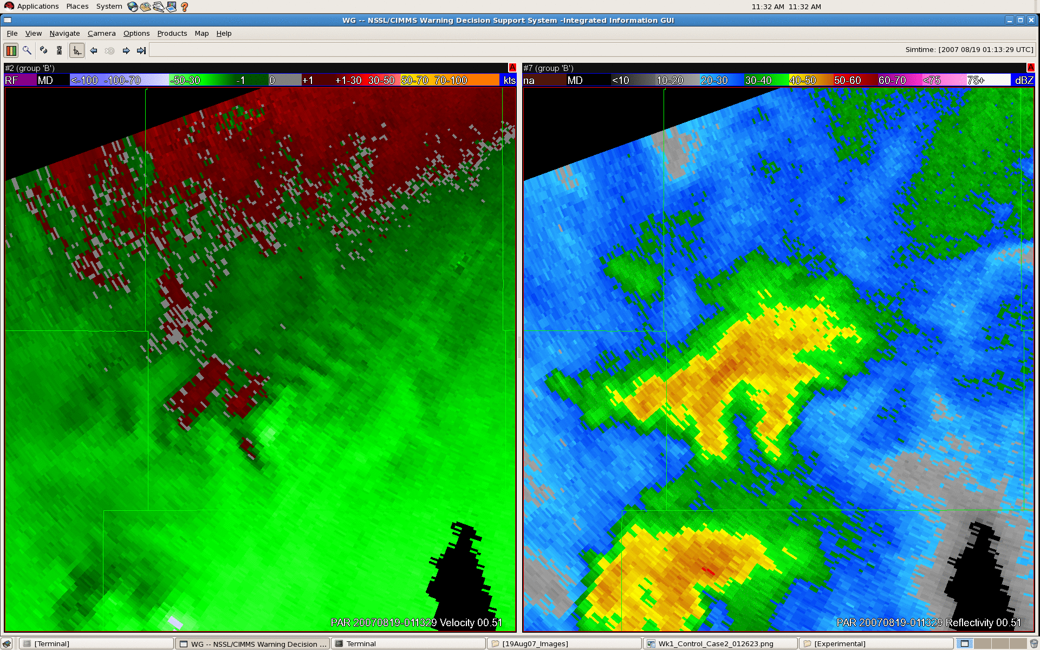
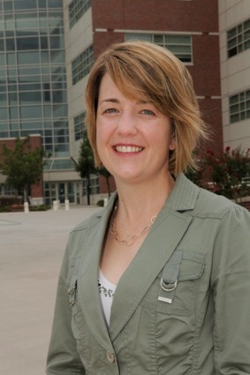
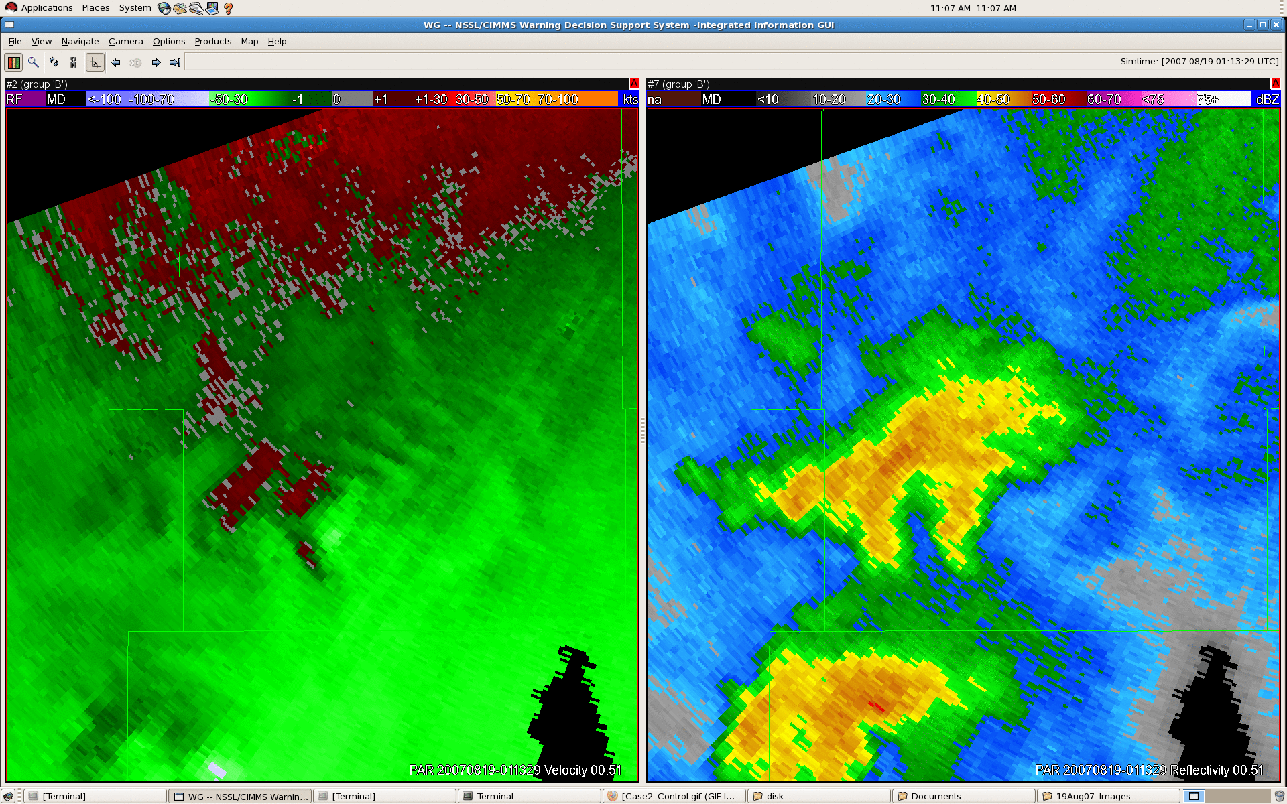
Next Webinar!
Pam Heinselman
Exploring Impacts of Rapid-Scan Radar data on NWS Decisions
Tuesday October 16, 2012
3-4 pm EDT
PAR data updated at 43 sec. intervals
Hosted by the National Severe Storms Lab
Norman, OK
PAR data updated at 4.5 min. intervals
Notes:
[Sandy MacDonald]
And I’d like to announce our next webinar.
Pam Heinselman from the National Severe Storms Lab will be presenting a paper on how rapid-refresh radar data can help improve forecasting decisions in severe storm events. Just as a preview, you can see in the animation the difference between a radar display that’s updating at 43 second intervals, compared to the same data updating every 4.5 minutes. Faster radar scans are helping forecasters determine the conditions on the ground.
That webinar is schedule for Tuesday October 16, 3-4 PM Eastern.

Slide 24




Thank You for Participating!
How did we do?
  Take the anonymous survey
  oar.communications@noaa.gov
Look for email where and when Webinar will be posted
Stay Connected: researchmatters.noaa.gov
Notes:
[Sandy MacDonald]
And finally, we’d like to know what you think about this webinar. You’ll receive an email in an hour or so with a link to an anonymous survey. Please let us know how we did!
This webinar will also be posted online, and we’ll let you know when.
Stay connected with what’s going on in OAR by visiting the OAR website or linking up with OAR social media

