Slide 1
Atlantic Hurricanes –
Flying into the Eye of the Storm
Rob Rogers
NOAA Hurricane Research Division
Miami, Florida, USA

Slide 2
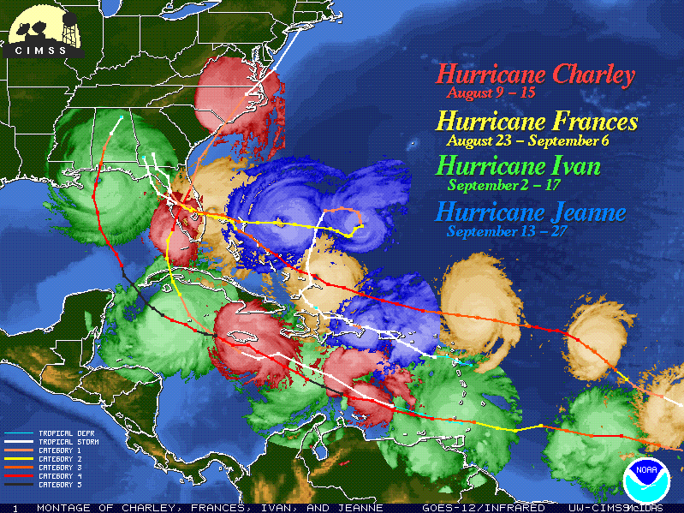
NOAA Dork Logo
Notes:
This is the NOAA dork logo…

Slide 3
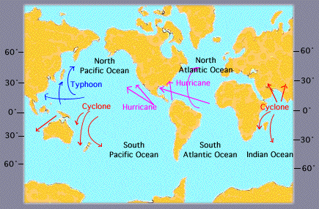

Slide 4
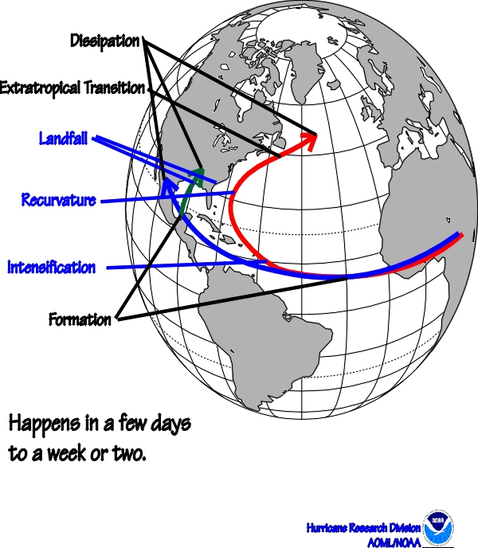
Hurricane Life Cycle

Slide 5
EVOLUTION OF A TROPICAL CYCLONE
Tropical Depression – Winds < 39 mph
(Circular winds with thunderstorms)
Tropical Storm – Winds 39-73 mph
Hurricane – Winds 74 mph & up
Major Hurricane (Saffir/Simpson
Category 3-4-5) – Winds 111 mph
& up

Slide 6
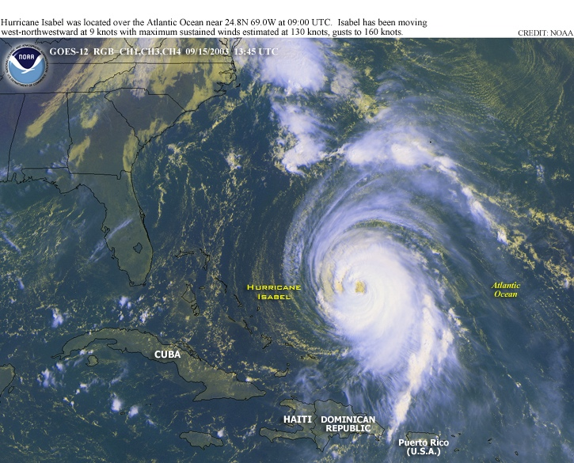

Slide 7




The Forecasters (them):
The Researchers (us):

Slide 8
Recipe for a Hurricane

Slide 9
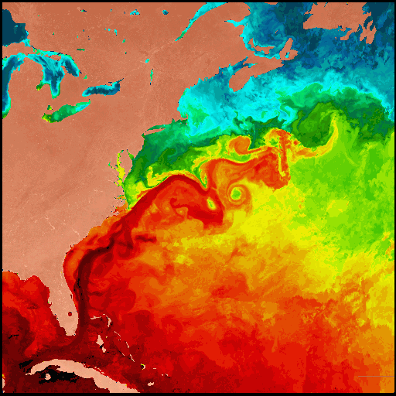
Warm Ocean

Slide 10
Not too much "Wind Shear"

Slide 11
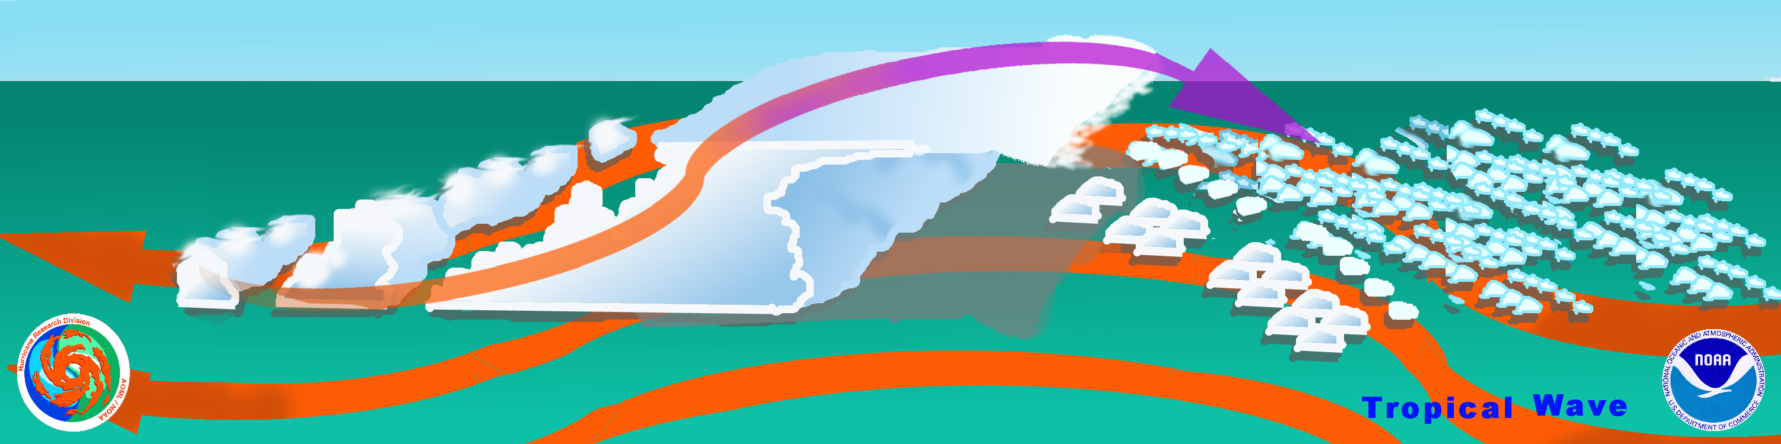
A pre-existing "Trigger"...

Slide 12
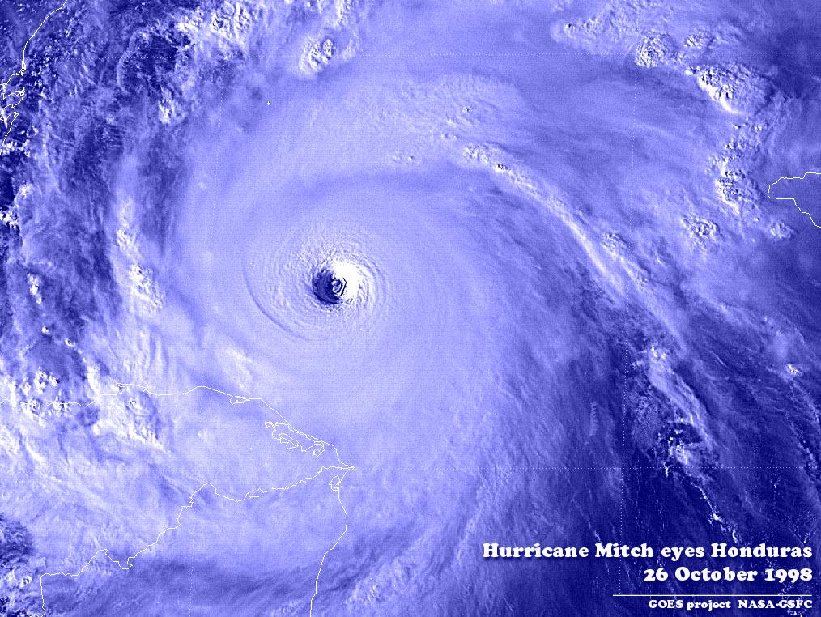
...and Voila !!
Hurricane Mitch Near Peak Intensity

Slide 13
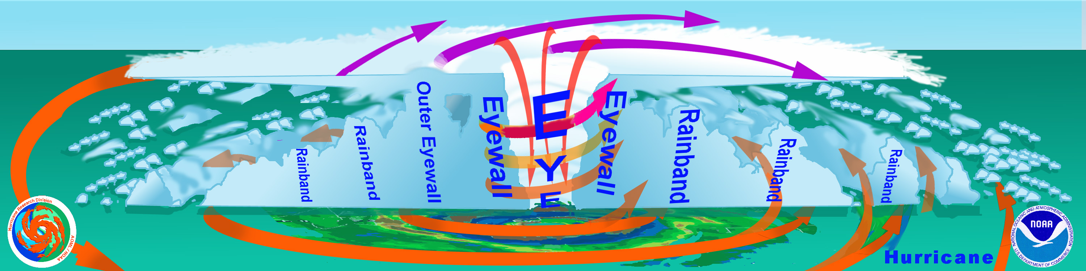
Nature's great heat engine...
The Hurricane
Outflow (“Exhaust”)
Energy Release
(“Cylinders”)
Ocean (“Fuel”)

Slide 14
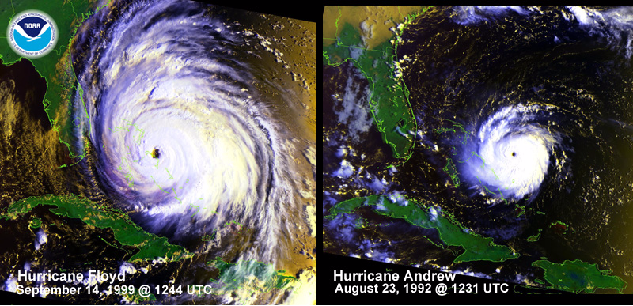
Natures Most Powerful Storm...
Size Matters!

Slide 15

On the aircraft

Slide 16
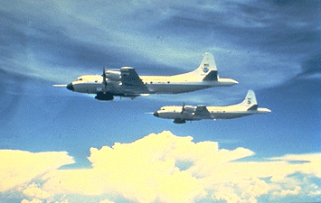


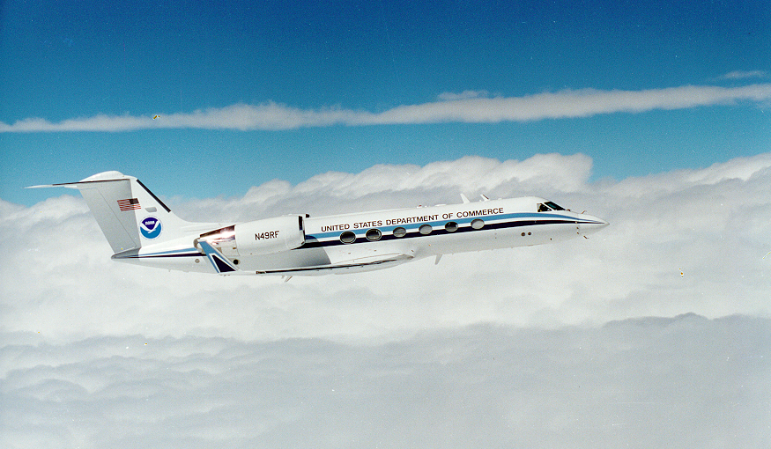

“Miss Piggy” Built in 1976 at Lockheed-Martin, Marietta, Georgia
“Kermit” Built in 1975 at Lockheed-Martin, Marietta, Georgia
“Gonzo” Built in 1994 at Gulfstream Aerospace Corporation in Savannah Georgia

Slide 17
Synoptic Surveillance

Slide 18
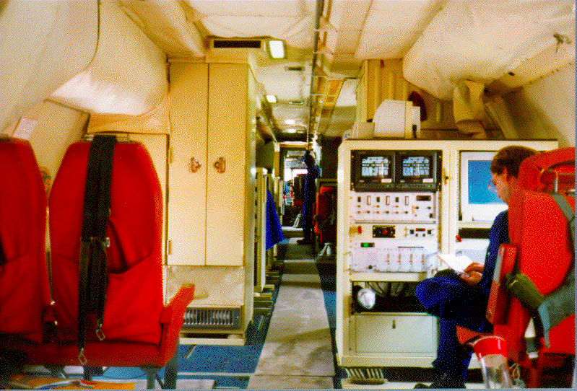
Inside the P-3 Aircraft

Slide 19
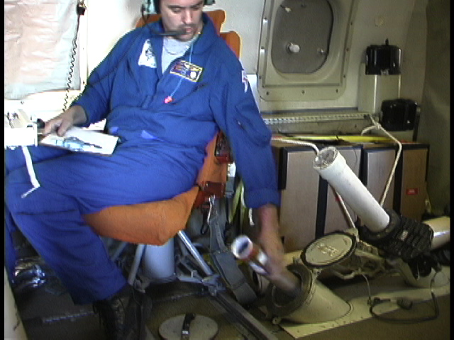

Slide 20

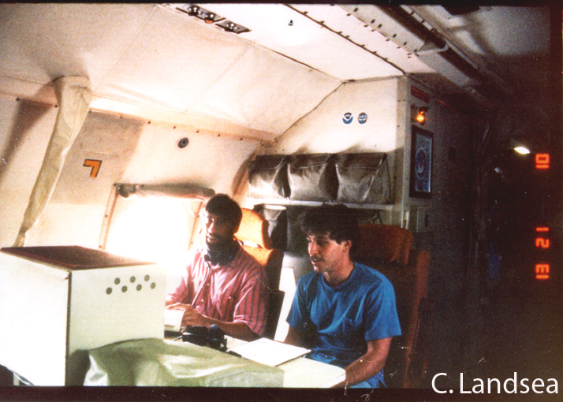
Inside the P-3 Aircraft
R. Rogers

Slide 21
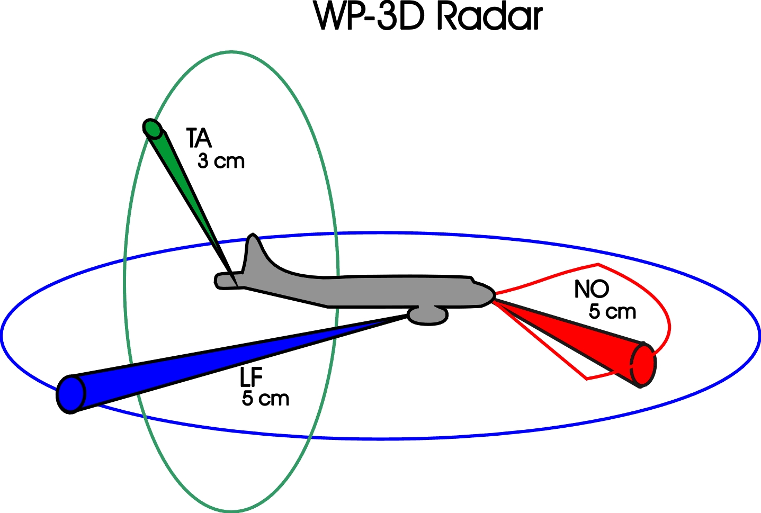

Slide 22
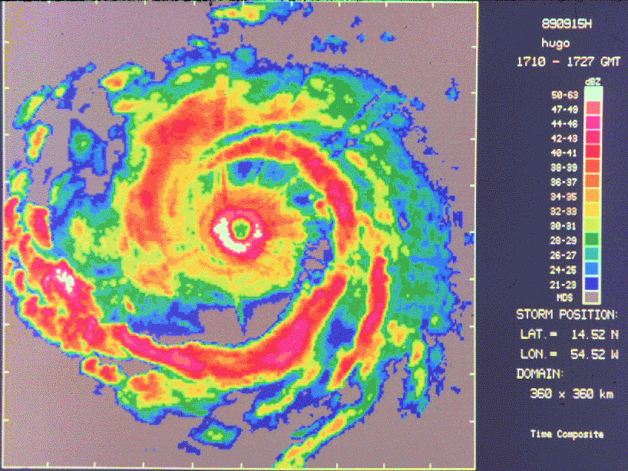
LF radar

Slide 23
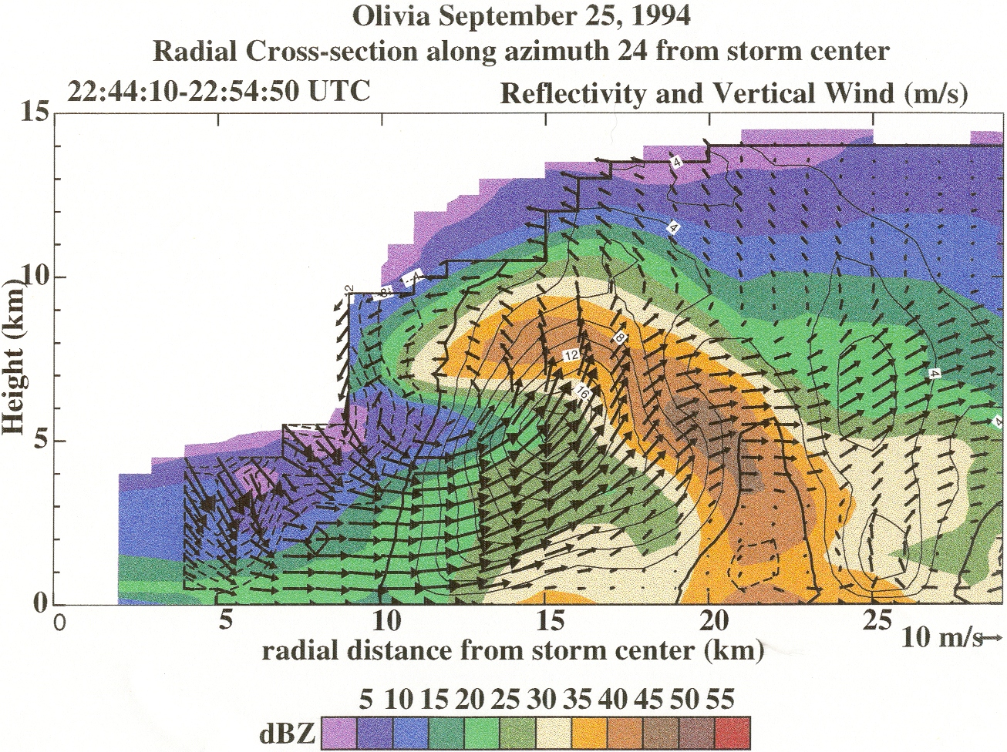
TA radar

Slide 24
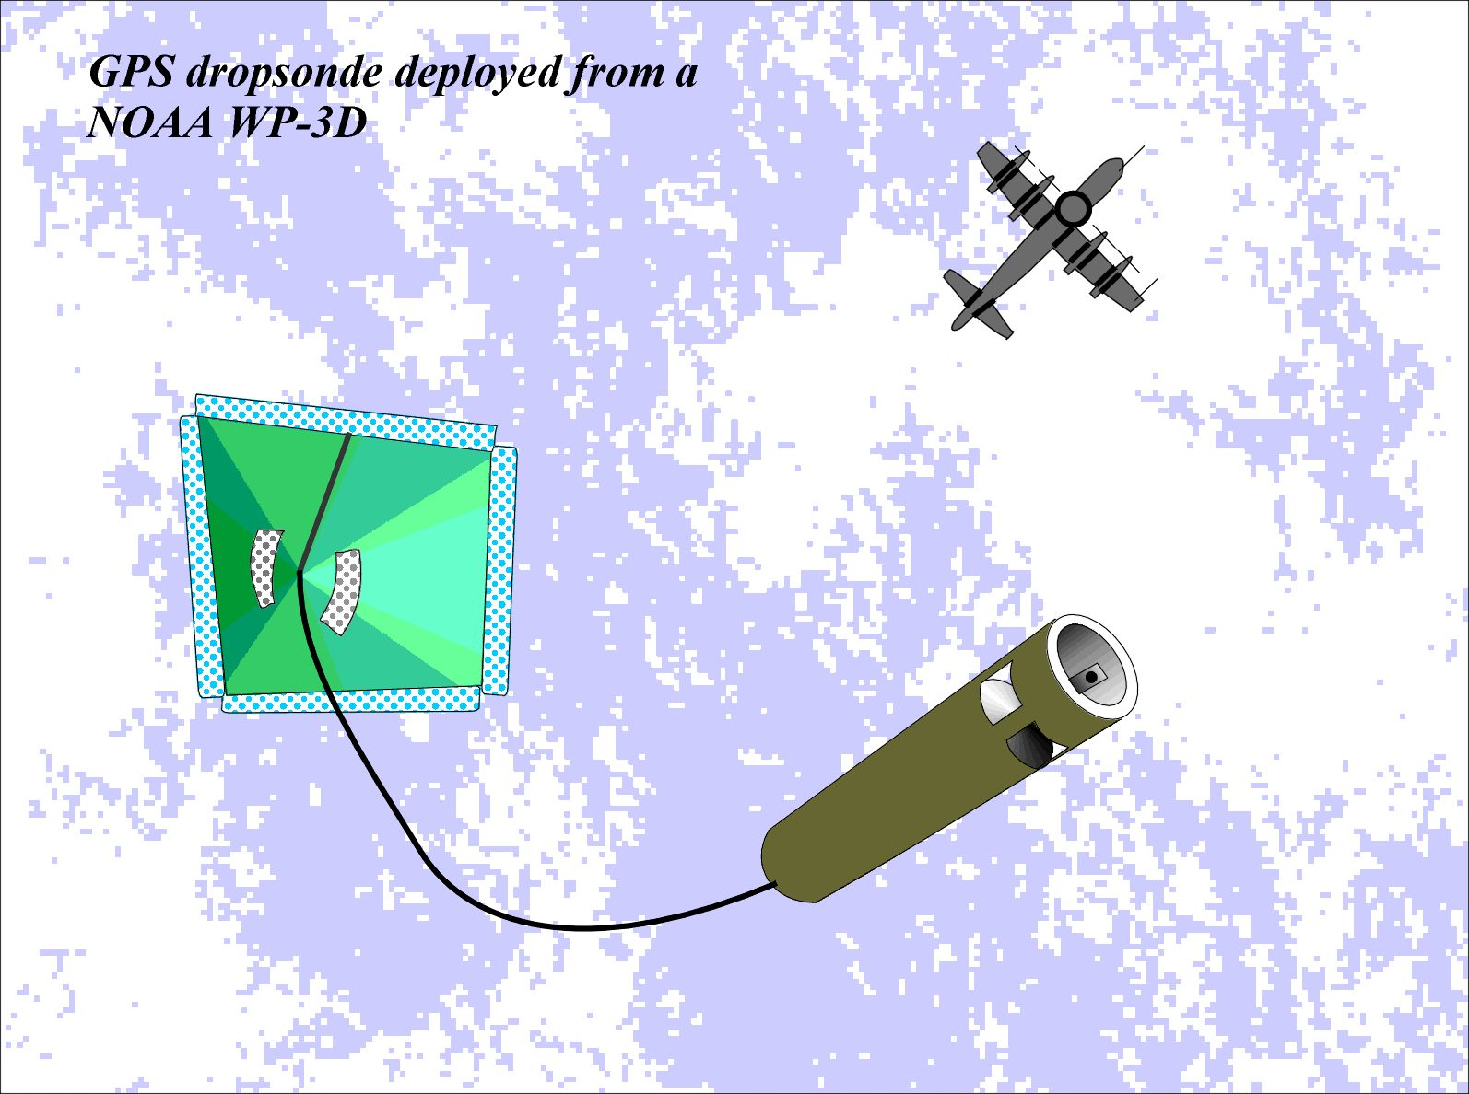

Slide 25
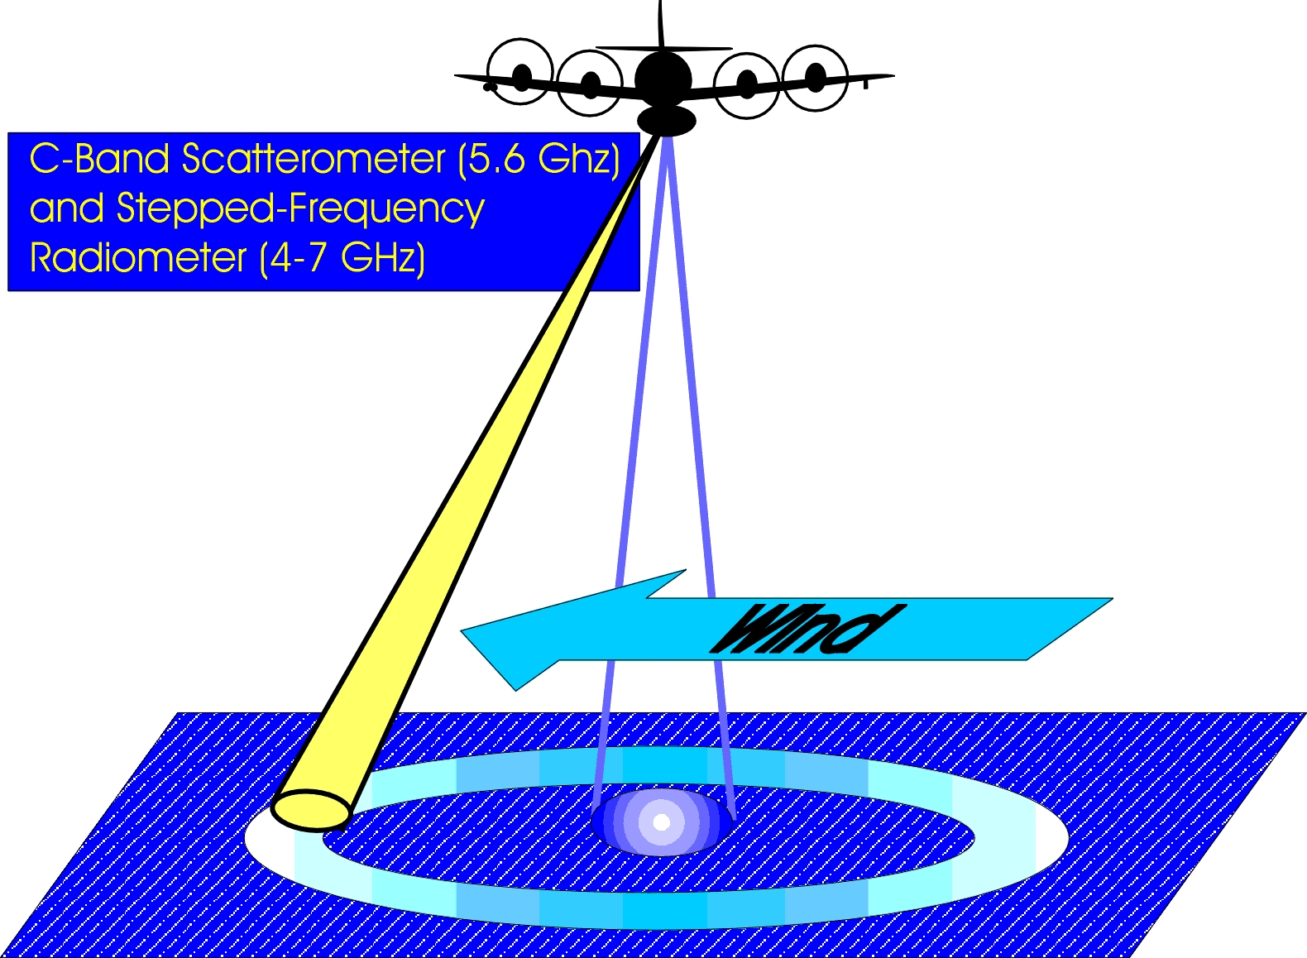
Remotely Sensed Surface Winds

Slide 26
Hurricane Floyd
rainband
eyewall

Slide 27
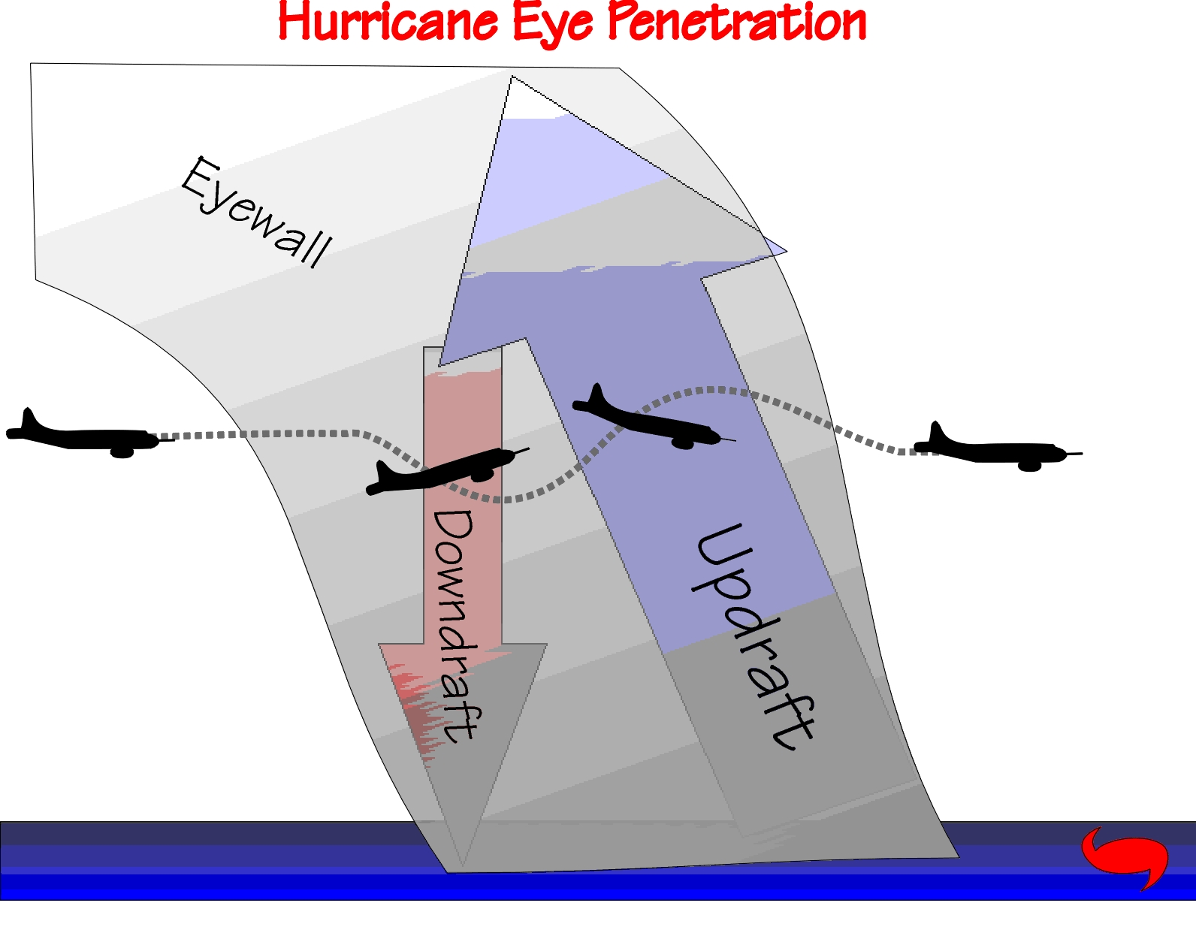

Slide 28

NOAA Gulfstream-IV jet flies at high altitudes in the hurricane environment

Slide 29
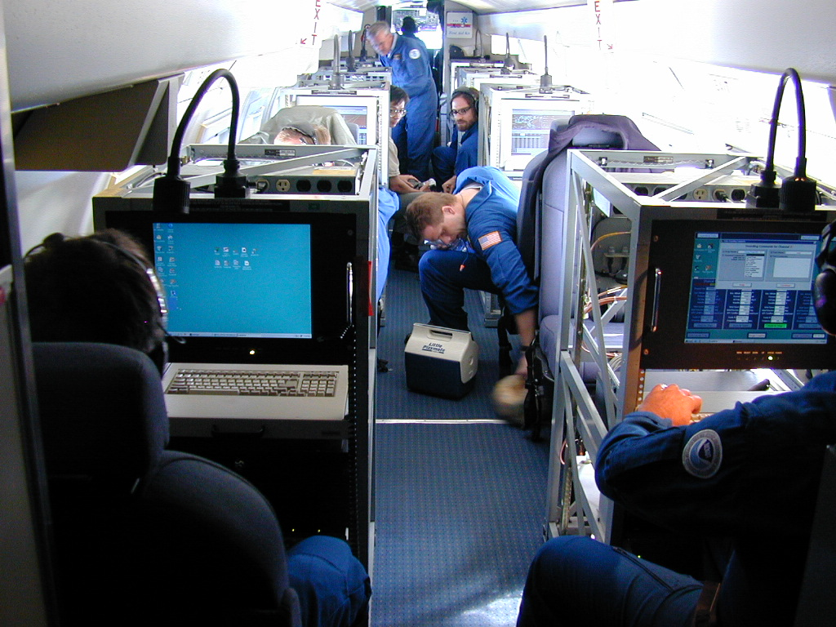

Slide 30

Pictures from the plane

Slide 31
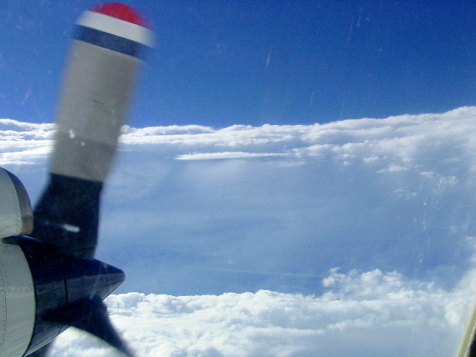
Hurricane Isabel 2003

Slide 32
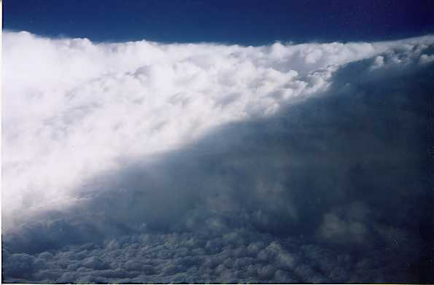
Within the Eye of Hurricane Georges
eyewall
low clouds above
sea-surface

Slide 33
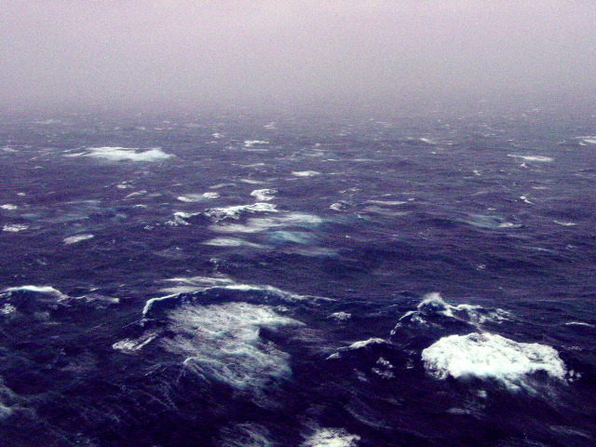
Sea state in a hurricane
50-60 ft waves

Slide 34
Hurricane Damage

Slide 35
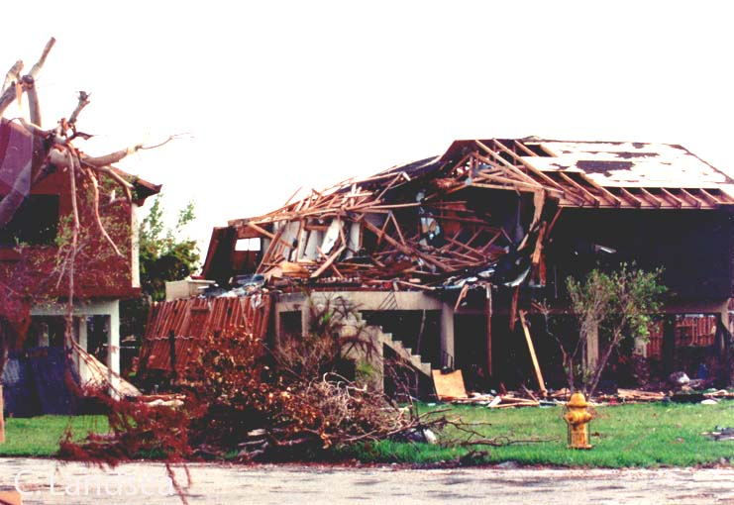
Wind-caused Damage

Slide 36
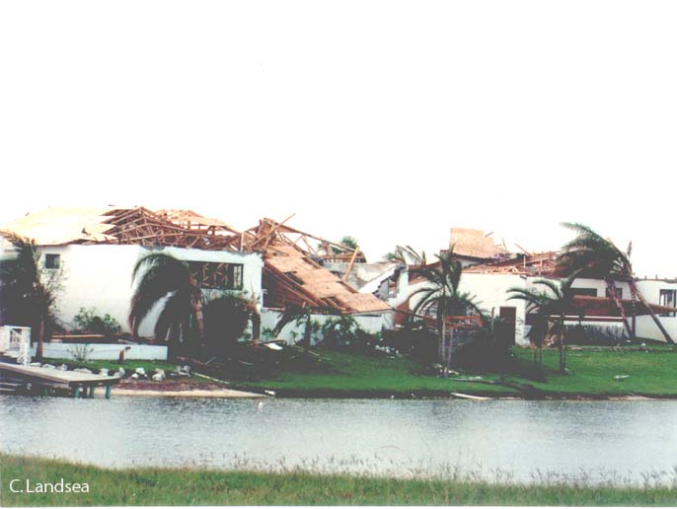
Wind-caused Damage

Slide 37
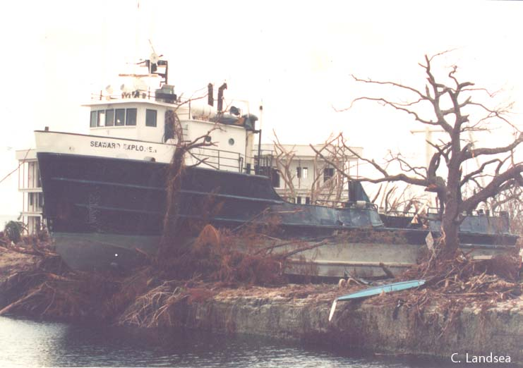
Storm Surge

Slide 38
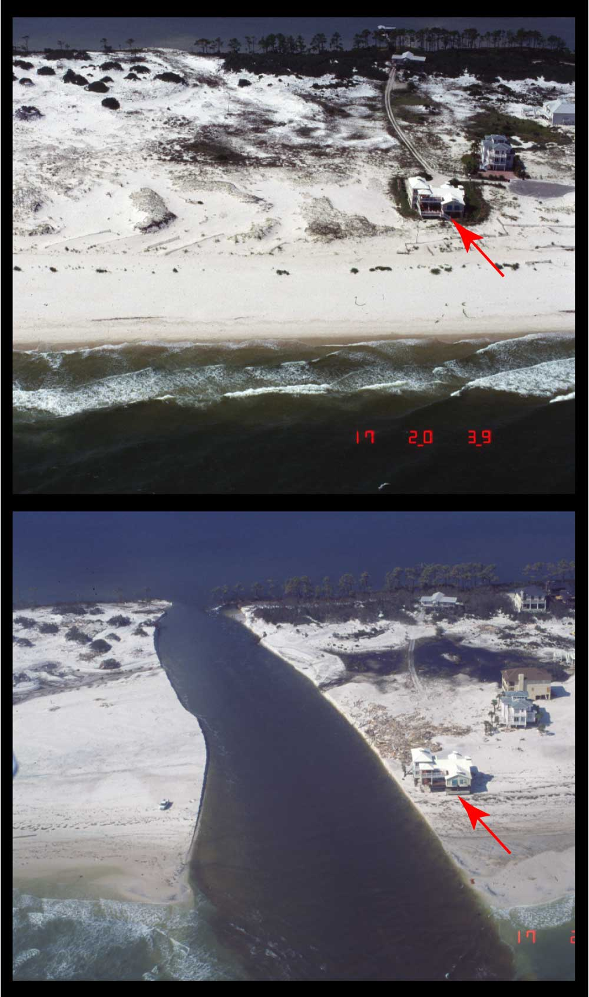
Storm Surge
Breach through barrier island, Pine Beach, AL
(USGS)
Notes:
The island was severed by a breach that may have developed as the back bay drained excess water following the peak of the storm surge, although the breach could have been initiated by waves and surge from the Gulf side. More analyses are required to determine the forcing processes.

Slide 39
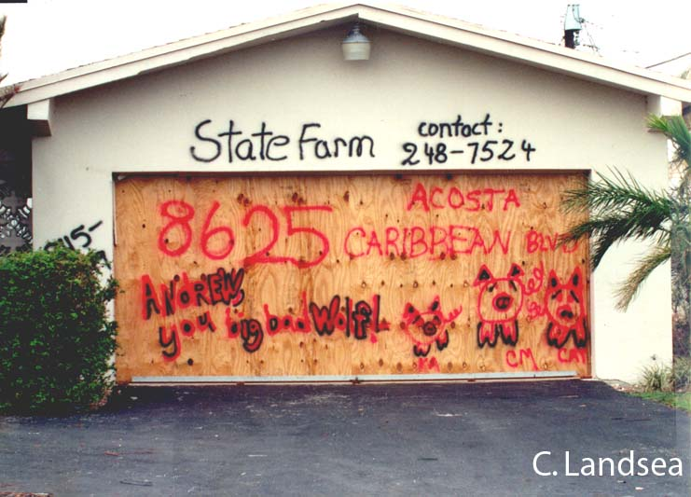
Messages on Homes

Slide 40
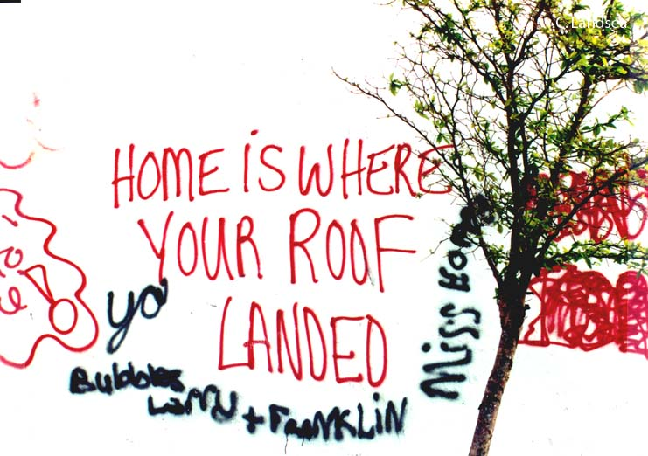

Slide 41
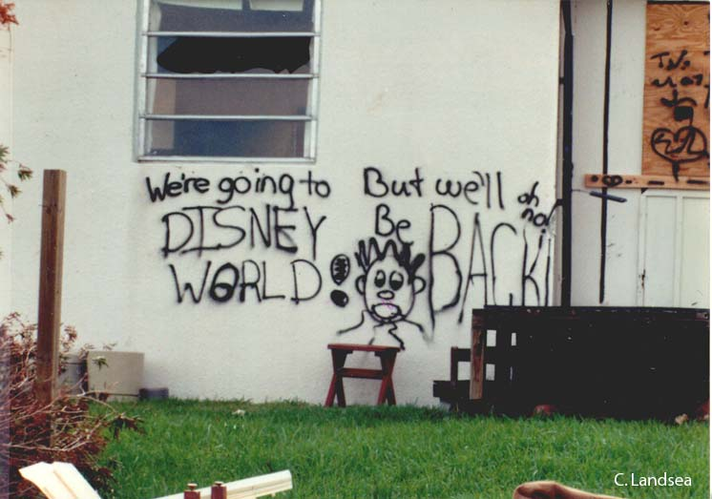

Slide 42




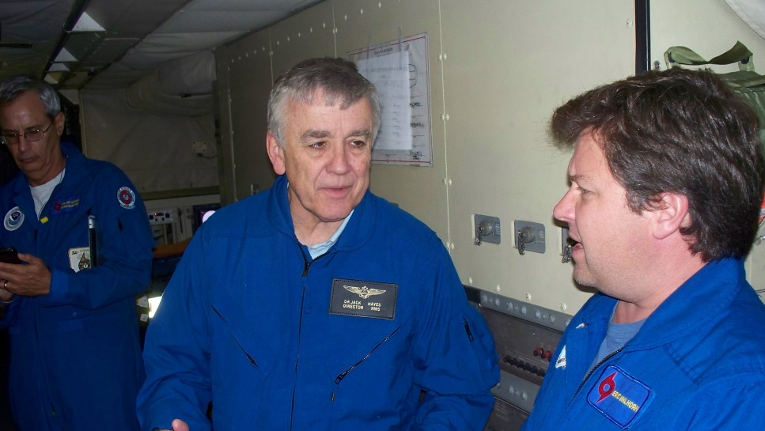
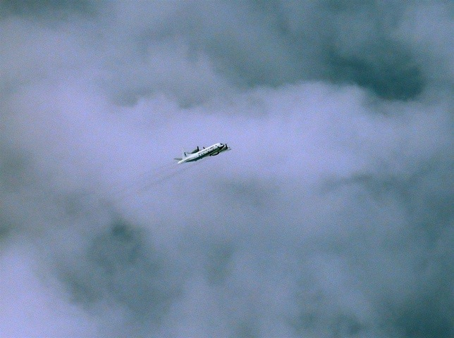
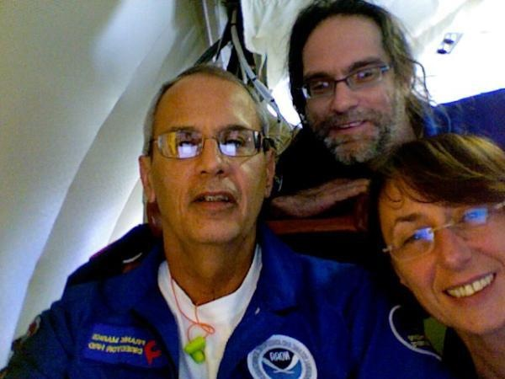
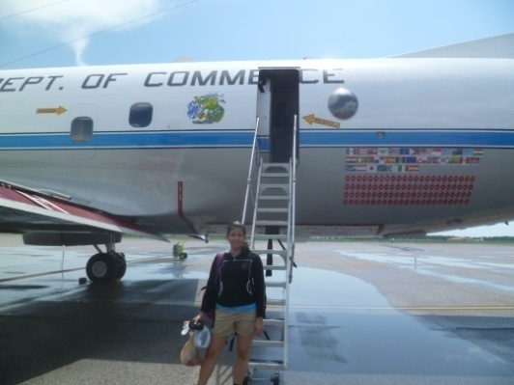
Communicating in the field
Blog
http://noaahrd.wordpress.com
HRD Web page
http://www.aoml.noaa.gov/hrd
Facebook
http://www.facebook.com/noaahrd
Twitter
http://twitter.com/#!/HRD_AOML_NOAA
Tweets from the eye
HRD visiting sci. prog

Slide 43
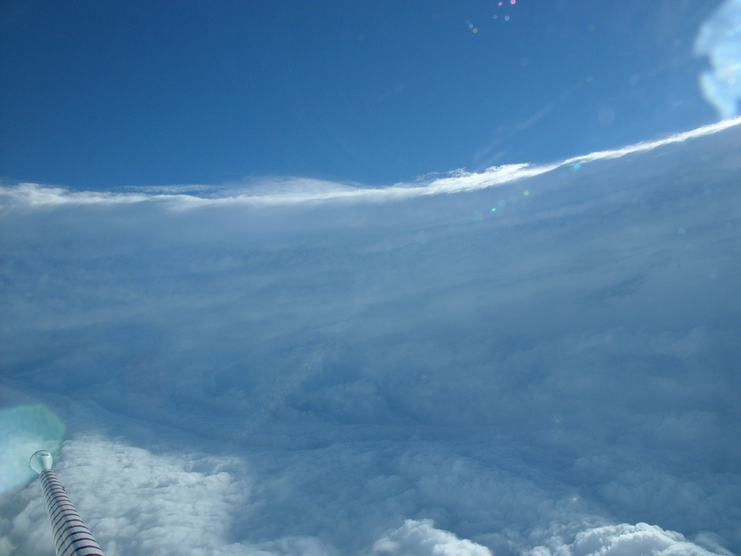
Thank you!

