Slide 1
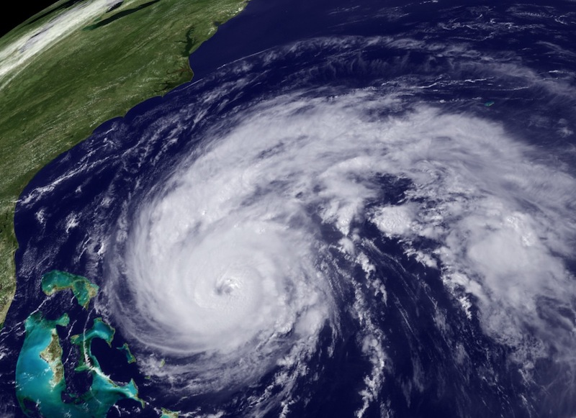
Advancements in Hurricane Research
Frank Marks
NOAA/AOML Hurricane Research Division
NOAA HFIP Research Lead
15 May 2012
Notes:
Hurricane Irene 27 August 2011

Slide 2
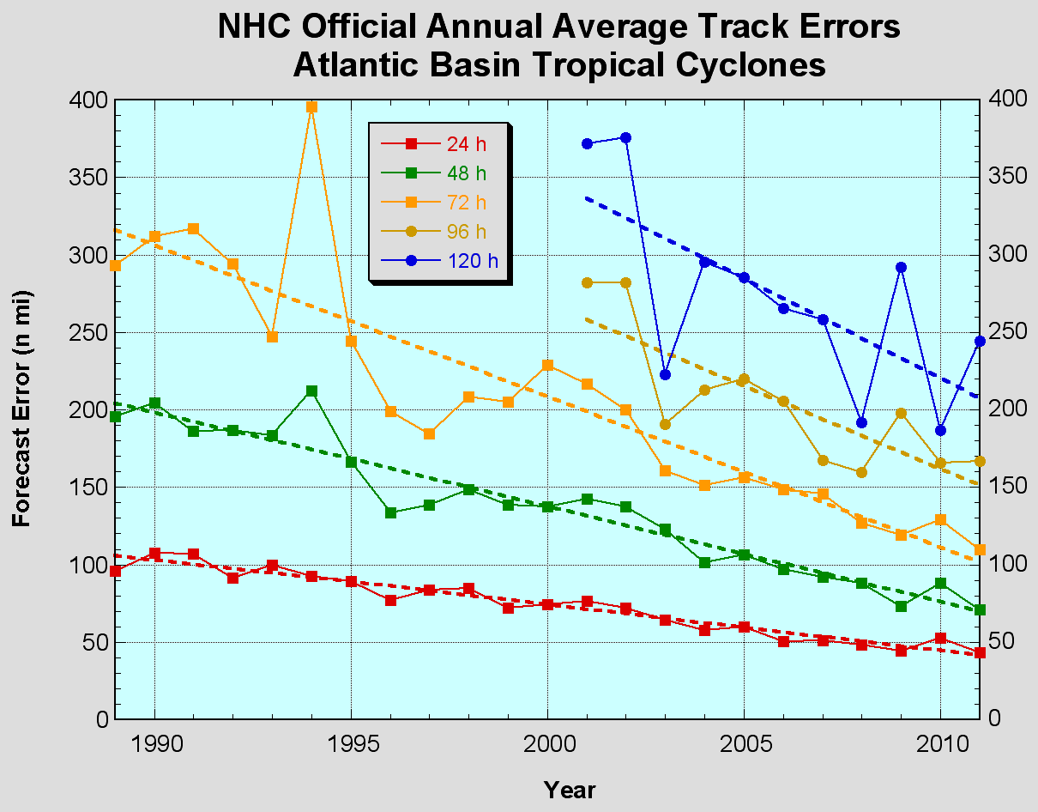
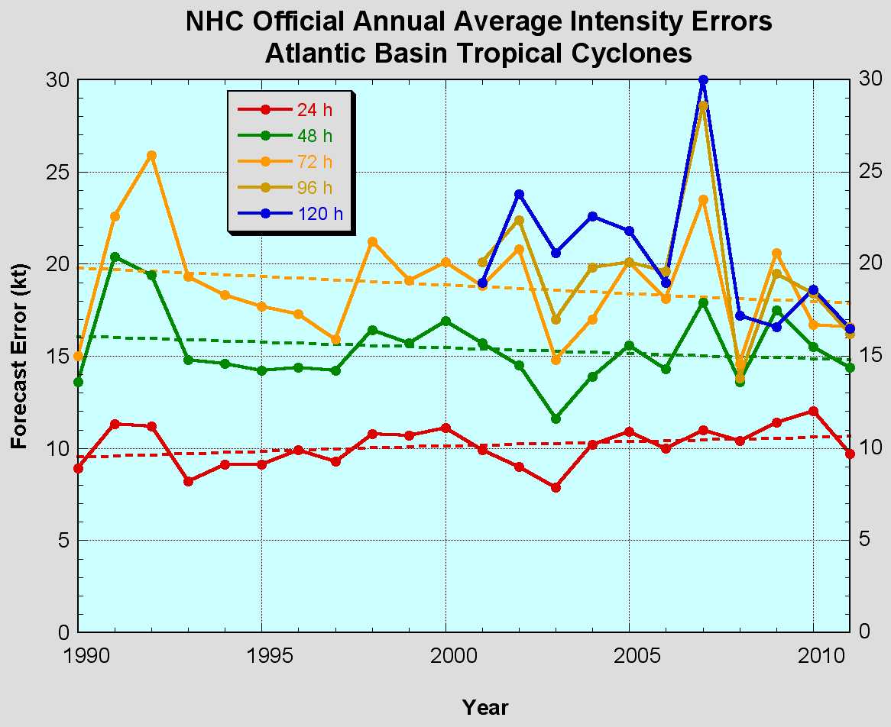
The Good – track forecast improvements
Current Capabilities
The Bad - Intensity no real gains
No progress with intensity in last 15-20 years
Errors cut in half over past 15 years
10-year improvement - As accurate at 48 hours as we were at 24 hours in 1999
24-48h intensity forecast off by 1 category
Off by 2 categories perhaps 5-10% of time
Notes:
Images from: http://www.nhc.noaa.gov/verification/verify5.shtml

Slide 3
Current Capabilities
Storm Size: Progress is difficult to measure due to inadequate observations
Storm Surge: Accurate within ±20% when track, intensity, and size known
Lead Time: Lead time was extended from 3 to 5 days in 2001
Precipitation: Modest annual improvements; forecast patterns match observations when track error is low
New/Improved Products: Refined cone graphic, wind speed probabilities, graphical tropical weather outlook, and probabilistic storm surge
Social/Behavioral Science: In its infancy

Slide 4
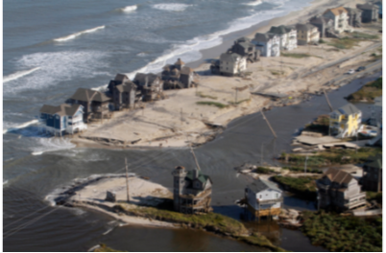

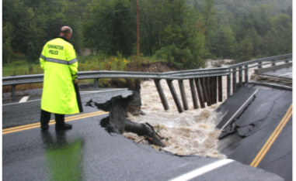
Improvements still needed!
NOAA’s National Weather Service (NWS) mission is to fulfill this commitment through building a Weather Ready Nation.
NWS must contribute to hazard resiliency by continually assessing and improving its services to the Nation.
Hurricane Irene (2011):
  41 deaths
  $7 to $10 Billion damage
  Major infrastructure losses
  Power lost to 8 million
Virginia Beach, Va
Hatteras Island, N.C.
Woodford, Vt.
Jim R. Bounds/AP
Austen Danforth/Bennington Banner/AP
Brendan Hoffman/Getty Images

Slide 5
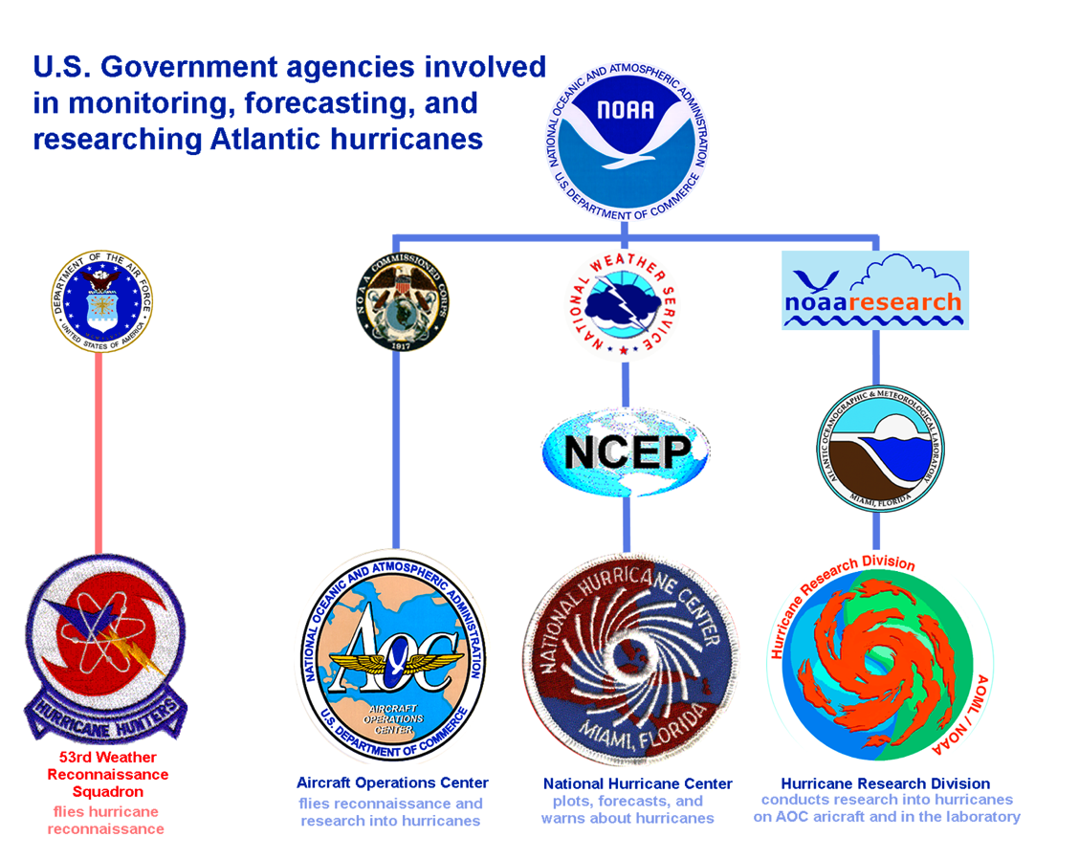


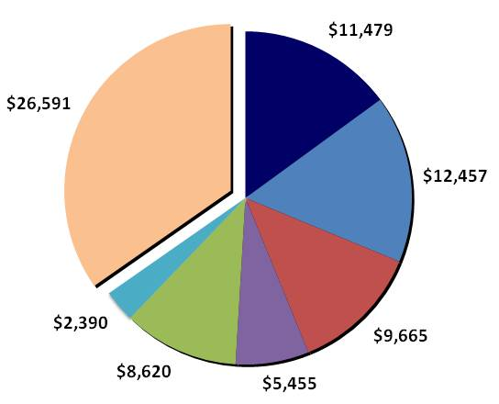





Federal Hurricane Team
2010 Snapshot
Total: $76,658K
HFIP
IFEX, GRIP,
&
PREDICT
NOAA Total:
$23,936
Notes:
Operations: $300M/year (NOAA & DoD)– observing, forecasting, instrumentation (satellites)
Research: 2008: $50M/year (16%), 2010: $76M (25%) – leveraged across multiple agencies
Manyears: 2008: 211, 2010: 279

Slide 6

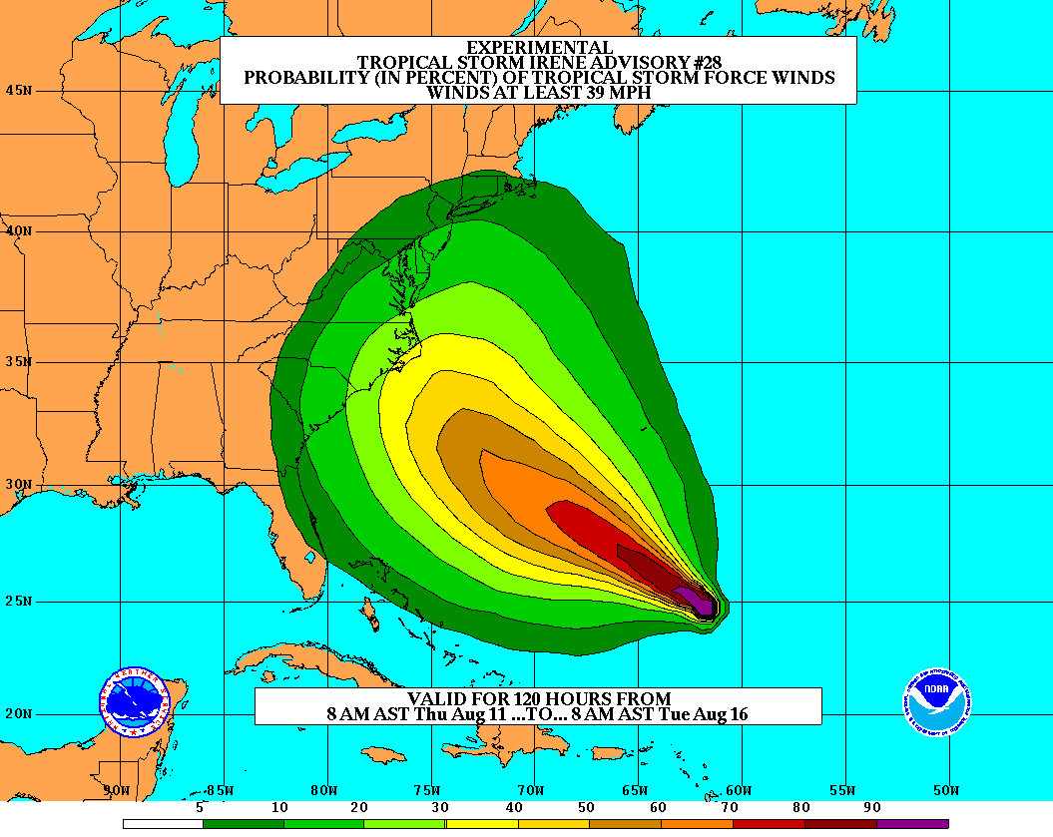
Goals
Improve Forecast Accuracy
  Hurricane impact areas (track) – 50%
  in 10 years
  Severity (intensity) – 50% in 10 years
  Storm surge impact locations
  and severity
Extend forecast reliability out to 7 days
Quantify, bound and reduce forecast uncertainty to enable risk management decisions
Notes:
http://www.nrc.noaa.gov/HFIPDraftPlan.html
HFIP Team
Frank Marks, research lead
Ed Rappaport, operations lead
Fred Toepfer, project manager
Robert Gall, development manager
Mark DeMaria
Chris Fairall
Jim McFadden
Daniel Melendez
HFIP executieve oversight board:
OAR DAA/Sandy MacDonald, co-chair
NWS AA/Jack Hayes, co-chair
NCEP/Louis Uccellini,
TPC/Bill Read,
NESDIS/Mark DeMaria,
NOS/Jesse Feyen,
AOML/Bob Atlas
PPI/Paul Doremus
NMFS/Bonnie Ponwith,
NOS/Liz Scheffler,
NMAO-PM Aircraft/Mike Devany
OFCM/Sam Williamson
Executive Secretariat: OAR/Brian Orndorff and NWS/Nasheema Lett

Slide 7

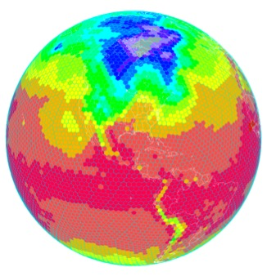
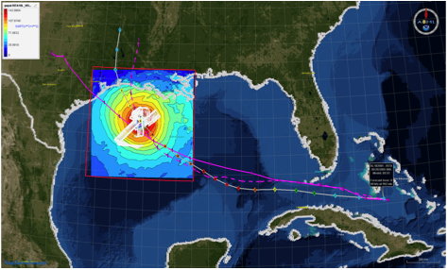
HFIP Activities
Traditional Hurricane Research Activities:
Observations, analysis, database, & instrument R&D (IFEX)
Statistical-dynamical model development
Advances in operational models (Stream 1)
New HFIP Research Thrusts:
Experimental global and regional hurricane model development (Stream 2)
Data assimilation techniques and observing system strategy analysis development (Stream 1 & 2)
Model evaluation tool development
Application and tool development for forecasters
D1
D2
Partnership: NCEP, AOC, AOML, ESRL, GFDL, DTC, USWRP, NESDIS/STAR
Notes:
Two Stream Approach to HFIP developments:
Stream 1– Operational Transition and Implementation
Stream 2 – Advanced Technology Demonstration
Unconstrained by near-term availability of operational computing
Uses both NOAA’s and computing resources from major supercomputing centers for testing and evaluation.
Emphasis is on high resolution global and regional models run as ensembles
Real-time or near real time runs during hurricane season
Stream 1.5 (JHT-like)
NHC Forecaster Defined.
Subset of Stream 2 that forecasters see as particularly promising or provides demonstrated capability
Will be configured to run in real-time and products made available to NHC.

Slide 8
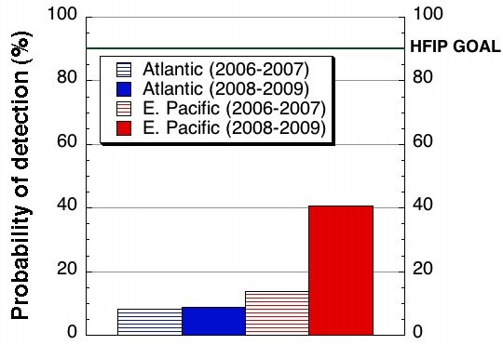
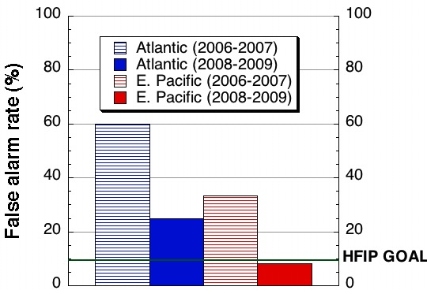
Improved Models:
Statistical-dynamical models–RI
SHIPS &LGEM most skillful intensity guidance. Explains 55% of intensity change variance
RI index explains 30% of variance
RI Index higher POD than model & OFCL in both ATL and EPAC, FAR comparable
  Evaluation of improved RI index shows 5-7% improvement over climatology
NHC’s Operational RI POD
Atlantic Intensity Forecast Errors - 1992-2010
NHC’s Operational RI FAR
Courtesy of J. Kaplan (AOML/HRD)
Notes:
Kaplan J., M. DeMaria, J. A. Knaff, 2009: A Revised Tropical Cyclone Rapid Intensification Index for the Atlantic and Eastern North Pacific Basins. Weather and Forecasting: In Press

Slide 9
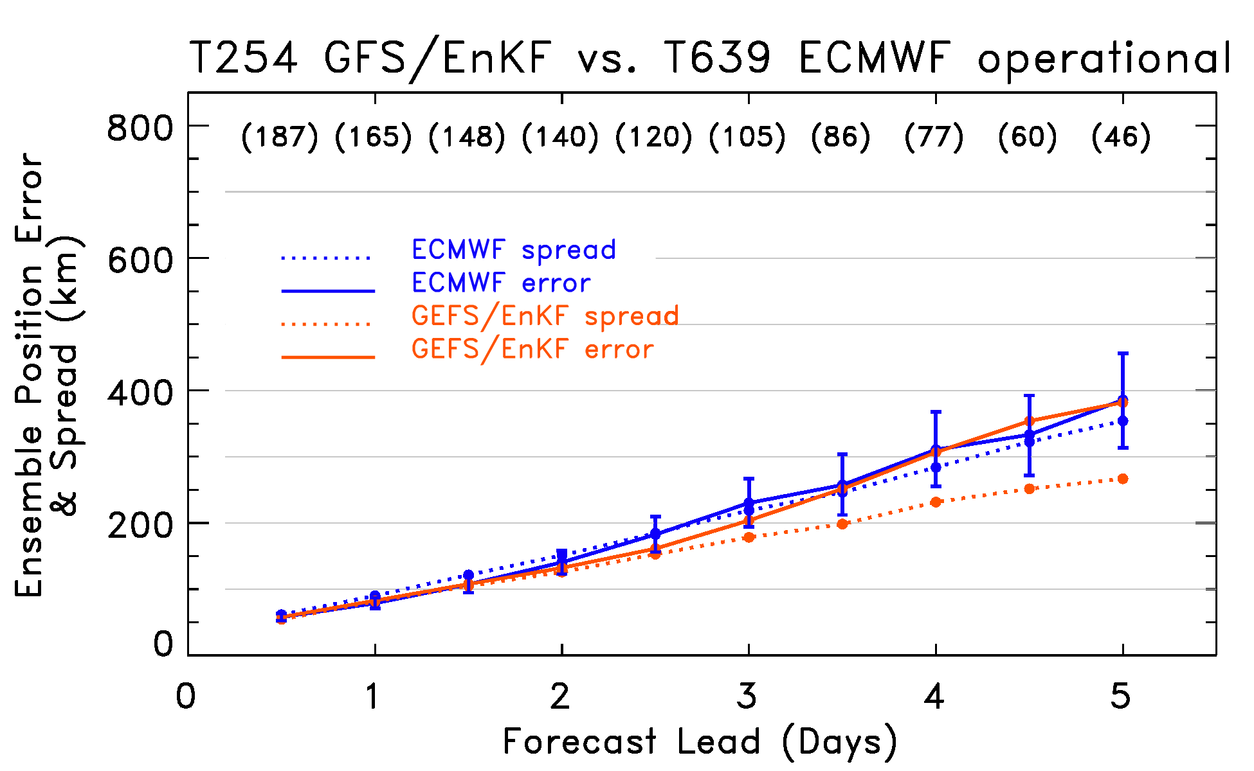
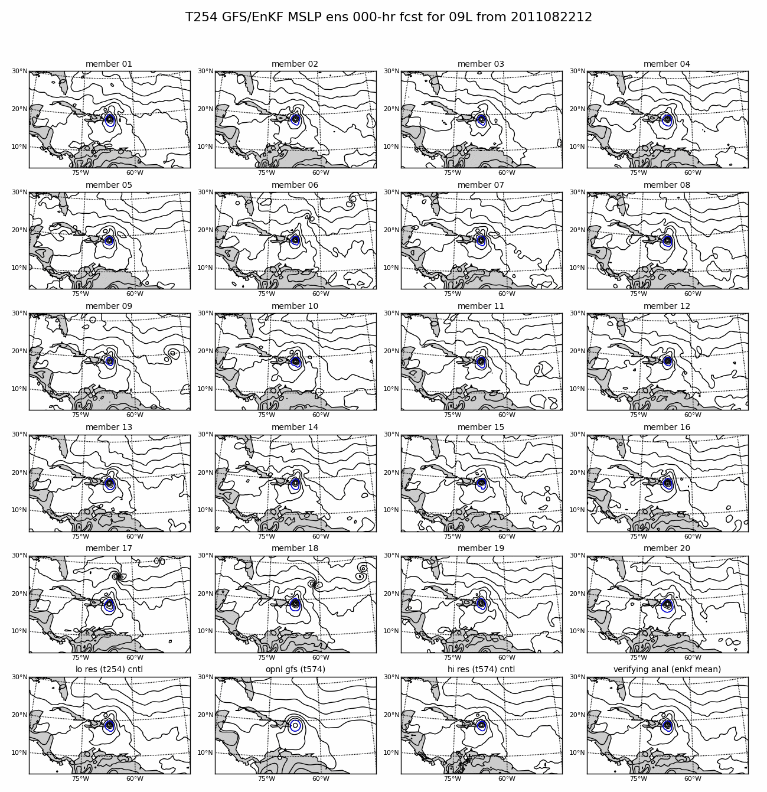
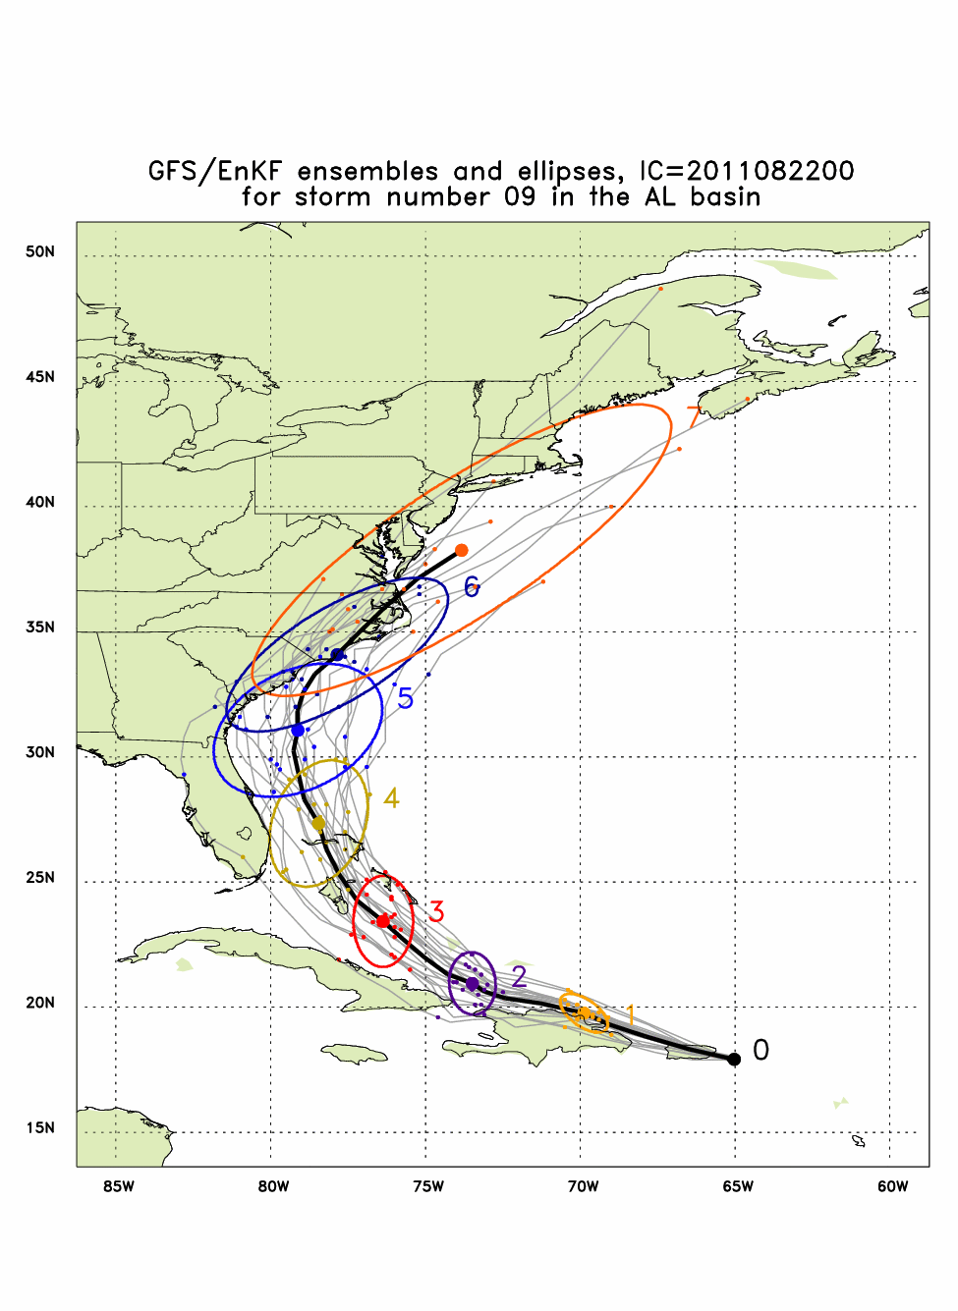
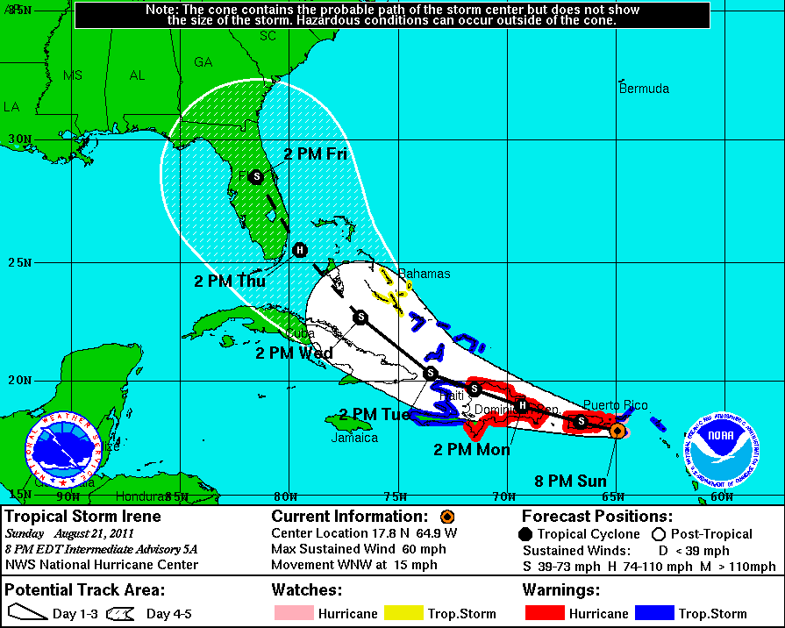
Global Model Development – GFS/EnKF
Irene (09L) – init 12Z 21 August
GFS/EnKF T256 20 member ensemble
NHC Official Forecast
Size of Official uncertainty
Observed Track (Aug 21 – 26)
http://www.esrl.noaa.gov/psd/forecasts/gfsenkf/ens/
Global Model Team - Tom Hamill & Jeff Whitaker (ESRL)
Notes:
Global Ensembles:
80-member T254 GFS ensembles cycled every 6-h continuously from 1 August to current time
Look at 20 members of the 80 member ensemble
Left panels shows ellipse plot of 20 members at each forecast time – ellipse shape shows the spread along/across track
Right panel show surface pressure post stamp images of 20 members

Slide 10
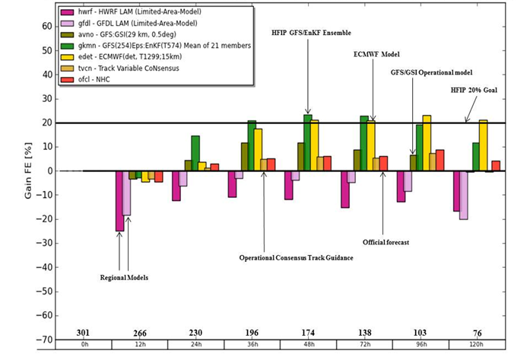
Global Model Development
Track Error (2010-2011)
Global Model Team – Mike Fiorino (ESRL)
Notes:
Track Error of Models (2010-2011) (% Improvement over HFIP baseline – average track error for three years of operational model guidance errors for 2006-2008 when HFIP began)
purples are the operational regional models
Greens represent the operational GFS and the HFIP GFS at lower resolution than the operational GFS but with ENKF data assimilation of central pressure
Yellows (ECMWF) and browns (UKMET) are two of the better global models
Orange is the best multi-model ensemble track guidance used by NHC
Dark orange is the Official NHC forecast error
Note that the HFIP GFS/EnKF model which is at ¼ the spatial resolution of ECMWF is competitive and also exceeds the 20% improvement goal of HFIP for 5 years.

Slide 11
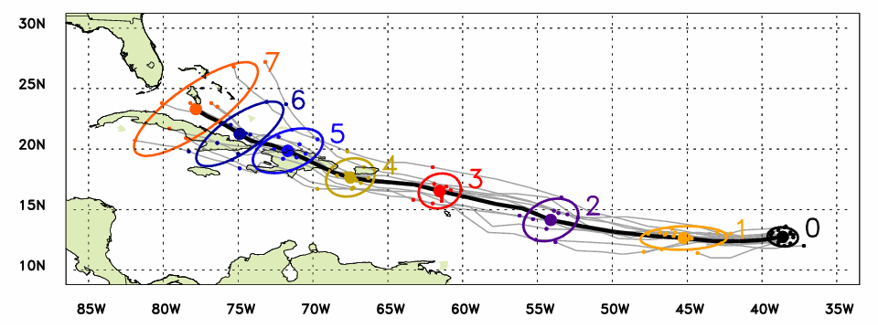
Global Model Development - Genesis
Observed Track (Aug 21 – 26)
Ensemble mean track
Ellipse includes 80% of members
Forecast lead time in days
Irene named
Irene declared an investigation area at 1200Z on August 18, 2011
Irene named at 0000Z August 21, 2011
Initial indication of the formation of Irene from ensemble at 00Z 16 August 2011
  2 days before it was declared an investigation area by NHC
  5 days before it was named
Global Model Team - Tom Hamill & Jeff Whitaker (ESRL)
Notes:
In the case of Irene new tools to forecast genesis developed by HFIP using the HFIP global model ensembles from GFS/EnKF (30 members) and FIM (10 members) were able to detect and track the system that formed into Irene 5 days before it was named by NHC and 2 days before NHC declared it an INVEST area
Thin black lines are the disturbance tracks from each of the ensemble members, the small black dots the location of each of the ensemble members at 24 h intervals after the initial time, and the colored ellipses enclose 75% of the ensemble positions. Note that the ellipses elongate along track (reflecting speed uncertainty) in the early forecasts, and elongate perpendicular to the track (reflecting uncertainty in the storm turn to the N at the later forecast times. At day 3 & 4 when the storm was named the uncertainty is the least.
The solid green line is the observed Best Track from NHC starting when the storm was named.

Slide 12
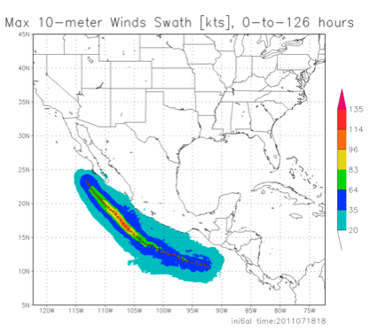
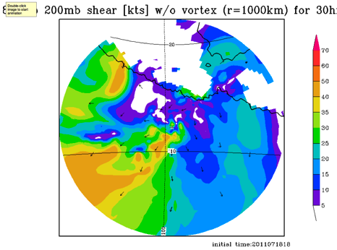
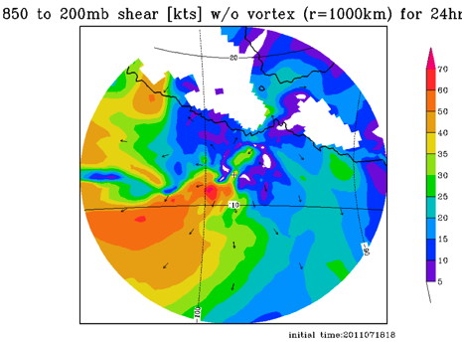
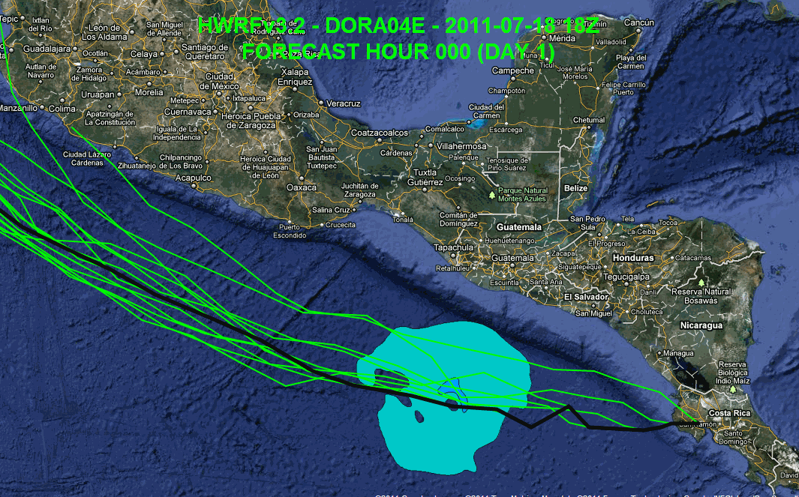
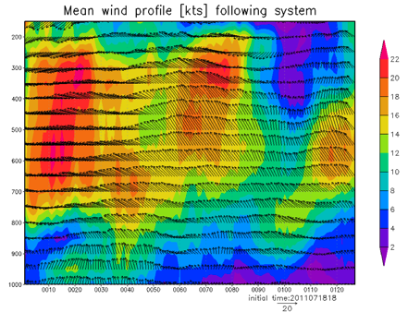
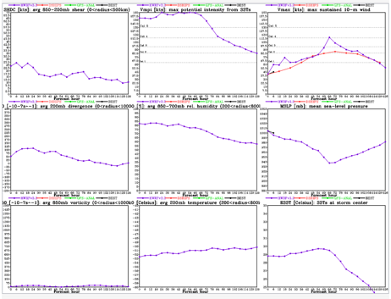
Regional Model Development: HWRF
https://storm.aoml.noaa.gov/realtime
HFIP stream 1.5 (27/9/3 km resolution)
  Advanced nesting algorithm providing resolutions to 3 km
  Viable operational pathway & potential transition to operations
  Pathway to Improved structure and intensity predictions*
  Extension of initialization algorithm down to 3 km resolution
All Storms of 2011 (4 cycles/day)
19 main products; e.g.,
  Synthetic microwave imagery
  SHIPS predictors
  Shear and Steering
  Time-height cross-sections
  Swaths (wind and rainfall)
Regional Model Team - Gopal, Xuejin Zhang, Kevin Yeh, AOML/HRD
Notes:
Demo 2011 season; Not only we have improved the products but also added a suite of NOAA HWRF systems at different configurations.
Example of Hurricane Dora 2004 (initialized at 18Z on 18 July 2011)
Top left: 10-m wind swath for 126 h forecast
Bottom left: time-height cross section of mean wind over 3 km nest centered on storm
Top right: storm-relative vertical wind shear on 3-km nest for 24 h and 30 h forecast – note decreasing NE shear over center
Bottom right: SHIPS type predictors for regional model
Overlay: moving 3-km inner nest showing 10-m wind evolution

Slide 13
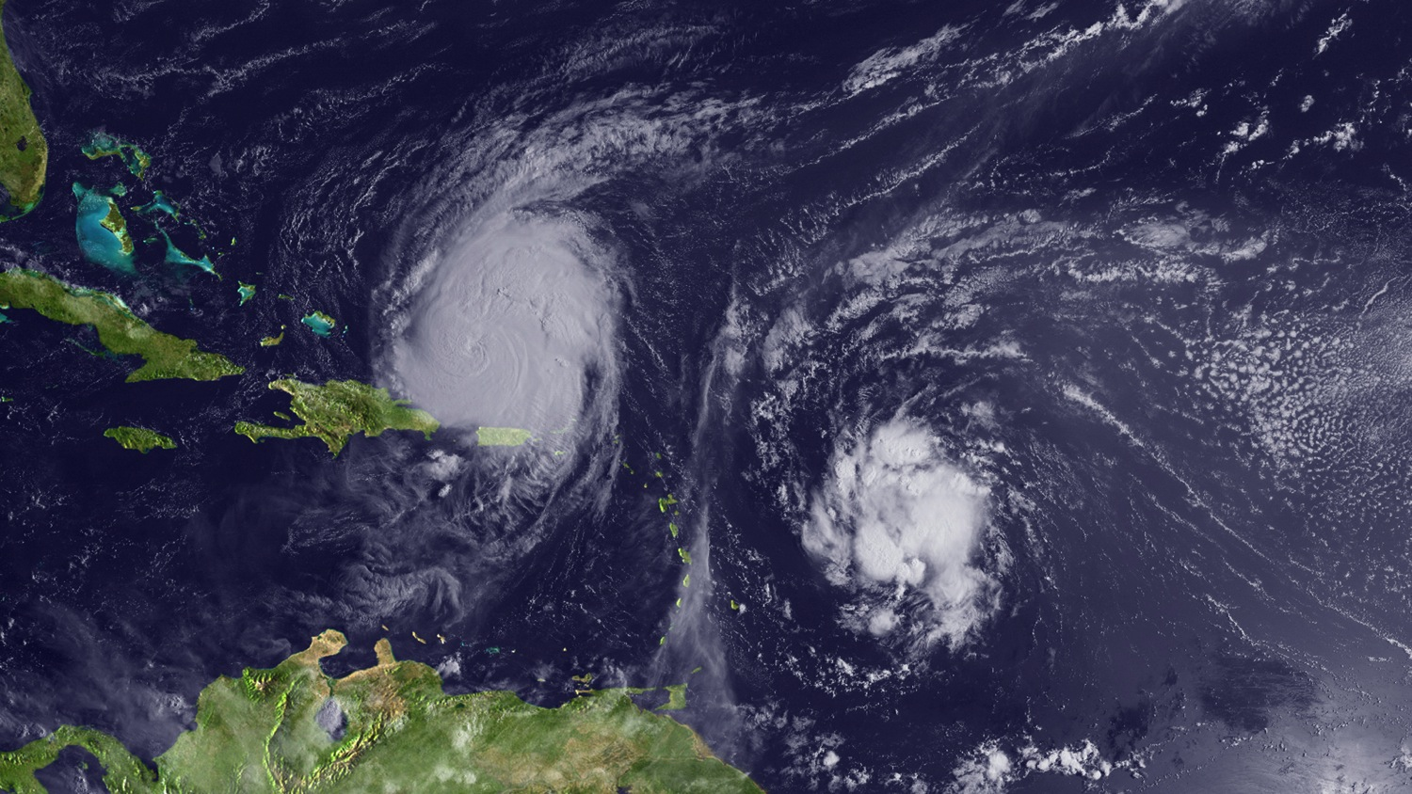
Regional Model Development: What Next?
Earl
Fiona
Notes:
Current regional hurricane model strategy is developed from GFDL model approach developed in 1977 – one forecast run per storm. So if there is two storms operations needs resources for two complete model runs. Not only inefficient, but causes issues with initialization when two storms are in the outer next interacting. Current storm occurrence climatology suggests that more that 50% of the time there is two storms active at the same forecast time.

Slide 14
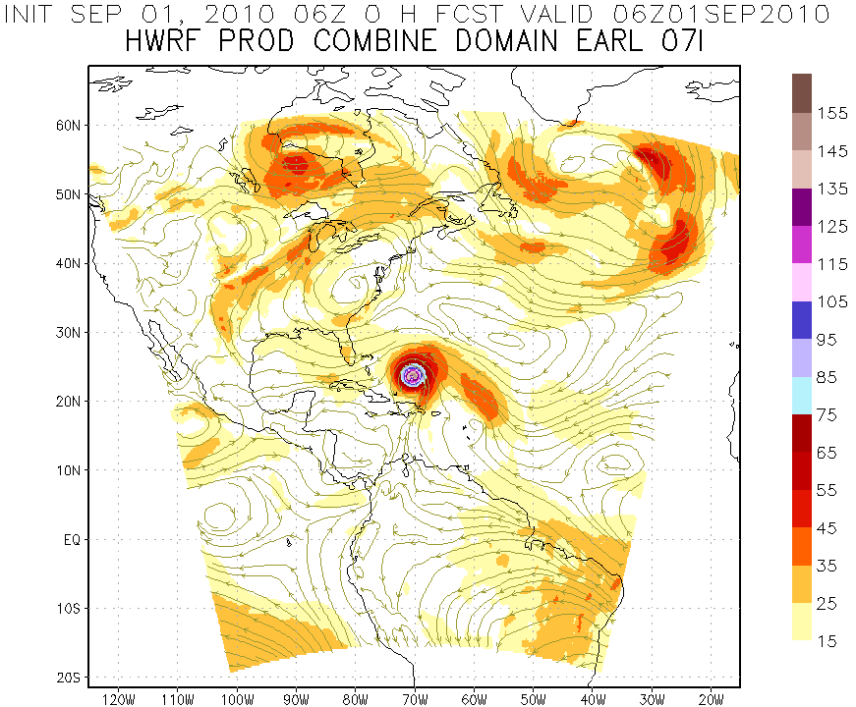
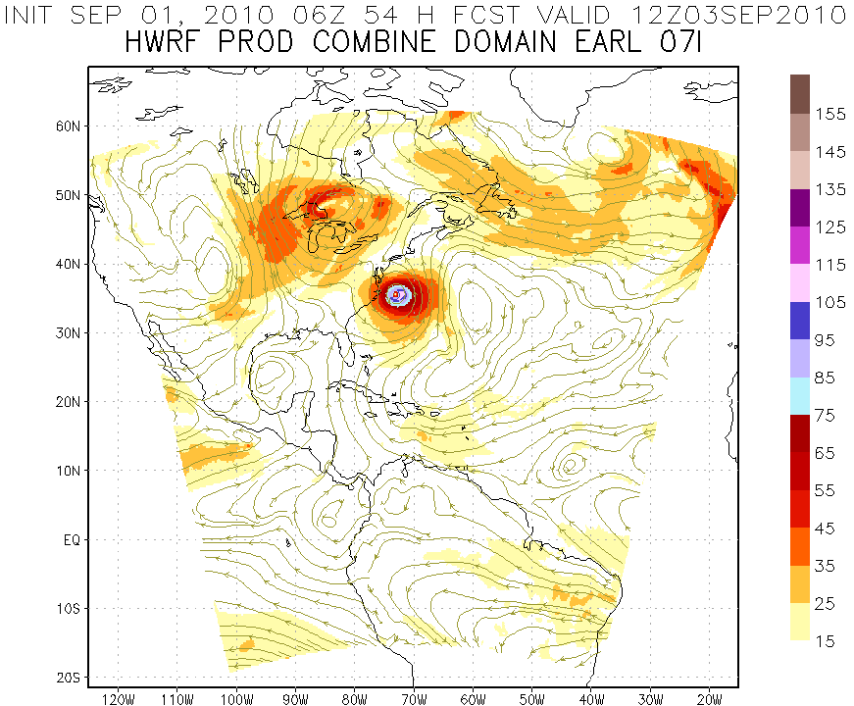
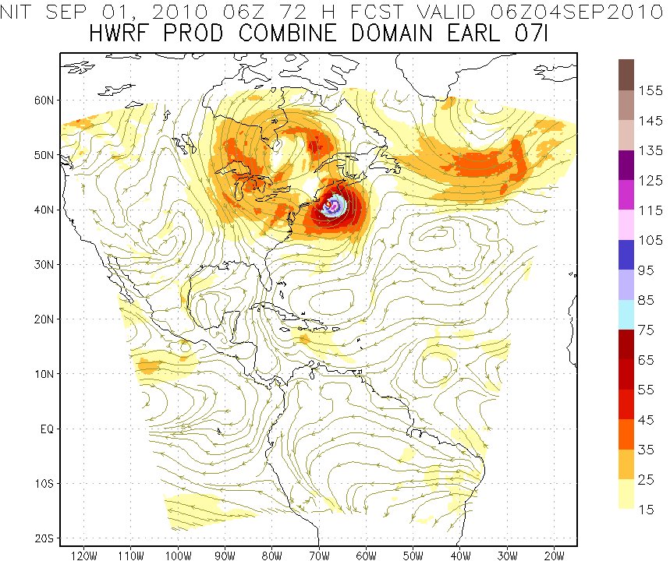
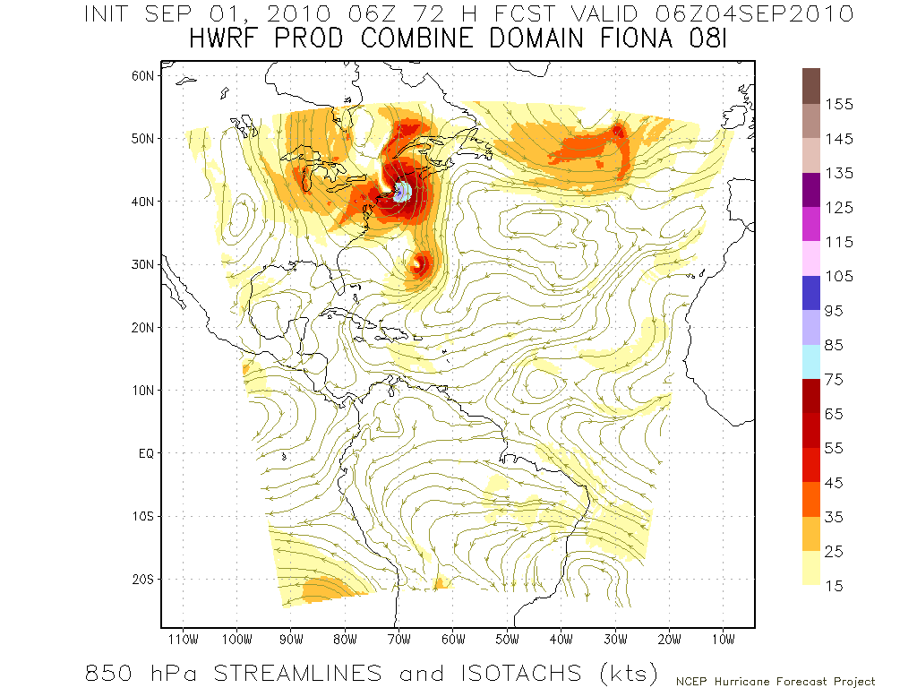
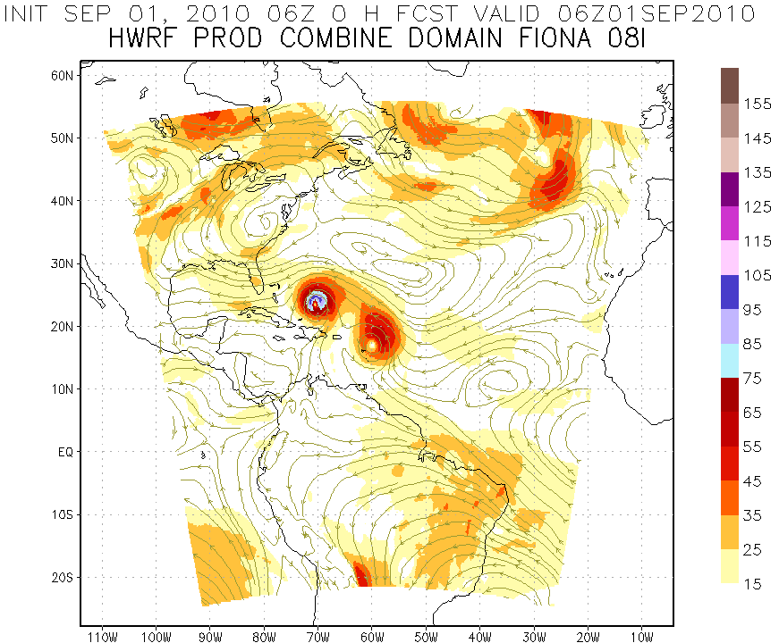
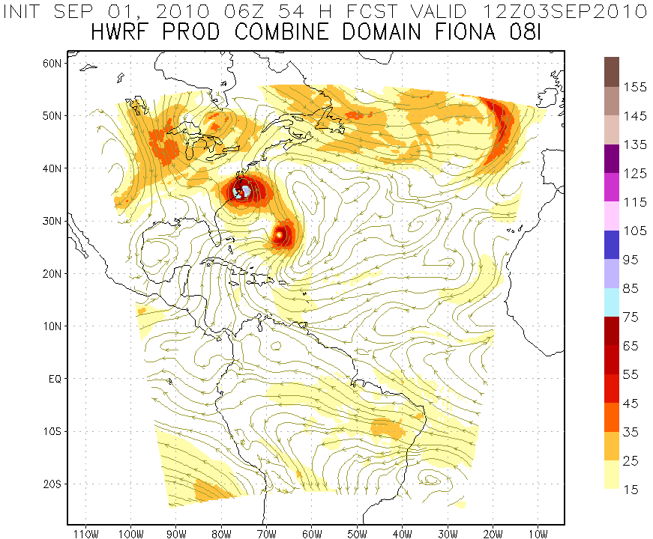
Regional Model Development: Storm-storm interactions?
Earl
Earl
Earl
Fiona
Initialize Earl Vortex
850hPa Streamlines and Isotachs (kts)
Earl
Earl
Earl
Fiona
Fiona
Fiona
Initialize Fiona Vortex
http://www.emc.ncep.noaa.gov/gc_wmb/vxt
Notes:
Example of initialization problem hen two storms are in the same outer nest for each initialization time. Forecast performance depends on which storm initialization you look at. In this case when initializing for Earl the forecast looks similar to best track. However, forecast initialized for Fiona at the same time looks nothing like reality with Fiona remaining a weak hurricane and has Earl making landfall in the outer banks.

Slide 15
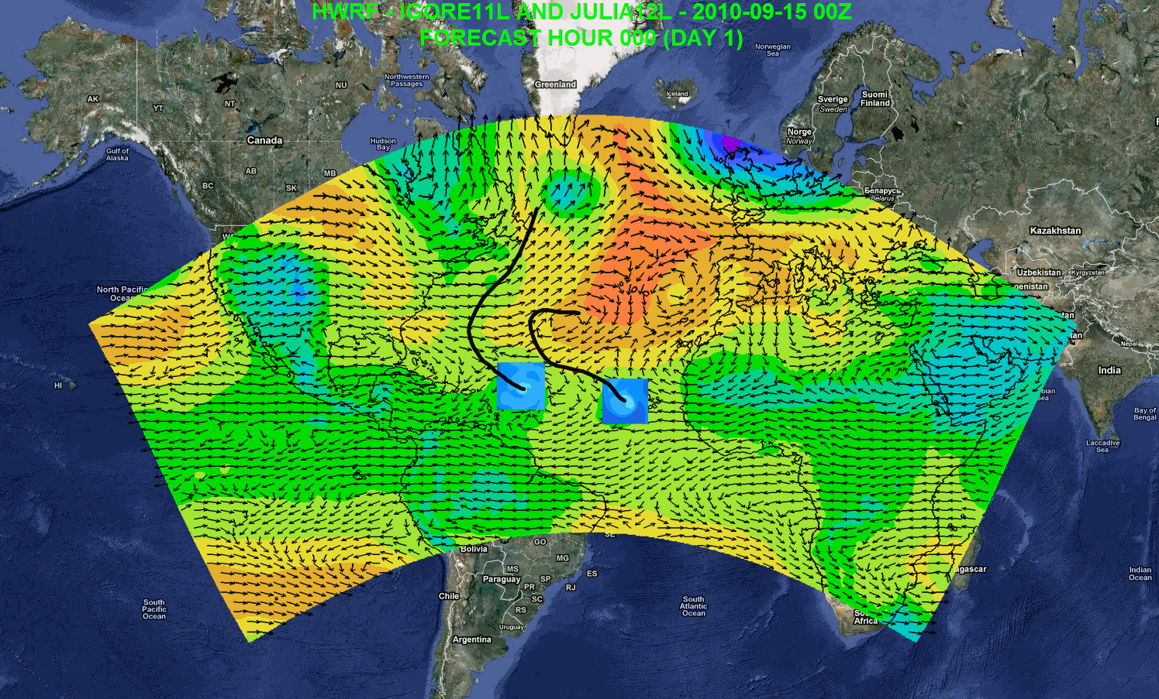

Regional Model Development: HWRF
Regional Model Team - Gopal, Xuejin Zhang, Kevin Yeh, AOML/HRD
Notes:
Igor and Julia forecast initialized at 0000Z 15 September 2010
Large “basin-scale” domain is at 27 km resolution with inner nest at 9-km using operational HWRF as the basis. Outer domain covers the EPAC and ATL TC development regions with one domain which remains fixed from cycle to cycle.
15

Slide 16
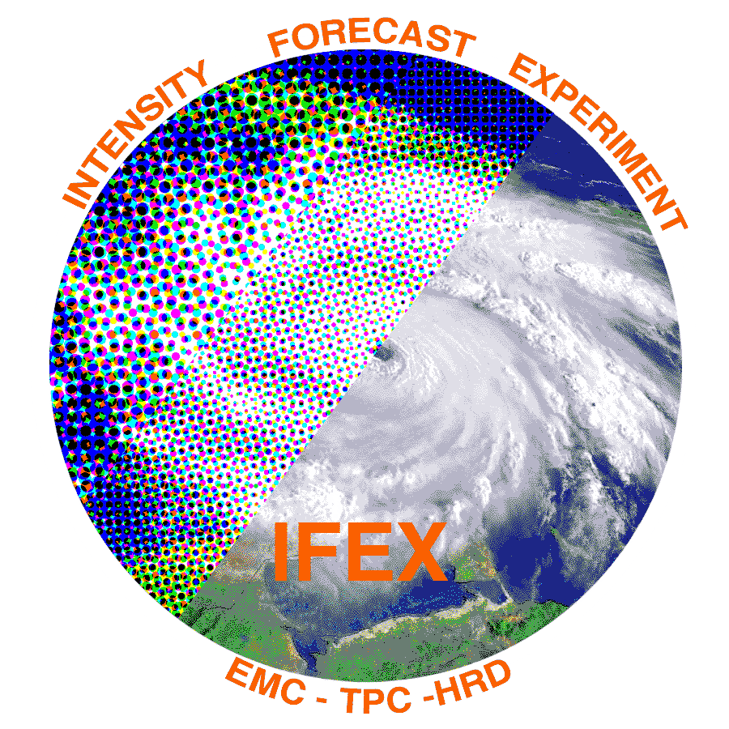
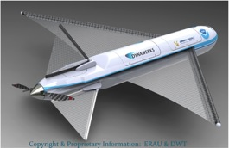

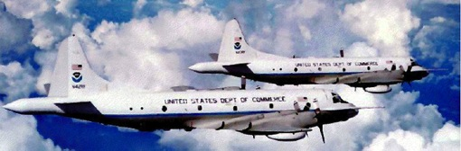
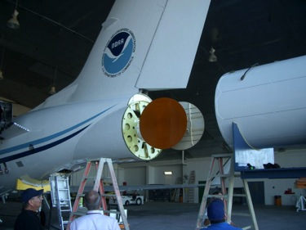
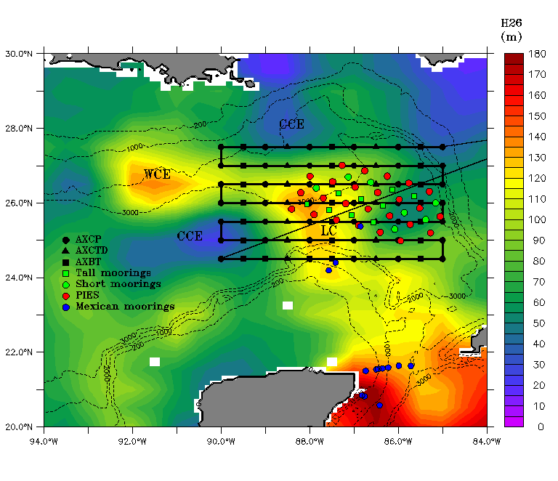

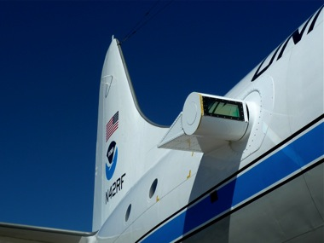
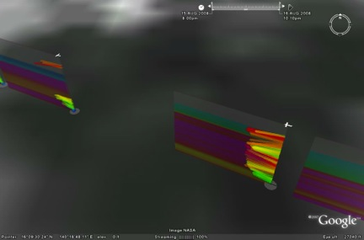
Improved Use of Observations:
HFIP & Intensity Forecast Experiment (IFEX)
In-situ
  Wind, press., temp.
Expendables
  Dropsondes
  AXBT, AXCP, buoy
Remote Sensors
  Doppler Radar
  SFMR/HIRAD
  WSRA
  Scatterometer/profiler
  UAS - LALE
Improve prediction of TC intensity change by:
  collecting observations through the TC life cycle
  developing and refining measurement technologies
  improving understanding of physical processes important in TC intensity change
GALE UAS
NASA Global Hawk
G-IV Tail Doppler Radar
AXBT profiles of Loop Current
ONR DWL
DWL profiles from TCS-08
S. Murillo, R. Rogers (AOML/HRD)
Notes:
UR image depicts dropsonde profiles in eyewall of Hurricane Guillermo (1997)
LR image is Doppler Wind Lidar profiles from TCS-08

Slide 17
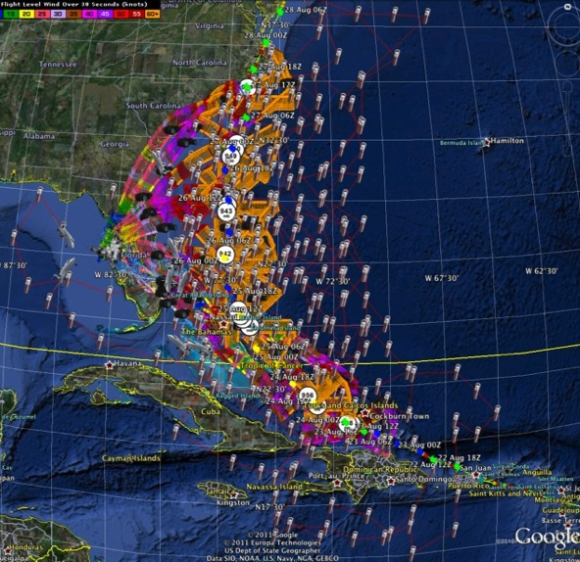
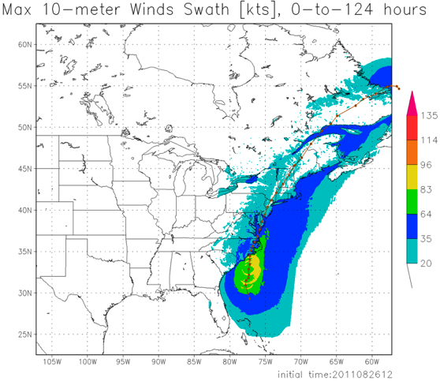
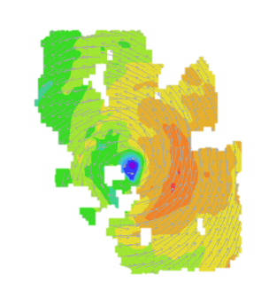
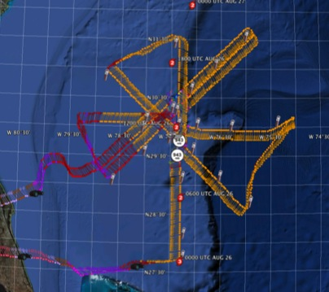
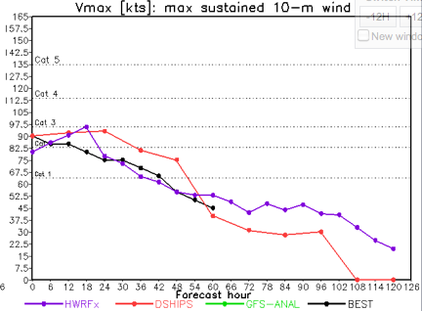
Improved Models & Data:
IFEX 2011: Irene
HWRF/HEDAS
20110826 12UTC
Doppler SO (EnKF) transmitted in real-time for assimilation into HWRF
20110826I1
0926-1416 UTC
7 P-3 Flights
23 August – 27 August 2011
HWRF/HEDAS
20110826 12UTC
7 missions from 23-27 Aug 2011 at ~12 h sampling of Doppler SO (HEDAS) & 8 G-IV missions
Sampled Irene as a major hurricane through landfall
Murillo, Aberson, Aksoy, Gamache, Gopal (AOML/HRD)
Notes:
Map shows flight tracks for all of the NOAA missions (color coded are the flight level winds for the P-3 missions, dropsonde symbols denote G-IV patterns)

Slide 18
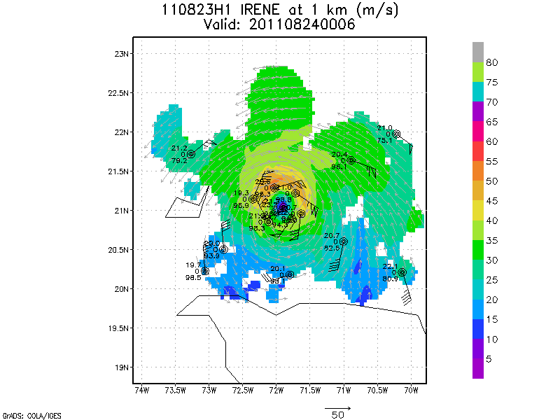
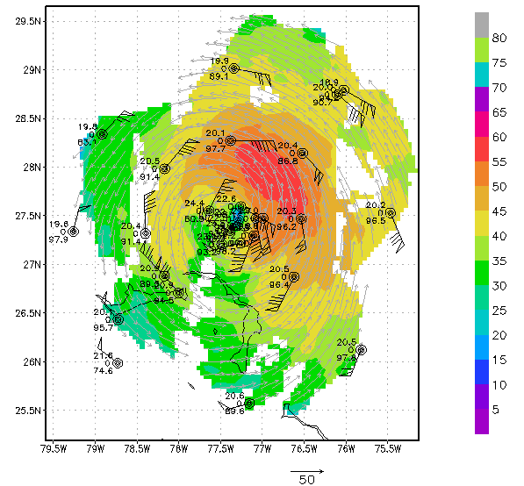
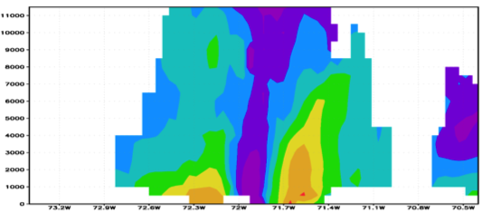
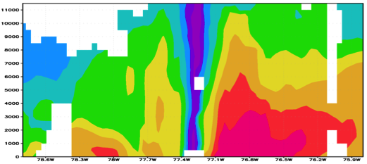

Improved Models & Data:
IFEX 2011: Irene
Real-time P-3 Tail Doppler and Dropsonde Composite at 1 km altitude
m/s
Flight 110823H1
Flight 110825H1
South
North
South
North
S. Murillo, R. Rogers (AOML/HRD)
Notes:
Colors denote Doppler winds and station codes denote dropsondes
West-east vertical cross section of wind speed (shaded, m/s).

Slide 19
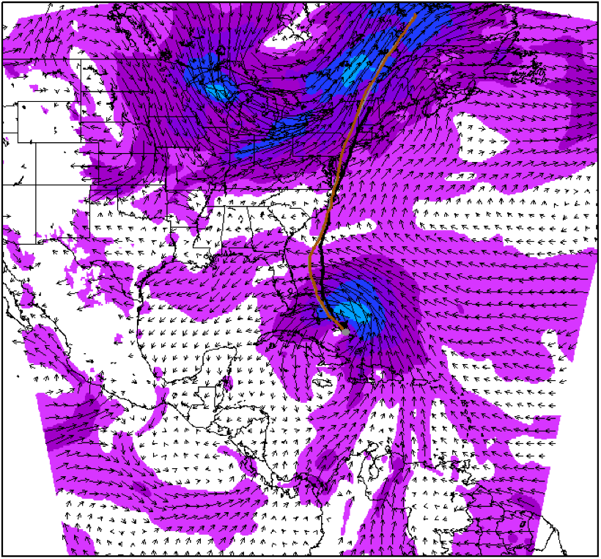
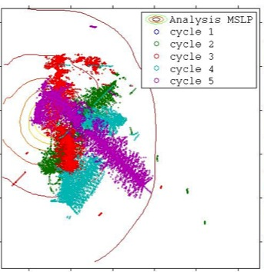


Improved Models & Data:
Assimilation of data into numerical models
Synergy of high resolution forecast and airborne observations
P-3 and G-IV observations – superobs (SO)
Data assimilation
Improving the initial condition in storm core region
Improving the high resolution regional forecast
Wind intensity at 10 m
Hurricane Irene(2011)
F. Zhang (PSU), Aberson, Aksoy, Gamache, Gopal (AOML/HRD)

Slide 20
Improved Use of Observations:
Impact of airborne Doppler radar
% Improvement over HFIP baseline
cases
All cases with Doppler data 2008-2011
Need help of Research community to address
F. Zhang (PSU), Aberson, Aksoy, Gamache (AOML/HRD)
Notes:
Intensity Error of Models for all cases (2009-2011) with airborne Doppler data available from NOAA P-3s (% Improvement over HFIP baseline – average intensity error for three years of operational model guidance errors for 2006-2008 when HFIP began)
Black lines are the baseline intensity skill (solid), 20%improvement threshold (large dash), and 50% improvement threshold (small dash)
Green lines represent the average intensity errors for two different regional models: small dash - Advanced Research WRF or ARW used by the bulk of the research community; and solid - high-resolution research version of HWRF developed at HRD and transitioned to EMC for operational implementation this summer
Red line is the average intensity error for the high-resolution research HWRF without the Doppler data
Note that from 36-96 h the average error is very close to or exceeding the 20% improvement threshold for HFIP at 5 years
We are busily investigating the reason for lack of improved skill from 0-24 h when the data should have the most impact. We identified some model biases due to physical parameterizations which we are working with EMC to correct thanks to the ability to use observations to improve the initial conditions.

Slide 21




Improved Models & Data:
Model evaluation: Wind Structure
Hurricane Bill 1600 UTC, 19 August 2009
HWRF 10m winds
Data Coverage
H*Wind 10m winds
IKE : for winds > TS force: 371 TJ, for winds > hurricane force: 109 TJ
IKE : for winds > TS force: 92 TJ, for winds > hurricane force: 30 TJ
Analyzed max wind: 117 kt from HWRF, 37 nm
Analyzed max wind: 107 kt from Tail Doppler, 23 nm
S. Murillo, M. Powell (AOML/HRD)

Slide 22




Improved Models & Data:
Model evaluation: Vortex-scale
Doppler
Tangential wind (m/s)
Height (km)
HWRF
Tangential wind (m/s)
Radial wind (m/s)
Vertical velocity (m/s)
Height (km)
normalized radius
normalized radius
normalized radius
R*=R/RMW
R. Rogers, J. Zhang, P. Reasor, & S. Lorsolo (AOML/HRD)
Notes:
Comparison of composites using different horizontal resolution

Slide 23






Future Aircraft Observations
GRIP & HS3:
NASA GRIP Global Hawk
Green-NASA DC-8
Purple-NASA WB57
Orange-NASA Global Hawk
Red-PREDICT G-V
Yellow-NOAA G-IV
Blue-NOAA P-3
HIWRAP
High Altitude Imaging Wind and Rain Profiler
(Horizontal wind vectors and ocean surface winds)
Mistsondes
High Altitude Lightweight Dropsonde
(Vertical profiles of temp, humidity, pressure & winds)
HAMSR
High Altitude MMIC Sounding Radiometer
(Temp, H2Ov, Cloud liquid & ice distribution)
LIP
Lightning Instrument Package
(Lightning and Electrical Storm observation)
GRIP & HS3 Teams – S. Braun (NASA/GSFC)

Slide 24
HFIP Success to Date
HFIP focused research efforts within NOAA & interagency partners
HFIP defined solution to transition research into operations with Stream 1.5 products available to NHC forecasters in real-time
  Resulted in transition of new global hybrid DA system and 3-km HWRF into operations this season
HFIP making significant progress – 5-year goals within reach
  Global ENKF ensembles providing 20% improvement in track guidance
  Improved model initialization and higher resolution models, along with inner core data shows significant (20-40%) improvement in intensity
  3-5 day lead-time hurricane genesis product with acceptable POD’s and FAR’s in development
  Still uncertain progress toward goal for POD/FAR of rapid intensification of 90%/10% at day 1 and 60%/40% at day 5.

Slide 25





Keys to Success
  Partnership: AOML, ESRL, GFDL, DTC, USWRP, NESDIS/STAR working closely with Operations (EMC, NHC, AOC) and Federal & Academic Partners (NASA, NSF, ONR, NRL, NCAR, MMS)
  More integrated use & support of Testbeds: JHT, DTC, JCSDA
  Blend Traditional hurricane research activities and HFIP research activities
  Manpower (diversity) to evaluate model performance with hurricane data sets is a critical need
CBLAST
IFEX/RAINEX
DOTSTAR
IFEX/TCSP
IFEX/PREDICT/GRIP

Slide 26









Outreach
Our blog
http://noaahrd.wordpress.com
HRD Web page
http://www.aoml.noaa.gov/hrd
Facebook
http://www.facebook.com/noaahrd
Twitter
http://twitter.com/#!/HRD_AOML_NOAA
Tweets from the eye
Visiting scientist program

Slide 27

Questions?

Slide 28
Assessment Team
Pre-decisional – Not for Public Release
  Dr. Frank Marks, Team Leader, OAR/AOML Hurricane Research Division
  Wes Browning, Technical Lead, Meteorologist in Charge, St. Louis, MO
  Dr. Vankita Brown, Social Scientist, NWS OCWWS
  Dr. Terri Adams-Fuller, Social Scientist, Howard University
  Dr. Susan Jasko, Social Scientist, California University of Pennsylvania
  Monica Allen, NOAA Public Affairs Specialist, Marine Fisheries
  Sean Wink, SOD Chief, Salt Lake City, UT
  Aimee Fish, Meteorologist, Environmental and Scientific Services Div., AK
  John Gordon, Meteorologist in Charge, Louisville, KY
  Alan Haynes, Service Coordination Hydrologist, CNRFC
  John Brost, Science and Operations Officer, Tucson, AZ
  Dr. William Hooke, Senior Policy Fellow and Director at AMS, Washington, DC
  Ray Tanabe, MIC HFO/Director, Central Pacific Hurricane Center
  Scott Lindsey, Service Coordination Hydrologist, ARRFC
  Mike Clay, Chief TV Meteorologist, Tampa, FL
  Dr. John Kelley, Meteorologist, NOS, Durham, NH
  John Winkelman, Coastal Engineer, USACE New England District
  Rick Dittmann, Meteorologist in Charge, Pocatello, ID

Slide 29


Meteorological Conditions
Pre-decisional – Not for Public Release
  4 Landfalls
    1:25 am AST, August 22 as Tropical Storm in Puerto Rico
    7:30 am EDT, August 27 as Category 1 Hurricane in NC
    5:35 am EDT, August 28 as Category 1 Hurricane in New Jersey
    9:00 am EDT as Tropical Storm in New York City
  Historic Inland Flooding from New Jersey to Vermont
  Major flooding in Puerto Rico
  Storm Surge from North Carolina to Massachusetts
Landfall #4
Landfall #3
Landfall #2
Landfall #1

Slide 30




Impacts
Pre-decisional – Not for Public Release
  41 deaths
  $7 to $10 Billion damage
  Major infrastructure losses
  Power lost to 8 million
Hatteras Island, N.C.
Iconic covered bridge narrowly escaped destruction along Route 100, VT
Virginia Beach, Va
Jim R. Bounds/AP
Lars Gange & Mansfield Heliflight
Brendan Hoffman/Getty Images
Woodford, Vt.
Austen Danforth/Bennington Banner/AP

Slide 31






Assessment Area
Pre-decisional – Not for Public Release
  Weather impacts primarily over CWAs of WFO SJU, ILM, MHX, AKQ, LWX, PHI, OKX, ALB, BOX, BTV, GYX
  Flooding impacts over areas covered by NERFC, MARFC, SERFC
  Impacts in areas covered by FEMA Regions 1-4 & Capital Region
  Focus on 20-28 August
BTV
00Z, 29 August
GYX
ALB
NERFC
MARFC
BOX
OKX
PHI
LWX
12Z, 28 August
AKQ
MHX
00Z, 28 August
SERFC
ILM
12Z 27 August
SJU
SERFC
12Z 20 August

Slide 32

Team Structure
Pre-decisional – Not for Public Release
Team 1–New England
Team 2–NYC region, New Jersey
Team 3–North Carolina, Virginia
Team 4–Washington DC
Team 5–National Hurricane Center
Media Expert–NY, VT, NC, Atlanta
Social Science Team–Input into all teams
Team 1
Team 2
Team 4
Team 3
Team 5
Team 4 (phone)

Slide 33
Team Fieldwork
Pre-decisional – Not for Public Release
Interviews – 273
Man Hours – ~1400
WFOs – 13
RFCs – 3
FEMA Regions – 4
States Covered…13 + Puerto Rico
Potential for Joint Meteorological Service of Canada (MSC) – NOAA Assessment

Slide 34
Team Fieldwork
Pre-decisional – Not for Public Release
External Partners Interviewed
FEMA Regions 1-4 and Capital Region
State and Local Emergency Managers
USGS
USCG
USACE
Insurance Industry
Power Suppliers
Media, Including America’s Weather Industry
Residents
The White House
NOS
NPS
Red Cross
Various Airlines

