Slide 1
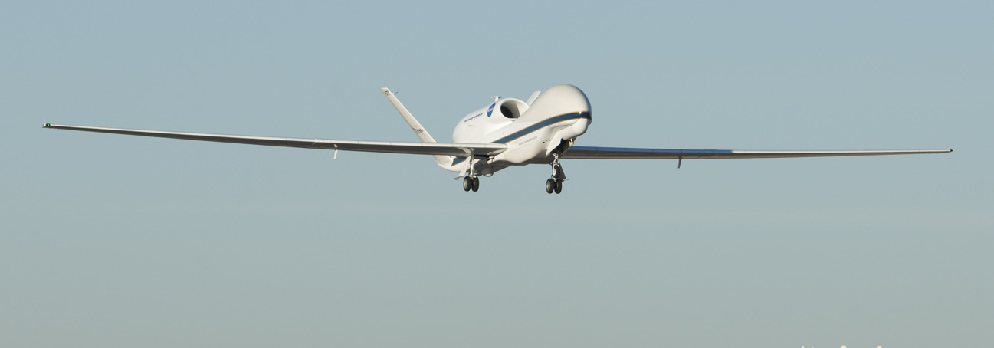
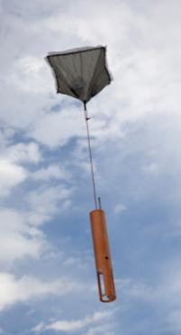




Global Hawk Dropsonde Data:
Ready for Prime Time?
NOAA: Robbie Hood, Gary Wick, Ryan Spackman, Michael Black, Marty Ralph, Yucheng, Song, Paul Neiman, Janet Intrieri, Dave Costa, Phil Hall
NASA: Ramesh Kakar, Scott Braun, Paul Newman, Chris Naftel, Dave Fratello,
Bjorn Lambrigtsen, Gerry Heymsfield
NCAR: Terry Hock, Junhong Wang, Dean Lauritsen , Charlie Martin, Cynthia Bradley,
Xuanyong Xu , Kate Young
A partnership with NOAA, NCAR, and NASA

Slide 2
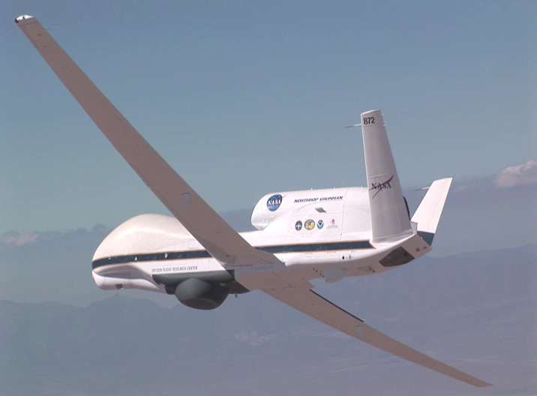
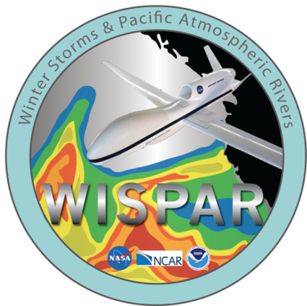
The NOAA Unmanned Aircraft Systems (UAS) Program:
Status and Activities
First science flight with the GH dropsonde system: Winter Storms and Pacific Atmospheric Rivers (WISPAR) Experiment
Gary Wick
Robbie Hood, Program Director
G. A. Wick, J. R. Spackman, M. L. Black, F. M. Ralph, Y. Song, Y. Zhu, P. J. Neiman, J. Intrieri,
T. Hock, B. H. Lambrigtsen, R. E. Hood

Slide 3
WINTER STORMS AND PACIFIC ATMOSPHERIC RIVERS
WISPAR Feb-Mar 2011, NASA Dryden Flight Research Center, Edwards, CA
Collaborative effort between NOAA-NASA-NCAR
WISPAR flights were designed to:
  Demonstrate the NOAA/NCAR GH dropsonde system for NOAA operations and research
  Evaluate the capabilities of the GH for operational observations of atmospheric rivers (ARs), winter storms, and remote Arctic atmosphere
177 soundings performed on 3 high-altitude long-endurance science flights

Slide 4

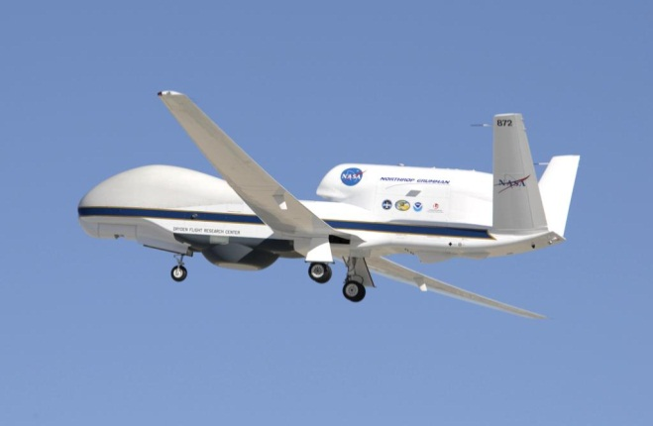
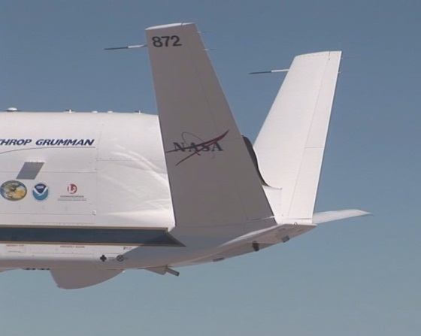
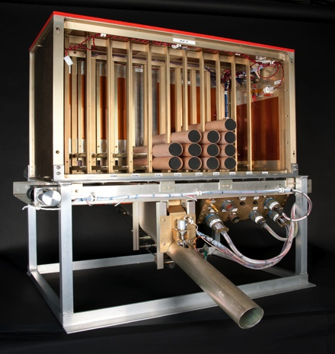
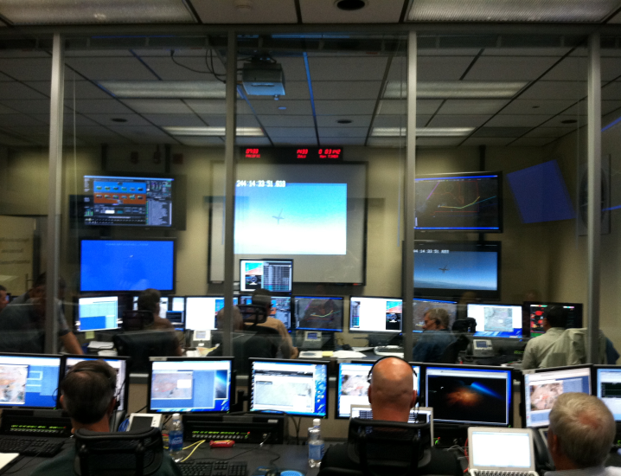
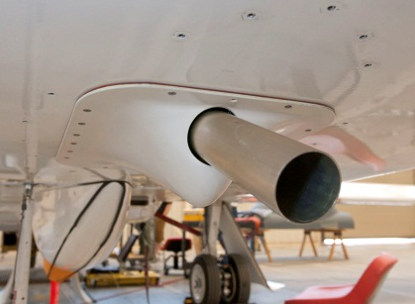
NASA GLOBAL HAWK UAS
  High-altitude, long-endurance UAS: 55 – 65 kft, 28 hr duration
  Remotely operated from NASA Dryden Flight Research Center, Edwards AFB, CA
Global Hawk
Global Hawk Operations Center (GHOC)
Dropsonde System Launch Tube
Dropsonde Launch Assembly

Slide 5
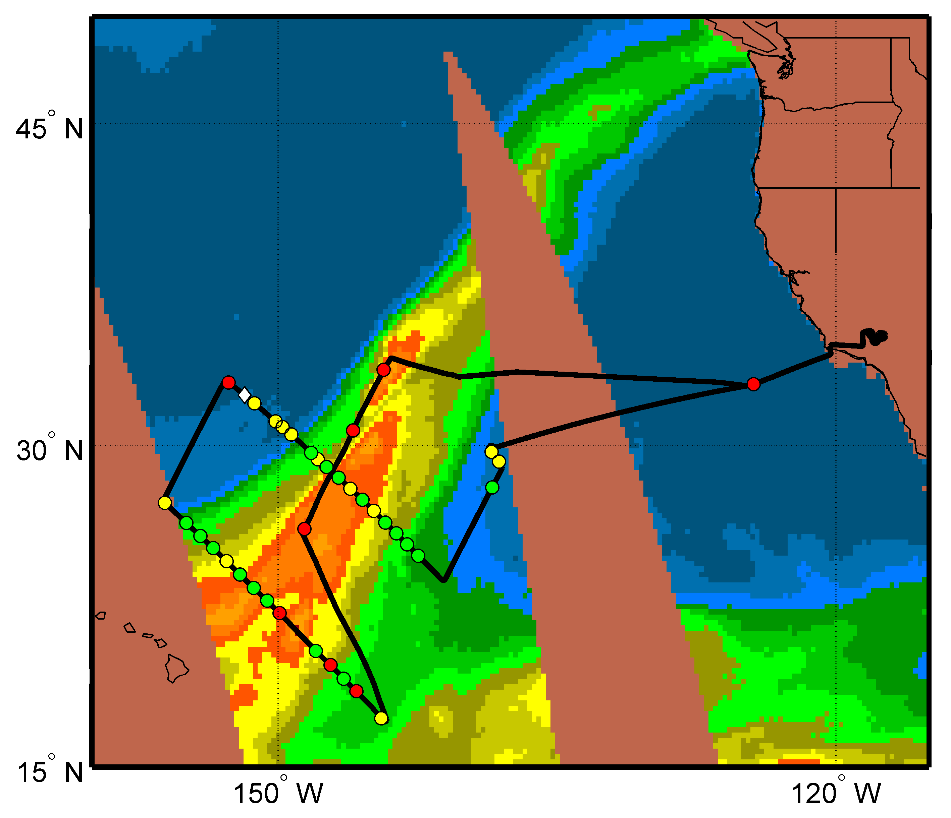
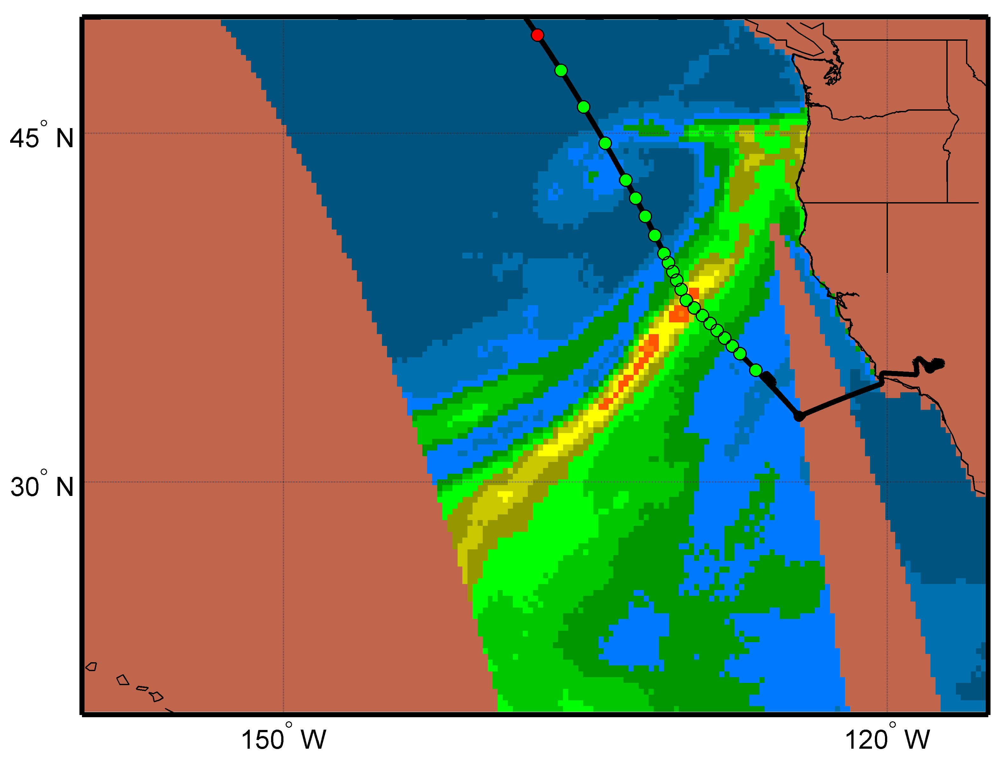
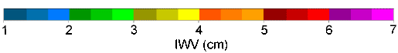
ATMOSPHERIC RIVERS FLIGHT
SSMIS F18
12 Feb 2011
~0530 UTC
GH Position
ARs are narrow regions of enhanced water vapor transport that can lead to extreme precipitation upon landfall
First flight sampled an AR near the tropical-extratropical connection to study transport from the tropics
37 sondes were deployed during the 20-hour flight
ARs were also sampled on each other flight
SSMIS F17
10 Mar 2011 ~0200 UTC

Slide 6


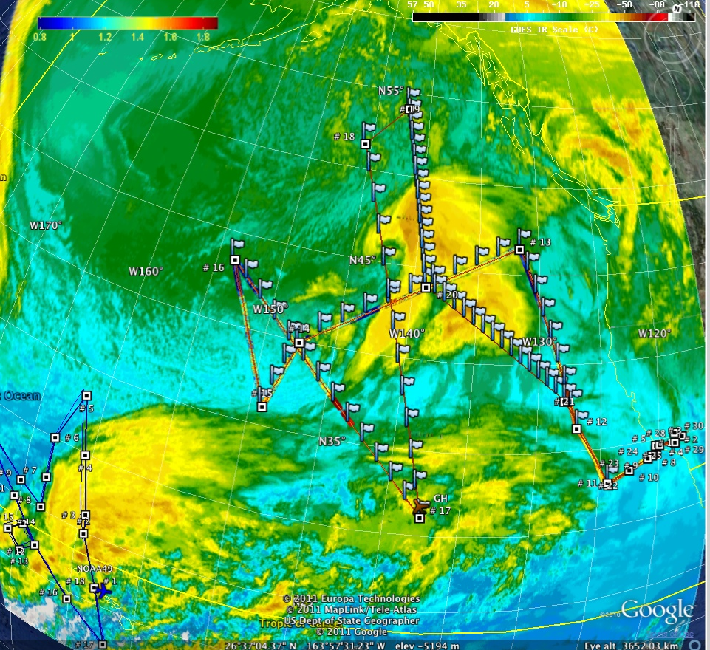
WINTER STORMS RECONNAISSANCE
Goal to perform targeted observations in a deepening winter storm to evaluate the impact of the observations on weather prediction over the continental US
GOES West IR image showing winter storm in North Pacific and system near Hawaii
GH: 70 dropsondes
G-IV: 43 dropsondes
Intensifying Low Pressure System
G-IV
GH

Slide 7
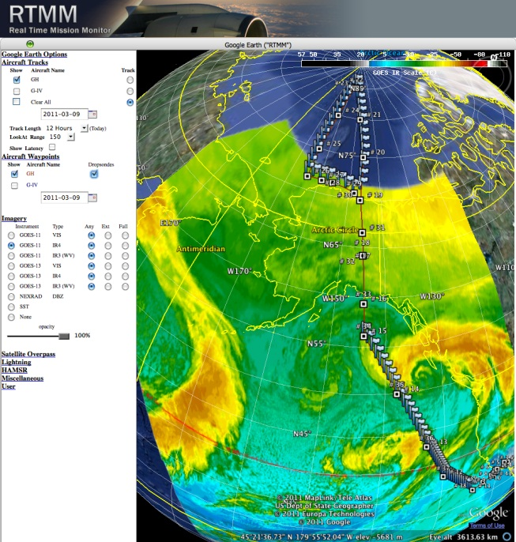
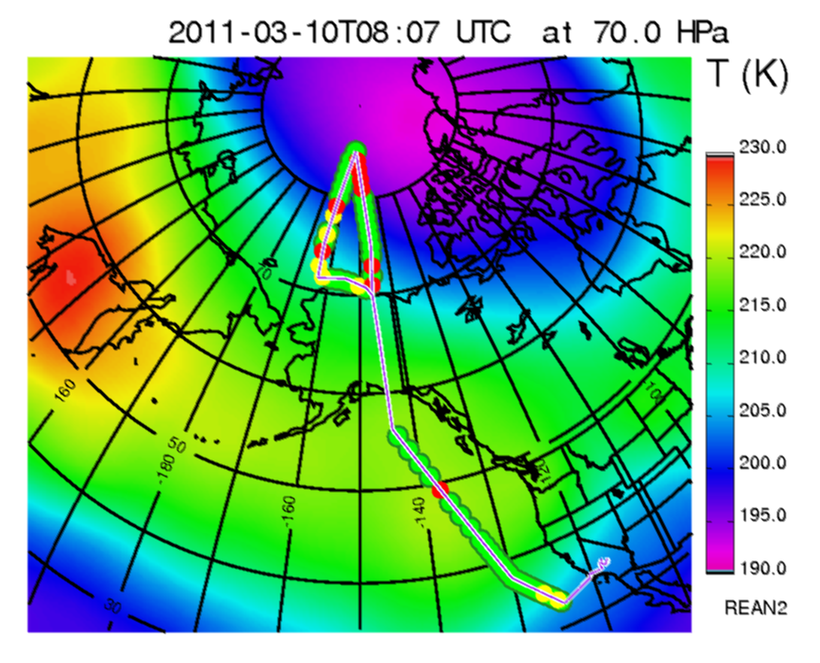
ARCTIC FLIGHT
Flight sampled an AR along the US west coast, an extratropical cyclone in the Gulf of AK, and the Arctic troposphere and lower stratosphere
A total of 70 sondes were deployed over the 25 hr flight
The GH completed a 7 hr survey of the western Arctic overnight, dropping a total of 35 sondes as far north as 85N
Notes:
The Arctic is:
Remote and expansive
Experiencing rapid change
Logistically difficult to perform observations
The range, altitude and endurance capabilities of UAS in the Arctic fill a critical gap in a region where few observations exist above the surface.
The meteorological and chemical observations in the Arctic will lead to important improvements in numerical weather prediction and coupled chemistry-climate models

Slide 8


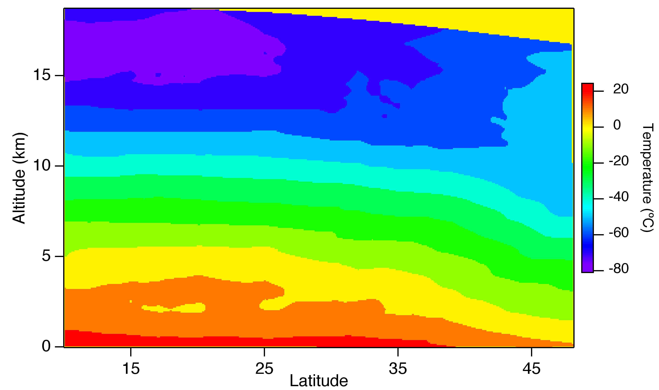
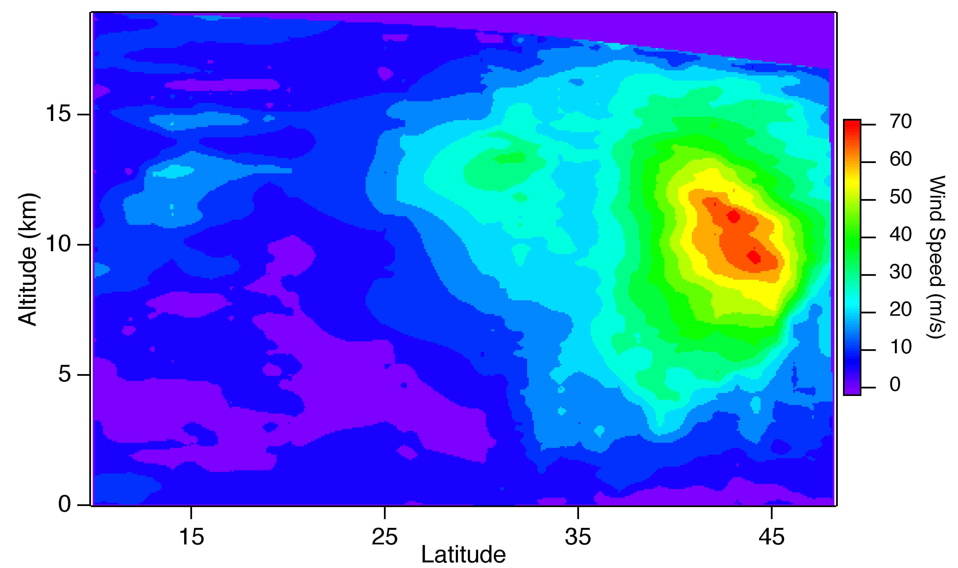
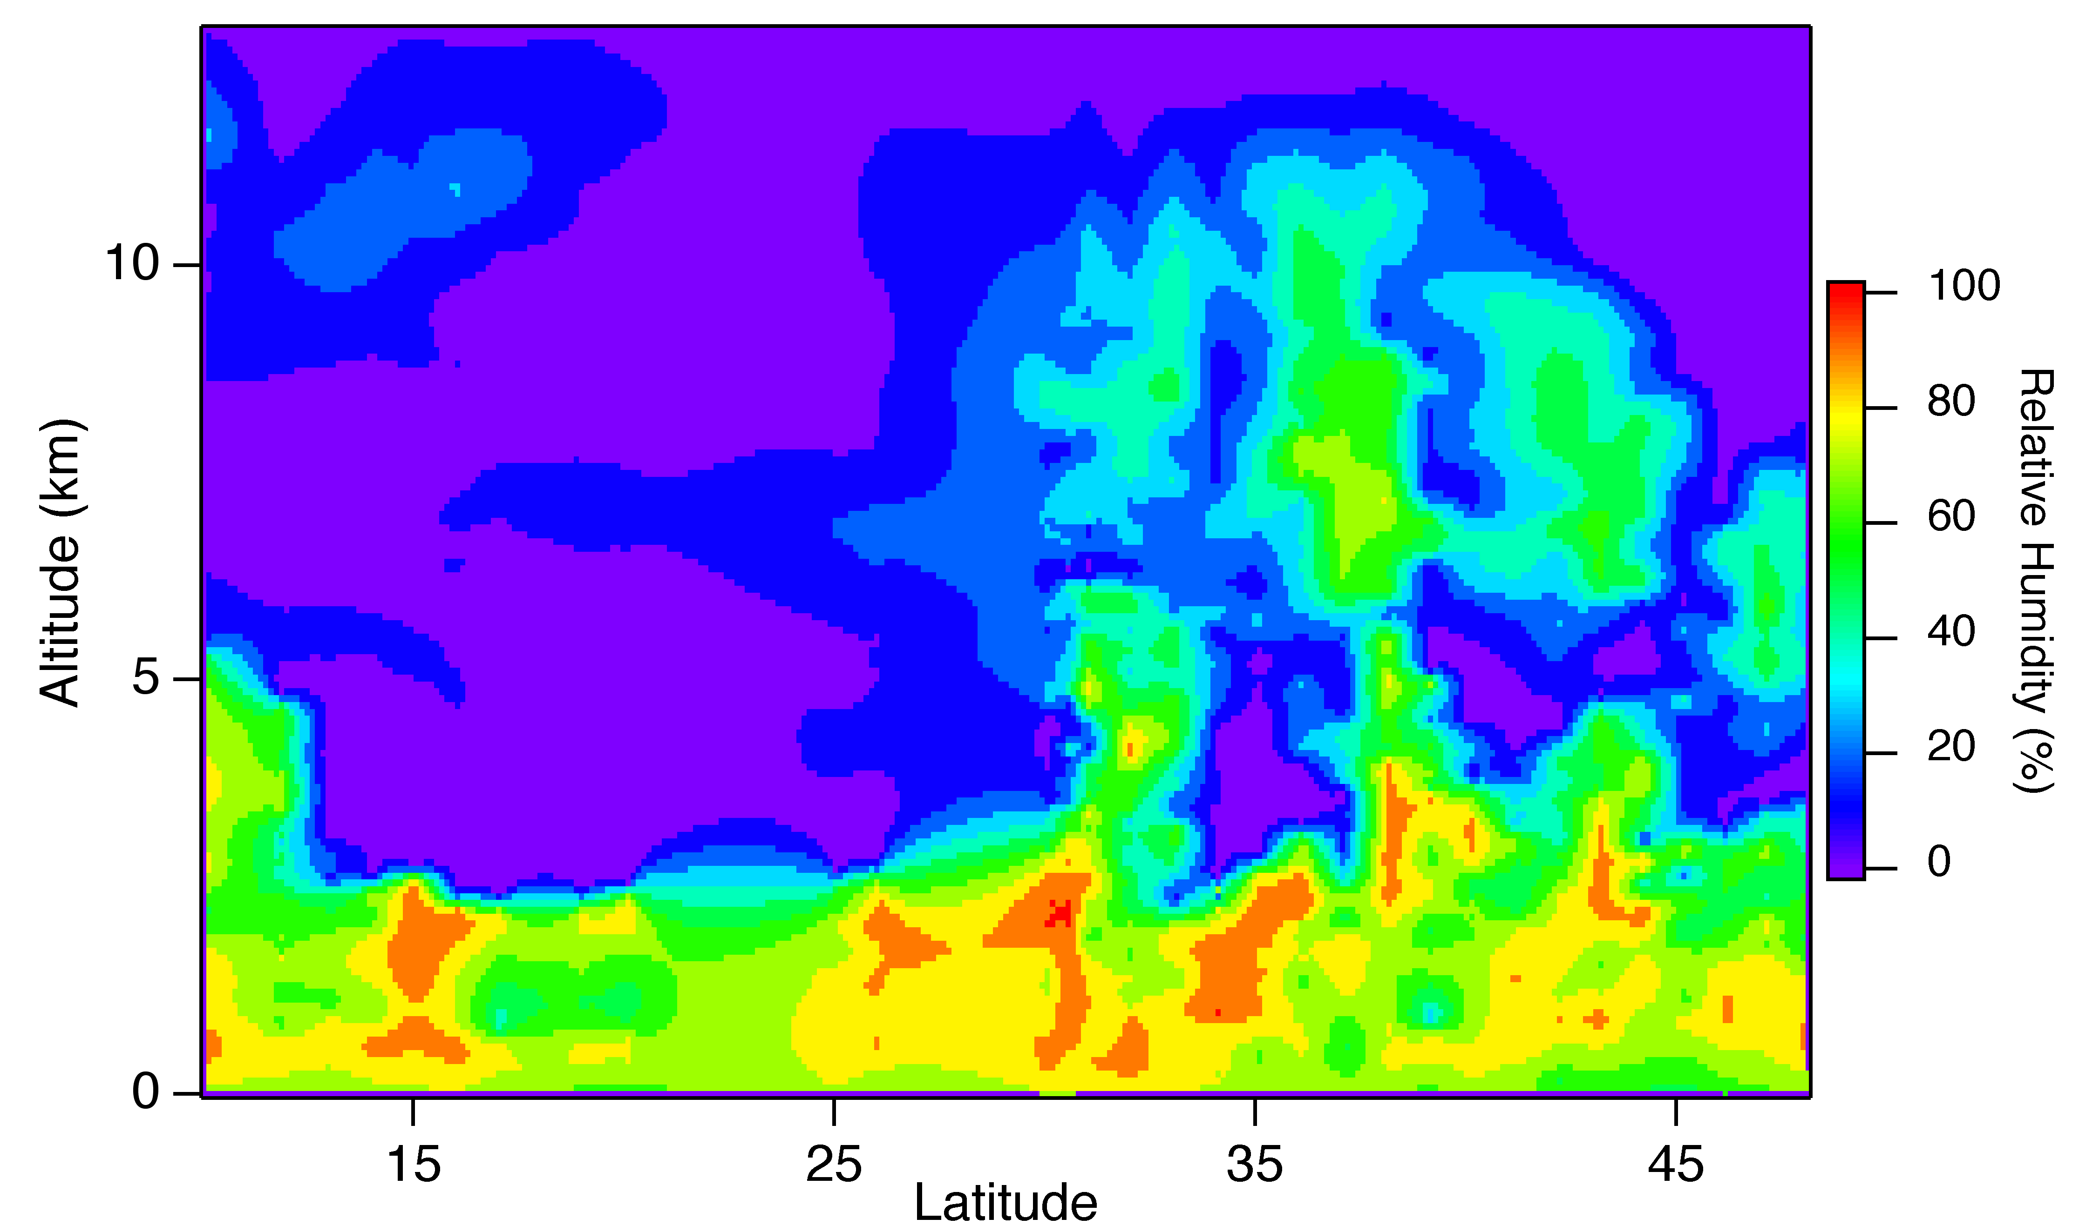
North Pacific Cross Sections
32 Dropsondes, 10°N – 48°N
Cold tropical
tropopause
Temperature
Stratospheric air
Wind Speed
Extratropical
storm
Relative Humidity
Strong polar jet stream in the upper troposphere at midlatitudes
Dry
subtropics
Atmospheric River
Notes:
The above cross sections were made by plotting all information from all drops along the north-south transect. Fields shown are temperature, wind speed, and relative humidity. The temperature field shows isotherms sloping downward from left to right, indicating the polar front north of 30-35°N. The cold tropical tropopause is also seen. Consistent with thermal wind balance, the wind speed field shows the wind maximum associated with the polar jet, with winds near 70 m/s. A much weaker secondary maximum is found at upper levels near 32°N. The relative humdity field shows the moist zone associated with the polar front and the atmospheric river. Interestingly, the moisture field is characterized by three vertical plumes of higher relative humidity. Further southward, one can see the very dry subtropics, the dryness caused by large-scale subsidence associated with the Hadley circulation. South of about 12°N can be seen the moist tropical region of the Pacific Inter-Tropical Convergence Zone (ITCZ) region.

Slide 9
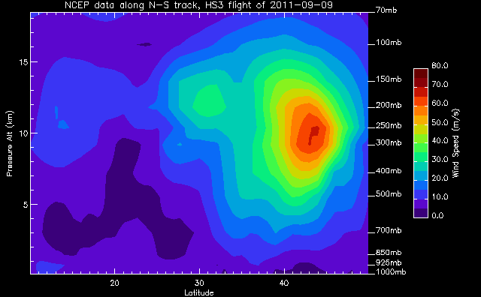
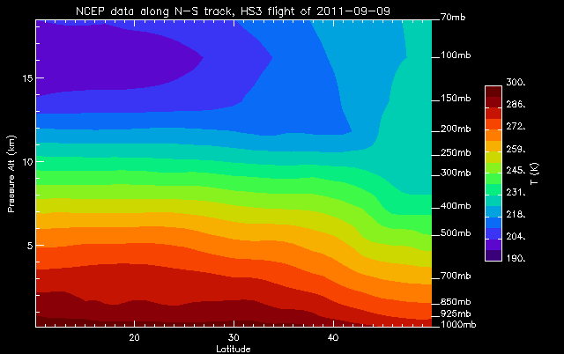
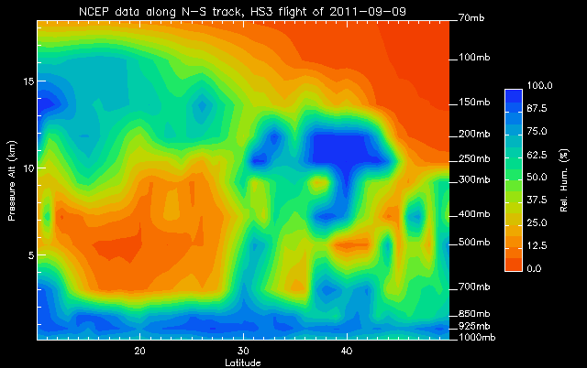
Wind Speed
Sonde (right) comparison to NCEP analysis (left)
Temperature
Relative Humdity
Notes:
This plot shows a comparison of NCEP analyzed winds, temperatures, and humidities (left) compared to those from the dropsondes. Note the the Dropsonde vertical cross section for humidity only extends up to 13 km compared to about 18 km for all other cross sections. The black horizontal line on the NCEP humidity field indicates this 13 km level. One can see very good agreement between the NCEP analysis and the dropsonde data. One significant difference is the drier tropical tropopause region seen in the dropsonde data compared to the analyses.

Slide 10


NOAA G-4 AVAPS II Dropsonde
Inter-comparison
NASA Global Hawk Mini Dropsonde
HS3 2012 Science Meeting Wallops
May 8, 2012
Terry Hock, June Wang
National Center for Atmospheric Research*
Boulder, CO
Special thanks to NOAA:
Michael Black, Phil Hall, Gary Wick
And all NOAA and NASA staff in the
planning and execution of these flights.
* NCAR is supported by the National Science Foundation

Slide 11

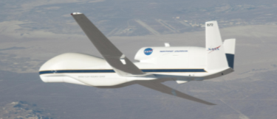
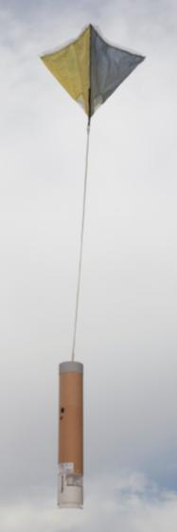
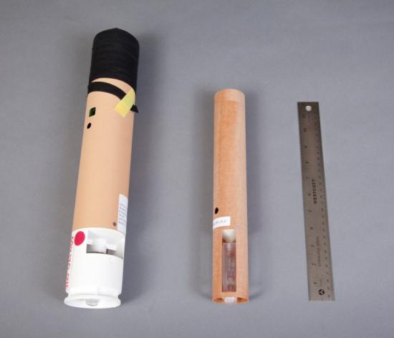
NCAR Dropsonde Technology
Precision In-situ high vertical resolution measurements
 | AVAPS II | Mini
Sensors | PTH & Winds | PTH & Winds
Mass | 320 g | 167 g
Size | 16” x 2.75” | 12”x 1.75”
Fall Speed | ~11 m/s at surface | ~11 m/s at surface
AVAPS II Dropsonde
Mini Dropsonde
Global Hawk
T & RH
sensors
AVAPS II Dropsonde
Operational NOAA Standard
Mini Dropsonde

Slide 12
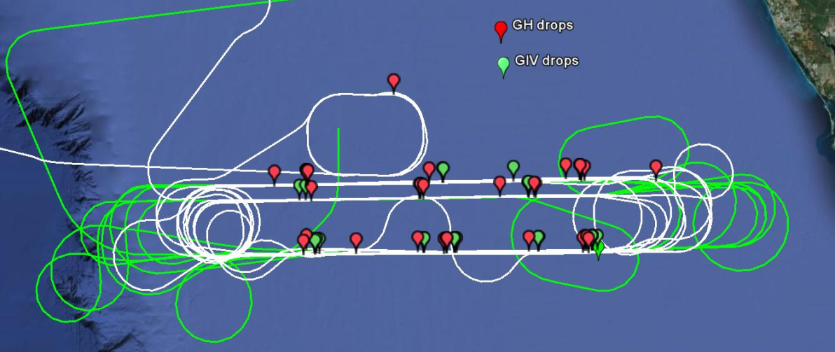
Flight Pattern and drop locations
Total 27 pairs on 9/14/2012 11-15 UTC (7-11am EST)
Planned Racetrack
Repeat
T+18
P7
P6
P5
P4
15nm
25nm
25nm
15nm
0
0
Start
P0
P1
P2
P3
T+15
Global Hawk
GIV-SP (leading GH by 5.1 nm)
6 Dropsonde Launch Location
Actual Racetrack
GH
GIV

Slide 13
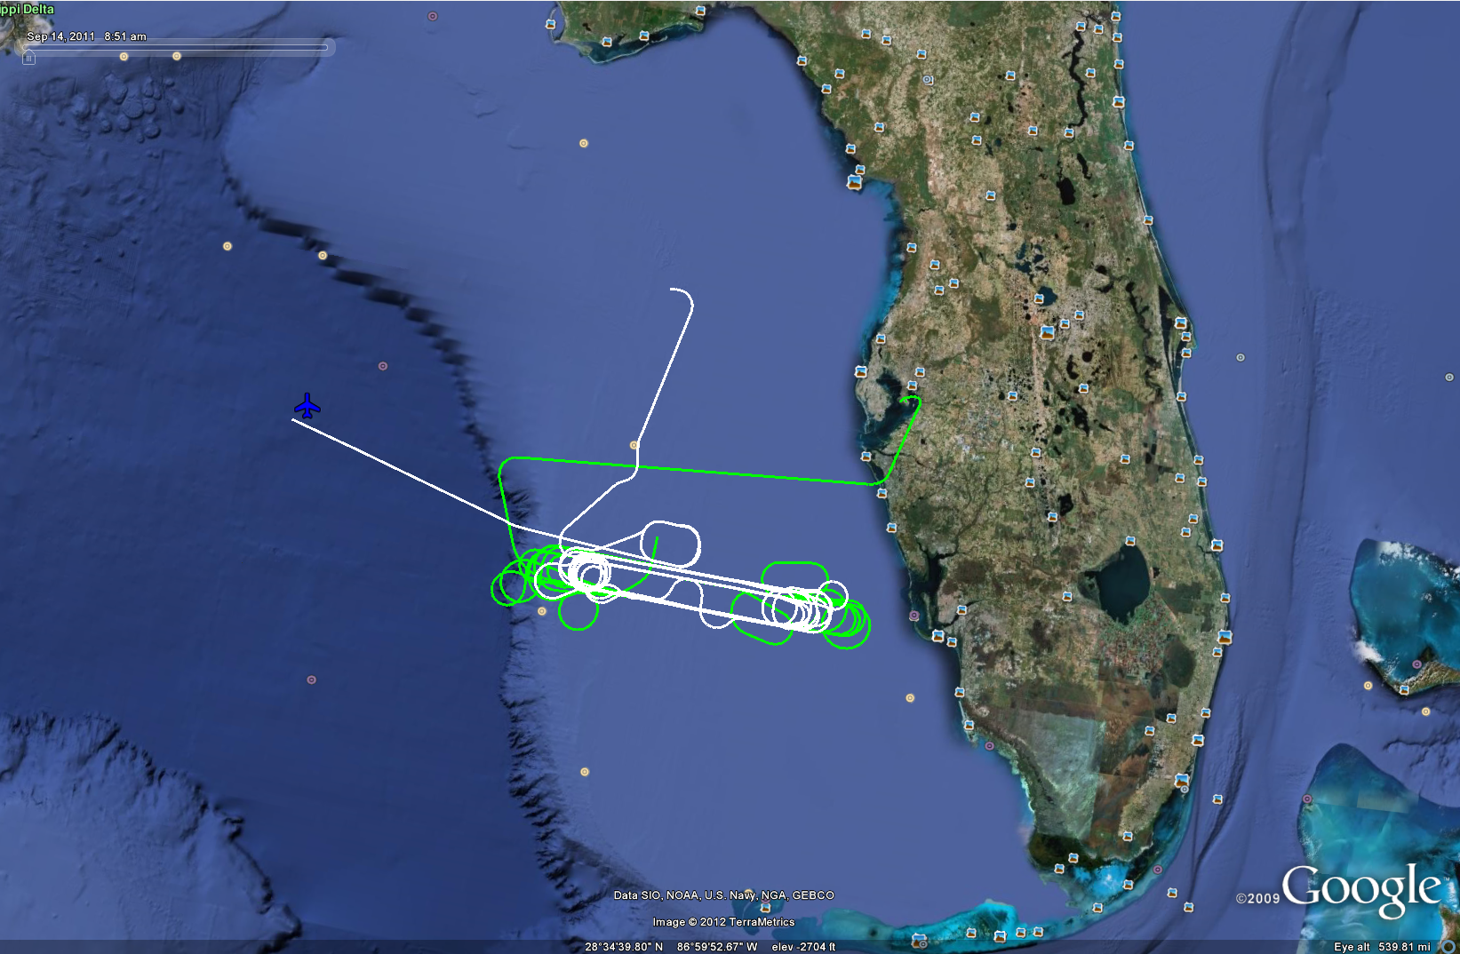
G-IV and GH Flight Tracks
White
NASA Global Hawk
Green
NOAA G-IV

Slide 14
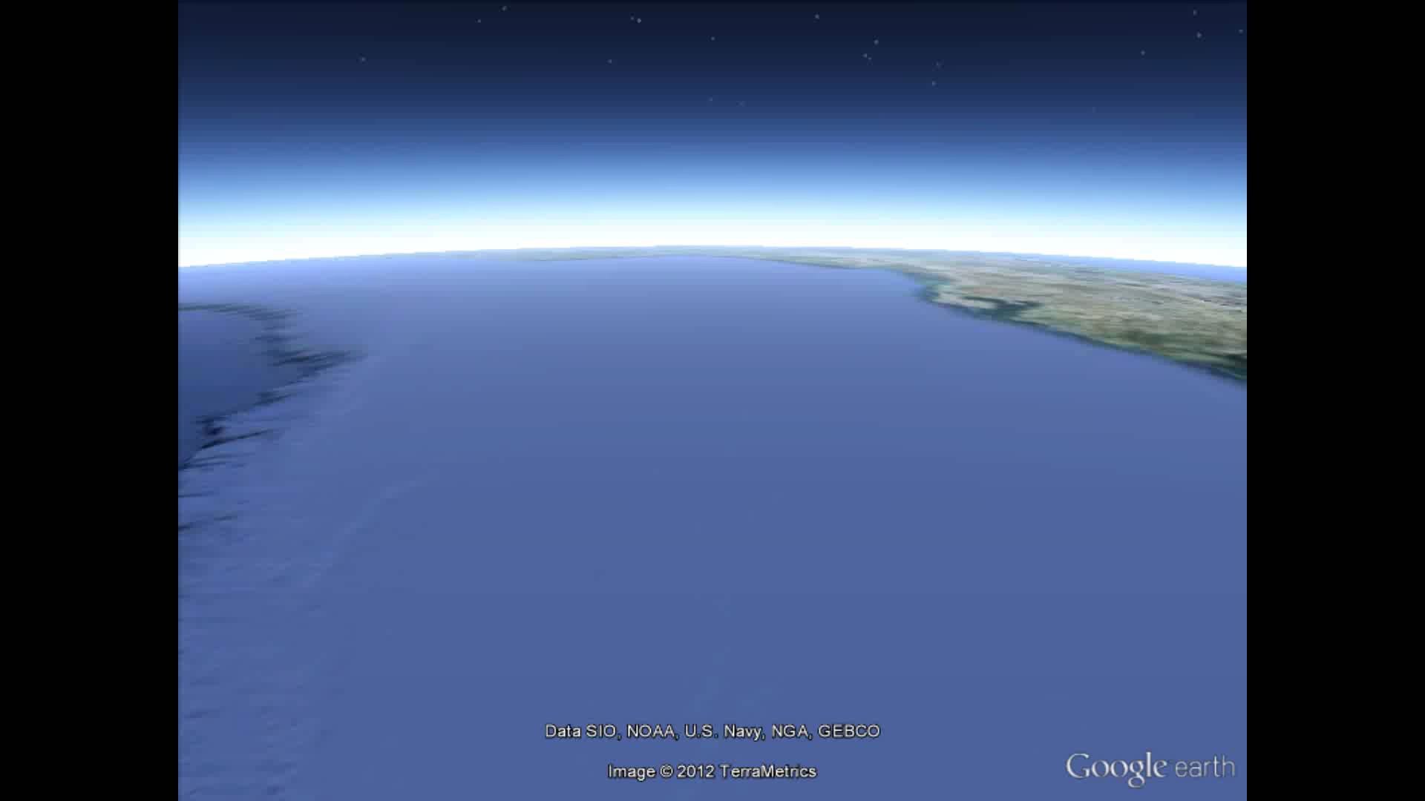
NOAA G-V and NASA Global Hawk Flight tracks

Slide 15
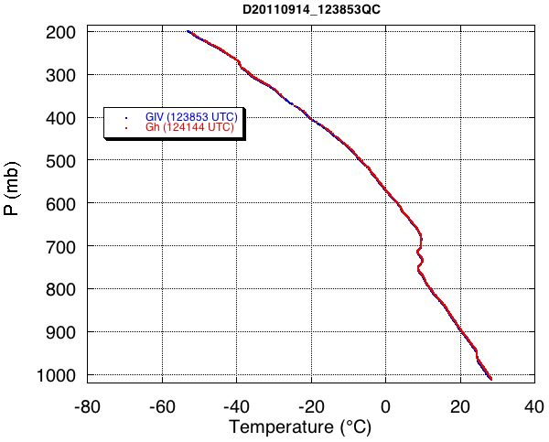
Typical Sounding Profile Comparison

Slide 16
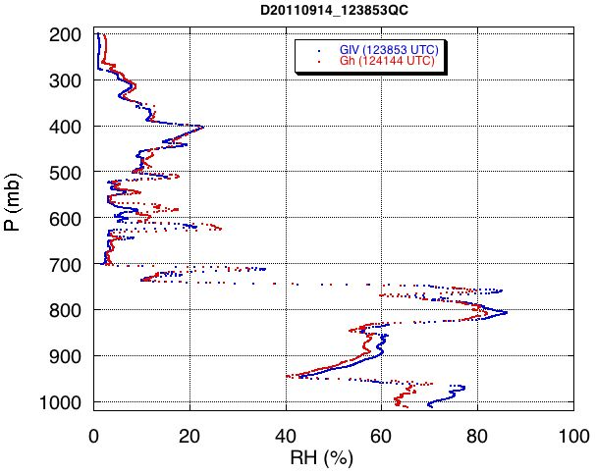
Typical Sounding Profile Comparison

Slide 17
Typical Sounding Profile Comparison

Slide 18
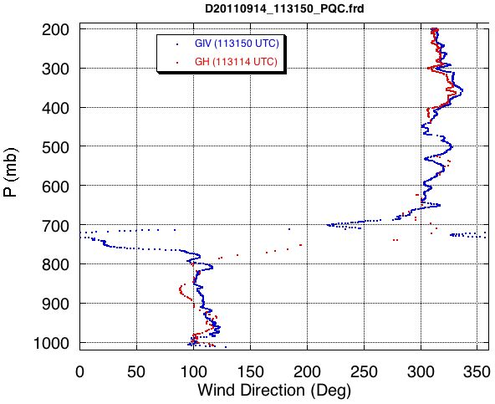
Typical Sounding Profile Comparison

Slide 19
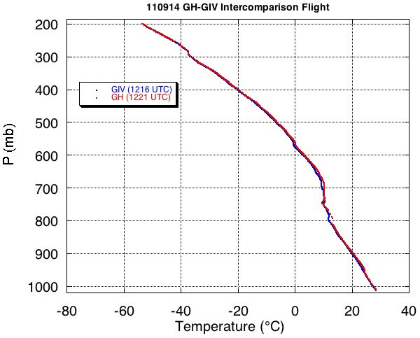
Typical Sounding Profile Comparison

Slide 20
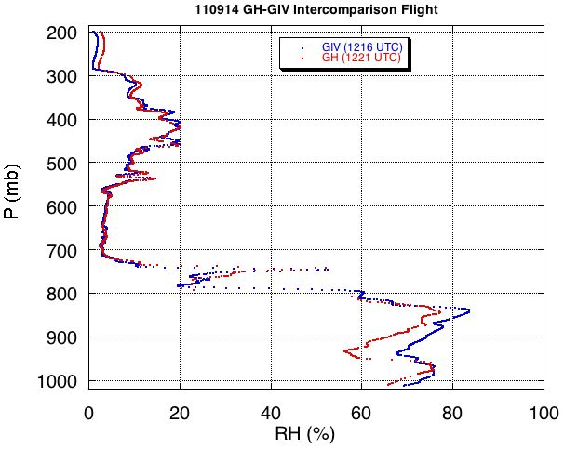
Typical Sounding Profile Comparison

Slide 21
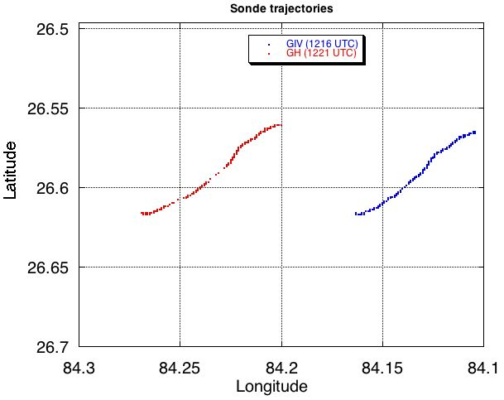
Typical Sounding Profile Comparison

Slide 22
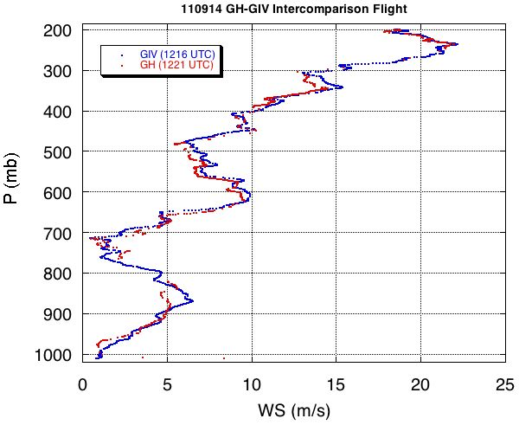
Typical Sounding Profile Comparison

Slide 23
Repeatability / Reproducibility is ...
  Repeatability is the closeness of the agreement between the result of successive measurements of the same measurand, carried out under the same conditions of measurement.
  Reproducibility is the closeness of the agreement between the result of successive measurements of the same measurand, carried out under changed conditions of measurement.
      Ref: Guide to the expression of uncertainty in measurement , ISO 1993
      International vocabulary of basic and general terms in Metrology , ISO 1993

Slide 24
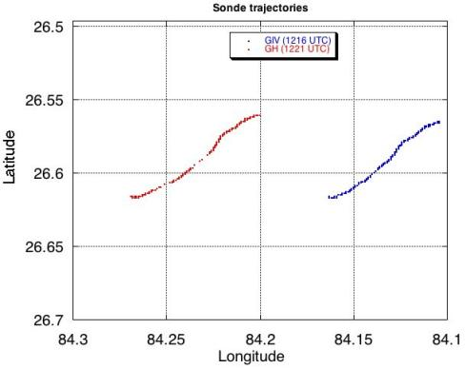
Time and space differences in G-IV & Global Hawk drops
Average launch location distance between GH and GIV drops is 4.3 km
Average time difference between GH and G-IV drops is 2.4 minutes

Slide 25
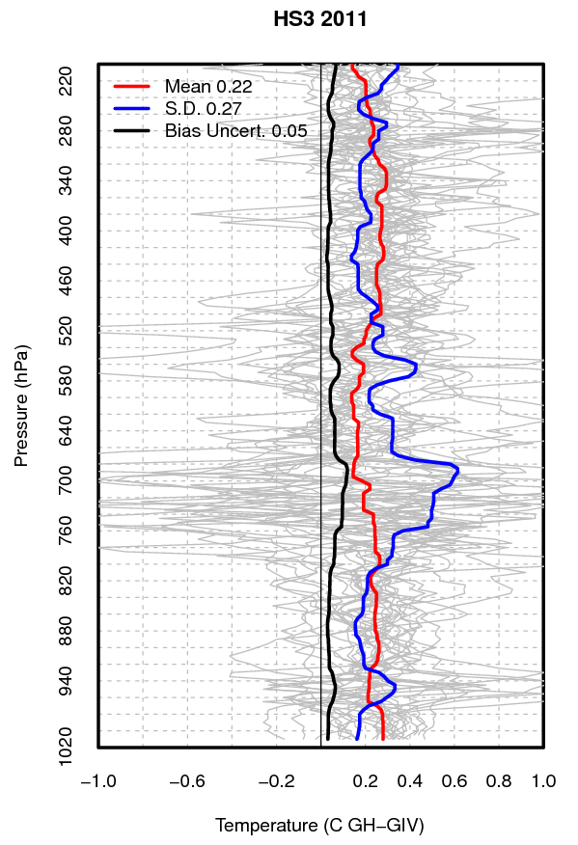
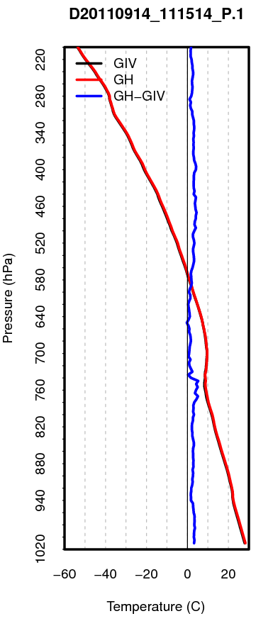
Temperature Differences
Suggesting a warm bias in the G.H. data with a mean of 0.22°C.
The bias is significant comparing with the uncertainty of the bias.
The reproducibility (2 * S.D.) is 0.54°C on average.
(*10)
Drops pair #1
Difference is x10 on graph

Slide 26
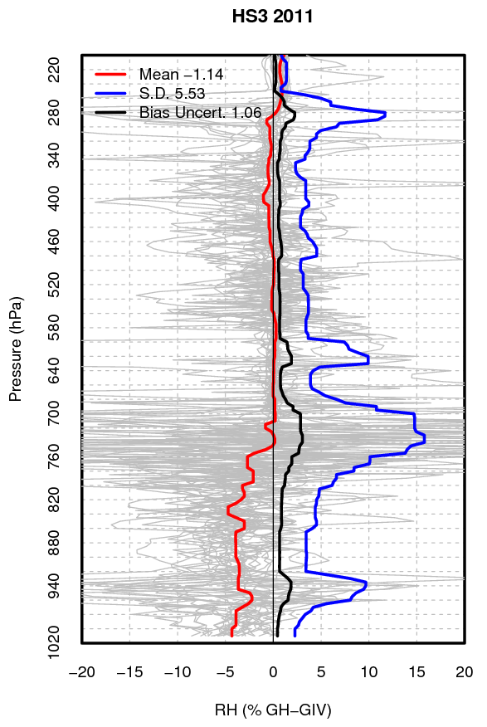
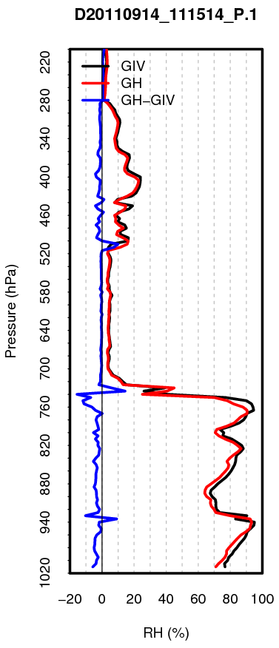
RH Differences
Good agreement above ~750 hPa.
A dry bias of ~4% below ~750 hPa.
The reproducibility (2 * S.D.) is 11% on average.

Slide 27
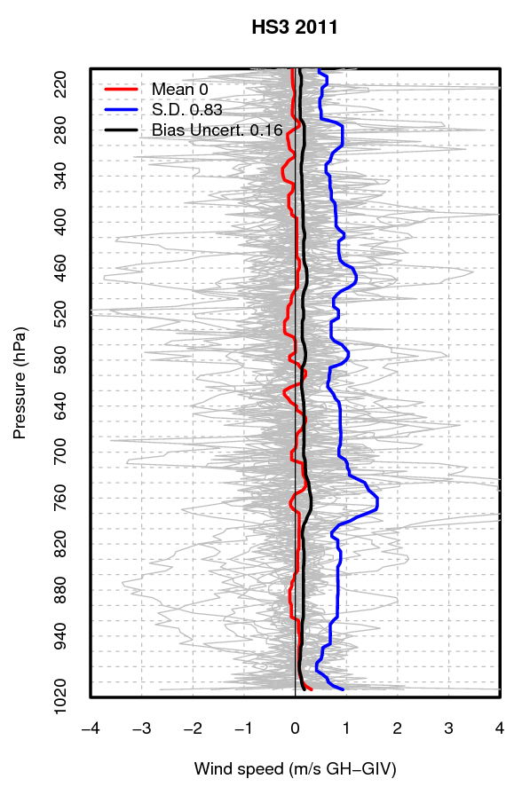
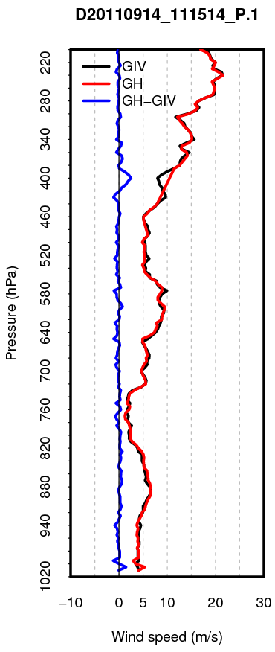
Wind Speed Differences
Excellent agreements with no mean bias.
The reproducibility (2 * S.D.) is 1.66 m/s on average.

Slide 28
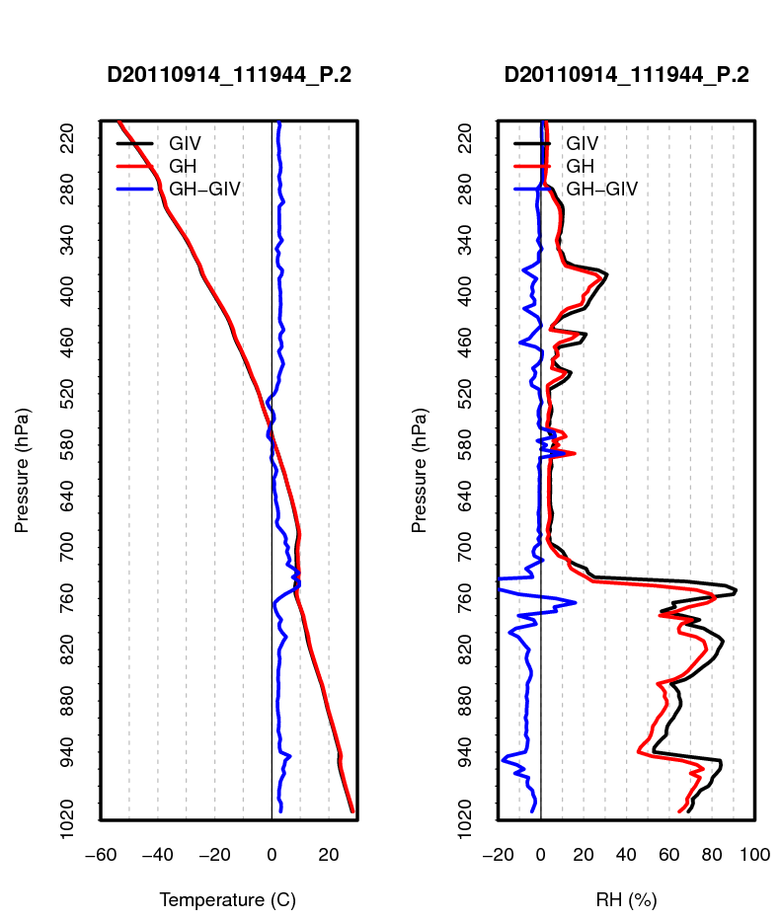
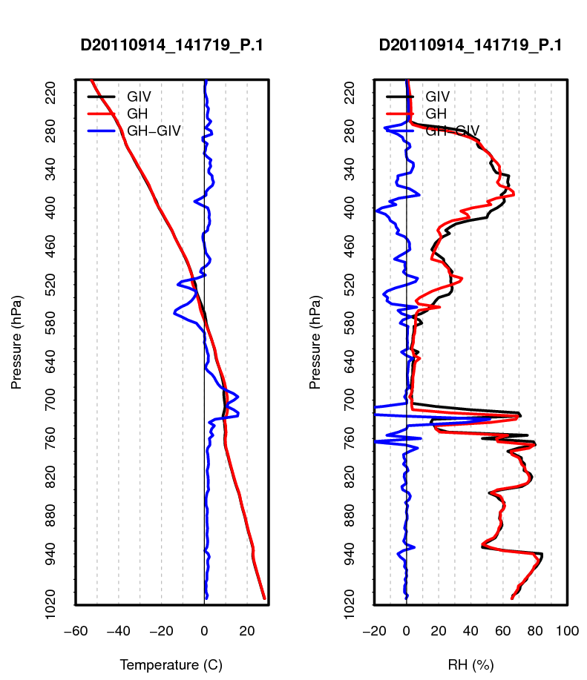
Warm and dry biases in the GH data
Warm & dry biases
Good agreement
(*10)
(*10)

Slide 29
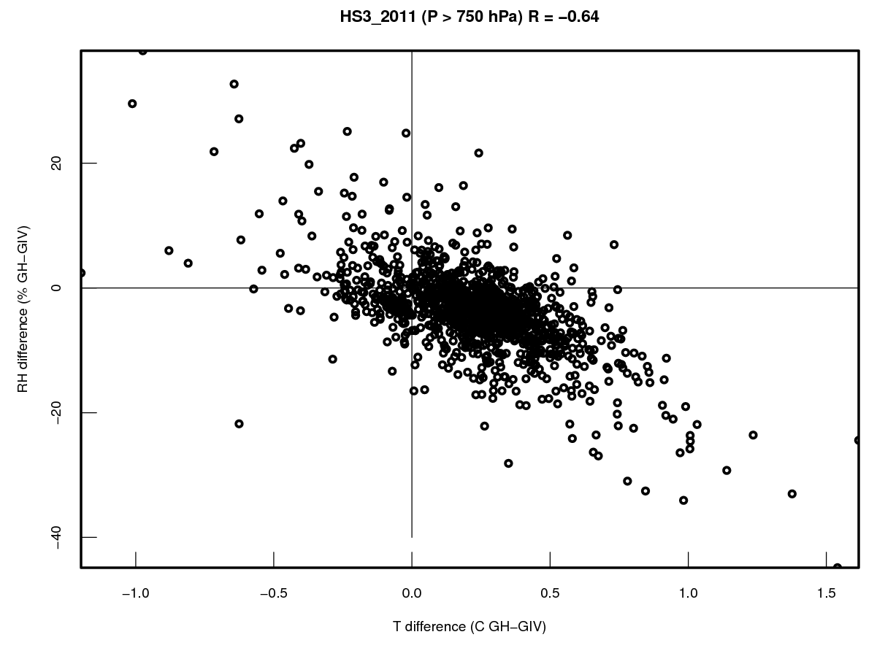
Correlation between the warm bias and the dry bias below 750 hPa
Significant correlation R=-0.64

Slide 30
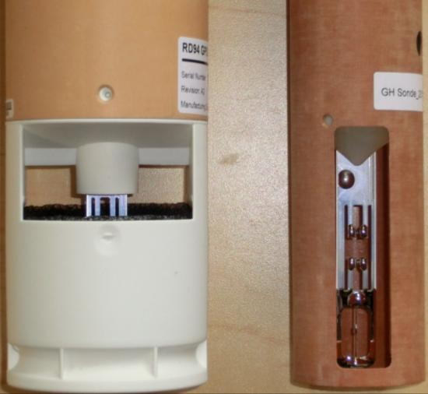
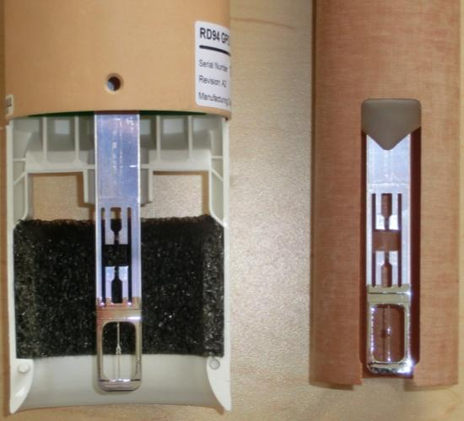
Suspected reasons
for warm/dry biases
AVAPS II
Dropsonde
(G-IV)
Mini
Dropsonde
(G.H.)
Solar radiation heating: AVAPS II has black radiation foam (BRF) and has PTU sensor module in the shade, so no direct solar radiation heating, while mini-dropsonde used in G.H. has no BRF, and three large windows make it susceptible to direct solar radiation heating.
Sonde body &
Radiation shield
BRF

Slide 31
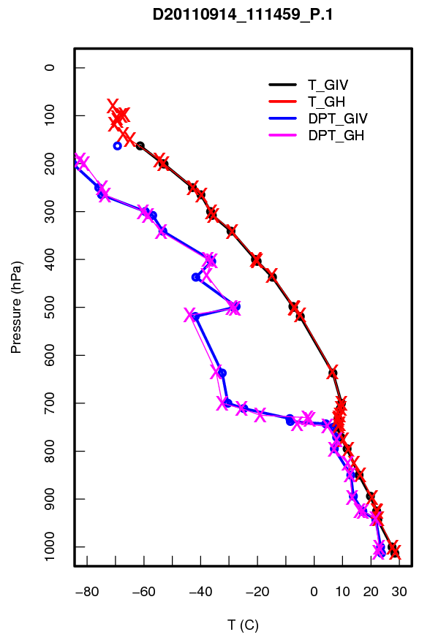

Comparisons of dropsonde TEMP messages from Global Hawk and NOAA-GIV during HS3
Atmospheric Sounding Processing Environment
ASPEN
Apply quality control procedures to the sounding data
ASPEN implements Federal Meteorological Handbook No.3 (FMH-3)
Automatically determine mandatory and significant levels
Code levels in WMO message formats
Drop Pair 1
Computed
Mandatory and Significant levels

Slide 32
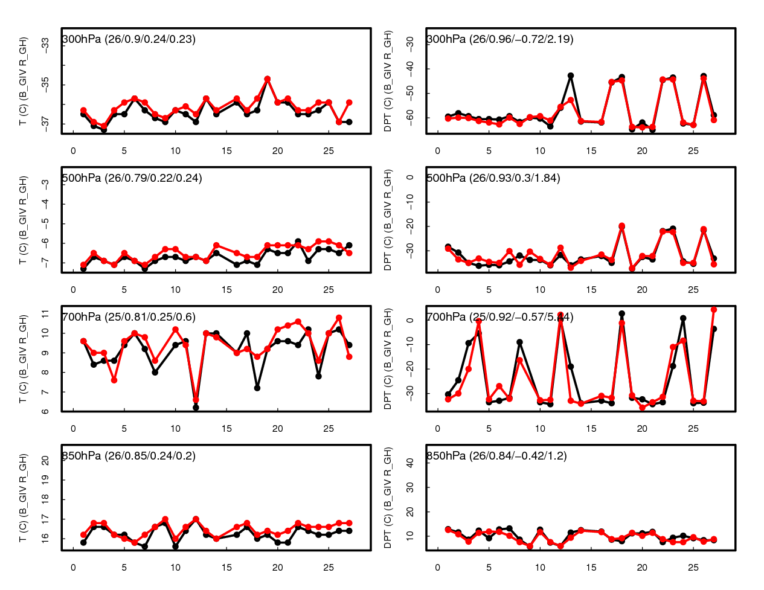
Comparison of significant levels
Temperature (G-IV & G.H.)
Dew-point T (G-IV & G.H.)
Drop pairs #
Drop pairs #

Slide 33
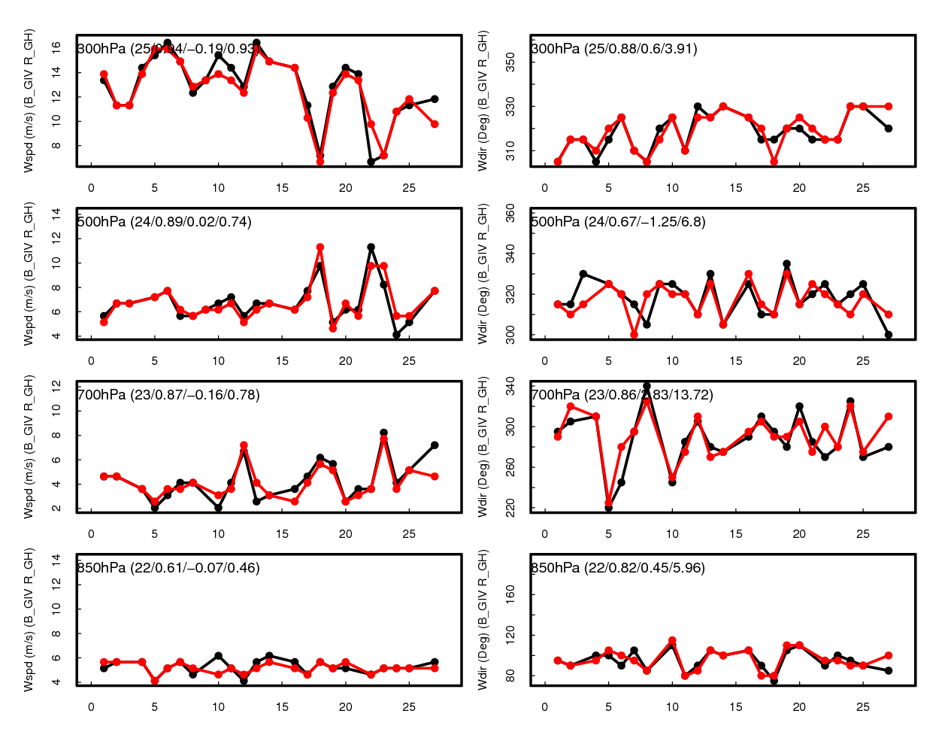
Comparison of significant levels
Wind Speed (G-IV & G.H.)
Wind Direction (G-IV & G.H.)
Drop pairs #
Drop pairs #

Slide 34
Summary
Twenty seven pairs of co-located soundings in a similar environment were collected within four hours during daytime from Global Hawk and G-IV.
The comparisons show excellent agreements for wind profiles without any systematic bias.
The temperature from the G.H. shows a warm bias with a mean of 0.2°C.
The RH profiles agree well with each other above~750 hPa, but show a 3-5% dry bias in the GH data below ~750 hPa.
Future Lab testing at NCAR to understand and improve the temperature bias.
Comparison of WMO Temp Drop message show excellent agreement

Slide 35
Future Plans
NASA will fly 2 GH out of Wallops, VA in September 2012, 2013, 2014 (HS3).
In 2012 one the the GH will have the NOAA/NCAR dropsonde system.
This will be the “environmental” aircraft.
A total of 5-6 , 24-30 hour flights planned.
The flights will be in the environment of tropical systems ranging from an easterly wave in the eastern-central Atlantic to mature hurricanes in the Atlantic, Gulf and, perhaps, EPAC basins.
NOAA plans to process and transmit to the GTS the GH dropsonde data in real time
Are the Global Hawk dropsonde data ready for NCEP data assimilation?

Slide 36
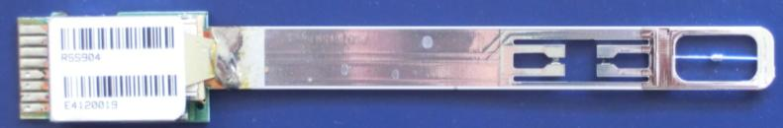
Same exact PTH sensors used in both dropsondes
Dropsonde Thermodynamic Sensor Specs
Pressure-Temperature-Humidity Sensors
Vaisala RSS904 module
(Similar module as standard Vaisala RS-92 Radiosonde)
Sensor have wide dynamic range
Very Fast response time P T H
Minimal radiation errors
Pressure
  Range: 1080 -3 mb
  Resolution: 0.1 mb (d-file 0.01mb)
  Accuracy:
    Repeatability: 0.4 mb
Temperature
  Range: -90° to +60° C
  Resolution: 0.1° C (d-file 0.01° C)
  Accuracy:
    Repeatability: 0.2 ° C
Humidity (dual sensors)
  Range: 0% to 100%
  Resolution: 1 % (d-file 0.1%)
  Accuracy:
    Repeatability: 2%
Vaisala RSS904 PTH sensor module
Pressure
Temperature
Dual Humidity
Info from Vaisala data sheet

Slide 37


Wind Measurements
Winds derived by tracking sonde motion
  GPS Receiver
  Stable descent, no induced drift
  Both sondes use same GPS
  Receiver and same parachute design
Winds (GPS rcvr vel. specs)
  Range: 0 to 100 m/s
  Resolution: 0.01 m/s
  Accuracy : 0.1 m/s
Stable Cone Parachute design
  Size scaled for mass of both sondes for same fall velocity
Cone
Parachute
Cone Parachute
Global Hawk
Mini Dropsonde
G-IV
AVAPS II

