Slide 1

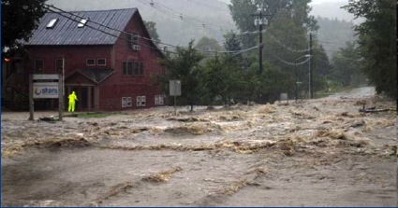
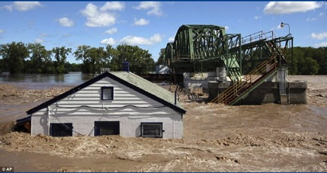

NOAA Service Assessment
Hurricane Irene
21-29 August 2011
Frank Marks and Wes Browning
(Co-team leads)
June 26, 2012
Notes:
UL – Flood waters cross Route 100, closing the main road to traffic in Waitsfield, VT (Credit: Sandy Maoys, AP)
UR - Lock 8 in Rotterdam, New York, overflows, and a metal barge is crashed into the gates, on Monday, (Credit: AP, www.daily.co.uk)

Slide 2

Hurricane Irene
Service Assessment
Service Assessment Team
Dr. Kathryn Sullivan, Executive Sponsor: Assistant Secretary & Deputy Administrator, NOAA
Dr. Frank Marks, Team Leader, NOAA/OAR Hurricane Research Division
Wes Browning, Technical Lead, Meteorologist in Charge, NWS WFO St. Louis, MO
Dr. Vankita Brown, Social Scientist, NWS OCWWS, Silver Spring, MD
Dr. Terri Adams-Fuller, Assistant Professor, Sociology, Howard University
Dr. Susan Jasko , Professor, Communication Studies, California University of Pennsylvania
Monica Allen, NOAA Public Affairs Specialist, Marine Fisheries, Silver Spring, MD
Sean Wink, Chief, Systems Operations Division, NWS WRH, Salt Lake City, UT
Aimee Fish, Meteorologist, Environmental & Scientific Services Div., NWS ARH, Anchorage, AK
John Gordon, Meteorologist in Charge, NWS WFO Louisville, KY
Alan Haynes, Service Coordination Hydrologist, NWS CNRFC, Sacramento, CA
John Brost, Science and Operations Officer, NWS WFO Tucson, AZ
Dr. William Hooke, Senior Policy Fellow and Director, AMS, Washington, D.C.
Ray Tanabe, Director, NWS Central Pacific Hurricane Center, Meteorologist in Charge NWS WFO Honolulu, HI
Dr. Scott Lindsey, Service Coordination Hydrologist, APRFC, Anchorage, AK
Mike Clay, Chief Meteorologist, Bay News 9, Tampa, FL
Dr. John Kelley, Meteorologist, NOS/Coast Survey Development Laboratory, Durham, NH
John Winkelman, Coastal Engineer, U.S. Army Corps of Engineers, New England District
Rick Dittmann, Meteorologist in Charge, NWS WFO Pocatello, ID

Slide 3
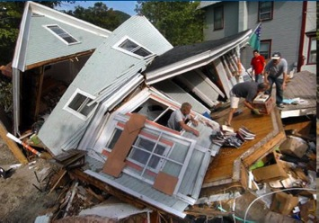
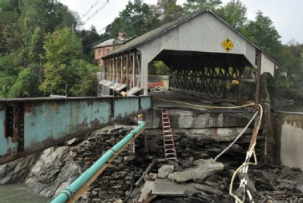
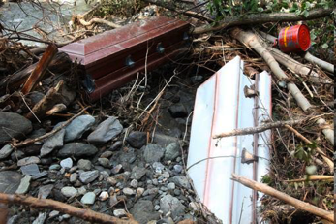
Hurricane Irene
Service Assessment
Outline
Event Overview
Event Statistics and Impacts
Assessment Charter & Process
Results & 6 Main Issues
Next Steps
Rochester, VT
Rochester, VT
Queeche Gorge, VT
Notes:
BL – Caskets that were forced from the village cemetery by rushing floodwaters lay in a river bed in Rochester, VT (Credit: Robert Ray, AP)
UR – A group of men help clear out a house that was destroyed during Tropical Storm Irene remains in a river near Route 100 in Rochester, VT
LR – Queeche Gorge VT wooden bridge destroyed in flooding (Credit: W. Davis, Jr.)

Slide 4
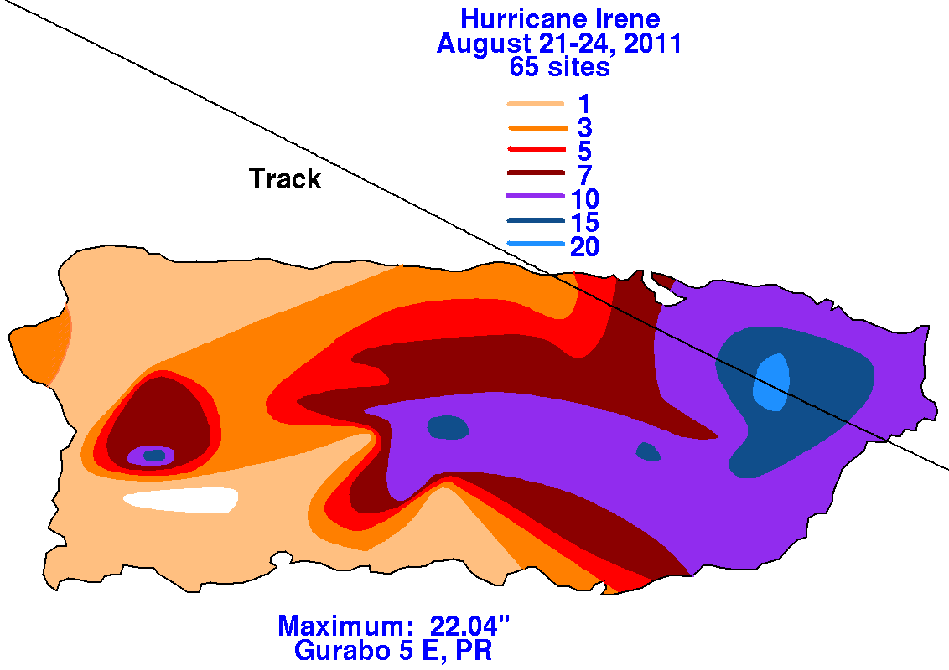
Hurricane Irene
Service Assessment
Event Overview
Notes:
L – 14 WFOs and 3 RFC impacted by Irene with storm track plotted as black line (inset WFO San Juan)
R – Observed storm total rainfall from Irene with storm track plotted as black line (inset WFO San Juan)

Slide 5
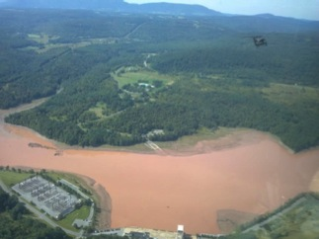
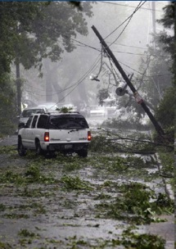
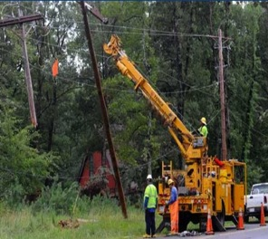
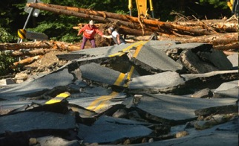
Hurricane Irene
Service Assessment
Event Statistics and Impacts
Prattsville, NY
45 deaths (26 from inland flood)
$7.3 Billion damage
Major infrastructure losses
Power lost to 8 million
Killington, VT
Lexington Park, MD
Greenville, NC
Notes:
UL – Black Hawk Helicopter over Prattsville, NY (Credit: FEMA)
BL – People climb over what is left of Route 4 in Killington, VT on Aug. 30th. (Credit: Vyto Starinskas, Rutland Herald, AP)
BM – Workers replace a broken utility pole in Lexington Park, Md., after Hurricane Irene. (Credit: Steve Ruak, AP)
BR - A vehicle avoids a downed utility pole in Greenville, NC on Aug. 27th (Credit: Chris Seward, The News and Observer, AP)

Slide 6
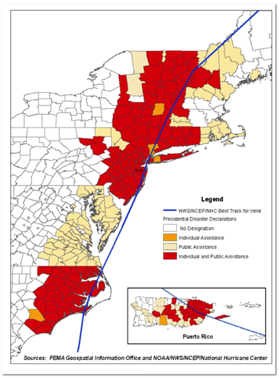
Hurricane Irene
Service Assessment
Event Statistics and Impacts
PR – Major flooding in east
NYC – no severe damage, but 3–6’ storm surge caused $100M in property damage in NYC, Long Island, & parts of CT coastline.
NY & CT – TS winds & heavy rains cause power outages for 3M residents in CT & Long Island
NY – floods made 3 towns in Catskills uninhabitable.
VT – ~2,400 roads, 800 homes and businesses, 300 bridges & railroad tracks damaged.
USDA designated many counties from NC - NH as disaster areas.
Notes:
L - counties/cities which were declared presidential disaster areas from Irene (inset WFO San Juan)

Slide 7
Hurricane Irene
Service Assessment
When & Why?
NWS conducts Service Assessments to evaluate its performance after significant hydrometeorological, oceanographic, or geological events. Assessments may be initiated when one or more of the following criteria are met:
Major economic impact on a large area or population
Multiple fatalities or numerous serious injuries
Extensive national public interest or media coverage
Unusual level of attention to NWS performance
Assessment teams, composed of experts from within and outside the NWS, evaluate activities before, during, and after events to determine the usefulness of NWS products and services.
The team generates a report, which serves as an evaluative tool to identify and share best practices in operations and procedures, and identify and address service deficiencies. The goal of the activity is for the NWS to continuously improve its services to the nation.

Slide 8
Hurricane Irene
Service Assessment
Charter
Document and evaluate performance and overall effectiveness of NWS products & services, decision support, collaboration & communication, procedures, and preparedness.
Identify best-case operations; procedures & practices; and make recommendations to address service deficiencies in areas such as forecasting intensity, track, flash and river flooding.
Examine impacts of increased upper air observations, effectiveness of NOAA-wide impact-based decision support before (preparation), during (response), and after (recovery) the storm, as well as media coverage.
Ascertain key facts surrounding the event and include evaluation of involved WFOs, RFCs, National Centers, and regional and national operations centers.
Examine collaboration & communication with White House, FEMA, USACE, USGS, and entities most impacted by winds, storm surge, coastal & inland flooding, and precipitation that caused casualties, significant property damage, and impact on commerce.
Evaluate important issues as they uncover them during assessment, keeping in mind how NOAA could contribute to hazard resiliency.

Slide 9
Hurricane Irene
Service Assessment
Process
Focus on:
  Coordination & Collaboration
  Resource Allocation
  Decision Support Service
  Data Collection, Dissemination, and Forecast Models
Interviews (>270) covered 14 WFOs, 3 RFCs, NCEP, 4 FEMA Regions, other Federal and State partners, Media, & private citizens
Recommendations classified as Operational (resolvable in near-term) or Strategic (requiring substantial time and resources to address)
Captured 15 Best Practices, 91 recommendations, 45 Operational & 44 Strategic, plus 2 Both

Slide 10
Hurricane Irene
Service Assessment
Results
While Hurricane Irene tested technical, human, and hydrometeorological capabilities of NWS, performance was generally outstanding. In particular:
NHC forecast track of Irene accurately, and worked successfully with federal, state, and local EM partners to warn and protect those in the storm’s path.
ER & SR WFOs along Irene’s track, worked in close partnership with NHC, HPC, SERFC, MARFC, and NERFC to deliver accurate, clear, & compelling forecasts, watches, and warnings.
Despite an extremely accurate HPC 5-day forecast of historic rainfall, the magnitude of inland flooding threat was not effectively conveyed to those most at risk.
NHC forecast intensity of Irene was too high during the slow weakening phase. Approximately 10-20 % of this high bias during Irene’s weakening can be attributed to initial (analysis) intensity error.

Slide 11
Hurricane Irene
Service Assessment
Results
Team uncovered excellence, innovation, emerging role of social and mobile forms of media, a growing demand from public and responders for NWS products and services, crucial role of partnerships with non-NOAA groups, and a dedicated group of weather professionals valued by their constituencies.
Investments in outreach and relationship building yielded big payoffs by spurring responses that helped safeguard lives and property across a vast area of the Eastern Seaboard (8 Best Practices).
Placement of embedded meteorologists at EOCs gave responders timely, customized information & analysis to enable decisions with greater confidence to safeguard lives & property (3 Best Practices).
One of the first natural disasters where NWS used social media extensively to communicate broadly with the public, media, and others who praised the timeliness of vital information disseminated in these creative ways, e.g., Twitter, Facebook, & NWSChat (4 Best Practices).

Slide 12
Hurricane Irene
Service Assessment
Results
Identified 6 Main Issues
  Inundation (Inland & Coastal)
  Decision Support Services
  Training/Hiring
  Resiliency (Backup/Communications)
  Safety/Infrastructure
  Quality & Availability of Data

Slide 13
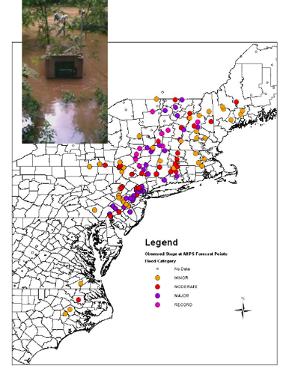

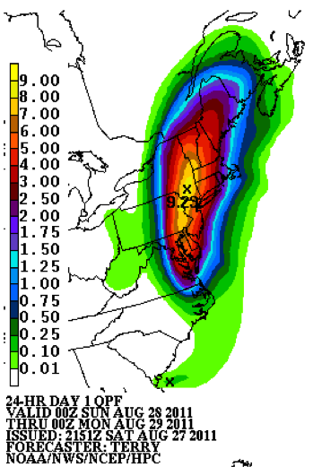
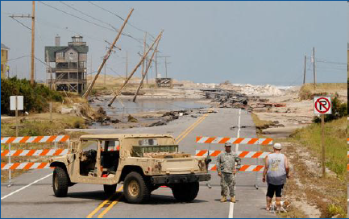

Hurricane Irene
Service Assessment
(1) Inundation (Inland & Coastal)
“I needed someone to tap me on the shoulder and say ‘hey, pay attention up north - the flooding is going to be really bad!!’ “ - FEMA Region I
Waitsfield, VT
“Surge: we said ‘5-7' but it was higher. Worst ever in Pamlico Sound… People are fixated on the category - this one shocked some folks.” - NC Broadcast Meteorologist
Rodanthe, NC
Resident, Rochester, VT
Notes:
TL – Raging floodwaters from Tropical Storm Irene cross Route 100 in Waitsfield, VT on Aug. 28th (Credit: Sandy Maoys, AP)
BL - Sgt. Michael Jarrett, of the 171st Engineer Company, turns back a dog walker from getting any closer to the broken sections of Highway 12 in Rodanthe, N.C. On Aug. 29th. The highway is the only road linking Hatteras Island and the mainland (Credit: Chuck Liddy, The News & Observer, AP)
R – Locations of record floods from Hurricane Irene. inset: USGS River Gage Lodi, NJ

Slide 14
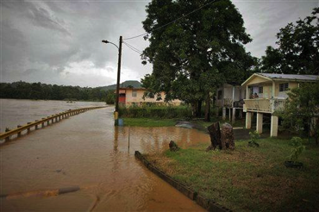
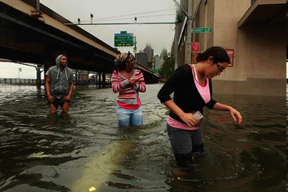
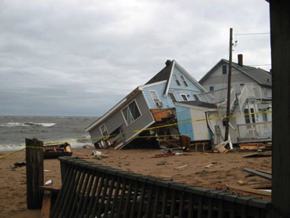
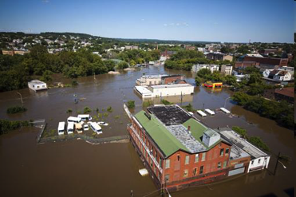
Hurricane Irene
Service Assessment
(1) Inundation (Inland & Coastal)
Toa Baja, PR
Manhattan, NY
East Haven, CT
Paterson, NJ
Notes:
UL – La Plata River overflows its bank the day After Irene hit Toa Baja, PR, Tues, Aug. 23, 2011 (Credit: AP/Richardo Arduengo)
BL – Floodwater inundates streets and surrounds buildings from the Passaic River in Paterson, N.J. on Aug. 30th (Credit: Michael Nagle, Getty Images)
UR – South Street in lower Manhattan, NY after the East River spilled over a sea wall (Credit: Carolyn Cole, LA Times)
BR - Cosey Beach, East Haven, CT Credit: Diane Zorich via TheDay.com

Slide 15
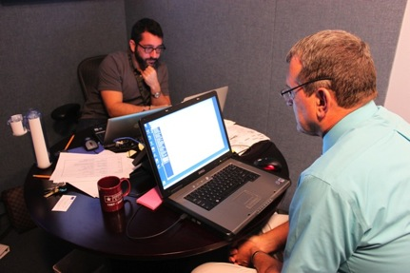

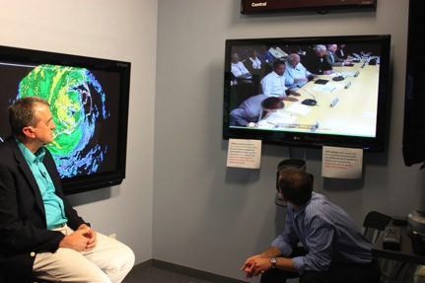
Hurricane Irene
Service Assessment
(2) Decision Support Services – HLT
Developed after 1995 season
Manage DSS FEMA requirements
Provides VTC briefing to FEMA during a major TC
HLT staffed by FEMA to facilitate coordination
“Bill Read gets it!” – Russ Washington, Director of the National Watch Center, FEMA
John Juskie, FEMA
Plays critical role in effective relationship between FEMA & NHC
NHC Director worked with HLT lead to prepare appropriate graphics to highlight potential storm impacts for VTC
Notes:
Left – HLT lead Matt Greene (l) and NHC Director Bill Read (r) prepare daily FEMA briefing during Irene
Right – NHC Director Bill Read (l) and SSU lead Jamie Rhome (r) brief FEMA and President Obama via daily HLT VTC briefing on 27 August during Irene

Slide 16
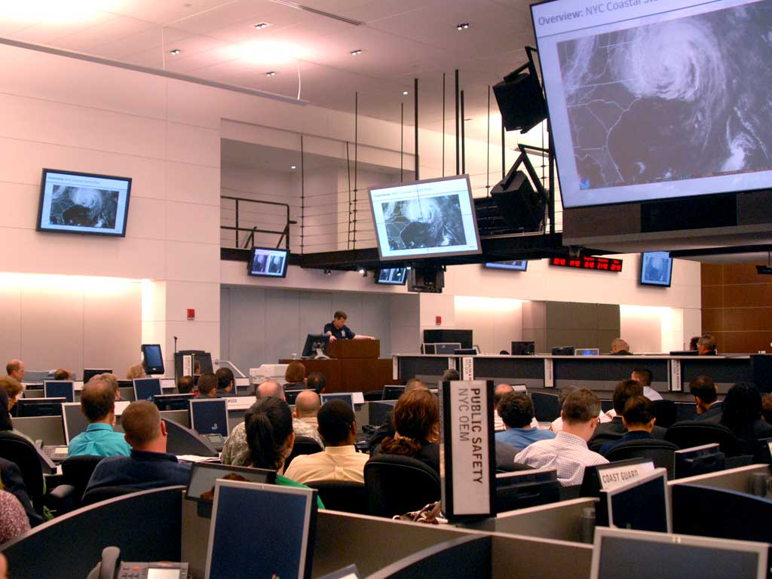

Hurricane Irene
Service Assessment
(2) Decision Support Services – Embedded Mets
“The most important point I can communicate is the importance of having an Incident Meteorologist on-site.” –NYC OEM Commissioner Joe Bruno
NYC OEM
Commissioner Joe Bruno, NYC OEM
Notes:
John Koch (ERH) briefing NYCOEM on 27 Aug.

Slide 17
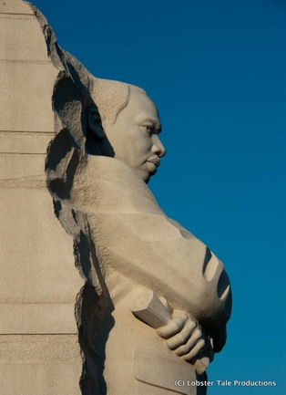





Hurricane Irene
Service Assessment
(2) Decision Support Services - Challenges
“HPC doesn’t understand how to convey the information to non-meteorologists the way NHC does (too technical). – Russ Washington, FEMA
“This is the first time in my 15 years in NWS management that I ever was asked to change my forecast for anything other than meteorological issues.” –James Lee, MIC, LWX
Russell Washington, FEMA
Jim Lee, MIC LWX
Notes:
Left – MLK memorial

Slide 18
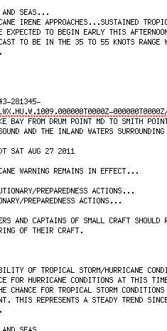
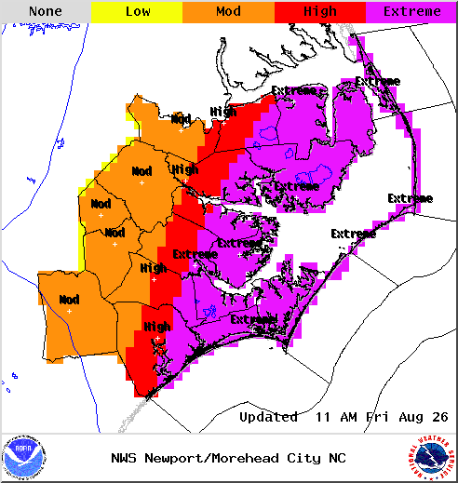
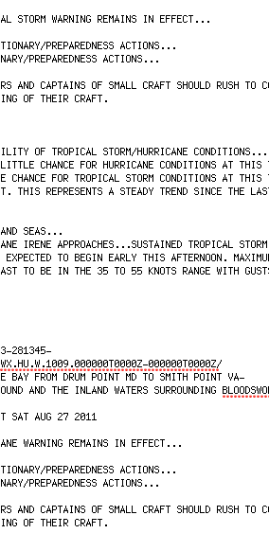
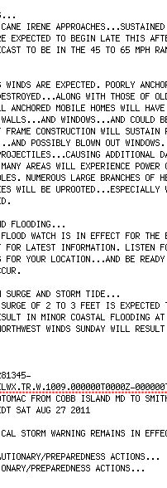
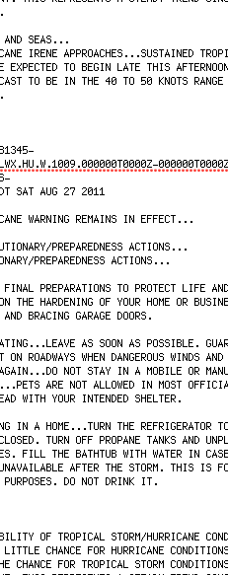
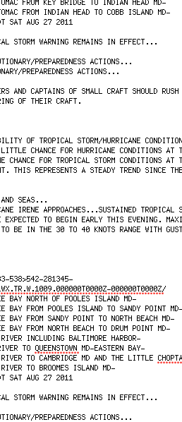
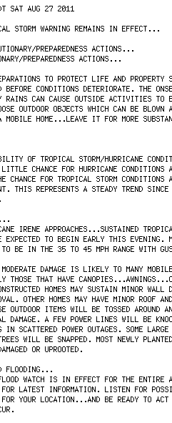
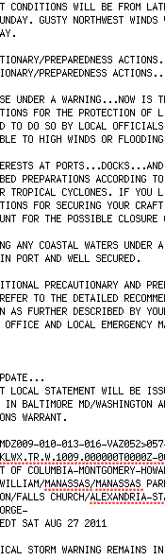
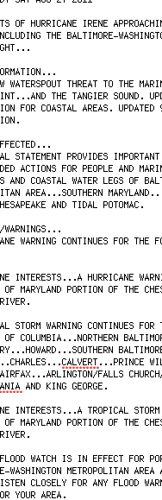

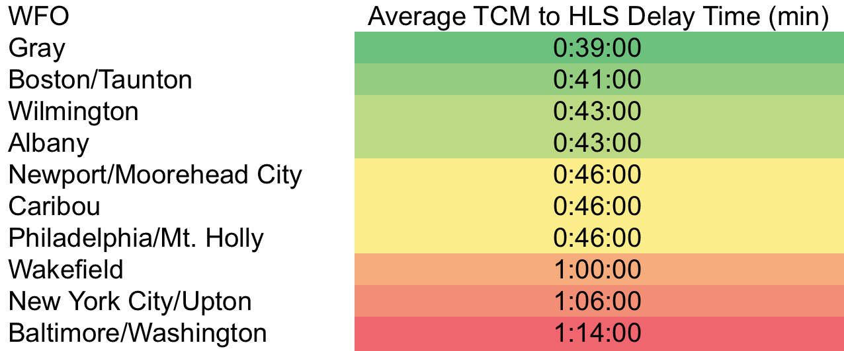
Hurricane Irene
Service Assessment
(2) Improved guidance products for local DSS
“(HLS products) were too long if you were trying to deal with multiple offices, too much to read.” And “…it was difficult to find the HLS on NWS web sites.”
Brian Norcross, The Weather Channel
8 pages
Notes:
R – 8 page LWX HLS issued at 1343UTC 27 August 2011
BL – plot of average delay time between TCM issuance and HLS release for each WFO in Irene
Overlay R – example of graphical product conveying risk of wind damage in HLS from Newport/Moorehead City WFO in Hurricane Irene

Slide 19
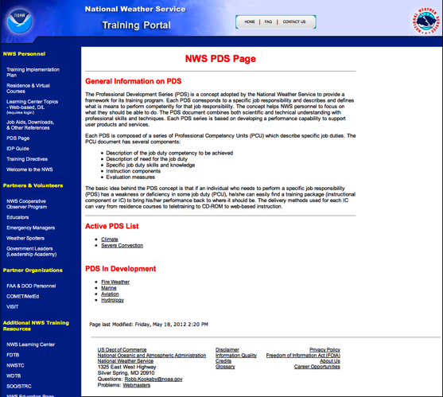
Hurricane Irene
Service Assessment
(3) Training/Hiring
Hurricanes are highest impact weather events (43% of $1.76T total damage)
Suggest need for comprehensive tropical training programs throughout the NWS.
Most needed at WFOs in tropical cyclone impacted regions, but also at WFOs serving as primary & secondary backups

Slide 20
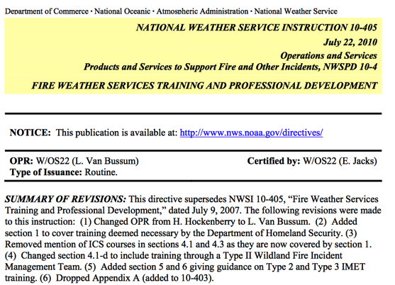
Hurricane Irene
Service Assessment
(3) Training/Hiring
DSS requires NWS to train staff to deliver high quality services during high impact events using ICS principles (i.e., NWSI 10-405)
Not all embedded meteorologists were ICS trained as defined in NWSI 10-405 in Irene
“All individuals who walk into my EOC must have completed ICS 100, 200, 300, 400, 700 and 800.” –Tom Collins, Pender County, NC Emergency Manager

Slide 21
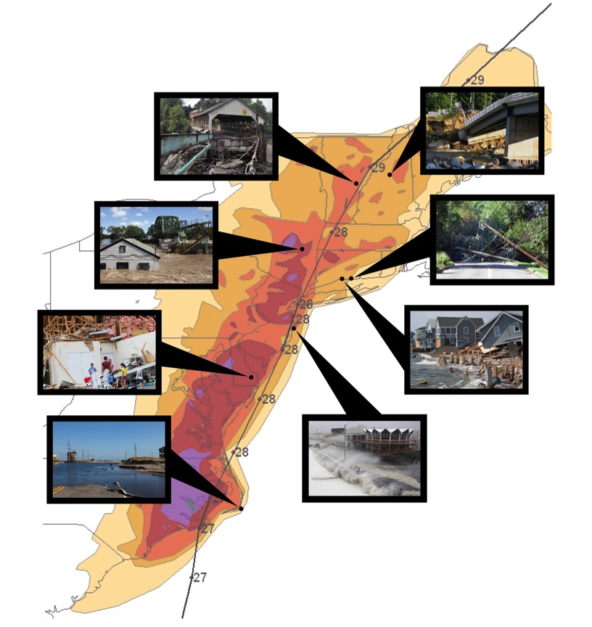
Hurricane Irene
Service Assessment
(3) Training/Hiring
Level of hydrologic training and experience varies within and among WFOs
Training for extreme hydrologic events, even when rare, needs to be more consistent & given higher priority to meet goals of Weather-Ready Nation. Are there ER Hydrometeorologists?

Slide 22
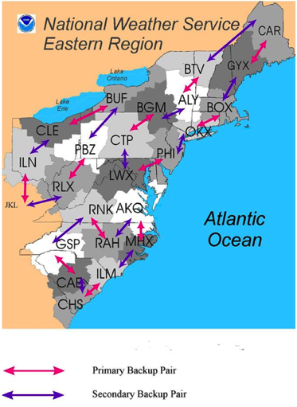

Hurricane Irene
Service Assessment
(4) Resiliency (Backup/Communications)
VSAT
All WFO staff should be trained on VSAT operations
Mission critical communications requirements must be defined, prioritized, and implemented during VSAT operations
NWS should explore other independent internet connection solutions such as 4G MiFi
Notes:
L – ERH Primary/Secondary WFO Backup plan
UR – Hughs VSAT antenna

Slide 23
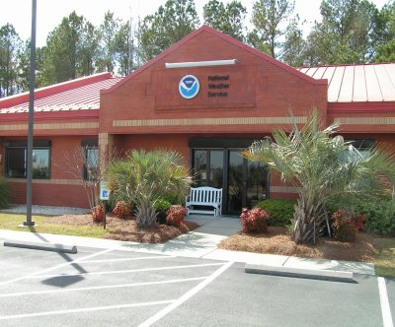

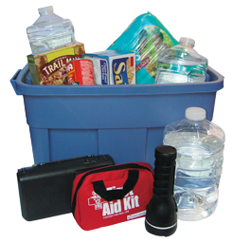
Hurricane Irene
Service Assessment
(5) Safety/Infrastructure
Notes:
L – Norfolk/Wakefield, VA WFO
UR – Cot
LR – Hurricane survival kit
FEMA recommends all citizens develop a 72-hour plan for emergencies. The plan should include a kit with 3 gallons of fresh water per person, canned goods, prescription medications, etc., during extreme events (Reference www.ready.gov/build-a-kit).

Slide 24

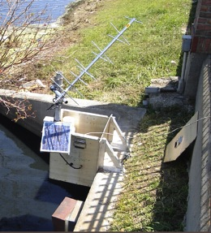
Hurricane Irene
Service Assessment
(6) Quality & Availability of Data
“If budget cuts materialize it will be unfortunate. We will lose the ability to forecast river stages due to loss of data” - USGS
James Franklin, NHC
“We have two models from HFIP that in Irene are beating our operational guidance” –James Franklin, NHC
“OSVW capable of seeing into the hurricane force winds…would allow us to get the initial intensity correct” –James Franklin, NHC
James Franklin, NHC

Slide 25
Hurricane Irene
Service Assessment
Next Steps

Slide 26
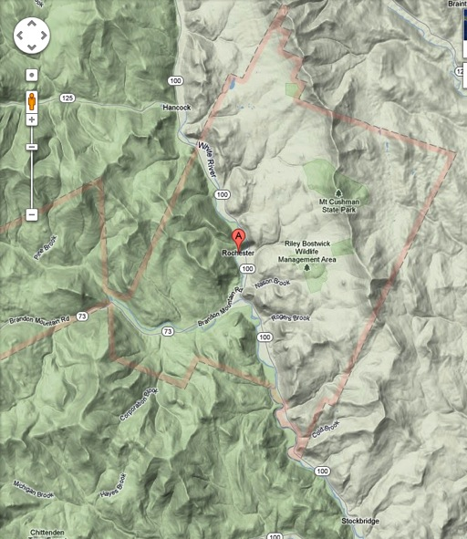
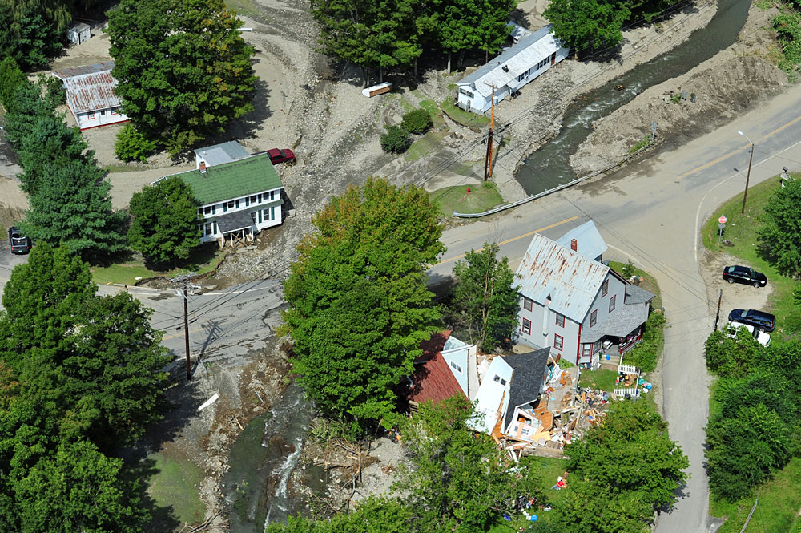
Questions?
Notes:
White River Valley, Rte 100, Rochester, VT

