Slide 1
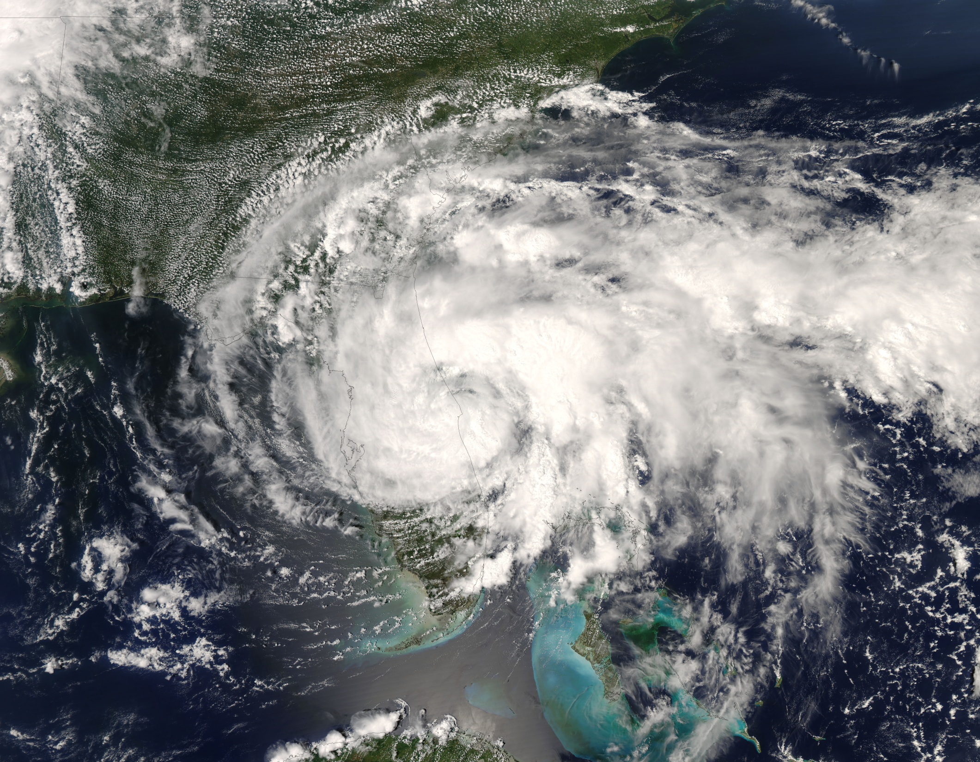
Land Surface Feedbacks on the Post-Landfall Tropical Cyclone Characteristics using the Hurricane Weather Research and Forecasting (HWRF) Modeling System
Monica Laureano Bozeman
Masters Defense
Sept 9th, 2011

Slide 2
Publications and Presentations
PEER REVIEWED PUBLICATIONS (accepted and in revision):
  Laureano, M., D. Niyogi, S. Gopalakrishnan, F. Marks, X. Zhang and V. Tallapragada 2011: An HWRF Based - Ensemble Assessment of Possible Land Surface Feedbacks on the Post-Landfall Intensification of Tropical Storm Fay of 2008. Natural Hazards special edition on Tropical Cyclones.
  Kishtawal, M., D. Niyogi, A. Kumar, M. Laureano and O. Kellner 2011: Sensitivity of Inland Decay of North Atlantic Tropical Cyclones to Soil Parameters. Natural Hazards special edition on Tropical Cyclones.
PROPOSALS:
  “Assessing the Role of Land Conditions on the Rainfall Distribution of Landfalling Tropical Cyclones”
    Department Of Energy Graduate Fellowship Grant
    NASA NSPIRES Fellowship
  PRESENTATIONS (to the Monthly Modeling Group Meeting, Atlantic and Oceanographic Meteorological Laboratory-Miami, FL unless otherwise noted):
  November 2010: An HWRF Examination of Land Surface Influence on Fay.
  August 2010: An Introduction to the Hurricane WRF (HWRF) NWP Model. State Climate Office of North Carolina-Raleigh, NC.
  August 2010: Land Surface Heterogeneity Effects on HWRF forecasts of Tropical Storm Fay.
  July 2010: LSM Sensitivity of HWRF on Tropical Storm Fay storm track and forecasts.
NSF, DOE

Slide 3
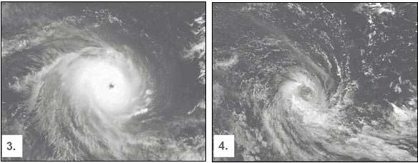
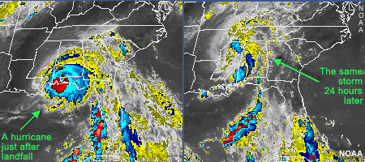
Final Stages of a TC Life Cycle
As a TC moves pole-ward into the extra-tropics they can either:
  reintensify by developing the necessary convection to sustain its tropical characteristics
  decay by encountering harsh environments in either the mid-latitudes or from making landfall
  TCs can switch to a cold-core system and intensify through low-level frontogenesis by interacting with a midlatitude trough during the process of Extratropical Transition, or “ET.”
Typically, more intense TCs will be able to survive the extratropical environment and reintensify or complete ET since many TCs will initiate ET but decay before finishing the transition to a strong midlatitude system (Laing and Evans 2010).
http://www.bom.gov.au/wa/cyclone/about/faq/faq_char_3.shtml

Slide 4
Research Framework
Understand the role of the land surface on the postlandfall structure of Tropical cyclones
The tool used in this research is the HWRF model
The storm of interest is Tropical Storm Fay from 2008
Should Hurricane modelers and forecasters be more concerned with the state of the land representation and influences with TC forecasts after landfall?

Slide 5
Research Goals in this Study
The overall objective of this study is to understand the impact of the land surface feedbacks on the inland characteristics of TS Fay using the HWRF modeling system.
The specific goals of the experiments are to:
Study the effects of different land surface parameterization schemes on the HWRF forecast
Study the effect of land surface features (and heterogeneity) including Lake Okeechobee and the Everglades, through idealized simulations.
Assess the relative impact of different ensemble experiments on the model forecast and delineate feedbacks that may have contributed to the post-landfall features of tropical storm Fay in HWRF simulations.

Slide 6
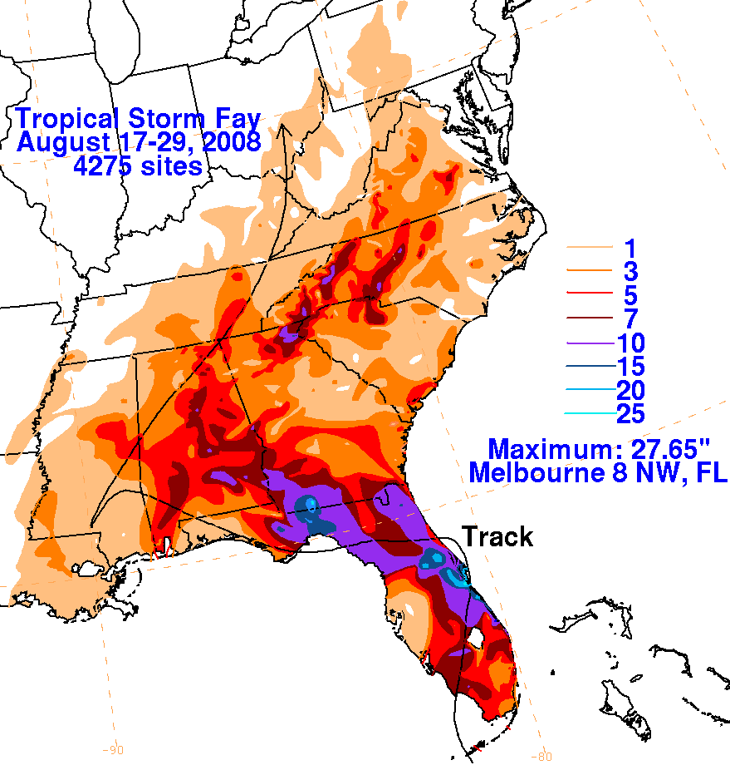
Why was Fay (2008) Chosen?
Tropical systems usually weaken and decay rapidly after making landfall.
The occurrence of TC strengthening post-landfall is therefore a rare occurrence
Only a few cases of overland storm reintensification have been observed for the Atlantic tropical storms in recent years including TCs Erin (2007), Danny (1997), Fran (1996) and David (1979).
Tropical Storm Fay is unique because it became organized through a first-time intensification over South Florida as opposed to a reintensification over land.
Fay did not develop a typical TC eye-like structure until after landfall over Florida near Lake Okeechobee (NHC TC Report). At 1800 UTC 19 Aug, Fay reached it’s maximum intensity of 60 kt and 986 mb.
Fun Facts about Fay’s landfall:
Heavy rainfall was the biggest hazard from Tropical Storm Fay.
Melbourne, Florida broke a 50-year old record for a rainfall event.
Fay’s track over FL resulted in a beneficial 4-ft rise in the water level of Lake Okeechobee –in less than one week.
graphic from NOAA/NCEP Hydrometeorological Prediction Center

Slide 7
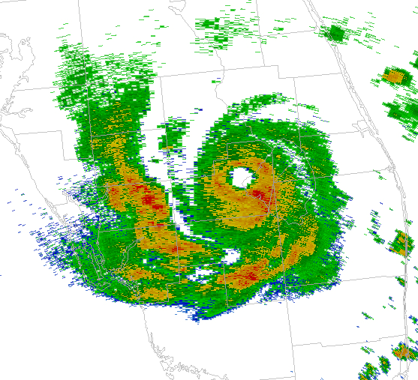
Fay Radar Observations
1811 UTC
19 August 2008
Fay was at its peak intensity of
60 kt and a minimum SLP of 986 mb while the eye was skirting the northwestern portion of Lake Okeechobee, Florida.
A well-defined eye feature developed at 0929 UTC 19 August 2008, shortly after moving inland over southwestern Florida, and persisted until 0212 UTC 20 August2008.
Fay remained over land during the entire period that the eye feature was apparent in radar imagery.
Image from Stuart and Beven 2009

Slide 8


Hurricane Forecast Improvement Project (HFIP)
HFIP major goals include reducing errors of hurricane track and intensity forecasts by 20% in the five years and by 50% in the next 10 years.
The HFIP project allows for collaboration of the NOAA’s operational centers, test-bed centers and academia.
This study can be a contribution to the land component of HWRF to the HFIP goals.
Achieving these goals will lead to greater confidence in hurricane forecasts and may be able to increase forecast lead times to affected forecast areas to reduce tropical cyclone damage and loss of life.

Slide 9
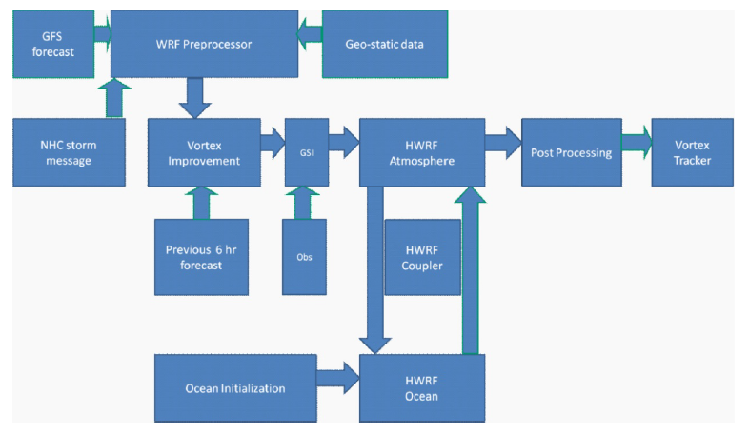
HWRF Model Components
  NHC Storm message aka “TC vitals” : use data from meteorological data from satellites, buoys, and data retrieved from hurricane hunter missions
The HWRF land model has transitioned from slab to Noah within the operational framework.
GSI: Gridpoint Statistical Interpolation

Slide 10
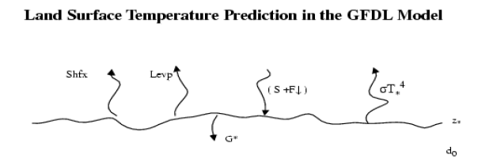
GFDL Slab model (Tuleya 1994)
1 soil layer
Predicts a bulk ground surface temperature by the energy balance and a tendency equation.
  all surface fluxes (enthalpy and momentum) are calculated by the surface layer scheme
  surface wetness remains constant with time and is initially specified by the input GFS lateral boundary conditions.
GFDL slab model with conjunction of the GFDL radiation scheme met the requirements for realistic TC activity over land at the time of development (Gopalakrishnan et al. 2010b).

Slide 11
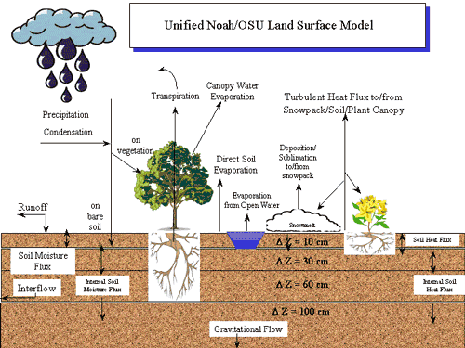
Noah LSM (Chen and Dudhia 2001; Ek et al. 2003)
4 soil layer depths
Predicts:
  Soil moisture
  Soil temperature
  Land surface skin temperature
  Land surface evaporation
  Sensible heat flux
  Total runoff
  Surface snow cover
Has a more complex vegetation representation based on the USGS landuse dataset (1992)

Slide 12
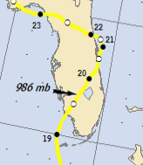
Adapted HWRF Configuration
Domains
Horizontal | 27km (80° x 80°) Stationary 9km (6° x 6°) Moving Nest (Gopalakrishnan et al. 2010b)
Vertical | 42 vertical levels with model top at 50 mb
Lateral Boundary Conditions | 6-hr GFS forecast on 1° grid
WPS Geography Resolution | 30 second resolution
Model Physics
Number of Soil Layers | 4
Microphysics | Etamp_hwrf scheme (Ferrier 2005)
Long-wave Radiation | Modified GFDL scheme (Schwarzkopf and Fels 1991)
Short-wave Radiation | Modified GFDL scheme (Lacis and Hansen 1974)
Surface-layer | GFDL surface-layer scheme (Moon et al. 2007)
Land-surface | GFDL Slab LSM (default) / Noah LSM (Tuleya 1994, Deardorff 1978) / (Ek et al. 2003)
Planetary Boundary Layer | NCEP GFS Scheme (Hong and Pan 1996)
Cumulus scheme | Simplified Arakawa-Schubert scheme (Hong and Pan 1998)
* Simulations of Fay were conducted from August 19, 2008 00Z until August 21 00Z, with particular focus on the period where the storm center was over the land surface (between August 19 09Z and 20th 06Z).
* Since HWRF was initialized only 9 hours before landfall, the Princeton Ocean Model (POM) or NCEP coupler components of the operational HWRF were not used.
-- the data needed to initialize the loop current in the POM were unavailable for this case.

Slide 13
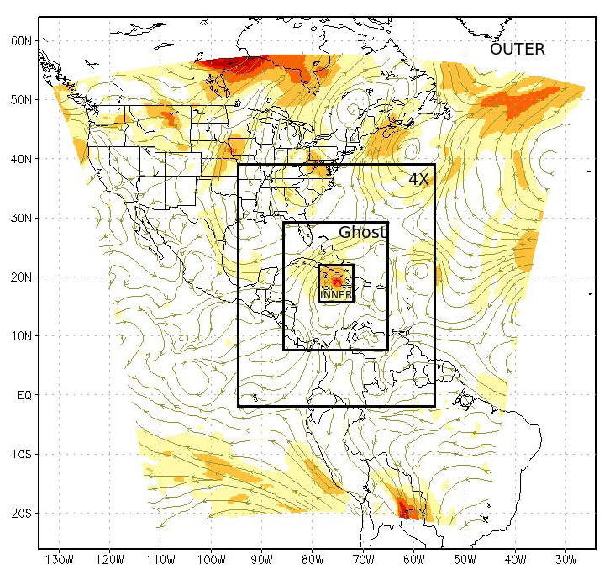
What does vortex relocation do?
Removes the initial vortex from either the GFS analysis fields (cold start) or previous 6 hr HWRF forecast (cycled run) and replaces this vortex with a high-resolution “model consistent” vortex.
Adjusts these aspects of the TC:
  Storm location
  Storm size
  Surface pressure (after size correction)
  Temperature
  Water vapor
  Storm intensity
  Surface pressure (after intensity correction)
  Storm structure

Slide 14
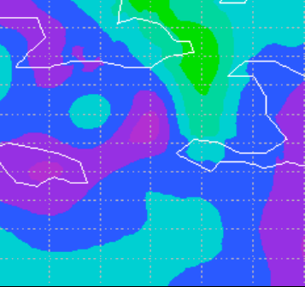

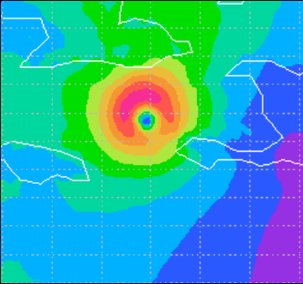
Vortex Initialization Examples
Gustav 2008 08 28 00 Nest domain 10-m winds
(observed. 10-m wind: 20 m/s)
Left: without vortex initialization (max wind 11 m/s)
Right: with vortex initialization (max wind 21 m/s)

Slide 15
Postlandfall Intensification of Fay
Fay intensified overland in the vicinity of Lake Okeechobee and the Everglades.
Did these features provide the storm with the moisture to sustain itself and intensify?
Broader Question: What is the role of land surface latent heat flux on the postlandfall structure?

Slide 16
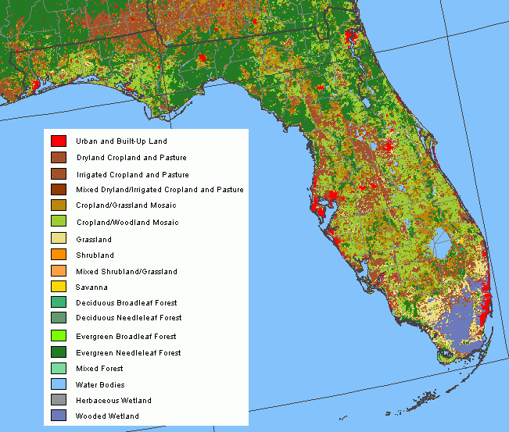
Experiments with a modified Land Surface
The goal of altering these surface variables is to attempt to dry out the land surface by using soil with reduced water storage capacity, and landuse or vegetation that is characterized by a higher roughness length and reduced moisture values.
  Allows for isolation of each feature to study it’s impacts on the TC.
  Being able to see how the TC may have severely weakened had the feature not been present.
FL USGS Landuse

Slide 17
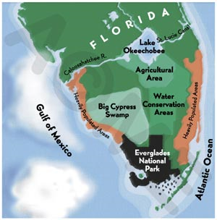
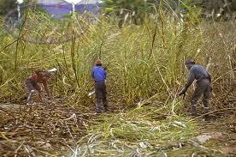
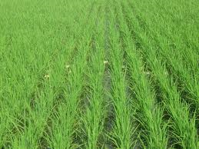
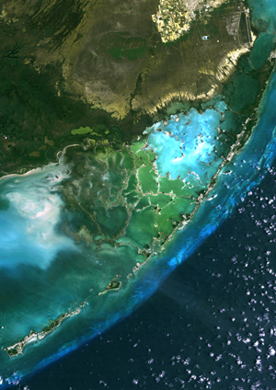
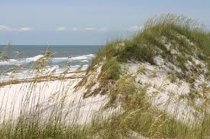
Land Surface Experiments on S. Florida Fay Landfall
Remove Lake Okeechobee (replaced with sandy agricultural area)
Remove Florida Everglades (replace with grasslands composed of sand over bedrock)
Currently areas around Lake Okeechobee are used for agriculture: dairy farms and beef cattle ranching (north side), and sugarcane crop (south side)
Investigate structure and development.
  How did the presence/loss of the lake/Everglades affect distribution and intensity of Fay SLP, surface winds, and rainfall?
  Assess evidence that land surface is important to forecasts.

Slide 18
HWRF Experiments
Run Name | LSM Used | Experimental Change | Changed Categories: LU; Soil Top; Soil Bottom
Slab (S) | GFDL Slab LSM
NOWET (SW) | GFDL Slab LSM | Lake and Everglades removed | Lake: 2; 1;1 Everglades: 7;1;15
NOLAKE (SL) | GFDL Slab LSM | Lake Okeechobee removed only | Lake: 2; 1;1
NOGLADES (SG) | GFDL Slab LSM | Everglades removed only | Everglades: 7;1;15
Noah (N) | Noah LSM
NOWET (NW) | Noah LSM | Lake and Everglades removed | Lake: 2; 1;1 Everglades: 7;1;15
NOLAKE (NL) | Noah LSM | Lake Okeechobee removed only | Lake: 2; 1;1
NOGLADES (NG) | Noah LSM | Everglades removed only | Everglades: 7;1;15
ALLOCEAN (NAO) | Noah LSM | “water world” | All land: 16;14;14
NOOCEAN (NNO) | Noah LSM | Ocean removed, Lake Okeechobee remains water | Ocean: 6; 1; 1 Lake: default Everglades : default
The hi-resolution 30s data was used in the WPS geogrid program when defining the static geography in the model domain.
Changes were done to the:
24-category USGS landuse
16-category soil type:
  soil top layer
  (∆Z = 10cm)
  soil bottom layer
  (∆Z = 30cm)

Slide 19
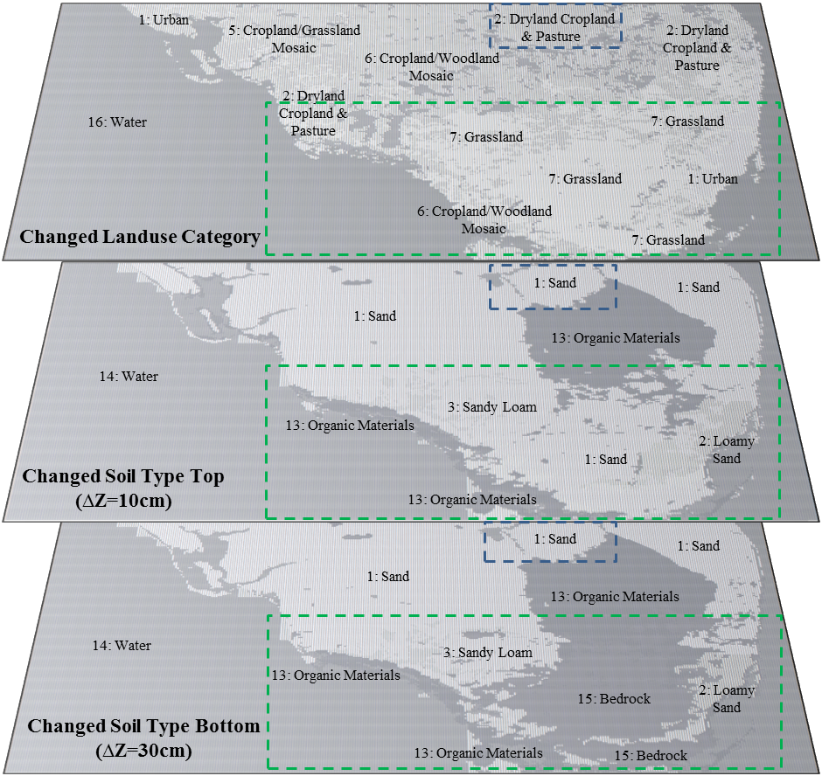
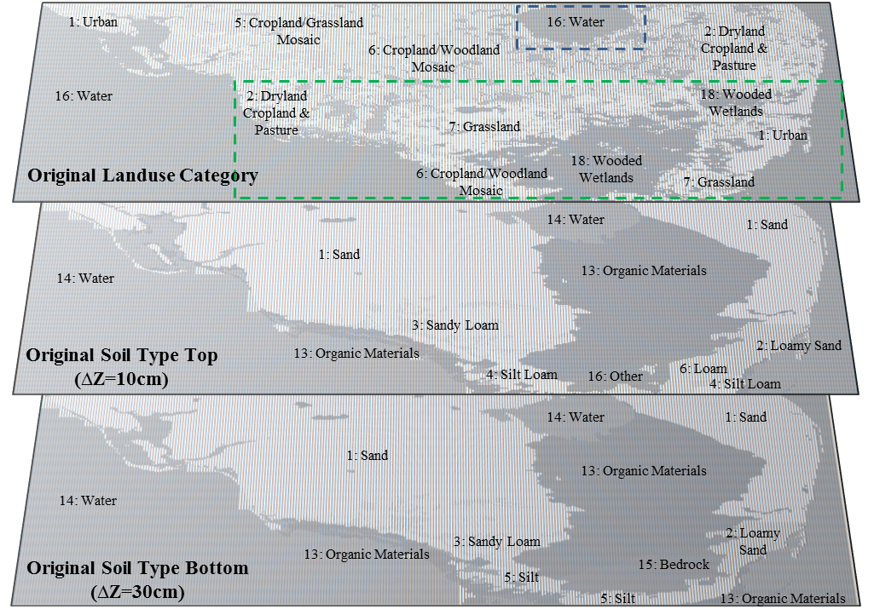
Original vs. Changed Land Surface
Boxes used in calculations for Lake Okeechobee (blue dashed) and the Everglades (green dashed)

Slide 20
USGS Landuse Characteristics
The model land/sea mask is determined from the landuse category as either water or land.
Cat # | Greenness Fraction | Min Albedo | Max Albedo | Min Zo | Max Zo | Landuse Description
1 | 0.1 | 0.15 | 0.15 | 0.5 | 0.5 | Urban and Built-up Land
2 | 0.8 | 0.17 | 0.23 | 0.05 | 0.15 | Dryland Cropland and Pasture
3 | 0.8 | 0.2 | 0.25 | 0.02 | 0.1 | Irrigated Cropland and Pasture
4 | 0.8 | 0.18 | 0.23 | 0.05 | 0.15 | Mixed Dryland/Irrigated Cropland and Pasture
5 | 0.8 | 0.18 | 0.23 | 0.05 | 0.14 | Cropland/Grassland Mosaic
6 | 0.8 | 0.16 | 0.2 | 0.2 | 0.2 | Cropland/Woodland Mosaic
7 | 0.8 | 0.19 | 0.23 | 0.1 | 0.12 | Grassland
8 | 0.7 | 0.25 | 0.3 | 0.01 | 0.05 | Shrubland
9 | 0.7 | 0.22 | 0.3 | 0.01 | 0.06 | Mixed Shrubland/Grassland
10 | 0.5 | 0.2 | 0.2 | 0.15 | 0.15 | Savanna
11 |  | 0.16 | 0.17 | 0.5 | 0.5 | Deciduous Broadleaf Forest
12 | 0.7 | 0.14 | 0.15 | 0.5 | 0.5 | Deciduous Needleleaf Forest
13 | 0.95 | 0.12 | 0.12 | 0.5 | 0.5 | Evergreen Broadleaf Forest
14 | 0.7 | 0.12 | 0.12 | 0.5 | 0.5 | Evergreen Needleleaf Forest
15 | 0.8 | 0.17 | 0.25 | 0.2 | 0.5 | Mixed Forest
16 | 0 | 0.08 | 0.08 | 0.0001 | 0.0001 | Water Bodies
17 | 0.6 | 0.14 | 0.14 | 0.2 | 0.2 | Herbaceous Wetland
18 | 0.6 | 0.14 | 0.14 | 0.4 | 0.4 | Wooded Wetland
19 | 0.01 | 0.38 | 0.38 | 0.01 | 0.01 | Barren or Sparsely Vegetated
20 | 0.6 | 0.15 | 0.2 | 0.1 | 0.1 | Herbaceous Tundra
21 | 0.6 | 0.15 | 0.2 | 0.3 | 0.3 | Wooded Tundra
22 | 0.6 | 0.15 | 0.2 | 0.15 | 0.15 | Mixed Tundra
23 | 0.3 | 0.25 | 0.25 | 0.05 | 0.1 | Bare Ground Tundra
24 | 0 | 0.55 | 0.7 | 0.001 | 0.001 | Snow or Ice

Slide 21
Results Outline
Slab vs. Noah: Which LSM gets the track right (to start as a baseline)?
  Track comparisons
  Storm intensity comparisons
Land Changes: How do the presence/lack of features affect the TC?
  Track comparisons
  Storm intensity comparisons
Noah Ensemble: How do changes in initial conditions and physics alter the forecast? Does this change perform better? What does it tell us about the sensitivities of HWRF?
  Track comparisons
  Storm intensity comparisons
Follow-up on Noah simulated intensity-Ocean Tests (All Ocean, No Ocean & Noah Default): How could Fay Intensify without FL? Decay with all land situation? Only pull moisture from land surface features? How do simulations between landfall and non-landfalling cases compare?
  Variables for Decay/Maintenance over time
  Water Budget

Slide 22
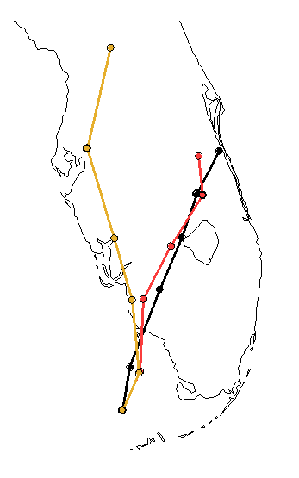
Slab vs Noah Tracks
Fcst Track Error (ie Great Circle Distance from best track point)
FTE =
Where:
latB, lonB = Best Track Latitude, Best Track Longitude
latF, lonF = Model Forecast Latitude, Model Forecast Longitude
GFDL Slab LSM used
NOAH LSM used
Fay Best Track

Slide 23
Slab vs Noah Intensity Analysis
TD: 0-34 kt
TS: 35-63 kt
C1: 64-82 kt
C2: 83-95 kt
C3: 96-113 kt

Slide 24

Slab vs Noah Tracks (Land Changes)
Fcst Track Error (ie Great Circle Distance from best track point)
FTE =
Where:
latB, lonB = Best Track Latitude, Best Track Longitude
latF, lonF = Model Forecast Latitude, Model Forecast Longitude
 |  | GFDL SLAB LSM used |  |  |  | Noah LSM used
time | fcst hr | SLAB | NOWET | NOLAKE | NOGLADES | NOAH | NOWET | NOLAKE | NOGLADES
08/19/00Z | 0 | 0 | 0 | 0 | 0 | 0 | 0 | 0 | 0
08/19/06Z | 6 | 14. | 15 | 14 | 15 | 15 | 15 | 15 | 15
08/19/12Z | 12 | 19 | 18 | 19 | 19 | 14 | 14 | 14 | 14
08/19/18Z | 18 | 28 | 29 | 28 | 28 | 11 | 13 | 12 | 12
08/20/00Z | 24 | 147 | 140 | 143 | 141 | 6 | 10 | 11 | 5
08/20/06Z | 30 | 191 | 187 | 187 | 192 | 30 | 22 | 25 | 25
08/20/12Z | 36 | 188 | 185 | 185 | 186 | 27 | 27 | 34 | 28
08/20/18Z | 42 | 270 | 278 | 286 | 278 | 54 | 51 | 47 | 57
08/21/00Z | 48 | 324 | 313 | 307 | 310 | 74 | 73 | 75 | 74
 | sum FTE | 1184 | 1170 | 1173 | 1173 | 234 | 229 | 236 | 234
GFDL Slab LSM used
NOAH LSM used
Fay Best Track

Slide 25
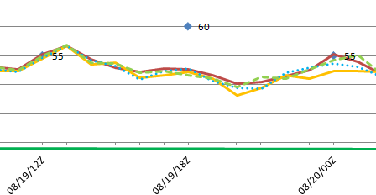
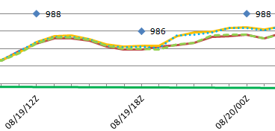
TD: 0-34 kt
TS: 35-63 kt
C1: 64-82 kt
C2: 83-95 kt
C3: 96-113 kt

Slide 26
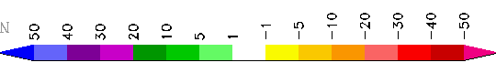
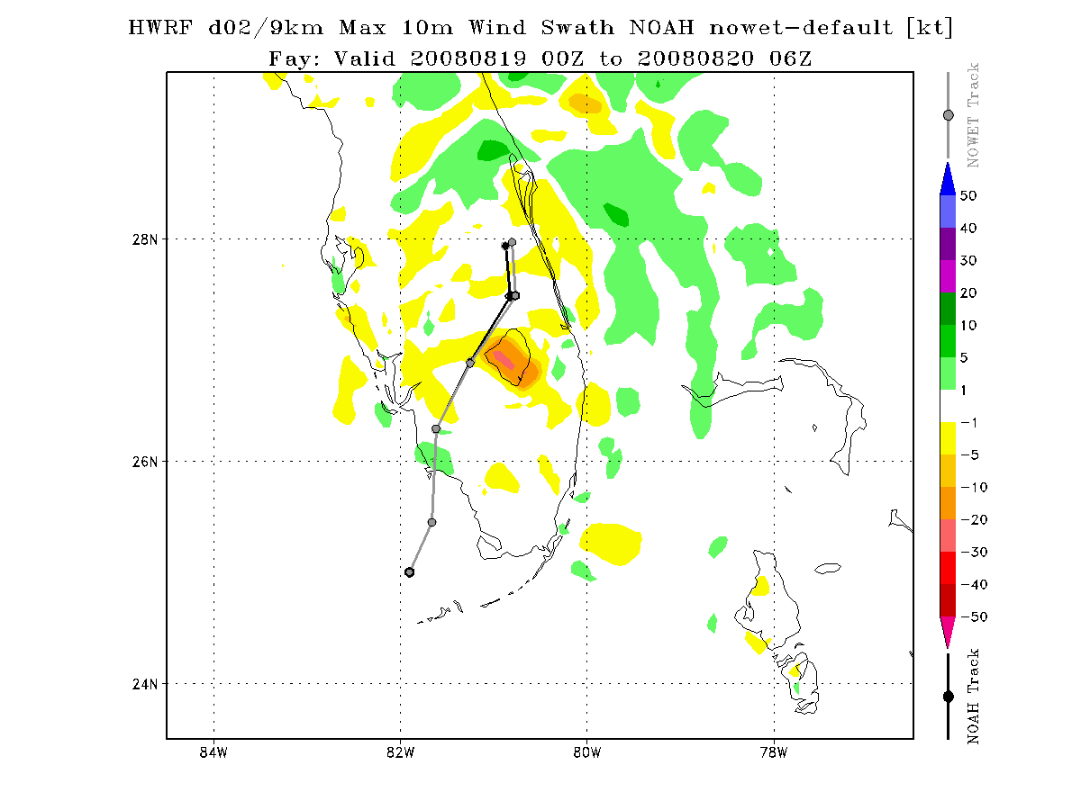
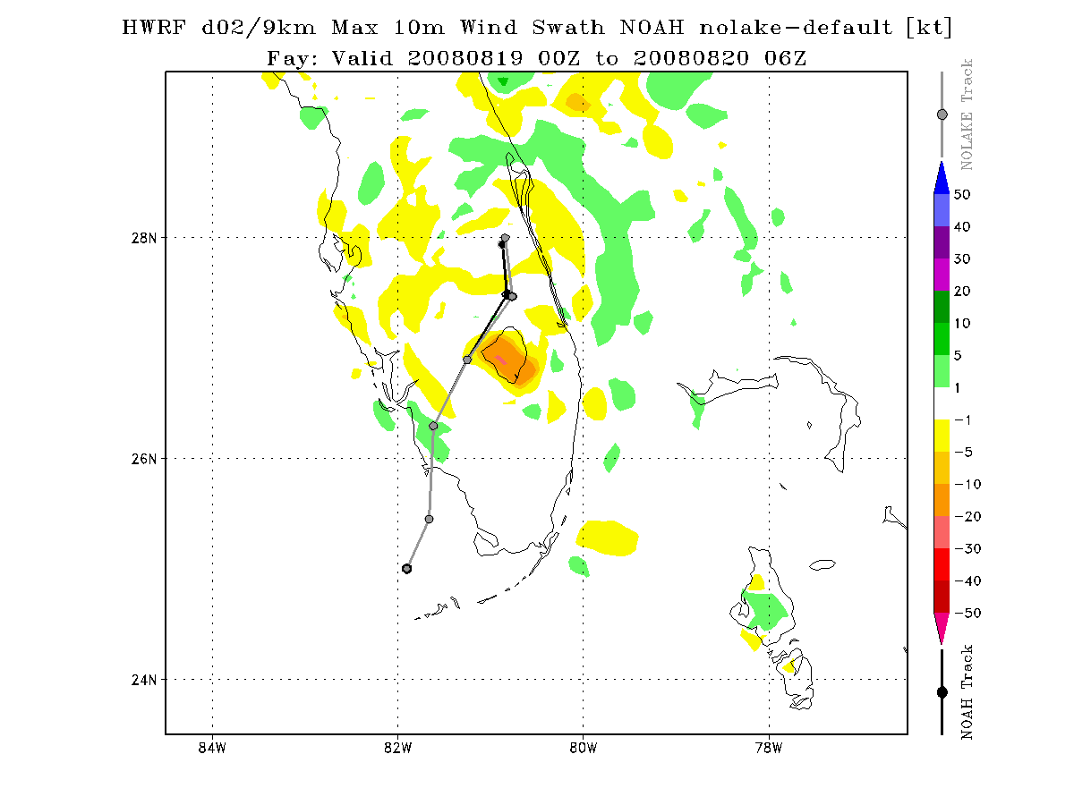
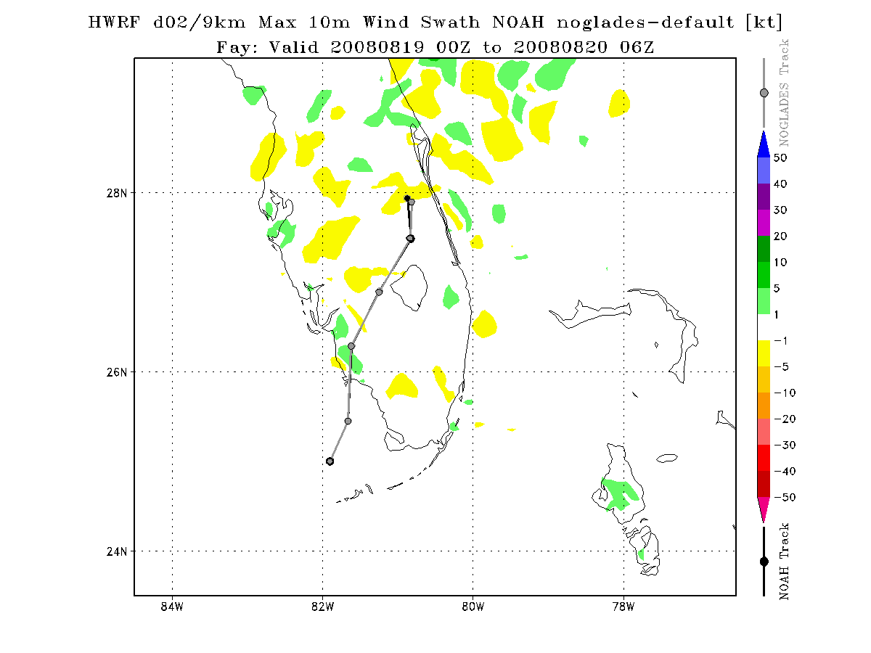
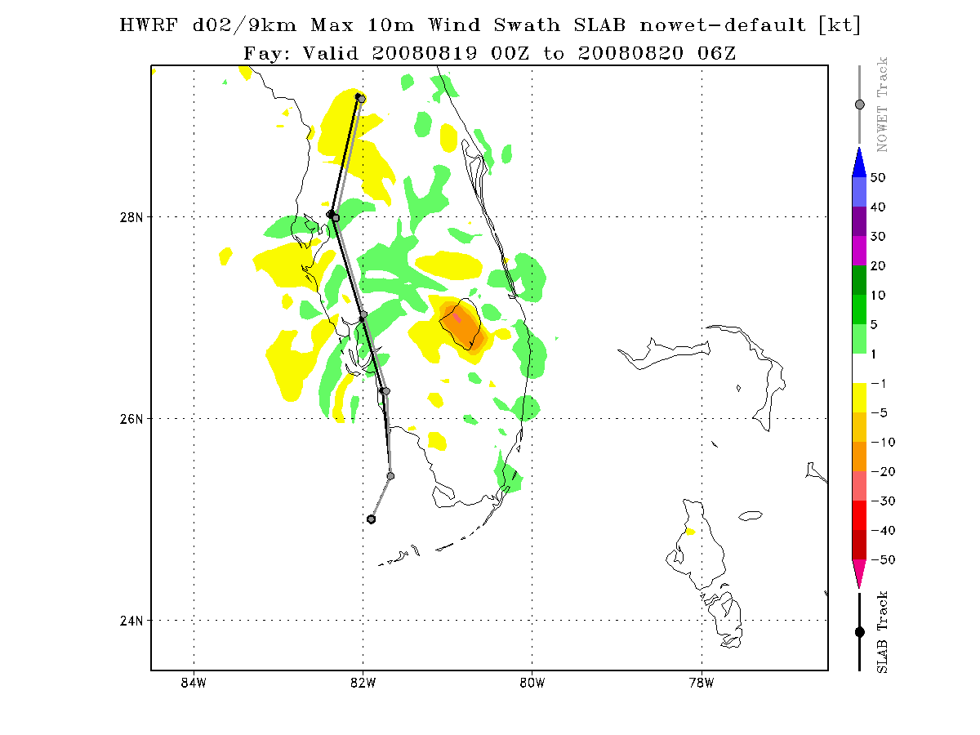
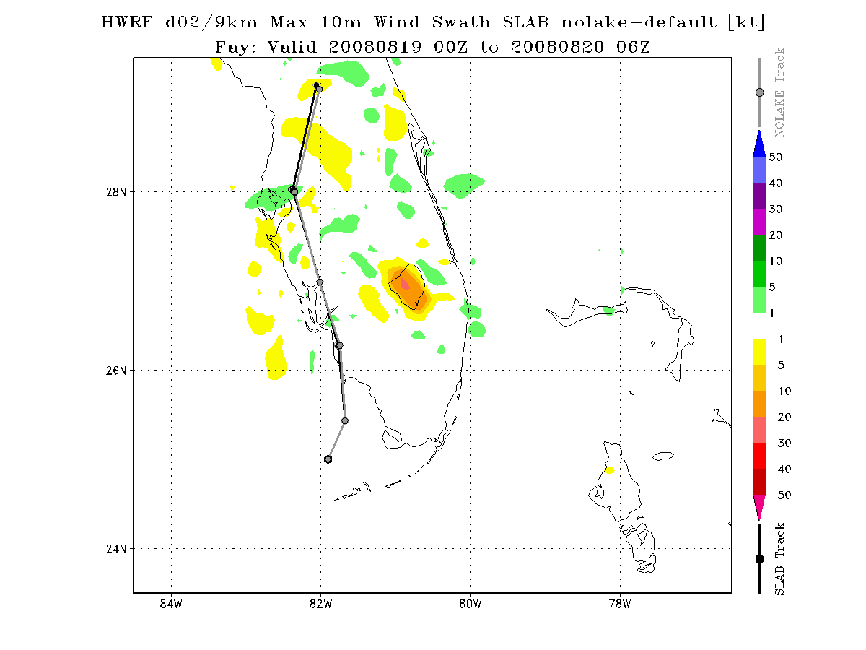
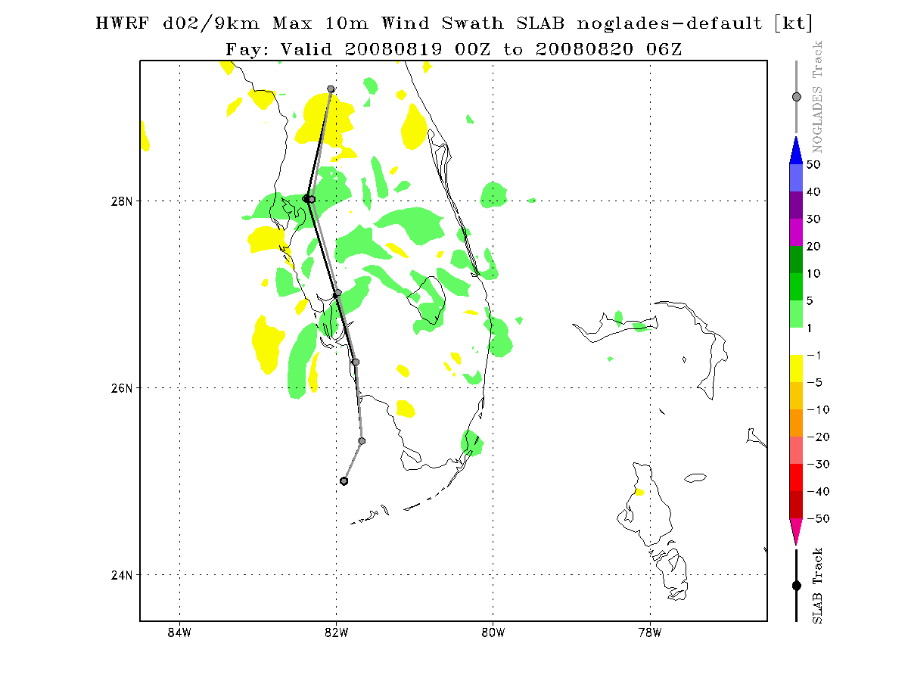
Land Changes 10m Wind Difference
NOAH
NOWET-Noah
NOLAKE-Noah
NOGLADES-Noah
SLAB
NOWET-Slab
NOLAKE-Slab
NOGLADES-Slab

Slide 27
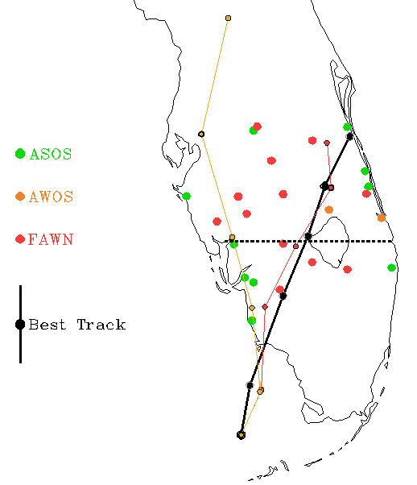
Model Horizontal Cross Sections
Horizontal cross sections taken at:
  Latitude: 26.95
  Longitude: -82.1 to -80.1
Time of cross section is forecast hour 18, corresponding to the time of Fay’s peak intensity.
Highlighted track points indicate model storm center location at t = 18 UTC
Selected ASOS (19 UTC) and FAWN (18 UTC) observations from KPGD, KFMY, KRSW, Palmdale, Clewiston, Sebring, Arcadia stations for comparison
Sousounis and Fritsch (1994):
Lakes may enhance precipitation in strong synoptic systems, but will not alter storm tracks.
The influence of the Great Lakes may have caused a 3-4 mb decrease in sea level pressure of strong extratropical cyclones passing over the lake region.
Hypothesize that weaker storms may be more affected by lake forcing than the stronger storms.
Sousounis P. J. and Fritsch J. M. (1994) Lake-aggregate mesoscale disturbances. Part II: A case study of the effects on the regional and synoptic-scale weather systems. BAMS
Sebring
Arcadia
Palmdale
KPGD
KFMY
Clewiston
KRSW
GFDL Slab LSM used
NOAH LSM used
Fay Best Track
Notes:
The cross section lines in the Slab runs are shifted slightly due to the variation in forecast track between land change runs that were more pronounced in Slab simulations.

Slide 28

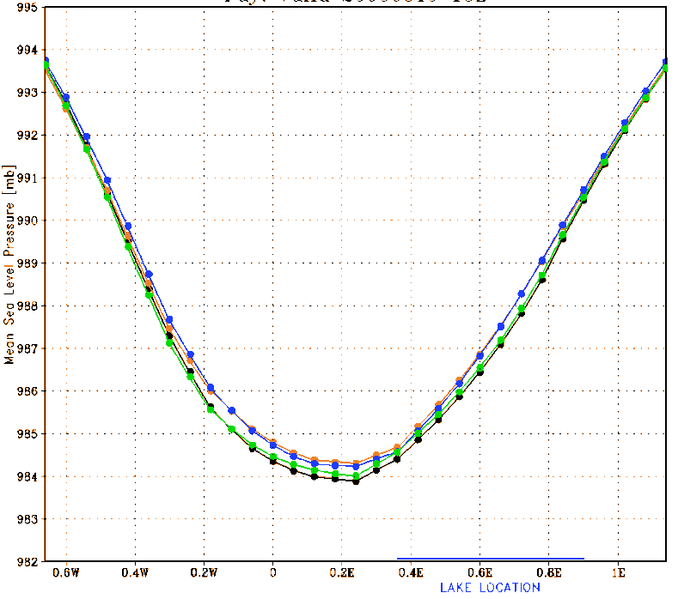
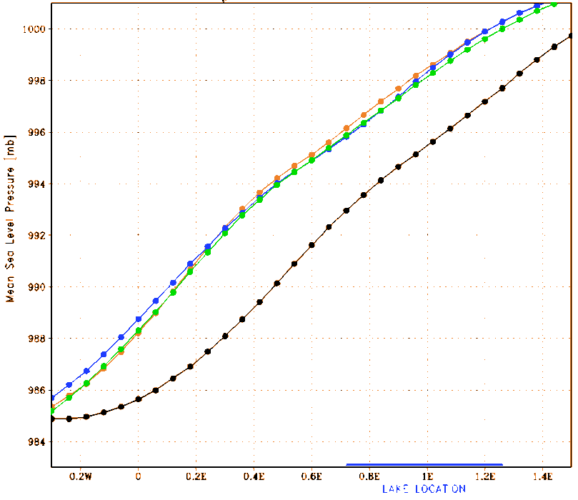
Mean SLP (mb)
Noah
GFDL Slab
Station | SLP (mb)/10m winds (kt) | 2m Temp (C) | -10cm Soil Temp (C)
KPGD | 1006.8/20.0 | 23.9 | NA
KFMY | 1006.4/15.6 | 25.0 | NA
KRSW | 1005.8/24.4 | 24.4 | NA
Palmdale | NA/9.3 | 24.7 | 25.5
Clewiston | NA/37.3 | 24.3 | 25.2
Sebring | NA/20.1 | 23.7 | 23.8
Arcadia | NA/23.6 | 23.9 | 25.6
Notes:
Pink circled pressure is the observed minimum SLP from the best track @ 18 UTC Aug 19th.

Slide 29
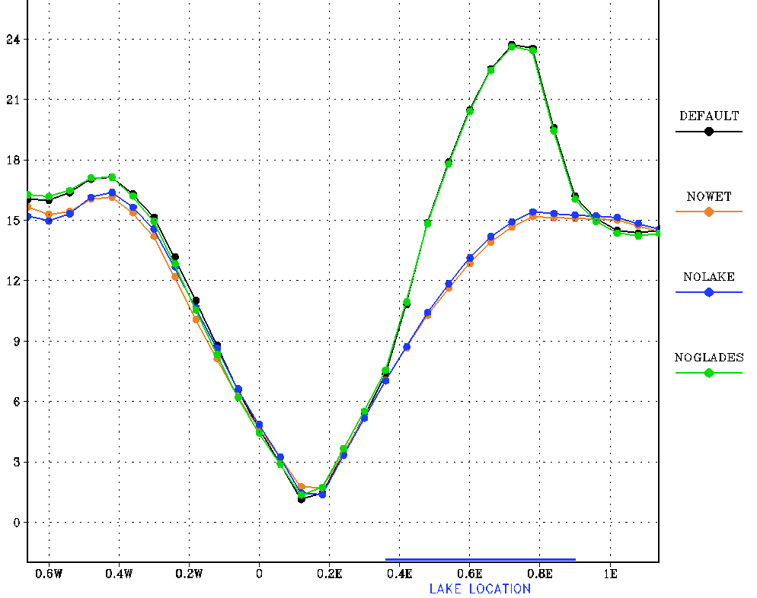
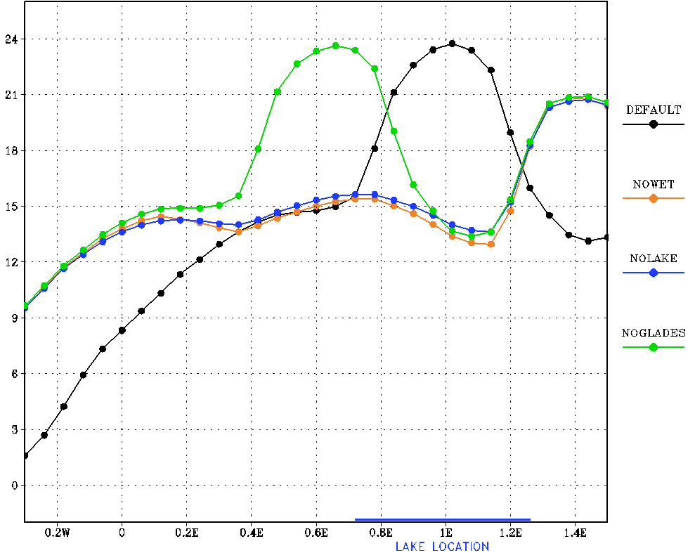
10m winds (kt)
Noah
GFDL Slab
Station | SLP (mb) /10m winds (kt) | 2m Temp (C) | -10cm Soil Temp (C)
KPGD | 1006.8/20.0 | 23.9 | NA
KFMY | 1006.4/15.6 | 25.0 | NA
KRSW | 1005.8/24.4 | 24.4 | NA
Palmdale | NA/9.3 | 24.7 | 25.5
Clewiston | NA/37.3 | 24.3 | 25.2
Sebring | NA/20.1 | 23.7 | 23.8
Arcadia | NA/23.6 | 23.9 | 25.6

Slide 30
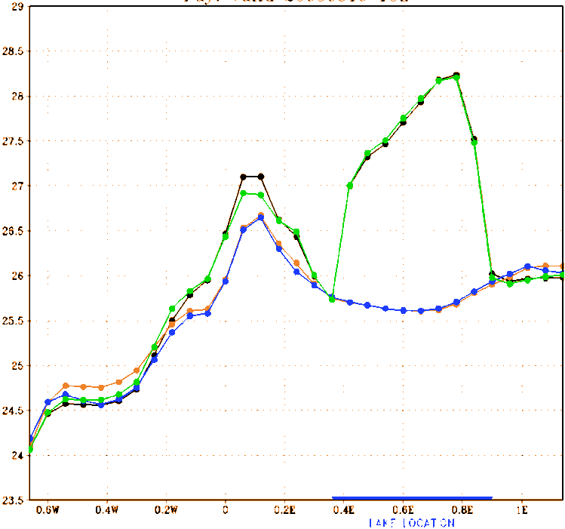
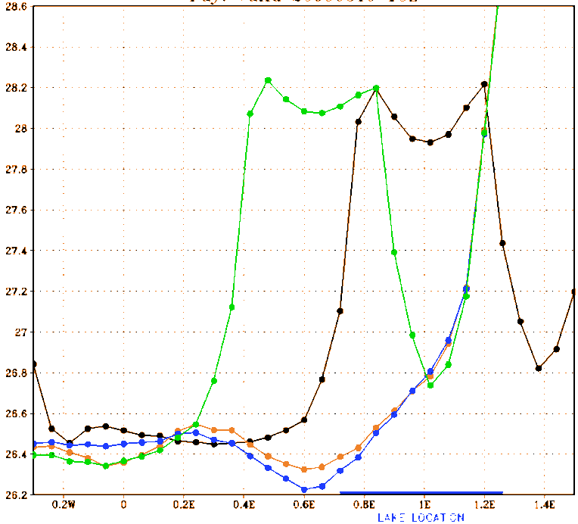
2m Temp (deg C)
Noah
GFDL Slab
Station | SLP (mb) /10m winds (kt) | 2m Temp (C) | -10cm Soil Temp (C)
KPGD | 1006.8/20.0 | 23.9 | NA
KFMY | 1006.4/15.6 | 25.0 | NA
KRSW | 1005.8/24.4 | 24.4 | NA
Palmdale | NA/9.3 | 24.7 | 25.5
Clewiston | NA/37.3 | 24.3 | 25.2
Sebring | NA/20.1 | 23.7 | 23.8
Arcadia | NA/23.6 | 23.9 | 25.6

Slide 31
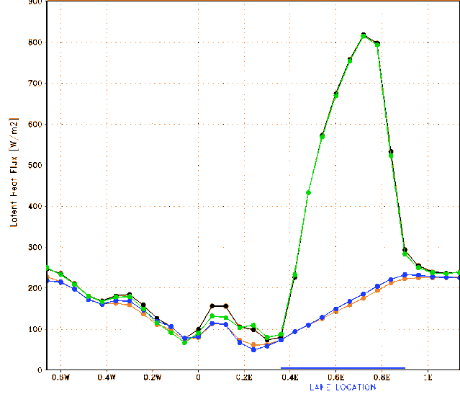
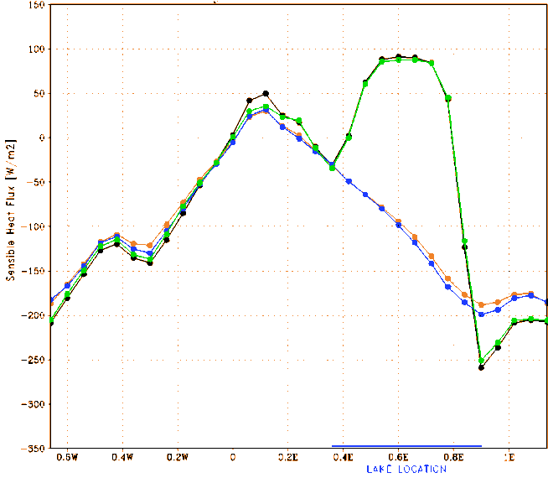
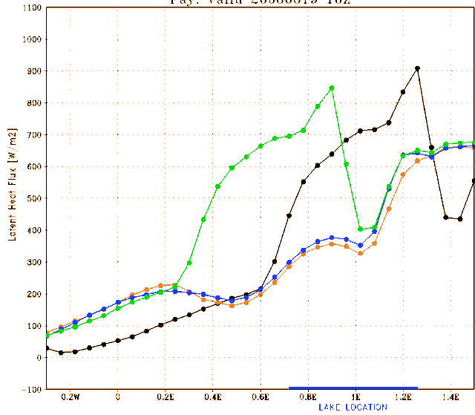
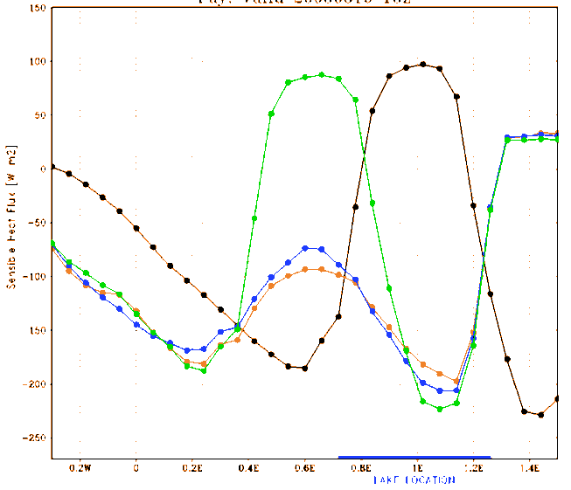
Fluxes Latent (top), Sensible (bottom)
Noah Latent
Noah Sensible
GFDL Slab Latent
GFDL Slab Sensible

Slide 32
Cross Section Conclusions
There is a noticeable difference when Lake is NOT present on surface variables and SLP.
Therefore, the lake has a more dominant effect on the TC than the Everglades

Slide 33
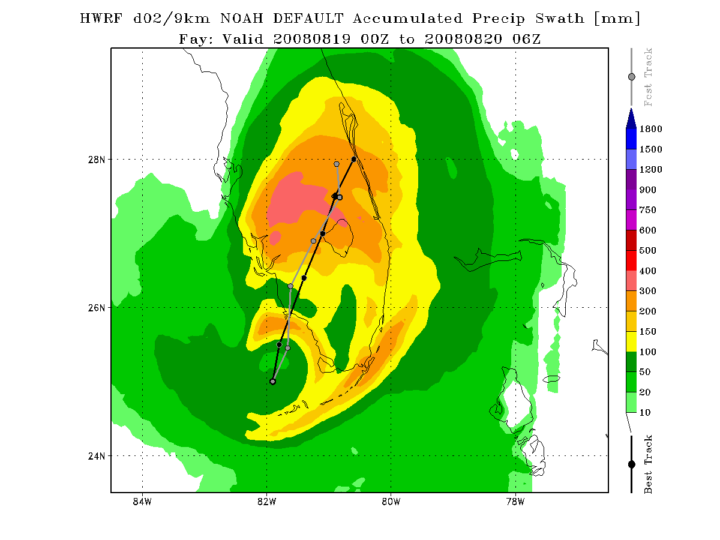
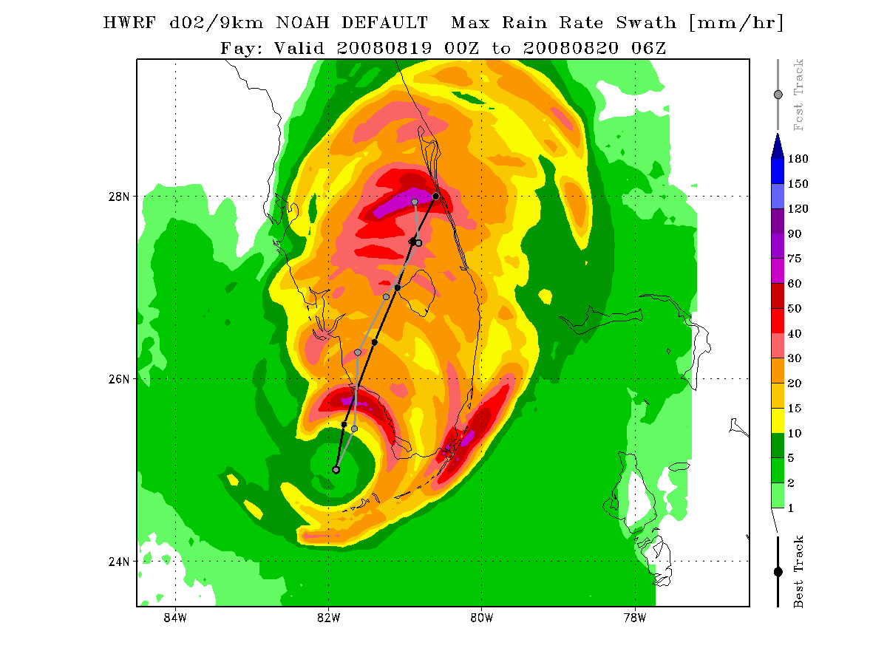
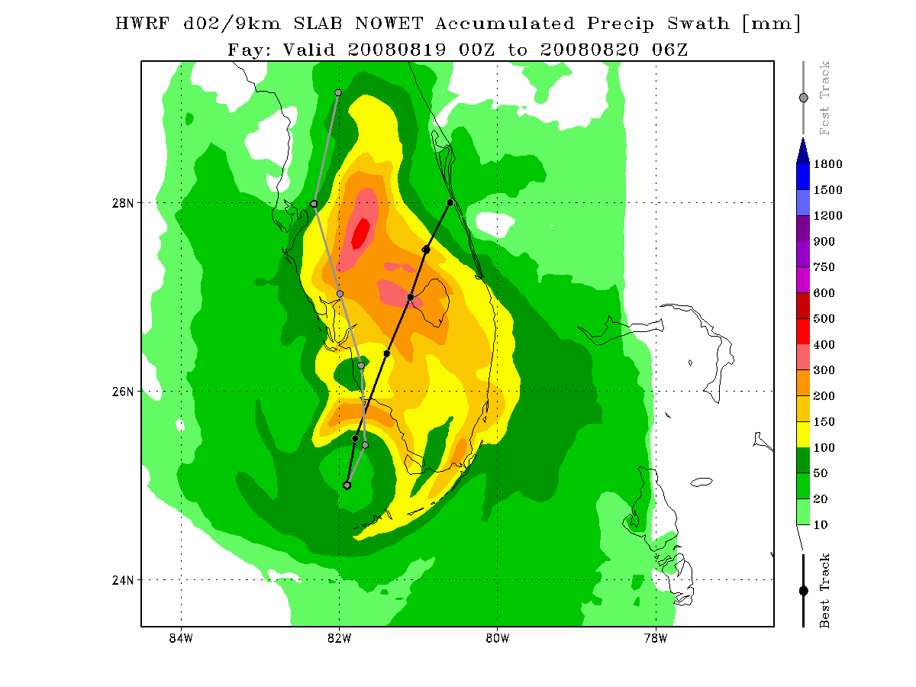
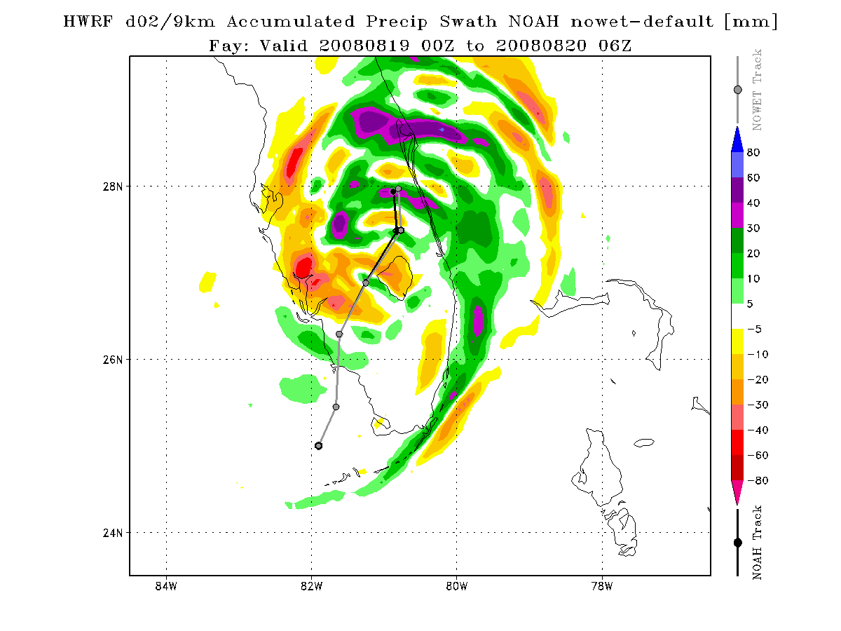
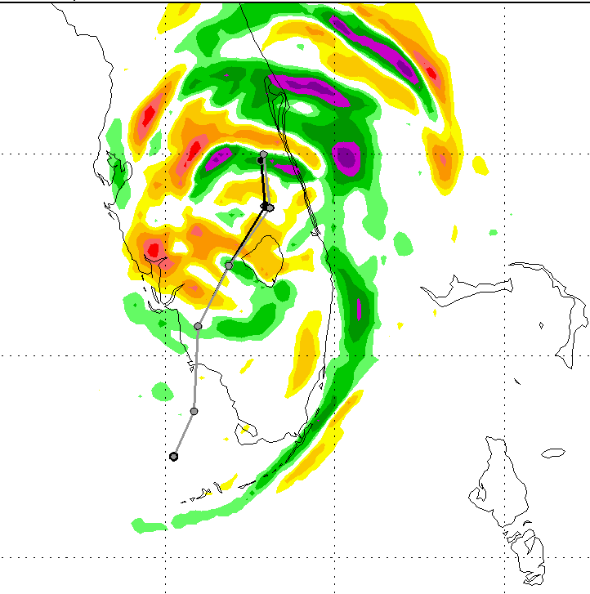
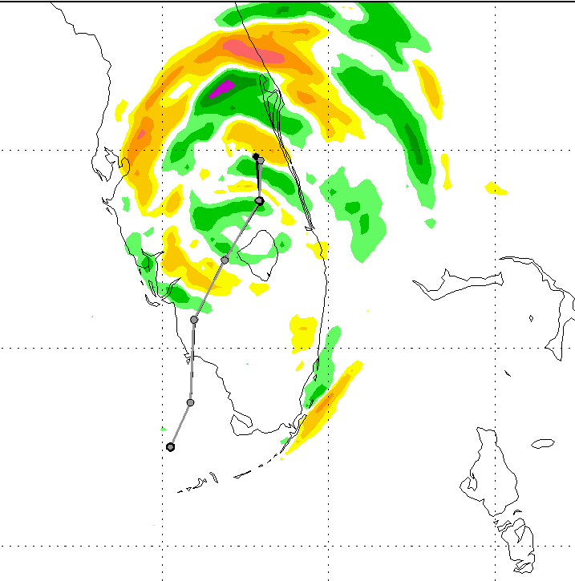
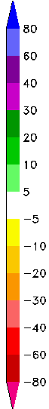
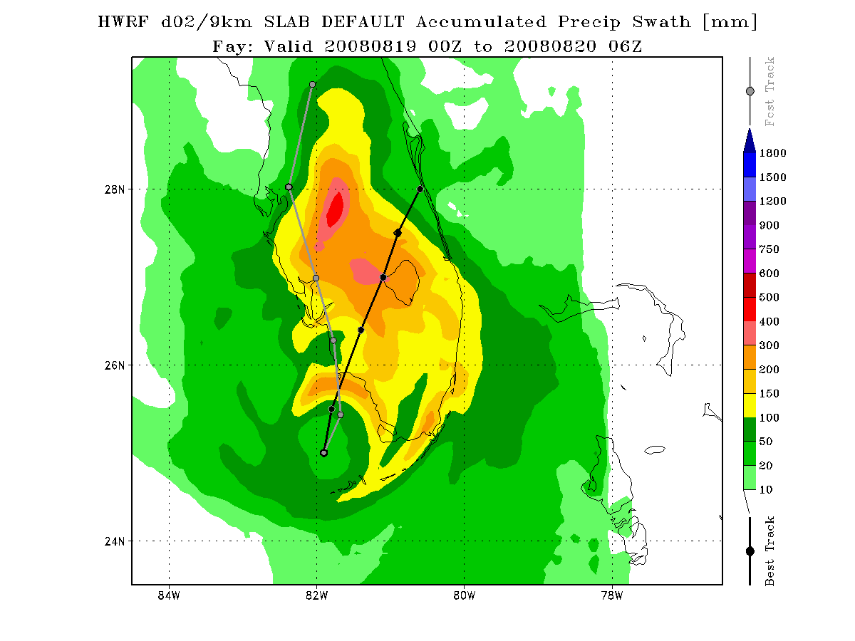
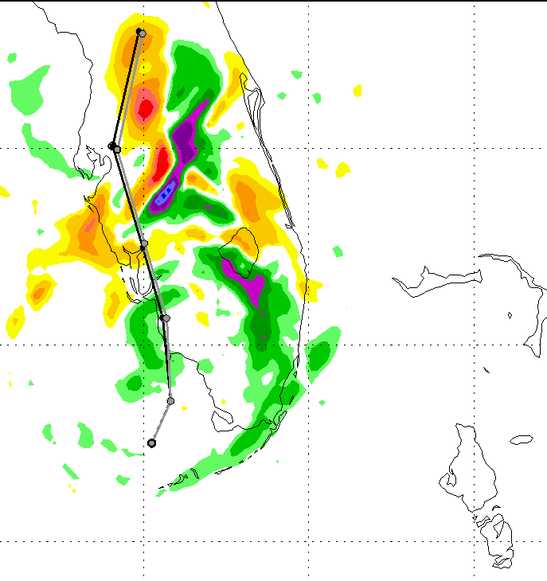



Land Changes Rainfall Difference
Rain Rate (mm/hr)
Accumulated Rain (mm)
NOAH
NOAH
NOWET-Noah
NOLAKE-Noah
NOGLADES-Noah
SLAB
SLAB
NOWET-Slab
NOLAKE-Slab
NOGLADES-Slab
Notes:
Blue circles: shows difference in spatial coverage by different LSMs. Swirling structure is more easily identified in Noah simulations than Slab.

Slide 34



No Ocean Comparison
FTE | Peak Wind
647 km | 51.7 kt @ 12Z
Noah No Ocean (NNO) difference in 10 meter wind magnitude from the Noah default (N)
Left: Noah No Ocean (NNO) forecast track and accumulated rainfall (mm). Right: No Ocean rainfall accumulation and track difference from the Noah default (N)
Notes:
To further isolate the possible influence of Lake Okeechobee and the Florida Everglades on Fay, the ensemble runs were compared to a simulation with both the Gulf of Mexico and the Atlantic Ocean moisture sources removed (NOOCEAN). In this simulation, the removal of these ocean basins are reflected by changing the 24 category USGS landuse category, 16 category soil type top and bottom from water to cropland and woodland mosaic, sand, and sand respectfully, while the original values of the lake and everglades remained unchanged. The goal of this model run is to eliminate the TC spiral rainbands to obtain moisture from the ocean basins as the storm center is influenced by land. Instead, this forces Fay to take in moisture from the only available sources - Lake Okeechobee and the Florida Everglades. We hope that including this simulation will isolate and further help to reveal the influence specifically from these features.

Slide 35


Ensemble Member Track Errors
Fcst Track Error (ie Great Circle Distance from best track point)
FTE =
Where:
latB, lonB = Best Track Latitude, Best Track Longitude
latF, lonF = Model Forecast Latitude, Model Forecast Longitude
N6B
N,NWNL,NG
BT
NM
NY
N6A
GFDL Slab LSM used
NOAH LSM used
Fay Best Track

Slide 36
TD: 0-34 kt
TS: 35-63 kt
C1: 64-82 kt
C2: 83-95 kt
C3: 96-113 kt

Slide 37









Noah Ensemble
Swath Rain Rate (mm/hr)
Valid through 2008-08-20 6 Z
Stage IV
Observations
NOAH
NOWET
NOLAKE
NOGLADES
6BEFORE
6AFTER
YSU PBL
MYJ PBL

Slide 38







Noah Ensemble
Swath Acc Precip (mm)
Valid through 2008-08-20 6 Z
NOAH
NOWET
NOLAKE
NOGLADES
6BEFORE
6AFTER
YSU PBL
MYJ PBL

Slide 39
Ocean Tests Intensity Analysis
Ocean test simulations attempt to present:
  The role of oceanic sustenance of the TC if Florida were not present (ALLOCEAN)
  The decay of the TC from traversing over a non-moist region for an extended period of time (NOOCEAN)
  Storm structure due to the transition from water to land (compare Noah default with the non-landfalling simulations)
    The predicted storm tracks of the ocean test simulations:
      ALLOCEAN tracks similarly to the Best track and Noah default
      NOOCEAN tracks more to the west (after hour 12 looks similar to the Slab track)

Slide 40


Ocean Tests Intensity Analysis
TD: 0-34 kt
TS: 35-63 kt
C1: 64-82 kt
C2: 83-95 kt
C3: 96-113 kt
Notes:
The 10 m Vmax is displayed since it takes into account the local exposure to the surface roughness from the land surface model. However, the maximum sustained winds in the storm (ie “storm Vmax”), (not shown for ALLOCEAN and NOOCEAN, while the Noah default Vmax is seen in Figure 4a) are more comparable to the NHC Vmax since they do not address the local roughness and are better representative of open terrain exposure. As such, the values of the 10 m Vmax is are lower and probably more in agreement with local station observations which were not studied in this paper.

Slide 41



Initial perception is that the latent heat is the driver of the system
Results indicate that Model “thinking” shows that the sensible heat is a more important driver of the storm.
Notes:
Tangential frictional stress over time (Figure 6e) suggests that for a water case, as in ALLOCEAN, the stronger the wind, the stronger the frictional stress becomes over time. However for a land case the evolution of the frictional stress is more complicated. As seen in NOOCEAN, there is an initial increase in stress yet as the wind spins down due to interactions with the land surface, the net stress decreases more rapidly in model simulations over land. Further evidence of both of these trends can be seen in the Noah default curve for frictional stress, where just after landfall there is a brief peak in stress similar to the NOOCEAN case. Then once the Noah default storm nears Lake Okeechobee, another peak in stress develops (similar to the ALLOCEAN case) since the wind field may have become stronger from traversing over a water body with less surface roughness (Shen et al. 2002).

Slide 42
Fay Water Budget……Why?
So far, results have showed:
  Changes to variables revealing TC intensity
  Changes to what the land surface is experiencing from the experimental changes
So the land surface does matter.
So WHY do a water budget?:
  Switch focus from local land scale to storm scale.
  Would like to see HOW the moisture is being used inside the tropical cyclone!

Slide 43
Mass Continuity in a Cylinder (Stull 2000)
Normal Mass Continuity Equation (MCE):
Assuming incompressible flow:
Incompressible MCE in a cylinder:
Divergence: more mass leaving cylinder than entering
Convergence: more mass entering cylinder than leaving
R
V_{in}
V_{in}
w

Slide 44
Moisture Budget for an Air Parcel
Analyzed for Convective Initiation in the Mid-latitudes
Banacos & Schultz (2004): The Use of Moisture Flux Convergence in Forecasting Convective Initiation: Historical and Operational Perspectives (WAF)
Moisture Flux Convergence (MFC) can be derived from the conservation of water vapor in pressure coordinates
S = storage of water vapor (E(into parcel)-C(into parcel)) or (E-P) assuming all condensed H₂O is rained out
A
B
C
D
where:
advection
term
convergence
term
A = local rate of change of q
B = horizontal moisture flux divergence (-MFC_{H})
C = vertical moisture flux divergence (-MFC_{V})
D = moisture sources and sinks of parcel
horizontal advection of specific humidity
product of specific humidity & horizontal mass convergence
Notes:
Mass continuity eqn allows for the expansion of the dq/dt eqn. By vector identity, horizontal MFC can be re-written into component form.

Slide 45



Tropical Cyclone Water Budget
Gamache et al (1993): Dual-Aircraft Investigation of the Inner Core of Hurricane Norbert. Part III: Water Budget. (JAS)
C = condensation
E = evaporation
T_{H}= (outward +, inward -) horizontal transport/divergence
T_{zcT,} T_{zcB} = outward (vertical) advection of cloud water through the top (T) and bottom (B) boundaries
R_{T ,} R_{B} = outward (vertical) advection of precipitation through the top (T, rain in) and bottom (B, rain out) boundaries
D_{H} = (outward +, inward -) horizontal diffusion
D_{T,} D_{B} = outward (vertical) diffusion of cloud water through the top (T, +up) and bottom (B, +down) boundaries
S = storage term (+ [rate of change of suspended liq water/ice], - [10 % of mean rain rate])
** All terms are integrated by the budget volume of the cylinder boundaries:
Top & bottom: z_{t} and z_{b}
Outer boundary of the budget volume: r_{max} (ie the radius of maximum winds in the system)
Radial distance from the storm center: r
Heading of a given location relative to the storm center: (ie “azimuth”)
Notes:
In integral formula for D_{H}, there is a negative sign so that the directions work out. C and R_{T} are the only sources of moisture for a TC in the described equation.

Slide 46
Comparing TC with Parcel q Budgets
Recalling that for a parcel
Recalling that C and R_{T} were the only moisture sources to a TC
Change S = E-C instead of = E-P (since already accounting for rain with R terms of TC budget)
Solving the TC budget for dq/dt (ie S term):
Conclude that:
C & R_{T} are sources and in-storm E is a sink for TC , whereas E is a source and C is a sink in a parcel
Necessary for D_{H} to be negative to obtain correct direction according to schematic from Gamache et al. study

Slide 47









Radial Q convergence (kg/kg/s) & Vertical Q divergence (kg/kg*m/s) @ F18
Fay Water Budget: Radius-Height Cross Sections
(Viewing Plane)
Azimuth
0° Longitude
Radial Q advection (kg/kg/s) & Vertical Q flux (g/m²*s) @ F18

Slide 48






Horizontal Gradients of Vertical Q flux
2000 m (top) 70 m (bottom)
x = radius, y =azimuth

Slide 49
Water Budget Conclusions
Radial terms are used to identify regions of moisture and convection – not a driver for the storm system
Vertical flux into the system (contours) allow for maintenance of the TC
  Consistent with earlier findings that the latent and sensible heat flux have more to do with storm development
  Agrees with findings from Banacos and Shultz (2004) that horizontal gradients of the vertical fluxes may be more important than the advective terms in some cases.

Slide 50
Conclusions and Rankings
Influences on forecasts should be ranked:
  Land surface parameterization scheme is of most importance to track forecast.
    Noah LSM seems to be performing better than GFDL Slab
  Initial boundary conditions
  PBL scheme (on intensity forecast-winds and SLP)
    Even better simulation of rainfall directly along the track even after landfall
  Land surface features and heterogeneity
    Presence of Lake Okeechobee shows a drop in pressure, but not by much.
    Presence of the Everglades does not seem very important with the Fay case, but mostly because the track was closer to the lake than the Everglades
In the model framework, combined effects of land surface physics and initial conditions created a boundary layer feedback beneficial for the chance of Fay’s intensification. The importance of this is emphasized by the severe TC weakening resulting from the use of the two different boundary layer (YSU and MYJ) parameterizations.
Florida’s geography may also have allowed for the ocean to continually influence the energy transport in the core of the system despite the central pressure tracking over land.
  Perhaps the sensible heat flux was dominant in enabling TS Fay to strengthen over land by slowing the evaporation and smearing gradients
  Helpful/sustaining moisture source from vertical latent heat (and vertical moisture convergence) over radial moisture advection –supported by literature.

Slide 51
Future Work
Evaluate if post-landfall TC features are better represented with high resolution land surface datasets by initializing the HWRF domains with NASA LIS, HRLDAS, AMSR soil moisture MODIS albedo and flux, and TRMM data.
  Figure out how to initialize and update the land surface in both the static, and vortex following domain in the operational HWRF for each forecast hour with these datasets.
Complete an in-depth moisture and heat budget for all terms in a TC and qualify/quantify the relative contributions to the TC system just before and after landfall.
  If tracks had been comparable, it would have been interesting to see a Slab water budget.

Slide 52
Questions?

Slide 53

Structural Differences between Tropical Cyclones and Extratropical Cyclones
Laing and Evans 2010; Evans and Hart 2003; Monteverdi and Edwards 2010
Tropical Cyclone (warm-core)
Extra-Tropical Cyclone (cold-core)
Fuel Source after development: maintained through taking in heat energy from high ocean temperatures and expelling heat in the cold temperatures of the upper troposphere.
Structure:
  Cloud/Precip/Wind Structure: characterized by a compact symmetrical wind and precipitation structure
  Vertical Wind structure: stronger winds near the surface that decrease with height
Fuel Source after development: obtain their energy from the horizontal temperature contrasts in the atmosphere otherwise known as “baroclinic effects”
Structure:
  Cloud/Precip/Wind Structure: characterized by an expansive asymmetrical wind and precipitation structure
  Vertical wind structure: weaker winds near the surface that increase with height
These satellite images show some of the structural differences between tropical cyclones (left) and extratropical cyclones (right). (Source: NASA and EUMETSAT)
http://www.air-worldwide.com/PublicationsItem.aspx?id=19216

Slide 54
Structural Differences between Tropical Cyclones and Extratropical Cyclones
Due to the characteristic vertical wind profile of a tropical cyclone and a midlatitude system, the thermal wind balance equation can determine the temperature of the tropospheric anomaly .
Tropical systems = “warm-cored”
Mid-latitude or Extra-tropical systems = “cold-cored”

Slide 55
HWRF Model Development
To fulfill the need for the US’s next-generation hurricane model forecasting problems, the Hurricane Weather Research and Forecasting system (HWRF) was developed by the EMC with collaboration from the GFDL and the University of Rhode Island (Bao et al. 2010 ; Gopalakrishnan et al. 2010a)
2002 2007 2007 2010
HWRF becomes operational at both NHC and EMC with a single moving nest
AOML develops “HWRFx” , an experimental version with dual moving nests
DTC releases a public version of the operational code to researchers & academia
HWRF development begins

Slide 56

Soil Type Characteristics
Cat # | Dry Threshold* | Porosity | Field Capacity | Wilting Point | Soil Type Description
1 | 0.010 | 0.339 | 0.236 | 0.010 | SAND
2 | 0.028 | 0.421 | 0.383 | 0.028 | LOAMY SAND
3 | 0.047 | 0.434 | 0.383 | 0.047 | SANDY LOAM
4 | 0.084 | 0.476 | 0.360 | 0.084 | SILT LOAM
5 | 0.084 | 0.476 | 0.383 | 0.084 | SILT
6 | 0.066 | 0.439 | 0.329 | 0.066 | LOAM
7 | 0.067 | 0.404 | 0.314 | 0.067 | SANDY CLAY LOAM
8 | 0.120 | 0.464 | 0.387 | 0.120 | SILTY CLAY LOAM
9 | 0.103 | 0.465 | 0.382 | 0.103 | CLAY LOAM
10 | 0.100 | 0.406 | 0.338 | 0.100 | SANDY CLAY
11 | 0.126 | 0.468 | 0.404 | 0.126 | SILTY CLAY
12 | 0.138 | 0.468 | 0.412 | 0.138 | CLAY
13 | 0.066 | 0.439 | 0.329 | 0.066 | ORGANIC MATERIAL
14 | 0.000 | 1.000 | 0.000 | 0.000 | WATER
15 | 0.006 | 0.200 | 0.170 | 0.006 | BEDROCK
16 | 0.028 | 0.421 | 0.283 | 0.028 | OTHER (land-ice)
Porosity: the amount of pore, or open space between soil particles. Fine textured soil has more pore space than coarse textured soil.
Field Capacity: the level of soil moisture left in the soil after drainage of the gravitational water. Water held between field capacity and the wilting point is available for plant use.
Wilting Point: the soil moisture content where most plants cannot exert enough force to remove water from small pores in the soil. Ie, plants will begin to “wilt” at this point of soil moisture.
*: threshold where direct evaporation from top soil layer ends.

Slide 57





All Ocean
Radial Q advection (kg/kg/s) & vertical Q flux (g/m²*s)
F6
F9
F12
F15
F18
F24

Slide 58






Noah Default
Radial Q advection (kg/kg/s) & vertical Q flux (g/m²*s)
F6
F9
F12
F15
F18
F24

Slide 59






No Ocean
Radial Q advection (kg/kg/s) & vertical Q flux (g/m²*s)
F6
F9
F12
F15
F18
F24

Slide 60





All Ocean
Radial Q convergence (kg/kg/s) & vertical Q divergence (kg/kg*m/s)
F6
F9
F12
F15
F18
F24

Slide 61





Noah Default
Radial Q convergence (kg/kg/s) & vertical Q divergence (kg/kg*m/s)
F6
F9
F12
F15
F18
F24

Slide 62





No Ocean
Radial Q convergence (kg/kg/s) & Vertical Q divergence (kg/kg*m/s)
F6
F9
F12
F15
F18
F24

Slide 63
No Ocean horizontal gradients of vertical Q flux @ F19
2000 m
Lake moisture flux?
70 m

