Slide 1
Reprocessing of the NOAA Tail Doppler Radar Data
By : Edumin Corrales
From William H. Turner Technical Arts High School
Collaborators: Sylvie Lorsolo, John Gamache, Paul Reasor (HRD)
Notes:
Affiliation - collaborators

Slide 2
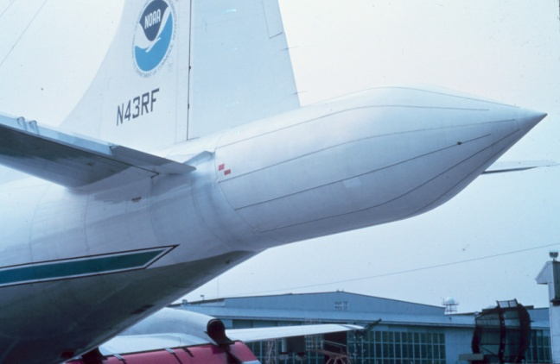
Purpose of the Reprocessing
To provide better quality data analyses (Correction of the NOAA antenna bias to improve vertical wind retrieval, changes for the data quality control to be less stringent)
To provide 3D analyses with finer resolution than real-time data
To have more consistent and more accurate storm center information
➔ Better estimates of storm motion
To establish a leg information and associated storm status database.
NOAA 43 Tail Doppler Radar

Slide 3
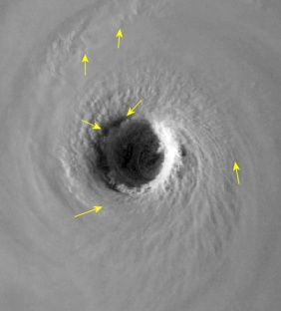
Terminology
Leg : A full leg refers to the complete penetration of a storm. The penetration/leg is divided into two parts: inbound and outbound. The inbound leg refers to when the NOAA aircraft penetrates the eyewall inwards to the storm center, and the outbound leg refers to when the aircraft penetrates the eyewall in the outwards direction
Inbound
Outbound
Eye/Eye Wall of Katrina 050829
Azimuth: Angle of reference from the center point on the meteorological coordinate plane.
0°
Track: Direction/Angle in which the aircraft is traveling.
270°
90°
Outbound Azimuth: Same as track angle
Inbound Azimuth: 180° + track angle
180°

Slide 4
Outline of Tasks
Create spreadsheet/database to facilitate data retention.
Collect flight leg data (time and location) from HRD website
Run center_from_radar script to pinpoint accurate leg times/length.
Once leg data are accurate, edit emacs radar_legs.dat file, which has calculated azimuth from script.
Run storm_motion_calculation.exe to find storm motion values.
Rename the file according to flight name and center fix of leg penetration.
Create job files using jobfilemaker_vrrms g script.
Run ja_anglecheck_vrrms, which creates files with reflectivity, wind and TKE data.

Slide 5
Creating a Spreadsheet Database
With the use of spreadsheet programs like Microsoft Excel, collecting and compiling leg data to facilitate future use.
An example of a spreadsheet created for Hurricane Katrina (2005).

Slide 6
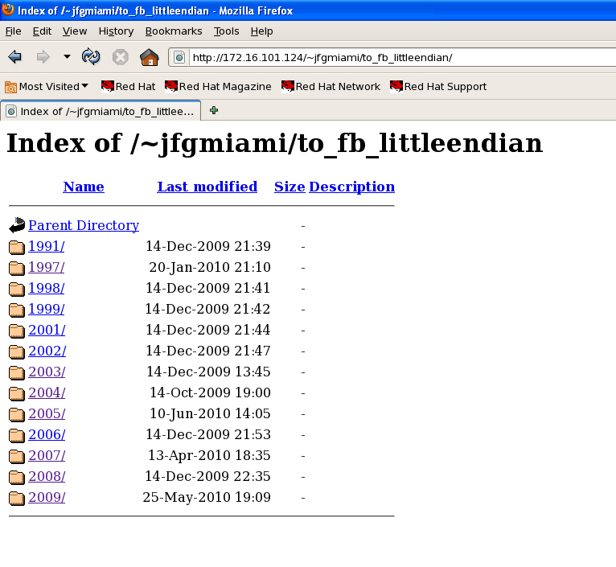
Downloading Tape Files
Tape files are found in an online directory, which are organized storm, aircraft, and observation date. These files store most of the information necessary to reprocess the radar data.

Slide 7
Finding the Legs Using Information from the HRD website
Leg data for storm systems are found online on the NOAA HRD website. With the use of mission catalogs, flight pattern maps, radar animations, and the track/center fix motion database, all the information necessary to pinpoint leg times and storm track locations are found.
http://www.aoml.noaa.gov/hrd/data_sub/hurr.html

Slide 8
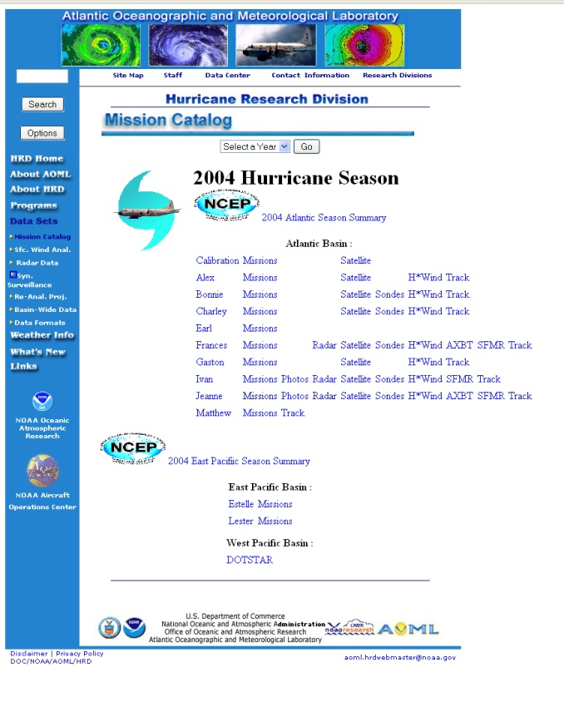
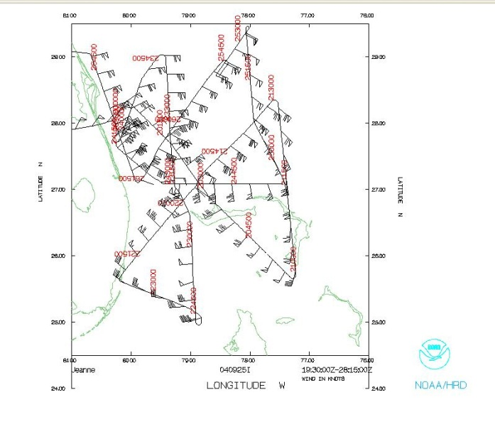
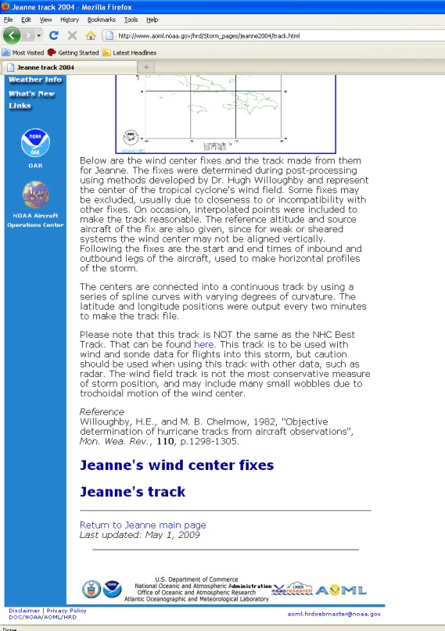
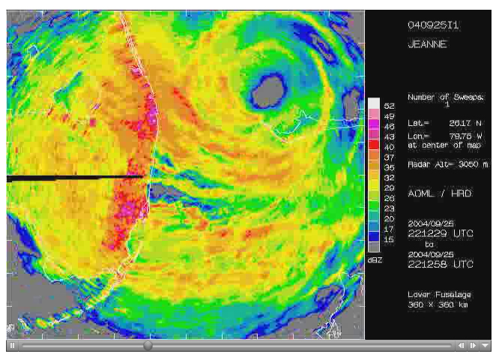
NOAA Mission Catalogs Website
Flight Pattern Diagram
Radar Imagery
Track and Center Fixes

Slide 9
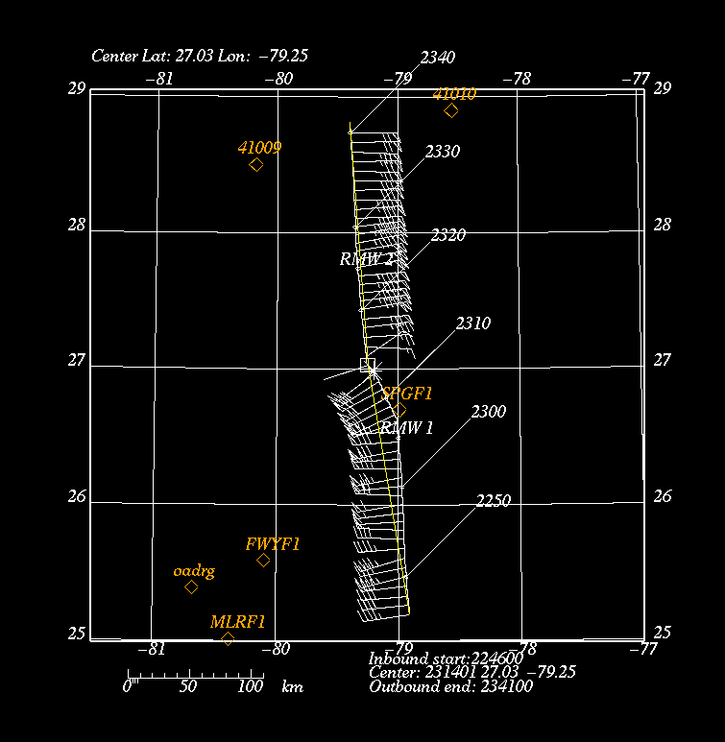
Verifying Legs Using center_from_radar Script
Leg
In order to find accurate start and end time values for legs and the correct center time fix for the storm, use the center_from_radar script in order test how the legs will look like. The script also creates inbound and outbound azimuth values which will be used later in reprocessing.
End of Leg
Start of Leg
Leg Info

Slide 10
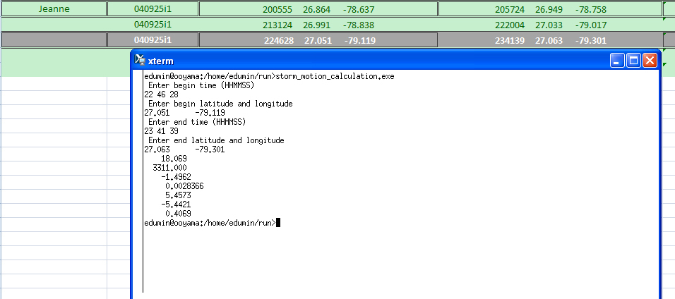
Obtaining Azimuth and Storm Motion
Obtaining the azimuth and storm motion rate is very important. Running center_from_radar determines the inbound and outbound track/azimuth values, and running the storm_motion_calculation.exe script finds the U and V values for the storm motion.
The storm motion values indicate at what rate (in m/s) the storm is moving in U and V components.
V
U
Notes:
Explain the values

Slide 11
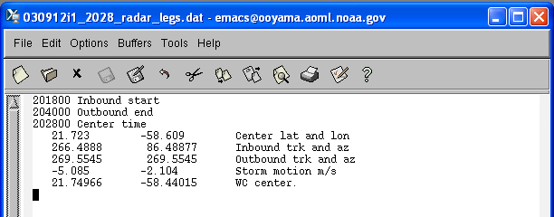
Compiling Information Into Files Using Emacs script
After obtaining the azimuth and storm motion values, a data file is created in order to store leg information. These files include inbound and outbound leg times, center latitude and longitude values, inbound and outbound azimuth/track values, and the storm motion rate. The data file is named according to the flight date and center fix time of the leg.
The file is named according to the flight ID format (YYMMDD) + Aircraft (H or I), center fix time, and type of data file.
Notes:
Remake figure to reflect the name of the file – emphasize this step

Slide 12
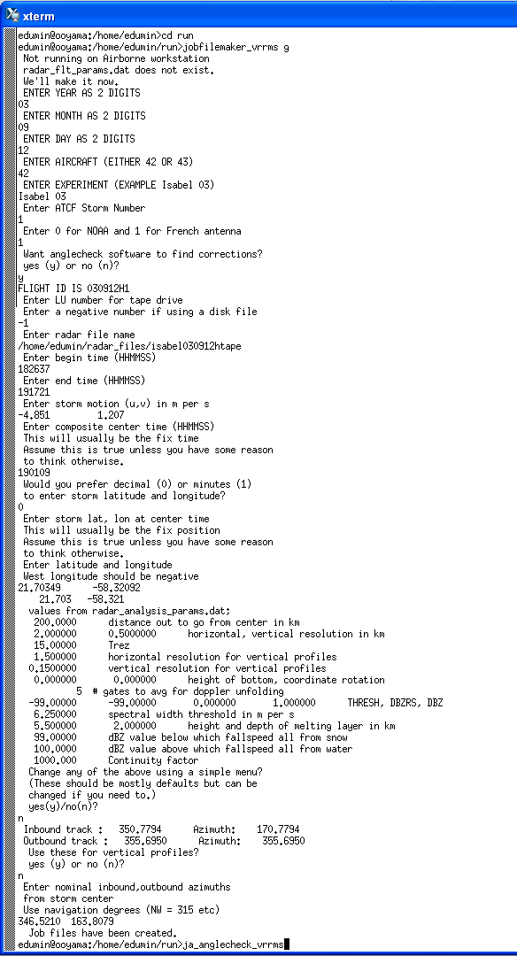
Running “jobfilemaker_vrrms g” Script
Flight information
Antenna Information
After the data file has been saved, there is sufficient information create job files. These job files include all the data values which have been found previously such as azimuth, storm motion, and location/time values.
Leg values
Azimuth

Slide 13
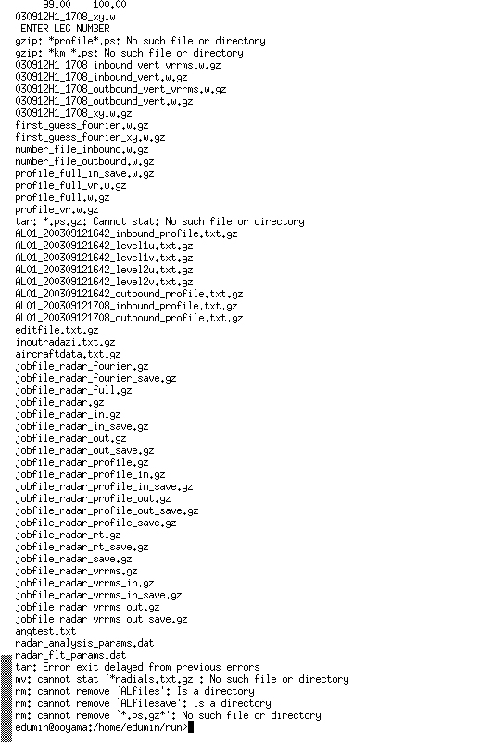
Final Step in Reprocessing
After job files have been created using the “jobfilemaker_vrrms g” script, another script command called “ja_anglecheck_vrrms” is used. Running this script takes about an hour at a time and creates w files.

Slide 14
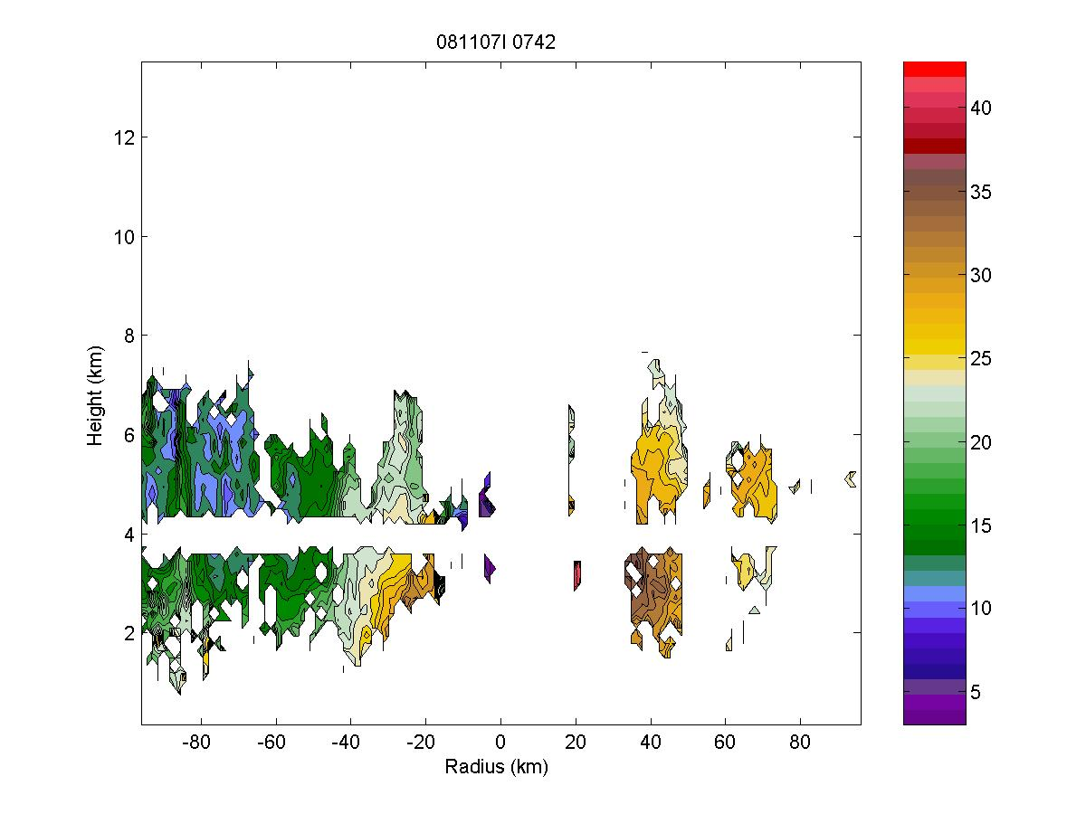
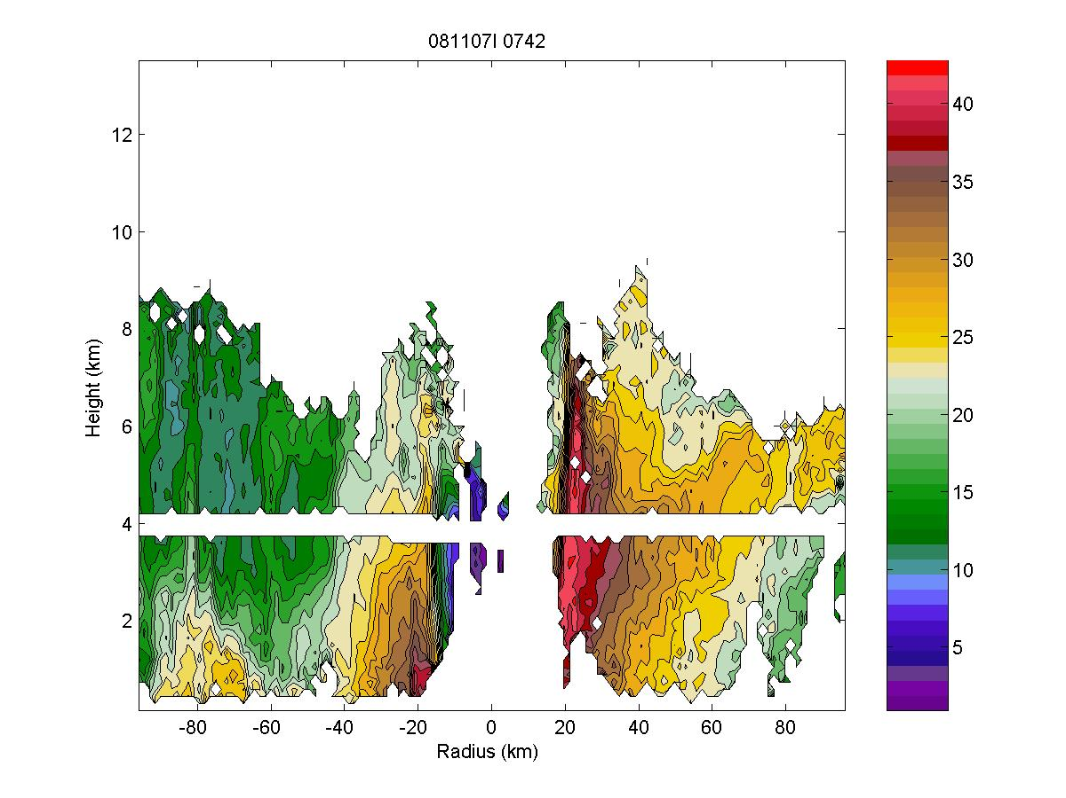
Resulting Data
Wind data obtained with former processing algorithm
Wind data obtained with new processing algorithm
WS (m/s)
WS (m/s)
The data to the left shows the wind field obtained from the old processing algorithm. Note how there is more data present in the reprocessed file, showing the new data obtained from the new algorithm. Reprocessing with the new algorithm seems to provide better quality analyses.

Slide 15
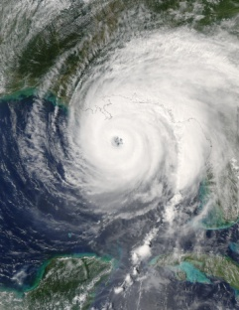
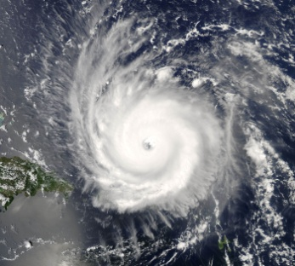
List of Prepared/Processed Storms
Hurricane Isabel (2003)*
030912h1 : 3 legs
030913h1: 1 leg
030914h1: 2 legs
030916h1: 2 legs
Hurricane Ivan (2004)
040907i1: 4 legs
040909i1: 3 legs
040912h1: 6 legs
040913i1: 6 legs
040914h1: 11 legs
040915h1: 10 legs
Hurricane Katrina
(2005)*
051020h1: 3 legs
051022h1: 3 legs
051023h1: 2 legs
Hurricane Wilma
(2005)
051020h1: 3 legs
051022h1: 3 legs
051022h1: 2 legs
Hurricane Rita
(2005)*
050920i1: 3 legs
050921i1: 3 legs
050922h1: 2 legs
050922i1: 4 legs
050923h1: 1 leg
050923i1: 4 legs
Hurricane Felix
(2007)
070901h1: 2 legs
070902i1: 1 leg
070903i1: 2 legs
Hurricane Frances (2004)*
040830i1: 2 legs
040831i1: 2 legs
040901i1: 3legs
040902i1: 2 legs
040903i1: 3 legs
040904i1: 3 legs
Hurricane Jeanne
(2004)
040922h1: 5 legs
040924h1: 9 legs
040925i1: 7 legs
Hurricane Paloma (2008)
081107i1:4 legs
081107i2: 5 legs
081108i1: 3 legs
Hurricane Bill (2009)*
090818i1: 3 legs
090819i1: 4 legs
090819i2: 4 legs
090820i1: 1 leg
Hurricane Frances (2004)
Hurricane Ivan (2004)
* Indicates storms which have been processed

Slide 16
Future Work
Have radar data available online: In order for the information to be available to others for their own research purposes, this information could be uploaded on the web portal. This would create another site similar to the HRD’s mission catalog site which I used to obtain storm information values. The site could be used by other researchers in the similar fashion that I used the HRD storm track and center fix page.
Continue analyzing the Bill case: I wish to expand on my studies on whether Hurricane Bill (2009) was affected by the Saharan Air Layer. There are indications that show that Hurricane Bill began to wrap in SAL and thus might have been weakened by this factor. I would like to take time later in the near future to further delve into sonde and radar data in order to obtain more information for this particular case and perhaps find other storms which indicate weakening caused by the Saharan Air Layer.

