Slide 1



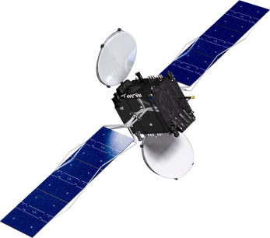
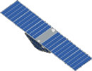
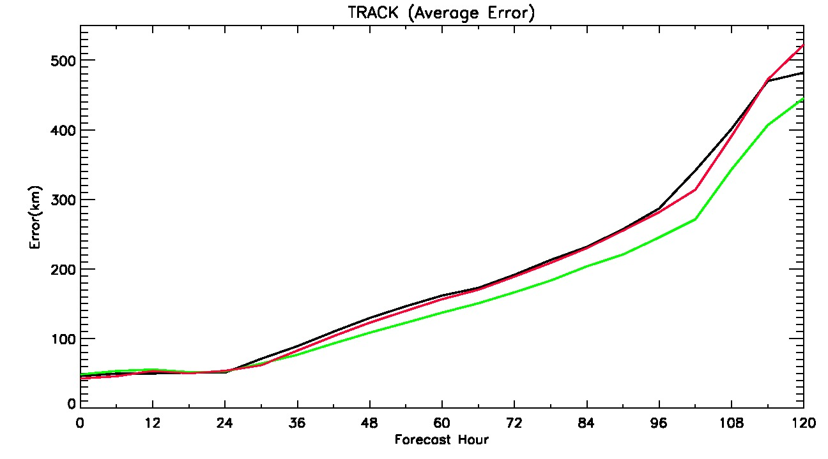

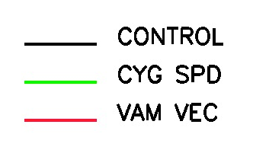
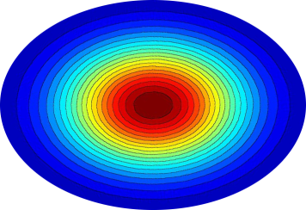
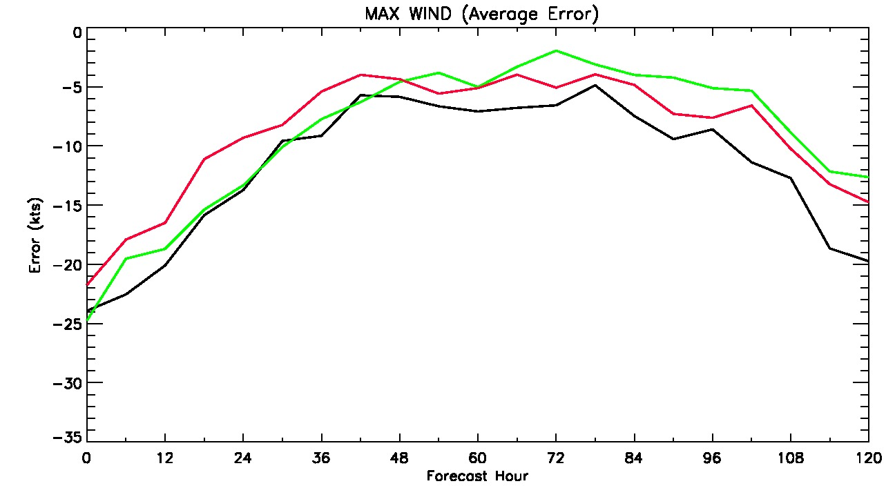
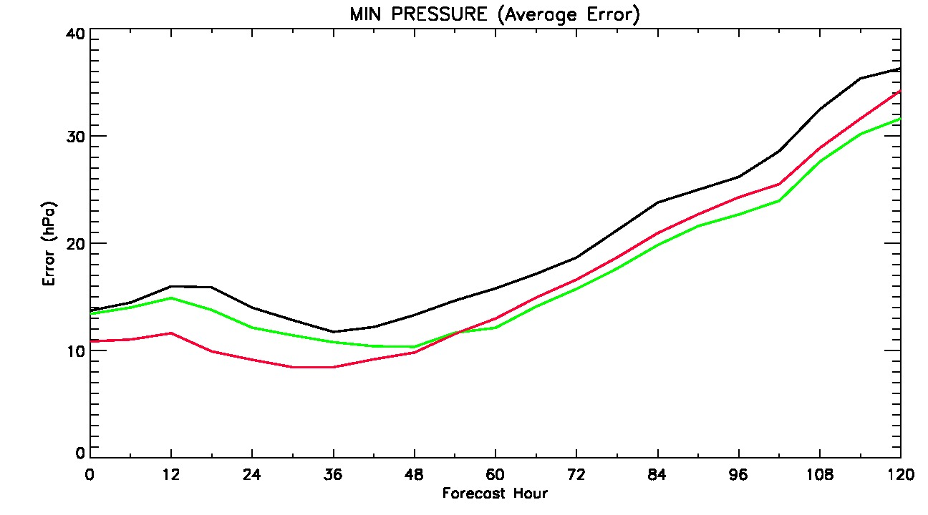
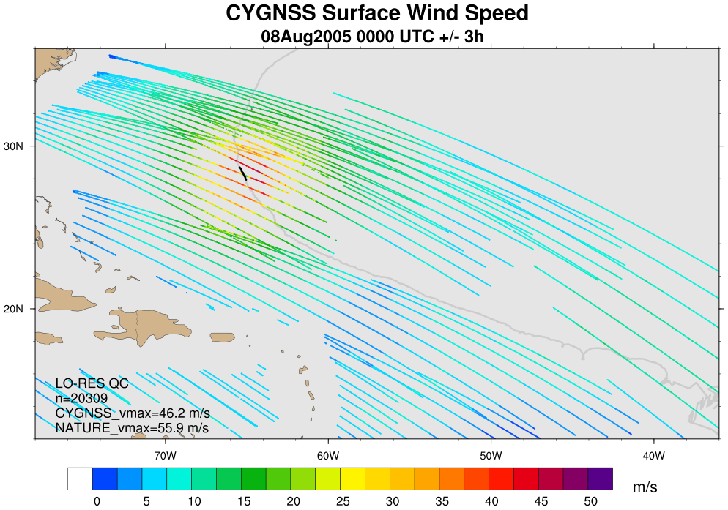
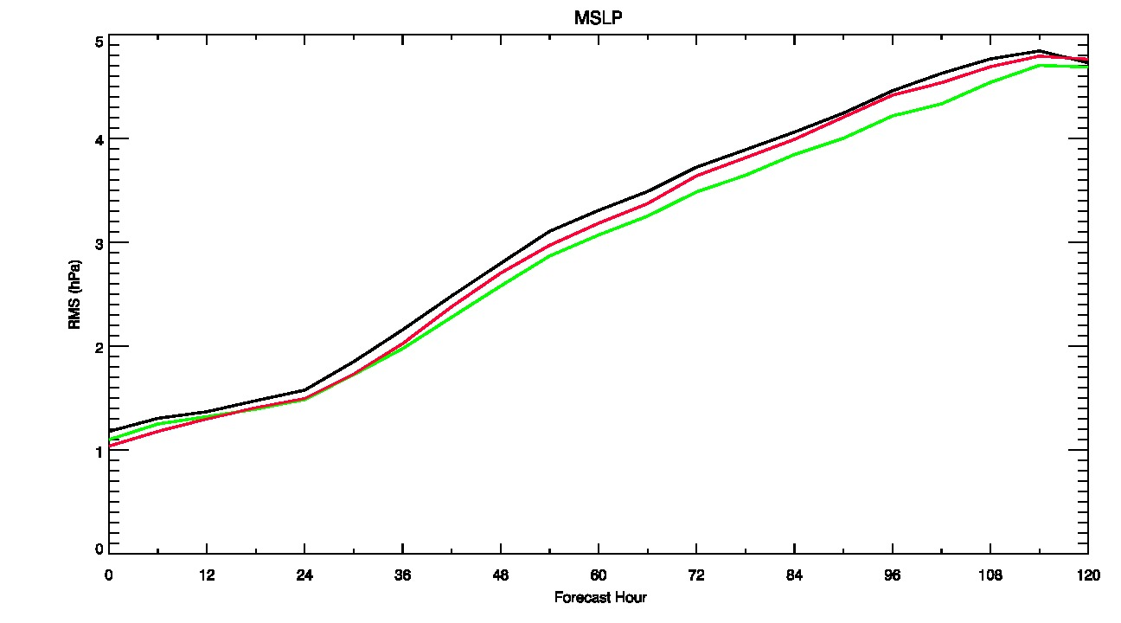
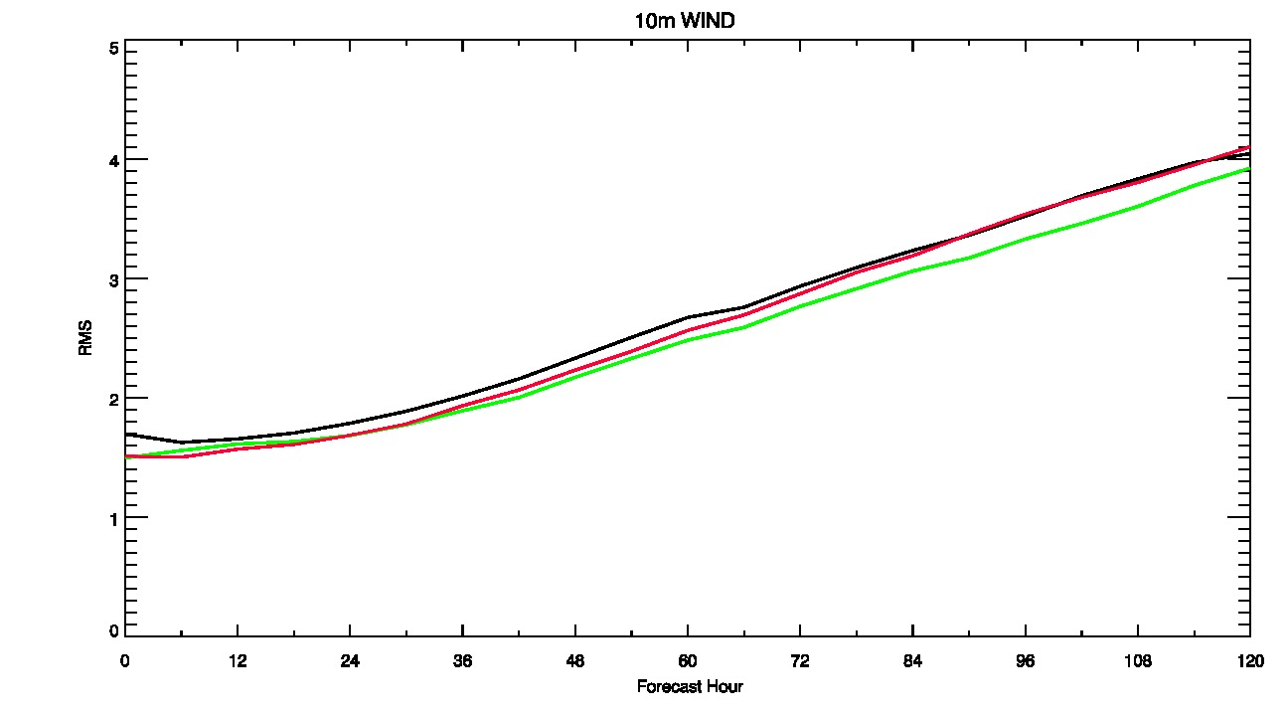
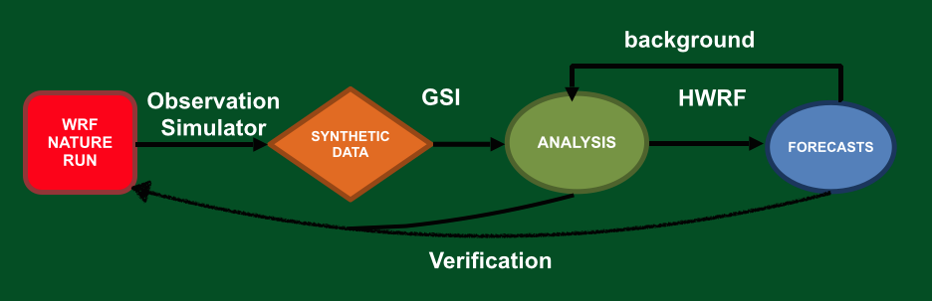
Impact of CYGNSS Data on Tropical Cyclone Analyses
and Forecasts in a Regional OSSE Framework
P0244
Bachir Annane¹, Brian McNoldy², Mark Leidner⁴, Javier Delgado¹, Robert Atlas³, Sharanya Majumdar², James Garrison⁵
¹ Univ. of Miami/CIMAS and NOAA/AOML/HRD, Miami, FL
² Univ. of Miami/RSMAS, Miami, FL
³ NOAA/AOML, Miami, FL, ⁴ AER, Lexington, MA, ⁵Purdue University, West Lafayette, IN
Observational Data: CYGNSS
Experiments and Results
· Average Storm Errors
Results only shown for 3-hourly cycling; results from cycling at other frequencies are generally similar but less accurate.
Intensity metrics are improved at all forecast times by use of CYGNSS information.
GPS
CYGNSS
The NASA Cyclone Global Navigation Satellite System (CYGNSS), planned for launch Dec 12, 2016, consists of a constellation of 8 micro-satellites.
These swan-sized satellites will receive signals reflected by the ocean from existing GPS satellites.
· One synthetic CYGNSS dataset spans the WRF nature run.
- ~25km effective footprint… nominal product.
Direction information added to CYGNSS wind speeds from 2D Variational Analysis Method (VAM) before the GSI analysis, using 9 km HWRF backgrounds.
DA and model cycling performed every 6, 3, or 1 hour, each run producing a 5-day forecast every 6 hours, for a total of 16 forecast cycles.
· All experiments listed use identical configurations of GSI for data assimilation and HWRF for forecasts.
1) CONTROL: conventional Satellite/Surface/sounding data, no CYGNSS
2) CYG SPD: CONTROL plus all available CYGNSS data points
3) VAM VEC: CONTROL plus VAM wind vectors at CYGNSS locations (VAM a priori surface winds from HWRF OSSE Control backgrounds, 9 km)
direct signal
scattered signal
Average Track Error
specular point
Fig 1. Geometry of GPS-based quasi-specular surface scattering. The GPS direct signal provides location, timing, and frequency references, while the forward scattered signal contains ocean surface information.
Average Central Pressure Error
Scattered signals contain information on ocean surface roughness, from which a wind speed can be retrieved under precipitating conditions and with sensitivity beyond 70 m/s.
Spatial and temporal coverage pro-vided by the 8-satellite constellation will be superior to ASCAT and OSCAT combined in the tropics.
Average Maximum Wind Error
· Storm Structure
- Addition of CYGNSS surface wind information generally improves upon the CONTROL run, bringing the analyzed TC closer to NATURE in terms of symmetry, peak intensity, central pressure, and wind radii.
· Large-scale ‘domain-averaged’ Errors
- A consistent improvement is noted throughout the 5-day forecasts.
- Improvements extend far beyond surface wind speed (not all fields are shown here, but include height, pressure, and temperature).
Fig 2. Example of synthetic CYGNSS data coverage over a 6-hour window. Colors correspond to retrieved wind speed.
OSSE Framework
The regional OSSE (Observing System Simulation Experiment) framework described here was developed at NOAA/AOML and UM/RSMAS and features a high-resolution regional nature run embedded within a lower-resolution global nature run.
Nature Runs
- ECMWF: low-resolution T511 (~ 40km) “Joint OSSE Nature Run”
- WRF-ARW: high-resolution 27 km regional domain with 9/3/1 km storm-following nests (v3.2.1)
Synthetic Data
- Simulated observations are generated and provided to a data assimilation scheme which provides analyses for a high-resolution regional forecast model.
Data Assimilation Scheme
- GSI: Gridpoint Statistical Interpolation; standard 3D variational assimilation scheme (v3.3). Analyses performed at 9 km.
Forecast Model
- HWRF: the 2014 operational Hurricane-WRF model (v3.5). Parent domain has ~ 9 km resolution, single storm-following nest has ~ 3 km resolution.
Average Domain 10-m Wind Error
Average Domain MSLP Error
Summary
· Cycling data assimilation of simulated CYGNSS observations with GSI improves the analysis of hurricane intensity and location.
· The improvement of tropical storm intensity is significant, and is a larger and more persistent finding in our results than reduction of track error.
· Assimilation of CYGNSS data with GSI always improves large-scale analyses of wind, pressure, temperature, height, etc. from the surface through upper troposphere.
· Assimilation of CYGNSS data can improve hurricane and synoptic field forecasts with HWRF at short and long lead times.
· Using a 2D pre-analysis (VAM) to add directional information to CYGNSS consistently improves GSI hurricane analyses and HWRF forecasts compared to wind speed only.
· GSI analyses are very sensitive to the exact location of the observational data… symmetry, coverage and background errors affect the results.
· We have very few samples from one storm, so error statistics are not robust, but provide some guidance.
Fig 4. Layer-average, near-surface wind speed and streamlines [lowest 30 mb] from the Nature Run (NR) and from the analysis of three OSSEs, valid at 1200 UT August 1. The storm is just forming in all DA treatments, as in the NR, but with a significant southwest displacement compared to the NR. Wind speed is shaded according to the color scale in Fig. 5.
Fig 5. Simulated CYGNSS wind speed data in the domain of Fig.1 and +/- 1.5 hours around 1200 UT August 1. For clarity, every 5th CYGNSS retrieved wind speed location is plotted. For reference, CYGNSS locations are plotted as solid gray circles in Figs. 4, 6 and 7.
Fig 3. Basic flow chart of the regional OSSE framework.
Acknowledgements
Funding for this research is from NASA Award NNL13AQ00C. We thank Dave Nolan for use of hurricane Nature Run results, the CYGNSS Science Team, the NOAA Office of Weather and Air Quality, and the NOAA HFIP program for computing support.
Fig 6. As in Fig. 4, but 24 hours later. The storm has strengthened in all treatments, but CYGNSS data have slowed the westward movement and brought the storm further north, in better agreement with the NR.
Fig 7. As in Fig. 4, but 48 hours later. The storm has strengthened further. CYGNSS treatments are in better agreement with the NR in terms of intensity and overall wind field structure.
12-16 December 2016 • AGU Fall Meeting • San Francisco, California

