Slide 1
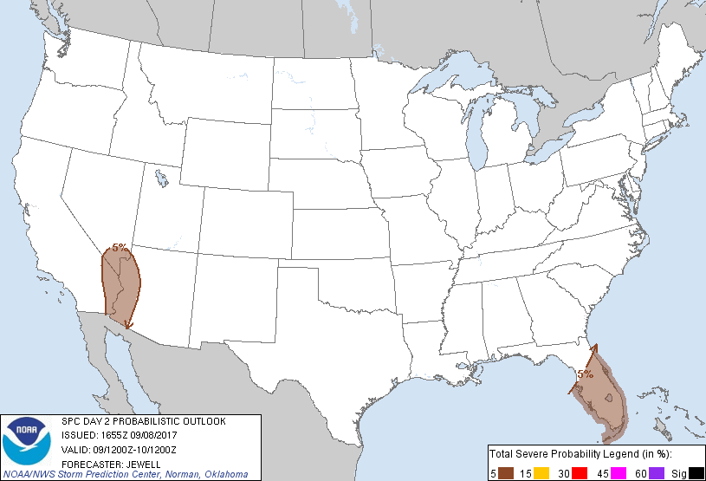
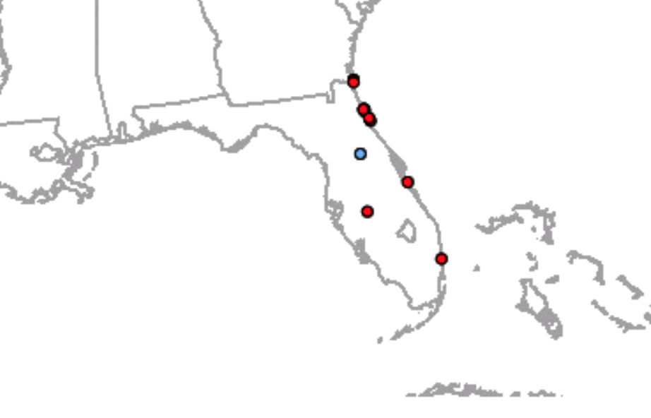
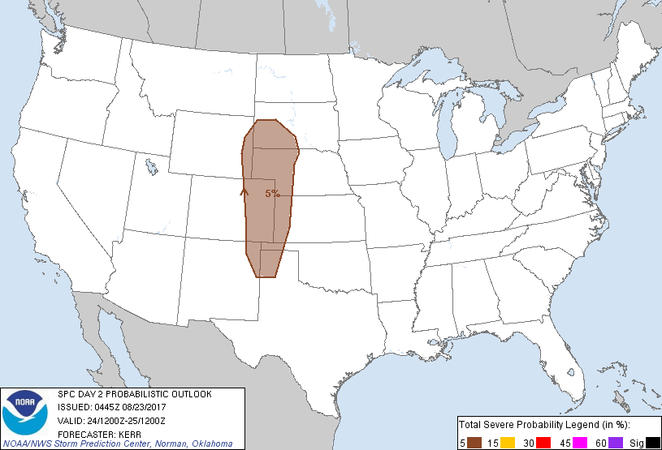
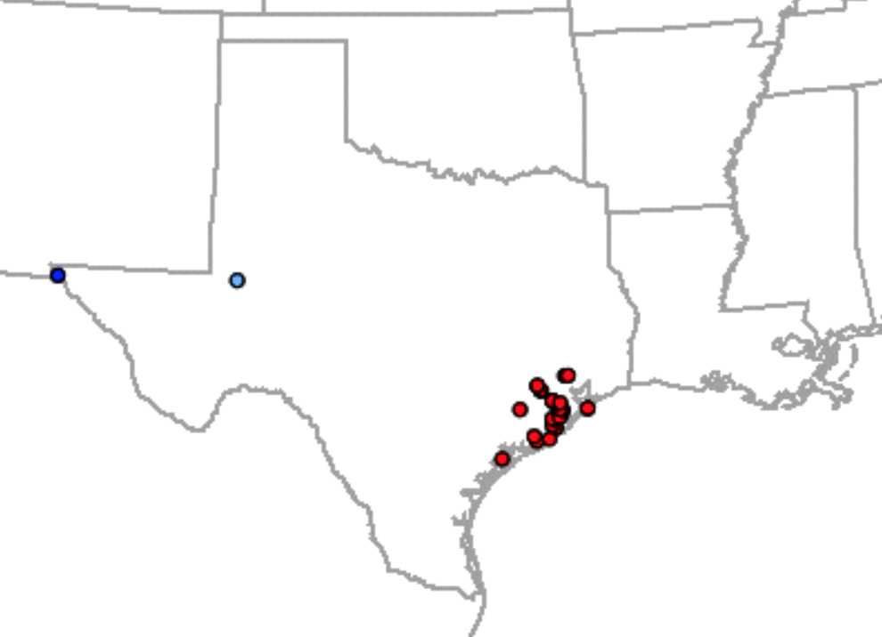
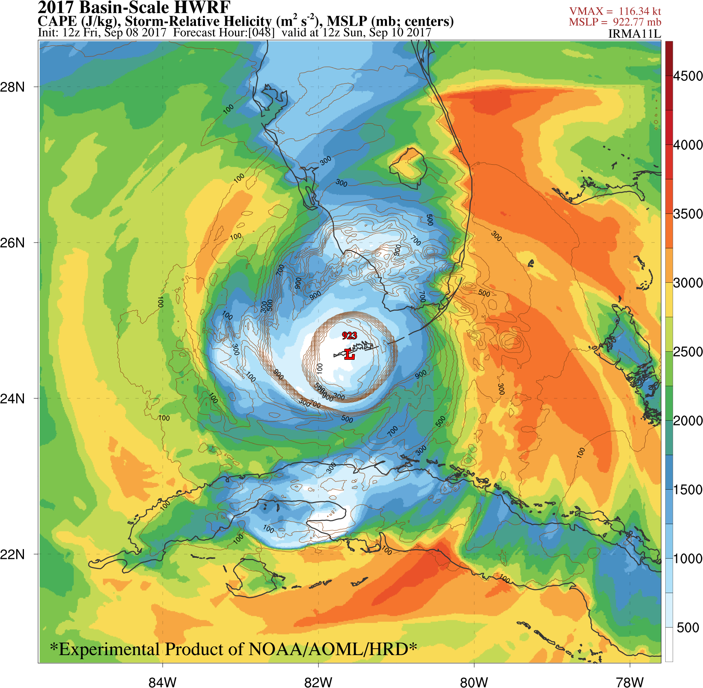
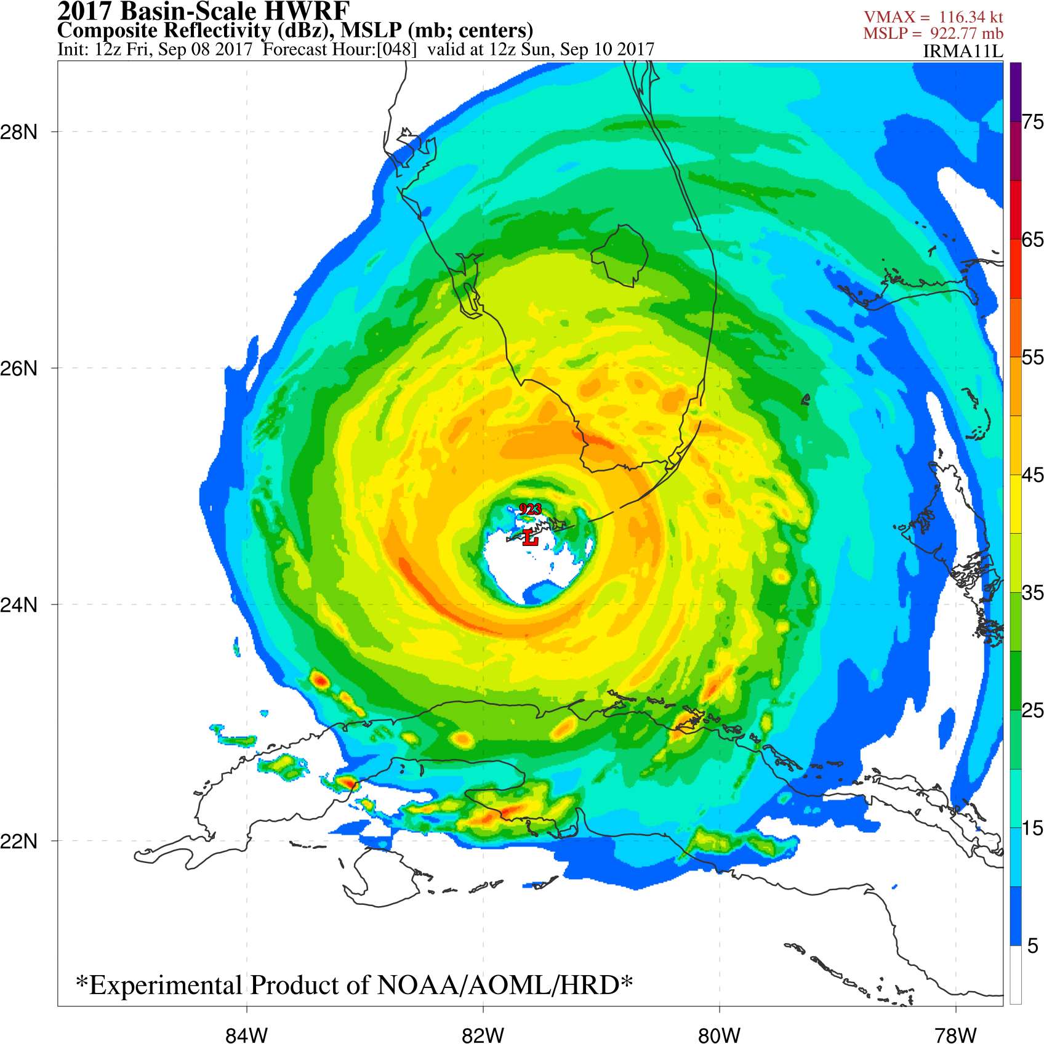
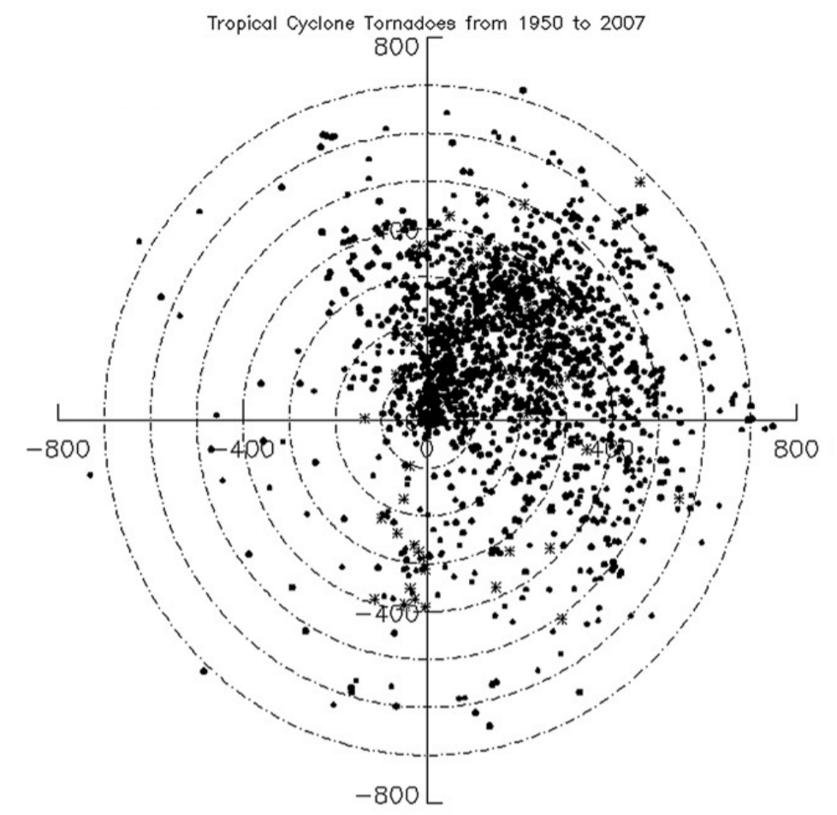
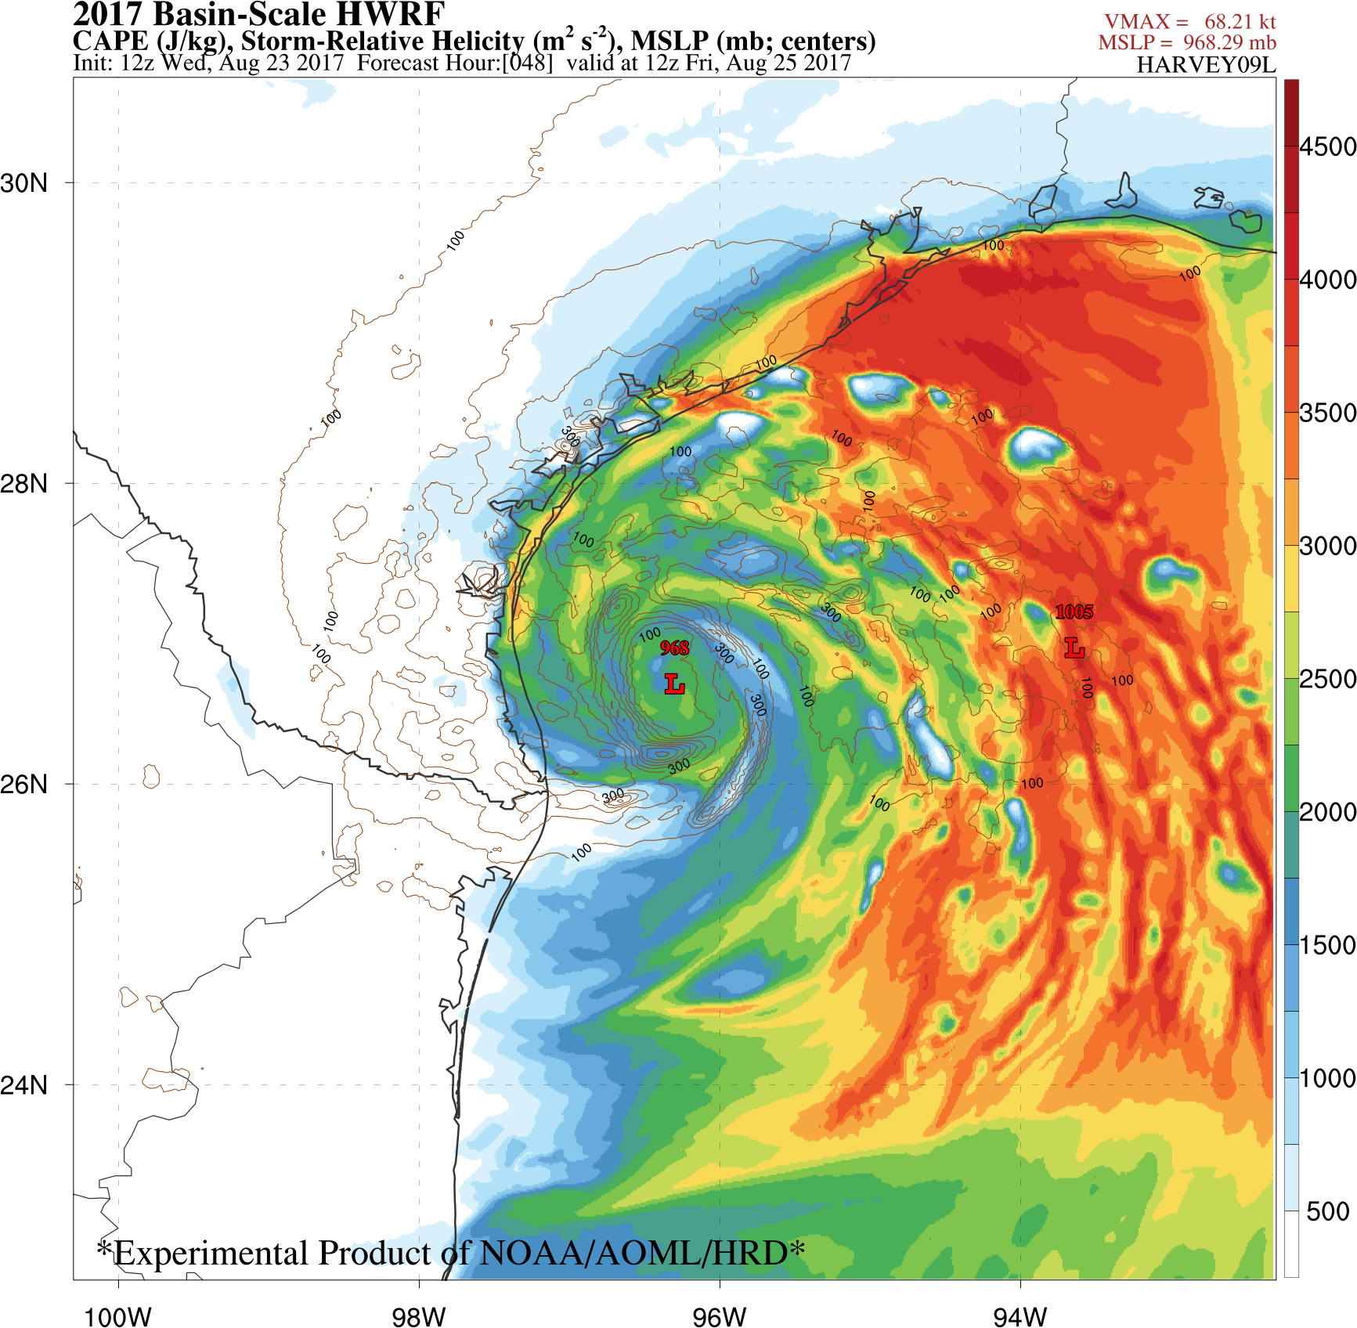
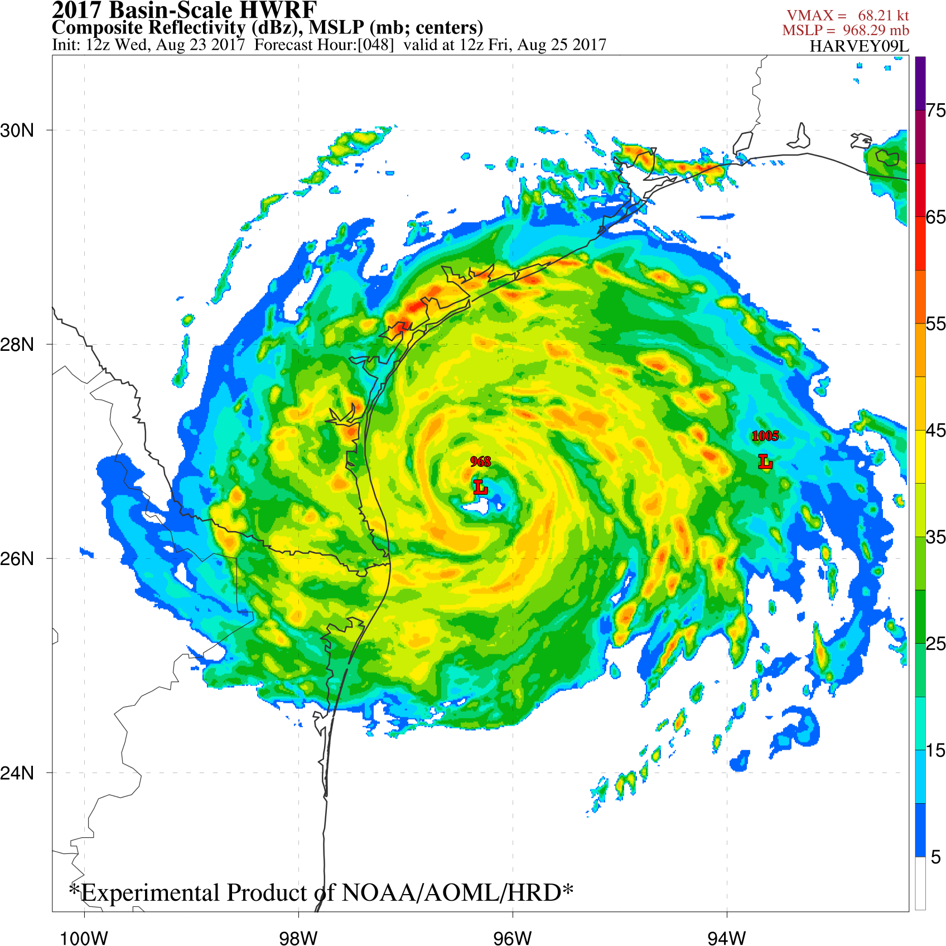
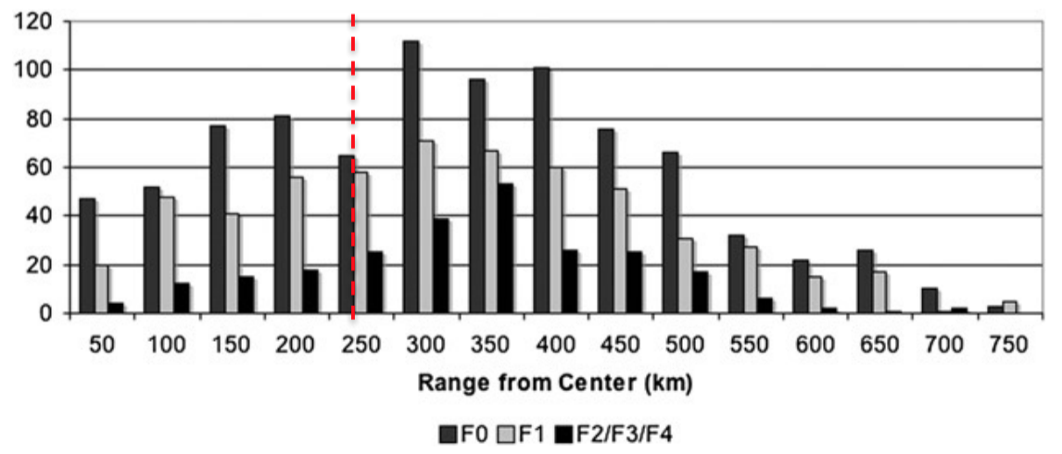
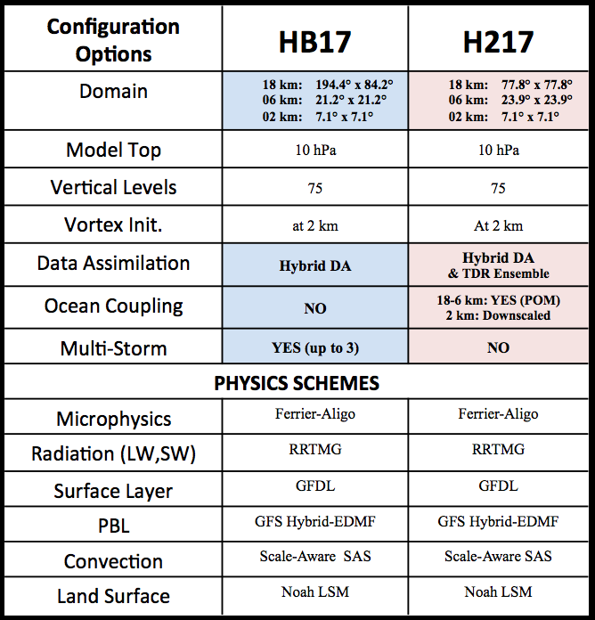
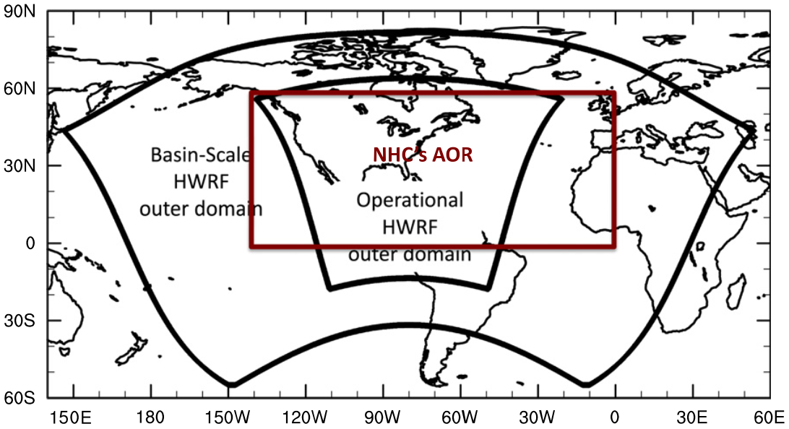
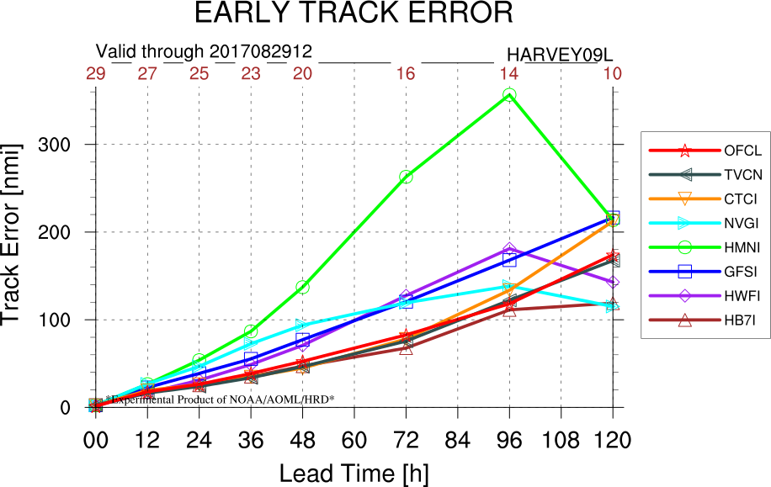
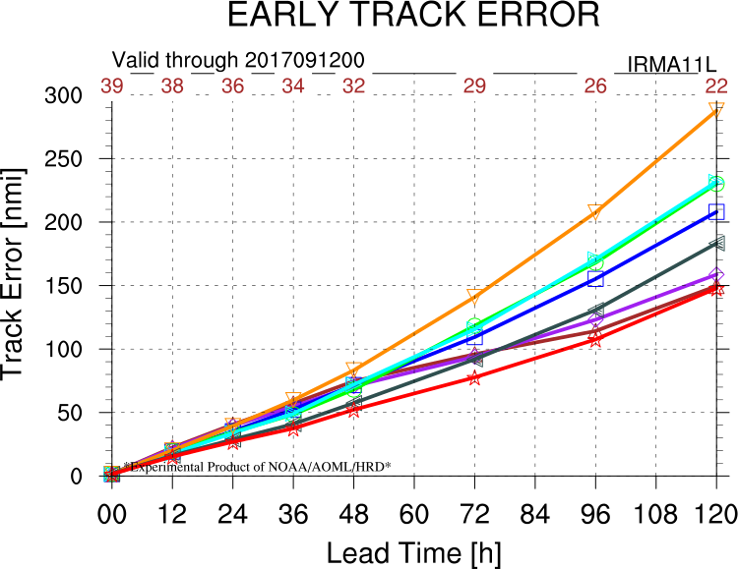
Inland Severe Weather Impacts Produced by
Landfalling Tropical Cyclones in 2017
Ghassan J. Alaka Jr.^{12*}, John Kaplan², Peter Dodge², Frank Marks Jr.², Sundararaman G. Gopalakrishnan²
¹Cooperative Institute for Marine and Atmospheric Studies, University of Miami, Miami, Florida
²NOAA/Atlantic Oceanographic and Meteorological Laboratory/Hurricane Research Division, Miami, Florida
*Correspondence: Ghassan.Alaka@noaa.gov
1. Introduction
4. Hurricane Harvey
5. Hurricane Irma
The 2017 Atlantic hurricane season was very active and destructive, with several landfalling tropical cyclones, including Hurricanes Harvey and Irma. These two hurricanes produced substantial impacts in Texas, Louisiana, and Florida, leading to significant loss of life and property. While many of the impacts associated with the landfall of Harvey and Irma were concentrated along the immediate coastline (e.g., storm surge, strongest sustained winds), other impacts, such as tornadoes and wind gusts, were observed further inland. In the case of Harvey, tornadoes and wind gusts compounded the danger imposed by widespread fresh water flooding, resulting in a very challenging forecast for the National Weather Service. In the case of Irma, dozens of tornado warnings were issued along the entire Florida Peninsula and damaging wind gusts were embedded within its rain bands, resulting in a perilous situation that lasted several hours in many locations. In this study, radar and surface wind data collected for Hurricanes Harvey and Irma are examined to evaluate the role that both tornadoes and wind gusts may have played in producing the inland damage that was observed for those two systems. In addition, numerical model forecasts are also evaluated to assess the potential predictability of severe weather in landfalling tropical cyclones.
The goal of this study is to evaluate severe weather impacts (e.g., tornadoes, wind gusts) in observations and numerical model forecasts.
a. SPC Storm Reports
a. SPC Storm Reports
Date | # Tornado | # Wind | State(s)
2017-08-25 | 29 | 0 | TX
2017-08-26 | 23 | 2 | TX/LA
2017-08-27 | 8 | 5 | TX/LA
2017-08-28 | 1 | 2 | TX/LA
2017-08-29 | 5 | 2 | LA/MS
2017-08-30 | 7 | 18 | MS/AL/GA
2017-08-31 | 16 | 49 | MS/AL/GA/FL/SC
TOTAL | 89 | 68 | TX/LA/MS/AL/GA/FL/SC/TN
7-day event
327 tornado warnings
~50 confirmed so far
Mostly outer-region tornadoes
Wind reports increased as Harvey moved inland
Date | # Tornado | # Wind | State(s)
2017-09-09 | 2 | 0 | FL
2017-09-10 | 12 | 2 | FL
2017-09-11 | 5 | 1 | SC
TOTAL | 19 | 3 | FL/SC
Table 4. As in Table 3, except for Hurricane Irma.
a)
b. SPC Outlook Verification
b)
Table 3. The number of tornado reports and wind gust/damage reports per day associated with Hurricane Harvey as recorded by NOAA’s Storm Prediction Center. Affected states are listed in the rightmost column.
a)
b. SPC Outlook Verification
b)
Fig. 6. a) Day 2 Probabilistic Outlook issued by SPC on 08 September 2017, valid for 10 September 2017. The probability of severe weather is shaded. b) Tornado reports (red) collected by SPC on 10 September 2017.
c. Model Evaluation
2. Background & Research Tools
a)
b)
a. TC-Tornado Climatology
Most tornadoes in front right quadrant of TC
Inner-core tornadoes vs. Outer-region tornadoes
More helicity, less CAPE than Great Plains tornadoes.
b. Hurricane Weather Research & Forecasting (HWRF) Model
Good tracks are key to issue
reliable severe weather forecasts
HB17 = 2017 basin-scale HWRF
Fig. 4. a) Day 2 Probabilistic Outlook issued by SPC on 23 August 2017, valid for 25 August 2017. The probability of severe weather is shaded. b) Tornado reports (red) collected by SPC on 25 August 2017.
c. Model Evaluation
a)
b)
CAPE + Helicity ≈ STP
Fig. 7. a) CAPE (shaded) and storm-relative helicity (contours) at 48-h into an HB17 forecast initialized at 12Z 08 September 2017, valid at 12Z 10 September 2017. b) Corresponding simulated composite radar reflectivity from HB17.
Fig. 1. Tropical cyclone tornado locations in storm-relative coordinates. Range rings are in 100-km increments (Schultz and Cecil 2009).
Fig. 2. Hurricane tornado F-scale as a function of range from the storm center (km) (Schultz and Cecil 2009). Vertical red dashed line separates core- from outer-region tornadoes.
SPC Day 2 Outlook identified some risk to FL Peninsula
HB17 48-h forecast showed realistic tornado risk along FL east coast
Corresponding simulated radar showed rainbands training onshore and spreading northward.
Fig. 5. a) CAPE (shaded) and storm-relative helicity (contours) at 48-h into an HB17 forecast initialized at 12Z 23 August 2017, valid at 12Z 25 August 2017. b) Corresponding simulated composite radar reflectivity from HB17.
SPC Day 2 Outlook did not identify the upcoming severe weather risk in Texas
CAPE & storm-relative helicity can be used as proxies for the Significant Tornado Parameter (STP)
HB17 48-h forecast showed realistic tornado risk along Texas coast
Corresponding simulated radar revealed pockets of high reflectivity embedded within rainbands (i.e., meso-vortices)
6. Model Track Error
a)
b)
Good track forecasts are vital to provide meaningful severe weather guidance.
Probabilistic methods could help, too.
Fig. 3. Schematic domains of basin-scale HWRF, operational HWRF, and NHC’s areas of responsibility (AOR) (Zhang et al. 2016).
Table 1. Configuration options for the 2017 basin-scale HWRF (HB17) and the 2017 operational HWRF (H217). Differences between HB17 and H217 are bolded and highlighted.
Fig. 8. Early (interpolated) track errors for a) Hurricane Harvey and b) Hurricane Irma. Interpolated HB17 forecasts (HB7I) are brown marked with triangles. The NHC official forecast and many early models are also shown for comparison.
3. Hurricane Irma Wind Gusts
Station | Lat (N) | Lon (W) | County | Peak Gust (mph)
CLWCH | 26.04 | 80.22 | Broward | 109
PBRPN | 26.01 | 80.27 | Broward | 109
DRFCE | 26.31 | 80.15 | Broward | 100
MRMRH | 25.99 | 80.28 | Miami-Dade | 98
SNRSC | 26.16 | 80.29 | Broward | 98
WSTNF | 26.06 | 80.39 | Broward | 98
SGGEW | 26.14 | 81.58 | Broward | 97
WFORT | 25.79 | 80.29 | Miami-Dade | 95
MMMCH | 25.74 | 80.30 | Miami-Dade | 93
LPIF1 | 25.39 | 80.68 | Miami-Dade | 91
KPBI | 26.68 | 80.09 | Palm Beach | 91
CHKF1 | 25.62 | 80.58 | Miami-Dade | 90
MDFRC | 25.73 | 80.26 | Miami-Dade | 90
CRLCG | 26.26 | 80.30 | Broward | 89
KPMP | 26.24 | 80.11 | Palm Beach | 87
HLLLYW | 25.99 | 80.16 | Broward | 86
3AS3W | 25.85 | 80.77 | Miami-Dade | 86
7. Summary & Next Steps
Acknowledgements
References
Schultz, L. A., and D. J. Cecil, 2009: Tropical Cyclone Tornadoes, 1950–2007. Mon. Weather Rev., 137, 3471–3484, doi:10.1175/2009MWR2896.1.
Zhang, X., S. G. Gopalakrishnan, S. Trahan, T. S. Quirino, Q. Liu, Z. Zhang, G. J. Alaka, and V. Tallapragada, 2016: Representing Multi-scale Interactions in the Hurricane Weather Research and Forecasting Modeling System: Design of Multiple Sets of Movable Multi-Level Nesting and the Basin-scale HWRF Forecast Application. Weather Forecast., 31, 2019–2034, doi:10.1175/WAF-D-16-0087.1.
No sustained hurricane-force winds in SE Florida (i.e., Miami)
Widespread wind gusts were equivalent to EF0 & EF1 tornadoes
17 EF1-equivalent wind gusts (Table 2)
33 EF0-equivalent wind gusts
Contributed to widespread power outages and substantial damage
2.1M customers in SE FL alone
Are the worst wind gusts associated with meso-vortices, like tornadoes?
Wind gusts are a critical severe impact that can produce EF0 & EF1 equivalent winds.
Basin-Scale HWRF severe weather forecasts appear to have some utility for Harvey & Irma.
Would real-time products from HWRF be helpful guidance when issuing severe weather outlooks for landfalling TCs?
What are similarities & differences between the mechanisms for tornadoes and wind gusts?
Table 2. Preliminary peak overland wind gusts in southeast Florida produced by Hurricane Irma (2017). Observed maximum wind gusts are taken from the Miami National Weather Service Forecast office’s preliminary post-storm report on Irma.

