Slide 1
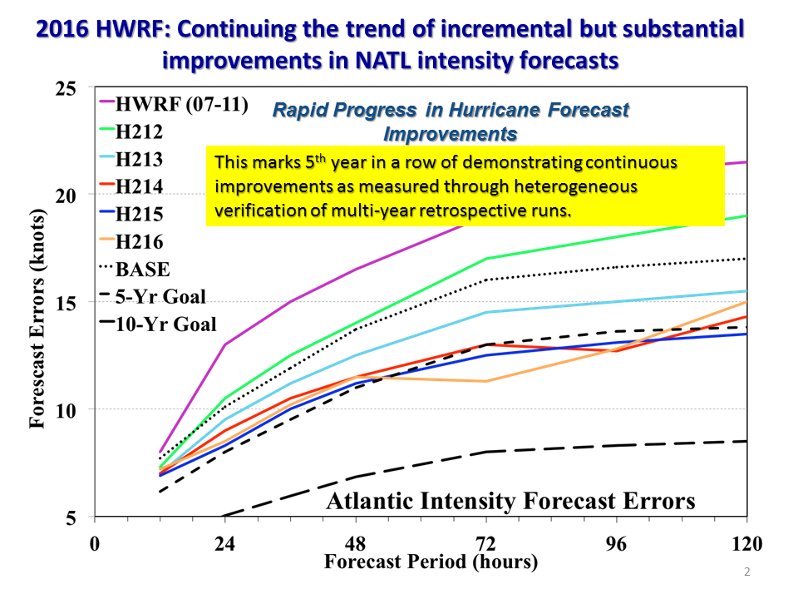
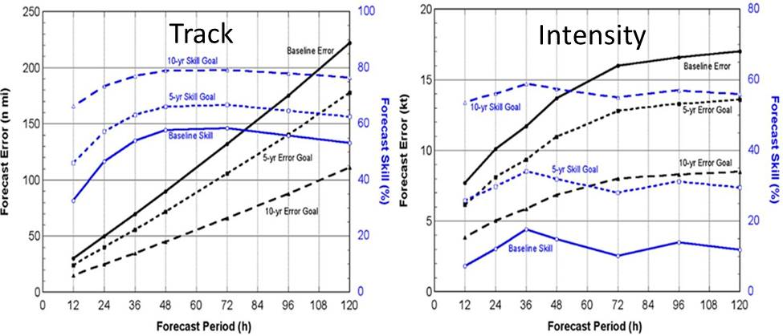
The Hurricane Forecast Improvement Project Awards – Summary of research-to-operations (R2O) gains at NWS
Daniel Meléndez^{1,} F. Toepfer¹, V. Tallapragada², F. Marks³, S. Gopalakrishnan³, N. Lett¹, C. Hedge¹, A. Mehra², R. Gall¹ ,and M. DeMaria⁴
7th R20 Conf: Poster# 881
¹ NOAA/NWS/OSTI , ²NWS/NCEP/EMC, ³OAR/AOML/HRD, ⁴NWS/NCEP/NHC
Introduction
Collaborative Awards I (2012-14)
Collaborative Awards II (2014-16)
R2O Impacts to HWRF (Past 4 Years)
National Weather Service’s (NWS) Hurricane Forecast Improvement Project (HFIP) is a ten-year effort to improve hurricane track, intensity and storm surge forecasts; and, extend the lead time and increase the confidence in those forecasts, thereby improving public response, and reduce unnecessary evacuations and preventable losses. HFIP goals are to reduce numerical forecast errors in track and intensity by 20% in 5 years and 50% in 10 years (see chart below); extend forecast guidance skill to 7 days; and, improve rapid intensification (RI) and storm surge forecasts while reducing false alarm ratio.
HFIP Round One (2012-14) Awards
PI Name | PI Institution | Project Title
Xugang Wang & M. Xue | University of Oklahoma | Improving High-Resolution Tropical Cyclone Prediction Using a Unified GSI-based Hybrid Ensemble-Variational Data Assimilation System for HWRF
T. Galarneau, T. Hamill & J. Whitaker (unfunded) | U Colorado - Boulder | HFIP Using Global Forecast System Reforecasts to Generate Tropical Cyclone Forecast Products
Jun Zhang, D. Nolan, and S. Lorsolo | University of Miami | Improving Sampling Strategies Through OSSEs for Optimal Assimilation of Airborne Doppler Radar Observations Using HRD's HEDAS
Xuejin Zhang, Kao-San Yeh & Da-Lin Zhang | University of Miami | Development of Multiple Moving Nests Within a Basin-Wide HWRF Modeling System
Aksoy, J. Chang & B. Klotz | University of Miami | Investigation of HWRF Model Error Associated with Surface-Layer and Boundary-Layer Parameterizations to Improve Vortex-Scale, Ensemble-Based Data Assimilation Using HEDAS
Fuqing Zhang, Y. Weng & X. Ge | The Pennsylvania State University | Real-time convection-permitting ensemble analysis and prediction of Atlantic hurricanes through assimilating airborne, radar and satellite observations
Ryan Torn | University of Albany | Evaluating Hurricane Intensity Predictability using the Advanced Hurricane WRF
T. Krishnamurti | Florida State University | Further Reduction in Intensity Forecast Errors for Hurricane by Extension of the Correlation Based Consensus (CBC) Method
Da-Lin Zhang | University of Maryland | Improving Hurricane Intensity Forecasts with Consistent Resolutions
Robert Fovell, K. L. Corbosiero, H. Su (JPL) & K-N Liou | UCLA | Assimilation of precipitation observations into HWRFX without the pitfalls of microphysical representations
Z. S. Haddad & S. Hristova-Veleva | UCLA | Assimilation of precipitation observations into HWRFX without the pitfalls of microphysical representations
Isaac Ginis and R. Yablonsky | University of Rhode Island | Advancing NOAA's HWRF Prediction System through New and Enhanced Physics of the Air-Sea-Wave Coupling
HFIP Round Two (2014-16) Awards
PI Name | PI Institution | Project Title
Xugang Wang | University of Oklahoma | Advancing the assimilation of airborne hurricane observations using the GSI-based hybrid ensemble-variational data assimilation system for HWRF
Ziad Haddad | UCLA (Finished) | A holistic approach to represent the dependence of all-sky nearly-simultaneous radiances from microwave (LEO) to IR (geostationary) on atmospheric variables for assimilation into WRF
Jun Zhang | University of Miami | Improving Sampling Strategies Through OSSEs for Optimal Assimilation of Airborne Doppler Radar Observations Using HRD's HEDAS
Ryan Torn | University of Albany | Assessing the Predictability of Tropical Cyclone Intensity using HWRF
Isaac Ginnis | University of Rhode Island (Finished) | Addressing Deficiencies in Forecasting Tropical Cyclone Rapid Intensification in HWRF
Chris Rozoff | University of Wisconsin (Finished) | Probabilistic Prediction of Hurricane Intensity with an Analog Ensemble
T. Krishnamurti | Florida State University (Finished) | Research Towards Improvement of Hurricane Intensity Forecasts using the Multi-model Superensemble and a Suite of Mesoscale Models
Greg Hakim | Univ. of Washington | Intrinsic Hurricane Predictability
Xiaolei Zou | U. of Maryland | Improved Satellite Data Assimilation and Vortex Initialization for Hurricane Forecast Using HWRF
Zhaoxia Pu | University of Utah | Improving vortex initialization in HWRF multiple-level nested domains with GSI hybrid data assimilation
Ping Zhu | Florida International University | Understanding the impact of sub-grid scale physics in HWRF on the predicted inner-core structure and intensity of tropical cyclones
Jason Otkin | Univ. of Wisconsin | Using synthetic satellite brightness temperature to evaluate the ability of HWRF parameterization schemes to accurately simulate clouds and moisture in the tropical cyclone environment
2016
Collaborative efforts helped improve the HWRF intensity forecast guidance as shown by lower errors since the announcement of Round One awards.
Collaborative Awards III (2016-18)
HFIP Round Three (2016-18) Awards
PI Name | PI Institution | Project Title
Xuguang Wang | University of Oklahoma | Further Advancement of HWRF Self-Consistent Ensemble-Variational Hybrid Data Assimilation System to Improve High Resolution Hurricane Vortex Assimilation
Chanh Kieu | Indiana University | Characteristics of Hurricane Intensity Error Growth and Predictability Limit in the HWRF Model
Ryan Torn | U. of Albany | Evaluating Methods of Parameterizing Model Error in the HWRF Ensemble Prediction System
Ping Zhu, J. Zhang, and B. Tyner | Florida International University | Improving HWRF’s Ability to Predict Rapid Change in Tropical Cyclone Intensity Governed by Internal Physical Processes
Chris Rozoff, W. Lewis, L. Delle Monache, S. Alessandrini, and M. DeMaria | University of Wisconsin | Probabilistic Prediction of Tropical Cyclone Track, Intensity, and Structure with an Analog Ensemble
Track and Intensity goals: baseline (solid lines) and goals (dashed). Absolute errors (black curves) and skill improvement (blue).
“R2O” Science Priorities
Selected “R2O” Gains for NWS
Selected “R2O” Gains for NWS
HFIP held three open competitions (2011, 2013, 2016) with 12 awards in the first two rounds and four in the last, totaling $2.46M , $3.78M, and $1.06M, respectively. Round Two is in its last year. Science priorities are:
Advancements in data assimilation (“DA”: 4DVAR, EnKF, hybrid) particularly airborne radar, Lidar, SFMR, dropsonde) data providing 3d inner core circulation
New and enhanced model physics
Advanced model diagnostics including errors and greater genesis model skill
High-resolution ensembles to improve intensity guidance and on optimality of number of members increasing intensity forecast skill, and post-processing t
Techniques to maximize impact of data to the accuracy of analyses and track/intensity predictions, including optimal observing strategies for inner core- and environment-scale circulations
Enhanced “hybrid” data assimilation system (DA) for HWRF assimilating tail-Doppler radar data
New and more efficient ocean model (MPIPOM-TC) coupled to HWRF showed improved track and intensity forecast skill
Improved radiative and PBL parameterizations
Perturbation in ensemble physics has different effects than perturbations in initial conditions or environment
“Far” environment can affect warm-core HWRF analysis
Intensity forecast uncertainty due to oceanic perturbations can be larger but lagging atmosphere-only
Enthalpy and bulk drag coefficient ensemble perturbations are greater than those from microphysics
Increased vertical resolution implemented in 2014 HWRF improved track and intensity forecasts
Vortex “spin-down” in HWRF can be mitigated by inner-core hybrid-DA or digital filter initialization (DFI) of analysis and possibly new turbulent mixing physics
Further improvements in vortex initialization and model clouds/moisture can be obtained using satellite retrieval products (microwave, sounders)
Extended new air-sea-module to all basins in HWRF
Short horizontal mixing lengths intensify vortex faster than that with longer mixing lengths
Largest HWRF forecast errors associated with shallower and weaker model convection
Analog Ensemble technique can improve HWRF biases
Developed corrected bias consensus
Improved boundary layer vertical diffusivity improves track and intensity HWRF forecast skill including RI
Improving all aspects of tropical cyclone forecasts involve upgrading multiple HWRF system components through a unified strategy.
R2O Way-Forward Strategy
Continue testing promising DA, model physics, statistical models, and ensemble-based forecast applications arising from the on-going awards based on a forward-looking strategy evaluating the following:
Physics/PBL/radiation and DA impacts with a common comparison of cases
Independence of statistical descriptors; cyclogenesis, track and intensity statistical model predictions in real-time; and, sensitivity of storm development to shear
Leverage Next Generation Global Prediction System (NGGPS)
Fred Toepfer, HFIP Program Manager (Frederick.Toepfer@noaa.gov)

