Slide 1


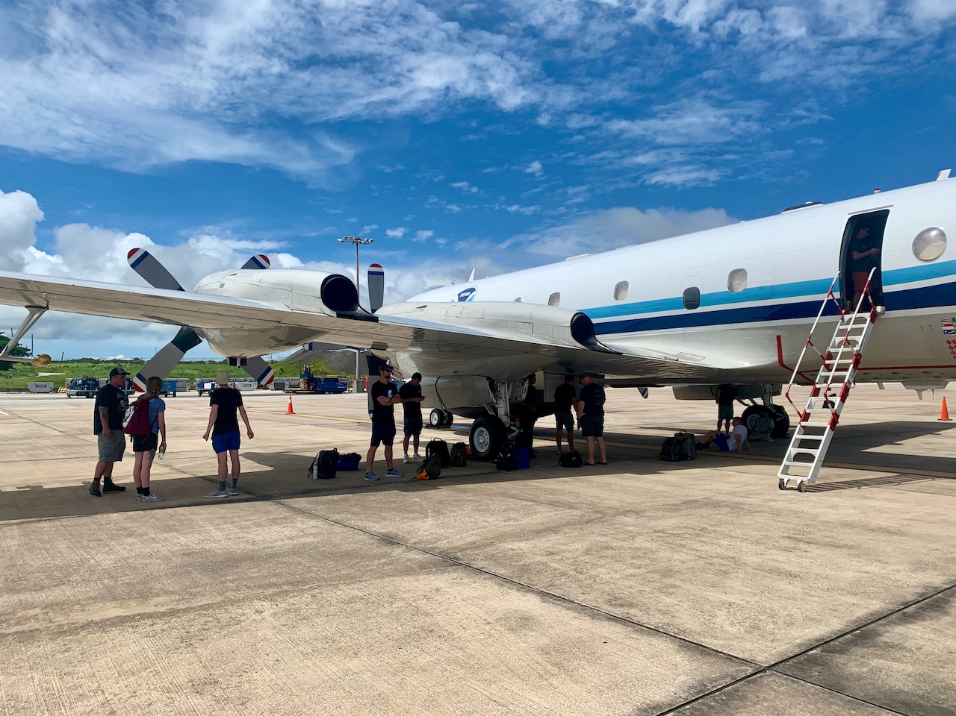
2023 Hurricane Field Program
Advancing the Prediction of Hurricanes Experiment (APHEX)
6-7 Aug AEWs Debrief
Jason Dunion – HFP Director
Heather Holbach - HFP Deputy Director
Rob Rogers – HFP Science Director
Photo credit: Sim Aberson

Slide 2
2023 Hurricane Field Program-APHEX
Summary of Missions (6-7 August 2023)
Mission Series Overview
1 P-3 Mission (HRD), 2 G-IV missions (HRD)
86 GPS dropsondes / 81 transmitted to the GTS
6 UM AXBTs deployed (4 good)
0 TDR analyses transmitted to EMC & NHC
APHEX Experiments & Modules: https://www.aoml.noaa.gov/2023-hurricane-field-program/
FAM (Genesis Stage)
PREFORM (Genesis Stage)

Slide 3
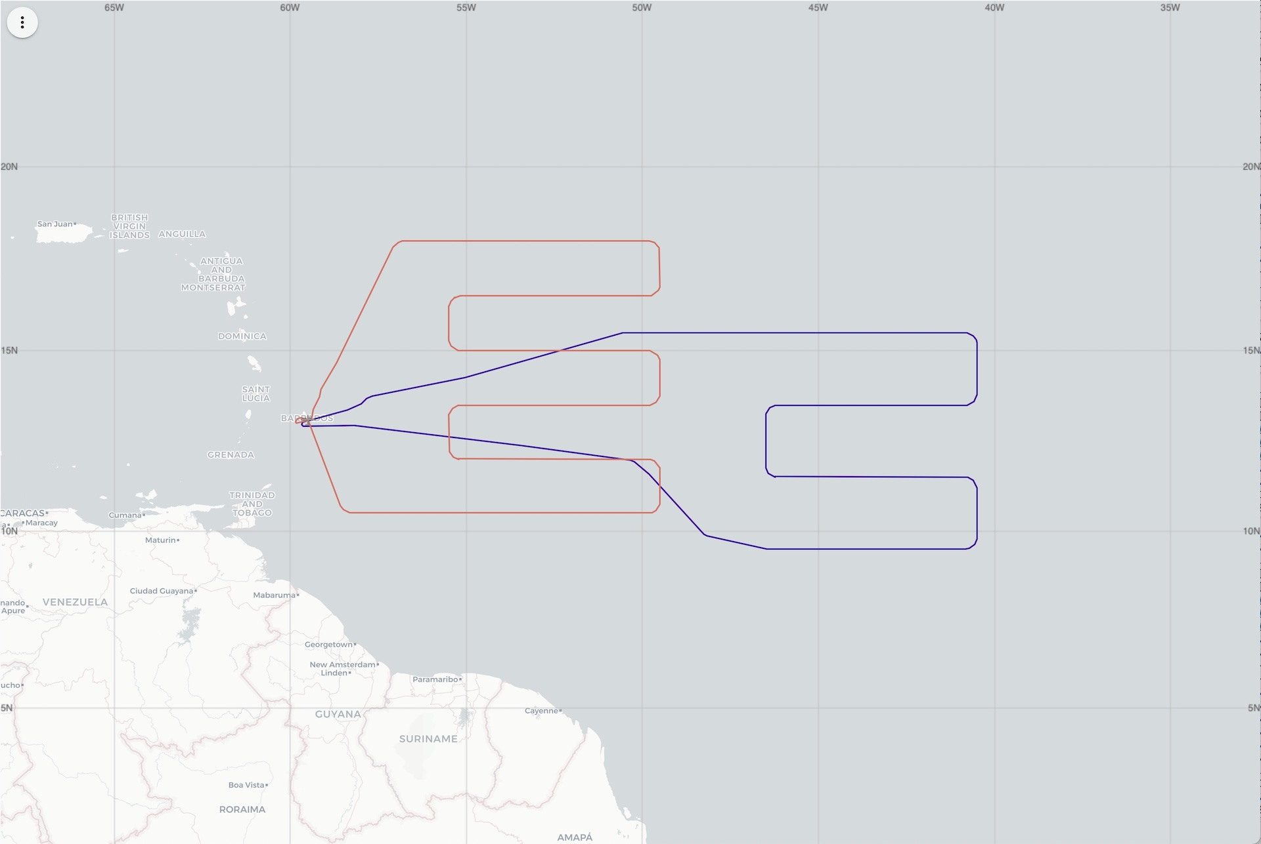
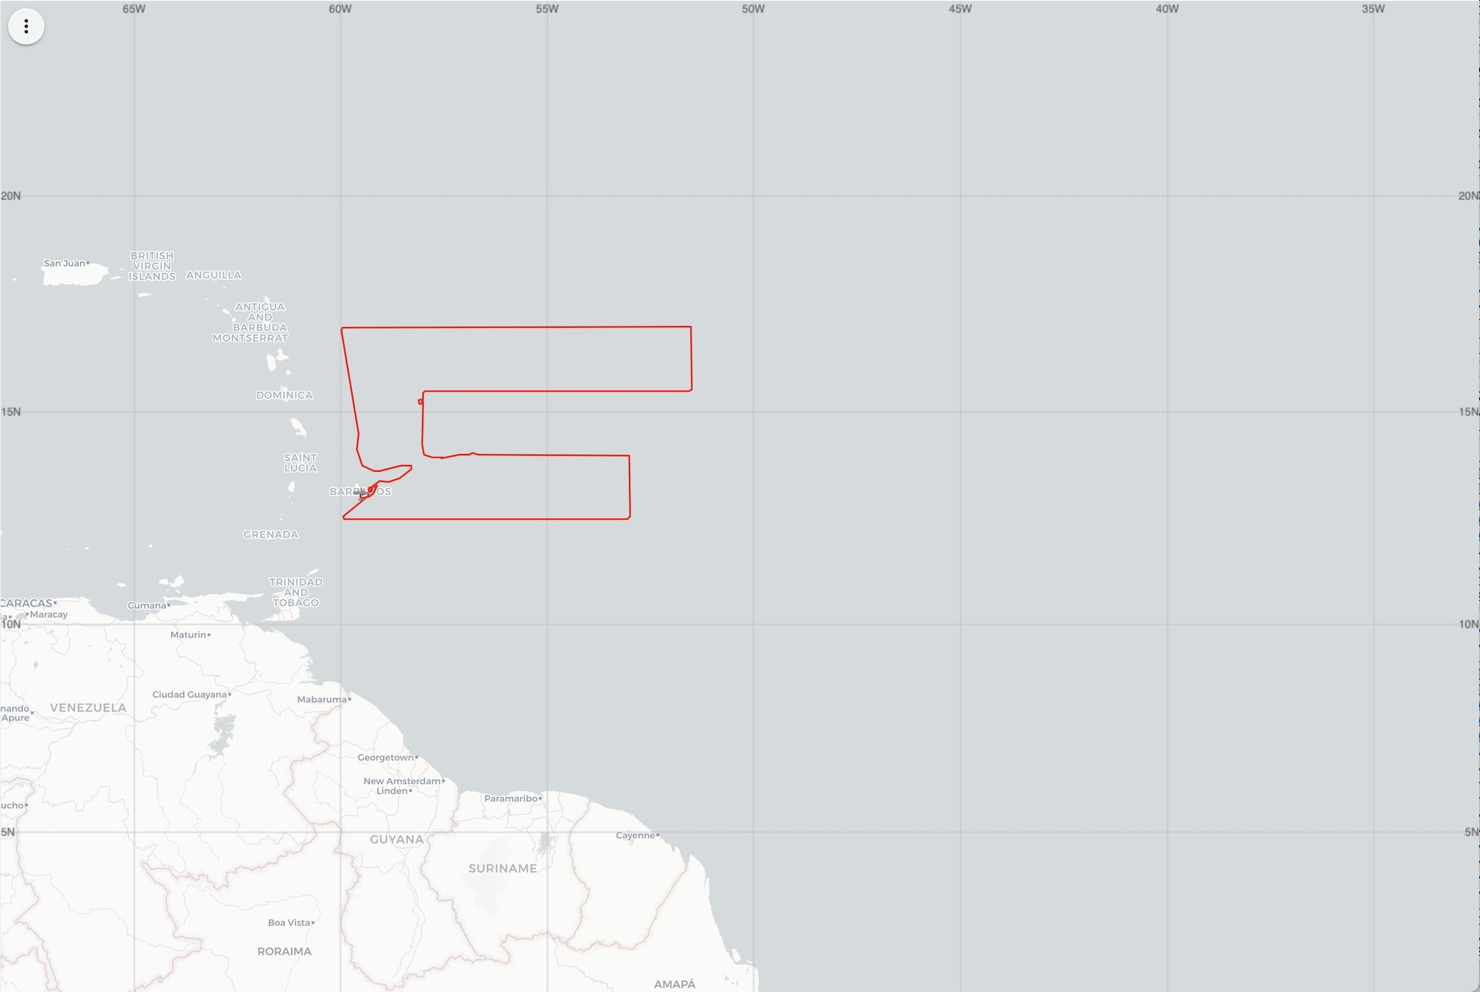
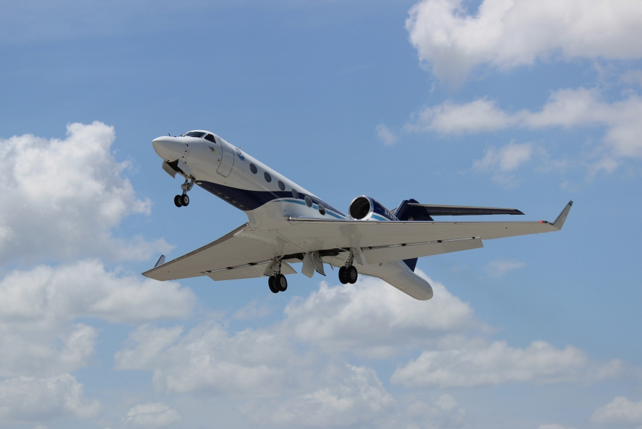
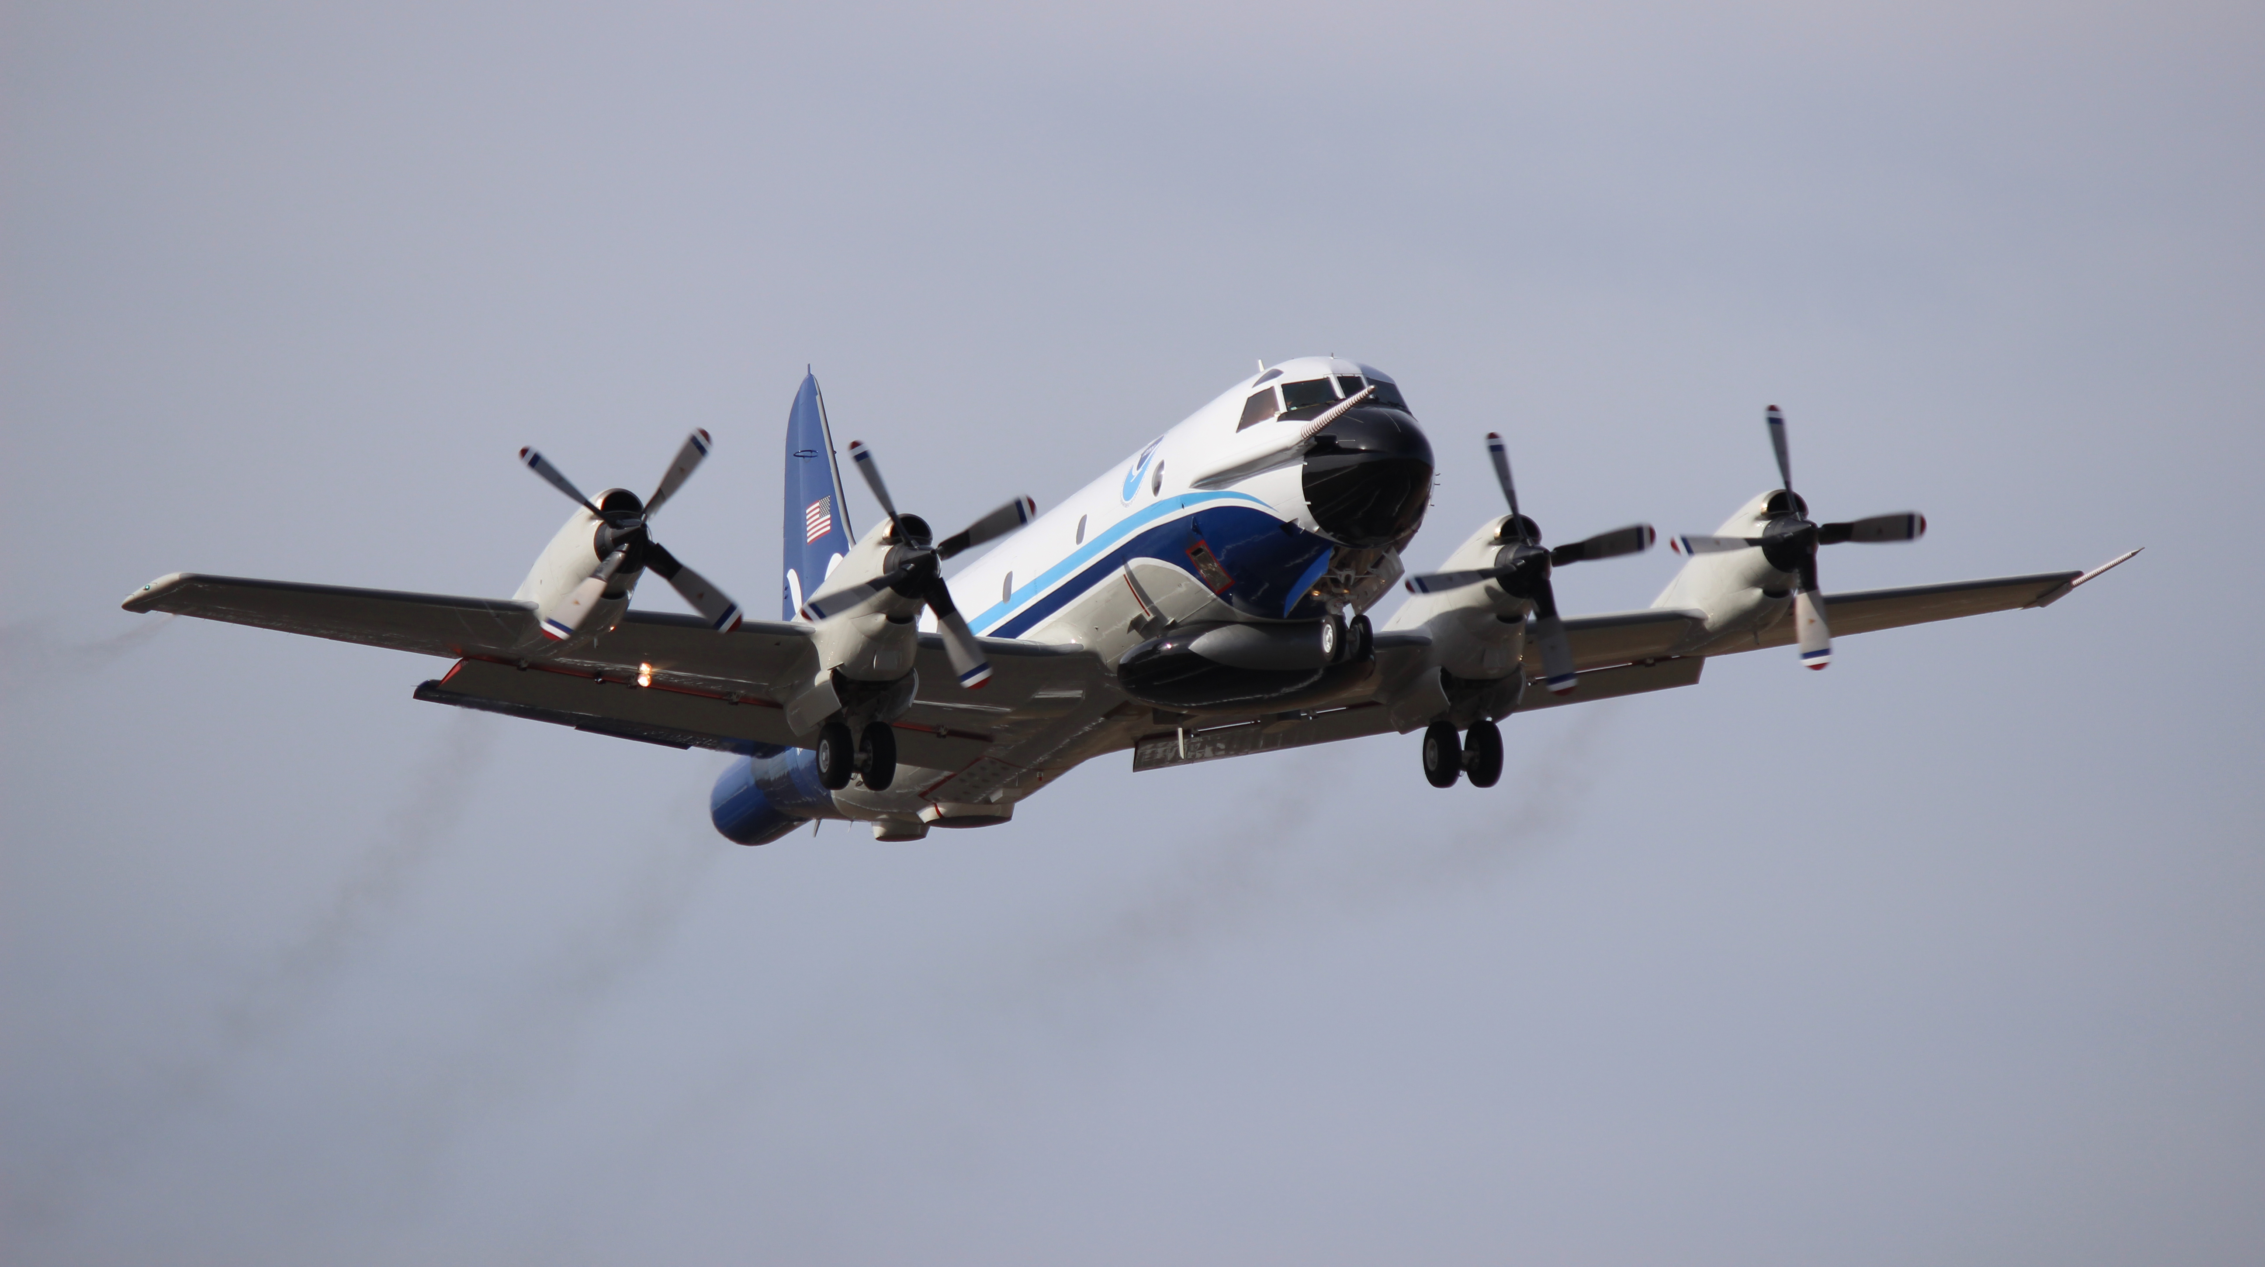
2023 Hurricane Field Program-APHEX
Summary of Missions (6-7 August)
20230806N1 (N49)
HRD (FAM)
NOAA 49
NOAA 43
20230807I1 (N43)
HRD (FAM, PREFORM MAGPIE)
20230807N1 (N49)
HRD (FAM)

Slide 4
2023 Hurricane Field Program-APHEX
Missions & Crewing
Missions & Crewing
20230806N1 (HRD): AOC FD (Aspen), Hazelton (GB LPS)
20230807I1 (HRD): Alaka (LPS, Radar), Aberson (Aspen), Rogers (GB LPS), NA (GB Radar)
20230807N1 (HRD): AOC FD (Aspen), Kaplan (GB LPS)

Slide 5
2023 Hurricane Field Program-APHEX
Logistics Highlights
Aircraft, instruments, equipment & resources
NOAA-43: prop cuff crack found before the Barbados-Lakeland ferry on 9 Aug
Part repaired, but needed time to cure >> 43 ferried home on 10 Aug
W-Band radar: still having minor interference issues…PSL instrument team is investigating
Experiments, Modules, & Coordination
20230806N1: FAM, Saharan Air Layer, numerical model sensitivity (COAMPS…GFS wasn’t tracking well)
20230807I1 mission: planned for a coordinated overflight of the ONR CIRPAS Twin Otter off the east coast of Barbados near ragged point.
Twin Otter was struck by lightning near the end of 43’s mission and before a 2-plane coordinated overflight could be completed
CIRPAS crew and mechanics assessed the Twin Otter and is back up and flying again
Still a good shakedown for NOAA-ONR aircraft comms >> Jason updated the aircraft coms sheet (frequencies, aircraft call signs etc.), we got to shakedown ground-to-aircraft & aircraft-to-aircraft coms, and the pilots got to meet in Barbados
20230807N1 mission: Saharan Air Layer, FAM & PREFORM, numerical model sensitivity (COAMPS…GFS still wasn’t tracking well)

Slide 6
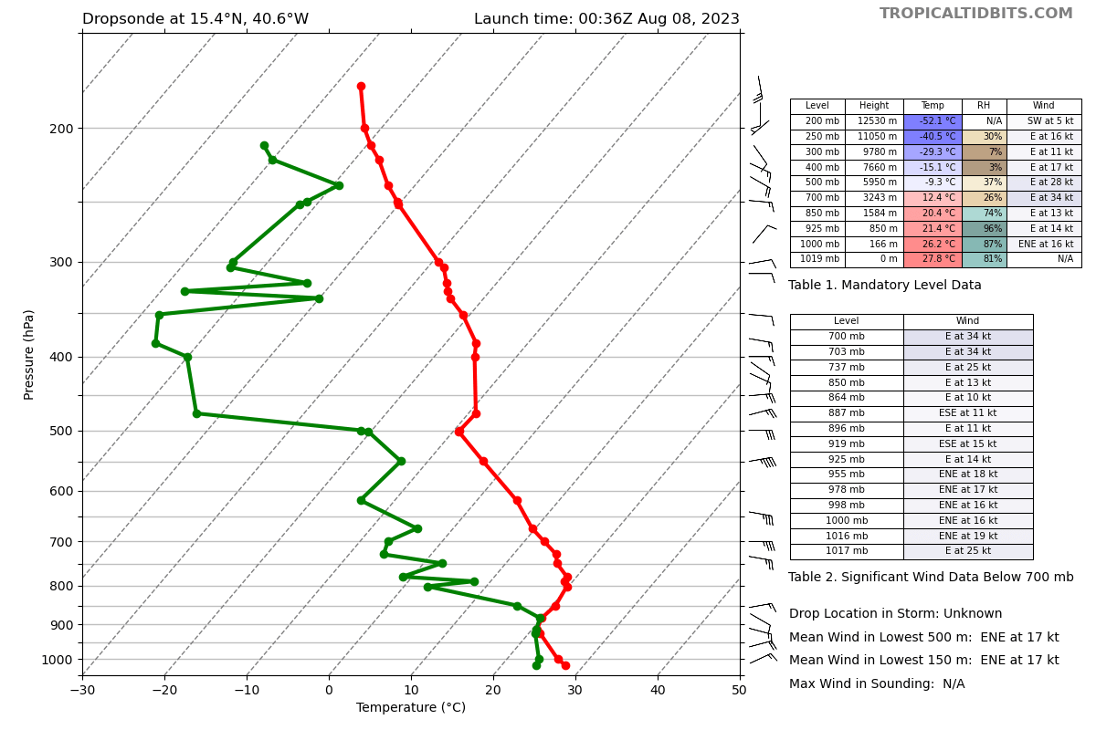
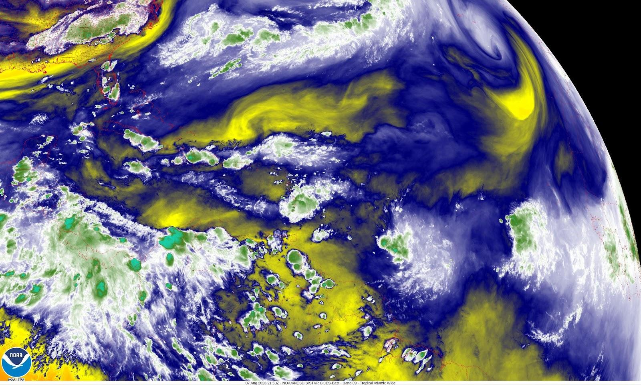
2023 Hurricane Field Program-APHEX
Interesting or Challenging Observations
Dropsondes
20230807N1- Drop on NE side of wave- Very dry in mid to upper levels (26% RH at 700 mb and 4% at 400
mb) with strong mid-level jet (550 mb >> 42 kt @ 82º)
Vertical Wind Shear 200-700 hPa: 38kt @266º
200-850 hPa: 18kt @ 251º
5kt @ 229 deg
42kt @ 81 deg
35kt @ 85 deg
NESDIS Mid-level water vapor @ 2150 UTC on 230807. Dry mid-levels on the northern side of the wave axis seen in the above NESDIS water vapor image.
34kt @ 91 deg
13kt @ 79 deg

Slide 7
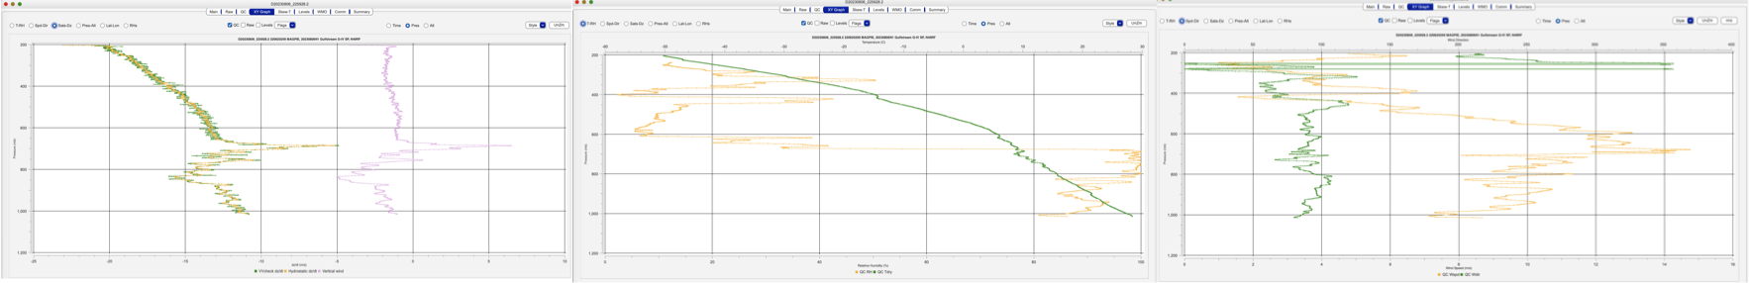
2023 Hurricane Field Program-APHEX
Interesting or Challenging Observations
Dropsondes
20230807N1- All drops in mainly quiescent environment (low wind speeds, not much vertical motion) except #2, with large upward and downward vertical velocity. Satellite picture shows no deep convection in area. Large updraft at what appears to be cloud top.

Slide 8
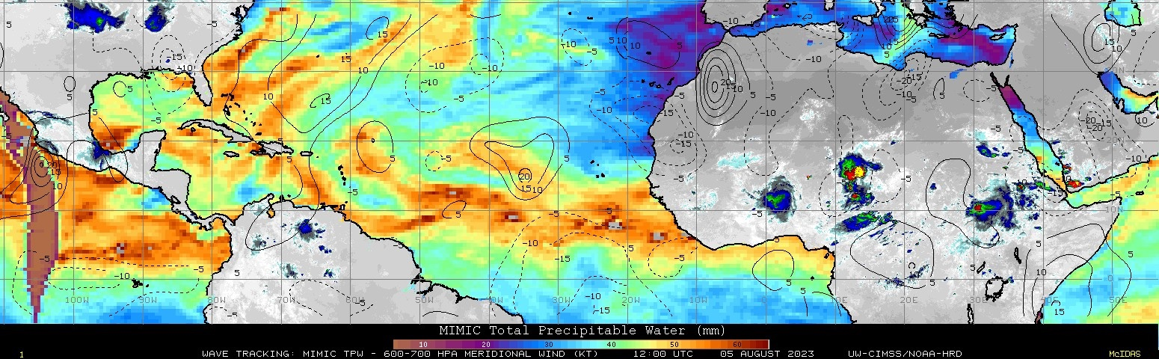
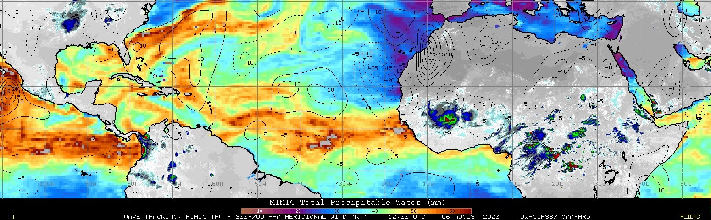
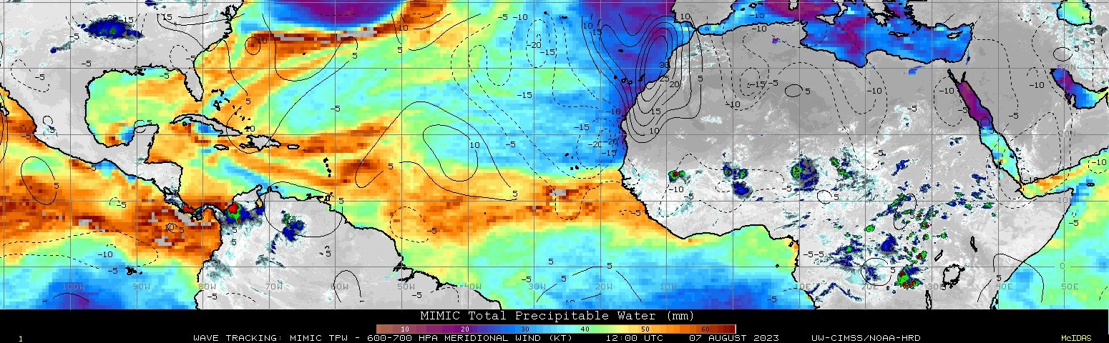
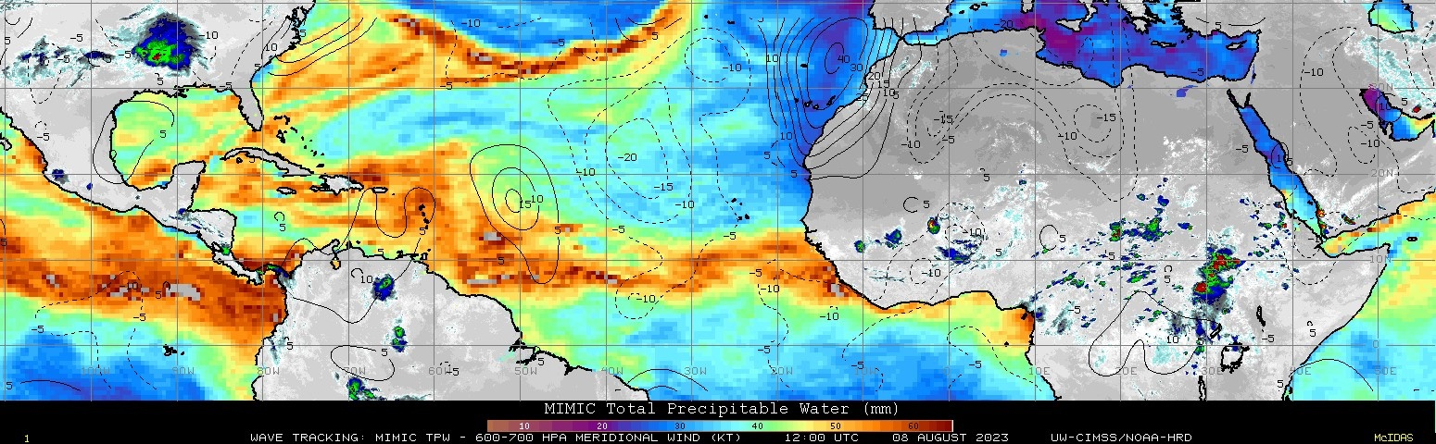
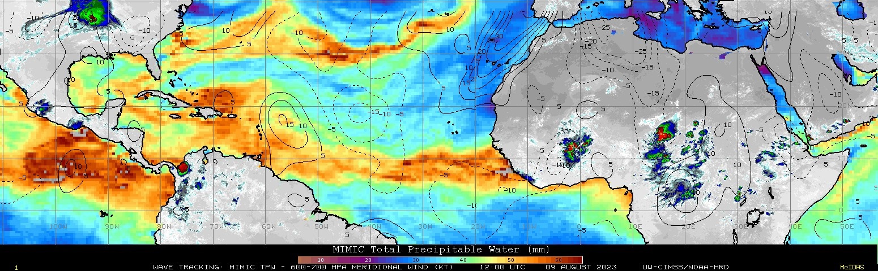
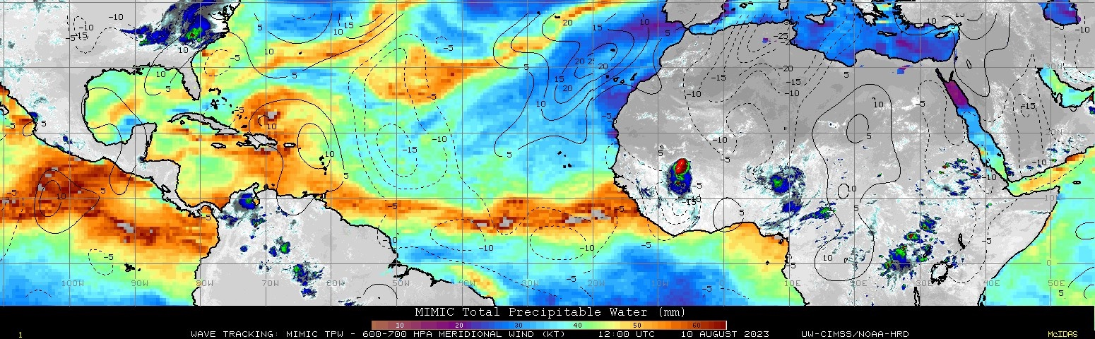
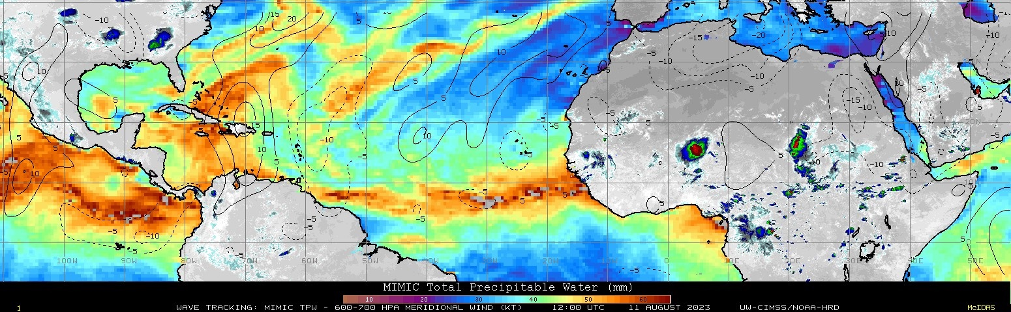
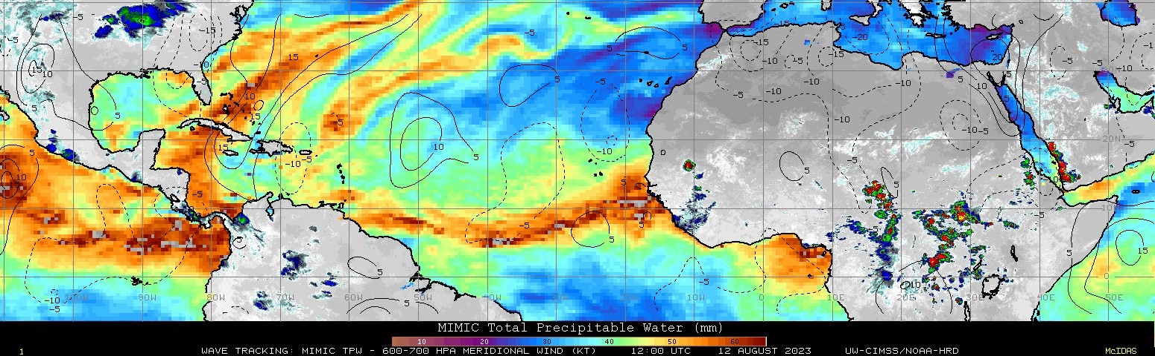
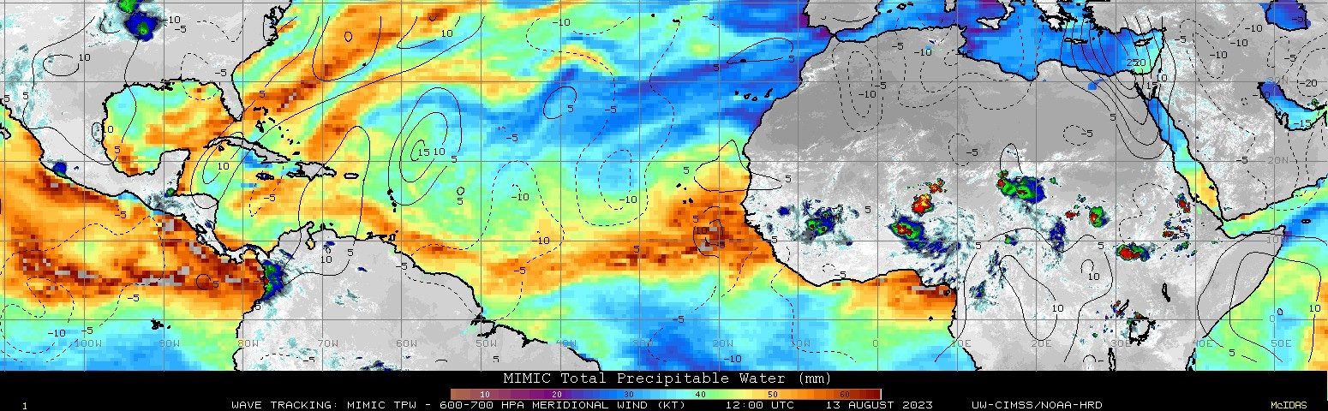
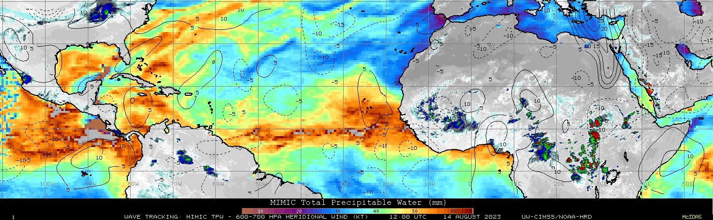
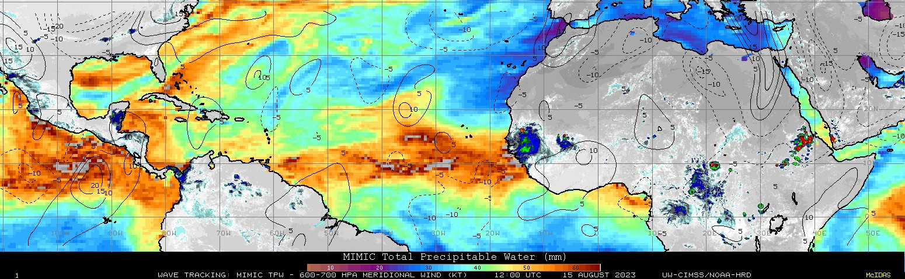
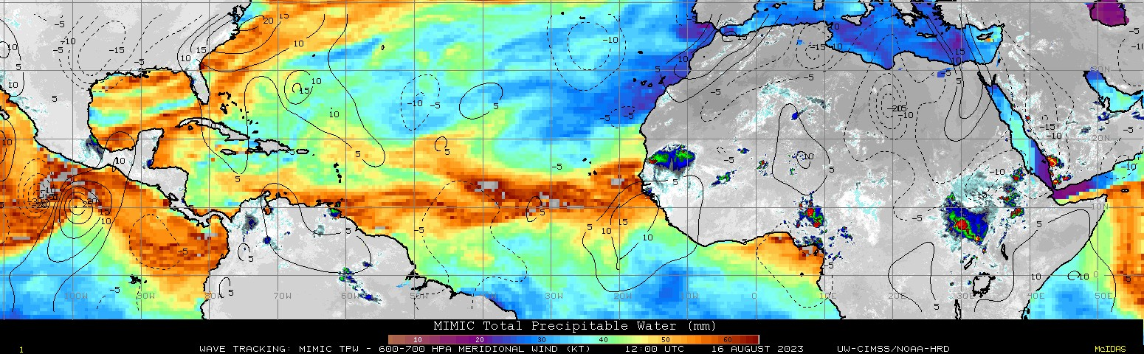
2023 Hurricane Field Program-APHEX
Synoptic Set-up: AEWs, SAL, and mid-latitude dry air intrusions
CIMSS MIMIC-TPW & 600-700 hPa Meridional Wind: 5-16 Aug 2023
MLDAI 1
SAL 2
MLDAI 1
MLDAI 1
AEW 2
MLDAI 1
AEW 2
SAL 2
MLDAI 1
AEW 2
SAL 1
MLDAI 1
SAL 2
MLDAI 1
SAL 3
AEW 2
MLDAI 1
SAL 3
SAL 2
SAL 2
AEW 2
SAL 1
MLDAI 1
MLDAI 1
SAL 3
SAL 2
G-IV (PM)
AEW 1
AEW 2
SAL 3
AEW 1
SAL 5
AEW 1
SAL 5
SAL 4
SAL 3
SAL 3
SAL 4
SAL 3
SAL 3
SAL 3
AEW 2
AEW 2
G-IV (PM)
AEW 2
SAL 4
SAL 4
SAL 3
AEW 1
AEW 1
SAL 3
AEW 2
AEW 2+3
AEW 1
SAL 1
SAL 1
SAL 1
SAL 1
AEW 2+3
SAL 3
SAL 4
AEW 2+3
SAL 4
AEW 4
AEW 3
SAL 4
AEW 4
AEW 4
AEW 4
AEW 2+3
AEW 4
AEW 4
AEW 2+3
AEW 2+3
P-3 (AM)
Pre-TS
Hilary
AEW 3
AEW 3
AEW 3
AEW 3

Slide 9
2023 Hurricane Field Program-APHEX
Synoptic Set-up: AEWs, SAL, and mid-latitude dry air intrusions
Phase differences between northern and southern vorticity centers made it difficult to distinguish one wave from another.
Abundant background vorticity, but lack of coordination
15N
FASTER FLOW
10N
SLOWER FLOW
OUT OF PHASE

Slide 10
2023 Hurricane Field Program-APHEX
Synoptic Set-up: AEWs, SAL, and mid-latitude dry air intrusions
Phase differences between northern and southern vorticity centers made it difficult to distinguish one wave from another.
Abundant background vorticity, but lack of coordination
15N
FASTER FLOW
10N
SLOWER FLOW
IN PHASE

Slide 11
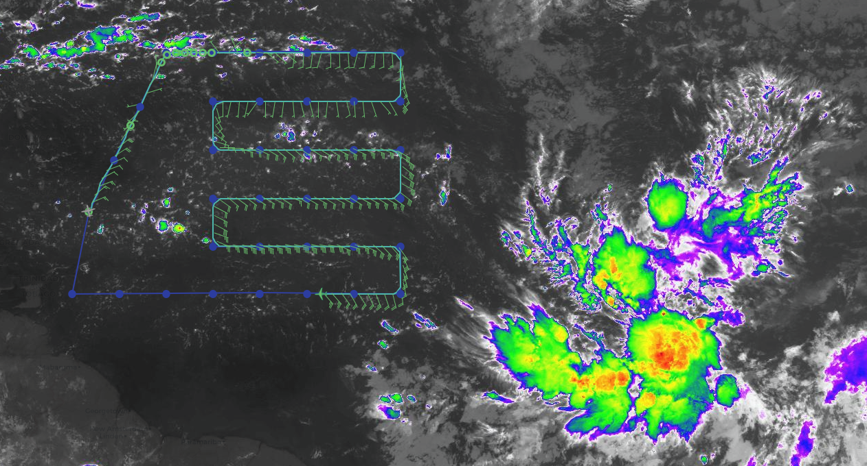
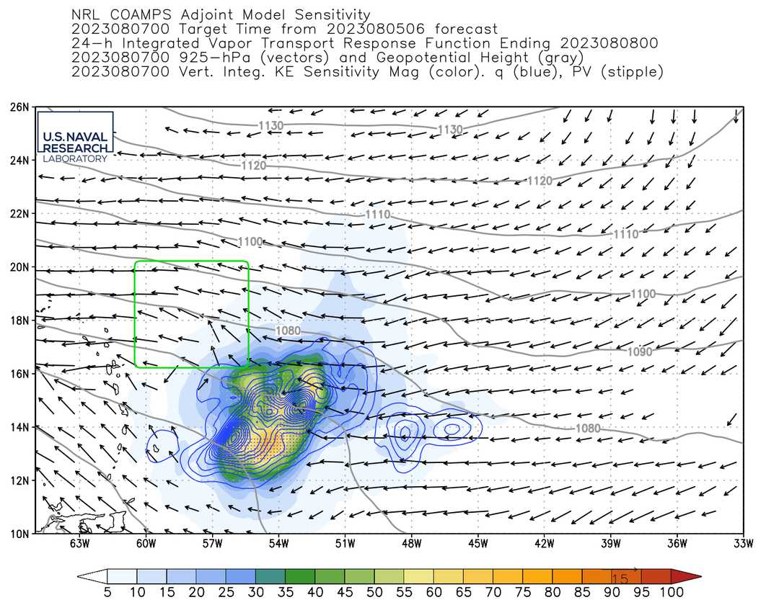
2023 Hurricane Field Program-APHEX
6-7 Aug AEWs: 20230806N1 (HRD)
Mission
Onboard
Aspen: AOC FD
Ground-Based
LPS: Hazelton, Radar: N/A
APHEX relevance:
FAM (Genesis)
Planned pattern: Lawnmower/Survey Pattern
T/O off (Barbados): 2225z, Land (Barbados): 0604z
FL 41-45 kft
Dropsondes: 36 drops (35 to GTS)
AXBTs (NRL/ONR): N/A
TDR analyses to EMC & NHC: N/A
AOC had an outdated version of Aspen
on the G-IV workstation that was
producing blank Skew-Ts.
Andy H. helped them troubleshoot and the latest version of Aspen was installed on the G-IV.
NOAA-49 flight track
Vert Int moisture sens
Vert Int wind sens
925 hPa winds
925 hPa heights
G-IV flight track
NRL COAMPS Adjoint Model Sensitivity (Jim Doyle)
Valid for 20230807 00z center time
The adjoint highlights the southern part of the AEW with sensitivity in the region 12-16N and 51-57W
The adjoint is picking up on where the moisture is being transported from

Slide 12
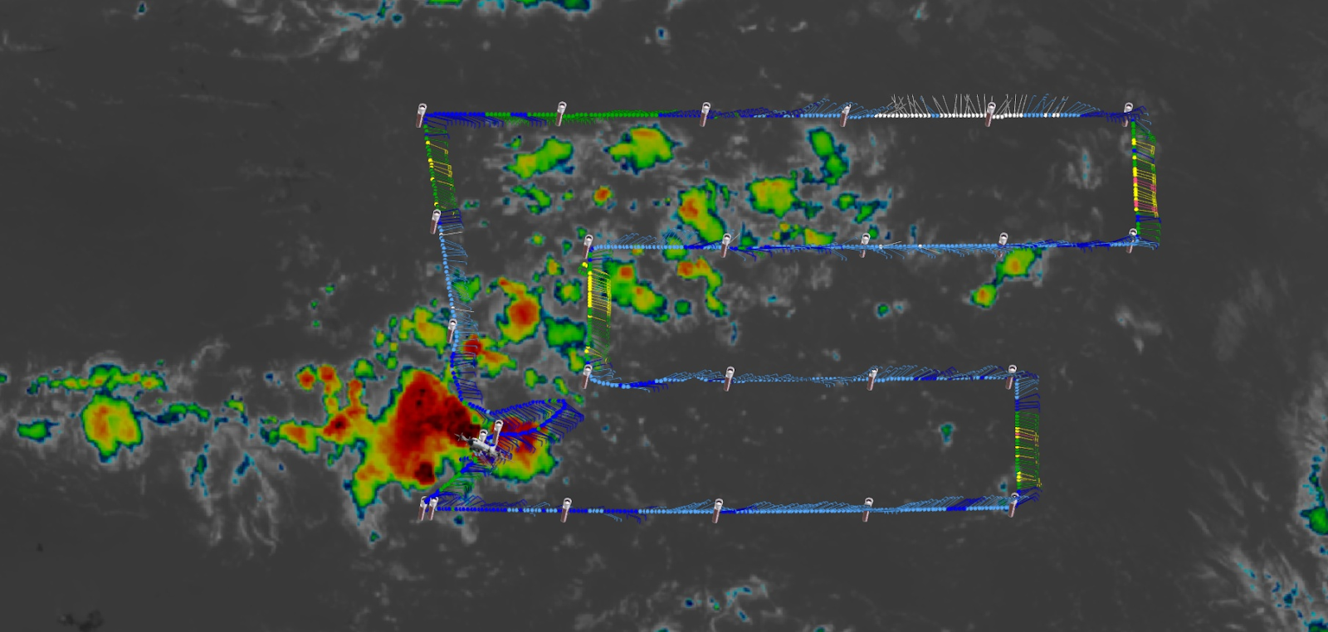
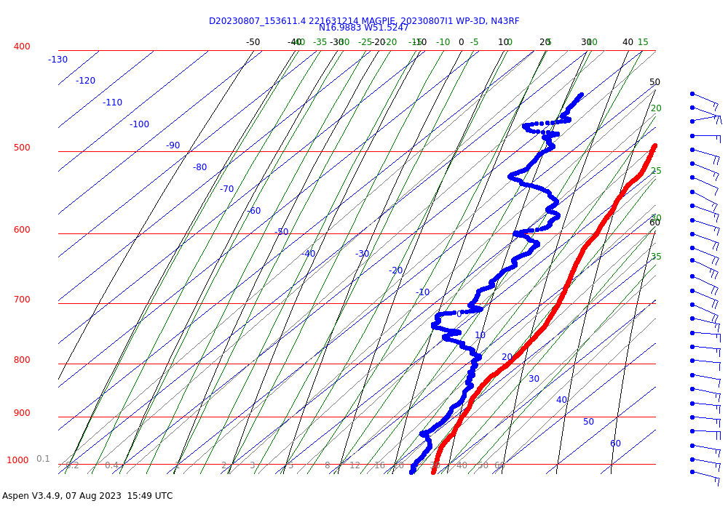
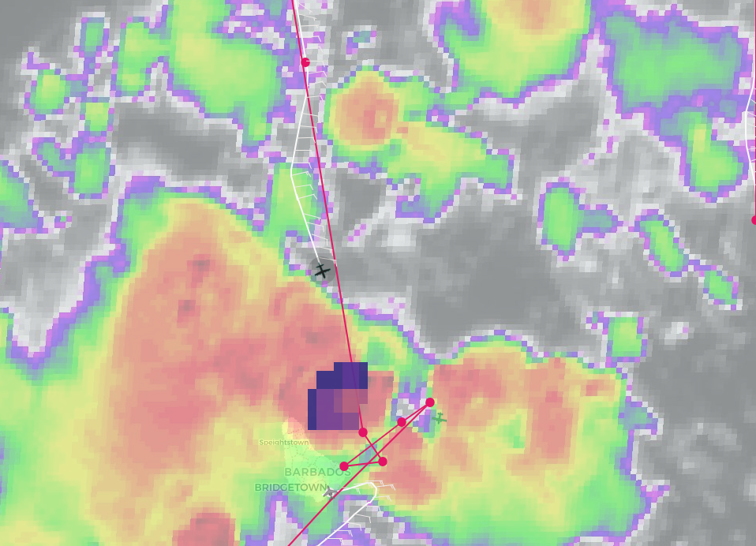
2023 Hurricane Field Program-APHEX
6-7 Aug AEWs: 20230807I1 (HRD)
Mission
Onboard
LPS/Radar: Alaka, Aspen: Aberson
Ground-Based
LPS: Rogers, Radar: N/A
APHEX relevance:
FAM, PREFORM (Genesis); MAGPIE Coordination
Planned pattern: Lawnmower/Survey Pattern
T/O off (Barbados): 1059z, Land (Barbados): 1843z
FL ~15-25 kft (pressure)
Dropsondes: 25 drops (25 to GTS)
AXBTs: 6 (4 good)
TDR analyses to EMC & NHC: N/A
Notes
Good sampling of N-S humidity gradient in lawnmower pattern; dry air in NE of pattern
Developing MCS at coordination point prevented coordinated pattern between P-3 and Twin Otter
NOAA-43 flight track
Skew-T from northeasternmost point showing dry air
Satellite image during attempted Twin Otter coordination

Slide 13
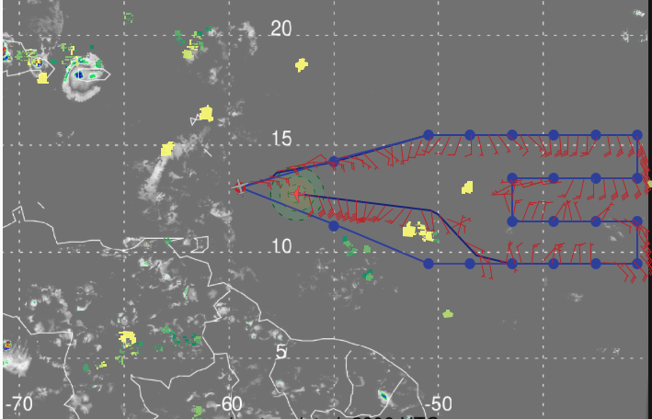
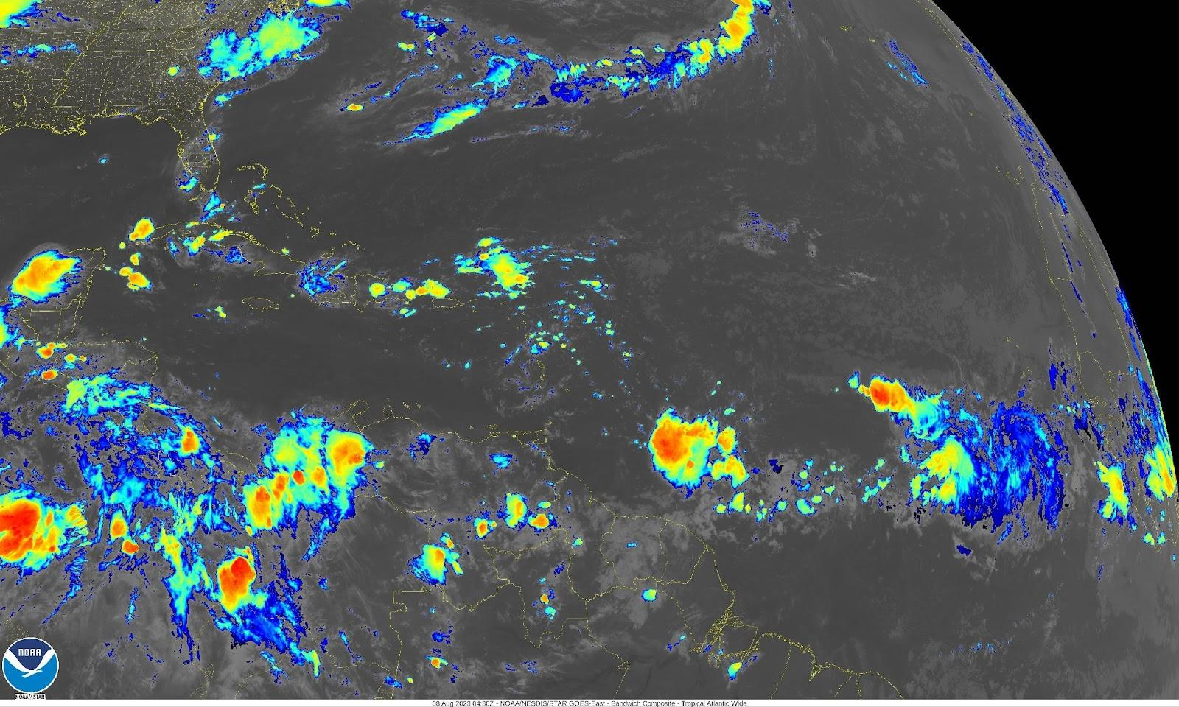
2023 Hurricane Field Program-APHEX
6-7 Aug AEWs: 20230807N1 (HRD)
Mission
Onboard
Aspen: AOC FD
Ground-Based
LPS: Kaplan, Radar: N/A
APHEX relevance:
FAM (Genesis)
Planned pattern: Lawnmower/Survey Pattern
T/O off (Barbados): 2200z, Land (Barbados): 0552z
FL 41-45 kft
Dropsondes: 25 drops (21 to GTS)
AXBTs (NRL/ONR): N/A
TDR analyses to EMC & NHC: N/A
Notes
Very dry mid to upper levels on northern portion of pattern with moist environment seen on southern side.
Evidence of mid-level jet seen on several drops.
Significant deviation from planned flight track near drop 19 was required to avoid deep convection so drops 20-22 made at different locations than planned.
NOAA-49 flight track
NESDIS IR image at 0430 UTC on 230808.

Slide 14
2023 Hurricane Field Program-APHEX
Social Media
AOML-HRD-NOAA Research Twitter
N/A
N/A
HRD Blog
NOAA Hurricane Field Program concludes research missions in the Central Atlantic
https://noaahrd.wordpress.com/2023/08/09/noaa-hurricane-field-program-concludes-research-missions-in-the-central-atlantic/
AOML Instagram & Facebook
N/A
N/A

Slide 15
2023 Hurricane Field Program-APHEX
Communications
Daily Plan of the Day (POD)
Sent daily to research partners, OAR Comms, AOML Comms
Laura Chaibongsai, Marike Pinsonneault, Jason D., Heather H. and Rob R.
Post-map discussion tag-up to discuss social media opportunities

Slide 16
2023 Hurricane Field Program-APHEX
Health-Safety-Sexual Assault/Sexual Harassment (SASH)
Any issues with health-safety-SASH, either during missions or downtime - anonymous responses can be submitted at:
https://docs.google.com/forms/d/e/1FAIpQLSeiFLPksVEXNmAvOKGAX259lKVAcIG0kh8TME6DU3xxatN6Gw/viewform
Discussions with crew suggest that there is an issue with safety, especially SASH safety, during time on the ground in public spaces or hotels.
Possibly develop a list of items that are legal to carry in different places (pepper spray, horns/alarms, etc.)
Other suggestions welcome (contact Sim Aberson, Emily Osborne, or Felix Muñoz, or use google form above.
Two new Victim Advocate Liaisons at AOC, and other contacts:
Laura Rock (laura.rock@noaa.gov)
Pete Gliechauf (peter.r.gliechauf@noaa.gov) - awaiting final certification
Emily Osborne (emily.osborne@noaa.gov) - AOML/OCED
Felix Muñoz (felix.munoz@noaa.gov) - NOAA/WVPR

Slide 17
2023 Hurricane Field Program-APHEX
Other Issues – what went well?...what can we do better?
What can we do better?
Improved communications between the HRD GB LPS and the aircraft, especially when there are no HRD onboard (e.g., 20230807N1)
Turn on TDR near convection for SA
GOV: Better communication/awareness of availability
Clarify overlaps between FAM and PREFORM
More photos and images and coordination to support social media (photo with people are good)
Confirm with AOC the best way to track Saildrones om the P-3 MMR radar
The settings for Aspen Skew-T temperature & pressure bounds don’t always behave as expected (Skew-Ts can be cut off) >> Kathryn S. will add to the Aspen cheat sheet the preferred settings for G-IV missions at 41-45 kft and P-3 missions at 10 kft and 25 kft flight levels.
For flight tracks, leave extra time before the 1st drop (so the aircraft can get up to flight level) and after the last drop (so that there’s time to close out the sonde before landing).
Dropsonde processing and transmission on the aircraft could be much more streamlined
What went well?
Good shake down missions to test equipment and processes and to test comms between NOAA (P-3s) and ONR (Twin Otter)
“Perfect game” for dropsondes on 20230807I1 (25/25)
Overlall, AOC had a good experience with the FBO and Grantley Adams ATC

Slide 18
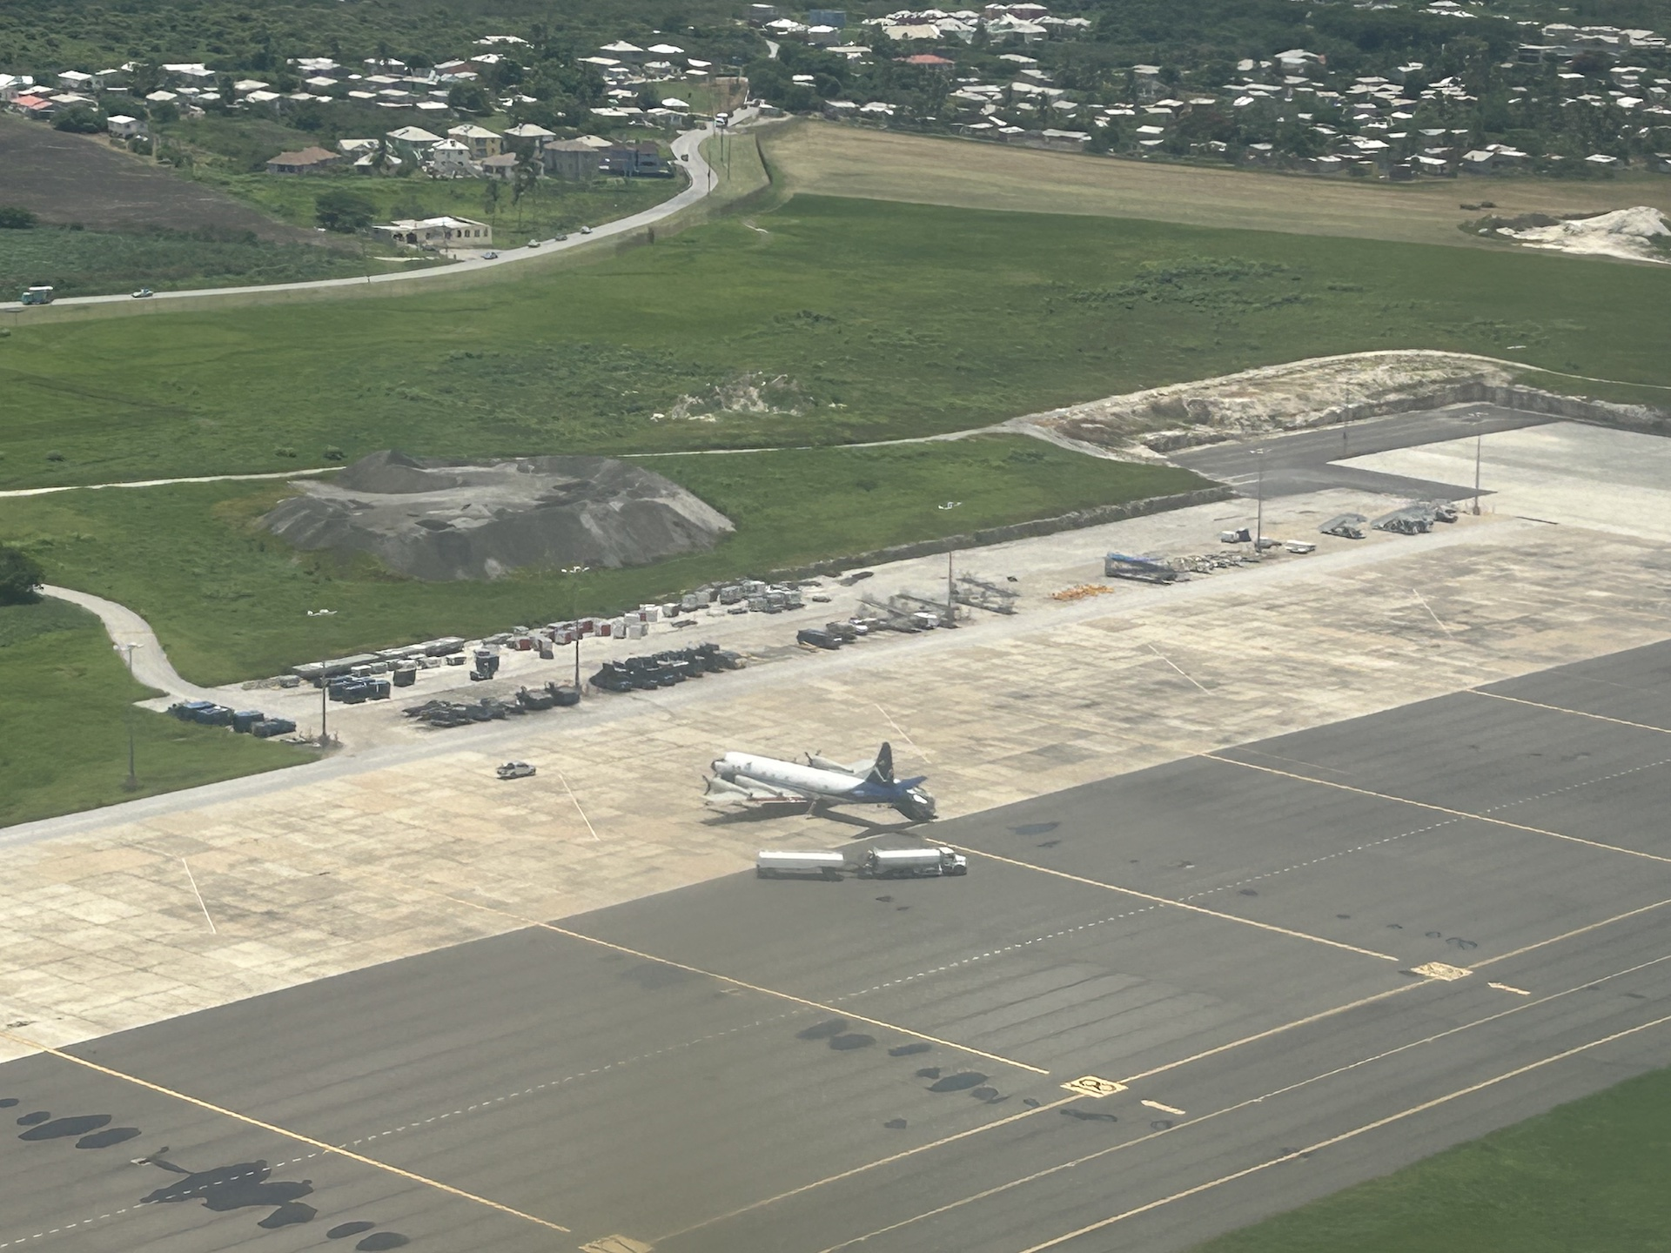
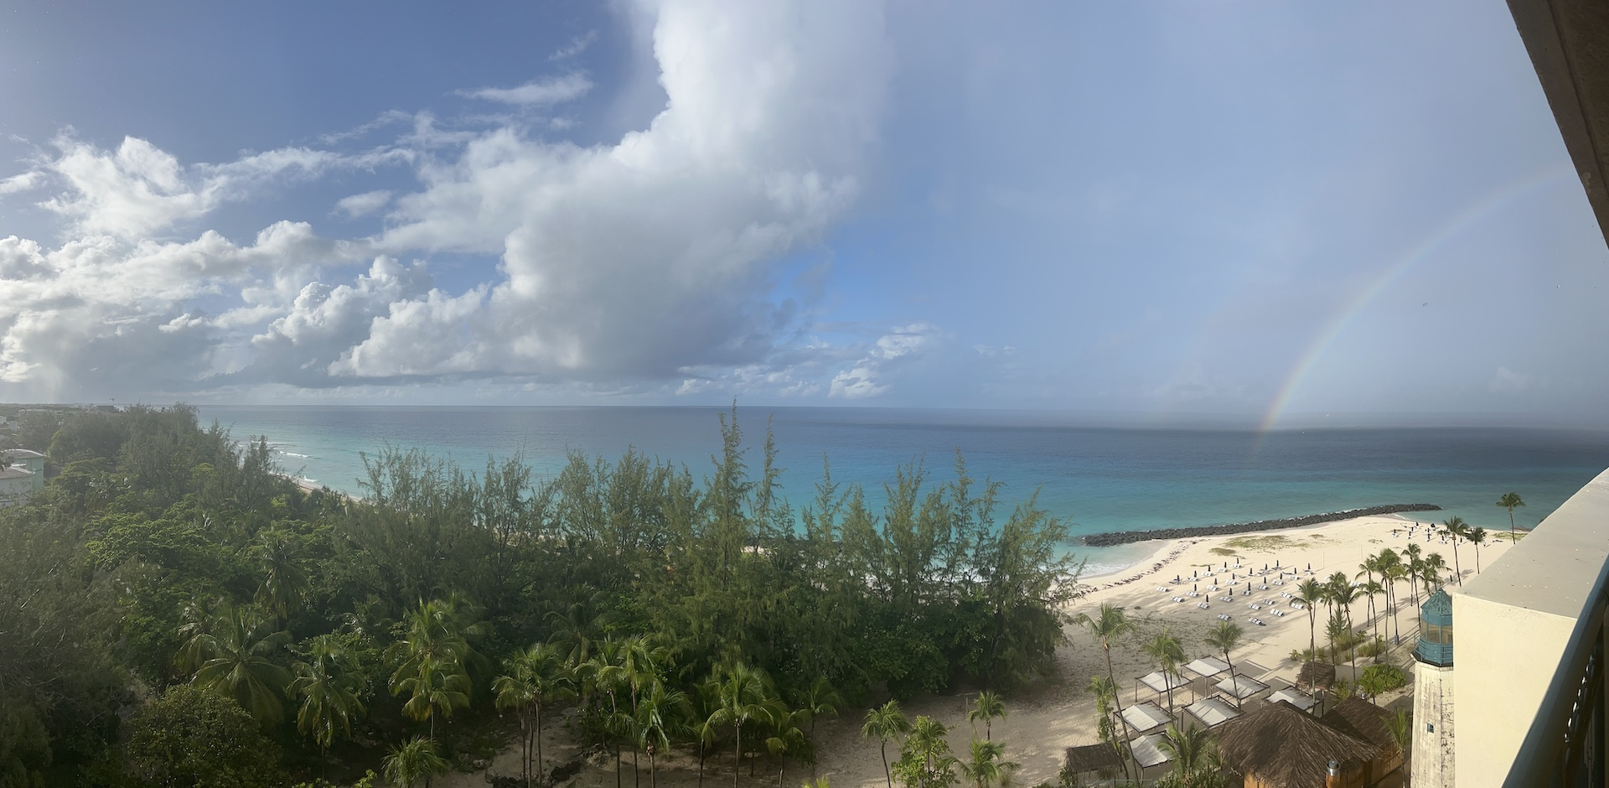
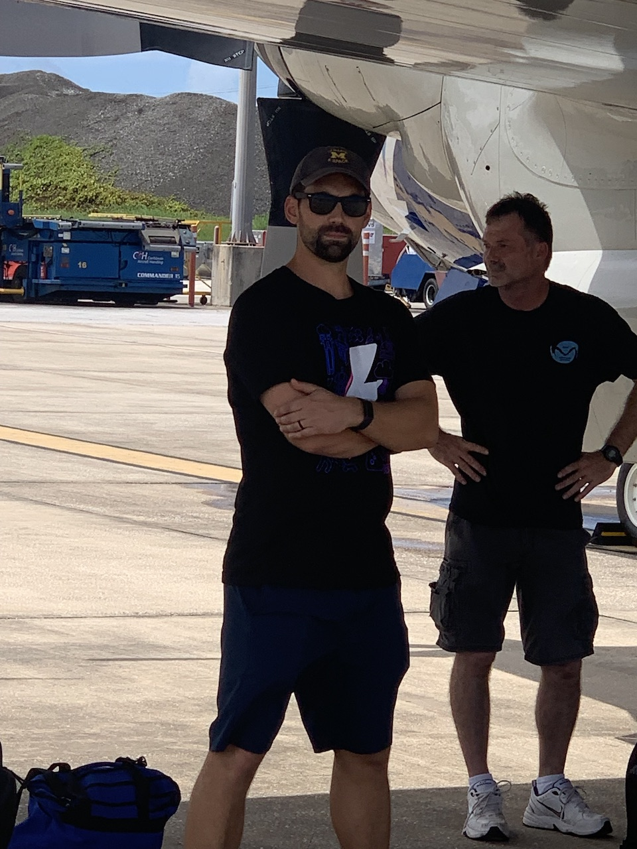
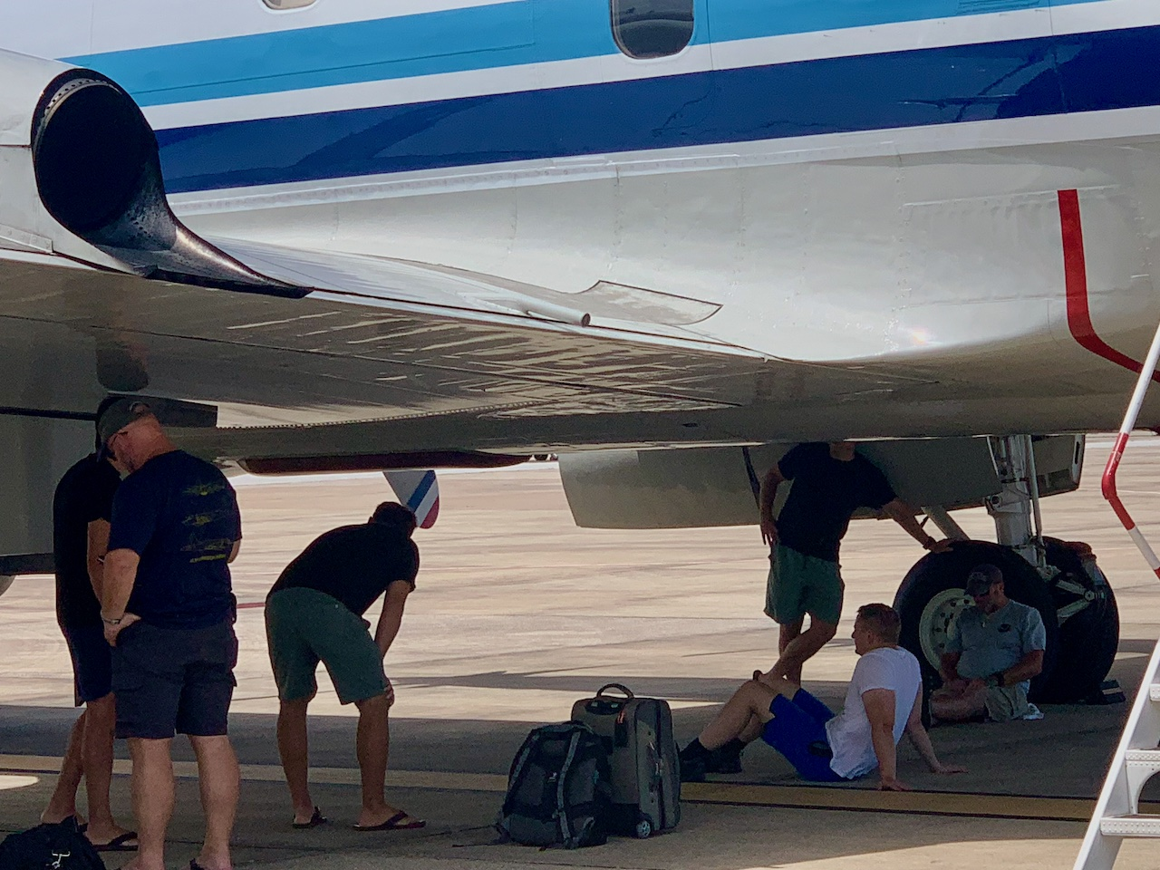
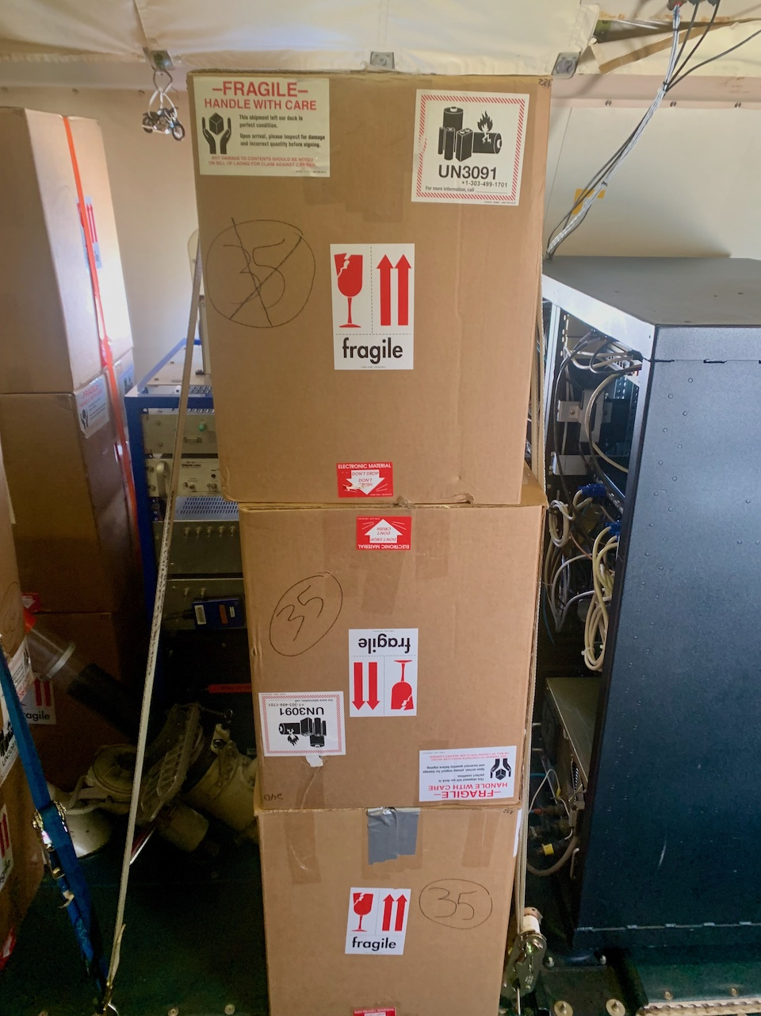

2023 Hurricane Field Program-APHEX
6-7 Aug AEWs
Photo credit Jason Dunion
Photo credit Sim Aberson
Photo credit Jason Dunion
Photo credit Sim Aberson
Photo credit Sim Aberson
Photo credit Heather Holbach
Photo credit Sim Aberson
Photo credit Sim Aberson
Copies of the 2023 6-7 Aug AEWs debrief can be found in the HRD Google Drive folder
HRD >> Hurricane Field Program >> 2023 >> Debriefs >> 6-7 Aug AEWs

