Slide 1



2022 Hurricane Field Program
Advancing the Prediction of Hurricanes Experiment (APHEX)
AL15/Lisa Debrief
Jason Dunion – HFP Director
Jon Zawislak - HFP Deputy Director
Photo credit: Jon Zawislak

Slide 2
2022 Hurricane Field Program-APHEX
Summary of Missions (30 October – 2 November 2022)
Mission Series Overview
5 P-3 Missions (EMC/NHC)
103 GPS dropsondes / 98 transmitted to the GTS
20 TDR analyses transmitted to EMC & NHC
APHEX Experiments & Modules: https://www.aoml.noaa.gov/2022-hurricane-field-program/
PREFORM, FAM (Genesis Stage)
AIPEX (Early Stage)
FLAIMS (AIPEX)
ONR TCRI RMWs (AIPEX)

Slide 3
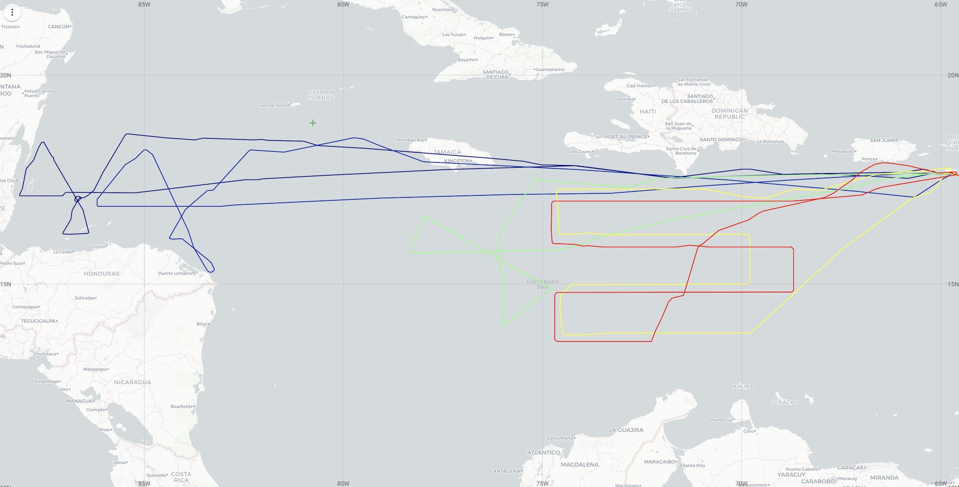
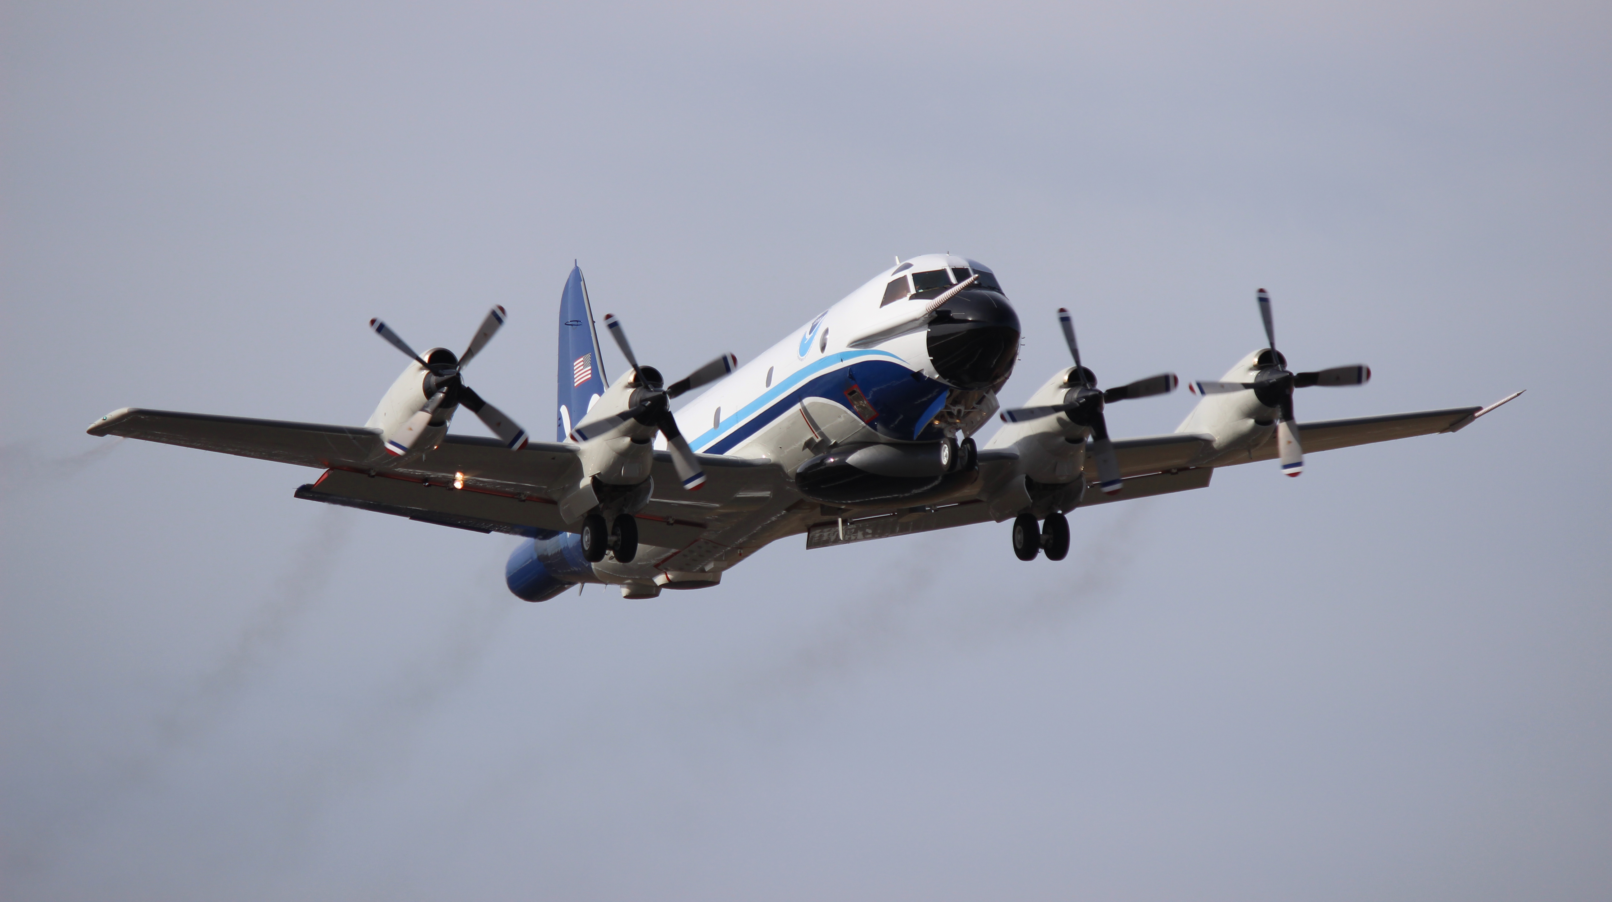
2022 Hurricane Field Program-APHEX
Summary of Missions (30 October – 2 November 2022)
NOAA 43
20221030I1 (N43)
EMC-NHC TDR
20221030I2 (N43)
EMC-NHC TDR
20221031I1 (N43)
EMC-NHC TDR
20221101I1 (N43)
EMC-NHC TDR
20221102I1 (N43)
EMC-NHC TDR

Slide 4
2022 Hurricane Field Program-APHEX
Summary of Missions (30 October – 2 November 2022)
Missions & Crewing
20221030I1 (EMC-NHC): Zawislak (LPS, Radar), J. Zhang (Aspen), None (GB LPS), Reasor >> Fischer (GB Radar)
20221030I2 (EMC-NHC): Hazelton (LPS, Radar), Sellwood (Aspen), Holbach(GB LPS), Gamache (GB Radar)
20221031I1 (EMC-NHC): Zawislak (LPS, Radar), J. Zhang (Aspen), Rogers (GB LPS), Reasor (GB Radar)
20221031I1 (EMC-NHC): PM mission cancelled (aircraft maintenance issues: TDR antennae power amp)
20221101I1 (EMC-NHC): AM mission cancelled (aircraft maintenance issues: TDR antennae power amp)
20221101I1 (EMC-NHC): Hazelton (LPS, Radar), Sellwood (Aspen), Holbach(GB LPS), Reasor (GB Radar)
20221102I1 (EMC-NHC): Zawislak (LPS, Radar), J. Zhang (Aspen), Aberson (GB LPS), Alvey (GB Radar)
20221102I2 (EMC-NHC): PM mission cancelled (Hurricane Lisa moving quickly inland)

Slide 5
2022 Hurricane Field Program-APHEX
Logistics Highlights
Aircraft, instruments, equipment & resources
Nov 4th: request from OAR re: impact of missing 2 NOAA-43 missions
The cancellation of 2 consecutive NOAA 43 missions (20221031I2 & 20221101I1) into then TS Lisa resulted in a gap of ~33 hours where no TDR data was assimilated into NOAA’s HWRF or HAFS forecast models.
This occurred during an especially critical time in Lisa's life cycle where it was apparent that the storm was becoming more organized and could intensify (potentially rapidly) before making landfall.
Experiments, Modules, & Coordination
Mission durations got long, quickly, so not much time for modules. Main coordination was on RMW sondes with ONR TCRI.
Ferries were ~3-3.5 hrs by the end of the sequence
Deployment flexibility is more challenging when 1 crew needs to fly Comair to deploy or redeploy
With 2 crews but only 1 P-3, it was not feasible to reposition (e.g., Aruba or Lakeland) before landfall

Slide 6
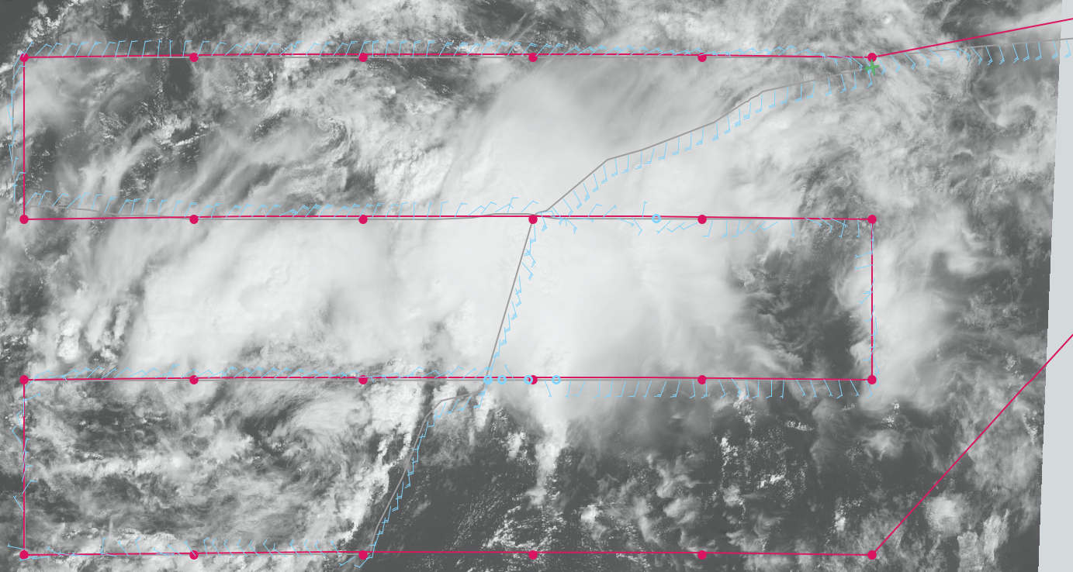
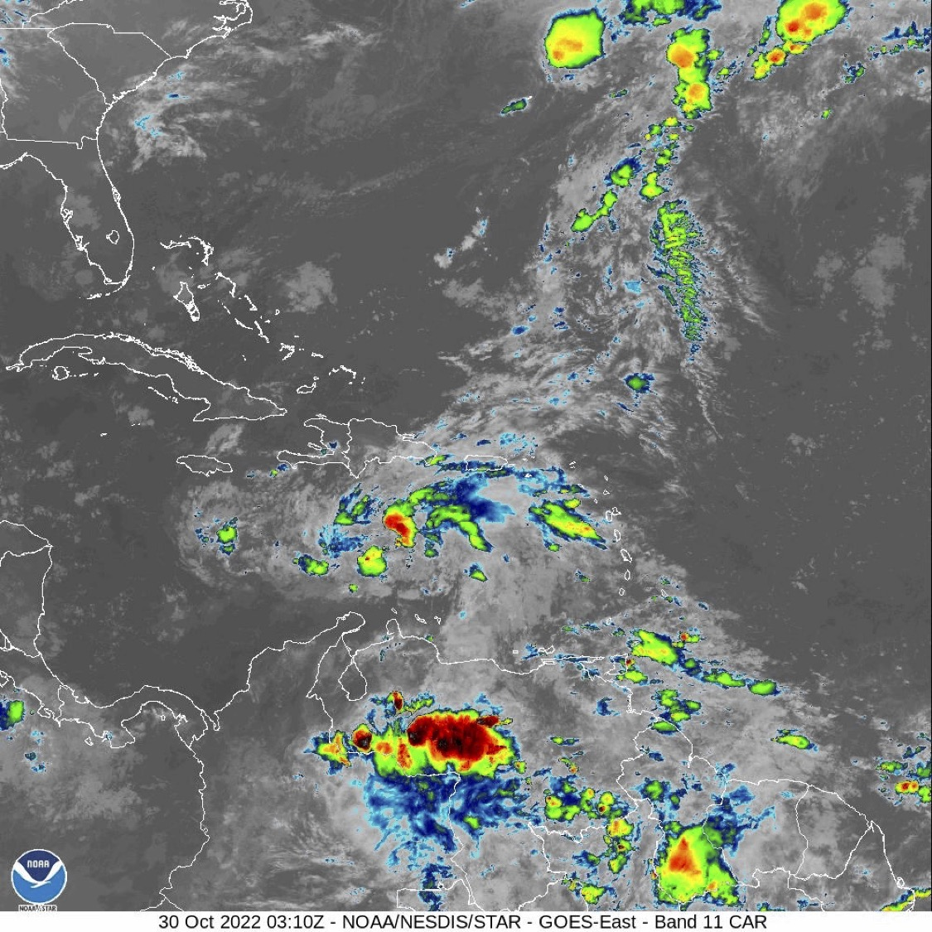
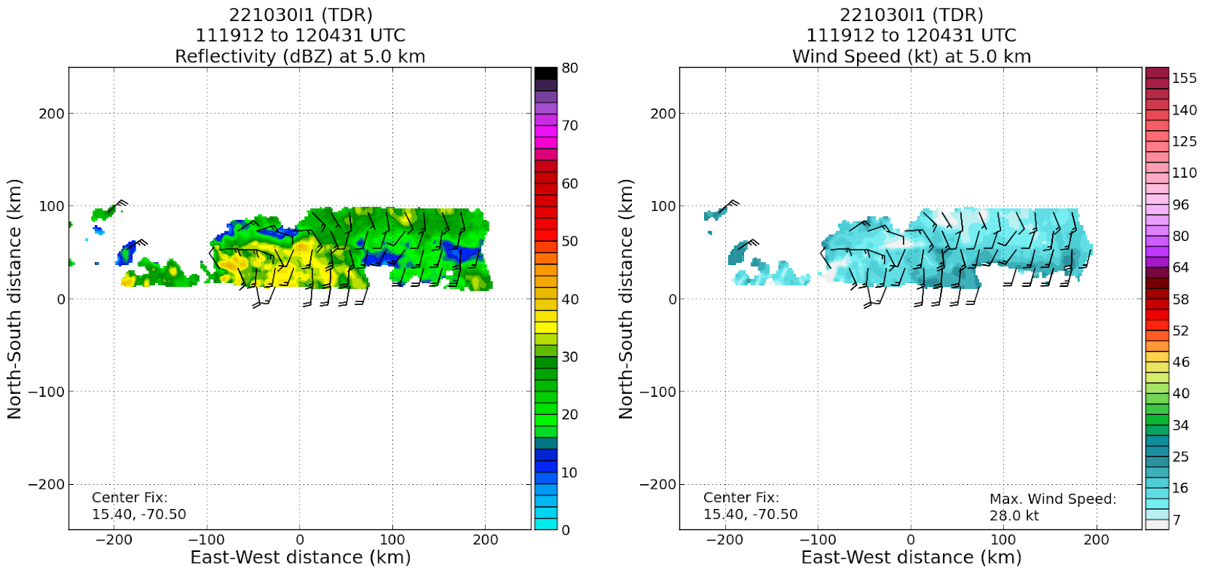
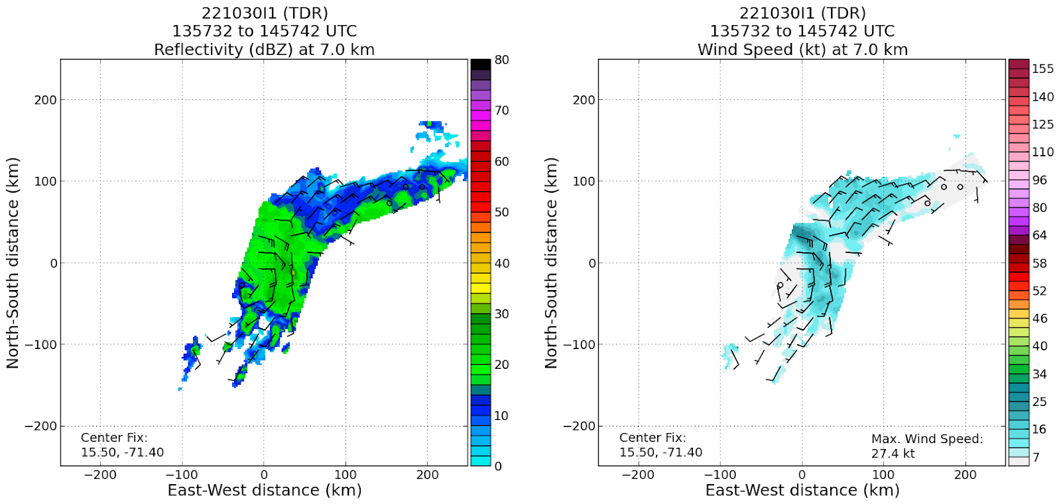
2022 Hurricane Field Program-APHEX
AL15/Lisa: 20221030I1 (EMC-NHC)
Mission (AL95)
Onboard
LPS/Radar: Zawislak, Aspen: J. Zhang
Ground-Based
LPS: None, Radar: Reasor >> Fischer
APHEX relevance:
EMC-NHC TDR, PREFORM & FAM (Genesis Stage)
Planned pattern: lawn mower
T/O off (St. Croix): 0853z, Land (St. Croix): 1558z
FL 10-25 kft (pressure)
Dropsondes: 25 drops (25 to GTS)
3 bad sondes sent to GTS, one fast fall, two with bad winds at top before equilibration
AXBTs (NRL/ONR): none
TDR analyses to EMC & NHC: 6
“It’s better than it looks” (i.e., not “It’s a mess”)...broad low-level circulation with what we believed to be an MCV development. This led to a modified final leg, passing through the convective burst area on the east side of the low.
N43 final flight track

Slide 7
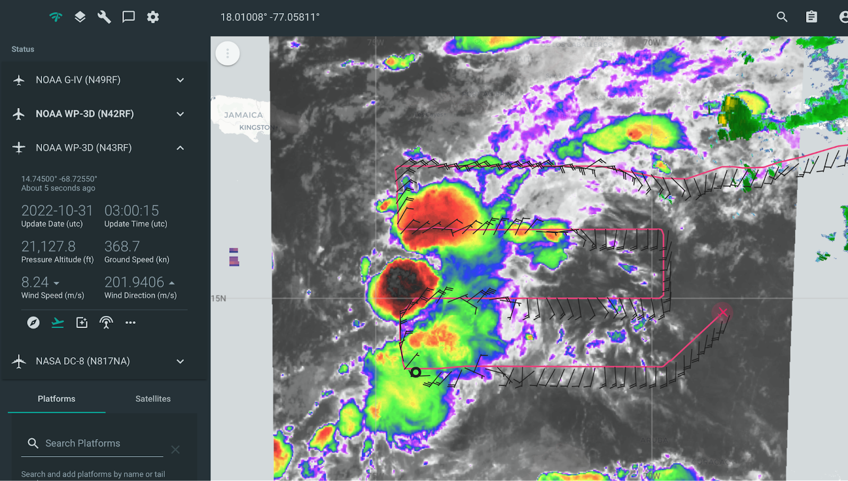
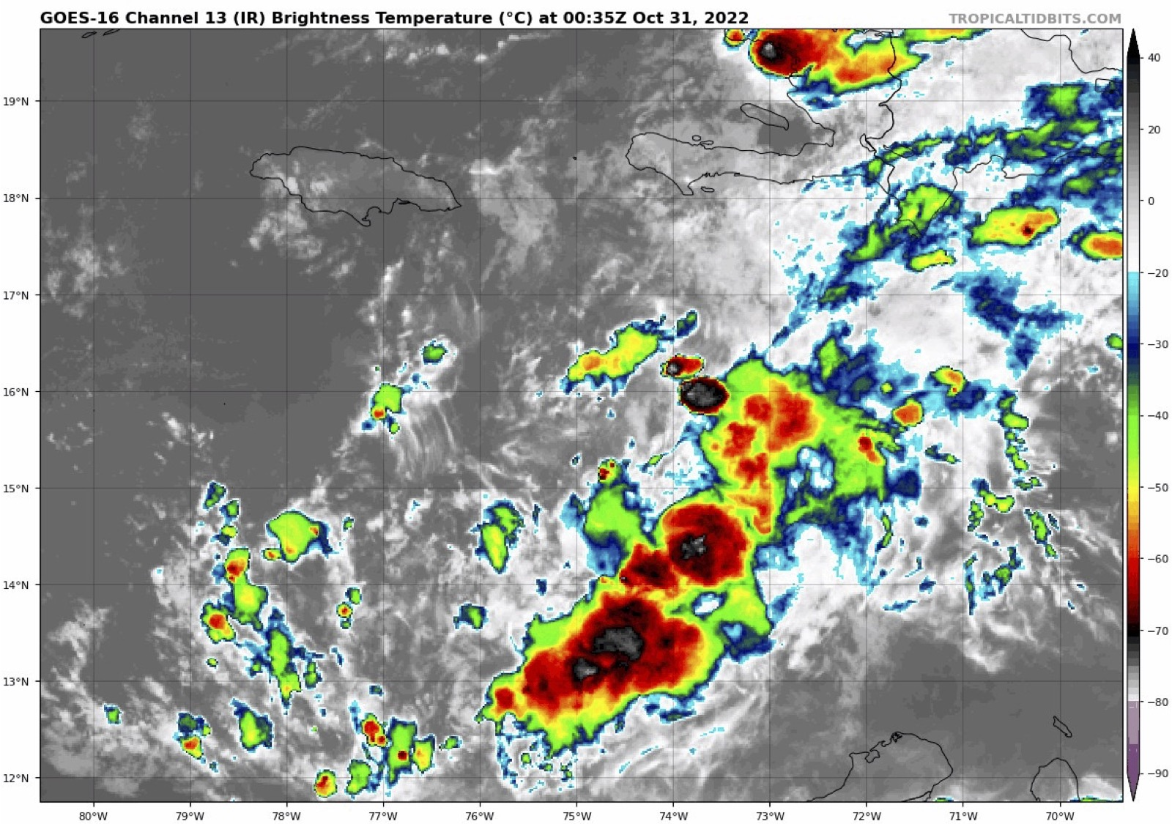
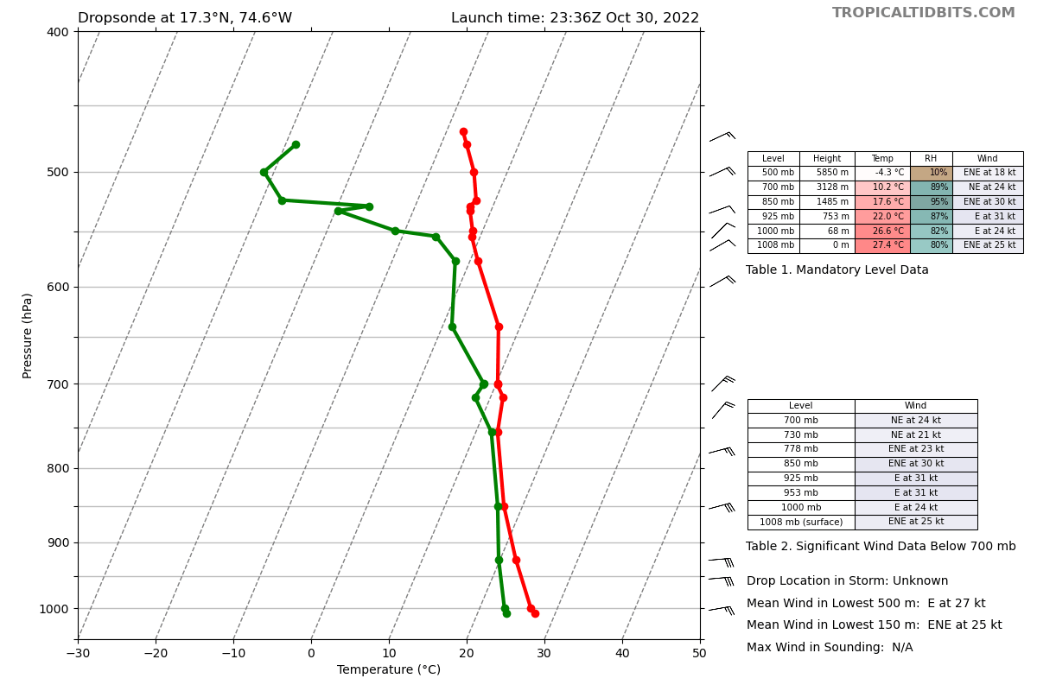
2022 Hurricane Field Program-APHEX
AL15/Lisa: 20221030I2 (EMC-NHC)
Mission (PTC15)
Onboard
LPS/Radar: Hazelton, Aspen: Sellwood
Ground-Based
LPS: Holbach, Radar: Gamache
APHEX relevance:
EMC-NHC TDR, PREFORM & FAM (Genesis Stage)
Planned pattern: lawn mower
T/O off (St. Croix): 2146z, Land (St. Croix): 0345z
FL 10-25 kft (pressure)
Dropsondes: 21 drops (20 to GTS)
AXBTs (NRL/ONR): none
TDR analyses to EMC & NHC: 5
4 westernmost points trimmed due to late takeoff
Western drops showed some dry air
Two CBs developed near the apparent LLC by the end of the mission
N43 final flight track

Slide 8
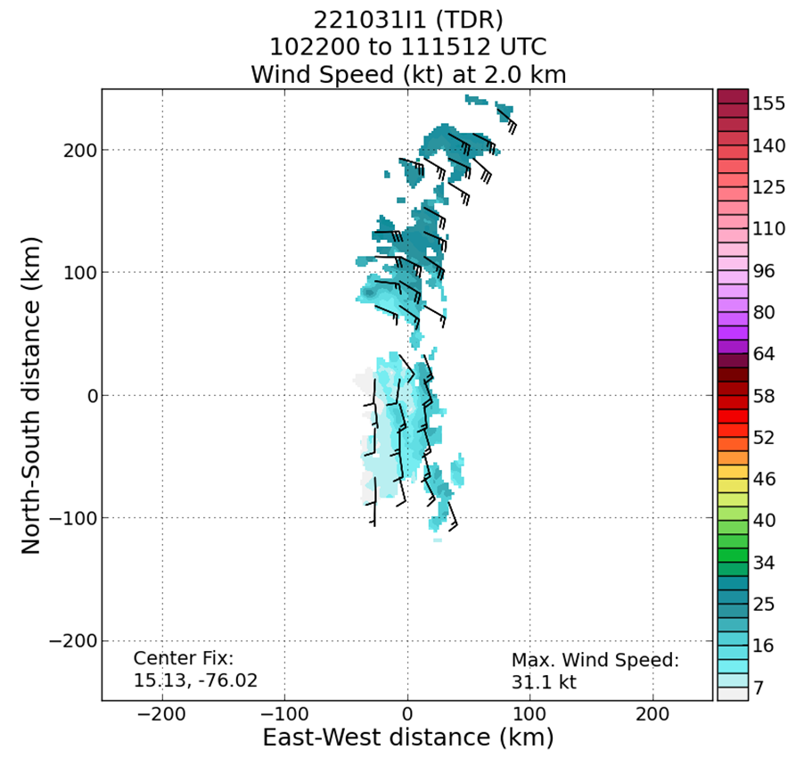
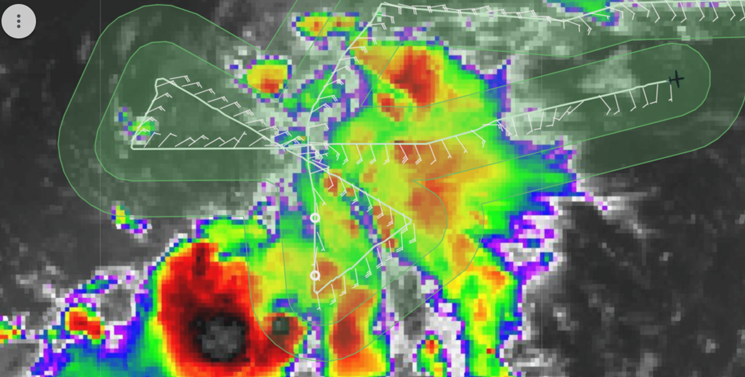
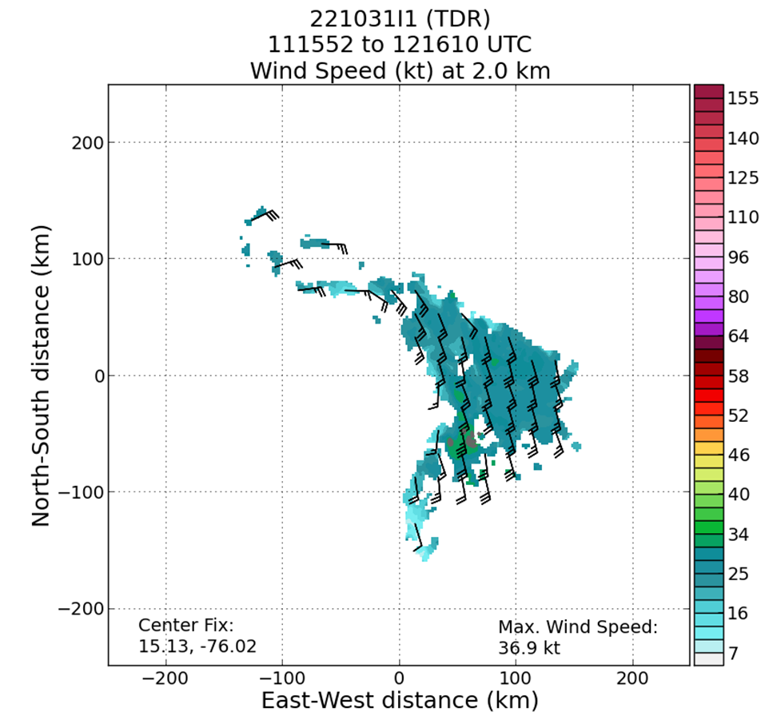

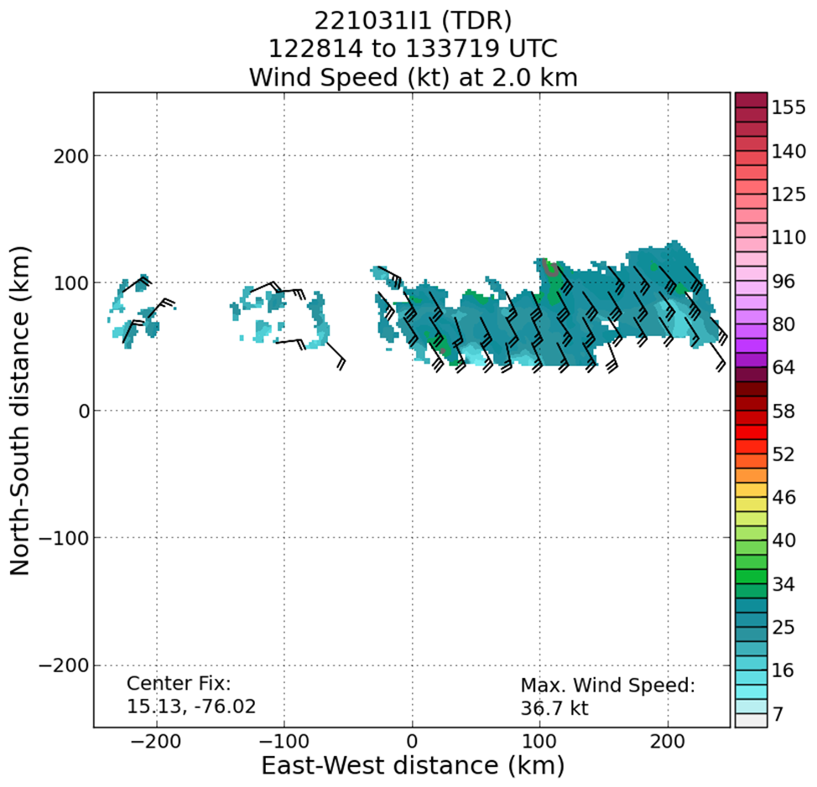
2022 Hurricane Field Program-APHEX
AL15/Lisa: 20221031I1 (EMC-NHC)
Mission (PTC15)
Onboard
LPS/Radar: Zawislak, Aspen: J. Zhang
Guest: Alexis Wilson (UM/Rosenstiel School)
Ground-Based
LPS: None, Radar: Reasor
APHEX relevance:
EMC-NHC TDR, PREFORM & FAM (Genesis Stage), AIPEX (Early Stage)
Planned pattern: butterfly
T/O off (St. Croix): 0824z, Land (St. Croix): 1515z
FL 10-15 kft (pressure)
Dropsondes: 15 drops (15 to GTS)
AXBTs (NRL/ONR): none
TDR analyses to EMC & NHC: 3
Still “exposed” LLC (sheared), but with considerable stratiform/moderately deep convection just on the east side…still “better than it looks”
But made a mistake – didn’t take the proper azimuth on the third pass (needed to be 240)
N43 final flight track

Slide 9
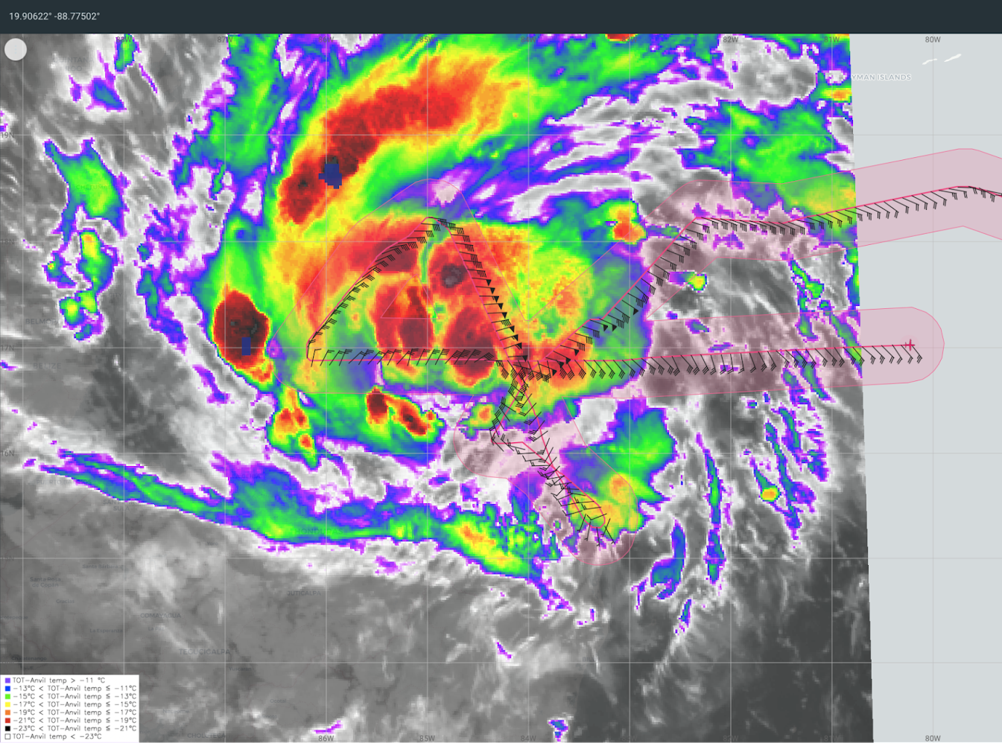
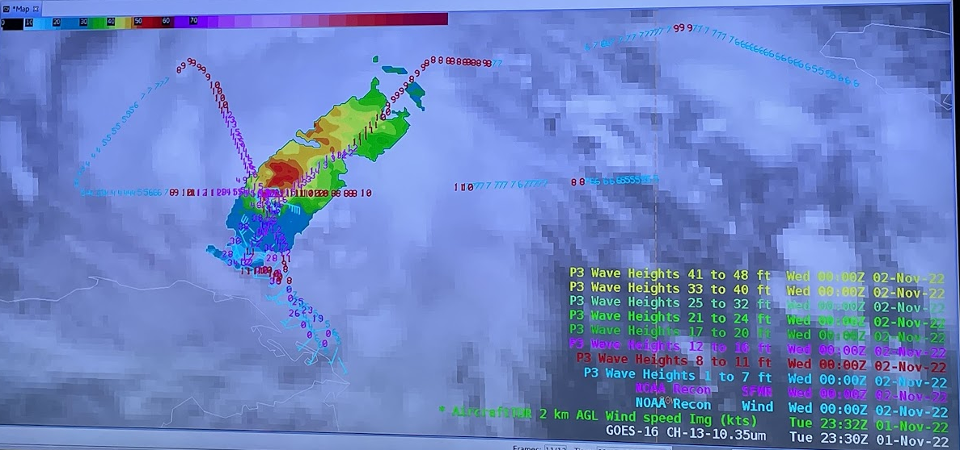
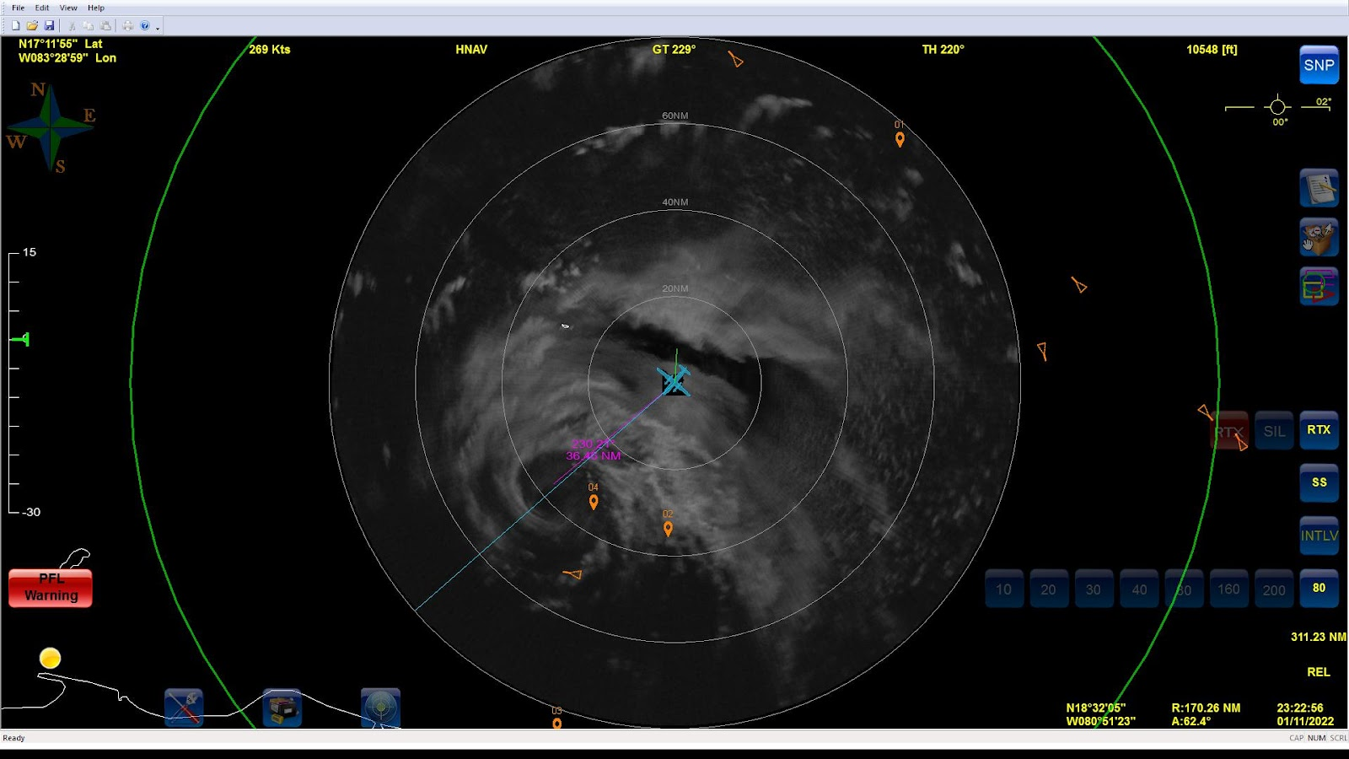
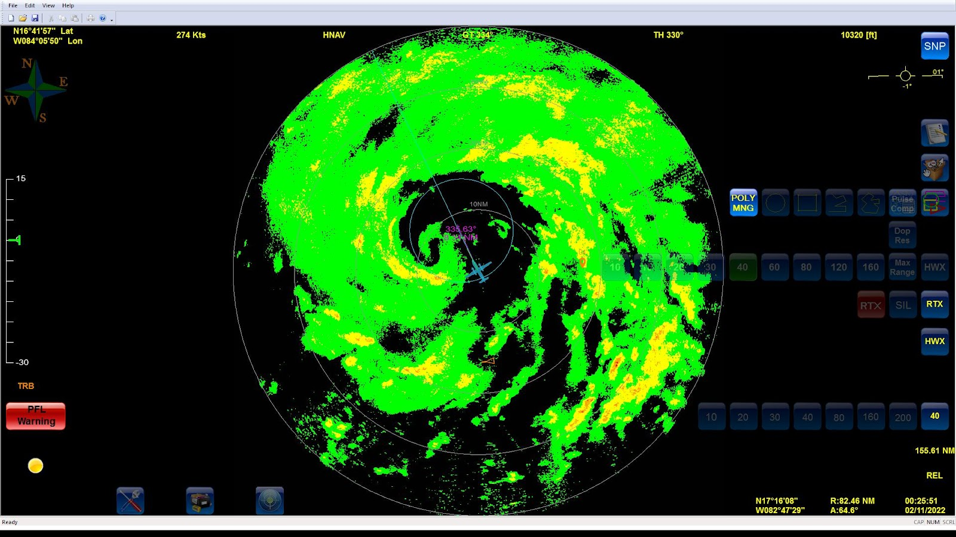
2022 Hurricane Field Program-APHEX
AL15/Lisa: 20221101I1 (EMC-NHC)
Mission (TS Lisa)
Onboard
LPS/Radar: Hazelton, Aspen: Sellwood
Ground-Based
LPS: Holbach, Radar: Reasor
APHEX relevance:
EMC-NHC TDR, AIPEX (Early Stage)
Planned pattern: butterfly
T/O off (St. Croix): 1958z, Land (St. Croix): 0515z
FL 10 kft (pressure)
Dropsondes: 18 drops (18 to GTS)
AXBTs (NRL/ONR): none
TDR analyses to EMC & NHC: 3
Small eye at start, later collapsed of the mission
The storm was more organized but not quite a hurricane yet
Missed center (small hook)
Successful Hackathon (HOT)
N43 final flight track

Slide 10
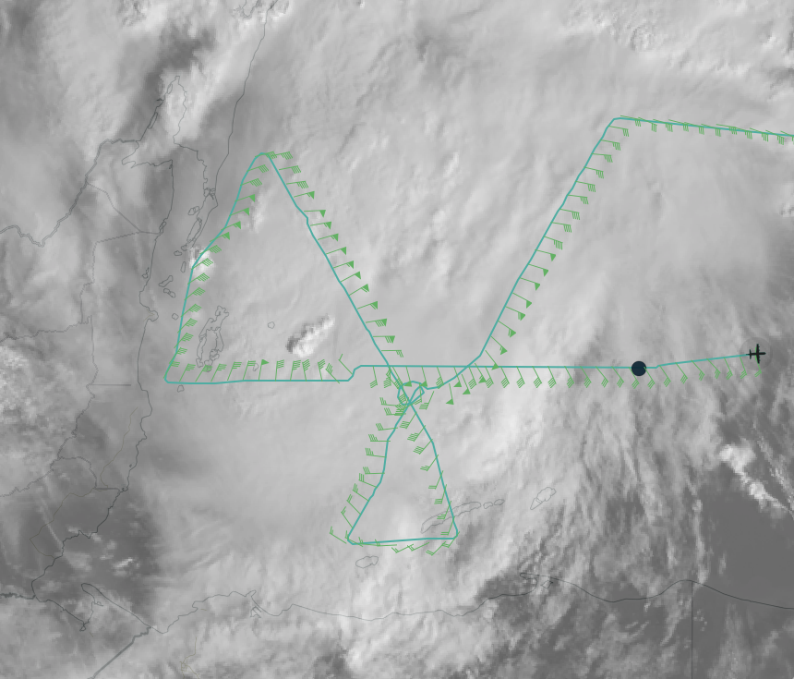
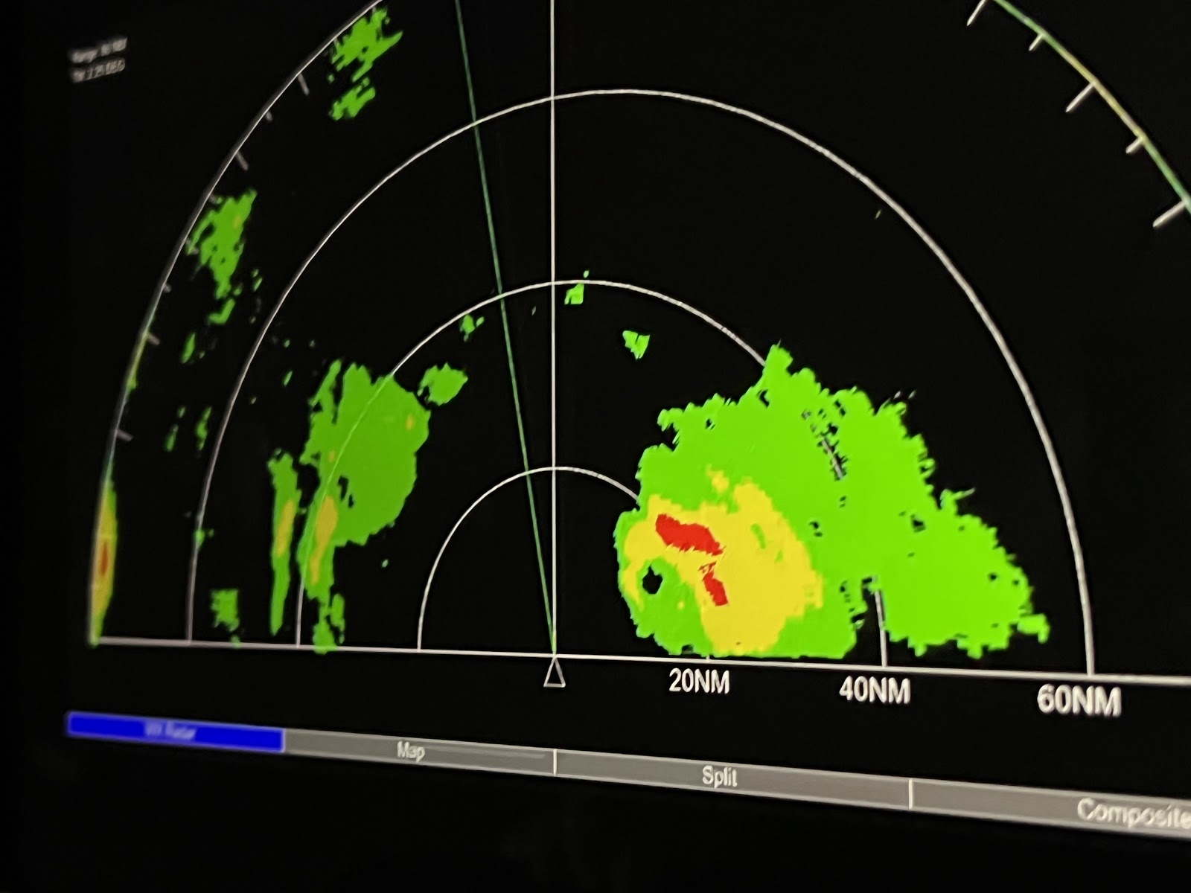
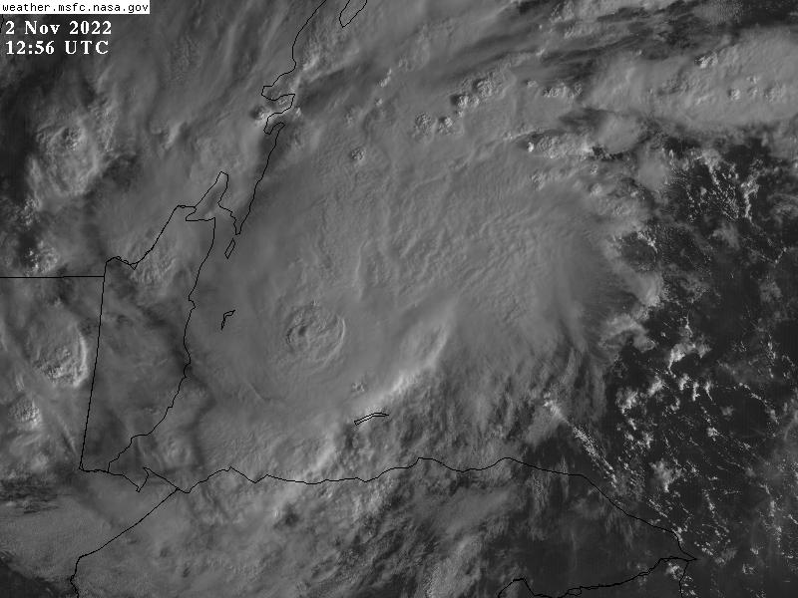
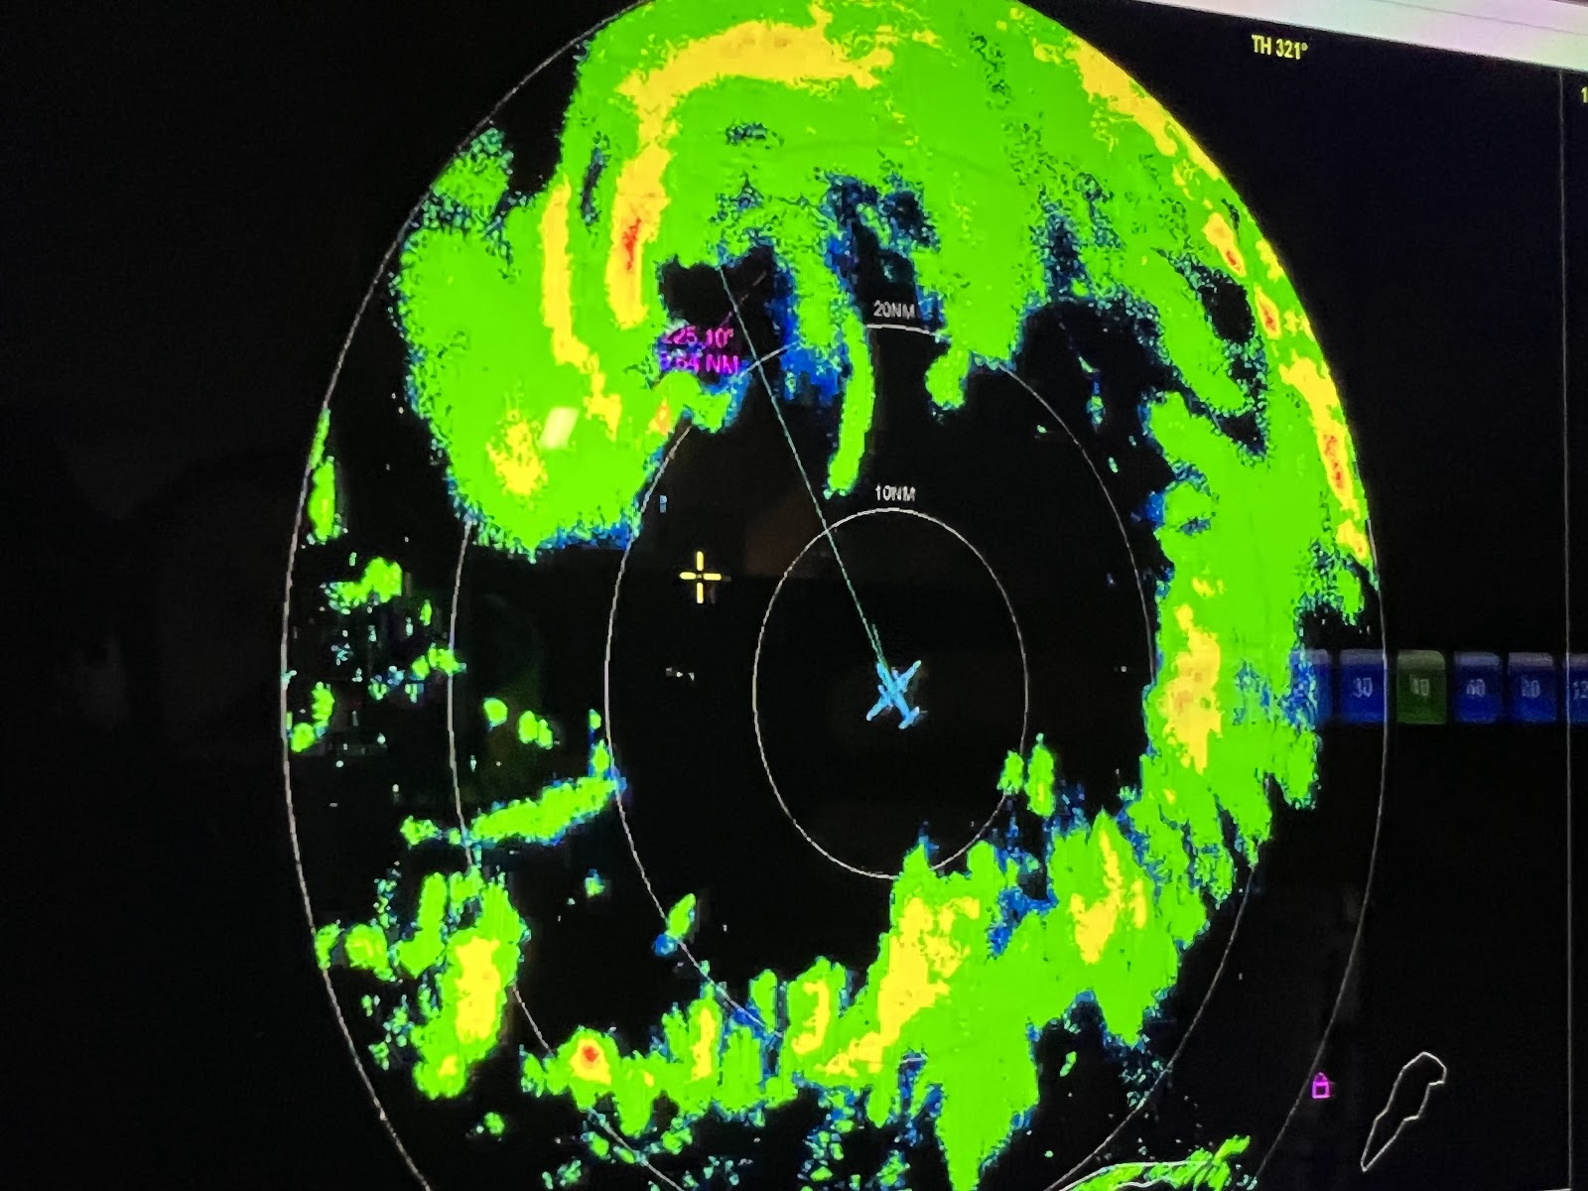
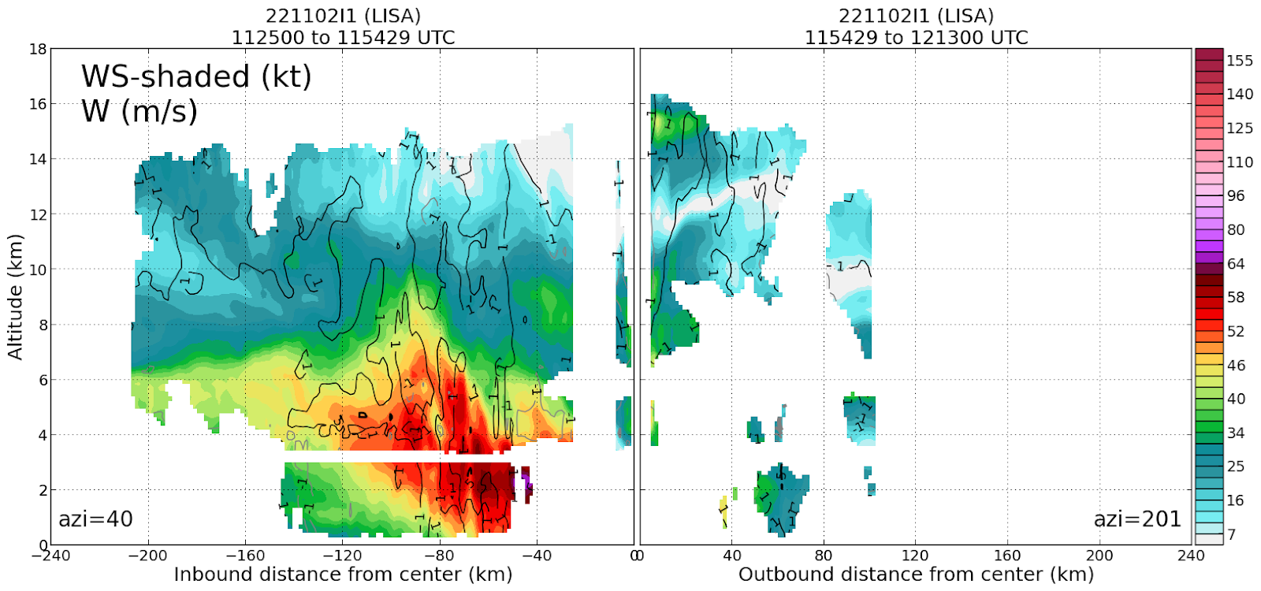
2022 Hurricane Field Program-APHEX
AL15/Lisa: 20221102I1 (EMC-NHC)
N43 final flight track
Mission (Hurricane Lisa)
Onboard
LPS: Zawislak, Radar: Wilson, Aspen: J. Zhang
Ground-Based
LPS: Aberson, Radar: Alvey
APHEX relevance:
EMC-NHC TDR, AIPEX (Early Stage)
Planned pattern: butterfly
T/O off (St. Croix): 0745z, Land (St. Croix): 1733z
FL 10 kft (pressure)
Dropsondes: 24 drops (20 to GTS)
AXBTs (NRL/ONR): none
TDR analyses to EMC & NHC: 3
L…….o……n…….g……F…….e…….r……..r…….y
Is that the center? or a mesovortex? RI, no RI? RMW, are we there yet?
Becoming aligned, but very small inner core – only slow intensification before landfall
Ran cameras for SWIm (Steve Albers), awaiting data

Slide 11
2022 Hurricane Field Program-APHEX
Social Media
AOML-HRD-NOAA Research Twitter
AWIPS relies on observational data collected by AOML & Hurricane Hunters, including from Tropical Storm Lisa…
https://twitter.com/HRD_AOML_NOAA/status/1587905491338170369
HRD Blog
During recent flights into Hurricane Lisa, researchers from NOAA’s Atlantic Oceanographic & Meteorological Laboratory….
https://noaahrd.wordpress.com/2022/11/16/hurricane-and-ocean-testbed-technical-workshop/
AOML Instagram & HRD Facebook
On Tuesday, researchers from NOAA’s Atlantic Oceanographic & Meteorological Laboratory (AOML), National Hurricane…
https://www.instagram.com/p/CkeRP9CPM8b/
On Tuesday, researchers from NOAA’s Atlantic Oceanographic & Meteorological Laboratory (AOML), National Hurricane…
https://www.facebook.com/noaaaoml/posts/pfbid0XTJhZTBZktCGSYHeRR7cBSn5hUZrQxtjiKsswKtwNHTWwbPmab29KPhCxS6swvW5l

Slide 12
2022 Hurricane Field Program-APHEX
Communications
Daily Plan of the Day (POD)
Sent to research partners, OAR Comms, AOML Comms, OAR leadership

Slide 13
2022 Hurricane Field Program-APHEX
Health-Safety-Sexual Assault/Sexual Harassment (SASH)
Any issues with health-safety-SASH, either during missions or downtime - anonymous responses can be submitted at:
https://docs.google.com/forms/d/e/1FAIpQLSeiFLPksVEXNmAvOKGAX259lKVAcIG0kh8TME6DU3xxatN6Gw/viewform?

Slide 14
2022 Hurricane Field Program-APHEX
Other Issues – what went well?...what can we do better?
Continued issues with getting timely TDR data to the ground from N43. This is an issue for both P-3s and relates to how the aircraft data system (Netman) queues and sends data off the aircraft.
Post-season discussions with AOC are planned to try to resolve this

Slide 15
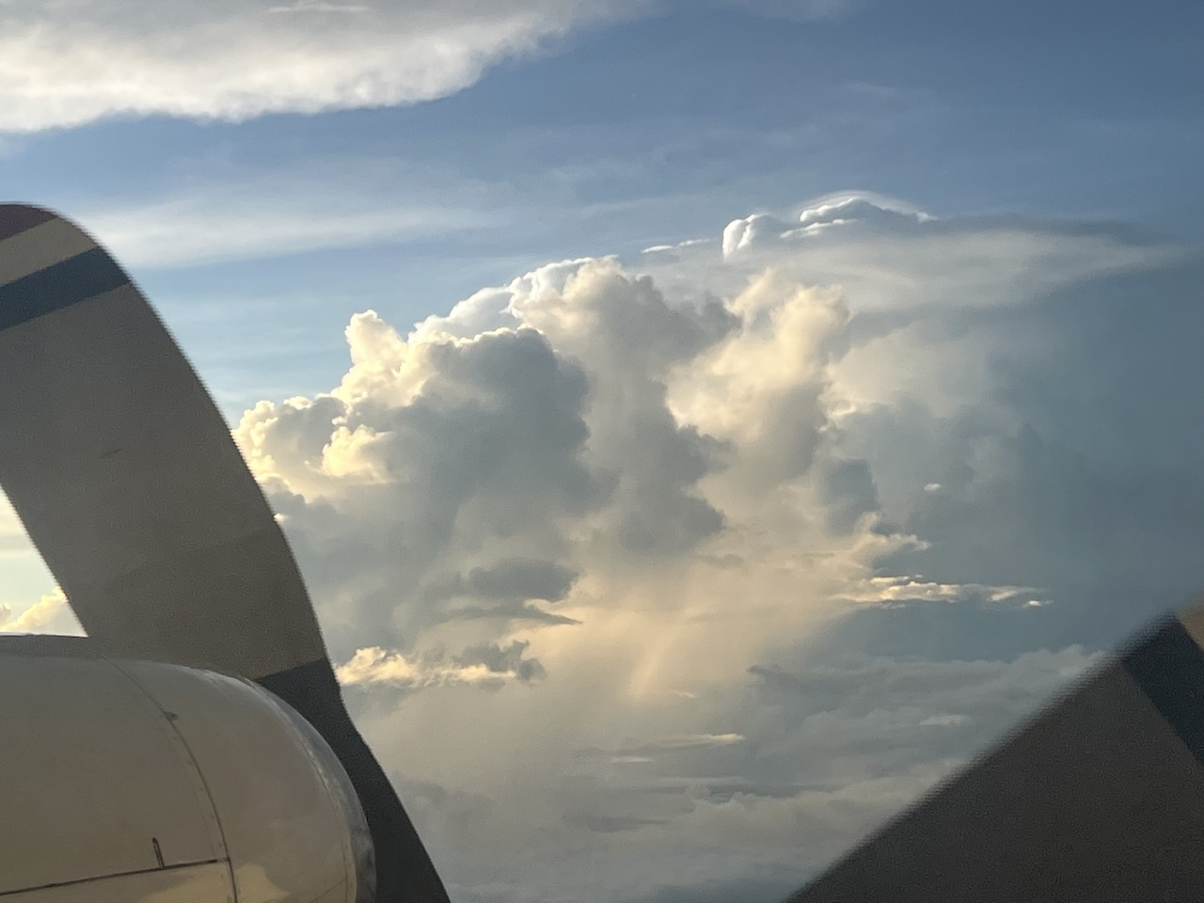
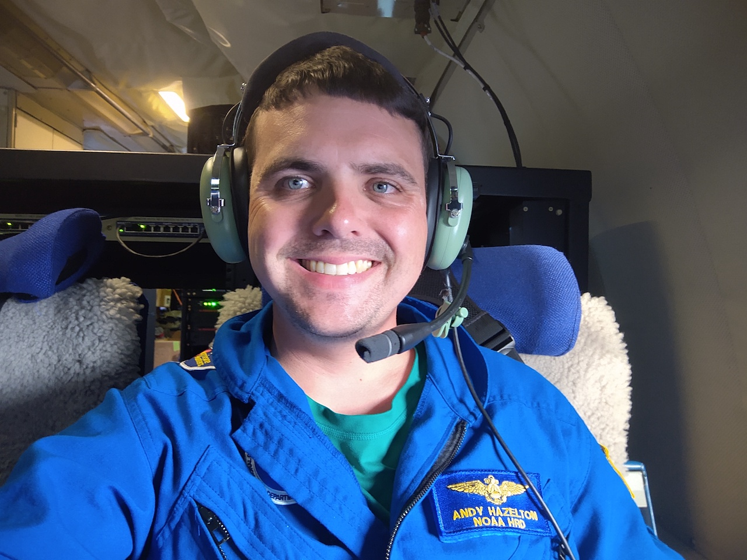
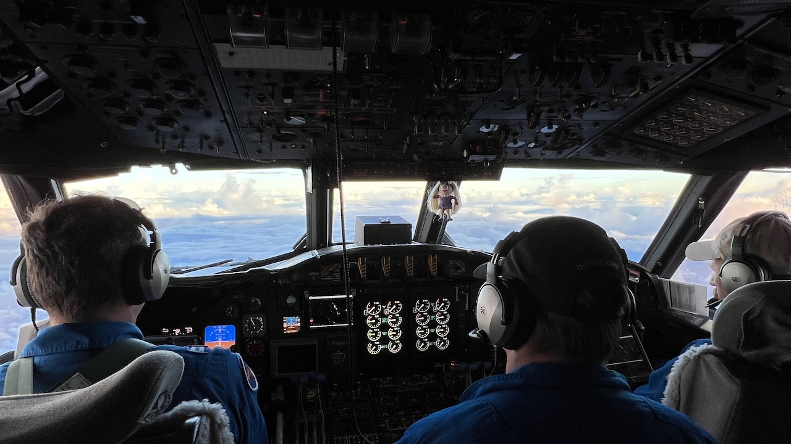

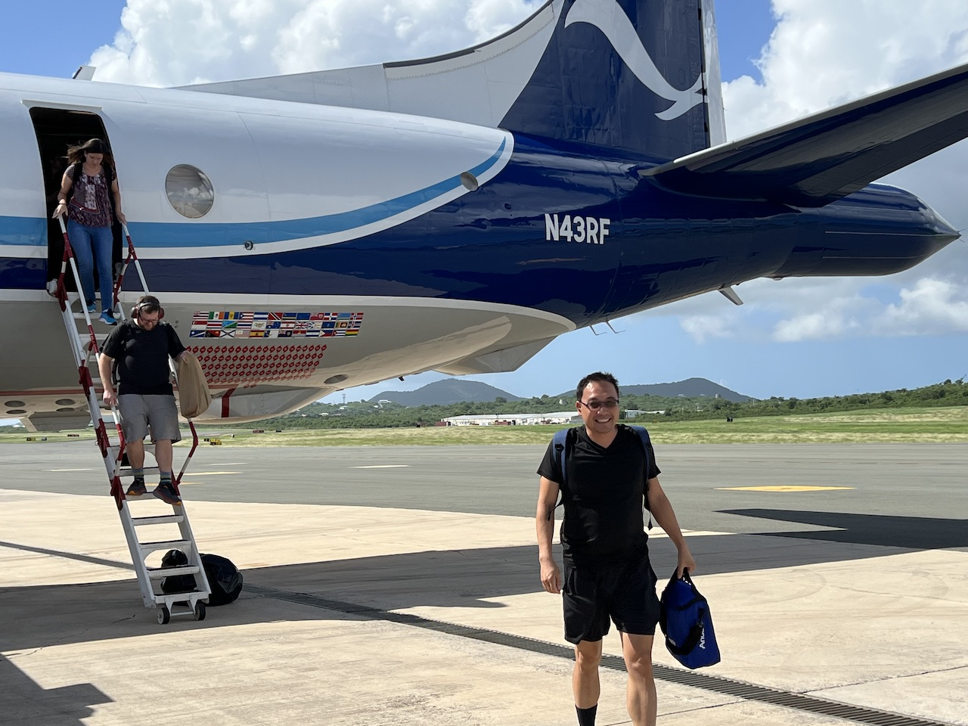
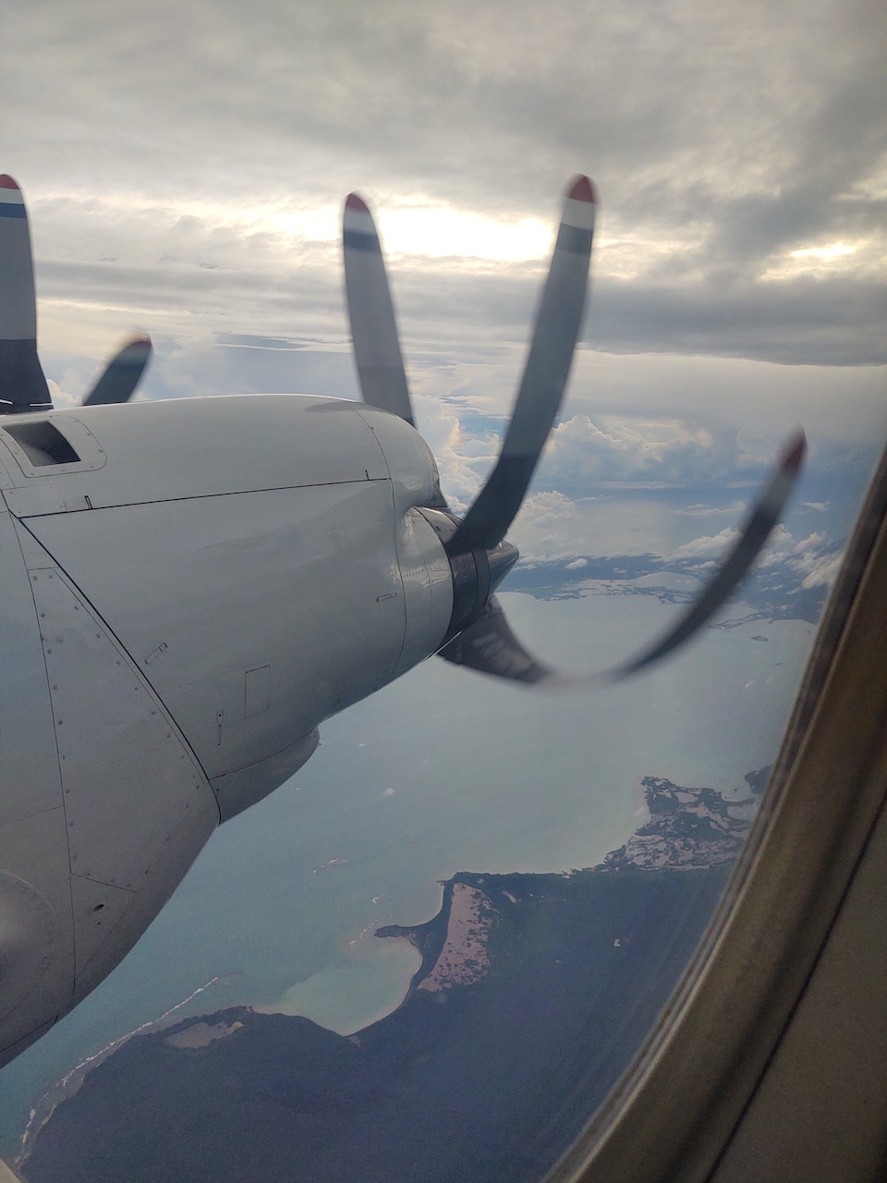
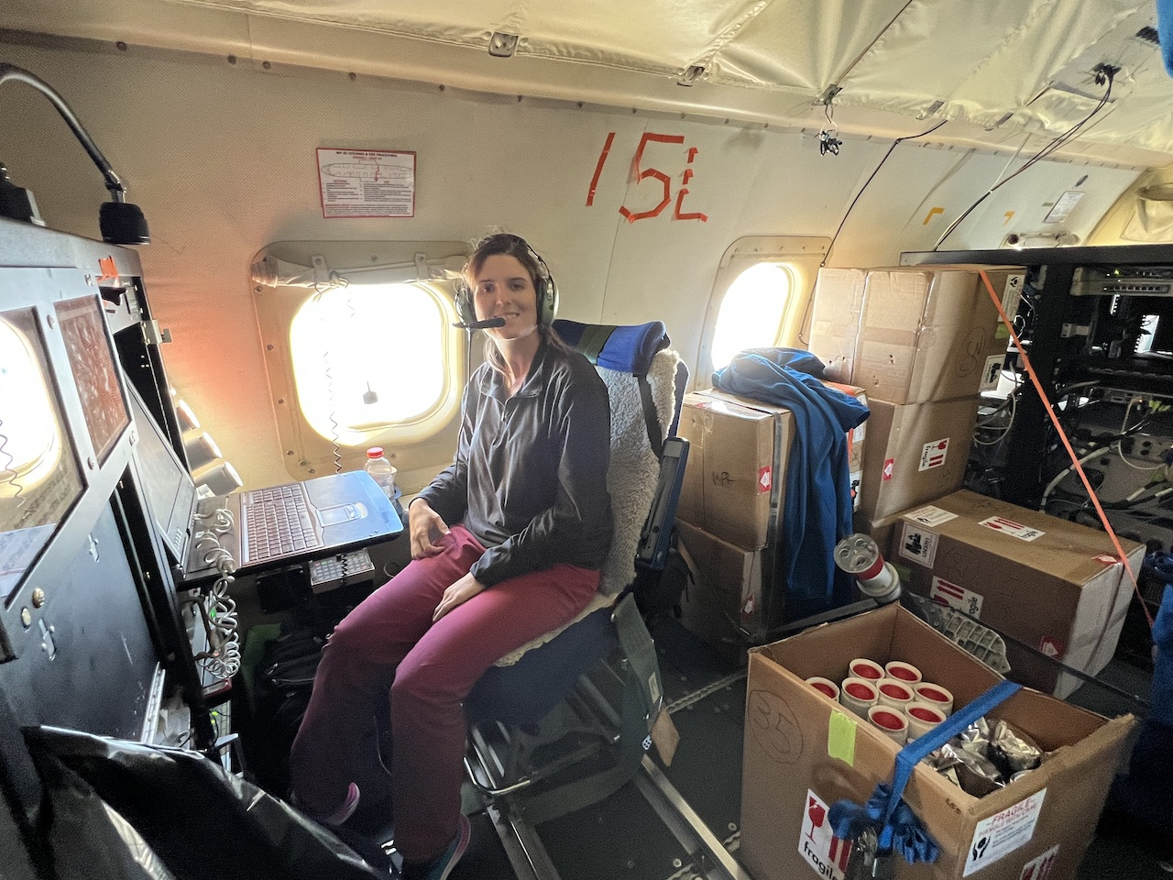
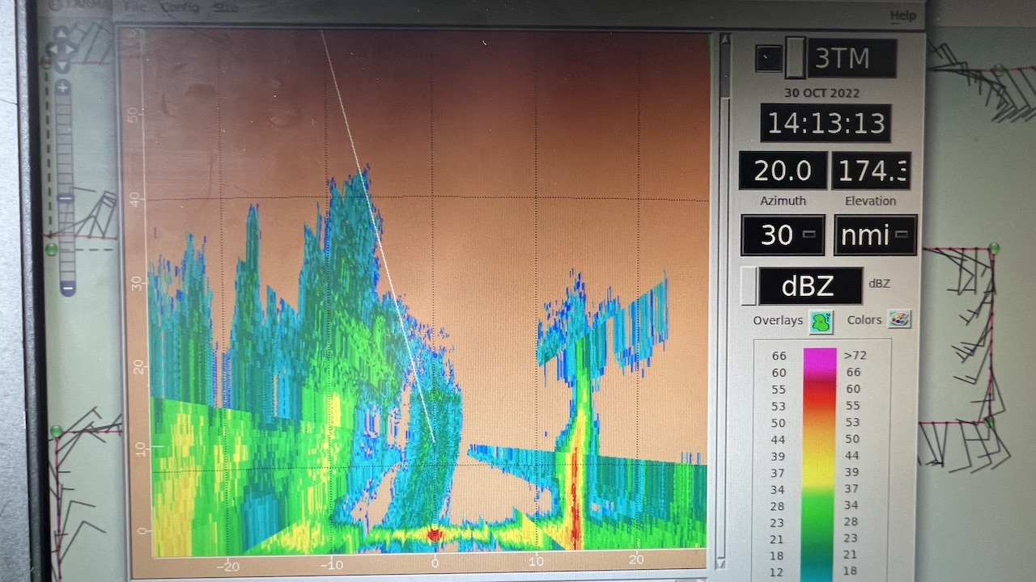
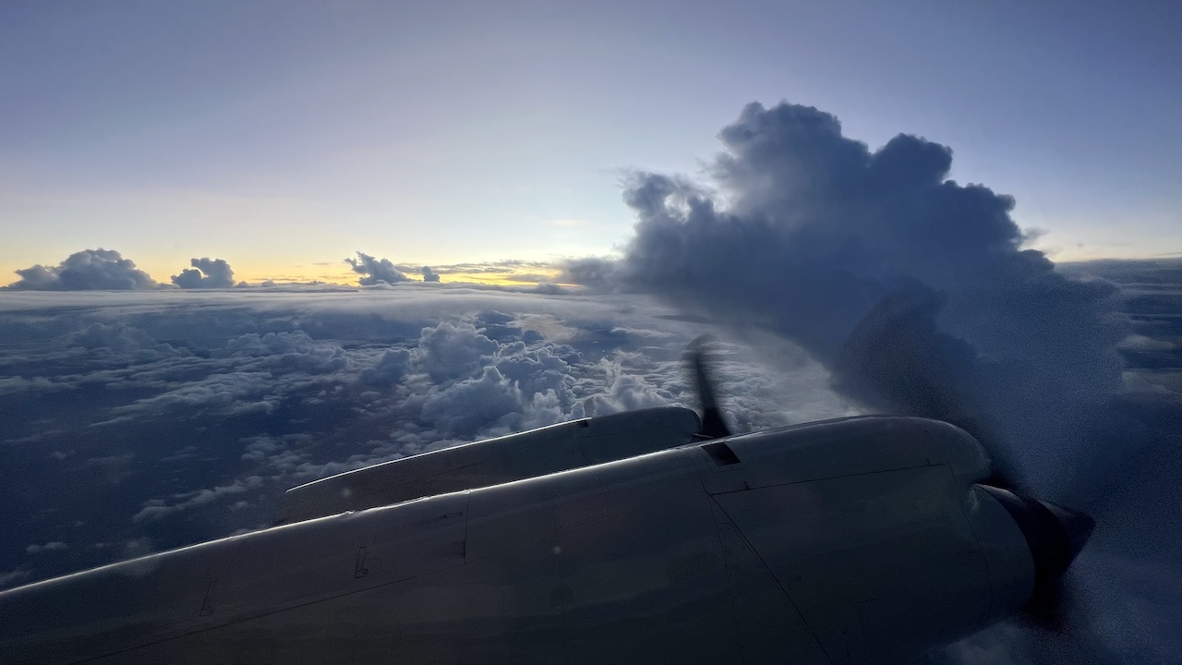
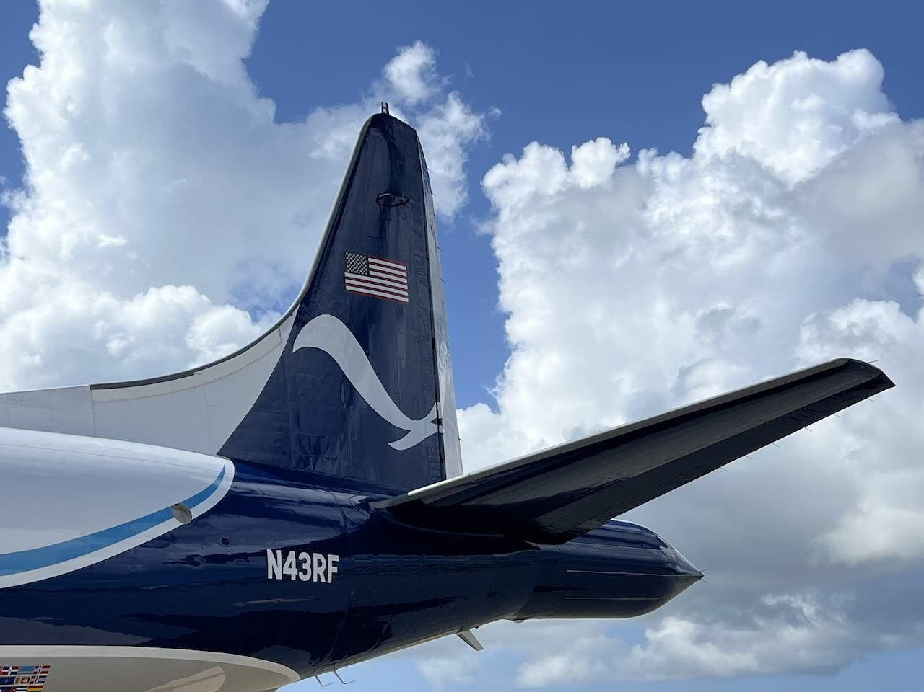
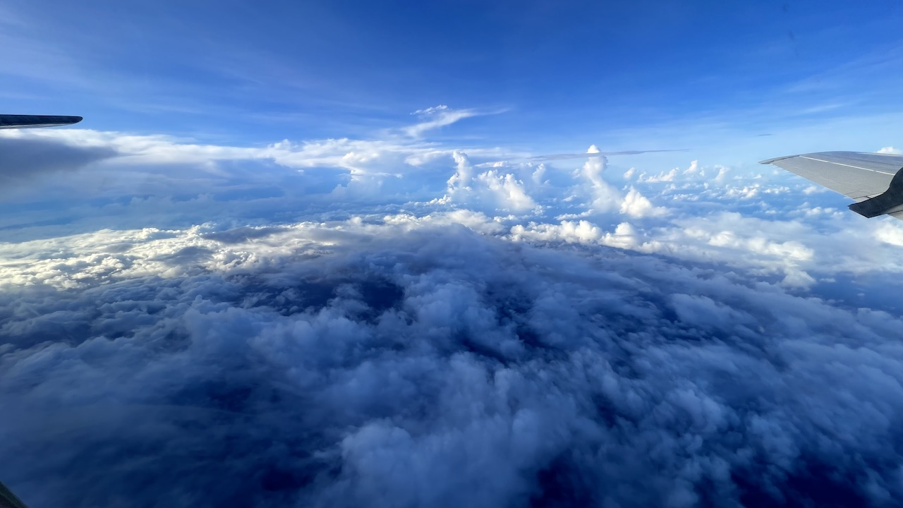
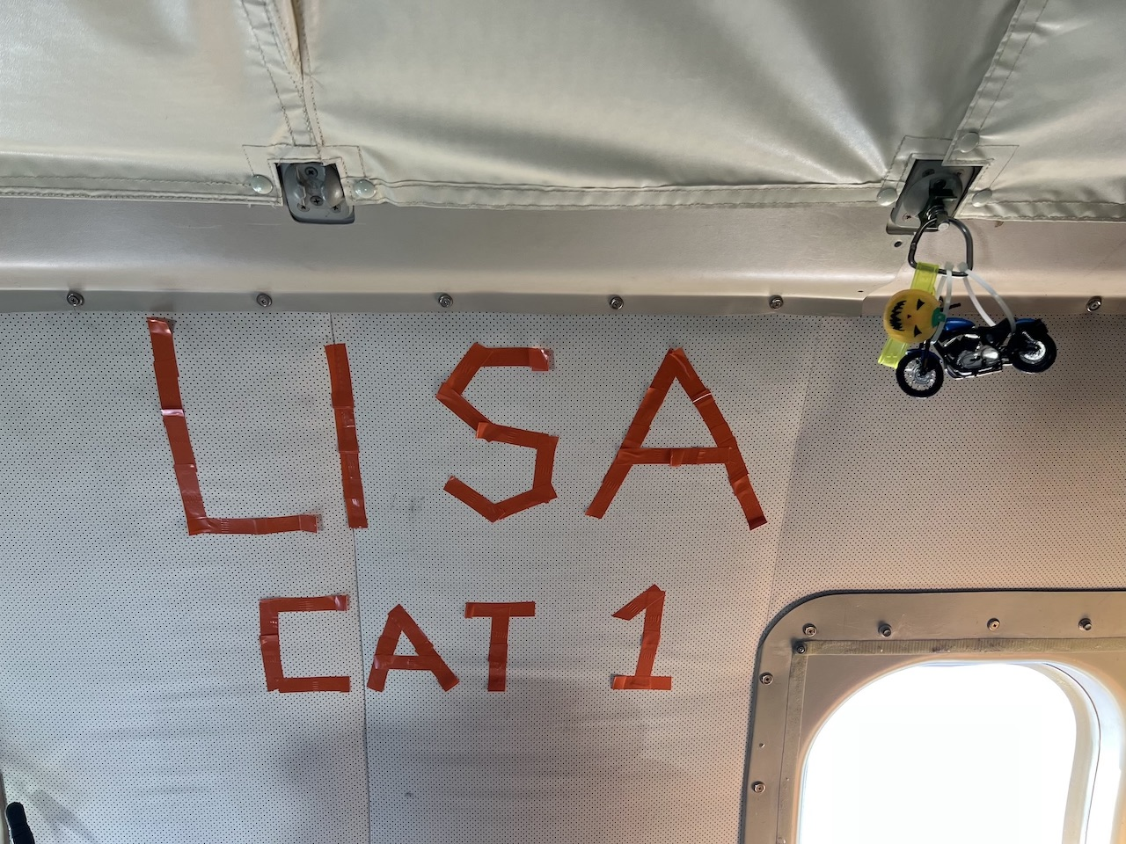
2022 Hurricane Field Program-APHEX
AL15/Lisa: 30 October - 2 November 2022
Photo credit Jon Zawislak
Photo credit Andy Hazelton
Photo credit Jon Zawislak
Photo credit Jon Zawislak
Photo credit Jon Zawislak
Photo credit Jon Zawislak
Photo credit Jon Zawislak
Photo credit Jon Zawislak
Photo credit Jon Zawislak
Photo credit Jon Zawislak
Photo credit Jon Zawislak
Photo credit Andy Hazelton
Copies of the 2022 AL15/Lisa debrief can be found in the HRD Google Drive folder
HRD >> Hurricane Field Program >> 2022 >> Debriefs >> AL15/Lisa

