Slide 1


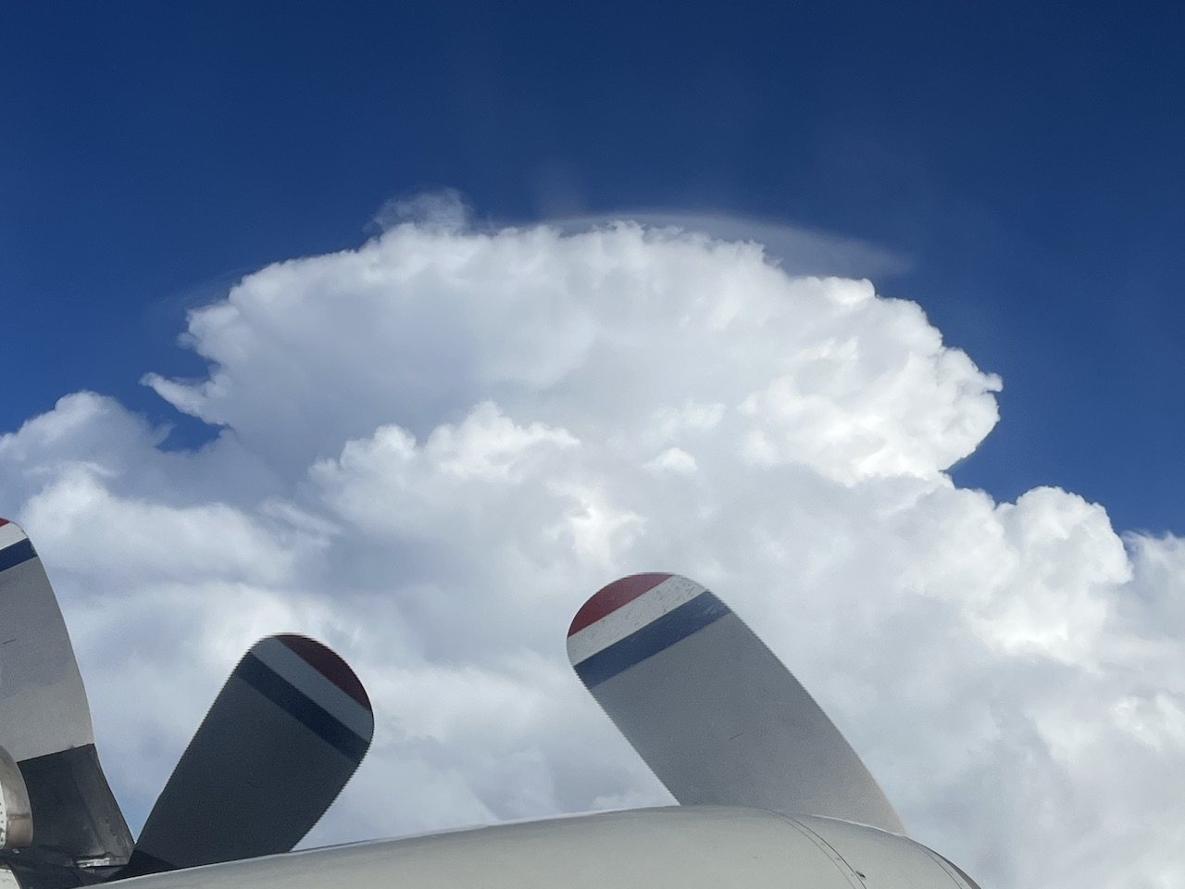
2022 Hurricane Field Program
Advancing the Prediction of Hurricanes Experiment (APHEX)
AL13/Julia Debrief
Jason Dunion – HFP Director
Jon Zawislak - HFP Deputy Director
Photo credit: Jon Zawislak

Slide 2
2022 Hurricane Field Program-APHEX
Summary of Missions (7-8 October 2022)
Mission Series Overview
2 P-3 Missions (EMC/NHC)
48 GPS dropsondes / 45 transmitted to the GTS
8 TDR analyses transmitted to EMC & NHC
APHEX Experiments & Modules: https://www.aoml.noaa.gov/2022-hurricane-field-program/
AIPEX
FLAIMS (AIPEX)
ONR TCRI RMWs (AIPEX)

Slide 3
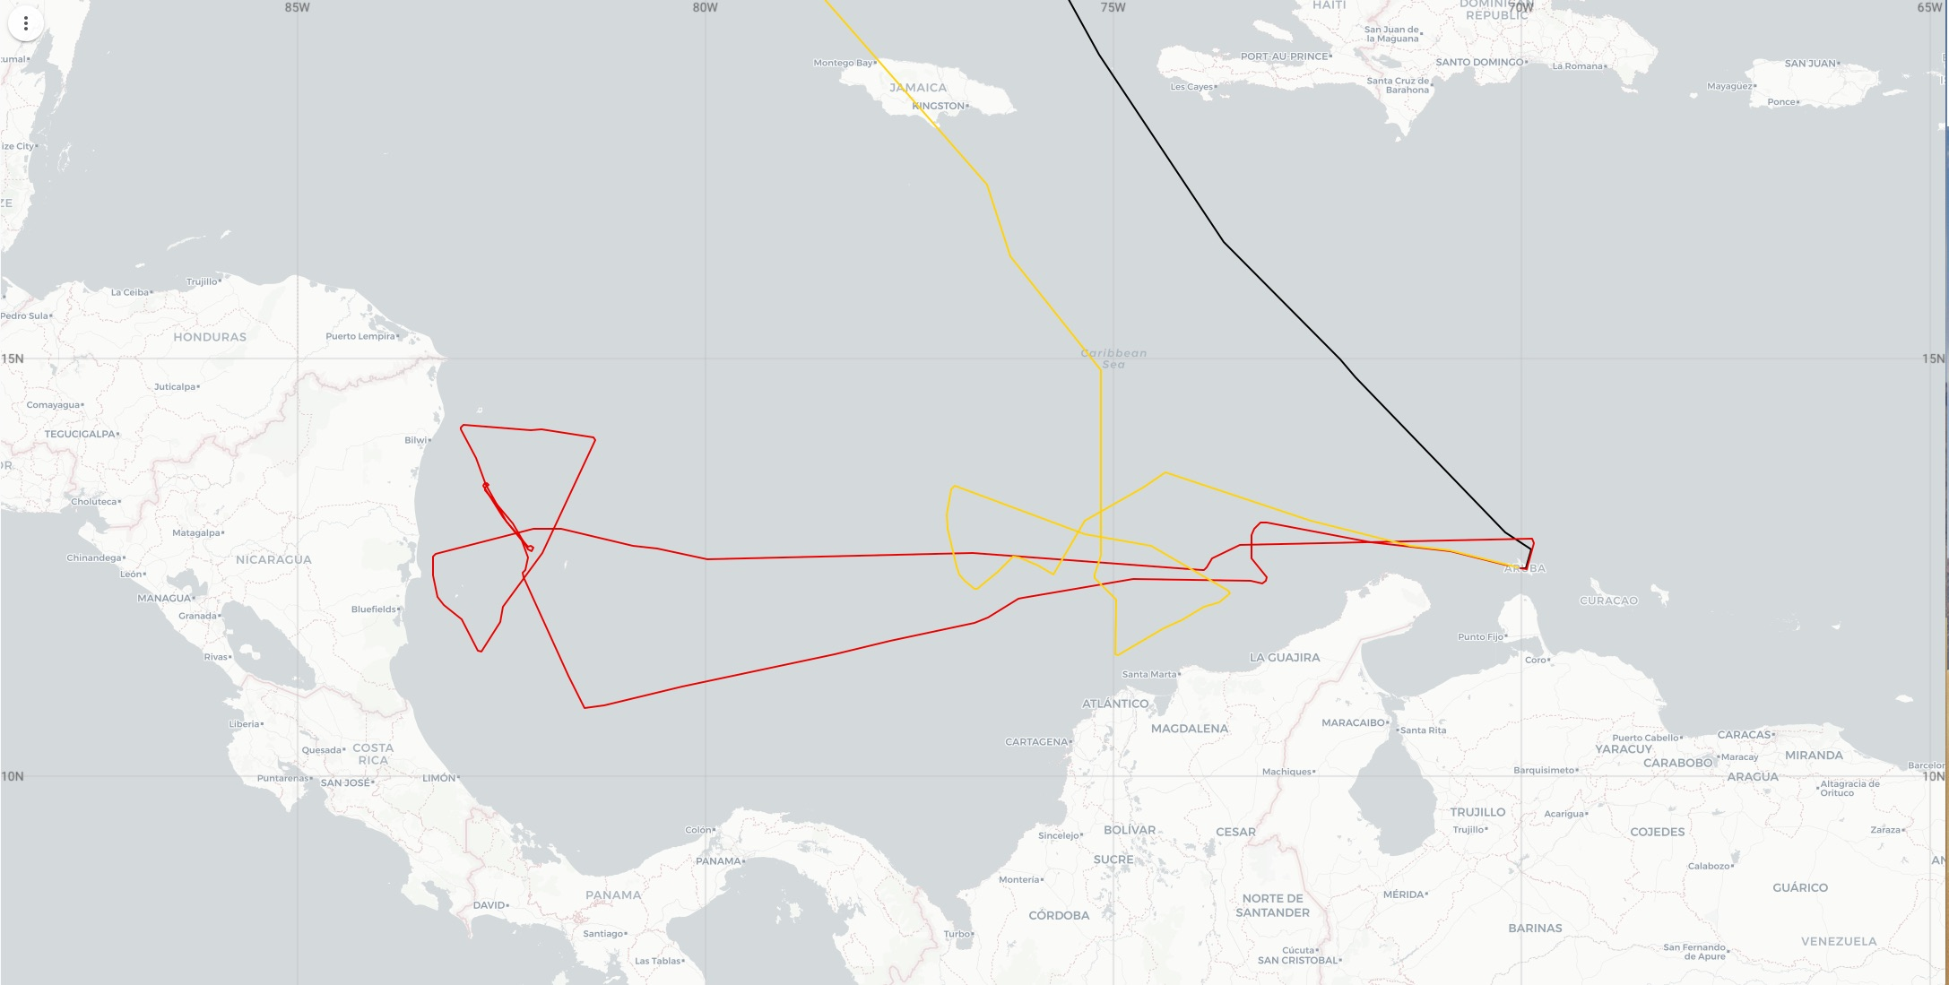
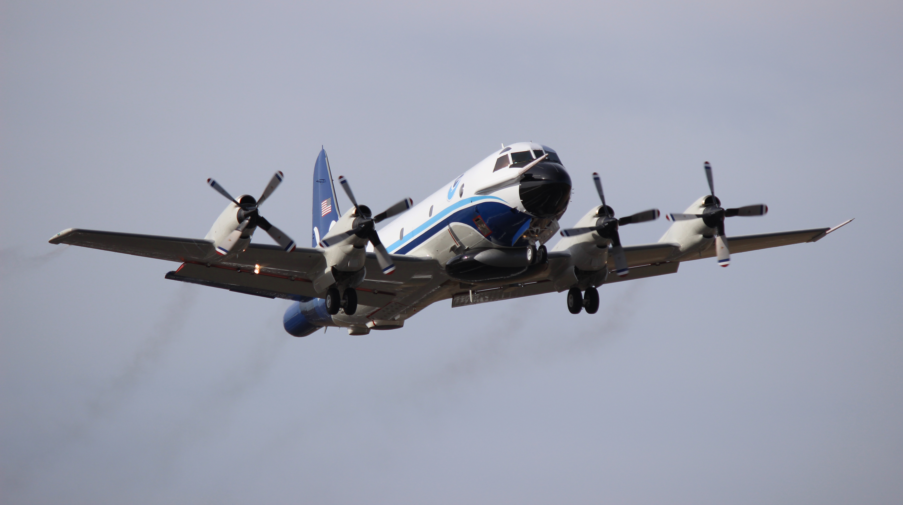
2022 Hurricane Field Program-APHEX
Summary of Missions (7-8 October)
NOAA 42
20221007H1 (N42)
EMC-NHC TDR
20221008H1 (N42)
EMC-NHC TDR

Slide 4
2022 Hurricane Field Program-APHEX
Summary of Missions (7-8 October 2022)
Missions & Crewing
20221007H1 (EMC): Zawislak (LPS, Radar), Sellwood (Aspen), Hazelton (GB LPS), Gamache (GB Radar)
20221008H1 (EMC): Zawislak (LPS, Radar), Sellwood (Aspen), Hazelton/Kaplan (GB LPS), Reasor (GB Radar)

Slide 5
2022 Hurricane Field Program-APHEX
Logistics Highlights
Aircraft, instruments, equipment & resources
Satellite communication systems (20221008H1)
At pre-flight only 1 of the 2 satellite communication systems was working on N42, which potentially slowed data transmission to the ground. And the aft antenna of the TDR didn’t start up correctly and required a power reset.
TDR aft antenna (20221008H1)
Didn’t start up correctly and required a power reset
NOAA-43 was not available due to unscheduled maintenance
Limited P-3 TDR missions to 1x per day
Experiments, Modules, & Coordination
Coordination with ONR TCRI on another AIPEX: FLAIMS module, flown while the storm was apparently intensifying just before landfall in continental Central America. Several RMW, mid/end sondes released in that module.

Slide 6
2022 Hurricane Field Program-APHEX
Interesting & Challenging Mission Aspects
Flight Pattern
Proximity to land (South America and Central America) – yet again ;-)

Slide 7
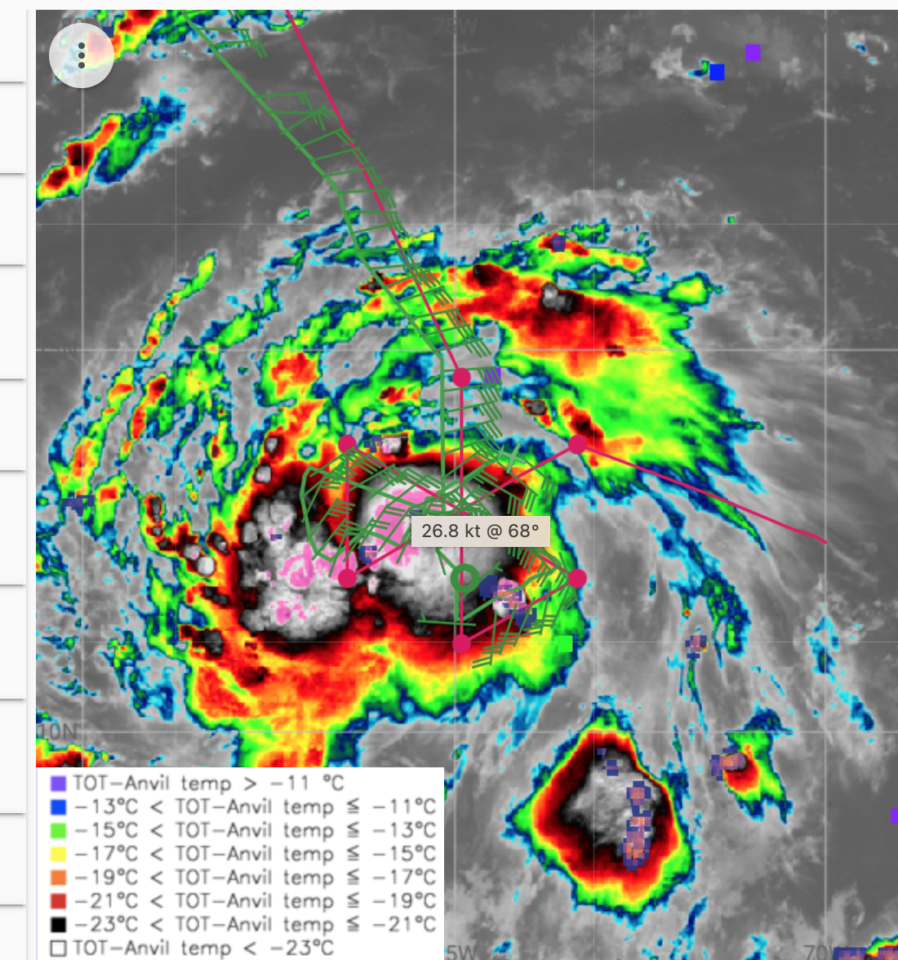
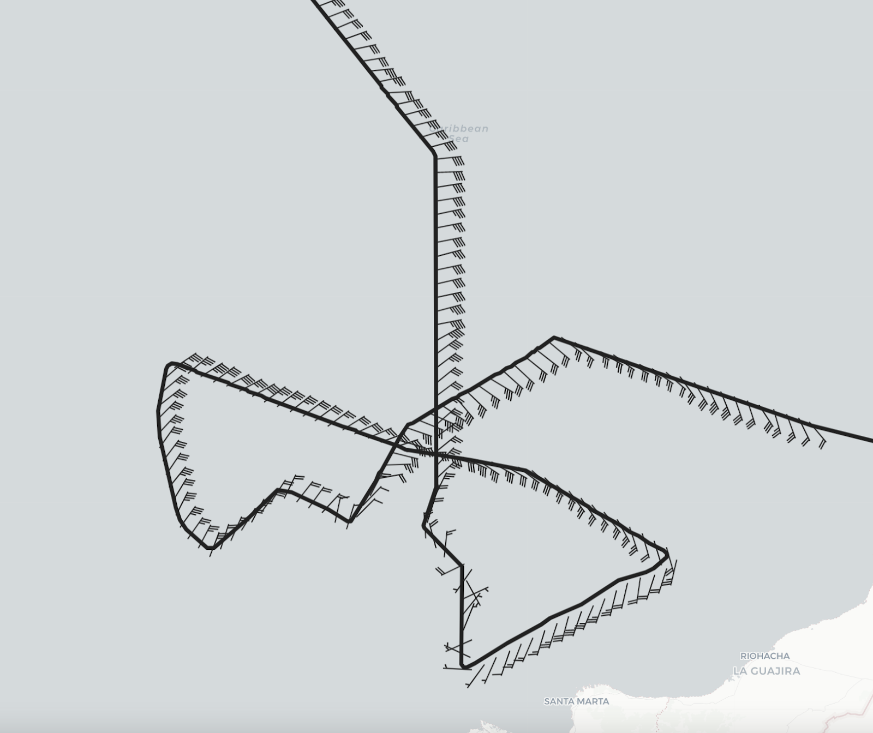
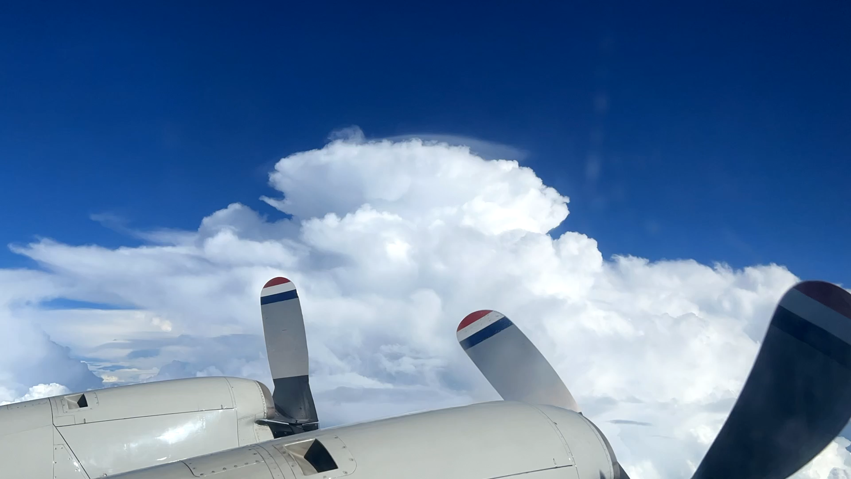
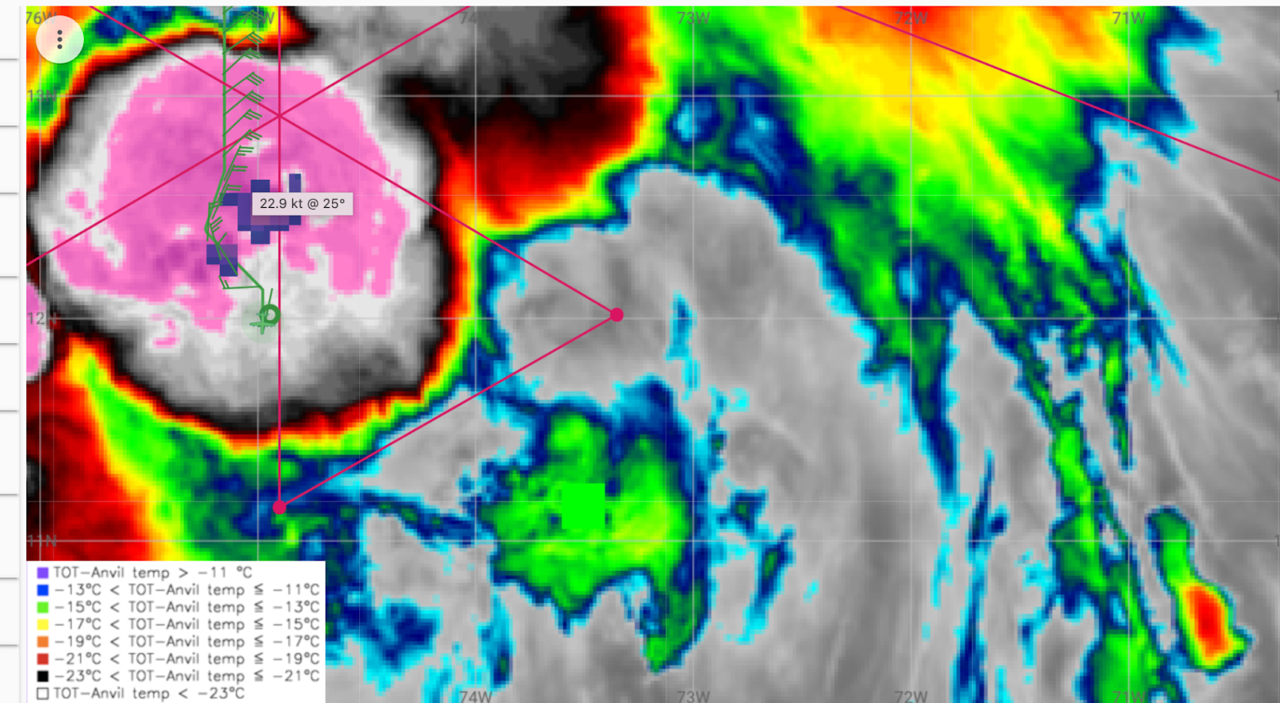
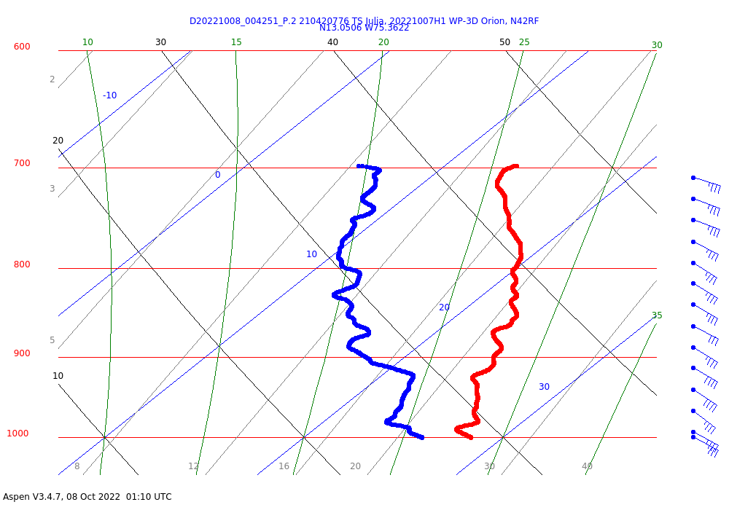
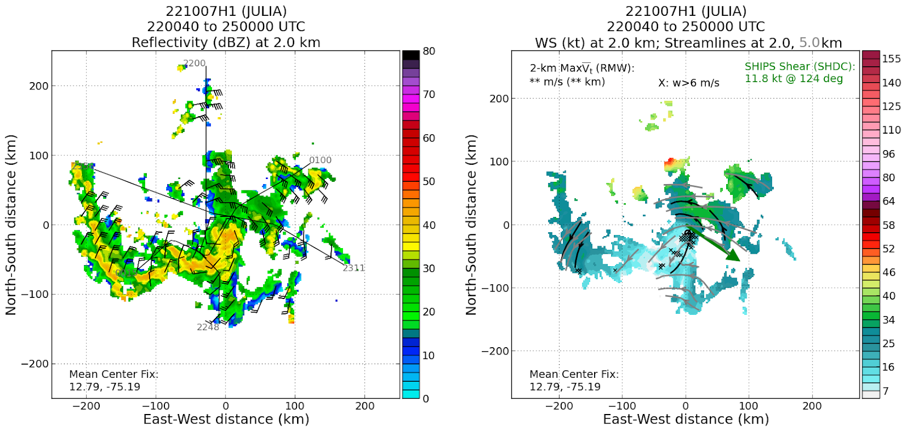
2022 Hurricane Field Program-APHEX
AL13/Julia: 20221007H1 (EMC)
Mission
Onboard
LPS/Radar: Zawislak, Aspen: Sellwood
Ground-Based
LPS: Hazelton, Radar: Gamache
APHEX relevance:
EMC TDR, AIPEX (Early Stage)
Planned pattern: butterfly
T/O off (Lakeland): 1901z, Land (Aruba): 0205z
FL 10 kft (pressure)
Dropsondes: 21 drops (20 to GTS)
AXBTs (NRL/ONR): none
TDR analyses to EMC & NHC: 3
Convection on the south and east sides of the circulation, particularly the southern burst, which was persistent and likely led to center alignment (reformation?).
Impressive burst by all convective intensity metrics
N42 final
flight track
Moving away from dry environment

Slide 8
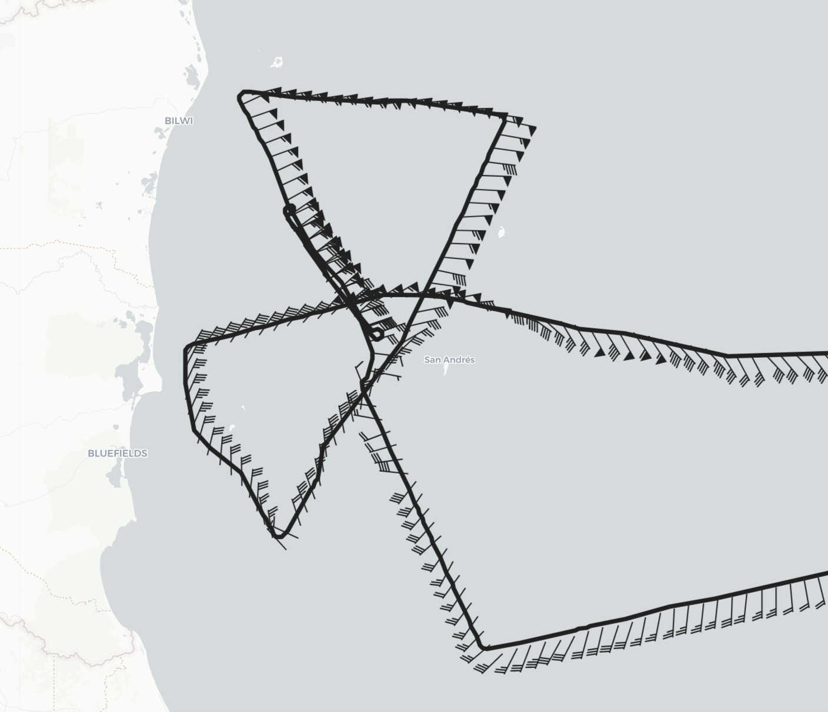
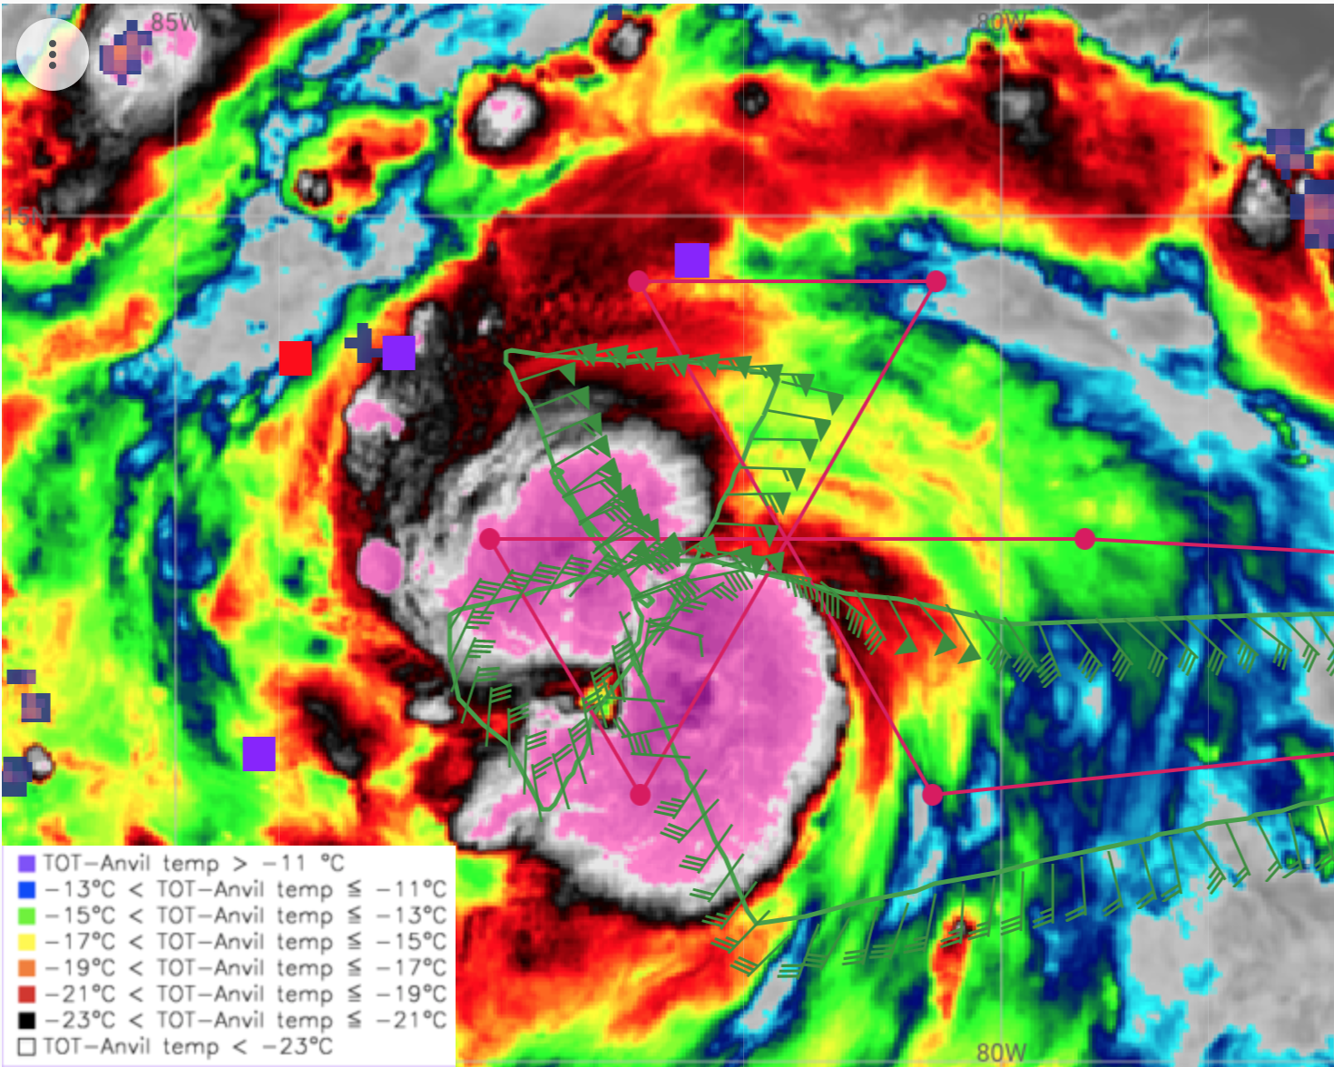
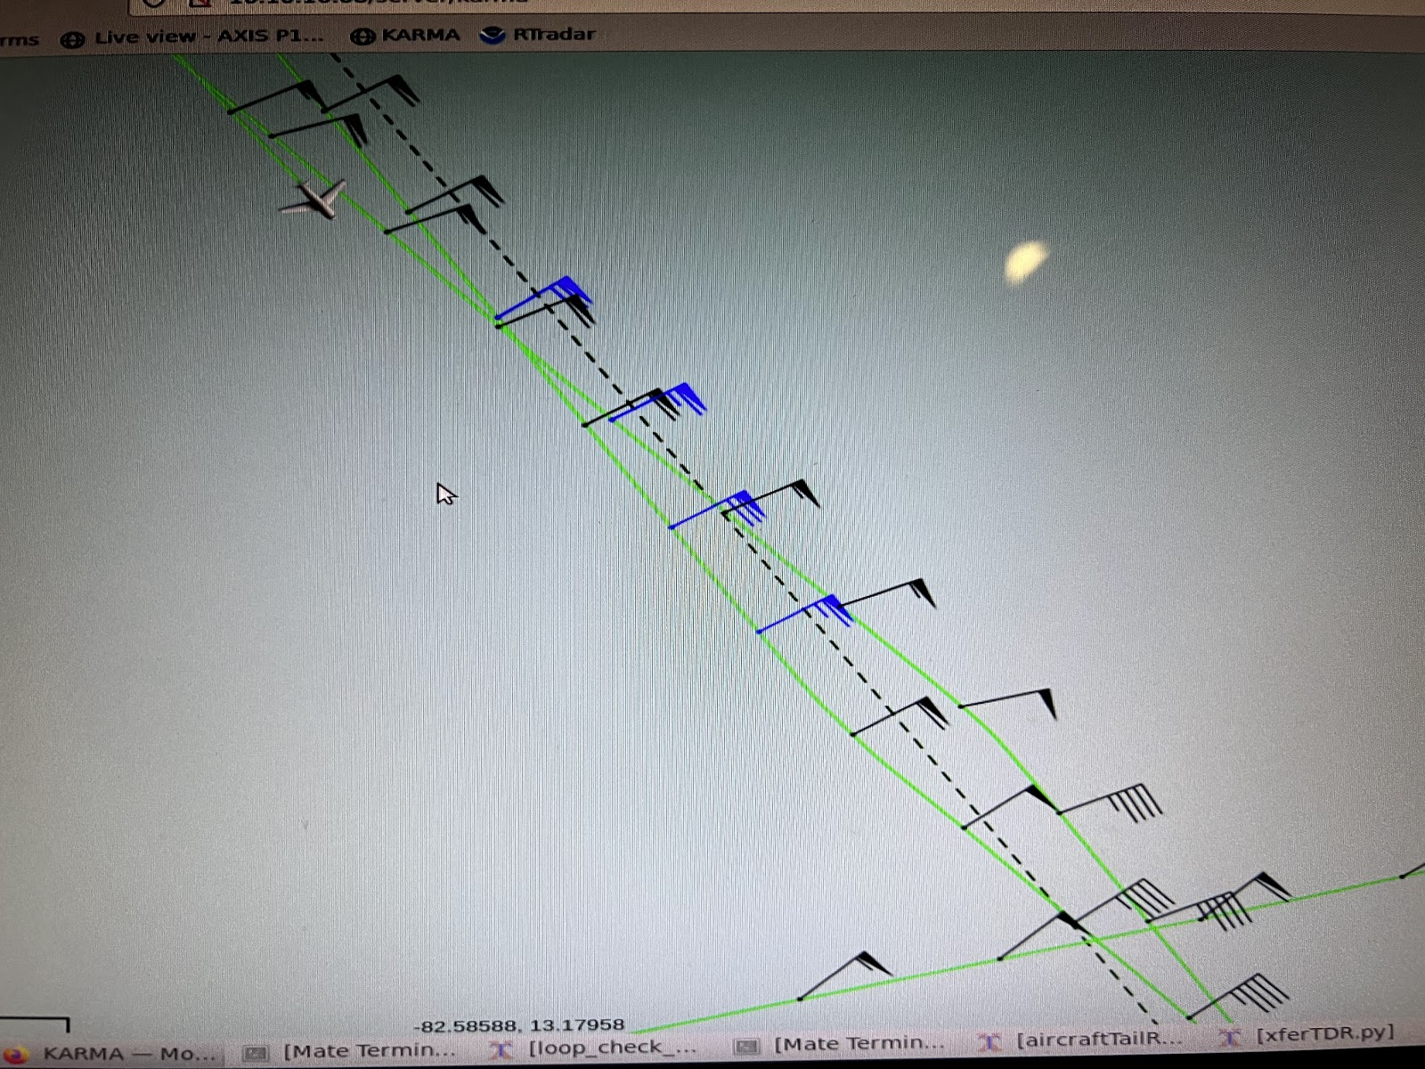
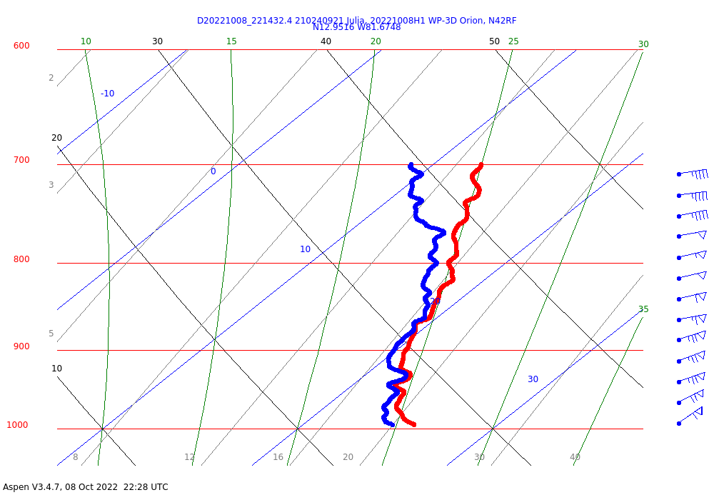
2022 Hurricane Field Program-APHEX
AL13/Julia: 20221008H1 (EMC)
Mission
Onboard
LPS/Radar: Zawislak, Aspen: Sellwood
Ground-Based
LPS: Hazelton/Kaplan, Radar: Reasor
APHEX relevance:
EMC TDR, AIPEX (FLAIMS), ONR TCRI RMWs
Planned pattern: butterfly
T/O off (Aruba): 1953z, Land (Aruba): 0348z
FL 10 kft (pressure)
Dropsondes: 27 drops (25 to GTS)
AXBTs (NRL/ONR): none
TDR analyses to EMC & NHC: 5
Pattern a bit challenging due to San Andres & Providencia islands, but deviations around the center (over the islands) allowed us to map the highest winds
FLAIMS module was quite interesting, having observed (though perhaps because of advection?) an increase of 10 to 15 kt in FL winds in NW quadrants in less than 45 min
N42 final
flight track
North side first pass
60kt sfc wind

Slide 9
2022 Hurricane Field Program-APHEX
Social Media
AOML-HRD-NOAA Research Twitter
None
HRD Blog
None
AOML Instagram & HRD Facebook
None

Slide 10
2022 Hurricane Field Program-APHEX
Communications
Daily Plan of the Day (POD)
Sent to research partners, OAR Comms, AOML Comms, OAR leadership

Slide 11
2022 Hurricane Field Program-APHEX
Health-Safety-Sexual Assault/Sexual Harassment (SASH)
Any issues with health-safety-SASH, either during missions or downtime - anonymous responses can be submitted at:
https://docs.google.com/forms/d/e/1FAIpQLSeiFLPksVEXNmAvOKGAX259lKVAcIG0kh8TME6DU3xxatN6Gw/viewform?

Slide 12
2022 Hurricane Field Program-APHEX
Other Issues – what went well?...what can we do better?
TBD

Slide 13
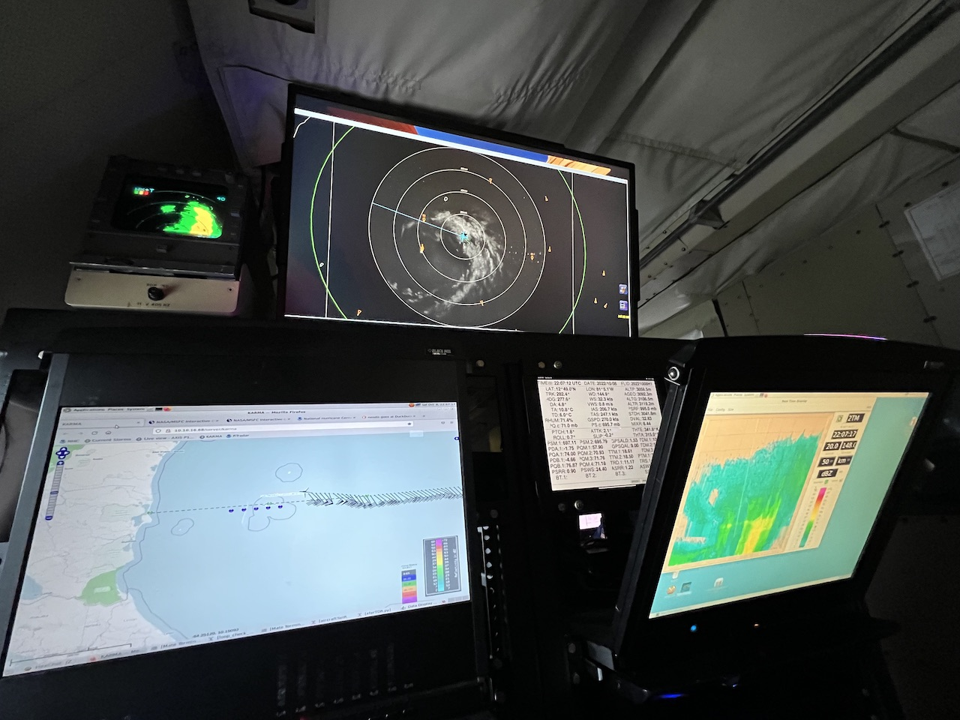
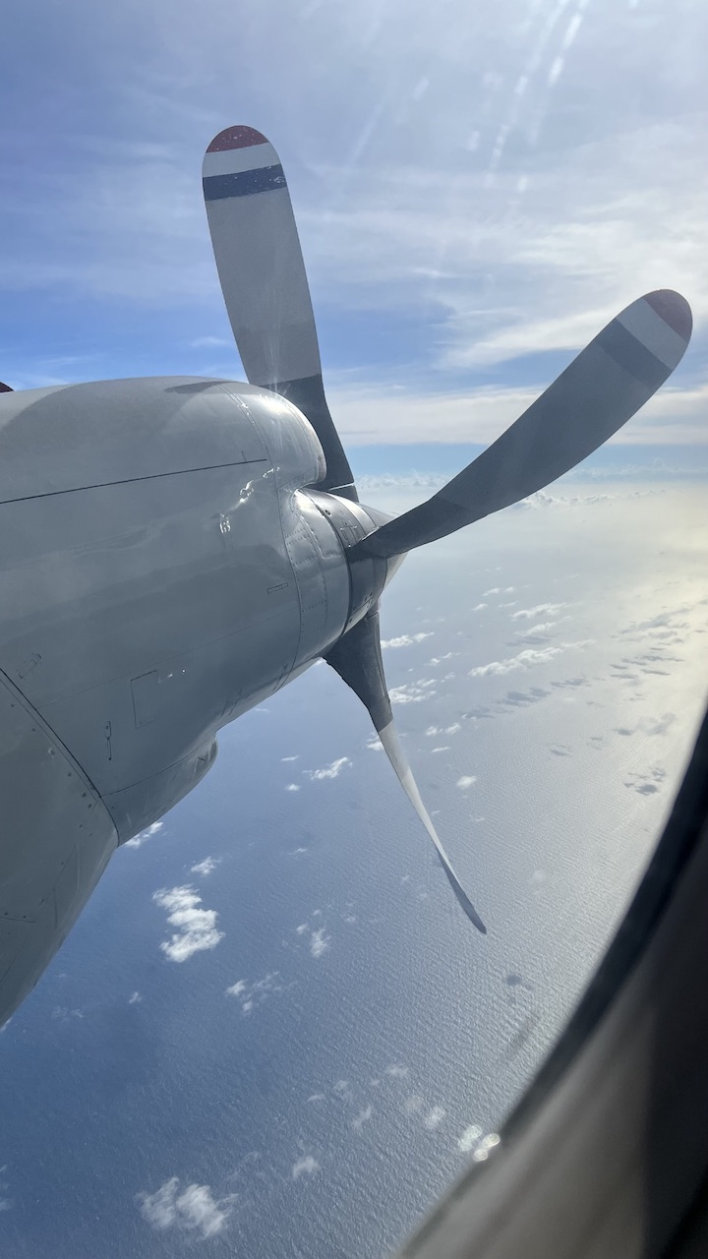
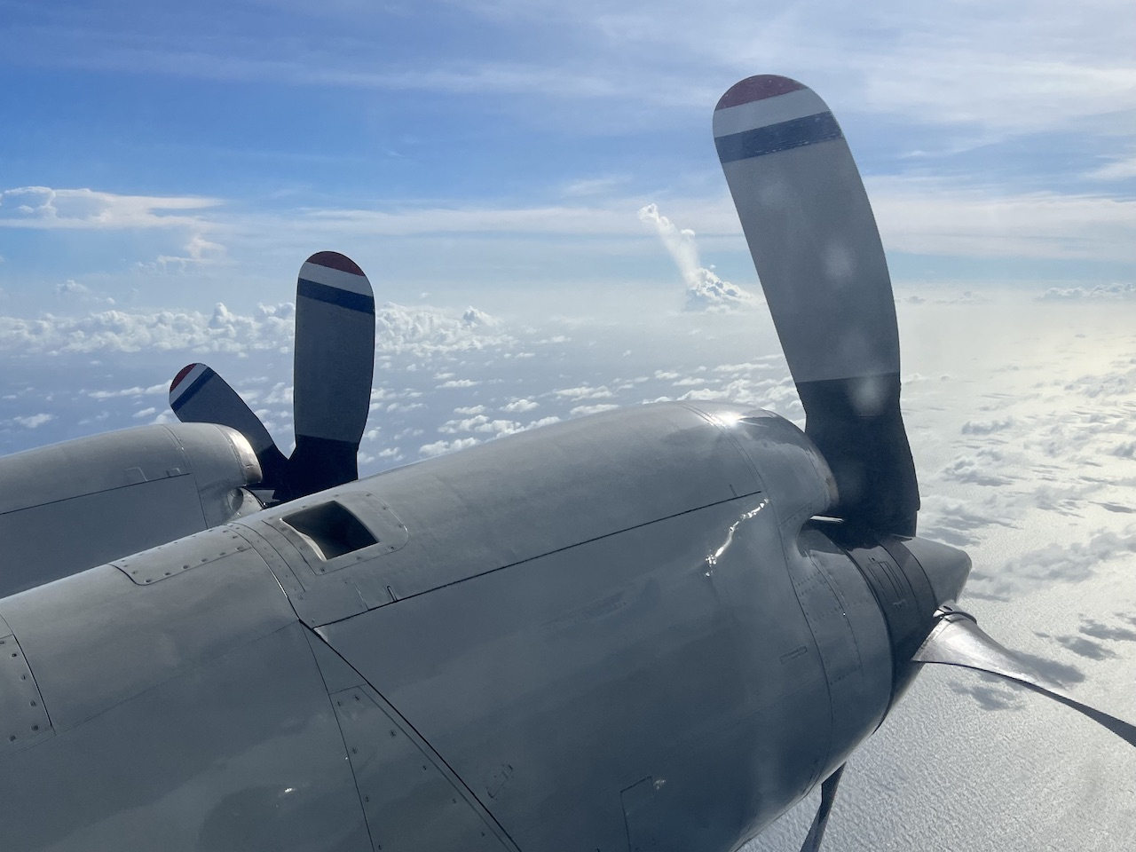
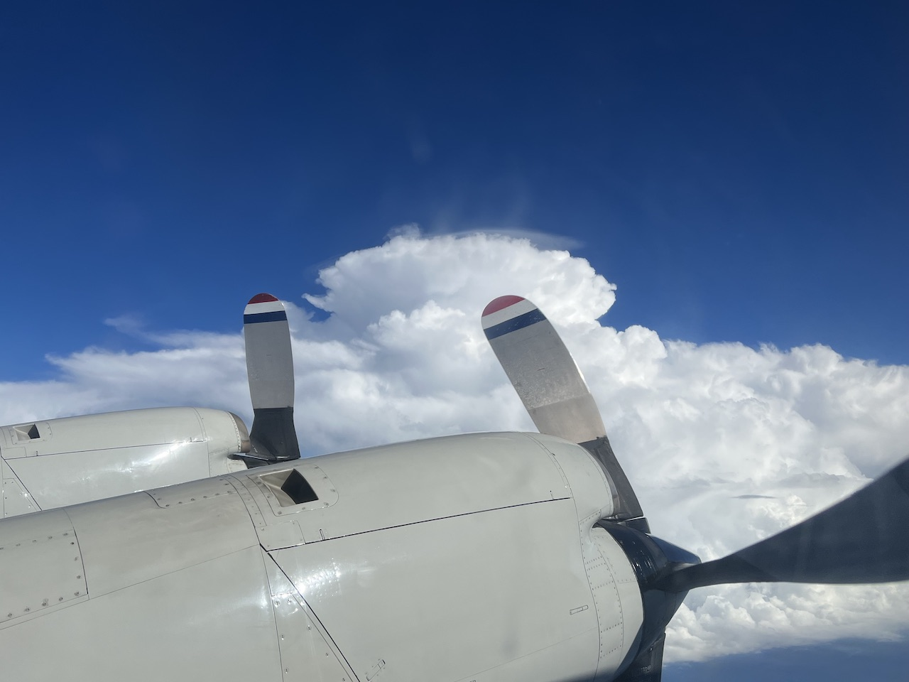
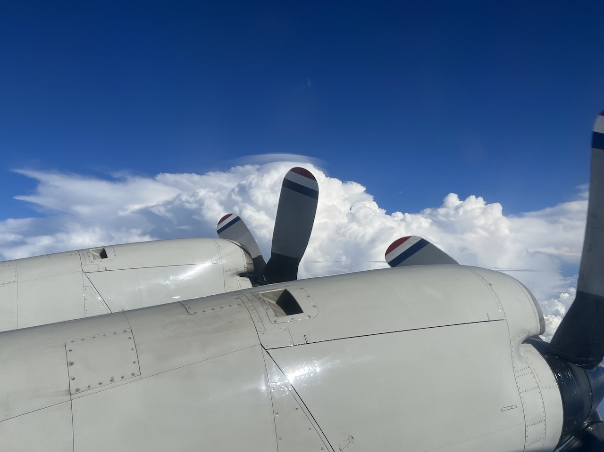
2022 Hurricane Field Program-APHEX
AL13/Julia): 7-8 October
Photo credit Jon Zawislak
Photo credit Jon Zawislak
Photo credit Jon Zawislak
Photo credit Jon Zawislak
Photo credit Jon Zawislak
Copies of the 2022 AL13/Julia debrief can be found in the HRD Google Drive folder
HRD >> Hurricane Field Program >> 2022 >> Debriefs >> AL13/Julia

