Slide 1


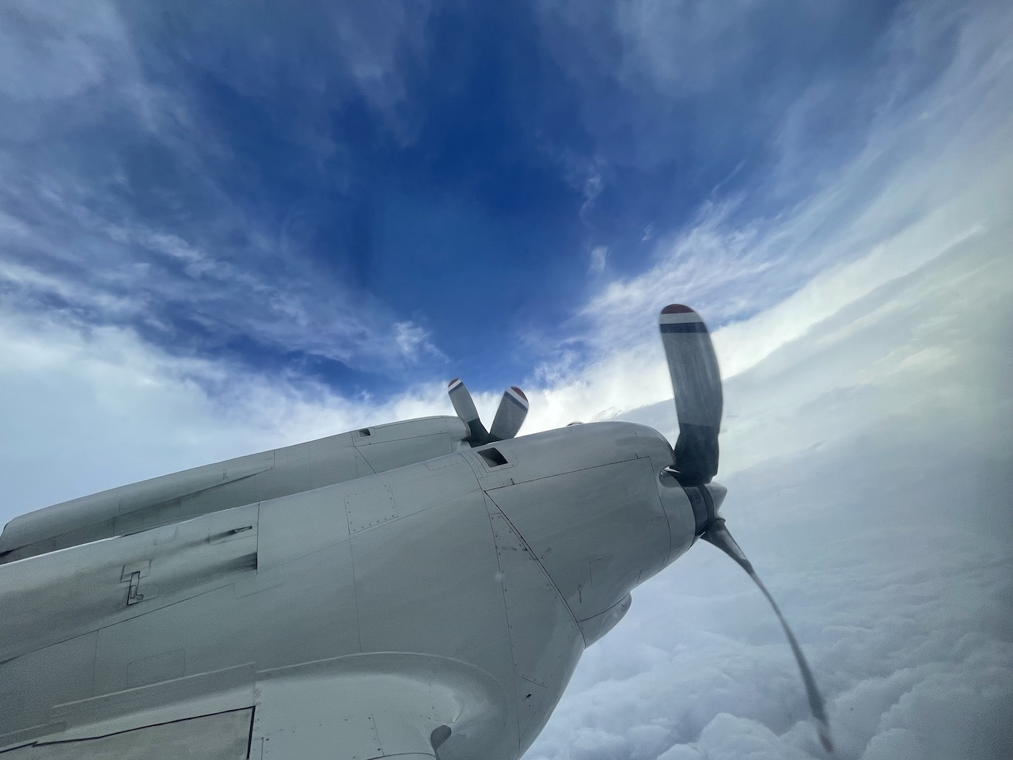
2022 Hurricane Field Program
Advancing the Prediction of Hurricanes Experiment (APHEX)
AL09/Ian Debrief
Jason Dunion – HFP Director
Jon Zawislak & Rob Rogers - HFP Deputy Directors
Photo credit: Heather Holbach

Slide 2
2022 Hurricane Field Program-APHEX
Summary of Missions (24-28 September 2022)
Mission Series Overview
8 P-3 Missions (EMC/NHC), 7 G-IV missions (NHC)
143 GPS dropsondes / 138 transmitted to the GTS >> excluding NHC Synoptic Surveillance
18 NRL/ONR, UM AXBTs deployed (18 good)
42 TDR analyses transmitted to EMC & NHC
APHEX Experiments & Modules: https://www.aoml.noaa.gov/2022-hurricane-field-program/
RICO SUAVE (sUAS)
FLAIMS (AIPEX)
TCRI RMWs (AIPEX)
Stratiform Spiral Module Module
Vortex Alignment Module (VAM, AIPEX)

Slide 3
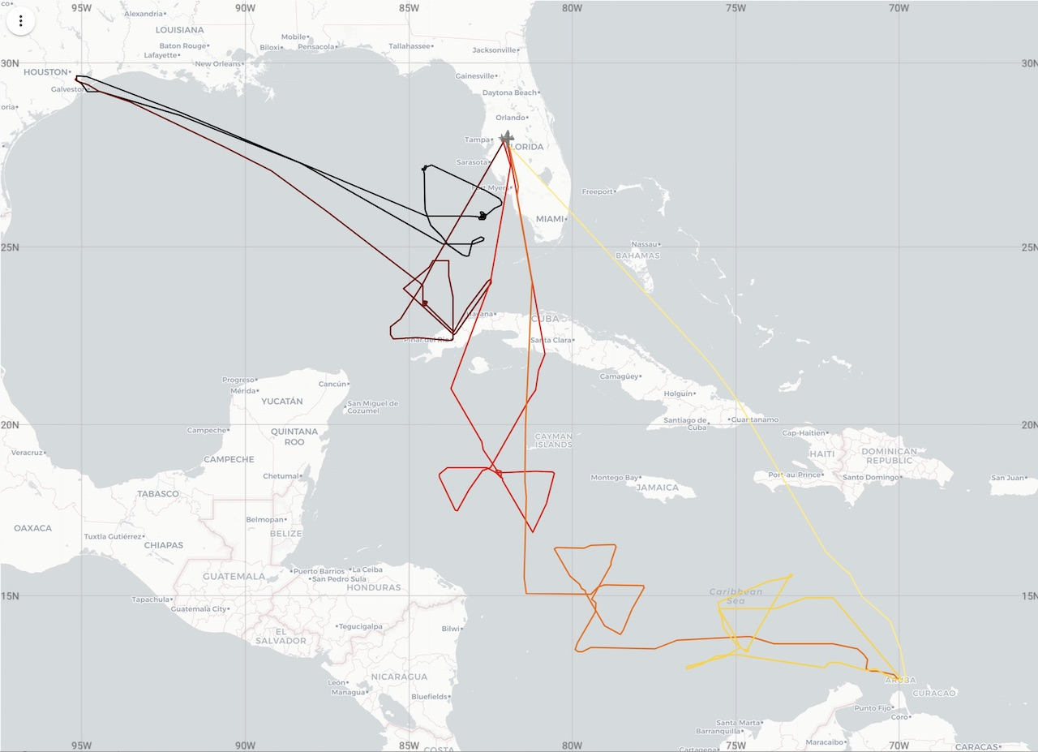
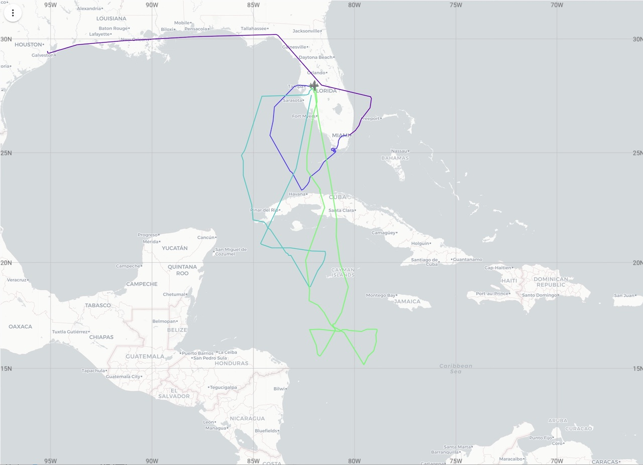
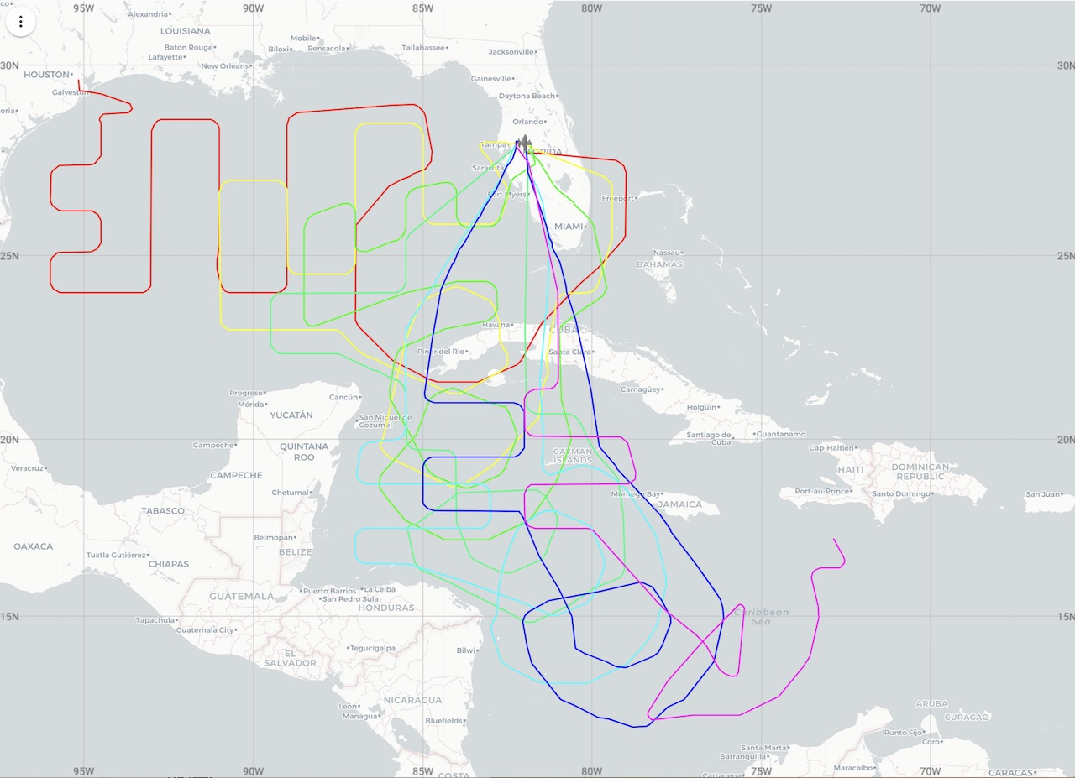
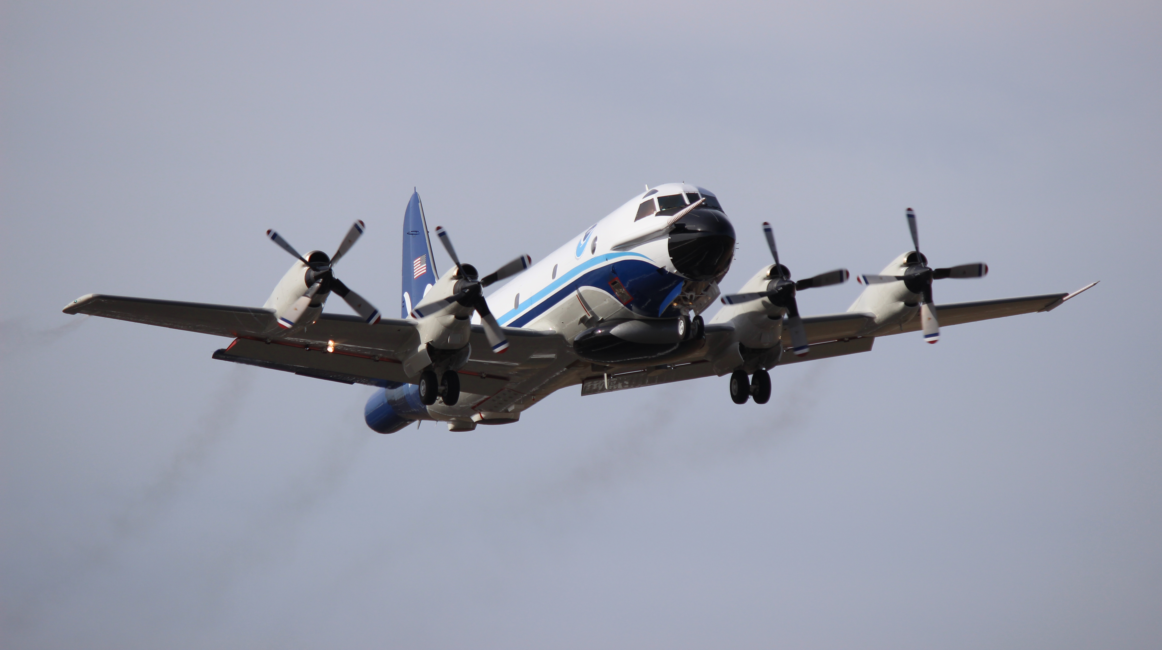
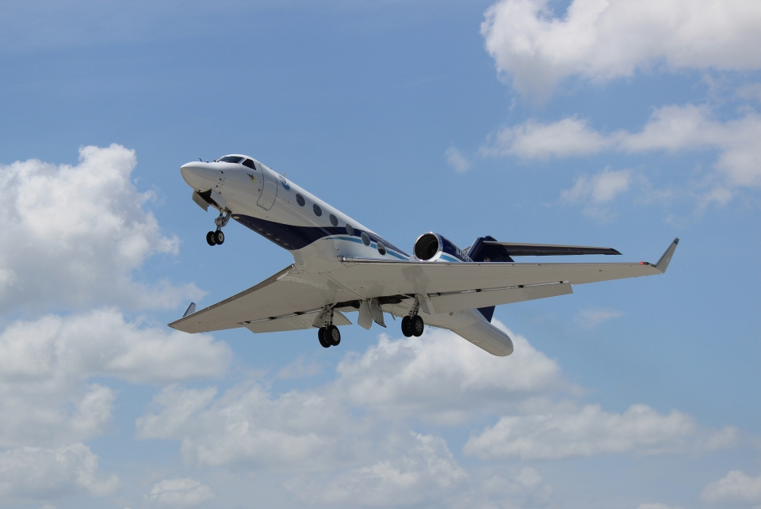
2022 Hurricane Field Program-APHEX
Summary of Missions (24-28 September)
NOAA 42
NOAA 43
NOAA 49
20220924H1 (N42)
EMC-NHC TDR
20220928H1 (N42)
EMC-NHC TDR
20220925I1 (N43)
EMC-NHC TDR
20220924N1 (N49)
NHC Syn Surv
20220926N2 (N49)
NHC Syn Surv
20220925H1 (N42)
EMC-NHC TDR
20220926I1 (N43)
EMC-NHC TDR
20220925N1 (N49)
NHC Syn Surv
20220927N1 (N49)
NHC Syn Surv
20220926H1 (N42)
EMC-NHC TDR
20220927I1 (N43)
EMC-NHC TDR
20220925N2 (N49)
NHC Syn Surv
20220927N2 (N49)
NHC Syn Surv
20220927H1 (N42)
EMC-NHC TDR
20220926N1 (N49)
NHC Syn Surv

Slide 4
2022 Hurricane Field Program-APHEX
Summary of Missions (24-28 September 2022)
Missions & Crewing
20220924H1 (EMC): Rogers (LPS, Radar), J. Zhang (Aspen), None (GB LPS), Reasor (GB Radar)
20220924I1 (EMC): Cancelled (TBD)
20220924N1 (NHC): Gamache (GB Radar)
20220925H1 (EMC): Rogers (LPS, Radar), J. Zhang (Aspen), None (GB LPS), Reasor (GB Radar)
20220925I1 (EMC): Holbach (LPS, Radar), Hazelton (Aspen), None (GB LPS), Gamache (GB Radar)
20220925N1 (NHC): Reasor (GB Radar)
20220925N2 (NHC): Gamache (GB Radar)
20220926H1 (EMC): Rogers (LPS, Radar), J. Zhang (Aspen), None (GB LPS), Reasor (GB Radar)
20220926I1 (EMC): Holbach (LPS, Radar), Hazelton (Aspen), Alvey (GB LPS), Alvey (GB Radar)
20220926N1 (NHC): Reasor (GB Radar)
20220926N2 (NHC): Gamache (GB Radar)

Slide 5
2022 Hurricane Field Program-APHEX
Summary of Missions (24-28 September 2022)
Missions & Crewing
20220927H1 (EMC): Rogers (LPS, Radar), J. Zhang (Aspen), None (GB LPS), Reasor (GB Radar)
20220927I1 (EMC): Holbach (LPS, Radar), Hazelton (Aspen), Alvey (GB LPS), Alvey/Chen (GB Radar) >> mission aborted
20220927N1 (NHC): Reasor (GB Radar)
20220927N2 (NHC): Gamache (GB Radar)
20220928H1 (EMC): Rogers (LPS, Radar), Cione (LPS sUAS), Wadler (sUAS), J. Zhang (Aspen), Fischer (GB LPS, Radar)
20220928I1 (EMC): Cancelled (aircraft maintenance issues)

Slide 6
2022 Hurricane Field Program-APHEX
Logistics Highlights
Aircraft, instruments, equipment & resources
NOAA-43: 2 consecutive missions with maintenance issues that ended the flights early (smoke in cabin)
20220927I1: mission aborted with an emergency landing at MIA
Resulted in some discussion as to whether the planned 20220928I1 mission was a “miss” for operations
HRD crew were told by N43 AC that they should consider the 20220928I1 mission canceled, so our crew remained in Miami and did not join the N43 transit to Ellington later that evening
Experiments, Modules, & Coordination
20220928H1 mission: planned for a Coastal Survey Module (Landfall Experiment) along the FL coast on the eastern side of the pattern >> weather conditions proved too difficult to complete (severe eyewall turbulence and intense convective bands along the FL coast

Slide 7
2022 Hurricane Field Program-APHEX
Interesting or Challenging Observations
Dropsondes transmitted to the GTS with errors
D20220924_184234 NOAA49 partial fast fall, bad data sent
D20220924_184234 NOAA49 partial fast fall, bad data sent
D20220925_205231 NOAA49 partial fast fall, bad data sent
D20220926_103724 NOAA42 post-splash data not removed (but marked in log that it was)
D20220926_001159 NOAA49 bad winds at top based on vvel
D20220926_085048 NOAA49 bad winds at top based on vvel
D20220926_193332 NOAA49 bad winds at top based on vvel
D20220926_195406 NOAA49 bad winds at top based on vvel
D20220926_222103 NOAA49 fast fall
D20220926_193332 NOAA49 bad winds at top based on vvel
D20220927_130401 NOAA42 fast fall
D20220926_193332 NOAA49 bad winds at top based on vvel
No sondes with wind speeds > 90 m/s from either AF or NOAA in Ian.

Slide 8
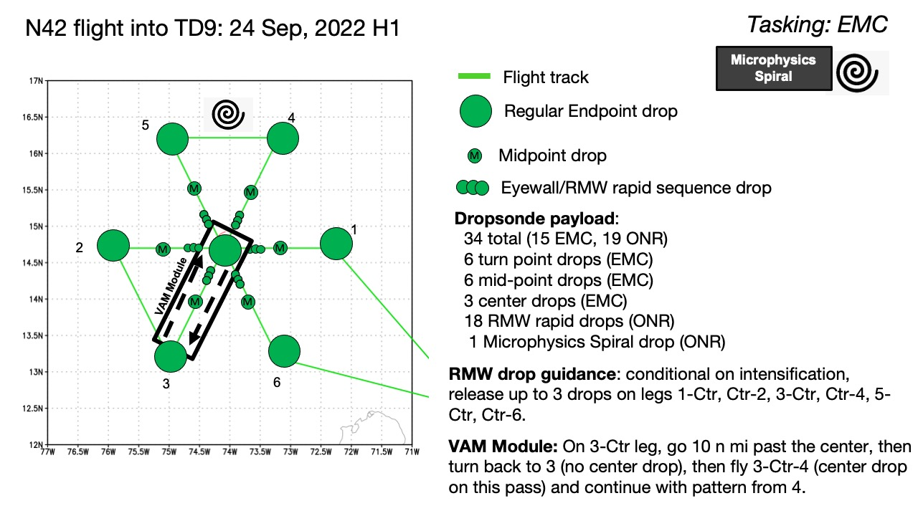
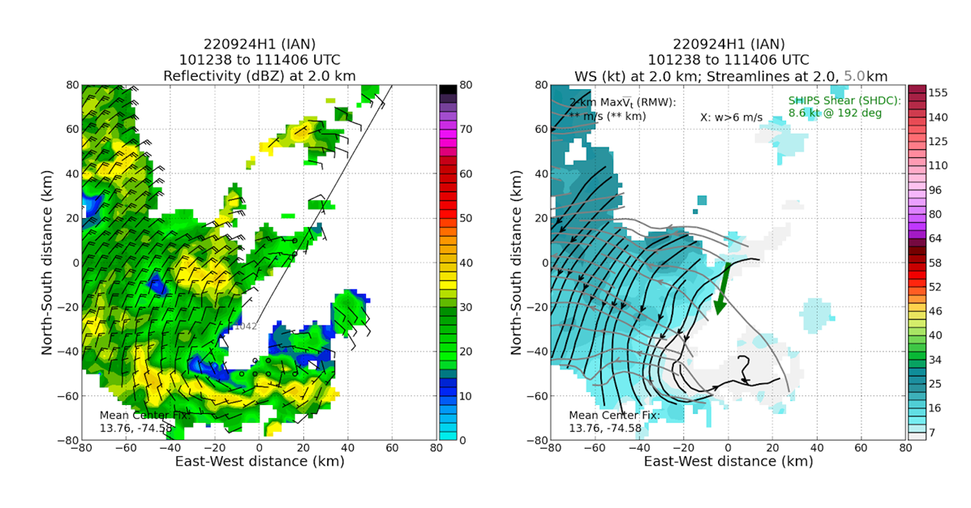
2022 Hurricane Field Program-APHEX
AL09/Ian: 20220924H1 (EMC)
Mission
Onboard
LPS/Radar: Rogers, Aspen: J. Zhang
Ground-Based
LPS: None, Radar: Reasor
APHEX relevance:
EMC TDR, VAM
Planned pattern: butterfly
T/O off (Aruba): 0847z, Land (Aruba): 1400z
FL 10 kft (pressure)
Dropsondes: 15 drops (15 to GTS)
AXBTs (NRL/ONR): none
TDR analyses to EMC & NHC: 4
Experiencing northeasterly shear, highly disorganized
Low-level center was displaced to the SW of expected position, NHC termed this a reformation
Modified VAM in the SW quadrant, with 5-km center displaced to WSW of 2-km center
N42 planned flight track
TDR-derived reflectivity and winds at 2km (left) and 2- and 5-km streamlines (right)

Slide 9
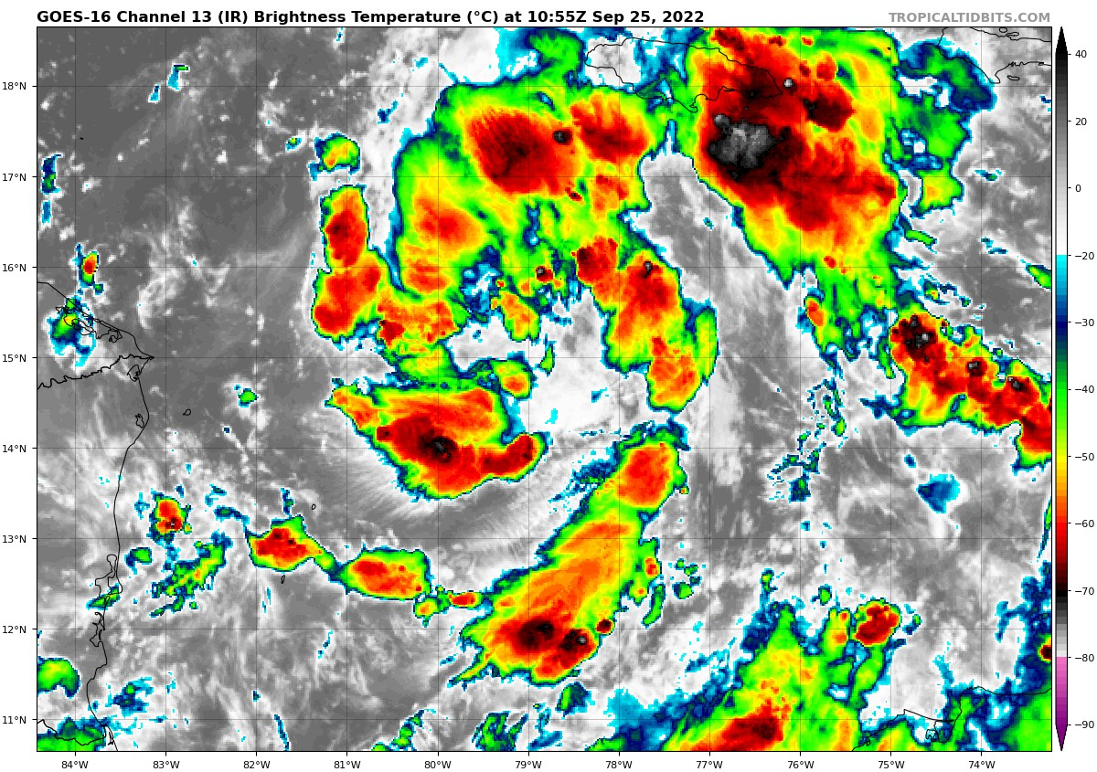
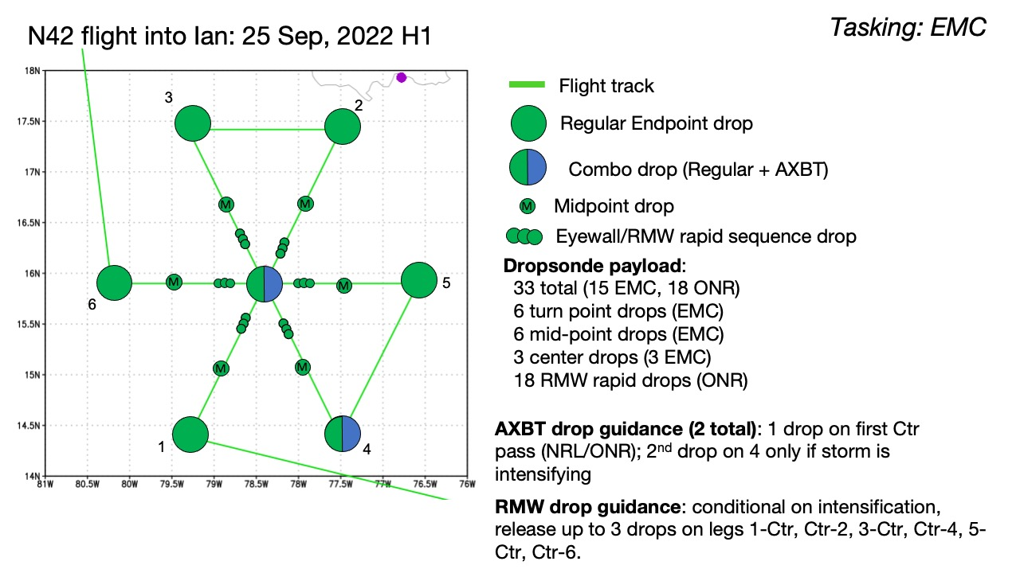
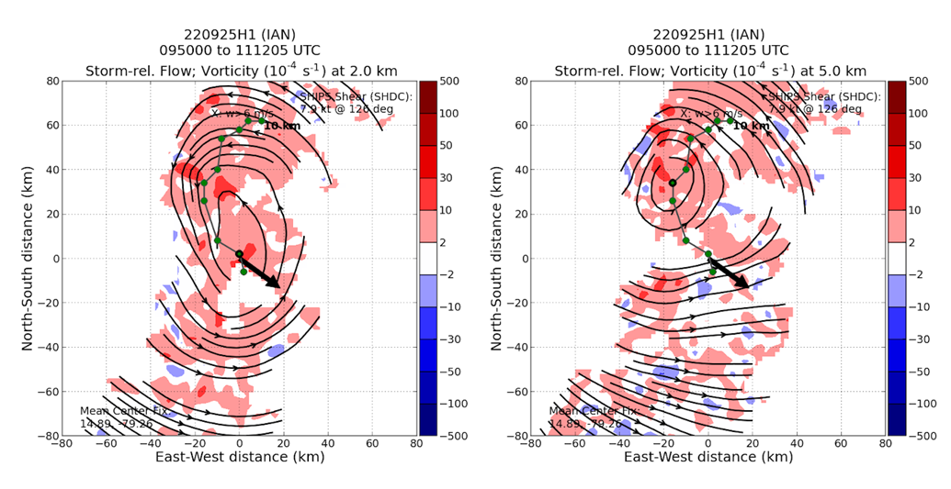
2022 Hurricane Field Program-APHEX
AL09/Ian: 20220925H1 (EMC)
Mission
Onboard
LPS/Radar: Rogers, Aspen: J. Zhang
Ground-Based
LPS: None, Radar: Reasor
APHEX relevance:
EMC TDR, TCRI RMWs (AIPEX)
Planned pattern: butterfly
T/O off (Aruba): 0821z, Land (KLAL): 0602z
FL 10 kft (pressure)
Dropsondes: 21 drops (20 to GTS)
AXBTs (NRL/ONR): 3
TDR analyses to EMC & NHC: 3
Still low-end tropical storm, diffuse appearance on satellite
Storm-relative circulations well-defined, but centers displaced toward NW between 2 and 5-km altitude.
TC entering very favorable environment, RI forecast
Certificate at AOML site expired, no access to RT radar products on the aircraft until it was reset
IR image when P-3 reached storm
N42 planned flight track
TDR-derived storm-relative streamlines and vorticity at 2 (left) and 5 (right) km

Slide 10
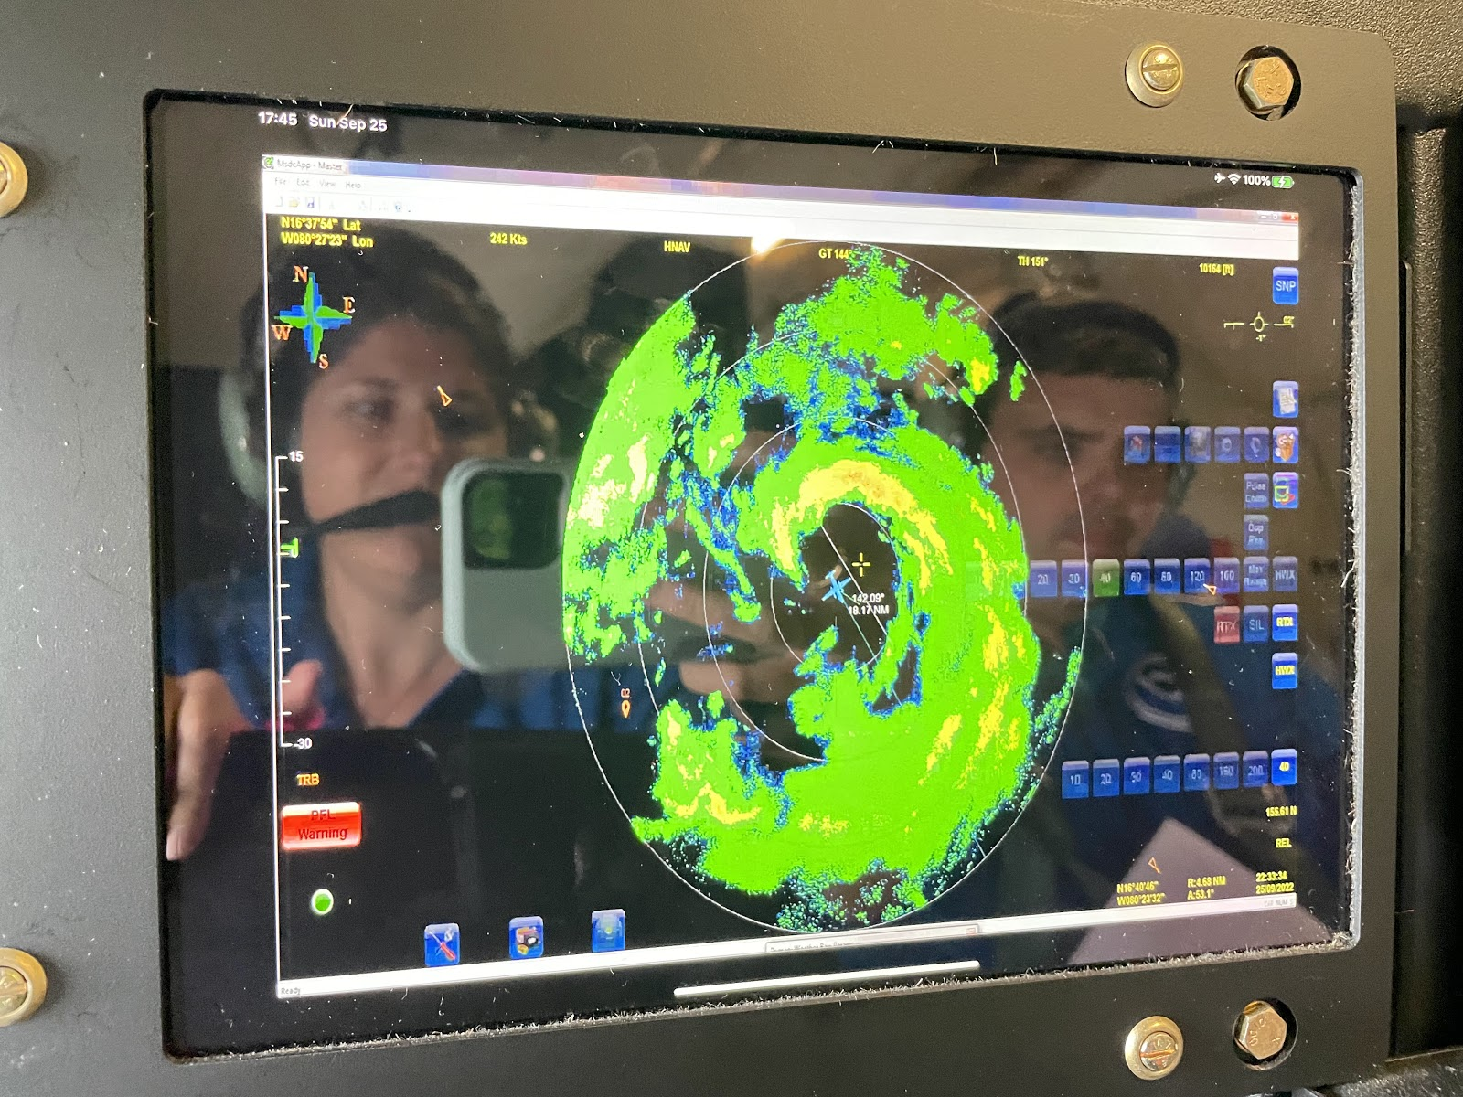
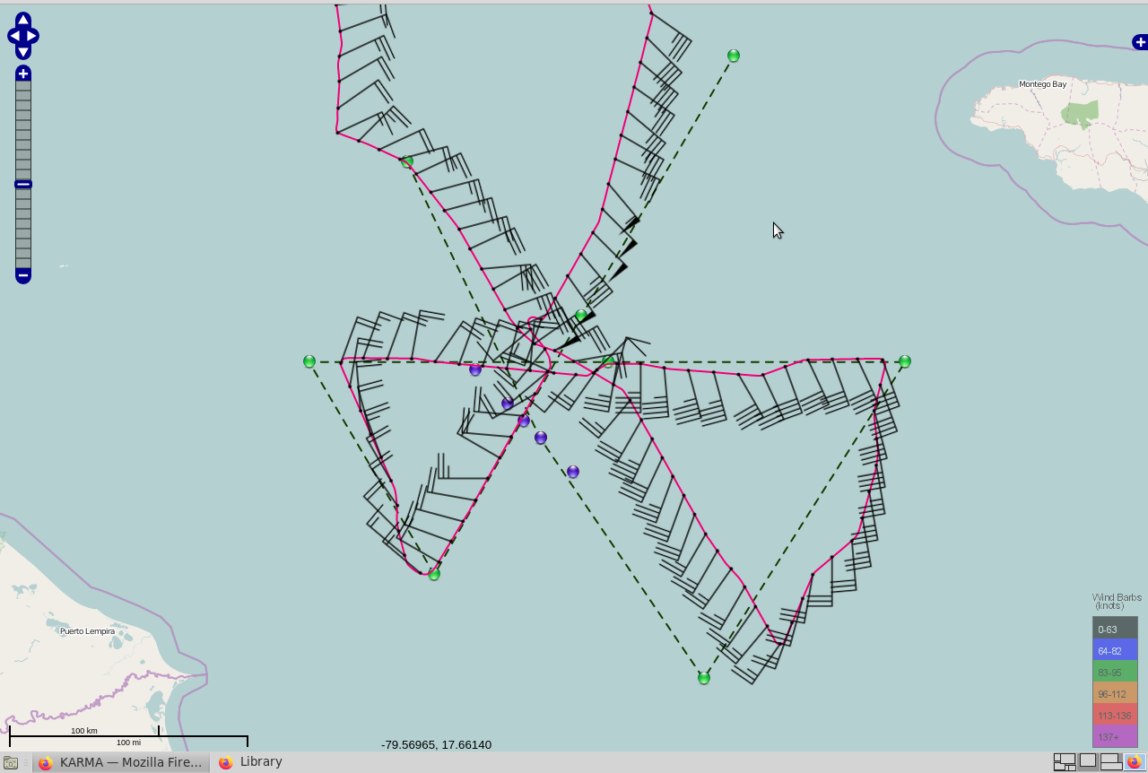
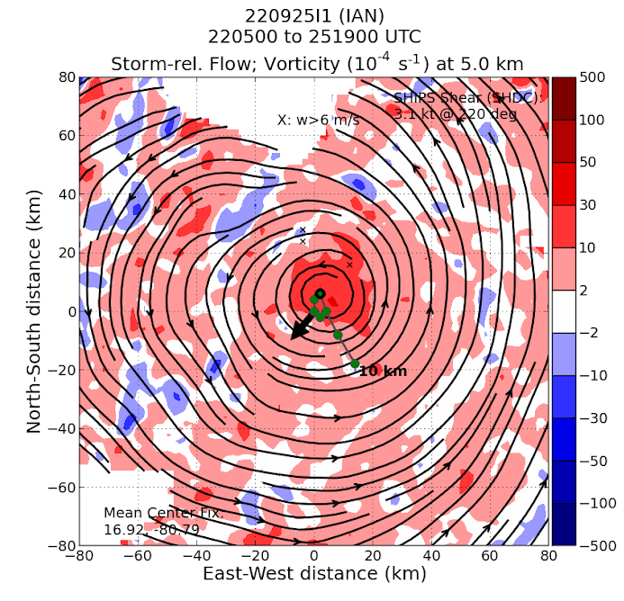
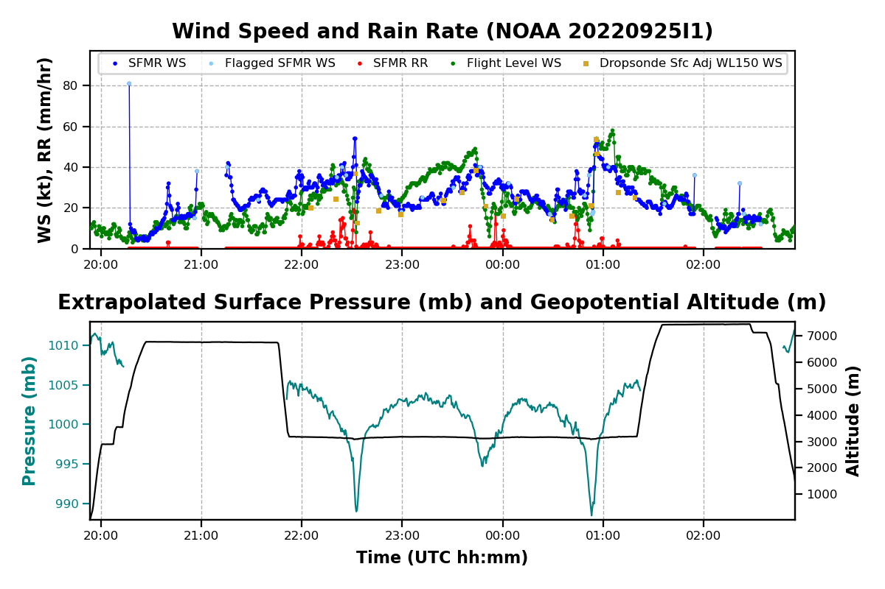
2022 Hurricane Field Program-APHEX
AL09/Ian: 20220925I1 (EMC)
Mission
Onboard
LPS/Radar: Holbach, Aspen: Hazelton
Ground-Based
LPS: None, Radar: Gamache
APHEX relevance:
EMC TDR, TCRI RMWs (AIPEX)
Planned pattern: butterfly
T/O off (KLAL): 1953z, Land (KLAL): 0304z
FL 10 kft (pressure)
Dropsondes: 21 drops (20 to GTS)
AXBTs (NRL/ONR): none
TDR analyses to EMC & NHC: 3
Partial eyewall present when we arrived which was somewhat surprising given it was still a TS
Found that Ian had become more vertically aligned
N43 final flight track

Slide 11
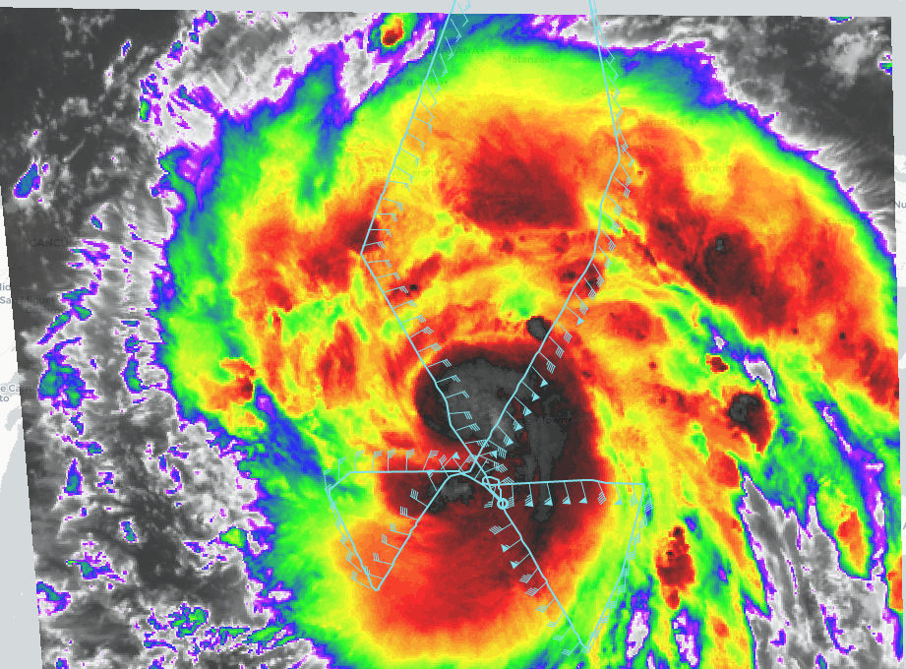
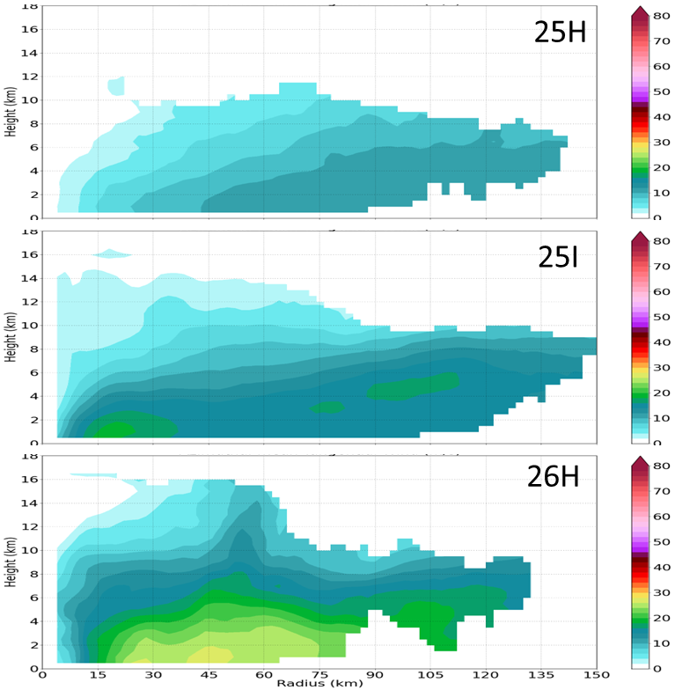
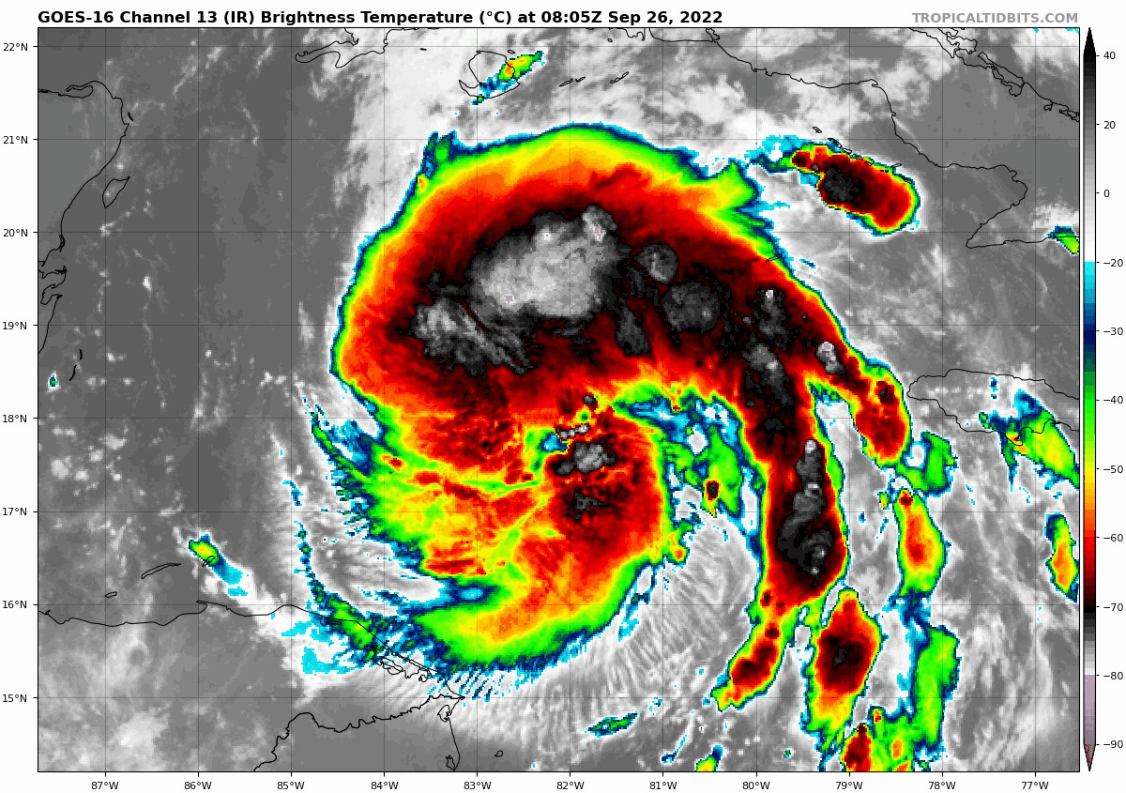
2022 Hurricane Field Program-APHEX
AL09/Ian: 20220926H1 (EMC)
Mission
Onboard
LPS/Radar: Rogers, Aspen: J. Zhang
Ground-Based
LPS: None, Radar: Reasor
APHEX relevance:
EMC TDR, TCRI RMWs (AIPEX)
Planned pattern: butterfly
T/O off (KLAL): 0759z, Land (KLAL): 1444z
FL 10 kft (pressure), dropped to 8 kft (AF OS)
Dropsondes: 34 drops (31 to GTS)
AXBTs (NRL/ONR): 8
TDR analyses to EMC & NHC: 3
Broad, not deep vortex
Convection developing in inner core
60-65 kt SFMR winds, 983 hPa – possibly tied to large size
Subsidence in NW inner core, possibly related to dry air intrusion there
That and TC size may have temporarily limited intensification
Tangential Wind (V_{t})
N42 final flight track

Slide 12
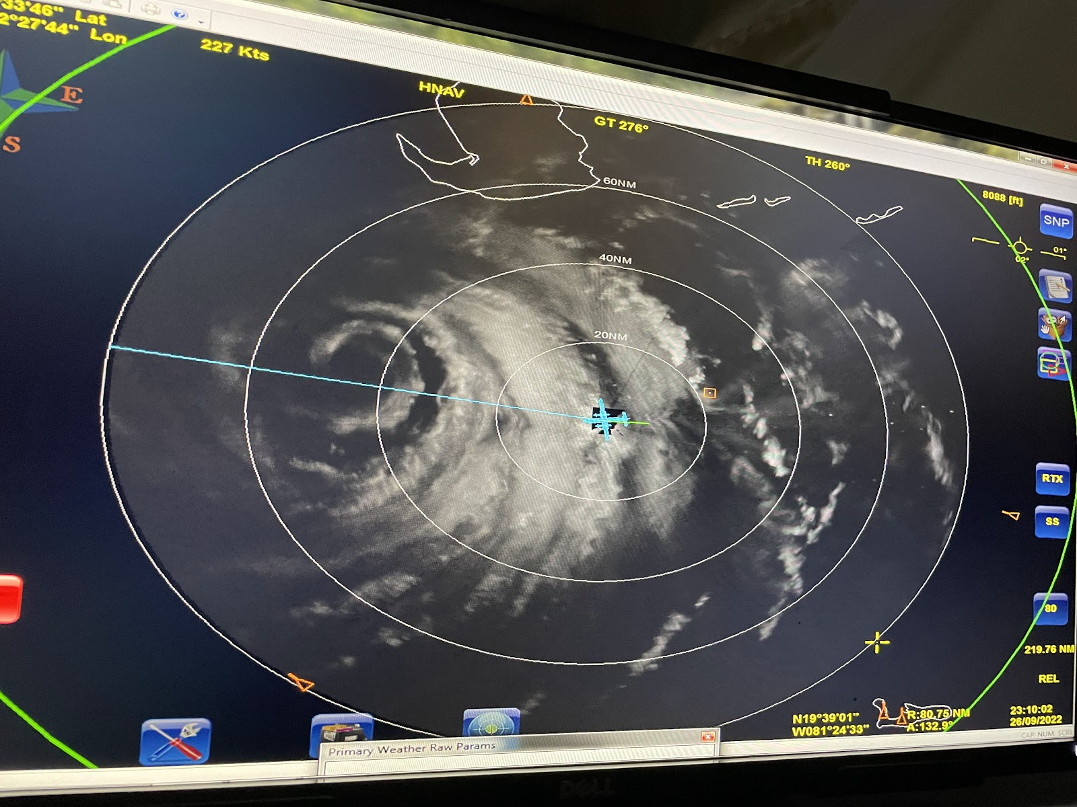
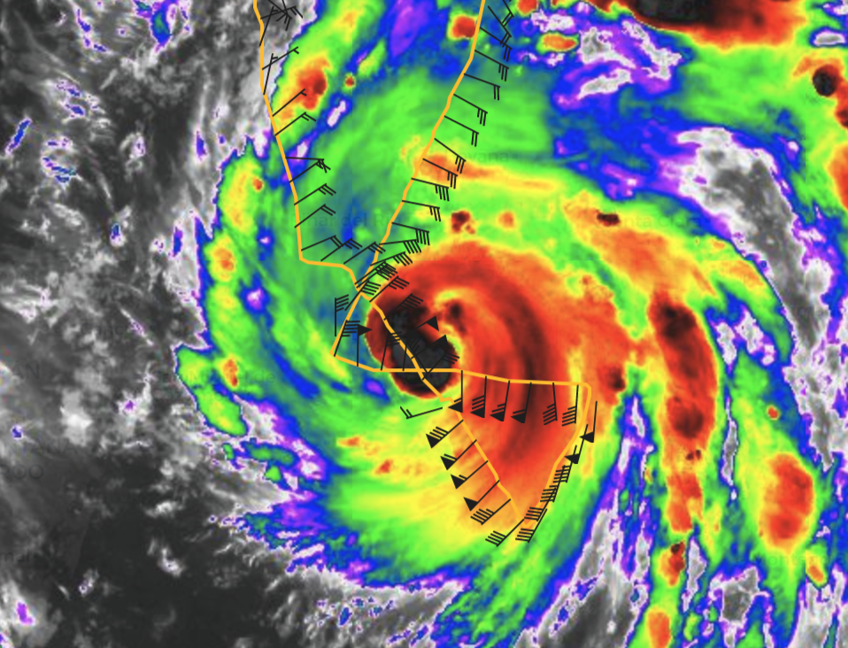
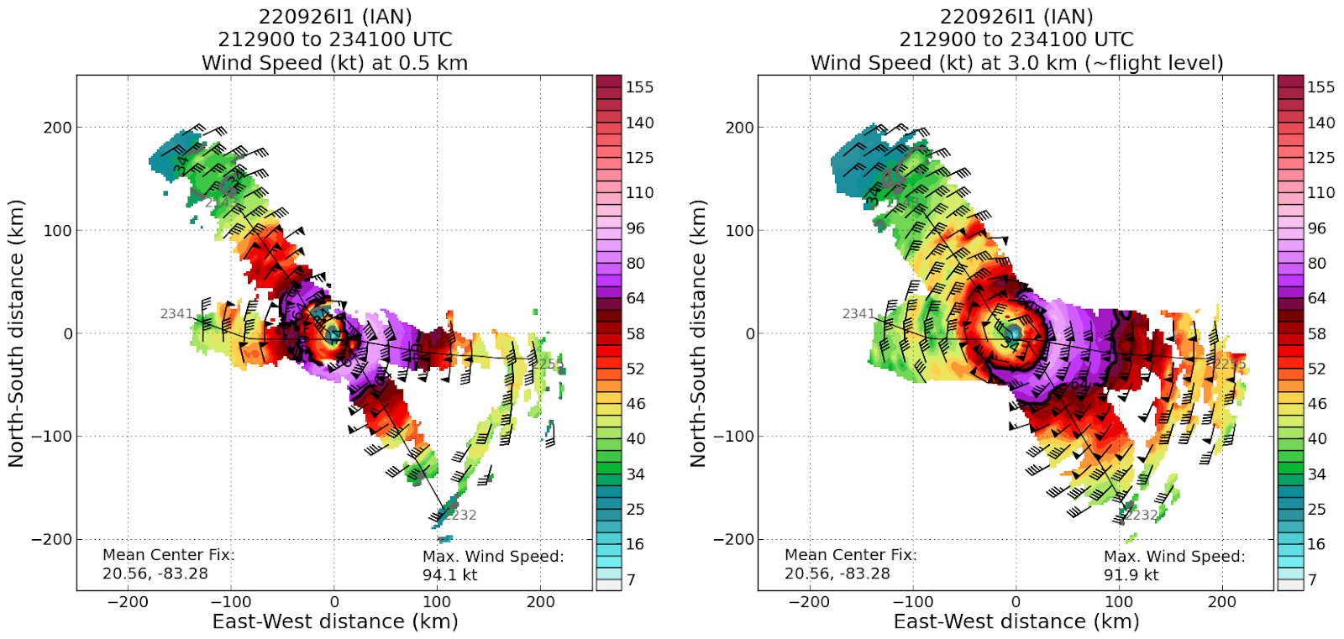
2022 Hurricane Field Program-APHEX
AL09/Ian: 20220926I1 (EMC)
Mission
Onboard
LPS/Radar: Holbach, Aspen: Hazelton
Ground-Based
LPS: Alvey, Radar: Alvey
APHEX relevance:
EMC TDR, TCRI RMWs (AIPEX)
Planned pattern: butterfly
T/O off (KLAL): 1948z, Land (KLAL): 0120z
FL 10 kft (pressure), dropped to 8 kft (AF OS)
Dropsondes: 17 drops (17 to GTS)
AXBTs (UM): 2
TDR analyses to EMC & NHC: 2
Complete satcom outages for 30 min after takeoff, contingency plans made for if it happened again
Ian was clearly progressing through an eyewall replacement cycle
Aborted after smoke started filling cabin upon exiting eyewall on second leg.
HDOBs overwritten in NHC archive by N49
N43 final flight track

Slide 13
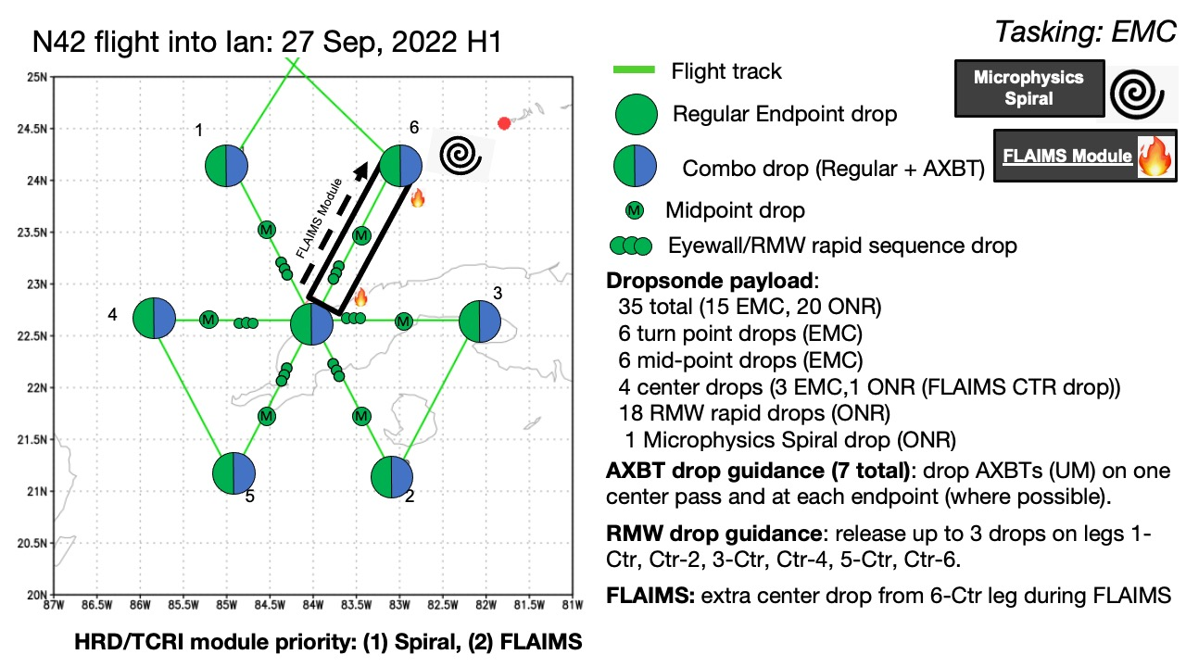
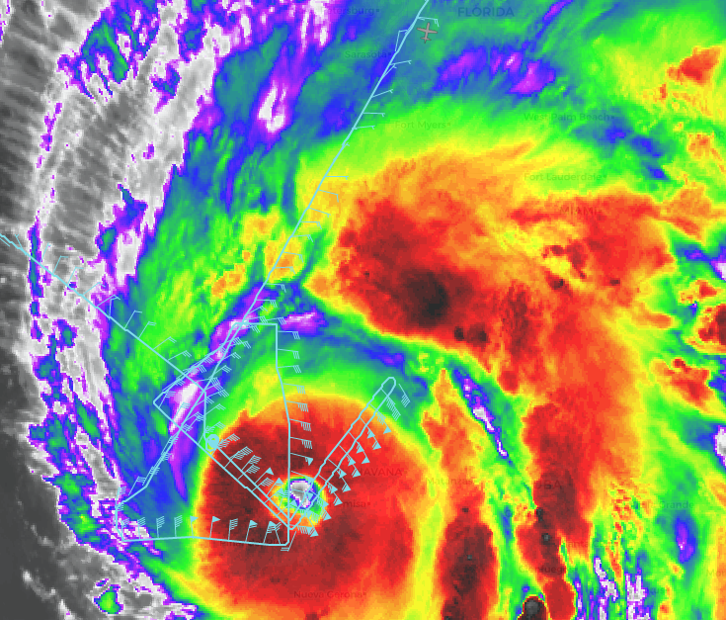
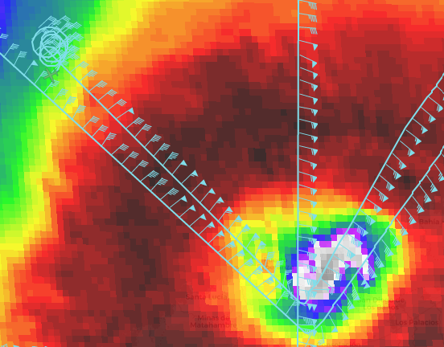
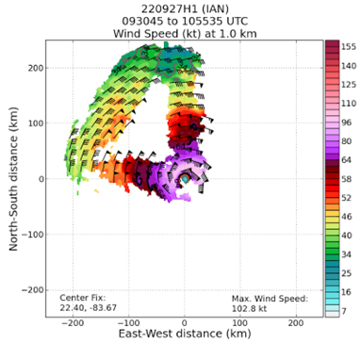
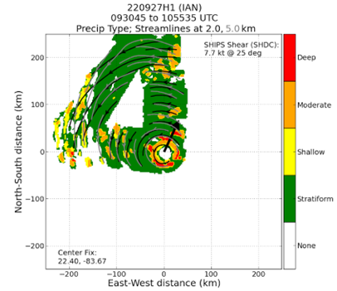
2022 Hurricane Field Program-APHEX
AL09/Ian: 20220927H1 (EMC)
Mission
Onboard
LPS/Radar: Rogers, Aspen: J. Zhang
Ground-Based
LPS: None, Radar: Reasor
APHEX relevance:
EMC TDR, FLAIMS, SSM, TCRI RMWs (AIPEX)
Planned pattern: butterfly
T/O off (KLAL): 0842z, Land (Ellington-TX): 1519z
FL 10 kft (pressure), dropped to 8 kft (AF OS)
Dropsondes: 12 drops (12 to GTS)
AXBTs (NRL/ONR): 3
TDR analyses to EMC & NHC: 3
Ian has intensified significantly, near major hurricane at t/o. Traversing western Cuba during mission
Ring of deep, moderate convection in small eyewall, widespread stratiform precip outside
Performed stratiform spiral on NW fringe of eyewall - hydrometeors ejected from eyewall? Azimuthal component downwind of convection on NE side?
Stratiform spiral
N42 final flight track
TDR winds at 1 km
Precip mode from first TDR analysis

Slide 14
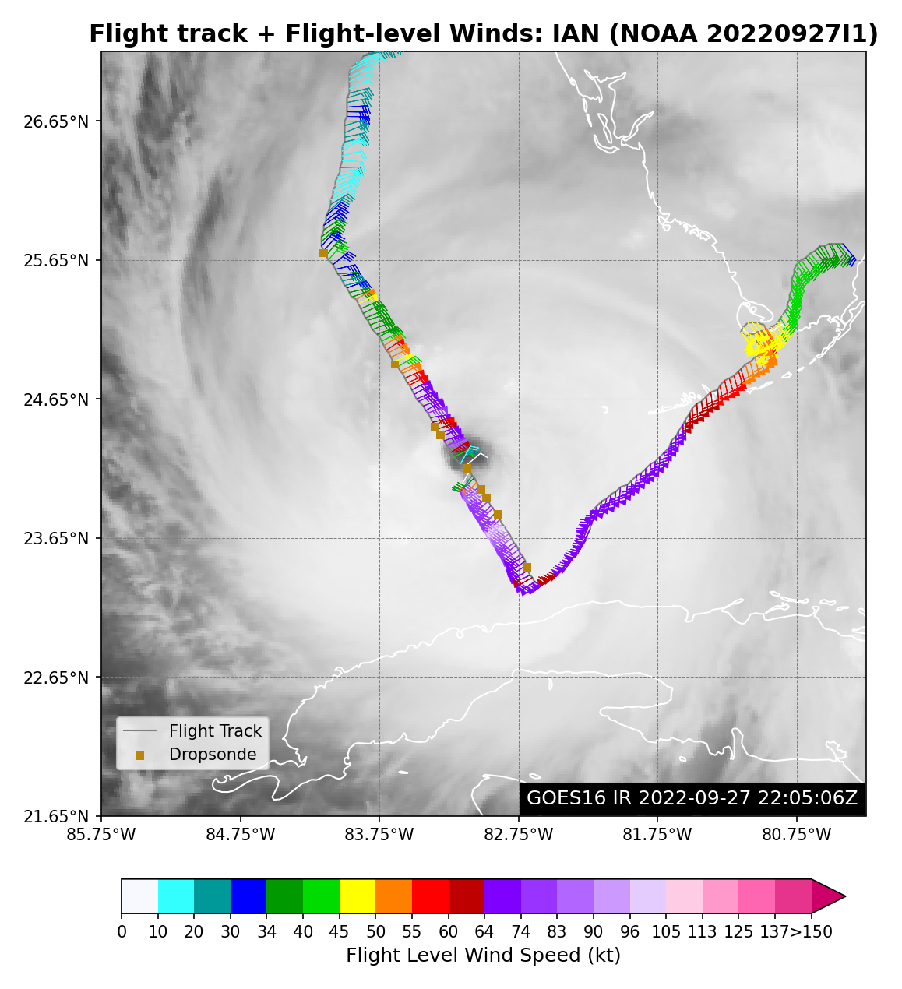
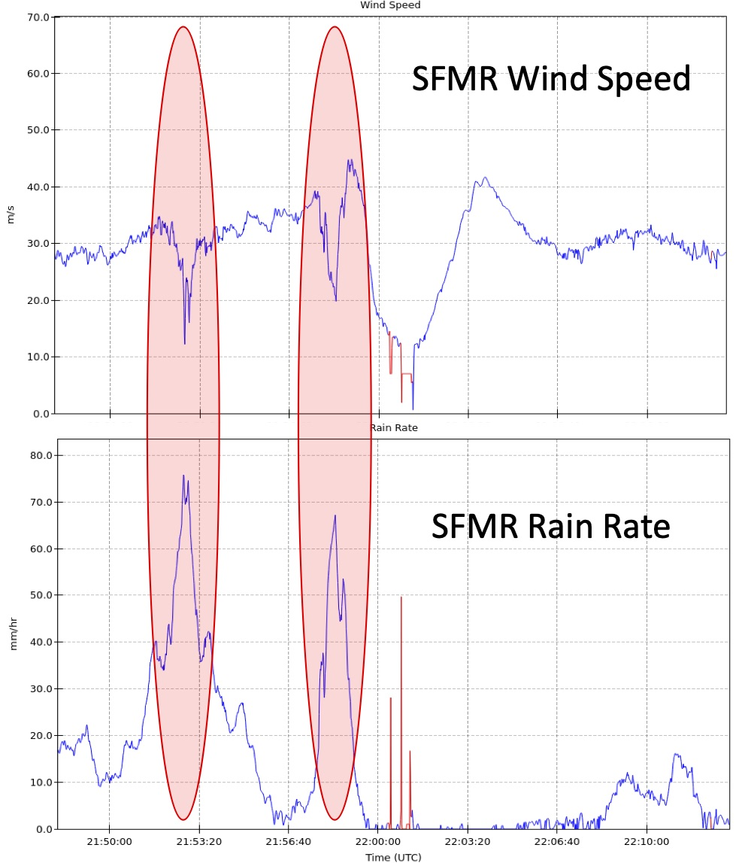
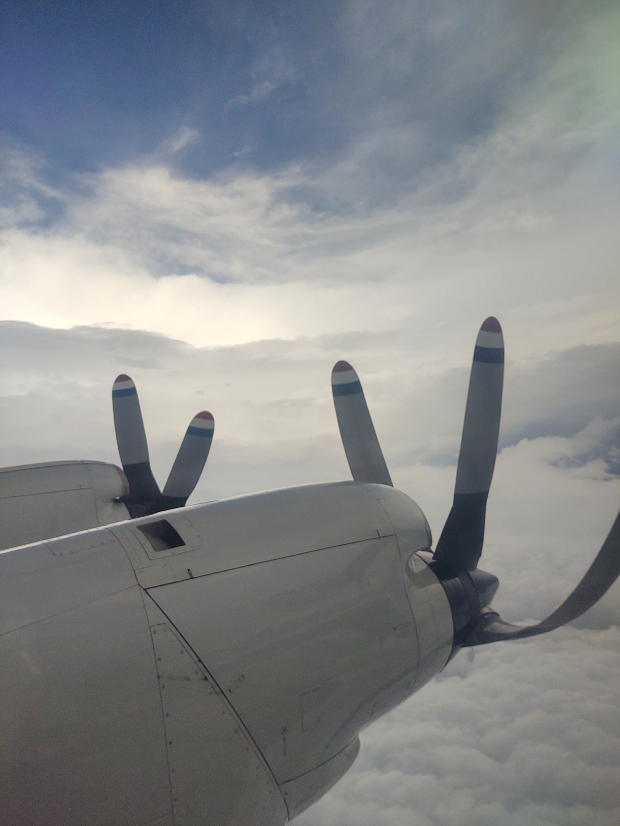
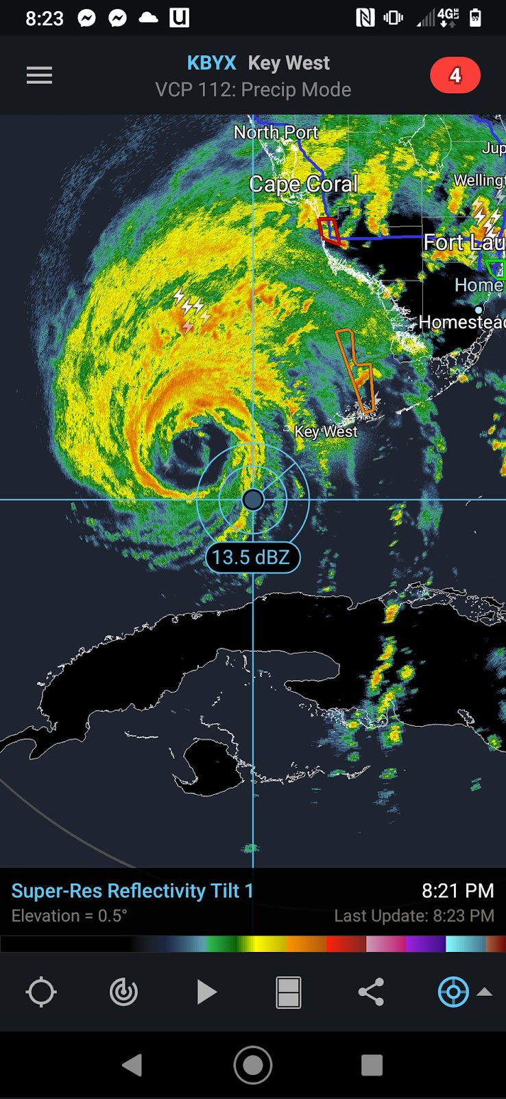
2022 Hurricane Field Program-APHEX
AL09/Ian: 20220927I1 (EMC)
Mission
Onboard
LPS/Radar: Holbach, Aspen: Hazelton
Ground-Based
LPS: Alvey, Radar: Alvey/Chen
APHEX relevance:
EMC TDR, TCRI RMWs (AIPEX)
Planned pattern: butterfly
T/O off (KLAL): 2045z, Land (MIA): 2318z
FL 10 kft (pressure)
Dropsondes: 10 drops (10 to GTS)
AXBTs (UM): 2
TDR analyses to EMC & NHC: 2
Beginning of another ERC
Noticeable rain issues with SFMR in eyewall
Mission aborted due to maintenance issue (emergency landing at MIA)
1 pass (NW-SE) completed before mission abort
N43 final flight track

Slide 15
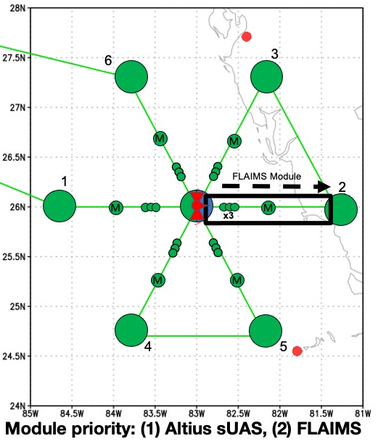
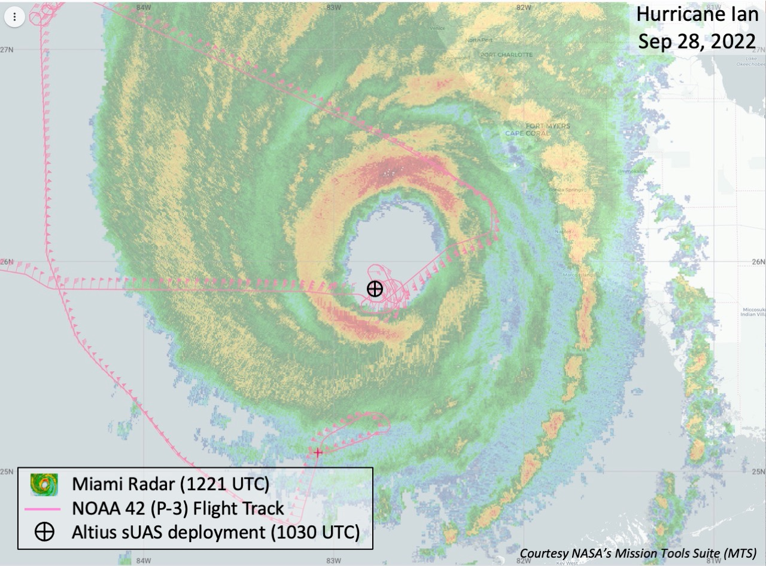
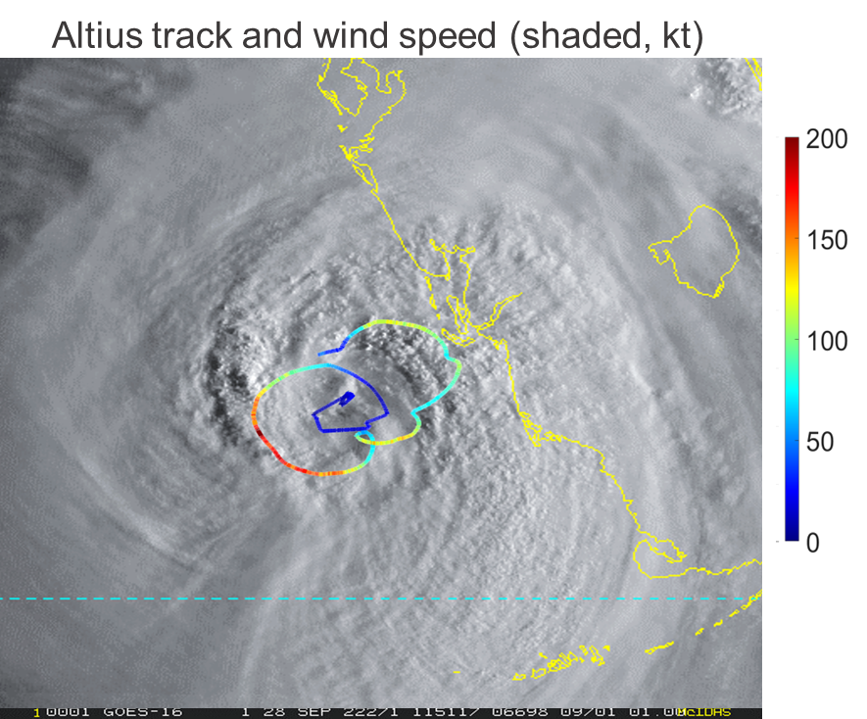
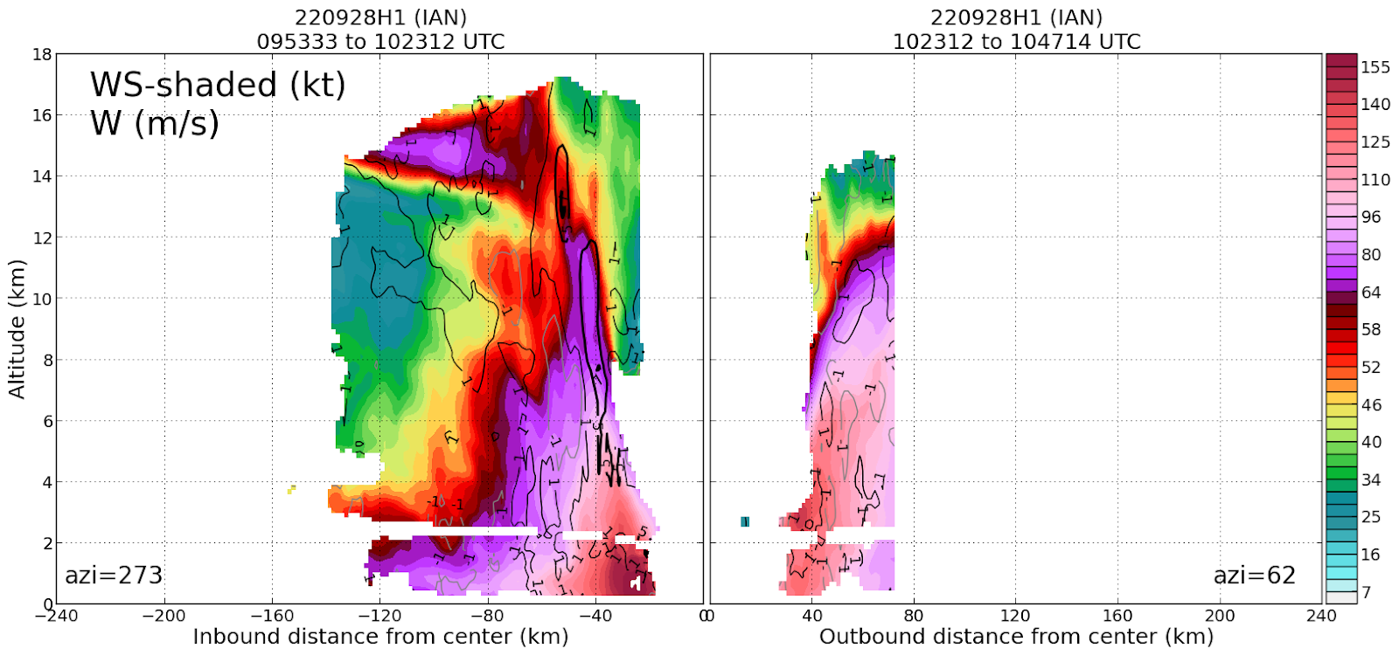
2022 Hurricane Field Program-APHEX
AL09/Ian: 20220928H1 (EMC)
Mission
Onboard
LPS/Radar: Rogers, LPS (sUAS): Cione, sUAS: Wadler, Aspen: J. Zhang
Ground-Based
LPS/Radar: Fischer
APHEX relevance:
EMC TDR, RICO SUAVE (sUAS), TCRI RMWs (AIPEX)
Planned pattern: butterfly
T/O off (Ellington-TX): 0755z, Land (Ellington-TX): 1442z
FL 8 kft (pressure, AF OS)
Dropsondes: 13 drops (13 to GTS)
AXBTs (NRL/ONR): none
TDR analyses to EMC & NHC: 3
Ian undergoing RI after completion of ERC
Extremely cold cloud tops, widespread lightning in W eyewall, contracting eye post-ERC, mesovortices with extremely sharp radial gradient in wind speed, significant yawing (“fishtailing”) experienced
Did one pass, aborted second pass due to safety concerns
Highlight: Altius launched, successfully flew ~2 h in eye, eyewall
N42 final flight track

Slide 16
2022 Hurricane Field Program-APHEX
Social Media
AOML-HRD-NOAA Research Twitter
Drones like Altius allow us to dive deeper into the storm to survey lower altitudes…
https://twitter.com/NOAA_AOML/status/1575862576189411328?s=20&t=_AwJIgQMpjztqP9Y_4gQ9Q
Scientists at NOAA’s Atlantic Oceanographic & Meteorological Laboratory have been working overtime to support research missions into Hurricane Ian…
https://twitter.com/NOAA_AOML/status/1575196948264632341?s=20&t=_AwJIgQMpjztqP9Y_4gQ9Q
NOAA launches new drone into Hurricane Ian!...
https://twitter.com/NOAA_AOML/status/1575862568731582464?s=20&t=_AwJIgQMpjztqP9Y_4gQ9Q
On September 28th, @NOAA_HurrHunter flew into Category 4 #HurricaneIan just before landfall in #Florida…
https://twitter.com/NOAA_AOML/status/1575862573848997888?s=20&t=_AwJIgQMpjztqP9Y_4gQ9Q
Watch as Dr. Heather Holbach explains what it was like to fly through the core of #HurricaneIan on September 27th…
https://twitter.com/NOAA_AOML/status/1579903373754925057?s=20&t=_AwJIgQMpjztqP9Y_4gQ9Q
This week, @NOAA_HurrHunter and @noaa_aoml flew into Cat4 #HurricaneIan just before landfall…
https://twitter.com/NOAAResearch/status/1575906674900348928

Slide 17
2022 Hurricane Field Program-APHEX
Social Media
HRD Blog
NOAA completes historic missions into Hurricanes Earl, Fiona, and Ian
https://noaahrd.wordpress.com/2022/09/29/noaa-completes-historic-missions-into-hurricane-ian/
NOAA deploys new Altius drone into the eye of Hurricane Ian
https://noaahrd.wordpress.com/2022/10/03/noaa-deploys-new-altius-drone-into-the-eye-of-hurricane-ian/
NOAA Researchers fly a series of missions into Hurricane Ian
https://noaahrd.wordpress.com/2022/09/27/noaa-researchers-fly-a-series-of-missions-into-hurricane-ian/
AOML Instagram & HRD Facebook
Watch as Dr. Heather Holbach explains what it was like to fly through the core of Hurricane Ian on September 27th...
https://www.instagram.com/tv/CjlVtMFj-Rc/?utm_source=ig_web_copy_link
Scientists at NOAA’s Atlantic Oceanographic & Meteorological Laboratory have been working overtime to support research missions into Hurricane Ian…
https://www.instagram.com/p/CjD6LIAJWBm/
NOAA launches new drone into Hurricane Ian
https://www.instagram.com/p/CjIuyFJuh66/

Slide 18
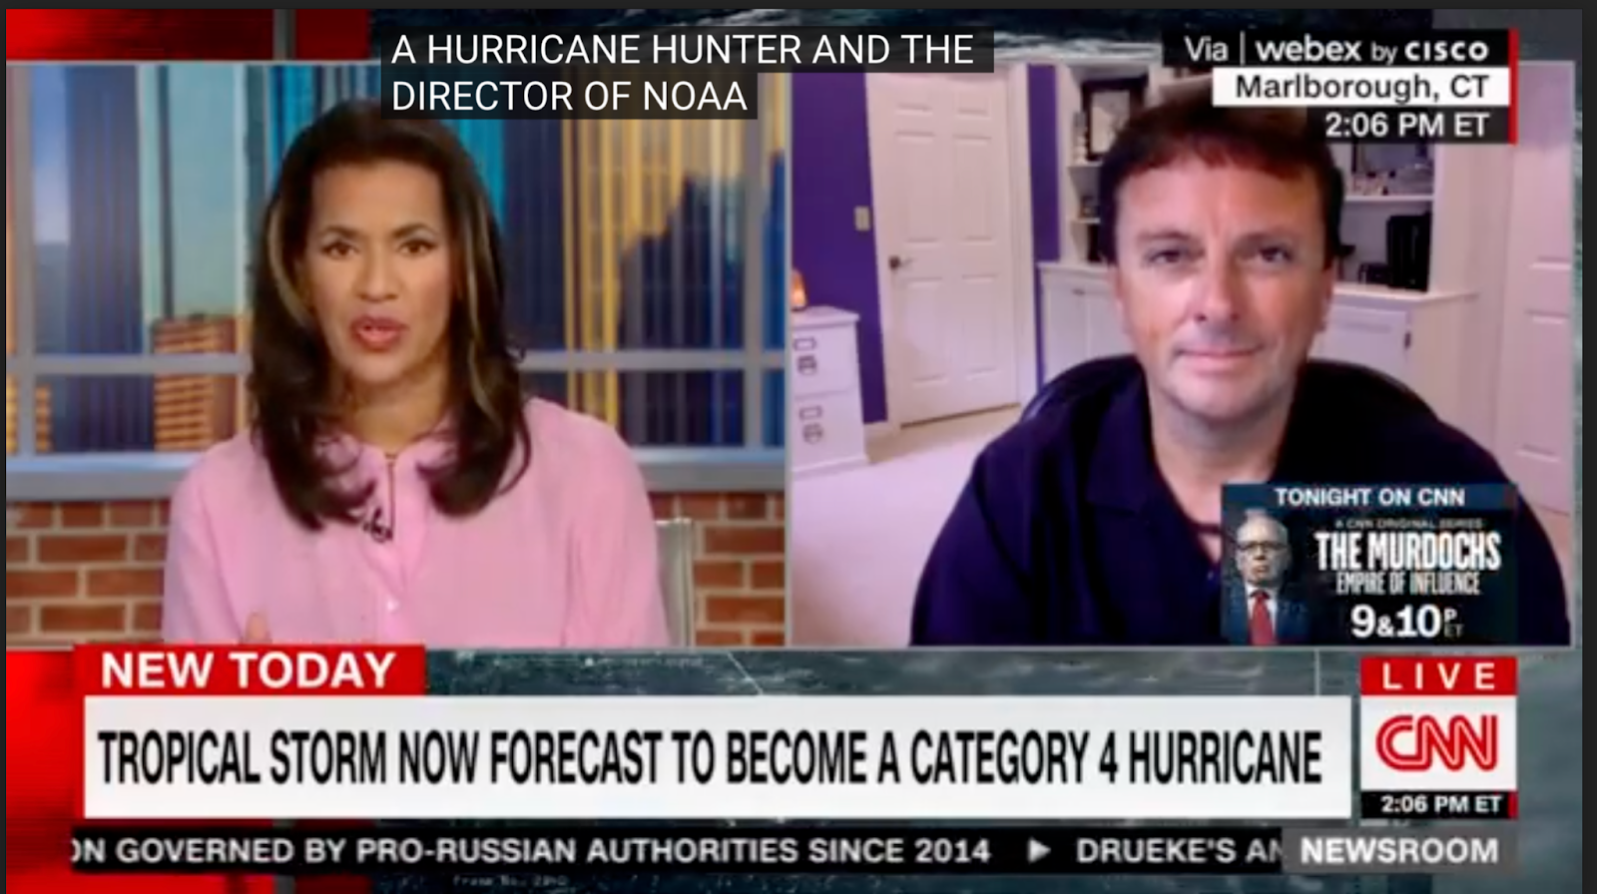
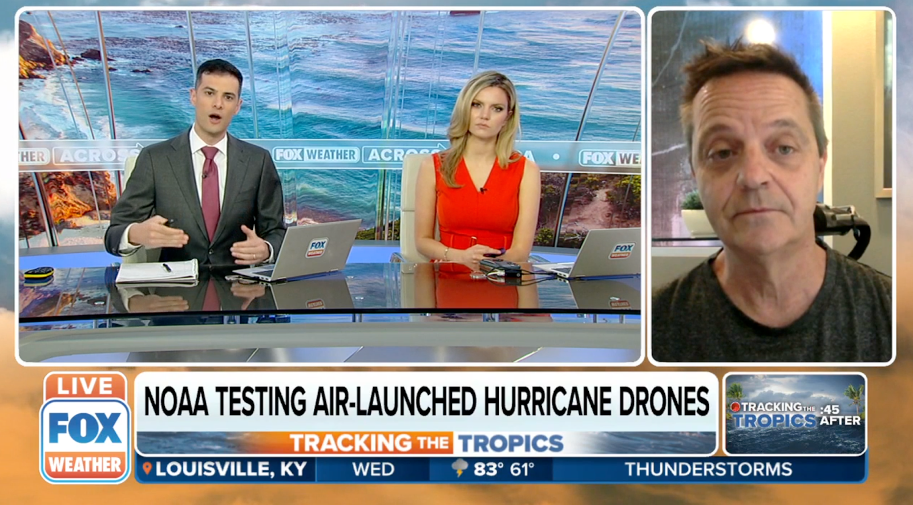
2022 Hurricane Field Program-APHEX
Sample of Media Interviews
CNN: Tropical Storm now forecast to become Category 4 hurricane
Fox Weather: NOAA launches first of its kind drone in Hurricane Ian to research areas unsafe for Hurricane Hunters
KCRA: NOAA scientists used drones to take measurements inside the most dangerous part of Hurricane Ian
Fox LiveNow: Hurricane Ian's path remains uncertain
CNBC: NOAA HFP director says Ian is a long duration event
CBS Mornings: How a 25-pound hurricane-hunting drone can help inform "life-or-death decisions"

Slide 19
2022 Hurricane Field Program-APHEX
Communications
Daily Plan of the Day (POD)
Sent to research partners, OAR Comms, AOML Comms
Monica Allen (Director of Public Affairs, NOAA Research ) and James Jenkins (Chief of Staff, OAR) requested to receive our Plan of the Day updates
Laura Chaibongsai, Holly Stahl, & Jason D.
Post-map discussion tag-up to discuss social media opportunities

Slide 20
2022 Hurricane Field Program-APHEX
Health-Safety-Sexual Assault/Sexual Harassment (SASH)
Any issues with health-safety-SASH, either during missions or downtime - anonymous responses can be submitted at:
https://docs.google.com/forms/d/e/1FAIpQLSeiFLPksVEXNmAvOKGAX259lKVAcIG0kh8TME6DU3xxatN6Gw/viewform?

Slide 21
2022 Hurricane Field Program-APHEX
Other Issues – what went well?...what can we do better?
Smoke in cabin: better info from AOC on options for going on oxygen and how to decide when you should would be very helpful
20220927I1 aborted mission and emergency landing in Miami
There was some post Ian discussion between AOC and the AOML/HRD HFP Director re: the next day’s N43 mission being a “go” or being cancelled
N43’s Aircraft Commander (AC) made the call that the HRD crew should consider that next mission “cancelled”, so HRD pulled its crew off of the N43 ferry to Ellington Field later that evening
Communication could have been better between HRD HFP Director & the AOC Chief of Programs over this period to make sure AOC and HRD were on the same page

Slide 22
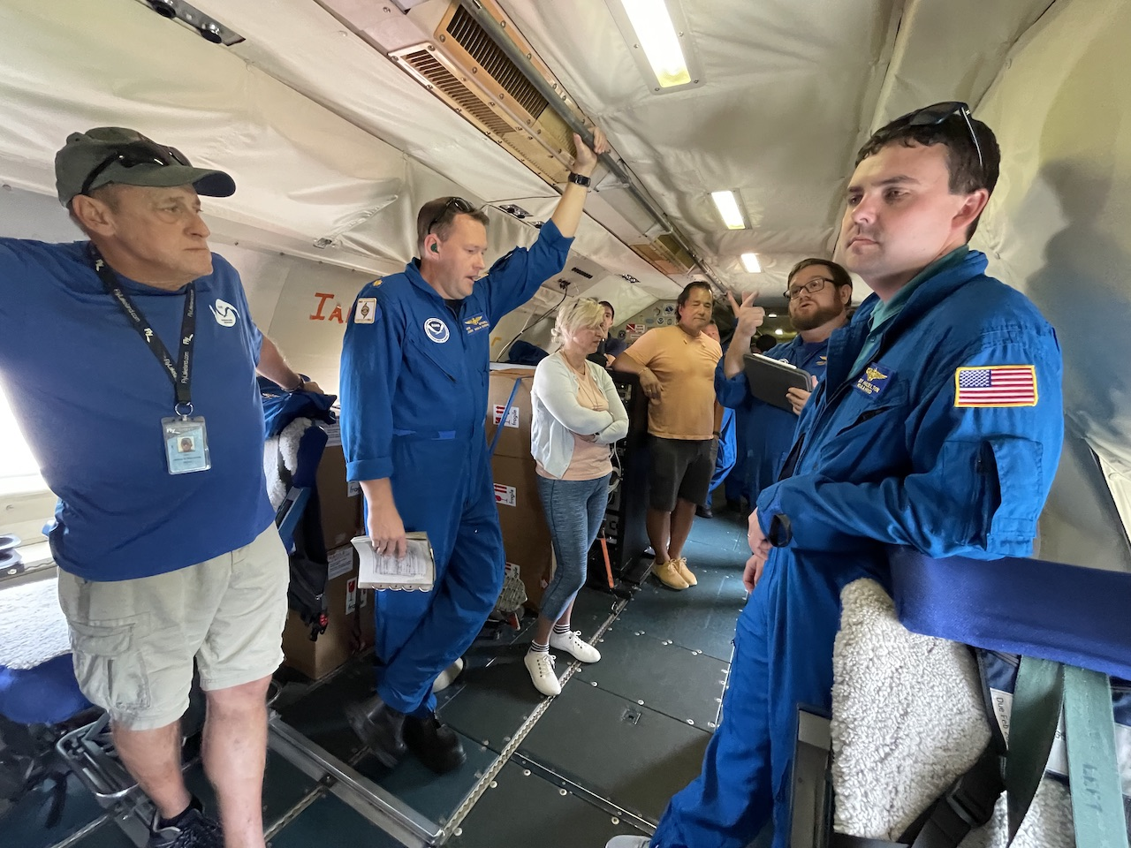
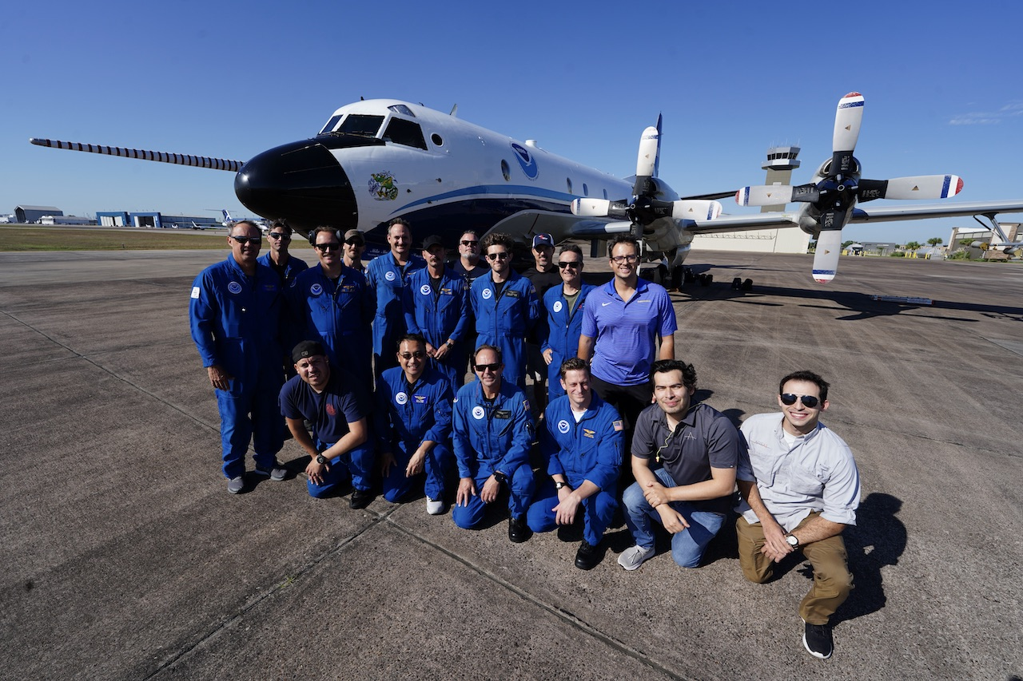
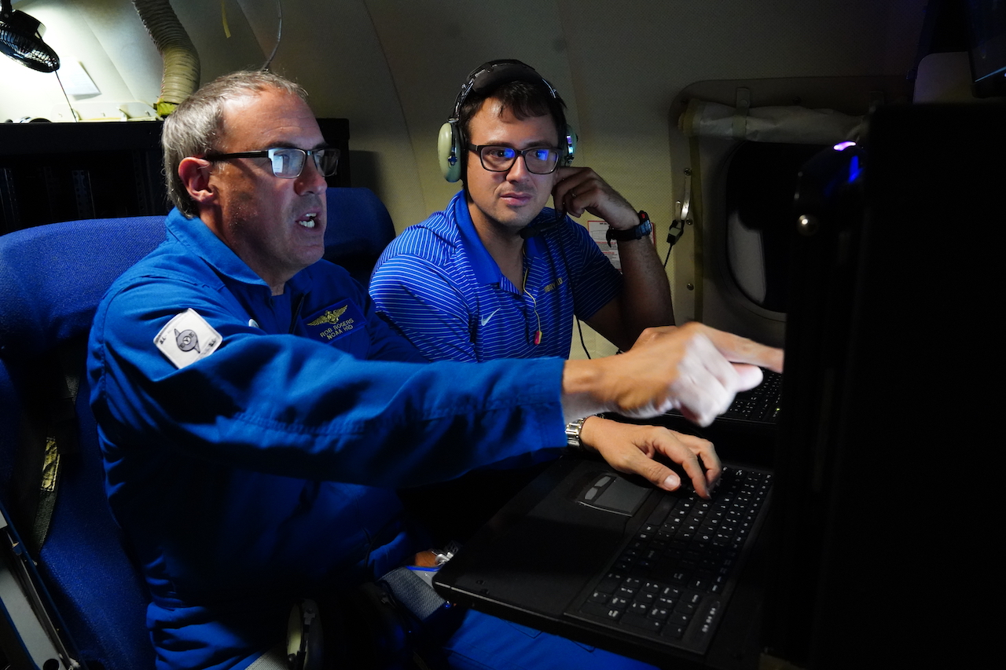
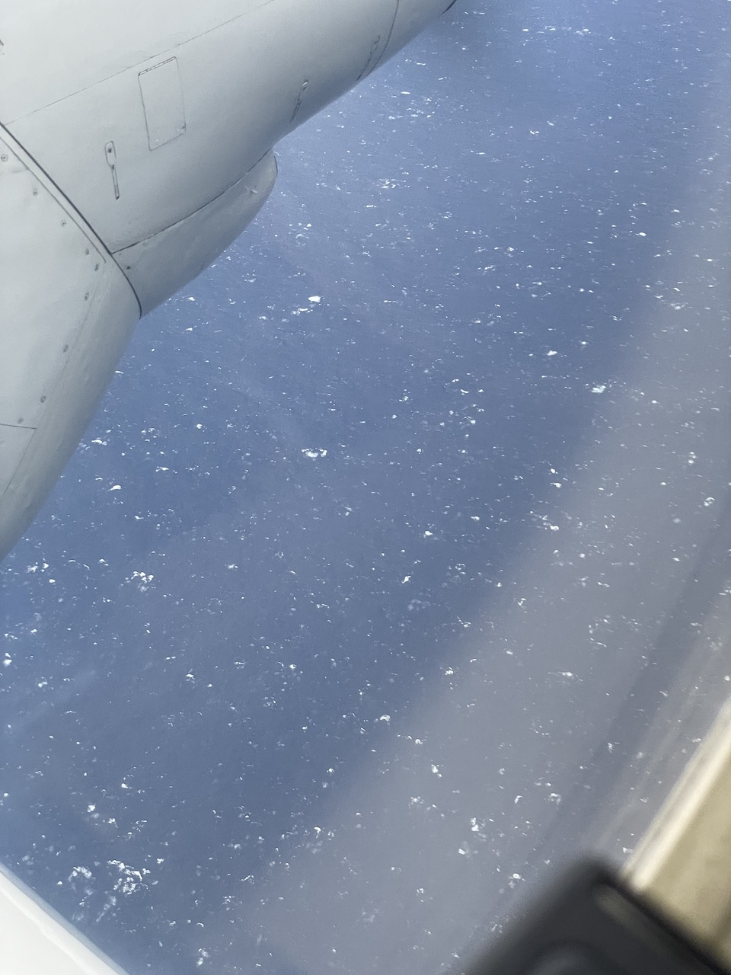
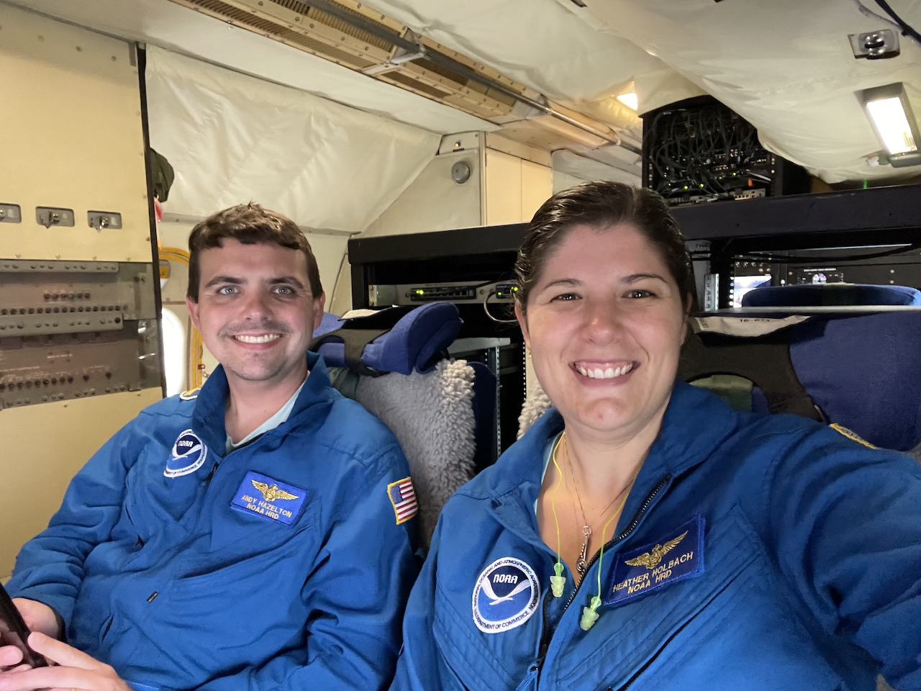
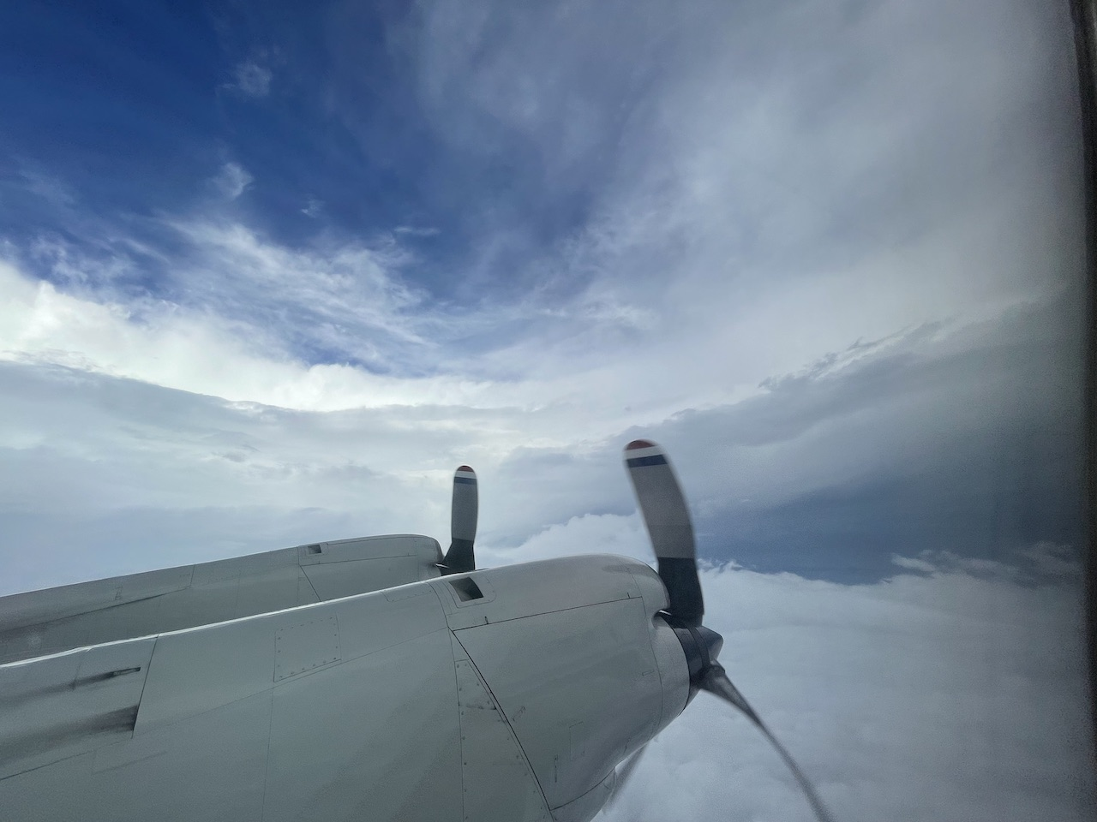
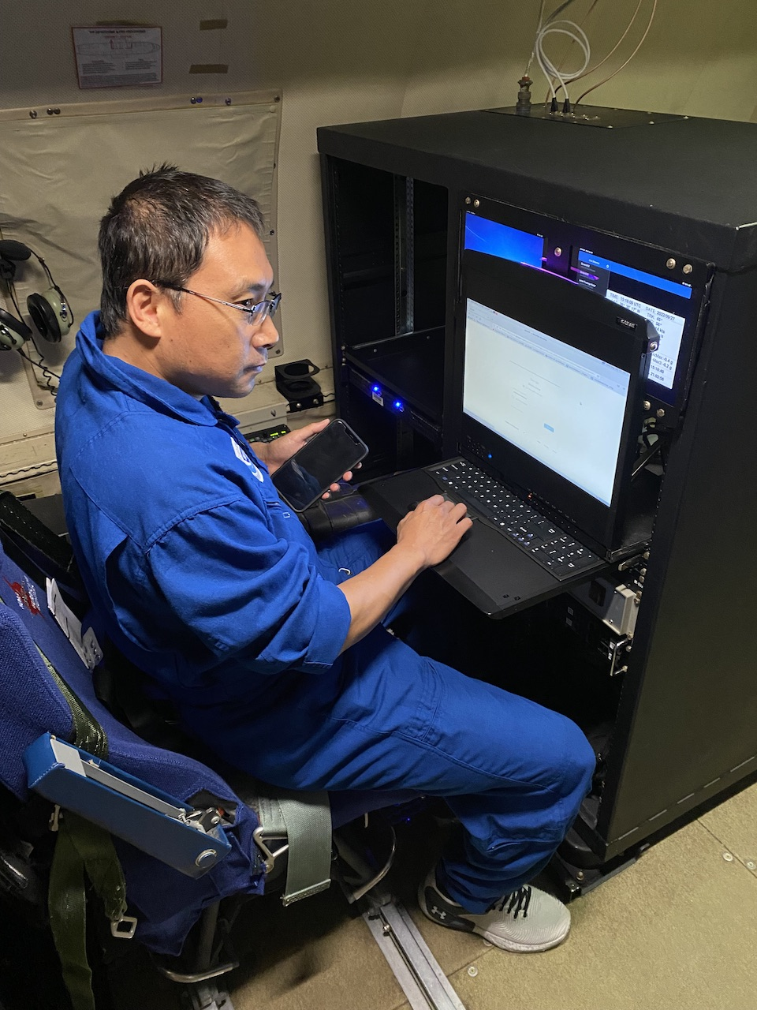
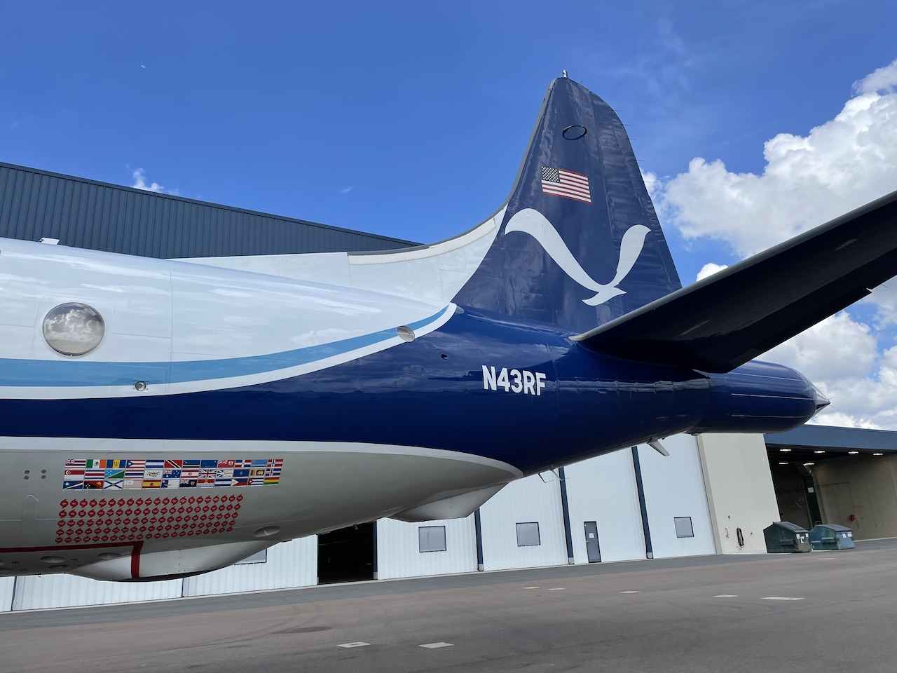
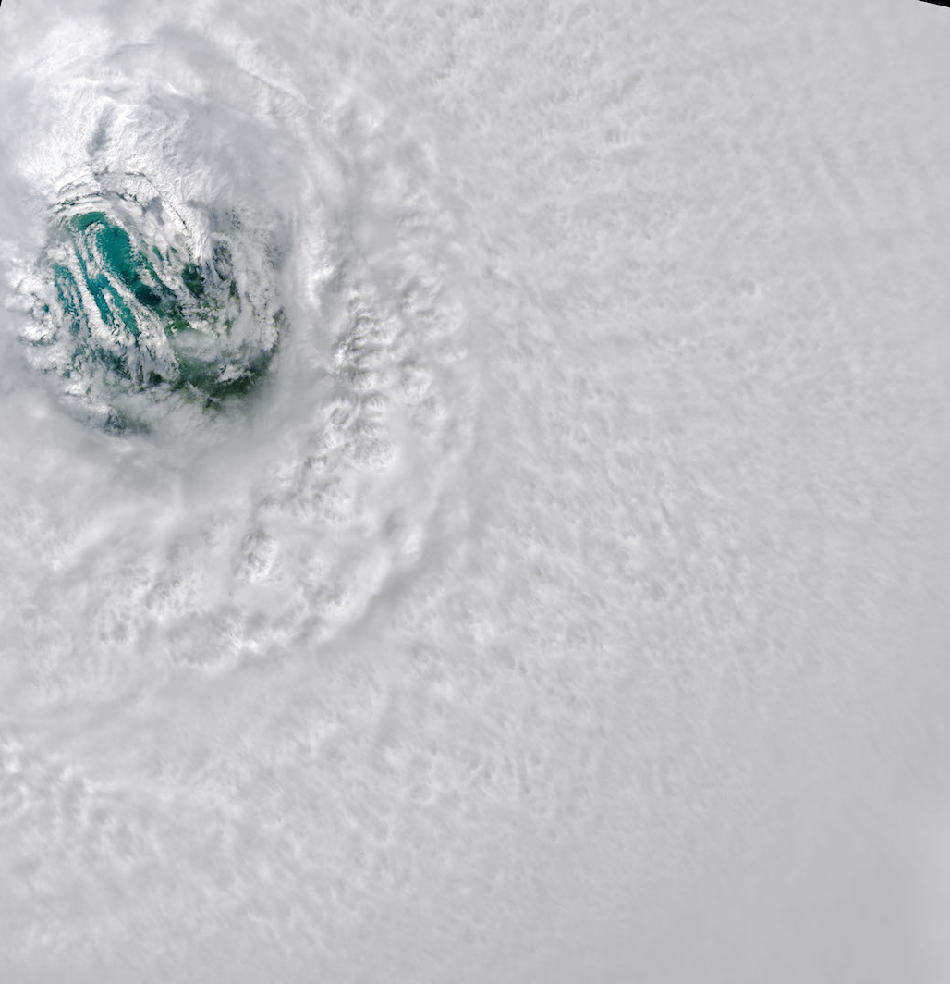
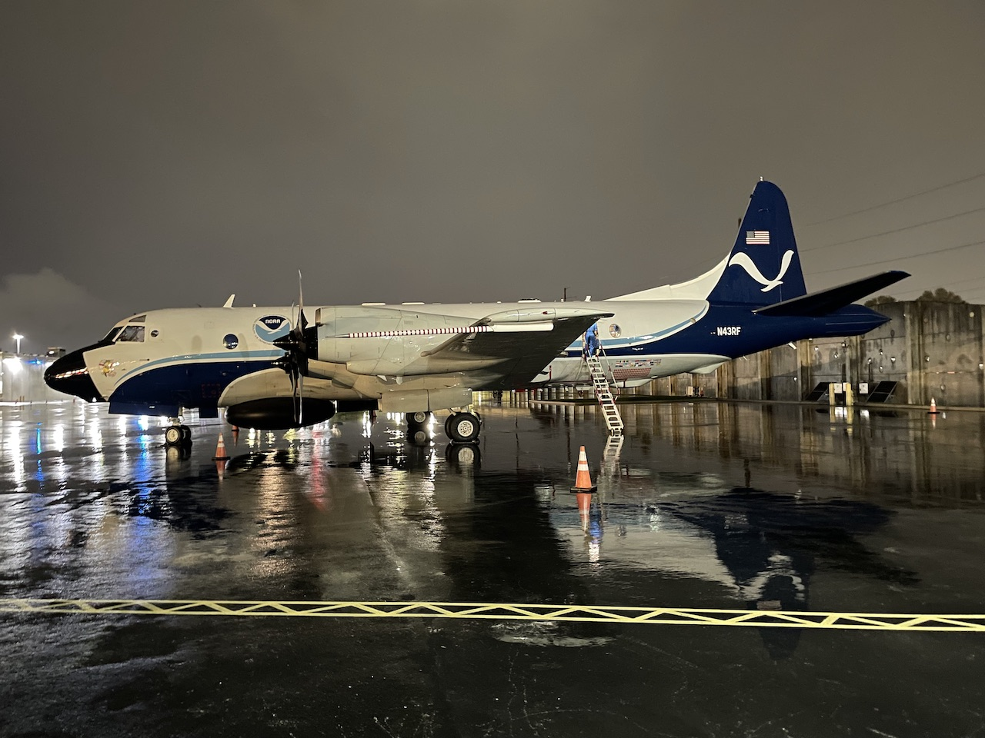
2022 Hurricane Field Program-APHEX
AL09/Ian): 24-28 September
Photo credit Heather Holbach
Photo credit Heather Holbach
Photo credit Heather Holbach
Photo credit Heather Holbach
Photo credit Heather Holbach
Photo credit Heather Holbach
Copies of the 2022 AL09/Ian debrief can be found in the HRD Google Drive folder
HRD >> Hurricane Field Program >> 2022 >> Debriefs >> AL09/Ian

