Slide 1


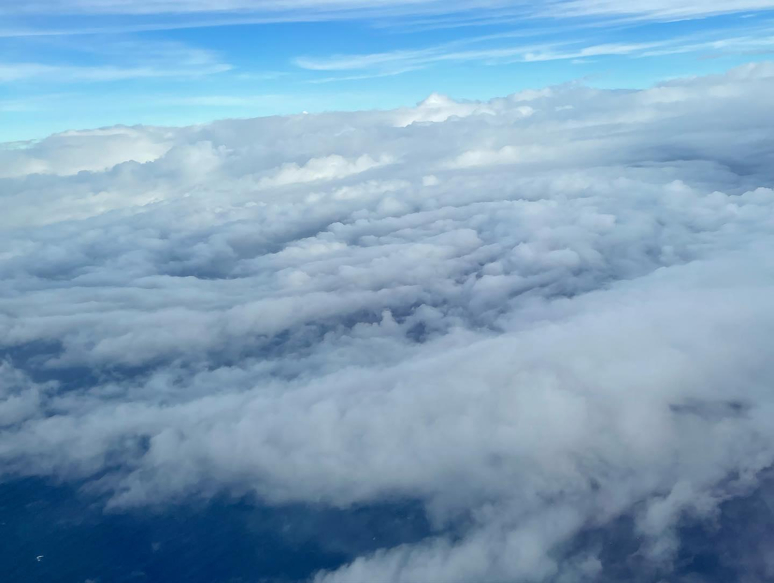
2022 Hurricane Field Program
Advancing the Prediction of Hurricanes Experiment (APHEX)
AL06/Earl Debrief
Jason Dunion – HFP Director
Jon Zawislak - HFP Deputy Director
Photo credit: Sim Aberson

Slide 2
2022 Hurricane Field Program-APHEX
Summary of Missions (28 August – 8 September 2022)
Mission Series Overview
17 P-3 Missions (HRD & EMC), 3 G-IV missions (HRD)
8 HRD research, 12 EMC-NHC TDR
475 GPS dropsondes / 458 transmitted to the GTS
52 NRL/ONR AXBTs deployed (46 good)
85 TDR analyses transmitted to EMC & NHC
APHEX Experiments & Modules: https://www.aoml.noaa.gov/2022-hurricane-field-program/
PREFORM and FAM (Genesis)
Vortex Alignment Module (VAM) – under AIPEX
Flight-Level Assessment of Intensification in Moderate Shear (FLAIMS) - under AIPEX
Impact of Targeted Observations on Forecasts (ITOFS)
Stratiform Spiral
Gravity Wave Module

Slide 3
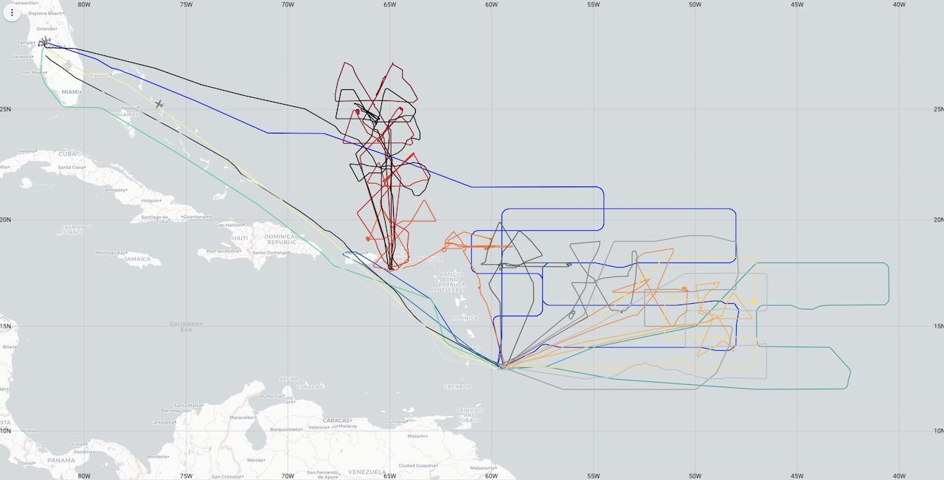
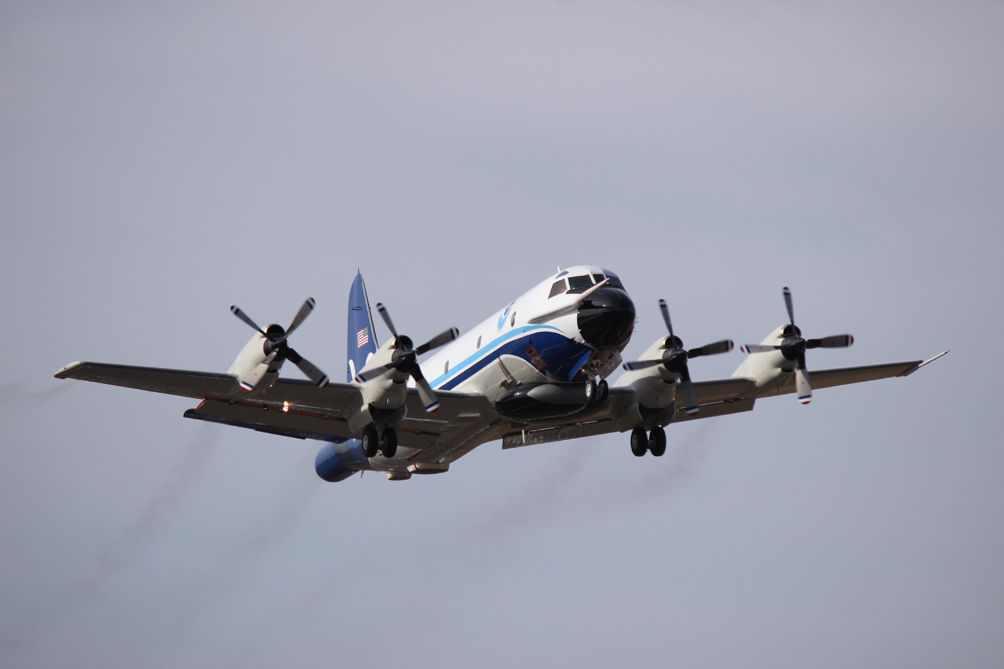
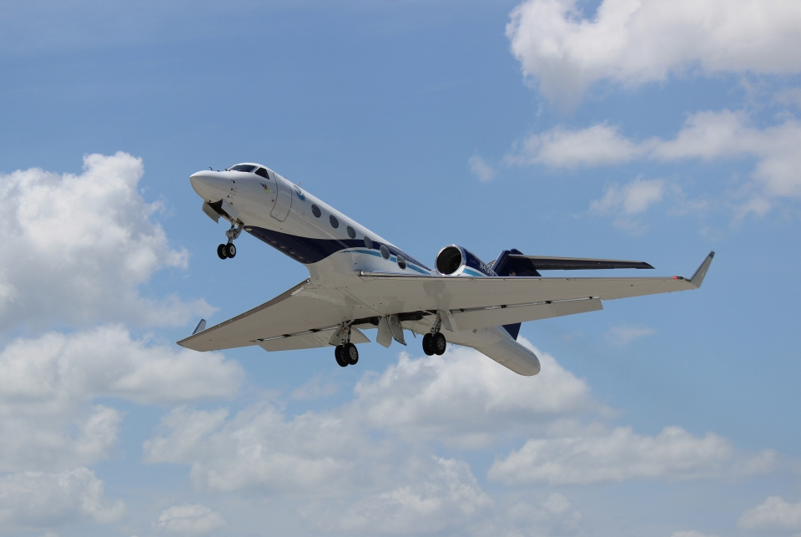
2022 Hurricane Field Program-APHEX
Summary of Missions (28 August – 8 September)
N42, N43, N49 (20 Missions)
NOAA-42
NOAA-43
NOAA-49

Slide 4
2022 Hurricane Field Program-APHEX
Summary of Missions (28 August – 8 September 2022)
Missions & Crewing
20220828N1 (HRD): AOC FD (Aspen), Dunion (GB LPS), Gamache (GB Radar)
20220829I1 (HRD): Marks (LPS), Aberson (Aspen), Reasor (Radar), Alaka (GB LPS), Alvey (GB Radar)
20220829N1 (HRD): Cancelled (maintenance issue - nitrogen pressurization for emergency landing gear)
20220830H1 (HRD): Rogers (LPS), J. Zhang (Aspen), Rogers/Englert (Radar), None (GB LPS), Fischer (GB Radar)
20220830I1 (HRD): Marks (LPS), Aberson (Aspen), Reasor (Radar), Hazelton (GB LPS), Alvey (GB Radar)
20220831H1 (HRD): Rogers (LPS), J. Zhang (Aspen), Rogers/Englert (Radar), None (GB LPS), Fischer (GB Radar)
20220831N1 (HRD): AOC FD (Aspen), Kaplan (GB LPS), Gamache (GB Radar)
20220901H1 (HRD): Rogers (LPS), J. Zhang (Aspen), Rogers/Englert (Radar), None (GB LPS), Fischer/Gamache (GB Radar)
20220901N1 (HRD): AOC FD (Aspen), Kaplan (GB LPS), Gamache (GB Radar)
20220901I1 (EMC): Marks (LPS), Aberson (Aspen), Reasor (Radar), Holbach (GB LPS), Gamache (GB Radar)
20220902I1 (EMC): Marks (LPS), Aberson (Aspen), Reasor (Radar), Hazelton (GB LPS), Gamache (GB Radar)

Slide 5
2022 Hurricane Field Program-APHEX
Summary of Missions (28 August – 8 September 2022)
Missions & Crewing
20220903H1 (EMC): Rogers (LPS), J. Zhang (Aspen), Rogers/Englert (Radar), None (GB LPS), Fischer/Gamache (GB Radar)
20220903I1 (EMC): Cancelled (maintenance issue - cooling system) >> ferry BGI - KLAL
20220904H1 (EMC): Rogers (LPS), J. Zhang (Aspen), Alvey/Englert (Radar), Stern (Obs), None (GB LPS), Fischer (GB Rad)
20220904I1 (EMC): Cancelled (maintenance issue - cooling system) >> repairs in KLAL
20220905H1 (EMC): Rogers (LPS), J. Zhang (Aspen), Rogers/Englert (Radar), Stern (Obs), None (GB LPS), Reasor (GB Rad)
20220905I1 (EMC): Aberson (LPS/Aspen/Radar), Holbach/Marks (GB LPS), Gamache (GB Radar)
20220906H1 (EMC): Rogers (LPS), J. Zhang (Aspen), Rogers/Englert (Radar), Stern (Obs), None (GB LPS), Fischer (GB Rad)
20220906I1 (EMC): Holbach (LPS/Radar), Aberson (Aspen), Hazelton (GB LPS), Gamache (GB Radar)
20220907H1 (EMC): Alvey (LPS), J. Zhang (Aspen), Rogers (Radar), None (GB LPS), Reasor (GB Radar)
20220907I1 (EMC): Holbach (LPS/Radar), Aberson (Aspen), Hazelton (GB LPS), Gamache (GB Radar)
20220908H1 (EMC): Alvey/Rogers (LPS), J. Zhang (Aspen), Rogers/Alvey (Radar), None (GB LPS), Reasor (GB Radar)
20220908I1 (EMC): Holbach (LPS/Radar), Aberson (Aspen), Alaka (GB LPS), Gamache (GB Radar)

Slide 6
2022 Hurricane Field Program-APHEX
Logistics Highlights
Expendables
Expendable counts weren’t always reliable…especially challenging on a long mission series like Earl
working with AOC to streamline the process.
Aspen
ASPEN crashed multiple times when trying to save synoptic plots - had to force quit and start again
ASPEN quit unexpectedly due to poor onboard keyboards/mouses
Several sondes had mismatched 31313 times vs RELEASE times and had to be CCAed (likely to early launch detect and using Dfiles without “_P”)
Rich Henning: the full size D files are definitely messier to deal with and ASPEN has more QC "decisions" to make as it processes them...often leading to some squirrelly results. If the launch detect is more than several seconds late...it is the only way to get a full sounding however. Personally. I much prefer using the _P files since they are cleaner and only use the full size D files in the air if the launch detect is something like 20 or 30 seconds or more late.
Holger Vomel: So far the guidance is to use the _P files. These files are limited in size by cutting off all data earlier than 30 s before launch-detect and cutting every off past the last received data line. Otherwise the two files are identical. Therefore, if a sonde is running in the aircraft for a long while, the regular D file can be quite a bit larger than the _P file and the initial guidance was to save costs of transmitting the larger files.
You are correct that if the launch detect is more than 30 s late, then data are skipped in the _P file, which are stored in the regular D file. For the small NRD41 missed launch-detects basically don't happen. On the other hand, with a lot of in-cabin data in the regular D file, ASPEN can sometimes misidentify a correct launch-detect and adjust it when no adjustment was needed. Therefore, the guidance in CPEX is to use the _P file.

Slide 7
2022 Hurricane Field Program-APHEX
Logistics Highlights
Aspen (Cont’d)
HRD Aspen operators: use the “_P” dfiles routinely unless launch detect is more than 30s late
Equipment, Log Sheets, & Resources
At least one keyboard was broken - no / or ? keys
Large-screen MMR and small nose-radar displays both broken on 43 (MMR display worked better in Fiona/Ian)
Google drive is too unreliable for using as primary method to fill out logs (ground-based LPS is super helpful for filling out the log and copying over notes that onboard LPS puts in Xchat.
Often easier to download drop log and fill in, periodically copying it to the GD, than to fill in log on the drive itself
Similar workaround for LPS/Flight log – Internet connectivity, and access to GD, would routinely fail. Workaround >> open a document utility on the workstation and type in entries. Once connectivity was restored, could just copy/paste.
Download a copy of the dropsonde processing directions onto the computers onboard for reference when needed.
Having a searchable (pdf) copy of the HFP plan will make it a lot easier on the aircraft to find information on experiments and modules.
Ensemble Sensitivity Guidance
Coordinated with Ryan Torn from Univ. at Albany SUNY for model sensitivity guidance (G-IV missions)
Also received COAMPS-TC Adjoint Sensitivity analyses from NRL-Monterey

Slide 8
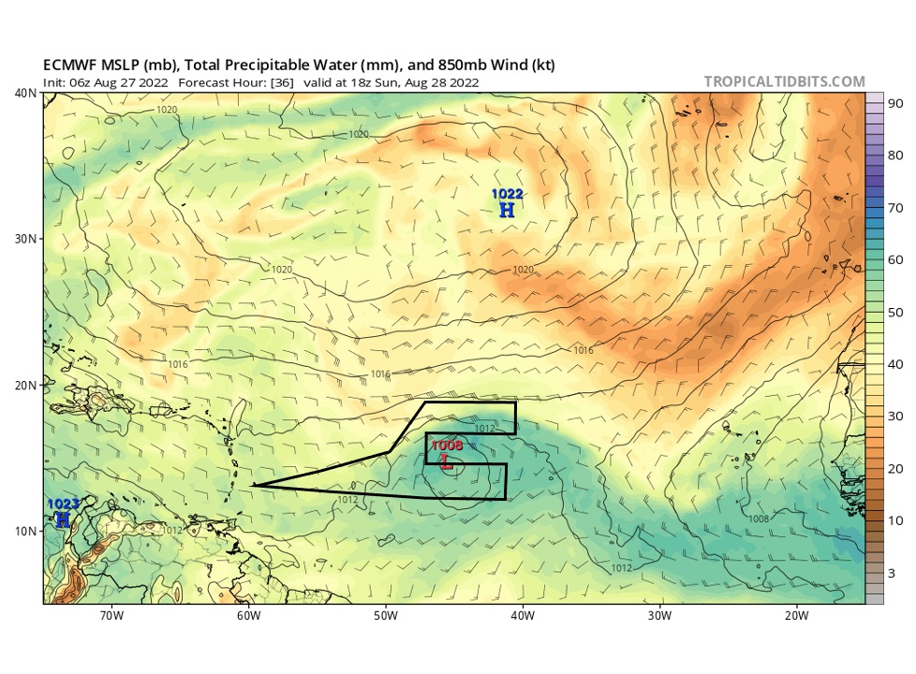
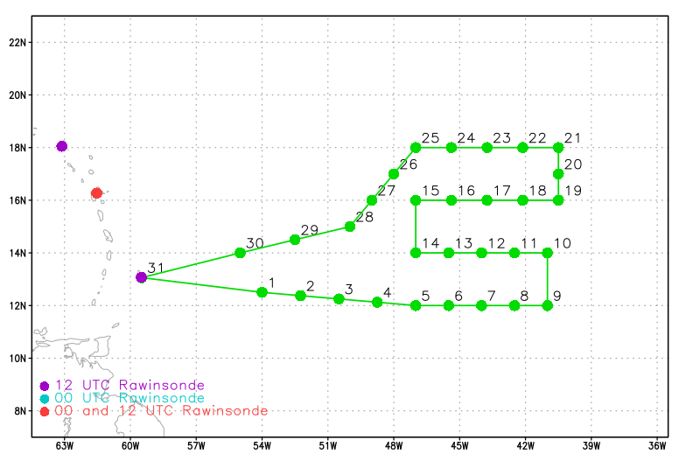
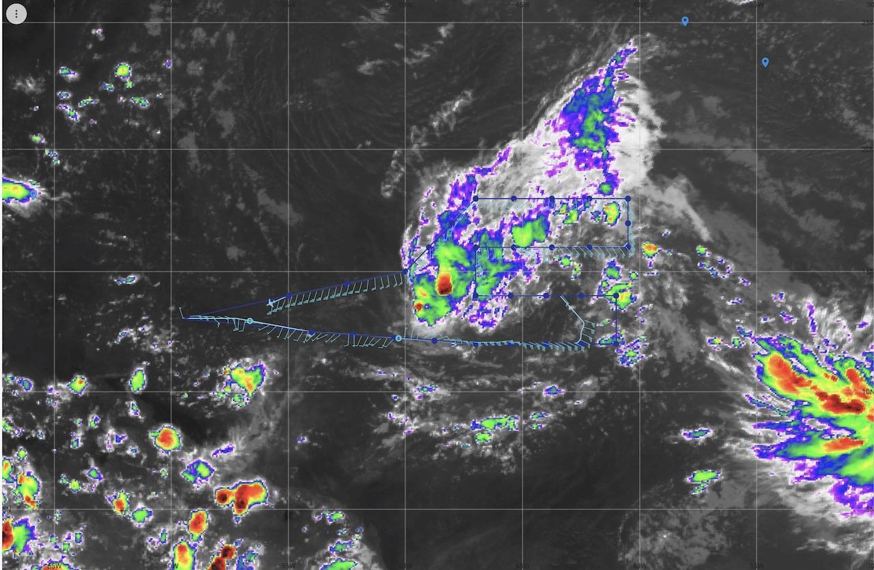
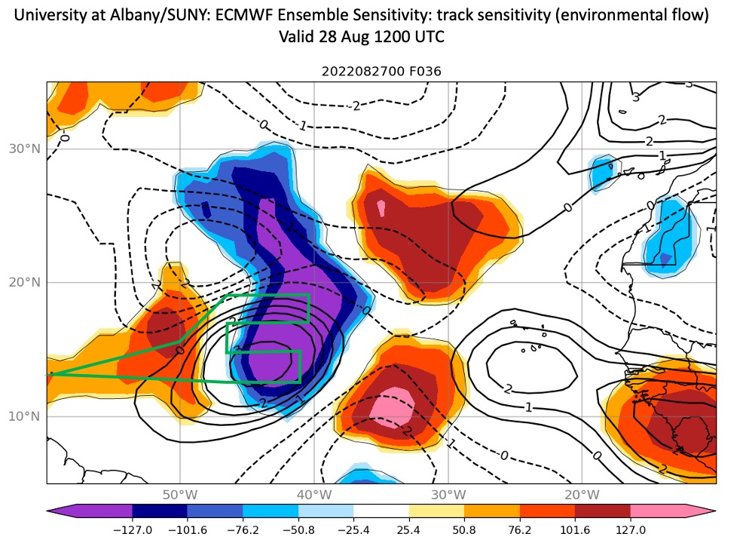
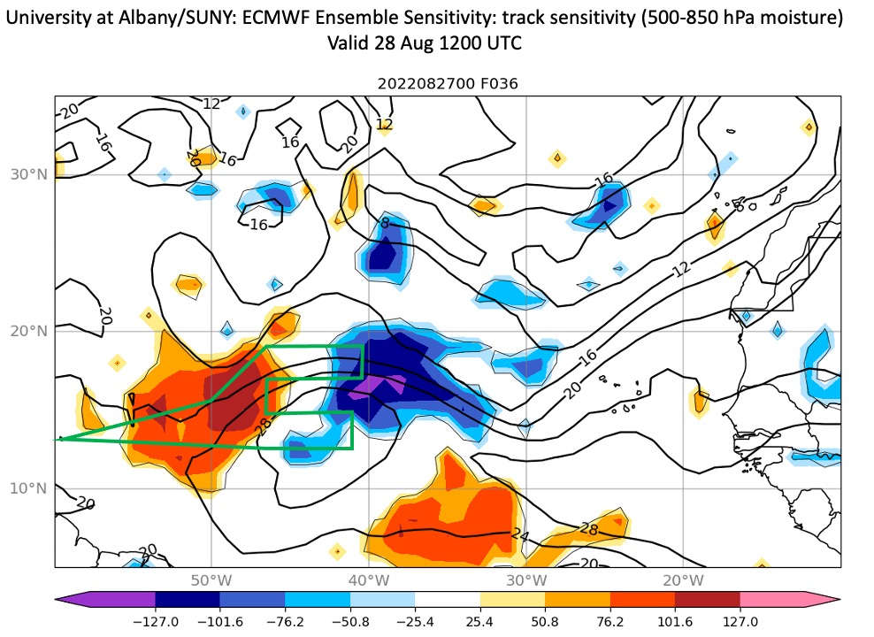
2022 Hurricane Field Program-APHEX
AL06/Earl: 20220828N1 (HRD)
ECMWF TPW forecast valid for the G-IV mission window
Mission
GB LPS: Dunion
Aspen: AOC FD
GB Radar: Gamache
APHEX relevance:
FAM (Genesis), ITOFS
Planned pattern: Survey/Lawn Mower
T/O off (BGI): 1518z, Land (BGI): 2250z
FL 41-45 kft
Dropsondes: 30 drops, 30 to GTS
4 TDR analyses to EMC & NHC
N49’s comms dropped out from ~1747-1801z. The MTS flight track appears to have missed WP 11, but that was just because of the comms outage.
Actual pattern flown was WP 7-8-11-12 (time)
Saharan Air Layer
(Left) Planned and (right) flown N49 flight track
ECMWF Model Ensemble Track Sensitivity based on (left) environmental flow and (right ) 500-850 mb moisture). Green curves indicate the planned G-IV track.

Slide 9
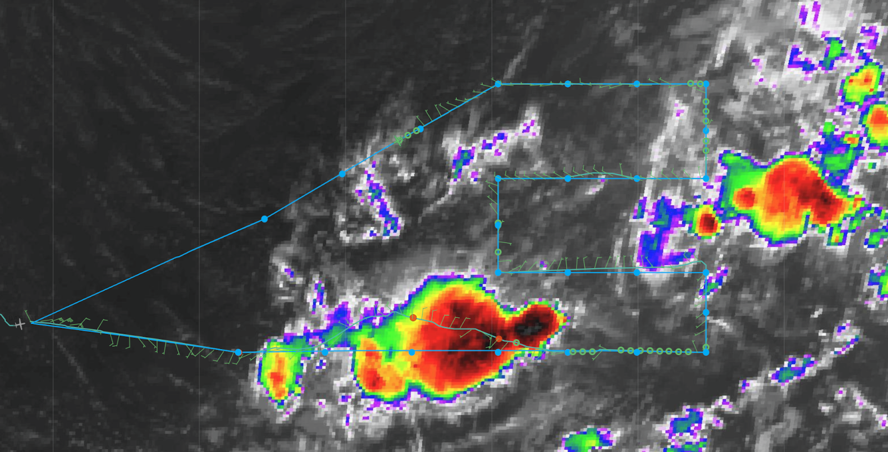
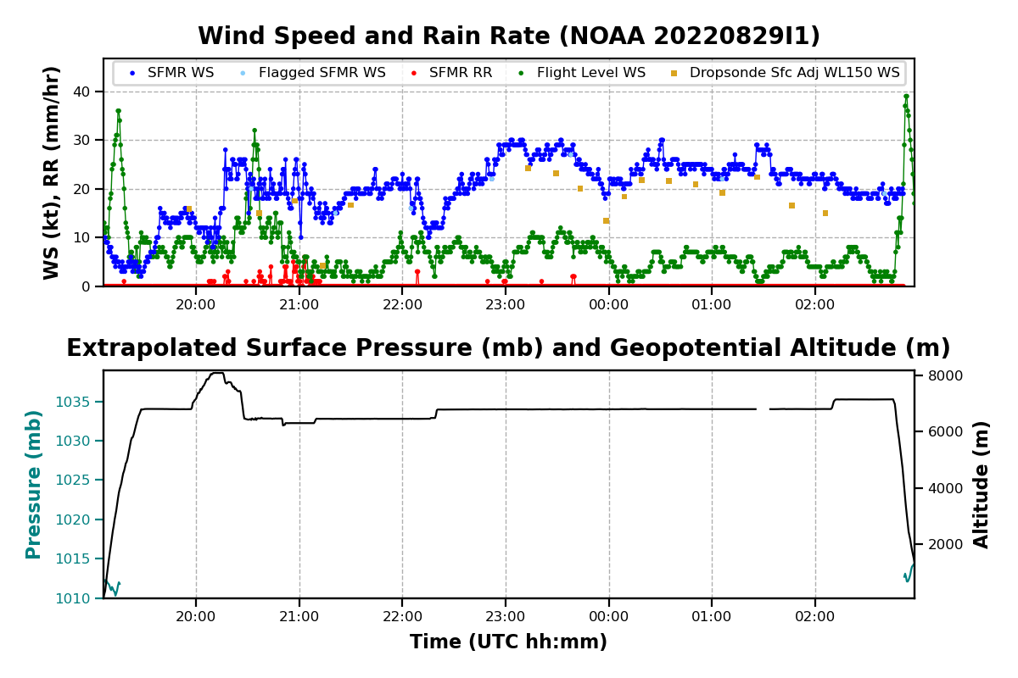
2022 Hurricane Field Program-APHEX
AL06/Earl: 20220829I1 (HRD)
Mission
Onboard
LPS: Marks, Aspen: Aberson, Radar: Reasor
Ground-Based
LPS: Alaka, Radar: Alvey
APHEX relevance:
FAM (Genesis), ITOFS
Planned pattern: Lawn Mower
T/O off (BGI): 1905z, Land (BGI): 0309z
FL 21 kft (pressure)
Dropsondes: 25 drops, 23 to GTS (one did not transfer to AVAPS computer (AOC needs to see if it is recoverable), one fast fall
AXBTs (NRL/ONR): N/A
1 TDR analyses to EMC & NHC
N43 final flight track

Slide 10
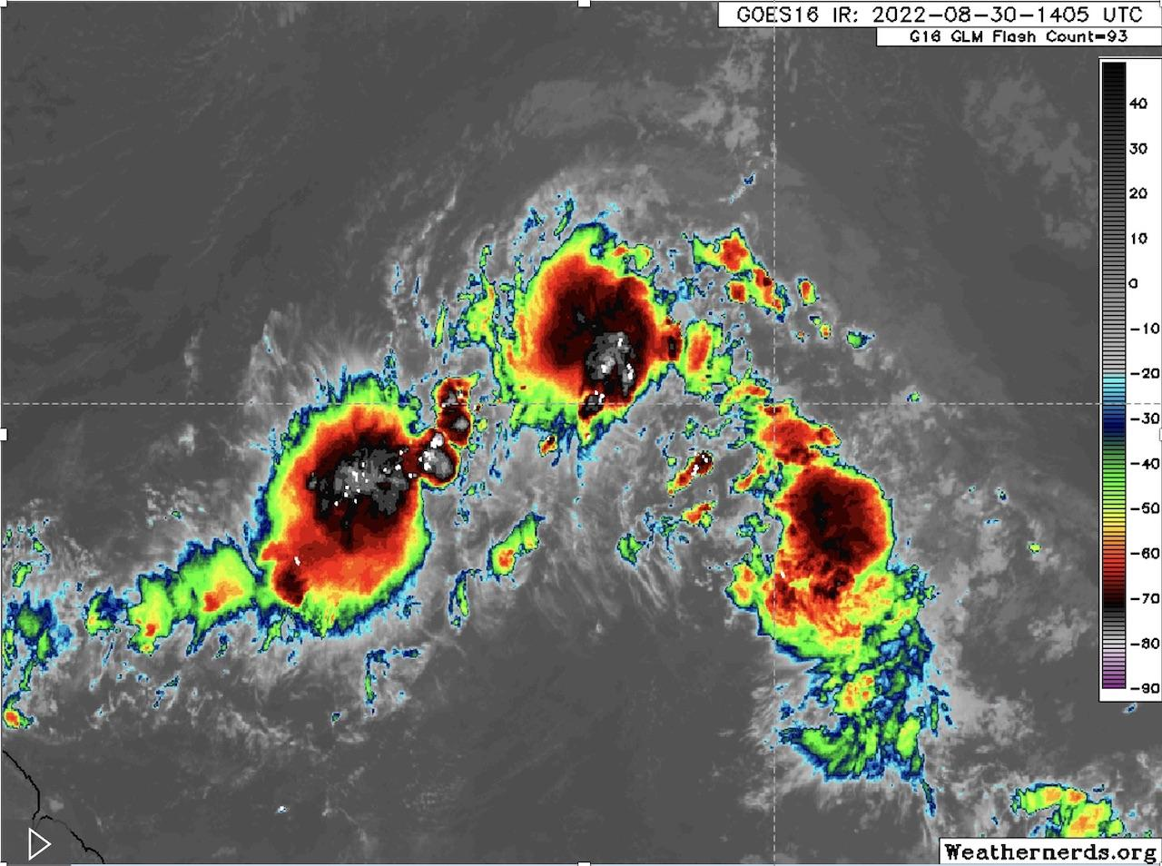
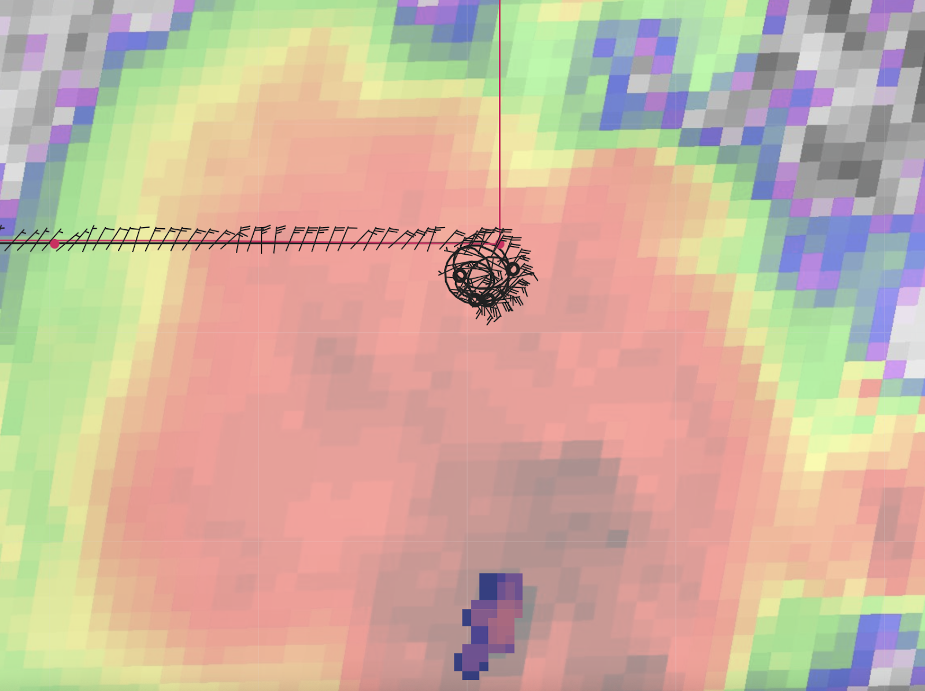
2022 Hurricane Field Program-APHEX
AL06/Earl: 20220830H1 (HRD)
Mission
Onboard
LPS: Rogers, Aspen: J. Zhang, Radar: Rogers, Englert
Ground-Based
LPS: None, Radar: Fischer
APHEX relevance:
FAM (Genesis), ITOFS, Stratiform Spiral Module
Planned pattern: Lawn Mower
T/O off (BGI): 0920z, Land (BGI): 1725z
FL 21 kft (pressure)
Dropsondes: 25 drops, 25 to GTS
AXBTs (NRL/ONR): N/A
3 TDR analyses to EMC & NHC
System still elongated circulation
Stratiform spiral flown, 25 kft → 10 kft → 23 kft
Very dry air on NW side
likely impacted convective evolution
N42 final flight track
GOES-E IR image during microphysics spiral (1405 UTC). Flown in northernmost MCS.
Location of microphysics spiral

Slide 11
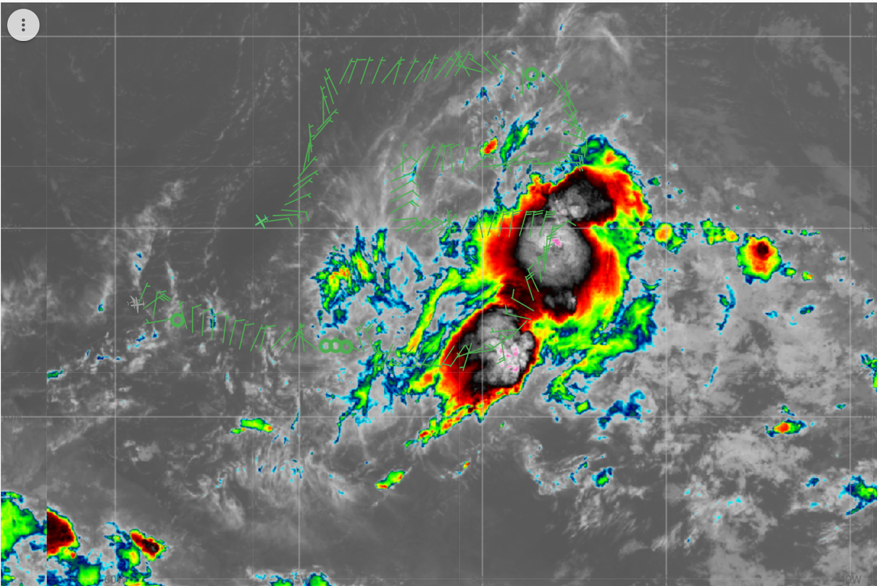
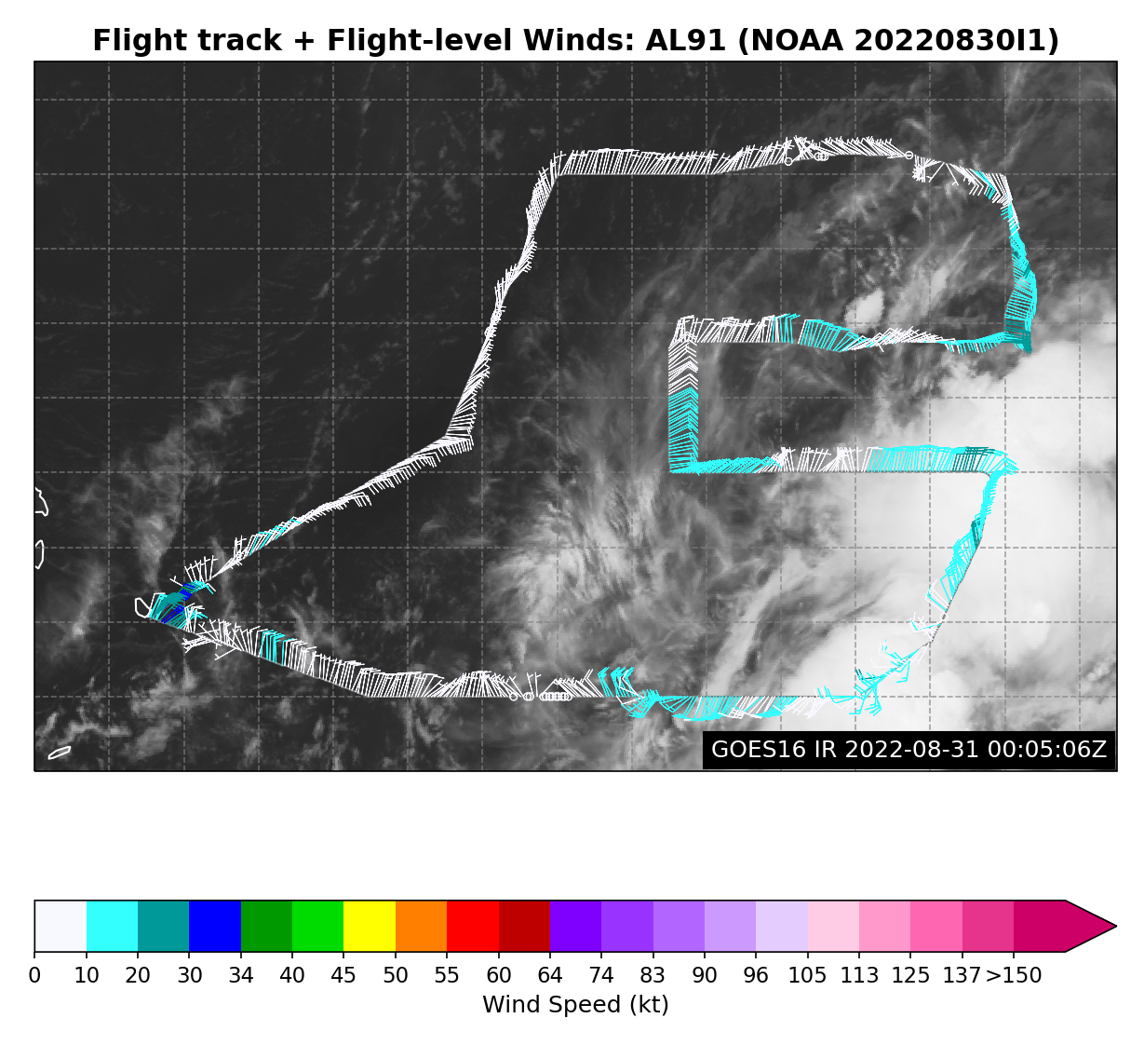
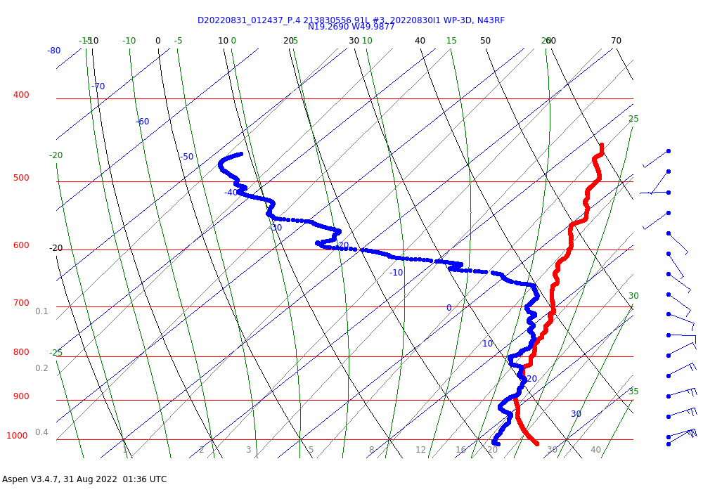
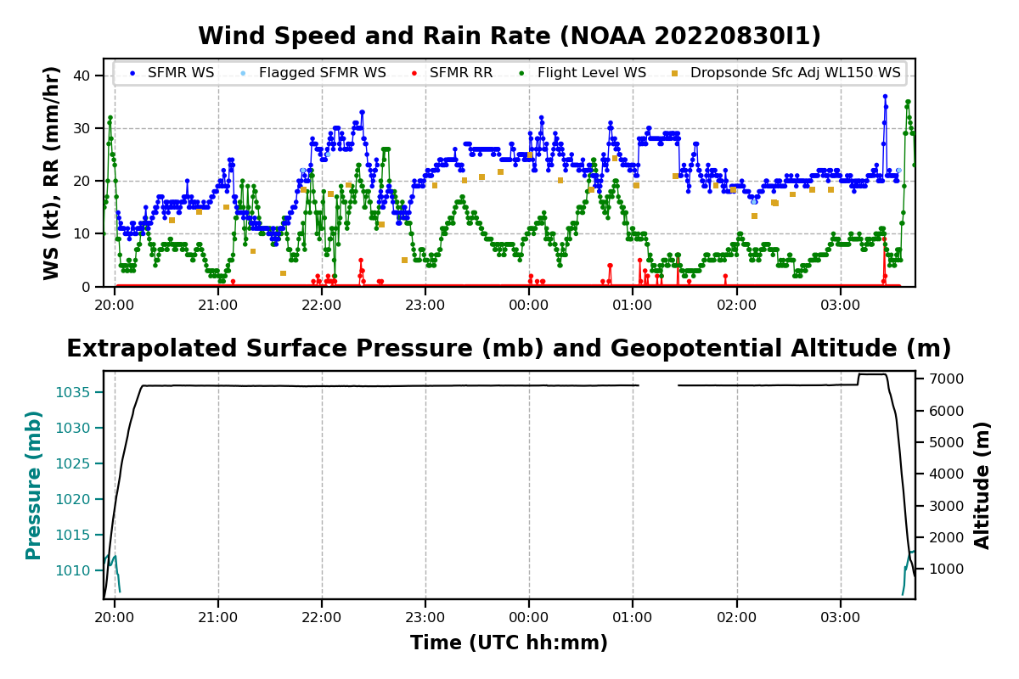
2022 Hurricane Field Program-APHEX
AL06/Earl: 20220830I1 (HRD)
Mission
Onboard
LPS: Marks, Aspen: Aberson, Radar: Reasor
Ground-Based
LPS: Hazelton, Radar: Alvey
APHEX relevance:
FAM (Genesis), ITOFS, Ocean Observing (Saildrone)
Planned pattern: Lawn Mower
T/O off (BGI): 1953z, Land (BGI): 0346z
FL 21 kft (pressure)
Dropsondes: 28 drops, 28 to GTS, one drop landed 7 n mi from Saildrone
AXBTs (NRL/ONR): N/A
1 TDR analyses to EMC & NHC
Mid-level center trying to form in the convection to the NE
Some very dry layers in sondes to the NW
The SFMR seemed to be behaving oddly from about 0100 - 0130 UTC: KARMA was out during this time period which was about the same time as the SFMR issue)...so SFMR was missing data updates it uses for the retrieval process which most likely caused the anomalous behavior.
N43 final flight track
Drop #20 19.25 N 50 W, passing just N of some weak cells. Very dry layer above ~660 mb.

Slide 12
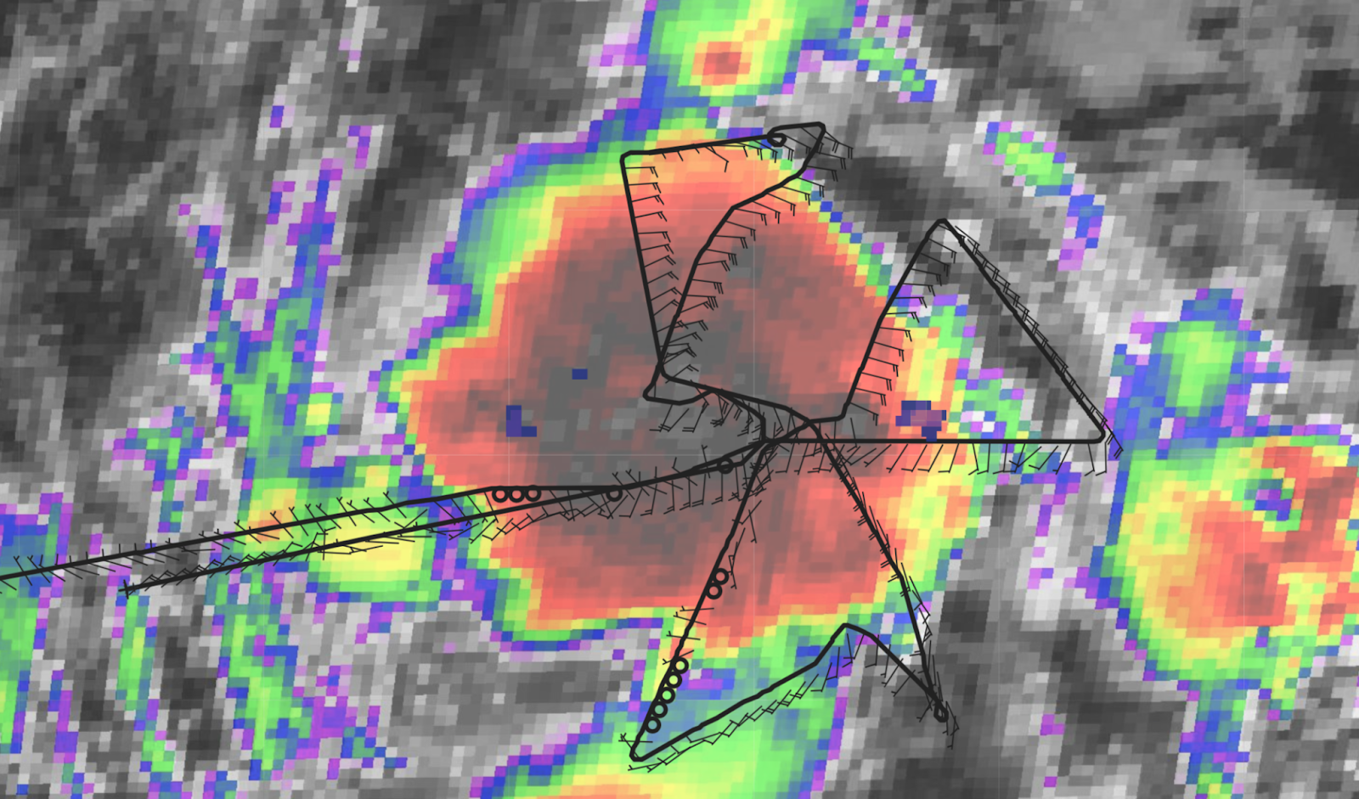
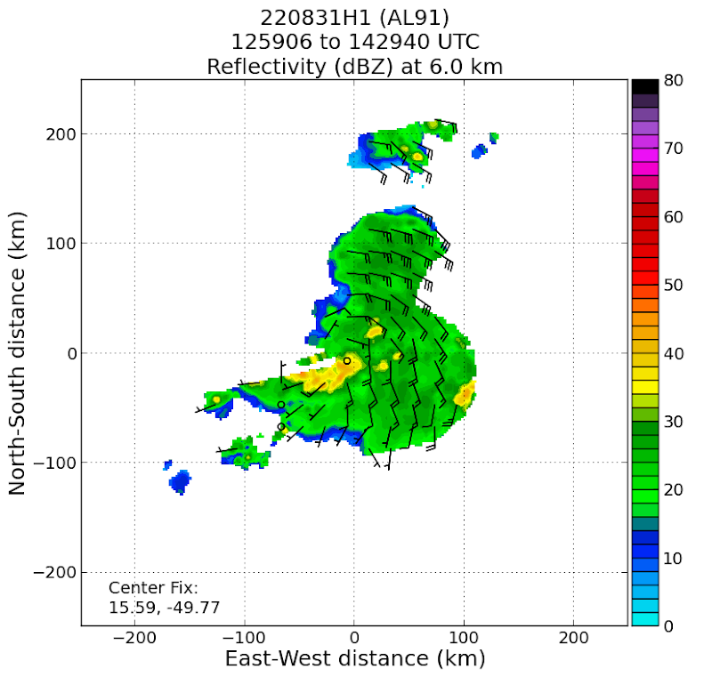
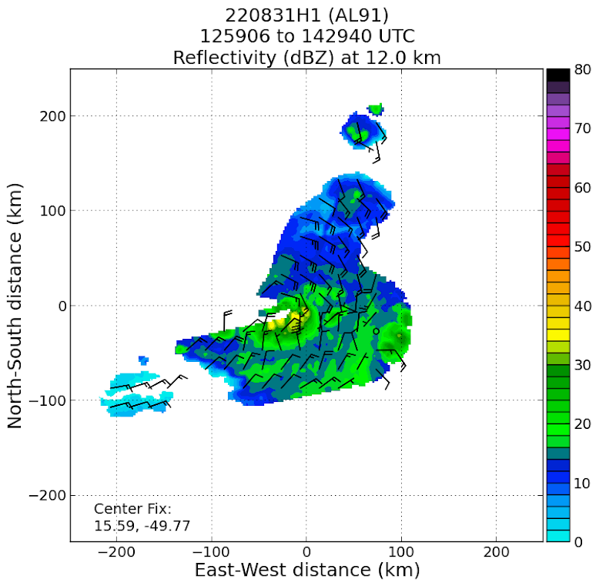
2022 Hurricane Field Program-APHEX
AL06/Earl: 20220831H1 (HRD)
Mission
Onboard
LPS: Rogers, Aspen: J. Zhang, Radar: Rogers, Englert
Ground-Based
LPS: None, Radar: Fischer
APHEX relevance:
FAM, PREFORM (Genesis)
Planned pattern: Butterfly
T/O off (BGI): 0800z, Land (BGI): 1555z
FL 10 kft (pressure)
Dropsondes: 18 drops, 18 to GTS
AXBTs (NRL/ONR): N/A
4 TDR analyses to EMC & NHC
Targeted amplifying midlevel circulation (MLC)
Convection developed within envelope of MLC, would typically collapse in presence of dry air
By end of mission, well-defined MLC, only trough axis in low levels
N42 final flight track
Composite TDR wind analyses, reflectivity at 6 km (left), 12 (right) km. Note robust circulation at 6 km, reflectivity >30 dBZ at 12 km co-located with MLC

Slide 13
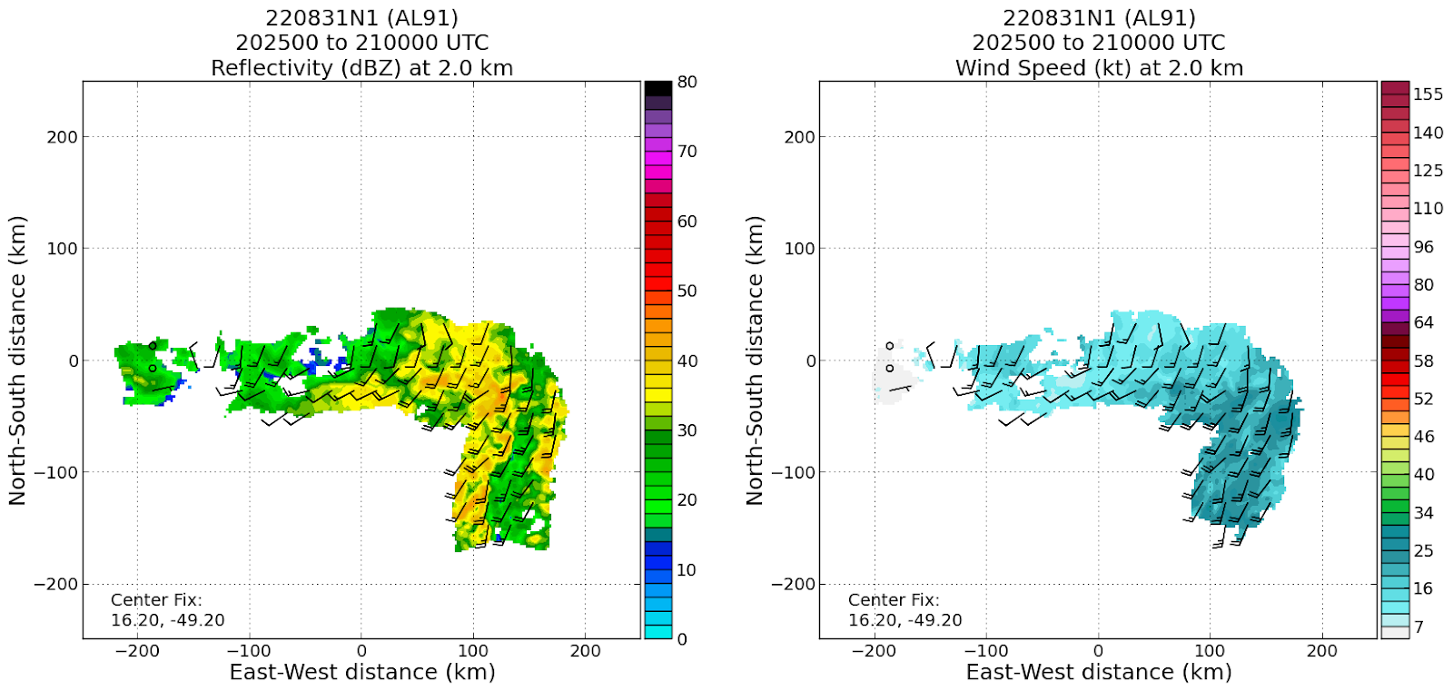
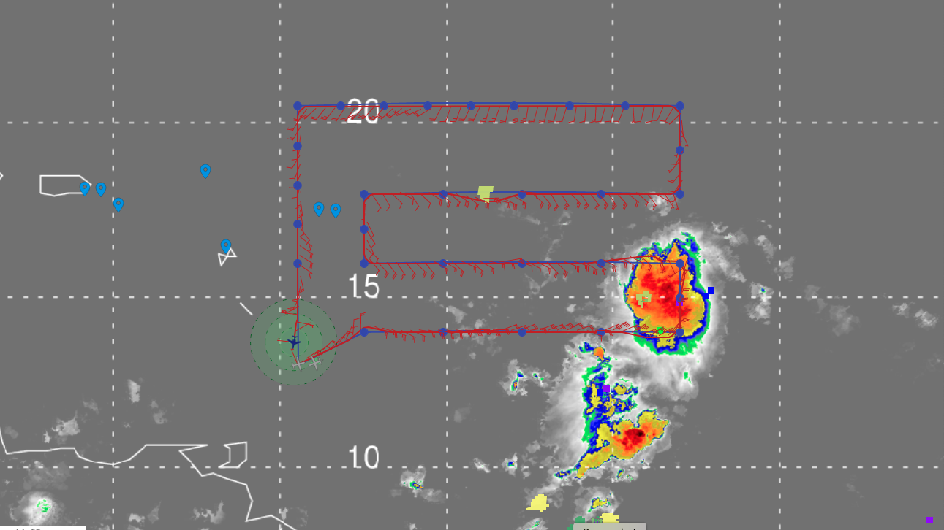
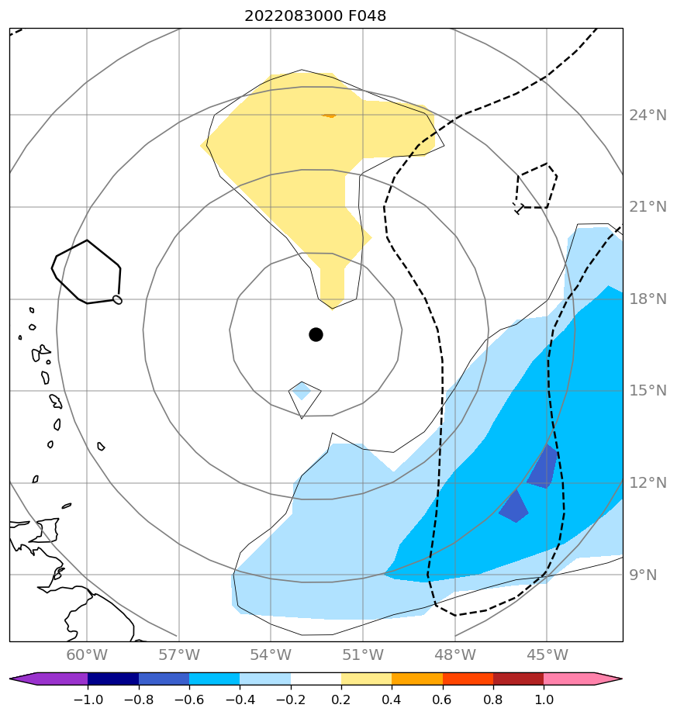
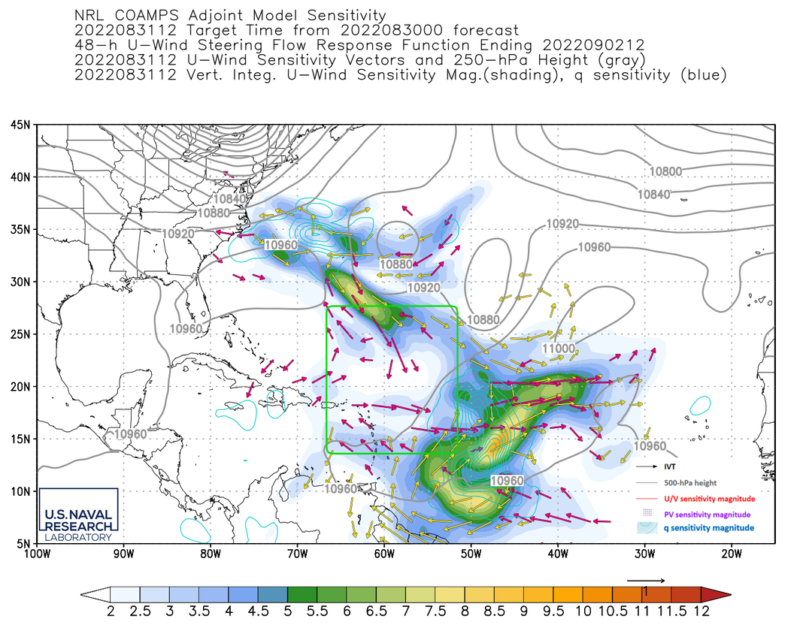
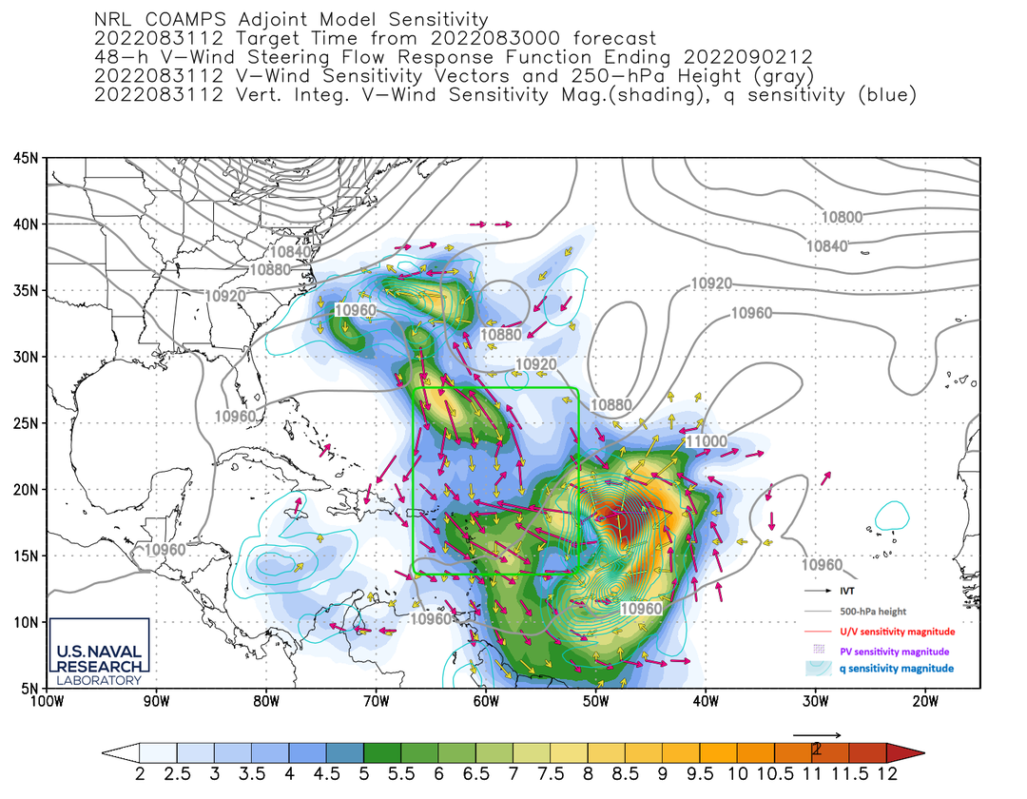
2022 Hurricane Field Program-APHEX
AL06/Earl: 20220831N1 (HRD)
Mission
GB LPS: Kaplan
Aspen: AOC FD
GB Radar: Gamache
APHEX relevance:
FAM (Genesis), ITOFS
Planned pattern: Survey/Lawn Mower
T/O off (BGI): 1838z, Land (BGI): 0220z
FL 41-45 kft
Dropsondes: 32 drops, 31 to GTS
5 TDR analyses to EMC & NHC
MTS cloud top heights satellite product not updating frequently enough
G-IV deviated due to convection (Legs 1,2,3,5)
Doppler analysis at 2 km for 2025-2100 UTC
N49 final flight track
(Left) ECMWF track sensitivity (steering vorticity). COAMPS-TC steering level sensitivity for (middle) zonal and (right) meridional winds.

Slide 14
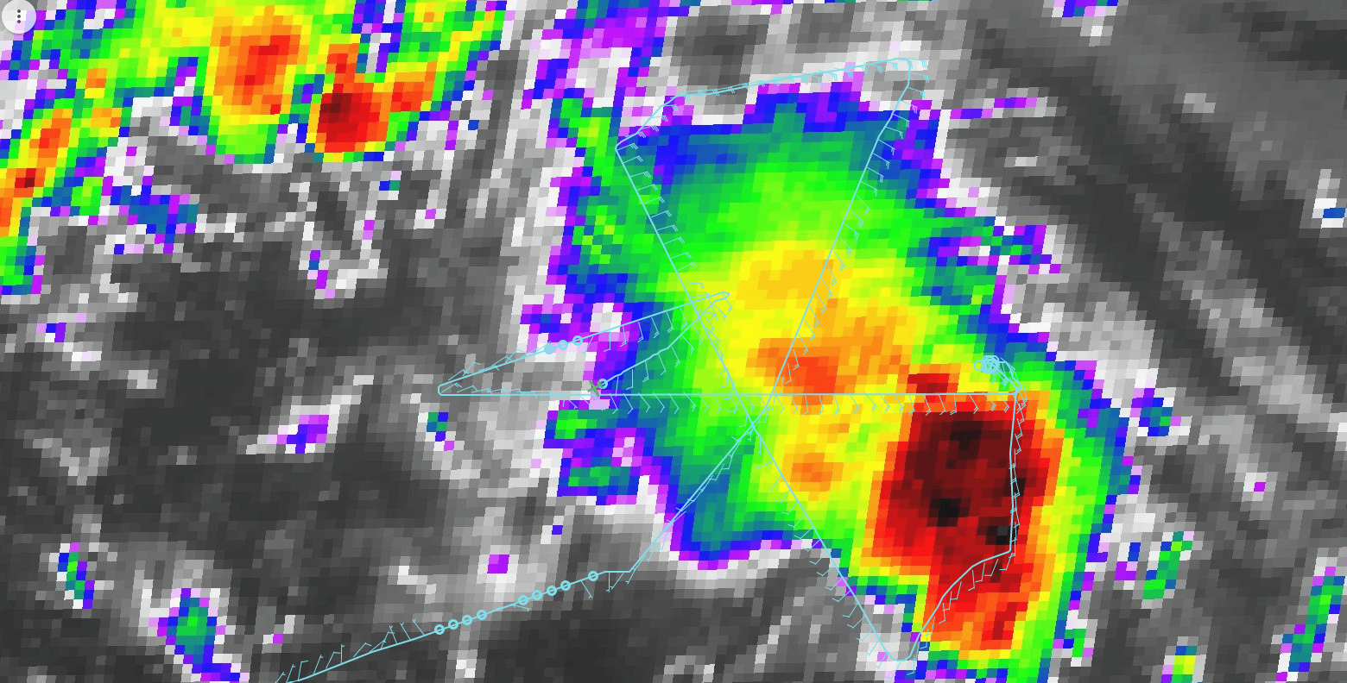
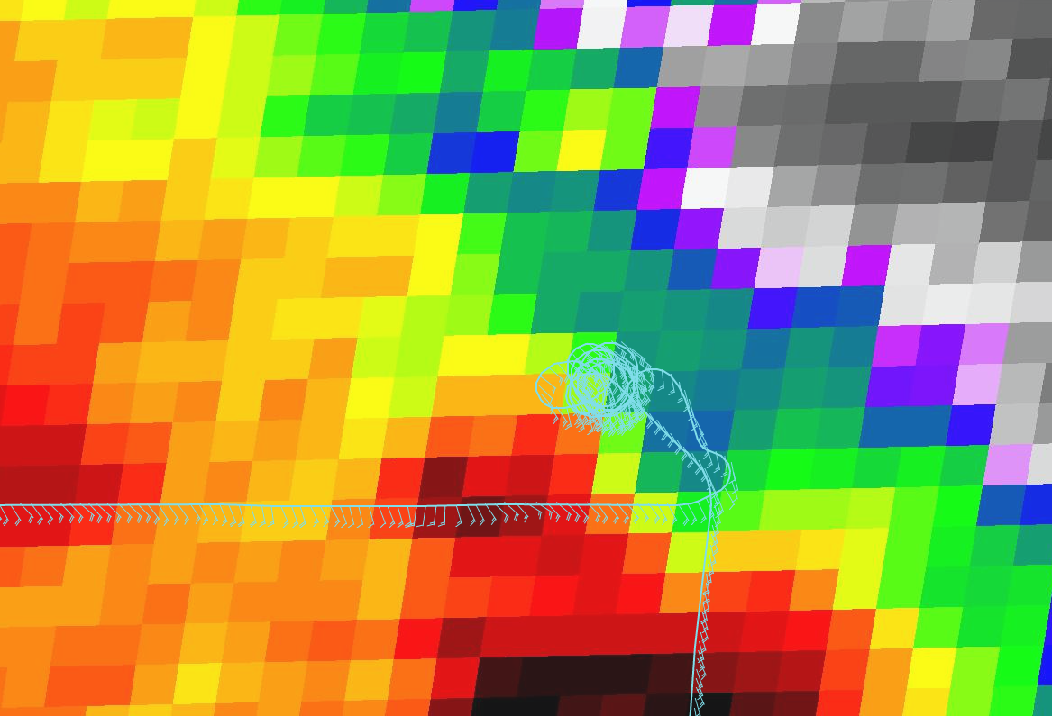
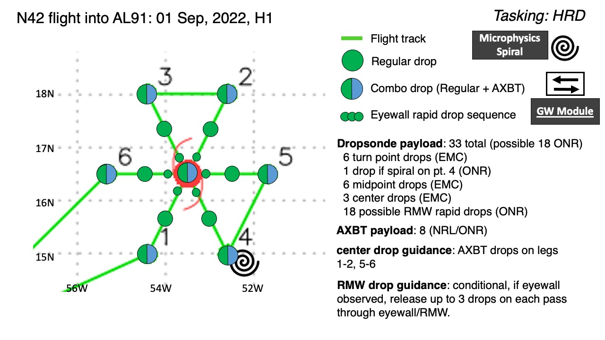
2022 Hurricane Field Program-APHEX
AL06/Earl: 20220901H1 (HRD)
Mission
Onboard
LPS: Rogers, Aspen: J. Zhang, Radar: Rogers, Englert
Ground-Based
LPS: None, Radar: Fischer/Gamache
APHEX relevance:
FAM, PREFORM (Genesis), Stratiform Spiral Module
Planned pattern: Butterfly
T/O off (BGI): 0732z, Land (BGI): 1454z
FL 10 kft (pressure)
Dropsondes: 16 drops, 16 to GTS
AXBTs (NRL/ONR): 8, (6 good)
4 TDR analyses to EMC & NHC
Flew SSM on edge of cloud shield
Attempted VAM, but abandoned due to collapsing convection and chaotic midlevel FL wind field
Storm continuing to struggle (dry air?)
N42 final flight track
Location of stratiform spiral

Slide 15
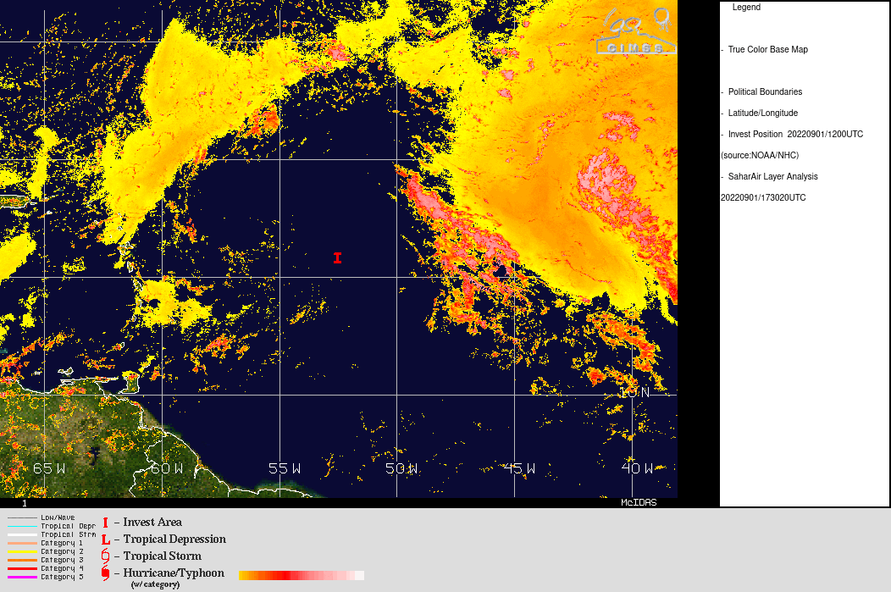
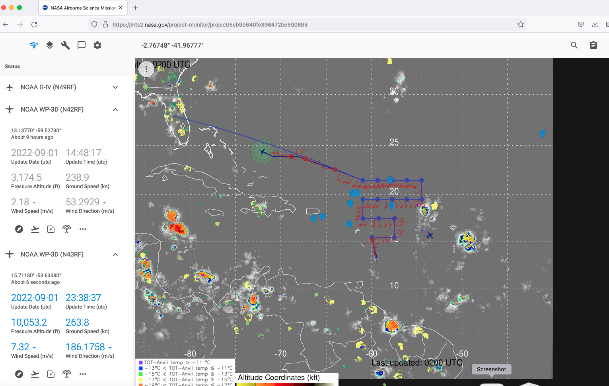
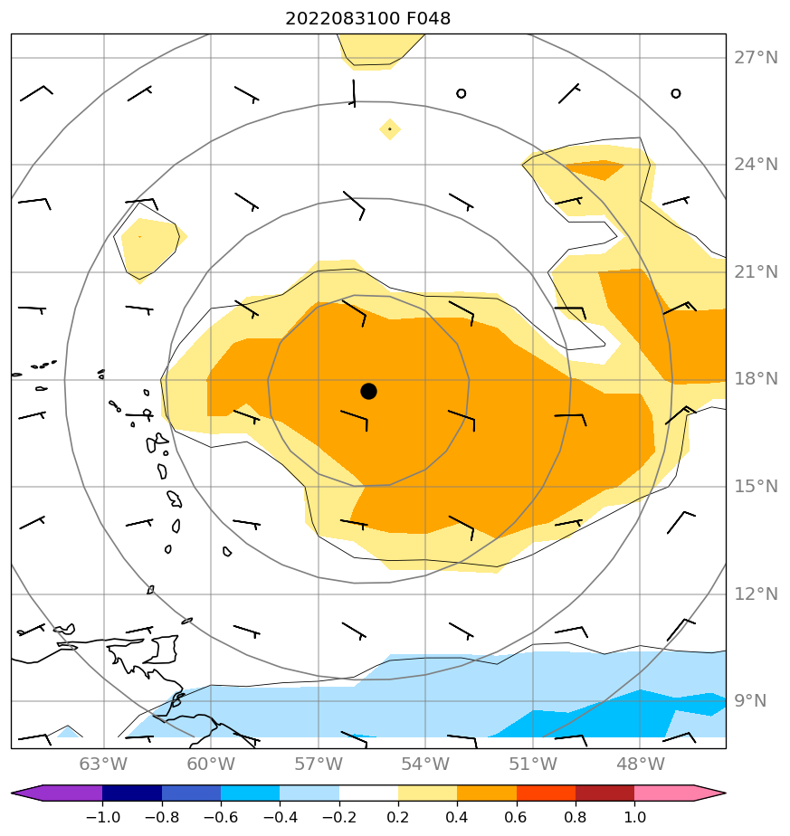
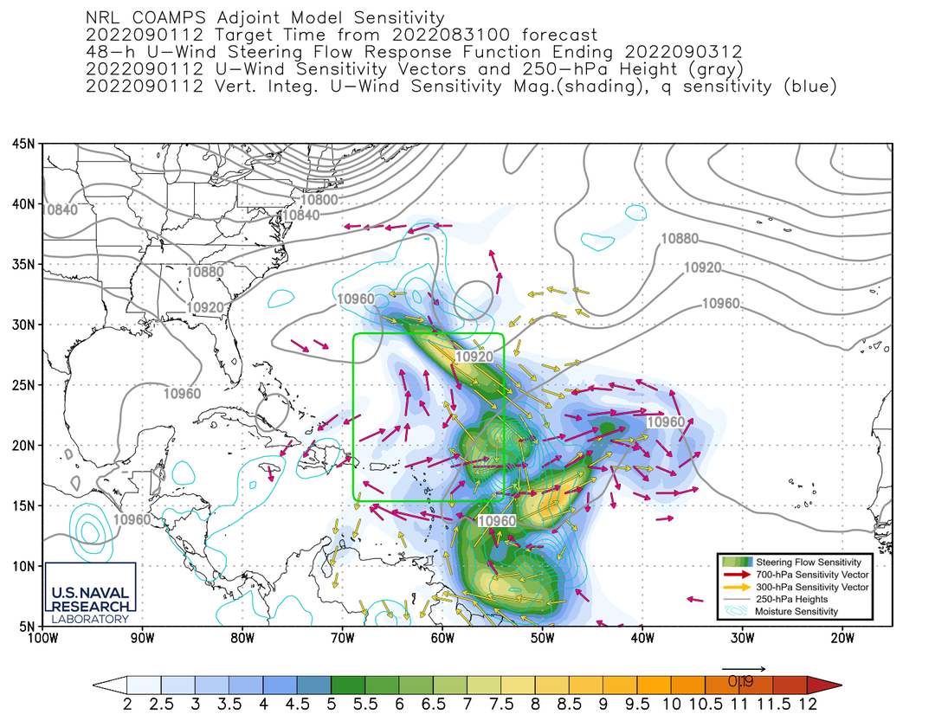
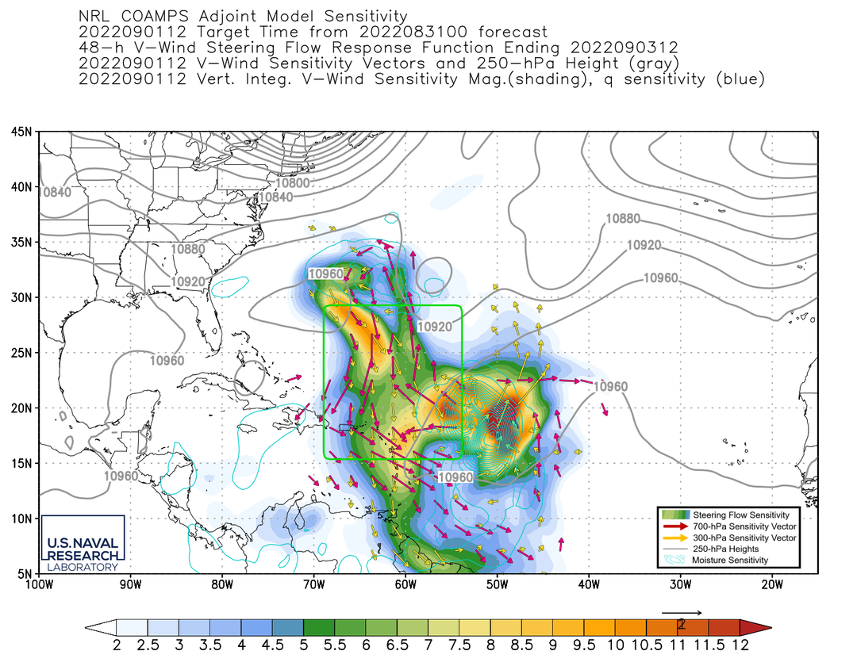
2022 Hurricane Field Program-APHEX
AL06/Earl: 202200901N1 (HRD)
Mission
GB LPS: Kaplan
Aspen: AOC FD
GB Radar: Gamache
APHEX relevance:
FAM (Genesis), ITOFS
Planned pattern: Survey/Lawn Mower
T/O off (BGI): 1827z, Land (KLAL): 0110z
FL 41-45 kft
Dropsondes: 16 drops, 15 to GTS
2 TDR analyses to EMC & NHC
Satcom problems delayed transmission of some sondes
INE not functioning properly due to loose cable that was tightened and problem resolved
Windborne balloon near flight track resulted in communications to insure deconflict rules obeyed
N49 final flight track
CIMSS SAL analysis 20220901 @1730 Z
(Left) ECMWF track sensitivity (steering vorticity). COAMPS-TC steering level sensitivity for (middle) zonal and (right) meridional winds.

Slide 16
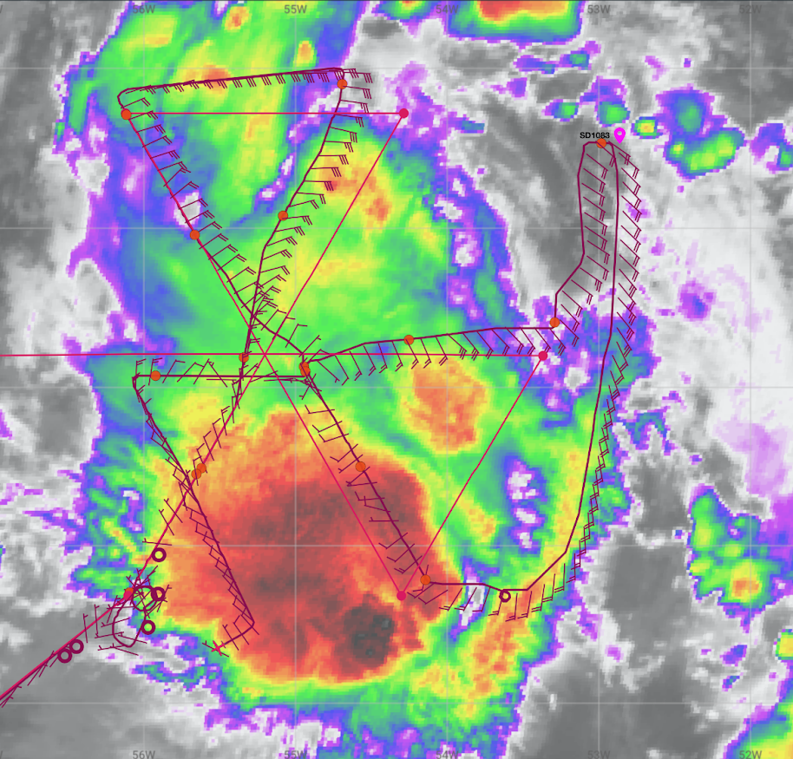
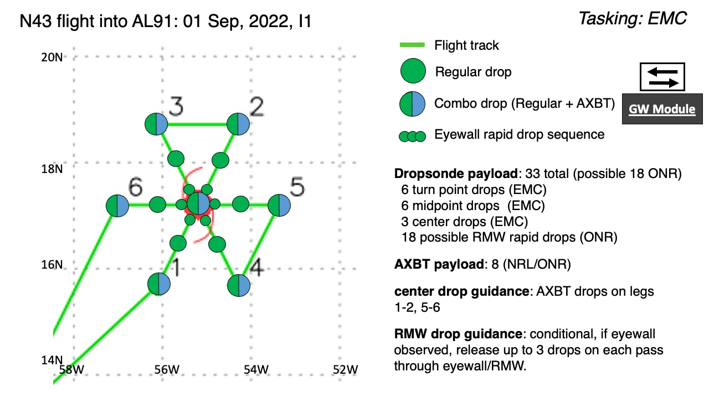
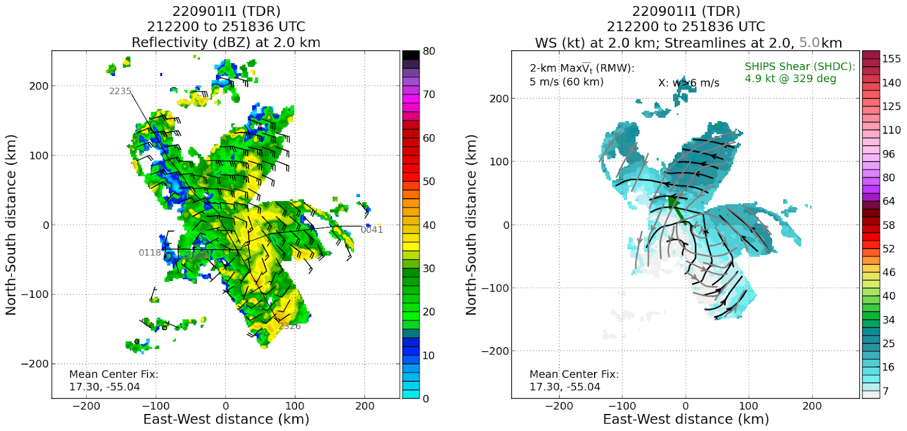
2022 Hurricane Field Program-APHEX
AL06/Earl: 20220901I1 (EMC)
Mission
Onboard
LPS: Marks, Aspen: Aberson, Radar: Reasor
Ground-Based
LPS: Holbach, Radar: Gamache
APHEX relevance:
EMC TDR, Earl Stage, (AIPEX) Ocean Observing (Saildrone)
Planned pattern: Butterfly
T/O off (BGI): 2004z, Land (BGI): 0247z
FL 10 kft (pressure)
Dropsondes: 18 drops, 18 to GTS, 1 had post-splash data ASPEN did not catch, lots of dry air, problems with ASPEN
AXBTs (NRL/ONR): 7 (6 good)
4 TDR analyses to EMC & NHC
AL91 was still tilted to the NE with the low-level circulation still more of an open trough
Saildrones show up on MMR making it easier for sonde targeting
N43 final flight track

Slide 17
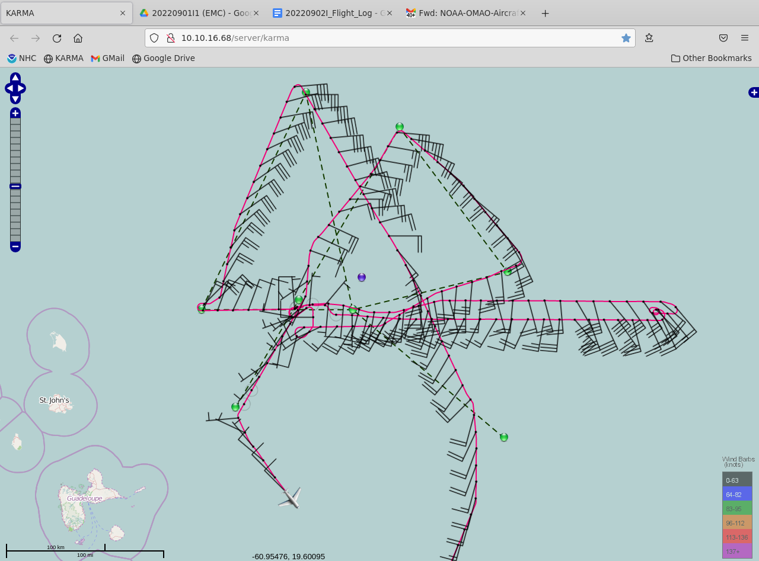
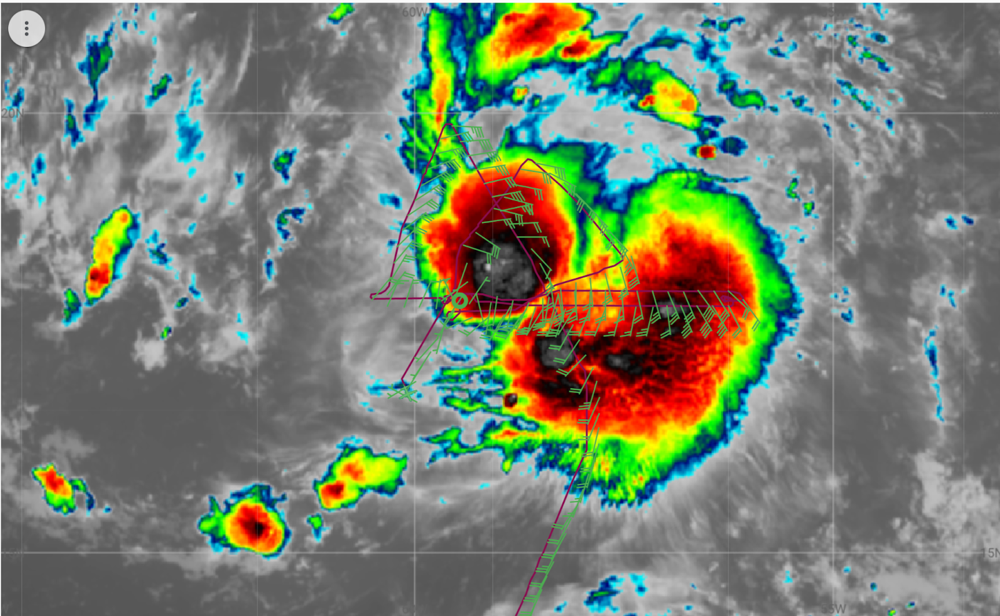
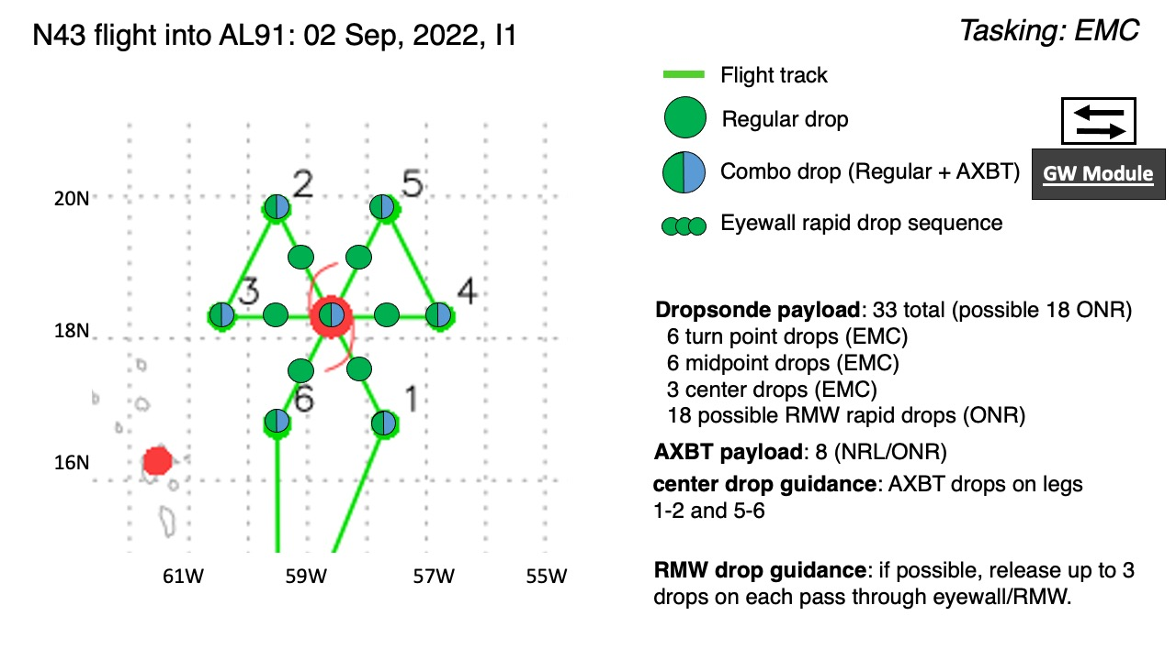
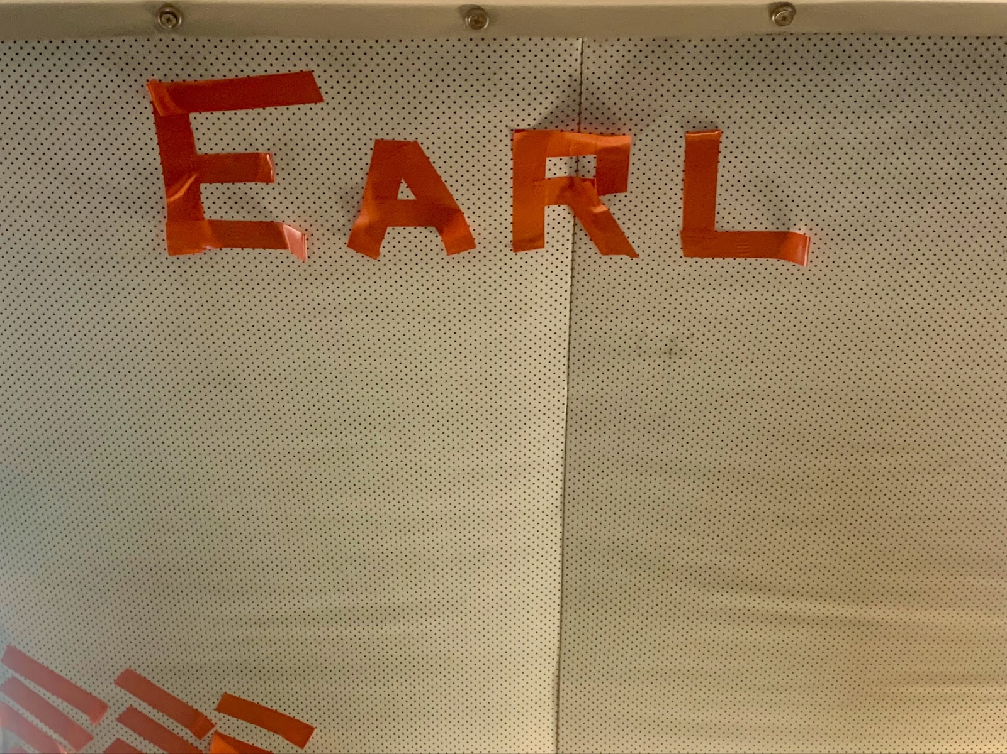
2022 Hurricane Field Program-APHEX
AL06/Earl: 20220902I1 (EMC)
Mission
Onboard
LPS: Marks, Aspen: Aberson, Radar: Reasor
Ground-Based
LPS: Hazelton, Radar: Gamache
APHEX relevance:
EMC TDR, Vortex Alignment Module (AIPEX), VAM
Planned pattern: Butterfly
T/O off (BGI): 1958z, Land (BGI): 0253z
FL 10 kft (pressure)
Dropsondes: 15 drops, 15 to GTS, 2 with gale-force surface wind speed
AXBTs (NRL/ONR): 8 (7 good)
5 TDR analyses to EMC & NHC
Data used to name the system Tropical Storm Earl
Successful vortex alignment module
N43 final flight track

Slide 18
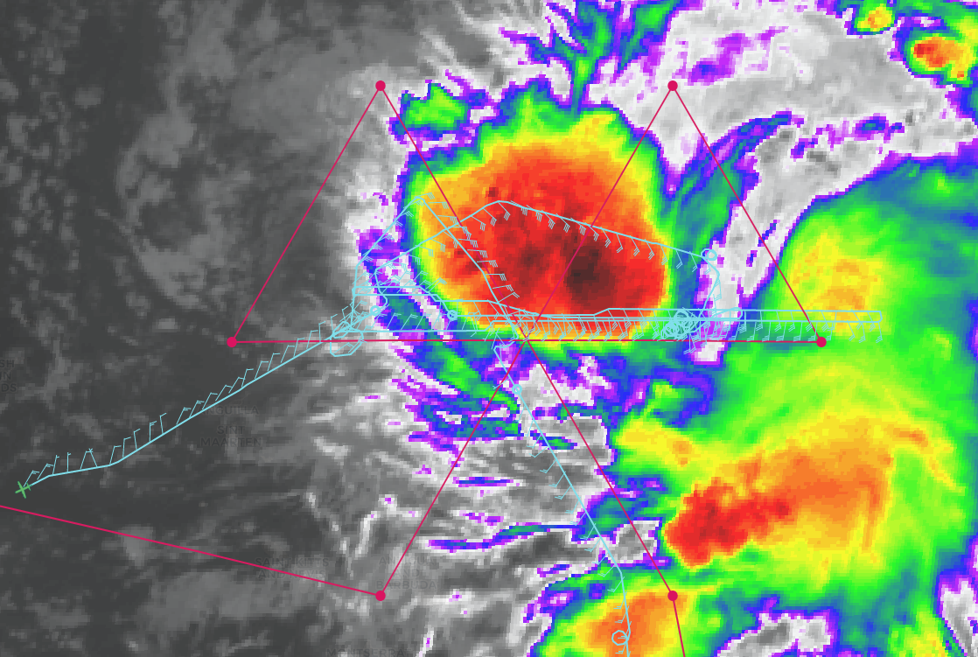
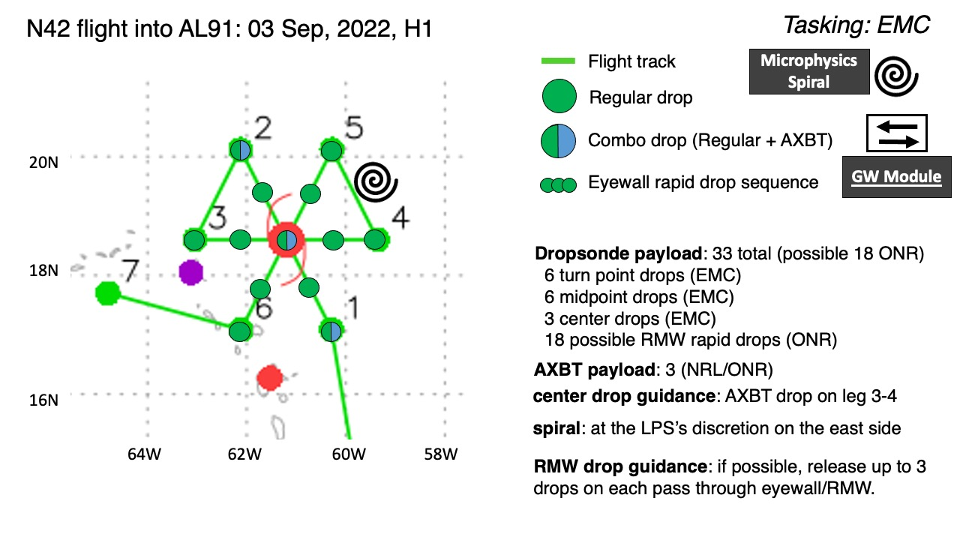
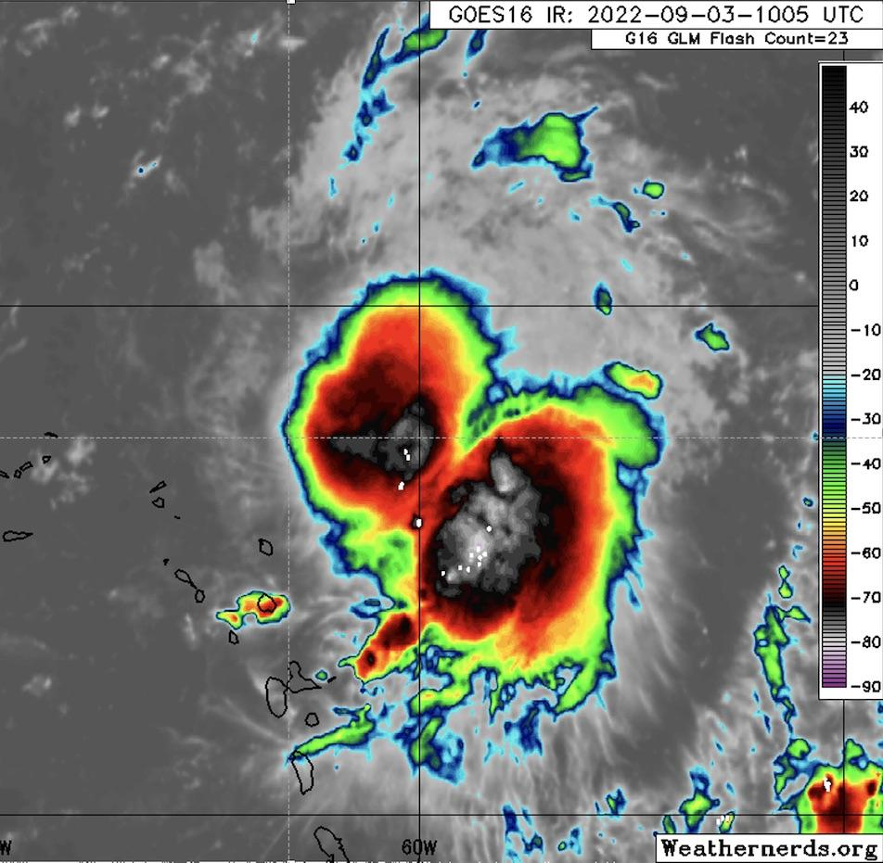
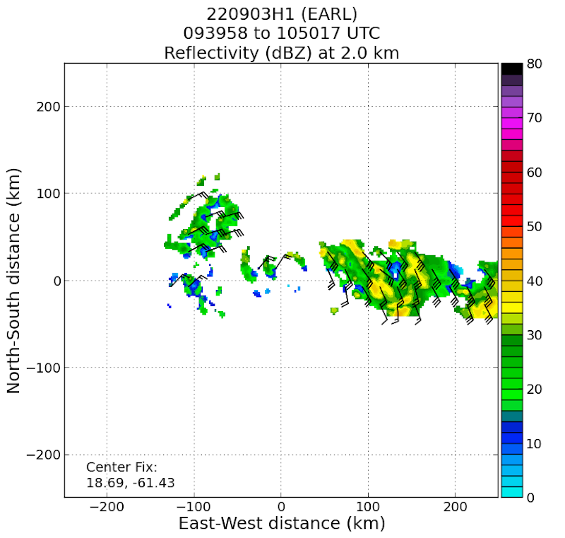
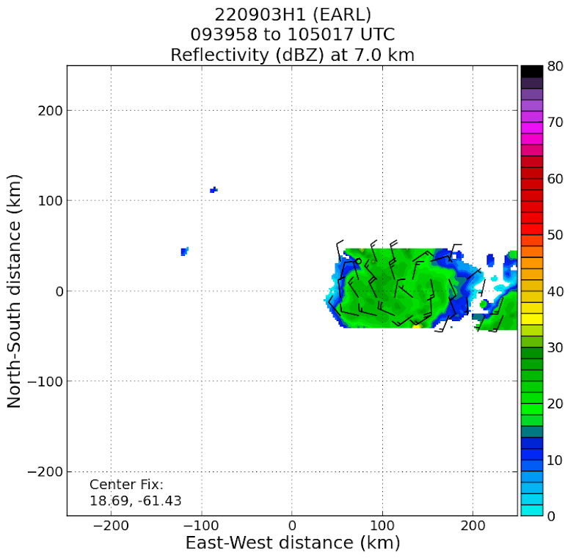
2022 Hurricane Field Program-APHEX
AL06/Earl: 20220903H1 (EMC)
Mission
Onboard
LPS: Rogers, Aspen: J. Zhang, Radar: Rogers, Englert
Ground-Based
LPS: None, Radar: Fischer/Gamache
APHEX relevance:
EMC TDR, Vortex Alignment Module (AIPEX), Stratiform Spiral Module (SSM)
Planned pattern: Butterfly
T/O off (BGI): 0920z, Land (STX): 1725z
FL 10 kft (pressure)
Dropsondes: 13 drops, 13 to GTS
AXBTs (NRL/ONR): 3
5 TDR analyses to EMC & NHC
Tropical Storm Earl now
VAM flown, circulations displaced to SE with ht
SSM flown
N42 final flight track
IR animation showing two convective systems
TDR analyses of winds, reflectivity at 7 (left), 2 (right) km. Note ~150 km eastward displacement in location of MLC.

Slide 19
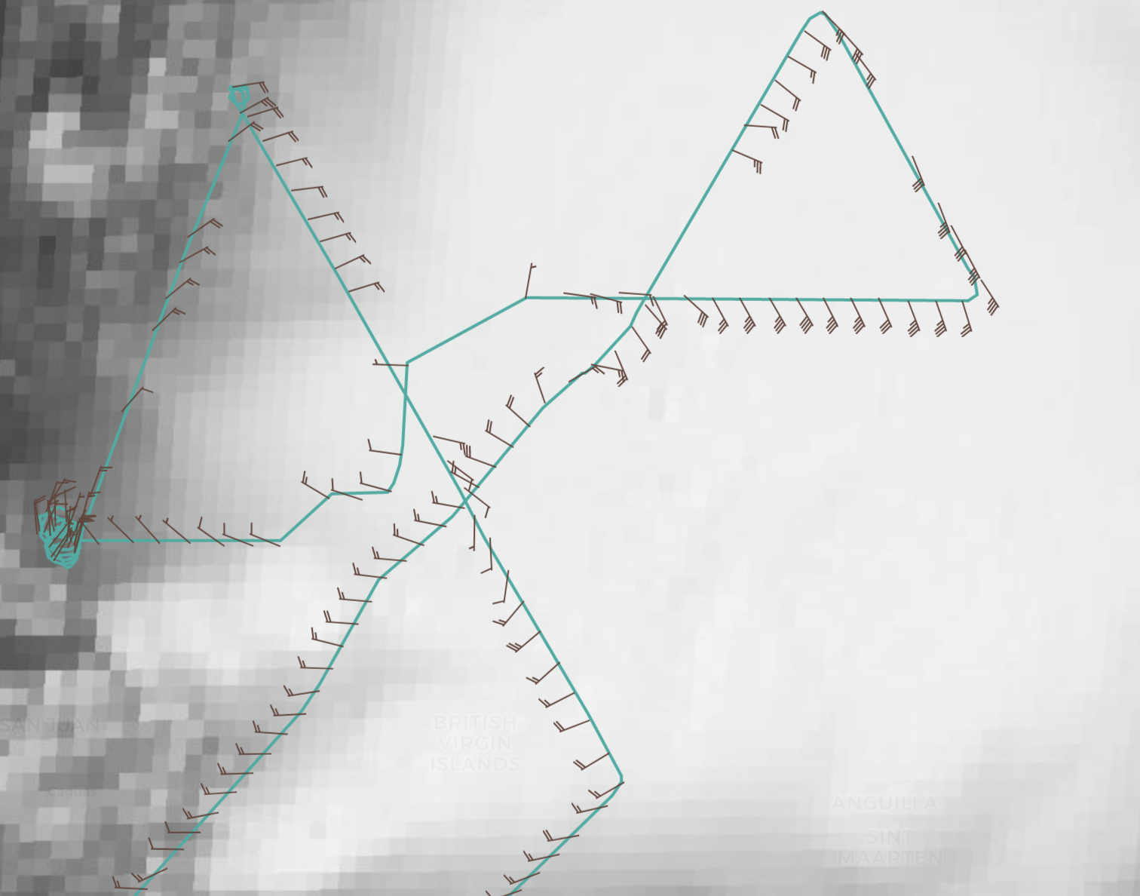
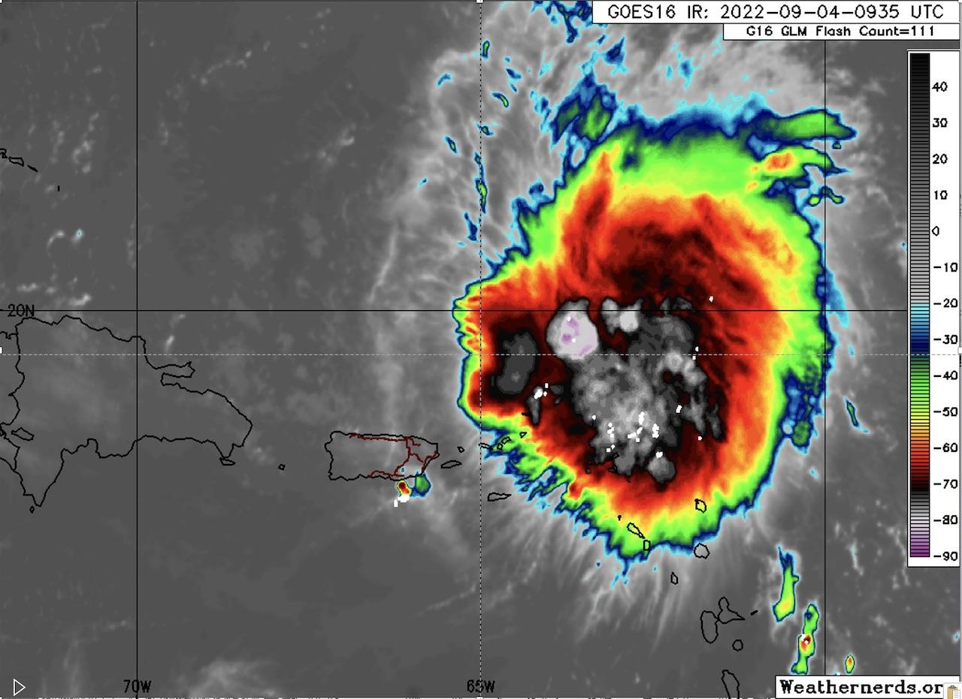
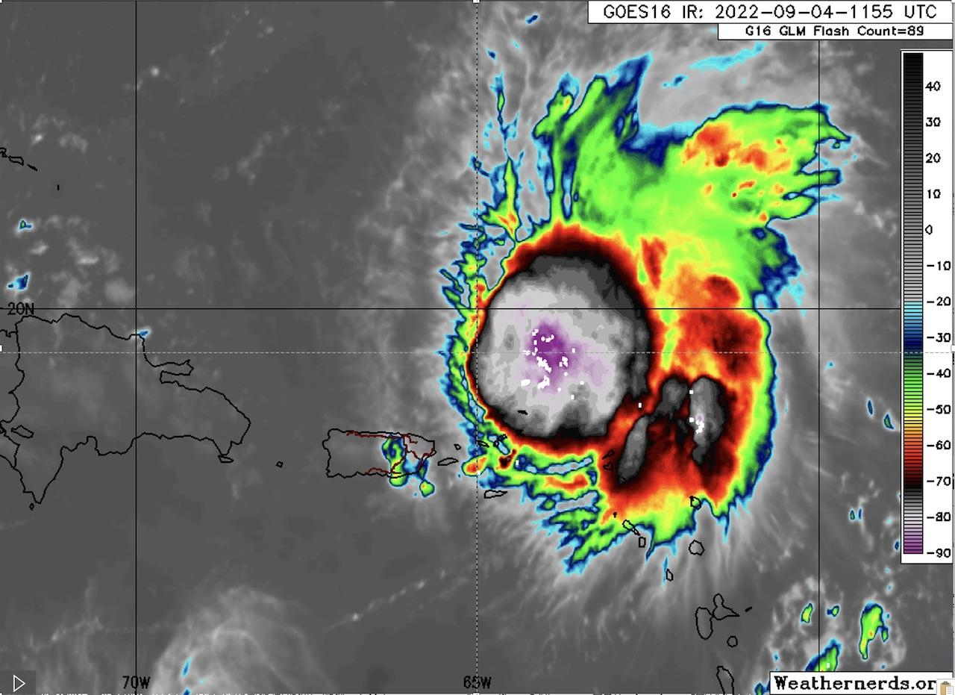
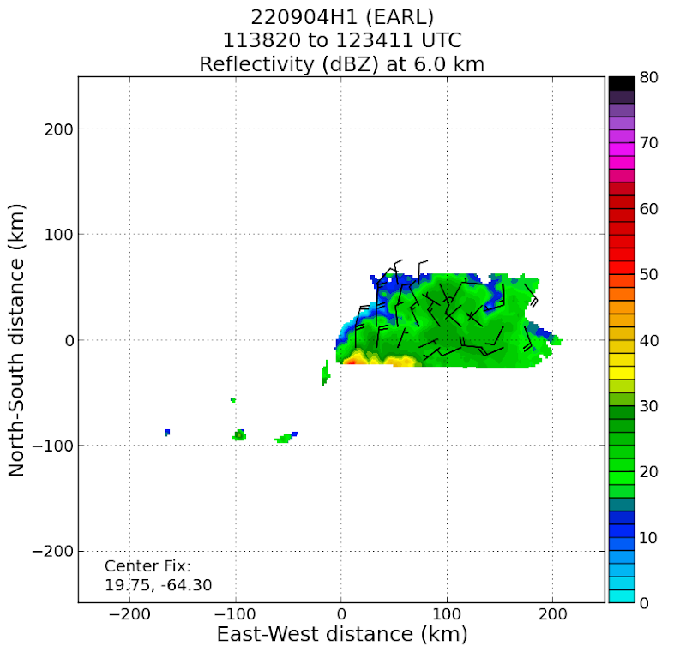
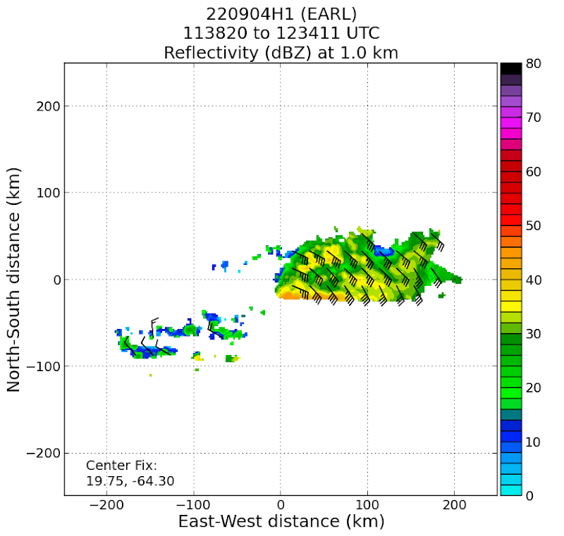
2022 Hurricane Field Program-APHEX
AL06/Earl: 20220904H1 (EMC)
Mission
Onboard
LPS: Rogers, Aspen: J. Zhang, Radar: Rogers, Englert, Guest: Dan Stern
Ground-Based
LPS: None, Radar: Fischer
APHEX relevance:
EMC TDR, Vortex Alignment Module (AIPEX), Stratiform Spiral Module
Planned pattern: Butterfly
T/O off (STX): 0904z, Land (STX): 1402z
FL 10 kft (pressure)
Dropsondes: 16 drops, 16 to GTS
AXBTs (NRL/ONR): 2
1 TDR analyses to EMC & NHC
Satcom issues for much of flight, prevented modules
Intense convective burst near MLC
W-E radar leg still showed displaced circulations
GOES-E IR showing intense convective burst with lightning that developed on the western side of the storm from 0935-1155 UTC.
N42 final flight track
TDR analyses of winds, reflectivity at 1 (left), 6 (right) km. Note continued eastward displacement in location of MLC.

Slide 20


2022 Hurricane Field Program-APHEX
AL06/Earl: 20220905H1 (EMC)
Mission
Onboard
LPS: Rogers, Aspen: J. Zhang, Radar: Alvey, Englert, Guest: Dan Stern
Ground-Based
LPS: None, Radar: Reasor
APHEX relevance:
EMC TDR, FLAIMS, VAM on NE side
Planned pattern: Butterfly
T/O off (STX): 0904z, Land (STX): 1412z
FL 10 kft (pressure)
Dropsondes: 27 drops, 25 to GTS
AXBTs (NRL/ONR): 2
5 TDR analyses to EMC & NHC
FLAIMS, VAM modules flown
Rapid-fire RMW drops released on NW, W, E, NE sides
Center displacement decreased during mission; aligned up to 5 km by end
N42 flight track
Composite TDR-derived vorticity (shading) and tilt hodograph.
Vorticity core becoming apparent near center, tilt ~20 km between 1-5 km altitude, increases significantly above that

Slide 21



2022 Hurricane Field Program-APHEX
AL06/Earl: 20220905I1 (EMC)
Mission
Onboard
LPS: Aberson, Aspen: Aberson, Radar: Aberson
Ground-Based
LPS: Holbach/Marks, Radar: Gamache
APHEX relevance:
EMC TDR, FLAIMS (AIPEX), TCRI rapid drop sequence
Planned pattern: Rotated Fig.-4
T/O off (KLAL): 1905z, Land (STX): 0326z
FL 10 kft (pressure)
Dropsondes: 27 drops, 26 to GTS, 3 late LD, 1 no winds
AXBTs (NRL/ONR): 4 (3 good)
4 TDR analyses. 3 to EMC & NHC
Bumpy ride. 1 sonde had an 8 m/s downdraft just below flight level
Too much work for one person. We had to sit on the ground for at least a half hour to allow data to get off the plane and systems to be shut down properly
Issues with getting FD to fly through eyewall and in comms between science and flight.
MMR screenshot
N43 final flight track

Slide 22



2022 Hurricane Field Program-APHEX
AL06/Earl: 20220906H1 (EMC)
Mission
Onboard
LPS: Rogers/Alvey, Aspen: J. Zhang, Radar: Alvey/Rogers
Ground-Based
LPS: None, Radar: Fischer
APHEX relevance:
EMC TDR, FLAIMS, VAM
Planned pattern: Butterfly
T/O off (STX): 0823z, Land (STX): 1452z
FL 10 kft (pressure)
Dropsondes: 27 drops, 25 to GTS
AXBTs (NRL/ONR): 2
4 TDR analyses to EMC & NHC
Flight level / mid-level center shifted slightly northeastward during flight (potential center repositioning?)
It could be beneficial to start the pattern with a pass along the VAM/FLAIMS vector for more temporal continuity
N42 final flight track
TDR analyses of winds, reflectivity at 5 km for the (left) SE-NW and (right) NE-SW passes.

Slide 23



2022 Hurricane Field Program-APHEX
AL06/Earl: 20220906I1 (EMC)
Mission
Onboard
LPS/Radar: Holbach, Aspen: Aberson
Ground-Based
LPS: Hazelton, Radar: Gamache
APHEX relevance:
FAM (Genesis), FLAIMS
Planned pattern: Butterfly
T/O off (STX): 2026z, Land (STX): 0321z
FL 10 kft (pressure)
Dropsondes: 29 drops, 27 to GTS, 1 fast fall, one with no launch detect, 1 erroneously tagged as fast fall by ASPEN
AXBTs (NRL/ONR): 3 (2 good)
8 TDR analyses to EMC & NHC
Data used by NHC to upgrade Earl to a hurricane
Late GPS signal on several sondes
N43 final flight track

Slide 24




2022 Hurricane Field Program-APHEX
AL06/Earl: 20220907H1 (EMC)
Mission
Onboard
LPS: Alvey, Aspen: J. Zhang, Radar: Rogers, Guest: Dan Stern
Ground-Based
LPS: None, Radar: Reasor
APHEX relevance:
FAM (Genesis), FLAIMS, Rapid-Fire RMWs (TCRI)
Planned pattern: Butterfly
T/O off (STX): 0823z, Land (STX): 1455z
FL 10 kft (pressure)
Dropsondes: 35 drops, 34 to GTS
AXBTs (NRL/ONR): 3
5 TDR analyses to EMC & NHC
Similar structure/asymmetries as 12h prior but slowly intensifying
N42 final flight track
TDR composite of (left) reflectivity and (right) 2 km wind speed and 2 & 5 km streamlines.
Dan’s 1st penny

Slide 25




2022 Hurricane Field Program-APHEX
AL06/Earl: 20220907I1 (EMC)
Mission
Onboard
LPS: Holbach, Aspen: Aberson
Ground-Based
LPS: Hazelton, Radar: Gamache
APHEX relevance:
FLAIMS (AIPEX), Gravity Wave Module
Planned pattern: Butterfly
T/O off (BGI): 2024z, Land (BGI): 0437z
FL 10 kft (pressure)
Dropsondes: 26 drops, 26 to GTS
AXBTs (NRL/ONR): 3
8 TDR analyses to EMC & NHC
Data used by NHC to upgrade Earl to a Cat-2 hurricane
McFadden Memorial on 600th penetration
Commemorating Dr. Jim McFadden
N43 final flight track

Slide 26




2022 Hurricane Field Program-APHEX
AL06/Earl: 20220908H1 (EMC)
Mission
Onboard
LPS: Alvey/Rogers, Aspen: J. Zhang, Radar: Rogers/Alvey
Ground-Based
LPS: None, Radar: Reasor
APHEX relevance:
EMC TDR, Gravity Wave Module
Planned pattern: Butterfly
T/O off (STX): 0818z, Land (KLAL): 1657z
FL 10 kft (pressure)
Dropsondes: 28 drops, 23 to GTS
AXBTs (NRL/ONR): 3
3 TDR analyses to EMC & NHC
In the future, it might be a better idea to do the GW module a little farther away from the center of the storm after beginning enroute back to Lakeland and ensuring that no deviations due to scatterers will be necessary.
N42 final flight track
Earl’s large eye

Slide 27




2022 Hurricane Field Program-APHEX
AL06/Earl: 20220908I1 (EMC)
Mission
Onboard
LPS: Holbach, Aspen: Aberson
Ground-Based
LPS: Alaka, Radar: Gamache
APHEX relevance:
Surface Wind/Wave, Ocean Winds
Planned pattern: Butterfly
T/O off (BGI): 1954z, Land (BGI): 0524z
FL 10 kft (radar)
Dropsondes: 24 drops, 24 to GTS
AXBTs (NRL/ONR): 4
9 TDR analyses to EMC & NHC
Earl was a mess and evolving very quickly between passes.
Dry air entrainment and ERC may have hindered its forecasted strengthening.
N43 final flight track
Pre-flight visit by AOML Coral Reef team
Fuel leak at beginning of flight

Slide 28
2022 Hurricane Field Program-APHEX
Social Media
AOML-HRD Twitter
9 Sep: some of the patterns we fly and why
https://twitter.com/HRD_AOML_NOAA/status/1568302419431559169?s=20&t=lVCo8QM3CvZfje9HLWhf1w
8 Sep (AOC Retweet): video from the P-3 cockpit going through Earl
https://twitter.com/NOAA_HurrHunter/status/1567943442658992138?s=20&t=lVCo8QM3CvZfje9HLWhf1w
6 Sep (NOAA P-3s and and tasking by NHC)
https://twitter.com/NOAA_AOML/status/1567235063313473536?s=20&t=lVCo8QM3CvZfje9HLWhf1w
6 Sep (NOAA flying Earl – photo of low-level swirl)
https://twitter.com/NOAA_AOML/status/1567235056653017090?s=20&t=lVCo8QM3CvZfje9HLWhf1w
30 Aug (HRD genesis missions)
https://twitter.com/NOAA_AOML/status/1564693366453018626?s=20&t=sw1z5ozIh02NNvLVAnvXKQ
30 Aug (HRD genesis missions with Cb cloud)
https://twitter.com/NOAA_AOML/status/1564693295795666948?s=20&t=sw1z5ozIh02NNvLVAnvXKQ
30 Aug (HRD genesis missions – P-3 on runway)
https://twitter.com/NOAA_AOML/status/1564693292058656771?s=20&t=sw1z5ozIh02NNvLVAnvXKQ
29 Aug (Gonzo flies a genesis mission – photo from cockpit)
https://twitter.com/NOAA_AOML/status/1564693292058656771?s=20&t=sw1z5ozIh02NNvLVAnvXKQ

Slide 29
2022 Hurricane Field Program-APHEX
Social Media
HRD Blog
NOAA aircraft examine tropical disturbance for signs of development
https://noaahrd.wordpress.com/2022/08/31/noaa-aircraft-examine-tropical-disturbance-for-signs-of-development/
AOML Instagram
AOML reunion on the island of St. Croix in the U.S. Virgin Islands! (Hurricane Earl missions from St. Croix:
https://www.instagram.com/p/Cifyv5VJ0aF/?utm_source=ig_web_copy_link
#AOML hurricane scientists have been busy flying this week aboard the NOAA Hurricane Hunter @flynoaa planes, looking at the development of tropical wave AL91:
https://www.instagram.com/p/Ch-LPfuuhOb/?utm_source=ig_web_copy_link

Slide 30
2022 Hurricane Field Program-APHEX
Communications
Daily Plan of the Day (POD)
Sent to research partners, AOML Comms
Laura Chaibongsai, Holly Stahl, & Jason D.
Post-map discussion tag-up to discuss social media opportunities

Slide 31

2022 Hurricane Field Program-APHEX
Other Issues – what went well?...what can we do better?
Sim is collecting a list of ASPEN issues - there were far more than were described here – to send to Isabel Suhr. If you have comments, send them to Sim.
Searchable pdfs of Field Program Plan for easy download to make finding information on modules and experiments easier to get.
We should get training on communications etiquette on the aircraft so we don’t step on toes.
Those with little Linux experience should get training on how to use Linux to smooth some issues with software and hardware.
Training of new flight director (Quinn Kalen) went very well.
Problems with broken keyboards and unstable mousepads needs to be solved.
GB LPS support for 4 am missions nearly non-existent (Dan Stern filled in once, and Michael served as de facto GB LPS while doing GB radar). Needs to be reconsidered somehow – it’s not appealing to wake up for a 4 am mission from the ground. Maybe get online by 6AM?

Slide 32
2022 Hurricane Field Program-APHEX
Other Issues – what went well?...what can we do better?
One thing we learned with VAM and FLAIMS modules – modules that target temporal evolution over the time scale of a single mission – is that the sampling frequency should scale with the phenomenon being studied.
Vortex-scale processes like alignment/intensification probably could be sampled at the start, middle, and end of mission.
Convective-scale processes like CB module could be sampled every 10 min or so. Repeated in-and-outs for VAM and FLAIMS were probably sampling too frequently to capture much evolution.
Any extra guidance on exactly what the goal is to sample for the rapid RMW sondes would be helpful. Surface RMW, flight-level RMW, wind or rain/reflectivity gradient...?
Any issues with health/safety/SASH, either during missions or downtime. Anonymous responses at https://docs.google.com/forms/d/e/1FAIpQLSeiFLPksVEXNmAvOKGAX259lKVAcIG0kh8TME6DU3xxatN6Gw/viewform?
Reminder re: fueling GOVs: if at all possible, always use 87 octane fuel

Slide 33










2022 Hurricane Field Program-APHEX
AL06/Earl): 28 August – 8 September
Photo by Jon Zawislak
Photo credit Frank Marks
Photo credit Heather Holbach
Photo credit Frank Marks
Photo credit Frank Marks
Photo credit Heather Holbach
Photo credit Heather Holbach
Photo credit Heather Holbach
Photo credit Frank Marks
Photo credit Sim Aberson
Photo credit Heather Holbach
Photo credit Heather Holbach
Copies of the 2022 AL06/Earl debrief can be found in the HRD Google Drive folder
HRD >> Hurricane Field Program >> 2022 >> Debriefs >> AL06/Earl

