Slide 1


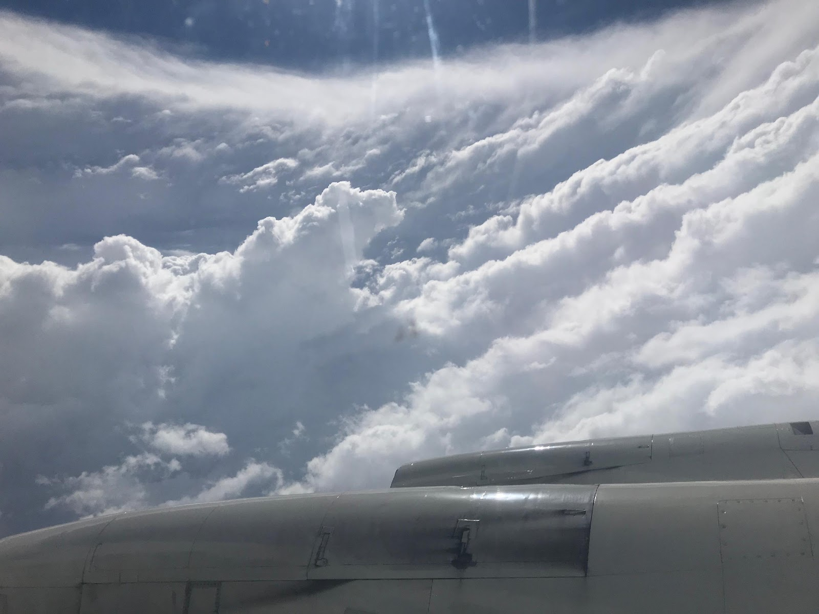
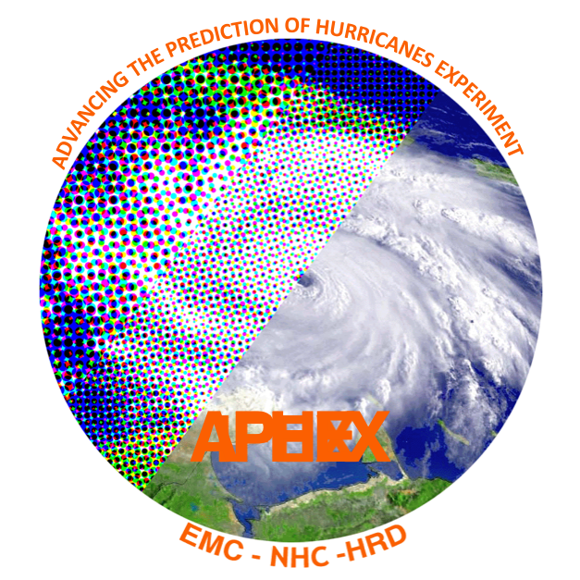




2022 Hurricane Field Program
Advancing the Prediction of Hurricanes Experiment (APHEX)
Kickoff Meeting
Jason Dunion – HFP Director
Jon Zawislak - HFP Deputy Director
HFP-APHEX Kickoff Meeting, June 27, 2022

Slide 2
2022 Hurricane Field Program-APHEX
Agenda
HFP-APHEX overview
COVID-19 Update
Operations & Logistics
Expendables & Instrumentation
Planned Collaborations with ONR & NASA
HFP Experiments & Modules

Slide 3
2022 Hurricane Field Program-APHEX
HFP-APHEX Overview

Slide 4
2022 Hurricane Field Program-APHEX
Advancing the Prediction of Hurricanes EXperiment (APHEX)
Goal 1: Collect observations that span the TC life cycle in a variety of environments for model initialization and evaluation
Goal 2: Develop and refine measurement strategies and technologies that provide improved real-time analysis of TC intensity, structure, environment, and hazard assessment
Goal 3: Improve the understanding of physical processes that affect TC formation, intensity change, structure, and associated hazards

Slide 5
2022 Hurricane Field Program-APHEX
Operations & Logistics

Slide 6
2022 Hurricane Field Program-APHEX
Operations & Logistics
Aircraft
N42, N43, and N49 all available this season
Potential Deployment Sites: Aruba, Bermuda, Barbados, Cabo Verde (G-IV), Puerto Rico (TBD), St. Croix
Twice daily P-3 and G-IV missions possible
HRD will continue to take advantage of “flights of opportunity” during operationally tasked missions
G-IV takeoff times for NHC Synoptic Surveillance: 1730/0530 UTC (adjustable for research)
P-3 take-off times for EMC: timed for roughly symmetric patterns (timewise) around the synoptic time (00 and 12 UTC)
HRD Crewing
1-2 onboard scientists to support P-3 missions (up to 1 for G-IV research)
HRD crewing will be a combination of onboard and ground-based (LPS, radar, Aspen-TAG)
HRD aircraft crews will consist of HRD scientists and visiting scientists & observers (when seats are available)

Slide 7
2022 Hurricane Field Program-APHEX
Operations & Logistics
FY22 P-3 OAR/NESDIS/NWS Flight Hours
Aircraft | Research (OAR) | Research (NESDIS) | NWS
P-3s | 113 (TBD) | 50 | 357.8
G-IV | 72+26+15 >> 113 (TBD) | - | 105
Aircraft Status
N42 (P-3)
  Hurricane Ready: 1 June
  WSRA not yet operational (software upgrade)
N49 (G-IV)
  THOR instrument install soon
  Hurricane Ready: 1 June
N43 (P-3)
  No working MMR (July install planned)
  Some TDR shakedown still required
  Hurricane Ready: 1 Aug

Slide 8
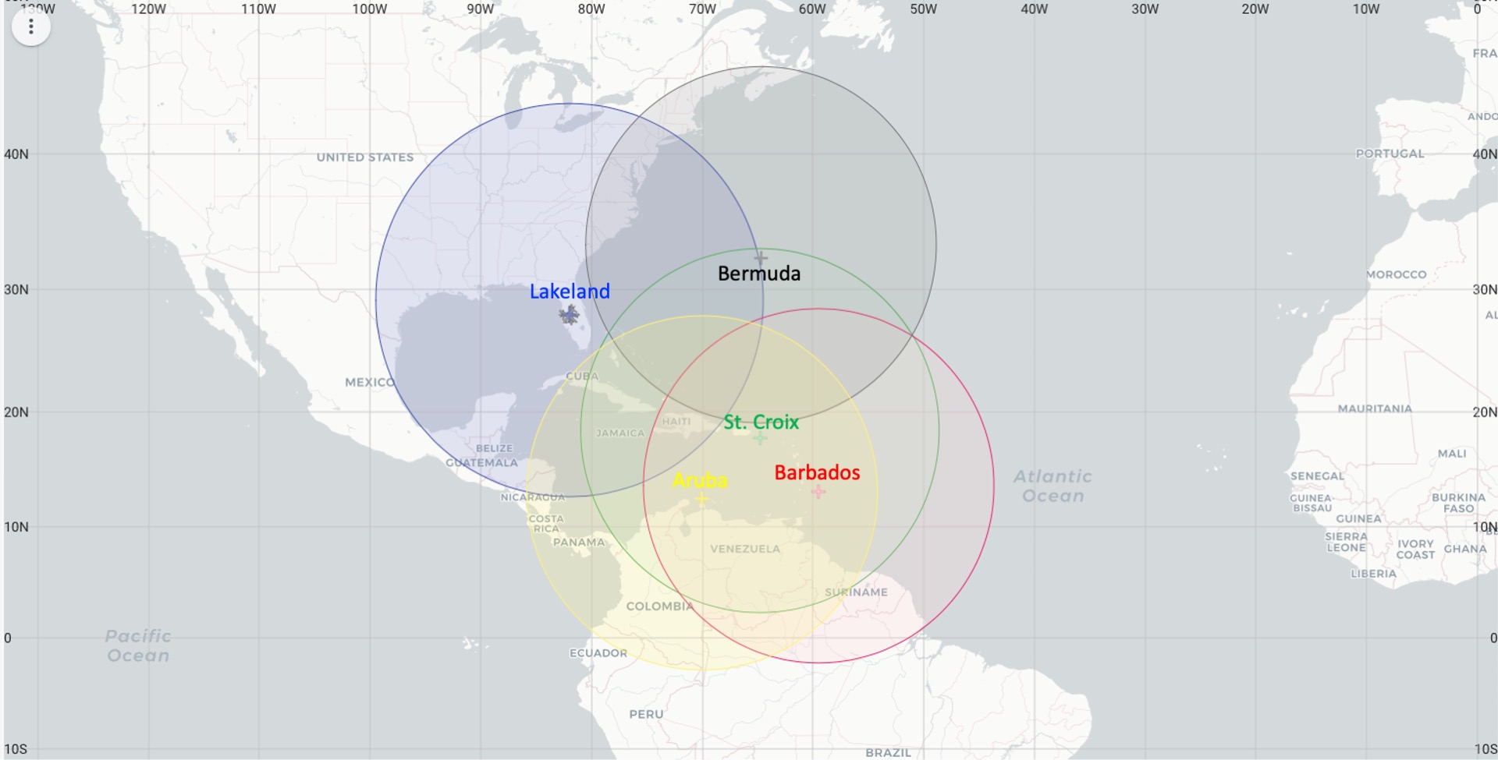
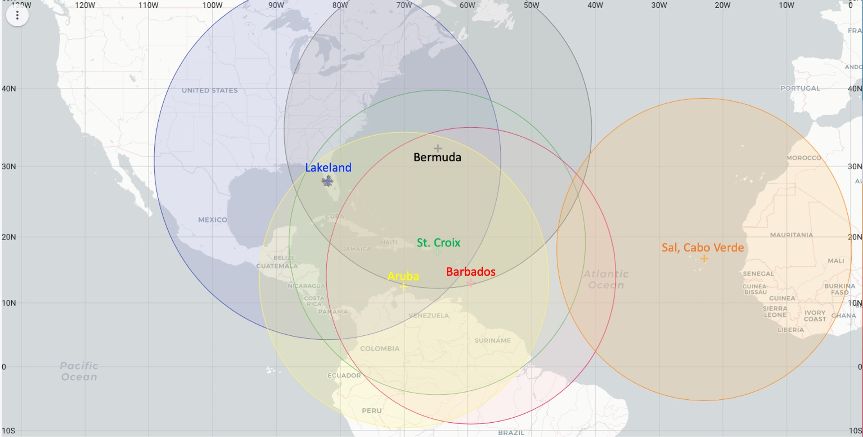
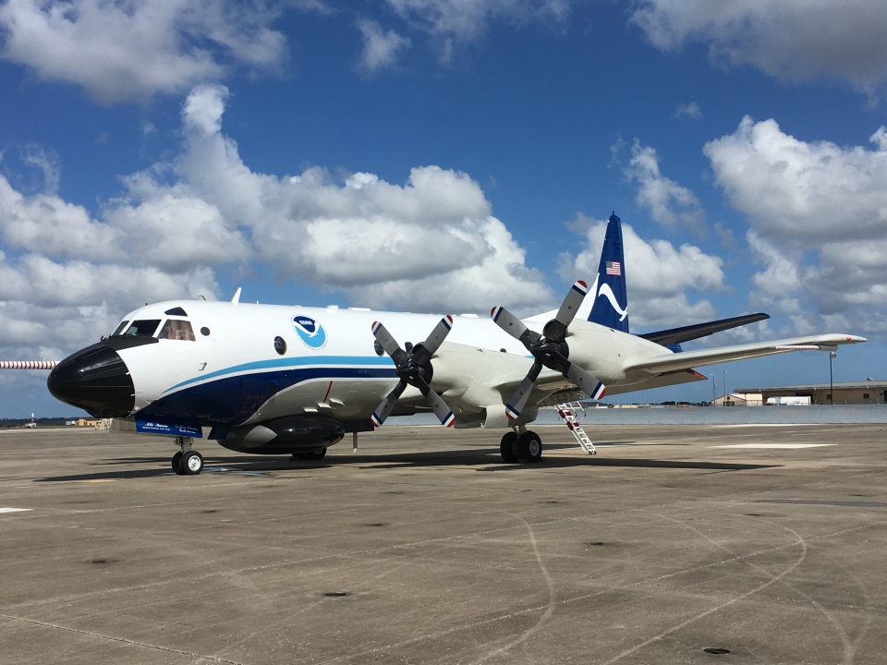
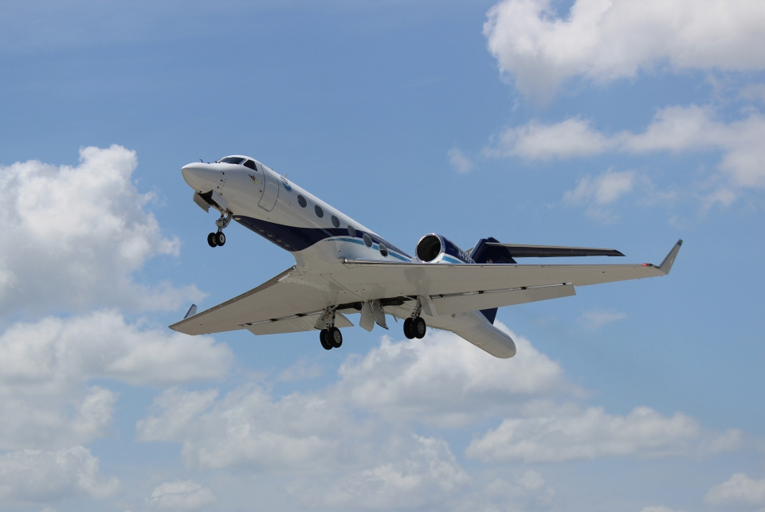
2022 Hurricane Field Program-APHEX
Operations & Logistics
Primary Atlantic Operating Bases and Ranges (2-h on-station time)
*Cabo Verde Ops planned for 2022

Slide 9
2022 Hurricane Field Program-APHEX
Operations & Logistics
Daily Schedule
0900 EDT (1300 UTC): Conference call with APHEX participants & collaborators (if needed)
0920 EDT (1320 UTC): NHC-EMC-HRD coordination call for operations & logistics (if needed)
1230-1300 EDT (1630-1700 UTC): HRD Map Discussion
1300 EDT (1700 UTC): Go/No-go coordination with NOAA AOC
HRD Map Discussion
Weekdays, 1230-1300 EDT (1630-1700 UTC), 25 July – 14 October
Anticipating a hybrid format (in-person & GotoMeeting remote participation)
Contact Jason D. if you’d like to lead or co-lead a week of map discussions
HRD Map Discussion Links (HRD Google Drive Folder):
  Hurricane Field Program >> 2022 >> Map Discussion Links
  Contact Sim A. if you have a link that you’d like added to the links document

Slide 10
2022 Hurricane Field Program-APHEX
Operations & Logistics
Mission Monitoring and Communication
NASA MTS will serve as our primary tool for monitoring and coordinating missions
  MTS training: Tue 28 June, 1300 EDT – 1700 UTC
  Contact Jason D. if you’re interested in getting a MTS account
GeoCollaborate testing in pre-season with more testing planned
  https://aoml1.geocollaborate.com/dashboard/
Google Meet will be used again this year by ground-based crew
  Limited participation (ground-based LPS, radar scientist, Aspen-TAG scientist)
  Science PIs will also be invited/encouraged to join if he/she has an experiment/module being flown
  Mission Flight Logs
    Will be used again this summer by ground-based LPSs to document the mission in real-time
    Mission log docs will be used for each mission to help standardize HRD’s mission summaries
    HRD >> Hurricane Field Program >> 2022 >> Mission Reports/Data

Slide 11
2022 Hurricane Field Program-APHEX
Operations & Logistics
Administrative / Travel
FTEs
  Emy Rodriguez & Jennifer Calderon will be HRD’s main POCs for HFP Fed travel this summer
  Counter Threat Awareness Training (CTAT): available through the CLC
    Required for personnel traveling internationally for less than a cumulative 90 days for the calendar year
    Requires ~5 hr to complete; certificate is valid for 6 years
    You are not required to take the new CTAT training until the expiration of your current HTSOS certification
    Check with Emy and Jennifer if you need to confirm certification
  FTE Mission Critical Travel Requirements
    HRD Travel Request form is still required and must be approved by Frank before Emy and Jennifer can initiate travel
    We must adhere "NOAA's TRAVEL JUSTIFICATION for MISSION CRITICAL'' policy which requires 'Deputy Chief Financial/Administrative Officer' (DUS-O) approval of all FTE Travel requests
    Link to NOAA Travel Policy: https://www.corporateservices.noaa.gov/~finance/Travel_policy.html
  Inform Shirley and Jason of completion of Online Aviation Safety Training & Videos
CIMAS Employees
  Must complete travel request forms prior to traveling (include COVID-19 Protocols that will be followed)
  Vehicle form required -- email to Isabel and Nathalia (if you need to complete or aren’t sure if you’re set)
  Email Emy & Jennifer all completed travel forms
  Inform Shirley and Jason of completion of Online Aviation Safety Training & Videos

Slide 12
2022 Hurricane Field Program-APHEX
Operations & Logistics
To Participate in the HFP:
CTAT Foreign Travel Course (Fed)
Safety Training (CIMAS and Fed): due by July 1st
  Aviation Safety Trainings
    Aviation Policy & Procedures
    Aviation Safety & Survival
  Aviation Safety Videos:
    Surviving on Open Water
    Survival Medicine (back by popular demand!)
Trained for one or more roles to perform HRD Science Crew duties
Lead Project Scientist (Ground or onboard)
Dropsonde Scientist (Ground or onboard)
Radar Scientist (Ground or onboard)

Slide 13
2022 Hurricane Field Program-APHEX
Operations & Logistics
HFP Trainings
Ground-based and onboard crews
  Radar (Ground, Invited): 13 June
  Radar (Airborne): 21 June
  ASPEN (Airborne): 15 & 22 June
  ASPEN (TAG): TBD
  LPS (Ground & Airborne, Invited): TBD
Mission monitoring tools
  NASA Mission Tools Suite (MTS): Tue, 28 June, 1-2pm ET
Safety Training
  Safety Training Video (FAA) Viewing Due: Fri 1 July
  CLC / CIMAS Online Aviation Safety: Fri 1 July
  GSA Drivers Course due: Before driving GOV
  CIMAS Employees submit new van forms: before driving GOV

Slide 14
2022 Hurricane Field Program-APHEX
Expendables & Instrumentation

Slide 15
2022 Hurricane Field Program-APHEX
Expendables & Instrumentation
FY22 P-3 OAR/NESDIS/NWS Expendables (*recoverable)
Expendable | Research (OAR) | Research (NESDIS) | Research (ONR) | Research (JPSS) | NWS
GPS Dropsondes | 76+358 = 434 (TBD) | TBD | 99 + 200 = 299 (TBD) | 61 + 49= 110 | 547
IR Dropsondes | 127 | - | - | - | -
AXBTs | N/A | - | 43 DW + 42 SW = 85 | - | -
sUAS (Altius-600) | 2-3 | - | - | - | -
ALAMO Floats | N/A | - | - | - | -
A-Sized Drifters & AXBTs | TBD | - | - | - | -
Hurricane Gliders* | Pre-deployed | - | - | - | -
Saildrones* | 5-7 Aug-Oct | - | - | - | -
AXBTs: testing onboard scripts to push auto QCed AXBT data to the AOC ground server in near real-time

Slide 16
2022 Hurricane Field Program-APHEX
Expendables & Instrumentation
2022 Aircraft Instrumentation
Instrument | Aircraft | Measurements
Flight-Level Measurements | N42, N43, N49 | Position, altitude, PT, moisture, winds (40 Hz & 1 Hz)
Tail Doppler Radar (TDR) | N42, N43, N49 | Reflectivity, 3-D winds (~0-15 km)
Multi-Model Radar (MMR) | N42, N43 (July install) | X-band horizontal-scanning pulse Doppler radar
Stepped Frequency Microwave Radiometer | N42, N43, N49 | Surface wind speed, rain rate
Cloud Microphysics: Cloud Combination Probe (CCP), Precipitation Imaging Probe (PIP), Cloud and Aerosol Spectrometer (CAS) | N42 | Aerosol, cloud hydrometeor, & precipitation size distributions: CCP (2-1550 µm), PIP (100 µm-6.4 mm), CAS (0.63-100 µm)

Slide 17
2022 Hurricane Field Program-APHEX
Expendables & Instrumentation
2022 Aircraft Instrumentation (cont’d)
Instrument | Aircraft | Measurements
Imaging Wind and Rain Airborne Profiler (IWRAP) | N43 | Profiles of volume reflectivity and Doppler velocity of precipitation, ocean surface backscatter
KaIA | N43 | Significant wave height
Wide Swath Radar Altimeter (WSRA) | N42 | Significant wave height and directional wave spectra
Compact rotational Raman Lidar (CRL) | N42 | T, moisture, aerosols (FL to surface)
Terrestrial High-energy Observations of Radiation (THOR) | N49 | gamma ray emissions associated with lightning
Airborne Wind Lidar (AWL) | N42 (possible camera port install TBD) | 3-D winds below flight level

Slide 18
2022 Hurricane Field Program-APHEX
Operations & Logistics
Data Products List
INSTRUMENTS | INVESTIGATORS
Tail Doppler radar (TDR) | John Gamache (john.gamache@noaa.gov) Paul Reasor (paul.reasor@noaa.gov)
Multi-Mode Radar (MMR) | John Gamache (john.gamache@noaa.gov) Paul Reasor (paul.reasor@noaa.gov)
Stepped Frequency Microwave Radiometer (SFMR) | Heather Holbach (heather.holbach@noaa.gov)
Cloud Physics Probes | Robert Black (Robert.a.black@noaa.gov)
Imaging Wind and Rain Airborne Profiler (IWRAP) | Paul Chang (paul.s.chang@noaa.gov)
Wide Swath Radar Altimeter (WSRA) | Heather Holbach (heather.holbach@noaa.gov) Ivan Popstefanija (popstefanija@prosensing.com)
Compact rotational Raman Lidar (CRL) | Zhien Wang (Zhien.Wang@Colorado.edu)
Terrestrial High-energy Observations of Radiation (THOR) | David Smith (dsmith8@ucsc.edu)
PLATFORMS | INVESTIGATORS
P-3 and G-IV Flight-level | Neal Dorst (neal.m.dorst@noaa.gov)
GPS Dropwindsonde | Kathryn Sellwood (Kathryn.sellwood@noaa.gov)
Airborne eXpendable BathyThermograph (AXBT) | Nick Shay (nshay@miami.edu) Jun Zhang (jun.zhang@noaa.gov)
OBSERVATIONAL PRODUCTS | INVESTIGATORS
HEDAS Pre-processing | Altug Aksoy (altug.aksoy@noaa.gov)
Center Fixes / Tracks (2-min) | Neal Dorst (neal.m.dorst@noaa.gov)
INFORMATIONAL | INVESTIGATORS
Flight Logs (e.g., LPS, Radar, Dropsonde, Boundary Layer) | Neal Dorst (neal.m.dorst@noaa.gov)
MODEL PRODUCTS | INVESTIGATORS
Basin-scale HWRF | Ghassan Alaka (ghassan.alaka@noaa.gov)
Hurricane Analysis and Forecast System (HAFS) | Andrew Hazelton (andrew.hazelton@noaa.gov)
HWRF Hurricane Ensemble Data Assimilation Scheme (HEDAS) | Sim Aberson (sim.aberson@noaa.gov) Altug Aksoy (altug.aksoy@noaa.gov)
Data Management
Main Document in the HFP Plan
Data Product List and contacts is provided in the HFPP
Focus on providing mission info and data to the HRD HFP Data Page as soon as possible after a storm sequence
Like last season, will maintain a Google Sheet inventory of mission info and data acquisition

Slide 19
2022 Hurricane Field Program-APHEX
Operations & Logistics
HFP Data
AOC will ensure that all data is transferred to AOC ground servers after missions
  HRDers no longer need to take an external hard drive on missions
  Aspen output should be copied (not moved) to the “FRD” folder periodically during missions
  All Aspen output should be moved to a mission ID folder and kept on the aircraft computer
  Auto Qced AXBT data will be transferred to AOC ground servers in near real-time
For any data downloaded by HRDers while onboard the aircraft, options include:
  Upload data to the Google Drive for scanning
  Upload data to the AOML FTP (for smaller data transfers) - no scanning done
  Download data to a USB then upload to Google drive via GFE (gov’t issued laptops/equipment)
    Use McAfee to scan the USB stick before using and after loading data

Slide 20
2022 Hurricane Field Program-APHEX
Operations & Logistics
External Communication
HRD will be working closely with AOML’s Comms Team (Laura Chaibongsai & Holly Stahl)
HRD blog: https://noaahrd.wordpress.com/
HRD webpage: http://www.aoml.noaa.gov/hrd/
Facebook: https://www.facebook.com/noaahrd/
Twitter: https://twitter.com/HRD_AOML_NOAA
Internal Communication
Daily Plan of the Day: when operations are ongoing
  aircraft status, potential targets, deployment logistics, travel
Daily map discussions

Slide 21


2022 HFP-APHEX: Health and Safety
https://www.aoml.noaa.gov/2022-hurricane-field-program/
Data gathering is the HFP’s ultimate goal, but the paramount concern is the safety and health (including mental health) of those individuals doing the work.
Link has information on:
Workplace Violence Prevention and Response
Behavioral Health and Wellness
Employee Assistance Programs (NOAA, UM, MSU)
The Fieldwork Initiative to Stop Sexualized Trauma (available here or here), and/or the Towards Sexual Literacy in Fieldwork training (available here).
WVPR info sheet will be in all flight bags and government vehicles. Services available to everyone everywhere, whether the incident happened in the workplace or not.
24

Slide 22
2022 Hurricane Field Program-APHEX
Planned Collaborations with
ONR & NASA

Slide 23


2022 Hurricane Field Program-APHEX
Planned Collaborations
ONR Tropical Cyclone Rapid Intensification (TCRI)
Main Objectives
  Identify the key processes and predictability of TC rapid intensification
Aircraft: NOAA P-3s and G-IV (in collaboration with AOML/HRD, usual deployment sites)
Timelines
  2022 Campaign: July-October (final field campaign year)
NASA CPEX-CV
Main Objectives
  Tropical convection, Saharan Air Layer, tropical waves, West African Monsoon, TC genesis (ENATL & W Africa)
  Validate the ADM-Aeolus satellite (wind lidar)
Aircraft: NASA DC-8 (Cabo Verde)
Timeline
  2022 Campaign: 1-30 Sep (final field campaign year)

Slide 24
2022 Hurricane Field Program-APHEX
HFP Experiments & Modules

Slide 25
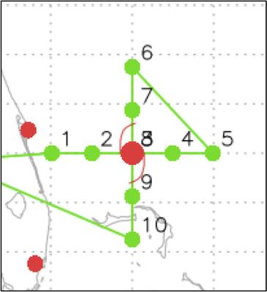
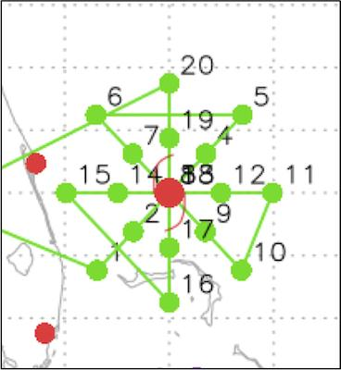
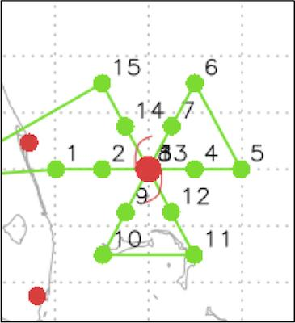
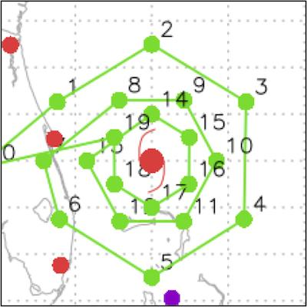
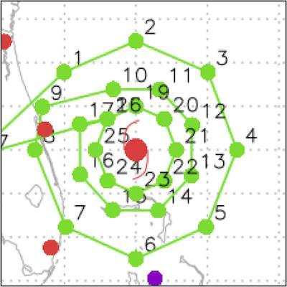
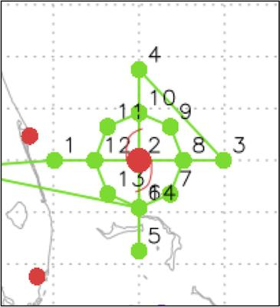
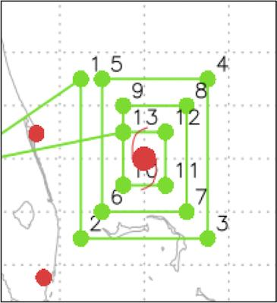
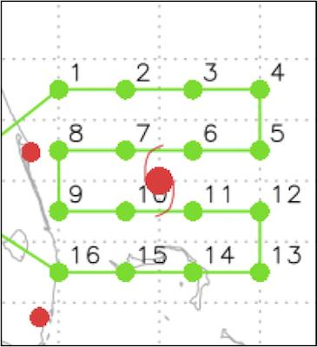
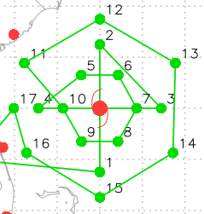
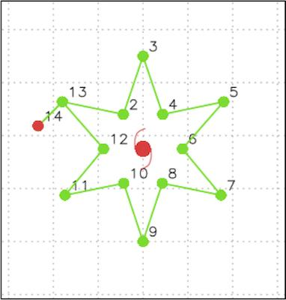
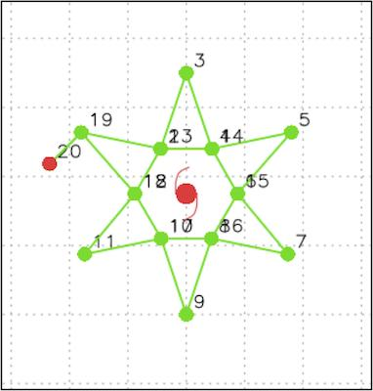
2022 Hurricane Field Program-APHEX
HFP Experiments and Modules
Figure-4
(P-3)
Rotated Figure-4
(P-3)
Butterfly
(P-3)
Circumnavigated Hexagon
(G-IV)
Circumnavigated Octagon
(G-IV)
Circumnav + Figure 4
(P-3)
Square Spiral
(P-3 & G-IV)
Lawn Mower
(P-3 & G-IV)
Figure-4 with
Double Circumnav
(G-IV)
Star 1
(G-IV)
Star 2
(G-IV)

Slide 26
2022 Hurricane Field Program-APHEX
HFP Experiments and Modules
EARLY STAGE (4)
Analysis of Intensification Processes Experiment (AIPEX)
Convective Burst Structure and Evolution Module (CBM)
Impact of Targeted Observations on Forecasts (ITOFS)
Stratiform Spiral Module (SSM)
GENESIS STAGE (2)
Favorable Air Mass (FAM) Experiment
Precipitation during Formation and Observing its Response across Multiple Scales (PREFORM)
MATURE STAGE (10)
Eye-Eyewall Mixing Module
Gravity Wave Module
Hurricane Boundary Layer Module
NESDIS Ocean Winds
Rainband Complex Module (RCM)
RICO SUAVE
Surface Wind and Wave Validation Module
Tail Doppler Radar Analysis Evaluation Module
Tropical Cyclone Diurnal Cycle Experiment
Ventilation Module
END STAGE (2)
Extratropical Transition Experiment
Tropical Cyclones at Landfall Experiment
OCEAN OBSERVING (2)
Ocean Survey Experiment
Sustained and Targeted Ocean Observations
SATELLITE VALIDATION (2)
Eval of the Tropical Transition Environment using Satellite Soundings
NASA TROPICS Satellite Validation Module

Slide 27
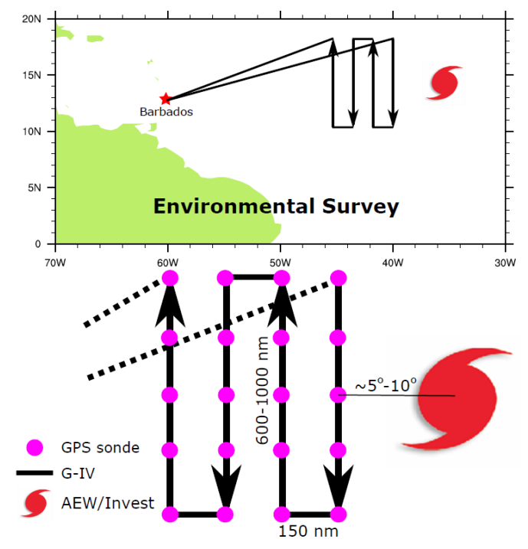
2022 HFP-APHEX: Genesis Stage
FAM (Favorable Air Mass)
Science Team: Jon Zawislak, Gus Alaka, Jason Dunion, Sharan Majumdar, Alexis Wilson, Quinton Lawton, Alan Brammer, Chris Thorncroft
To investigate the favorability in both dynamics (e.g., vertical wind shear) and thermodynamics (e.g., moisture, relative humidity) for tropical cyclogenesis in the environment near a pre-tropical depression, especially in the environmental air mass surrounding and ahead (downstream) of the pre-TD
Consecutive missions are recommended to observe the evolution of the observations over time and how that pertains to the (non-)development of a pre-TD
Adaptable to both the G-IV (preferred) and the P-3s
Twice-a-day missions preferred
Potential opportunity to collaborate with ITOFS-East and CPEX-CV

Slide 28
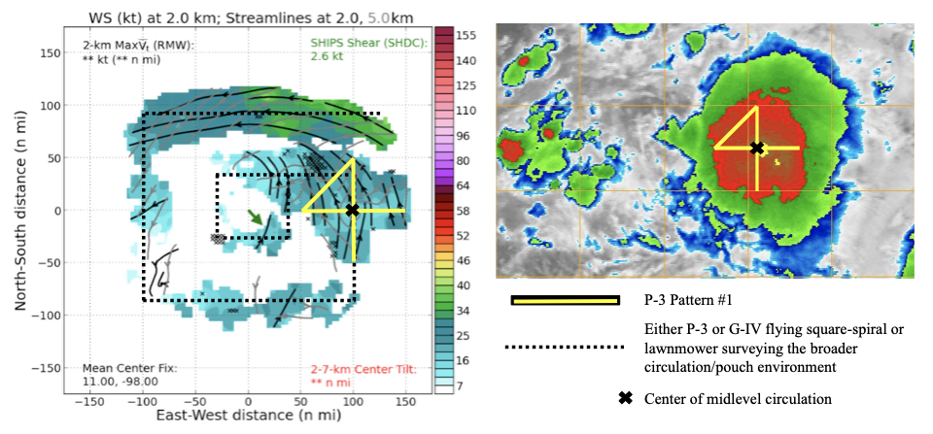
2022 HFP-APHEX: Genesis Stage
PREFORM (PREcipitation during Formation and Observing its Response across Multiple scales)
Science Team: Jon Zawislak, Gus Alaka, Rob Rogers, Jason Dunion, Paul Reasor, Sharan Majumdar, Alexis Wilson, Quinton Lawton
Measure the relative contributions of various precipitation modes (e.g., deep convection, moderately deep convection, stratiform) to the total precipitating area
Quantify the moisture and relative humidity characteristics of the circulation, relate those to precipitation characteristics, and measure their evolutions over multiple days
Identify the location, strength, and origins of circulations from the low to middle troposphere, and relate changes to the precipitation observed
Ideally 2 aircraft (adaptable for both P-3 and G-IV): one samples the environment (wave) and one focused on the convective systems
Twice-a-day missions preferred
Collaborative with ITOFS-East and CPEX-CV
Example strategy adapted to pre-Sergio (2018) in the EPAC

Slide 29
2022 Hurricane Field Program-APHEX
HFP Experiments and Modules
EARLY STAGE (4)
Analysis of Intensification Processes Experiment (AIPEX)
Convective Burst Structure and Evolution Module (CBM)
Impact of Targeted Observations on Forecasts (ITOFS)
Stratiform Spiral Module (SSM)
GENESIS STAGE (2)
Favorable Air Mass (FAM) Experiment
Precipitation during Formation and Observing its Response across Multiple Scales (PREFORM)
MATURE STAGE (10)
Eye-Eyewall Mixing Module
Gravity Wave Module
Hurricane Boundary Layer Module
NESDIS Ocean Winds
Rainband Complex Module (RCM)
RICO SUAVE
Surface Wind and Wave Validation Module
Tail Doppler Radar Analysis Evaluation Module
Tropical Cyclone Diurnal Cycle Experiment
Ventilation Module
END STAGE (2)
Extratropical Transition Experiment
Tropical Cyclones at Landfall Experiment
OCEAN OBSERVING (2)
Ocean Survey Experiment
Sustained and Targeted Ocean Observations
SATELLITE VALIDATION (2)
Eval of the Tropical Transition Environment using Satellite Soundings
NASA TROPICS Satellite Validation Module

Slide 30
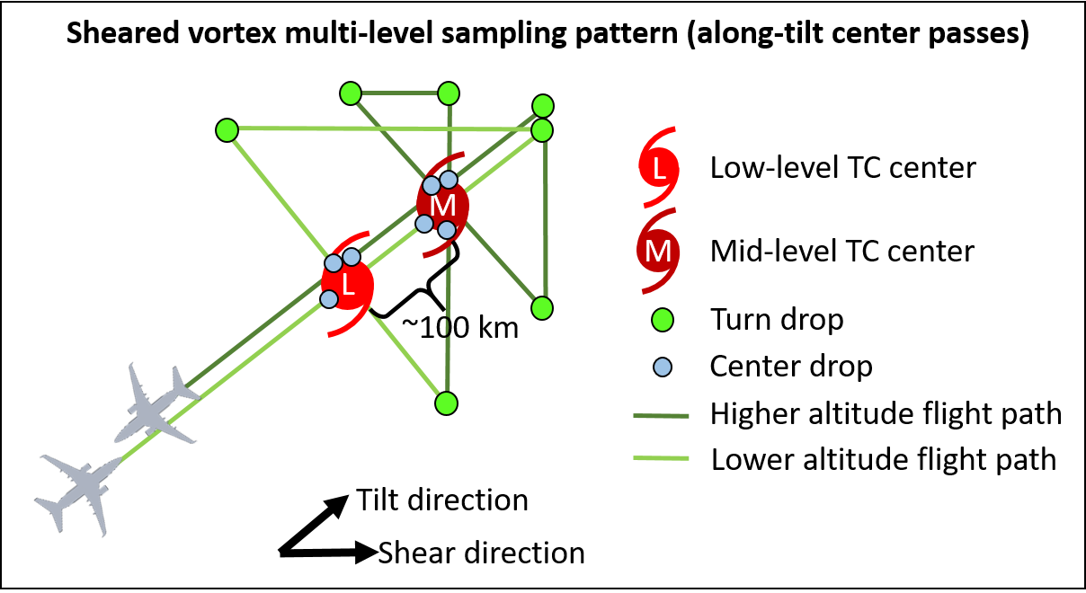
2022 HFP-APHEX: Early Stage
AIPEX (Analysis of Intensity Change Processes EXperiment)
Science Team: Zawislak, Rogers, Dunion, Alland, Rios-Berrios, G. Bryan, Judt, Fischer, J. Zhang, Reasor, Cione, Alvey, X. Chen, Alaka, Holbach, Wadler, Doyle, Stern, Finnochio, Majumdar, Nolan, Wimmers, Fuchs-Stone, Raymond, Tang, Bell, Foster
Collect aircraft observations that will allow us to characterize the precipitation and vortex-scale kinematic and thermodynamic structures of TCs experiencing moderate vertical shear
Understanding the reasons behind these structures, particularly greater azimuthal coverage of precipitation, vortex alignment, change in the vertical mass flux profiles, and boundary layer ventilation and recovery
Greater understanding of the physical processes that govern whether TCs will intensify, (especially those that undergo RI) in this type of environment
New Additions:
VAM (Vortex Alignment Module) – fly repeated legs along the vortex tilt vector from uptilt of low-level center to downtilt of the midlevel center; intensive sampling in back-to-back-to-back-to-back P-3 and G-IV flights
FLAIMS (Flight-level Assessment of Intensification in Moderate Shear) – fly radial legs into/out of center along azimuth of maximum winds
STILTSS (Sampling TILTed Storms in Shear) – fly a Fig. centered on low-level center, then higher altitude Fig. 4 centered on midlevel center
STILTSS flight pattern design

Slide 31
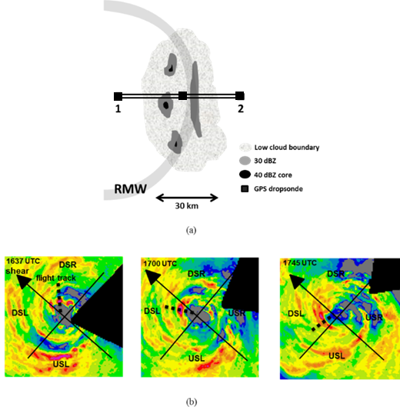
2022 HFP-APHEX: Early Stage
Convective Burst Structure and Evolution Module (CBM)
Science Team: Rob Rogers (PI), Jon Zawislak, Trey Alvey, Josh Wadler, Robert Black, Josh Wadler, Hua Leighton, Xuejin Zhang, Michael Bell (CSU), Anthony Didlake (PSU), Jim Doyle (NRL), Dan Stern (NRL), Ralph Foster (UW)
Obtain a quantitative description of the kinematic and thermodynamic structure and evolution of intense convective systems (convective bursts) and the nearby environment to examine their role in TC intensity change
Repeatedly sample the kinematic and reflectivity structure and evolution of individual convective bursts and their associated precipitation structures using airborne Doppler radar
Follow CBs as they translate azimuthally downwind in a shear-relative framework (where relevant)
Optimal additional measurements include:
  Deep-layer measurements of temperature and humidity in the local environment of the CBs from high-altitude aircraft will provide the thermodynamic context within the mid-and lower troposphere
  Measurements of sea-surface temperature and subsurface temperature profiles from ocean probes and/or IR dropsondes will provide context on the surface boundary
Sampling schematic of CB
Example pattern following CB during translation upshear

Slide 32
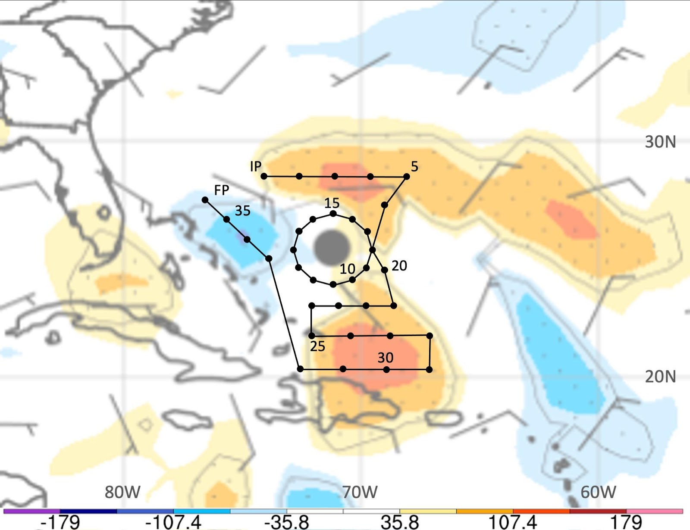
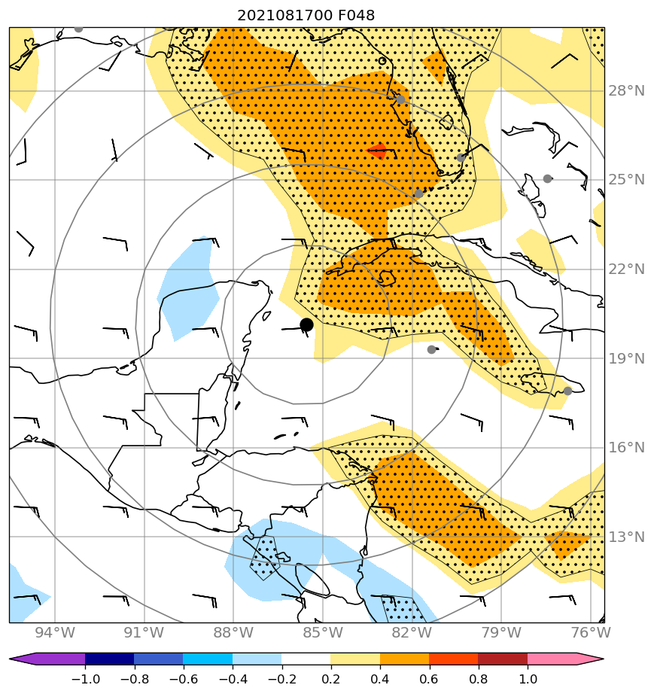
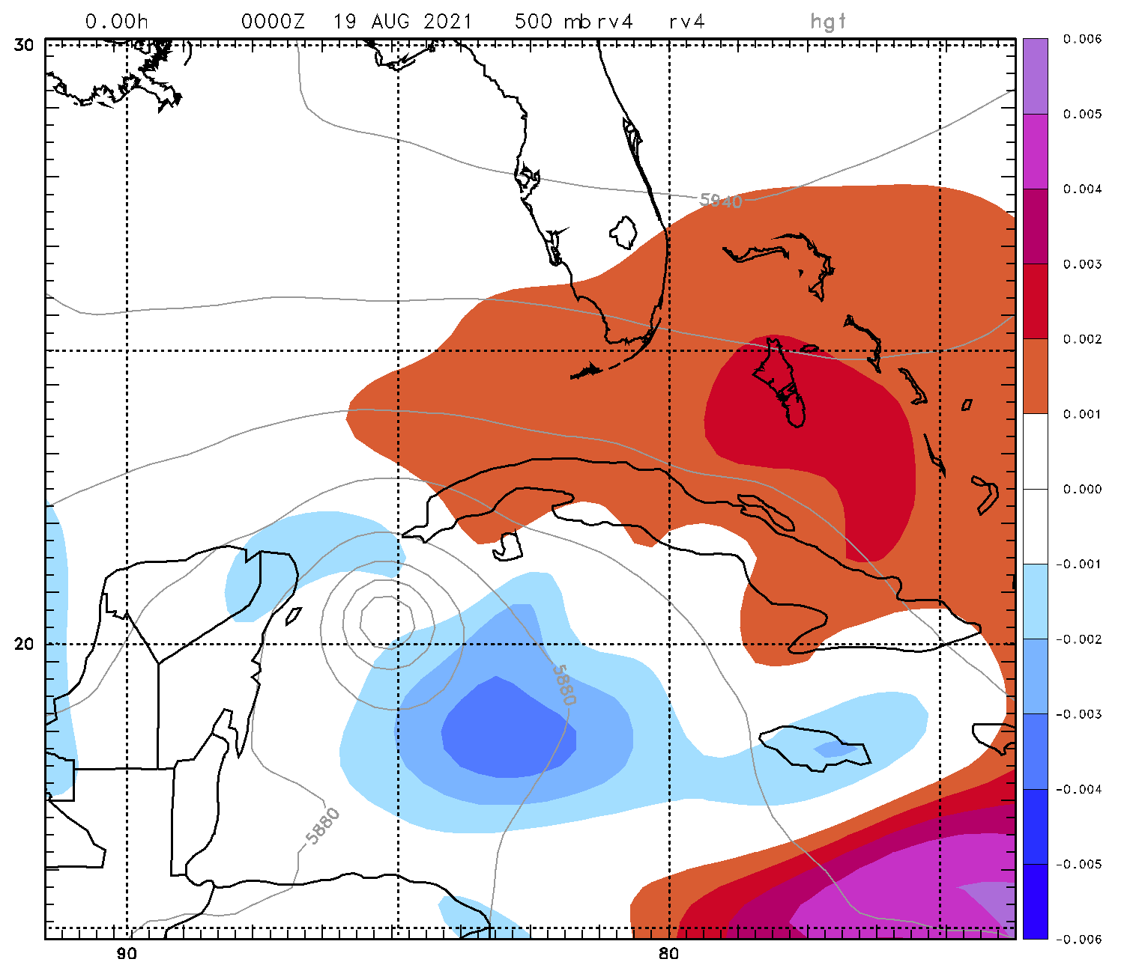
2022 HFP-APHEX: Early Stage
Impact of Targeted Observations on Forecasts (ITOFS) Experiment
Science Team: Jason Dunion (Co-PI), Jon Zawislak, Sim Aberson (Co-PI), Kelly Ryan, Jason Sippel, Ryan Torn (Univ at Albany-SUNY),
Jim Doyle (NRL-Monterey), Eric Blake (NWS/NHC), Mike Brennan (NWS/NHC), Chris Landsea (NWS/TAFB)
Goal: Identify when and where we should target aircraft observations (e.g., dropsondes) to help improve model forecasts of TC track, intensity, structure, and precipitation. Test advanced guidance techniques from models and new areas of operation (e.g., Cabo Verde) that could enhance NHC’s G-IV Synoptic Surveillance missions.
2021 Hurricane Grace: 20210818N1 (G-IV)
G-IV ITOFS survey and circumnavigation pattern (black curve) with dropsonde points (black circles) for 2019 Hurricane Dorian. Locations with warm and cool shading indicate areas where dropsonde sampling could improve the ECMWF 48-hr model track forecast.
Sensitivity targeting for (left) track (SUNY Albany-ECMWF) and (right) intensity (NRL-Monterey, COAMPS-TC)

Slide 33
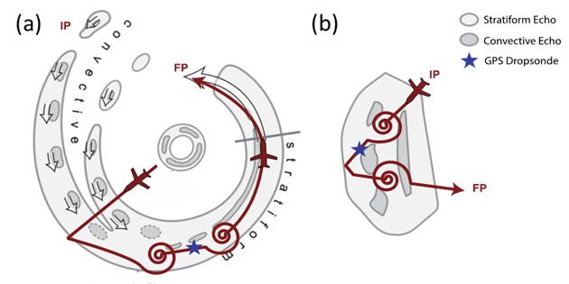
2022 HFP-APHEX: Early Stage
Stratiform Spiral Module (SSM)
Science Team: Rob Rogers (PI), Jon Zawislak, Trey Alvey, Robert Black, Josh Wadler, Hua Leighton, Xuejin Zhang, Michael Bell (CSU), Anthony Didlake (PSU), Jim Doyle (NRL), Dan Stern (NRL)
Obtain a quantitative description of the distribution of liquid and frozen hydrometeors in stratiform precipitation to better understand the processes that govern these distributions and how they are represented in numerical models.
Precipitation probe measurements of stratiform regions in TCs can also help improve retrievals of stratiform microphysical properties by polarimetric radar.
Spiral ascents/descents in stratiform regions of deep convection at radii outside the RMW will provide microphysical measurements from in situ probes, including how the microphysics vary in a shear-relative framework
Optimal additional measurements include:
  Deep-layer measurements of temperature and humidity in the local environment of the stratiform precipitation from high-altitude aircraft will provide the thermodynamic context within the mid-and lower troposphere
  Measurements of sea-surface temperature and subsurface temperature profiles from ocean probes and/or IR dropsondes will provide context on the surface boundary
(a) Example spiral ascent and descent in stratiform portion of primary rainband. (b) Example spiral ascent and descent in isolated CB during stratiform transition.

Slide 34
2022 Hurricane Field Program-APHEX
HFP Experiments and Modules
EARLY STAGE (4)
Analysis of Intensification Processes Experiment (AIPEX)
Convective Burst Structure and Evolution Module (CBM)
Impact of Targeted Observations on Forecasts (ITOFS)
Stratiform Spiral Module (SSM)
GENESIS STAGE (2)
Favorable Air Mass (FAM) Experiment
Precipitation during Formation and Observing its Response across Multiple Scales (PREFORM)
MATURE STAGE (10)
Eye-Eyewall Mixing Module
Gravity Wave Module
Hurricane Boundary Layer Module
NESDIS Ocean Winds
Rainband Complex Module (RCM)
RICO SUAVE
Surface Wind and Wave Validation Module
Tail Doppler Radar Analysis Evaluation Module
Tropical Cyclone Diurnal Cycle Experiment
Ventilation Module
END STAGE (2)
Extratropical Transition Experiment
Tropical Cyclones at Landfall Experiment
OCEAN OBSERVING (2)
Ocean Survey Experiment
Sustained and Targeted Ocean Observations
SATELLITE VALIDATION (2)
Eval of the Tropical Transition Environment using Satellite Soundings
NASA TROPICS Satellite Validation Module

Slide 35
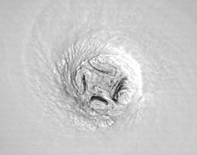
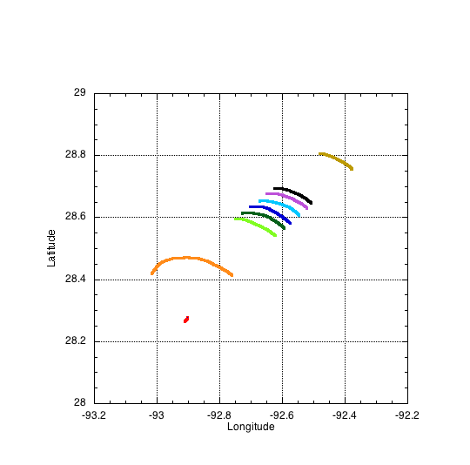
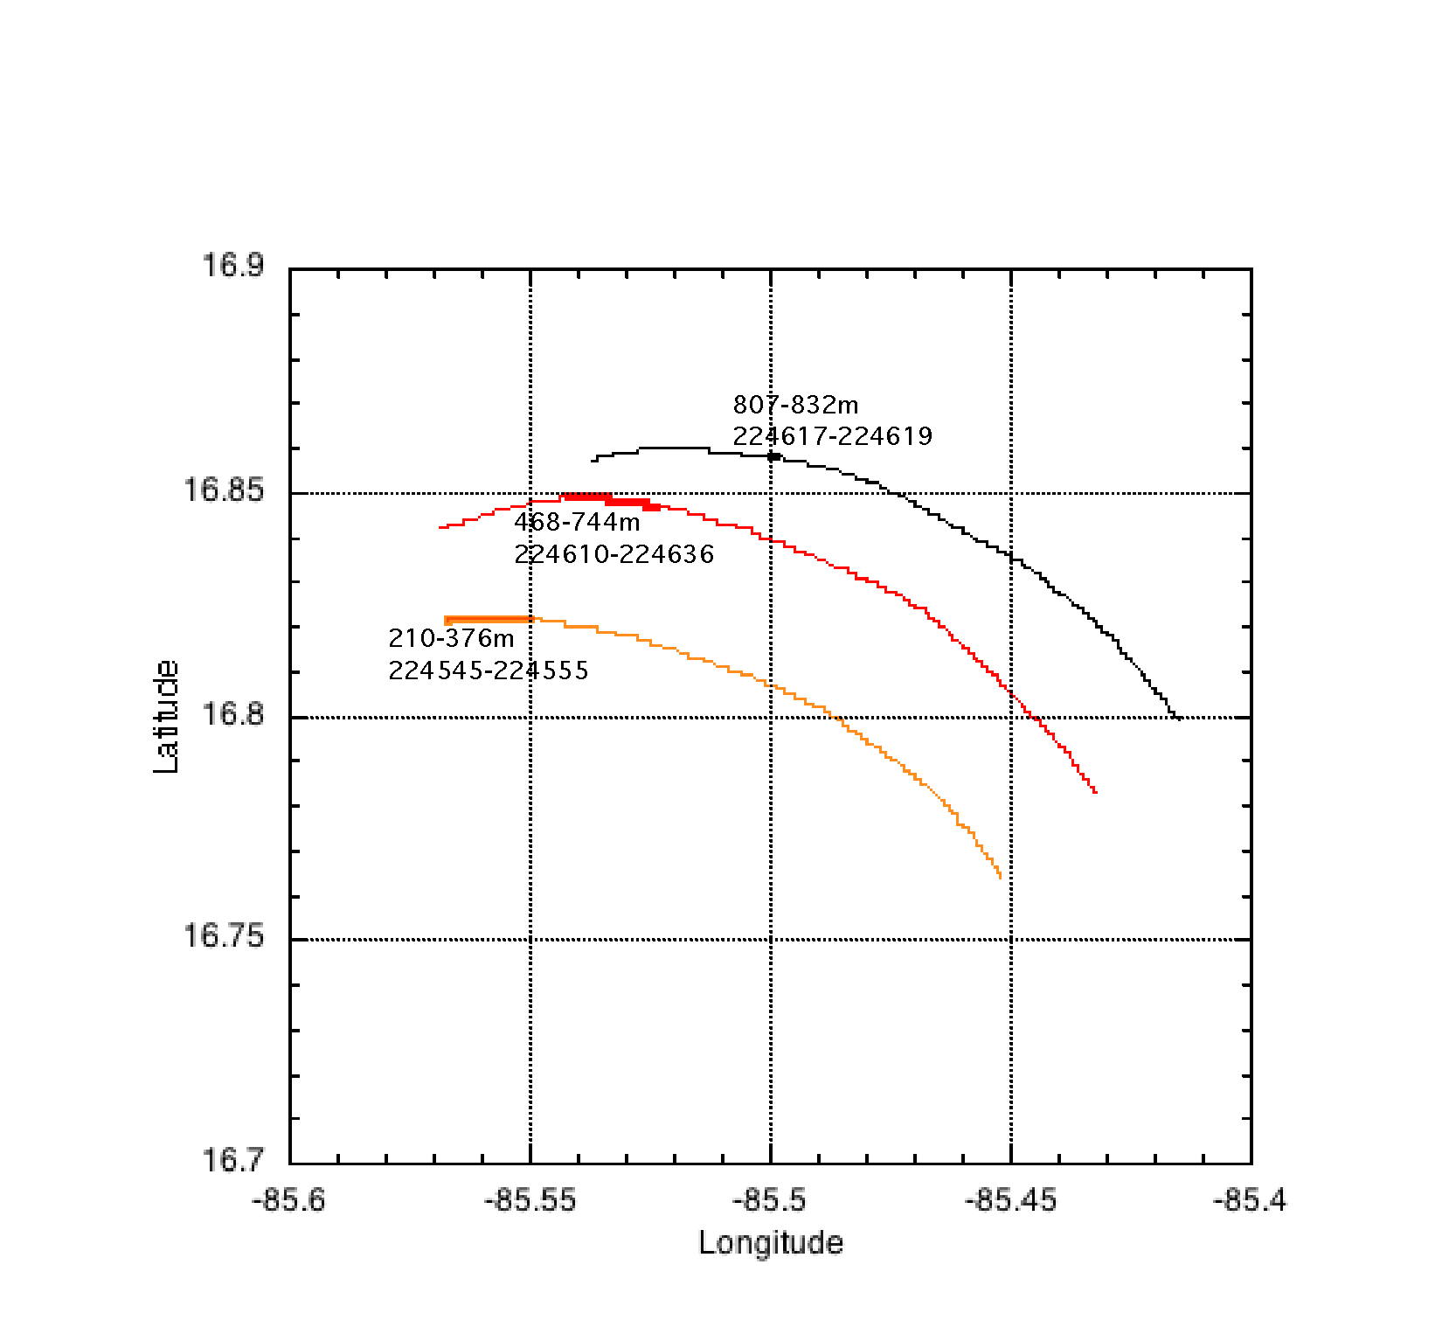
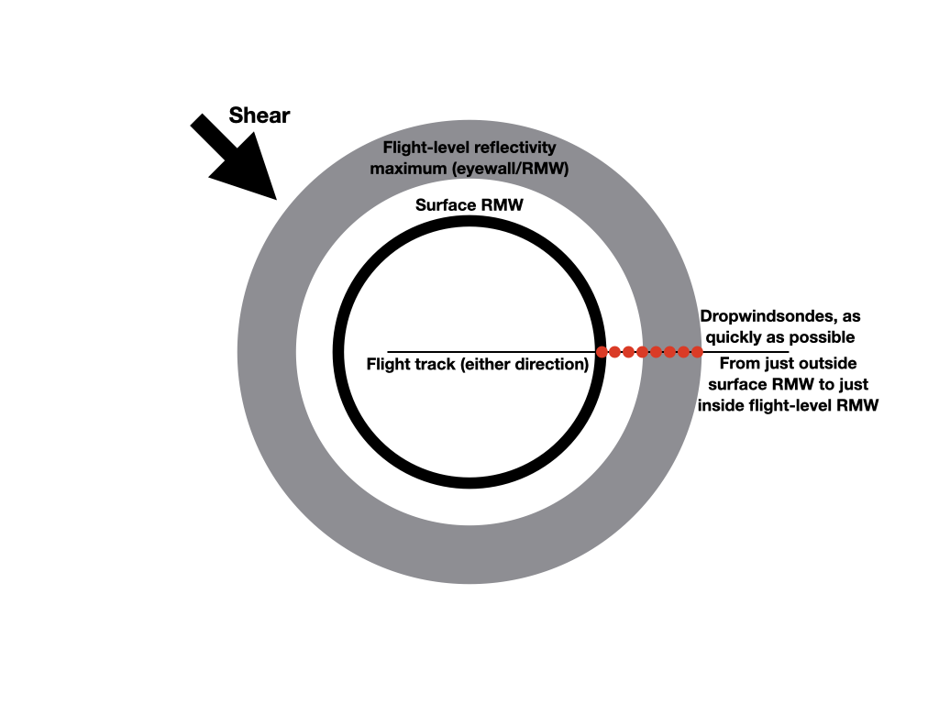
2022 HFP-APHEX: Mature Stage
Eye-Eyewall Mixing
Sim Aberson, Joe Cione, Josh Wadler, Jun Zhang
Hurricane Isabel
Hurricane Laura
We continue to have no direct evidence of meso-cyclones in the eye and eyewall
What are these features? What are their thermodynamic and kinematic properties?
Are they important for intensity change, or do they have no impact besides flight safety?
RMW
Hurricane Mitch
Surround RMW with sondes
Fly circle inside eye timed for HEDAS cycling (based on Fabian results (6-min or 10-min circles).
NEW!
UAS data!

Slide 36

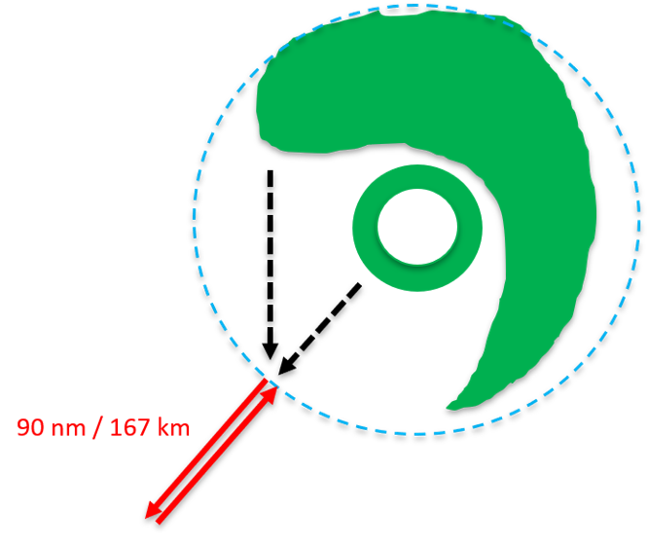
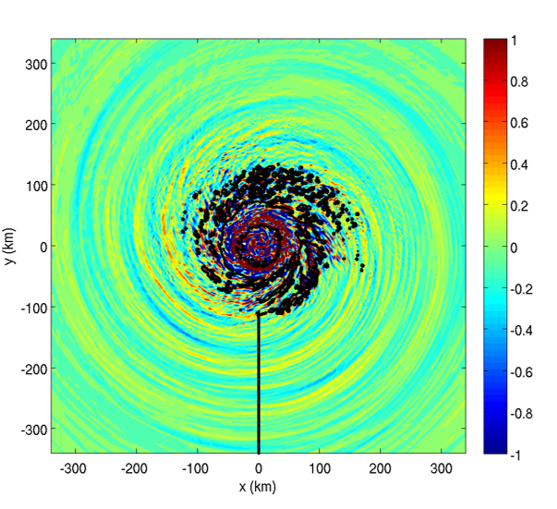
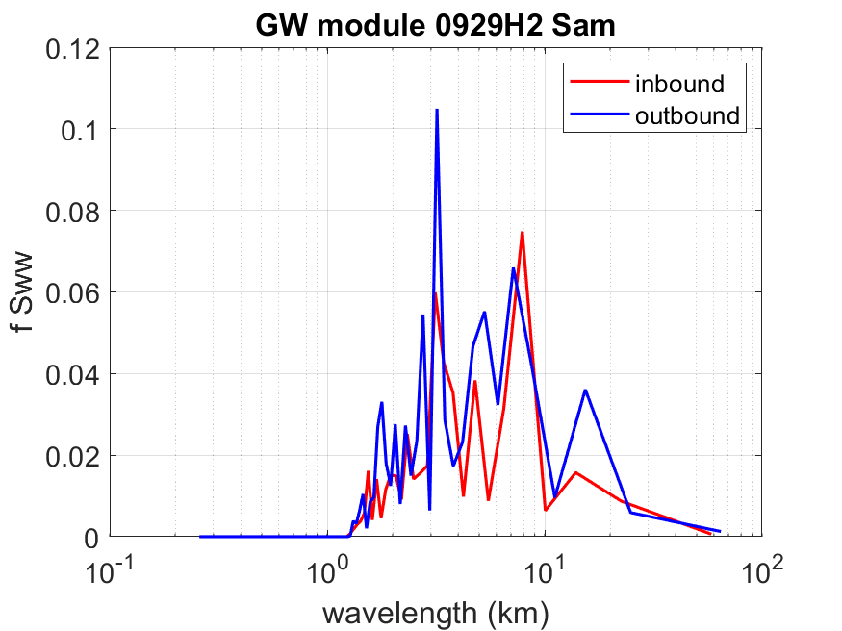
2022 HFP-APHEX: Mature Stage
Gravity Wave Module
Science Team: Jun Zhang and David Nolan
Collect observations targeted at better understanding the characteristics of gravity waves in hurricanes
Quantify how the characteristics of these waves are related to hurricane intensity and intensity change
Directly observe the phase speed (C_{p}), period (T) and wavelength (λ) of the outward moving gravity waves
It requires passing through the waves in both directions
S – true air speed

Slide 37
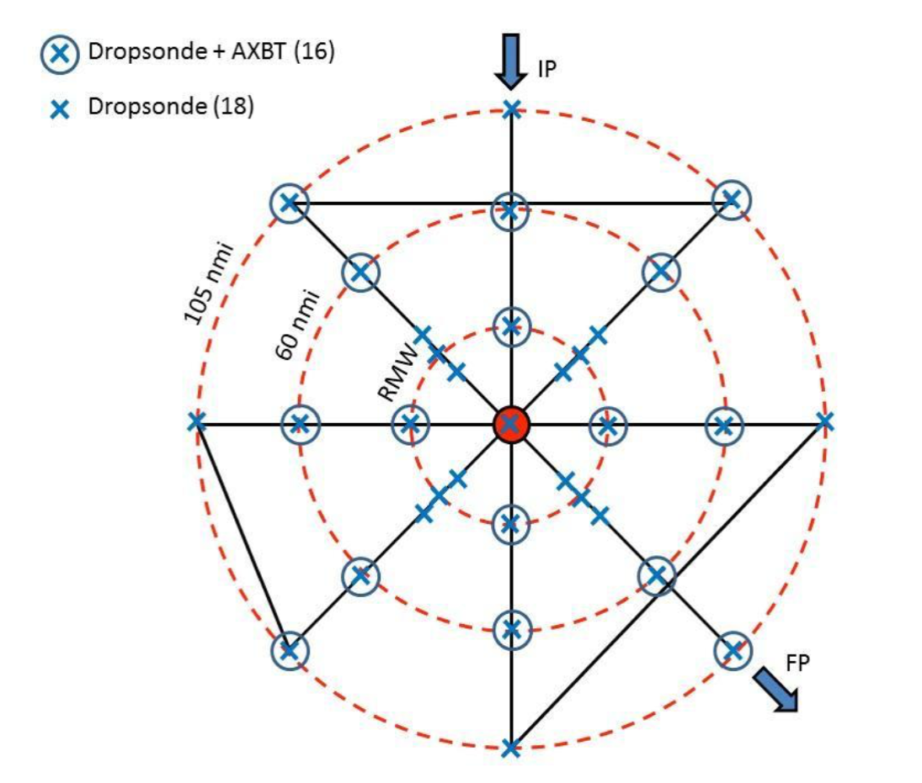
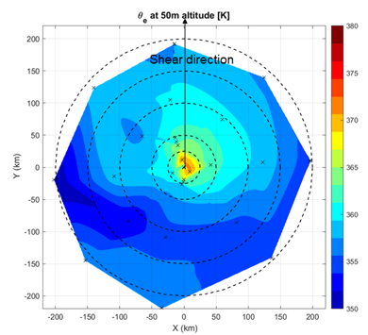
2022 HFP-APHEX: Mature Stage
Hurricane Boundary Layer (HBL) Module
Science Team: J. Zhang, Stern (NRL), S. Chen (NRL), Cione, Sanabia (USNA), Dunion, Rogers, Wadler, Zawislak, Chen, Hazelton, Marks, Shay (RSMAS), Rudzin (MSU), Doyle (NRL), Jin (NRL), Bryan (NCAR), Rios-Berrios (NCAR), Judt (NCAR), Tang (Albany), Fovell (Albany), Bell (CSU), Wang (CU), Foster (UW), Stienbarger (GOMO), and Smith (GOMO)
To better understand details of boundary layer structure and evolution before and during TC intensification
How are boundary-layer inflow and thermodynamic fields related before TC intensification?
How do boundary layer height scales evolve before and during TC intensification?
How might environmental shear modulate the boundary layer asymmetry during TC intensity change?
What is the role of boundary layer recovery in TC intensity change in shear?
What is the relative importance of boundary layer recovery for TCs near landfall compared to over ocean?

Slide 38
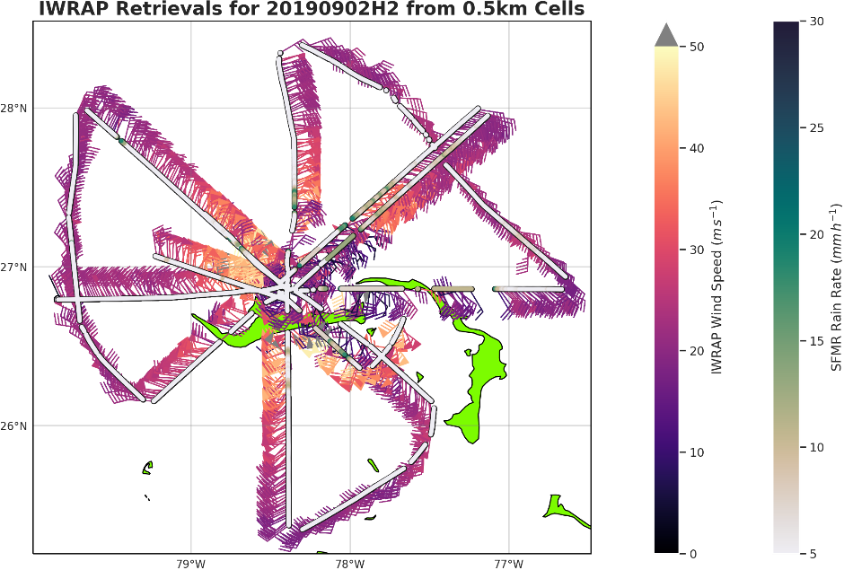
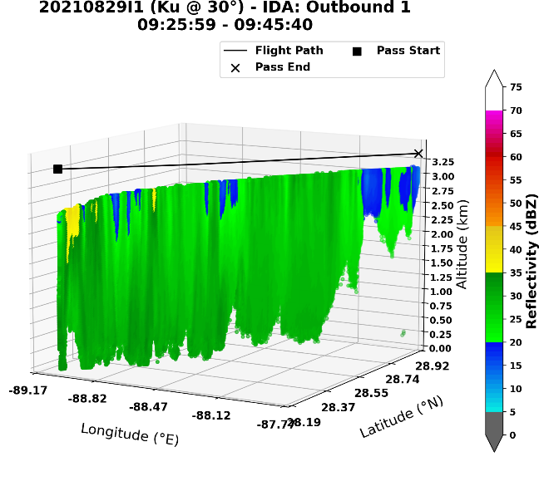
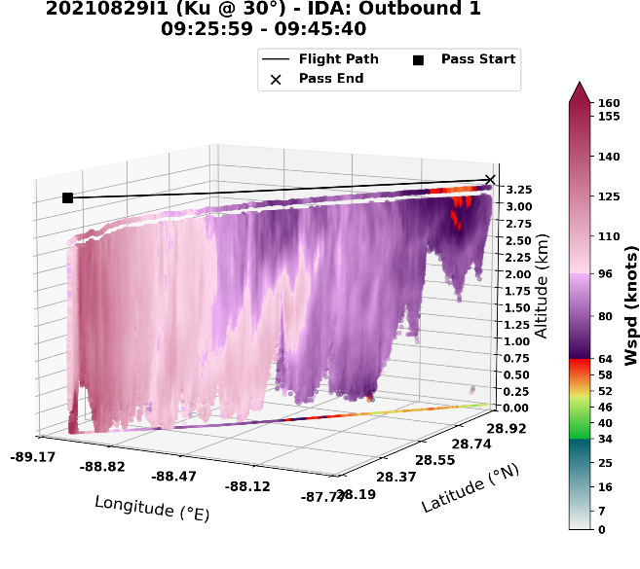
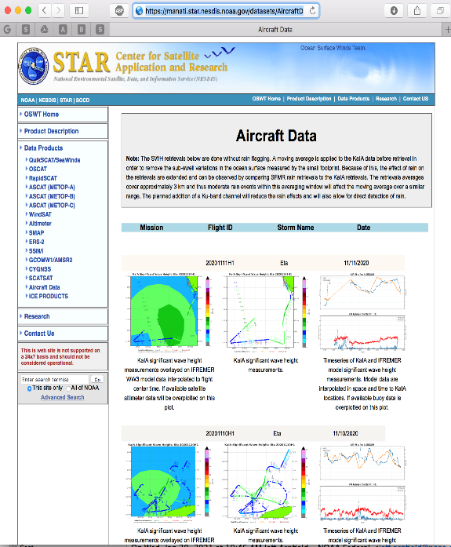
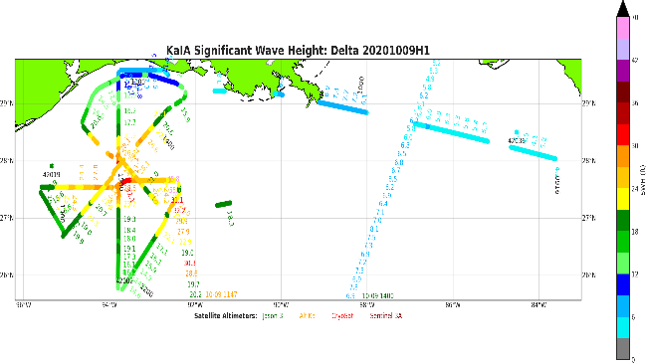
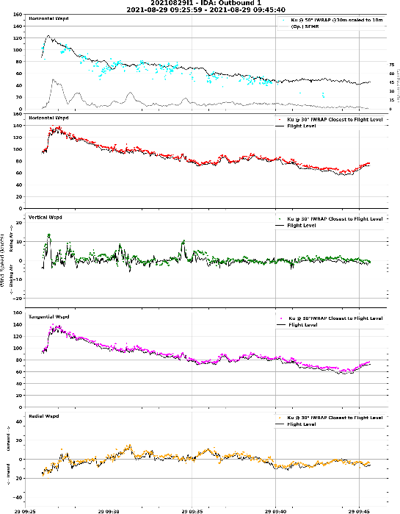
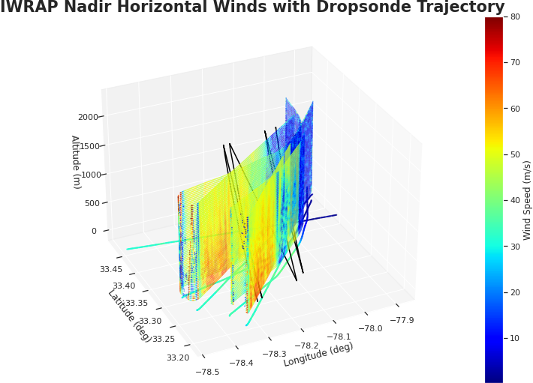
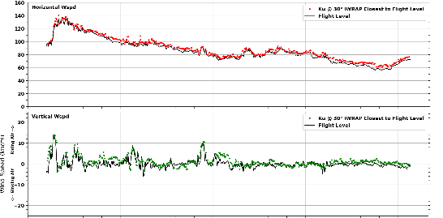
2022 HFP-APHEX: Mature Stage
NESDIS Ocean Winds
Science Team: Paul Chang, Zorana Jelenak, Joe Sapp
To improve our understanding of microwave retrievals of the ocean surface and atmospheric wind fields, and to evaluate new remote sensing techniques/technologies
To validate satellite-based sensors of the ocean surface in extreme conditions and perform risk reduction for future satellite missions
Provide forecasters with near-real-time hurricane boundary layer profiles (wind and reflectivity) and wave information
IWRAP Ocean Surface Wind Vector retrievals (Scatterometry)
IWRAP Ku-band Reflectivity
IWRAP Horizontal Wind Speed
IWRAP 3-D winds, reflectivity and surface winds, KaIA SWH, SFMR winds and dropsonde winds are posted as flight progresses on our data distribution web site
IWRAP and Flight Level Wind Speed Comparison
SWH Retrievals from KaIA
https://manati.star.nesdis.noaa.gov/datasets/AircraftData.php

Slide 39
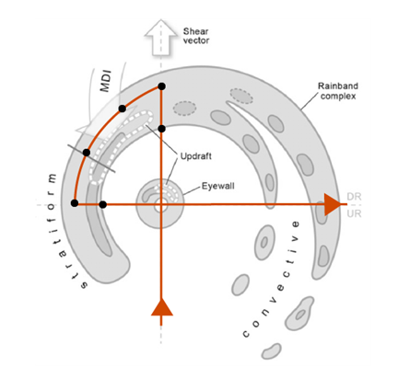
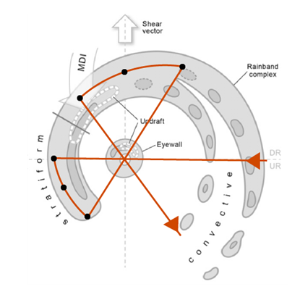
2022 HFP-APHEX: Mature Stage
Rainband Complex Module (RCM)
Science Team: Rob Rogers (PI), Michael Fischer, Anthony Didlake (PSU), Michael Bell (CSU), Anthony Wimmers (UWisc), Jim Doyle (NRL), Dan Stern (NRL)
Goal is to improve understanding of the dynamic and microphysical processes of the mature rainband complex and role in storm evolution.
Sample the wind and precipitation structures of both convective and stratiform regions of the rainband complex in varied storms across varied shear and moisture environments.
Sample the microphysics of the convective-to-stratiform transition and the downwind stratiform regions of the rainband complex (when combined with Stratiform Spiral Module)
Validate key features linked with different hypotheses of rainband-vortex interaction (e.g., sampling along the mesoscale descending inflow (MDI), generally located downshear left)
Rainband Complex modules in Figure-4 (left) and Butterfly (right) survey patterns. Target the stratiform and transition regions of a mature rainband complex. The downwind straight legs of a regular survey pattern are replaced with along-band curved legs, and the radial leg lengths are adjusted to meet the endpoints of the module leg. The “optimal” dropsonde (black dots) strategy is in the left panel, and the “acceptable” dropsonde strategy is in the right panel, for each RCM

Slide 40
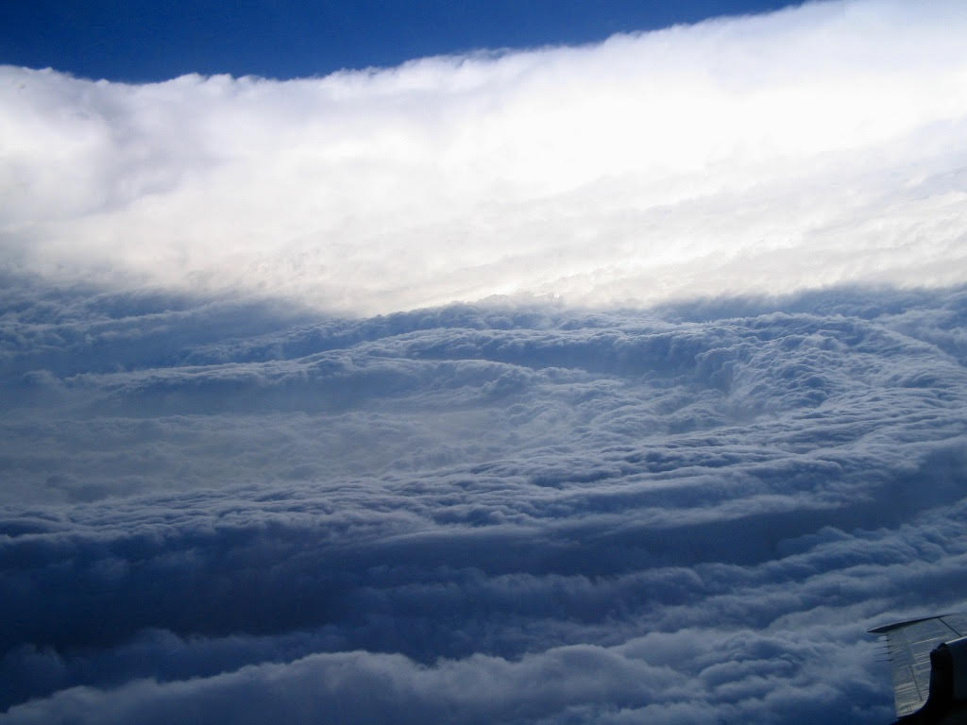
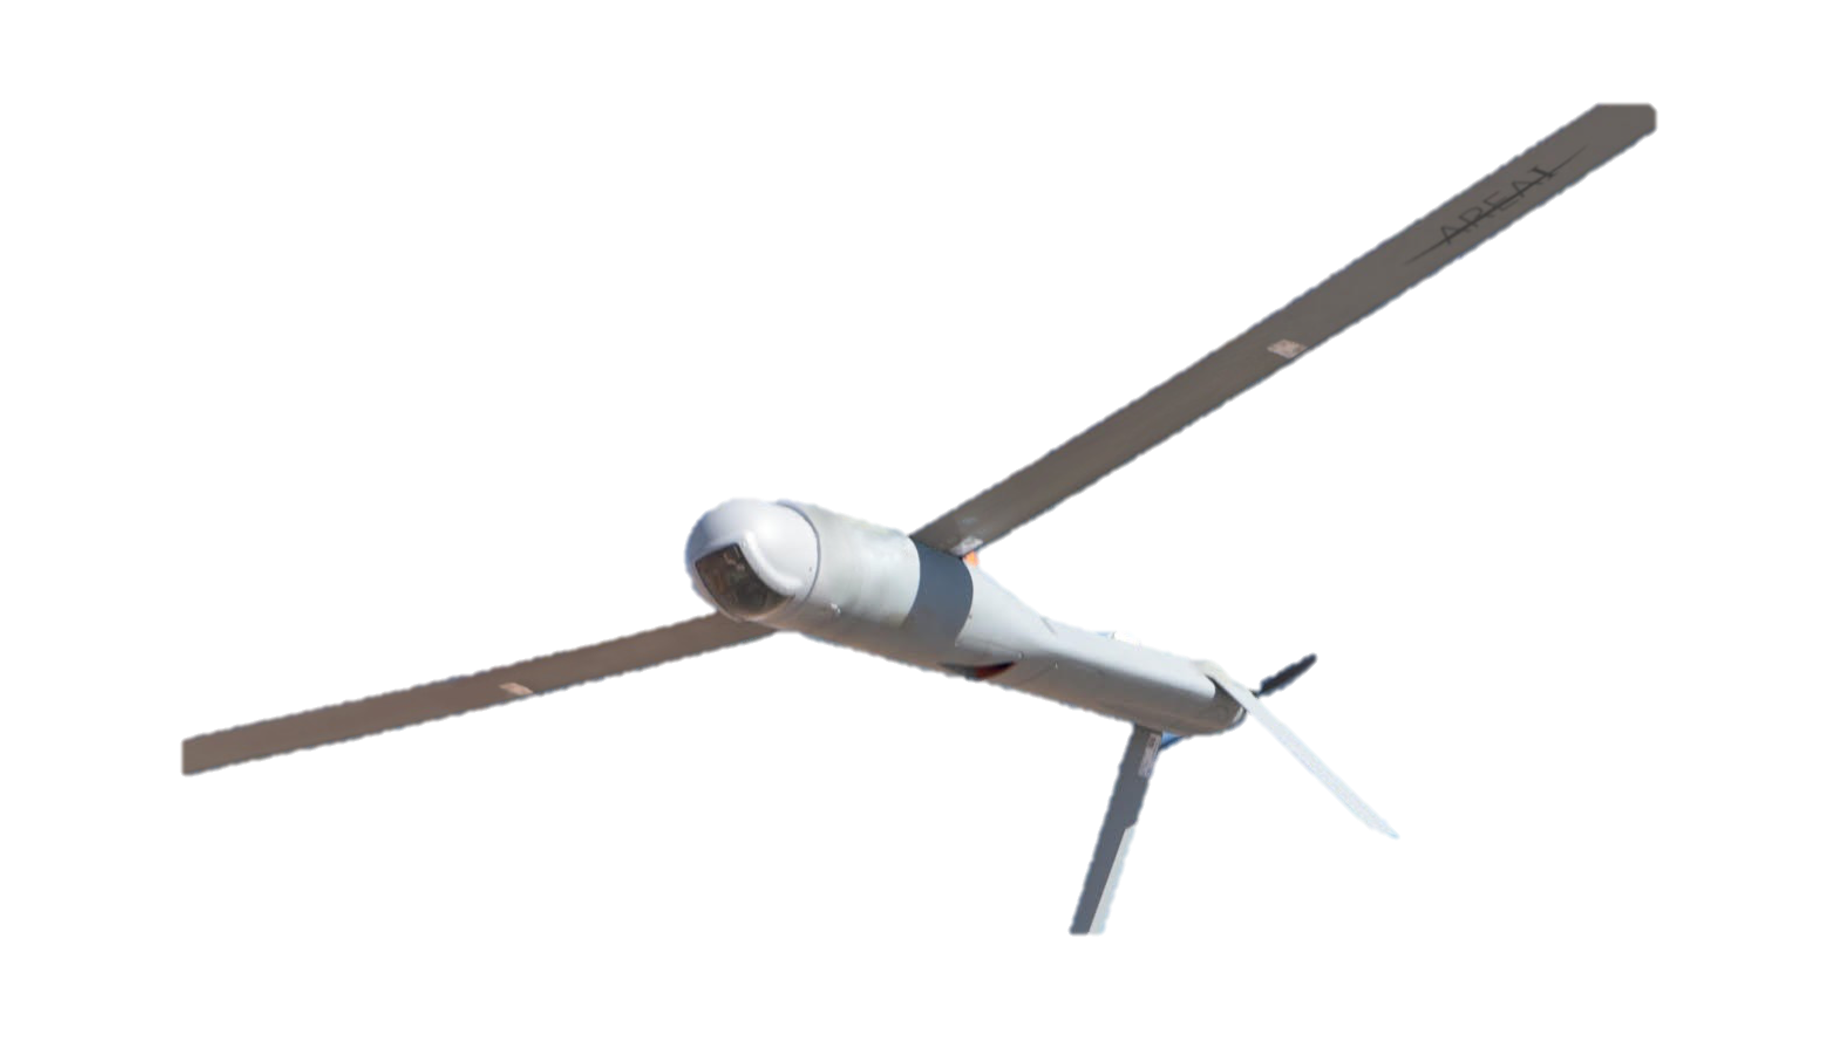
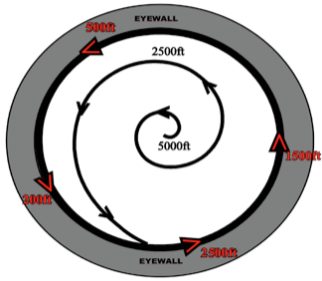
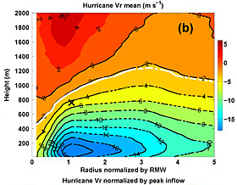
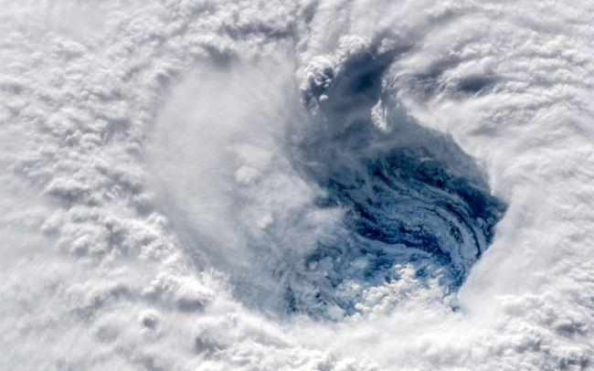
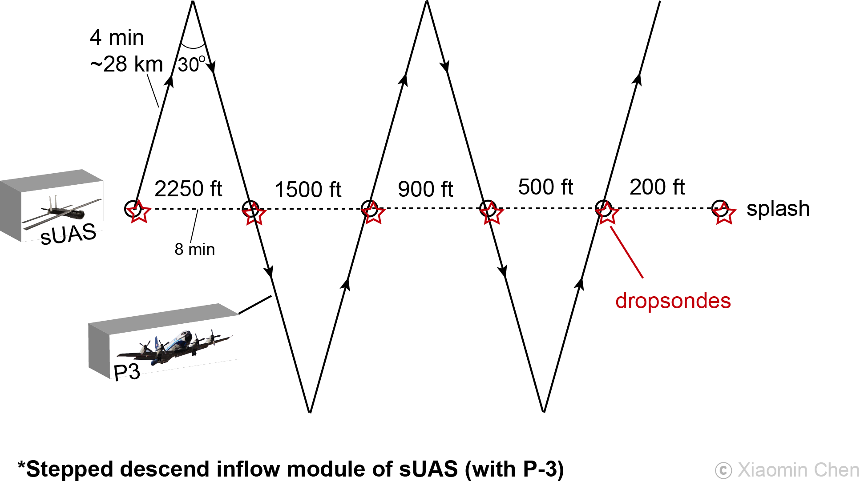
2022 HFP-APHEX: Mature Stage
RESEARCH IN COORDINATION WITH OPERATIONS
SMALL UNMANNED AIRCRAFT VEHICLE EXPERIMENT
(RICO SUAVE)
Science Team: Joseph J. Cione, Jun Zhang, Josh Wadler, Altug Aksoy, George Bryan (NCAR), Ron Dobosy (NOAA/ARL-ret), Frank Marks, Kelly Ryan, Brittany Dahl, Josh Alland (NCAR), Rosimar Rios-Berrios (NCAR), Gijs deBoer (NOAA/PSL), Don Lenschow (NCAR), Xiaomin Chen, Chris Rozoff (NCAR), Eric Hendricks (NCAR), Falko Judt (NCAR), Jonathan Vigh (NCAR)
Plain Language Description: This experiment uses small drones, instead of manned aircraft, to sample the lowest and most dangerous regions of the tropical cyclone. It is believed that observations from these unique platforms will improve basic understanding and enhance forecaster situational awareness. Detailed analyses of data collected from these small drones also have the potential to improve the physics of computer models that predict changes in storm intensity.

Slide 41
2022 HFP-APHEX: Mature Stage
Surface Wind and Wave Validation Module
Science Team: Heather Holbach, Ivan PopStefanija (ProSensing Inc.), Mark Bourassa (FSU), Tony Wimmers (UW-SSEC), Jim Doyle (NRL),
Sue Chen (NRL), James Cummings (NRL), Ralph Foster (UW-APL), and Steve Guimond (UMBC)
Motivation: Observations of surface wind speed and wave fields in TCs are extremely important for producing accurate analyses and forecasts of the hazards associated with a TC.
Goals: To collect data with the NOAA P-3 aircraft to:
Improve wind speed and rain rate estimates from the SFMR
Understand how wind speed observations from the SFMR, flight-level winds, dropsondes, and TDR relate to each other and to a 1-minute mean wind
Improve surface wind products from Synthetic Aperture Radar (SAR) satellites
Validate Wide Swath Radar Altimeter (WSRA) wave data and map the extent of 8 ft seas

Slide 42






2022 HFP-APHEX: Mature Stage
Surface Wind and Wave Validation Module
Science Team: Heather Holbach, Ivan PopStefanija (ProSensing Inc.), Mark Bourassa (FSU), Tony Wimmers (UW-SSEC), Jim Doyle (NRL),
Sue Chen (NRL), James Cummings (NRL), Ralph Foster (UW-APL), and Steve Guimond (UMBC)
Dropsonde Overflights
SFMR High-Incidence Angle (15-60 deg)
**NEW** Wind Buoy Overflights **NEW**
Wave Buoy
Overflights
SAR Overflights
High Seas
Notes:
Each of these plots shows an example of the flight patterns that we could fly for each of the sub-experiments within the Wind and Wave module.
Dropsonde overflights: Example from Hurricane Lorenzo where we were releasing rapid eyewall sondes inbound and overflying their splash locations outbound. Also, an option in the plan to perform overflights with two P-3s.
SFMR High-Incidence Angle: Example of the module pattern for the SFMR circles
Wind Buoy Overflights: This is a new addition this year. This example was just a straight pass over a buoy, but the module calls for repeated passes for about 30 mins (~10 min legs). Important to maintain straight and level parallel to the flight-level wind direction in a region of homogenous wind conditions.
SAR Overflights: Coordination with SAR satellite overpasses.
High Seas: Collect WSRA significant wave height data to map the extent of the 8 ft seas. Should not require modifications to standard flight patterns except to possibly extend flight legs.
Wave Buoy Overflights: Example from Sam of a straight and level approach to a wave buoy followed by a 90° turn and flying straight and level away from the buoy

Slide 43

2022 HFP-APHEX: Mature Stage
TDR Analysis Evaluation Module
Science Team: Paul Reasor, John Gamache, Peter Dodge
Module Goals
Quantify the sensitivity of TDR-derived peak wind speed estimates to radar range and beam orientation relative to the horizontal wind vector
Quantify the robustness of the 3-D TDR wind retrievals and standard derived diagnostics, and develop a greater understanding of coherent regions of large discrepancy
Verify reflectivity calibration corrections and assess impacts of attenuation within the eyewall and near-core vortex
Data Collection
Collect simultaneous measurements of peak eyewall wind speed from two TDRs at different (order 15-nmi) radar range
Collect independent, near-simultaneous (center crossings within 5 min) TDR velocity measurements along orthogonal flight tracks within the eyewall region
Collect independent, near-simultaneous (center crossings within 5 min) TDR reflectivity measurements along orthogonal flight tracks within the eyewall region
Sample max wind near TDR
Necessary radial leg length ~ 25-30 nmi
Optimal
RMW ~ 15 nmi
Sample max wind at long range

Slide 44




2022 HFP-APHEX: Mature Stage
Tropical Cyclone Diurnal Cycle Module
Science Team: Jason Dunion (PI), Jun Zhang (Co-PI), Morgan O’Neill (Stanford Univ.), Daniel Chavas (Purdue Univ.), and Allison Wing (Florida State University), Dave Raymond (New Mexico Tech), Zeljka Fuchs-Stone (New Mexico Tech)
Goal: Improve our understanding of how day-night fluctuations in radiation affect the intensity and structure of hurricanes, particularly the flow of air into the storm at the lowest levels above the ocean.
TCDC clock that estimates the radial location of TC diurnal pulses/waves propagating away from the storm.
Night (0-6 LT)
Day (12-18 LT)
Inner Core
Near- Environment
Inner Core
Near- Environment
Zhang et al. 2019
Inner Core: Stronger inflow Weaker inflow
Near Envir: Stronger, deeper inflow Weaker, shallower inflow
Dropsondes launched either (left) inbound (R=160-80 n mi) or (right) outbound (R=80-160-80 n mi) to (from) the storm. Dropsonde spacing is ~20 n mi.

Slide 45


2022 HFP-APHEX: Mature Stage
Ventilation Module
Science Team: Brian Tang (Albany), Rosimar Rios-Berrios (NCAR), Jun Zhang, George Bryan (NCAR), Falko Judt (NCAR), Robert Fovell (Albany)
Ventilation occurs when drier, cooler environmental air intrudes into a sheared tropical cyclone, weakening it. Ventilation can occur through radial and downdraft pathways.
Goals:
Collect observational data to study ventilation pathways
Validate model simulations of ventilation in sheared tropical cyclones
Assess the link between ventilation and intensity changes
Proposed P-3 rotated figure-4 pattern (left) and G-IV double circumnavigation pattern (right) for the ventilation module. Gray shading illustrates precipitation of a tropical cyclone in westerly shear (Hence and Houze 2012), and brown and blue areas indicate possible ventilation pathways.

Slide 46
2022 Hurricane Field Program-APHEX
HFP Experiments and Modules
EARLY STAGE (4)
Analysis of Intensification Processes Experiment (AIPEX)
Convective Burst Structure and Evolution Module (CBM)
Impact of Targeted Observations on Forecasts (ITOFS)
Stratiform Spiral Module (SSM)
GENESIS STAGE (2)
Favorable Air Mass (FAM) Experiment
Precipitation during Formation and Observing its Response across Multiple Scales (PREFORM)
MATURE STAGE (10)
Eye-Eyewall Mixing Module
Gravity Wave Module
Hurricane Boundary Layer Module
NESDIS Ocean Winds
Rainband Complex Module (RCM)
RICO SUAVE
Surface Wind and Wave Validation Module
Tail Doppler Radar Analysis Evaluation Module
Tropical Cyclone Diurnal Cycle Experiment
Ventilation Module
END STAGE (2)
Extratropical Transition Experiment
Tropical Cyclones at Landfall Experiment
OCEAN OBSERVING (2)
Ocean Survey Experiment
Sustained and Targeted Ocean Observations
SATELLITE VALIDATION (2)
Eval of the Tropical Transition Environment using Satellite Soundings
NASA TROPICS Satellite Validation Module

Slide 47


2022 HFP-APHEX: End Stage
Extratropical Transition
Science Team: Aberson
Target: mature hurricane entering the midlatitudes that has not recently encountered land.
P-3: Sample the system with at least a figure-4 pattern.
G-IV: Sample the system with a figure-4 pattern (not necessarily all together), plus the interface between the system and the environmental flow.
Sample every 12 h from the time it begins the transition to an extratropical cyclone to the time it is out of range of the aircraft, or the system dissipates or makes landfall.
G-IV
P-3

Slide 48
2022 HFP-APHEX: End Stage
Tropical Cyclones at Landfall
Science Team: Heather Holbach, Jun Zhang, John Kaplan, Peter Dodge, Ghassan Alaka, Frank Marks, Lew Gramer, Trey Alvey, Xiaomin Chen, Forrest Masters (University of Florida), Michael Biggerstaff (University of Oklahoma), David Nolan (University of Miami), Johna Rudzin (Mississippi State University), and John Schroeder (Texas Tech University)
Motivation: Landfalling TCs produce a variety of damaging weather due to both the sustained and gust winds as well as tornadoes for which there exists limited model guidance.
Goal(s): Employ P-3 aircraft and land-based mobile research teams to collect thermodynamic and kinematic observations in landfalling tropical cyclones (TCs) to:
  1) Reduce the uncertainty in SFMR wind speed estimates in coastal regions
  2) Investigate factors that influence gust and sustained wind magnitude and wind field extent
3) Improve our understanding of the mechanisms that modulate TC generated tornadoes
4) Evaluate the impact of coastal oceanic conditions on landfalling TC intensity and structure

Slide 49




2022 HFP-APHEX: End Stage
Tropical Cyclones at Landfall
P-3 Flight Patterns
SFMR Coastal Coastal Survey
Flight level: > 5-12 kft Flight level: ~10 kft
Timing: Winds are > 30 kt Timing: <6 h from landfall
Length: ~30-45 min Length: ~2-3 h
Offshore Intense Convection Coastal Air-Sea Interaction
Flight level: > 10kft Flight level: 8-10 kft
Timing: 12-24 h from landfall Timing: < 200 km of land
Length: ~1-2 h Length: ~5 h

Slide 50
2022 Hurricane Field Program-APHEX
HFP Experiments and Modules
EARLY STAGE (4)
Analysis of Intensification Processes Experiment (AIPEX)
Convective Burst Structure and Evolution Module (CBM)
Impact of Targeted Observations on Forecasts (ITOFS)
Stratiform Spiral Module (SSM)
GENESIS STAGE (2)
Favorable Air Mass (FAM) Experiment
Precipitation during Formation and Observing its Response across Multiple Scales (PREFORM)
MATURE STAGE (10)
Eye-Eyewall Mixing Module
Gravity Wave Module
Hurricane Boundary Layer Module
NESDIS Ocean Winds
Rainband Complex Module (RCM)
RICO SUAVE
Surface Wind and Wave Validation Module
Tail Doppler Radar Analysis Evaluation Module
Tropical Cyclone Diurnal Cycle Experiment
Ventilation Module
END STAGE (2)
Extratropical Transition Experiment
Tropical Cyclones at Landfall Experiment
OCEAN OBSERVING (2)
Ocean Survey Experiment
Sustained and Targeted Ocean Observations
SATELLITE VALIDATION (2)
Eval of the Tropical Transition Environment using Satellite Soundings
NASA TROPICS Satellite Validation Module

Slide 51




2022 HFP-APHEX: Ocean Observing
Ocean Survey Experiment
Science Team: J. Zhang, Shay (RSMAS), Cione, S. Chen (NRL), Jaimes (RSMAS), Wadler, Sanabia (USNA), Rudzin (MSU), Gramer, Holbach, Marks, Lumpkin (PHOD), Foltz (PHOD), Goni (PHOD), Doyle (NRL), Cummings (NRL), Centurioni (SIO), Paluszkiewicz (OOC), Jayne (WHOI), C. Zhang (PMEL), D. Zhang (PMEL), Meinig (PMEL), Stienbarger (GOMO), and Smith (GOMO)
Collect observations targeted at better understanding the response of hurricanes to changes in underlying ocean conditions;
Collect temporal and spatially coincident ocean, wave, and atmosphere observations during the pre-, during, and post-storm phases in order to better address hypotheses related to the ocean and wave boundary layer’s role in energy exchange and intensification;
Use observational data collected in this experiment to evaluate and improve hurricane model physics related to air-sea interaction and support data assimilation.
Pre- and post- storm P3 pattern
In-storm P3 pattern over drifters and floats
Collocated observations
WP-3D
sUAS
GPS Dropsonde
Saildrone
AXBT, Floats, Drifters, etc.
Glider

Slide 52








2022 HFP-APHEX: Ocean Observing
Sustained and Targeted Ocean Observations
Science Team: C. Stienbarger, G. Goni , T. Miles, E. Smith, J. Cione, P. Chang, J. Wadler, J. Zhang, C. Zhang, D. Zhang, G. Foltz, J. Rudzin, S. Jayne, L. Centurioni, M. Schönau, K. Bailey, H-S Kim, C. Fairall, R. Lumpkin, J. Morell, P. Chardon-Maldonado, D. Wilson, S. Glenn, C. Edwards, K. Martin, F. Bringas, J. Trinanes, M. Finlayson, N. Higgs, J. Garcia Savinon, L. Werner
GOALS:
Deploy and operate a suite of ocean-atmosphere observing instruments and platforms to collect observations of Essential Ocean Features (EOFs) and the air-sea transition zone to be assimilated into operational and experimental forecast models, to validate models, and to use to advance scientific research to improve TC intensity forecasts.
Provide tools for monitoring in real and near-real time the location of ocean observational assets, ocean conditions and products, and the air-sea transition zone from in situ and satellite observations.
Compare, verify and validate measurements from in-situ sensors and airborne remote sensing instruments.
Drifters
EOFs
GeoCollaborate®
Argo floats
Saildrone
Saildrone deployments
Glider lines
Underwater gliders

Slide 53
2022 Hurricane Field Program-APHEX
HFP Experiments and Modules
EARLY STAGE (4)
Analysis of Intensification Processes Experiment (AIPEX)
Convective Burst Structure and Evolution Module (CBM)
Impact of Targeted Observations on Forecasts (ITOFS)
Stratiform Spiral Module (SSM)
GENESIS STAGE (2)
Favorable Air Mass (FAM) Experiment
Precipitation during Formation and Observing its Response across Multiple Scales (PREFORM)
MATURE STAGE (10)
Eye-Eyewall Mixing Module
Gravity Wave Module
Hurricane Boundary Layer Module
NESDIS Ocean Winds
Rainband Complex Module (RCM)
RICO SUAVE
Surface Wind and Wave Validation Module
Tail Doppler Radar Analysis Evaluation Module
Tropical Cyclone Diurnal Cycle Experiment
Ventilation Module
END STAGE (2)
Extratropical Transition Experiment
Tropical Cyclones at Landfall Experiment
OCEAN OBSERVING (2)
Ocean Survey Experiment
Sustained and Targeted Ocean Observations
SATELLITE VALIDATION (2)
Eval of the Tropical Transition Environment using Satellite Soundings
NASA TROPICS Satellite Validation Module

Slide 54




2022 HFP-APHEX: Satellite Validation
Evaluation of the tropical transition environment using satellite soundings
Science Team: Rebekah Esmaili (STC/JPSS), Jason Dunion (HRD), Michael Folmer (NWS/OPC), Jon Zawislak (HRD)
1
2
3
4
Motivation
NUCAPS¹ is a satellite sounding retrieval that provides timely, global observations in clear to partly cloudy scenes which can help forecasters monitor tropical cyclones in remote regions.
Background
We previously found good statistical agreement with dropsondes.
NUCAPS infrared and microwave (IR+MW) temperature profiles had a 1 K RMSE² and a 1.7 km vertical resolution from 600-1000 mb.³
2022 Science Objectives
Investigate if NUCAPS can anticipate extratropical/tropical transition by examining the atmospheric column composition and thermodynamics.
Validate NUCAPS thermodynamic structure with coincident (< 1hr, < 5km) dropsondes.
2022 Operational Objectives
Provide NUCAPS using timely data delivery in forecaster-friendly software tools (e.g., plan view maps, Skew-T profiles, web tools, SHARPpy, AWIPS-II) to campaign organizers, collaborators.
1NOAA-Unique Combined Atmospheric Processing System 2Root mean square error 3Esmaili et al., 2022 (in review)

Slide 55



2022 HFP-APHEX: Satellite Validation
TROPICS Satellite Validation
Science Team: Brittany Dahl, Jason Dunion, Rob Rogers, Jon Zawislak, Trey Alvey, Bill Blackwell (MIT/LL)
Background:
  TROPICS satellite constellation is designed to deliver microwave observations at high temporal and spatial resolution that will be valuable for studying the evolution of the mesoscale precipitation structure and thermodynamic environment of TCs
  Due to recent launch setbacks with the constellation satellites, only data from TROPICS Pathfinder will be available for the 2022 season
Pathfinder orbit with Ida overpass
Objectives:
  Collect dropsonde and TDR data to validate TROPICS satellite-derived temperature, moisture, and precipitation profiles in a variety of tropical environments
  Coordinate P-3 and G-IV GPS dropsonde releases with TROPICS satellite overpasses
  Evaluate the impact of TROPICS data on regional numerical prediction of tropical cyclones, including a comparison to the impact of aircraft data
Ida overpass 08/28 2007Z
TROPICS Pathfinder

Slide 56















Questions?
Copies of the 2022 HFP Kickoff and today’s chat log can be found on the HRD Google Drive folder
HRD >> Hurricane Field Program >> 2022 >> Presentations >> HFP Kickoff

