Slide 1
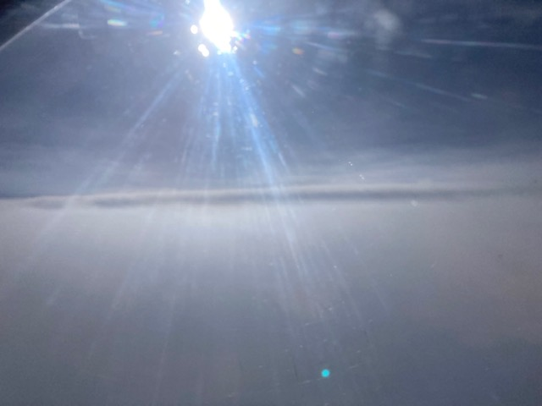


2021 Hurricane Field Program
Advancing the Prediction of Hurricanes Experiment (APHEX)
Larry (AL12) Debrief
Jason Dunion – HFP Director
Jon Zawislak - HFP Deputy Director
Photo by Jack Parrish

Slide 2
2021 Hurricane Field Program-APHEX
Summary of Missions (5-7 September 2021)
Summary of Missions
2 P-3 missions (1 HRD, 1 NESDIS), 3 G-IV missions (HRD)
  134 GPS dropsondes / 128 transmitted to the GTS
  8 NRL AXBTS (7 good)
  16 TDR analyses transmitted to EMC & NHC
  Potential collaboration with NASA CPEX-AW, which didn’t transpire after DC-8 was downed for a maintenance issue
    1 DC-8 mission, flown on 4 September, 1 day before NOAA

Slide 3
2021 Hurricane Field Program-APHEX
Summary of Missions (5-7 September 2021)
Summary of Missions
HRD Crewing
  20210905N1: HRD
    None (LPS), AOC FD #2 (Aspen), Reasor/Gamache (GB radar), Dunion/O’Neill/Wing (GB LPS)
  20210906I1: HRD
    Holbach (LPS, radar), Hazelton (Aspen), Gamache (GB radar), Wadler (GB LPS)
  20210906N1: HRD
    None (LPS), AOC FD #2 (Aspen), Reasor/Gamache (GB radar), Dunion/O’Neill/Wing (GB LPS)
  20210907I1: NESDIS
    Holbach (LPS, radar), Hazelton (Aspen), Alvey/Gamache (GB radar), Zawislak (GB LPS)
  20210907N1: HRD
    None (LPS), AOC FD #2 (Aspen), Reasor (GB radar), Dunion (GB LPS)

Slide 4
2021 Hurricane Field Program-APHEX
Logistics Highlights
NOAA-42 had a significant oil leak in one of its engines during the Lakeland to St. Croix ferry
  N42 unavailable for missions for the entire Larry deployment
Planned aircraft coordination between NOAA & NASA was not possible
NASA DC-8 was down for maintenance issues for the first few days of our deployment
Gail Skofronick-Jackson (NASA CPEX-AW prog manager) passed away on 7 Sep during a hiking accident
NASA made the decision to cancel the remainder of the 2021 CPEX-AW campaign
20210908N1 mission (NESDIS JPSS collaboration)
  N49’s satcom not functioning and there were issues with the onboard data system (a mission “no go”)
  Satcom outage would have meant to drops to the GTS, no Xchat with ground LPS, and no internet for FD situational awareness (drops could still be collected for research though)
  Data system back up around 55 min after scheduled take-off >> this was enough of a delay to make the NOAA-20 overpass timing not less than optimal for the planned G-IV pattern >> mission scrubbed
Daily coordination calls between NHC-CARCAH-EMC-HRD were helpful
  Pre-deployment discussions: we agreed that NHC would not task for P-3 invests missions. HRD and NESDIS would task for research and would provide NHC with fix information if requested.

Slide 5


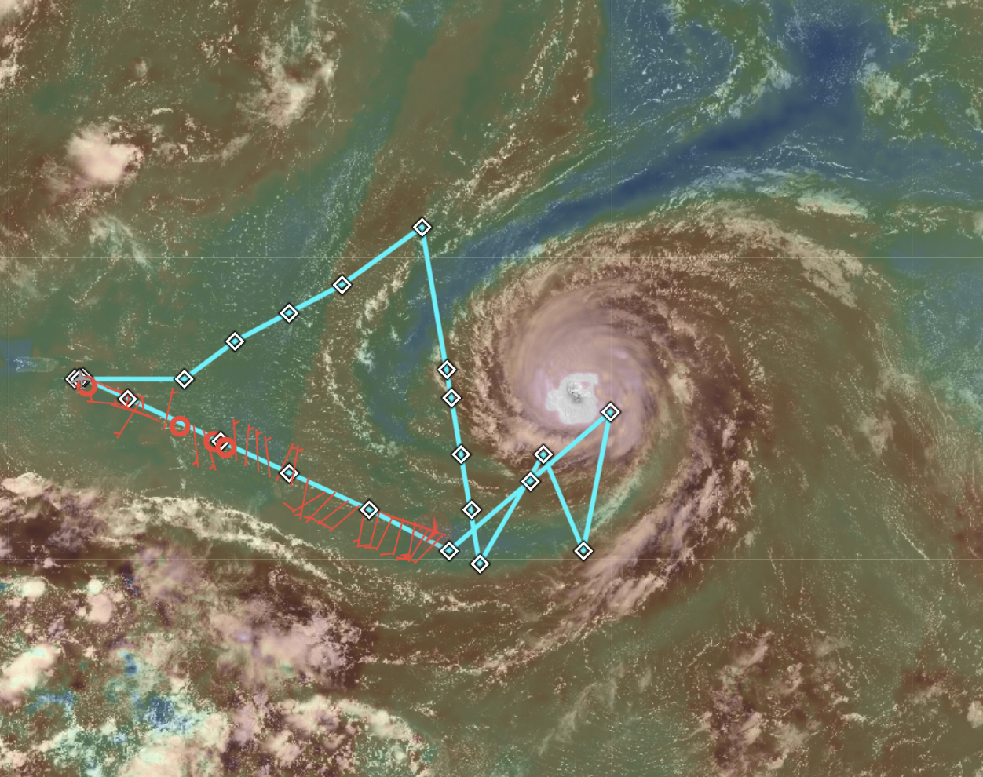
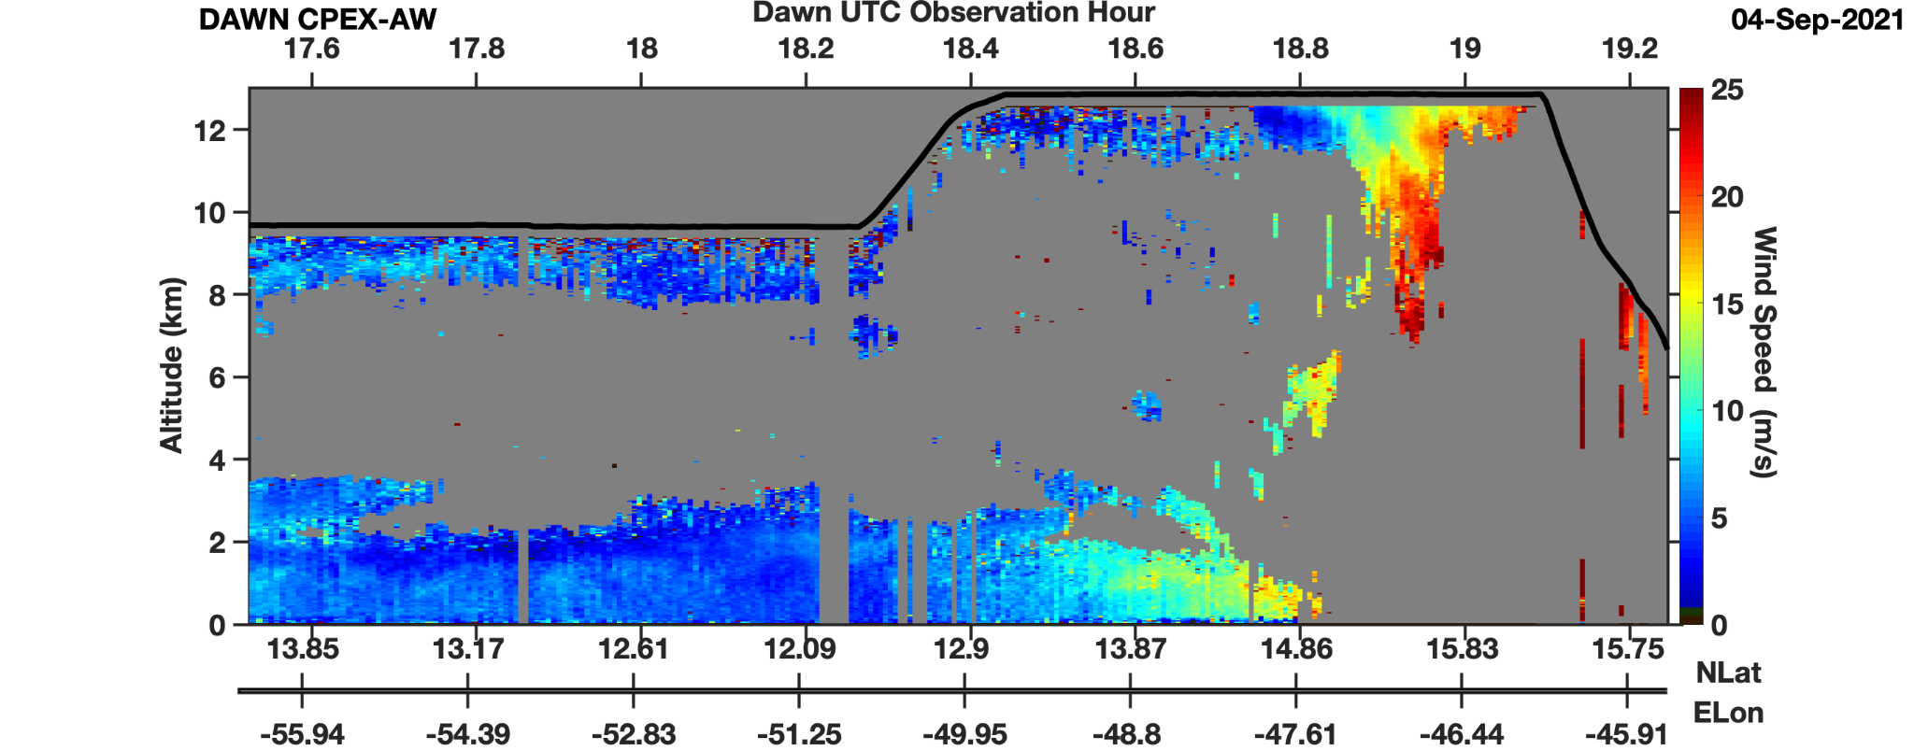
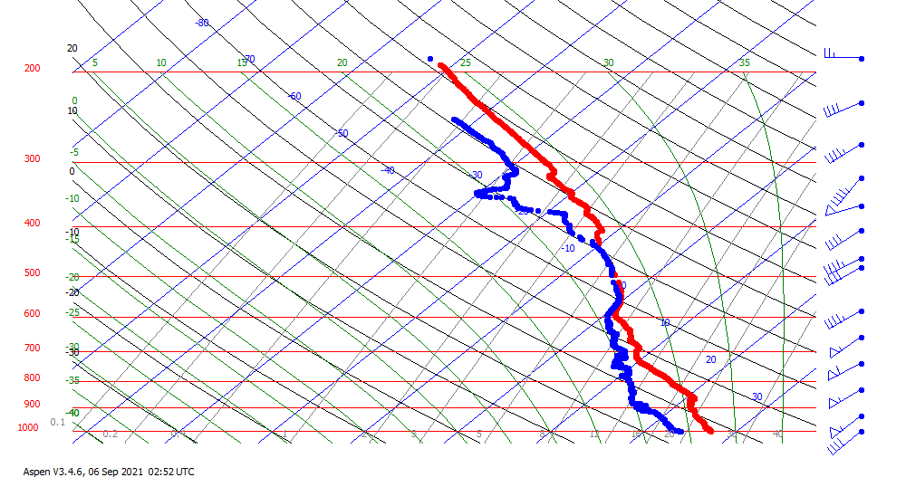
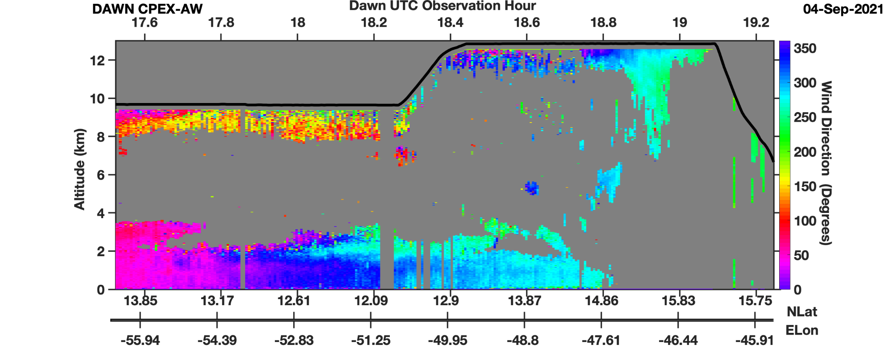
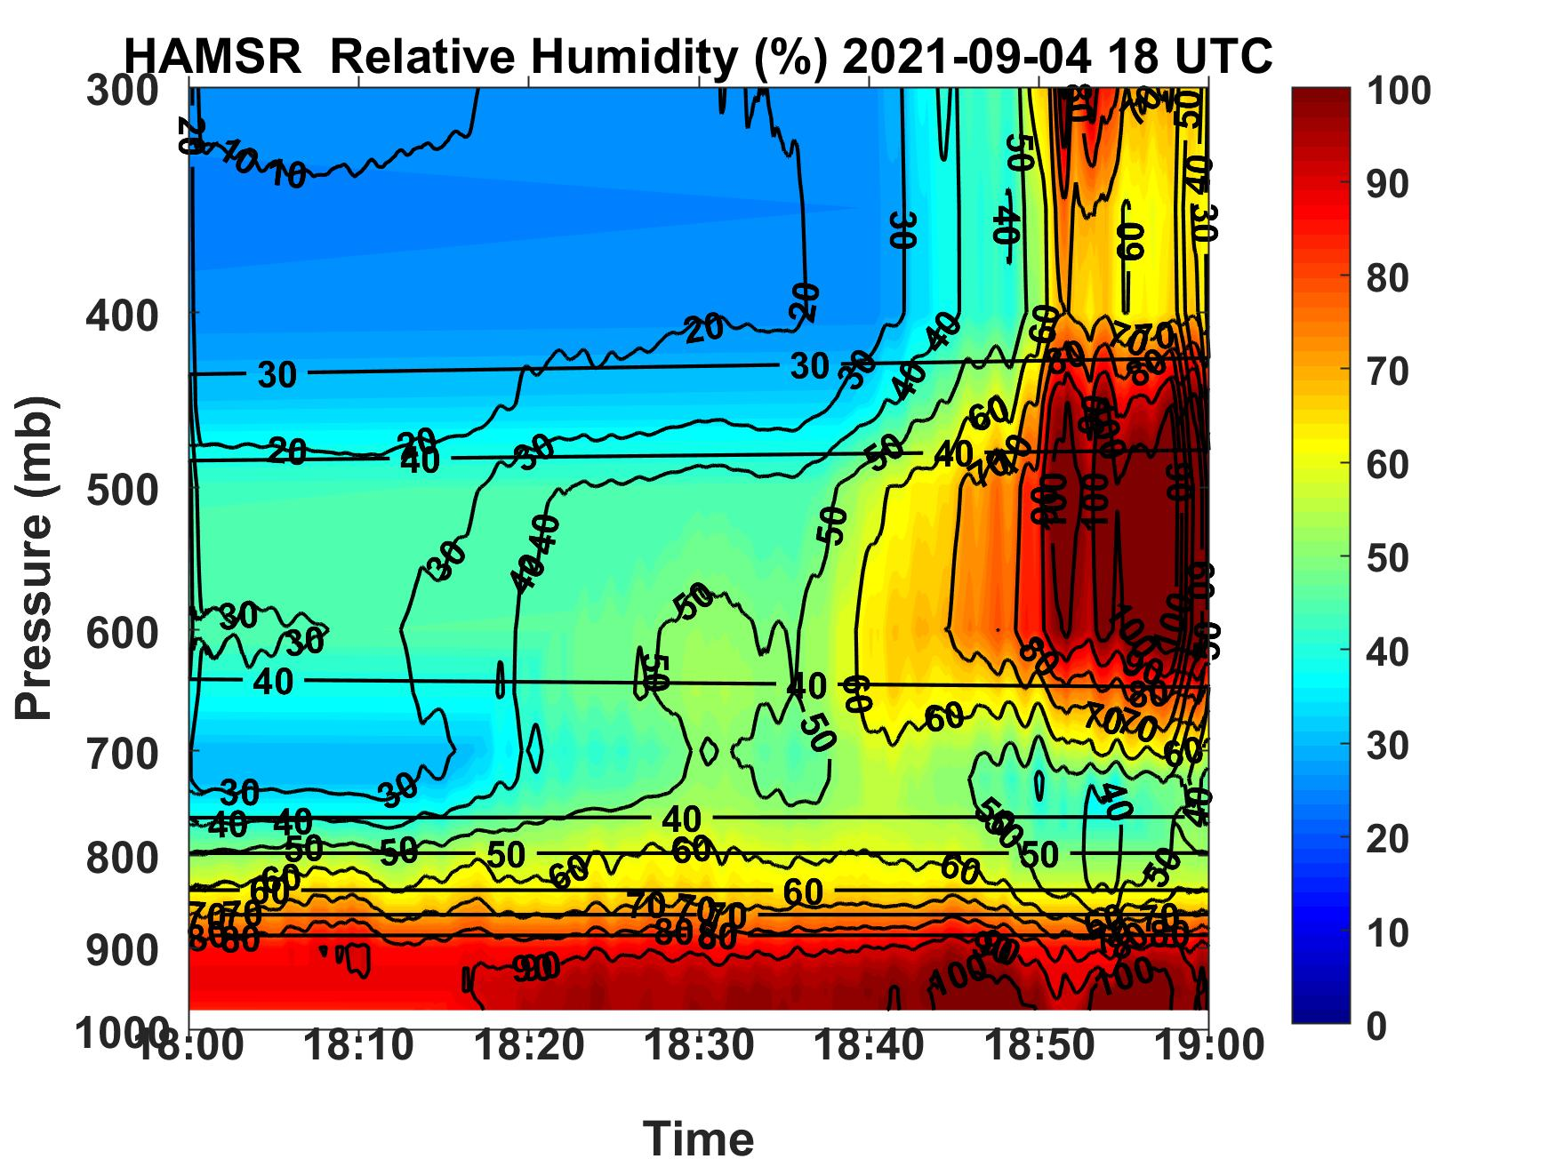
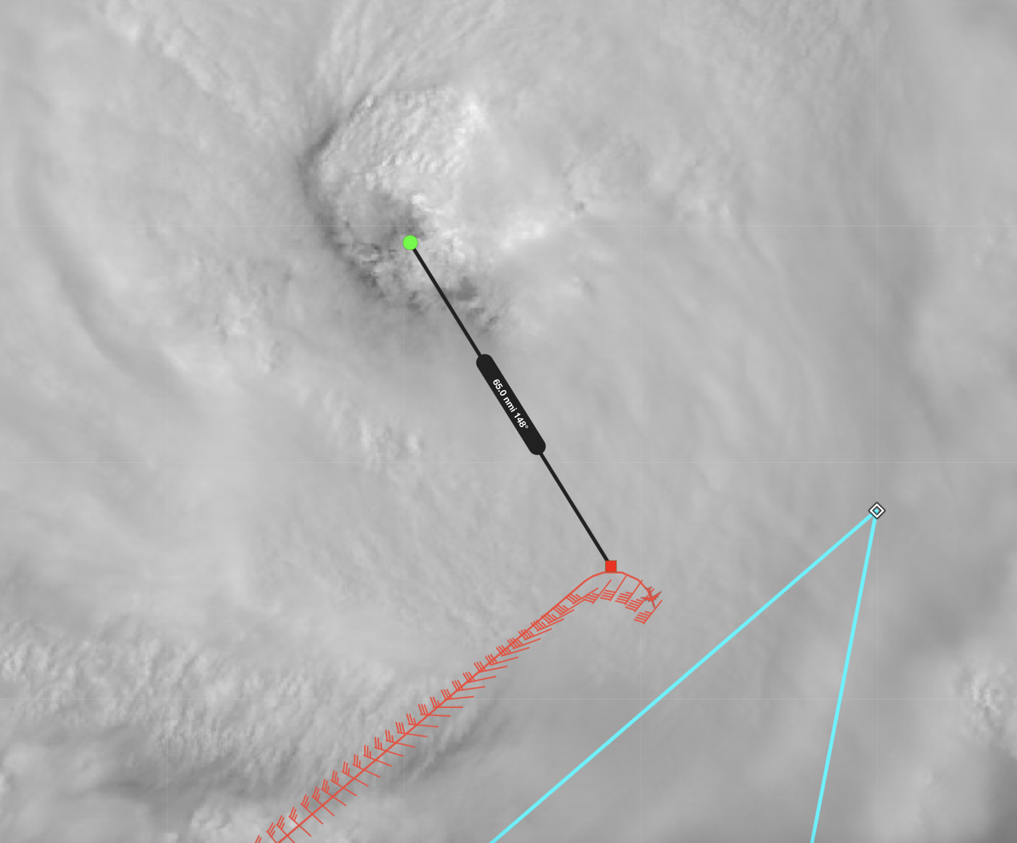
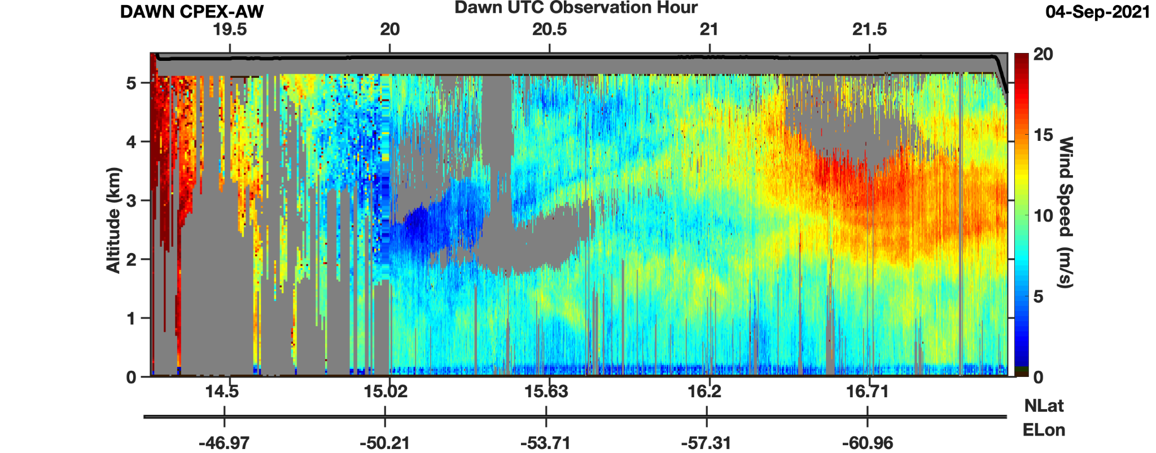
2021 Hurricane Field Program-APHEX
CPEX-AW Larry: 4 September (RF07)
Dropsonde at 1901Z; closest to the center
Example curtains from DAWN (Doppler Aerosol Wind Lidar) inbound to Larry; windspeed (top), wind direction (bottom)
windspeed on ferry home from Larry when DC-8 at lower altitude
RH curtain from HAMSR on approach into Larry showing potential dry intrusion (?) at 700-900 mb

Slide 6
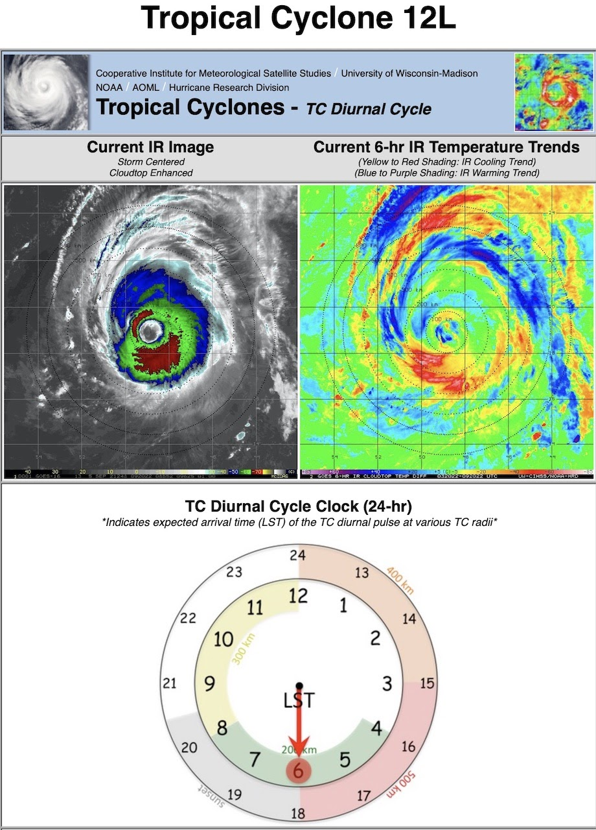
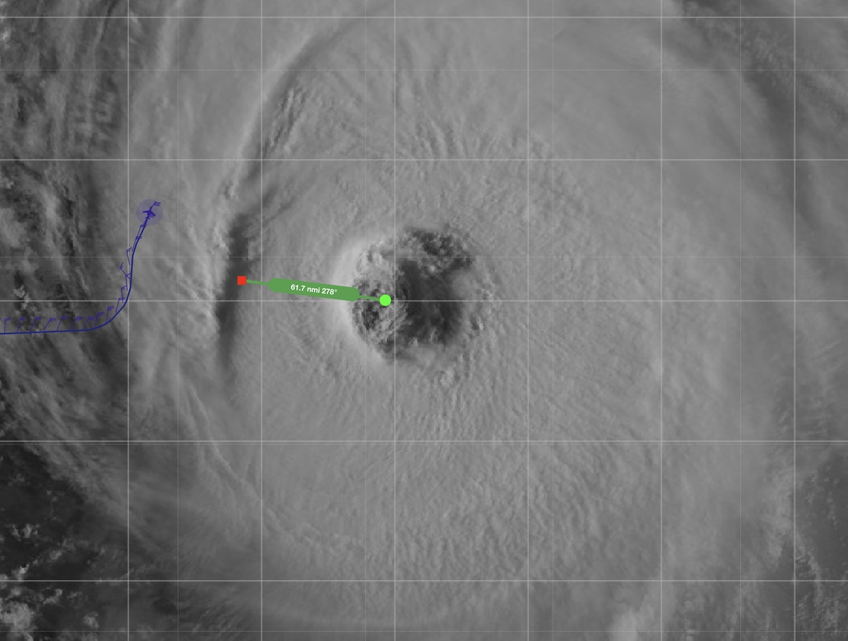
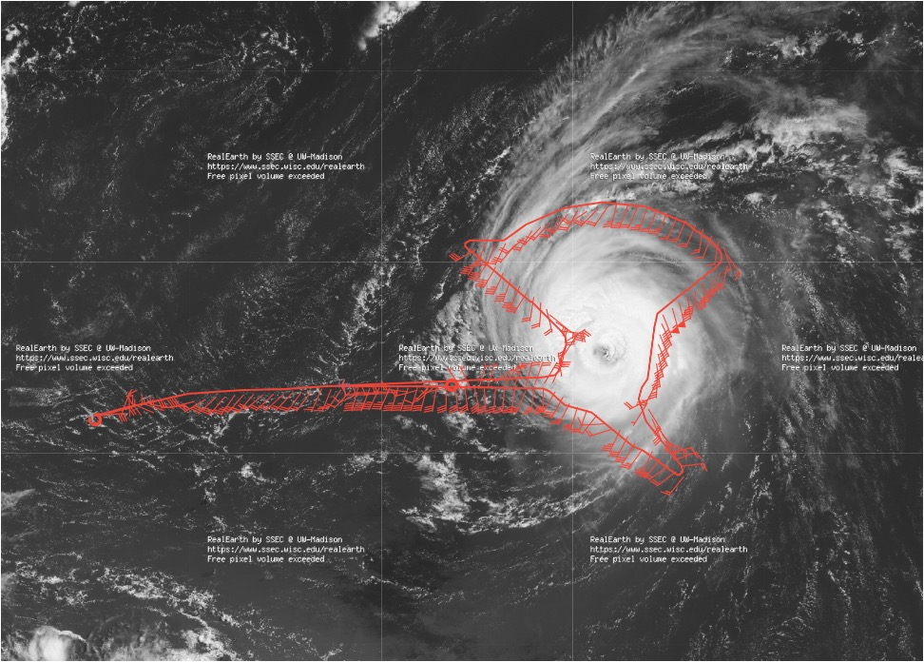
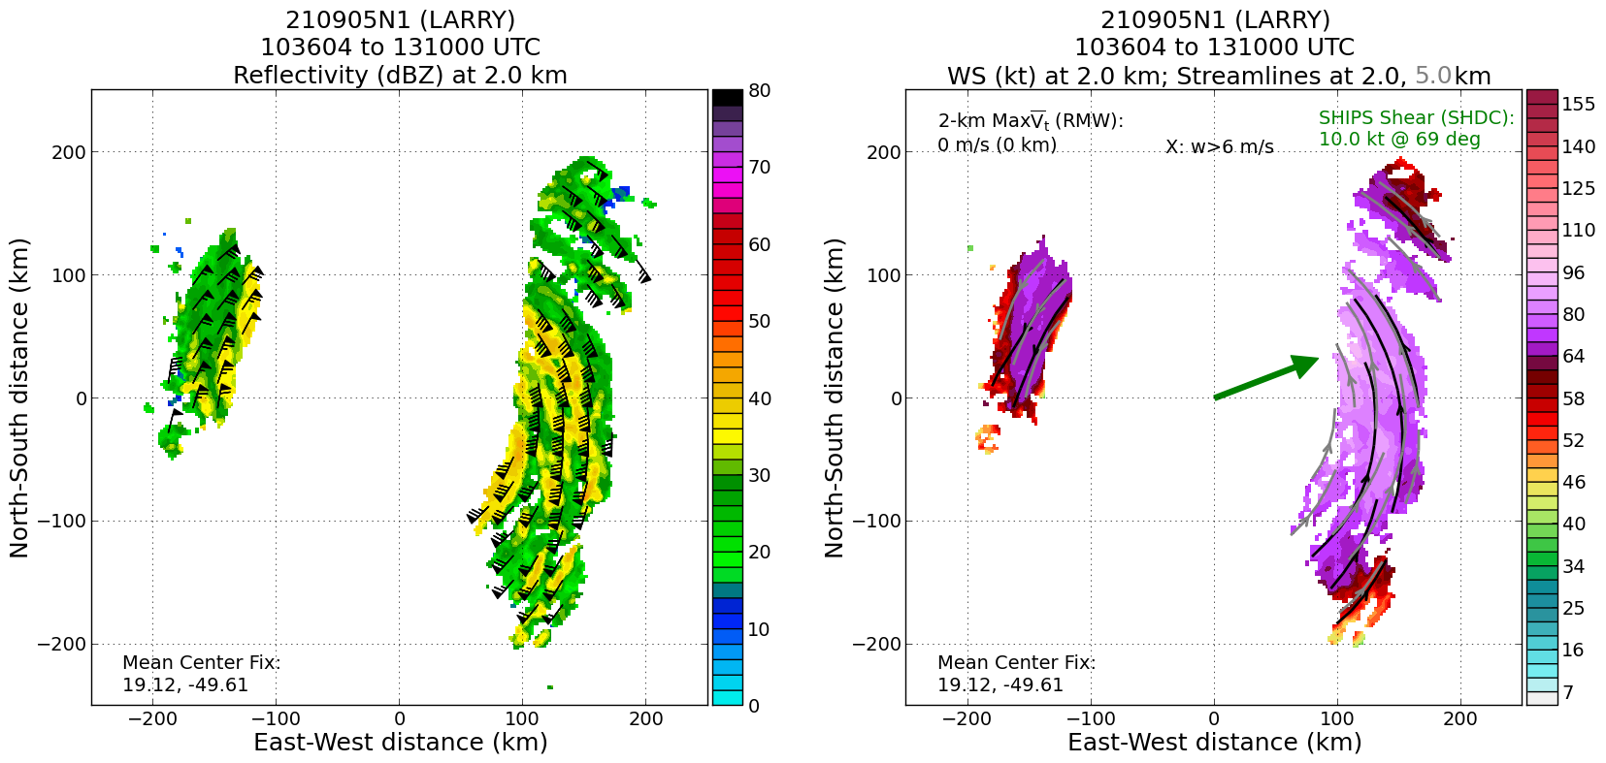
2021 Hurricane Field Program-APHEX
Hurricane Larry: 20210905N1 (HRD)
Mission
  LPS: None, Aspen: AOC FD #2
  GB LPS: Dunion/O’Neill/Wing, GB Radar: Reasor/Gamache
  APHEX relevance:
    TC Diurnal Cycle
  Planned pattern: survey + circumnavigation
  T/O off (STX) – Landing (STX): 0851 – 1604z
  FL 41-45 k ft
  38 dropsondes (36 to GTS): 25 STAN, 13 HRD
  3 TDR analyses to EMC & NHC
Excellent mission that targeted the early stage of the TC diurnal cycle evolution (~0500 – 1200 LT when diurnal pulse radius is at R~200-400 km)
G-IV
shelf cloud
N49 final flight track
shelf cloud
2.0 km reflectivity and winds (left image) and 2.0 and 5.0 km streamlines with 2.0 km winds shaded (right image).

Slide 7
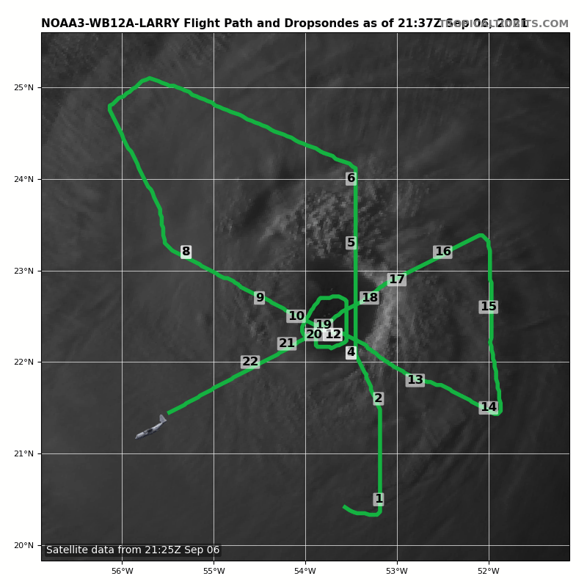
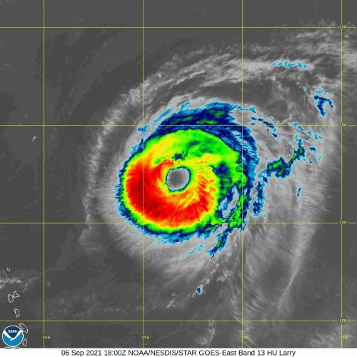
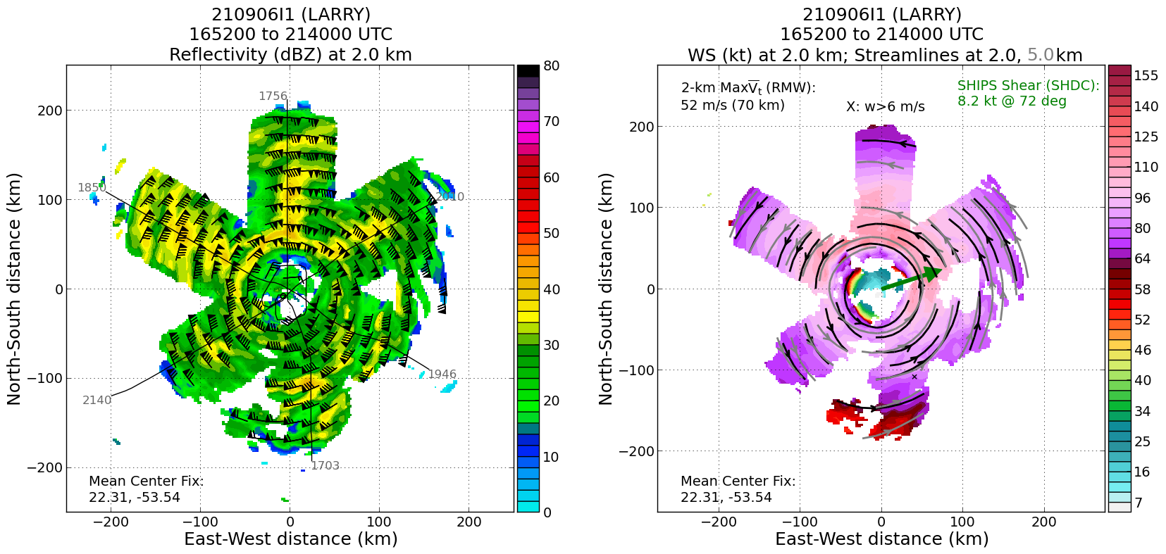
2021 Hurricane Field Program-APHEX
Hurricane Larry: 20210906I1 (HRD)
Mission
  LPS/Radar: Holbach, Aspen: Hazelton
  GB LPS: Wadler, GB Radar: Gamache
  APHEX relevance:
    AIPEX, Eye-eyewall Mixing
    Ocean Observing (Sustained and Targeted Ocean Obs)
    Collaboration with ONR TCRI
  Planned pattern: butterfly
  T/O off (STX) – Landing (STX): 1447 – 2330z
  FL 10 k ft
  21 dropsondes (20 to GTS): 13 EMC, 2 NHC, 5 HRD, 1 ONR
  8 NRL AXBTs (7 good)
  2 AOML/PhOD ALAMO floats (both failed)
  3 TDR analyses to NHC and 2 to EMC
2 AOML/PhOD ALAMO floats were deployed at WPs 3 & 4. It appears that the floats may not have been deployed correctly and that the parachutes were inadvertently cut. Both ALAMOs were lost (no signals acquired).
An issue with the N43 MMR. FD said that N43’s MMR is worse than N42’s. Surface roughness field is ok, but HWX and NAW are bad -- lower than expected reflectivity on the MMR.
Which direction to circle in the eye (upwind vs downwind)? Benefit of adding sondes?
WP3
WP4
WP2
WP7
WP5
FP
WP6
IP
N43 final flight track
2.0 km reflectivity and winds (left image) and 2.0 and 5.0 km streamlines with 2.0 km winds shaded (right image).

Slide 8
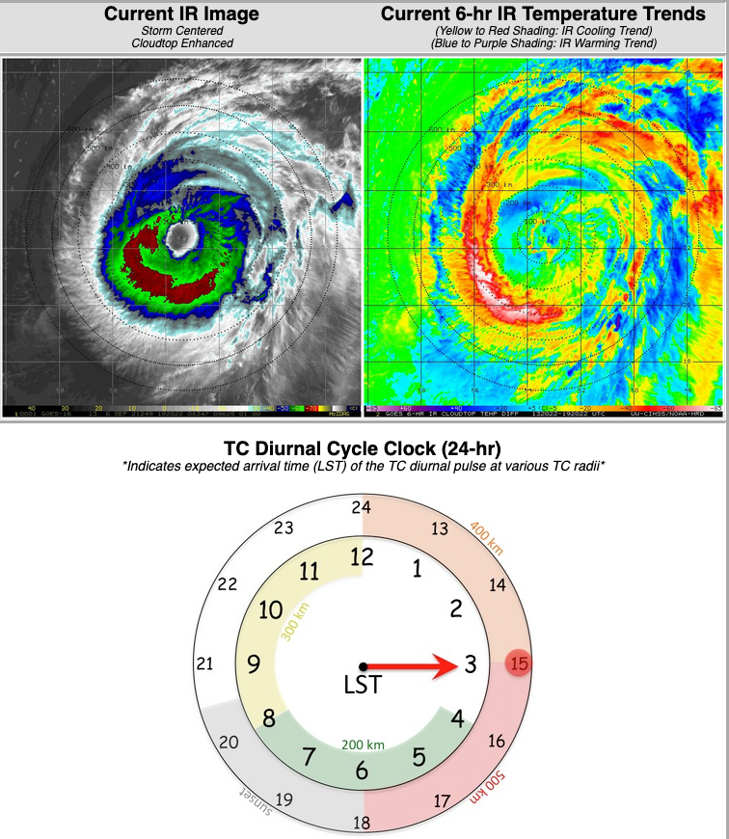
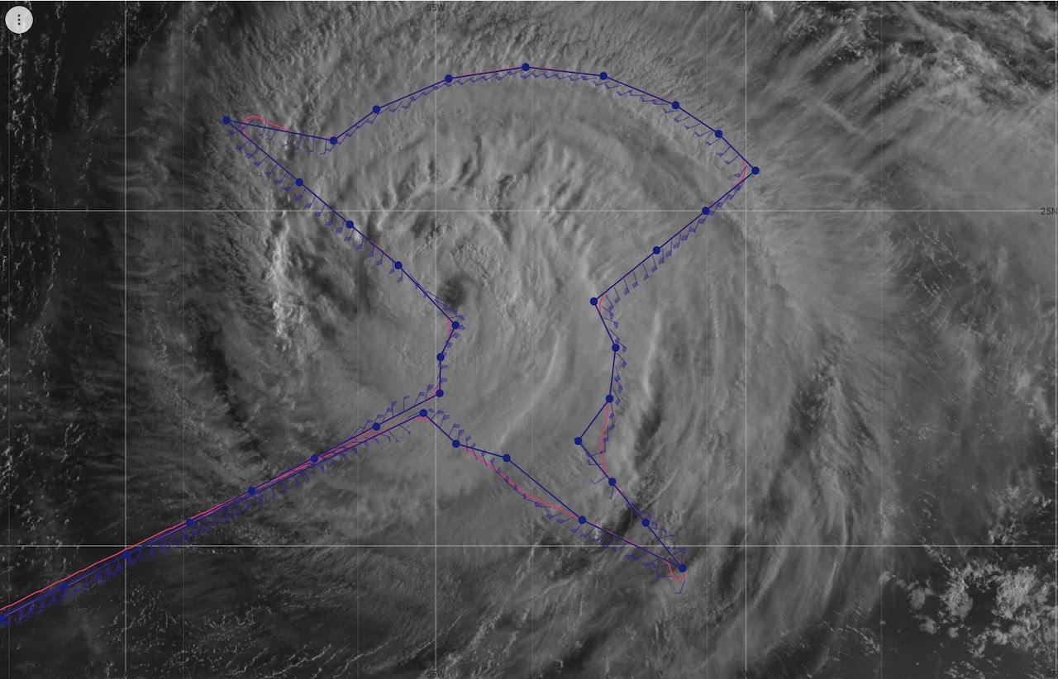
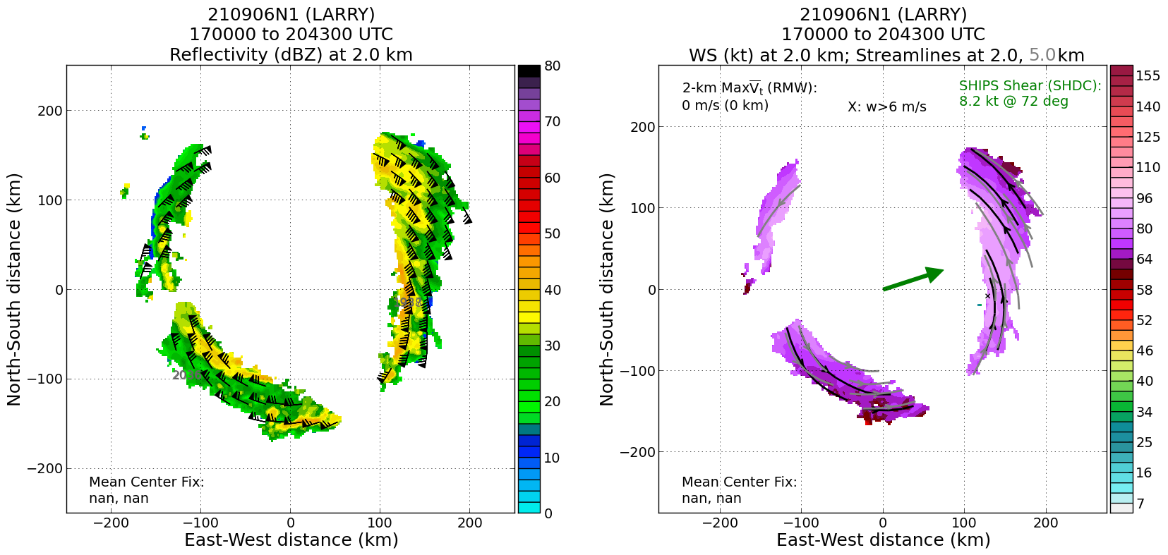
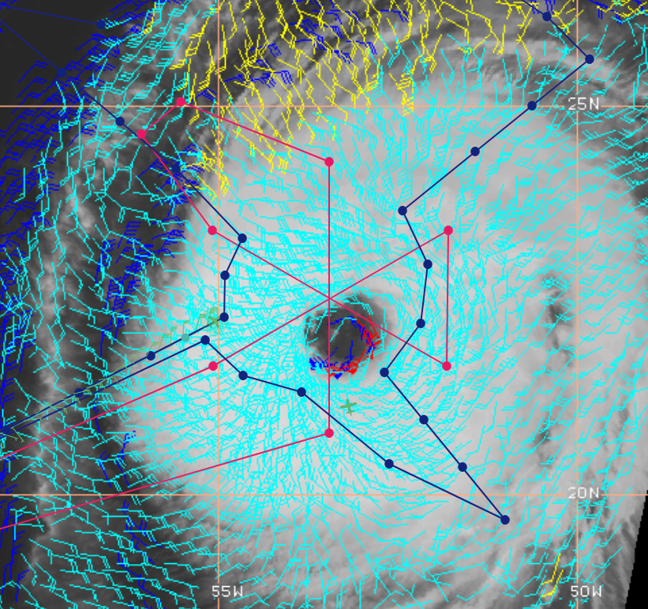
2021 Hurricane Field Program-APHEX
Hurricane Larry: 20210906N1 (HRD)
Mission
  LPS: None, Aspen: AOC FD #2
  GB LPS: Dunion/O’Neill/Wing, GB Radar: Reasor/Gamache
  APHEX relevance:
    TC Diurnal Cycle
  Planned pattern: survey + circumnavigation
  T/O off (STX) – Landing (STX): 1545 – 2253z
  FL 41-45 k ft
  35 dropsondes (35 to GTS), 25 STAN, 10 HRD
  3 TDR analyses to EMC & NHC
Excellent mission that targeted the later stage of the TC diurnal cycle evolution (~1200 – 1800 LT when diurnal pulse radius is at R~400-500 km)
N49 final flight track
2.0 km reflectivity and winds (left image) and 2.0 and 5.0 km streamlines with 2.0 km winds shaded (right image).
CIMSS Meso Winds with N43 (red curve) and N49 (blue curve) planned flight tracks.

Slide 9
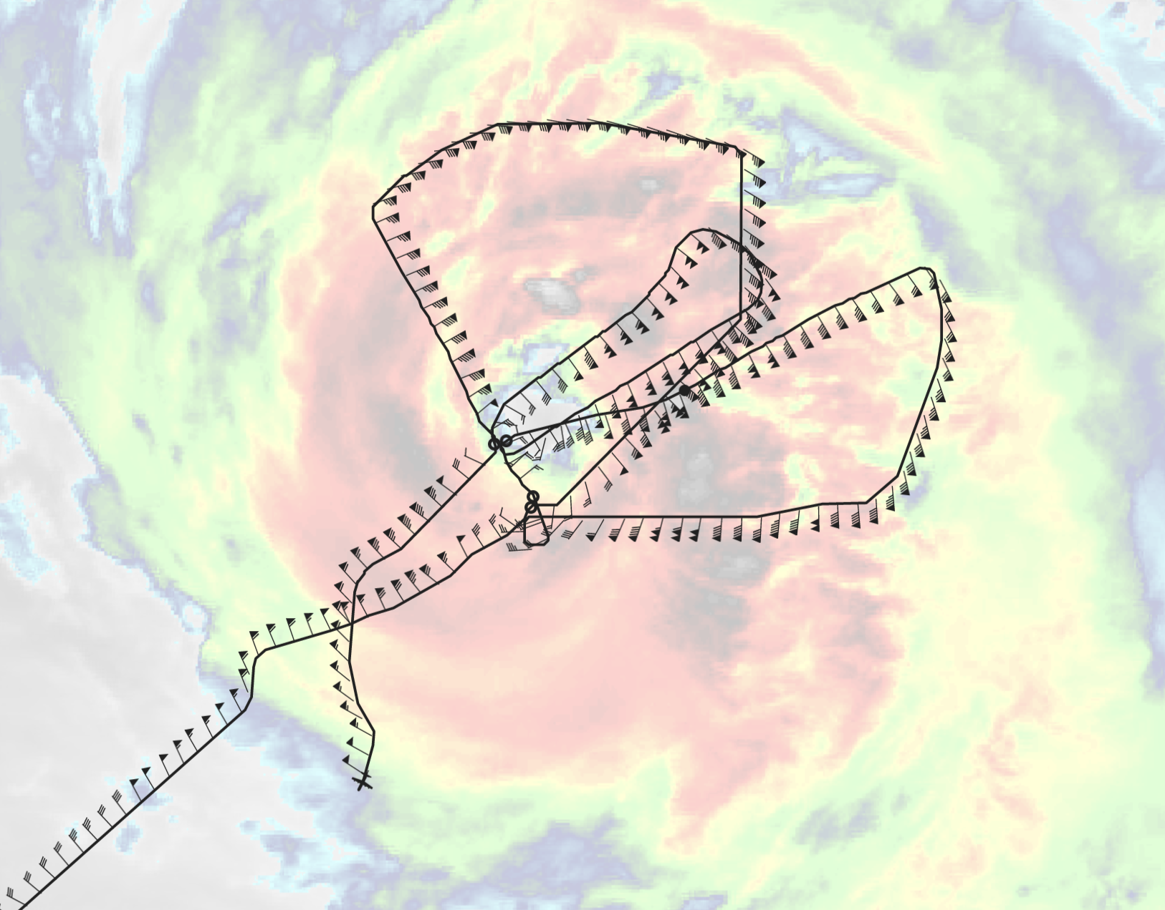
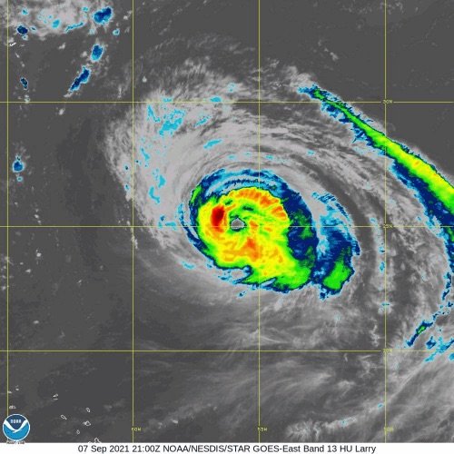
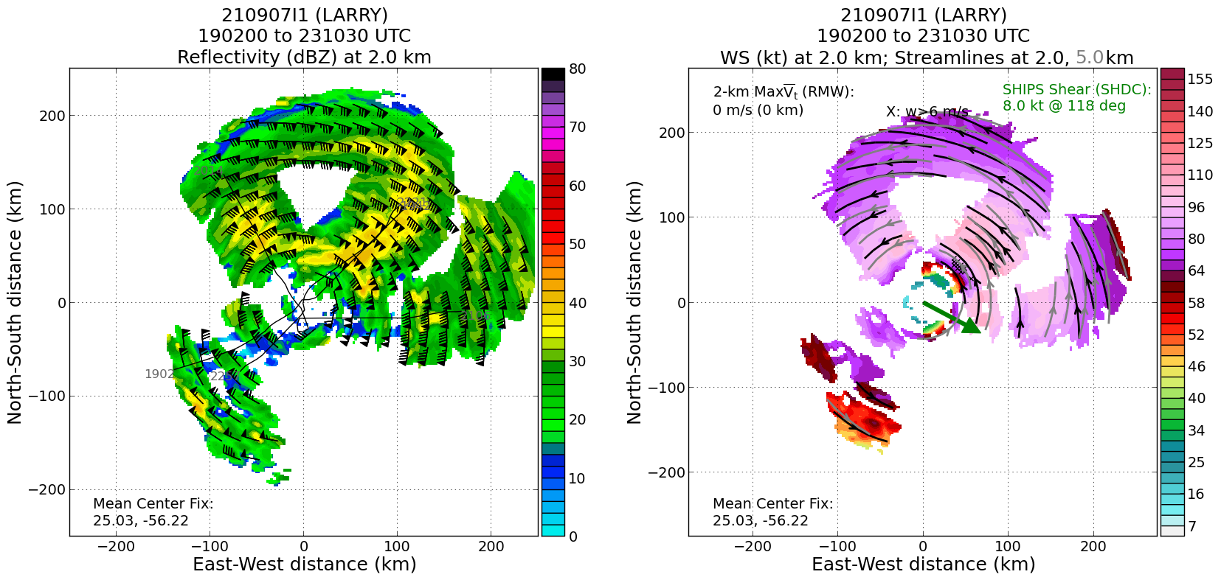
2021 Hurricane Field Program-APHEX
Hurricane Larry: 20210907I1 (NESDIS)
Mission
  LPS/Radar: Holbach, Aspen: Hazelton
  GB LPS: Zawislak, GB Radar: Alvey/Gamache
  APHEX relevance:
    NESDIS Ocean Winds
  Planned pattern: Alpha + modules + Sentinel 1 underflight
  T/O off (STX) – Landing (STX): 1709 – 0108z
  FL 8 k ft (radar)
  5 dropsondes (4 to GTS), 2 NHC, 3 NESDIS
  AXBTs: None
  4 TDR analyses to EMC & NHC
MMR was still showing very low reflectivities compared to the nose radar. It appeared to perform a little better on cellular precip that wasn’t embedded. Surface roughness mode was showing more details than NAW (HWX was even worse).
Because of MMR issues, 43 was restricted to daylight hours for in-storm, which led to our slightly early takeoff.
N43 final flight track
2.0 km reflectivity and winds (left image) and 2.0 and 5.0 km streamlines with 2.0 km winds shaded (right image).

Slide 10
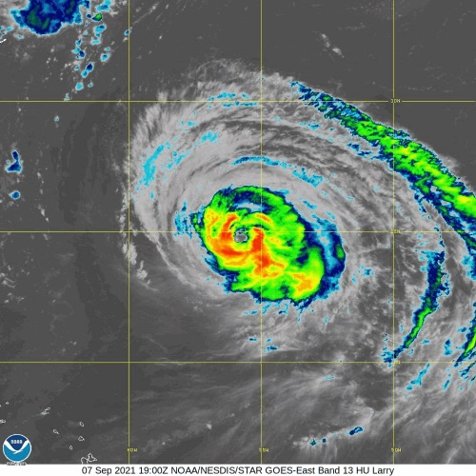
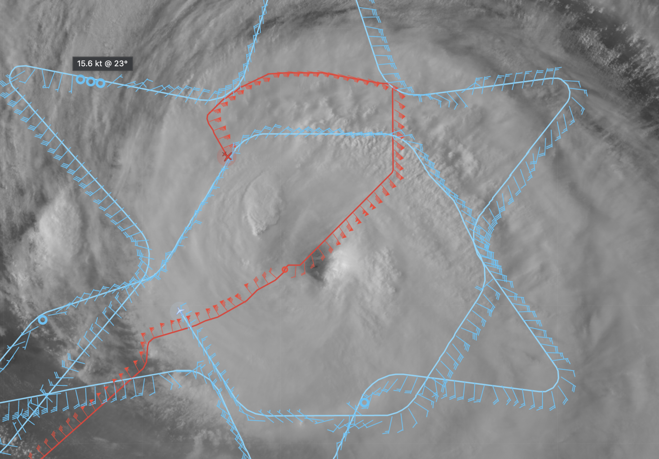
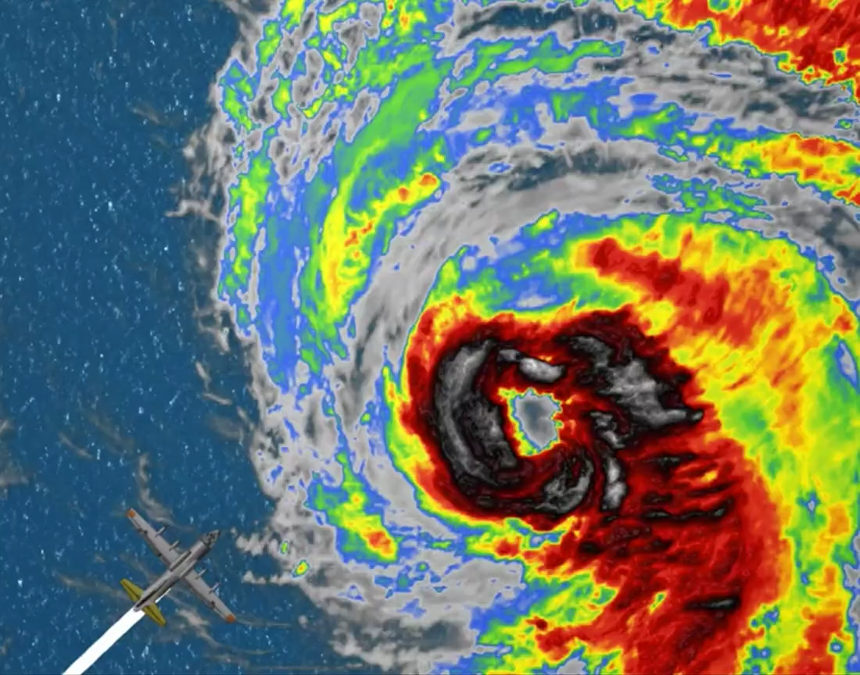
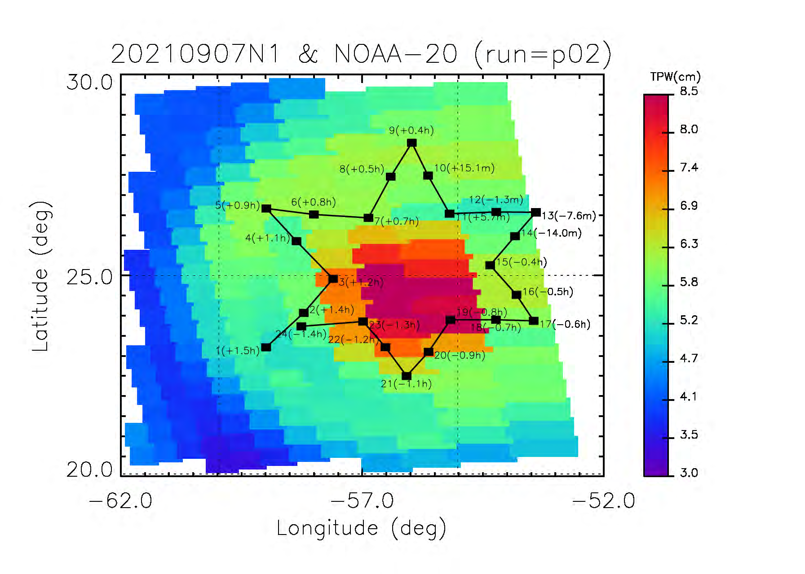
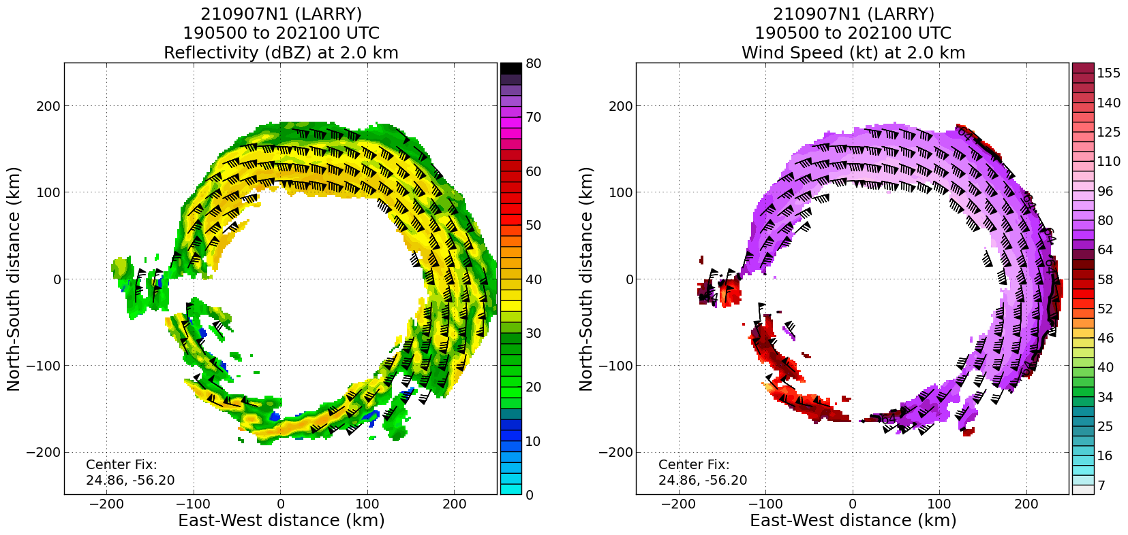
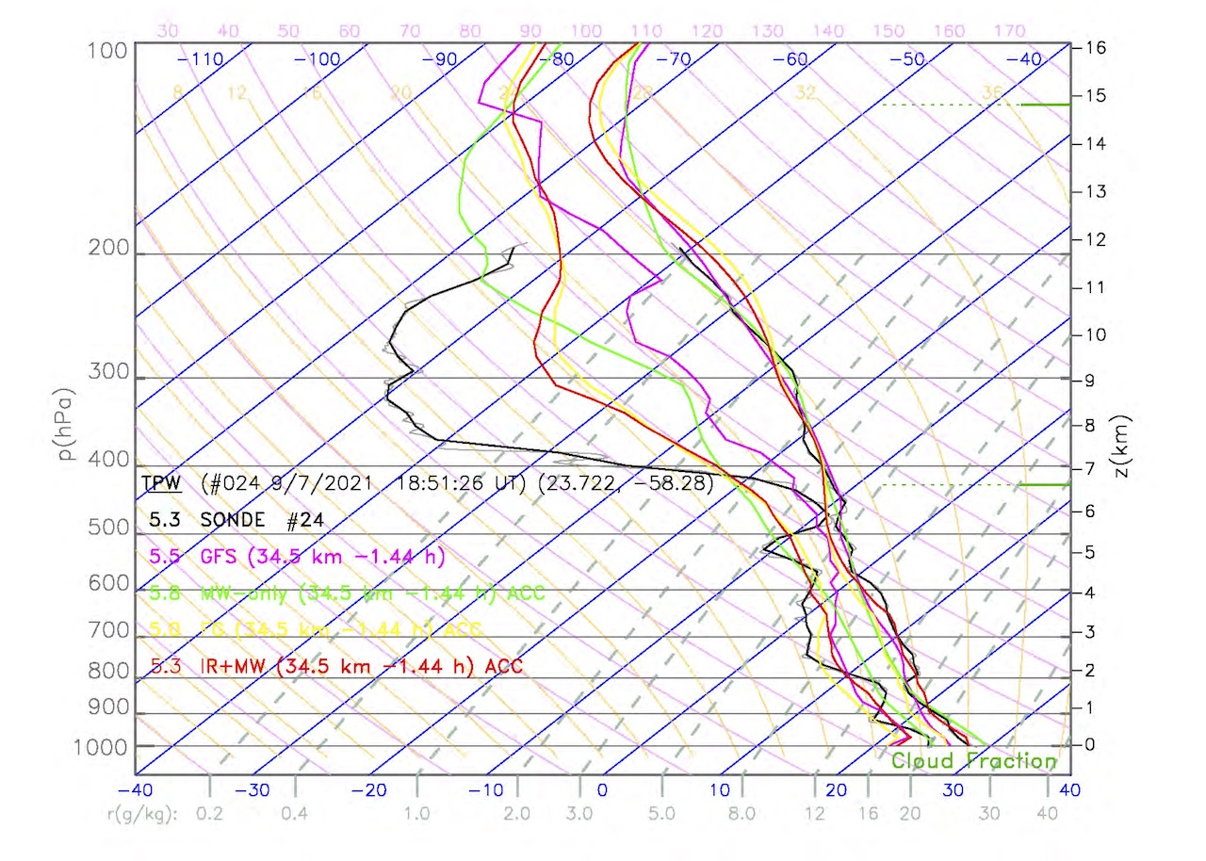
2021 Hurricane Field Program-APHEX
Hurricane Larry: 20210907N1 (HRD)
Mission
  LPS: None, Aspen: AOC FD #2
  GB LPS: Dunion, GB Radar: Reasor
  APHEX relevance:
    Evaluation of TC Environment using Satellite Soundings Experiment
  Planned pattern: star + circumnavigation
  T/O off (STX) – Landing (STX): 1442 – 2155z
  FL 41-45 k ft
  35 dropsondes (33 to GTS), 35 SAT
  3 TDR analyses to EMC & NHC
Mission goals: collect dropsonde obs in the environment/near environment of Hurricane Larry (star pattern) to validate against NOAA NUCAPS temperature and moisture soundings from the Aqua satellite and TDR data (R~90 n mi circumnav)
From Chris Barnett, JPSS collaboration Co-lead: “All-in-all this was a great investment and I already sent these summaries to the JPSS management so they know we got something valuable happened here.”
N49 final flight track
N49 track (blue) adjusted to better center R~90 n mi circumnav
Aqua NUCAPS, dropsonde, GFS soundings (1851 UTC)
2.0 km reflectivity and winds showing Larry’s large wind field.

Slide 11
2021 Hurricane Field Program-APHEX
Hurricane Larry: 5-7 September 2021
Social Media
HRD Twitter
  7 Sep (Larry flights, eye-eyewall mixing): https://twitter.com/HRD_AOML_NOAA/status/1435337476059578371?s=20
  7 Sep (Larry’s eye, AOC retweet): https://twitter.com/NOAA_HurrHunter/status/1435251755349168135?s=20
Media
  Here's why hurricane hunters fly their planes in weird patterns into storms (CNN): https://www.cnn.com/2021/09/19/weather/weather-hurricane-hunter-flights/index.html
Daily Plan of the Day
  Sent to research partners, AOML Comms, OAR Communications Office
  Emily Ashe, Michael F., Jason D., and Jon Z.
    Post-map discussion tag-ups to discuss social media opportunities

Slide 12
2021 Hurricane Field Program-APHEX
Hurricane Larry: 5-7 September 2021
Other Issues – what went well?...what can we do better?
Kudos from AOC – Heather captured several MMR/nose radar side-by-side examples at Station 3 during the mission. The issue is still ongoing, “but what is clear is that Heathers' actions single-handedly expedited any future solution.”
Ground based LPS coverage was too sparse
Clarify a few details of the Eye-eyewall Mixing module for future missions
  Specify if dropsonde expendables are required during the eye orbit and what potential dropsonde targets would be
  Specify approach to flying the eye orbit (e.g., a more constant steady bank vs more polygonal straight legs with turn points)

Slide 13
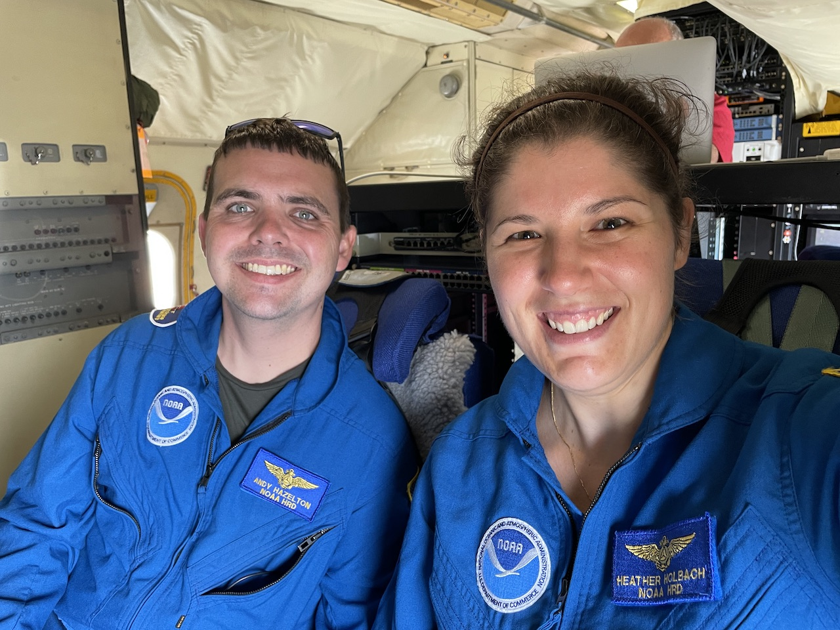
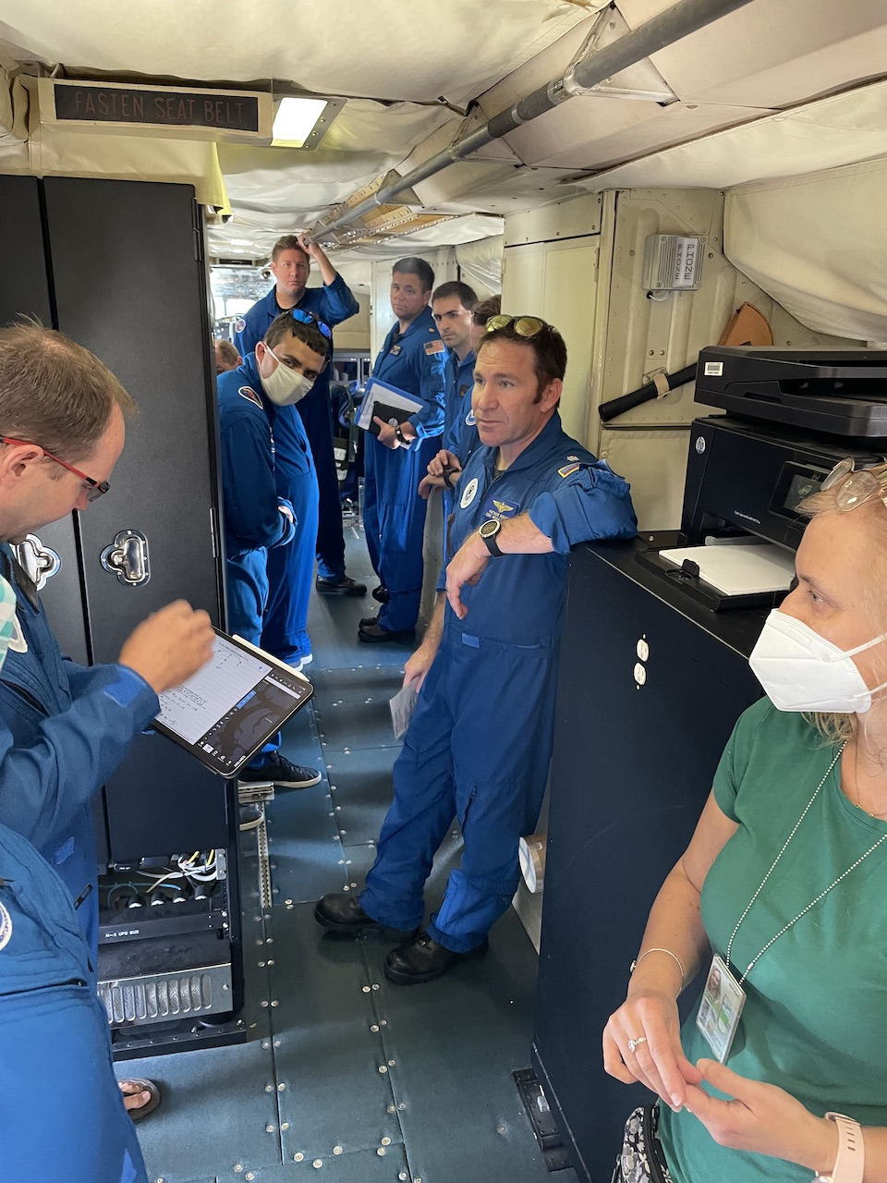
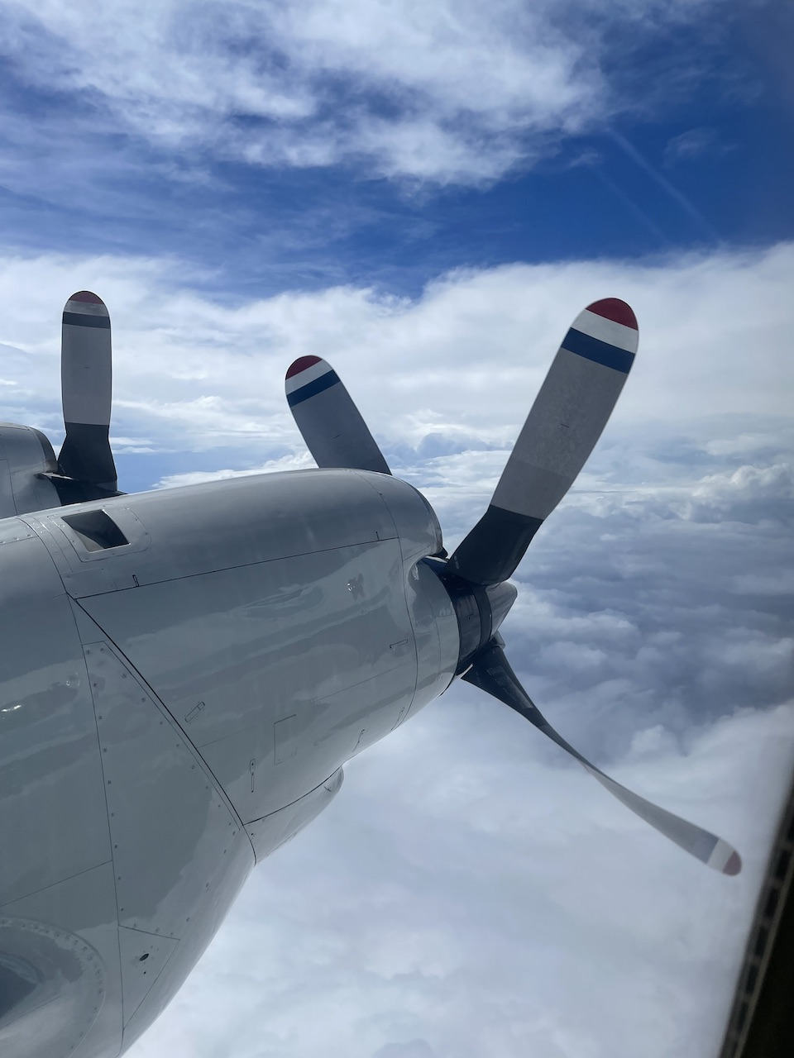
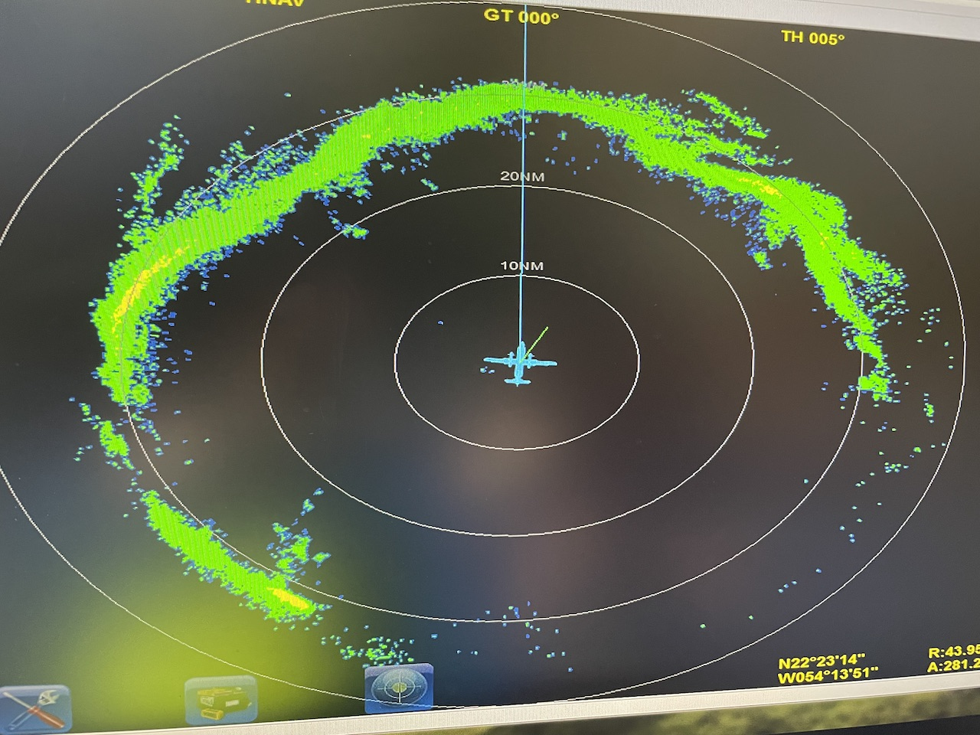
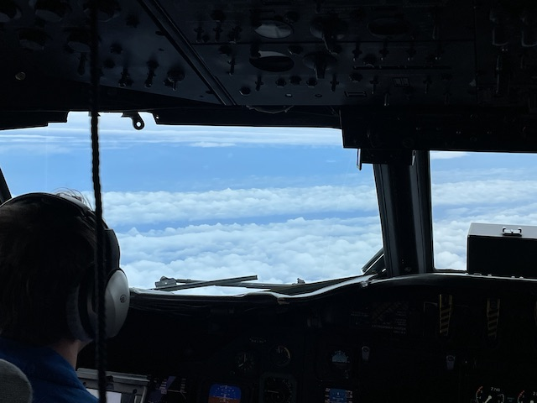
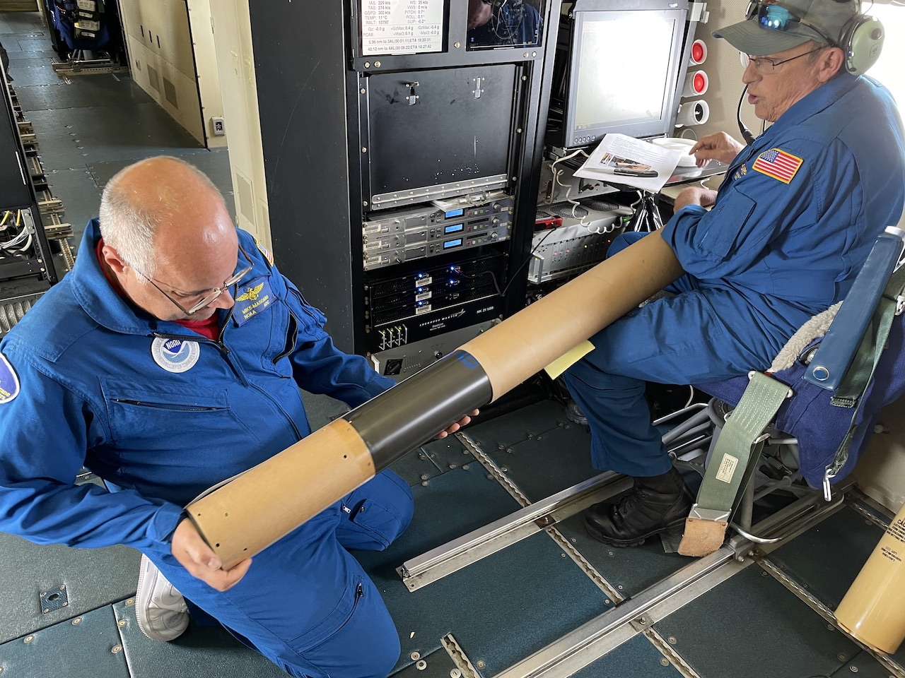
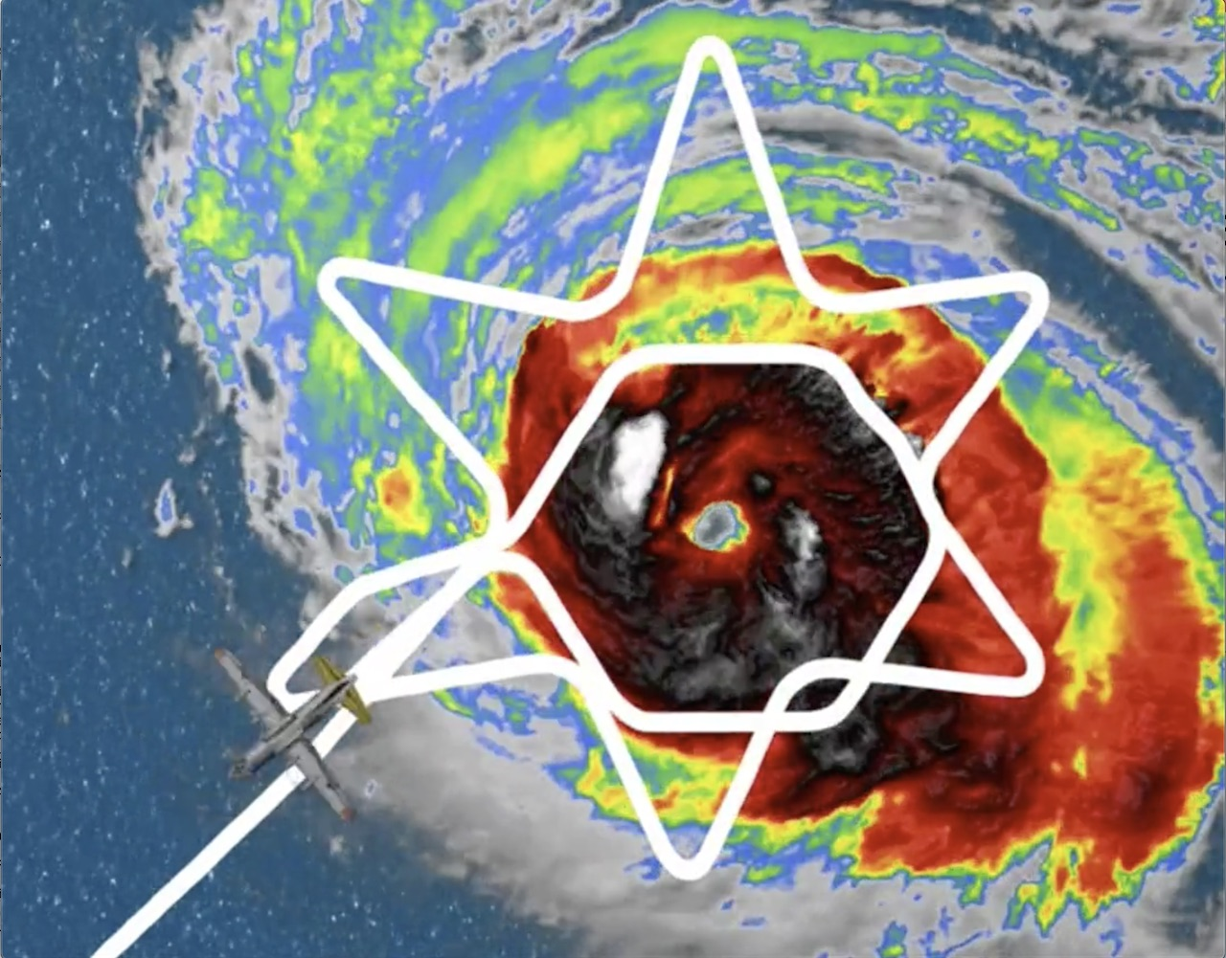
2021 Hurricane Field Program-APHEX
Hurricane Larry: 5-7 September 2021
Photo by Jon Zawislak
Photo by Heather Holbach
Photo by Heather Holbach
Photo by Heather Holbach
Photo by Heather Holbach
Photo by Heather Holbach
Photo by Jack Parrish
Photo by Heather Holbach
Copies of the 2021 AL12/Larry debrief can be found in the HRD Google Drive folder
HRD >> Hurricane Field Program >> 2021 >> Debriefs >> AL12/Larry

