Slide 1
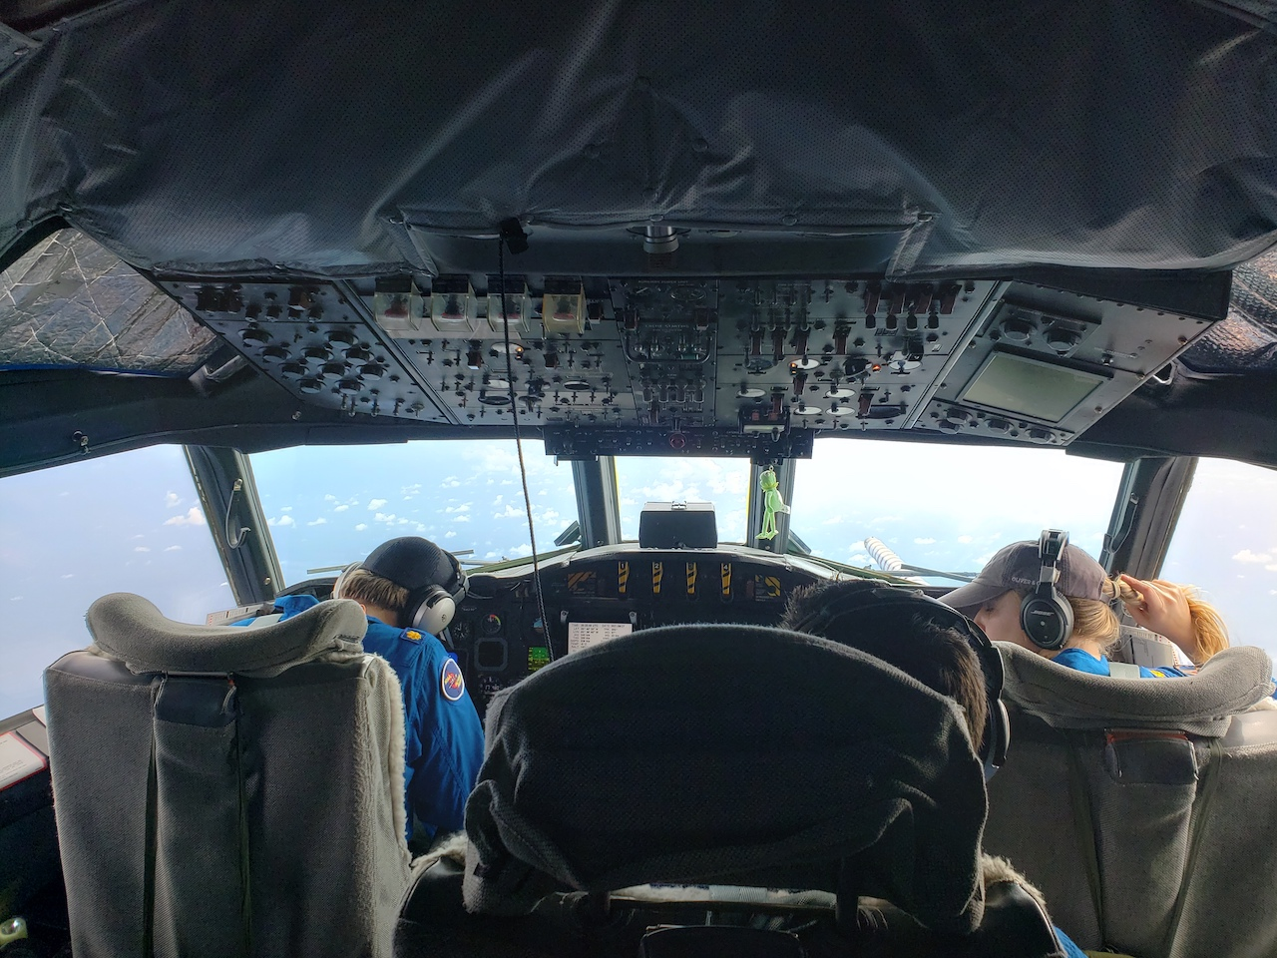


2021 Hurricane Field Program
Advancing the Prediction of Hurricanes Experiment (APHEX)
Ida (AL09) Debrief
Jason Dunion – HFP Director
Jon Zawislak - HFP Deputy Director
Photo by Rob Rogers

Slide 2
2021 Hurricane Field Program-APHEX
Summary of Missions (27-29 August 2021)
Summary of Missions
6 P-3 missions (EMC)
169 GPS dropsondes / 160 transmitted to the GTS
42 NRL AXBTS (TBD good)
30 UM AXBTS (26 good)
27 TDR analyses transmitted to EMC & NHC
HRD Crewing
20210827I1: EMC TDR
Alaka (LPS, radar), Hazelton (Aspen), Reasor (GB radar), Bucci (GB LPS)
20210827H1: HRD
Rogers (LPS, radar), J. Zhang (Aspen), Gamache/Alvey (GB radar), Holbach (GB LPS)
20210828I1: EMC TDR
Alaka (LPS, radar), Hazelton (Aspen), Fischer (GB radar), Bucci (GB LPS)

Slide 3
2021 Hurricane Field Program-APHEX
Summary of Missions (27-29 August 2021)
Summary of Missions
HRD Crewing (cont’d)
20210828H1: EMC TDR
Rogers (LPS, radar), J. Zhang (Aspen), Alvey/Gamache (GB radar), Marks (GB LPS)
20210829I1: NESDIS
Alaka (LPS, radar), Hazelton (Aspen), Reasor (GB radar), Dunion/Holbach (GB LPS)
20210829H1: HRD
Rogers (LPS, radar), J. Zhang (Aspen), Gamache (GB radar), Holbach (GB LPS)

Slide 4
2021 Hurricane Field Program-APHEX
Logistics Highlights
NWS P-3 hours were depleted by the end of the Henri mission sequence
Some OAR research hours used to support NWS missions into Ida
NOAA-42 SFMR still running ~5-10 kt too high
No time for an cal mission over the Atlantic after Henri series
NOAA-43 surface pressure extrapolation
43’s extrapolation appears to be running 10+ mb too high (noted by NHC and HRD)
20210829I1 mission: 43’s extrap pressure was 20-25 mb too high compared to a dropsonde center drop during the initial pass into Ida - AOC is looking into the issue
WSRA shakedown still a work in progress
WSRA coding issue prevented WSRA from producing SWH and 2d ocean wave spectra on all three flights in Ida. Issue has hopefully been resolved for future missions.
ProSensing is working to recover SWH data from Ida flights.
WSRA Level 1 data looks much cleaner after recent instrument upgrade
CRL failed multiple times 20210828H1 mission (reason unknown) - CRL shut off for safety
From instrument PI Zhien Wang: The CRL is fine. The laser turn off was due to strong turbulence triggered water levels indicator (too low). We figured this out, and just need to restart the laser.

Slide 5


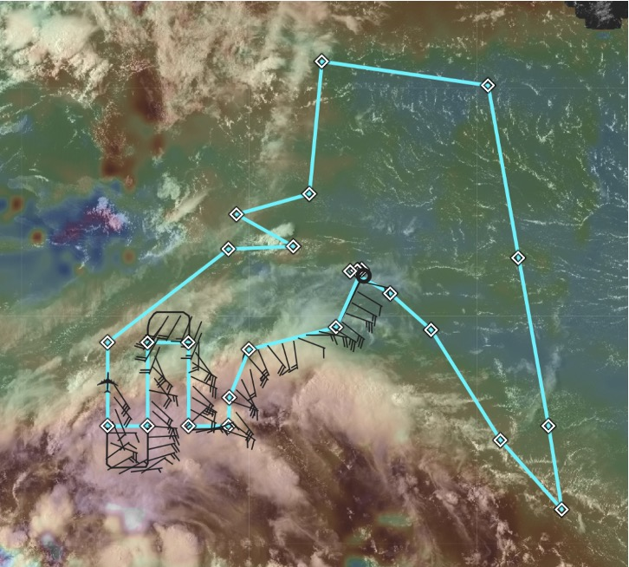
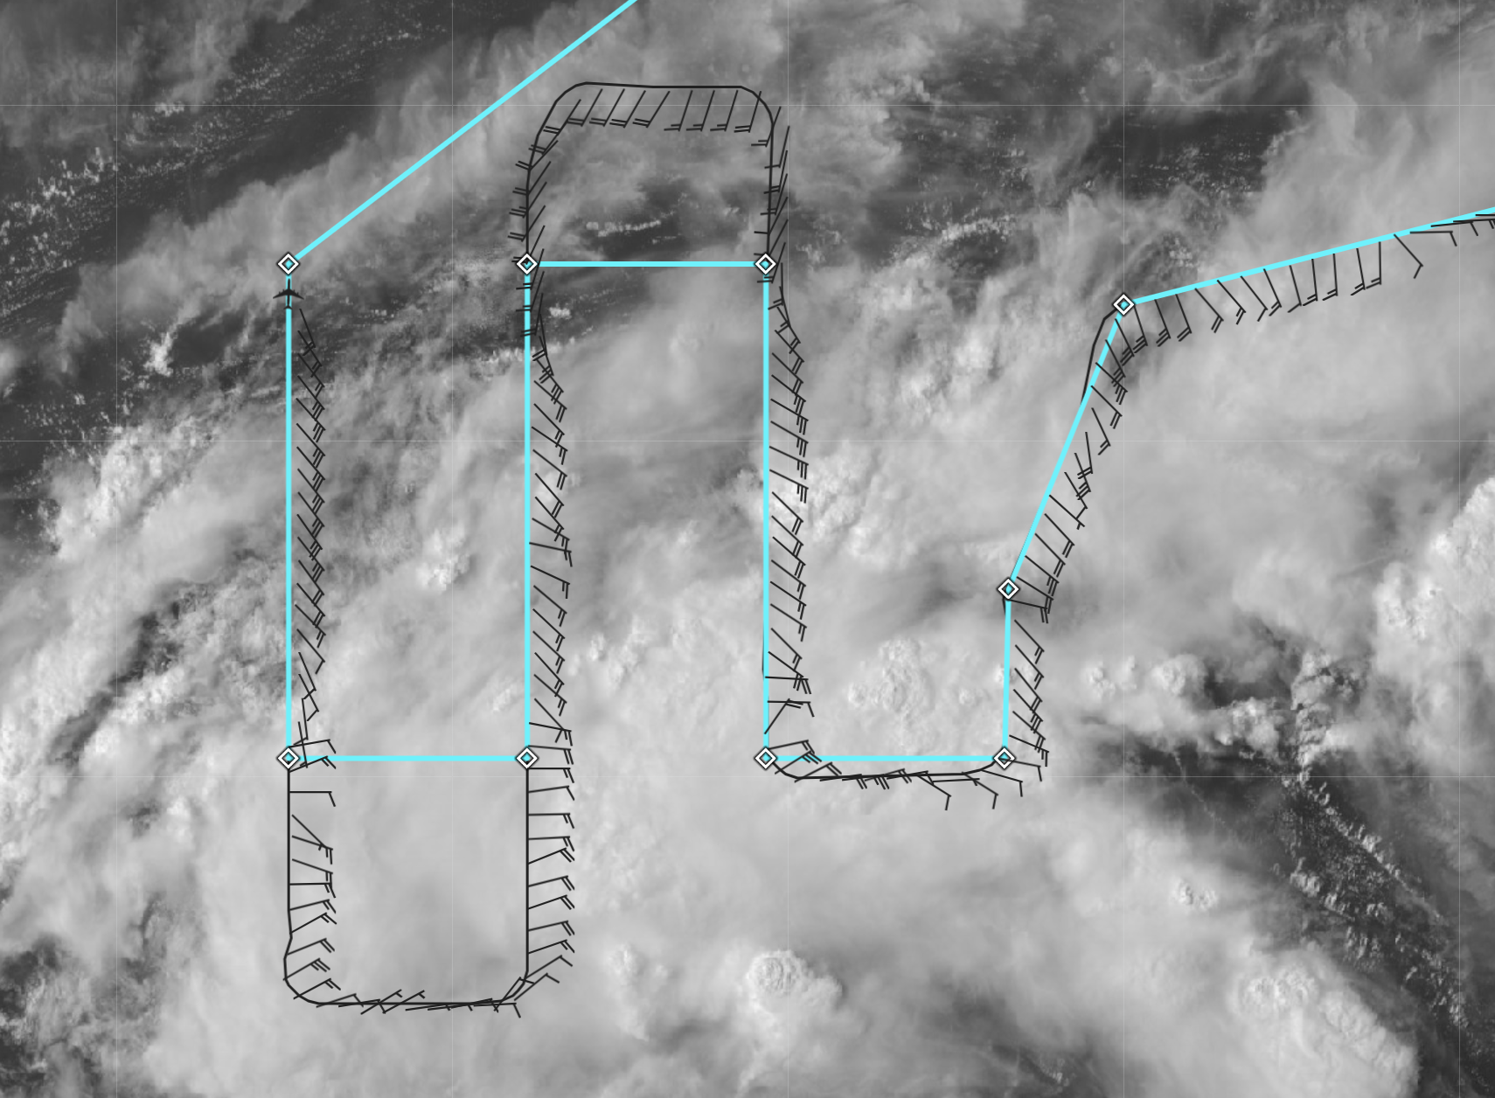
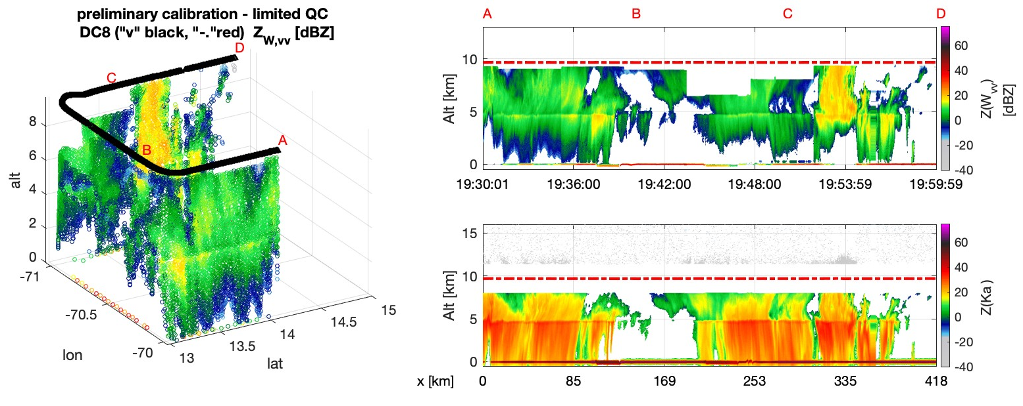
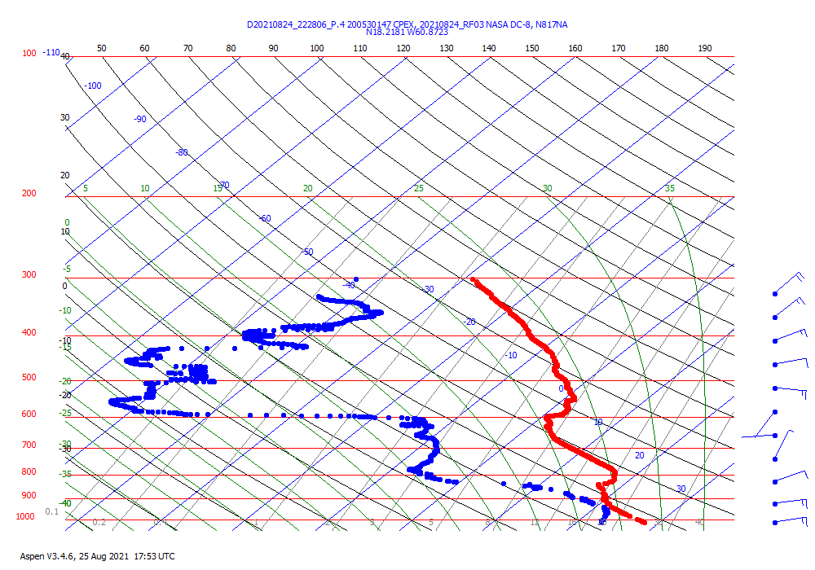
2021 Hurricane Field Program-APHEX
CPEX-AW Ida: 24 September (RF03)
W- (left, top right) and Ka-band (bottom right) reflectivity curtains from APR-3 in AL99
Dropsondes prior to RF06 had significant dropouts below 850 mb
Data is useable, but becomes less helpful in the boundary layer
Lawnmower sampled convection in the southern Caribbean associated with AL99, which became Ida
Sampled across moisture gradients in vicinity of convection
Completed ADM-Aeolus underflight

Slide 6
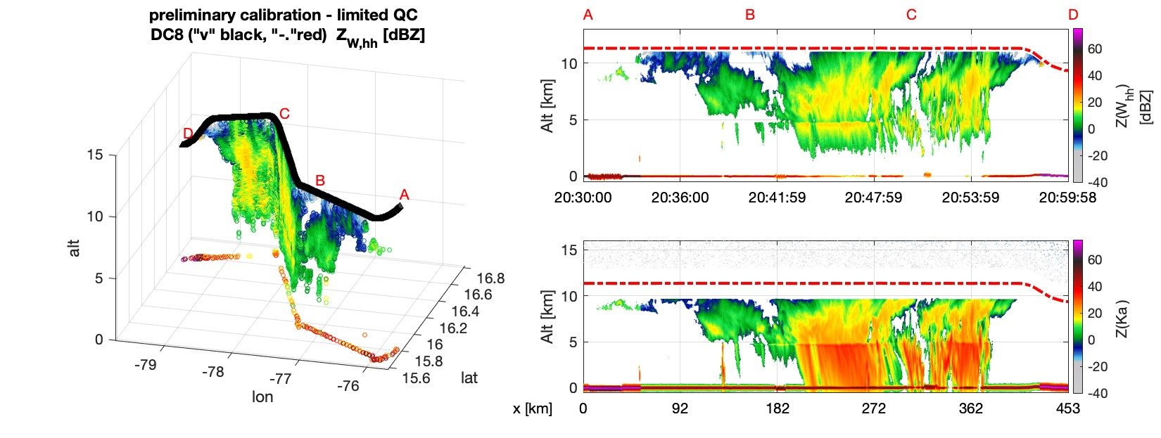
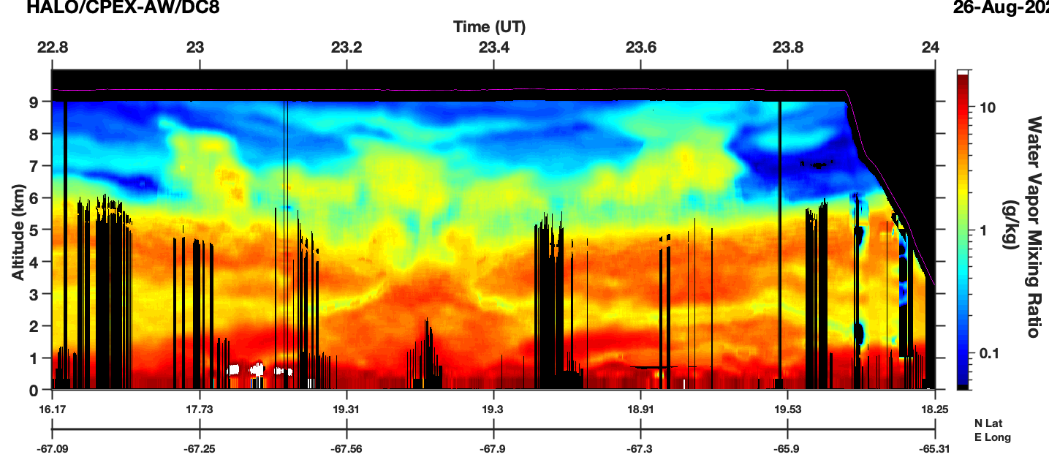
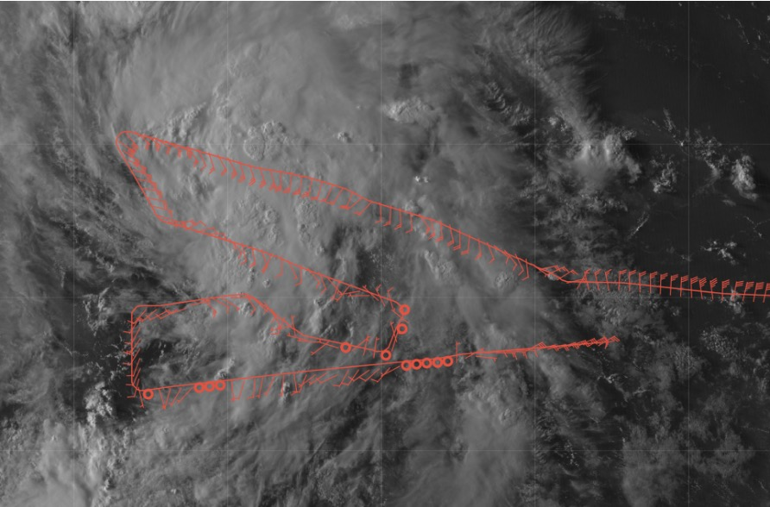
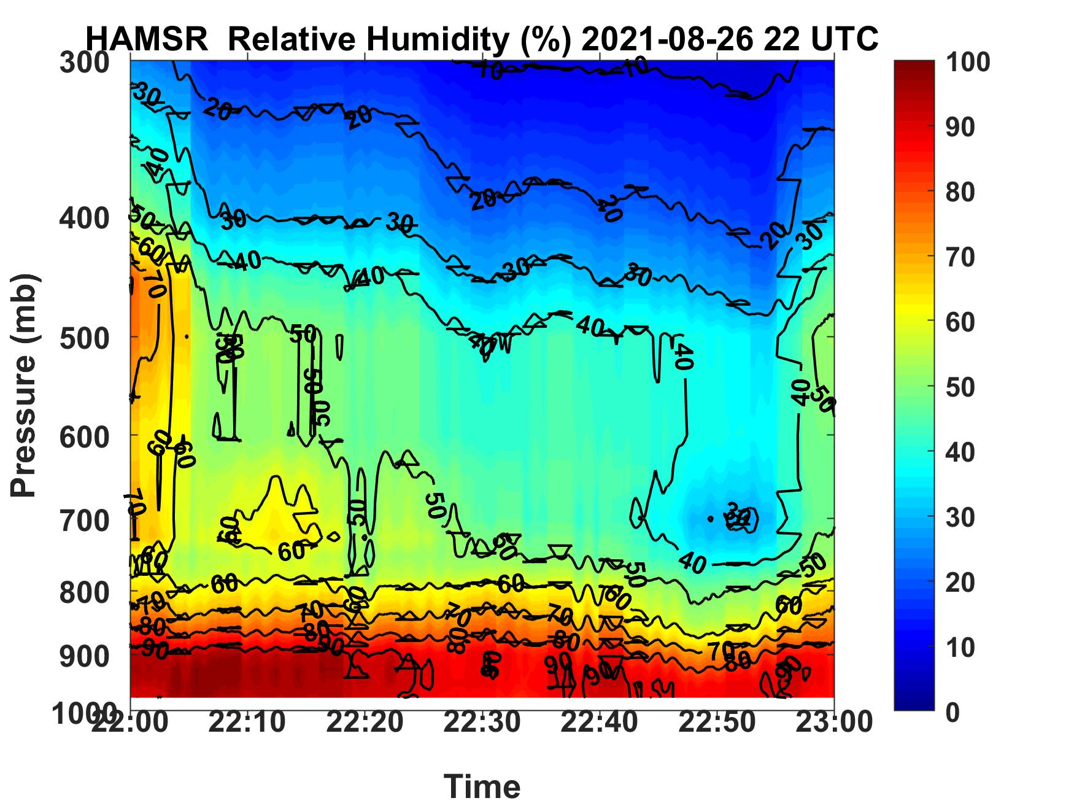
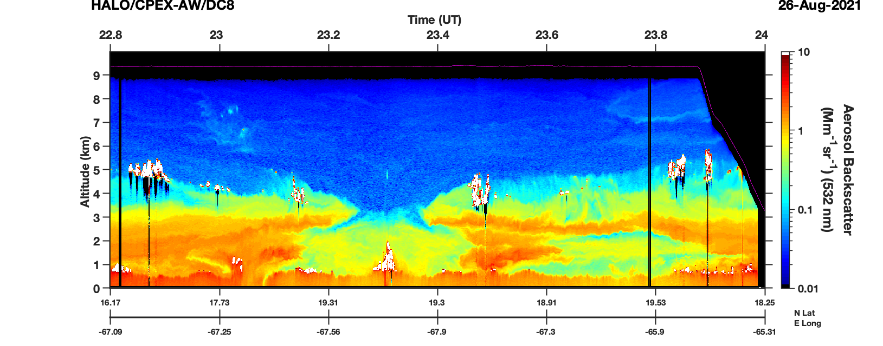
2021 Hurricane Field Program-APHEX
CPEX-AW Ida: 26 September (RF04)
Data from APR-3
HALO 532 nm aerosol backscatter
Lawnmower surveyed Tropical Storm Ida, focusing mainly on dropsonde and APR-3 measurements
Flew another ADM-Aeolus transect --- images show data from HALO (High Altitude Lidar Observatory) and HAMSR
RH curtain from HAMSR (High-altitude MMIC Sounding Radiometer) -- around Aeolus transect

Slide 7
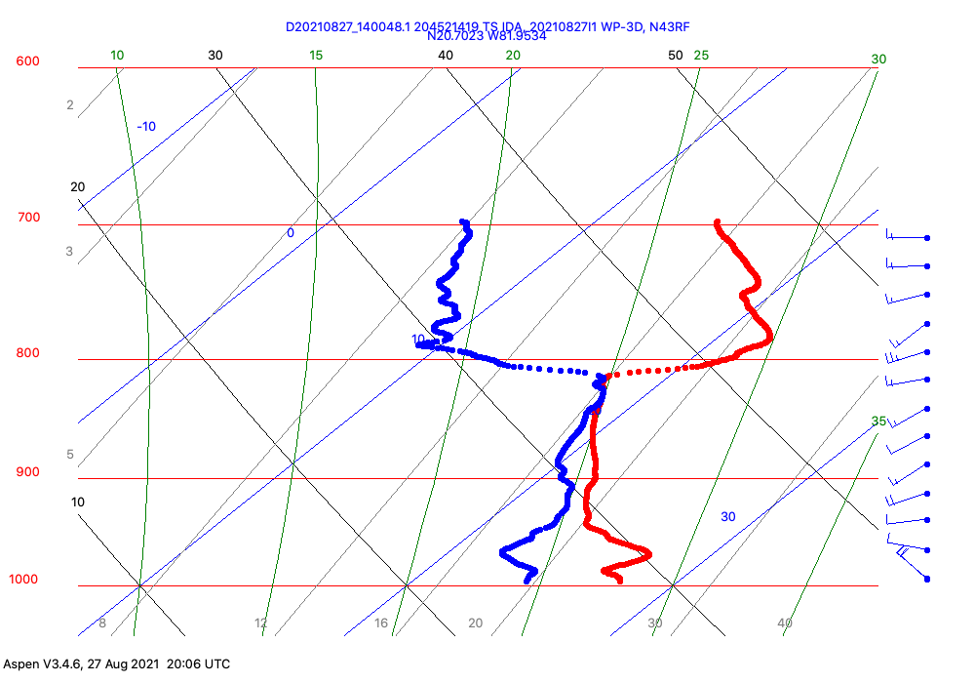
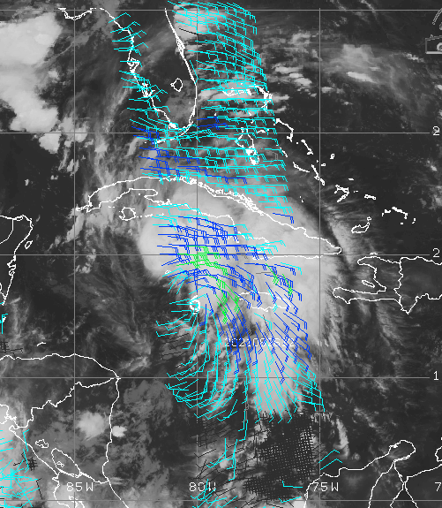
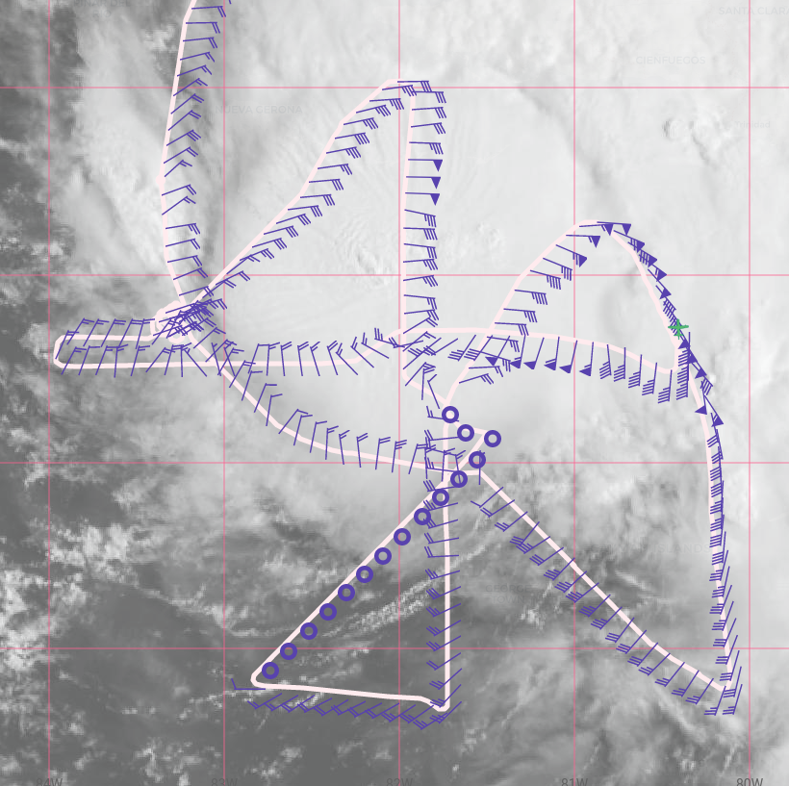
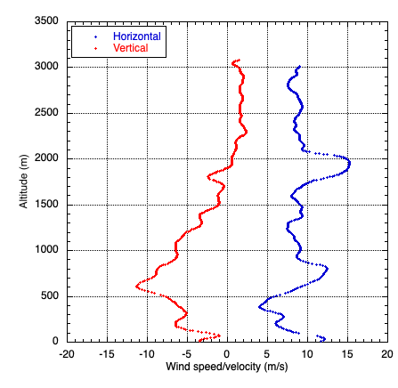
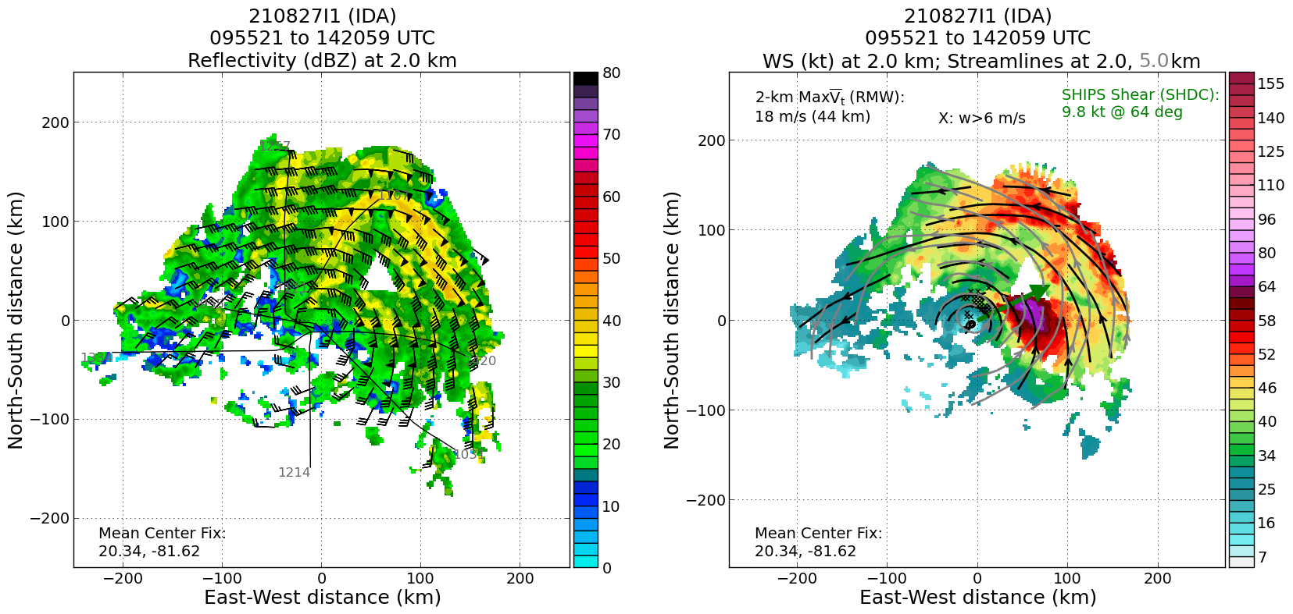
2021 Hurricane Field Program-APHEX
Hurricane Ida: 20210827I1 (EMC TDR)
Mission
LPS/Radar: Alaka, Aspen: Hazelton
GB LPS: Bucci, GB Radar: Reasor
APHEX relevance:
AIPEX (Early Stage)
Collaboration with ONR TCRI
Planned pattern: rotated figure-4
T/O off (KLAL) – Landing (KLAL): 0747 – 1549z
FL 10 k ft
28 dropsondes (28 to GTS), 20 NWS, 8 ONR
5 NRL AXBTs (5 good)
4 TDR analyses to NHC and zero sent to EMC
Technical issues in Boulder, CO (fiber optic cut disrupted the operations of the mission and the delivery of tail Doppler radar data to EMC
TDR data was still available to the NHC forecasters who used it for situational awareness.
The flight level winds in the north and east quadrants were stronger than expected and Ida was upgraded to a hurricane near the end of the mission in the 11AM EDT NHC advisory.
1400z center drop
N43 final flight track
1400z center drop
ASCAT Scatterometer pass
11 m/s
downdraft
(~600 m)
2.0 km reflectivity and winds (left image) and 2.0 and 5.0 km streamlines with 2.0 km winds shaded (right image). Low- and mid-level centers appear to be well-aligned.

Slide 8
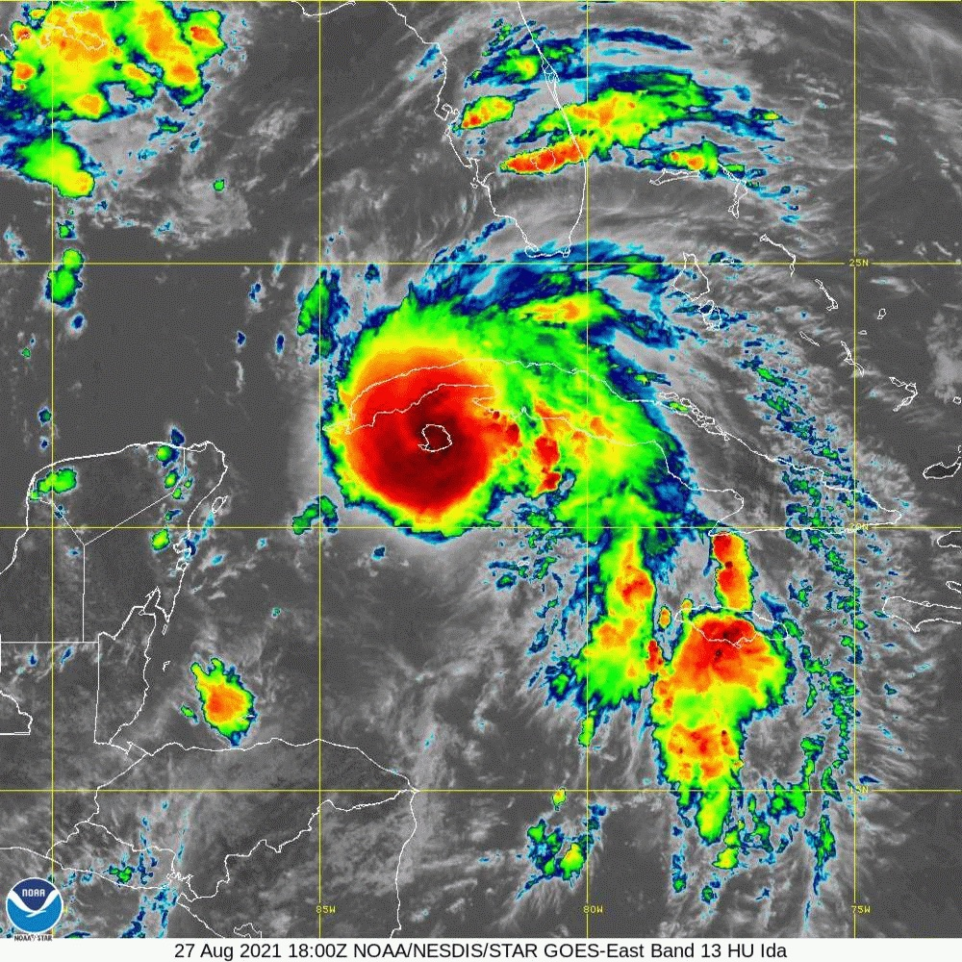
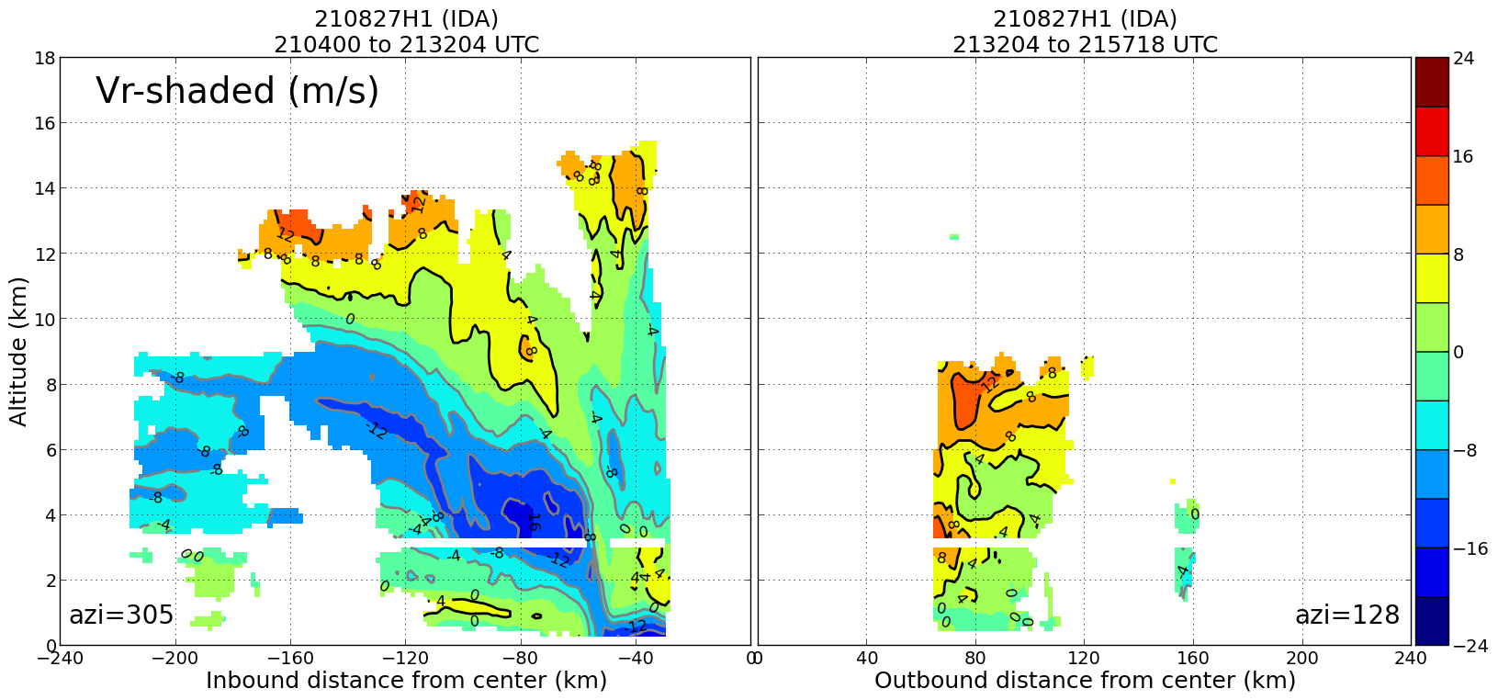
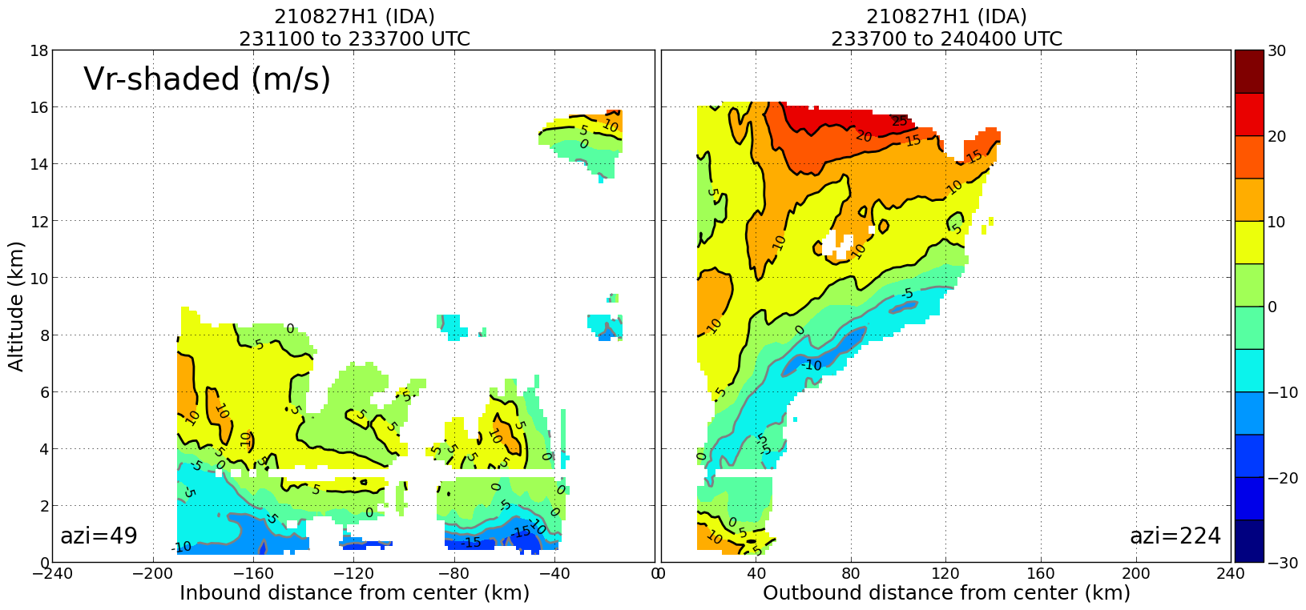
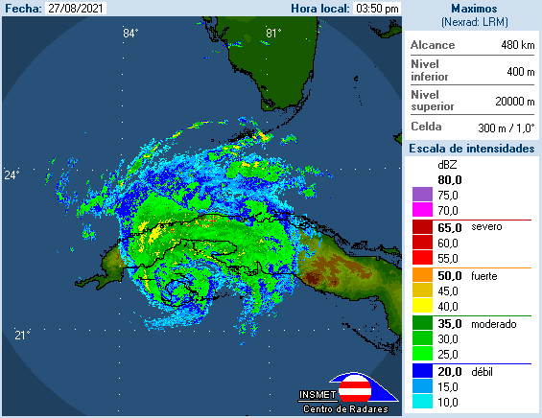
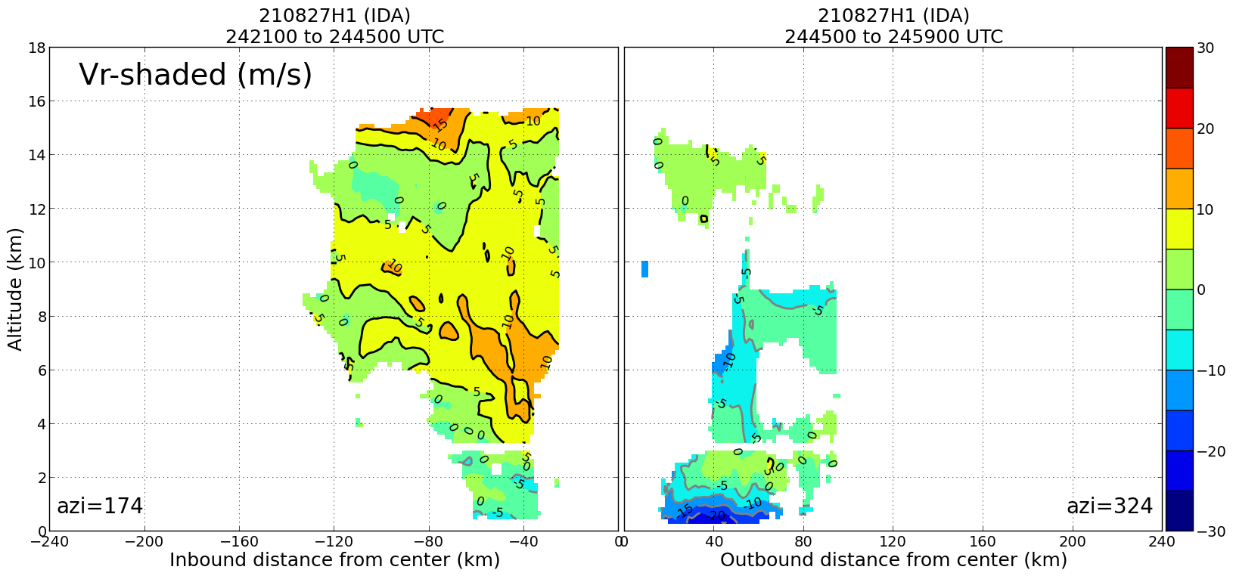
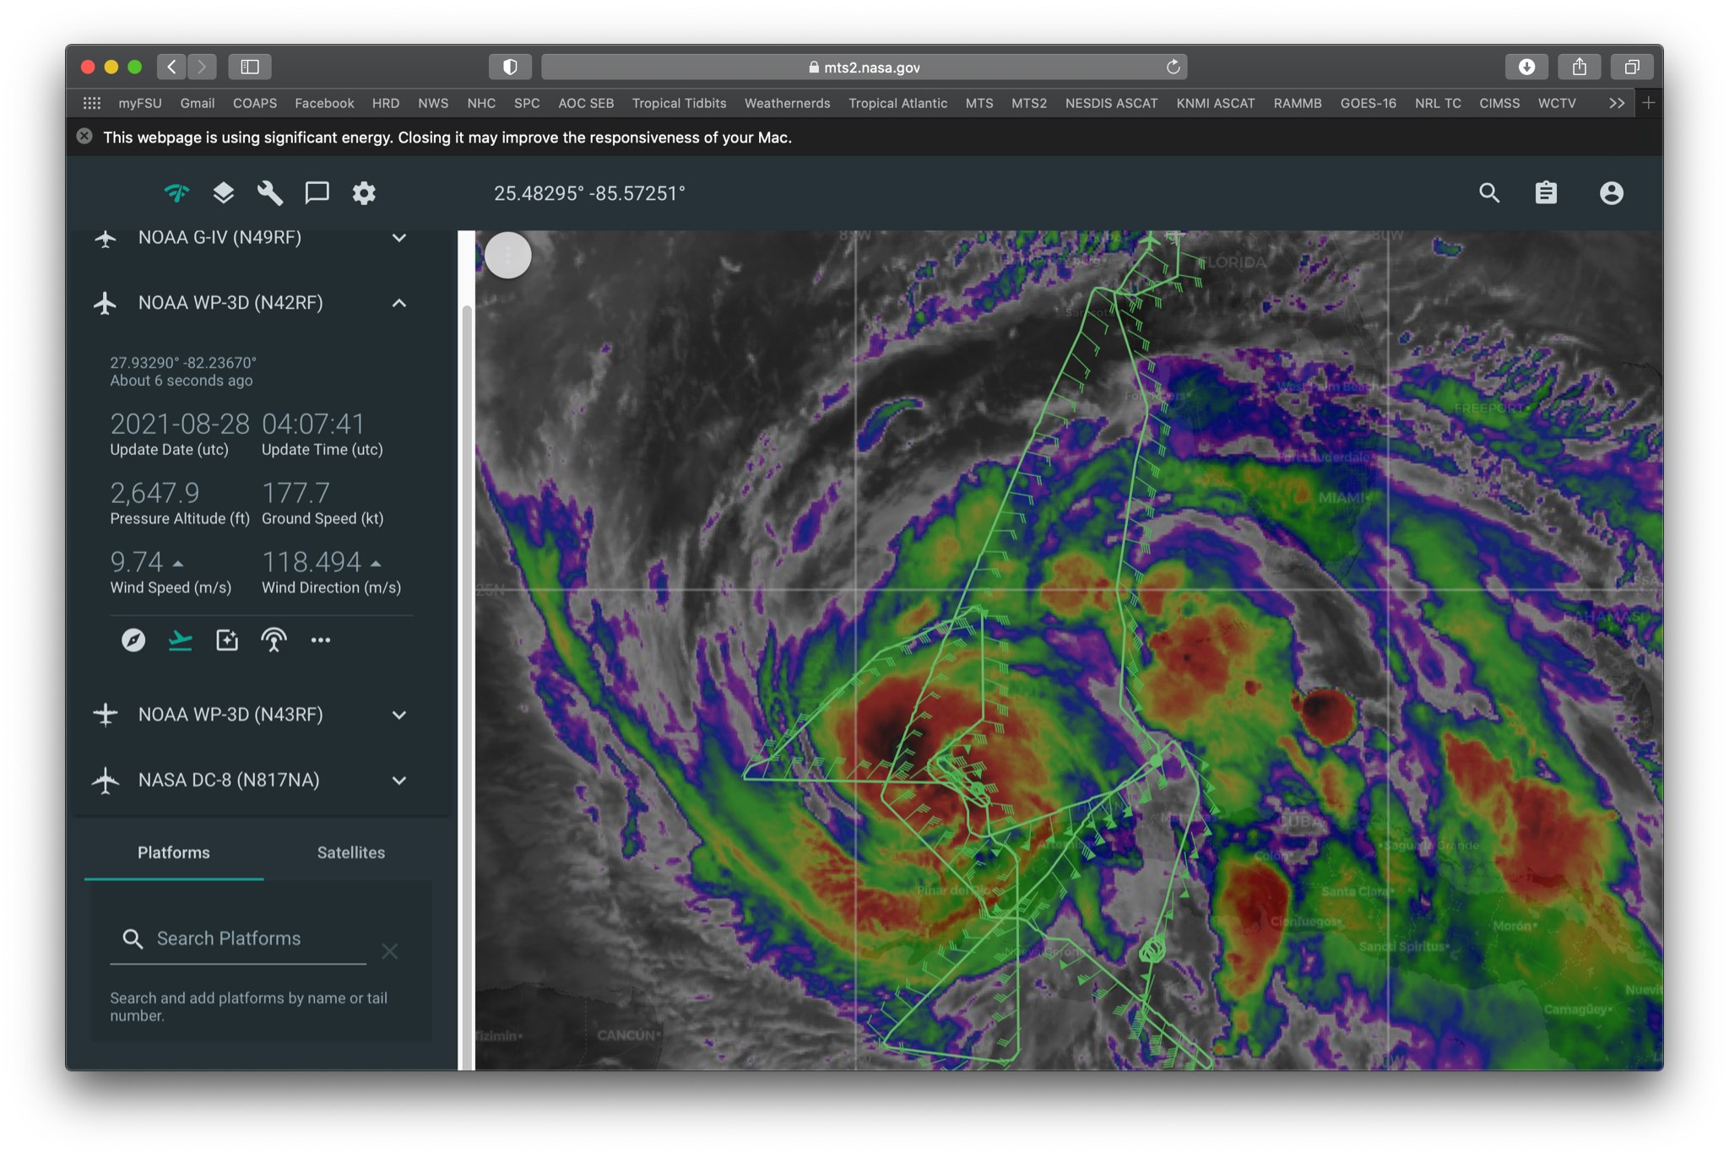
2021 Hurricane Field Program-APHEX
Hurricane Ida: 20210827H1 (HRD)
Mission
LPS/Radar: Rogers, Aspen: J. Zhang
GB LPS: Holbach, GB Radar: Gamache/Alvey
APHEX relevance:
Convective Burst Structure and Evolution
Stratiform Spiral Module
Collaboration with ONR TCRI
Planned pattern: rotated figure-4
T/O off (KLAL) – Landing (KLAL): 1955 – 0413z
FL 10 k ft
25 dropsondes (25 to GTS), 10 HRD, 15 ONR
5 NRL AXBTs (TBD good)
4 TDR analyses to NHC & only 1.5 to EMC
Several issues with data transmission, especially during the second half of the flight. We also had problems with the TDR radarsync throughout the flight.
We sampled a newly forming region of thunderstorms on the north side of Cuba as Ida was coming offshore to see how this new region would impact the eyewall development.
N42 final flight track
Strongest inflow was depicted on the N side of the circulation. Real or an artifact of land in the TDR data?

Slide 9
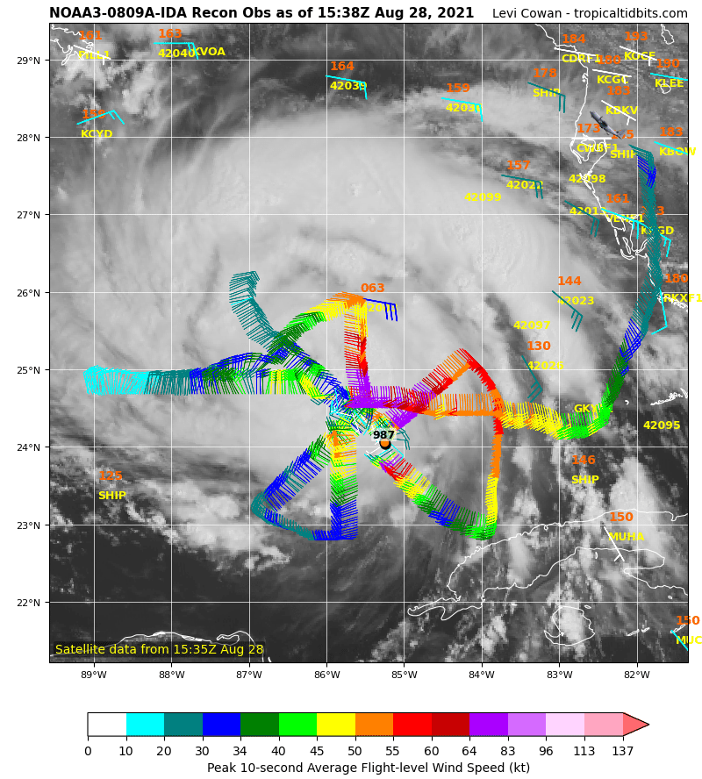
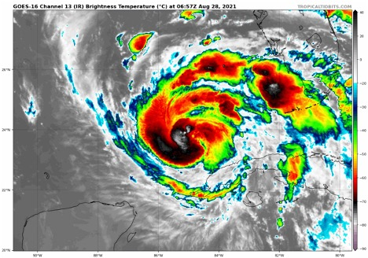
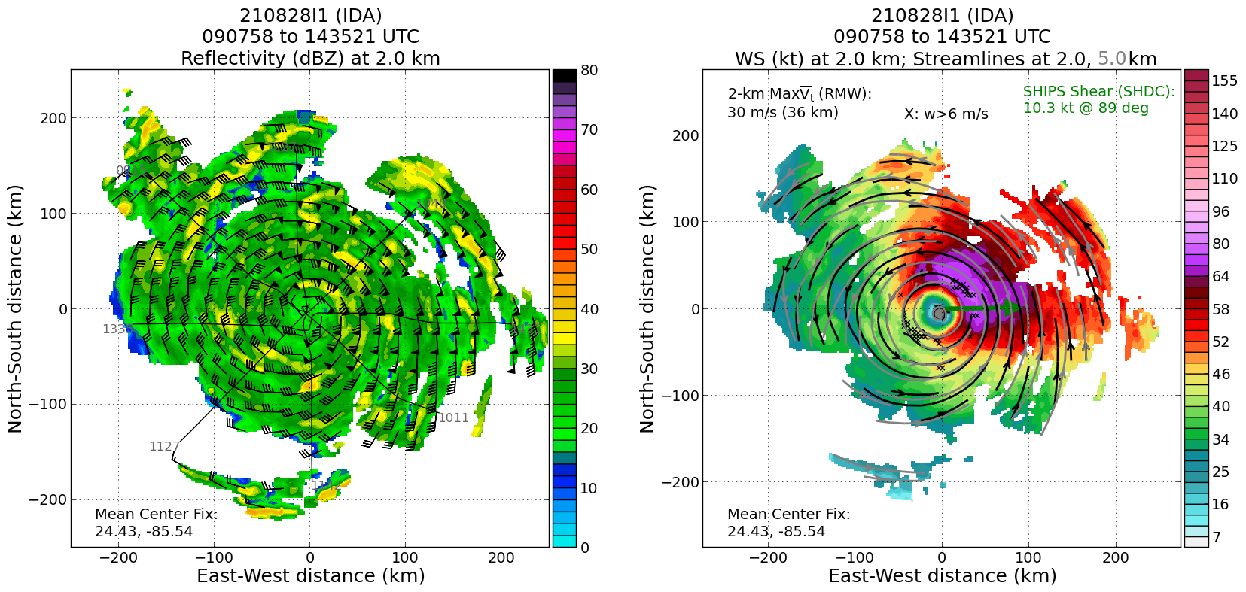
2021 Hurricane Field Program-APHEX
Hurricane Ida: 20210828I1 (EMC TDR)
Mission
LPS/Radar: Alaka, Aspen: Hazelton
GB LPS: Bucci, GB Radar: Fischer
APHEX relevance:
Ocean Observing Experiment: Ocean Survey
Gravity Wave Module (ONR TCRI)
Planned pattern: rotated figure-4
T/O off (KLAL) – Landing (KLAL): 0757 – 1543Z
FL 10 k ft
33 dropsondes (30 to GTS), 23 NWS, 10 ONR
19 UM AXBTs (17 good)
4 TDR analyses to NHC and EMC
Data was transmitted to both EMC and NHC (with some comms issues occasionally interrupting the process).
Due to limitations in the number of externally launched AXBTs, only 19 of the 25 planned UM AXBT combo drops were executed.
For single channel BTs: UM shallow BTs (400 m): can drop every ~8 min; NRL deep BTs (800 m): can drop every ~13 min
N43 final flight track
2.0 km reflectivity and winds (left image) and 2.0 and 5.0 km streamlines with 2.0 km winds shaded (right image).

Slide 10
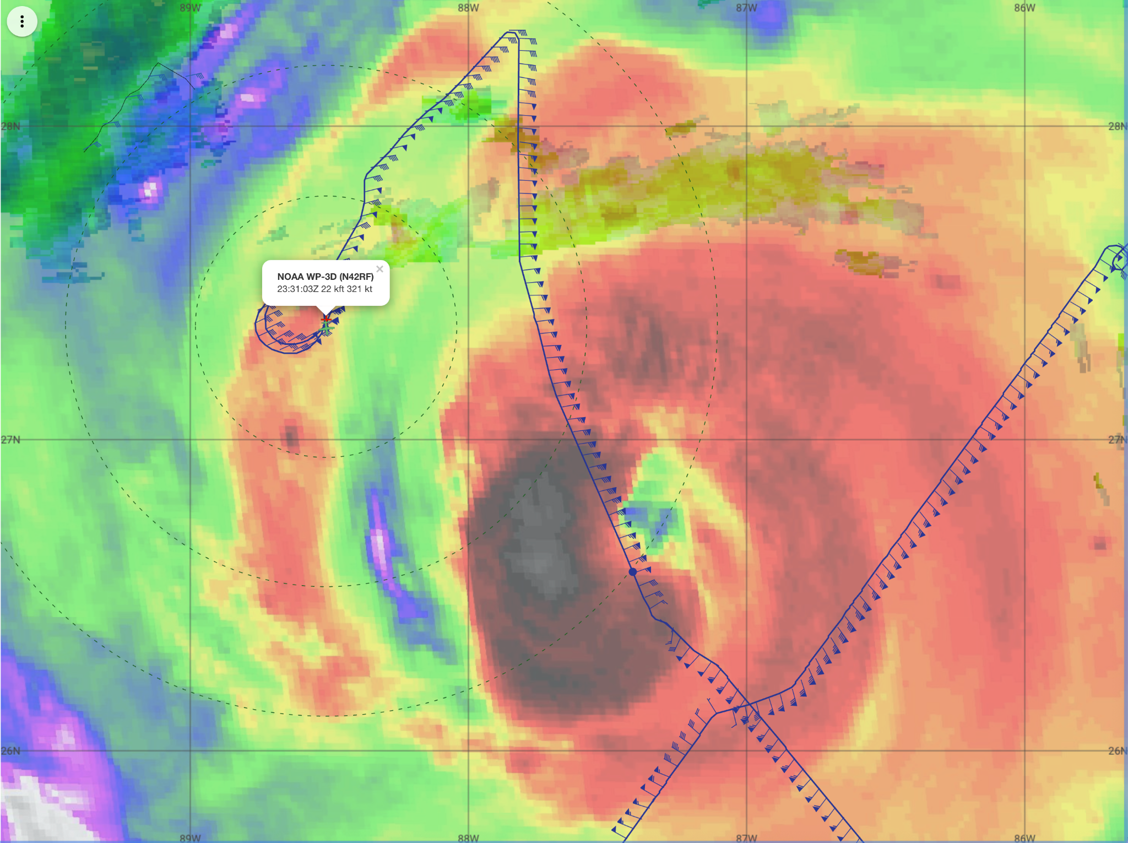
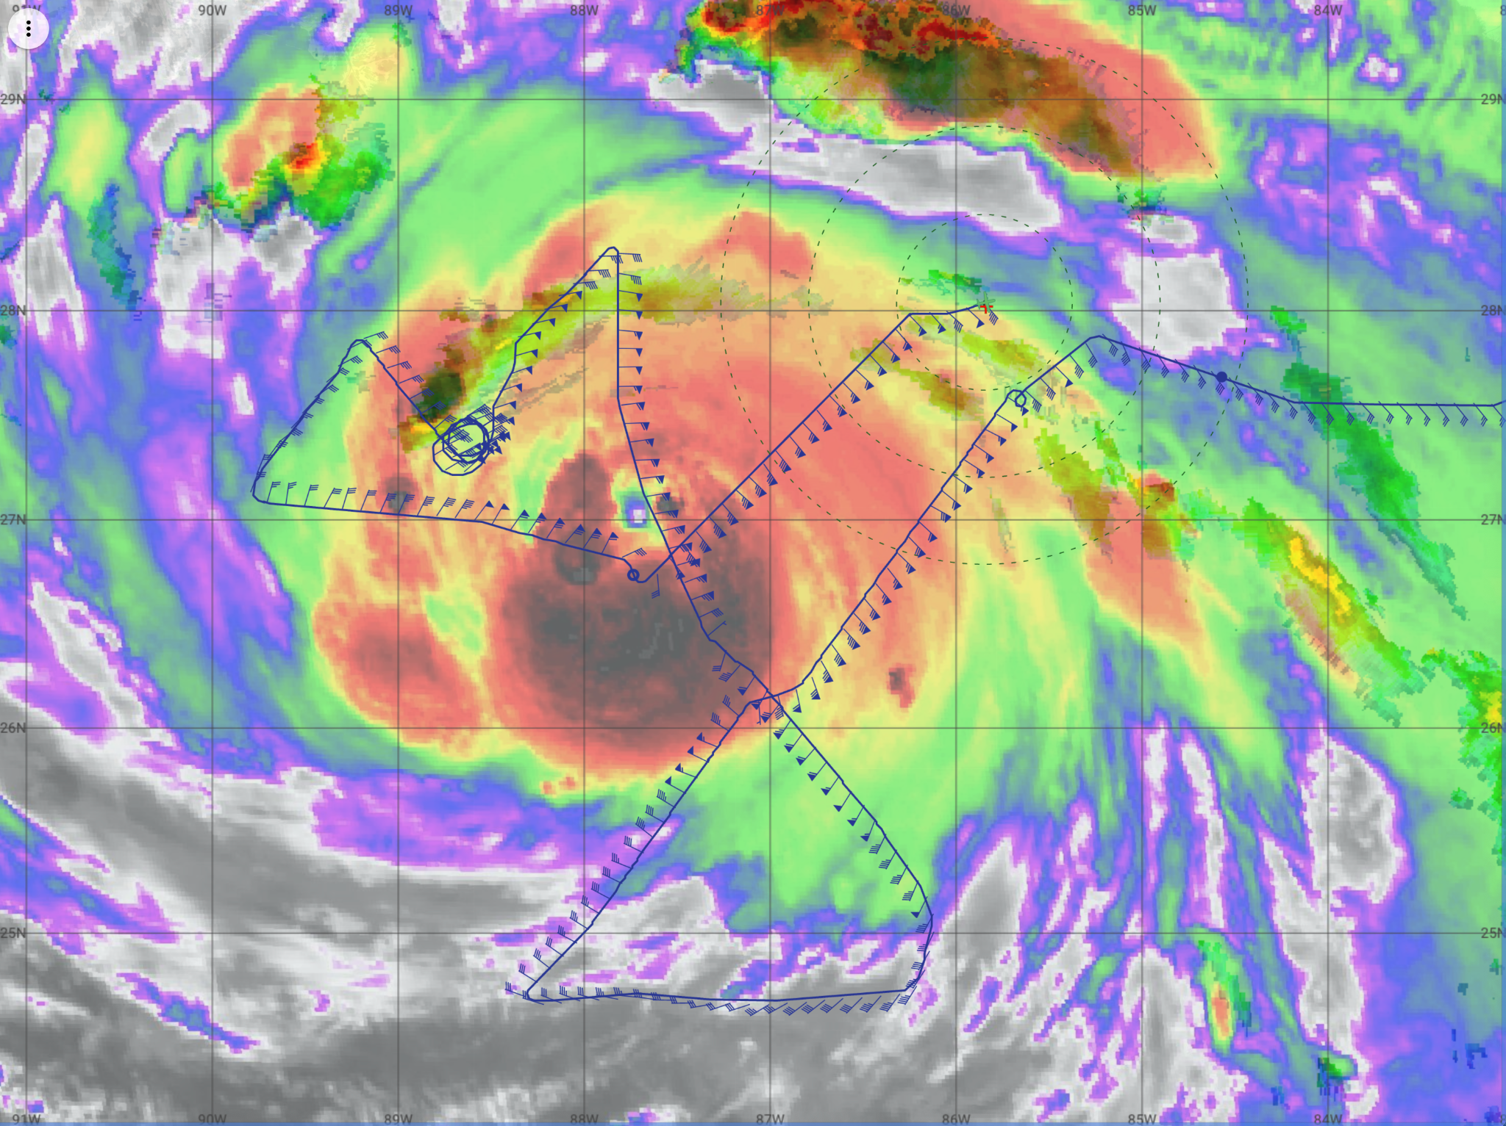
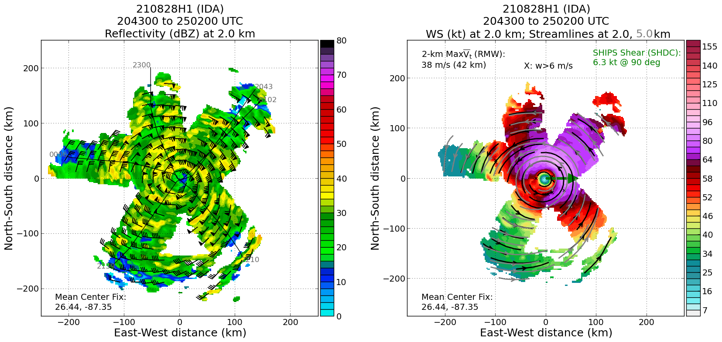
2021 Hurricane Field Program-APHEX
Hurricane Ida: 20210828H1 (EMC TDR)
Mission
LPS/Radar: Rogers, Aspen: J. Zhang
GB LPS: Marks, GB Radar: Alvey/Gamache
APHEX relevance:
Stratiform Spiral Module, Eye-eyewall Mixing Mod (7 rapid fire drops across eyewall)
Sustained & Targeted Ocean Observations
Planned pattern: butterfly
T/O off (KLAL) – Landing (KLAL): 1955 – 0156z
FL 10 k ft
30 dropsondes (27 to GTS), 20 NWS, 10 ONR
16 NRL AXBTs (13 good)
3 TDR analyses to NHC and EMC
We did not exit to the east of the storm as planned due to the AF C-130 having to abort their mission and NHC requesting more coverage to the NE of the center.
This was a very successful EMC TDR mission in a rapidly intensifying (1.8 hPa/h) TC.
CRL failed multiple times during the flight- don't know why. CRL shut off for safety >> issue resolved (see slide 4 - Logistics Highlights)
Slow transmission rates influenced analysis decision making.
Top of microphysics spiral at 7.14 km, dropsonde; -9.5°C in solid stratiform rain.
N42 final flight track
2.0 km reflectivity and winds (left image) and 2.0 and 5.0 km streamlines with 2.0 km winds shaded (right image).

Slide 11
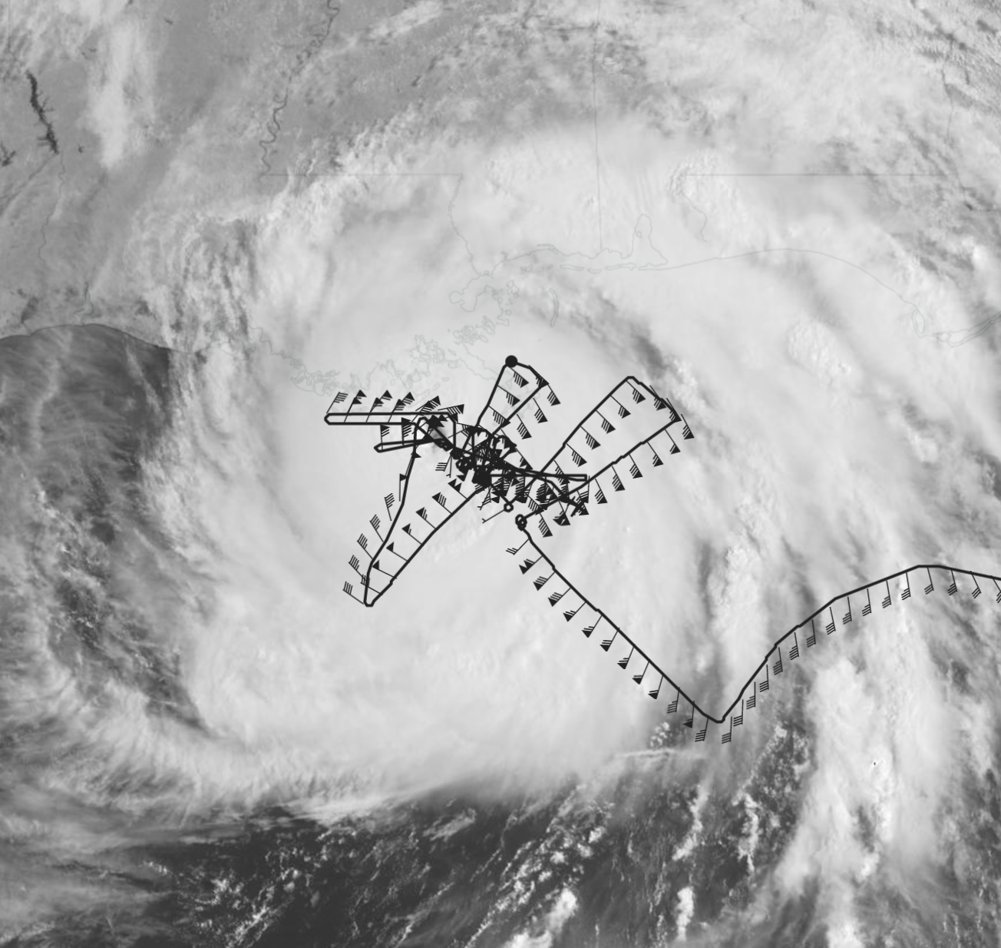
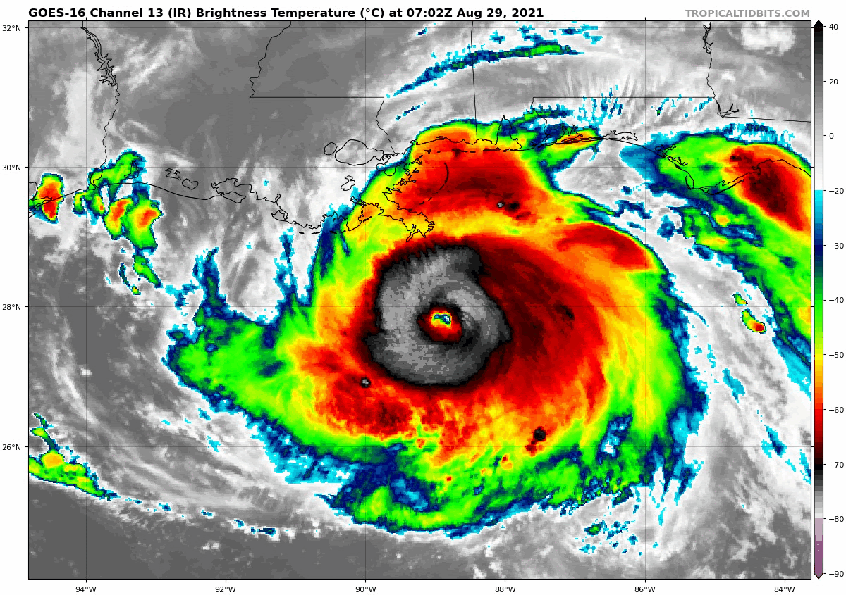
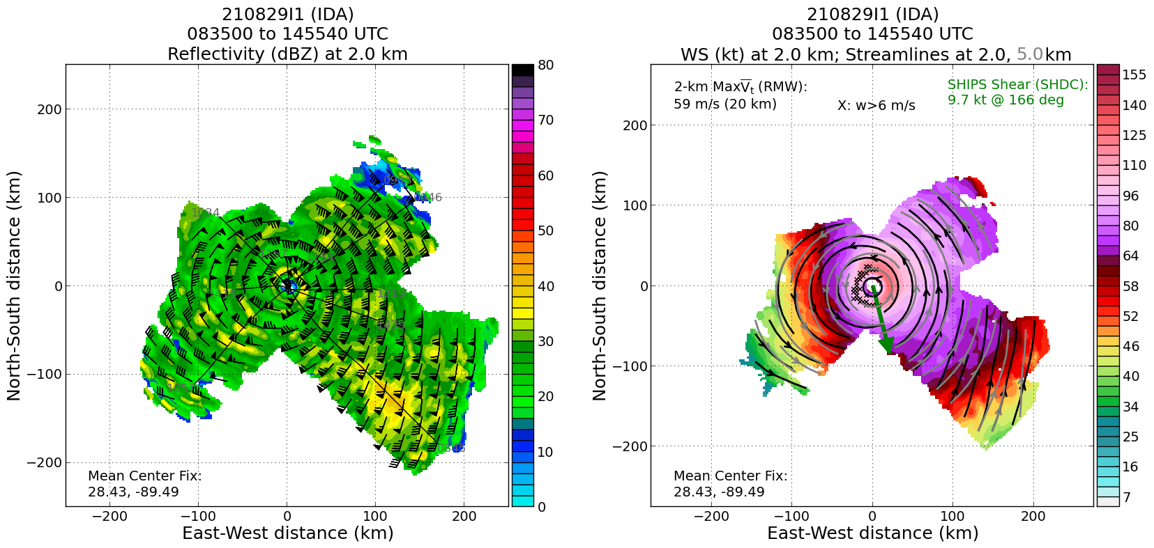
2021 Hurricane Field Program-APHEX
Hurricane Ida: 20210829I1 (NESDIS Ocean Winds)
Mission
LPS/Radar: Alaka, Aspen: Hazelton
GB LPS: Dunion/Holbach, GB Radar: Reasor
APHEX relevance:
NESDIS Ocean Winds; Surface Wind and Wave Validation; Tropical Cyclones at Landfall (Coastal Survey Module)
Planned pattern: alpha + modules
T/O off (KLAL) – Landing (KLAL): 0738 – 1604z
FL 8 k ft
35 dropsondes (32 to GTS), 2 NWS, 19 HRD, 14 ONR
11 UM AXBTs (9 good)
9 TDR analyses to NHC and EMC
Multiple TDR radarsync failures
1st center drop (SW IP to center) >> N43 extrap surface pressure of mid to high 950s…dropsonde had 932 mb. Large pressure discrepancy caused delay in reporting (confirmed with a 2nd center drop after a quick outbound/inbound to the NE).
N43 final flight track
2.0 km reflectivity and winds (left image) and 2.0 and 5.0 km streamlines with 2.0 km winds shaded (right image).

Slide 12
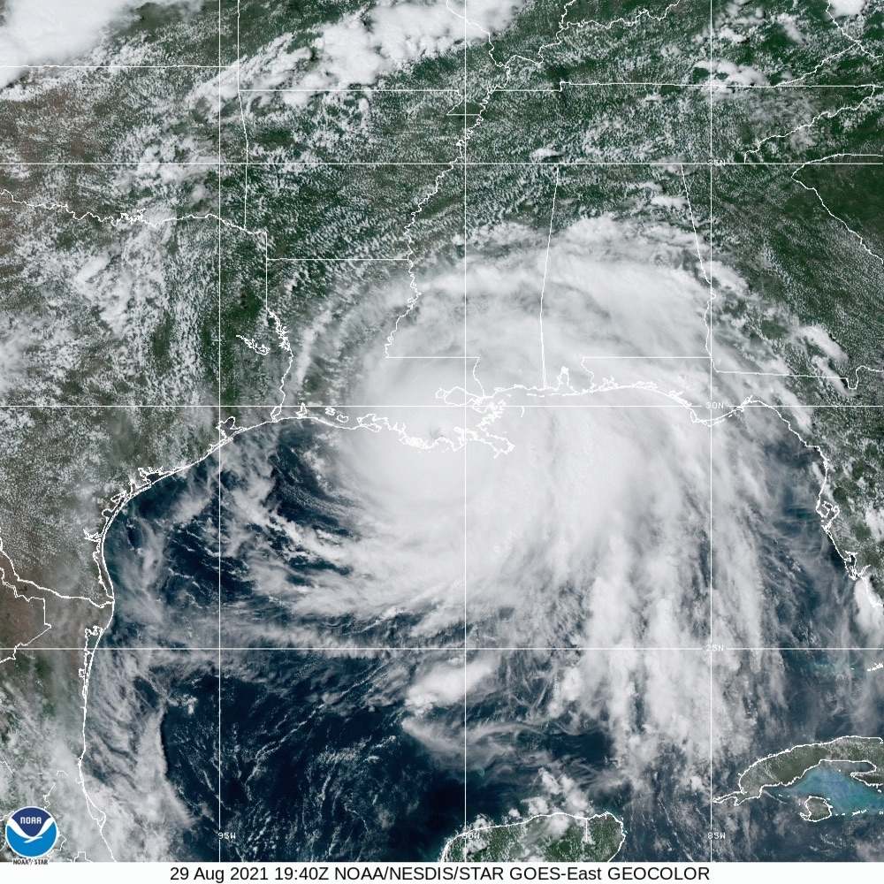
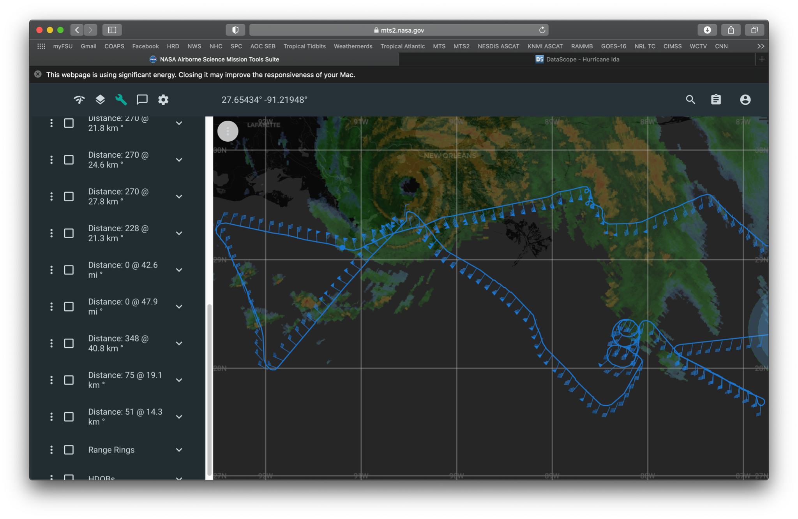
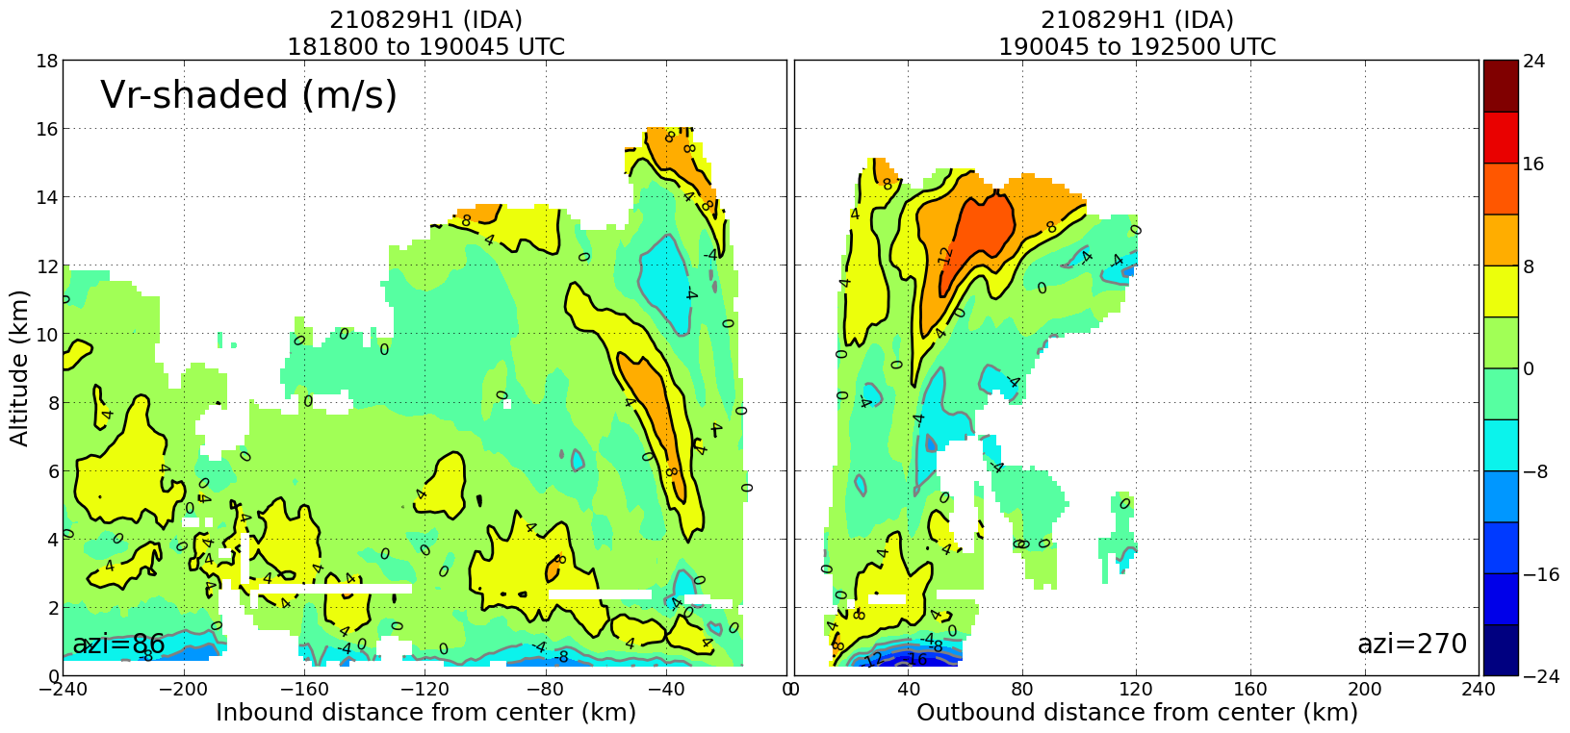
2021 Hurricane Field Program-APHEX
Hurricane Ida: 20210829H1 (HRD)
Mission
LPS/Radar: Rogers, Aspen: J. Zhang
GB LPS: Holbach, GB Radar: Alvey/Gamache
APHEX relevance:
TCs at Landfall (Coastal Survey, SFMR Coastal); Surface Wind and Wave Validation; Stratiform Spiral; ONR TCRI Gravity Wave Module; Ocean Observing: Ocean Survey
Planned pattern: modified butterfly
T/O off (KLAL) – Landing (KLAL): 1955 – 0156z
FL 10 k ft
18 dropsondes (18 to GTS), 9 HRD, 9 ONR
7 UM AXBTs (TBD good)
3 TDR analyses to NHC and EMC
Slow/inconsistent transmission rates persisted
Great measurements of PBL structure variation in on- vs. off-shore flow at landfall
Successful coordination with land-based partners. Great overlap with OU smart radars and UF towers (among others).
N42 final flight track
TDR radial wind profile for a W to E pass with deeper, stronger inflow on the west (offshore) side compared to the onshore side with a better defined corner flow region too. ~20-25 m/s inflow on the offshore side. (note: image flipped)

Slide 13
2021 Hurricane Field Program-APHEX
Hurricane Ida: 27-29 August 2021
Social Media
HRD Twitter
Flights continue into IDA: https://twitter.com/HRD_AOML_NOAA/status/1431728286372089860?s=20
Ida’s RI: https://twitter.com/HRD_AOML_NOAA/status/1432036188802662400?s=20
NOAA researchers fly Ida: https://twitter.com/HRD_AOML_NOAA/status/1432435632635326469?s=20
IDA AXBTs retweet from NOAA AOC: https://twitter.com/NOAA_AOML/status/1432433389026557952?s=20
NOAA scientists collect radar and microphysics data in Ida: https://twitter.com/HRD_AOML_NOAA/status/1432807309441478659?s=20
Daily Plan of the Day
Sent to research partners, AOML Comms, OAR Communications Office
Emily Ashe, Michael F., Jason D., and Jon Z.
Post-map discussion tag-ups to discuss social media opportunities

Slide 14
2021 Hurricane Field Program-APHEX
Hurricane Ida: 27-29 August 2021
Other Issues – what went well?...what can we do better?
Calibration and shakedown still needed
NOAA-42 SFMR still running ~5-10 kt too high (no time for a cal mission over the Atlantic after Henri series)
NOAA-43 surface pressure extrapolation needs calibrating (running 10+ mb too high)
WSRA coding issue preventing real-time retrievals of SWH and 2-D ocean wave spectra
HRD/CIMAS crewing SIP and COVID testing schedule continues to work well for us
Pre-landfall discussions with various landfall ground team leads were fruitful

Slide 15

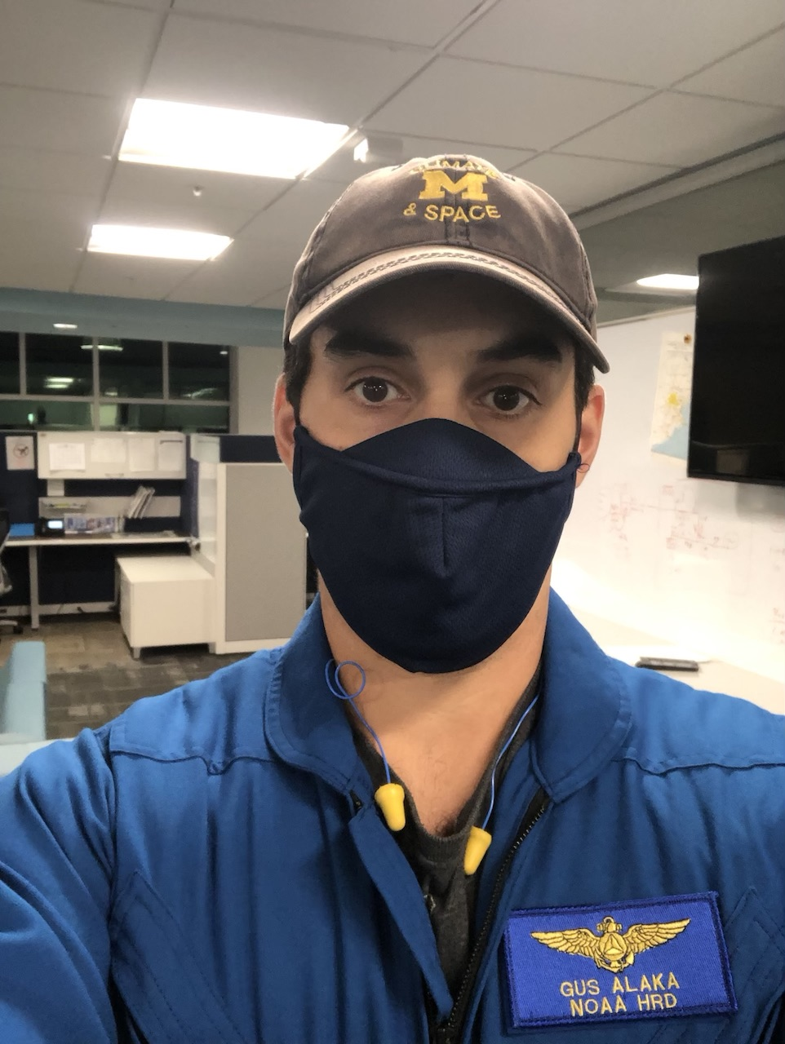
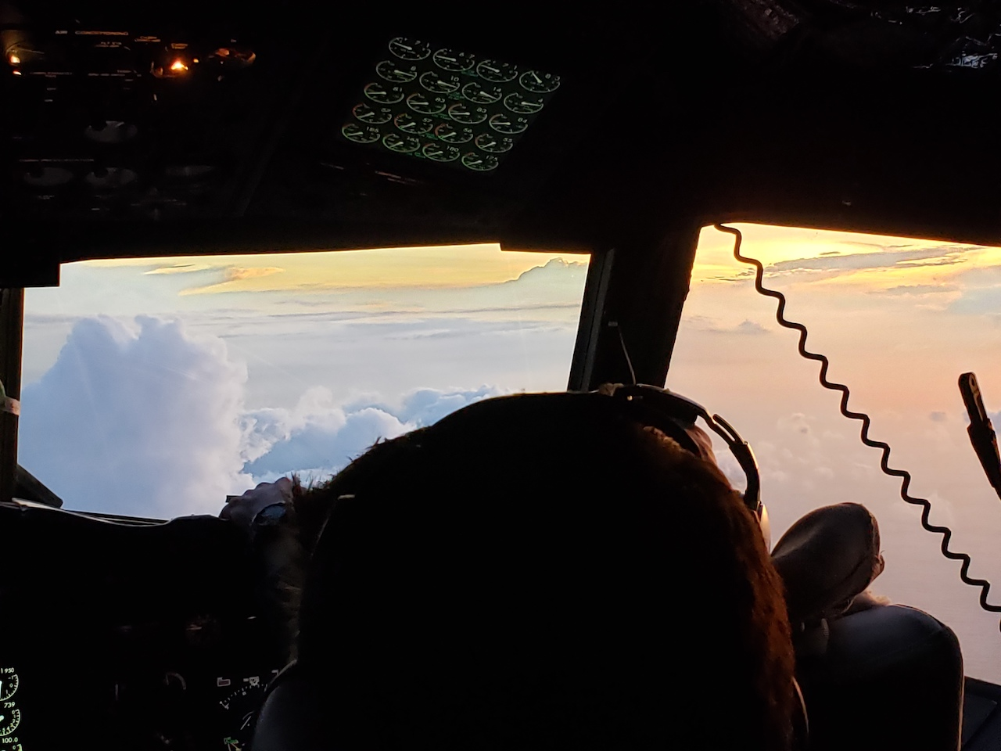
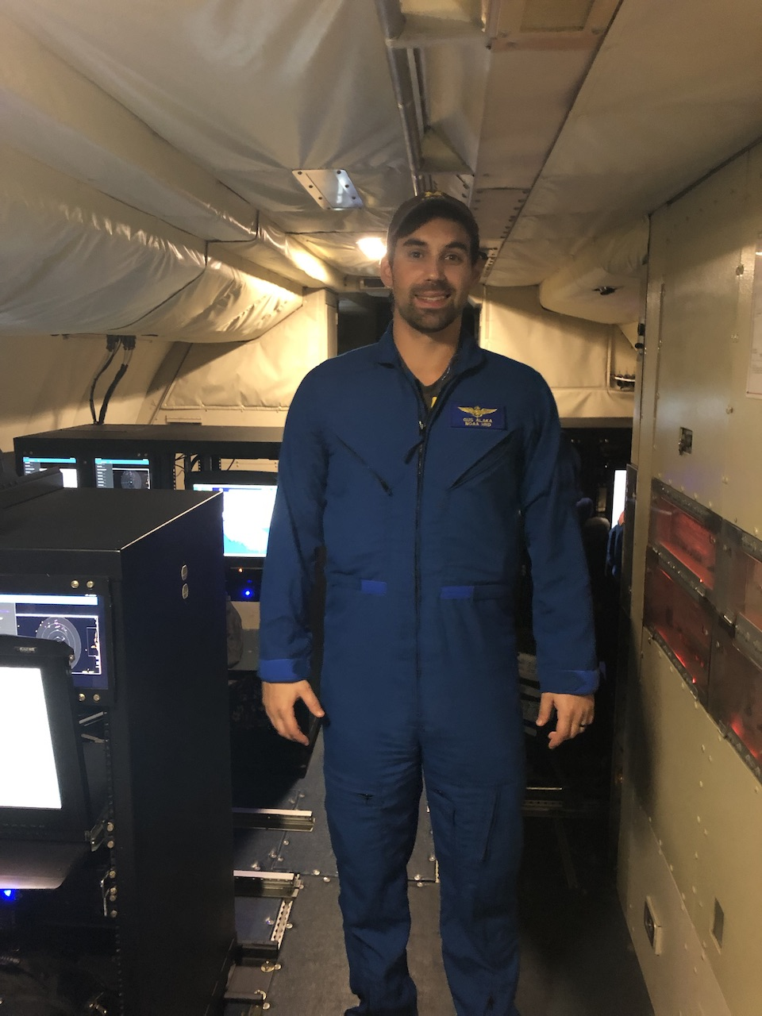
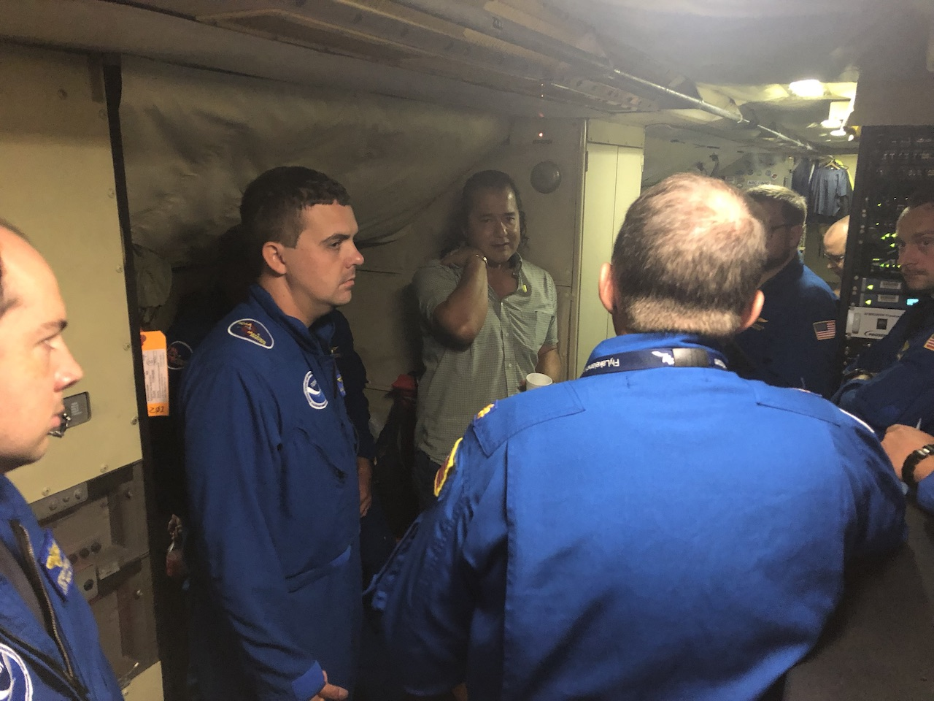
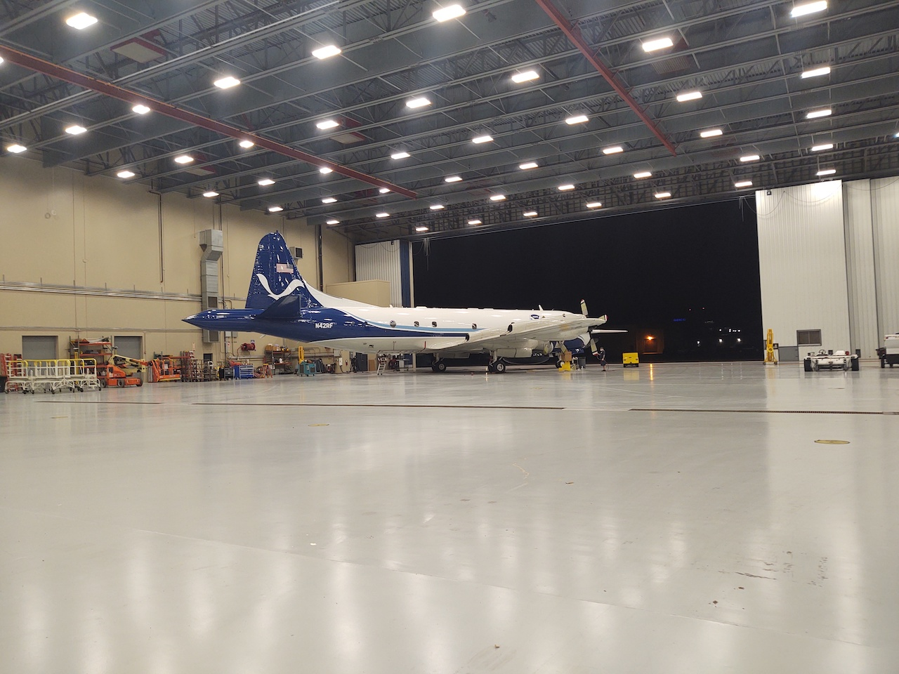
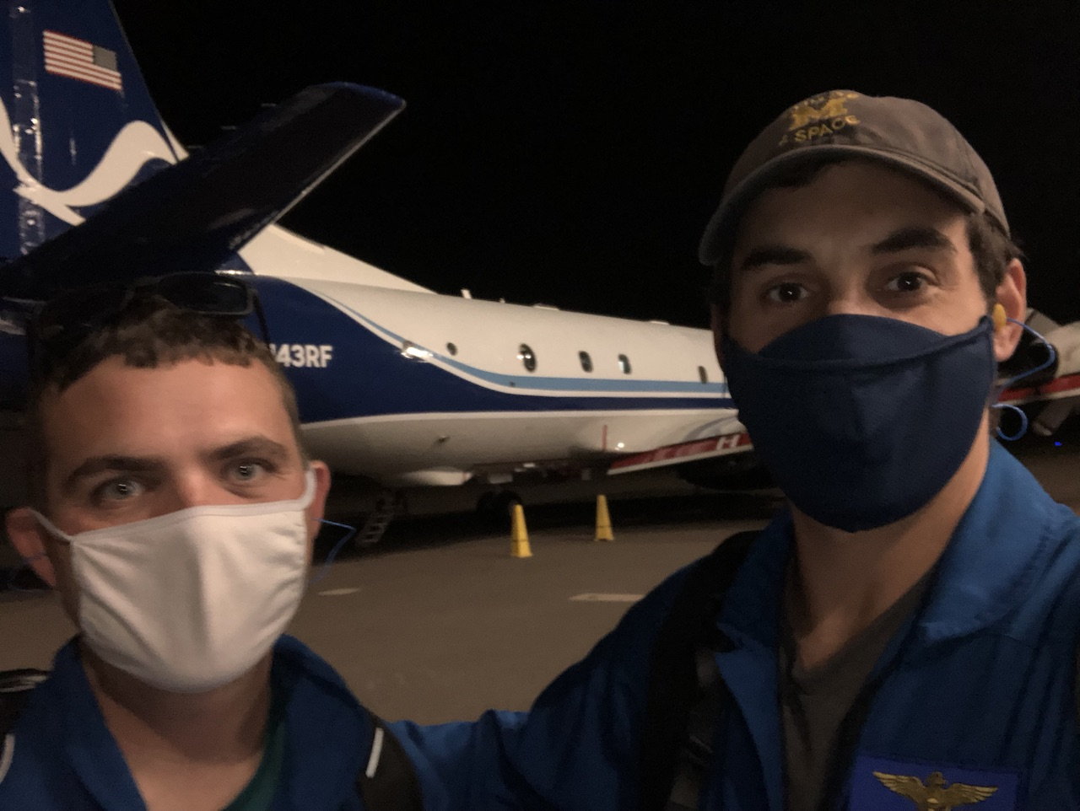
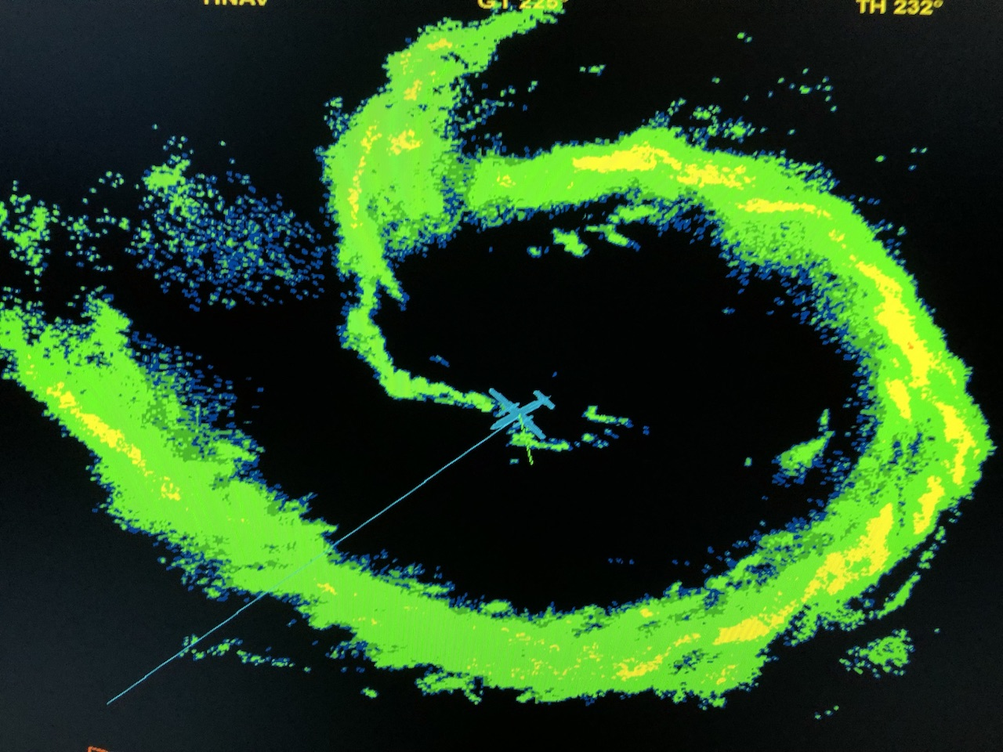
2021 Hurricane Field Program-APHEX
Hurricane Ida: 27-29 August 2021
Photo by Jon Zawislak
Photo by Rob Rogers
Photo by Rob Rogers
Photo by Gus Alaka
Photo by Andy Hazelton
Photo by Gus Alaka
Photo by Rob Rogers
Photo by Andy Hazelton
Copies of the 2021 AL08/Henri debrief can be found in the HRD Google Drive folder
HRD >> Hurricane Field Program >> 2021 >> Debriefs >> AL09/Ida

