Slide 1
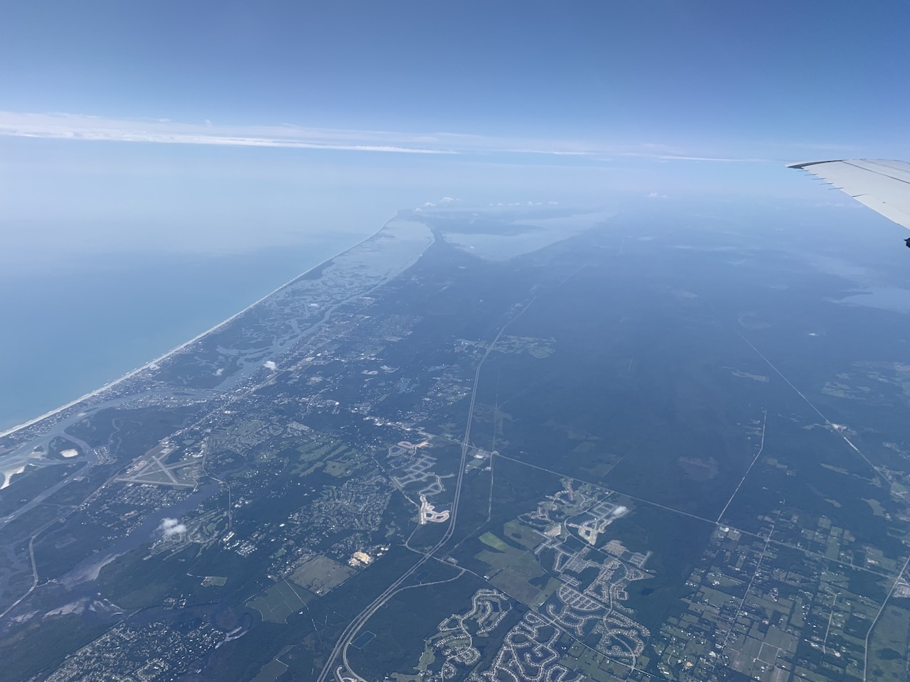


2021 Hurricane Field Program
Advancing the Prediction of Hurricanes Experiment (APHEX)
Henri (AL08) Debrief
Jason Dunion – HFP Director
Jon Zawislak - HFP Deputy Director
Photo by Sim Aberson

Slide 2
2021 Hurricane Field Program-APHEX
Summary of Missions (20-21 August 2021)
Summary of Missions
3 P-3 missions (EMC)
  62 GPS dropsondes / 60 transmitted to the GTS
  20 NRL AXBTs (18 good)
  9 TDR analyses transmitted to EMC & NHC
HRD Crewing
  20210820H1: EMC TDR
    None (LPS, radar), None (Aspen), Alvey/Gamache (GB radar), Zawislak (GB LPS), Sellwood (GB Aspen/TAG)
  2021021H1: EMC TDR
    Aberson (LPS, radar), None (Aspen), Fischer/Reasor (GB radar), Holbach (GB LPS), Dunion/J. Zhang (GB Aspen/TAG)
  20210821H2: EMC TDR
    None (LPS, radar), None (Aspen), Alvey/Gamache (GB radar), Zawislak (GB LPS), Sellwood (GB Aspen/TAG)

Slide 3
2021 Hurricane Field Program-APHEX
Logistics Highlights
NWS P-3 hours were depleted by the end of the Henri mission sequence
  In these scenarios, NWS uses OAR research hours to supplement flight hours
NOAA-42 SFMR
  SFMR unit S/N 001 still appears to be ~5-10 kt higher than sondes
20210820I1 mission
  N43 had a component malfunction that overheated and delaminated the aircraft windshield >> scrubbed mission
20210821H2 mission
  AF 53rd fix mission had to RTB, N42 picked up missed fixes that day
P-3 SFMRs (max altitude for reporting)
  AOC set a max altitude for reporting P-3 SFMR data at 12.5 k ft
  No current studies that have dug into how the SFMR retrieval is affected by aircraft altitude
  Could use HDOB flags to allow all SFMR winds to get reported, but be flagged in a systematic way
  AOC science is meeting on 14 Sep 2021 to decide max altitude values for SFMR reporting

Slide 4
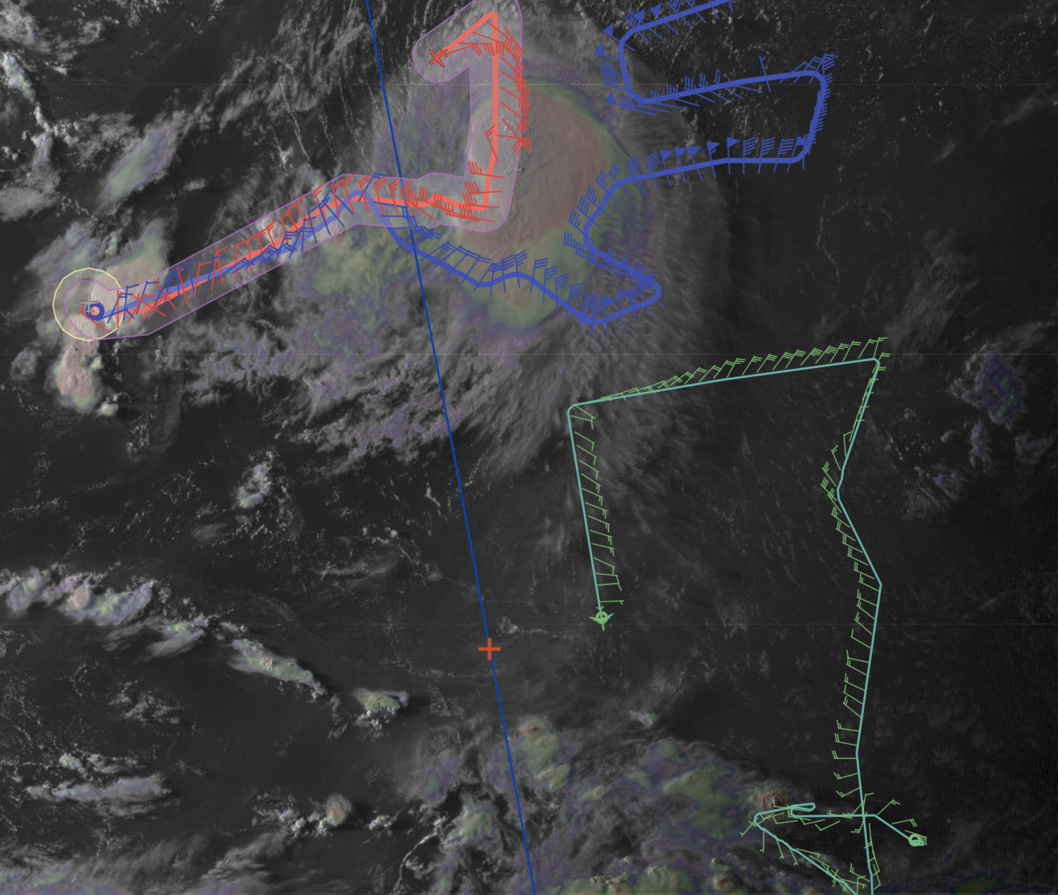
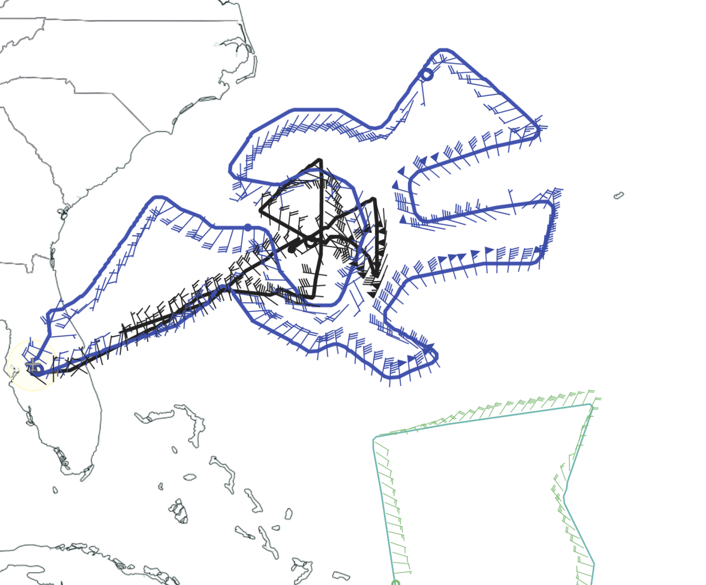
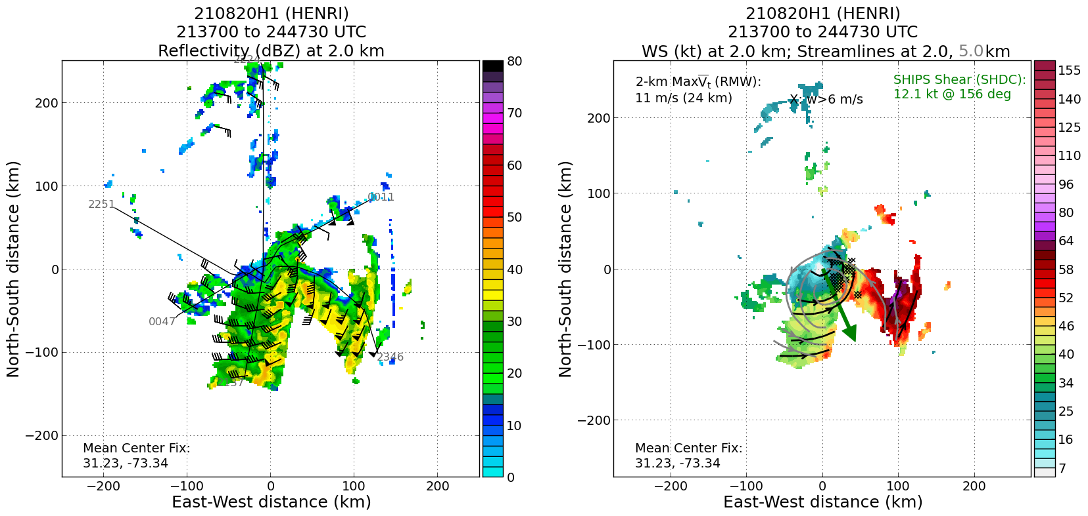
2021 Hurricane Field Program-APHEX
Tropical Storm Henri: 20210820H1 (EMC TDR)
Mission
  LPS/Radar: None, Aspen: None
  GB LPS: Zawislak, GB Aspen-TAG: Sellwood, GB Radar: Alvey/Gamache
  APHEX relevance:
    AIPEX (Early Stage); Ocean Observing Exp
    Sustained & Targeted Observations (Saildrone)
  Planned pattern: butterfly
  T/O off (KLAL) – Landing (KLAL): 2003 – 0232z
  FL 10 k ft
  22 dropsondes (20 to GTS), 16 NWS, 6 ONR
  7 NRL AXBTs (6 good)
  3 TDR analyses to NHC and EMC
  1 sonde-AXBT combo ~10 nm from Saildrone 1801556
The Saildrone was fortuitously on the last outbound track, but was missed (miscomm onboard?)... P-3 turned around in the middle of the outbound leg and dropped combo
2 drops did not reach the ground server (N42 data tech resent). Some sondes not linking up with the GPS signal (either delayed or no winds in the profile)
Somewhat tilted structure, but this seemed to be an improvement over the previous days when the LLC was exposed
N42 final flight track (black curve)
NOAA P-3 (N42)
NOAA G-IV
NASA DC-8
+ ADM-Aeolus
LL
ML
2.0 km reflectivity and winds (left image) and 2.0 and 5.0 km streamlines with 2.0 km winds shaded (right image). The final TDR composites showing the still tilted (to the south with height) circulation structure in Henri.

Slide 5
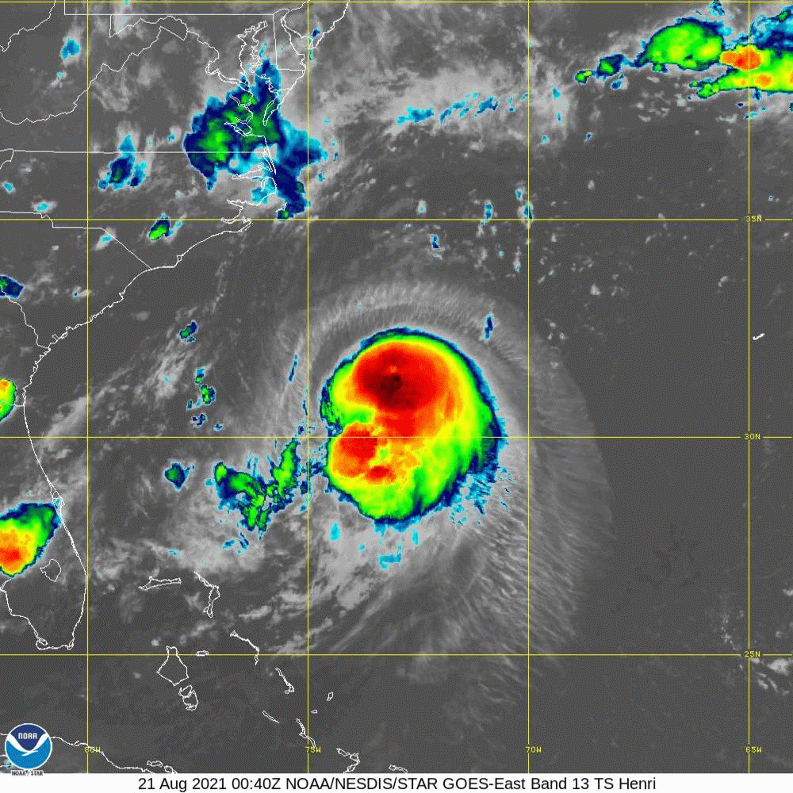
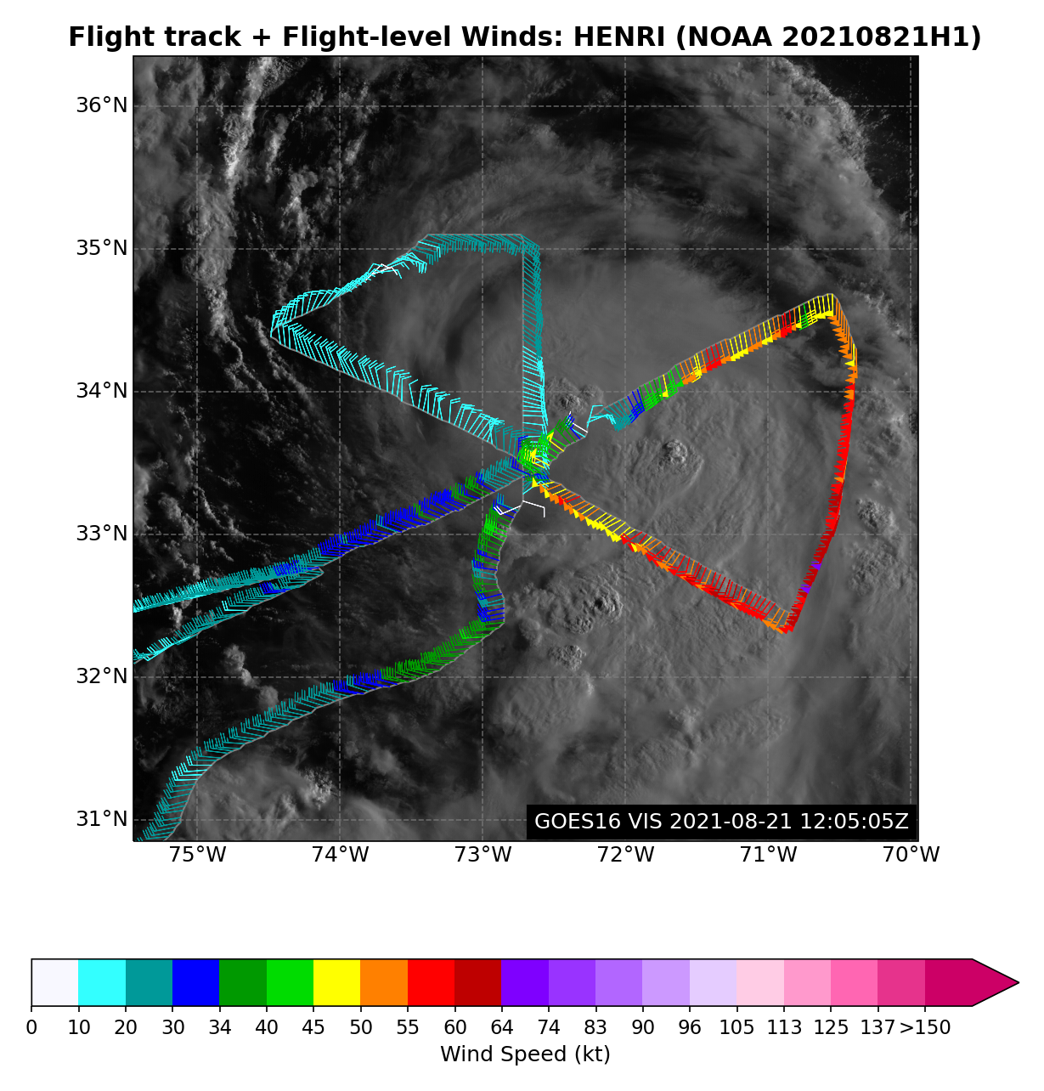
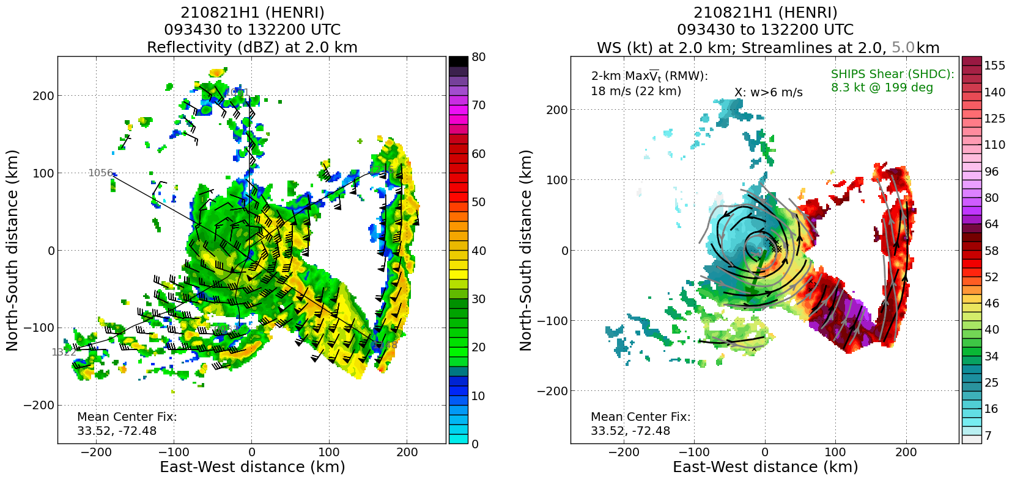
2021 Hurricane Field Program-APHEX
Hurricane Henri: 20210821H1 (EMC TDR)
Mission
  LPS/Radar: Aberson, Aspen: None
  GB LPS: Holbach, GB Aspen-TAG: J. Zhang/Dunion, GB Radar: Fischer/Reasor
  APHEX relevance:
    AIPEX (Early Stage), ONR TCRI collaboration
  Planned pattern: butterfly
  T/O off (KLAL) – Landing (KLAL): 0757 – 1540z
  FL 8-10 k ft
  19 dropsondes (19 to GTS), 14 NWS, 5 ONR
  6 NRL AXBTs (4 good, 1 partial, 1 bad)
  3 TDR analyses to NHC and EMC
  ONR TCRI Gravity Wave Module (SW corner of pattern)
SFMR unit S/N 001 still appears to be ~5-10 kt higher than sondes
1500z NHC discussion: “The NOAA tail Doppler radar data indicate that the storm is becoming more vertically aligned and that a more symmetric eyewall appears to be forming.”
N42 final flight track
2.0 km reflectivity and winds (left image) and 2.0 and 5.0 km streamlines with 2.0 km winds shaded (right image). shows a fairly well aligned LLC between 2 & 5 km. Convective center is quite small ~10 n mi. Strongest winds are in E half of the storm.

Slide 6
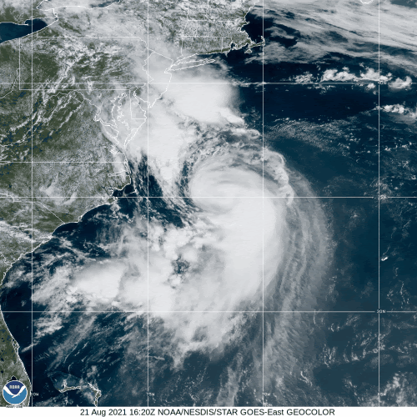
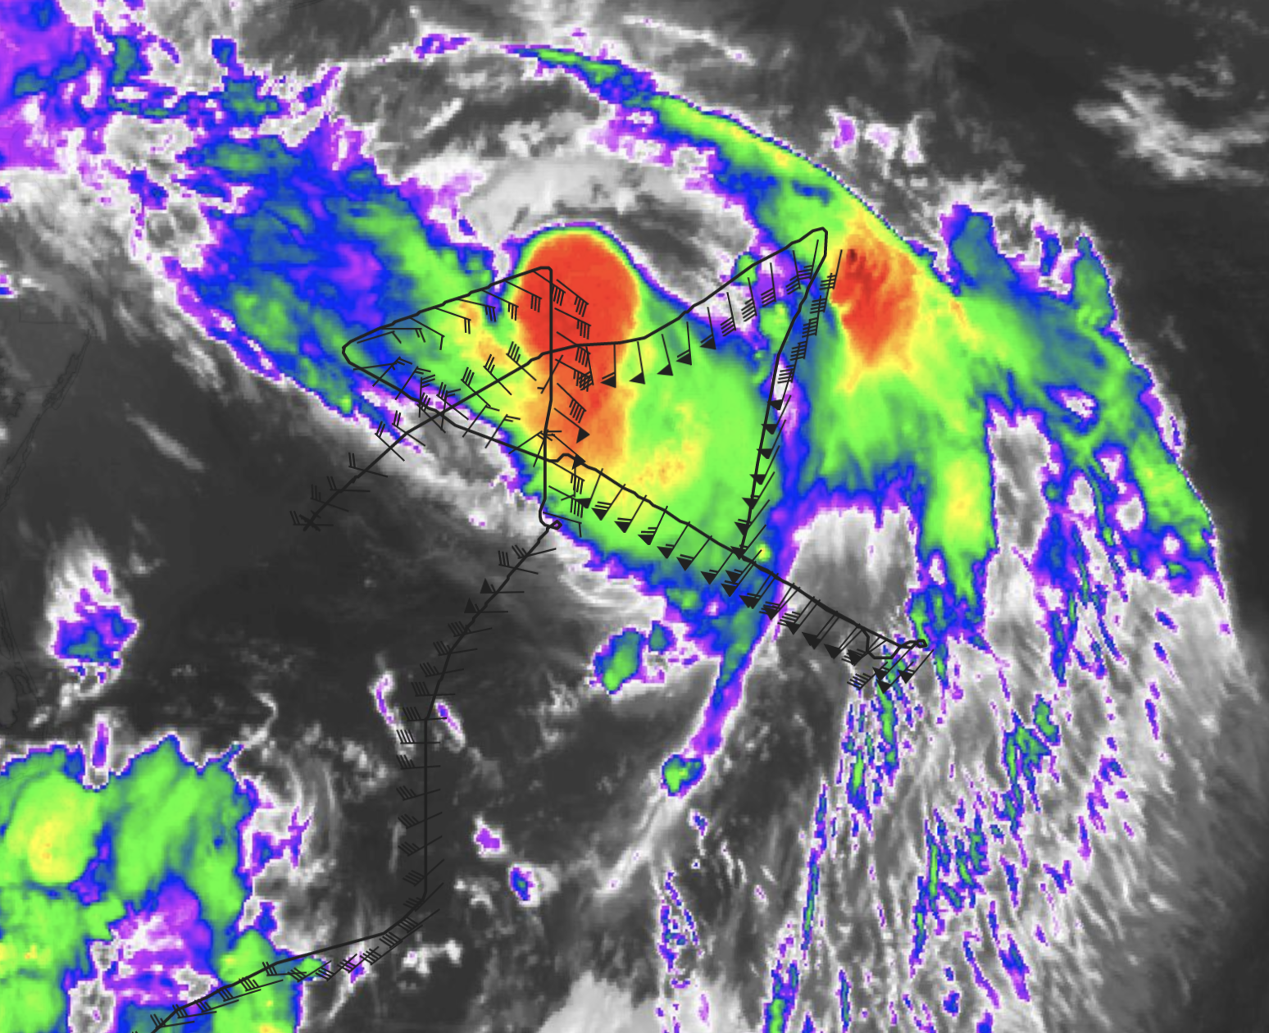
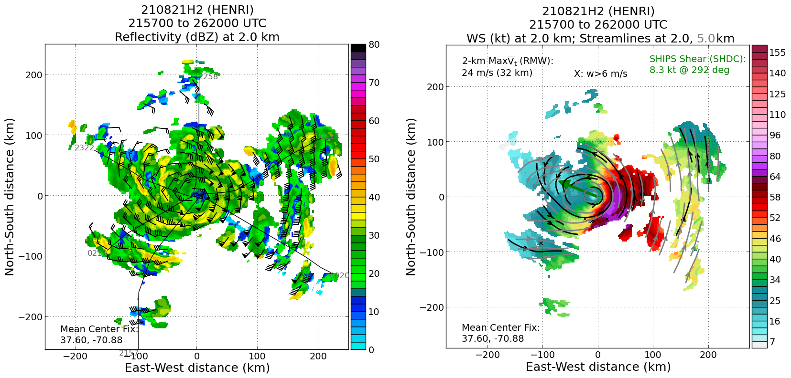
2021 Hurricane Field Program-APHEX
Hurricane Henri: 20210821H2 (EMC TDR)
Mission
  LPS/Radar: None, Aspen: None
  GB LPS: Zawislak, GB Aspen-TAG: Sellwood, GB Radar: Alvey/Gamache
  APHEX relevance:
    AIPEX (Early Stage)
    ONR TCRI collaboration
  Planned pattern: butterfly
  T/O off (KLAL) – Landing (KLAL): 1942 – 0452z
  FL 10 k ft
  21 dropsondes (21 to GTS), 15 NWS, 6 ONR
  7 NRL AXBTs (all good)
  3 TDR analyses to NHC and EMC
  ONR TCRI Gravity Wave Module (SE corner of pattern)
Since AF had to RTB, N42 picked up the 2330z fix. With possibility of required 0230z fix too, we needed a delay and the GW Module allowed us to fulfill that delay
Well aligned and near symmetric precip around center
N42 final flight track
Open Wave
ML
Open Wave
2.0 km reflectivity and winds (left image) and 2.0 and 5.0 km streamlines with 2.0 km winds shaded (right image).

Slide 7
2021 Hurricane Field Program-APHEX
Hurricane Henri: 20-21 August 2021
Social Media
HRD Twitter
  NOAA Hurricane Hunters fly into and around Fred, Grace, and Henri, and gear up for the next system: https://twitter.com/HRD_AOML_NOAA/status/1430948086155816967?s=20
HRD Blog
  NOAA Hurricane Hunters fly into and around Fred, Grace, and Henri, and gear up for the next system: https://noaahrd.wordpress.com/2021/08/26/noaa-hurricane-hunters-fly-into-and-around-fred-grace-and-henri-and-gear-up-for-the-next-system/
  AOML Instagram tagged by “flynoaa” (NOAA AOC)
  https://www.instagram.com/p/CS121CdLE-d/
Daily Plan of the Day
  Sent to research partners, AOML Comms, OAR Communications Office
  Emily Ashe, Michael F., Jason D., and Jon Z.
    Post-map discussion tag-ups to discuss social media opportunities

Slide 8
2021 Hurricane Field Program-APHEX
Hurricane Henri: 20-21 August 2021
Other Issues – what can we do better?
N42 SFMR needs proper calibration ASAP
    Calibration should be over the Atlantic and not Gulf of Mexico (RFI issues)
Continued to improve social outreach efforts
For Feds traveling back and forth between Lakeland and Miami >> need 2 separate travel vouchers whenever you return to Miami

Slide 9
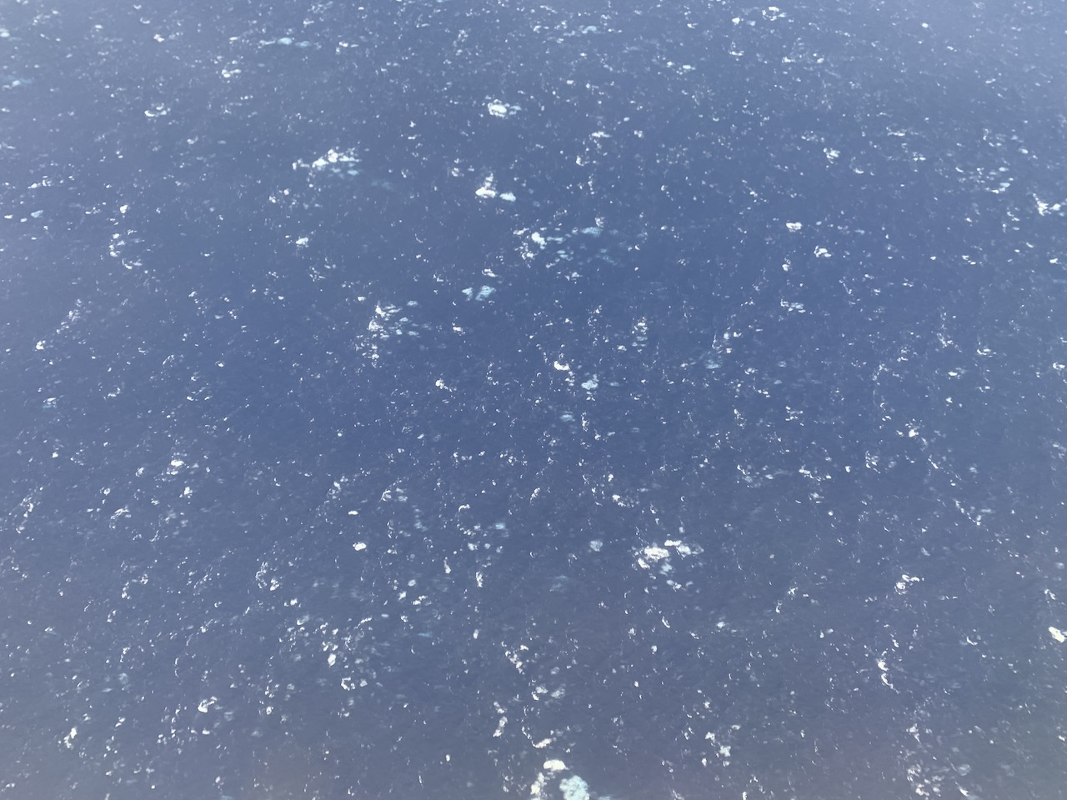
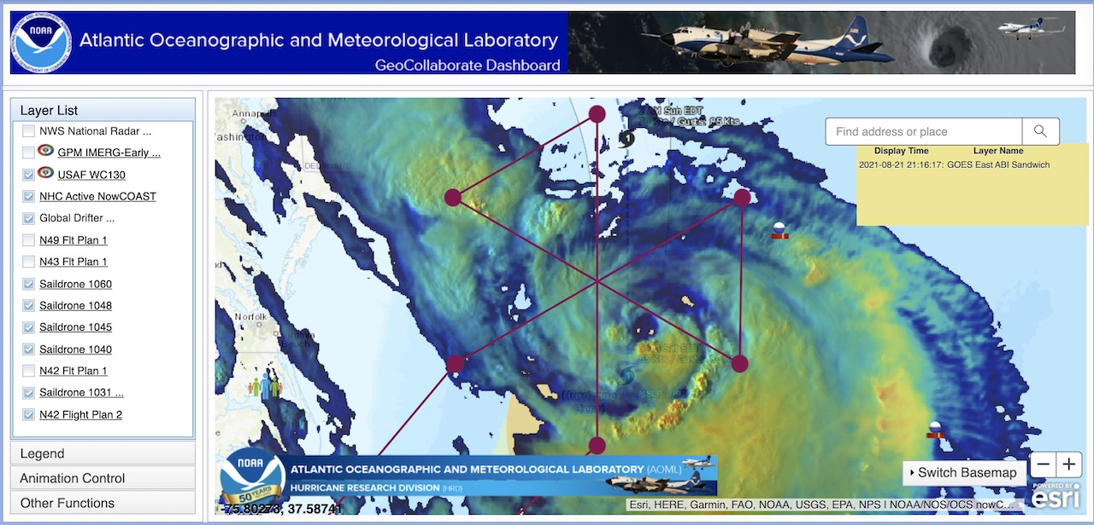
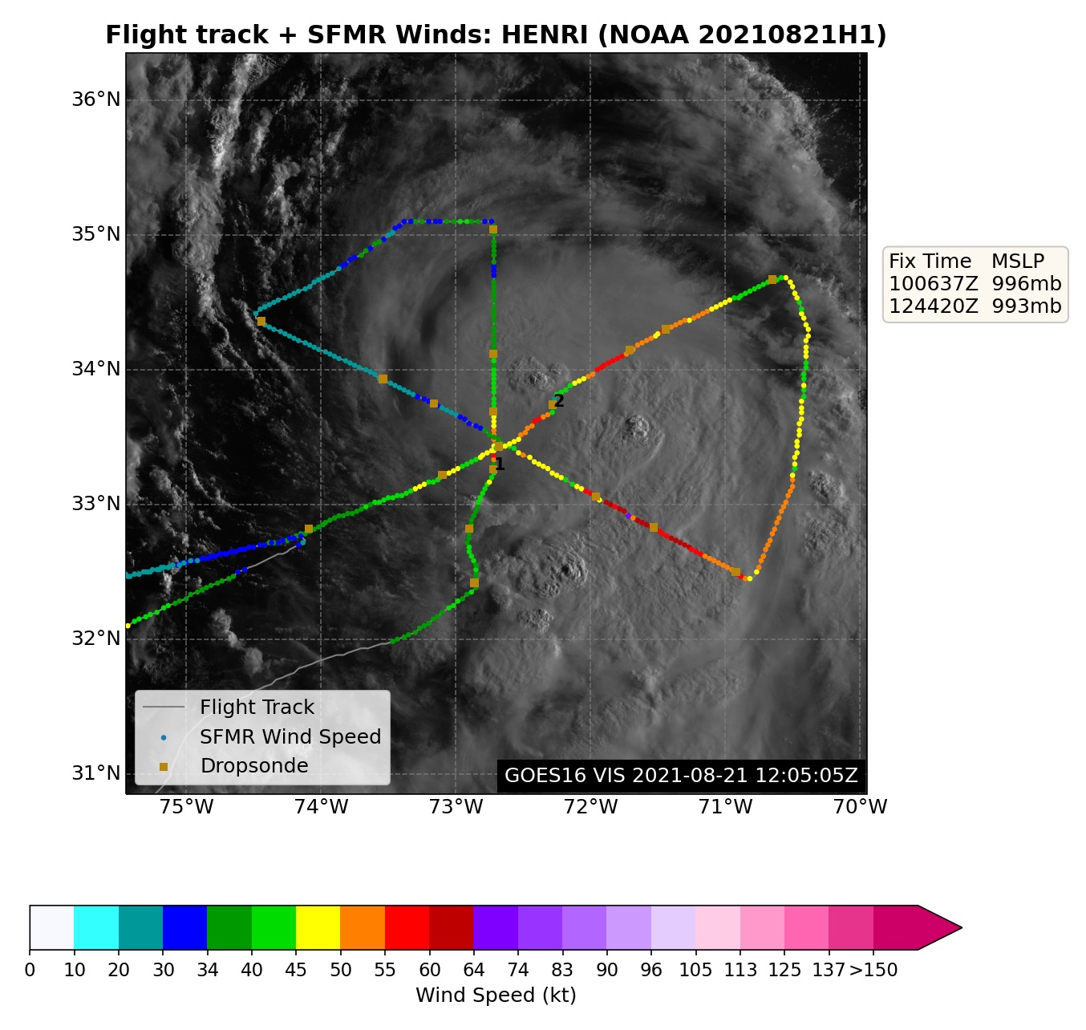
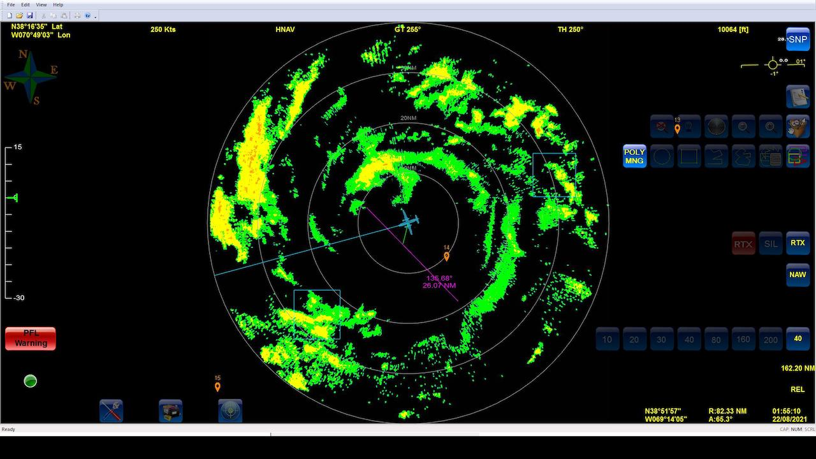
2021 Hurricane Field Program-APHEX
Hurricane Henri: 20-21 August 2021
Photo by Jon Zawislak
Photo by Sim Aberson
Photo by Sim Aberson
Copies of the 2021 AL08/Henri debrief can be found in the HRD Google Drive folder
HRD >> Hurricane Field Program >> 2021 >> Debriefs >> AL08/Henri

