Slide 1
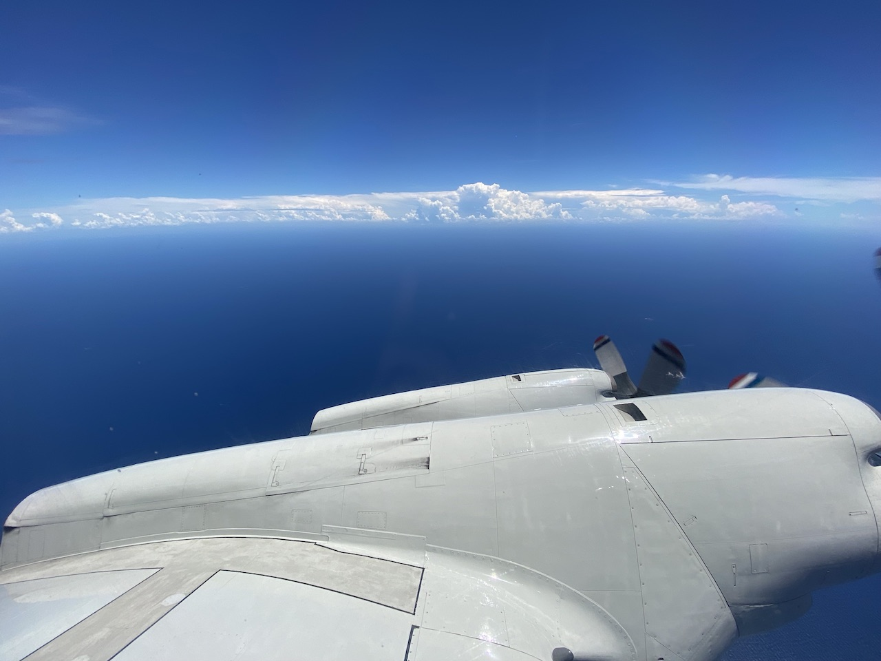


2021 Hurricane Field Program
Advancing the Prediction of Hurricanes Experiment (APHEX)
Grace (AL07) Debrief
Jason Dunion – HFP Director
Jon Zawislak - HFP Deputy Director
Photo by Jon Zawislak

Slide 2
2021 Hurricane Field Program-APHEX
Summary of Missions (14-19 August 2021)
Summary of Missions
8 P-3 missions, 3 G-IV missions (2 NHC, 6 EMC, 3 HRD)
  218 GPS dropsondes transmitted to the GTS
  32 TDR analyses transmitted to EMC & NHC
HRD Crewing
  20210814I1: NHC Fix
    Zawislak (LPS, radar), Sellwood (Aspen), Gamache (GB radar), N/A (GB LPS)
  20210814N1: HRD
    N/A (LPS, radar), AOC FD #2 (Aspen), Reasor (GB radar), Alaka (GB LPS)
  20210815I1: NHC Fix
    Zawislak (LPS, radar), Sellwood (Aspen), Reasor (GB radar), N/A (GB LPS)
  20210815N1: HRD
    N/A (LPS, radar), AOC FD #2 (Aspen), Gamache (GB radar), Hazelton (GB LPS)

Slide 3
2021 Hurricane Field Program-APHEX
Summary of Missions (14-19 August 2021)
Summary of Missions
HRD Crewing (Cont’d)
  20210816H1 (AM mission): EMC TDR
    Aberson (LPS, radar), Aberson (Aspen), Reasor (GB radar), Holbach (GB LPS)
  20210817H1 (AM mission): EMC TDR
    Aberson (LPS, radar), N/A (Aspen), Fischer/Reasor (GB radar), Wadler (GB LPS), Dunion (GB Aspen-TAG)
  20210817I1 (PM mission): EMC TDR
    Zawislak (LPS, radar), Sellwood (Aspen), Alvey/Gamache (GB radar), Alaka (GB LPS)
  20210818I1 (AM mission): EMC TDR
    Aberson (LPS, radar), N/A (Aspen), Fischer/Reasor (GB radar), Bucci (GB LPS), Dunion/J. Zhang (GB Aspen-TAG)
  20210818H1 (PM mission): EMC TDR
    Zawislak (LPS, radar), Sellwood (Aspen), Gamache/Alvey (GB radar), Hazelton (GB LPS)
  20210818N1: HRD
    N/A (LPS, radar), AOC FD #2 (Aspen), Gamache (GB radar), Alaka (GB LPS)
  20210819H1: (PM mission): EMC TDR
    Zawislak (LPS, radar), Sellwood (Aspen), Alvey/Gamache (GB radar), Hazelton (GB LPS)

Slide 4
2021 Hurricane Field Program-APHEX
Logistics Highlights
Flight Log Dropsonde accounting (there’s a lot to track)
  Post Flight (bottom of doc) >> we may a subsection called “Expendables Deployed” to help with expendable accounting. For Example:
    Dropsondes:
    Total Deployed: 30
    Backups: 2 (no launch detect)
    Accounts Charged: NWS (23), HRD (5)
    AXBTS:
    Total Deployed: 5
    # Failed AXBTs: 1
    Accounts Charged: HRD (1), NRL (4)

Slide 5
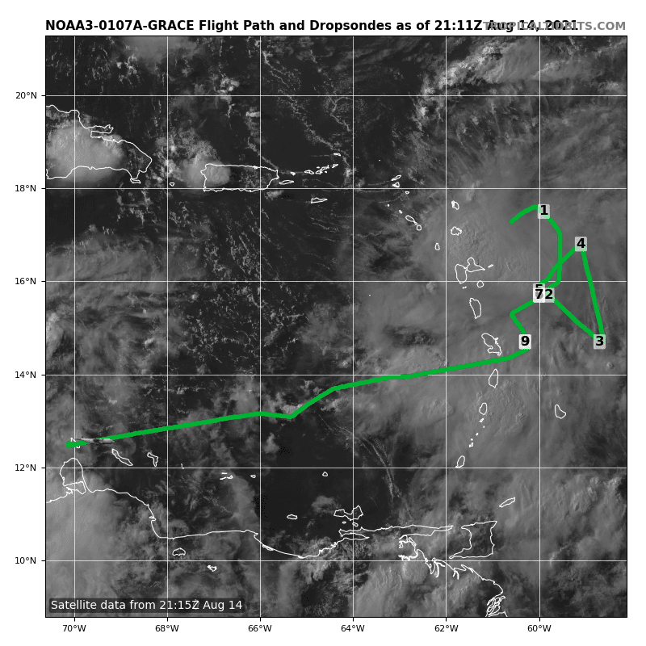
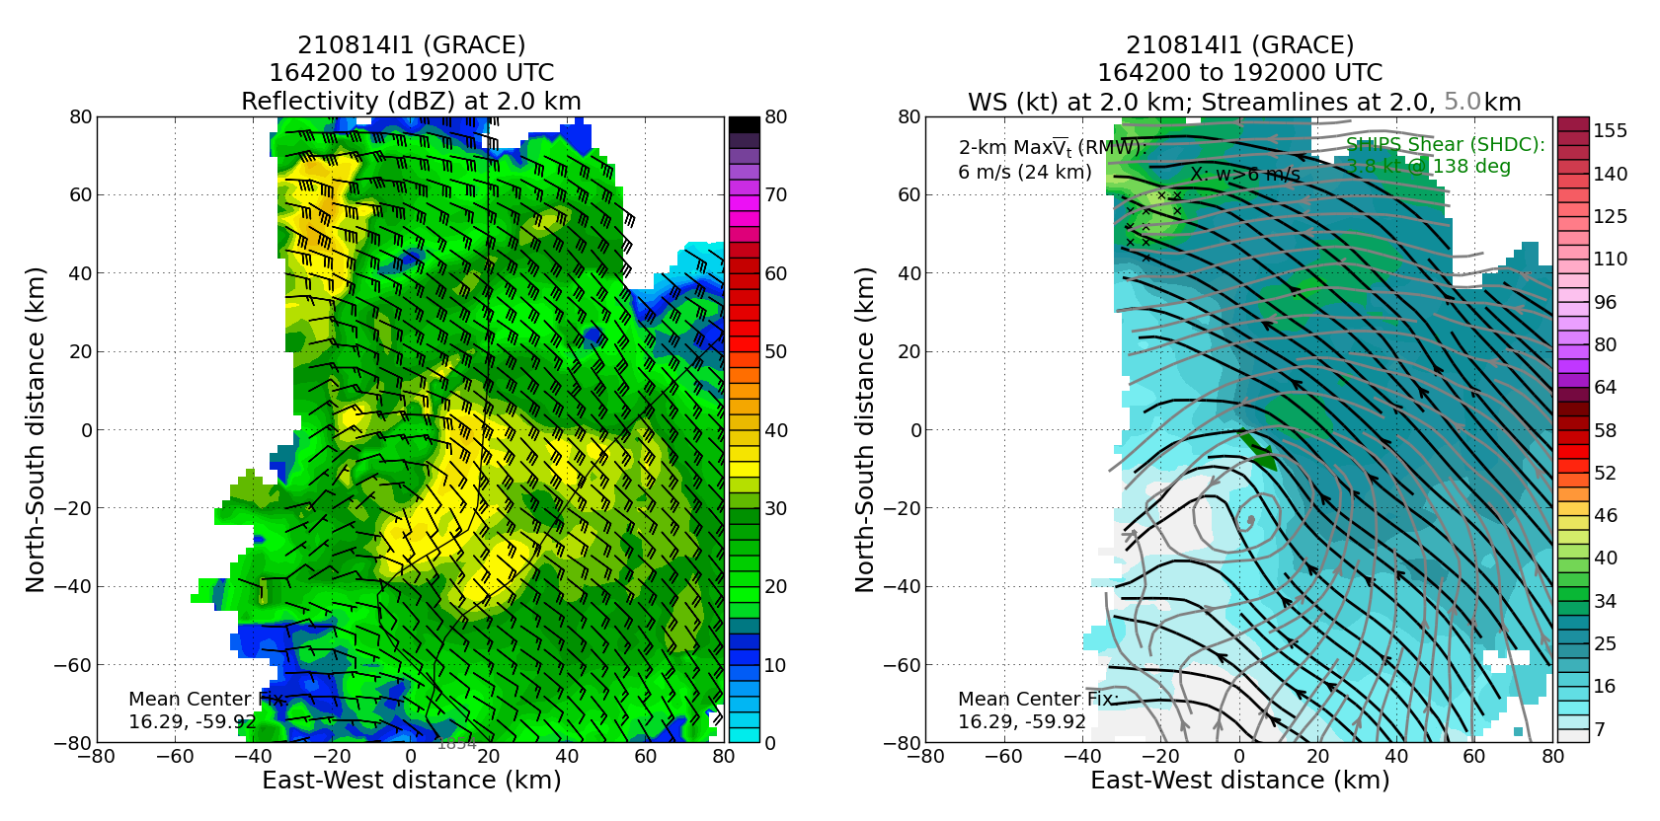
2021 Hurricane Field Program-APHEX
Tropical Storm Grace: 20210814I1 (NHC Fix)
Mission
  LPS/Radar: Zawislak, Aspen: Sellwood
  GB LPS: None, GB Radar: Gamache
  APHEX relevance:
    PREFORM (Genesis Stage)
  Planned pattern: alpha
  T/O off (AUA) – Landing (AUA): 1442 – 2108z
  FL 5 k ft
  7 NWS dropsondes (7 to GTS)
  3 TDR analyses to NHC and EMC
One interesting observation from this flight was that the disturbance appeared to exhibit multiple vorticity centers at low-levels. The “southern” low-level vorticity center was actually aligned with the midlevel center.
(Since synchro slippage impacted pre-season angle corrections, angle correction module conducted off the FL west coast during ferry to Aruba)
Open Wave
ML
Open Wave
2.0 km reflectivity and winds (left image) and 2.0 and 5.0 km streamlines with 2.0 km winds shaded (right image).

Slide 6
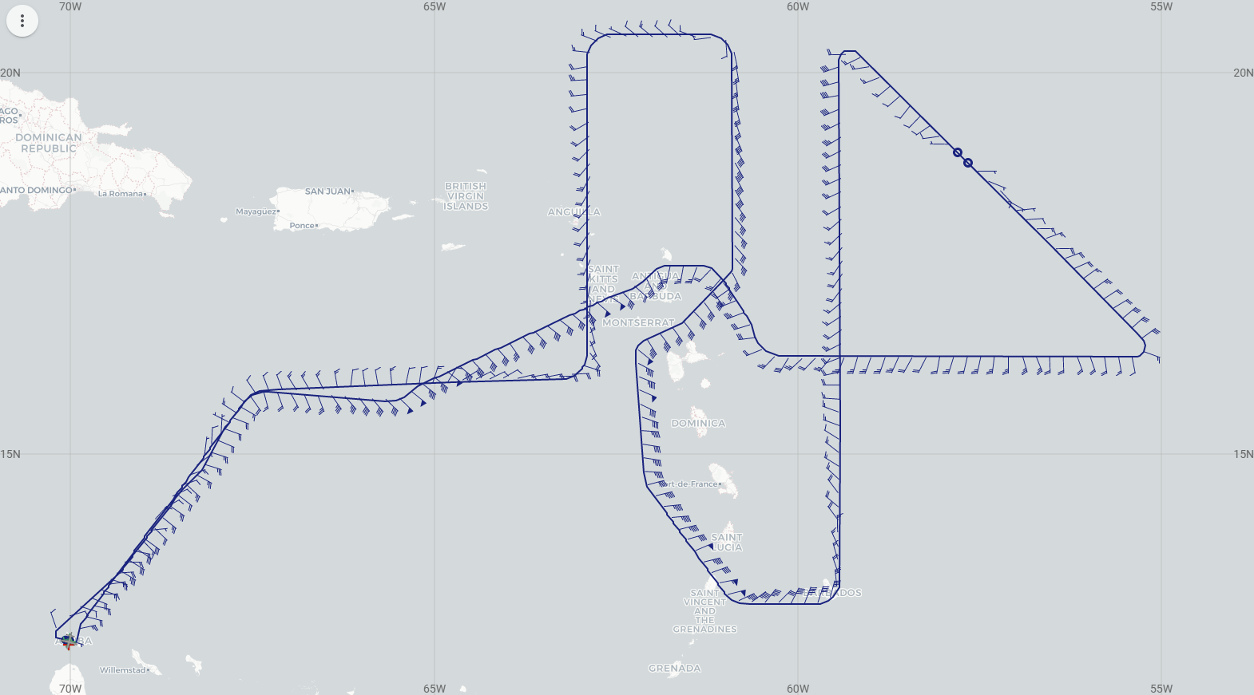
2021 Hurricane Field Program-APHEX
Tropical Storm Grace: 20210814N1 (HRD)
Mission
  LPS/Radar: None, Aspen: AOC FD #2
  GB LPS: Alaka, GB Radar: Reasor
  APHEX relevance:
    PREFORM, FAM (Genesis Stage)
    ITOFS (targeting)
    ONR TCRI collaboration
  Planned pattern: lawnmower + Fig-4
  T/O off (AUA) – Landing (KLAL): 1634 – 0015z
  FL 41-45 k ft
  33 dropsondes (33 to GTS), 21 HRD/12 ONR
  0 TDR analyses (to NHC and EMC) >> blended IMU failure
Flight plan adjustments for Venezuelan airspace >> initial leg will be NE to the latitude of WP 4, then they will turn E to WP 4 and resume the original flight plan.
In-flight track modifications needed to account for Grace’s fast forward motion and to avoid Guadeloupe air space (WPS 11 & 12).
N49 final flight track.

Slide 7
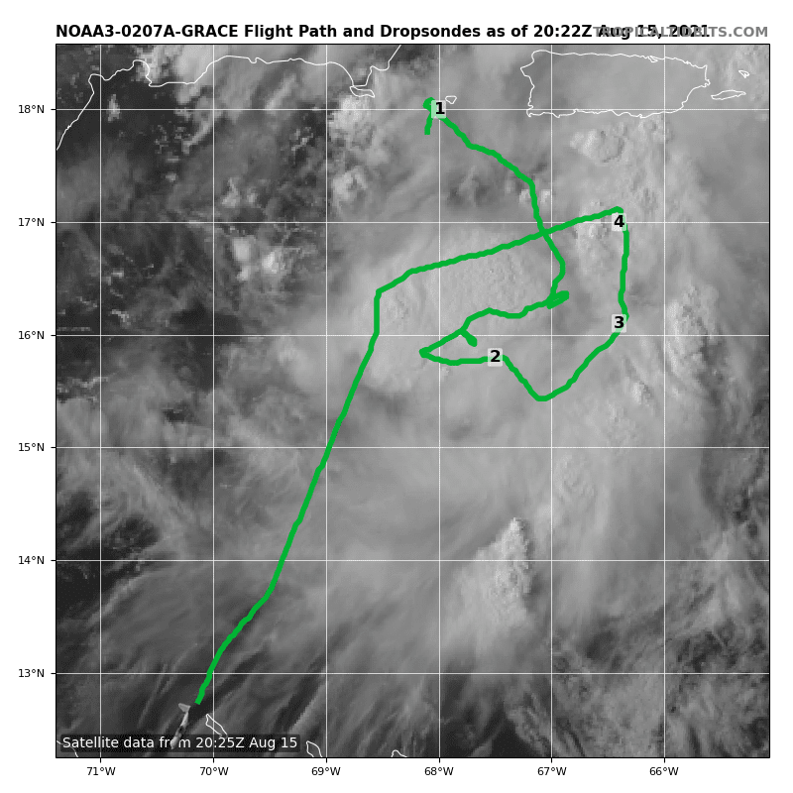
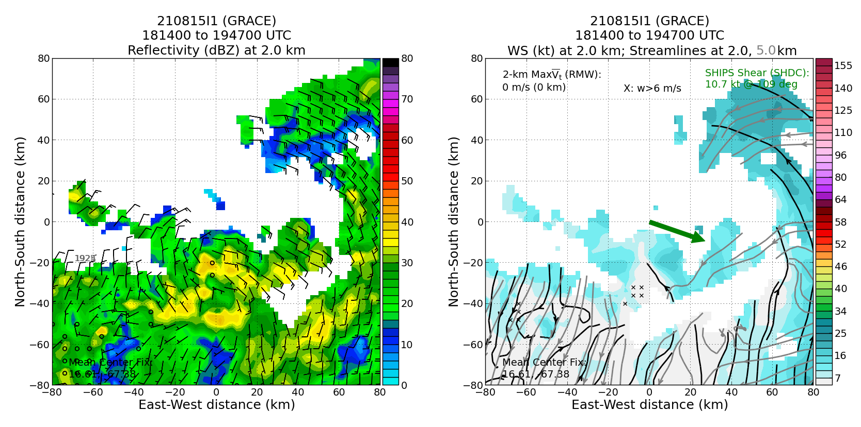
2021 Hurricane Field Program-APHEX
Tropical Storm Grace: 20210815I1 (NHC Fix)
Mission
  LPS/Radar: Zawislak, Aspen: Sellwood
  GB LPS: None, GB Radar: Reasor
  APHEX relevance:
    PREFORM (Genesis Stage)
  Planned pattern: alpha
  T/O off (AUA) – Landing (AUA): 1553 – 2031z
  FL 5 k ft
  4 dropsondes (4 to GTS)
  3 TDR analyses (to NHC and EMC)
TDR angle correction work off the FL west coast during ferry to Aruba.
This flight attempted to identify the center of circulation of TS Grace. Rather than finding a clear center, data showed that the storm has an elongated circulation center or wave axis that made it challenging to fix an actual closed center.
N49 final flight track
Elongated LL Center/Wave Axis
2.0 km reflectivity and winds (left) and 2.0 and 5.0 km streamlines with 2.0 km winds shaded (right image).

Slide 8
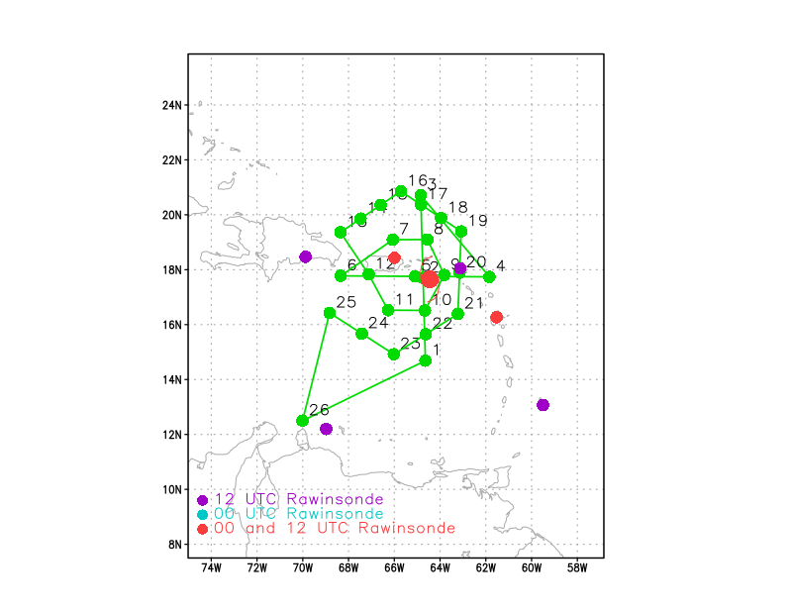
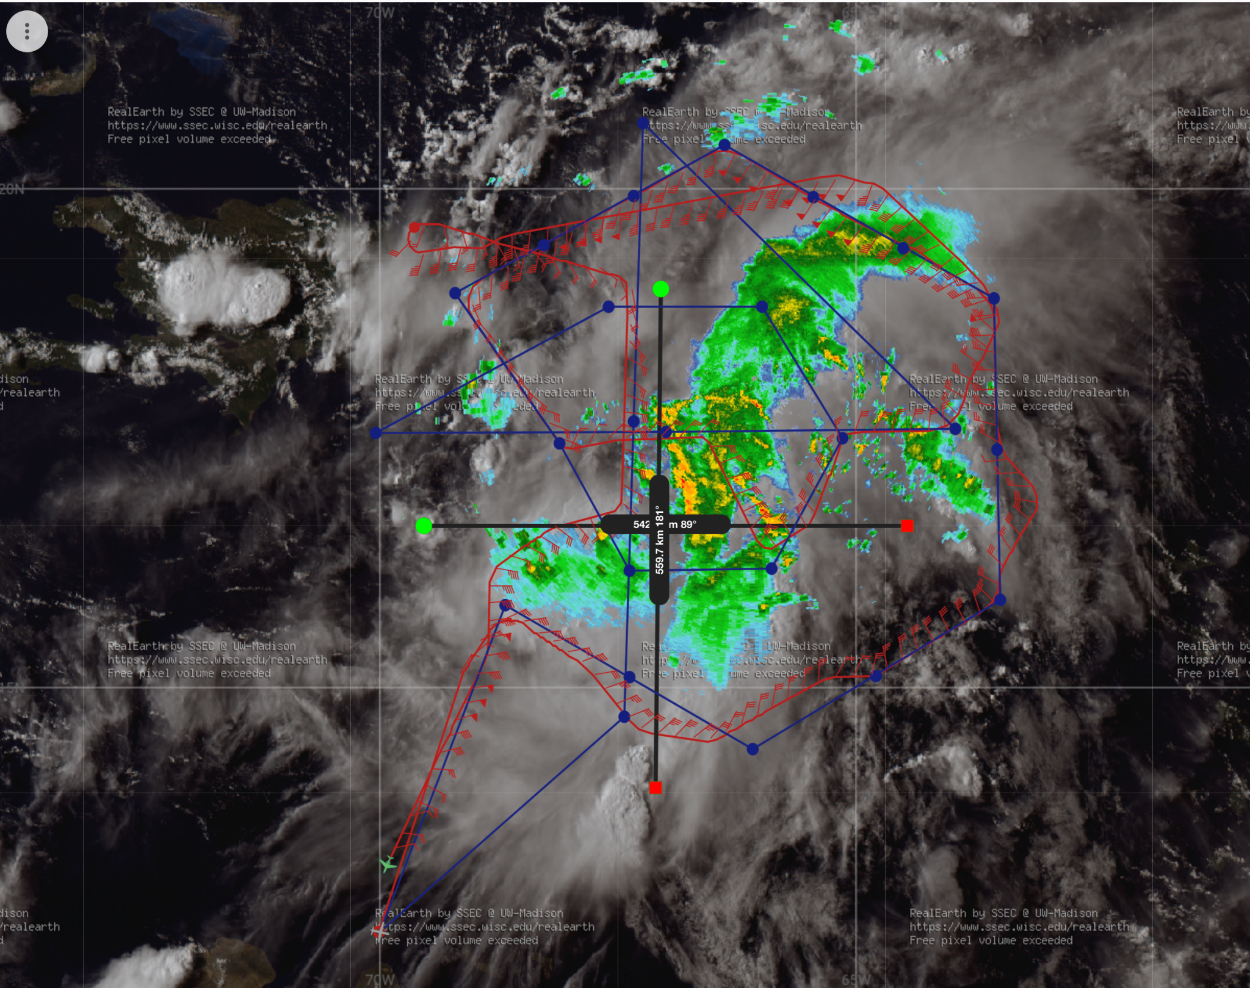
2021 Hurricane Field Program-APHEX
Tropical Storm Grace: 20210815N1 (HRD)
Mission
  LPS/Radar: None, Aspen: AOC FD #2
  GB LPS: Hazelton, GB Radar: Gamache
  APHEX relevance:
    PREFORM (Genesis Stage)
    ITOFS
    ONR TCRI collaboration
  Planned pattern: double circumnavigation + Fig-4
  T/O off (AUA) – Landing (AUA): 1505 – 2121z
  FL 41-45 k ft
  32 dropsondes (27 to GTS)
  5 TDR analyses (to NHC and EMC) -- HRD INE correction software used until IMU repaired
Successful outer circumnavigation and a clean N-S pass across the center.
Inner circumnavigation was somewhat altered by convection and airspace considerations.
Venezuelan airspace issues once again.
N49 planned (left) and final (right) flight tracks.

Slide 9
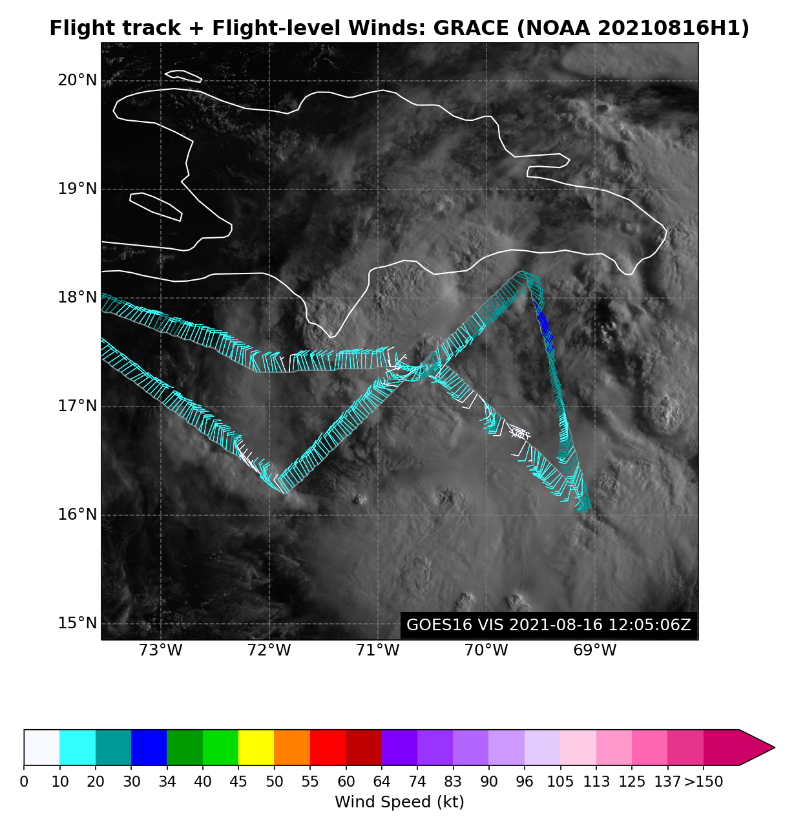
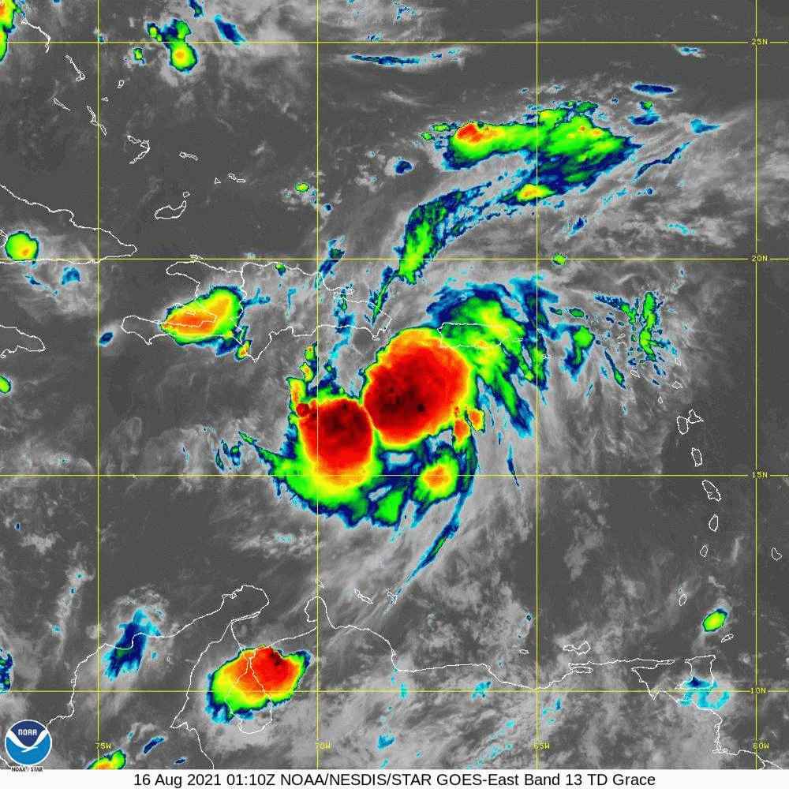
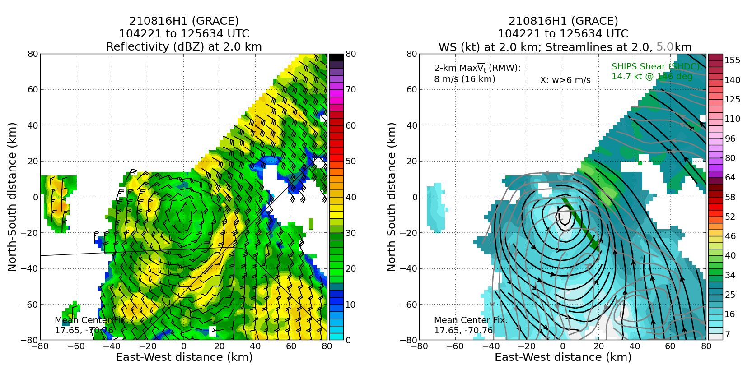
2021 Hurricane Field Program-APHEX
Tropical Depression Grace: 20210816H1 (EMC TDR)
Mission
  LPS/Radar: Aberson, Aspen: Aberson
  GB LPS: Holbach, GB Radar: Reasor/Fischer
  APHEX relevance:
    PREFORM (Genesis Stage)
  Planned pattern: Fig-4
  T/O off (KLAL) – Landing (KLAL): 0753 – 1527z
  FL 10 k ft
  14 dropsondes (12 GTS)
  2 TDR analyses (to NHC and EMC)
TDR data showed the circulation organizing from the bottom upwards.
SFMR: wind speeds seemed a bit high (5-10 kt), but hard to judge accuracy in a weak system.
TDR: issue with satcom that caused jobfile to not download. After satcom reboot analyses ran smoothly.
The modification to the Fig-4 pattern that was made during pre-flight worked well and led to really good TDR coverage. Other than the change to the pattern, no deviations occurred during the flight.
N42 final flight track
LL
LL
ML
ML
Final TDR composite zoom graphic depicting coherent low level circulation, but competing circulations at 5 km.

Slide 10
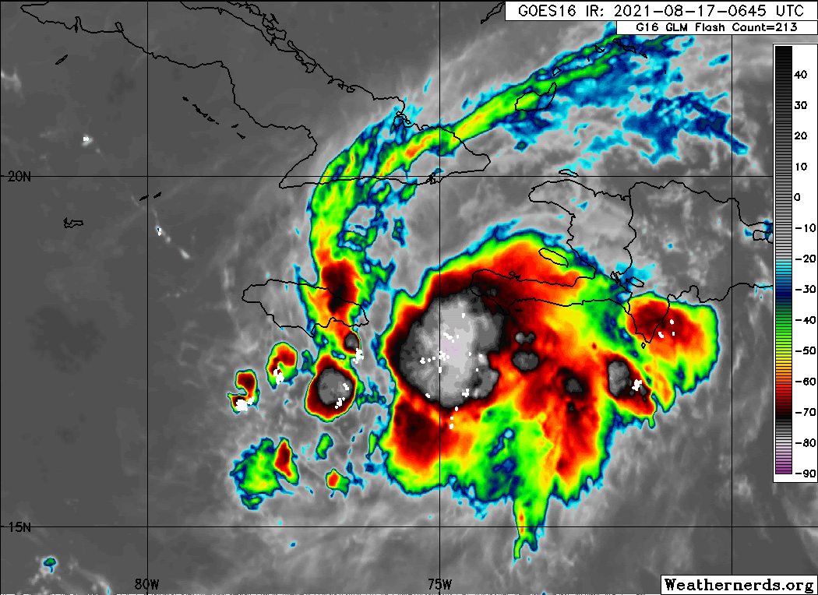
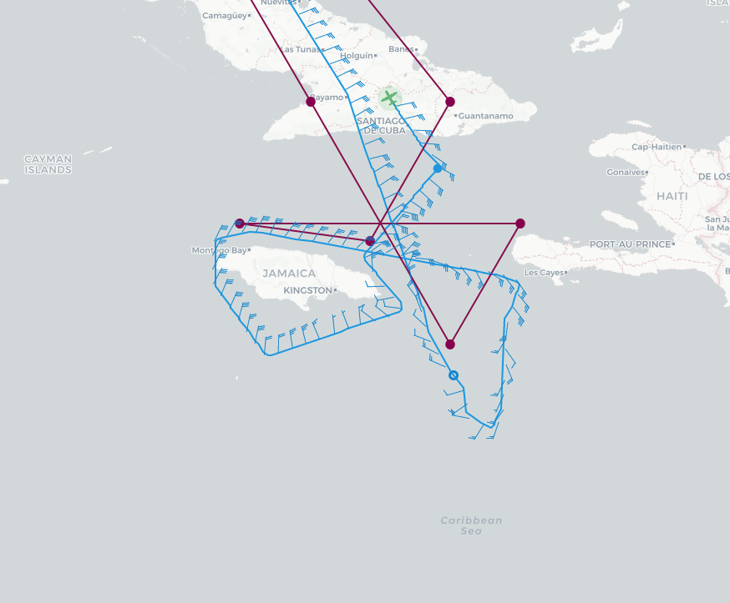
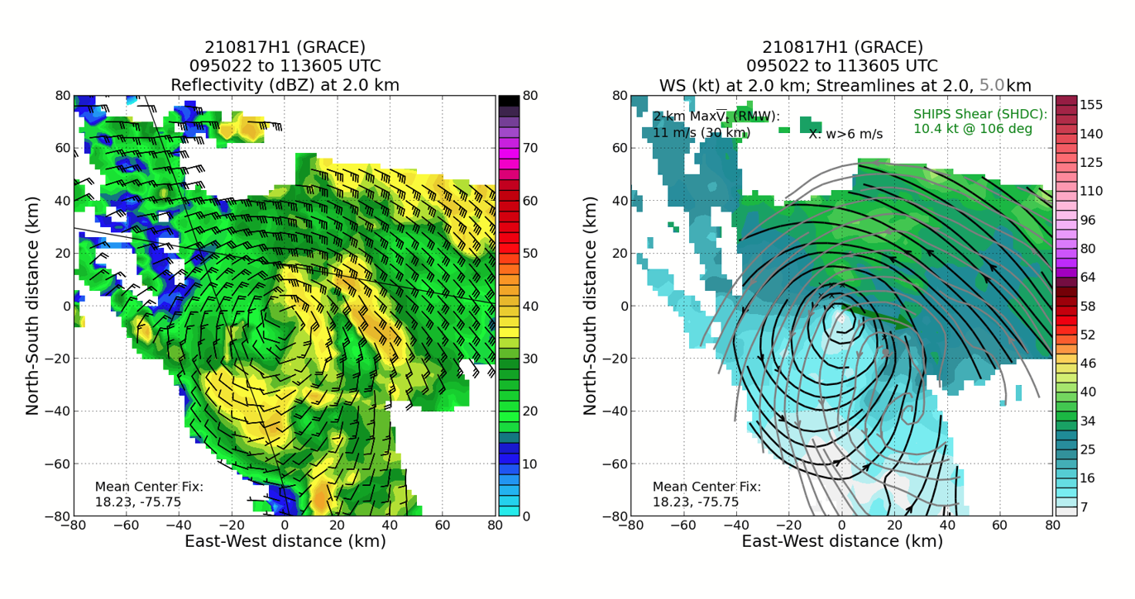
2021 Hurricane Field Program-APHEX
Tropical Storm Grace: 20210817H1 (EMC TDR)
Mission
  LPS/Radar: Aberson, Aspen: None
  GB LPS: Wadler, GB Aspen-TAG: Dunion, GB Radar: Fischer/Reasor
  APHEX relevance:
    AIPEX (Early Stage)
    ONR TCRI collaboration
  Planned pattern: modified butterfly
  T/O off (KLAL) – Landing (KLAL): 0807 – 1248z
  FL 12 k ft (terrain concerns)
  14 dropsondes (14 GTS)
  3 TDR analyses (to NHC and EMC)
The original pattern had to be rotated 10 degrees to avoid land and the altitude of the mission was raised to 12 k ft.
The only pattern modification was that the P-3 went around Jamaica before the last radial pass.
N42 planned (red) and final (blue) flight tracks.
LL
LL
ML
TDR composite showing 2 km - 5 km tilt - possibly related to the mid-level shear to the west of the storm that was noted.

Slide 11
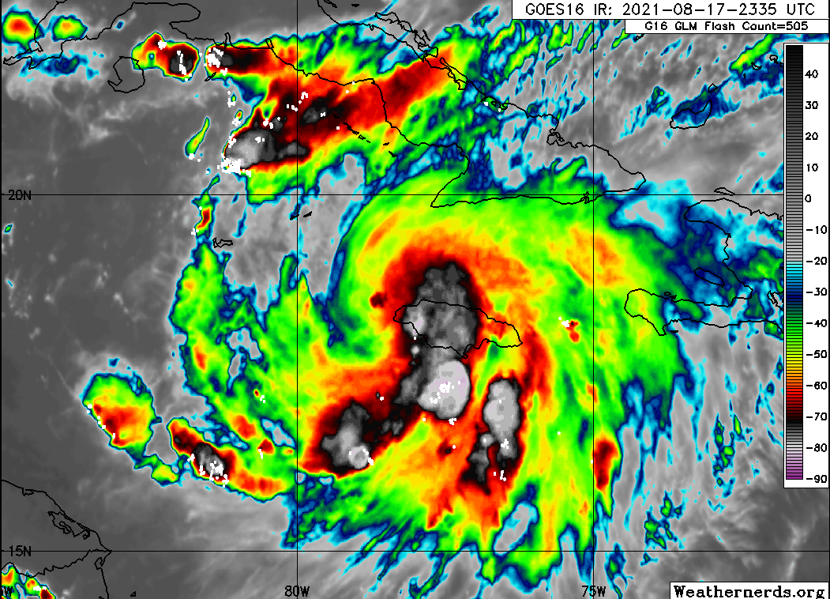
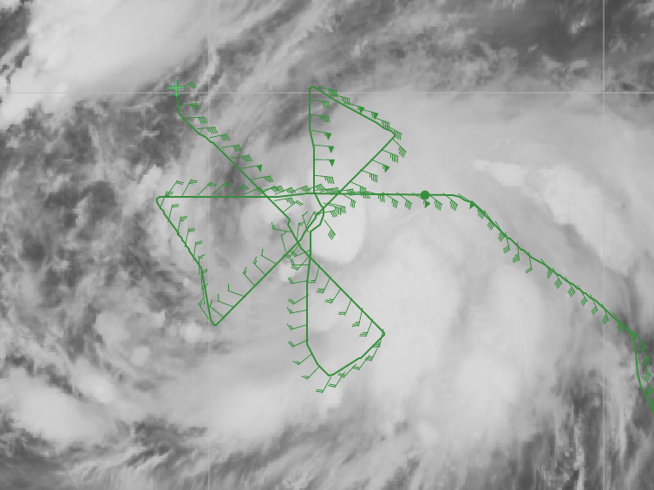
2021 Hurricane Field Program-APHEX
Tropical Storm Grace: 20210817I1 (EMC TDR)
Mission
  LPS/Radar: Zawislak, Aspen: Sellwood
  GB LPS: Alaka, GB Radar: Alvey/Gamache
  APHEX relevance:
    AIPEX (Early Stage)
    ONR TCRI collaboration
  Planned pattern: butterfly
  T/O off (AUA) – Landing (KLAL): 1953 – 0337z
  FL 8 k ft
  30 dropsondes (24 GTS), 23 NWS, 7 TCRI
  3 NRL AXBTs
  4 TDR analyses (to NHC and EMC)
More issues than usual with dropsonde dropouts as there were difficulties acquiring GPS during initialization of the sonde. There were a few no launch detects, and a few had sporadic winds in the profile due to that GPS satellite issue.
N43 final flight track
GOES East IR with GLM lightning

Slide 12
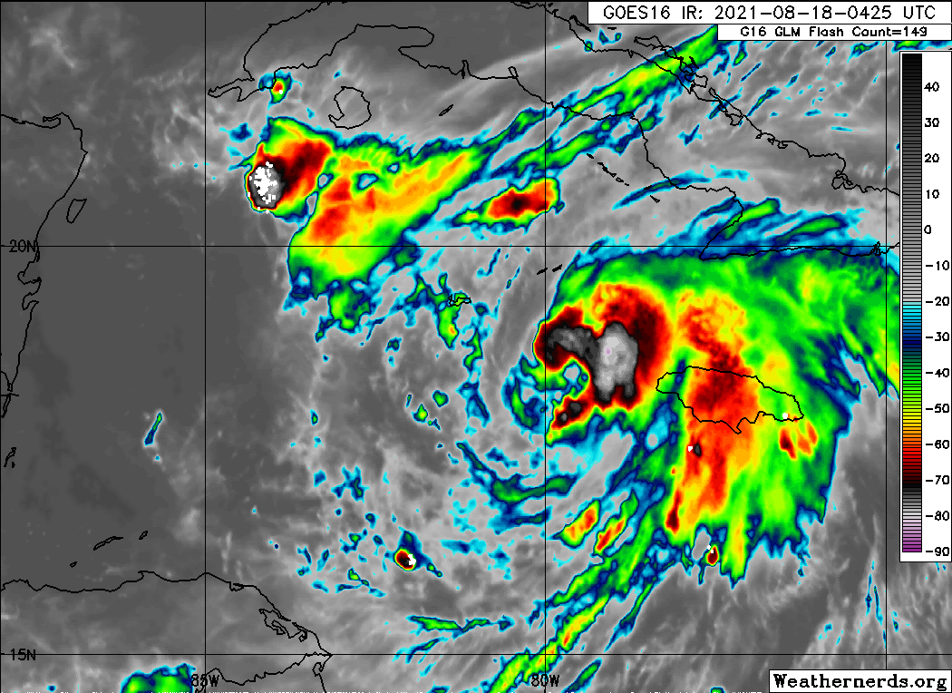
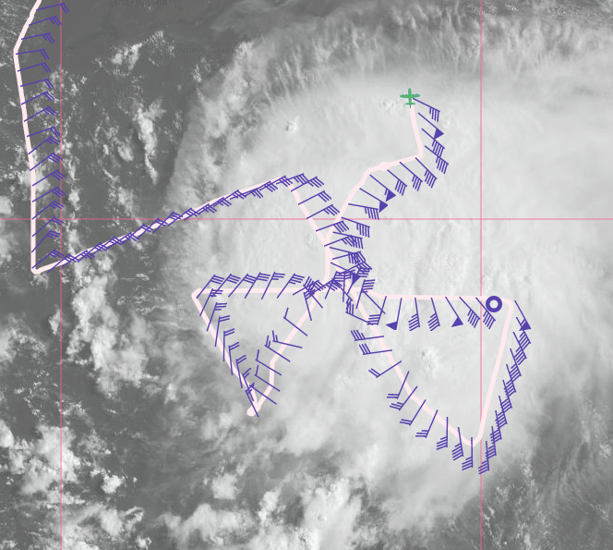
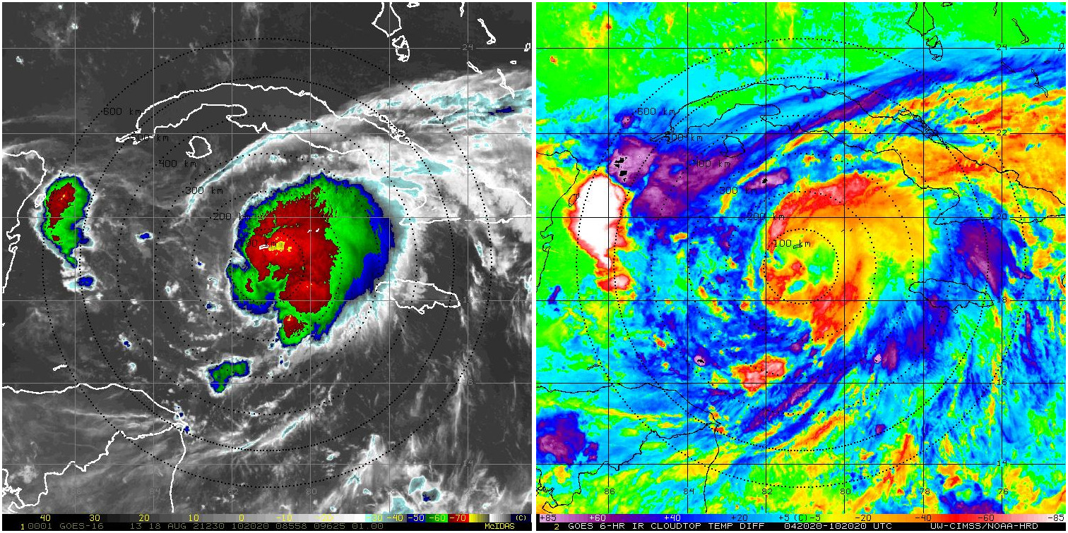
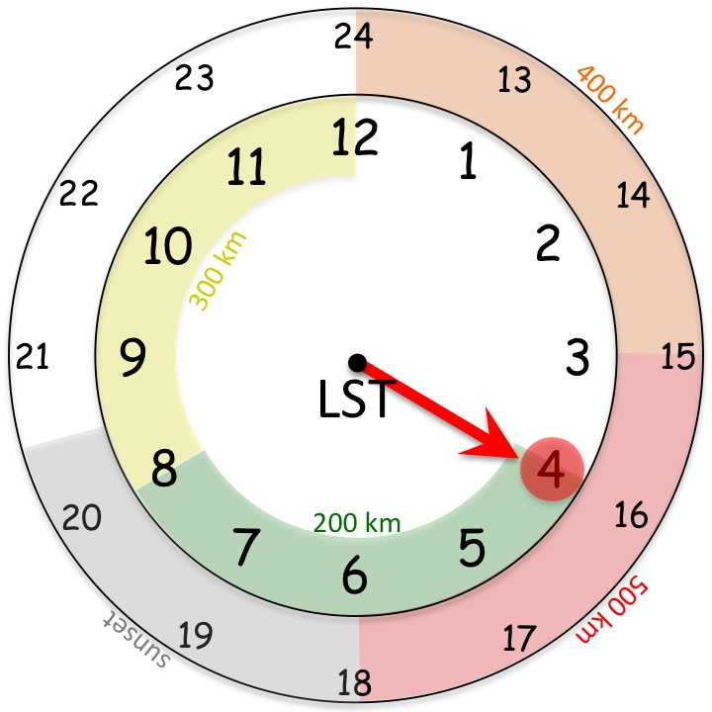
2021 Hurricane Field Program-APHEX
Tropical Storm Grace: 20210818I1 (EMC TDR)
Mission
  LPS/Radar: Aberson, Aspen: None
  GB LPS: Bucci, GB Aspen-TAG: Dunion/J. Zhang, GB Radar: Fischer/Reasor
  APHEX relevance:
    AIPEX (Early Stage)
    ONR TCRI collaboration
  Planned pattern: butterfly
  T/O off (KLAL) – Landing (KLAL): 1953 – 0337z
  FL 8 k ft
  17 dropsondes (17 GTS)
  2 Navy ALAMO floats (~18-24 hr ahead of Grace)
  3 TDR analyses (3 to NHC and “2.5” to EMC)
More issues than usual with dropsonde dropouts as there were difficulties acquiring GPS during initialization of the sonde. There were a few no launch detects, and a few had sporadic winds in the profile due to that GPS satellite issue.
N43 final flight track
GOES East IR with GLM lightning
Growth of cold cloud tops on the IR satellite is substantial. Appears Grace is “pushing” back the shear and attempting symmetrization. Burst falls on the diurnal cycle 4 AM clock.

Slide 13
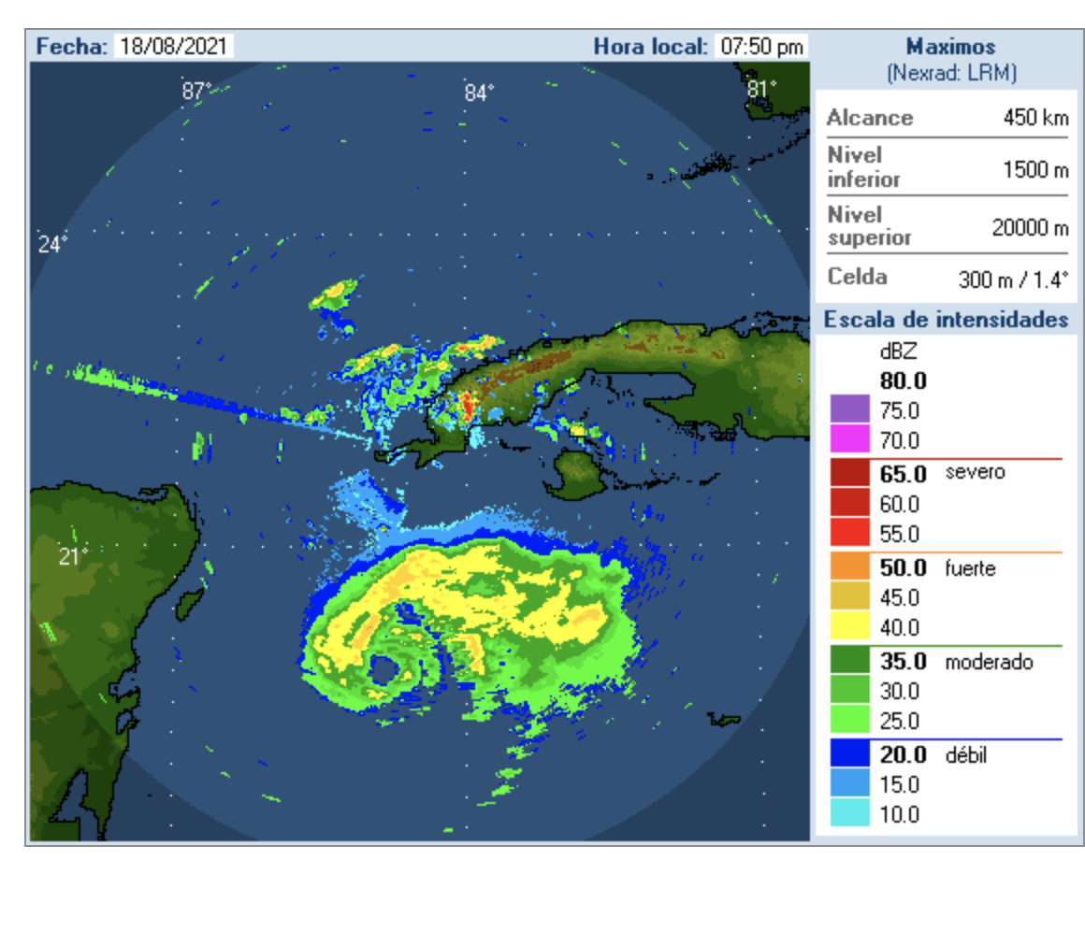
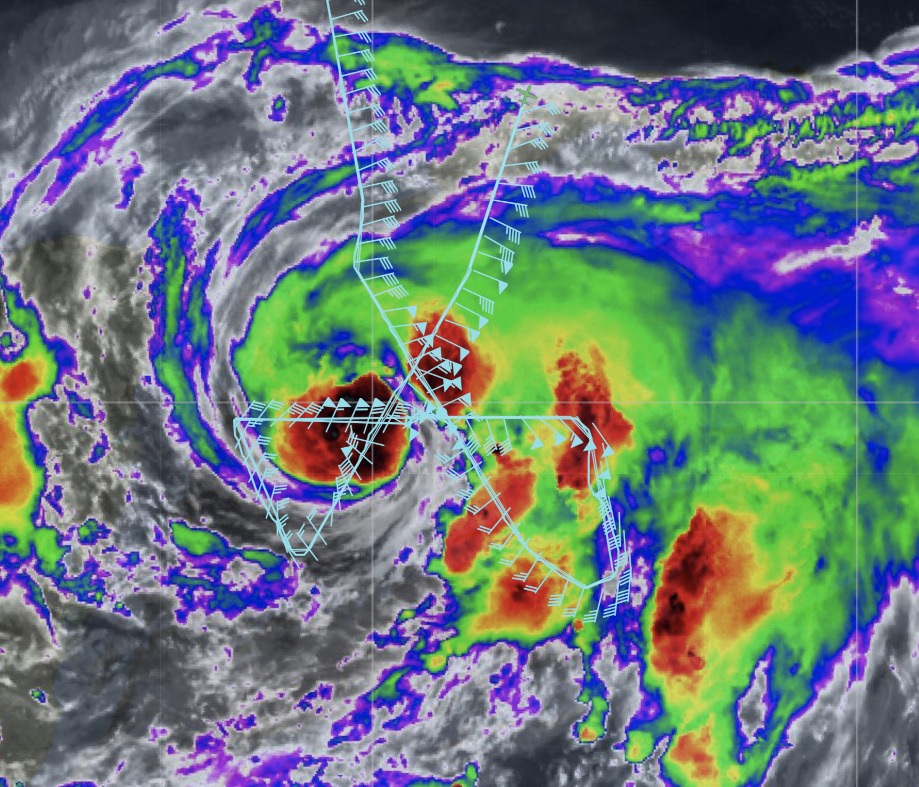
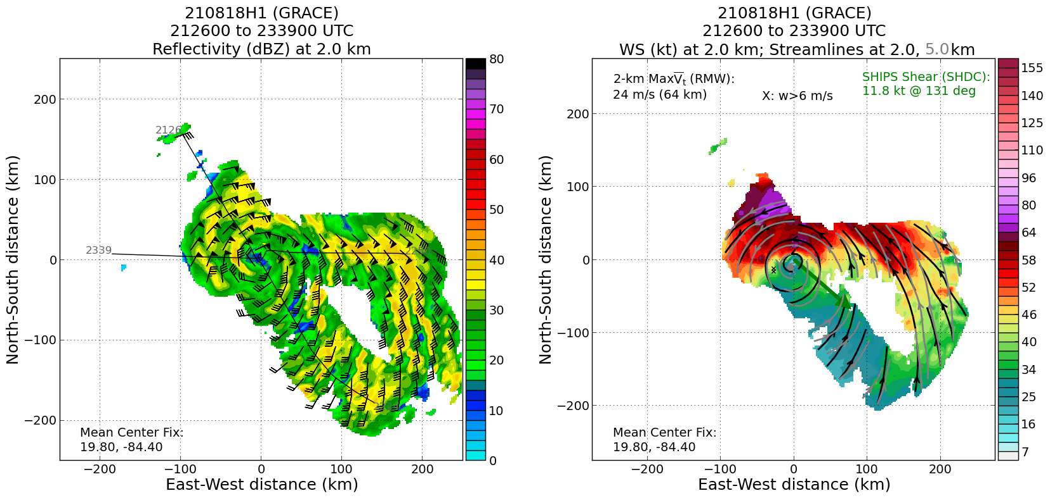
2021 Hurricane Field Program-APHEX
Hurricane Grace: 20210818H1 (EMC TDR)
Mission
  LPS/Radar: Zawislak, Aspen: Sellwood
  GB LPS: Hazelton, GB Radar: Gamache/Alvey
  APHEX relevance:
    AIPEX (Early Stage)
    ONR TCRI collaboration
  Planned pattern: butterfly
  T/O off (KLAL) – Landing (KLAL): 1954 – 0217z
  FL 10 k ft
  26 dropsondes (25 GTS), 15 NWS, 11 ONR
  5 NRL AXBTs (3 good)
  3 TDR analyses (to NHC and EMC)
TDR data showed that vortex tilt was not an issue (the circulation was aligned), but did further reveal the asymmetric nature of the wind field.
Cuban radar
N42 final flight track
2.0 km reflectivity and winds (left) and 2.0 and 5.0 km streamlines with 2.0 km winds shaded (right image). TC is aligned but wind field is still asymmetric.

Slide 14
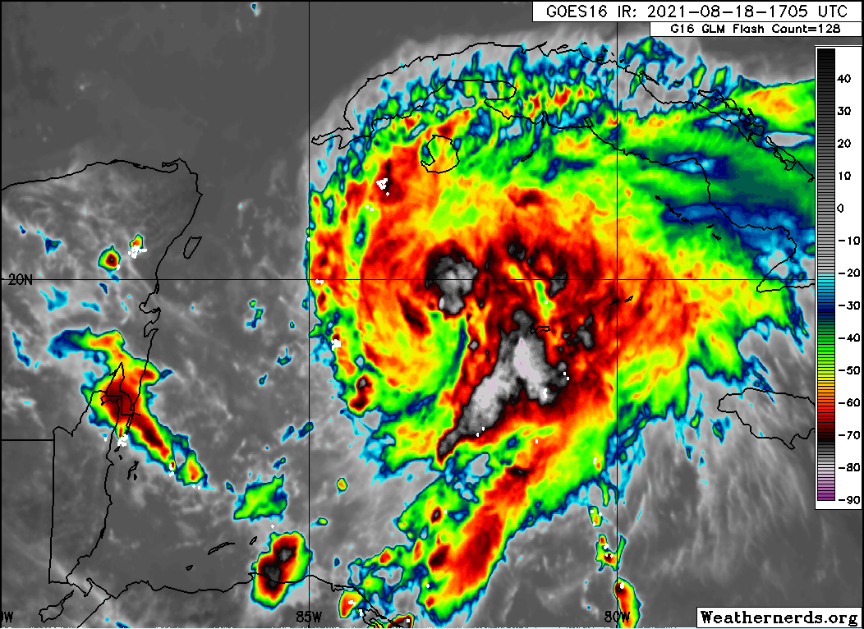
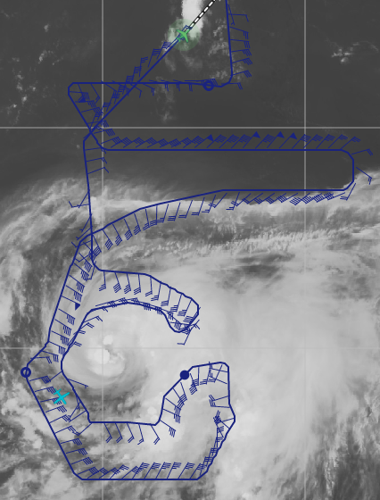
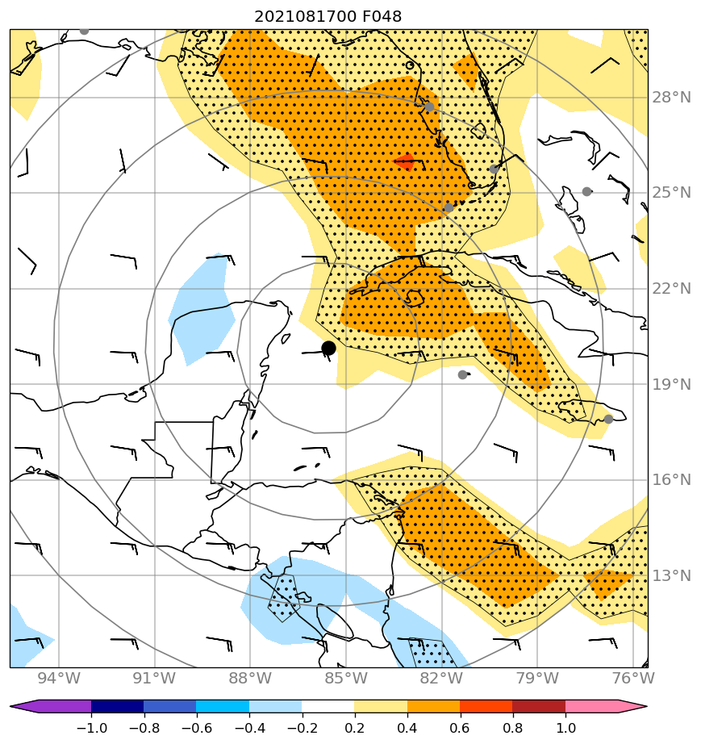
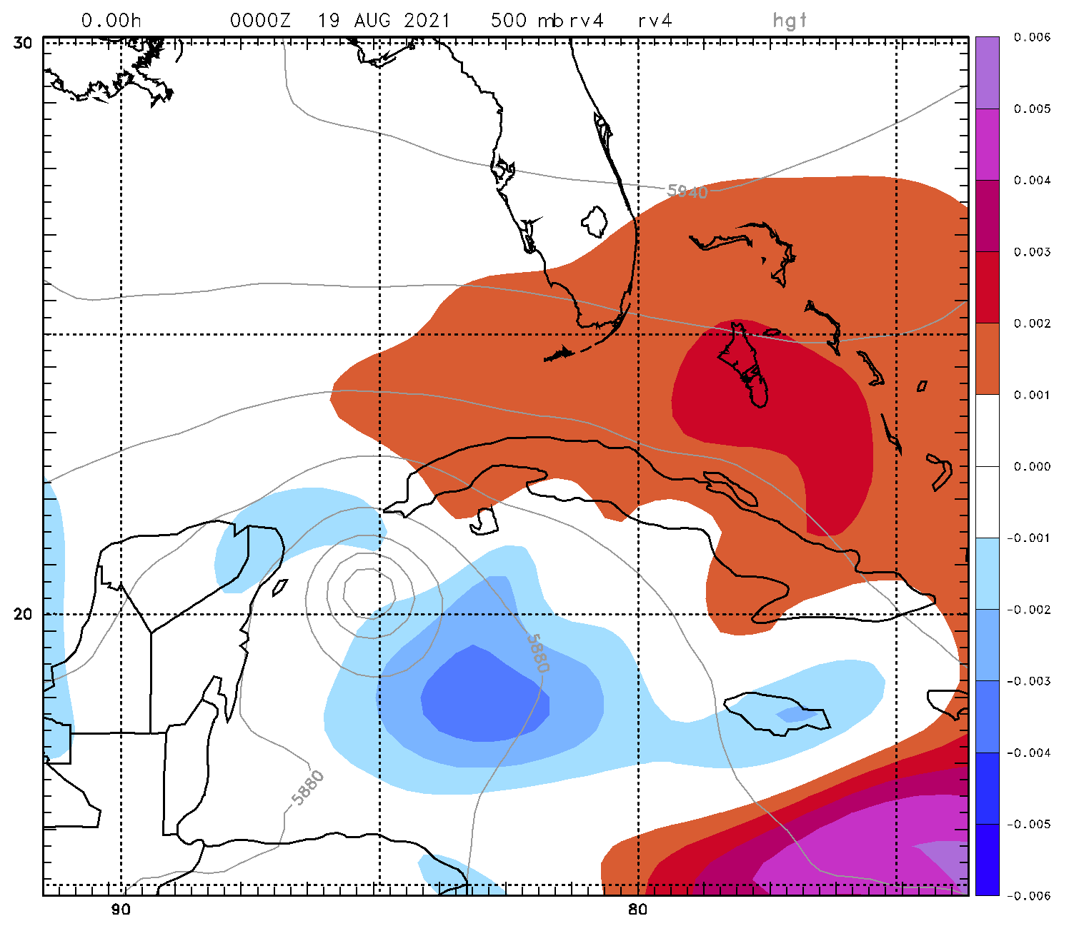
2021 Hurricane Field Program-APHEX
Hurricane Grace: 20210818N1 (HRD)
Mission
  LPS/Radar: None, Aspen: AOC FD #2
  GB LPS: Alaka, GB Radar: Gamache
  APHEX relevance:
    AIPEX, ITOFS (Early Stage)
    ONR TCRI collaboration
  Planned pattern: double circumnav + lawnmower
  T/O off (AUA) – Landing (KLAL): 1954 – 0217z
  FL 41-45 k ft
  41 dropsondes (36 GTS), 21 HRD, 20 ONR
  2 TDR analyses (to NHC and EMC) -- Switched to blended IMU at end of flight. Checked out well.
Lots of mid-level dry air in the W and N quadrants of the storm.
Adjusted the flight plan to account for hazardous convection in the eastern semicircle. The plan is to go from Point 22->28, then do as much of the inner ring as possible (28-36,25,26,24).
Great situational awareness to avoid hazardous convection to the east of the TC center. However, all planned points were hit, just in a different order.
N49 final flight track
Sensitivity targeting for (left) track (SUNY Albany-ECMWF) and (right) intensity (NRL-Monterey, COAMPS-TC

Slide 15
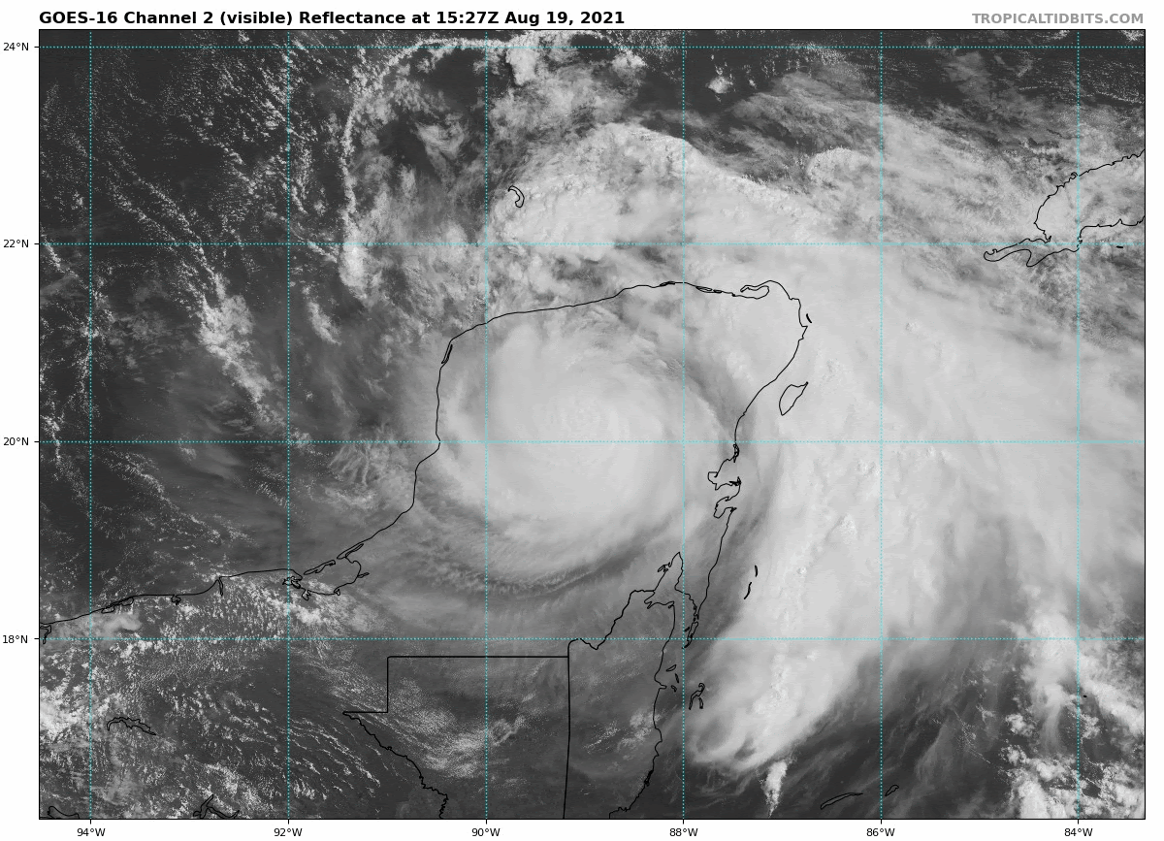
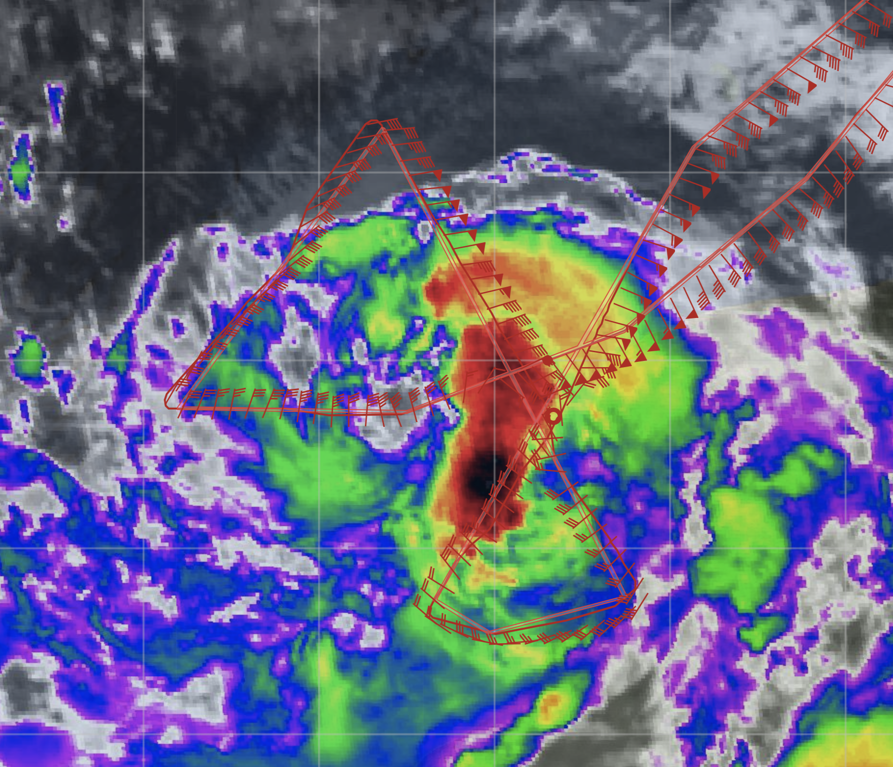
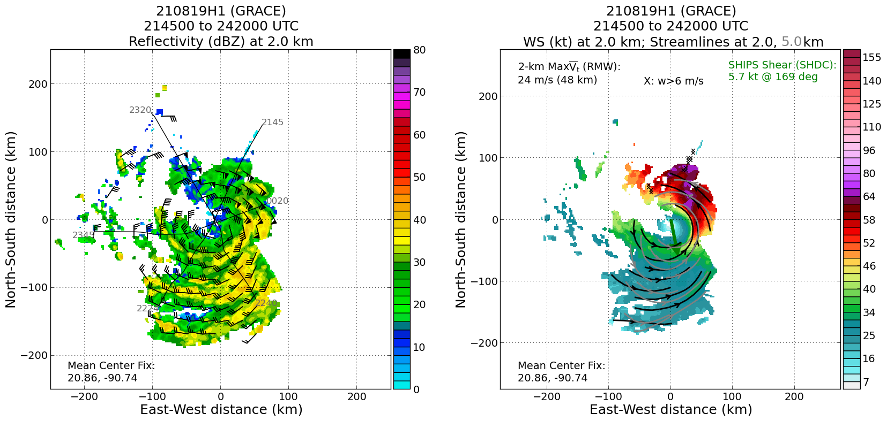
2021 Hurricane Field Program-APHEX
Tropical Storm Grace: 20210819H1 (EMC TDR)
Mission
  LPS/Radar: Zawislak, Aspen: Sellwood
  GB LPS: Hazelton, GB Radar: Alvey/Gamache
  APHEX relevance:
    AIPEX (Early Stage)
  Planned pattern: modified butterfly
  T/O off (KLAL) – Landing (KLAL): 1957 – 0230
  FL 10 k ft
  19 dropsondes (19 GTS)
  3 NRL AXBTs (3 good)
  3 TDR analyses (to NHC and EMC)
The radar data suggested some southward tilt with height, especially above 6-7 km, but it looks like the center is fairly broad at upper levels.
Some artifacts in the radar data along the flight track where the winds were weak and the land was in view of the TDR; therefore, some reprocessing of the level-2 will be required before its release.
N42 final flight track
Final 2.0 km reflectivity and winds (left) and 2.0 and 5.0 km streamlines with 2.0 km winds shaded (right image). Strong but still asymmetric wind field on the north side.

Slide 16
2021 Hurricane Field Program-APHEX
Hurricane Grace: 13-19 August 2021
Social Media
HRD Twitter
  Video of G-IV takeoff, was quite popular (117 likes)
    https://twitter.com/HRD_AOML_NOAA/status/1426986000086192132
  Highlights the first deployment of ALAMO floats from a P3
    https://twitter.com/NOAA_AOML/status/1429877237394857990
  AOML Twitter
  Video from NOAA AOC of a view through TS Grace
    https://twitter.com/NOAA_HurrHunter/status/1426705349046845440
Daily Plan of the Day
  Sent to research partners, AOML Comms, OAR Communications Office
  Emily Ashe, Michael F., Jason D., and Jon Z.
    Post-map discussion tag-ups to discuss social media opportunities

Slide 17
2021 Hurricane Field Program-APHEX
Hurricane Grace: 14-19 August 2021
Other Issues – what can we do better?
Social media efforts >> improving though (thanks Emily and Michael!)

Slide 18
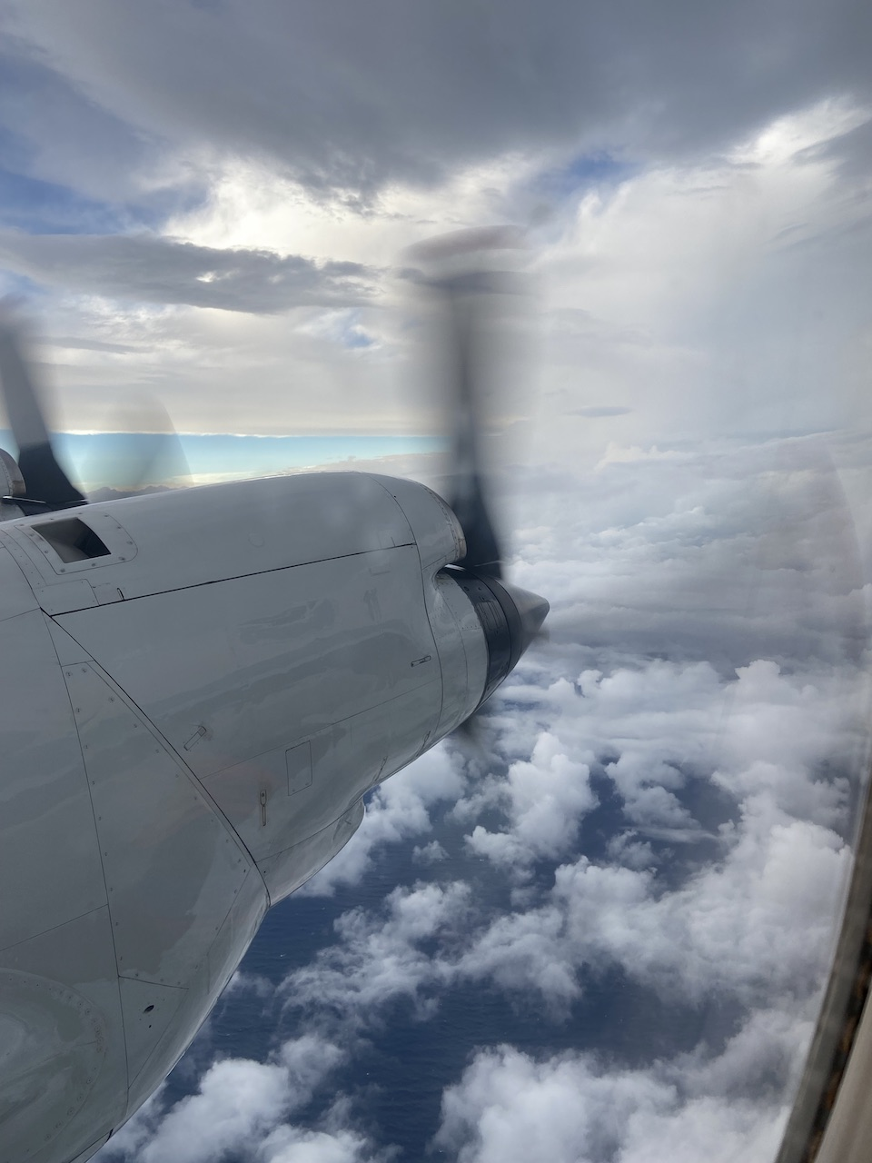
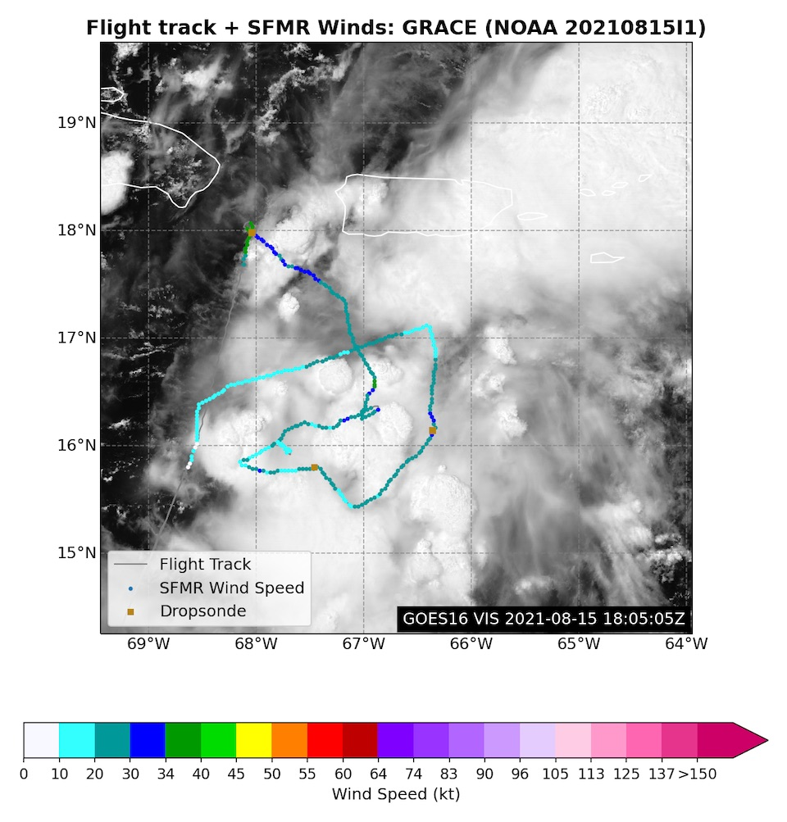
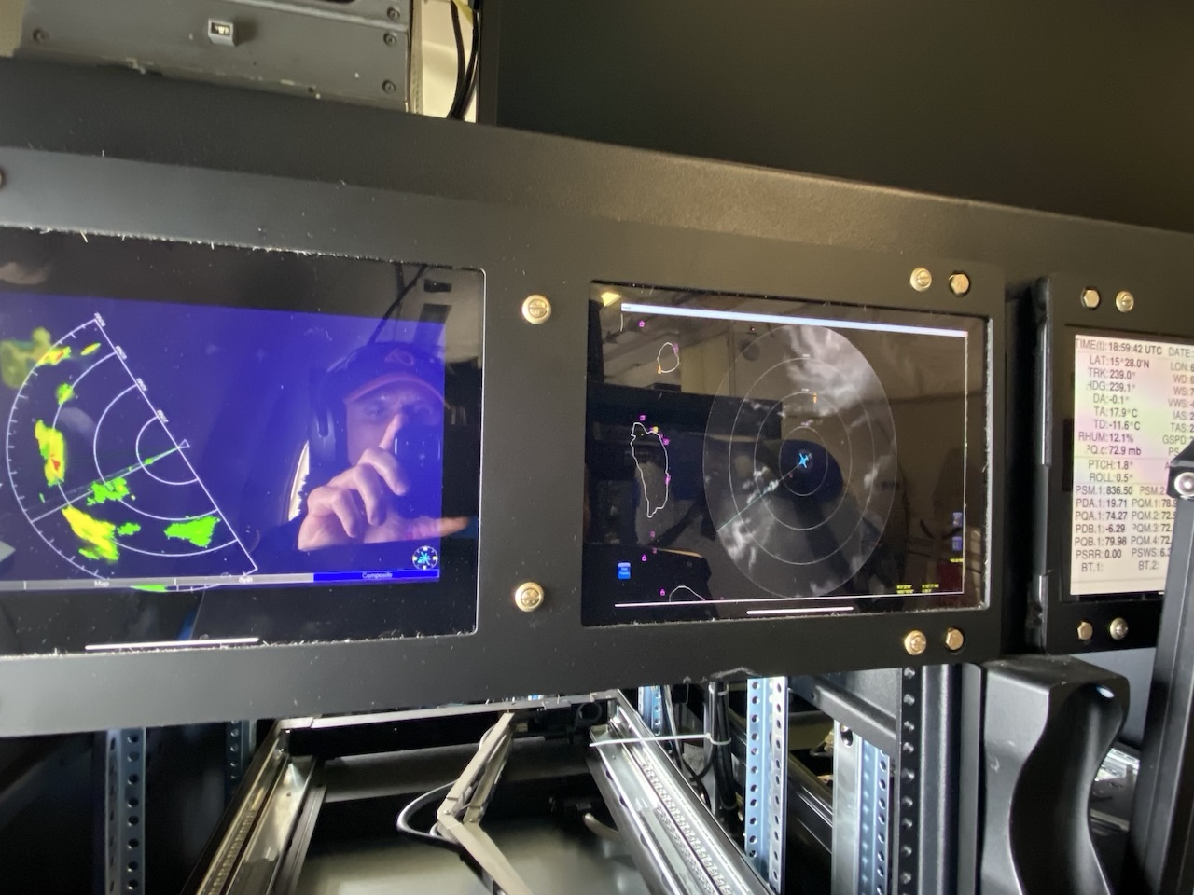
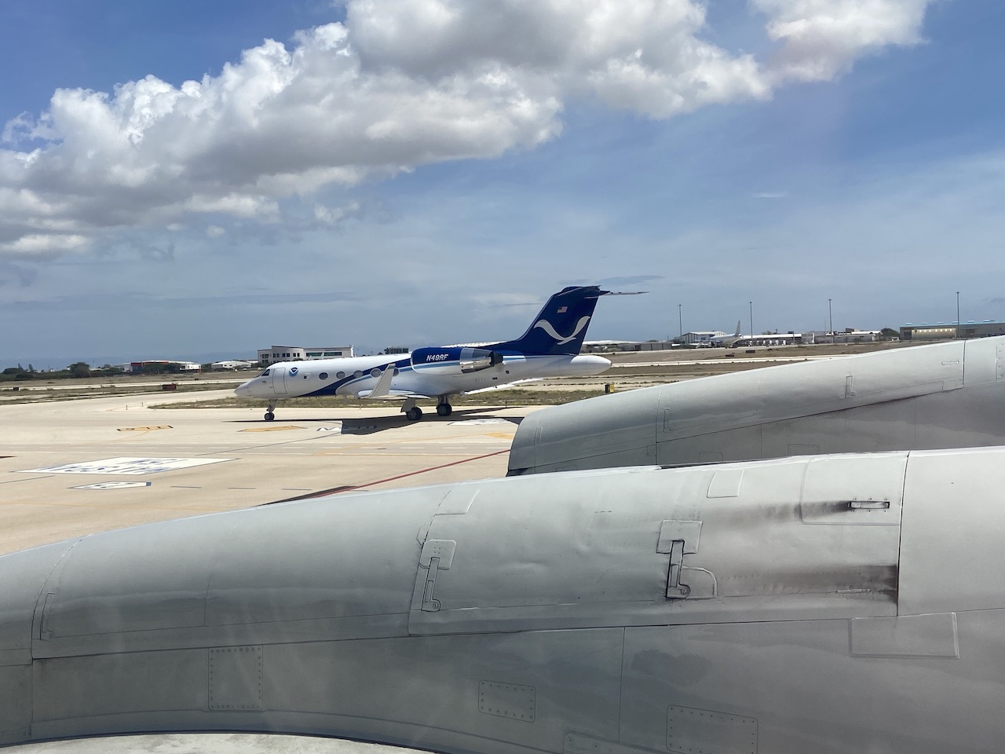
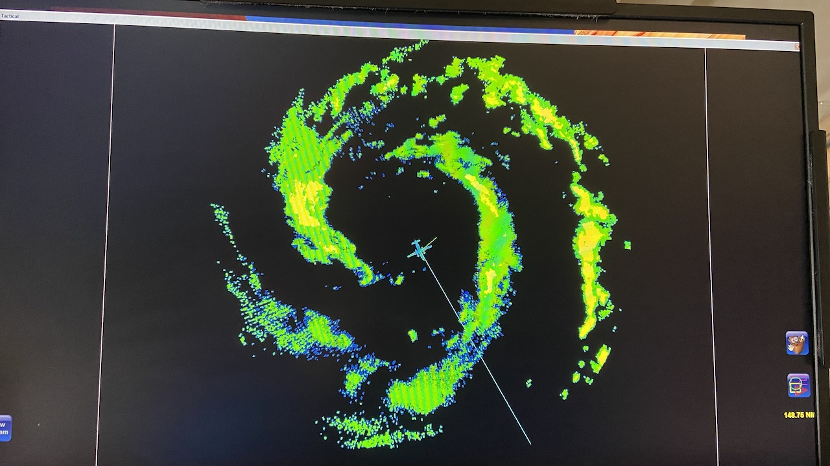
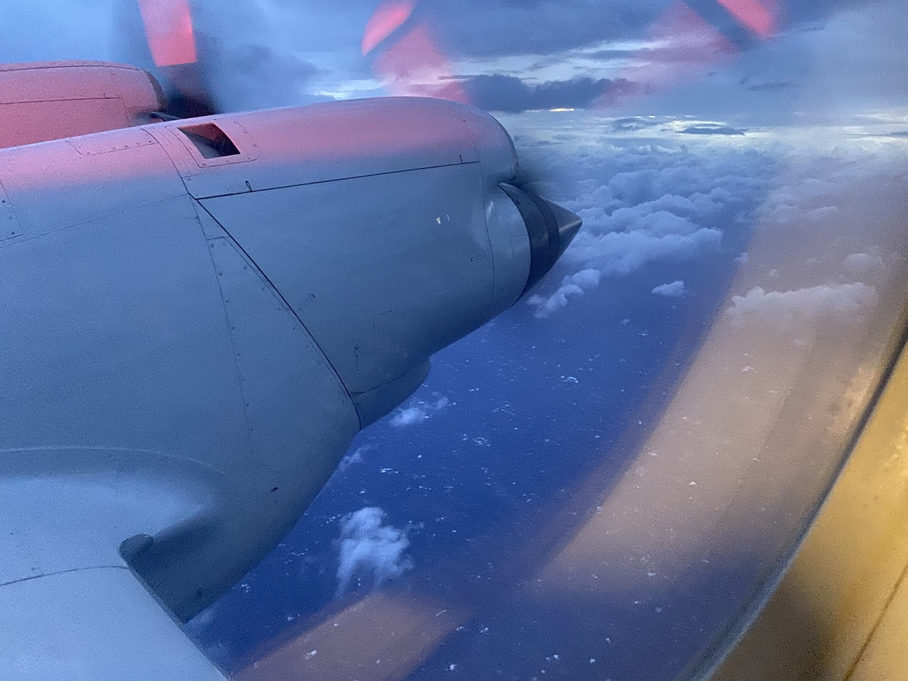
2021 Hurricane Field Program-APHEX
Hurricane Grace: 14-19 August 2021
Photo by Jon Zawislak
Photo by Jon Zawislak
Photo by Jon Zawislak
Photo by Jon Zawislak
Photo by Jon Zawislak
Photo by Jon Zawislak
Photo by Jon Zawislak
Copies of the 2021 AL07/Grace debrief can be found in the HRD Google Drive folder
HRD >> Hurricane Field Program >> 2021 >> Debriefs >> AL07/Grace

