Slide 1
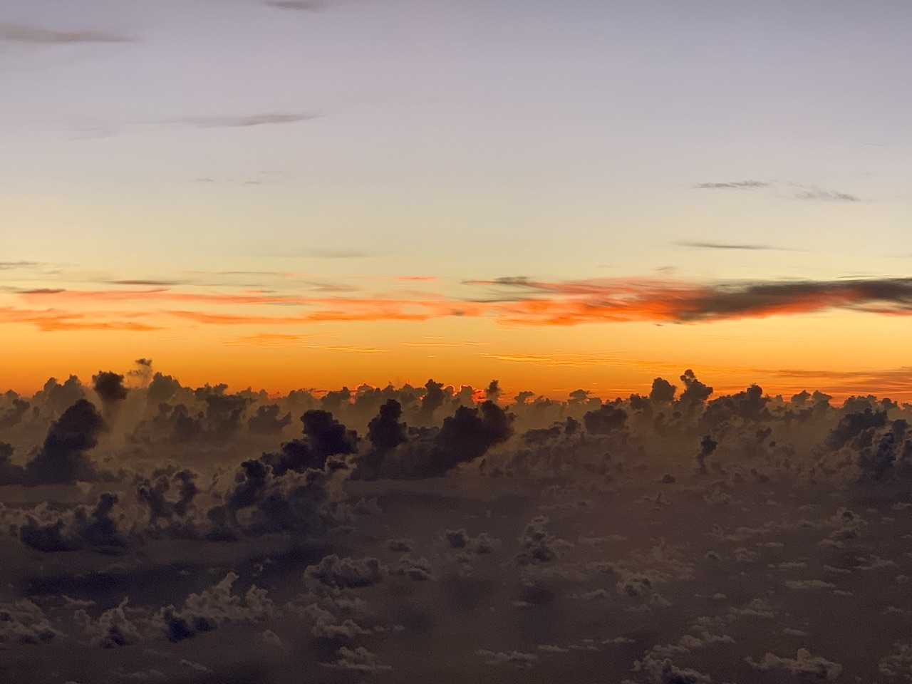


2021 Hurricane Field Program
Advancing the Prediction of Hurricanes Experiment (APHEX)
Fred (AL06) Debrief
Jason Dunion – HFP Director
Jon Zawislak - HFP Deputy Director
Photo by Frank Marks

Slide 2
2021 Hurricane Field Program-APHEX
Summary of Missions (10-13 August 2021)
Summary of Missions
6 P-3 missions (1 NHC, 5 EMC): 10-13 August
  75 GPS dropsondes transmitted to the GTS
  16 TDR analyses transmitted to EMC & NHC
HRD Crewing
  20210810I1 (AM mission): NHC Invest – PT 06)
    Marks (LPS, radar), Wadler (Aspen), Reasor (GB radar), Dunion (GB LPS)
  20210811I1 (AM mission): EMC TDR
    Marks (LPS, radar), Wadler (Aspen), Reasor (GB radar), Hazelton (GB LPS)
  20210811H1 (PM mission): EMC TDR
    Zawislak (LPS, radar), Sellwood (Aspen), Alvey/Gamache (GB radar), Rogers (GB LPS)

Slide 3
2021 Hurricane Field Program-APHEX
Summary of Missions (10-13 August 2021)
Summary of Missions
HRD Crewing (Cont’d)
  20210812H1 (AM mission): EMC TDR
    Marks (LPS, radar), Wadler (Aspen), Fischer/Reasor (GB radar), GB LPS Bucci
  20210812H2 (PM mission): EMC TDR
    Zawislak (LPS, radar), Sellwood (Aspen), Alvey/Gamache (GB radar), GB LPS Rogers
  20210813H1 (AM mission): EMC TDR
    Aberson (LPS, radar), X. Zhang (Aspen), Reasor (GB radar), GB LPS Dunion/Holbach

Slide 4
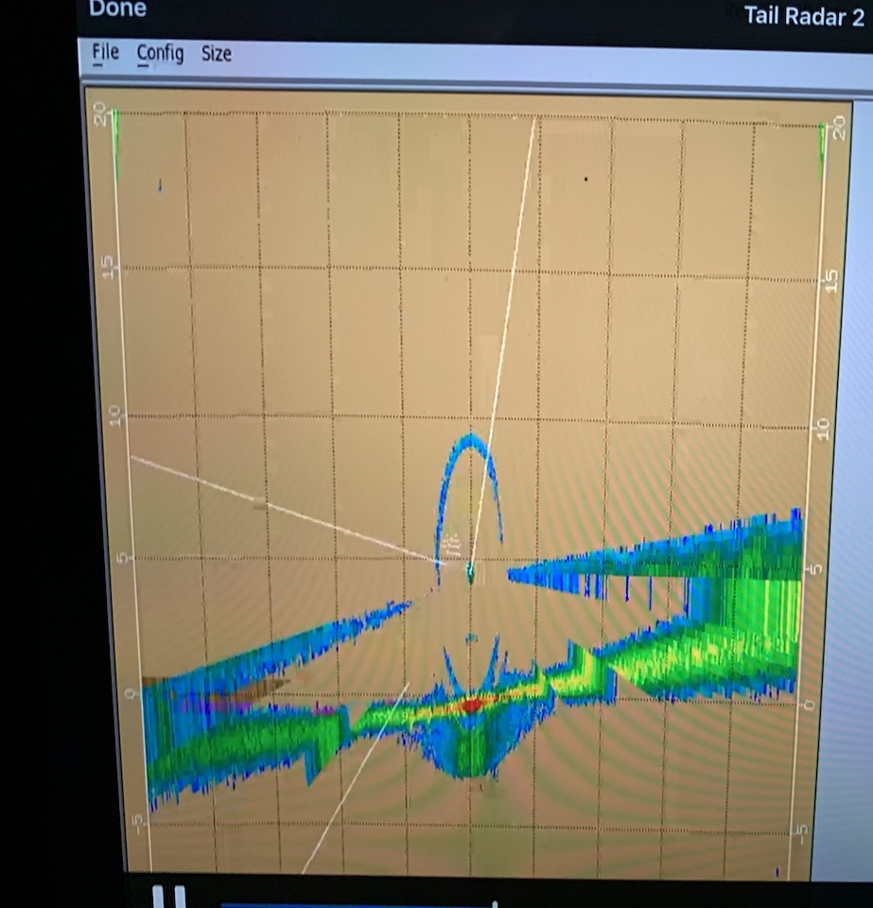
2021 Hurricane Field Program-APHEX
Logistics Highlights
“Proposed flight track” emails
  became a bit cumbersome with lots of requests to add recipients...will look into a Flight Tracks list serve
N43 TDR angle correction issue
  Affected the 20210810I1 mission (John G. noticed a marked across-track sloping of the melting layer in TDR dBZ)
  AOC (Ops, FD, SSAs, AC) was very responsive during post flight discussions to come up with a plan forward
  Attempted a pre-storm TDR shakedown during the 20210811I1 mission, but couldn’t resolve (no TDR sent off to EMC)
  Requested to swap out N43 and fly N42 for the remainder of the Fred series
  TDR fix: the issue was an electro-magnetic component gear slip (synchro slippage)
  Note: no way to transmit analyses w/o them also getting into AWIPS (challenge for real-time troubleshooting)
N43 TDR across-track sloping (surface)
SFMR (HDOBs)
  SFMR was not reporting HDOBs during the 20210811H1 & 20210812H1 missions (thanks to Heather for sleuthing)
  It was determined that AOC set a pre-season flag in the software to not report SFMR HDOBs when the P-3s fly above 12.5 k ft (radar)
  Discussions ongoing regarding what FL flag to use (for now it’s 12.5 k ft, so no SFMR HDOBS above that)

Slide 5
2021 Hurricane Field Program-APHEX
Logistics Highlights
SFMR (calibration)
  Issue with N42’s SFMR calibration was found (thanks again to detective Holbach)
  SFMR rain rates for the 20210813H1 mission were “hovering around 5 mm/hr when they should have been closer to 00 mm/hr”
  Determined that SFMR unit 002 needed a new calibration flight
    AOC mentioned that there was concern that RFI (RF interference) in the GMex affected units 001 & 002
    AF also had RFI issues with SFMR calibrations in the GMex this year (C-Band radars on ships and oil rigs?)
    SFMR unit 003 was calibrated in the Atlantic and hasn’t had the same problems
  With Grace missions looming, N42’s 002 SFMR unit was swapped out for 001
  SFMR unit 001 looks better than unit 002, but still needs calibration
SFMR Status
  N43’s SFMR looks good, N42’s SFMR (unit 001) needs calibration, SFMR unit 002 being sent off to ProSensing
  Recommending a N42 SFMR calibration flight with unit 001 in the Atlantic ASAP
  Should be able to reprocess N42 SFMR data once we get new cal coeffs >> back to research quality data
  Issues with the SFMR may have shaken the confidence of some of the forecasters

Slide 6
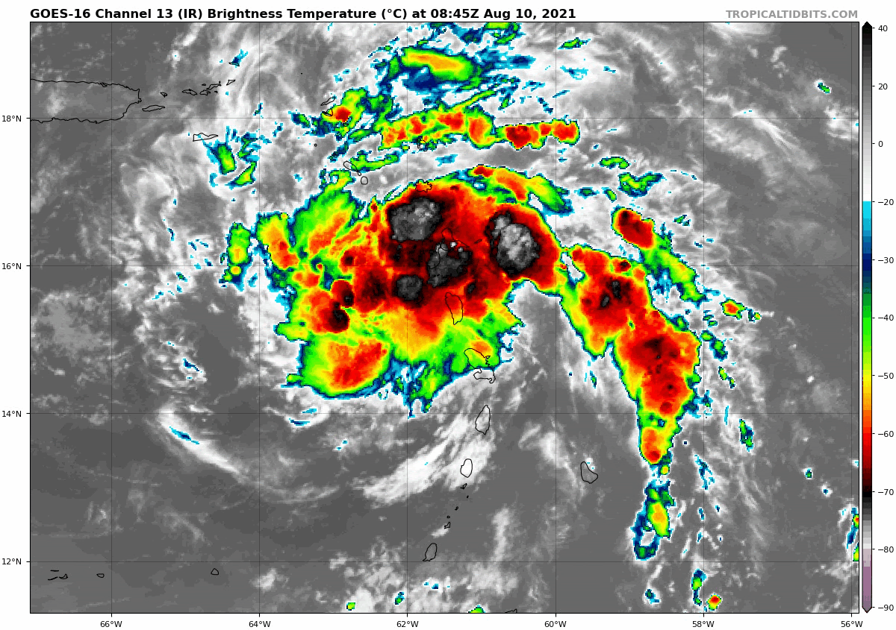
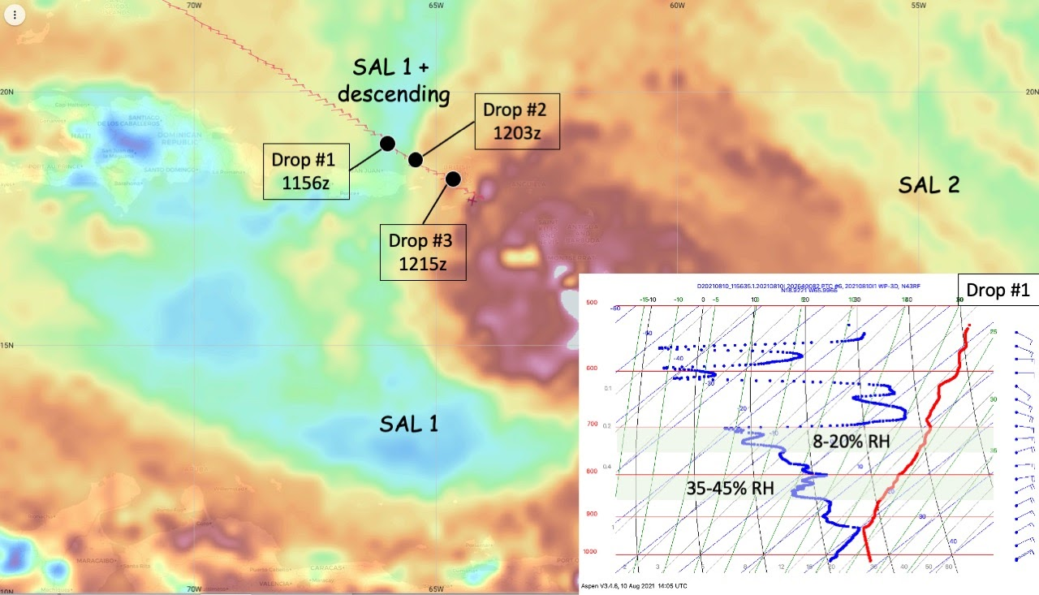
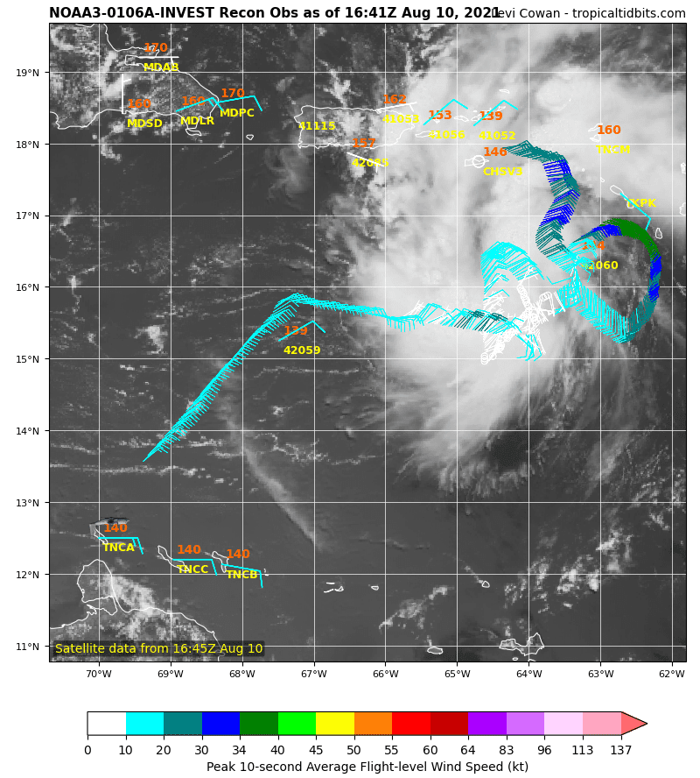
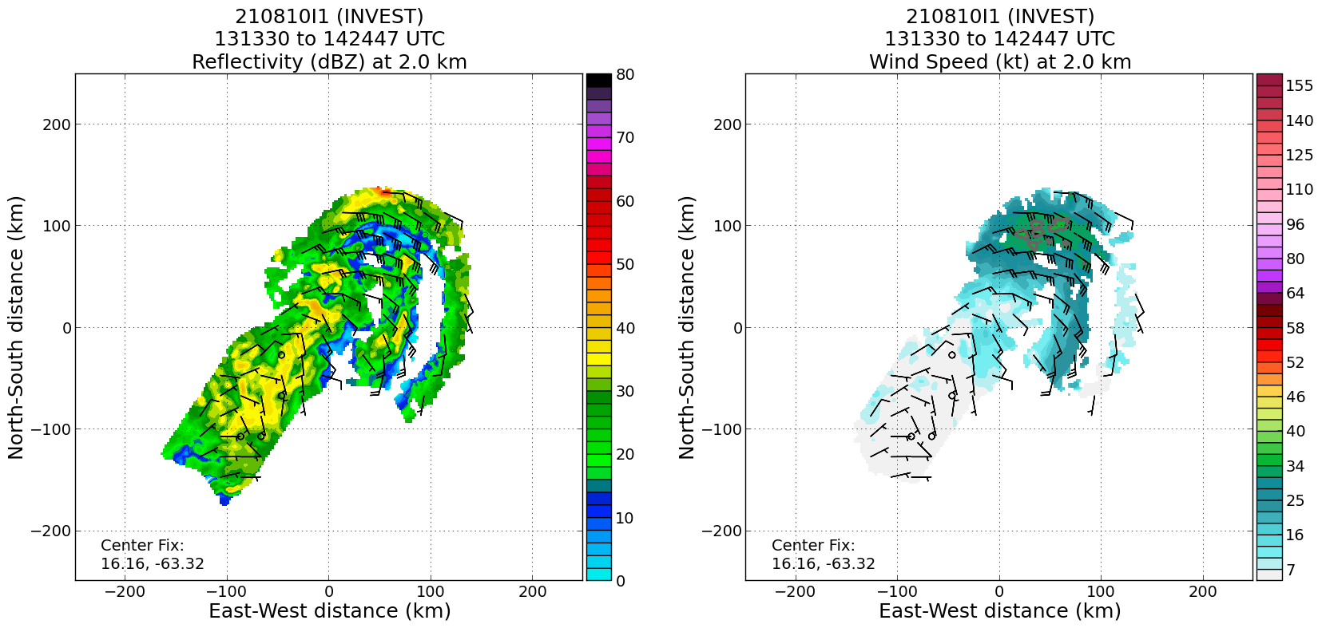
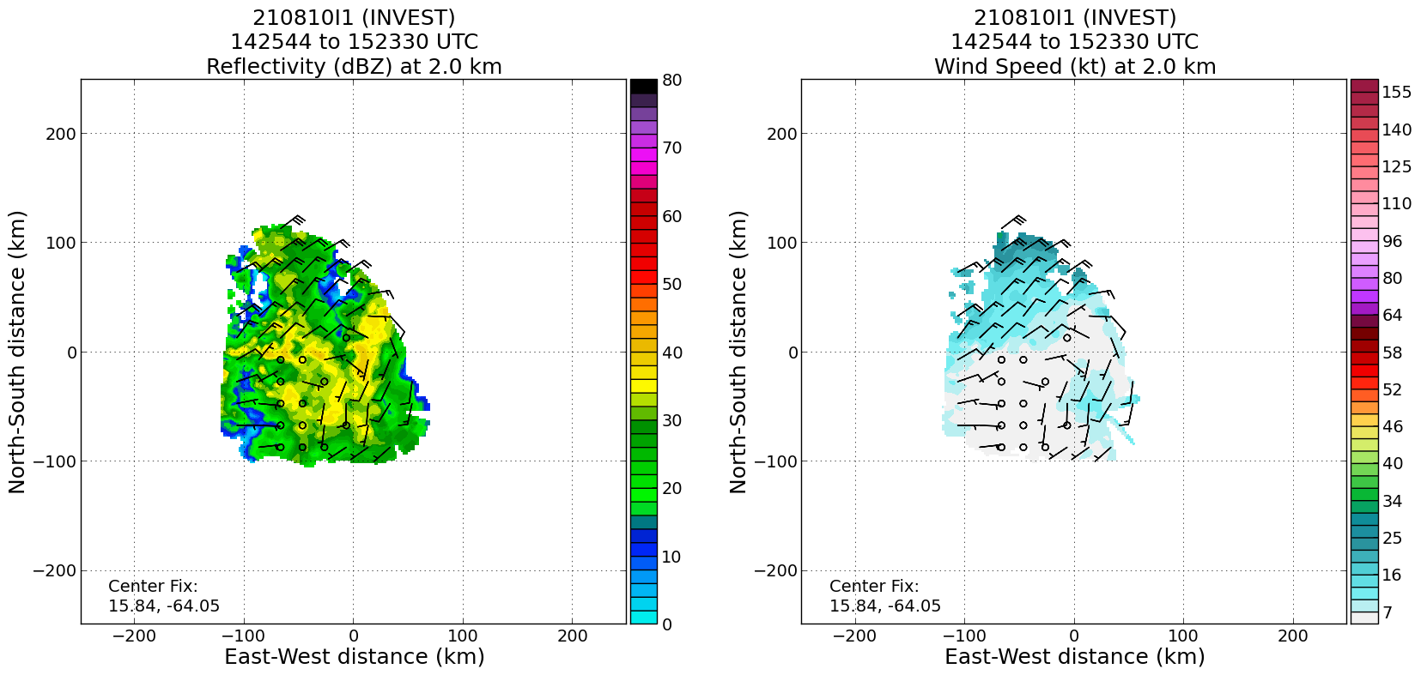
2021 Hurricane Field Program-APHEX
PTC 06 (Fred): 20210810I1 (NHC Invest)
Mission
  LPS: Marks, GB LPS: Dunion
  APHEX relevance:
    FAM & PREFORM (Genesis Stage)
    ONR TCRI
  Planned pattern: alpha + box pattern
  T/O off (KLAL) – Landing (AUA): 0839 – 1645z
  FL 5-10 k ft
  3 TCRI dropsondes (GTS)
    moist tropical - SAL+subsidence - PTC 06 moisture gradients
  3 TDR analyses to NHC and EMC
No well-defined circulation found with the system more resembling an open wave) >> NHC maintained as PTC 06 (30 kt)
John and Paul determined that there may have been an issue with N43’s TDR for this mission. Planned pre-storm testing for the following day’s N43 mission
MIMIC TPW (1100z)
NE-SW and S-N passes indicate PTC Six still an open wave at 2 km. Signs of a mid-level 5-km closed circulation.

Slide 7
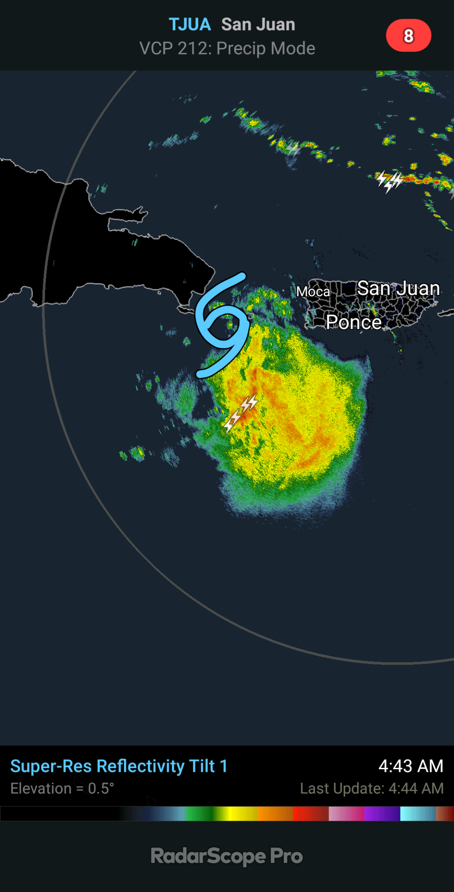
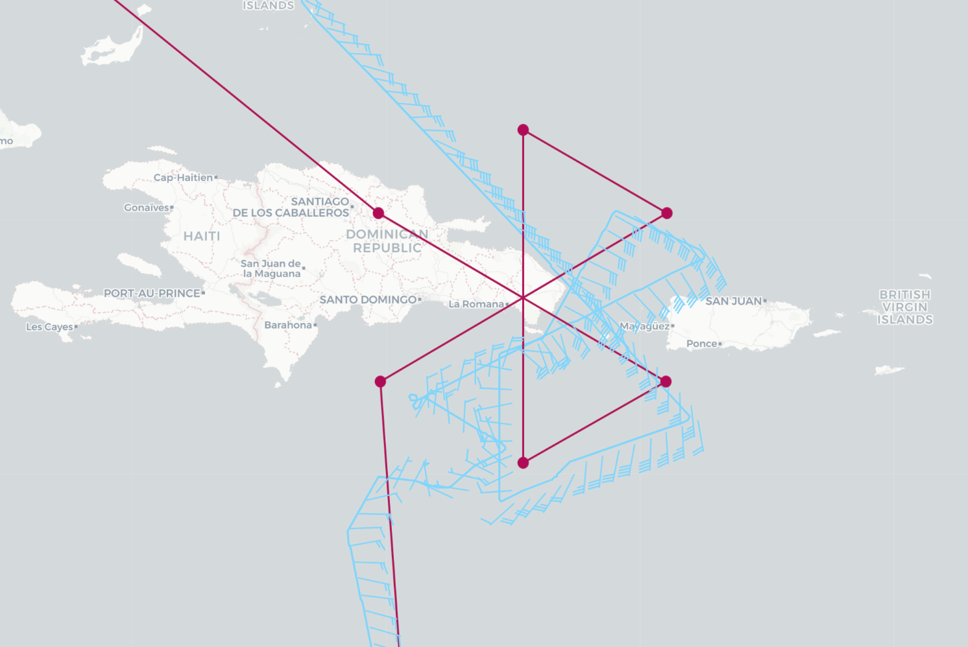
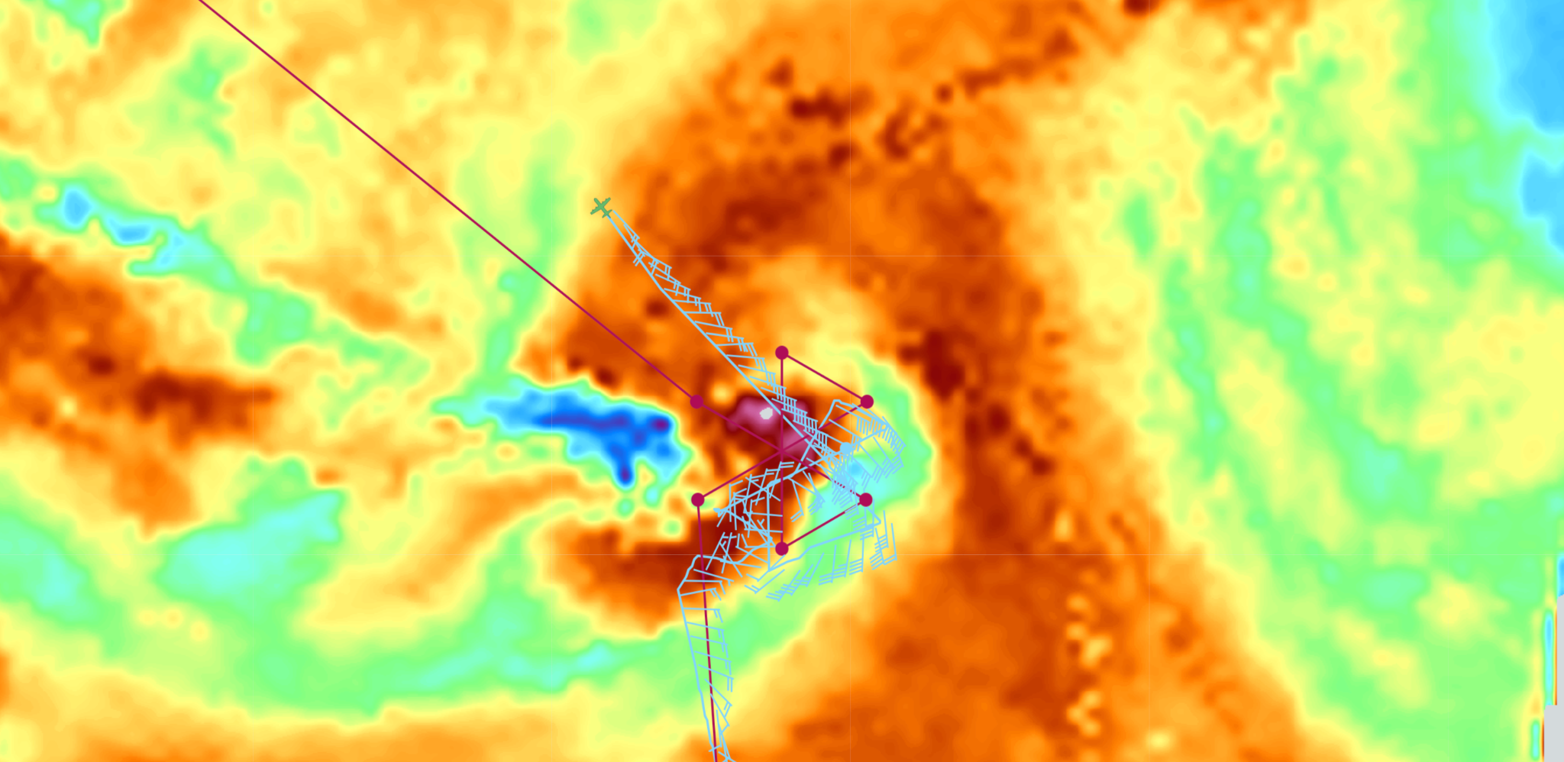
2021 Hurricane Field Program-APHEX
Tropical Storm Fred: 20210811I1 (EMC TDR)
Mission
  LPS: Marks, GB LPS: Hazelton
  APHEX relevance:
    AIPEX (Early Stage)
    ONR TCRI
  Planned pattern: modified butterfly
  T/O off (AUA) – Landing (KLAL): 0837 – 1557z
  FL 10 k ft
  17 dropsondes (12 to GTS), 14 NWS/3 ONR
  3 TDR analyses (none transmitted)
On-the-fly azimuth angle correction modifications deemed inadequate, preventing transmission of any TDR data to EMC
Moisture gradient NW of Fred was sampled in collaboration with ONR TCRI
Radar from TJUA: Seems like there is N-S tilt of the vortex (most convection south of the center).
N43 planned (magenta) and actual (light blue) flight tracks.
ONR Sonde 1 (drop 15): starting to target this moisture gradient) from 19 k ft

Slide 8
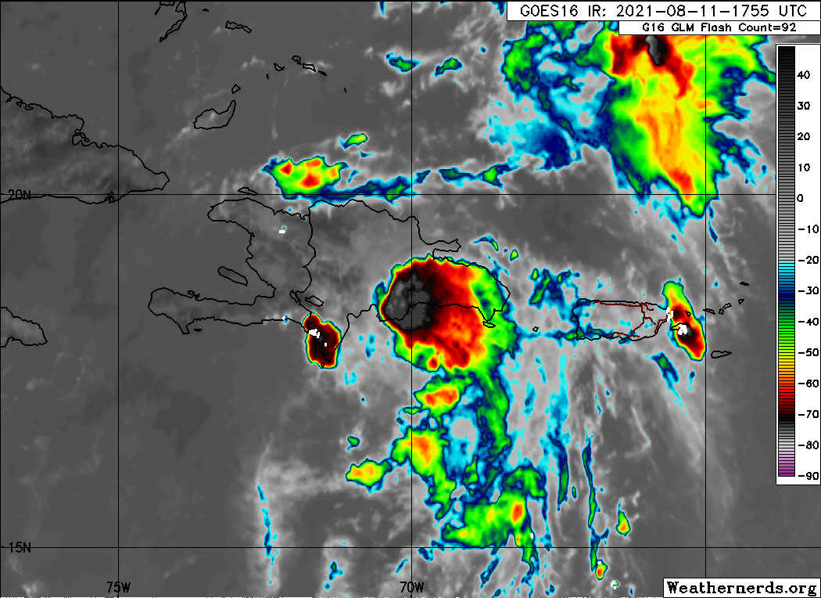
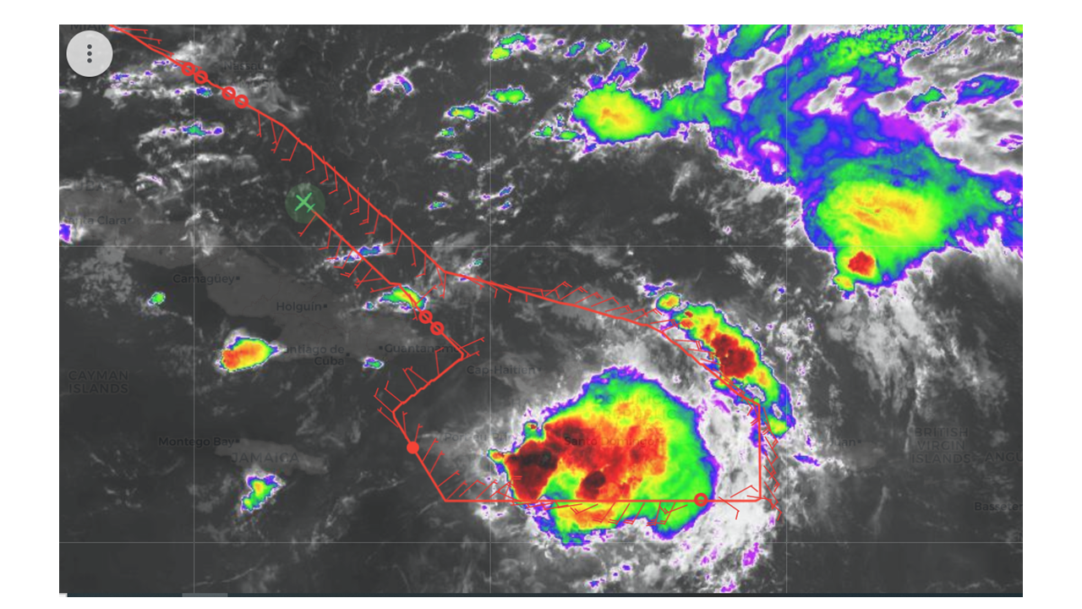
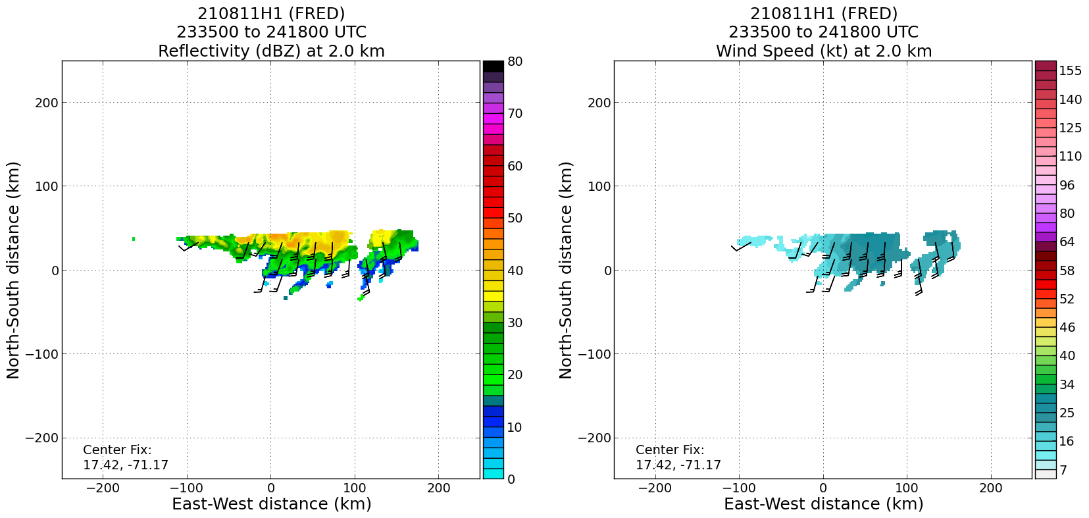
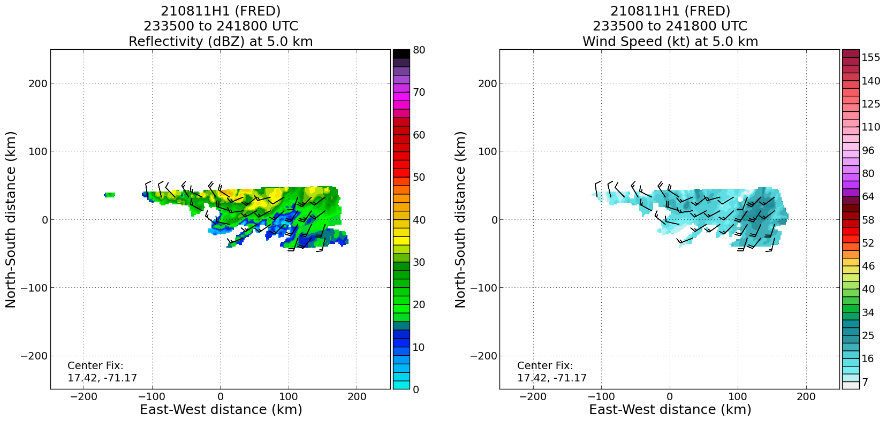
2021 Hurricane Field Program-APHEX
Tropical Storm Fred: 20210811H1 (EMC TDR)
Mission
  LPS: Zawislak, GB LPS: Rogers
  APHEX relevance:
    AIPEX (Genesis Stage)
  Planned pattern: survey
  T/O off (KLAL) – Landing (KLAL): 1946 – 0314z
  FL 10-20 k ft
  20 dropsondes (GTS)
  2 TDR analyses (to NHC and EMC)
High-level dropsondes from the P-3 documented the distribution of dry air in the environment ahead of Fred
TDR provided information on the complicated structure of the wind field of Fred’s inner core
Sampled structure of a weak TS Fred that was dealing with a hostile environment (WVS & dry air) while also encountering steep mountains of Hispaniola
Over the past few hours, convection has developed over and to the north of the LLC as it’s traveled along the S coast.
LL southerlies
LL southerlies
Solid southerly flow at 2 km altitude, and clear curvature in the flow at 5 km to the north of the flight track. This curvature is coincident with a region of deep convection.
ML curvature
ML curvature

Slide 9
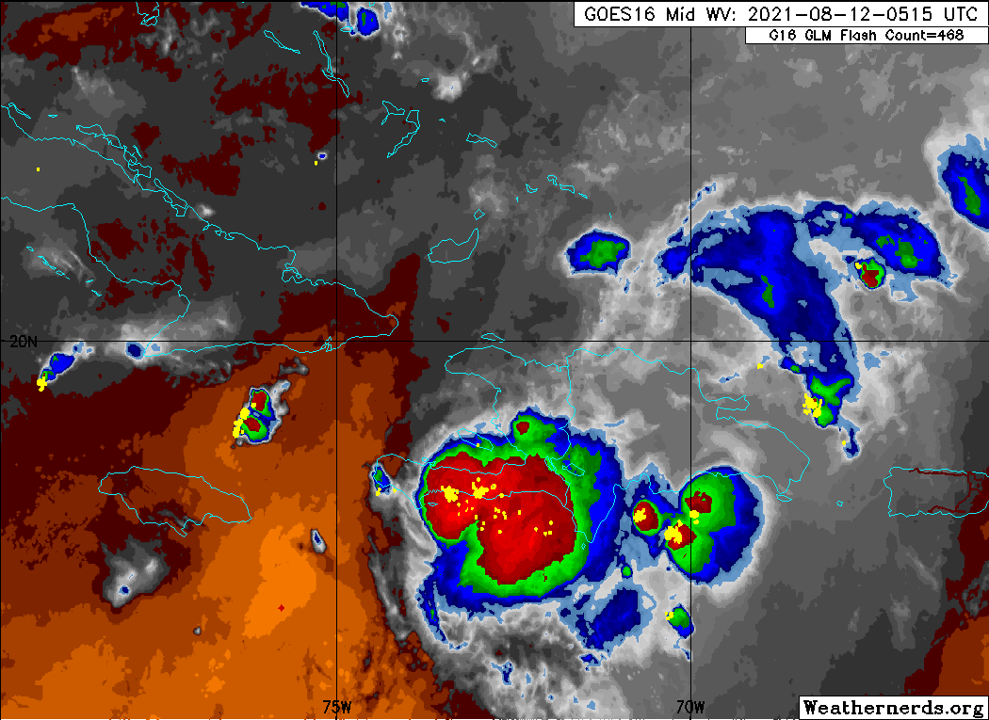
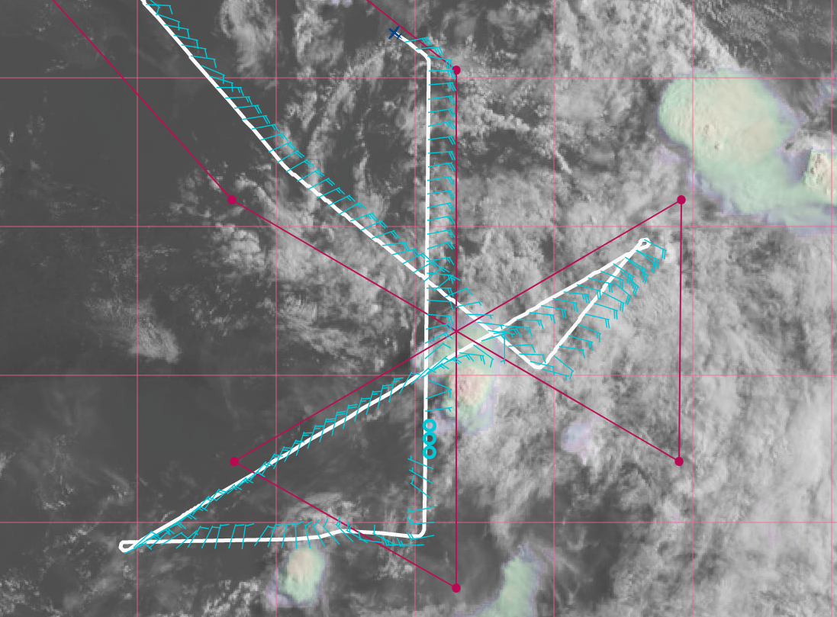
2021 Hurricane Field Program-APHEX
Tropical Storm Fred: 20210812H1 (EMC TDR)
Mission
  LPS: Marks, GB LPS: Bucci
  APHEX relevance:
    AIPEX (Early Stage)
  Planned pattern: modified butterfly
  T/O off (KLAL) – Landing (KLAL): 0805 – 1447z
  FL 10-20 k ft
  14 dropsondes (GTS)
  3 TDR analyses (to NHC and EMC)
Found a shallow weak system emerging from the coast of Hispaniola.
TDR was transmitting slowly because the second sat comm was not turned on.
There may be an issue with the land masking algorithm for the SFMR. H. Holbach noted that data was not transmitted regularly and T. Richards said ProSensing has a firmware update they are waiting to install.
Circulation is decoupled from convection with the majority of cold (but warming) cloud tops remain south of Haiti. It appears the predicted and actual center will be close to one another and little/no pattern shifts will need to occur.

Slide 10
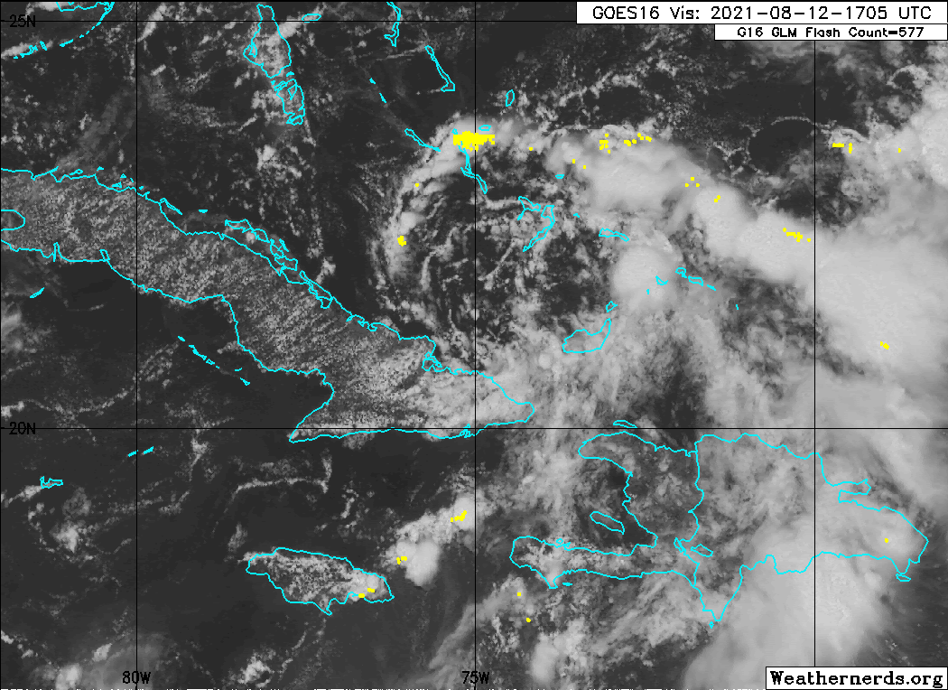
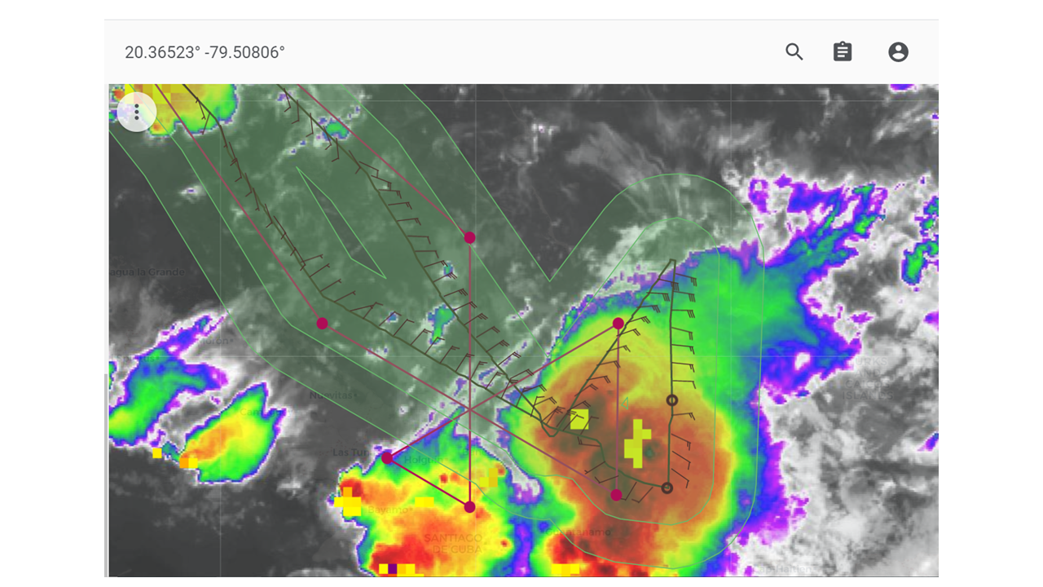
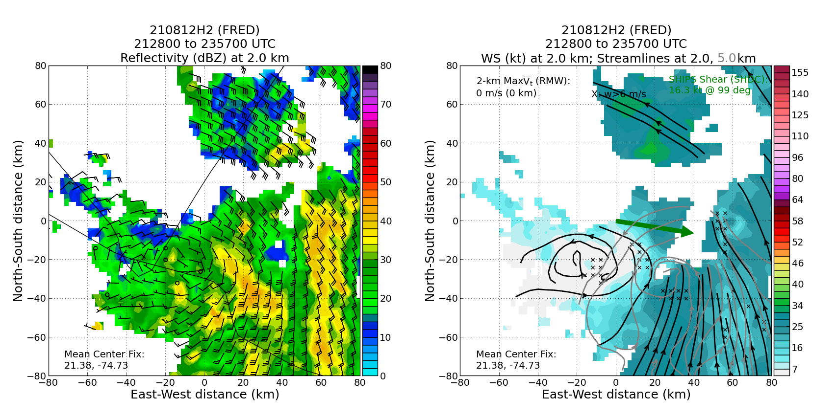
2021 Hurricane Field Program-APHEX
Tropical Storm Fred: 20210812H2 (EMC TDR)
Mission
  LPS: Zawislak, GB LPS: Rogers
  APHEX relevance:
    AIPEX (Early Stage)
  Planned pattern: modified butterfly
  T/O off (KLAL) – Landing (KLAL): 2003 – 0119z
  FL 12 k ft
  11 dropsondes (10 GTS)
  2 TDR analyses (to NHC and EMC)
Radar analyses showed that the center was tilted (or displaced) toward the ESE with height between 2 & 5 km. Interestingly, though, there was little difference pass to pass.
P-3 mission sampled the structure of tropical depression Fred, which had become quite disorganized after passage over Hispaniola.
Strong thunderstorms developed to the southeast of the existing center during the mission, causing many rapid adjustments to the flight pattern during the mission.
Exposed low-level circulation just north of the southeast Cuban coast.
N42 planned (red) and final (black) flight tracks.
LL
LL
ML
TDR analyses from the 2nd pass >> about a 50-60 km tilt/displacement toward the ESE between about 2 and 5 km (also confirmed by the tilt hodograph). So not too much evolution between passes.

Slide 11
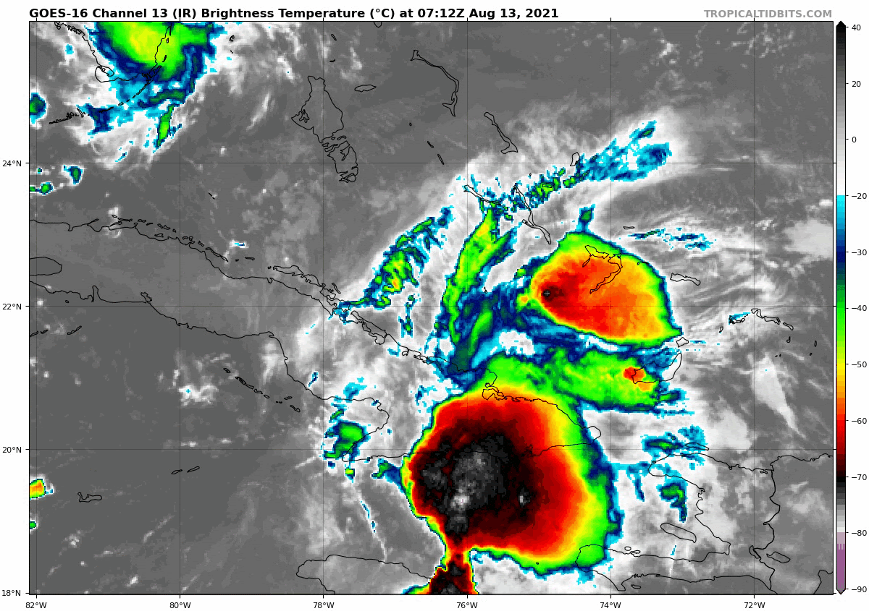
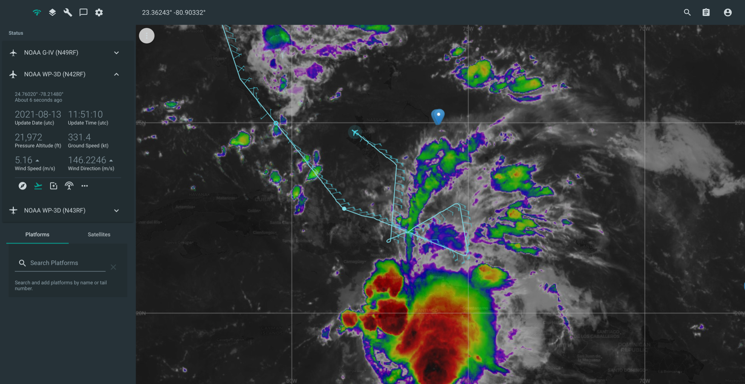
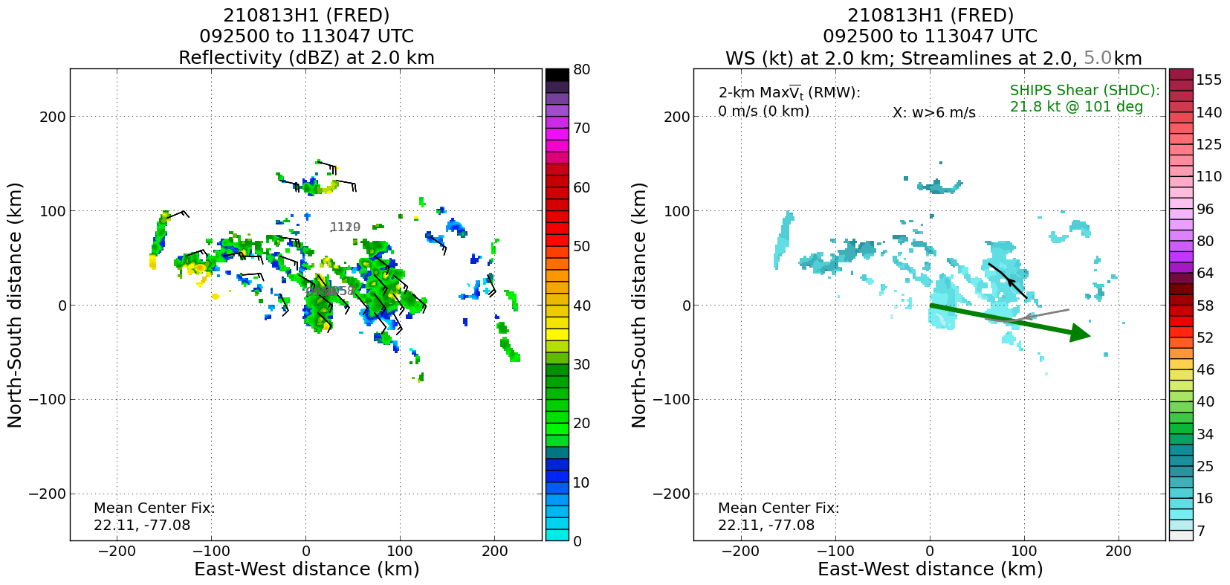
2021 Hurricane Field Program-APHEX
Tropical Storm Fred: 20210813H1 (EMC TDR)
Mission
  LPS: Aberson, GB LPS: Dunion/Holbach
  APHEX relevance:
    AIPEX (Early Stage)
  Planned pattern: modified butterfly
  T/O off (KLAL) – Landing (KLAL): 0807 – 1248z
  FL 12 k ft
  11 dropsondes (11 GTS)
  3 TDR analyses (to NHC and EMC)
P-3 mission into TD Fred sampled the northern portion of the circulation on the north side of Cuba
Large area of thunderstorms formed on the south side of Cuba overnight, which may lead to a reorganization of the storm.
Some excessive flagging of the SFMR in the HDOBs. Workstation had to be rebooted to generate a synoptic map.
Very few deviations from the planned pattern except for repositioning on the vortex center and slight deviations around convection on leg 1.
N42 final flight track (cyan).
Final TDR composite

Slide 12
2021 Hurricane Field Program-APHEX
Tropical Storm Fred: 10-13 August 2021
Social Media
Twitter
  https://twitter.com/HRD_AOML_NOAA/status/1425876795170205697
Daily Plan of the Day
  Sent to research partners, AOML Comms, OAR Communications Office
  Emily Ashe, Michael F., Jason D., and Jon Z.
    Post-map discussion tag-ups to discuss social media opportunities

Slide 13
2021 Hurricane Field Program-APHEX
Tropical Storm Fred: 10-13 August 2021
Other Issues – what can we do better?
Social media efforts
Streamline communications with Jennifer and give as early a heads up as possible re: Fed travel plans
HRD Fed logistics
  Familiarization with HFP rules re: time & attendance, HD pay, premium pay requests for OT, etc.
  Submit post-travel receipts ASAP, especially as we get closer to the end of the FY
GB LPS is an excellent addition to our support of missions, but do we have the people-power to make it work?
  Mission summary writing, eyes on the ground, LPS training
  GB LPS on mission pre-brief 2 hour before
Confirming that TDR display looks “reasonable” after take-off
  Radar training: include examples of TDR displays that are “bad” and should be acted on immediately
  When in doubt, onboard LPS could email a screen shot of the TDR display on the aircraft
More thorough confirmation that pre-season SFMR calibration flights are adequately free from RFI

Slide 14
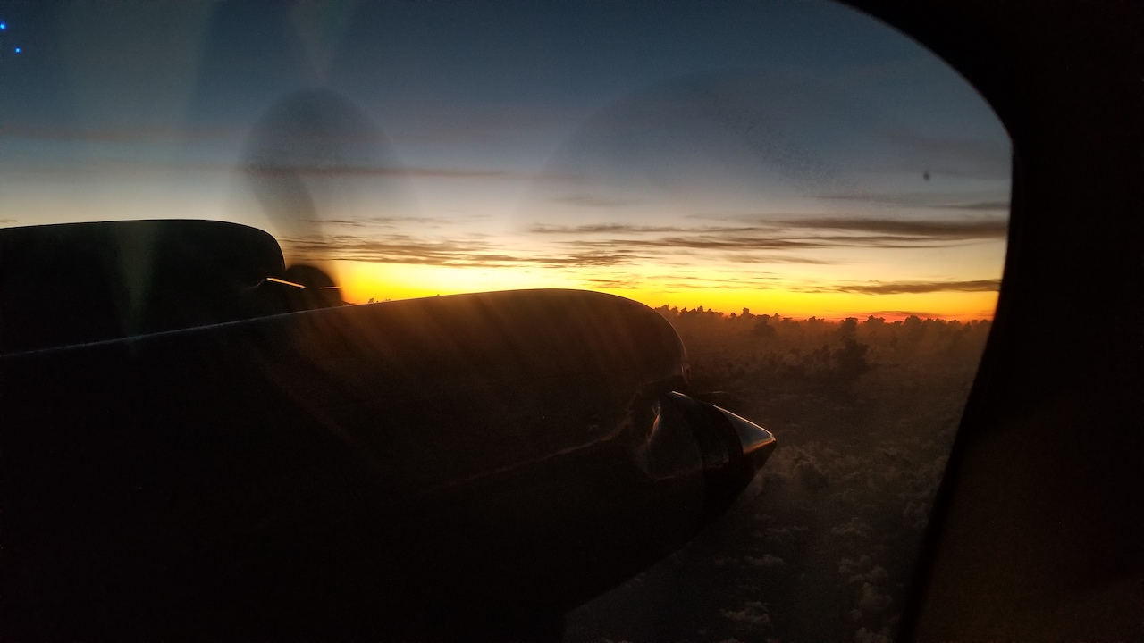
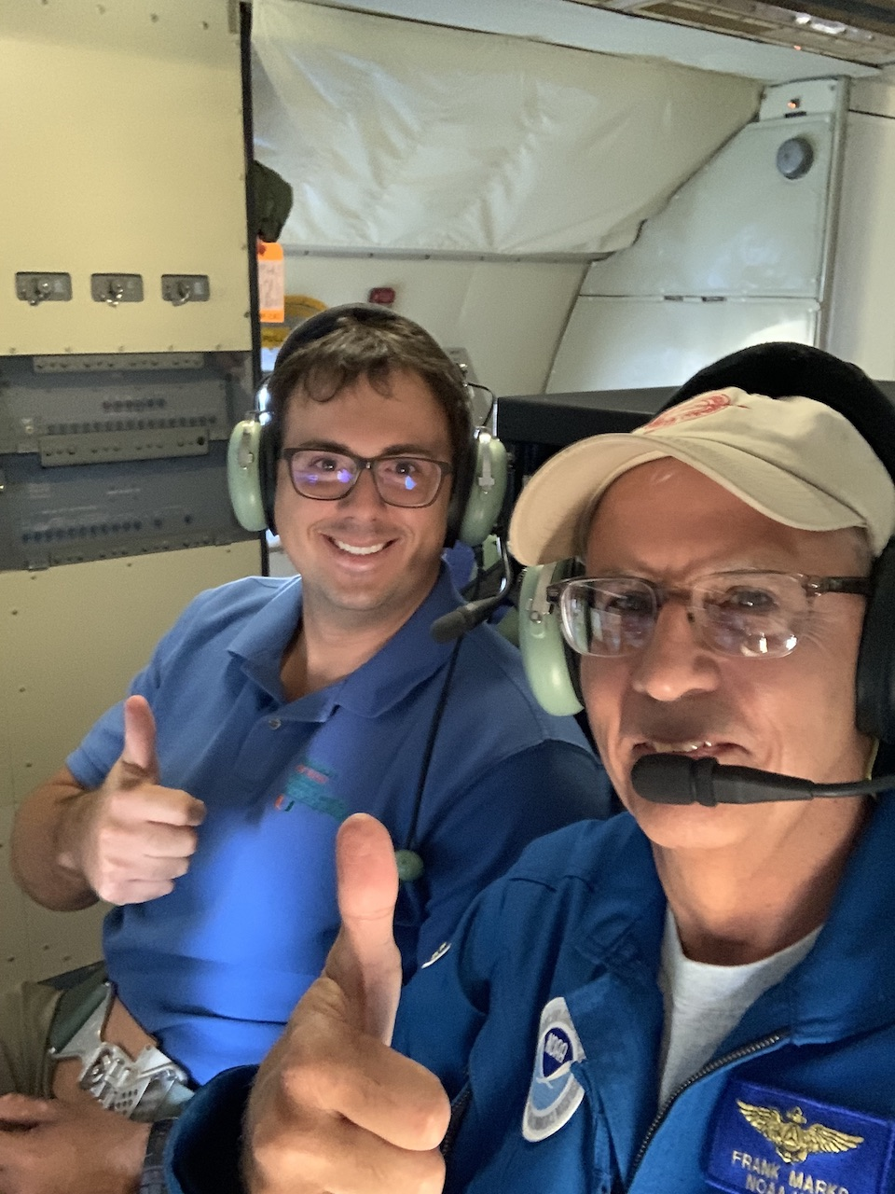
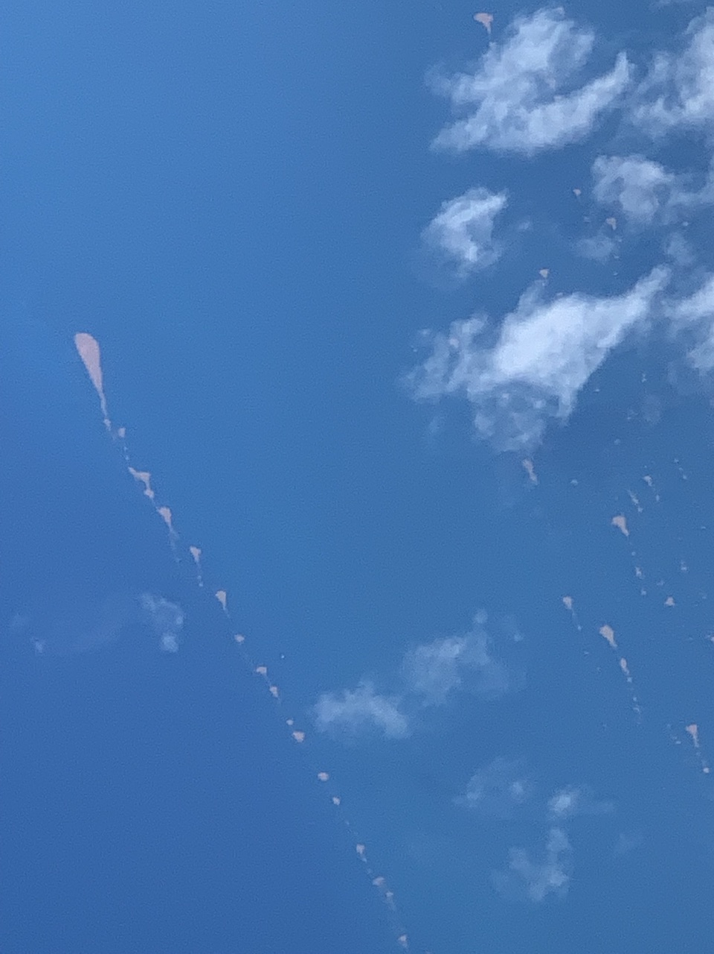
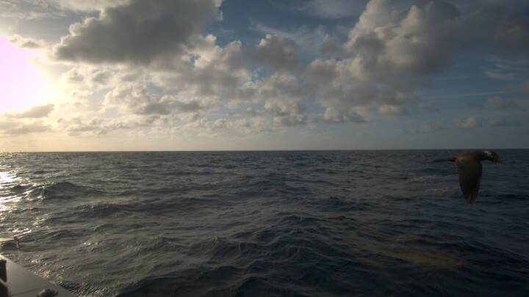
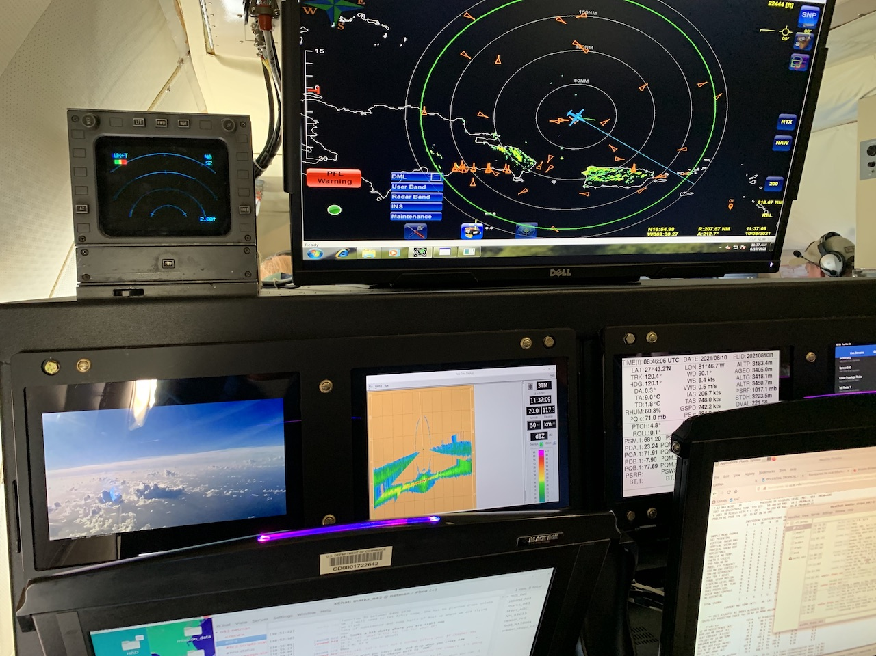
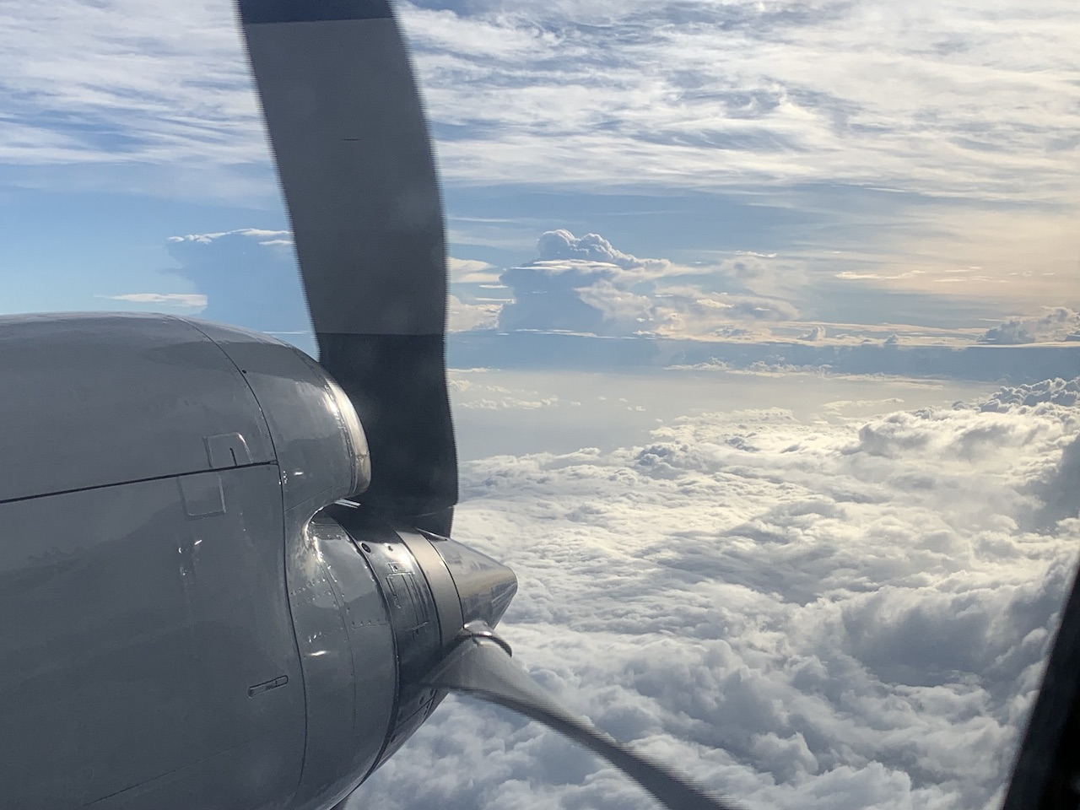
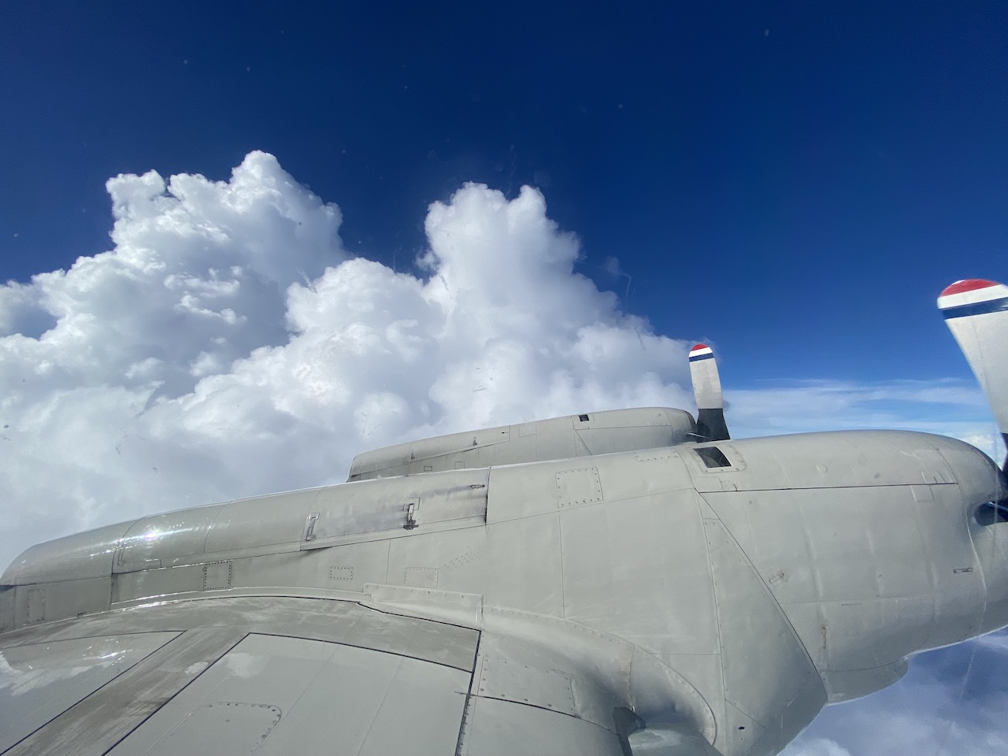
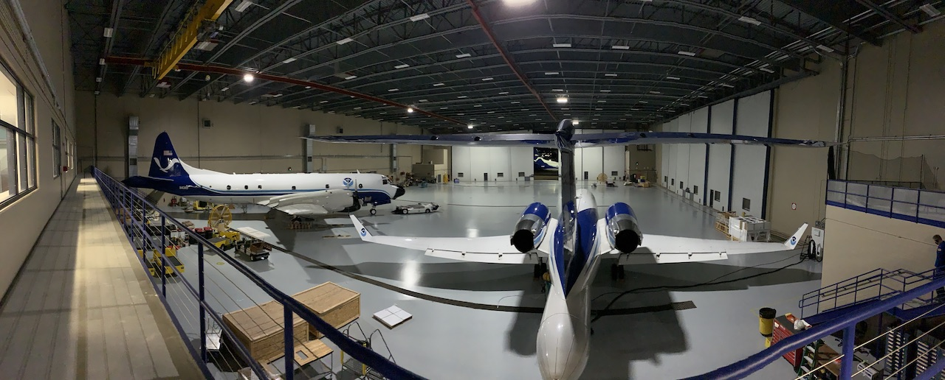
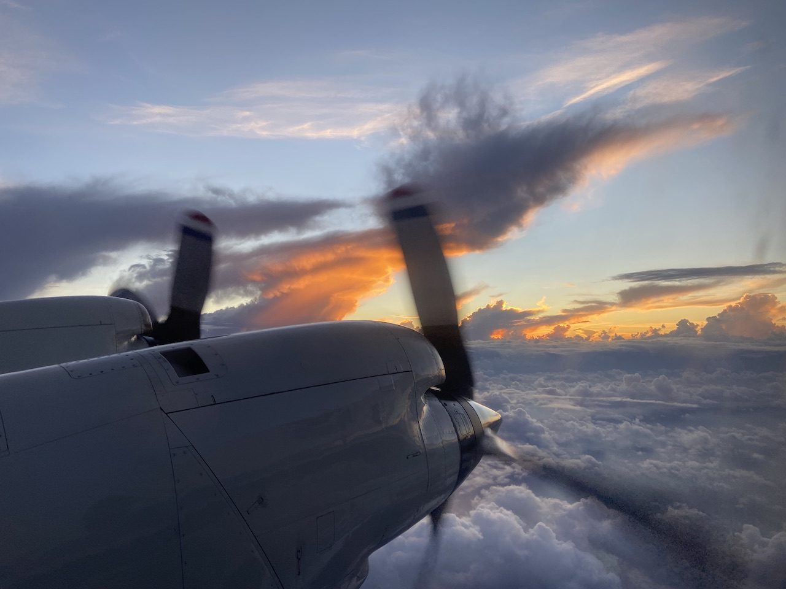
2021 Hurricane Field Program-APHEX
Tropical Storm Fred: 10-13 August 2021
Photo by Josh Wadler
Photo by Frank Marks
Photo by Frank Marks (Sargassum)
Photo by Frank Marks
Photo by Frank Marks
NOAA Saildrone gets a visit
Photo by Frank Marks
Photo by Jon Zawislak
Photo by Frank Marks
Photo by Jon Zawislak
Copies of the 2021 AL06/Fred debrief can be found in the HRD Google Drive folder
HRD >> Hurricane Field Program >> 2021 >> Debriefs >> AL06/Fred

