Slide 1


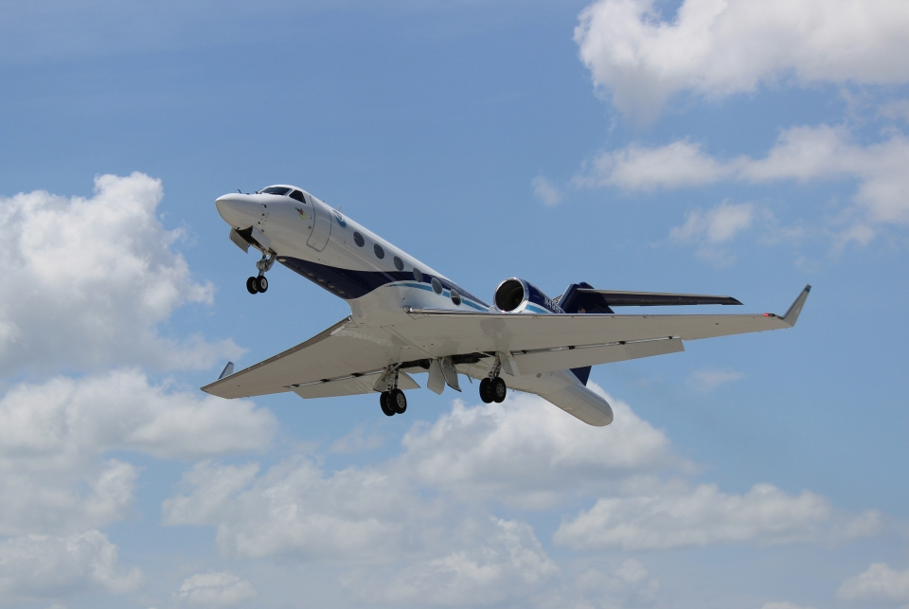
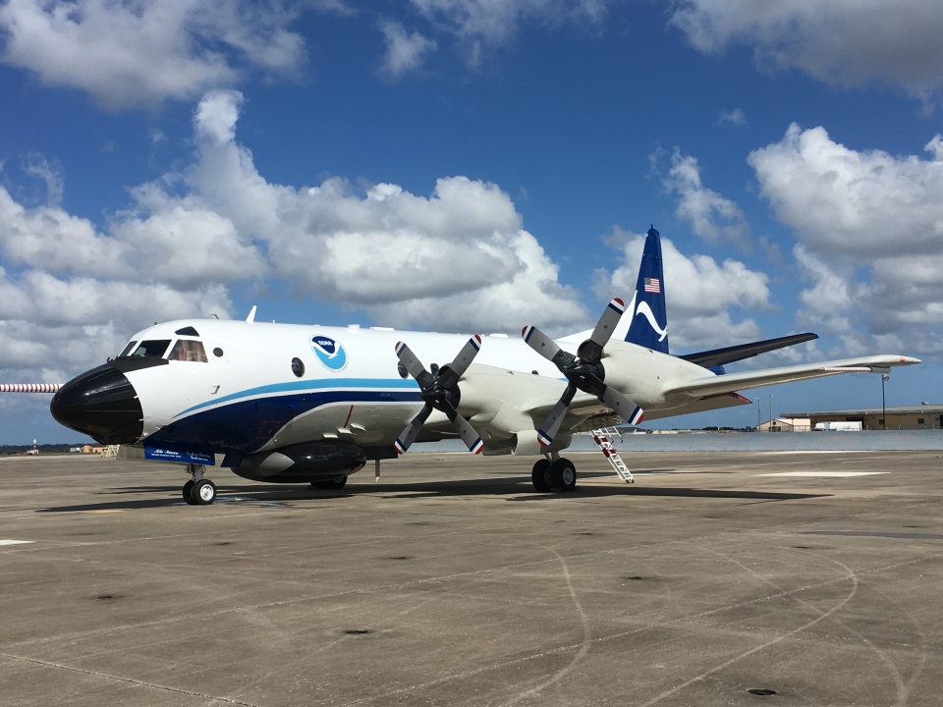
2021 Hurricane Field Program
Advancing the Prediction of Hurricanes Experiment (APHEX)
Elsa (AL05) Debrief
Jason Dunion – HFP Director
Jon Zawislak - HFP Deputy Director

Slide 2
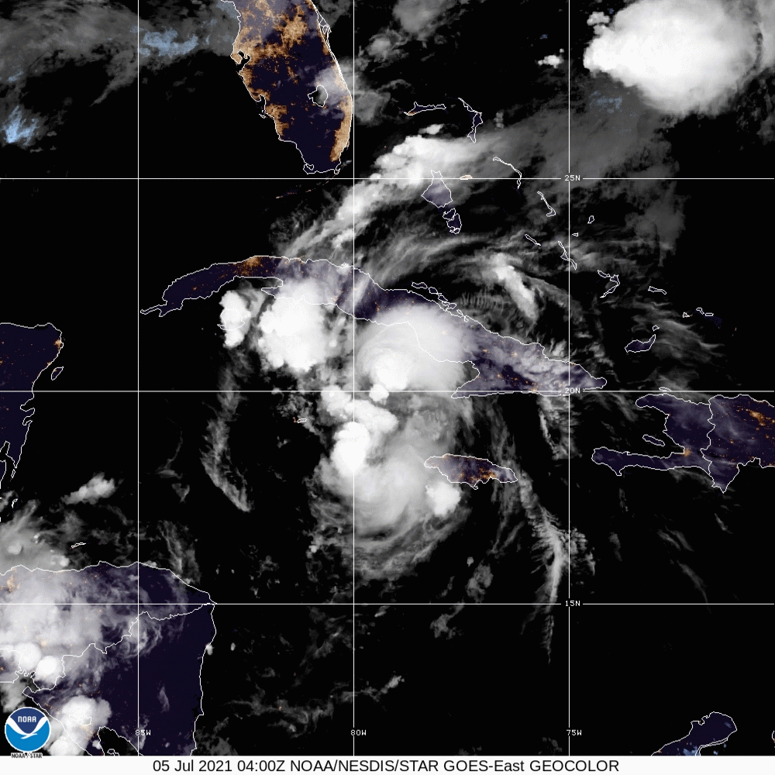
2021 Hurricane Field Program-APHEX
Summary of Missions (2-5 July 2021)
Summary of Missions
4 P-3 missions (NHC, EMC): 2-5 July
56 GPS dropsondes transmitted to the GTS
14 TDR analyses transmitted to EMC & NHC
2 G-IV missions (NHC)
2 July (Venezuelan airspace restrictions)
3 July (aborted mission)
HRD Crewing
20210702H1
Zawislak (G-LPS), Gamache/Reasor/Alvey/Fischer (G-Radar), Sellwood/Wadler (Aspen-TAG)
20210703H1
Zawislak (G-LPS), Gamache/Reasor/Fischer (G-Radar), Sellwood/Aberson (Aspen-TAG)
20210704H1
Dunion (G-LPS), Reasor/Gamache (G-Radar), Aberson/Sellwood (Aspen-TAG)
20210705H1
Dunion (G-LPS), Reasor/Gamache (G-Radar), Sellwood/Hazelton (Aspen-TAG)

Slide 3
2021 Hurricane Field Program-APHEX
Logistics Highlights
Operational tasking was a mix of EMC TDR-only and combination NHC Fix / EMC TDR missions
Dual-task missions were a bit challenging re: communication and getting all objectives accomplished
Testing the Flight Log templates proved successful and have positioned us to get information to management and the public more efficiently
Elsa’s vortex structure was quite complex (lots of good science discussions)
NASA MTS was not available until the final P-3 mission
AOC’s Honeywell site, Tropical Atlantic, UCAR EOL Flight Tracker, and Flight Aware were helpful
Ground-support situational awareness was compromised at times
Elsa’s fast forward motion & proximity to the islands made pattern execution challenging
Cuba ATC >> several uncharted overland & overwater “prohibited airspace” areas >> also challenging
N-42 THOR instrument (gamma ray detector) was not functioning after the 1st mission
AOC and instrument PI determined that too many post-flight hard shutdowns of the unit may have caused the issue
THOR is back up now and new shutdown procedures are in place

Slide 4
2021 Hurricane Field Program-APHEX
Logistics Highlights
Compact Raman Lidar not operational (3 issues)
Laser failed and needed to be replaced
Mirror control motor needed to be replaced
Noise interference on the CRL data acquisition trigger needed to be fixed
All issues now resolved and CRL is flight ready
P-3 Cloud microphysics probes
P-3 cloud microphysics probes were not installed pre-Elsa
Lesson learned: in the future, clarify with AOC what instruments are included in the definition of “1 June hurricane ready”
N42’s microphysics package is degraded and needs to be sent out for refurbishing
N43’s microphysics package will be swapped over to N42 in the next week
N43’s refurbished microphysics package will be put on N42 when it returns to AOC in ~3 weeks (important for TCRI work)
N42’s microphysics package will then be swapped back to N43
Ground-based support >> good opportunity to train HRDers on Radar and Aspen/TAG
HRD’s plan is to have 2 scientists onboard operational (most) & research missions when possible
Onboard HRDers : 1) LPS/Radar, 2) Dropsondes

Slide 5
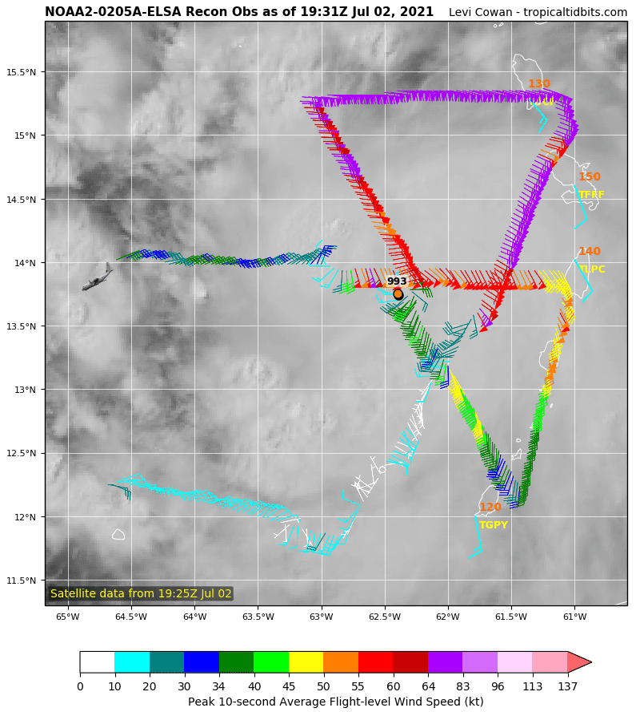
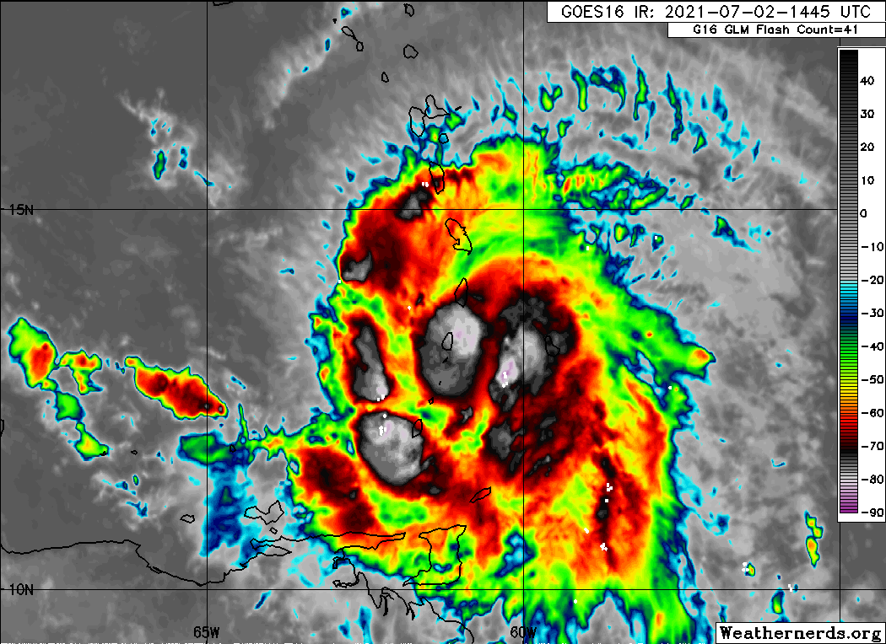
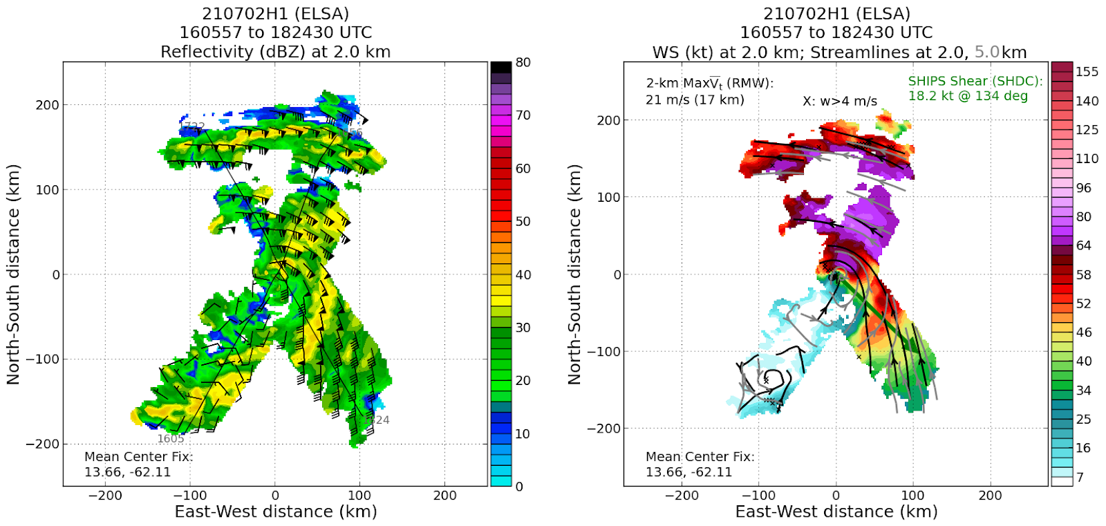
2021 Hurricane Field Program-APHEX
Hurricane Elsa: 20210702H1 (EMC TDR Tasking)
Mission
G-LPS: J. Zawislak
APHEX relevance: AIPEX
Planned pattern: butterfly
T/O off (AUA) – Landing (AUA): 1431z - 2049z
FL 10 k ft
16 dropsondes (15 to GTS)
3 TDR analyses to NHC and EMC
Elsa strengthened to 75 kt, but had a highly asymmetric wind field (strongest on the N & E sides)
Circulation >> diffuse below FL, more coherent above FL (elongated above ~7 km)
NASA MTS >> not tracking N42

Slide 6
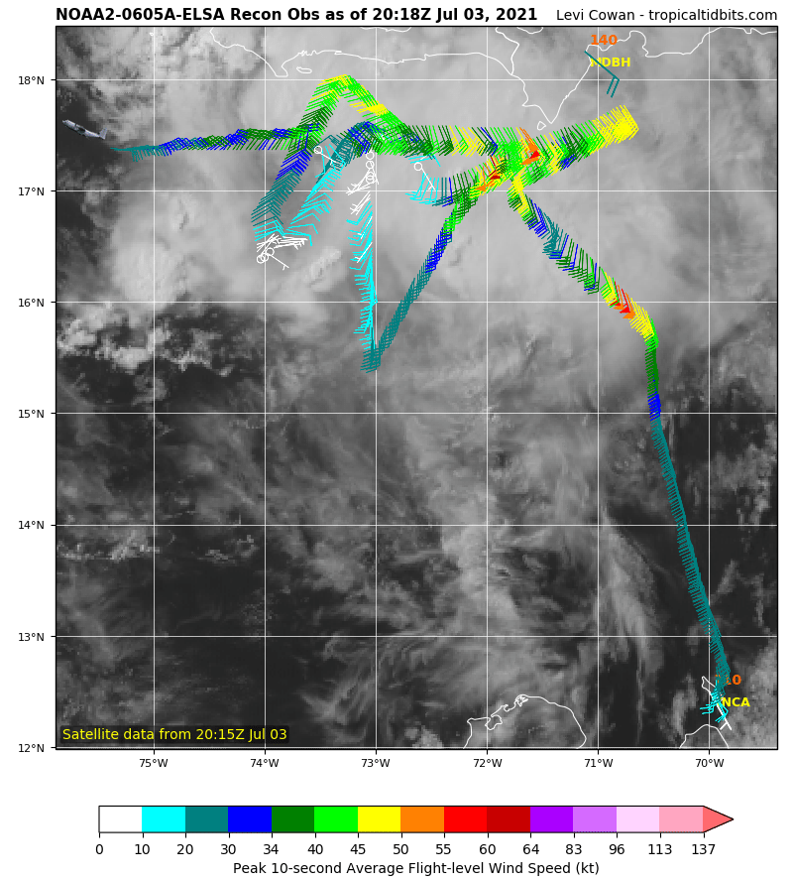
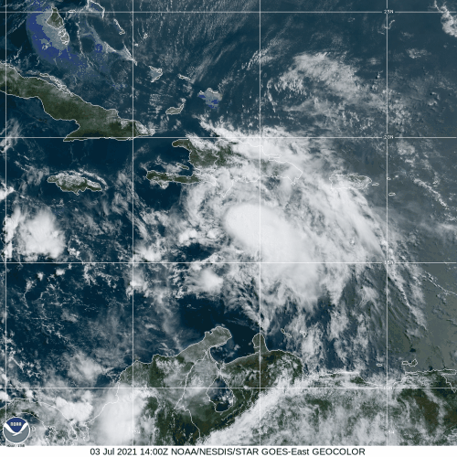
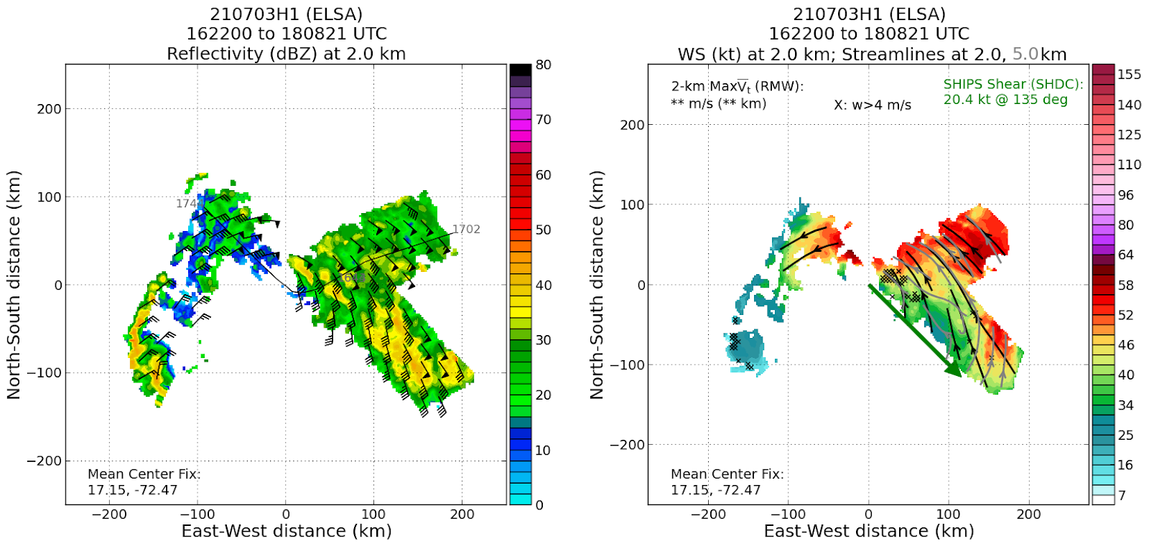
2021 Hurricane Field Program-APHEX
Hurricane Elsa: 20210703H1 (EMC TDR Tasking)
Mission
G-LPS: J. Zawislak
APHEX relevance: AIPEX
Planned pattern: rotated Fig-4
T/O off (AUA) – Landing (KLAL): 1538z – 2242z
FL 10 k ft
17 dropsondes (17 to GTS)
4 TDR analyses to NHC and EMC
Challenging pattern >>fast forward speed & proximity to Hispaniola
Highly tilted vortex: low-level center ~100 km west of the mid- to upper-level center
NASA MTS >> not tracking N42
THOR instrument not functioning

Slide 7
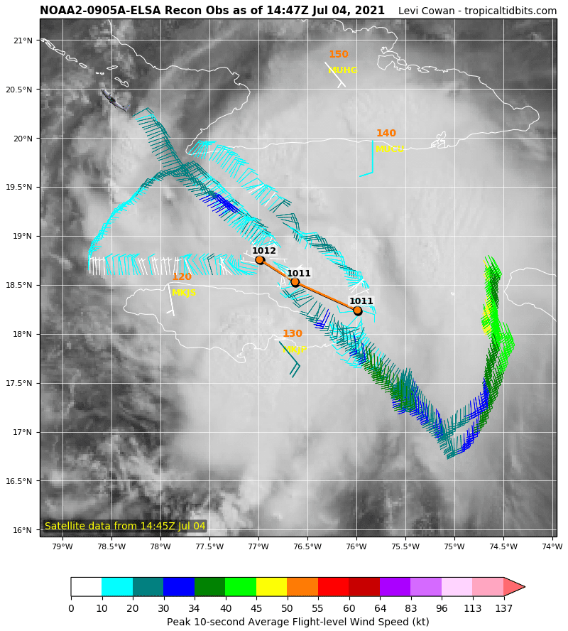
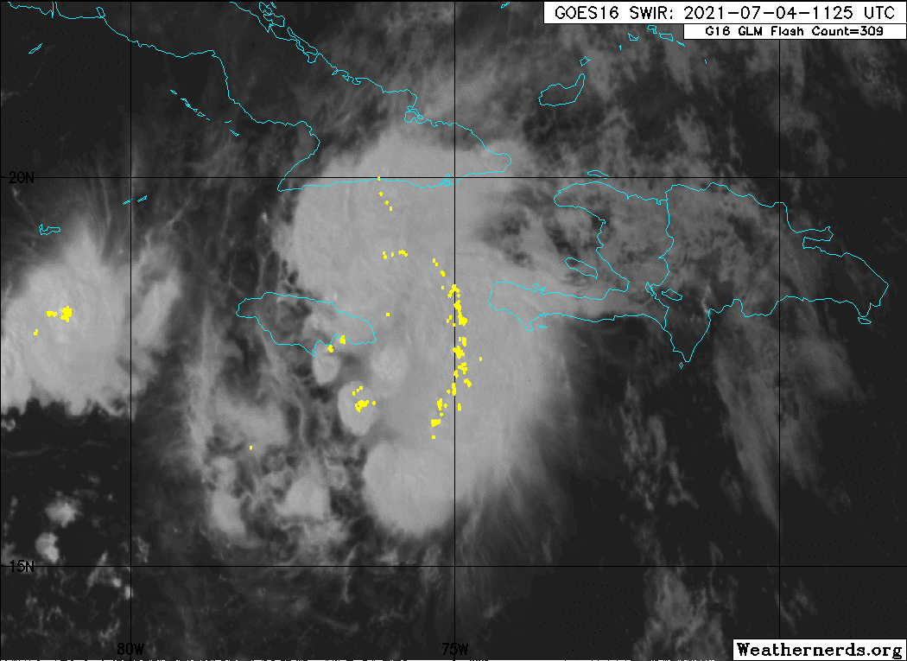
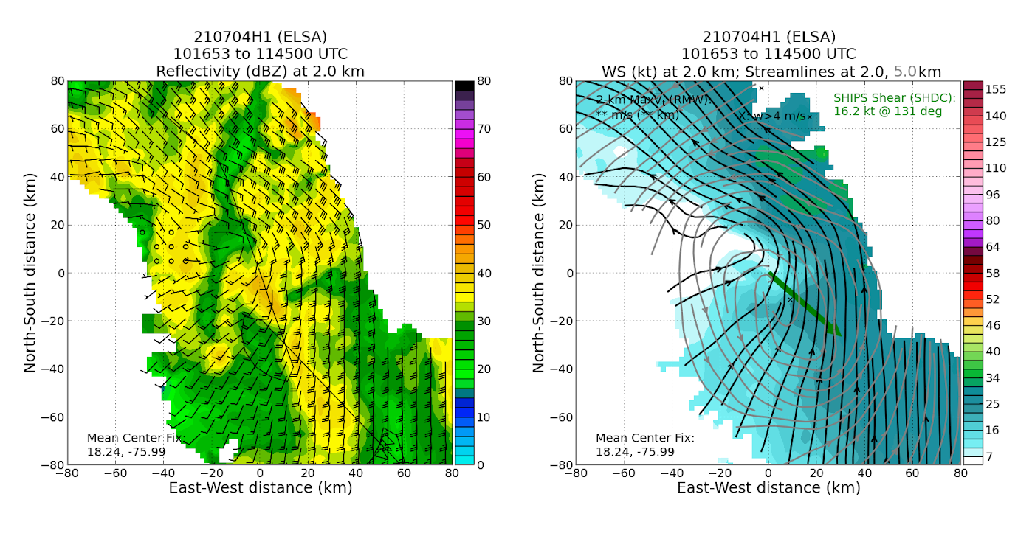
2021 Hurricane Field Program-APHEX
TS Elsa: 20210704H1 (NHC Fix - EMC TDR Tasking)
Mission
G-LPS: J. Dunion
APHEX relevance: AIPEX
Planned pattern: rotated Fig-4
T/O off (KLAL) – Landing (KLAL): 0828z – 1623z
FL 10 k ft
14 dropsondes (13 to GTS)
3 TDR analyses to NHC and EMC
Very active band in the E semicircle with 40+ dBZ cellular convection jamming up against Cuba
could not get to NE point for inbound…repeated SE-NW
2 km center ~20 km NW of 5 km center
NASA MTS >> not tracking N42; THOR down
N42 FL, SFMR, TDR mentioned in NHC’s 15z adv
significant cellular convection >40 dBZ
GLM Lightning
L
M

Slide 8
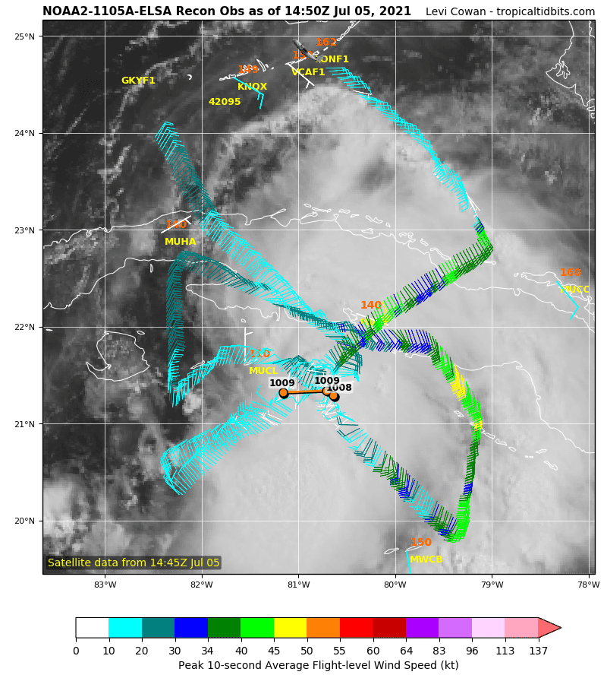
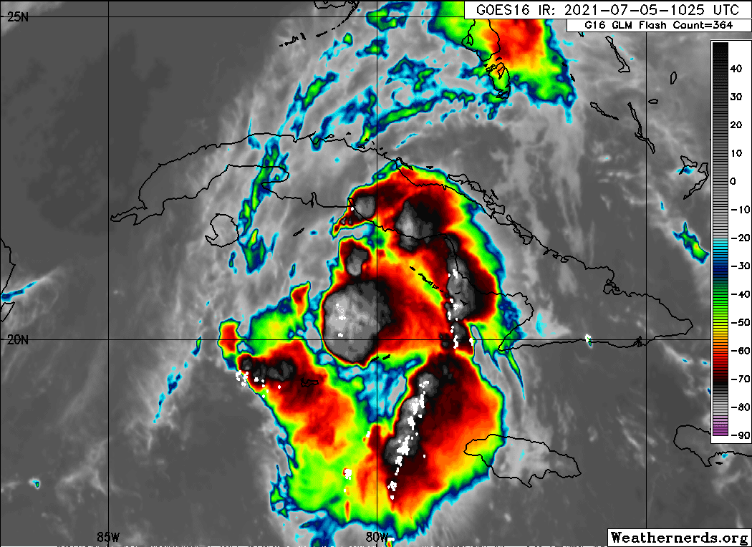
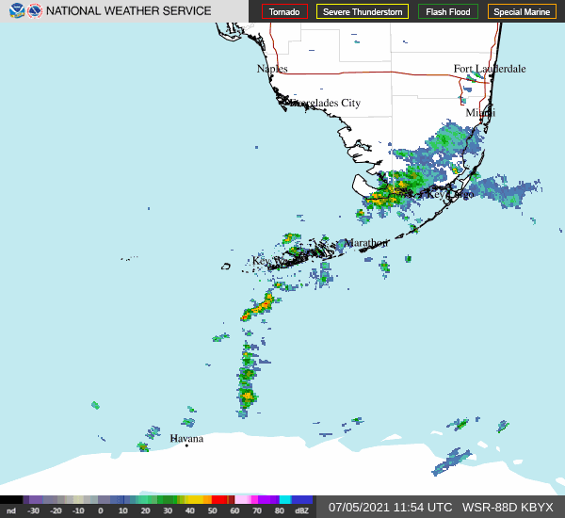
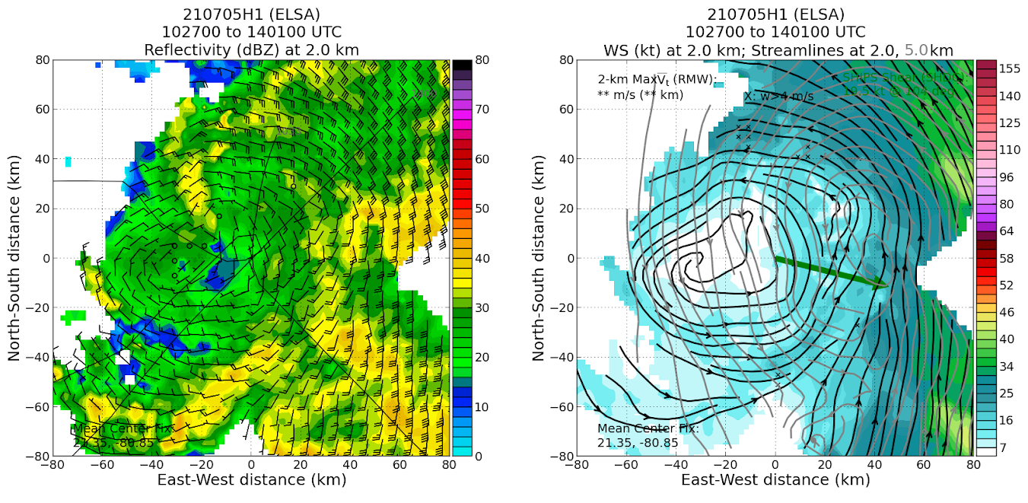
2021 Hurricane Field Program-APHEX
TS Elsa: 20210705H1 (NHC Fix - EMC TDR Tasking)
Mission
G-LPS: J. Dunion
APHEX relevance: AIPEX
Planned pattern: rotated Fig-4
T/O off (KLAL) – Landing (KLAL): 0853 – 1545z
FL 10 k ft
11 dropsondes (11 to GTS)
4 TDR analyses to NHC and EMC
A few challenges with dual operational tasking
Meeting fix requirements + TDR coverage requirements
Proximity to Cuba and Cuba ATC were challenging
uncharted overland & overwater “prohibited airspace”
NASA MTS >> not tracking N42; THOR down
Vortex >> tilted ESE with height
GLM
Flash
Counts
L
M

Slide 9
2021 Hurricane Field Program-APHEX
Questions?
Copies of the 2021 AL05/Elsa debrief can be found in the HRD Google Drive folder
HRD >> Hurricane Field Program >> 2021 >> Debriefs >> AL05/Elsa

