Slide 1

HFIP Goals and Status
Frank Marks (NOAA/AOML/HRD)
HFIP Research Lead
November 17, 2020
‹#›

Slide 2
Weather Act Sec.104: HFIP
Develop an updated plan, detailing the specific research, development, & technology transfer activities necessary to sustain HFIP & achieve the 3 focus areas in Section 104 of the 2017 Weather Research and Forecasting Innovation Act:
improve prediction of rapid intensification & track of hurricanes
improve forecast & communication of storm surges from hurricanes
incorporate risk communication research to create more effective watch & warning products
Plan details long-term HFIP goals, priorities, & approaches.

Slide 3
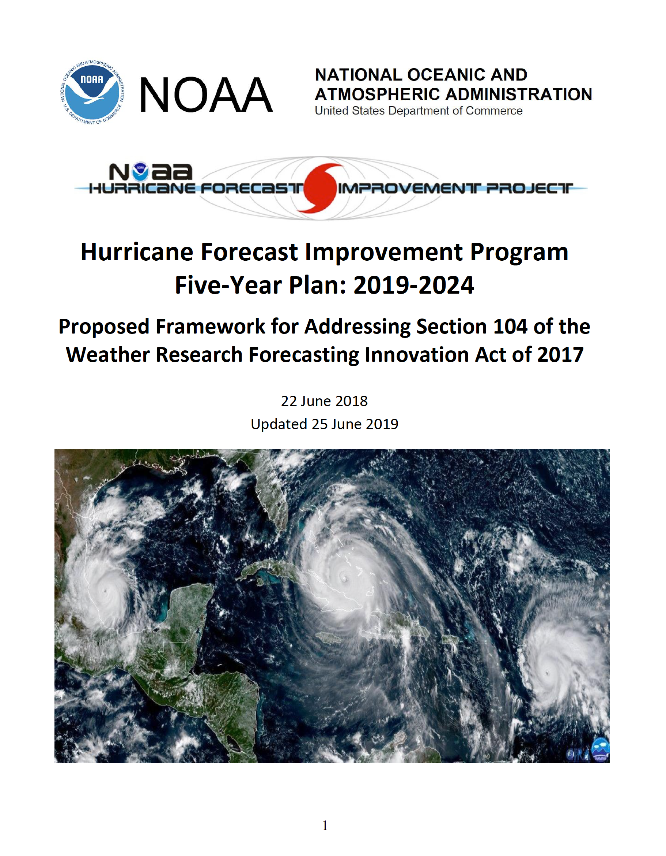
HFIP Strategic Plan – 2019-2024
High-level plan approved by NOAA for submission to Congress – May 2019
HFIP Strategic Plan provides details on long-term HFIP goals (Appendix A), priorities, & strategies – June 2019

Slide 4
HFIP Goals aligned with Weather Act
Reduce numerical forecast guidance errors, including during rapid intensification, by 50% from 2017;
Produce 7-day forecast guidance similar to 2017 5-day forecast guidance;
Improve guidance on pre-formation disturbances, including genesis timing, track & intensity forecasts, by 20% from 2017; and
Improve hazard guidance & risk communication, based on social and behavioral science, to modernize TC product suite for actionable lead times for storm surge & all other threats.

Slide 5
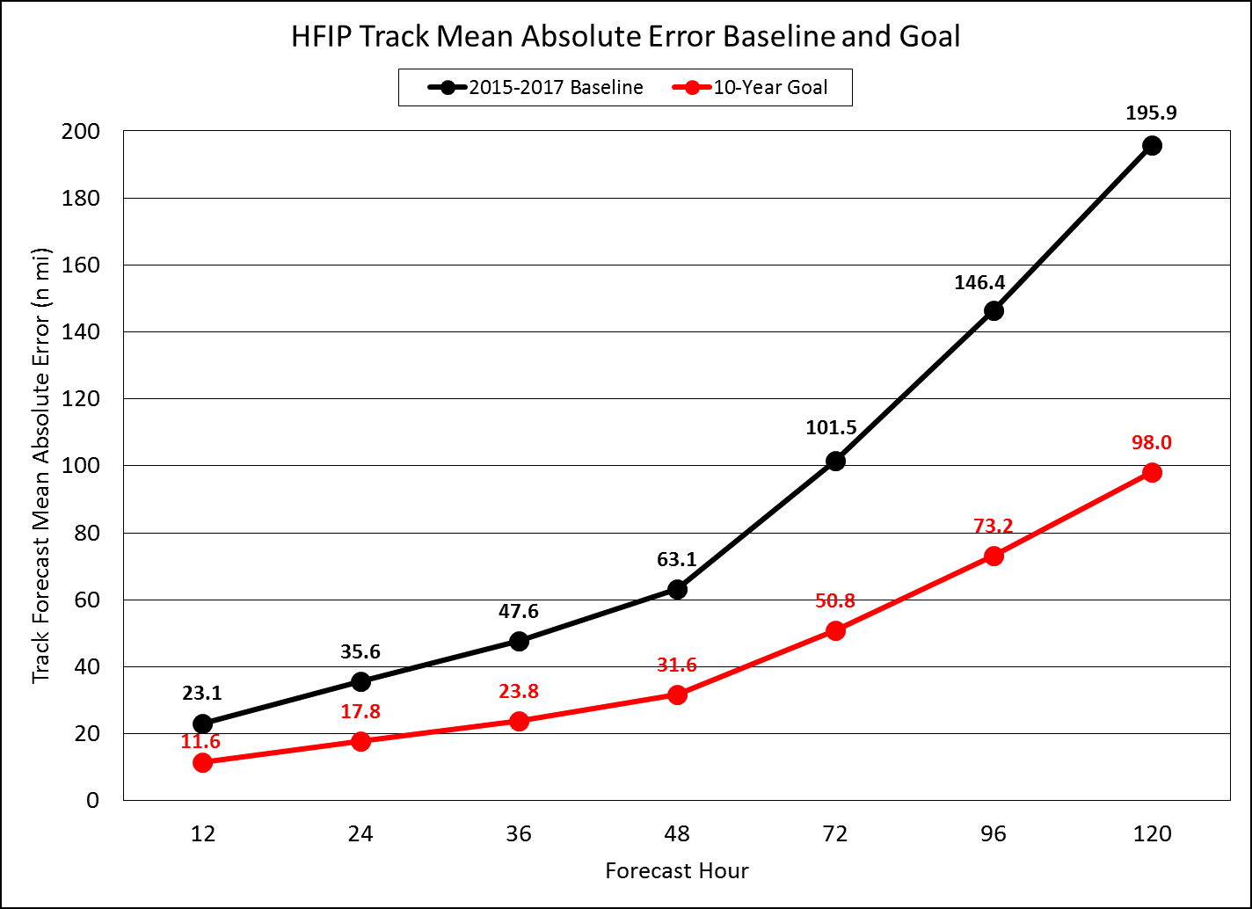
HFIP Goals aligned with Weather Act
HFIP Intensity Error Baseline and Goal

Slide 6
Key Strategies:
Advance an operational Hurricane Analysis & Forecast System (HAFS)
Improve probabilistic guidance
Enhance communication of risk & uncertainty
Support dedicated high performance computing allocation
R2O Enhancement
Broaden expertise & expand interaction with external community

Slide 7

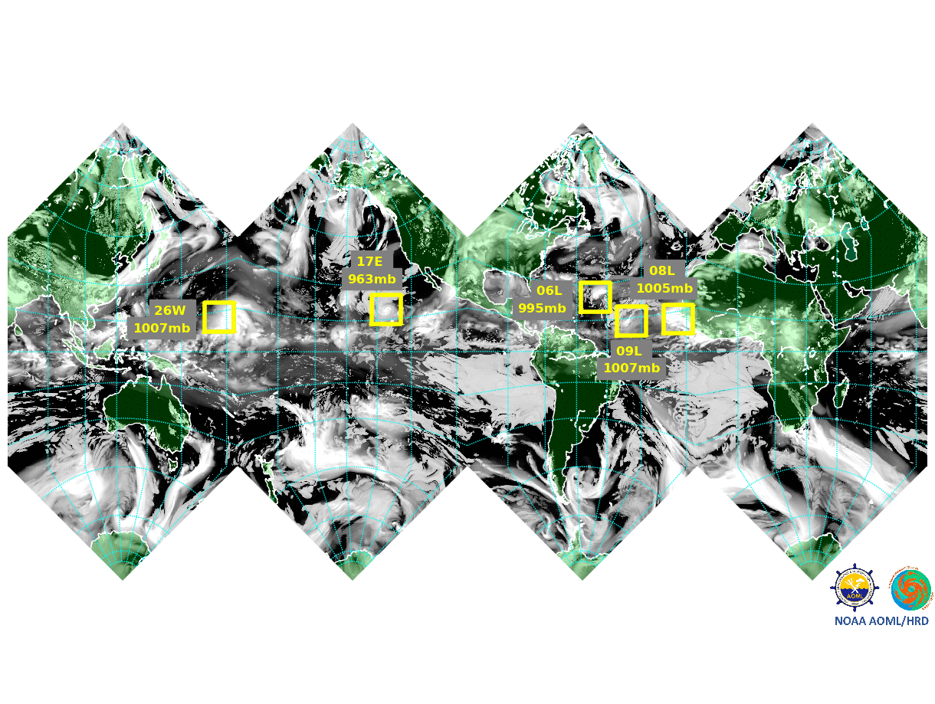
Key Strategies: HAFS
Advance operational HAFS
R&D for HAFS to advance deterministic & ensemble prediction capabilities
R&D for fusion of modeling, data assimilation & observations to produce an Analysis of Record
R&D for ensemble post-processing to extract guidance & uncertainty information
Moving nests in global FV3 to track all hurricanes
Notes:
Elaborate as desired.

Slide 8
Key Strategies: HAFS
Coordinating six 2018 and one 2019 Hurricane Supplemental Plans to Accelerate Improvements in Hurricane Intensity Forecasting
1A.4: Accelerate HAFS moving nest development (Gopal)
3A.1: Accelerate implementation of Updated HFIP Plan (Marks)
3A.2: Accelerate re-Engineering of HAFS (Mehra)
3B: Sustained Ocean Observations - “picket fence” gliders (Goni)
4A.1: Optimize current observing system to improve prediction of extreme weather (Cucurull)
4A.2: Data Impact Studies (OSE) (Cucurull)
HU-2: Accelerate development of HAFS DA (Marks)
Notes:
Elaborate as desired.

Slide 9
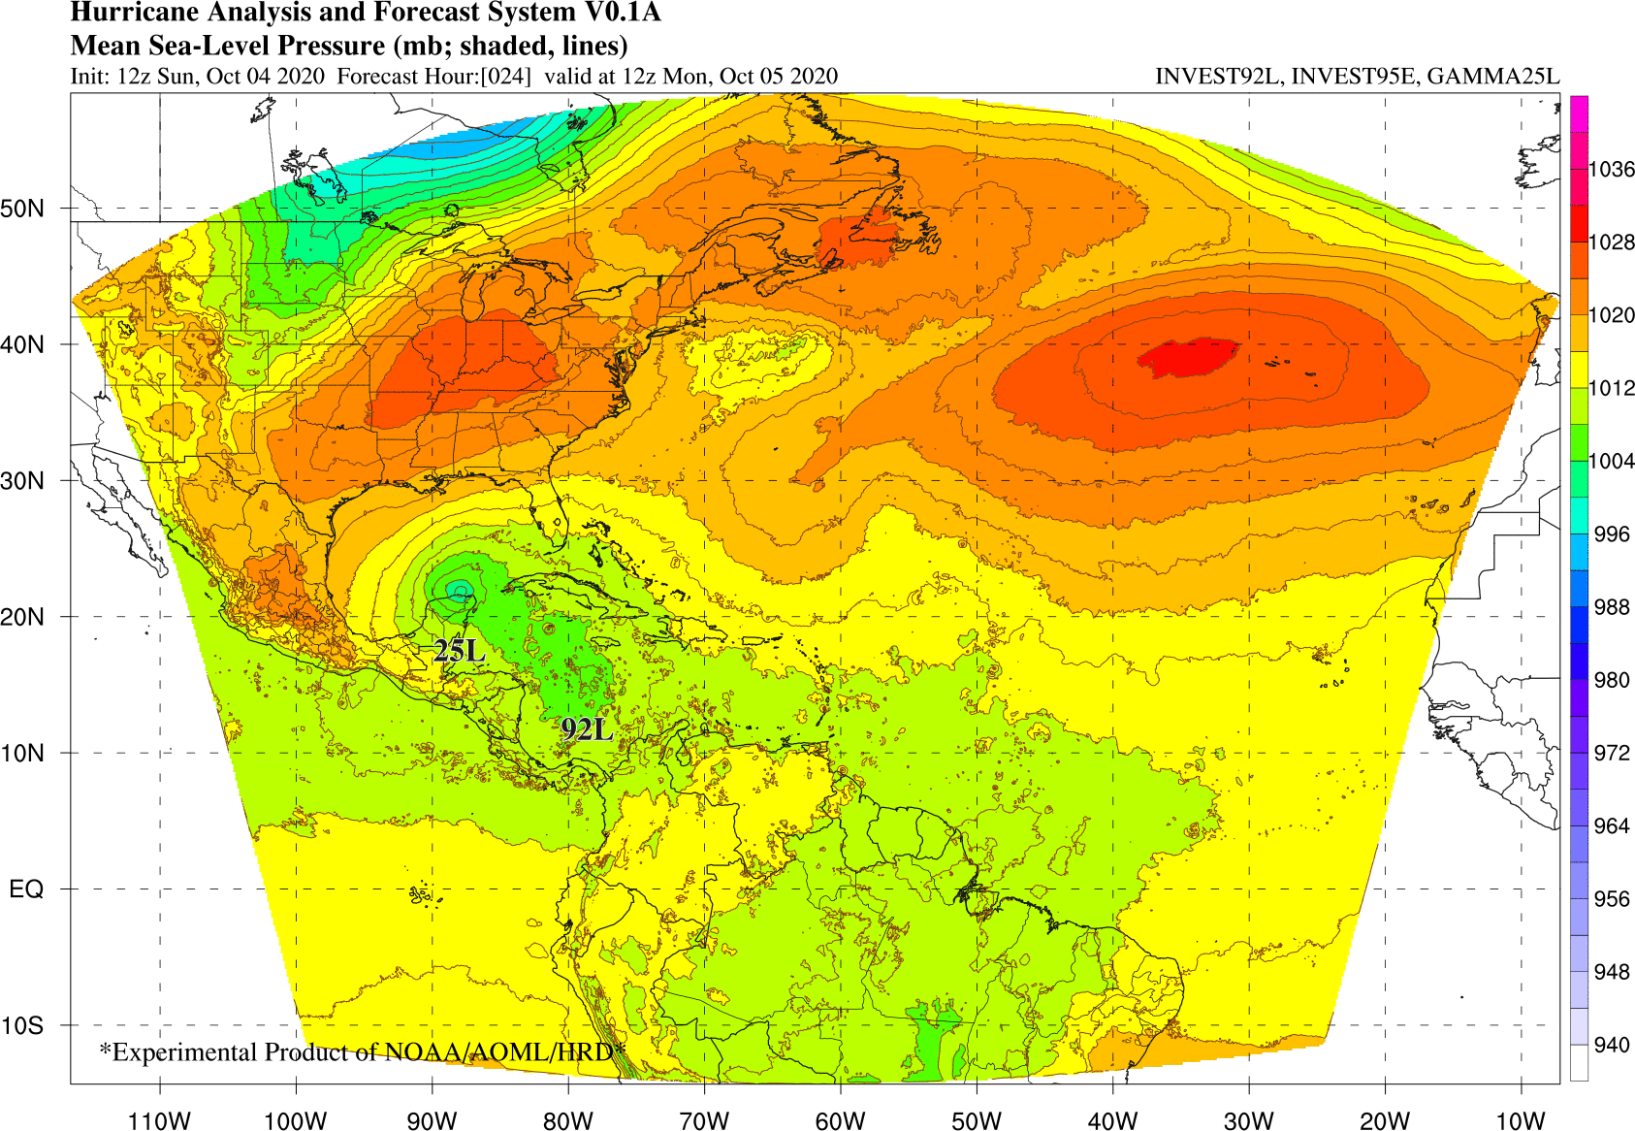
HAFS Yearly Milestones
HAFS v0.1A: stand-alone regional (SAR) nest configuration over NATL basin, 3 km hor. res, 91L, mod. HWRF physics, VI, DA & ocean coupling
HAFS v0.1B: Global-regional nest configuration over NATL basin, 3-km hor. res, 78L, mod. GFS physics & VI
HAFS v0.1J: SAR nest ESG configuration over NATL & EPAC, 3 km hor. res, 64L, HWRF physics
HAFS v0.1E: 17-member ensemble of HAFS v0.1A, 6-km hor. res, 64L, No ocean coupling, SKEB, SPPT, SHUM
HFIP Demo
Model | # cases
HAFS-A | 1390
HAFS-B | 1140
HAFS-E | 6884
HAFS-J | 1049
HAFS v0.2: Fully-coupled SAR nest configuration with moving nest & DA - Year 3

Slide 10
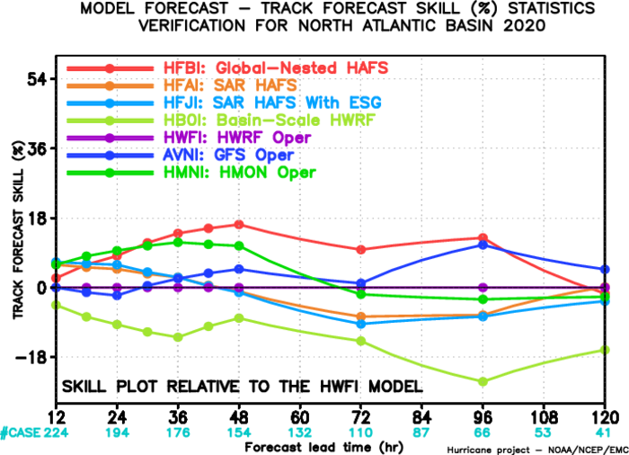
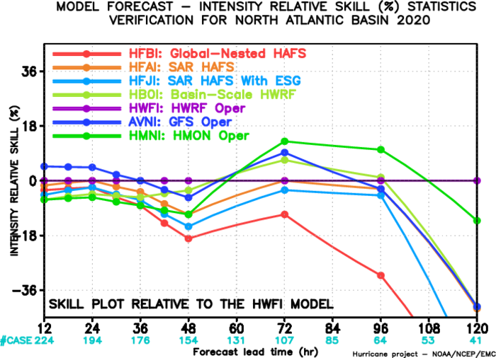
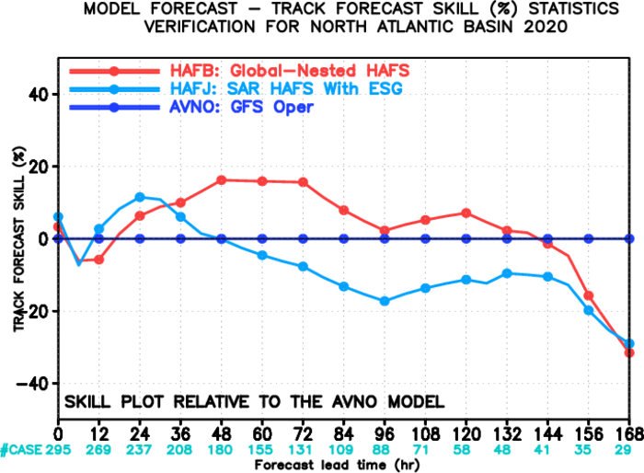
HAFS V0.1 Model Performance
Skill relative HWRF
Skill relative HWRF
Skill relative GFS
7-Day
5-Day Results:
HAFS-B is best track model ≤96 h, including statistically-significant result at 72 h.
HAFS-B has large intensity errors at long lead times (>72 h), high bias from no ocean coupling
7-Day Results:
HAFS-B track better than GFS and HAFS-J 12-144 h
GFS superior >144 h

Slide 11
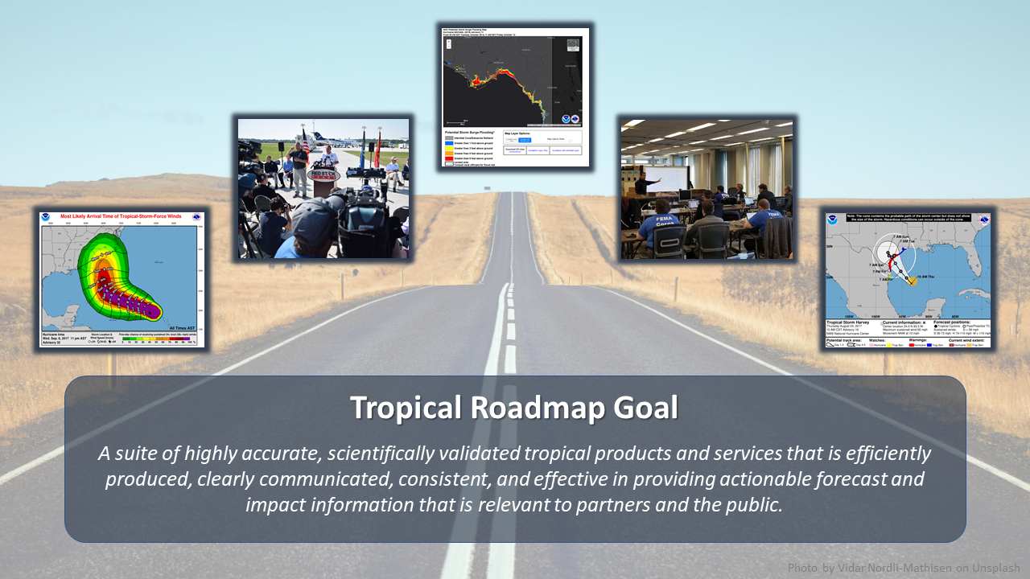
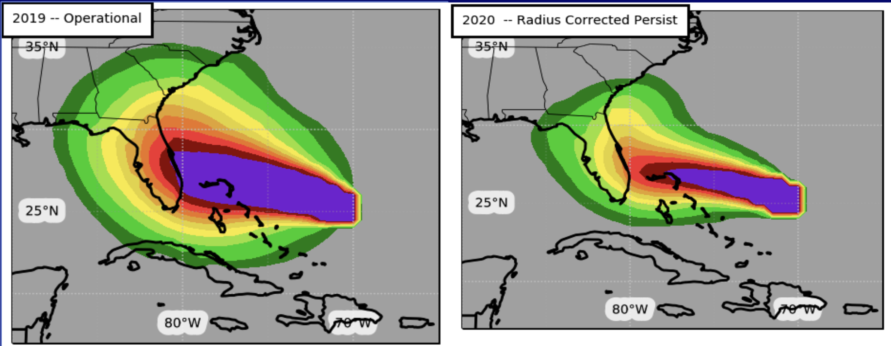
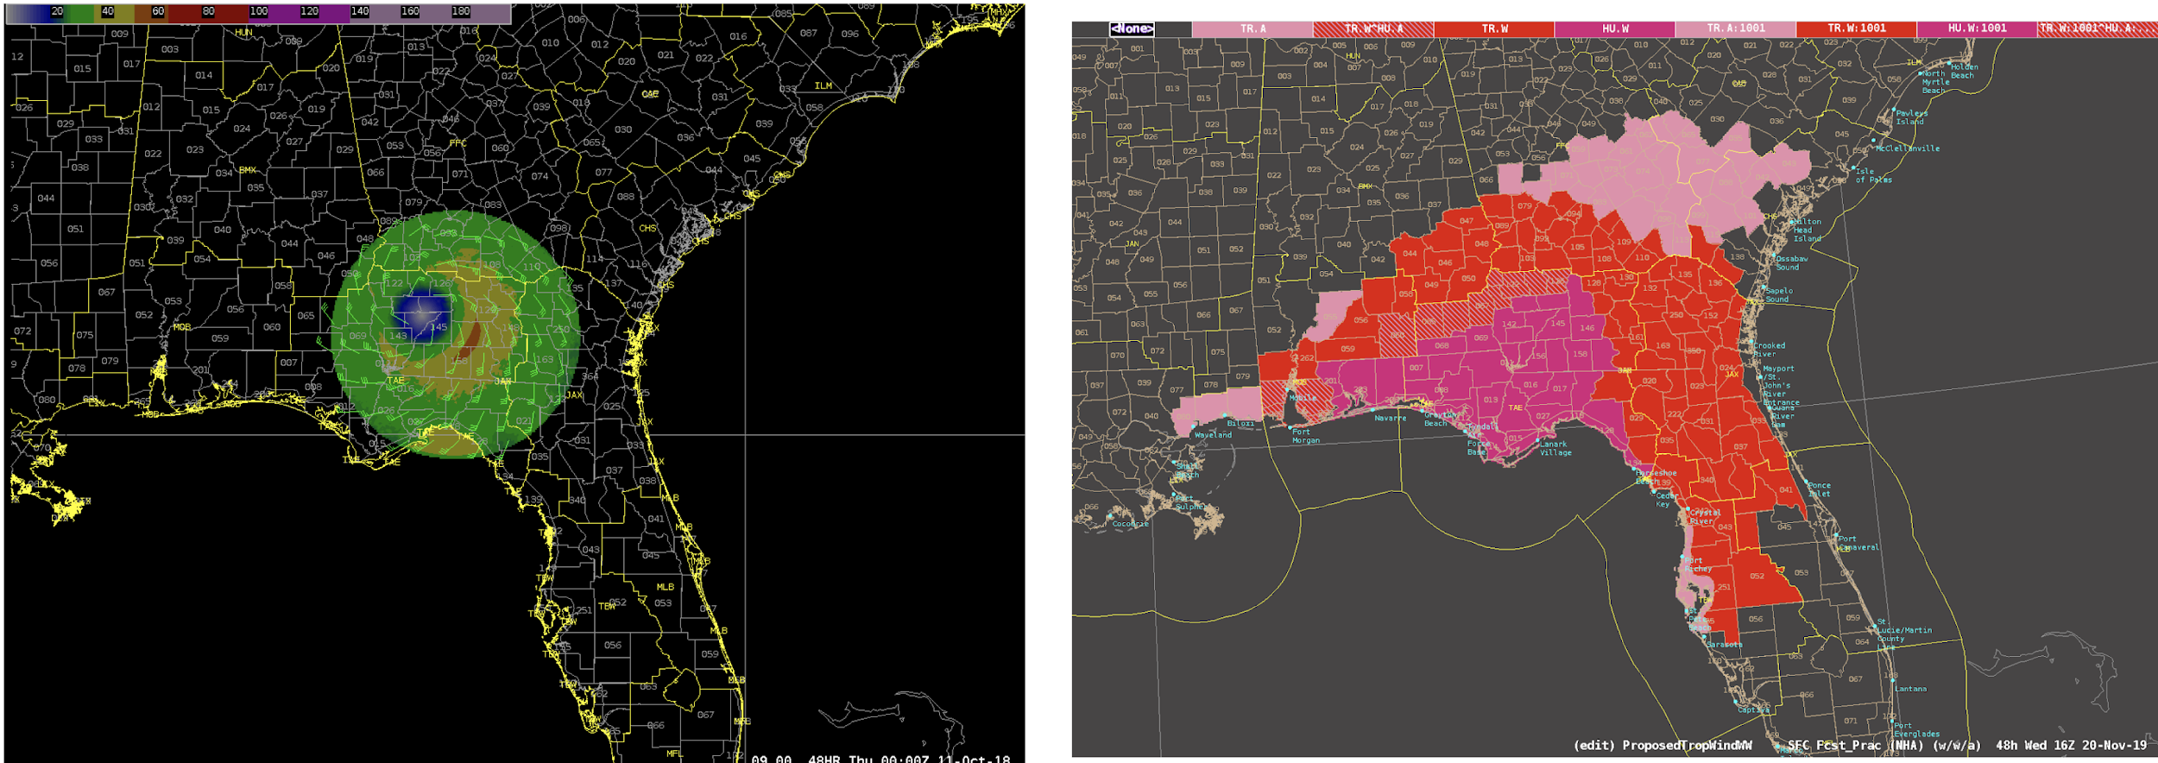
Key Strategies: Guidance & Products
2. Improve probabilistic guidance
  Incorporate dynamically-based uncertainty into hazard models & products
  R&D for hazard-specific products from AFS Tropical Roadmap
Wind Speed Probability Upgrades
TC Wind Hazard Recommender
Dorian
Michael
Notes:
Elaborate as desired.

Slide 12
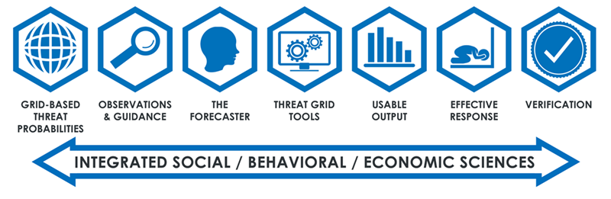
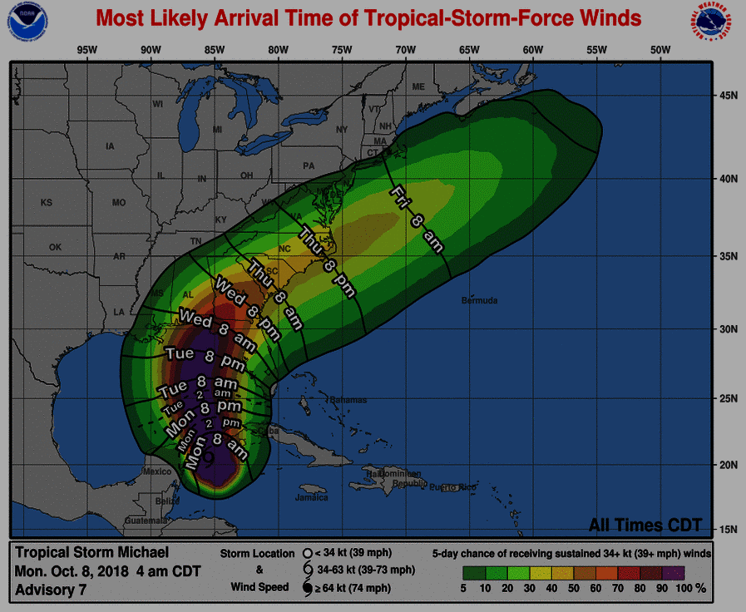




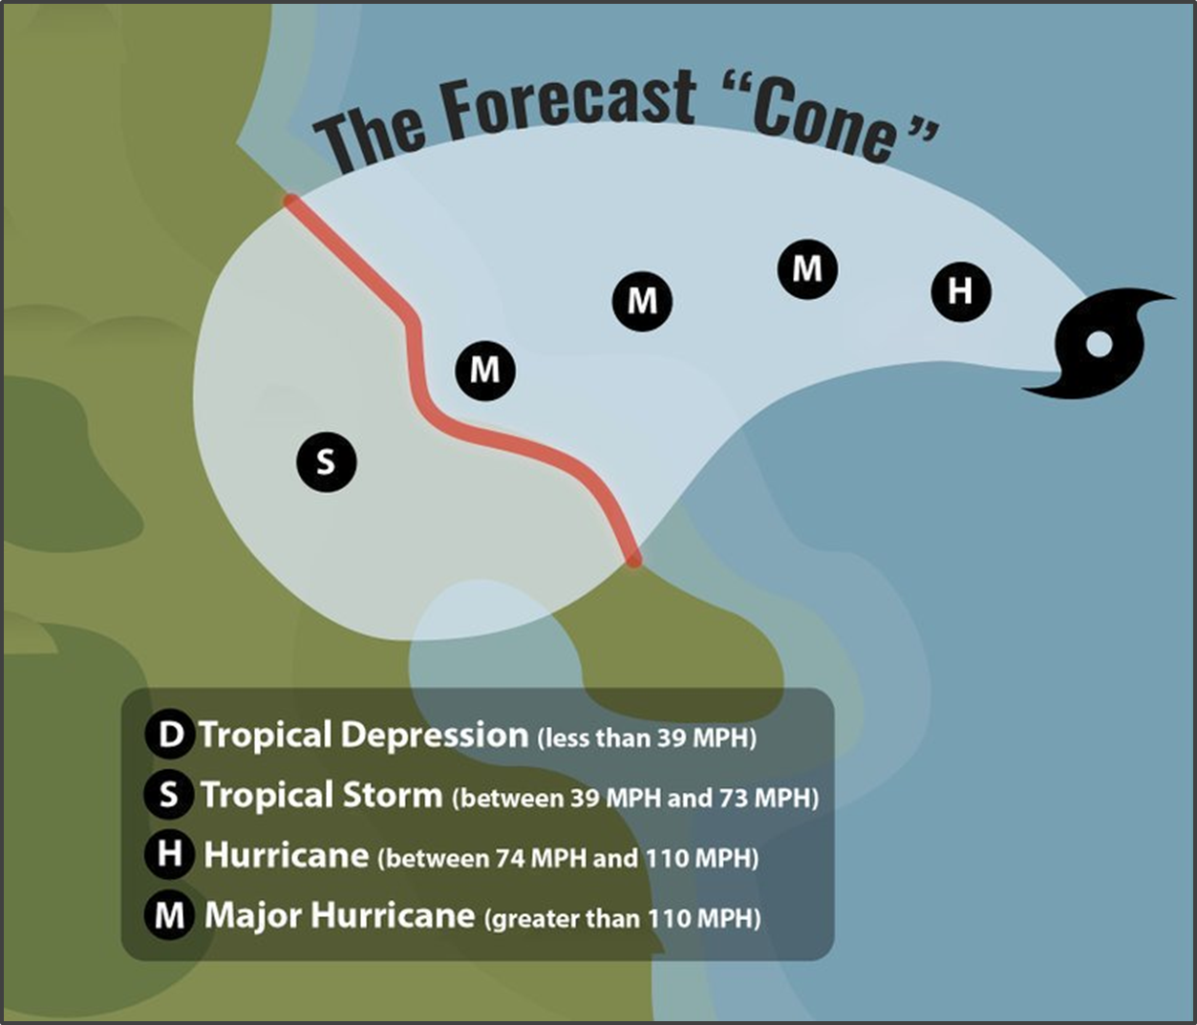

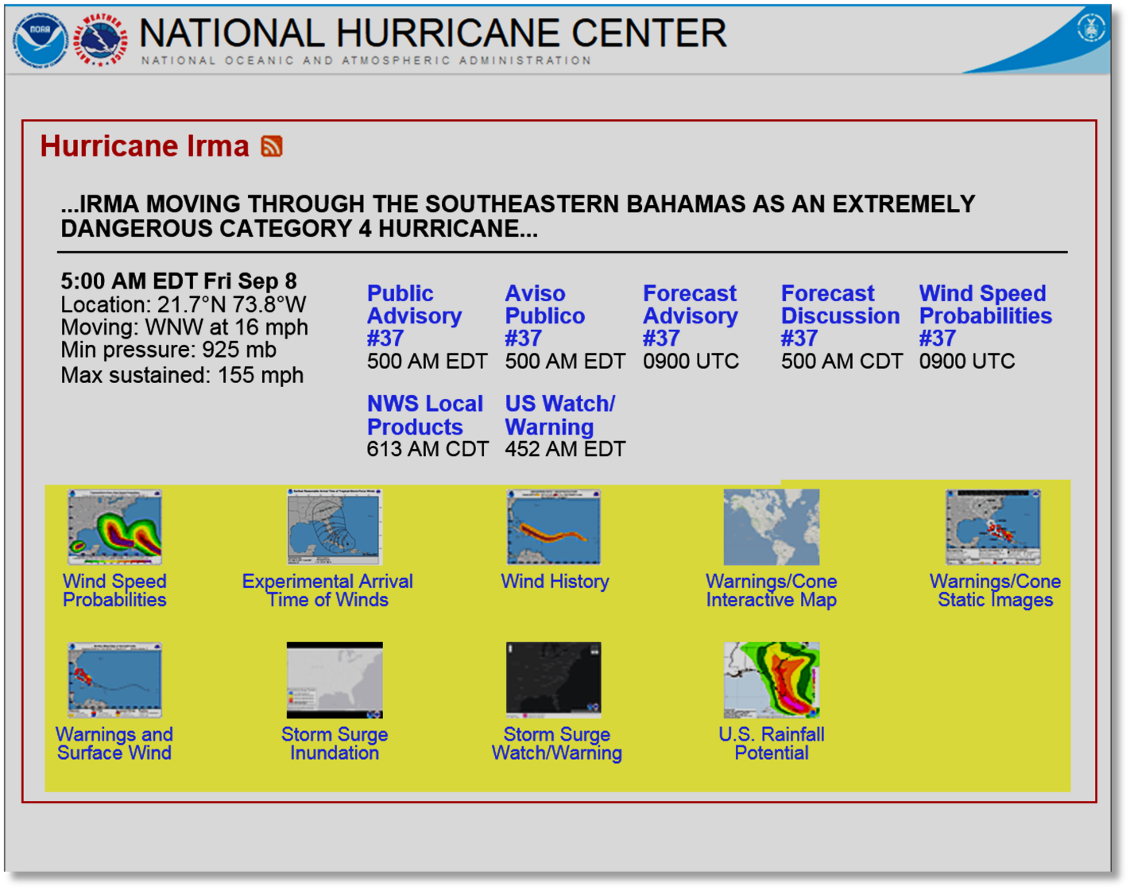

Key Strategies: Enhance Communications of Risk
Minding the Gap: Modernizing the TC Product Suite by Evaluating NWS Partner Information Needs
Hazard Prediction and Communication Dynamics in the Modern Information Environment
There’s a Chance of What? Assessing Numeracy Skills of Forecasters, Partners, and Publics to Improve TC Product Uncertainty Communication, IDSS, and Training
3. Enhance communication of risk and uncertainty
  Evaluate TC products for effective communication of risk using FACETs
  Modernize TC products as informed by social & behavioral science
Coordinating 9 OAR & Hurricane Supplemental Projects using social & behavioral science research to evaluate TC products
Wait, That Forecast Changed? Assessing How Publics’ Consume and Process Changing Tropical Cyclone Forecasts over Time
A Web-Based Survey to Estimate the Economic Value of Improved Hurricane Forecasts
Cone of Uncertainty Social and Behavioral Science Research
Public Response to Emergency Communications: Hurricane Maria
Optimizing Tropical Cyclone Information: An NHC Web User Experience Study from a Public Perspective
RAPID: Responding to the Risk of Hurricanes Harvey and Irma: Choices and Adjustment over Time
Notes:
Elaborate as desired.

Slide 13
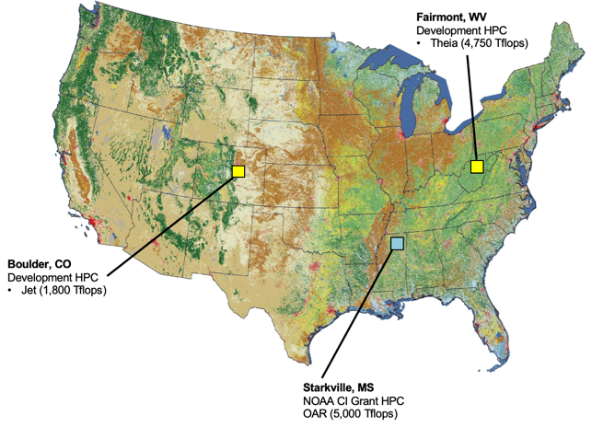

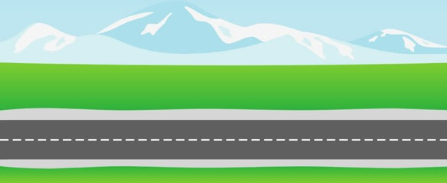
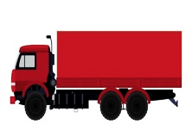
Key Strategies: HPC & R2O
4. Increase HPC Capacity
      NOAA R&D & operational computing to support HAFS development
      Hurricane Supplemental will provide R&D HPC ~24M core h/month for HAFS development (Hera & Orion)
5. Research to Operations (R20) Enhancements
Accelerate transition to operations by following NOAA’s best practices for promoting readiness levels (RLs)
Develop a process to prioritize research targeted for operational improvements
    Integrated use & support of Testbeds (JHT, DTC, JCSDA, HWT, HMT, & EPIC)
Research
Operations
O2R R2O
HFIP
VALLEY OF DEATH

Slide 14
Key Strategies:
Outreach to Community
HFIP Collaborative Awards Round VI (2020-2022)
PI Name | PI Institution | Project Title
Alan Brammer | CSU-CIRA | Extending the Tropical Cyclone Genesis Index to Global Ensemble Forecasts
Enrique Curchitser | Rutgers | Developing Regional Ocean Modeling Capabilities with MOM6 for use in the UFS
Ryan Torn | SUNY Albany | Application of Innovation Statistics to Diagnose Biases in the HAFS System
6. Broaden expertise and expand interaction with external community
  Re-invigorate grants program
  Maintain a visiting scientist program at research and operational centers
  Advisory committees, community workshops
  Collaborate/coordinate with social and behavioral sciences
  Outreach to America’s Weather Industry (AWI)
HFIP Collaborative Awards Round V (2018-2020)
PI Name | PI Institution | Project Title
Agnes Lim | University of Wisconsin (UWI) | Advanced DA Techniques for Satellite-Derived Atmospheric Motion Vectors from GOES 16/17 in HWRF
Andrea Schumacher | Colorado State University (CSU) | Using Dynamically-Based Probabilistic Forecast Systems to Improve the NHC Wind Speed Products
Kerry Emanuel | Massachusetts Institute of Technology (MIT) | New Frameworks for Predicting Extreme Rapid Intensification
Ping Zhu | Florida International University (FIU) | Rapid Intensification Changes: Improving Sub-Grid Scale Model Parameterization and Microphysical-Dynamical Interaction
Ryan Torn | SUNY Albany | Evaluating Initial Condition Perturbation Methods in the HWRF Ensemble Prediction System
Ting-Chi Wu | Colorado State University (CSU) | Enabling Cloud Condensate Cycling for All-Sky Radiance Assimilation in HWRF
Notes:
Elaborate as desired.

Slide 15
EISWG HFIP Recommendations to NOAA SAB
To achieve the increasingly urgent goals of the Weather Act, Section 104 in a reasonable time, NOAA will need to continue to support HFIP, plus:
invest in additional physical, social & behavioral science research, motivated & targeted by an expanded set of success metrics;
leverage scientific & technological advances enabled by other line offices, testbeds, agencies, organizations & industry;
entrain a broader network of expert personnel external to NOAA for convergent research and workforce development.
Provided 5 Specific Recommendations - HFIP response will be required
Notes:
Environmental Information Services Working Group (EISWG) of the NOAA Science Advisory Board (SAB)
https://sab.noaa.gov/WorkingGroups/StandingWorkingGroups.aspx#1031914-environmental-information-services-working-group-eiswg

Slide 16
Questions
To register for the 2020 HFIP Annual Workshop go to:
http://www.hfip.org/events/annual_meeting_nov_2020/index.php

Slide 17
HFIP Recommendations to NOAA SAB
Expanded HFIP scope must be mapped to necessary resources & timelines. (Supplemental $ run out in FY22)
Expand participation through dedicated science campaigns that cross the atmosphere-ocean interface to improve model physics and data assimilation and increase the use of probabilistic forecasts to quantify uncertainty. Continue HAFS development and entrain more external researchers. (GOMO & IOOS can help)
Communicating storm-surge risk should be prioritized and account for uncertainty from multiple sources and address diversities of human perception, behavior, and needs. Evaluation and improvement of operational storm surge models should also be prioritized. (NOS?)
Severe weather can evoke subsequent hazards; warning and watch products need to address risk from multiple threats. Developing a strategic plan for social and behavioral research with milestones and metrics should be a high priority to ensure forecasts and forecast products address diverse societal needs and impacts. (AFS Roadmap & FACETs can help)
Increase internal coordination across OAR, NWS, & NOS and expand science and technology partnerships. (HFIP strategic plan, FACETs, AFS Roadmap, ?)

