Slide 1
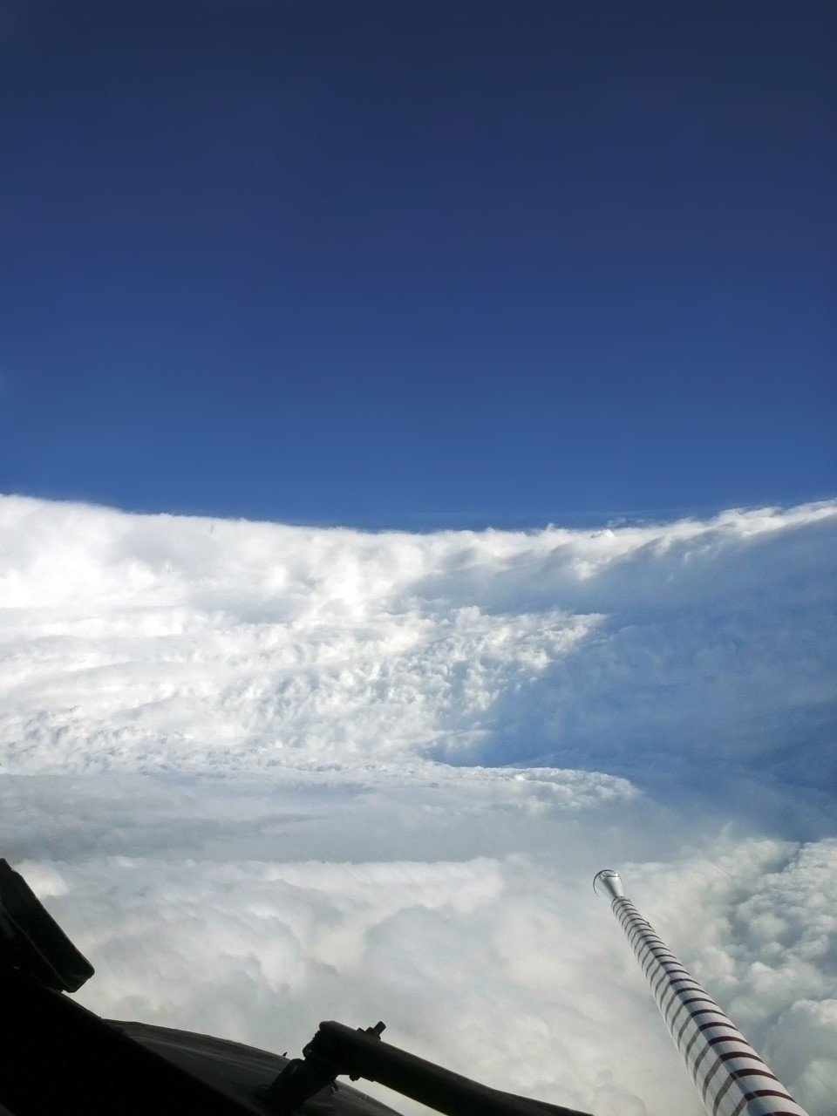




DROPSONDE BEHAVIOUR IN HIGH WIND / TURBULENCE REGIMES
Kathryn Sellwood
University of Miami CIMAS and NOAA/AOML/HRD
Notes:
Use Stadium Eye picture as background

Slide 2
2018: NOAA AIRCRAFT SAMPLED 3 MAJOR HURRICANES
Florence in the tropical Atlantic Sept. 8-12
Michael in the Gulf of Mexico Oct 8-10
Lane in the Central Pacific Aug. 19-22
STORM | TOTAL SONDES | UPDRAFT > 10 m/s | DOWNDRAFT < -10 m/s | UPSONDES | WINDS > 100kts
LANE | 135 | 11 | 6 | 9 | 50
FLORENCE | 118 | 1 | 4 | 0 | 22
MICHAEL | 163 | 3 | 11 | 1 | 42
Notes:
Add flight tracks to background or insert figure? Add max wind from NHC

Slide 3
“UPSONDES”
Vertical velocities great enough to propel dropsonde upward
Associated with eyewall region
Major updraft above the boundary layer ~ 1500m
Large vertical wind speeds throughout the boundary layer
Very strong horizontal winds from below updraft to surface
Radially fluctuating motion
SONDES WITH BOTH LARGE UPDRAFTS AND DOWNDRAFTS
Also in eyewall region
Far more common than upsondes
Large updraft above boundary layer + Large downdraft closer to surface
Wind maxima near level of both upward and downward vertical velocity maxima
Strong horizontal winds to surface
Little radial motion
SONDES WITH LARGE DOWNDRAFTS
Flagged as possible fast fall ( may cause ASPEN to crash unexpectedly)
Eyewall slightly outside
Moist cool layer (probable cloud)
Strong horizontal winds below
Radially fluctuating motion

Slide 4
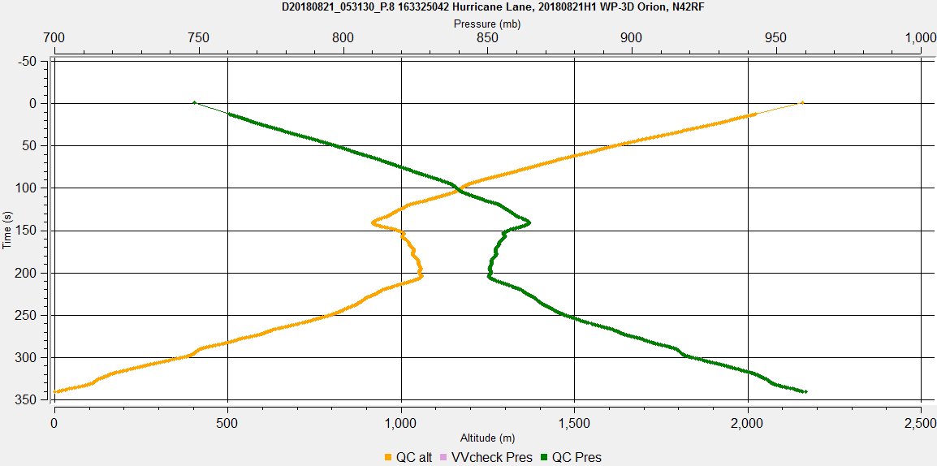
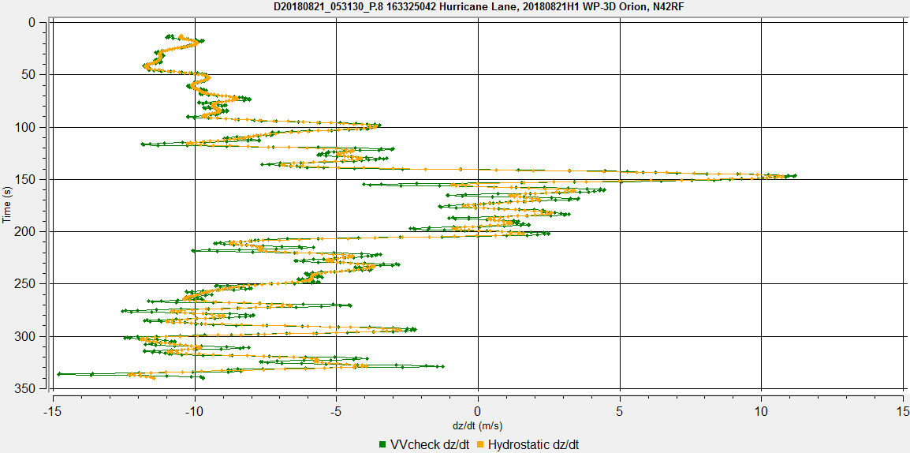
21 m/s updraft observed in Hurricane Lane 08/21 5:21Z
Upward sonde motion for > 1 minute (800-1500m)
Pressure / Altitude
Vertical wind Speed

Slide 5
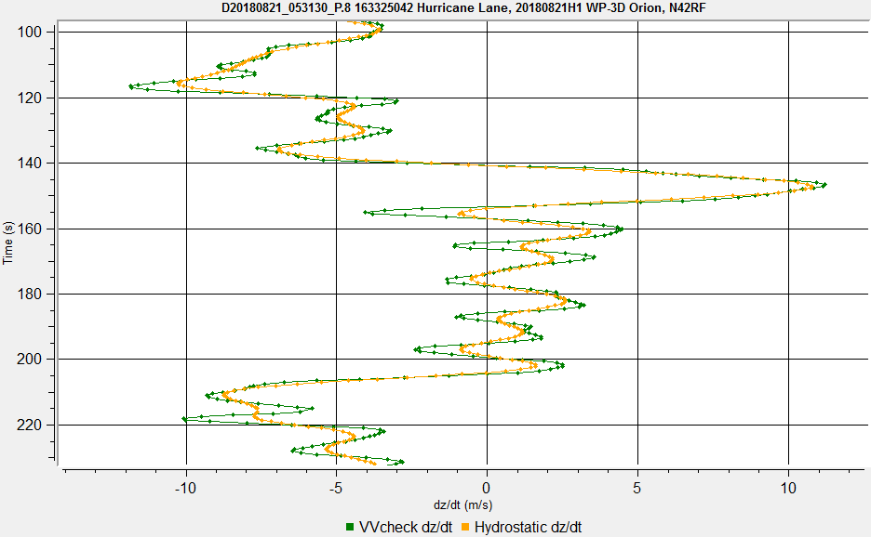
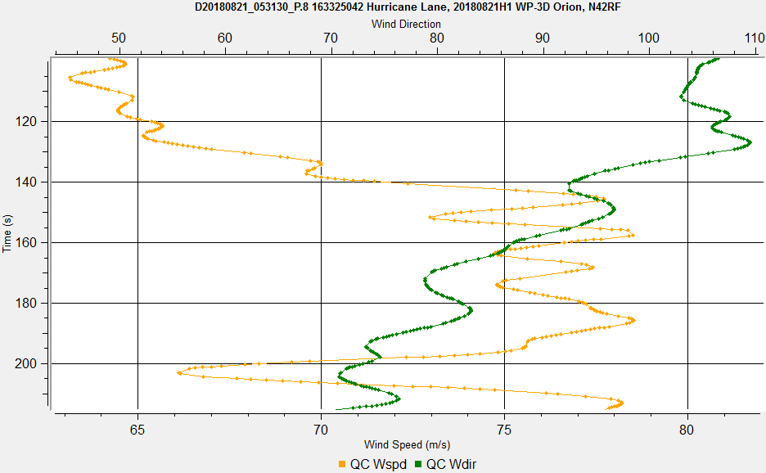
Updraft region:
Vertical wind Speed
Horizontal wind Speed / Direction

Slide 6
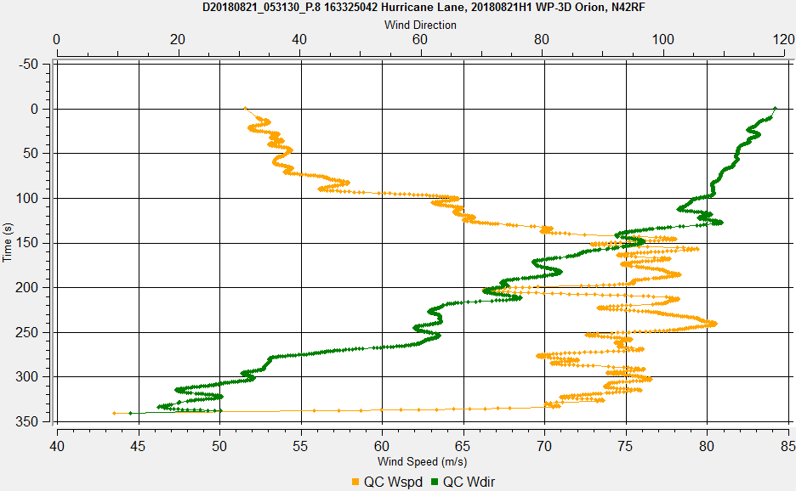
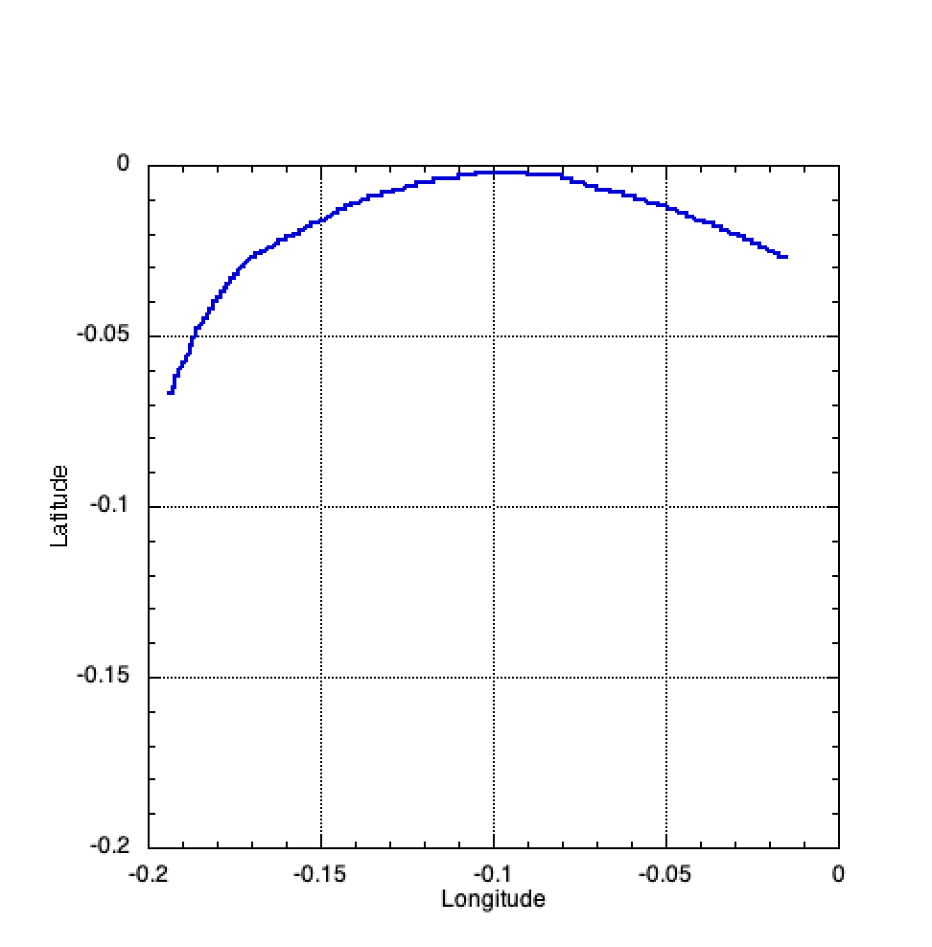
High winds extend to surface
Radial wind fluctuations
Horizontal wind Speed / Direction

Slide 7
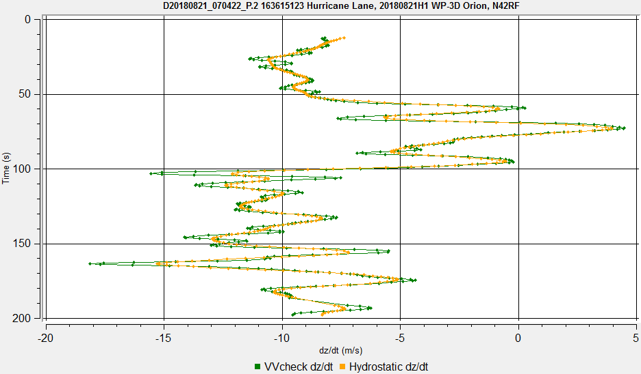
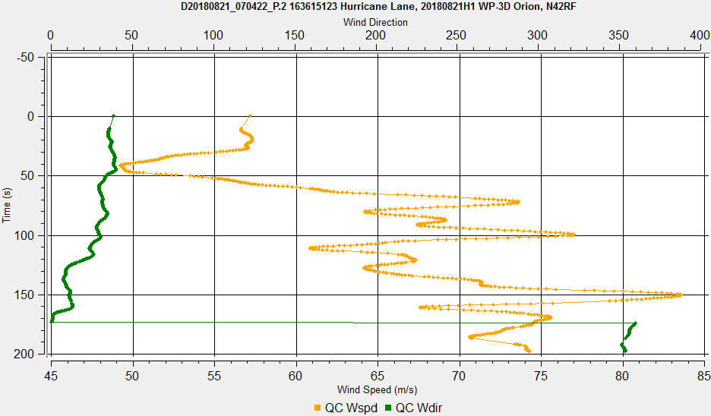
14m/s Updraft above boundary layer - local wind max below
5m/s Downdraft within boundary layer - local wind max above
Vertical wind Speed
Horizontal wind Speed / Direction
Notes:
Also from Lane but similar sondes from Michael and Florence

Slide 8
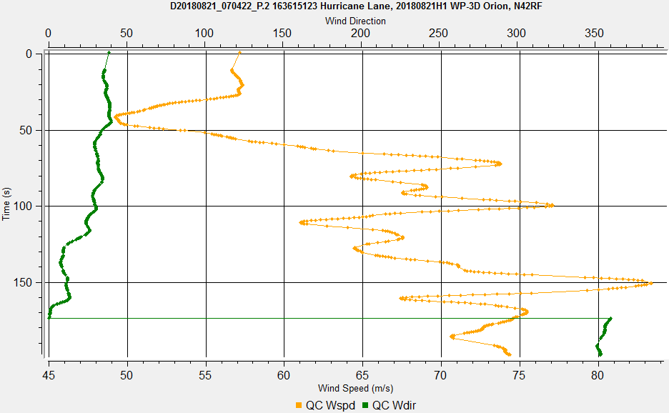
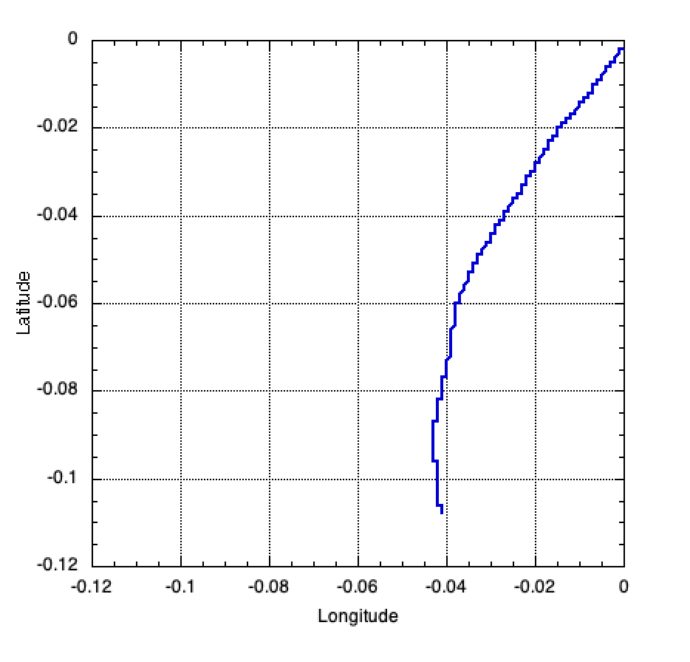
High winds extend to surface
Less radial fluctuation
Horizontal wind Speed / Direction

Slide 9
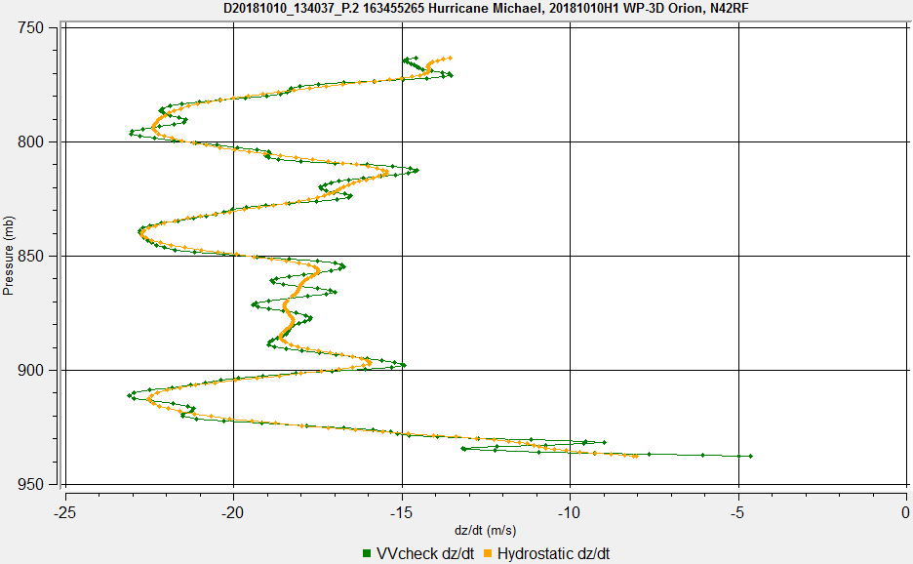
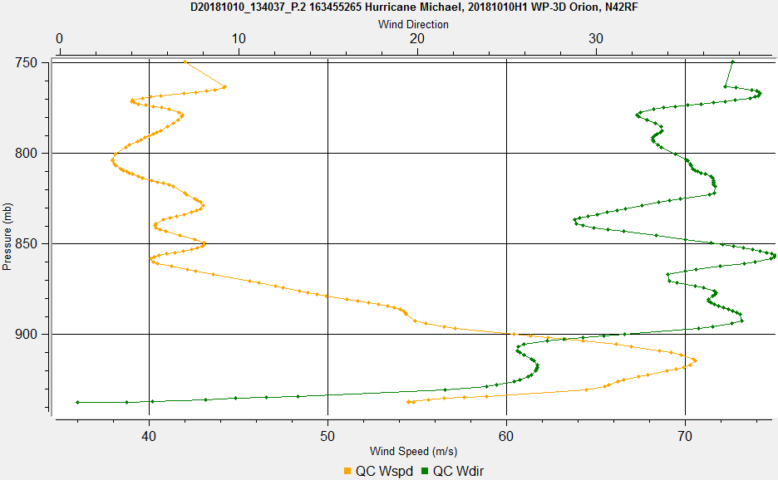
Wind Profile:
15m/s downdraft + multiple downward vertical wind gusts
Vertical wind Speed
Horizontal wind Speed / Direction
Notes:
Doesn’t have “spikey” winds associated with fast fall

Slide 10
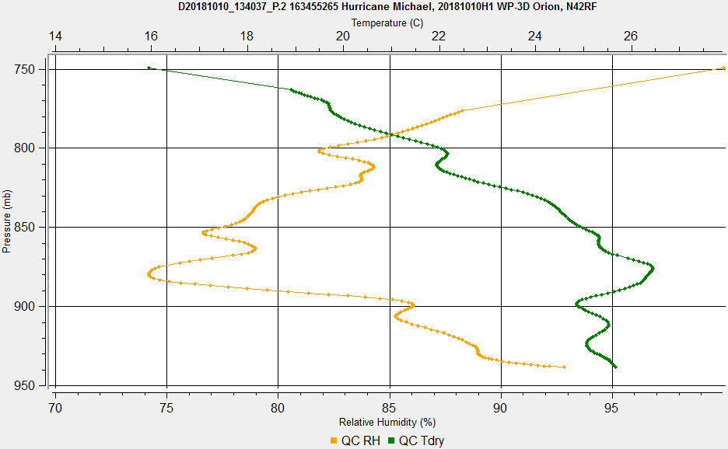
Temperature / Humidity Profile: Cloud Layer

Slide 11
Sharp gradients and extreme values caused many good wind data flagged
by ASPEN QC procedures
No surface wind values produced without unflagging multiple data points
Difficult to determine which points to retain
Value of surface wind in Tempdrop message strongly dependent on the choice
of observations retained and QC parameters for wind
Default parameters found to be too strict for the observed winds
Buddy Check slope of 1.5 m/s² increased to 4.5 m/s²
Default value to be increased to 10 m/s² for 2019
Outlier check increased from 5 to 10 std.
Larger Buddy check slope should make this unnecessary
No adjustment to vertical velocity 2.5 m/s
Move towards a uniform approach to processing extreme sondes
Notes:
Check values for buddy and outlier checks

Slide 12
Surface Wind Speed coding may vary, depending on retained observations and QC parameters
UZPN13 KWBC
XXAA 71088 99141 71511 05241 99965 24600 00639 00813 ///// /////
92372 22400 04155 85107 19400 07148 88999 77999
31313 09608 80743
61616 AF100 WXWXA TRAIN OB 99
62626 MBL WND 03147 AEV 33666 DLM WND 06128 965750 WL150 01654 07
6 REL 1407N15111W 074349 SPG 1402N15122W 074714 =
UZPN13 KWBC
XXAA 71088 99141 71511 05241 99965 24600 00640 00813 ///// /////
92372 22400 04155 85107 19400 07147 88999 77999
31313 09608 80743
61616 AF100 WXWXA TRAIN OB 99
62626 MBL WND 03148 AEV 33666 DLM WND 06128 965750 WL150 01654 07
7 REL 1407N15111W 074349 SPG 1402N15122W 074716 =
UZPN13 KWBC
XXAA 71088 99141 71511 05241 99965 24600 01139 00813 ///// /////
92372 22400 04155 85107 19400 07147 88999 77999
31313 09608 80743
61616 AF100 WXWXA TRAIN OB 99
62626 MBL WND 03148 AEV 33666 DLM WND 06128 965750 WL150 01655 08
0 REL 1407N15111W 074349 SPG 1402N15122W 074715 =

Slide 13
2019 ASPEN training
QC procedure document and powerpoint to be available via Google drive
Set of practice dropsondes to process prior to in-person or online training
Completion of practice sondes and training required for field program
participation as dropsonde scientist
Will use 2019 operational version of AVAPS
Practice dropsondes should be available by end of May
Examples of problem sondes will be included
In person (go to meeting available) training in early June
Plan is to record training session and place on Google drive
Contact myself kathryn.sellwood@noaa.gov to share Google drive folder
and / or to be added to email list
Notes:
Check values for buddy and outlier checks

Slide 14
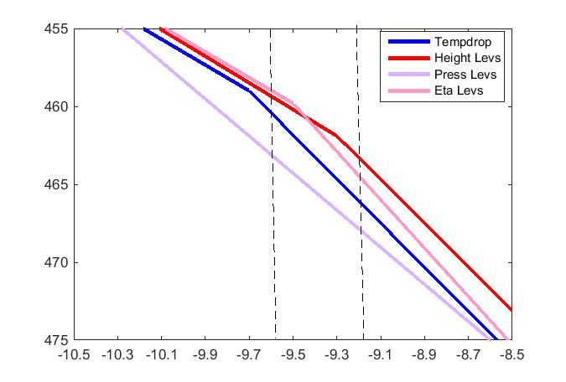
FUTURE CONSIDERATIONS
- Move to BUFR format may produce more extreme observations
Tempdrop constrains significant levels
How can we avoid sending bad data in BUFR?
Should we thin BUFR data?
How to thin?
OSE experiments in process

