Slide 1



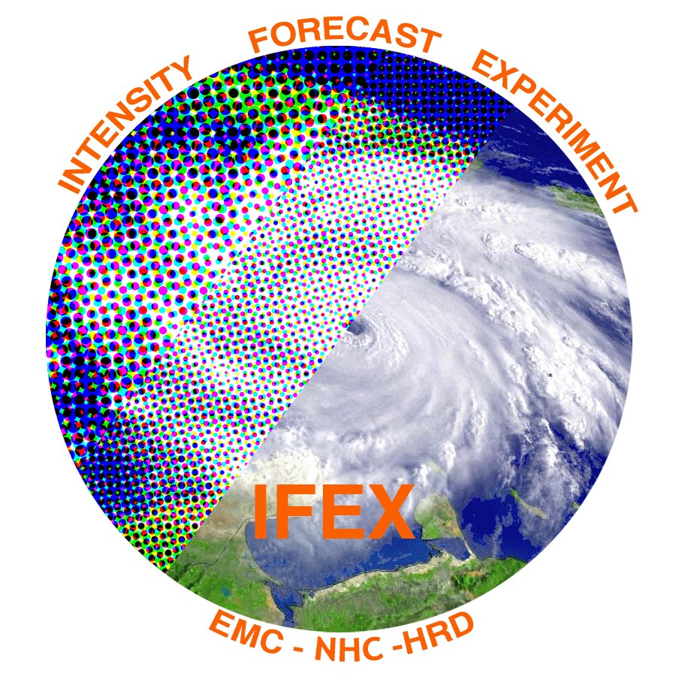
2019 NOAA/AOML/HRD Hurricane Field Program
Intensity Forecast Experiment (IFEX)
AL02 / Barry Debrief

Slide 2
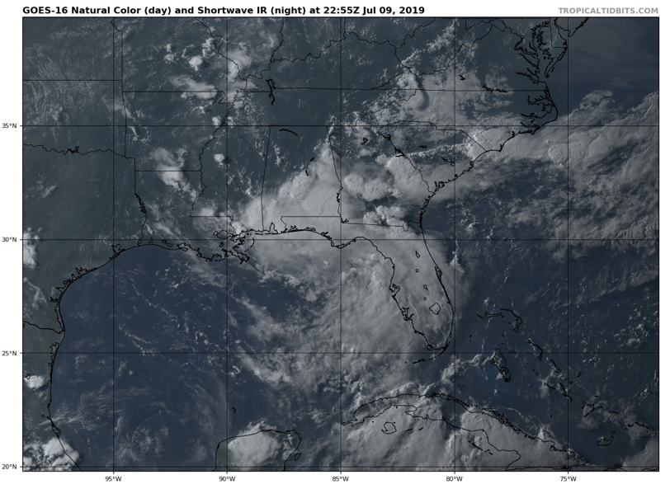
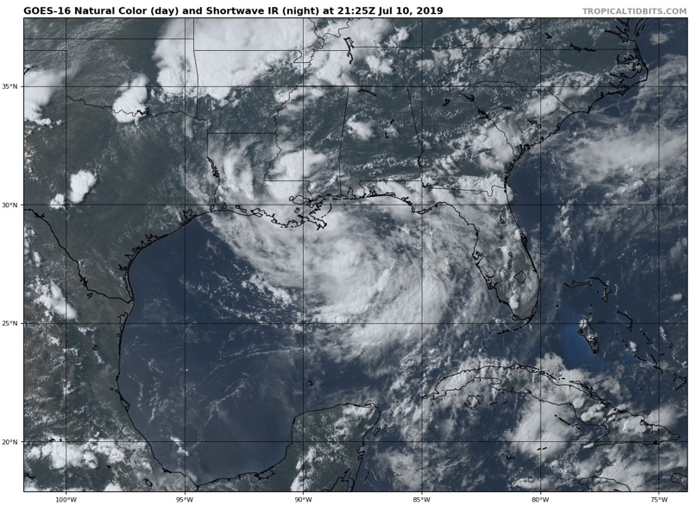
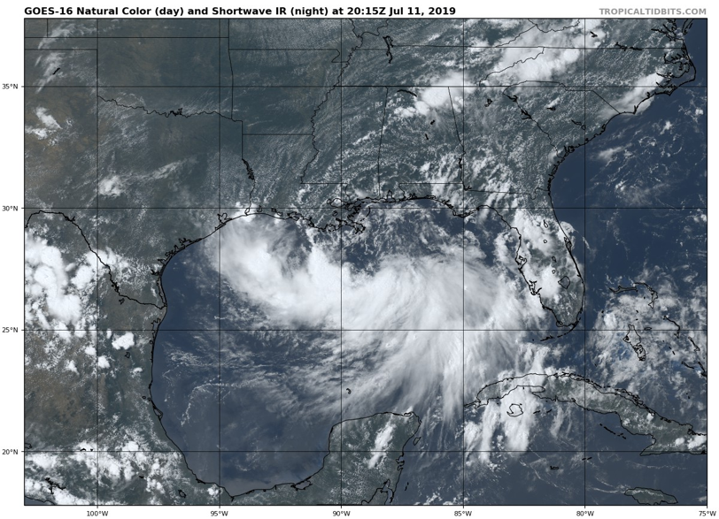
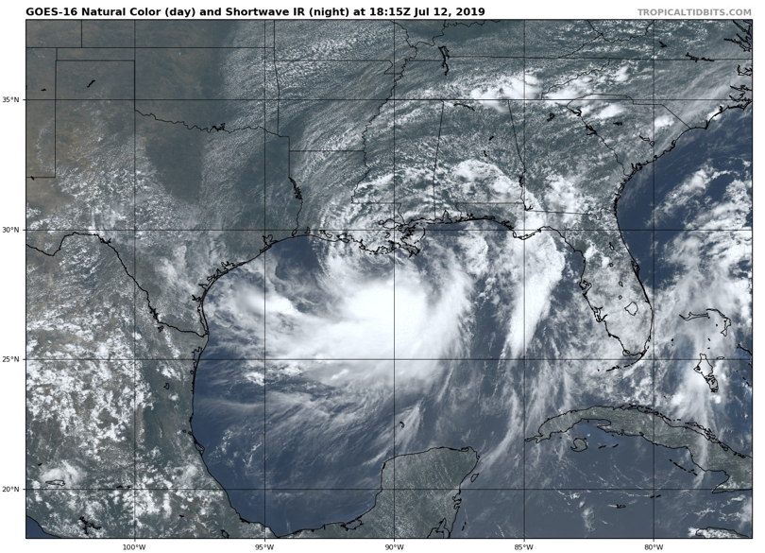
2019 NOAA/AOML/HRD Hurricane Field Program
Intensity Forecast Experiment (IFEX)
AL02/Barry Debrief
July 10-12
July 9
July 10
5 EMC-tasked P-3 (NOAA42) Missions
35 P-3 Flight Hours
101 Dropsondes
10 AXBTs (In storm)
Agenda
July 11
July 12
Missions Overview
Deployment Overview
190710H1 (Rogers)
190711H1 (Marks)
190711H2 (Rogers)
190712H1 (Marks)
190712H2 (Rogers)
EMC (Winterbottom)

Slide 3
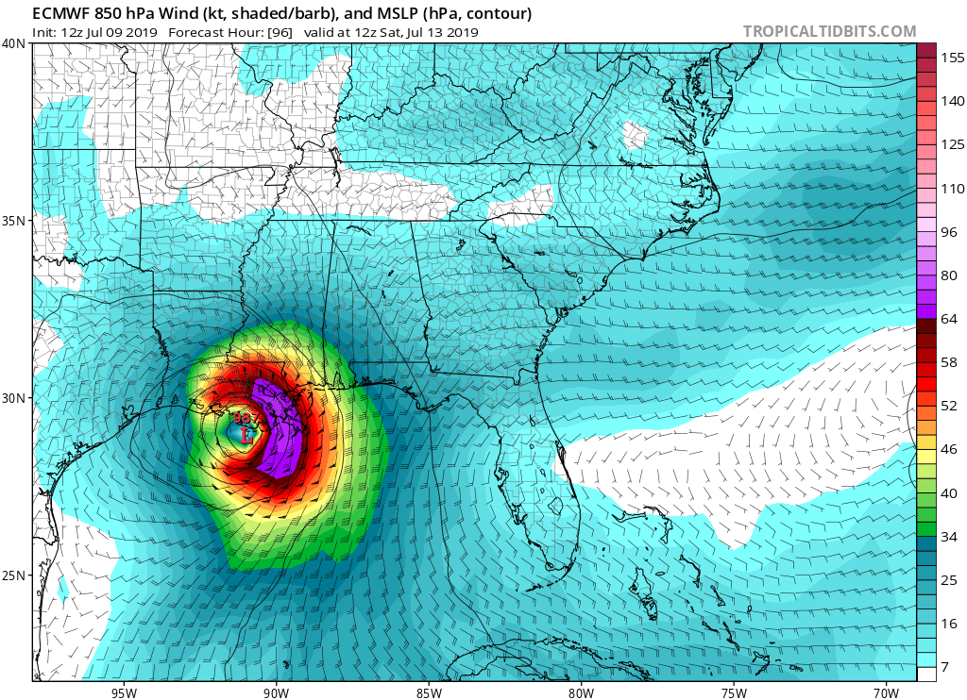
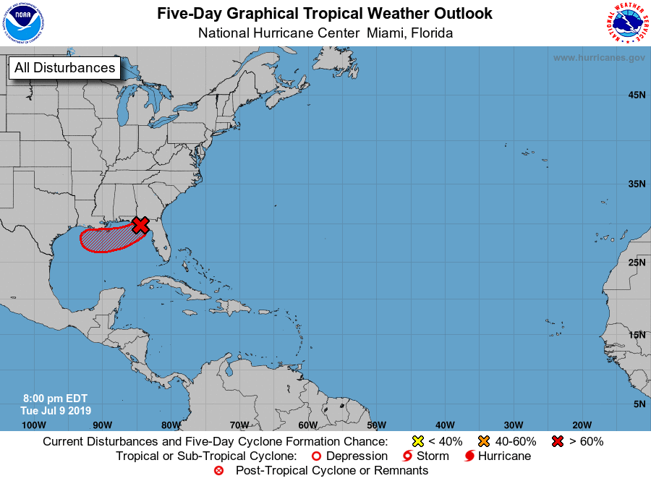
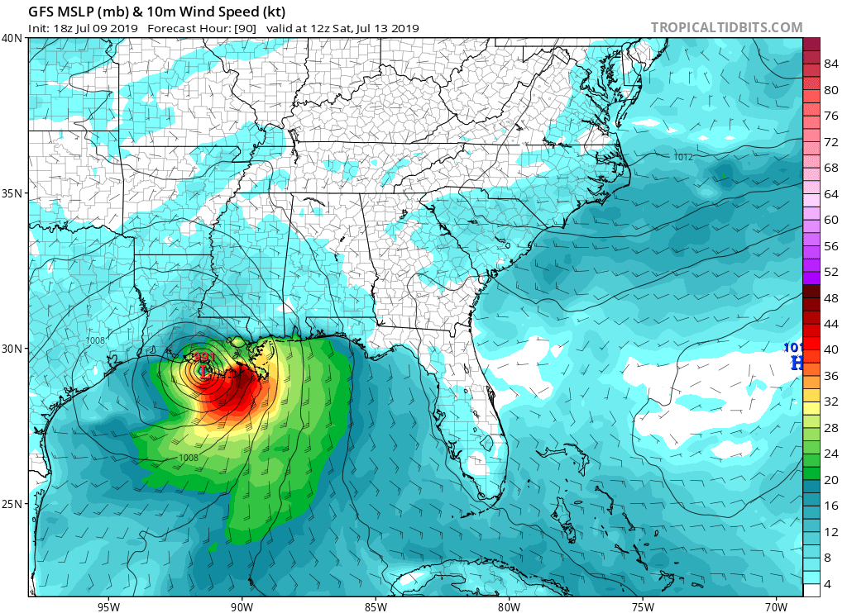
2019 NOAA/AOML/HRD Hurricane Field Program
Intensity Forecast Experiment (IFEX)
AL02/Barry Debrief

Slide 4
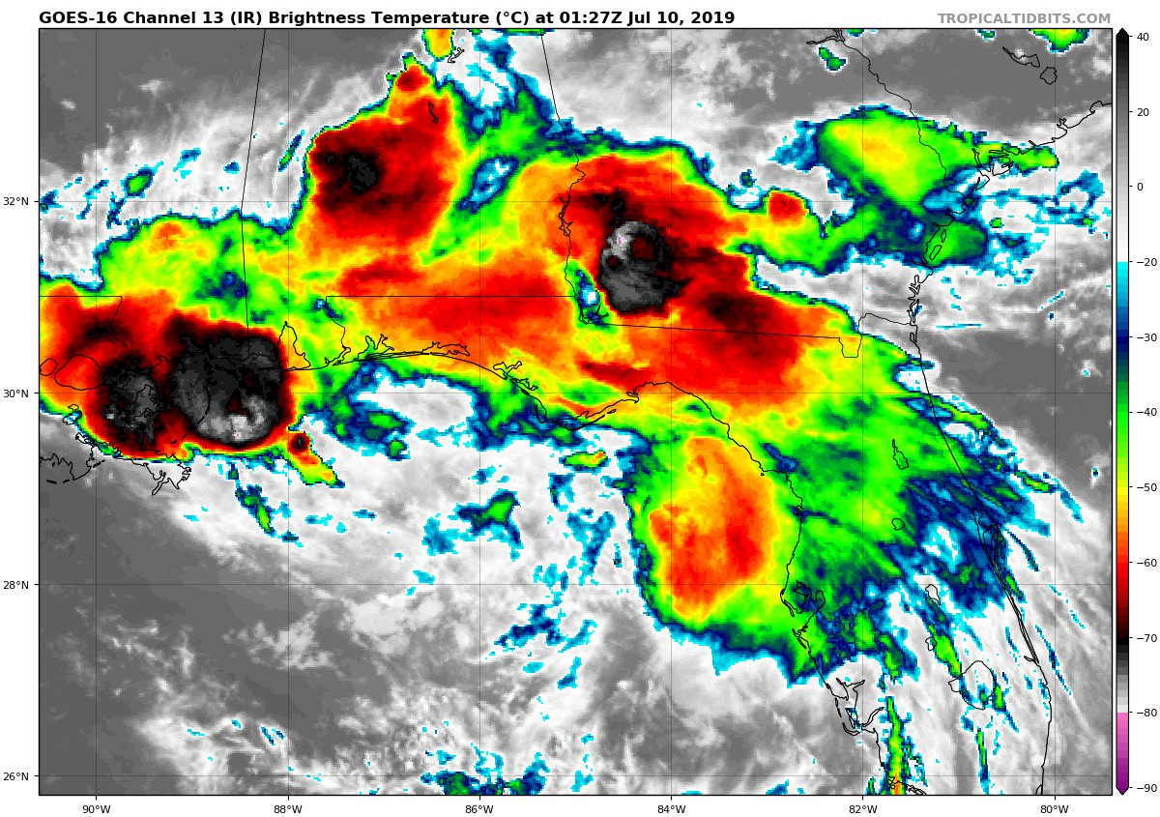
2019 NOAA/AOML/HRD Hurricane Field Program
Intensity Forecast Experiment (IFEX)
AL02/Barry Debrief
NHC forecast just as we were starting P-3 missions
Organization of pre-Barry as P-3 missions began

Slide 5
2019 NOAA/AOML/HRD Hurricane Field Program
Intensity Forecast Experiment (IFEX)
AL02/Barry Debrief
Purpose:
EMC-tasked P-3 (N42) data collection targeting 00 and 12 UTC HWRF cycles
Accomplish research objectives within the HFP-IFEX for:
Genesis Stage: Precipitation Mode (PMODE) and Pouch Experiments
Early Stage Experiment: AIPEX
Satellite Validation: ADM/Aeolus Validation
Target:
Developing and intensifying Barry moving westwards through the northern Gulf of Mexico, with a potential for hurricane landfall on the northern Gulf Coast
Mission Timeline:
12-hourly P-3 missions, takeoffs from Lakeland at 4 AM EDT (0800 UTC) and 4 PM EDT (2000 UTC)

Slide 6
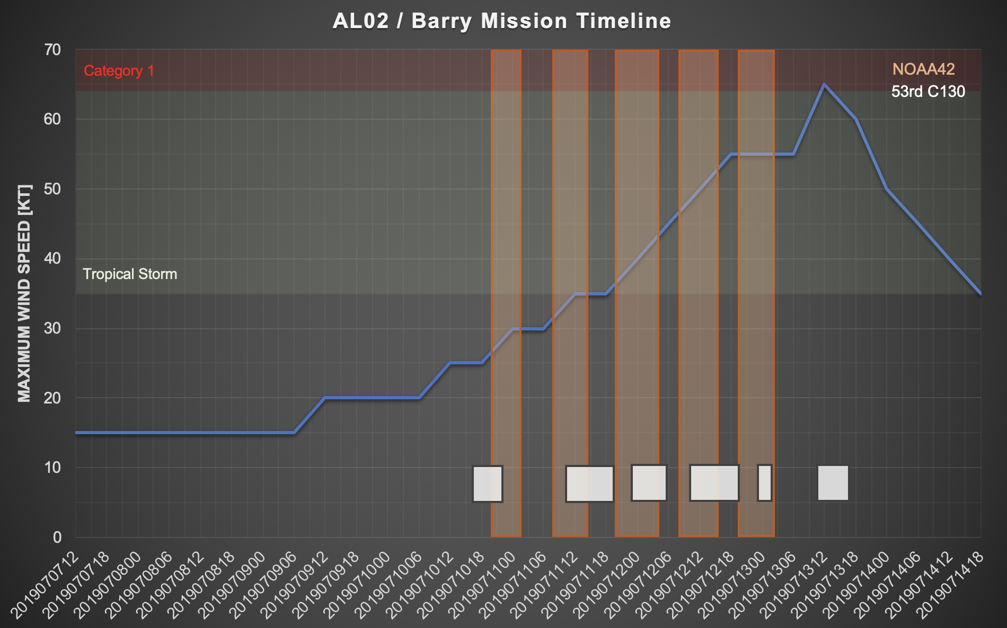
2019 NOAA/AOML/HRD Hurricane Field Program
Intensity Forecast Experiment (IFEX)
AL02/Barry Debrief

Slide 7
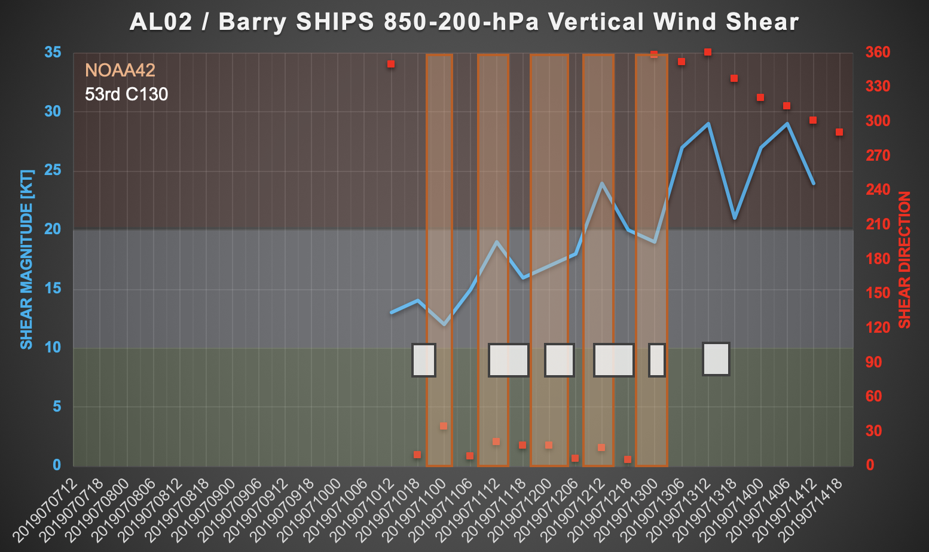
2019 NOAA/AOML/HRD Hurricane Field Program
Intensity Forecast Experiment (IFEX)
AL02/Barry Debrief

Slide 8
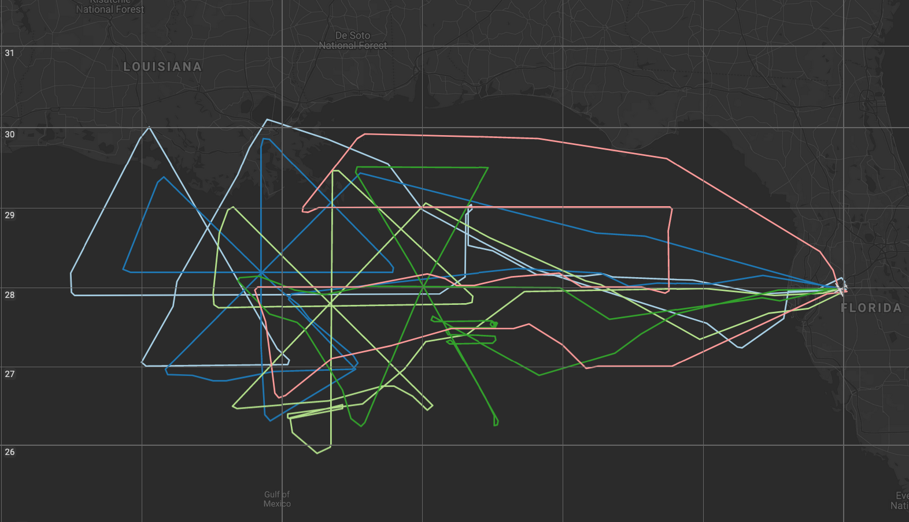
2019 NOAA/AOML/HRD Hurricane Field Program
Intensity Forecast Experiment (IFEX)
AL02/Barry Debrief
P-3 Flight Tracks
190712H2
190710H1
190712H1
190711H1
190711H2
NASA MTS

Slide 9
2019 NOAA/AOML/HRD Hurricane Field Program
Intensity Forecast Experiment (IFEX)
AL02/Barry Debrief
Mission Highlights:
Mostly successful data collection and transmission from P-3 to EMC, including at higher altitudes (up to ~21 kft) outside of precipitation
Issue with dropsonde transmission to EMC around 0000 UTC (both P-3 and C-130)
Interesting case study for the Early and Mature Stage Experiments, as we flew during both the genesis and slow intensification periods of Barry. The storm remained very asymmetric in both precipitation and winds. Intensification despite moderate vertical wind shear.
Accomplished an ADM-Aeolus validation leg for Satellite Validation Experiment
Three AOML summer students (Nicholas Johnson, Kelly Nunez Ocasio, and Addison Alford) were able to fly on the first two missions

Slide 10
2019 NOAA/AOML/HRD Hurricane Field Program
Intensity Forecast Experiment (IFEX)
AL02/Barry Debrief
HWRF Reconnaissance Observation Usage for Tropical Cyclone Barry (AL02 2019)
Henry R. Winterbottom
I.M. Systems Group, Inc. (IMSG)
National Oceanic and Atmospheric Administration (NOAA)/National Weather Service (NWS)
National Centers for Environmental Prediction (NCEP) Environmental Modeling Center (EMC)
5830 University Research Court
College Park, Maryland 20740
On Behalf of the EMC HWRF Team

Slide 11
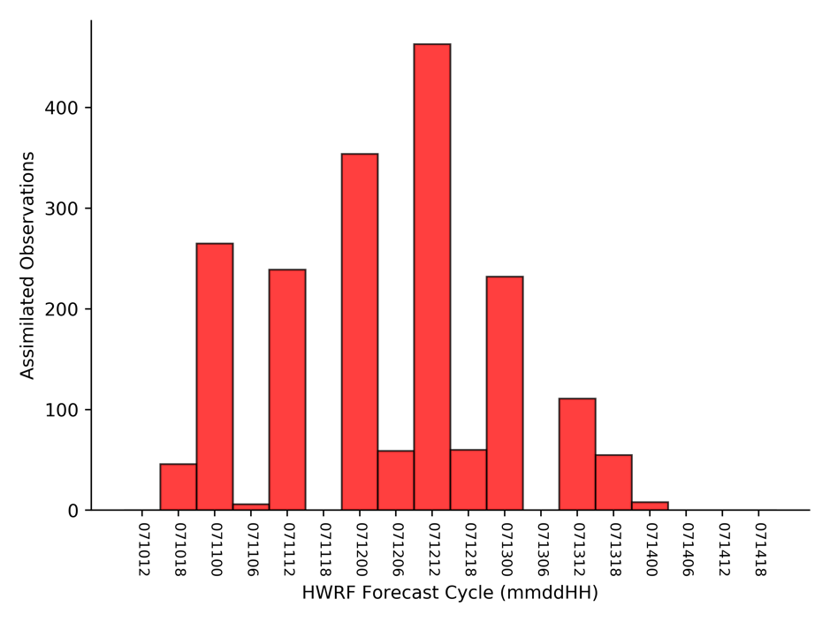
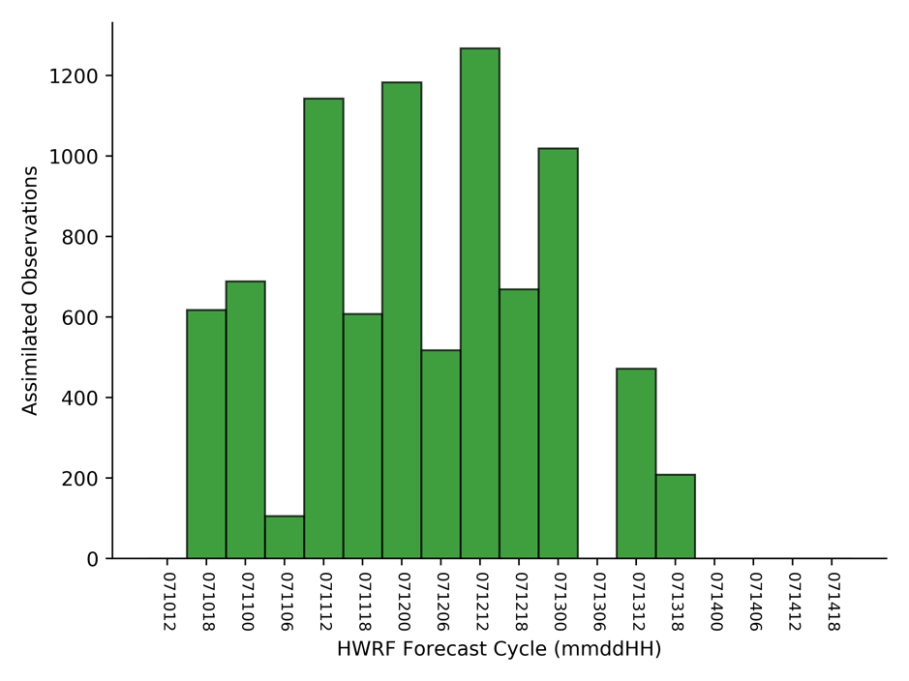
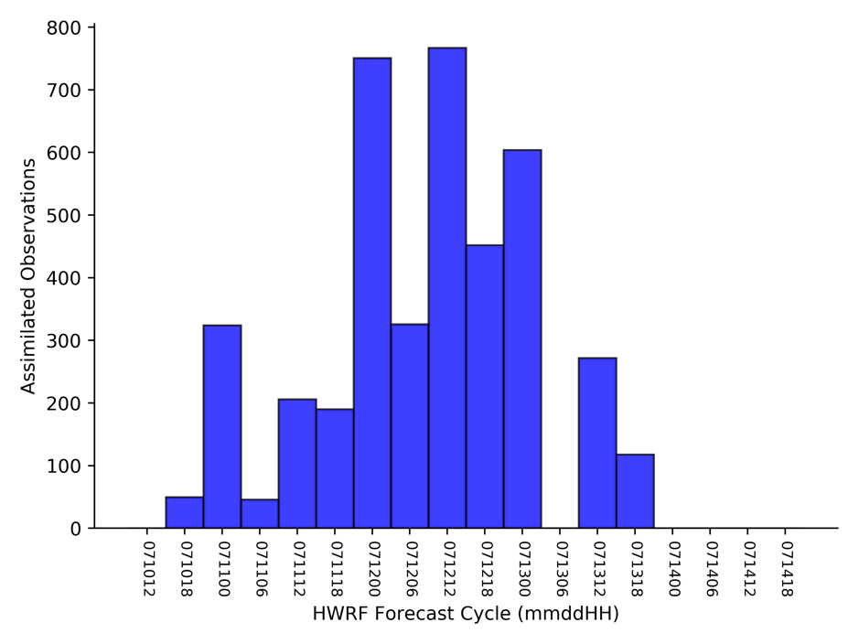
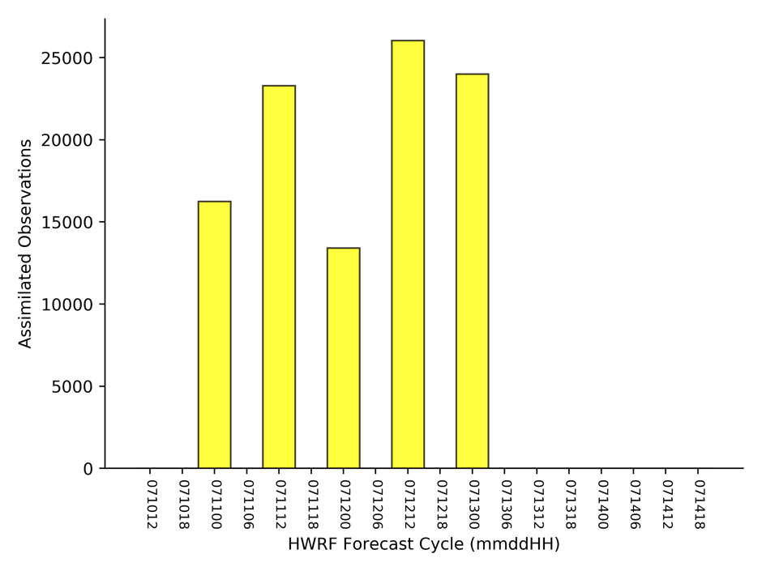
Assimilated Reconnaissance Observations:
Total Number of Reconnaissance Observation Types per HWRF Forecast Cycle
Dropsonde (w/ drift)
Flight-level
SFMR
TDR

Slide 12
Reconnaissance Observation Usage:
Observation Type | Total Number Assimilated | Total Number Rejected | Percentage of Total Assimilated*
Dropsondes (w/drift) | 1898 | 3 | 99.8%
Flight-level | 8502 | 110 | 98.7%
Stepped Frequency Microwave Radiometer (SFMR) | 4106 | 1848 | 69.0%
Tail Doppler Radar (TDR) | 103010 | 502 | 99.5%
* Statistics computed following the third GSI cost-function minimization iteration.

Slide 13
2019 NOAA/AOML/HRD Hurricane Field Program
Intensity Forecast Experiment (IFEX)
AL02/Barry Debrief
AL02
Flight 190710H1
Meteorological highlights
AL02 a broad circulation just emerging in northeastern Gulf of Mexico
Elongated regions of precipitation focused on southern side of diffuse circulation
Moderate to strong northerly shear, sharp shear gradient; moist low-level environment
Drops showed N-S shear axis below 700 hPa, possible midlevel circulation at 500 hPa
Models forecast slow intensification initially, then more significant intensification near landfall
Mission highlights
Lawnmower pattern, flown at high altitude (20-22 kft) for much of pattern
24 GPS dropsondes (22 were good), 5 AXBTs (2 were good) released
Coordinated leg on SW side of pattern with AEOLUS overpass
LPS: Rob Rogers
Radar (air): Paul Reasor
Radar (ground): Nancy Griffin
Dropsonde: Kathryn Sellwood

Slide 14
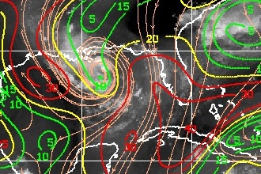
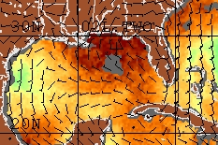
2019 NOAA/AOML/HRD Hurricane Field Program
Intensity Forecast Experiment (IFEX)
AL02/Barry Debrief
Environmental conditions
CIMSS 850-200 hPa shear 18 UTC July 10
TPW 18 UTC July 10
Shear gradient, 30+ kt northerly shear in eastern Gulf
Moist low-level environment, shear axis in eastern Gulf

Slide 15
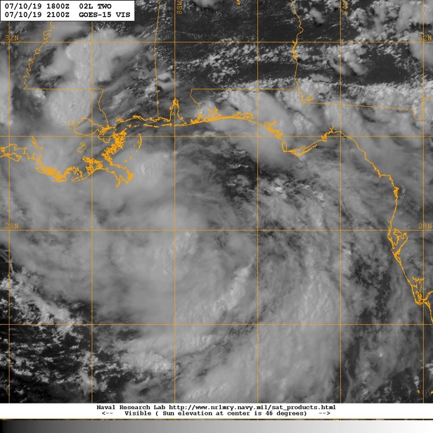
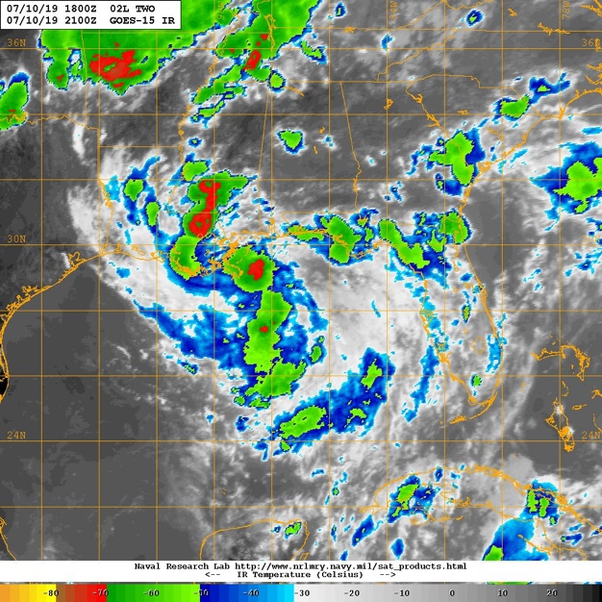
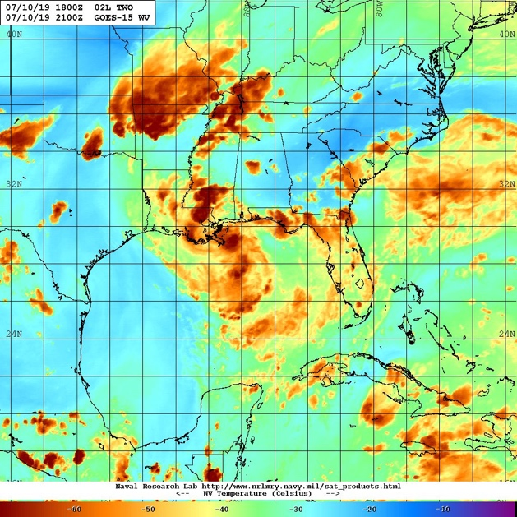
2019 NOAA/AOML/HRD Hurricane Field Program
Intensity Forecast Experiment (IFEX)
AL02/Barry Debrief
Satellite presentation: GEO
GOES-15 Vis valid 2100 UTC July 10
GOES-15 IR valid 2100 UTC July 10
GOES-15 WV valid 2100 UTC July 10
Scattered areas of convection
Complex environment, dry mid-, upper-level air over SE U.S.

Slide 16
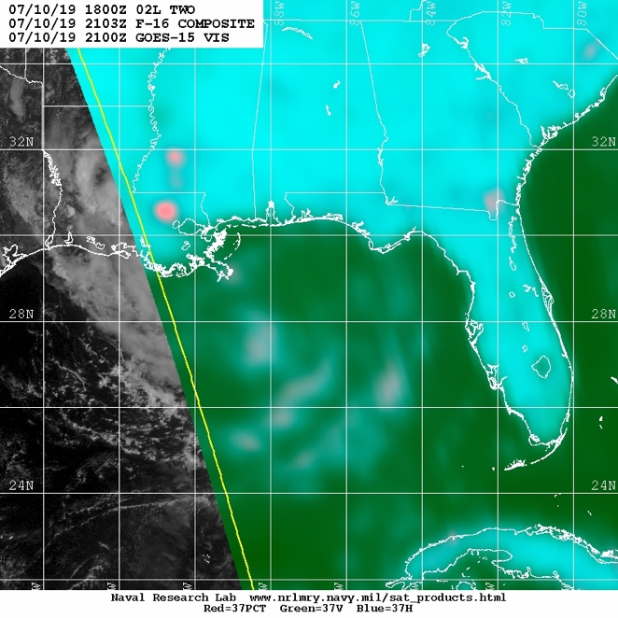
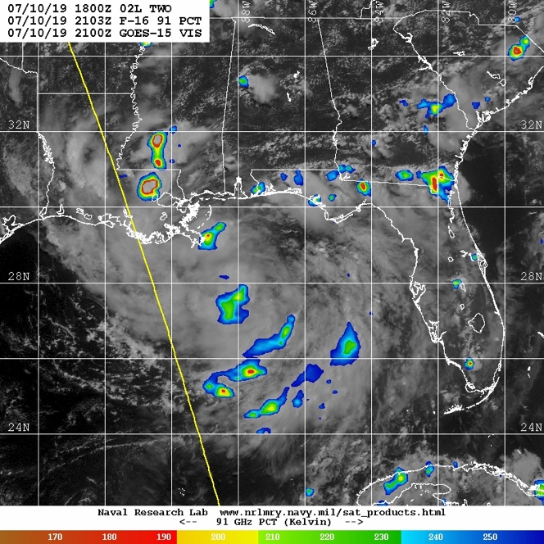
2019 NOAA/AOML/HRD Hurricane Field Program
Intensity Forecast Experiment (IFEX)
AL02/Barry Debrief
Satellite presentation: Microwave
F-16 37 GHz composite valid 2103 UTC July 10
F-16 91 GHz PCT valid
2103 UTC July 10
Most rain, ice scattering in central Gulf, southern part of disturbance consistent with shear

Slide 17
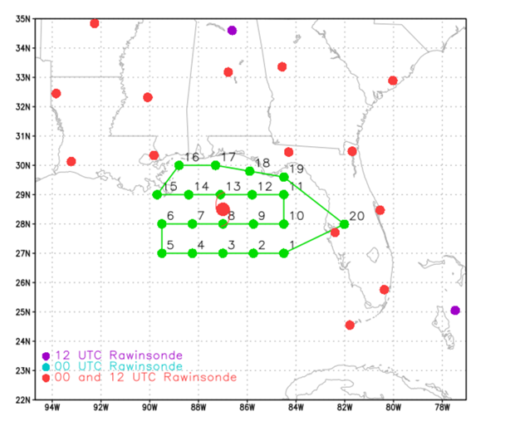
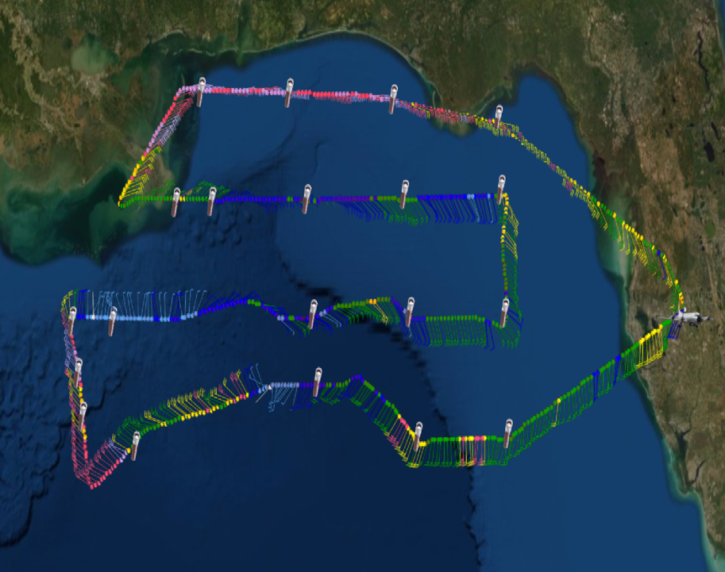
2019 NOAA/AOML/HRD Hurricane Field Program
Intensity Forecast Experiment (IFEX)
AL02/Barry Debrief
Lawnmower survey pattern
Fly as high an altitude as possible (20 kft or higher) especially on north (upshear) side
IP originally planned for SE corner, shifted to NE corner
Flew leg aligned with AEOLUS overpass in SW corner
Planned flight track for 190710H1
Flight tracks
Actual flight track for 190710H1

Slide 18
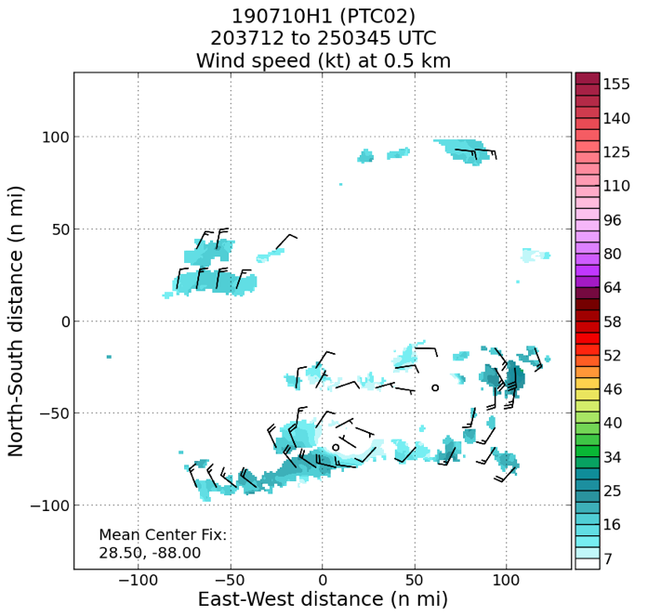
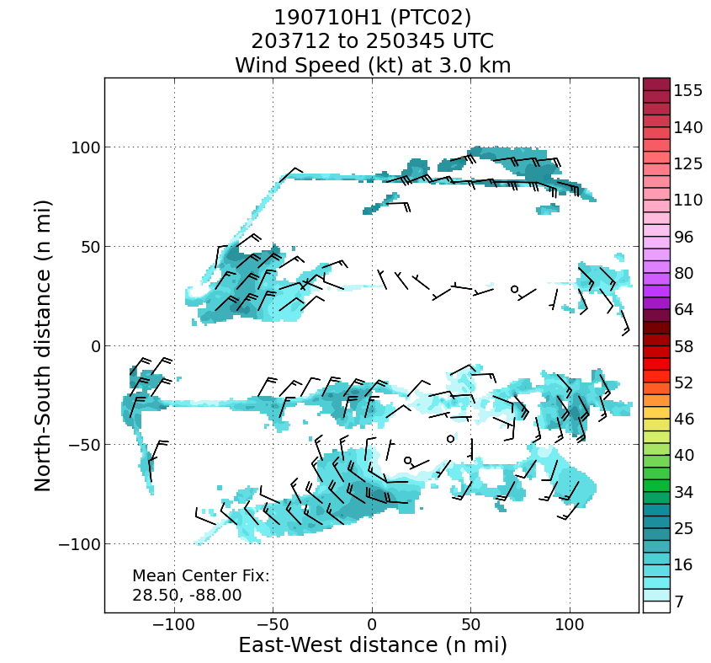
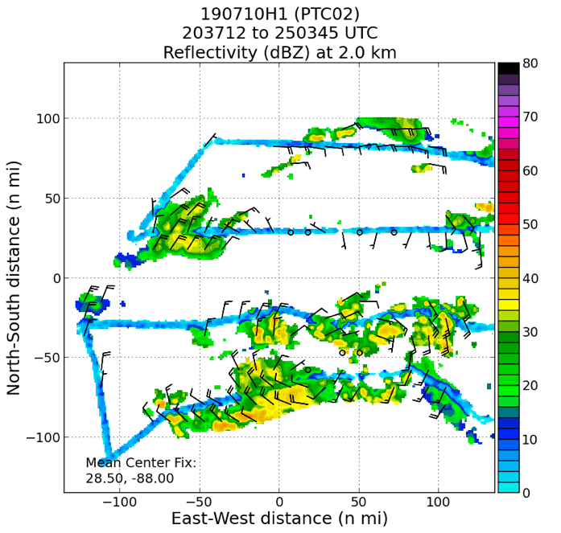
2019 NOAA/AOML/HRD Hurricane Field Program
Intensity Forecast Experiment (IFEX)
AL02/Barry Debrief
Real-time radar analyses
Limited coverage, problems with noise
Scatterers mostly on south side of circulation
Broad circulation, centers fairly aligned between 0.5 and 3 km

Slide 19
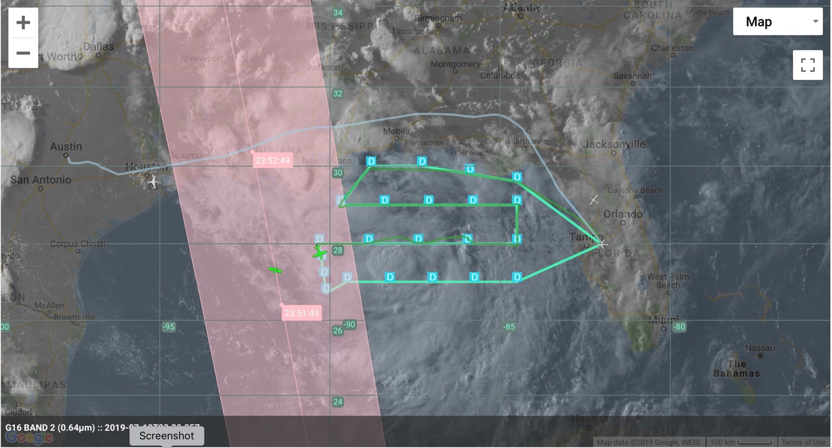
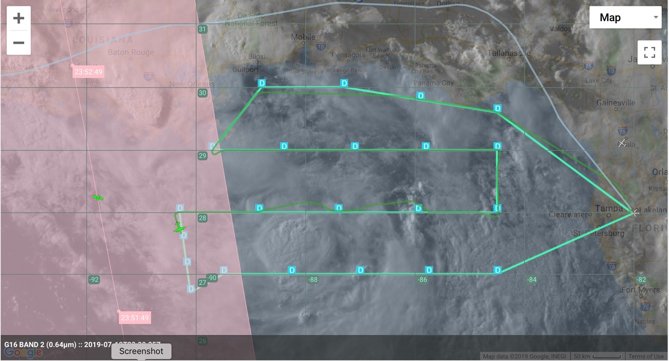
2019 NOAA/AOML/HRD Hurricane Field Program
Intensity Forecast Experiment (IFEX)
AL02/Barry Debrief
ADM-Aeolus Satellite Validation Module on 20190710H1
Objective: validate & evaluate ADM-Aeolus profiles of winds and aerosols in a variety of tropical environments using aircraft data
Coordination Details:
Target: ADM-Aeolus ascending pass (~2352z) in region 125 n mi east of nadir (E edge of red shaded swath)
Pattern Adjustment: final N-S leg adjusted slightly eastward and oriented NNW-SSE
Dropsondes: 3 extra sondes deployed
Sonde Comparisons (≤30 min, ≤50 n mi): 232640/234230/234836/235409/235821/000408/001308/002508z (partial)
Satellite Status: switched from laser A to B in early July (calibration ongoing)
125 n mi
ADM-Aeolus
NOAA-42

Slide 20
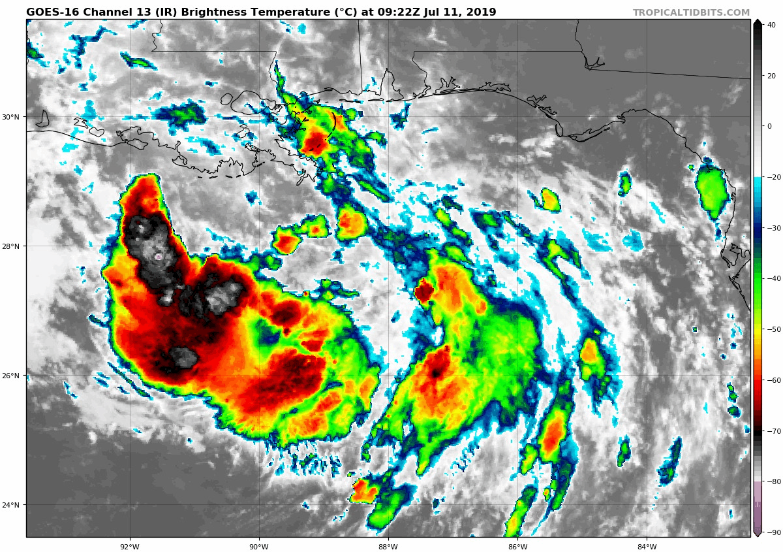
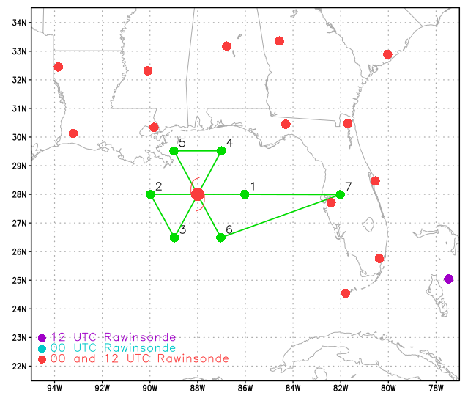
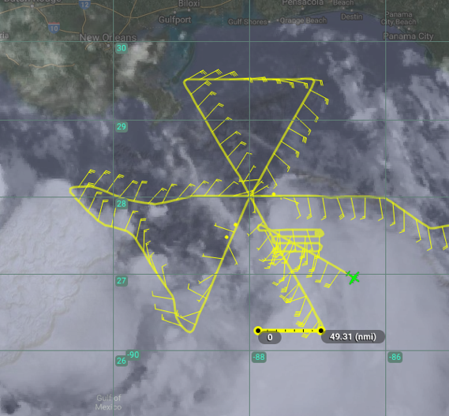
2019 NOAA/AOML/HRD Hurricane Field Program
Intensity Forecast Experiment (IFEX)
AL02/Barry Debrief
Mission 2: 20180711H1 (EMC-Tasked TDR)
LPS: Marks
Radar: Alvey
Drops: Aberson/Diaz
Ground Radar: Gamache
Hollings: Johnson
25 kt / 1009 hPa
Takeoff: 0807 UTC, Landing: 1443 UTC
Pattern: Butterfly, 15 kft radar alt.
Drops: 18: 3 centers, 6 midpoints, 6 endpoints, and 2 burst module
AXBTs: 5/2 worked
3 center fixes
MOTION 260° 4-5 kt
SHIPS SHR NNE 15 kt
IP ARRIVAL 0857 UTC

Slide 21
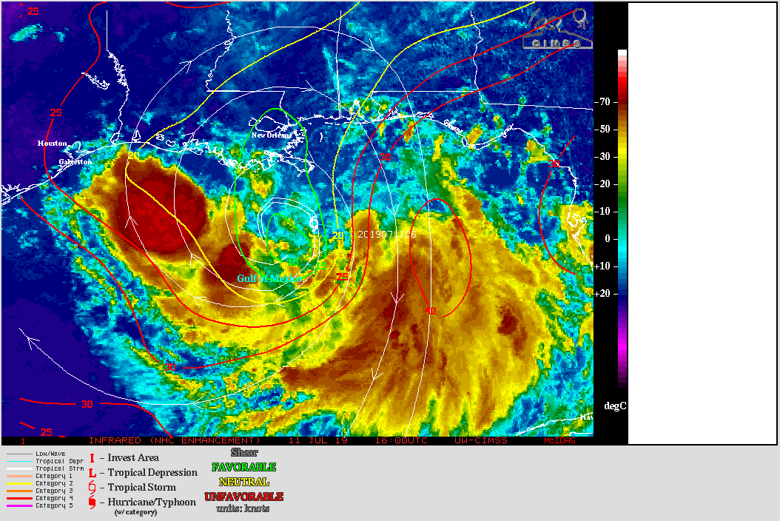
2019 NOAA/AOML/HRD Hurricane Field Program
Intensity Forecast Experiment (IFEX)
AL02/Barry Debrief
Mission 2: 20180711H1 (EMC-Tasked TDR)
200-850 mb deep layer mean shear (07/11 12Z)
PTC02: MOTION: 4-5 kt
Figure credit: CIMSS

Slide 22
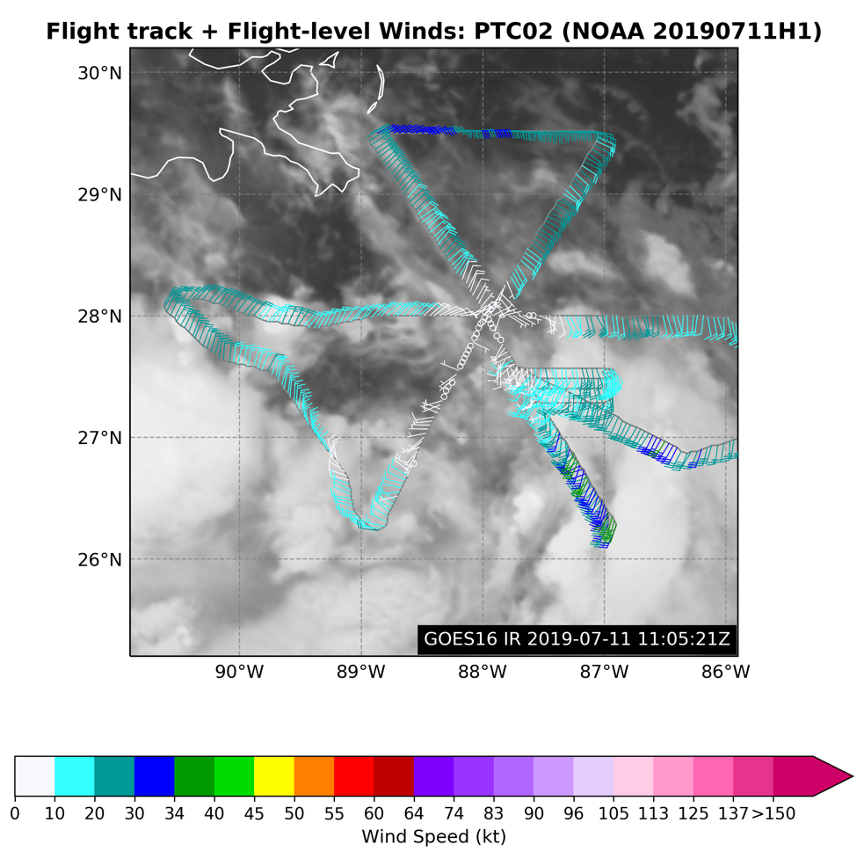
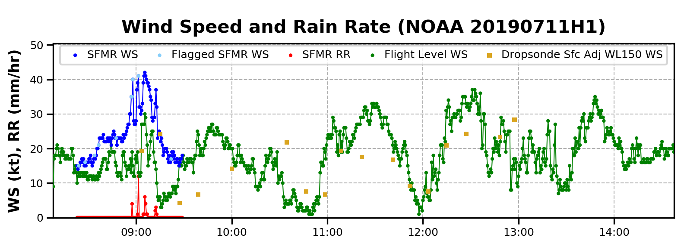
2019 NOAA/AOML/HRD Hurricane Field Program
Intensity Forecast Experiment (IFEX)
AL02/Barry Debrief
Mission 2: 20180711H1 (EMC-Tasked TDR)
The highest flight level winds was 35 kt
SFMR was too high – discontinued at 0930 UTC
Figure credit: Heather Holbach

Slide 23
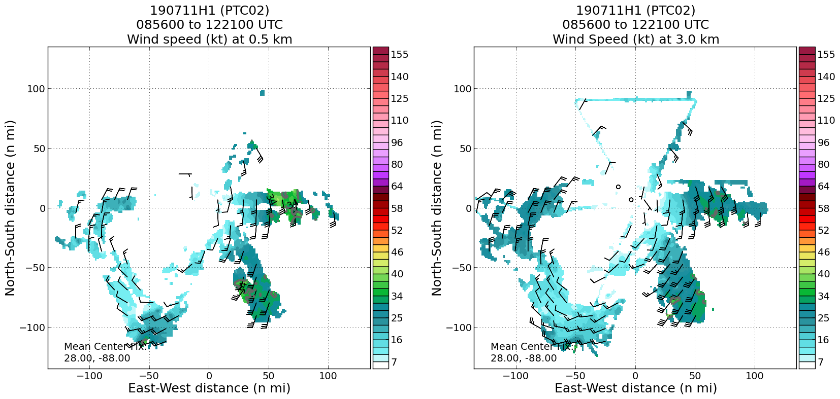
2019 NOAA/AOML/HRD Hurricane Field Program
Intensity Forecast Experiment (IFEX)
AL02/Barry Debrief
Mission 2: 20180711H1 (EMC-Tasked TDR)
Burst module
Figure credit: Paul Reasor

Slide 24
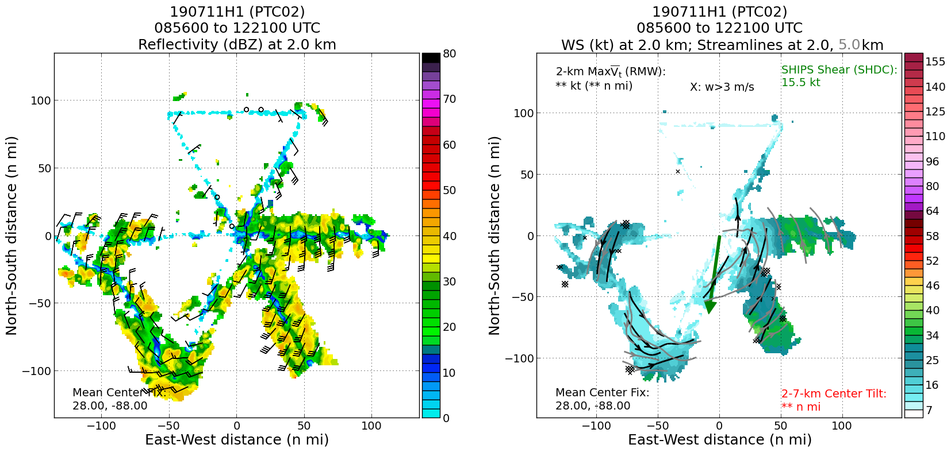
2019 NOAA/AOML/HRD Hurricane Field Program
Intensity Forecast Experiment (IFEX)
AL02/Barry Debrief
Mission 2: 20180711H1 (EMC-Tasked TDR)
Figure credit: Paul Reasor

Slide 25
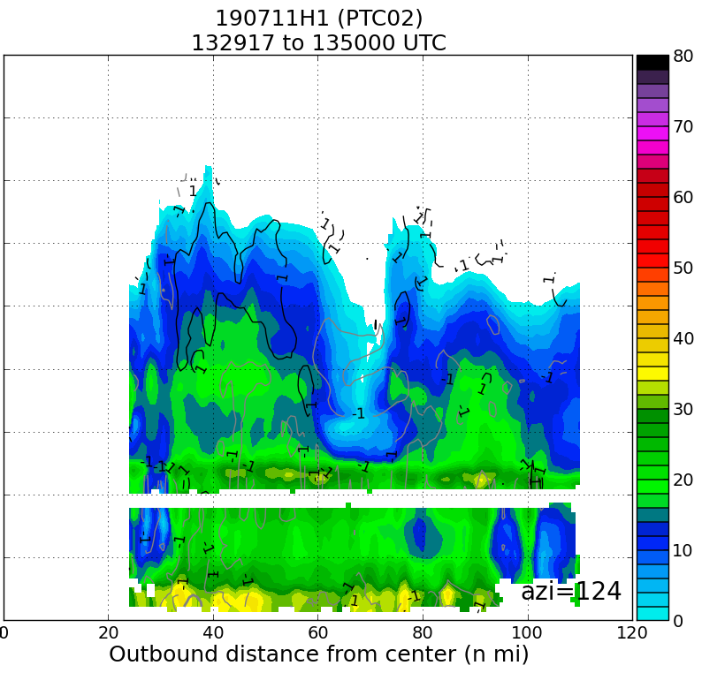
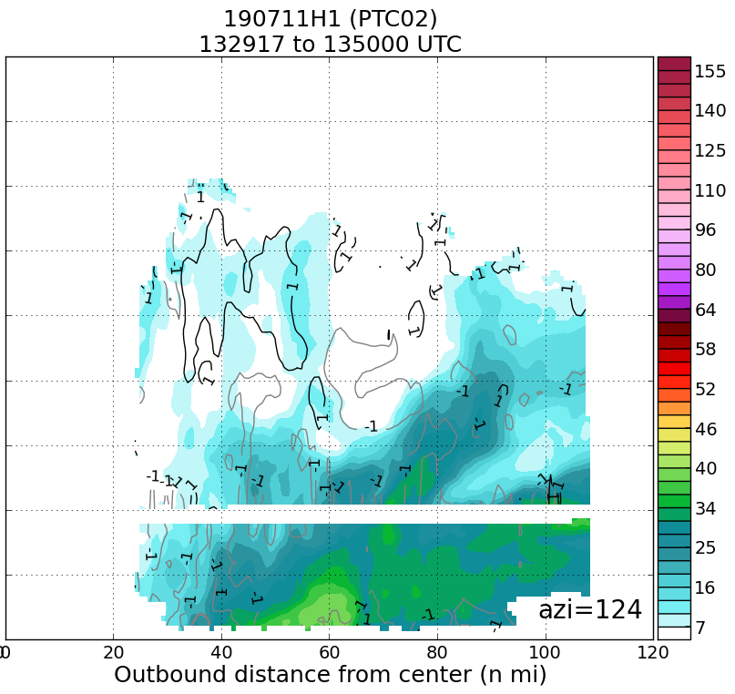
2019 NOAA/AOML/HRD Hurricane Field Program
Intensity Forecast Experiment (IFEX)
AL02/Barry Debrief
Mission 2: 20180711H1 (EMC-Tasked TDR)
dBZ-shaded
W (m/s)
WS-shaded (kt)
W (m/s)
Burst module

Slide 26
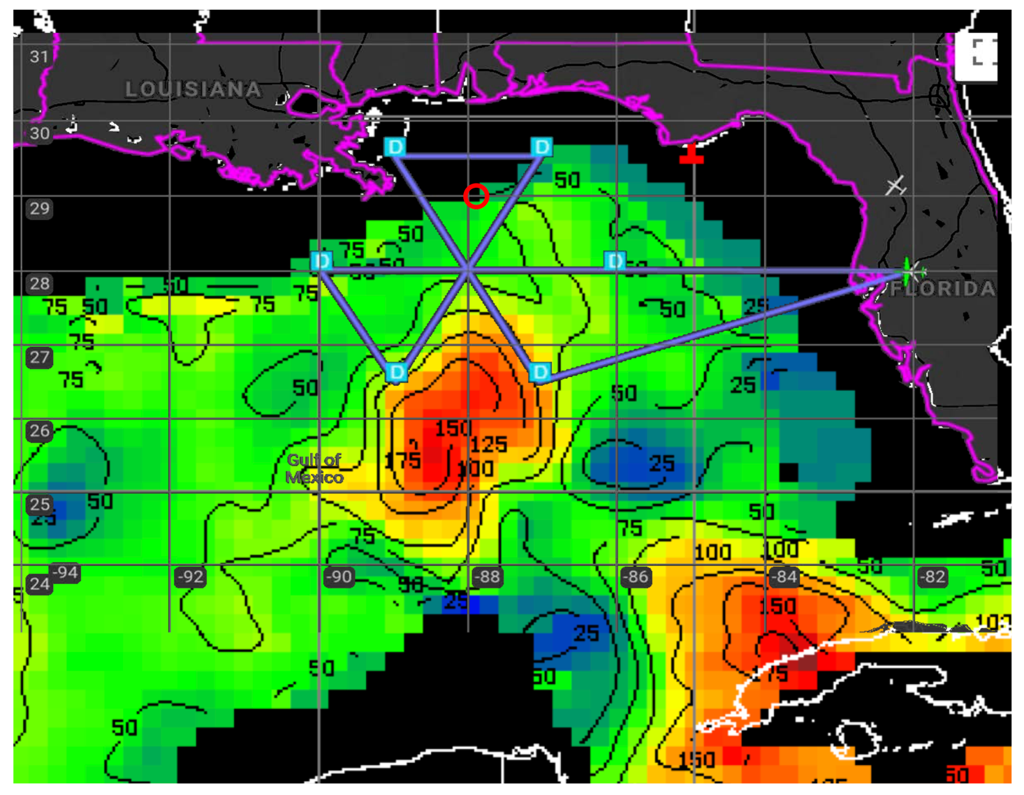
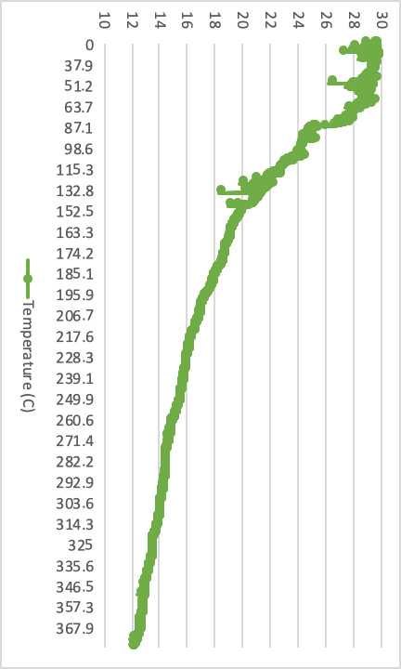
2019 NOAA/AOML/HRD Hurricane Field Program
Intensity Forecast Experiment (IFEX)
AL02/Barry Debrief
Mission 2: 20180711H1 (EMC-Tasked TDR)
*
*
*
+
+

Slide 27
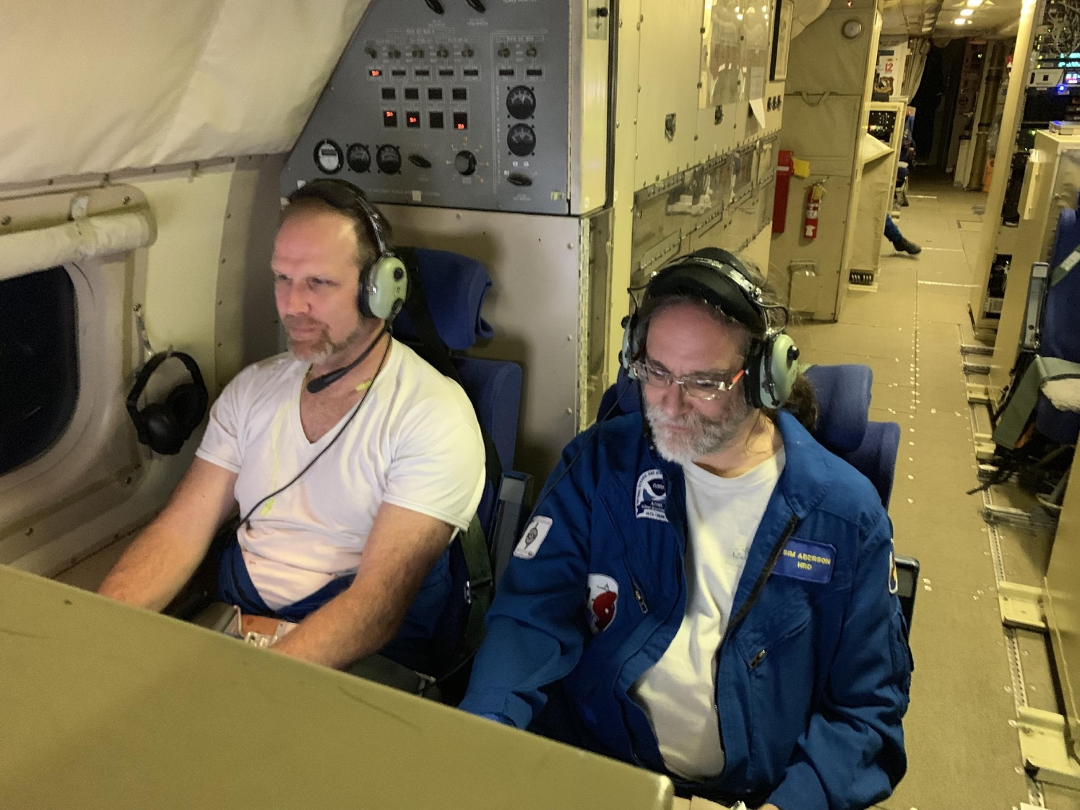
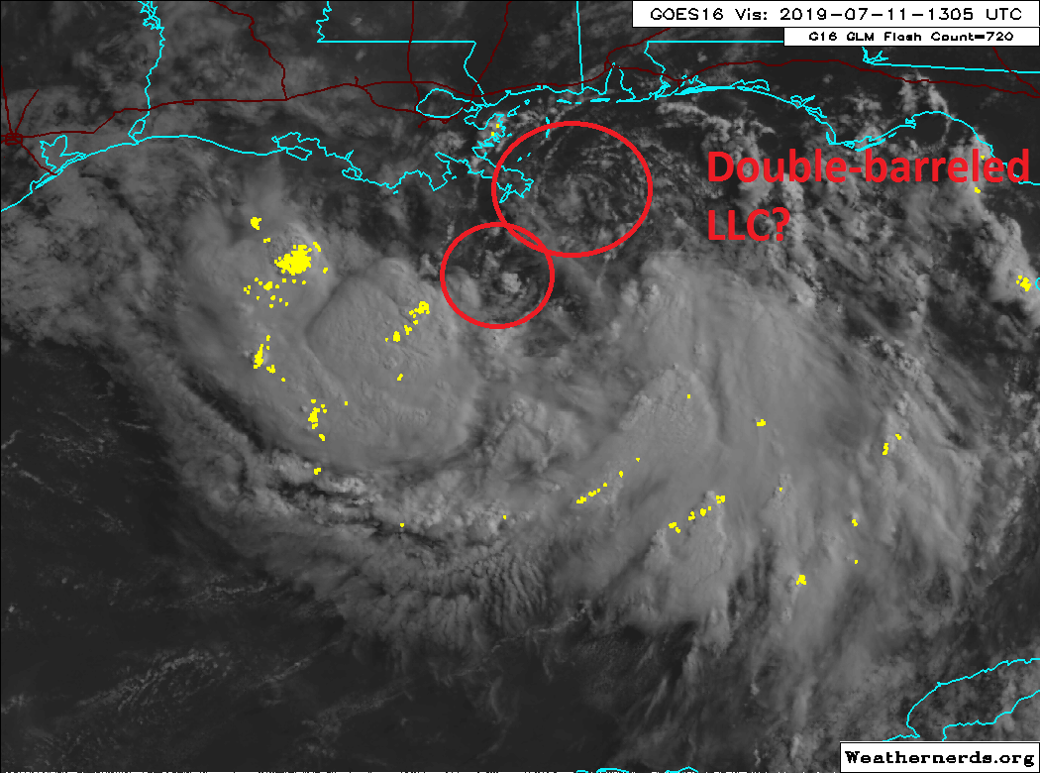
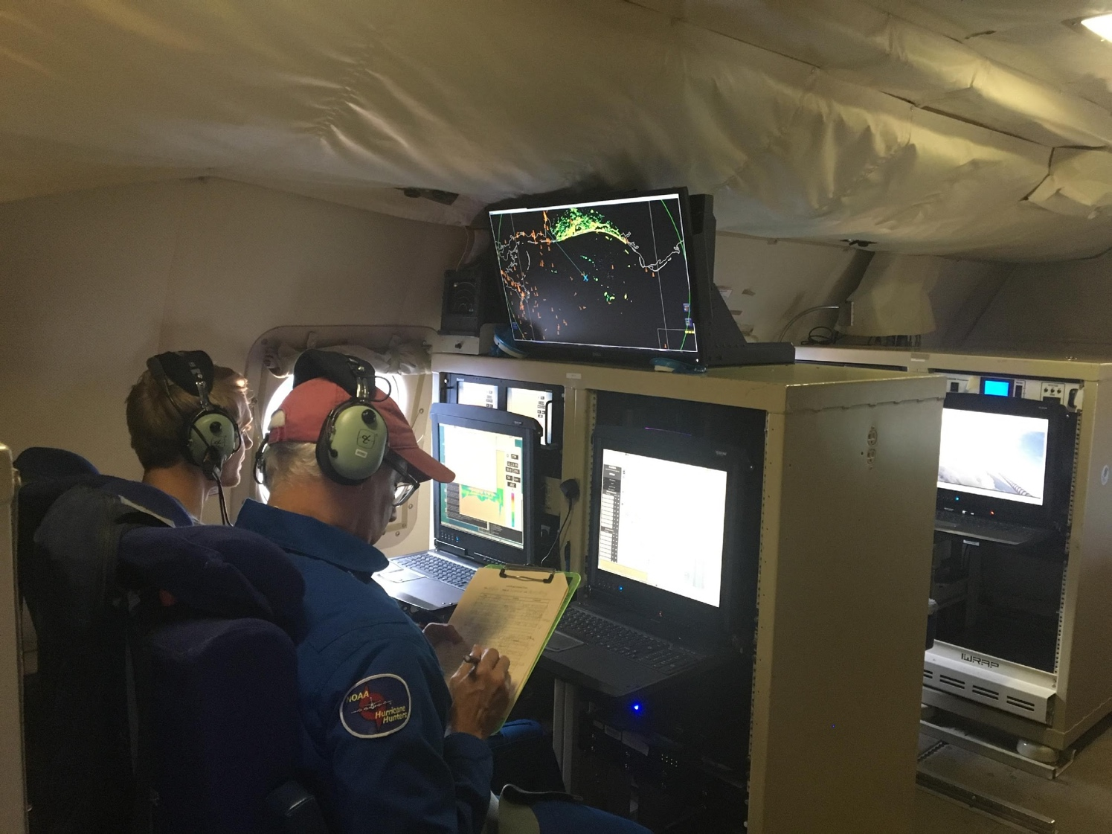
2019 NOAA/AOML/HRD Hurricane Field Program
Intensity Forecast Experiment (IFEX)
AL02/Barry Debrief
Mission 2: 20180711H1 (EMC-Tasked TDR)
Figure credit: Weathernerds.com
Photo credits: Nick Johnson & Frank Marks

Slide 28
2019 NOAA/AOML/HRD Hurricane Field Program
Intensity Forecast Experiment (IFEX)
AL02/Barry Debrief
Meteorological highlights
TS Barry remains a broad circulation in northern Gulf
Moderate northerly shear; stronger shear on east side
Dry air in northern portion of Gulf, Gulf coast
Peak winds from AF ~100 nm SE of center
Multiple vortices rotating out from precipitation region confined to S, SW sides
More widespread convective, stratiform precipitation on S side toward end of mission
Mission highlights
Rotated figure-4 pattern, flown at high altitude (20-22 kft) for much of pattern
22 GPS dropsondes (20 were good), No AXBTs released
Flew convective burst module on S side after survey pattern was complete, sampled region of warming cloud tops
Shortly after CB module complete, a broad cold cloud shield developed
TS Barry
Flight 190711H2
LPS: Rob Rogers
Radar (air): Paul Reasor
Radar (ground): Nancy Griffin
Dropsonde: Kathryn Sellwood

Slide 29
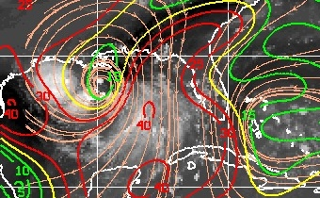
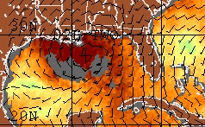
2019 NOAA/AOML/HRD Hurricane Field Program
Intensity Forecast Experiment (IFEX)
AL02/Barry Debrief
Environmental conditions
CIMSS 850-200 hPa shear 18 UTC July 11
TPW 18 UTC July 11
Shear gradient persists, 30+ kt northerly shear in eastern Gulf
Low-level center closer to low-shear region
Moist low-level environment, dry air SW of circulation

Slide 30
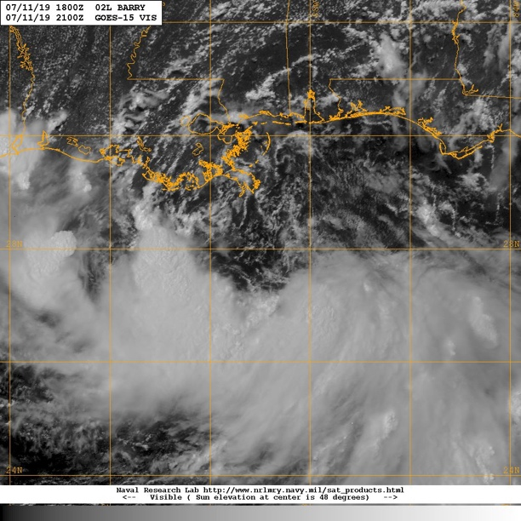
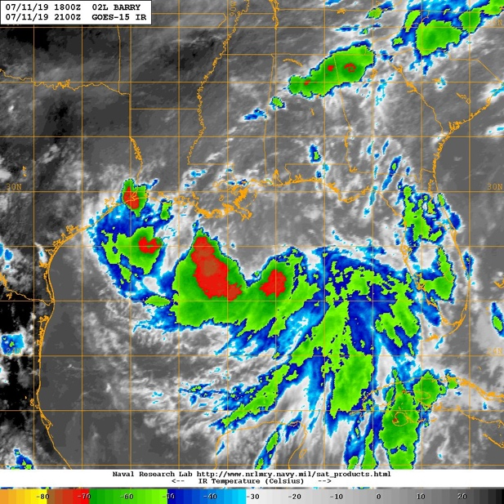
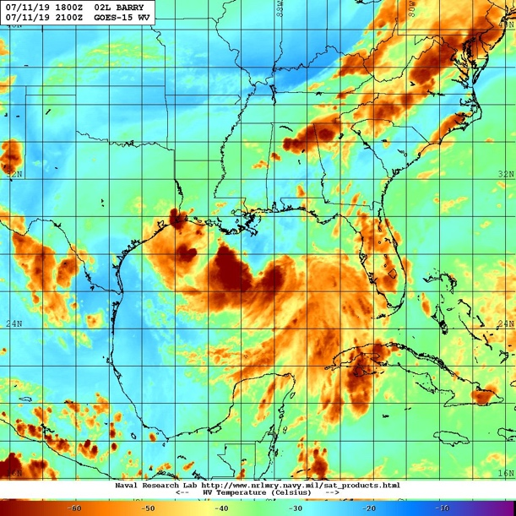
2019 NOAA/AOML/HRD Hurricane Field Program
Intensity Forecast Experiment (IFEX)
AL02/Barry Debrief
Satellite presentation: GEO
GOES-15 Vis valid 2100 UTC July 11
GOES-15 IR valid 2100 UTC July 11
GOES-15 WV valid 2100 UTC July 11
Convection, cold cloud tops confined to W-E line south of circulation
Multiple low-level swirls in visible rotating out from convective regions to north
Dry mid-, upper-level air in northern Gulf

Slide 31


2019 NOAA/AOML/HRD Hurricane Field Program
Intensity Forecast Experiment (IFEX)
AL02/Barry Debrief
Rotated figure-4 pattern
Fly at 20 kft altitude for most of pattern (except on downwind legs on NW, S sides)
Radials very straight
Flew convective burst module on S side, 3 racetracks ~30-40 nm long
Planned flight track for 190711H2
Flight tracks
Actual flight track for 190711H2
Inset for CB module

Slide 32

2019 NOAA/AOML/HRD Hurricane Field Program
Intensity Forecast Experiment (IFEX)
AL02/Barry Debrief
Actual flight track for 190711H2
Convective burst module
~30-40 nm
Targeted region of cold cloud tops on south side of circulation near center (noted during survey pattern)
Racetrack pattern flown ~10 nm offset from precipitation
Sampling occurred over 34 minute span, 0156 – 0230 UTC

Slide 33


2019 NOAA/AOML/HRD Hurricane Field Program
Intensity Forecast Experiment (IFEX)
AL02/Barry Debrief
Convective burst module
Approximate location of legs
Decaying region of convection
Warming cloud tops

Slide 34


2019 NOAA/AOML/HRD Hurricane Field Program
Intensity Forecast Experiment (IFEX)
AL02/Barry Debrief
Convective burst module
Approximate location of legs
Decaying region of convection
Warming cloud tops

Slide 35


2019 NOAA/AOML/HRD Hurricane Field Program
Intensity Forecast Experiment (IFEX)
AL02/Barry Debrief
Convective burst module
Approximate location of legs
Decaying region of convection
Warming cloud tops

Slide 36


2019 NOAA/AOML/HRD Hurricane Field Program
Intensity Forecast Experiment (IFEX)
AL02/Barry Debrief
Convective burst module
2.5 h after end of module
Line of convection redeveloping

Slide 37


2019 NOAA/AOML/HRD Hurricane Field Program
Intensity Forecast Experiment (IFEX)
AL02/Barry Debrief
Convective burst module
4.5 h after end of module
Broad shield of cold cloud tops in region of previously-warming tops

Slide 38



2019 NOAA/AOML/HRD Hurricane Field Program
Intensity Forecast Experiment (IFEX)
AL02/Barry Debrief
Real-time radar analyses
Limited coverage again, almost all on SE
Wind speed up to 50 kt on east side

Slide 39

2019 NOAA/AOML/HRD Hurricane Field Program
Intensity Forecast Experiment (IFEX)
AL02/Barry Debrief
Real-time radar analyses
Reflectivity > 40 dBZ below 2 km on east side
Echo tops of ~10 km – moderate convection? Heavy stratiform?

Slide 40



2019 NOAA/AOML/HRD Hurricane Field Program
Intensity Forecast Experiment (IFEX)
AL02/Barry Debrief
Mission 2: 20180712H1 (EMC-Tasked TDR)
LPS: Marks
Radar: Alvey
Drops: Aberson/Diaz
Ground Radar: Gamache
Hollings: Johnson
45 kt / 1008 hPa
Takeoff: 0803 UTC, Landing: 1525 UTC
Pattern: Rotated Fig. 4, 21 kft radar alt.
Drops: 24: 4 centers, 9 midpoints, 8 endpoints, 2 burst module, & 1 arc clouds
4 center fixes
Arc clouds
MOTION 295 4 kt
SHIPS SHR NNE 24 kt
IP ARRIVAL 0916 UTC

Slide 41

2019 NOAA/AOML/HRD Hurricane Field Program
Intensity Forecast Experiment (IFEX)
AL02/Barry Debrief
Mission 2: 20180712H1 (EMC-Tasked TDR)
200-850 mb deep layer mean shear (07/11 12Z)
AL02:
MOTION: 4-5 kt

Slide 42


2019 NOAA/AOML/HRD Hurricane Field Program
Intensity Forecast Experiment (IFEX)
AL02/Barry Debrief
Mission 2: 20180712H1 (EMC-Tasked TDR)
Highest flight level wind - 53 kt
Highest SFMR wind – 50 kt
Figure credit: Heather Holbach

Slide 43

2019 NOAA/AOML/HRD Hurricane Field Program
Intensity Forecast Experiment (IFEX)
AL02/Barry Debrief
Mission 2: 20180712H1 (EMC-Tasked TDR)
Burst module
Figure credit: Paul Reasor

Slide 44

2019 NOAA/AOML/HRD Hurricane Field Program
Intensity Forecast Experiment (IFEX)
AL02/Barry Debrief
Mission 2: 20180712H1 (EMC-Tasked TDR)
Figure credit: Paul Reasor

Slide 45




2019 NOAA/AOML/HRD Hurricane Field Program
Intensity Forecast Experiment (IFEX)
AL02/Barry Debrief
Mission 2: 20180712H1 (EMC-Tasked TDR)
Burst module

Slide 46



2019 NOAA/AOML/HRD Hurricane Field Program
Intensity Forecast Experiment (IFEX)
AL02/Barry Debrief
Mission 2: 20180712H1 (EMC-Tasked TDR)
Photo credit: Frank Marks

Slide 47
2019 NOAA/AOML/HRD Hurricane Field Program
Intensity Forecast Experiment (IFEX)
AL02/Barry Debrief
Meteorological highlights
TS Barry a 55-kt storm in northern Gulf
Moderate-to-strong northerly shear persists
Still asymmetric, almost all convection on S side, though some instances of strong convection appearing near low-level center (from satellite)
Strongest winds on SE side; AF had found 70 kt flight-level winds prior to mission
Potential for downshear reformation
Mission highlights
EMC-tasked, butterfly pattern, flown at 10 kft for much of pattern, 20 kft on W-E leg
Longer legs on south side to better sample dominant precipitation region
15 GPS dropsondes (15 were good), No AXBTs released
Offshore intense convection module flown on ferry home
TS Barry
Flight 190712H2
LPS: Rob Rogers
Radar (air): Paul Reasor
Radar (ground): Nancy Griffin
Dropsonde: Kathryn Sellwood

Slide 48


2019 NOAA/AOML/HRD Hurricane Field Program
Intensity Forecast Experiment (IFEX)
AL02/Barry Debrief
Environmental conditions
CIMSS 850-200 hPa shear 18 UTC July 12
TPW 18 UTC July 12
Overall increase in shear, small region of reduced shear collocated with low-level circulation
Moist low-level environment

Slide 49



2019 NOAA/AOML/HRD Hurricane Field Program
Intensity Forecast Experiment (IFEX)
AL02/Barry Debrief
Satellite presentation: GEO
GOES-15 Vis valid 2100 UTC July 12
GOES-15 IR valid 2100 UTC July 12
GOES-15 WV valid 2100 UTC July 12
Convection, cold cloud tops remain generally confined to south of circulation
Sharp gradient in cloud-top temperature in IR indicative of northerly shear
Dry mid-, upper-level air remains in northern Gulf

Slide 50


2019 NOAA/AOML/HRD Hurricane Field Program
Intensity Forecast Experiment (IFEX)
AL02/Barry Debrief
Butterfly pattern
Fly at 10 kft altitude for most of pattern due to expected precipitation; 20 kft on W-E pass
Drops at turn, mid, center points
Flew offshore intense convection module on ferry home
Planned flight track for 190712H2
Flight tracks
Actual flight track for 190711H2
Inset for landfall module

Slide 51

2019 NOAA/AOML/HRD Hurricane Field Program
Intensity Forecast Experiment (IFEX)
AL02/Barry Debrief
Offshore intense convection module
~30 nm
Actual flight track for 190712H2
Targeted N-S line of precipitation near coastline on ferry home (noted during survey pattern)
Racetrack pattern flown ~10 nm offset from precipitation
Sampling occurred over 23 minute span, 0119 – 0142 UTC
Most moderate & shallow convection, stratiform precipitation (i.e., not intense)

Slide 52



2019 NOAA/AOML/HRD Hurricane Field Program
Intensity Forecast Experiment (IFEX)
AL02/Barry Debrief
Real-time radar analyses
Limited coverage again, almost all on SE
Wind speed up to 65 kt on southeast side
Still intensifying, albeit slowly, despite moderate to strong shear and asymmetric precipitation
No sign of downshear reformation

Slide 53

2019 NOAA/AOML/HRD Hurricane Field Program
Intensity Forecast Experiment (IFEX)
AL02/Barry Debrief
Real-time radar analyses
Reflectivity > 40 dBZ below 2 km on southeast side
Clear bright banding structure, but high echo tops of ~16 km – mixed moderate, deep convection and stratiform

Slide 54







