Slide 1
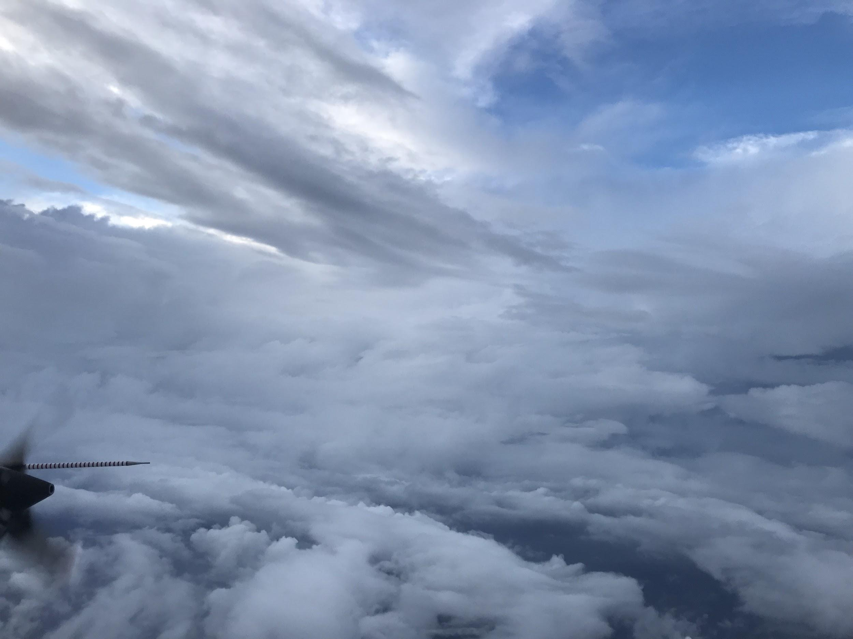


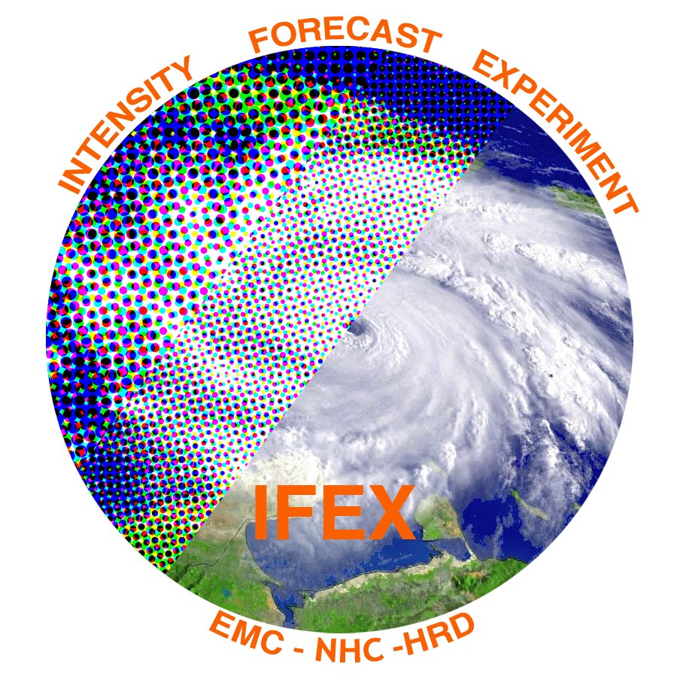
2018 NOAA/AOML/HRD Hurricane Field Program
Intensity Forecast Experiment (IFEX)
AL03/Chris Debrief

Slide 2
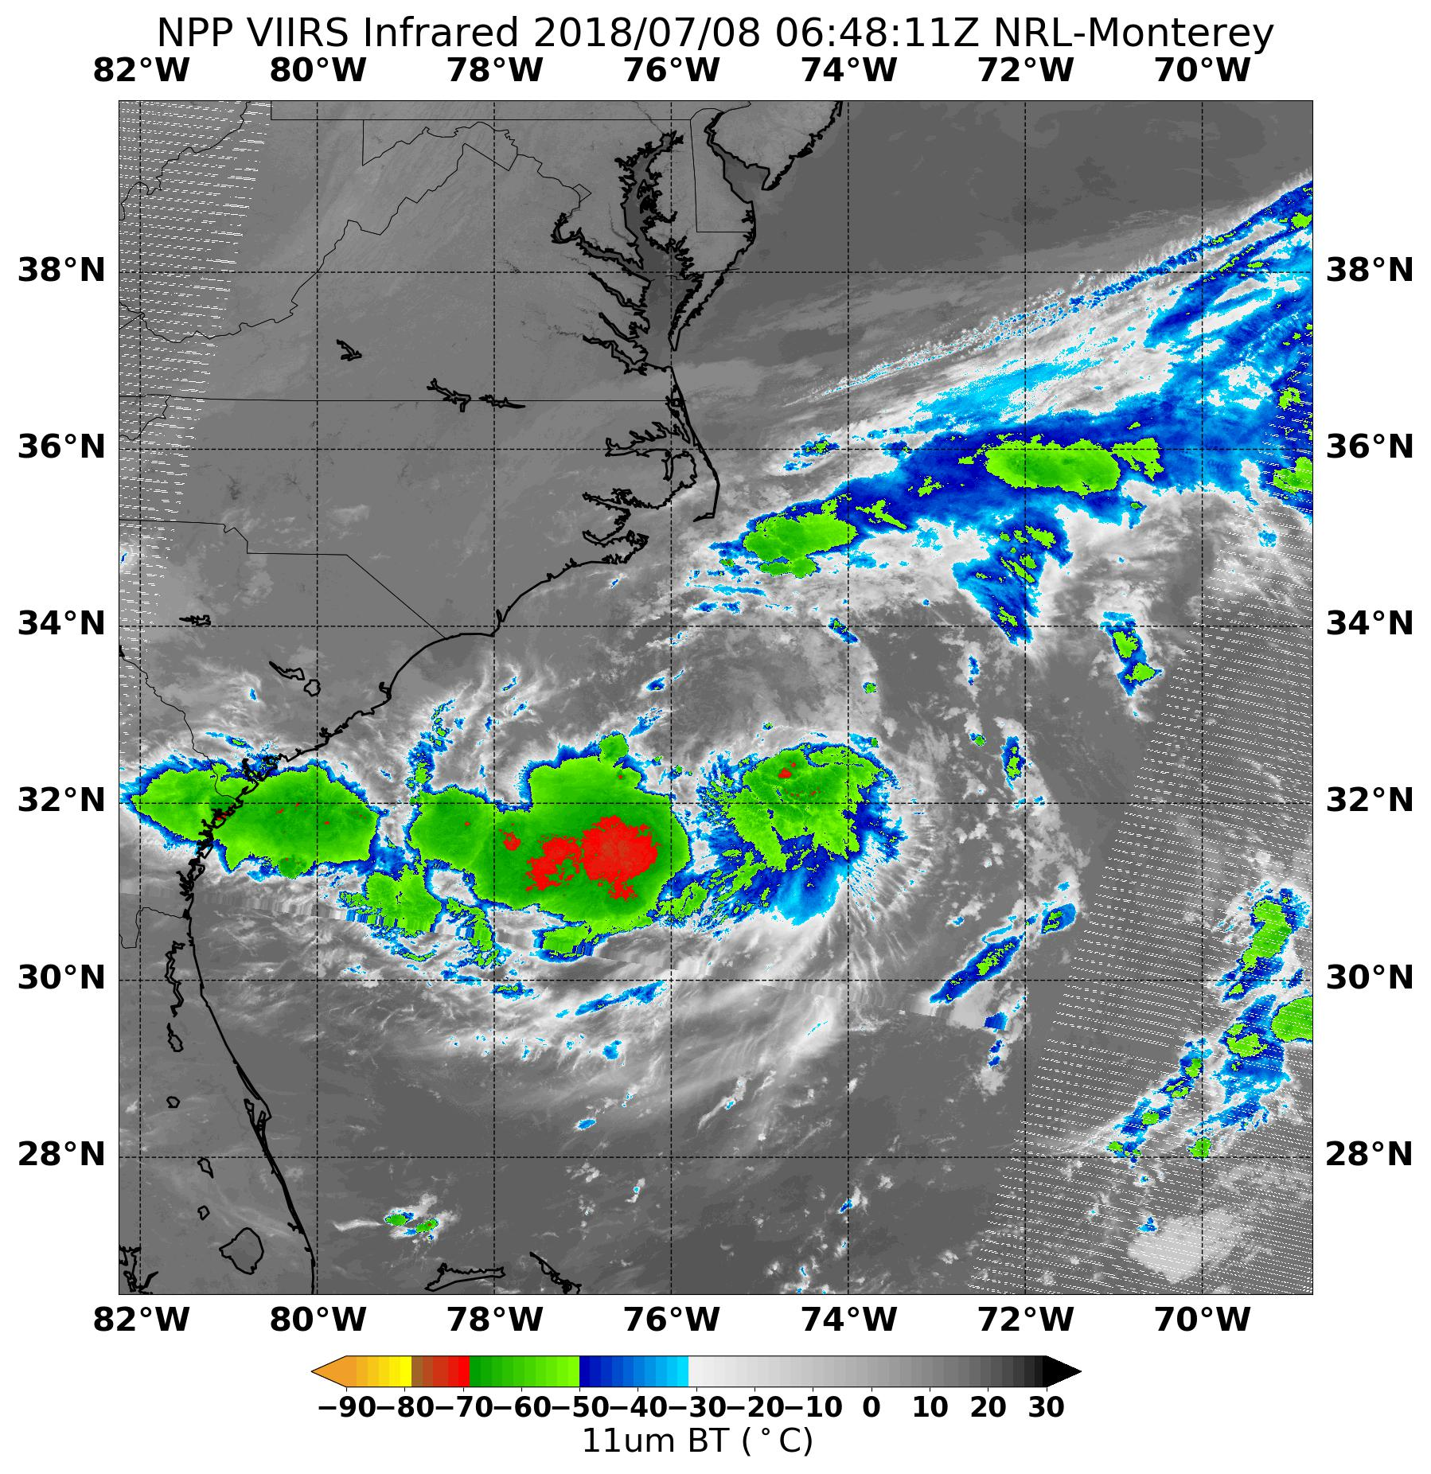
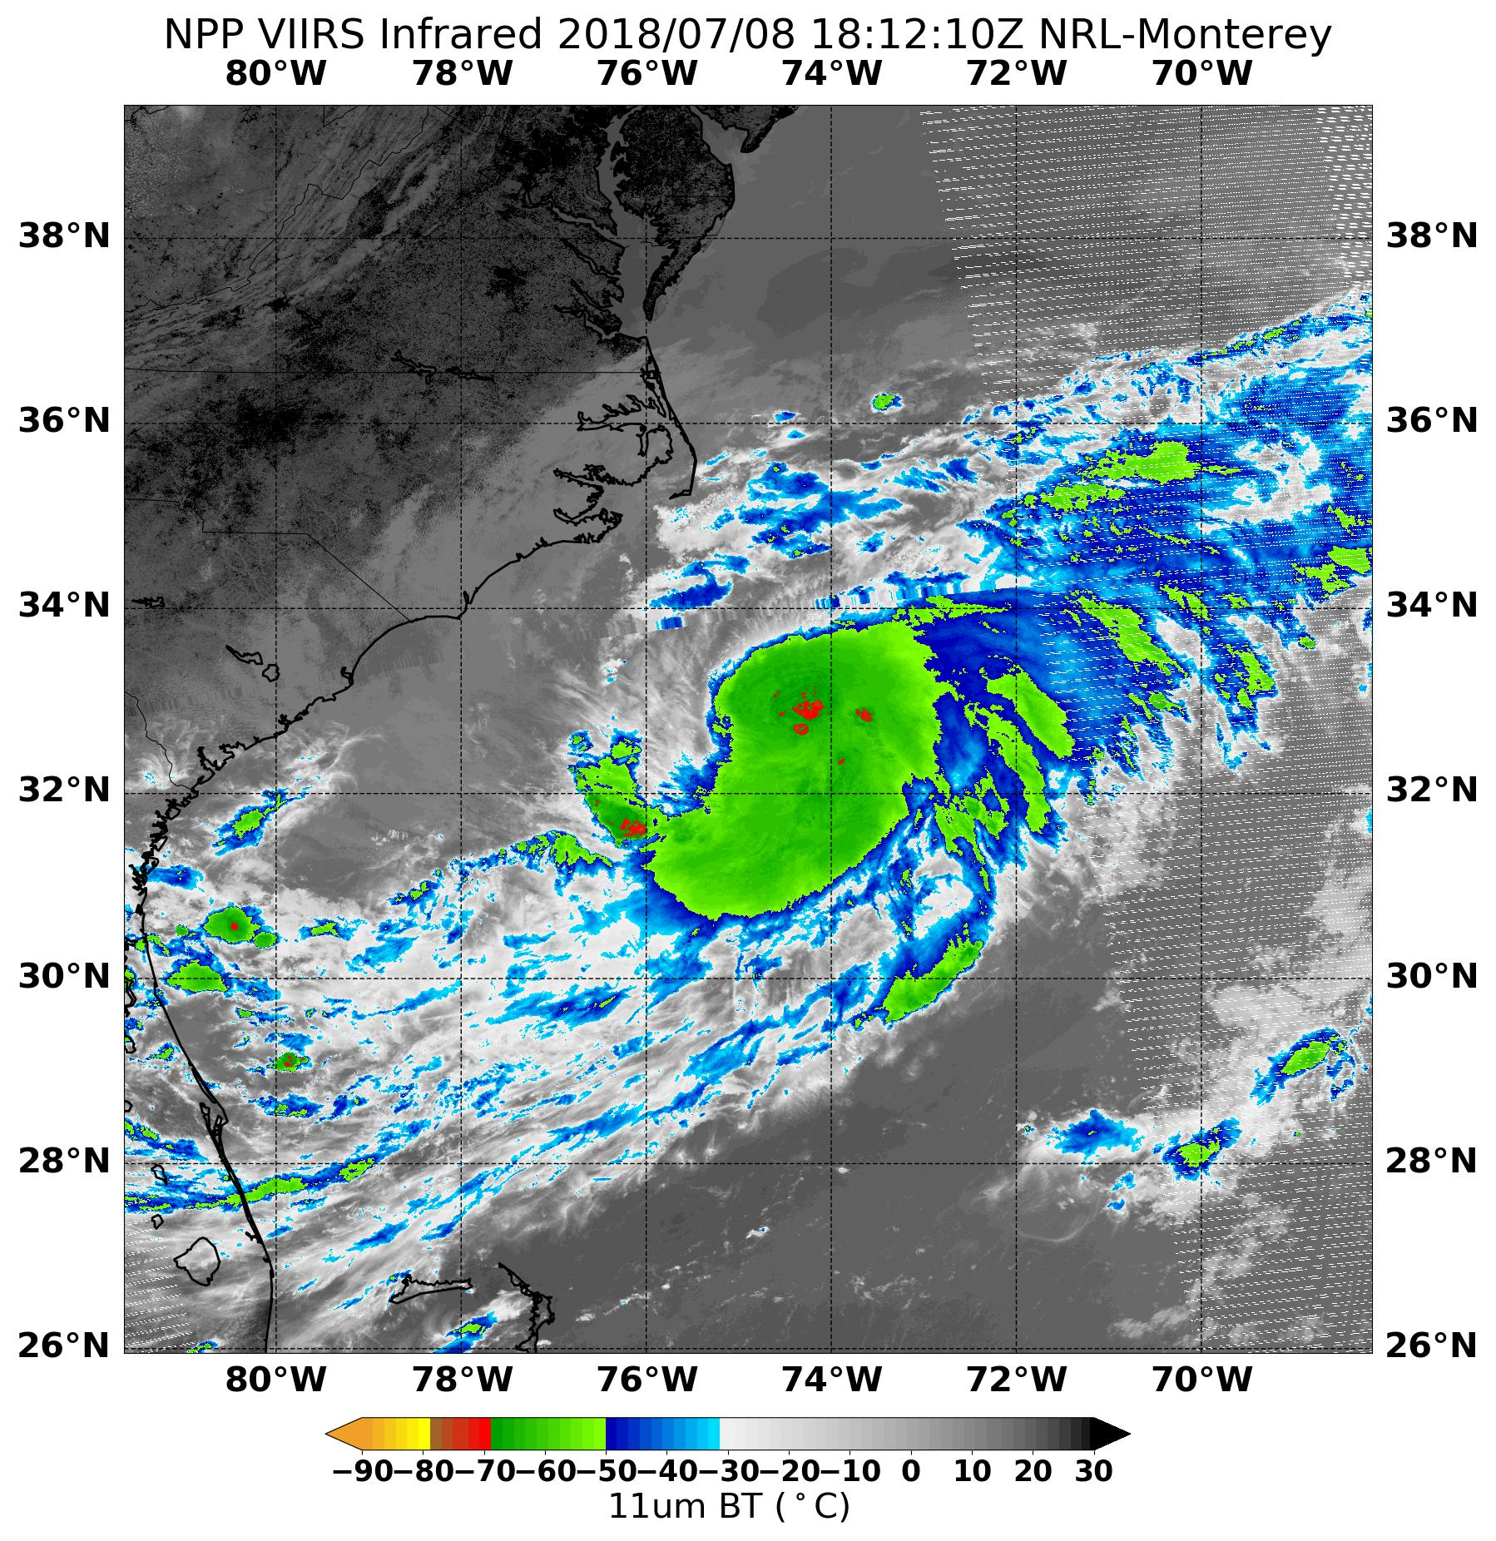
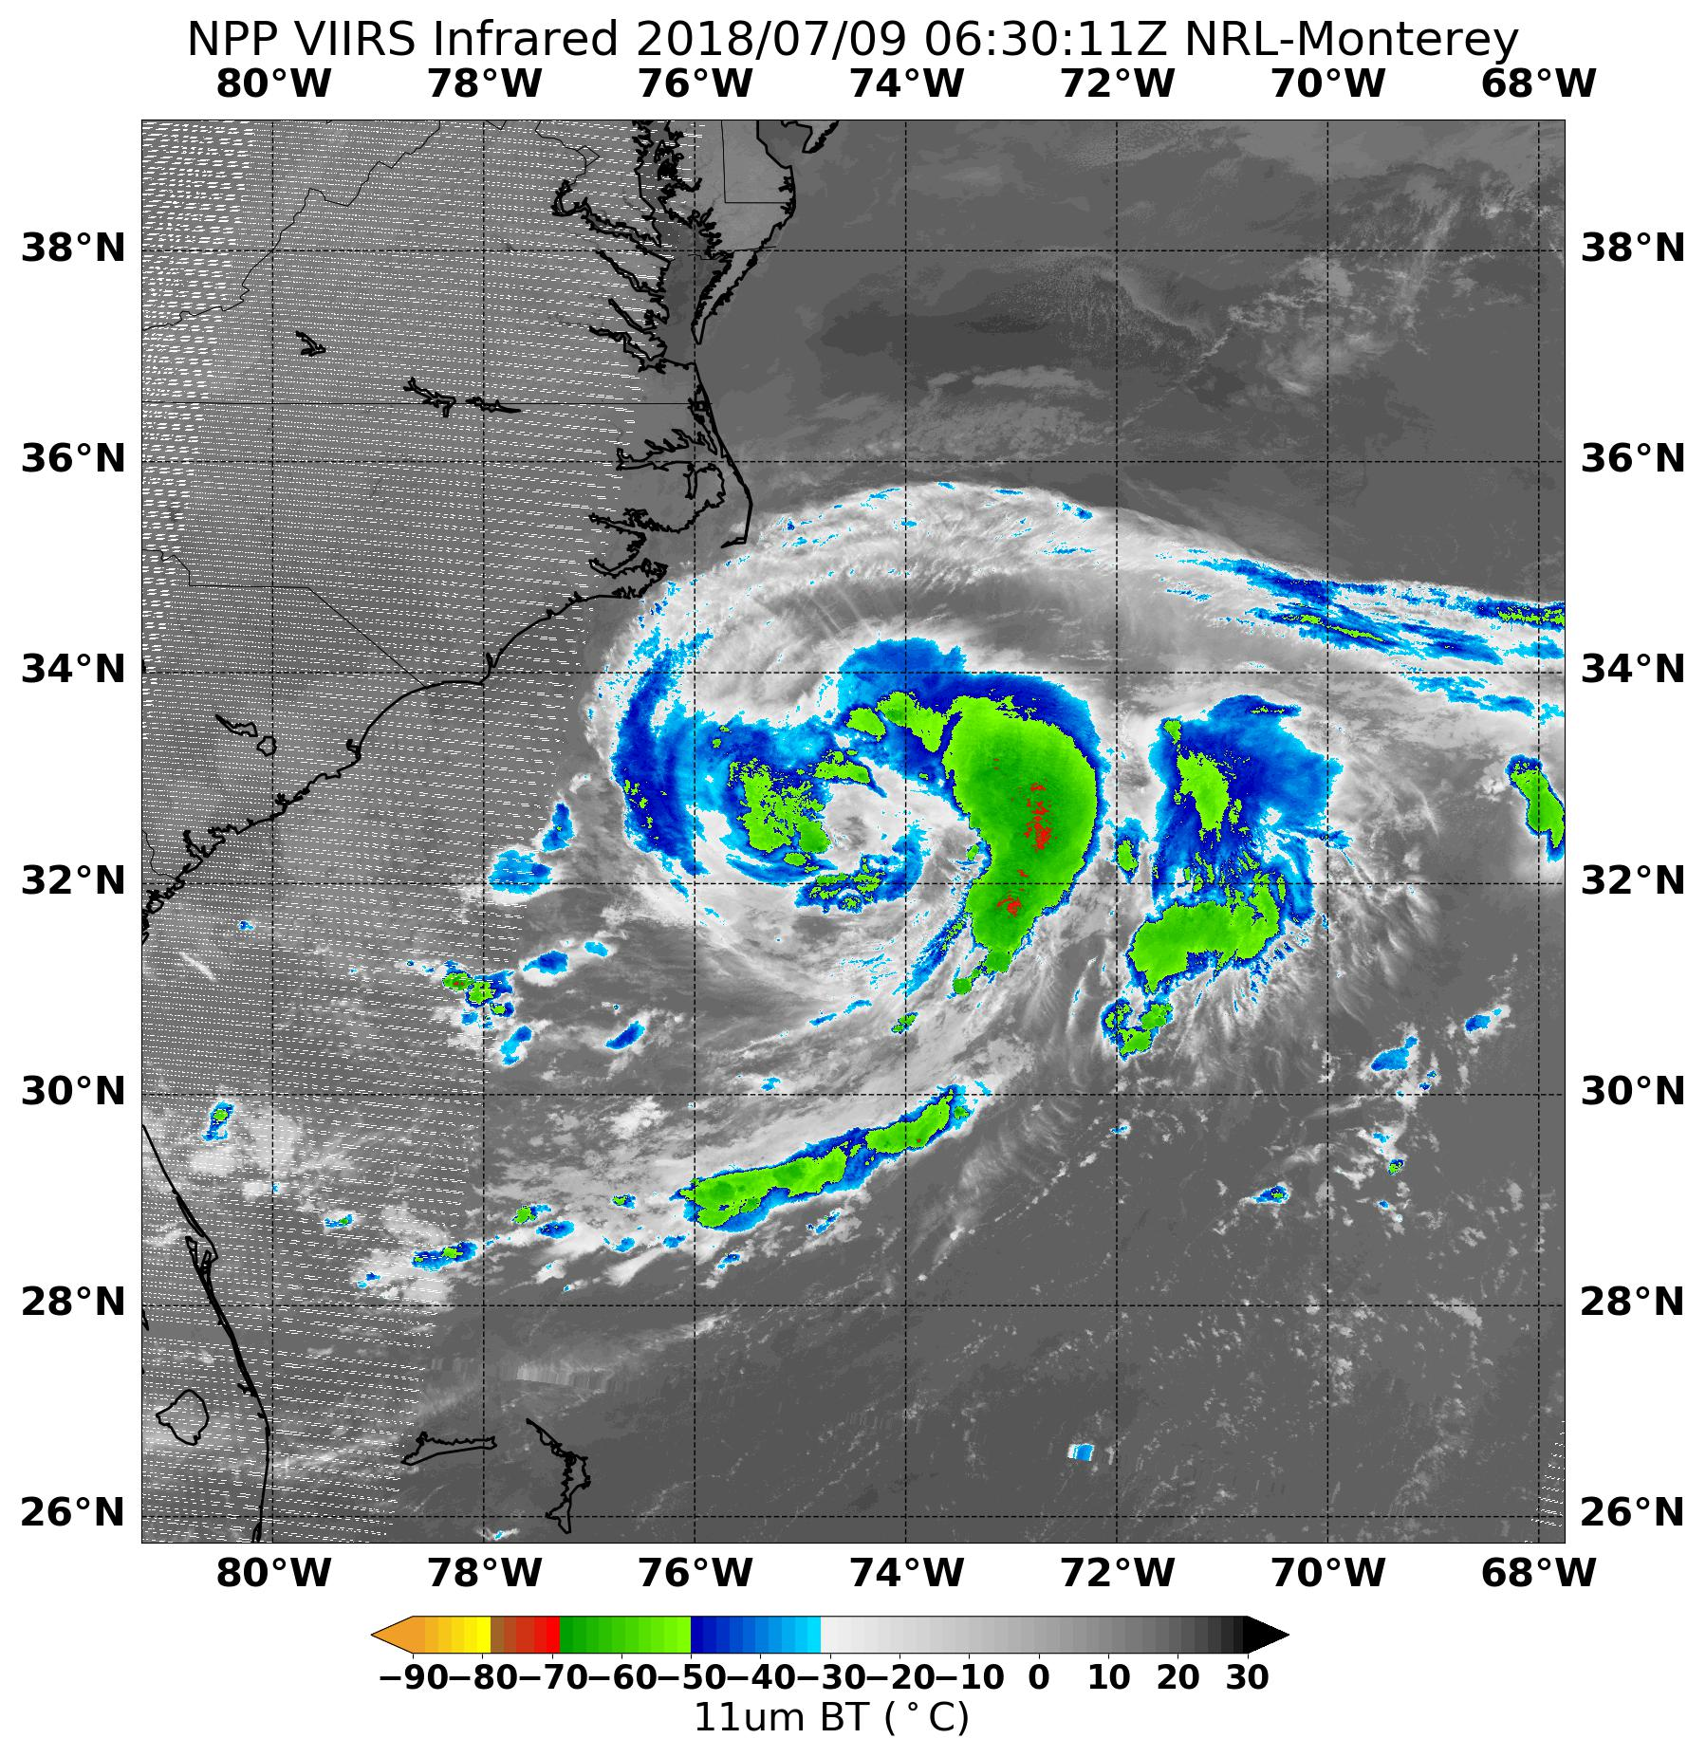
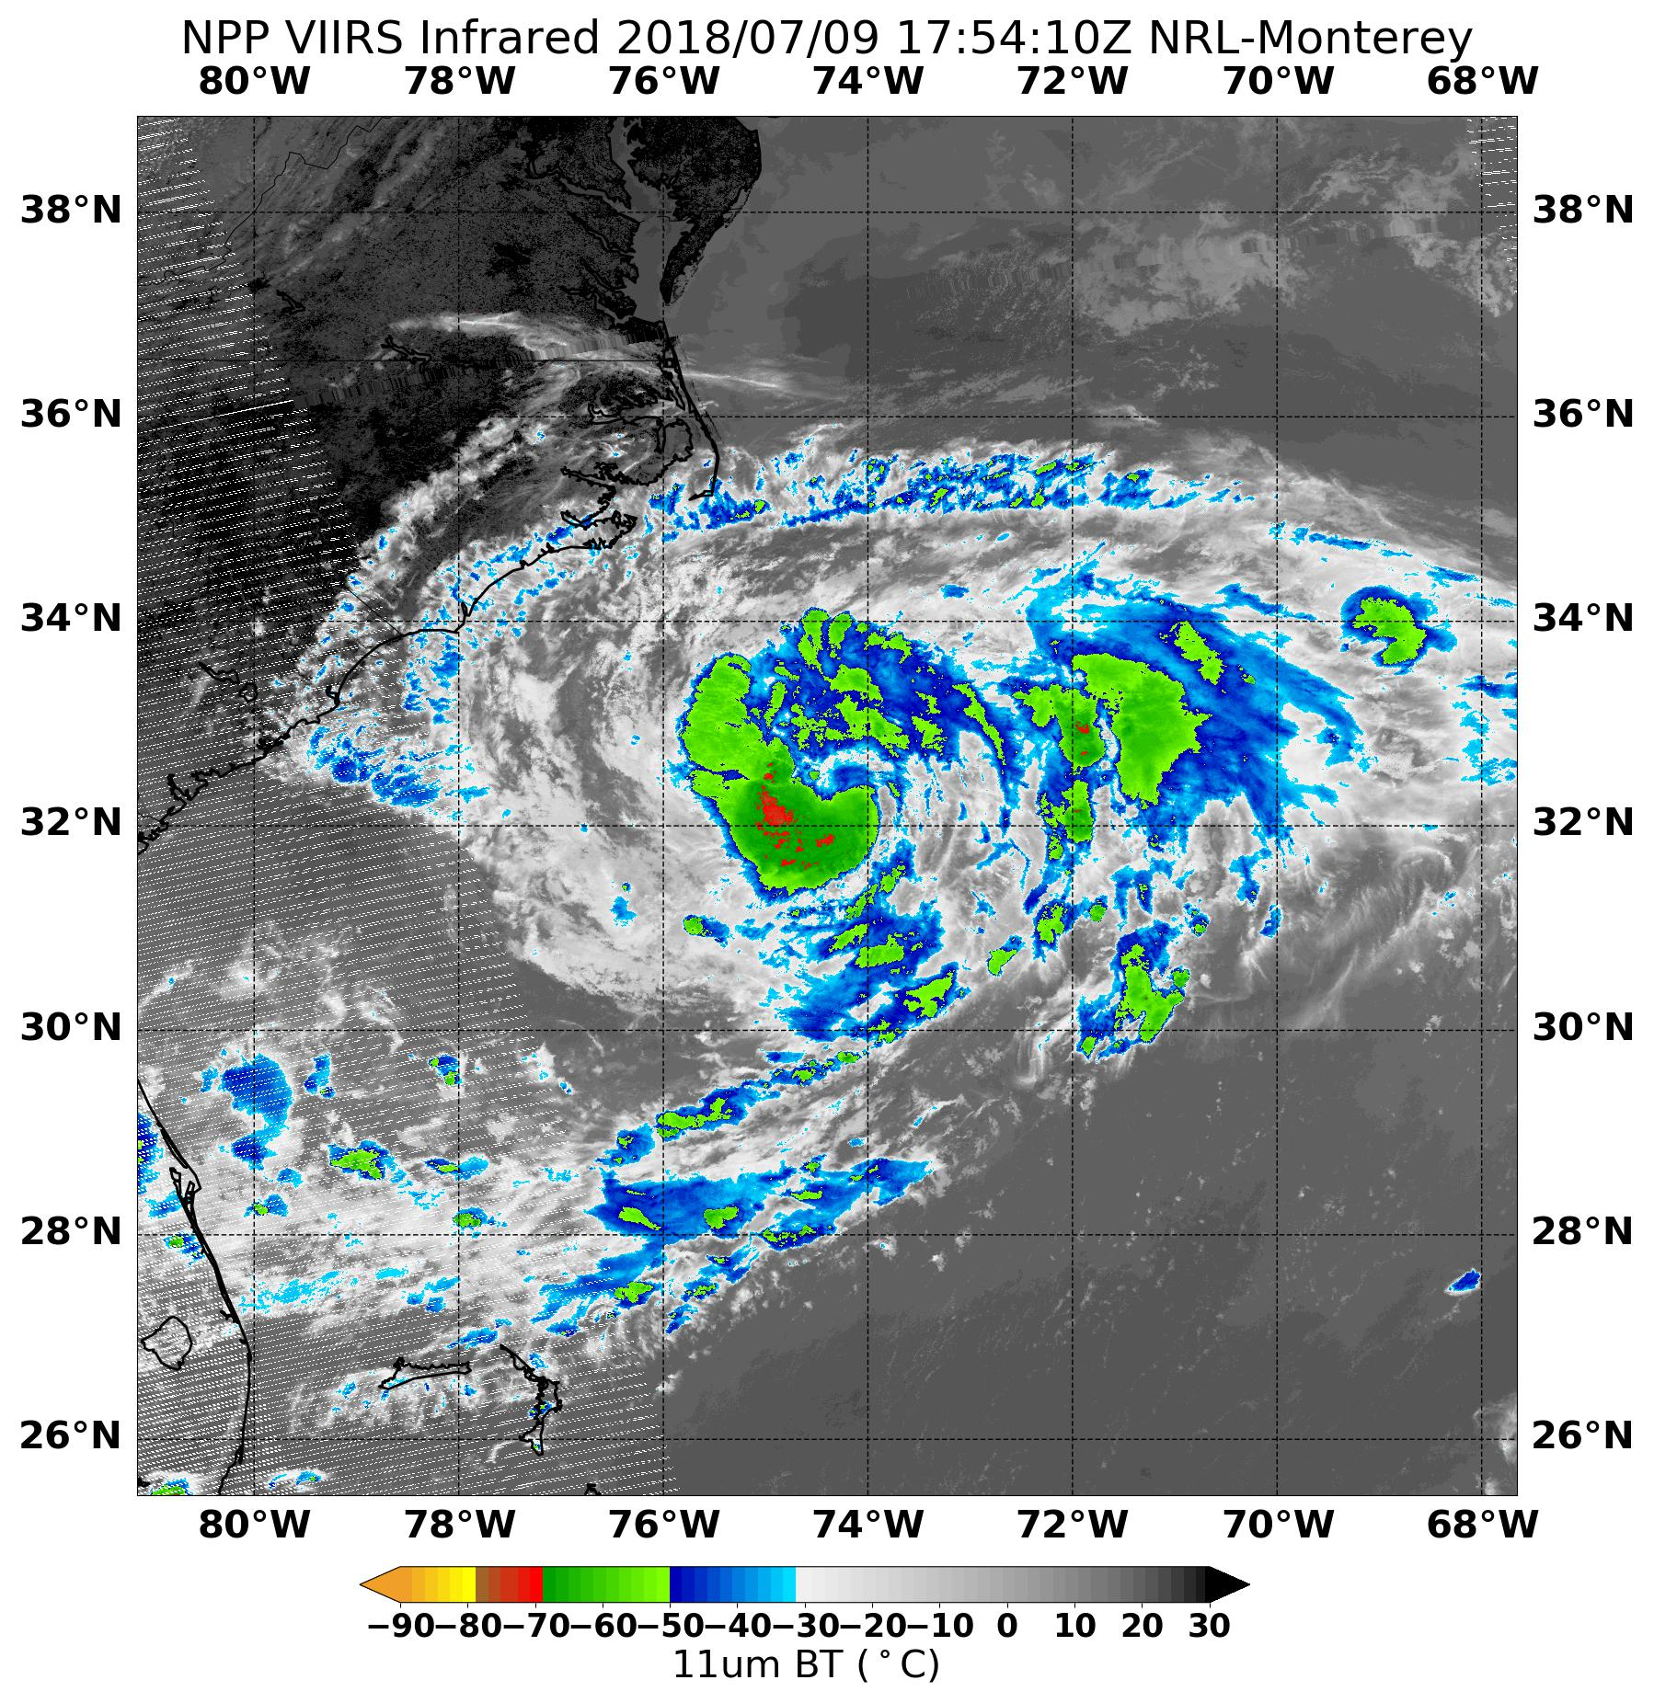
2018 NOAA/AOML/HRD Hurricane Field Program
Intensity Forecast Experiment (IFEX)
AL03/Chris Debrief
July 9-10
Missions Overview
180708H1 (Kelly Ryan)
180708H2 (Hui Christophersen)
180709H1 (Kelly Ryan)
180709H2 (Gus Alaka)
4 EMC-tasked Missions
Agenda
30 P-3 Flight Hours
55 Drops

Slide 3
2018 NOAA/AOML/HRD Hurricane Field Program
Intensity Forecast Experiment (IFEX)
AL03/Chris Debrief
Purpose:
EMC-tasked data collection targeting 00 UTC and 12 UTC HWRF cycles
Test assimilation after H218 implementation, 7/9 at 12 UTC
Shakedown for the season
Possibly get a look at the MMR (new lower fuselage radar)
Target:
TD 3 / Tropical Storm Chris as it was slowly intensifying off the coast of the Carolinas
Mission Timeline:
08 July (Sun): 0430 L, 1930 L (Delayed from 1630 L Takeoff) Mission
09 July (Mon): 0430 L, 1630 L Missions
7 53rdWRS Missions between 07/15Z and 10/18Z

Slide 4
2018 NOAA/AOML/HRD Hurricane Field Program
Intensity Forecast Experiment (IFEX)
AL03/Chris Debrief
Mission Highlights:
All TDR data transmitted successfully
180708H1, 180708H2 sondes transmitted, issue with 180709H1, 180709H2
After H218 implementation, WMO messages required a semicolon (tested 180709H2)
No DWL; WSRA collected on each mission, though hardware difficulties led to some outages on 180709H1 and 180709H2
Progress was made on the implementation of new Multi-mode Radar (MMR) (replacement for the lower fuselage), thanks to the work by AOC and engineers from Harris and Elta onboard 180709H1
Research-worthy case within the “Early Stage Experiment”, Objective #1: AIPEX
Partial high-altitude circumnavigation accomplished, some of it in precipitation
Slowly intensifying storm in moderate shear (no motion to worry about!)

Slide 5
2018 NOAA/AOML/HRD Hurricane Field Program
Intensity Forecast Experiment (IFEX)
AL03/Chris Debrief
Deployment Notes:
Thanks to all HRD and AOC crews for overcoming many challenges, particularly the crew on 180708H1 and P-3 maintenance for getting 180708H2 off the ground
Able to get Erin, Miguel, and Tyler onboard
Thanks to Frank and Sim, allowed us to train Kelly, Hui, and Gus at LPS
John Gamache, Paul Reasor, and Nancy Griffin on the ground radar processing
No safety issues
Data download procedures forthcoming
Use of HFP Document Repository
My first deployment as FPD -- any comments/suggestions for me?

Slide 6
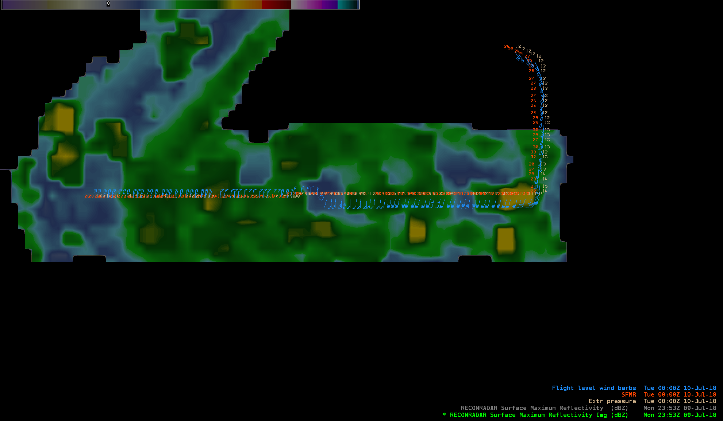
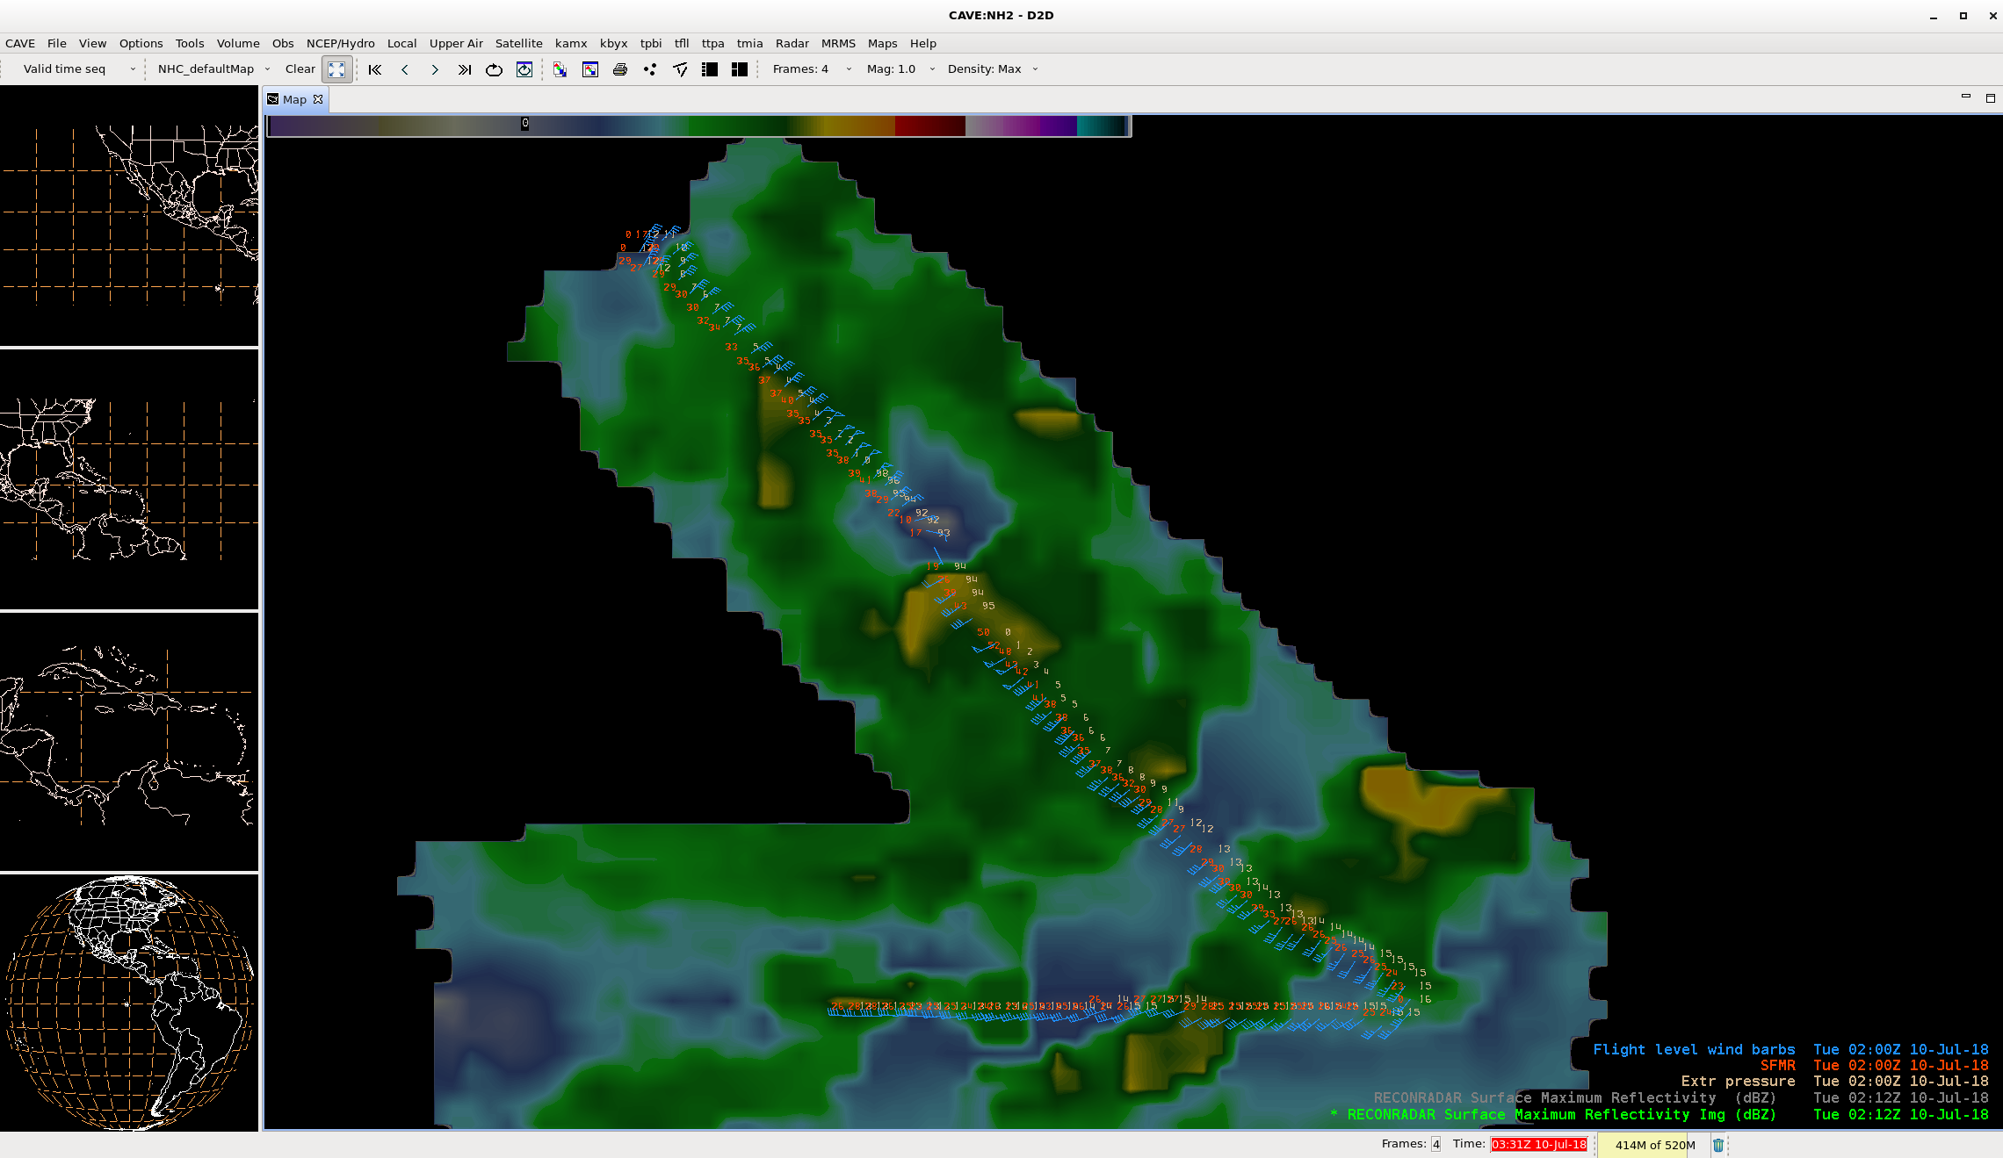
2018 NOAA/AOML/HRD Hurricane Field Program
Intensity Forecast Experiment (IFEX)
NOAA WP-3D TDR is now in AWIPS-II
AL03/Chris Debrief
AWIPS-II is NHC’s new display software
TDR data will now ingest and display in AWIPS-II from AOC in near-real-time
20180709H2 sample:
Max reflectivity
Flight-level data
Huge thanks to
Chris Mello (NHC)
John Gamache (HRD)

Slide 7
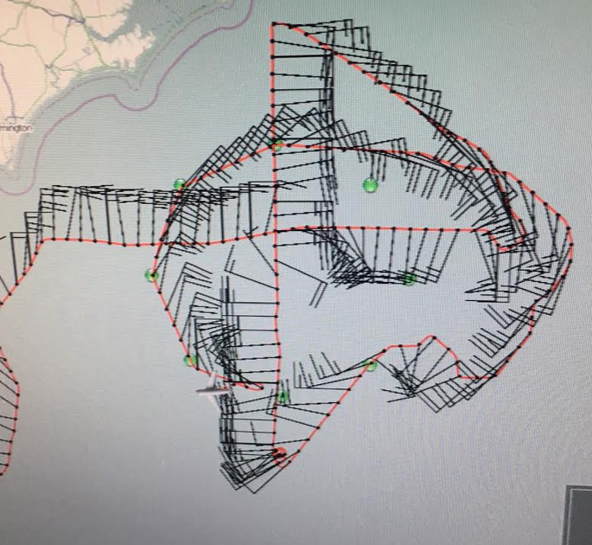
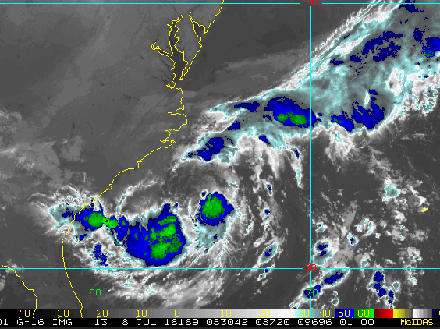
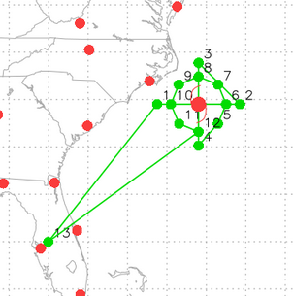
20180708H1 AL03 Chris “Shake-n-bake” TDR Tasking
LPS: Ryan
Radar: Aberson
Dropsonde: Annane
Ground Radar: Gamache/Griffin
Observer: Miguel Cortez
Latest TC specs at takeoff time
(TEAL): Vmax: 40 kts; Motion: 0 kts
SHIPS VWS: 15 kts @ 327
Take off: 833 UTC, Landing: 1703 UTC
Flight pattern plan: 1 figure-4 @ 8kft with endpoints and 1 center sonde followed by circumnavigation @ 20kft with sondes every 45° (storm relative) along 70 nautical mi. radius

Slide 8
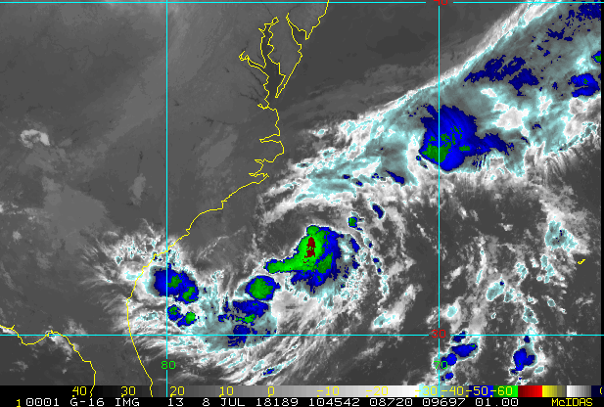
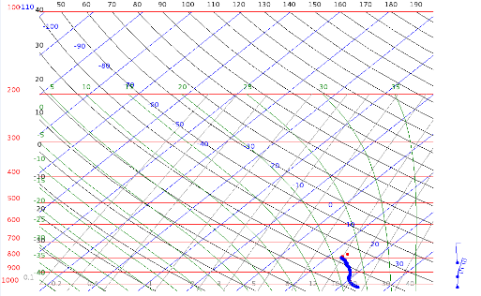
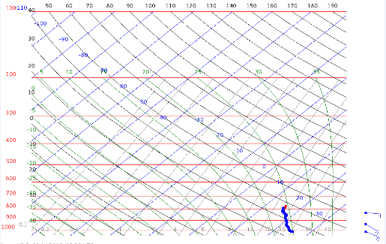
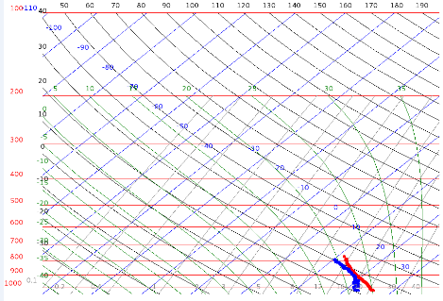
Figure-4: 1st pass (8000 ft)
IP Time: 1011 UTC
Final endpoint time: 1257 UTC
Notes:
Sonde 1 (W) and 2 (C) indicated RH values 100% to the surface
Hunted for center (could not find one along 1st pass trajectory)
→ found FL center located further south while avoiding new convection
Sonde 3 (E) deployed just outside new band of convection
→ very turbulent here
X
X
X
(W) 1011 UTC
(C) 1044 UTC
(E) 1111 UTC

Slide 9
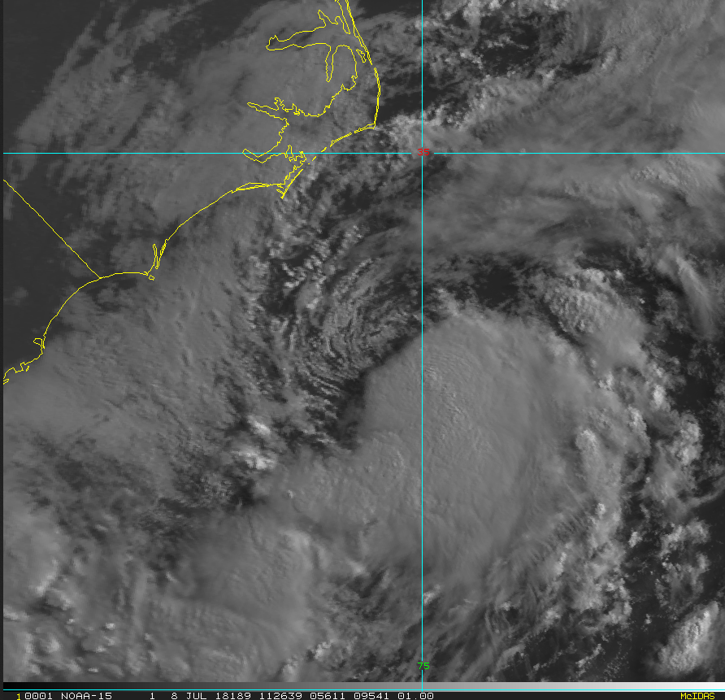
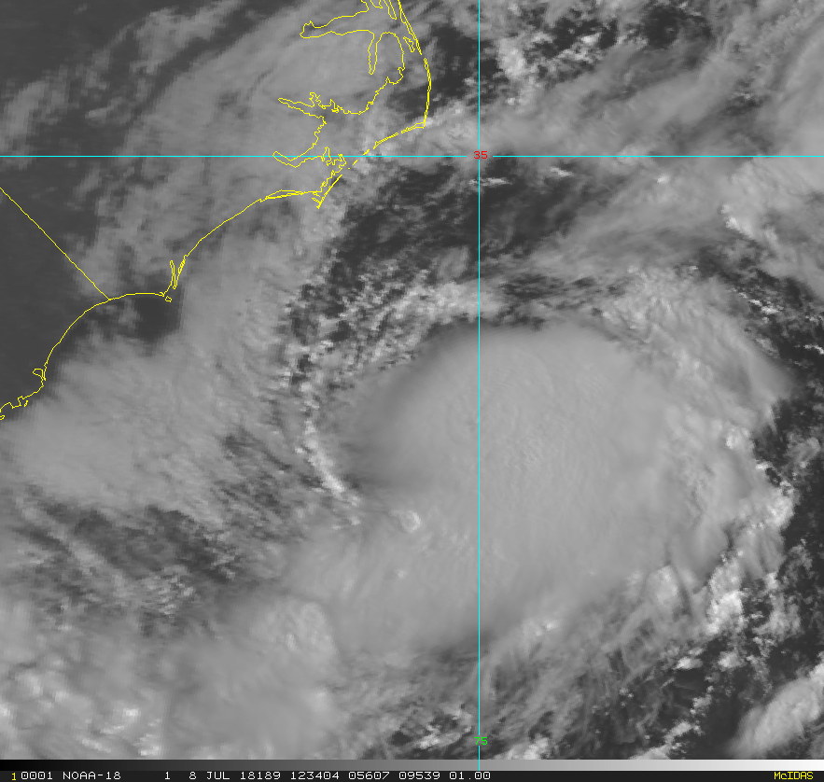
X
X
X
During downwind leg
During center fix

Slide 10
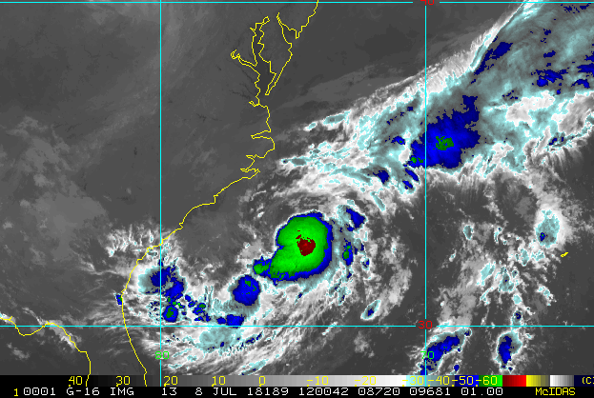
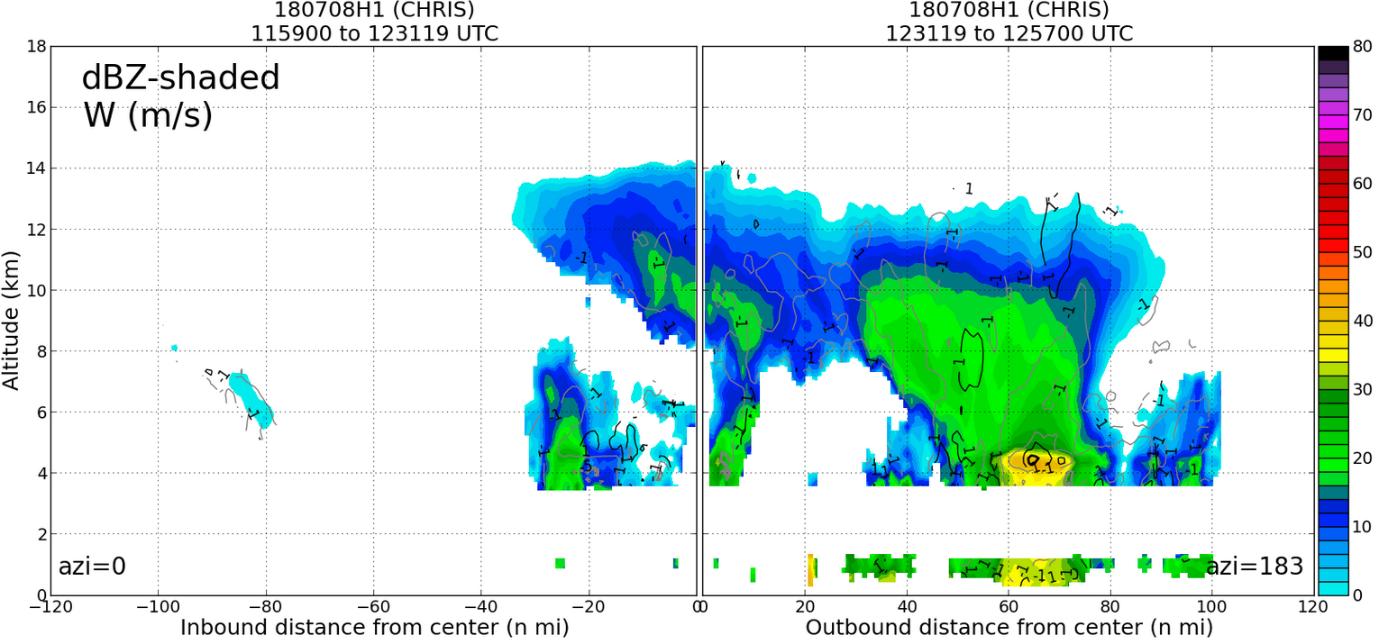
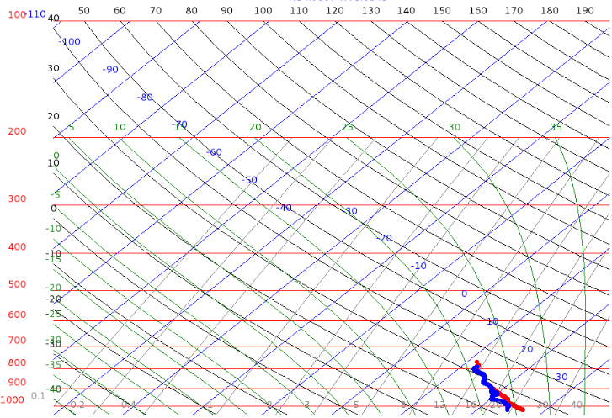
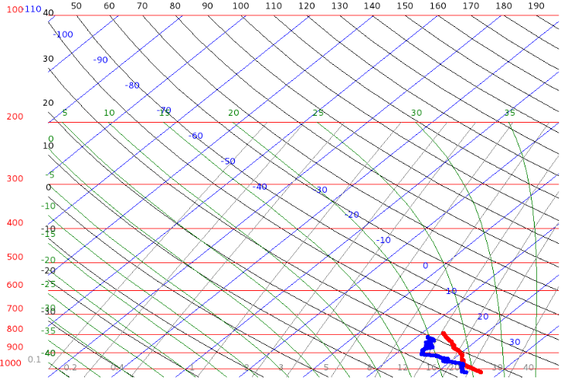
Figure-4: 2nd pass (8000 ft)
IP Time: 1011 UTC
Final endpoint time: 1257 UTC
Notes:
Sonde 4 (N) consistent with sondes 1 & 2 with RH near 100% to surface
Cirrus shield develops in east/south quadrants during this 2nd pass
X
X
X
(N) 1158 UTC
(S) 1257 UTC

Slide 11
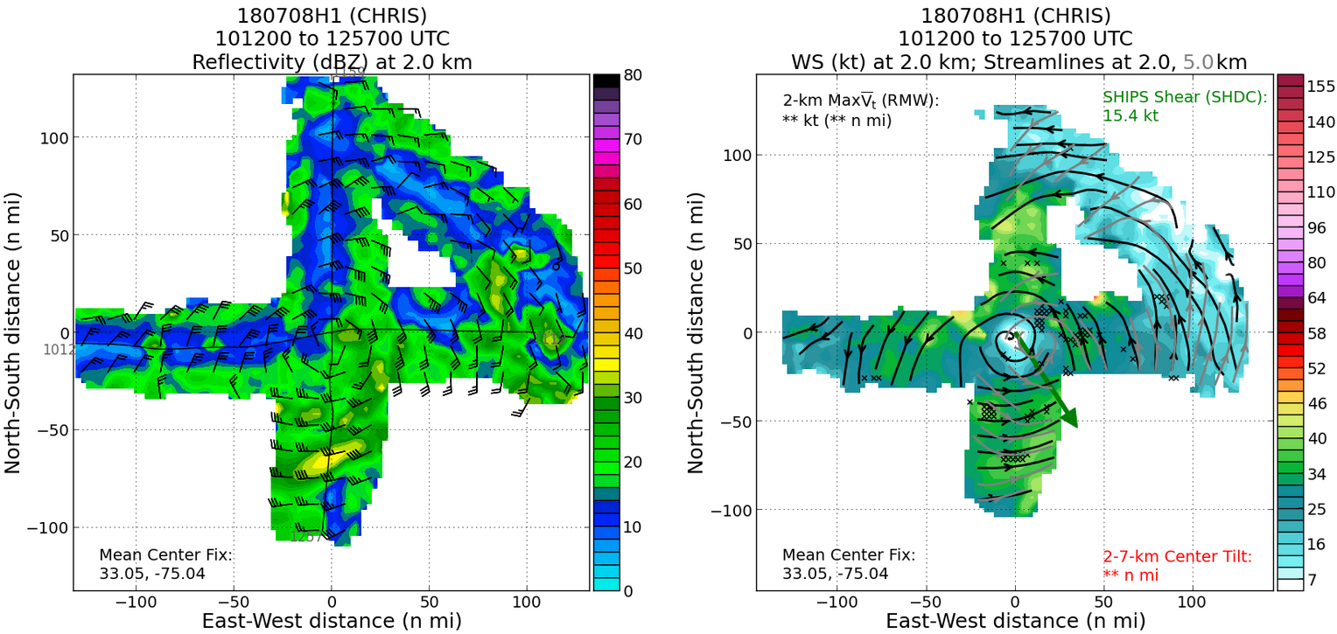
Figure-4 (8000 ft)

Slide 12
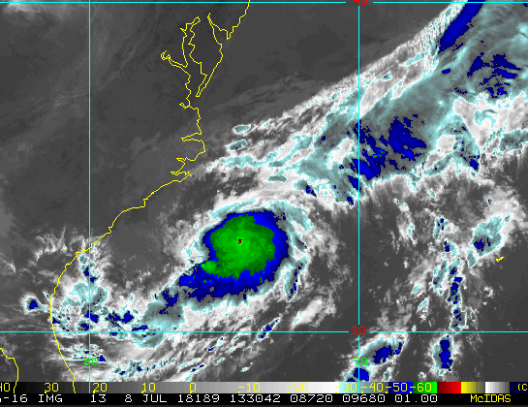
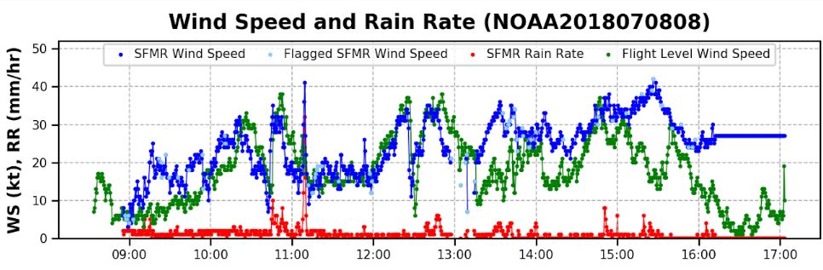
Circumnavigation (20000 ft)
X
X

Slide 13
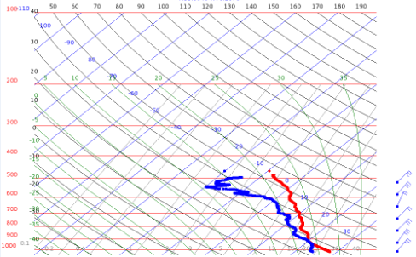
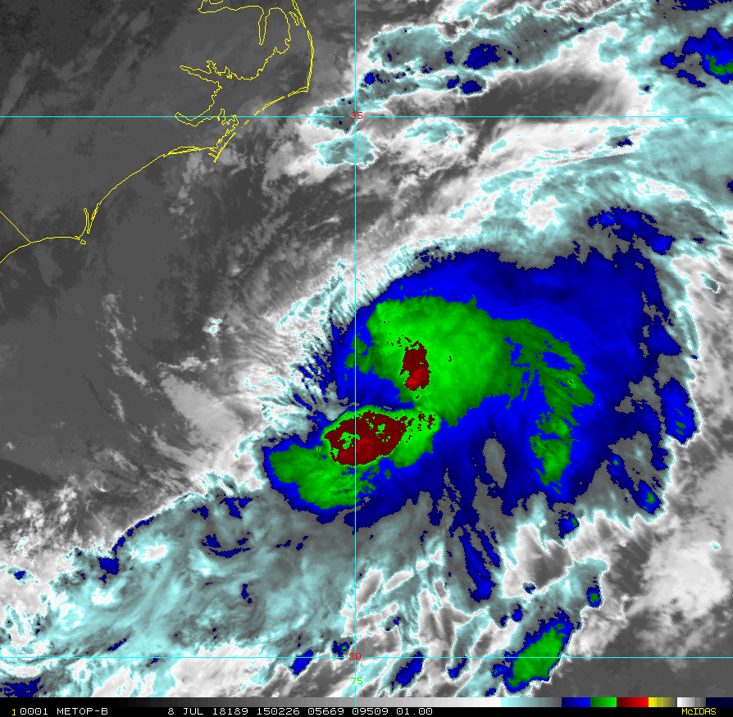
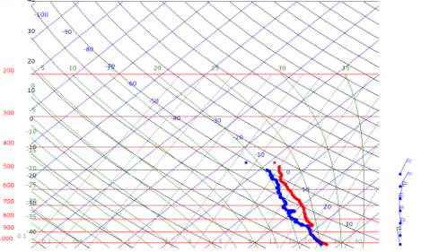
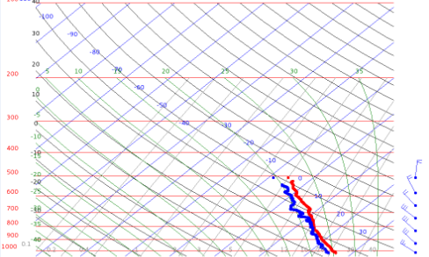
(NW) 1456 UTC
X
X
X
X
(W) 1506 UTC
X
X
X
X
(SW) 1516 UTC

Slide 14
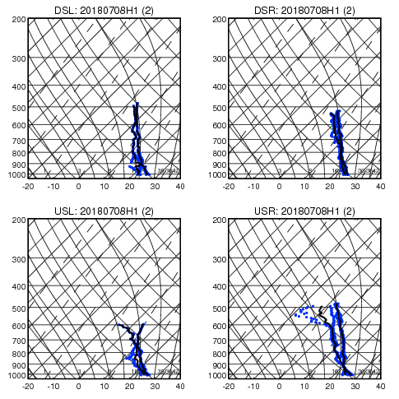
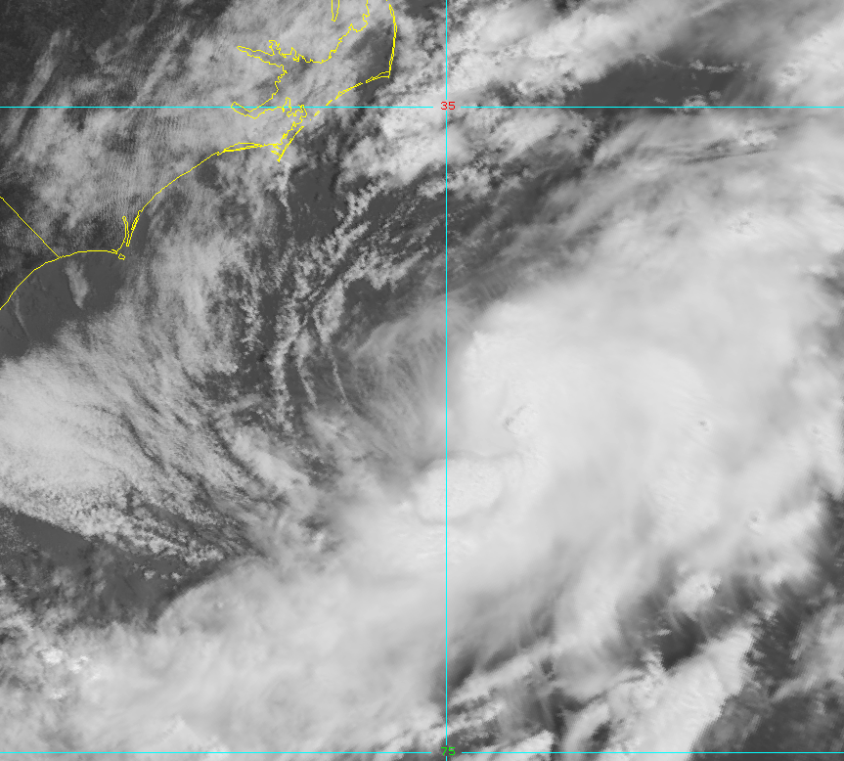

Slide 15
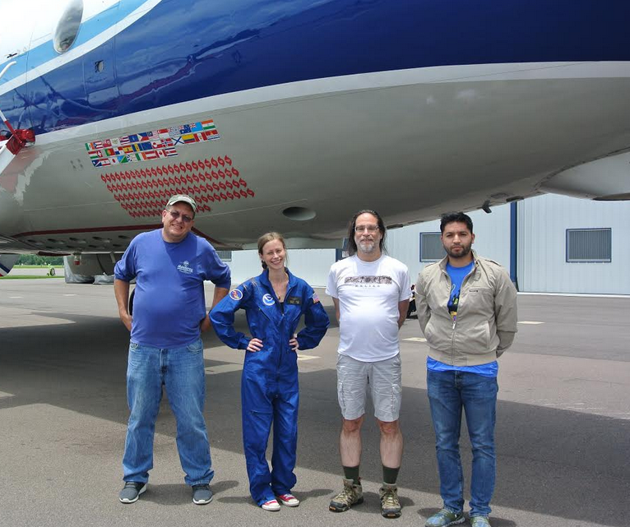
Observer Experience: Miguel Cortez
“The thing that surprised me the most was the amount of information that can be extracted from the flight”
“Propellers have huge advantages, for instance they are able to deliver "power on demand" since the propeller can change its angle as it spins "biting more air" as opposed to the turbine that has to wait to compress the air, resulting in a delay for a change in velocity.”

Slide 16
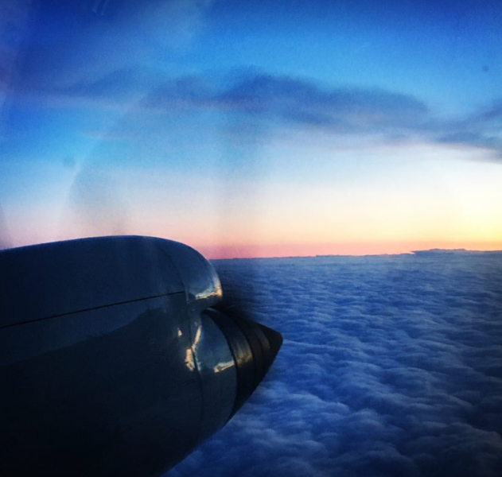
Summary of Shake-n-Bake
General
Peak FL winds: 47 kts
Peak SFMR winds: 40 kts
MSLP: 1006 mb
Estimated RMW: 60 nautical miles (highly asymmetric)
Center became better defined throughout flight and convection began near the RMW in the south and eastern quadrants
1st high-altitude circumnavigation with P-3
Problems
Numerous workstation issues: disks were swapped multiple times (BIG THANKS to Mike Mascaro) and scientists sat in different seats throughout the entire flight
ASPEN not available on any workstations other than FD: multiple attempts to download from website, ended up copying to USB drive and putting on sonde processing workstation (not most recent version so bugs were encountered)
MMR unusable for situational awareness
When copying to external disk, jobfiles too big to transfer: these were remade smaller to be copied over
Problem de-icing wings; needed to descend for a portion of the circumnavigation
Expendables
13 dropsondes

Slide 17
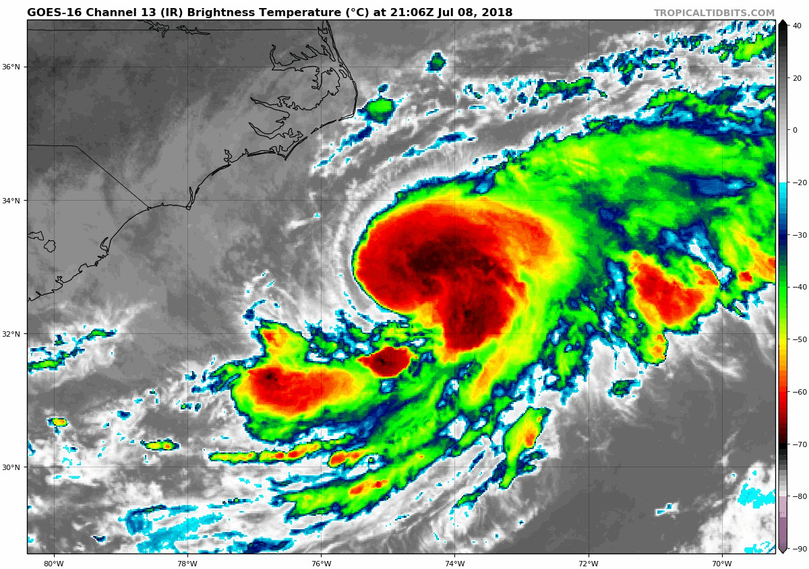
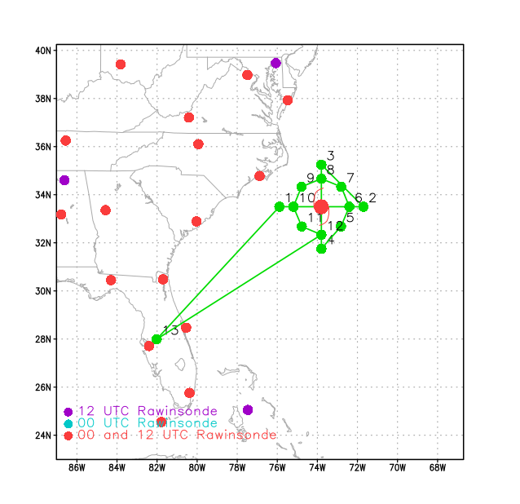
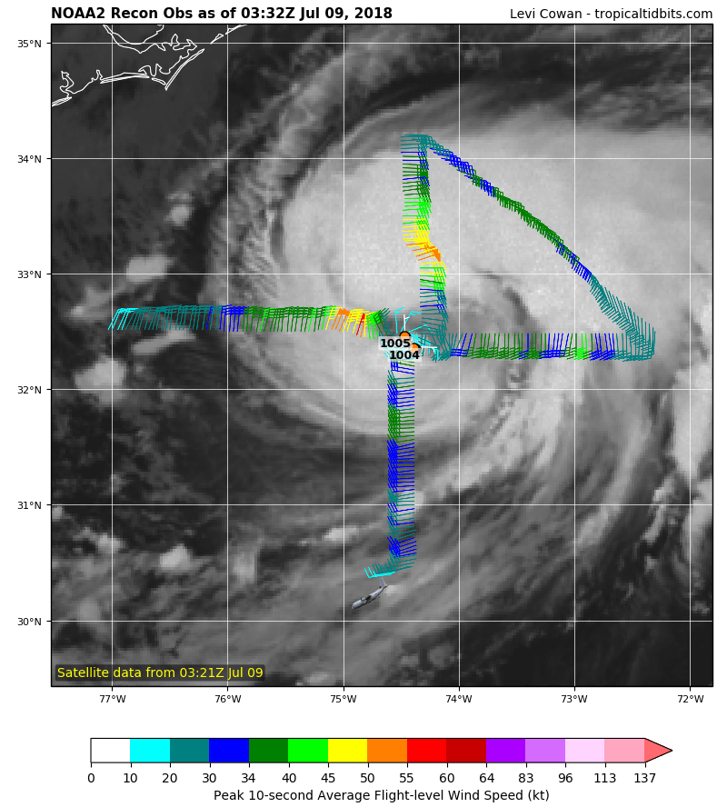
2018 NOAA/AOML/HRD Hurricane Field Program
Intensity Forecast Experiment (IFEX)
AL03/Chris Debrief
LPS: Christophersen
Radar: Marks
Drops: Alaka
Ground Radar: Reasor
Hollings: Jones
Mission 2: 20180708H2 (EMC-Tasked TDR)
Takeoff: 2332 UTC, Landing: 0452 UTC
Pattern: Single Figure-4, 8 kft radar alt.
Drops: 2 centers and 4 endpoints
AXBTs: None
2 center fixes
45 kt / 1008 mb
MOTION 0 kt
SHIPS SHR WSW 17 kt
IP ARRIVAL 0044Z
Takeoff delayed ~ 3 h due to mechanical issues

Slide 18
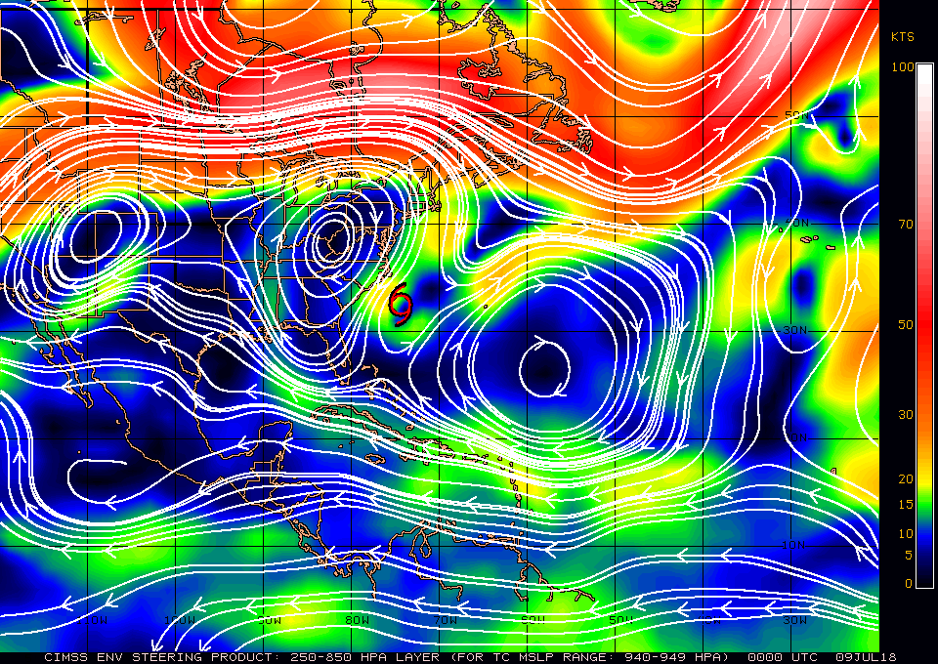
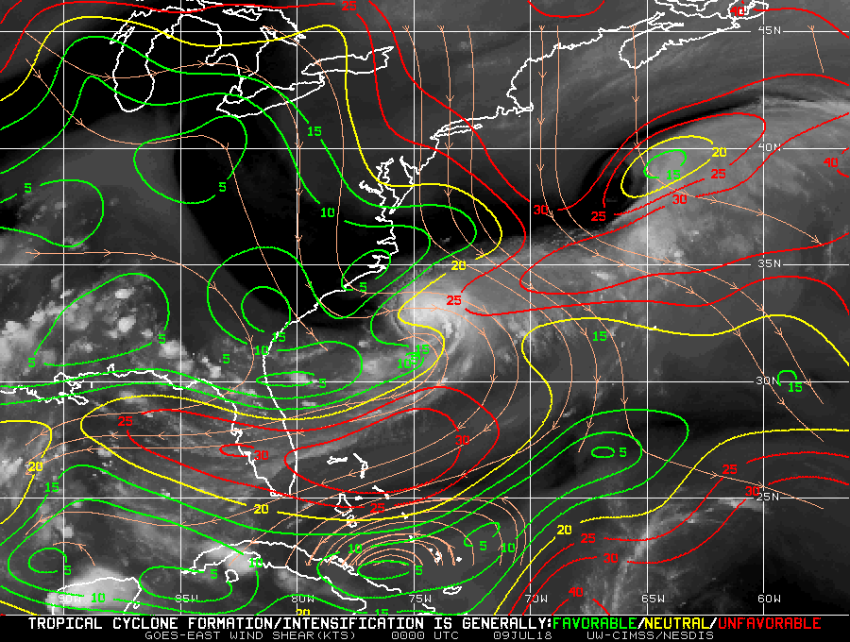
2018 NOAA/AOML/HRD Hurricane Field Program
Intensity Forecast Experiment (IFEX)
AL03/Chris Debrief
Mission 2: 20180708H2 (EMC-Tasked TDR)
200-850mb deep layer mean (07/09 00Z)
Deep shear (07/09 00Z)
TS Chris MOTION: 0 kt
Figure credit: CIMSS

Slide 19
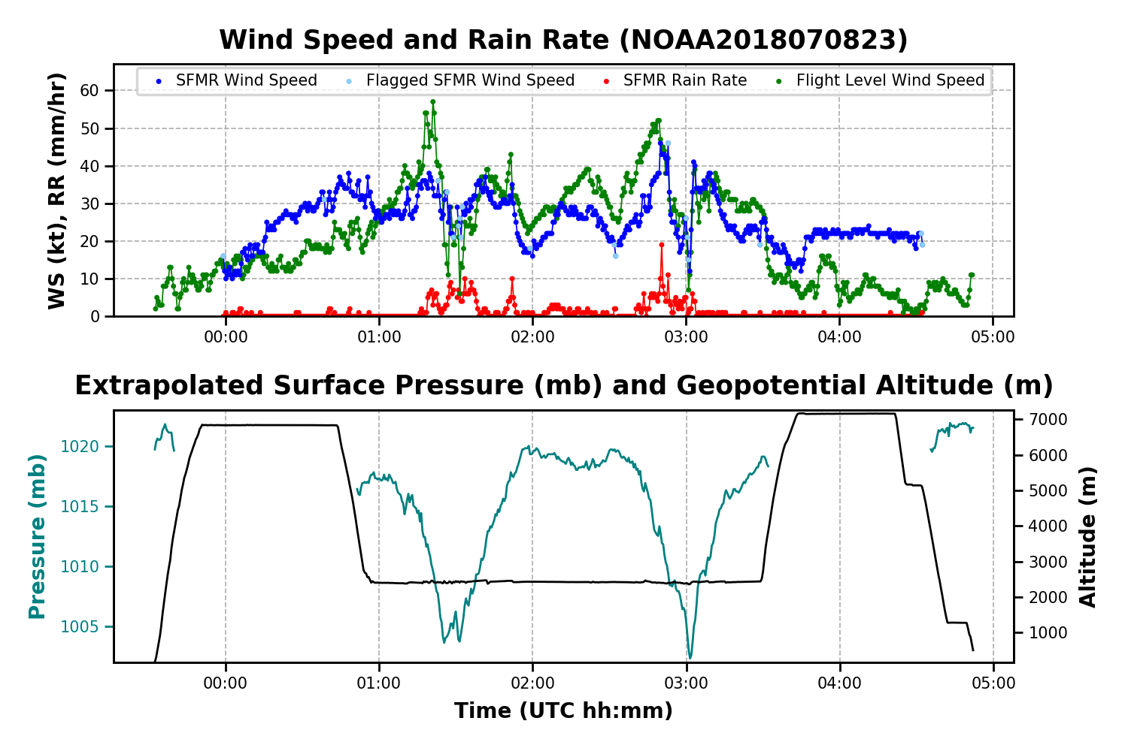
2018 NOAA/AOML/HRD Hurricane Field Program
Intensity Forecast Experiment (IFEX)
AL03/Chris Debrief
Mission 2: 20180708H2 (EMC-Tasked TDR)
The highest flight level winds was 57 kt
Figure credit: Heather Holbach

Slide 20
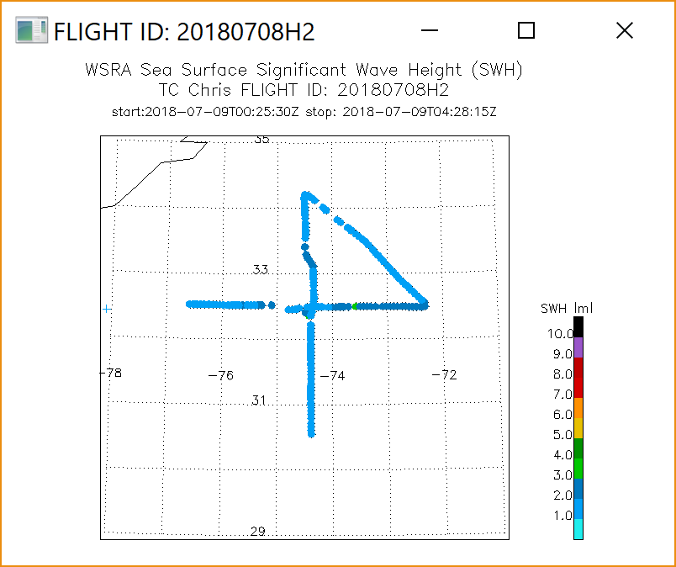
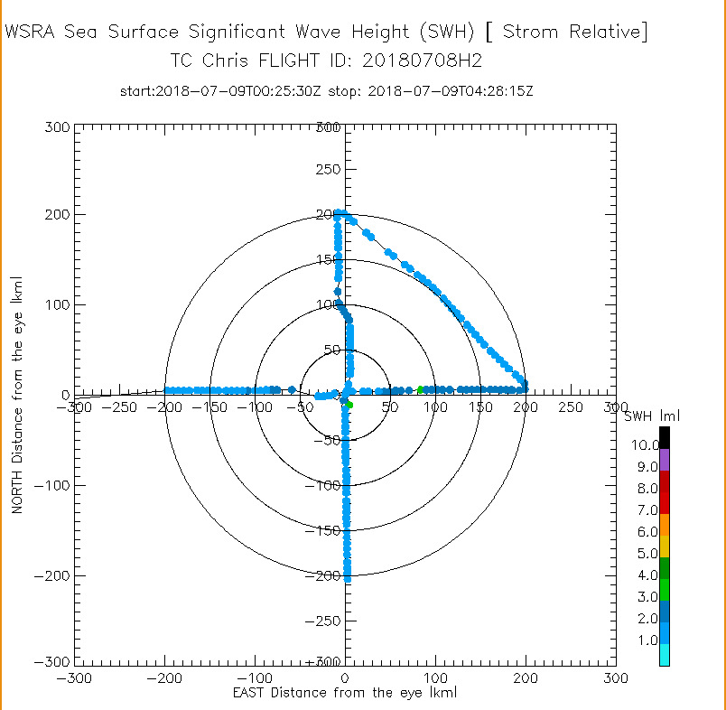
2018 NOAA/AOML/HRD Hurricane Field Program
Intensity Forecast Experiment (IFEX)
AL03/Chris Debrief
Mission 2: 20180708H2 (EMC-Tasked TDR)
Figure credit: Ivan PopStefanija

Slide 21
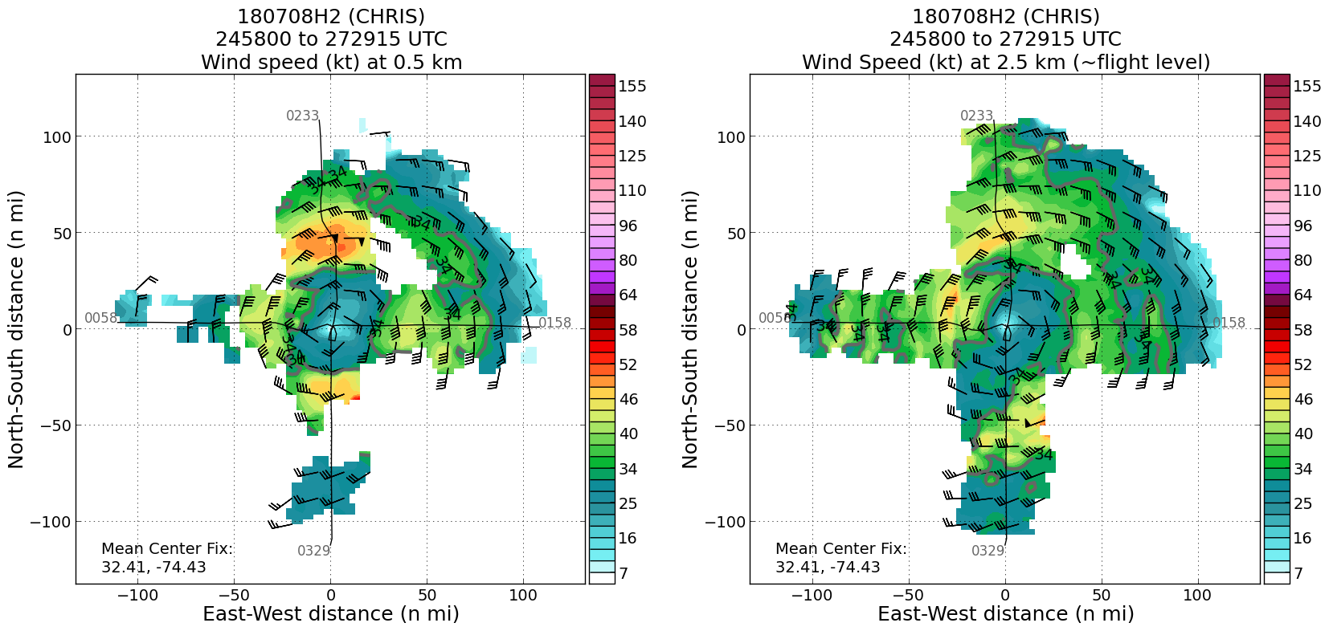
2018 NOAA/AOML/HRD Hurricane Field Program
Intensity Forecast Experiment (IFEX)
AL03/Chris Debrief
Mission 2: 20180708H2 (EMC-Tasked TDR)
we flew
a circle!
Figure credit: Paul Reasor

Slide 22
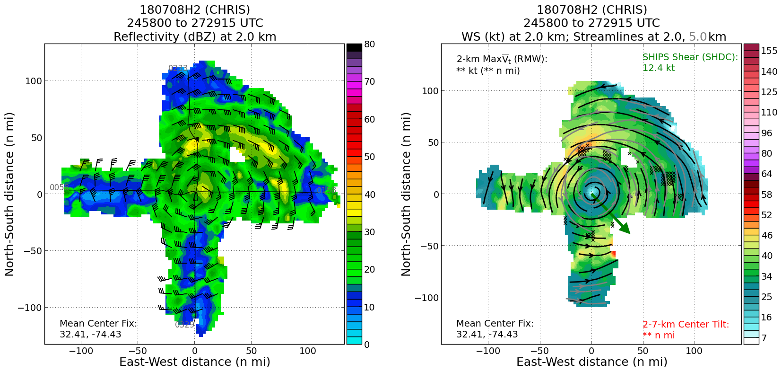
2018 NOAA/AOML/HRD Hurricane Field Program
Intensity Forecast Experiment (IFEX)
AL03/Chris Debrief
Mission 2: 20180708H2 (EMC-Tasked TDR)
Figure credit: Paul Reasor

Slide 23
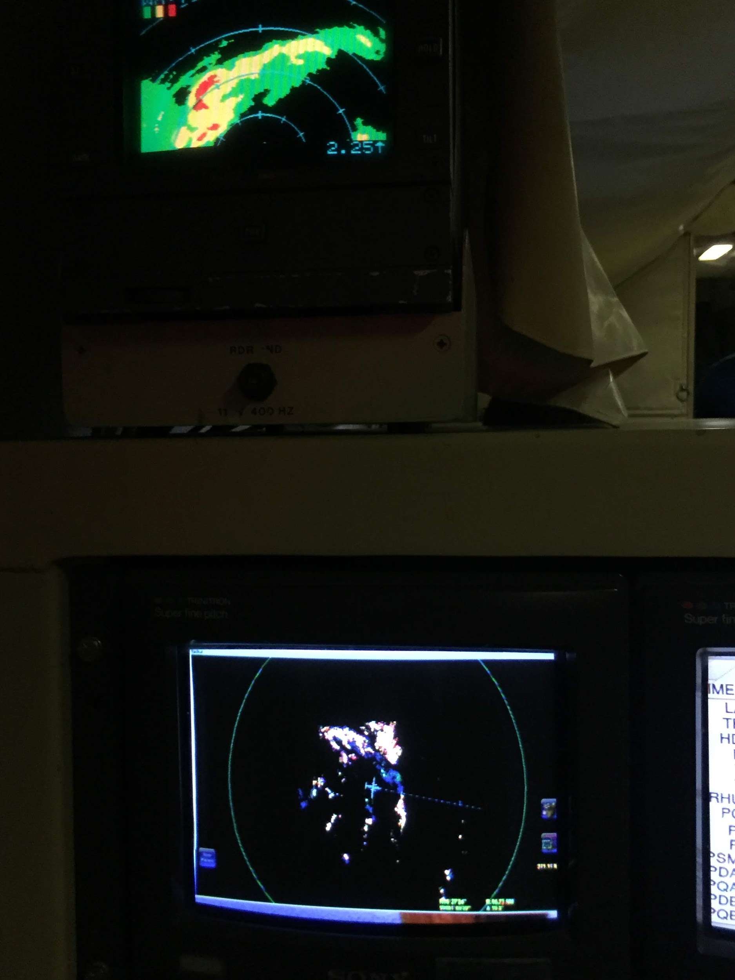
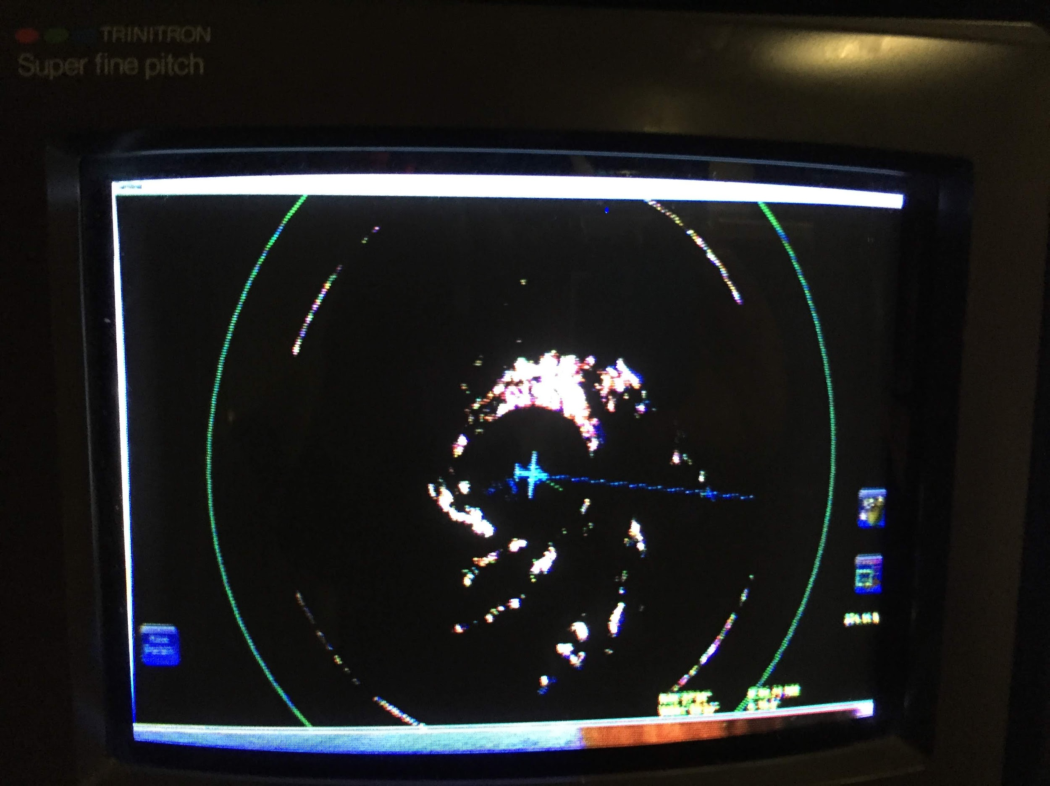
2018 NOAA/AOML/HRD Hurricane Field Program
Intensity Forecast Experiment (IFEX)
AL03/Chris Debrief
Mission 2: 20180708H2 (EMC-Tasked TDR)
Nose Radar
Zoomed MMR
MMR
Inbound first leg
Photo credit: Frank Marks

Slide 24
2018 NOAA/AOML/HRD Hurricane Field Program
Intensity Forecast Experiment (IFEX)
AL03/Chris Debrief
Mission 2: 20180708H2 (EMC-Tasked TDR)
Mission Summary/Problems:
Thanks for AOC crew for their efficient support! 3-h on station time only allowed us to get a single figure-4 pattern
MMR was operating during the mission but the settings for the radar made situation awareness very difficult using the MMR. The nose radar is used mainly for situation awareness throughout the course of the mission
TDR issues:
Radar processing parameters in the plane were not set correctly
During the second TDR analysis, the terminal in the Linux computer was also not responsive
What I learned as a first-time LPS:
Be proactive. Anticipate opportunities
Be flexible
Communicate different options ahead of time

Slide 25
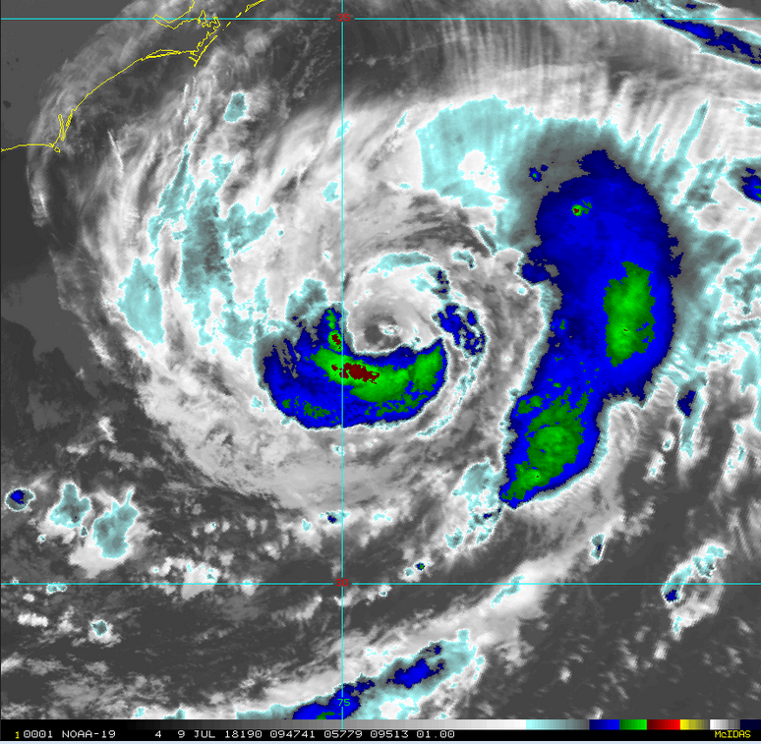
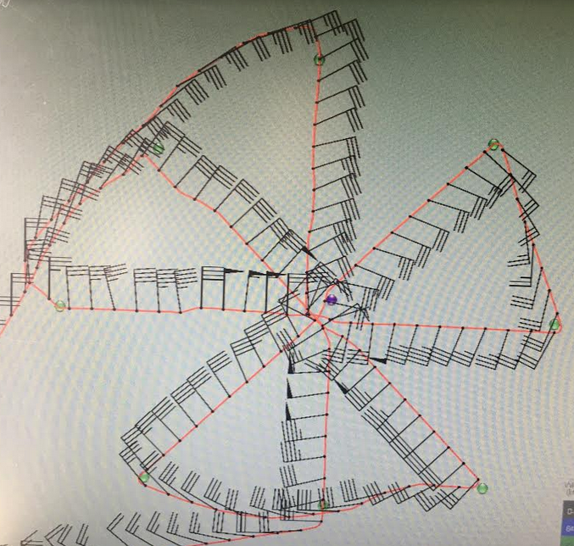
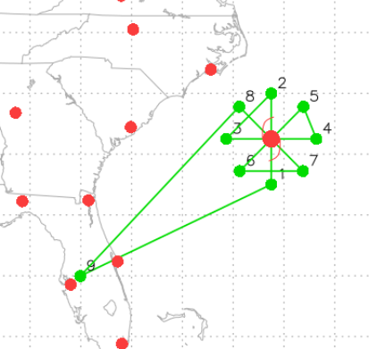
20180709H1 AL03 Chris “Shake-n-bake-take2” TDR Tasking
LPS: Ryan
Radar: Aberson
Dropsonde: Annane
Ground Radar: Gamache/Griffin
MMR Engineers: Naaman, Price, Broder
Latest TC specs at takeoff time
(TEAL): Vmax: 50 kts; Motion: 2 kts @ 110
SHIPS VWS: 11 kts @ 354
Take off: 832 UTC, Landing: 1552 UTC
Flight pattern plan: Rotated figure-4 starting @ 8kft with endpoints and 1 center sonde followed @ 10kft with endpoints and 1 center sonde; deploy sonde in environment on transit back to Lakeland

Slide 26
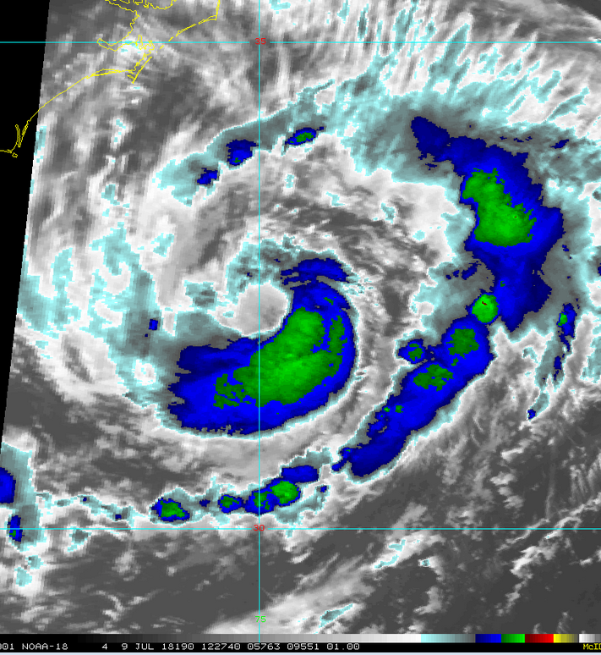
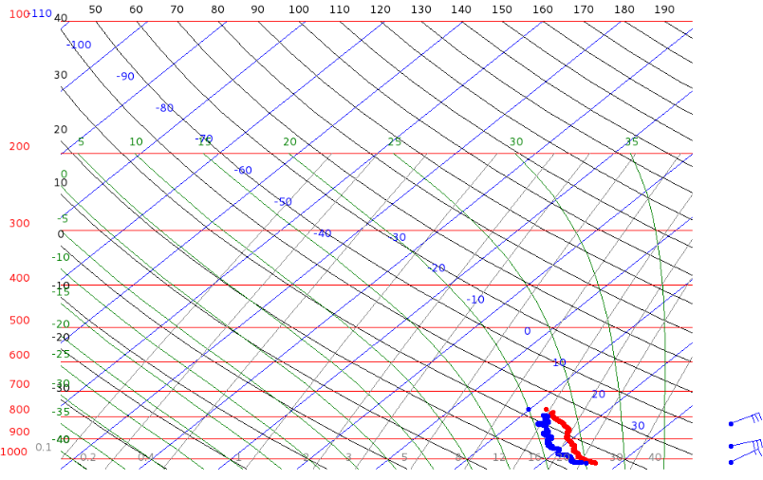

(N) 1047 UTC
X
X
(S) 1005 UTC

Slide 27
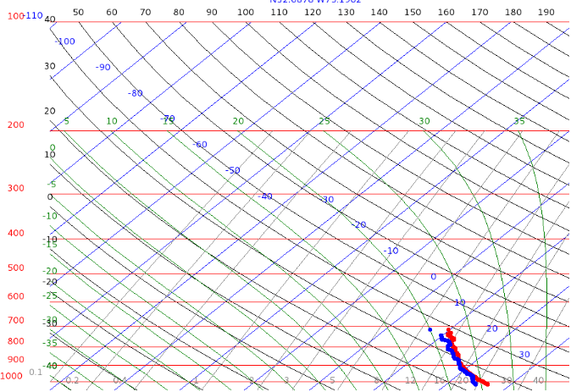



(NW mid) 1408 UTC
X
(SE mid) 1337 UTC
X
X
(SW mid) 1257 UTC

Slide 28


TDR Analysis

Slide 29


Transit back to Lakeland
X

Slide 30



MMR display progression throughout flight
Thanks to MMR engineers onboard!!!

Slide 31

Summary of Shake-n-Bake-Take2
General
Peak FL winds: 60 kts
Peak SFMR winds: 52 kts
MSLP: 999 mb
Estimated RMW: 15 nautical miles (asymmetric)
Constant intensity and asymmetric convection presentation for duration of mission.
The asymmetry in convection flipped between figure-4s from SW to NE
Intrusion of dry air evident in dropsonde measurements
MMR was usable for situational awareness by the start of 2nd figure-4 !!!
Problems
Numerous workstation issues: LPS and sonde scientist switched seats for majority of flight
LPS did not have easy access to satellite or other websites: communicated with FD and radar scientist to discuss conditions
MMR radials incorrect: preventing download of data
Expendables
15 dropsondes

Slide 32


2018 NOAA/AOML/HRD Hurricane Field Program
Intensity Forecast Experiment (IFEX)
AL03/Chris Debrief
LPS: Alaka
Radar: Marks
Drops: Christophersen
Ground Radar: Reasor
Observer: Zawislak
Hollings: Young
Mission 4: 20180709H2 (EMC-Tasked TDR)
Takeoff: 2025 UTC, Landing: 0431
Pattern: Rotated Figure-4’s, 8-12 kft
Drops: centers, midpoints, endpoints
AXBTs: None
Fixes: 5 w/ drops
55 kt / 997 mb
updated
MOTION 0 kt
SHIPS SHR SW 5.7 kt
IP ARRIVAL 2202Z

Slide 33





2018 NOAA/AOML/HRD Hurricane Field Program
Intensity Forecast Experiment (IFEX)
AL03/Chris Debrief
Mission 4: 20180709H2 (EMC-Tasked TDR)
22:20Z
21:08Z
11:34Z
T.S. Chris
before the mission
55 kt / 997 mb
Intensifying?
Forecasts coming into better focus for track & intensity

Slide 34

2018 NOAA/AOML/HRD Hurricane Field Program
Intensity Forecast Experiment (IFEX)
AL03/Chris Debrief
Mission 4: 20180709H2 (EMC-Tasked TDR)
Synoptic-Scale Evaluation
Chris was situated in a col, or a region of weak steering and was expected to move very little throughout the mission.
Lows to the ENE and WSW
Highs to the NW and SE
In fact, all 5 center fixes were within 10 n mi of one another.
H
L
L
H

Slide 35


2018 NOAA/AOML/HRD Hurricane Field Program
Intensity Forecast Experiment (IFEX)
AL03/Chris Debrief
Mission 4: 20180709H2 (EMC-Tasked TDR)
WMO Message Test
Added semicolons to 5 messages

Slide 36

2018 NOAA/AOML/HRD Hurricane Field Program
Intensity Forecast Experiment (IFEX)
AL03/Chris Debrief
Mission 4: 20180709H2 (EMC-Tasked TDR)

Slide 37

2018 NOAA/AOML/HRD Hurricane Field Program
Intensity Forecast Experiment (IFEX)
AL03/Chris Debrief
Mission 4: 20180709H2 (EMC-Tasked TDR)

Slide 38

2018 NOAA/AOML/HRD Hurricane Field Program
Intensity Forecast Experiment (IFEX)
AL03/Chris Debrief
Mission 4: 20180709H2 (EMC-Tasked TDR)

Slide 39


2018 NOAA/AOML/HRD Hurricane Field Program
Intensity Forecast Experiment (IFEX)
AL03/Chris Debrief
Mission 4: 20180709H2 (EMC-Tasked TDR)
Cross section of the final center pass
Inbound from NW, Outbound to SW
new MMR!

Slide 40



2018 NOAA/AOML/HRD Hurricane Field Program
Intensity Forecast Experiment (IFEX)
AL03/Chris Debrief
Mission 4: 20180709H2 (EMC-Tasked TDR)
09:36Z
12:16Z
06:59Z
T.S. Chris
after the mission
60 kt / 993 mb
Slowly intensifying...
Chris became a hurricane at 1200Z 10 July
Maximum Intensity:
90 kt on 06Z 11 July

Slide 41
2018 NOAA/AOML/HRD Hurricane Field Program
Intensity Forecast Experiment (IFEX)
AL03/Chris Debrief
Mission 4: 20180709H2 (EMC-Tasked TDR)
Summary
T/O: 997 mb / 55 kt L/D: 993 mb / 60 kt
Slow intensification despite conducive environmental conditions
Vertical wind shear < 10 kt
near Gulf Stream (upwelling?)
Very weak steering currents led to almost no movement throughout the mission
Peak SFMR of 61 kt in SW eyewall
not supported by later dropsonde
Climbed to 12 kft to maximize tropospheric coverage in dropsondes
5th center pass to accommodate NHC drop
Extended 2 legs to 105 n mi
Successful use of MMR to guide in-flight decisions
Problems
Semicolon in WMO msg
WSRA not functional for Center Pass #1
Expendables
21 drops (20 EMC, 1 NHC)
BEFORE
AFTER

