Slide 1

HRD Observations Team Meeting
June 2017

Slide 2
Agenda
HFP 2017 plans (Reasor)
Coyote update (Cione)
Discussion of dropsonde bogus data (Aberson)
Dropsonde composite work (J. Zhang)

Slide 3
Dropsonde Composites of Symmetric Boundary-layer Structure in Intensifying and Steady-state hurricanes (preliminary result)
Jun Zhang
HRD Observation Team Meeting, 06-15-2017

Slide 4
Motivation
Recent observational studies of intensifying vs. steady-state hurricanes pointed out that deep convection tends to stay inside the radius of maximum wind speed (RMW) with greater azimuthal coverage at downshear and upshear left quadrants (Rogers et al. 2013; 2015; 2016; Zagrodnik and Jiang 2014; Zawislak et al. 2016; Nguyen et al. 2017).
Boundary layer convergence may be one of the mechanisms that is responsible for the different distributions of the deep convection between intensifying and steady-state storms (Rogers et al. 2016).
Previous theoretical and numerical studies showed that boundary-layer processes are also crucial to hurricane intensification and/or weakening (e.g., Emanuel 1995; Smith et al. 2009; Riemer et al. 2010; Bryan 2012; J. Zhang et al. 2017).
The above-mentioned studies motivate us to study the structural difference of the boundary layer between intensifying and steady-state hurricanes. We use dropsonde data in a composite framework for this research.

Slide 5
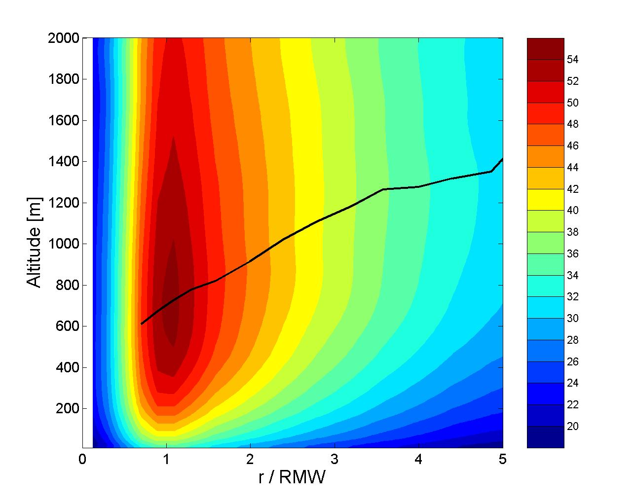
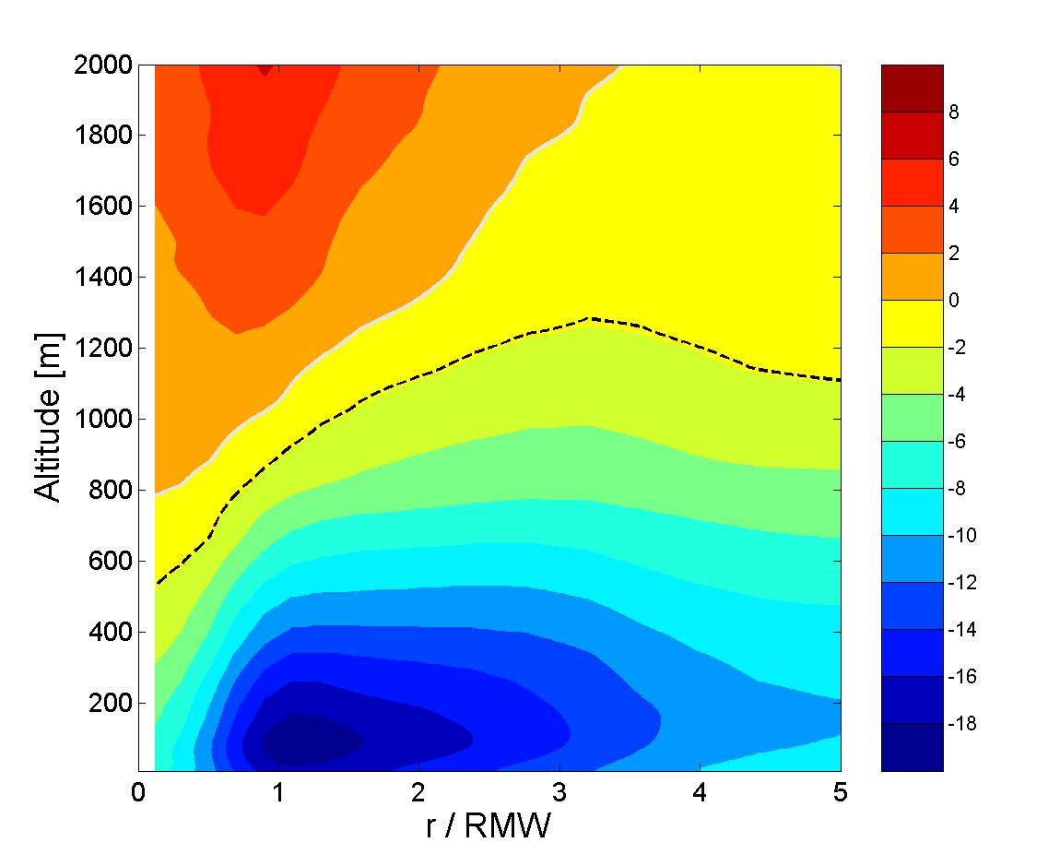
Axisymmetric hurricane boundary-layer structure from dropsonde composite
(J. Zhang, Rogers, Nolan, and Marks, 2011 MWR)
Tangential wind speed (m/s)
Radial wind speed (m/s)
x
The kinematic boundary layer heights decrease with radius toward the storm center;
The boundary layer jet is located within the strong inflow layer;
The height of the peak inflow is within the surface layer.

Slide 6
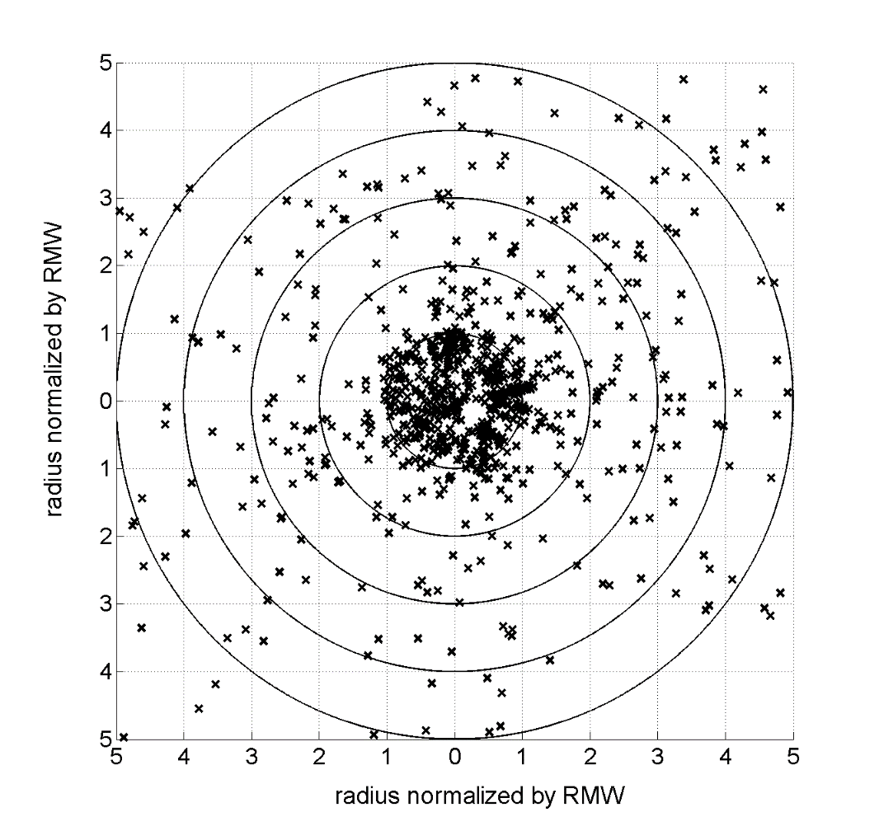
Sonde Data Distribution
~ 1900 Dropsondes
(J. Zhang et al. 2013)
~800 Dropsondes
(J. Zhang et al. 2011)

Slide 7
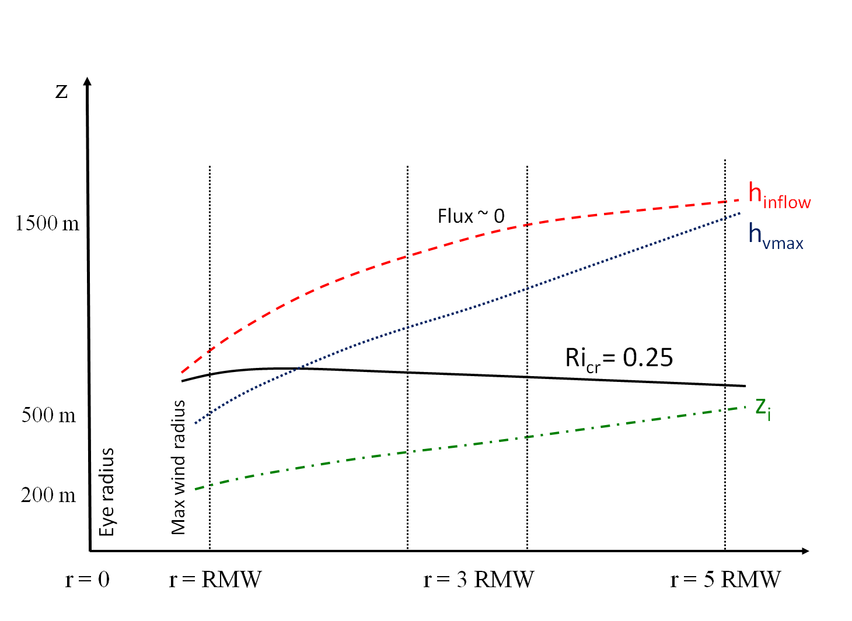
PBL heights from dropsonde composites
(Jun Zhang, Rogers, Nolan, and Marks, 2011 MWR)
h _{inflow} – inflow depth
h_{vmax}- height of the maximum tangential wind speed (Vt)
Z_{i} - mixed layer depth from the virtual potential temperature profile
Ri_{cr}-critical Richardson number defined as buoyancy to shear forcing
Flux – momentum flux from CBLAST-hurricane exp
Max Vt in storm rel coordinates occurs well within the inflow layer and within the frictional boundary layer associated with strong inflow that arises in part because of the departure from gradient wind balance.
Notes:
This figure needs a bit of work still in my opinion:
1. ‘Flux needs to be defined.
2. RI needs to be defined.
3. Z_i needs to be defined.
Need to make main point clearer. Max V_t in storm rel coordinates occurs well within the inflow layer and within the frictional boundary layer associated with strong inflow that arises in part because of the departure from gradient wind balance.
7

Slide 8
Conceptual model for shear-relative PBL heights
(J. Zhang, Rogers, Reasor, Uhlhorn and Marks, 2013 MWR)
h _{inflow} – inflow layer depth
h_{vmax}- height of the maximum tangential wind speed (Vt)
Z_{i} - mixed layer depth from the virtual potential temperature profile

Slide 9
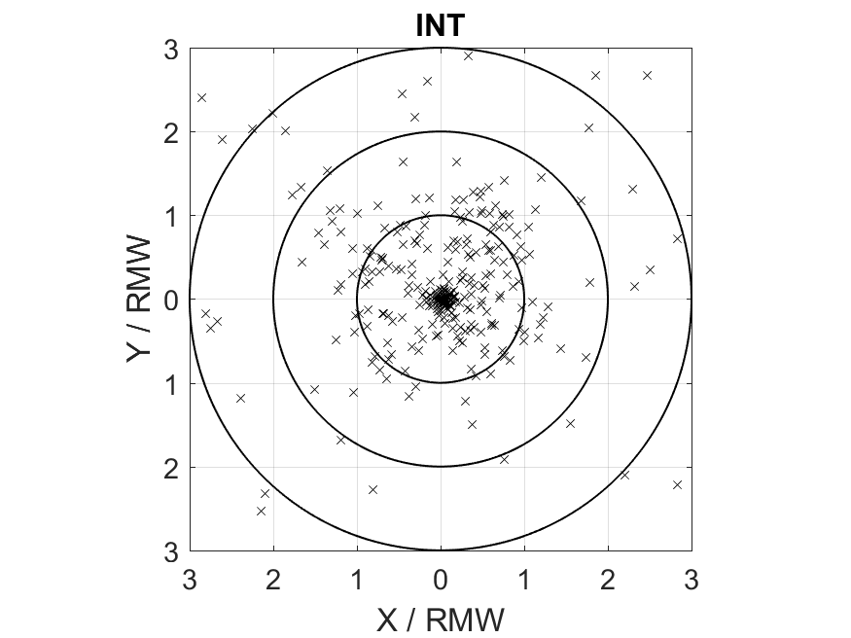
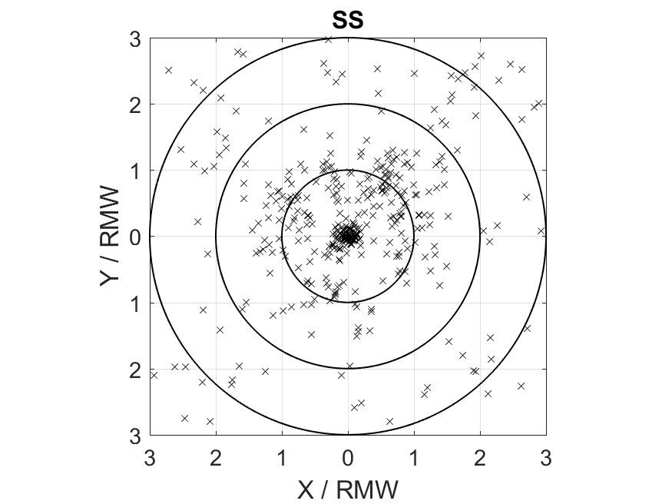
Sonde Distribution Intensifying vs steady-state hurricanes
(n=318)
(n=371)
Intensifying hurricane (INT): 24 h intensity change > 20 kt
Steady-state hurricane (SS): |24 h intensity change| < 10 kt

Slide 10
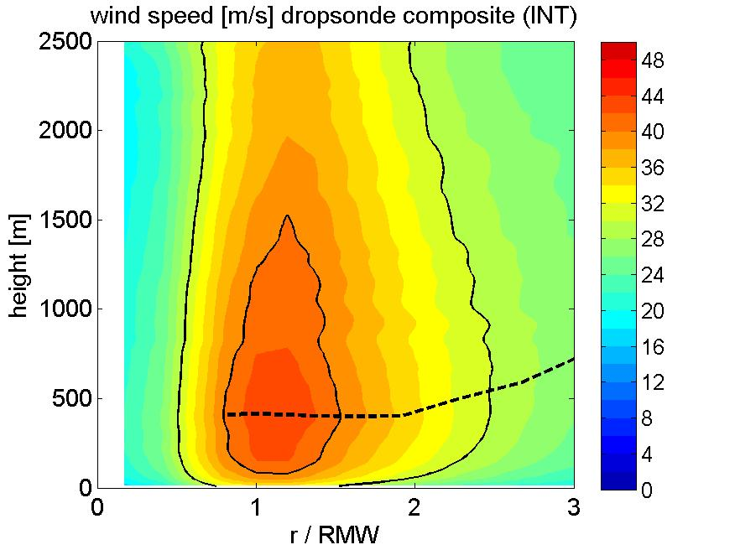
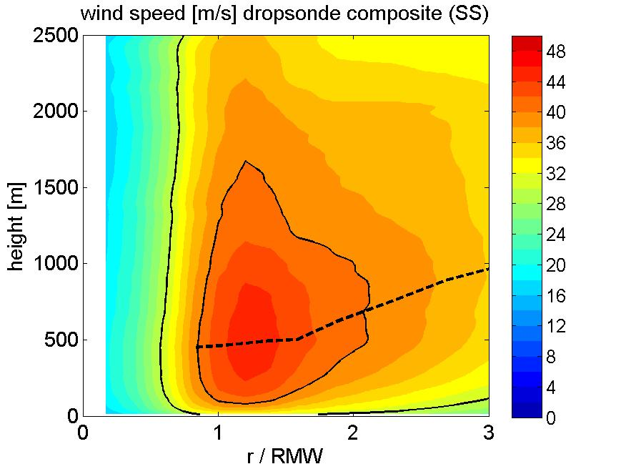
Tangential wind velocity
The tangential wind field is broader at the outer radii in the SS composite than in the INT composite.
The height of maximum tangential wind is comparable to each other for the INT and SS composites.

Slide 11
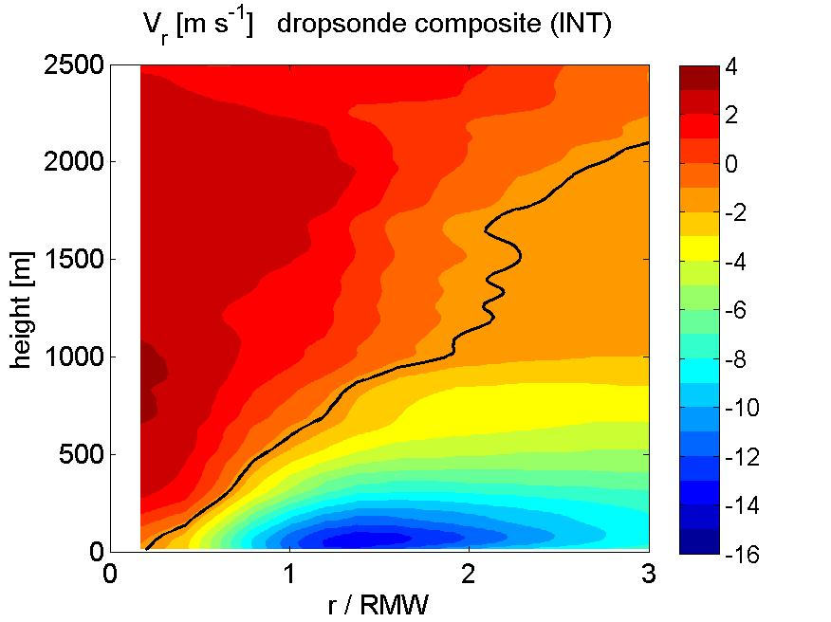
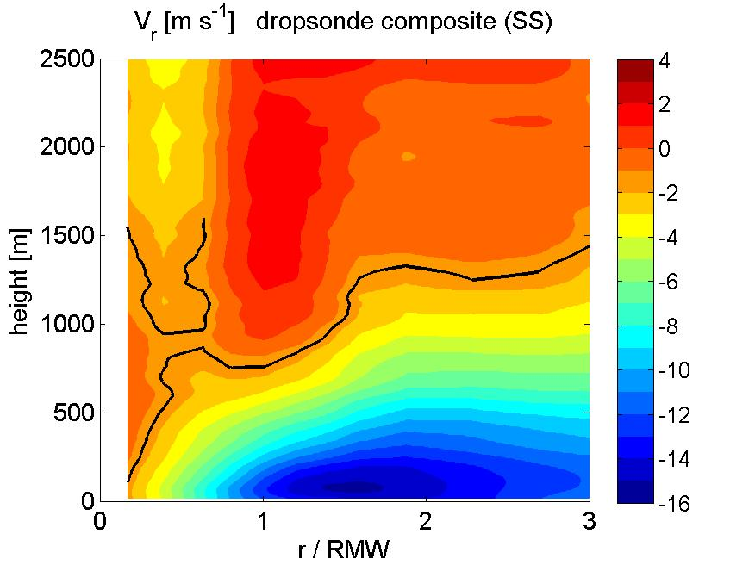
Radial wind velocity
The inflow layer is deeper at outer radii (r/RMW>2) in the INT composite than the SS composite, in agreement with Rogers et al. (2013).
The peak inflow is slightly closer to the storm center in the INT composite than in the SS composite.

Slide 12
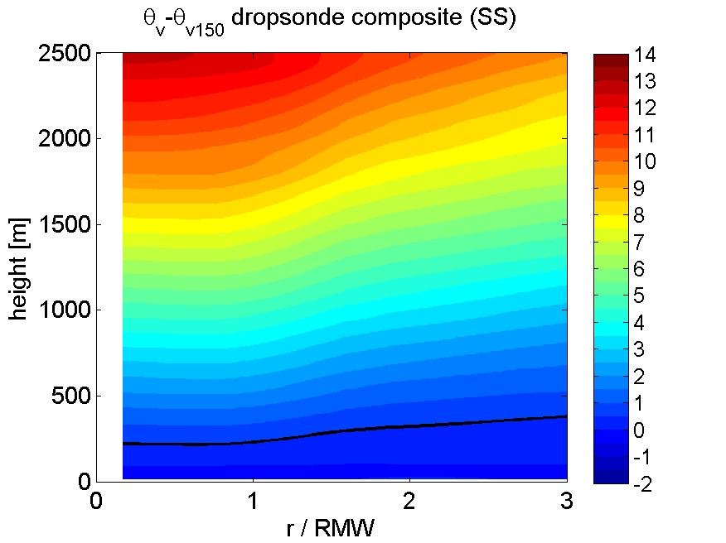
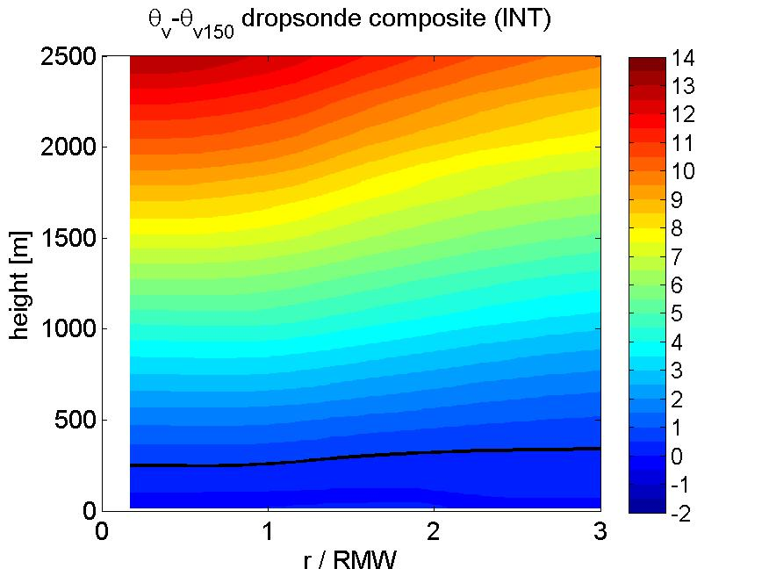
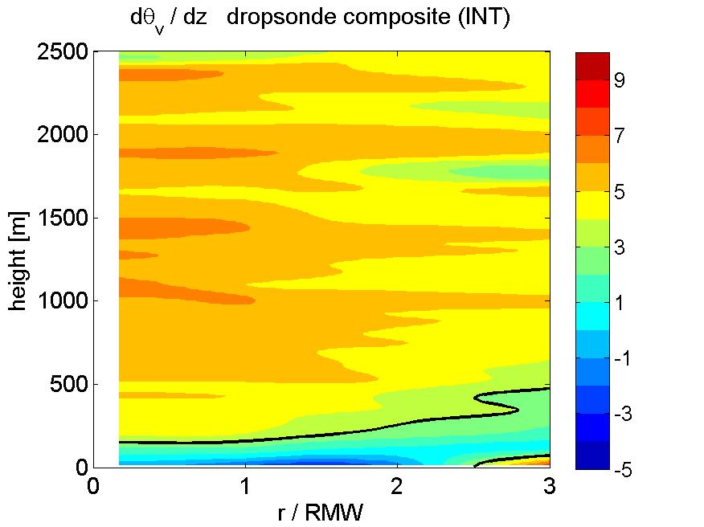
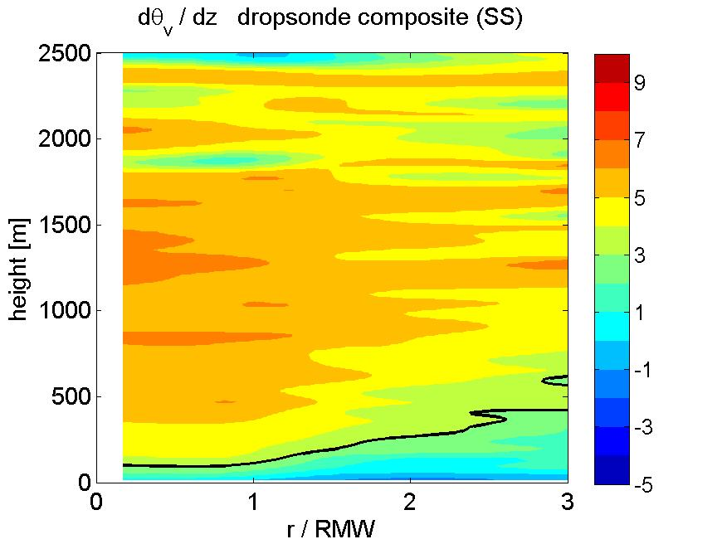
Thermodynamic mixed-layer depth
The mixed layer depth is comparable to each other for the INT and SS composites.

Slide 13
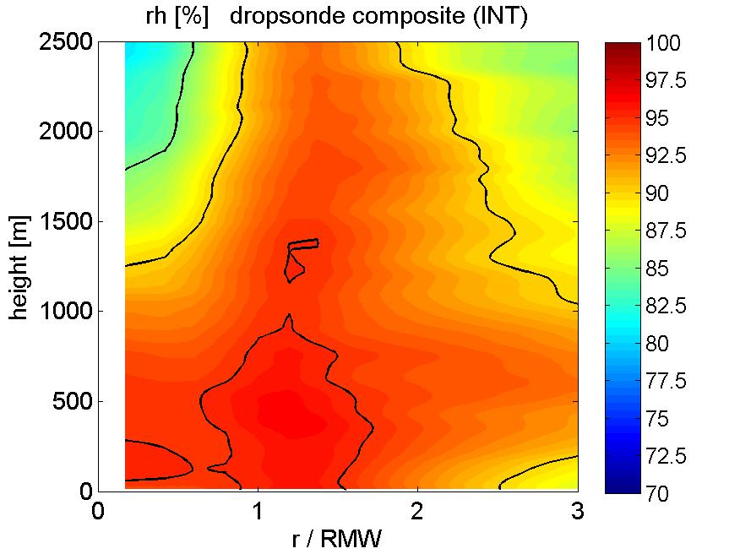
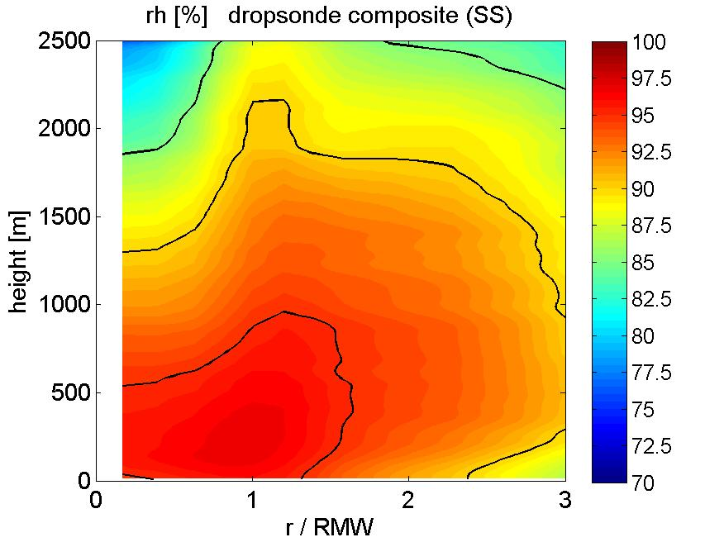
Relative humidity
The relative humidity is larger near the top of the boundary layer in the INT composite than in the SS composite.

Slide 14
Summary
We composite the dropsonde data to study the differences in axisymmetric boundary-layer structure between intensifying (INT) and steady-state (SS) hurricanes.
Preliminary results show that the INT composite has deeper inflow layer, narrower tangential wind field, and larger relative humidity near top of the inflow layer than the the SS composite.
Future work will investigate the boundary layer convergence, inertial stability, and gradient wind balance for the axisymmetric structure. Asymmetric structure will be analyzed using a much larger sample of dropsonde data (under development by Jon Zawislak).
Any suggestions?

Slide 15
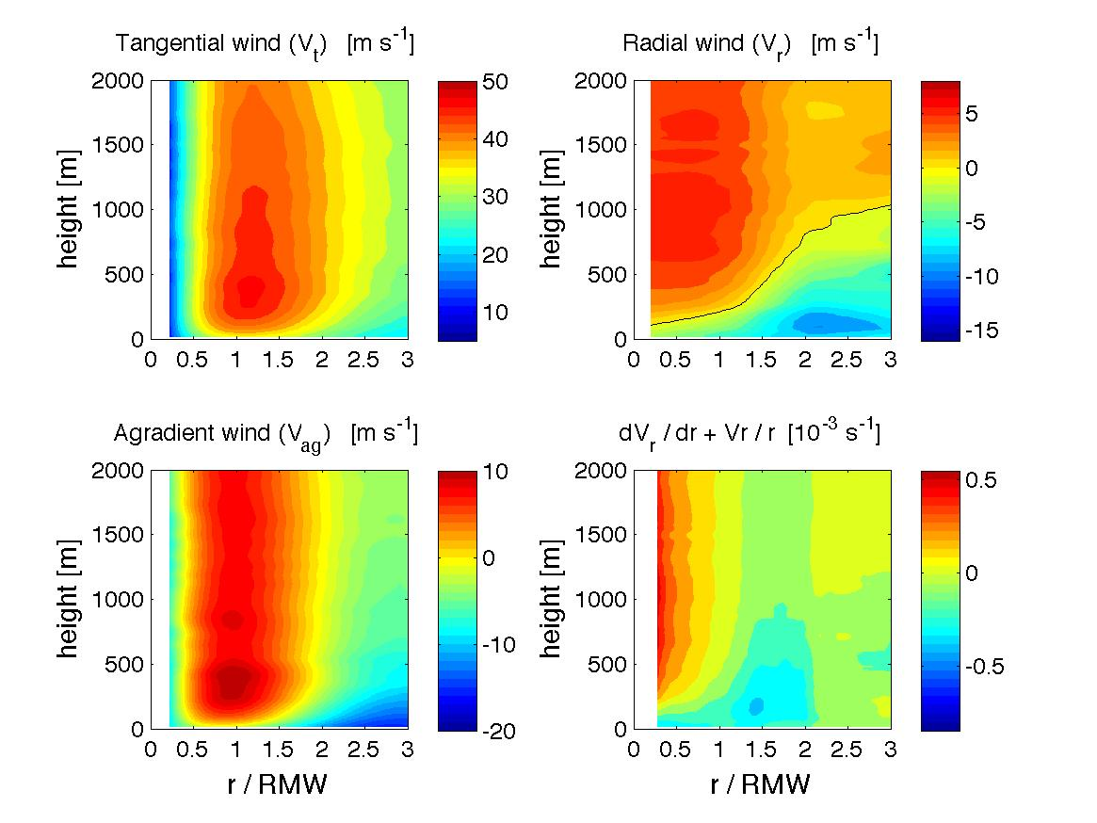
Radial distribution: PBL kinematic structures for Earl (2010) and Edouard (2014)
(Rogers et al. 2015; 2016)
Earl
r/RMW
r/RMW
r/RMW
Rogers et al. (2015)
Edouard
r/RMW
r/RMW
r/RMW
Both storms showed supergradient flow, Edouard had a shallower, weaker inflow than Earl.
Radial location of peak convergence for Edouard at ~1.5 x RMW, for Earl peak was at ~0.75 x RMW.

Slide 16
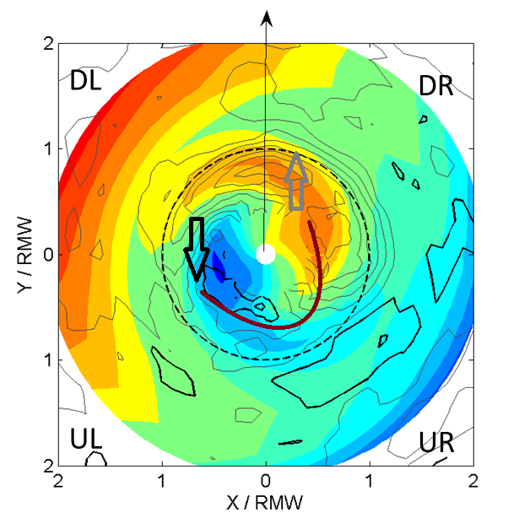
A paradigm of energy cycling process tied to shear-induced asymmetry of convection (J. Zhang et al. 2013)
As air parcels rotate from the upshear left (UL) quadrant to the downshear right (DR) quadrant, they acquire equivalent potential temperature (θ_{e}) from surface fluxes ;
Convection is triggered in the DR quadrant in the presence of asymmetric mesoscale lifting coincident with the θ_{e} maximum.;
Energy is then released by latent heating in the downshear left (DL) quadrant;
Convective downdrafts bring down cool and dry air to the surface and lower θ_{e} again in the DL and UL quadrants.
Energy released
Convection triggered
Primary downdraft

