Slide 1
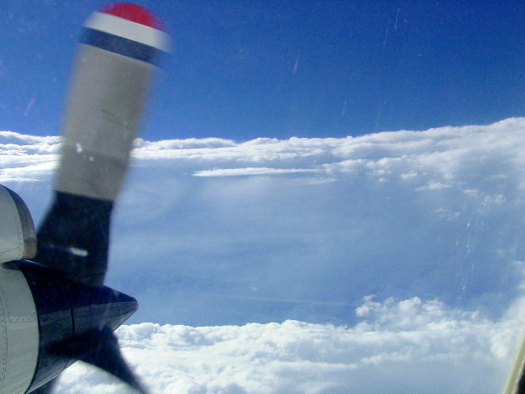
HRD Observations Team Meeting
April 2017

Slide 2
Agenda
HFP 2017 plans (Reasor)
Coyote update (Cione)
LROSE workshop summary (Dodge, Gamache, Reasor)
Recently-passed Weather Research Law
Use and relevance of HRD observational datasets (Marks)

Slide 3
Coyote Update

Slide 4
2017 HFP
Coming up in May/June
Meeting at NHC to get input on priorities (tbd)
AOC transitions to Lakeland early May; N42 phase inspection begins 10 May (4-6 wks)
HFP kick-off meeting at AOML (10AM-12PM on 18 May)
Radar, sonde, and G-IV LPS trainings (late May/early June); Safety courses (tbd)
Field program plan finalized and published (1 June)
HFP briefing at AOC in Lakeland (tbd)
HFP Plan
21 submissions: AIPEX, Arc Cloud, Conv. Burst, Raman Lidar, CYGNSS-SFMR, DWL, ET, GenEx, G-IV SFMR, G-IV TDR, Gliders, High-In. SFMR, Landfall, Eye-Eyewall Mixing, Offshore Windfarm, P-3 TDR, SEF-ERC, SUAVE, Diurnal Cycle, TC in Shear, TC-Ocean
Priorities submitted to AOC for ORM: P-3 TDR, G-IV TDR, DWL, SUAVE and AIPEX
Misc.
Yes/no to pursuing Mexican research clearance for Harlingen or La Paz option
Travel cap may mean limited Fed participation in the field this season
Rem: P-3/G-IV flight hrs remaining in FY17 → 32/25 research, 86/121 NWS
Rem: 66 (HRD), 100 (HFIP), 167 (IR) sondes; 55 AXBTs (some to be used by Otter project)

Slide 5
2017 HFP
FYI from Jeff Smith:
“I’ve been assisting as the NOAA technical lead on a SBIR to develop a new ocean profiler, the MASED. This cool sonde will launch from any AVAPS dropsonde tube, and be able to perform multiple ocean profiles at a programmable time interval from minutes to days. The standard data profile includes temperature, current and salinity. Data transfer is via Iridium satellite link.
We are nearing the end of Phase II of the SBIR, which will culminate with launching an operational MASED or two in June. The research company is looking for some seed money to further refine the design and manufacture some units. If further development of this project has some interest with your group, I can put you in contact with them.”

Slide 6
H.R.353 - Weather Research and Forecasting Innovation Act of 2017
https://www.congress.gov/bill/115th-congress/house-bill/353
TITLE I—UNITED STATES WEATHER RESEARCH AND FORECASTING IMPROVEMENT
Sec. 101. Public safety priority.
Sec. 102. Weather research and forecasting innovation.
Sec. 103. Tornado warning improvement and extension program.
Sec. 104. Hurricane forecast improvement program.
Sec. 105. Weather research and development planning.
Sec. 106. Observing system planning.
Sec. 107. Observing system simulation experiments.
Sec. 108. Annual report on computing resources prioritization.
Sec. 109. United States Weather Research program.
Sec. 110. Authorization of appropriations.
Sec. 413. Hurricane hunter aircraft.

Slide 7
SEC. 102. Weather research and forecasting innovation.
(a) Program.—The Assistant Administrator for the Office of Oceanic and Atmospheric Research shall conduct a program to develop improved understanding of and forecast capabilities for atmospheric events and their impacts, placing priority on developing more accurate, timely, and effective warnings and forecasts of high impact weather events that endanger life and property.

Slide 8
SEC. 106. Observing system planning.
The Under Secretary shall—
(1) develop and maintain a prioritized list of observation data requirements necessary to ensure weather forecasting capabilities to protect life and property to the maximum extent practicable;
(2) consistent with section 107, utilize Observing System Simulation Experiments, Observing System Experiments, Analyses of Alternatives, and other appropriate assessment tools to ensure continuous systemic evaluations of the observing systems, data, and information needed to meet the requirements of paragraph (1), including options to maximize observational capabilities and their cost-effectiveness;
(3) identify current and potential future data gaps in observing capabilities related to the requirements listed under paragraph (1); and
(4) determine a range of options to address gaps identified under paragraph (3).

Slide 9
SEC. 413. Hurricane hunter aircraft.
(a) Backup capability.—The Under Secretary shall acquire backup for the capabilities of the WP–3D Orion and G–IV hurricane aircraft of the National Oceanic and Atmospheric Administration that is sufficient to prevent a single point of failure.
(b) Authority to enter agreements.—In order to carry out subsection (a), the Under Secretary shall negotiate and enter into 1 or more agreements or contracts, to the extent practicable and necessary, with governmental and non-governmental entities.
(c) Future technology.—The Under Secretary shall continue the development of Airborne Phased Array Radar under the United States Weather Research Program.
(d) Authorization of appropriations.—For each of fiscal years 2017 through 2020, support for implementing subsections (a) and (b) is authorized out of funds appropriated to the Office of Marine and Aviation Operations.

Slide 10
Use and relevance of HRD observational datasets
Are we meeting our needs for research in HRD?
Are we meeting our needs to support NOAA? NWS? Research community?
What is the most effective way to pass on the responsibilities as data custodians to others/successors?
Is our data policy still appropriate given the changing observation technologies?
How should we insure archival of our unique data sets?

