Slide 1
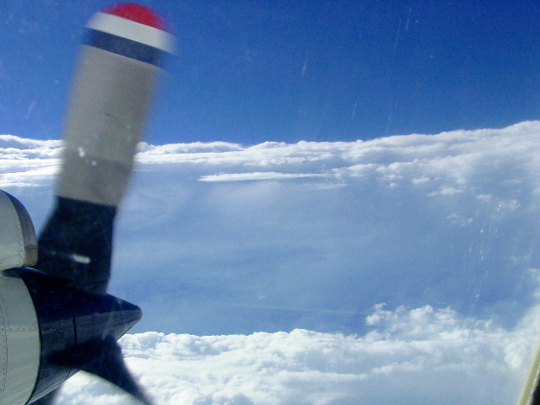
HRD Observations Team Meeting
February 2017

Slide 2
Agenda
HFP 2017 plans (Reasor)
  Updates on planning
  Online form for submitting experiments/modules for HFP
  Online form for submitting LPS mission summaries
Potential for web-based GUI for aircraft data visualization (Klotz)
HWRF case studies of interest and analysis plans (Alaka)
Initial analysis of Hermine, Karl dropsondes in shear-relative framework (Zawislak)

Slide 3
HFP 2017
Reasor

Slide 4
Data Visualization Portal
Brad Klotz, Obs Team Meeting (2/16/17)
As part of our field program, we often send out images of radar, dropsonde, or other data we collect during our missions.
Currently, these data/images are scattered in various places on our website and can sometimes be difficult to find
For example…

Slide 5
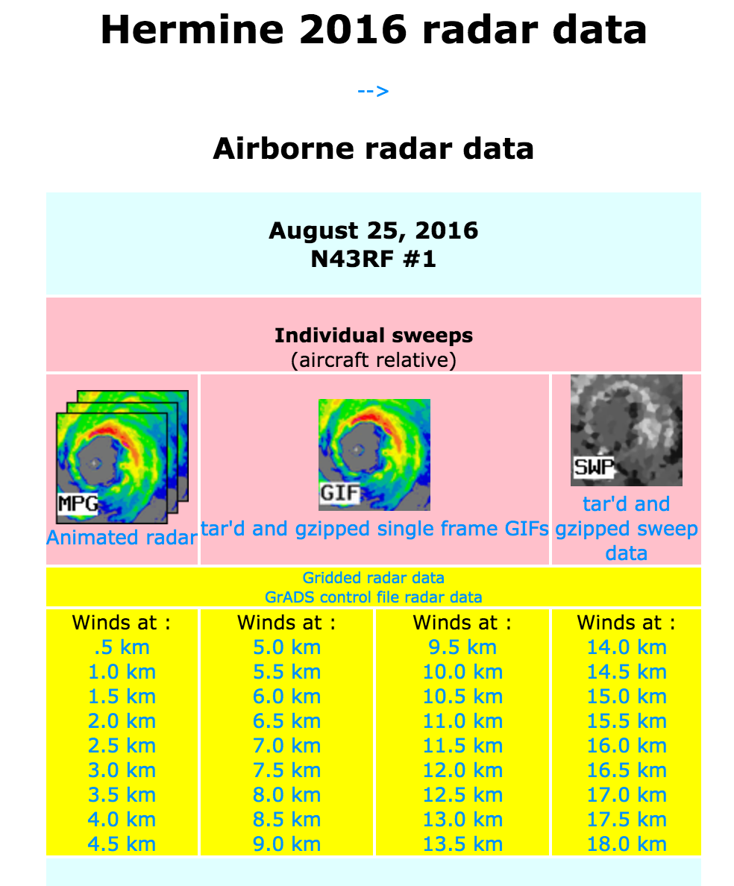
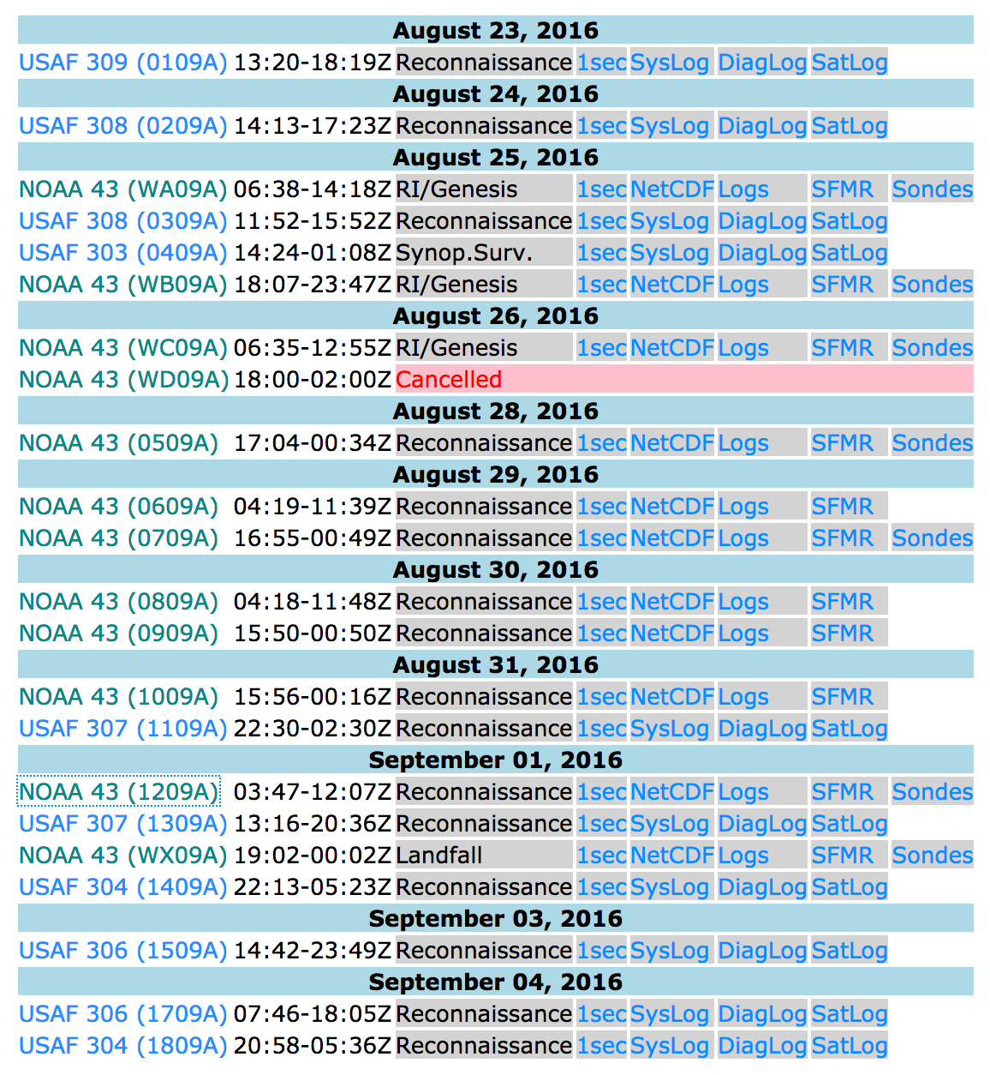
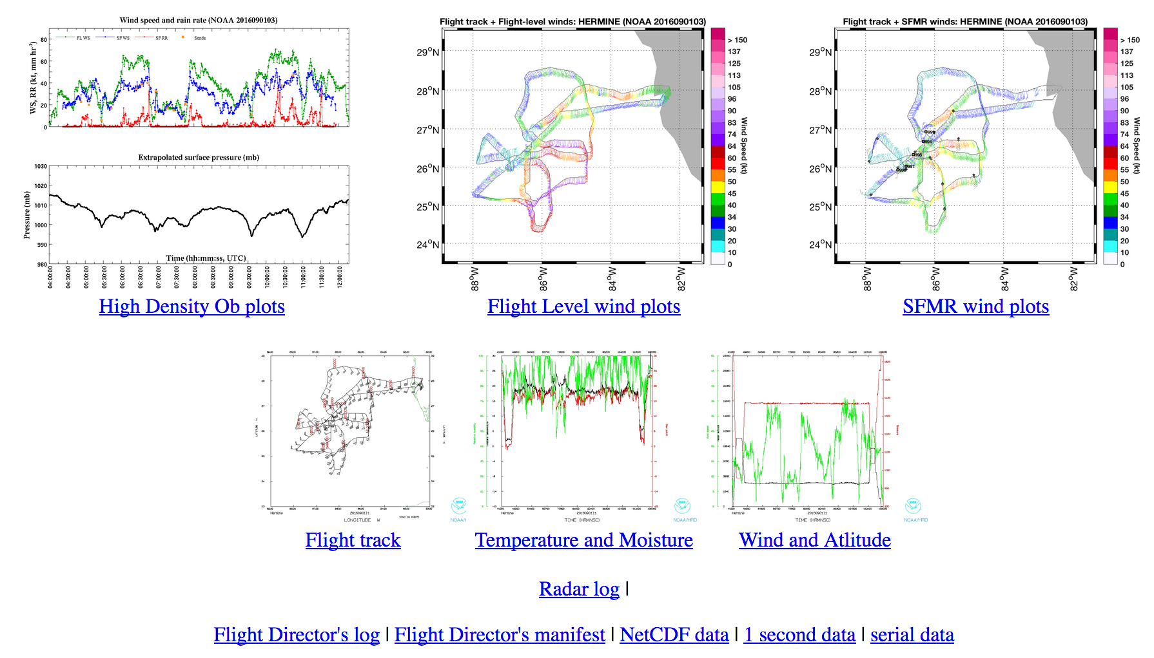
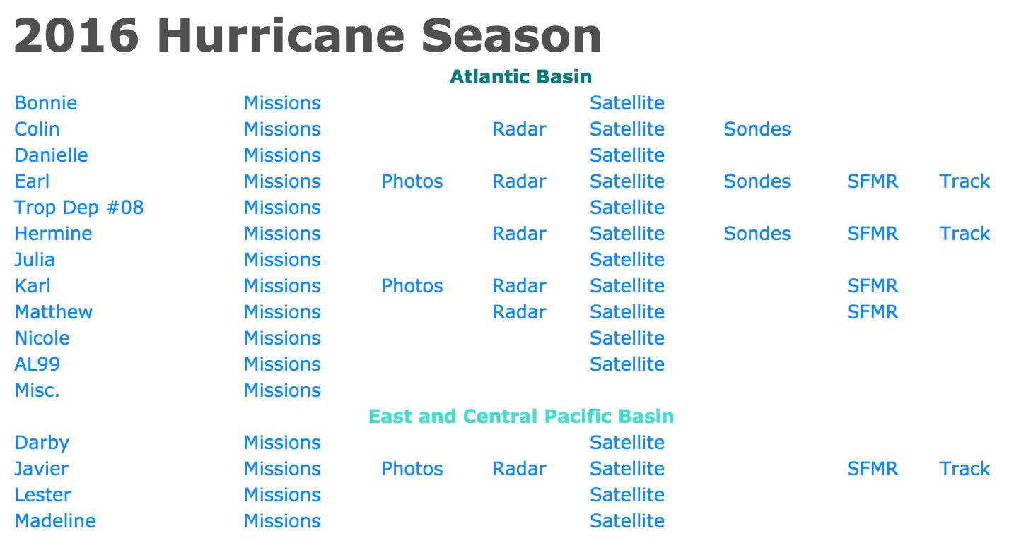
Data Visualization Portal

Slide 6
Data Visualization Portal
To remedy this issue, I am proposing that we create a portal or GUI where someone can come to our website and…
  Click on the portal link
  Select the data they want visualized
  And see the desired image
I envision this being useful in (semi) real time as well as for the historical images.
The purpose of creating this application would be to:
Make our data more accessible during aircraft missions
Hopefully bring more traffic to our website and increase interest in what we do during our field program

Slide 7
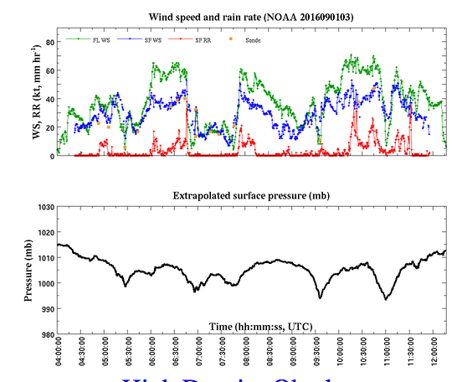
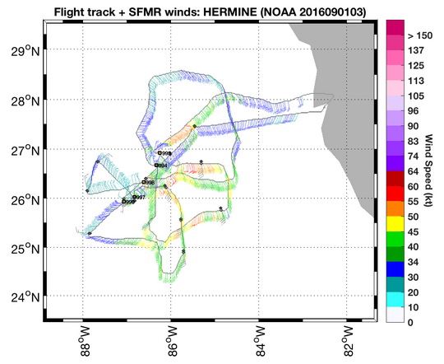
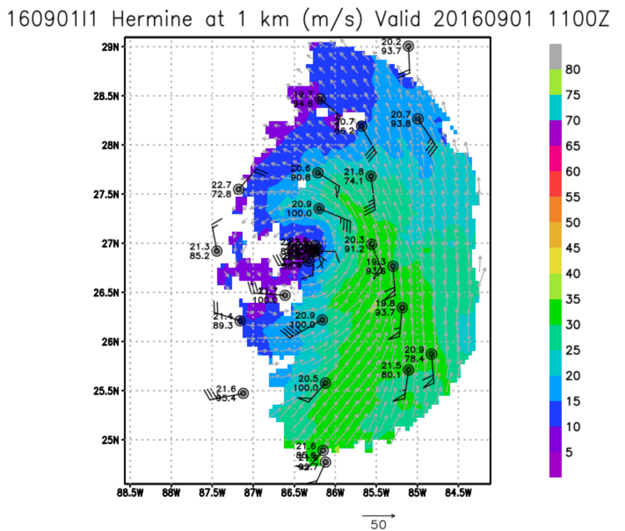
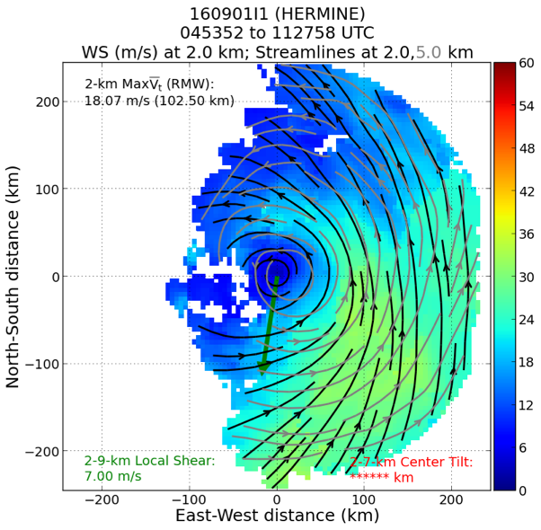
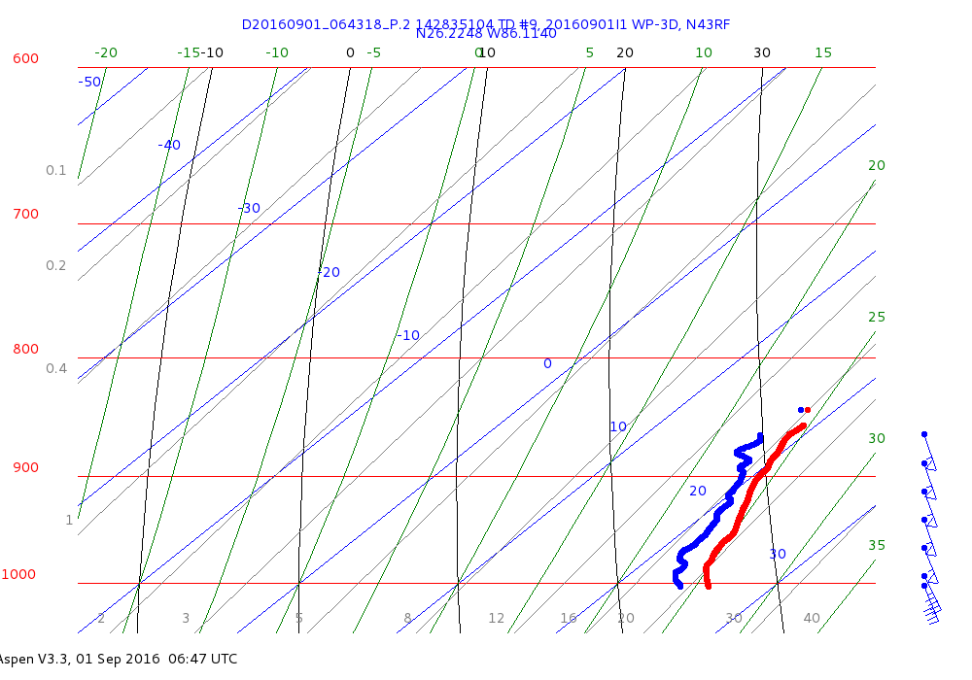
Data Visualization Portal
Enter data portal
Select flight and data type(s) to view
Flight-level or surface data
Radar
Dropsonde/Skew-T
Other data (DWL?)

Slide 8
HWRF Basin-scale Cases
2016 Basin-Scale HWRF Retrospective Case Studies
NOAA/AOML/Hurricane Research Division
2 February 2017
Tropical Cyclones:
Hurricane Hermine AL 2016
Tropical Storm Karl AL 2016
Hurricane Matthew AL 2016
Hurricane Nicole AL 2016
Hurricane Lester EP 2016
Tropical Storm Erika AL 2015
Hurricane Joaquin AL 2015
Hurricane Ignacio EP 2015
Hurricane Jimena EP 2015
Hurricane Patricia EP 2015
Hurricane Arthur AL 2014
Hurricane Edouard AL 2014
Hurricane Gonzalo AL 2014
Hurricane Isaac AL 2012
Hurricane Leslie AL 2012
Alaka

Slide 9
Zawislak Update: February 14, 2017
An Initial Look at Hermine and Karl (2016) Dropsonde Analyses
Update on TC-DROPS
TROPICAL CYCLONE - DROPSONDE RESEARCH AND OPERATIONS PRODUCT SUITE (TC-DROPS)
WHAT IS IT?
Level-2 product suite that accumulates dropsonde data from all flights in a single storm into a commonly formatted dataset (output .nc) and outputs various figures
RESEARCH APPLICATIONS:
Combine multiple aircraft
More easily facilitates dropsonde composite studies
Differentiate observations by storm, intensity, intensity change, location (shear) relative to the center
Additional variables and metrics
OPERATIONAL APPLICATIONS:
Can be run in near-real time after the flight (Best track, FL, SHIPS, Rainfall)
Dropsonde pattern planning purposes (where did we miss? Interesting features that we should sample again?)

Slide 10
TROPICAL CYCLONE - DROPSONDE RESEARCH AND OPERATIONS PRODUCT SUITE (TC-DROPS)
WHAT DOES IT OFFER?
Dropsonde data are located with respect to the TC center
Interpolated to the same pressure/height levels
Additional kinematic and thermodynamic variables (θ, θ_{E}, θ_{V}, W, V_{R}, V_{T}, Z_{PBL}, SST)
Rotated with respect to shear
Each observation assigned current intensity, -6, -12, -24 h intensity change
If Flight Level Data Available:
Automatic T/O, L/D, “on-station” time detection
Automatic flight leg detection for cross-section analyses (hopefully)
Rainfall accumulation (if on-station available, otherwise uses first/last Drop times)
    NASA GPM IMERG (30-min, 0.10°, IR-PMW Merged Rain Rate)
WHAT ARE THE CHALLENGES?
Common QC procedures
FRD file availability, though flexibility should be built in
PLANS FOR NOW:
Developmental and evaluation stage based on IFEX/SHOUT 2016
Implementation for HFP 2017
Processing complete HFP dropsonde record

Slide 11
HERMINE: P-3 ---- 850 hPa RH (SHEAR RELATIVE)
20160825i1
20160826i1
20160828i1
DSL
DSR
USL
USR
20160829i2
20160830i1
20160830i2
Shading: Accumulated rainfall

Slide 12
HERMINE: P-3 ---- 850 hPa RH (SHEAR RELATIVE)
20160831i1
20160901i1
20160901i2
GH 20160829
GH 20160831

Slide 13
HERMINE: P-3 ---- Mean RH profiles from each flight (0-200 km)

Slide 14
HERMINE: P-3 ---- Mean θ_{E} profiles from each flight (0-200 km)

Slide 15
KARL: P-3 & G-IV ---- 850 hPa RH (SHEAR RELATIVE)
20160920i1
20160920n1
20160921i1
20160921n1
20160922n1
20160922i1

Slide 16
KARL: P-3 & G-IV ---- 850 hPa RH (SHEAR RELATIVE)
20160923i1
20160923n1
20160923i2
20160924i1
20160924n1
20160924i2

Slide 17
KARL: G-IV ---- MIDLEVEL RH (700-500 hPa layer average) (SHEAR RELATIVE)
20160920n1
20160921n1
20160922n1
20160923n1
20160924n1
GH 20160922

Slide 18
KARL: P-3 & G-IV ---- Mean RH profiles from each flight (0-200 km)

Slide 19
KARL: P-3 & G-IV ---- Mean θ_{E} profiles from each flight (0-200 km)

