Slide 1
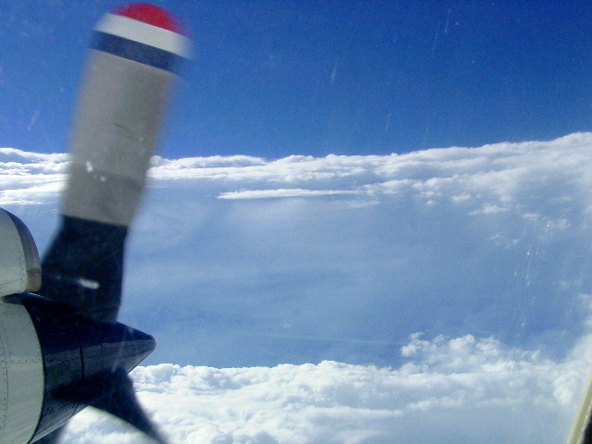
HRD Observations Team Meeting
January 2017

Slide 2
Agenda
Update on 2017 HFP (Reasor)
Coyote, IR/BT comparison, west Pac updates (Cione)
2) DWL/dropsonde comparisons (Bucci)
3) HIRAD observations for initialization of the HWRF vortex (Sellwood)

Slide 3
2017 HFP
Coming up
Call for instrumentation requests on 6 Feb (Due 24 Feb)
Call for experiments/modules on 13 Feb (Due 31 March)
Misc.
Sondes: 66 (HRD), 100 (HFIP), 167 (IR/Cione)
Pursuing Mexican overflight/take-off clearance
N42 left for Winter Ocean Winds 18 January; VORTEX-SE from March-April
HFP Plan
Remove GH references (?)
Options: Status quo OR separate into justification and flight pattern/expendable docs
List typical patterns executed and usual expendable distributions at lifecycle stages upfront
Individual experiments/modules cite a typical pattern (and justify deviations) and justify additional expendables
Science priority (e.g., ocean sampling)?
Science
Where do we stand with the “TDR Mission”? Are we making progress? Should we do anything differently this year?

Slide 4
P3DWL vs. Dropsonde
Observation Meeting
January 19th, 2017
Lisa Bucci

Slide 5
Initial Comparison of P3DWL to Dropsondes

Slide 6
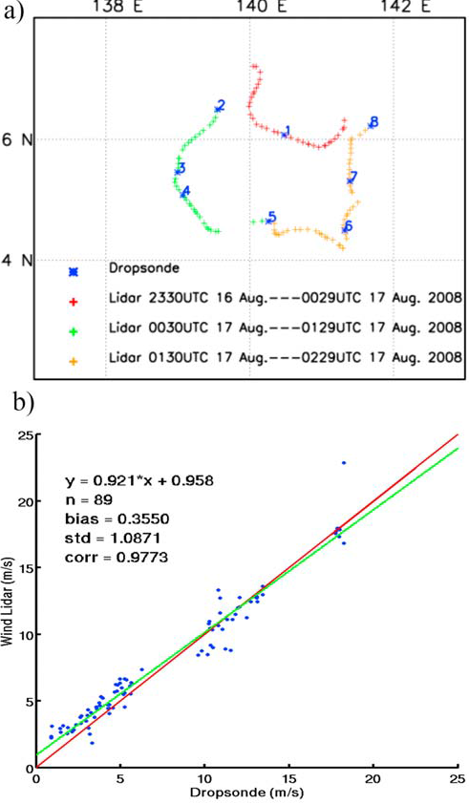
Pu et al., 2009

Slide 7
Requirements
DWL profile and drop within 10km
1 m vertically
Flown with the tropical cyclone
Erika had a forward sweep scan pattern
Earl looked both up and down (less down profiles)
Differences between Pu

Slide 8
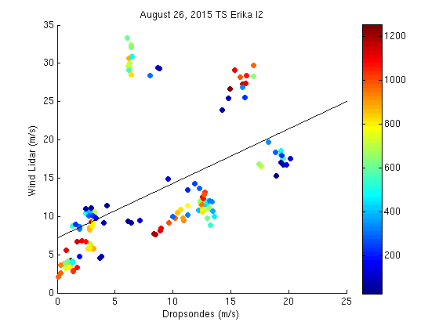
y=0.7127*x + 7.1941
n=143
corr=0.5150

Slide 9
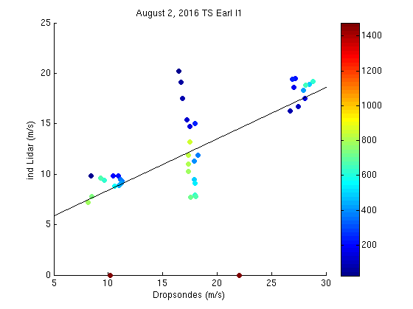
y=0.5102*x + 3.2831
n=41
corr=0.6667

Slide 10
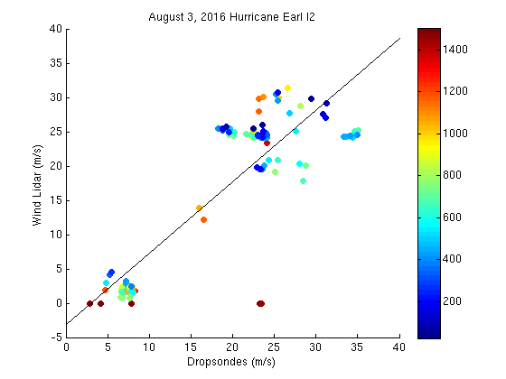
y=1.0436*x - 3.1483
n=115
corr=0.861

Slide 11
Future Work
Test other QC parameters on DWL profiles
# of shots in the profile
Compare DWL wind directions to drops
Compare DWL surface or near surface obs to SFMR

