Slide 1


Irma/Jose/Maria Debrief: Part II
N42 Flights from September 3rd to 26th
14 EMC-tasked, 3 HRD-tasked missions
~105 Regular/IR Sondes
Also
13 G-IV Synoptic surveillance missions
51 Air Force recon missions
October 19, 2017

Slide 2
Agenda
HRD/AOML support for EMC operations (Reasor)
TDR-related issues, resolved and continuing (Gamache)
Data impacts on HWRF forecasts (Sippel)
Open discussion of EMC-tasked missions (All)
Verification of basin-scale HWRF (Alaka)

Slide 3
HRD/AOML Support for EMC Operations during Irma/Jose/Maria
Irma
  Deployed to Barbados 2 Sept, EMC-tasked missions 3-5 Sept
  Tried to get all data in 00Z and 12Z HWRF cycles
  Sondes on all passes; Some ferry sondes
  Let take-off time slip 1 hour as Irma neared islands
  Deployed to Lakeland 7 Sept, EMC-tasked missions 8 Sept
  Scrubbed 9 Sept EMC-tasked mission (proximity to Cuba)
Jose
  Deployed to Lakeland 17 Sept, EMC-tasked missions 17-18 Sept
  Tried to get all data in 00Z and 12Z HWRF cycles
  Endpoint sondes for initial Fig-4 only; Some ferry sondes
  Scrubbed 2nd mission on 18 Sept (TDR coverage, reduced threat)

Slide 4
HRD/AOML Support for EMC Operations during Irma/Jose/Maria
Maria
  Deployed to Lakeland 21 Sept, HRD/EMC-tasked missions 22-26 Sept
  For HRD-tasked missions tried to get all Fig-4 data in 00Z cycle
  For EMC-tasked missions tried to split data between 06/12Z cycles and between 18/00Z cycles
  Endpoint sondes for initial Fig-4 only; Some ferry sondes
  All EMC-tasked missions performed wo/ HRD personnel on the P3
  Missions ceased when storm no longer a US threat

Slide 5
New TDR in 2017 on NOAA 42
Simultaneous transmission from fore and aft antennas.
New motor allowing 15 RPM instead of 10 RPM
Three-times the along-track resolution, approximately 500 m.
Real-time processing switched to every third sweep to assure timeliness of TDR data and analyses to EMC and AOML .
Research analyses could be done at .5 km horizontal resolution, if needed.
Solid-state pulse-compression techniques have improved sensitivity—resulting in analyses that appear to be as much as 2 km deeper, with much more coverage of the outflow.
The same pulse-compression has eliminated good data in the first 3-km from the radar, substantially affecting vertical profiles.
No mitigation this season of this 3-km issue.

Slide 6
2017 Hurricane-Season NOAA 42 Solid State TDR Issues
20170824H1 (Harvey). Bad slave (aft) TDR in raw data files. Unrecoverable.
  Possible mitigation—run analysis on an entire figure-4 or an entire flight. Pseudo-dual Doppler.
20170904H2 (Irma). Insufficient navigation/attitude data in sweep files to perform an analysis based upon setting in HRD RVP8 TDR I/O software.
  Mitigation—there are enough data in sweeps to do the analyses. No need to make a special case using data from flight level netcdf files. Settings changed to use INE and AAMPS locations in sweep files instead of GPS.
20170923H1-20170926H2 (Maria) Failure of a clock within master system affected master (fore) reflectivity, and changed the slave (aft) Nyquist velocity from 25 m/s to 12.8 m/s. This caused the most egregious errors (mostly aloft) seen in wind analyses. Actually changed many other portions of Maria analyses during earlier flights more subtly.
  Mitigation—Slave reflectivity data already fixed the problem. Slave aft data reanalyzed using a substitute 12.82 m/s Nyquist velocity.

Slide 7
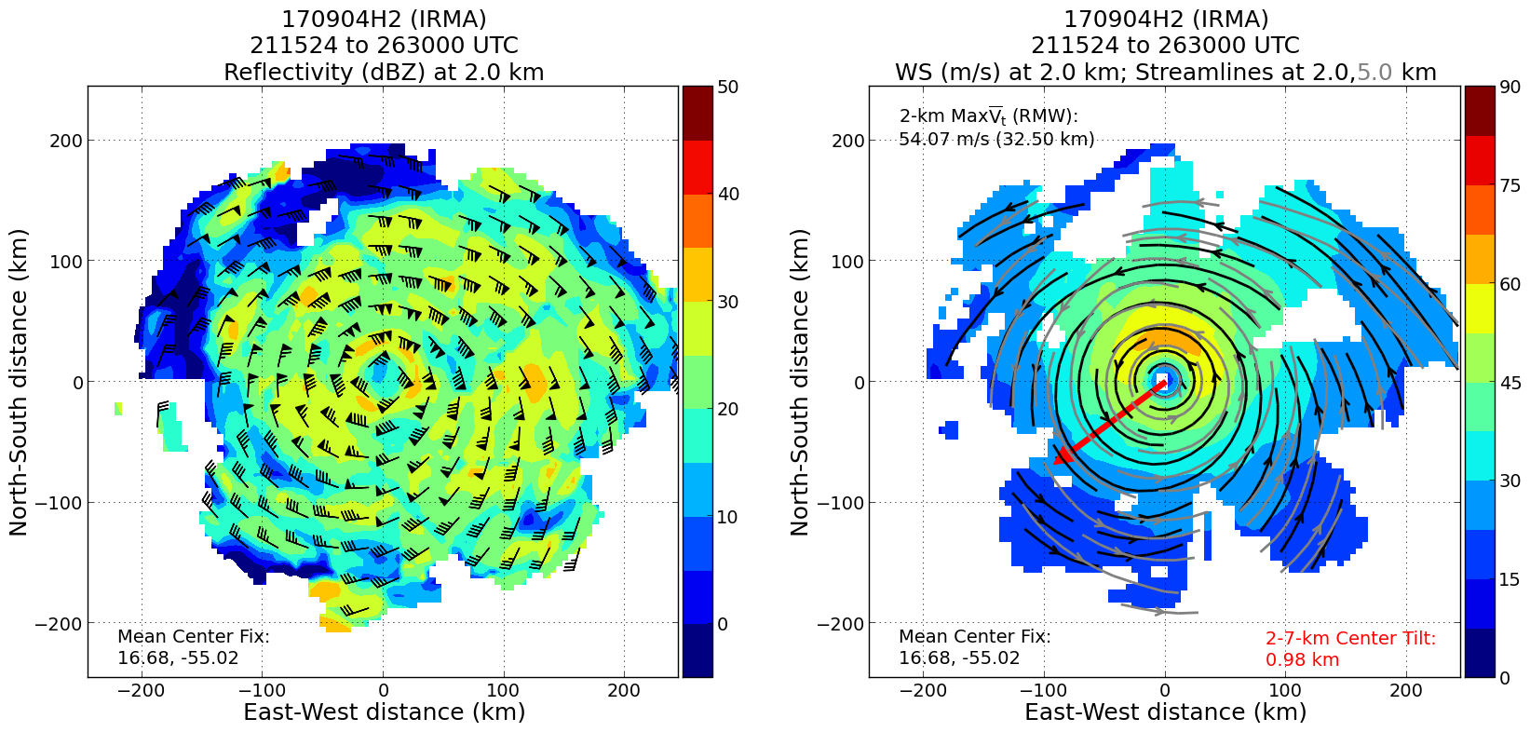
Hurricane Irma 20170904H2

Slide 8
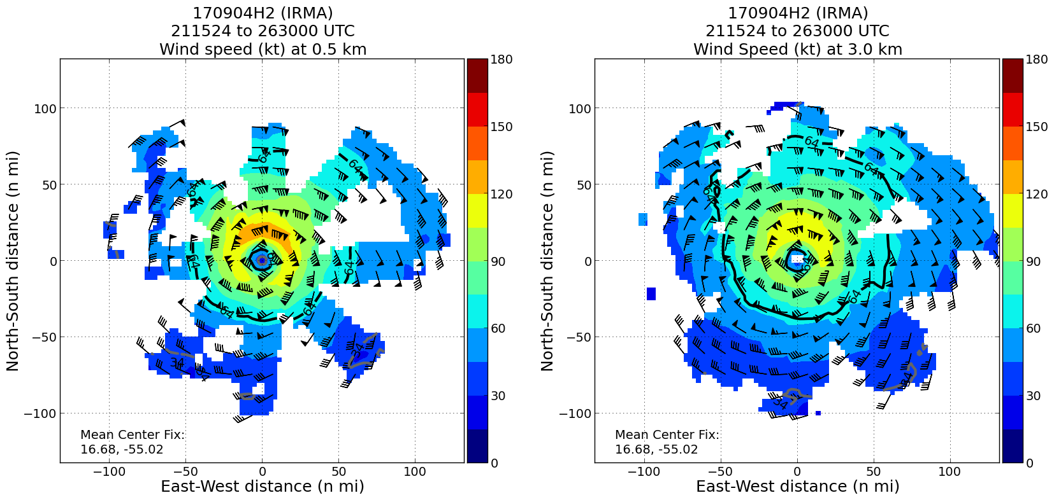
Hurricane Irma 20170904H2

Slide 9
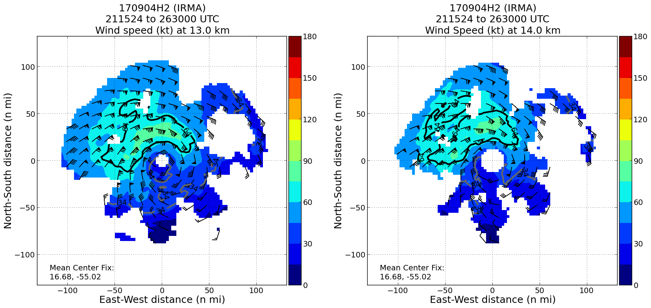
Hurricane Irma 20170904H2

Slide 10
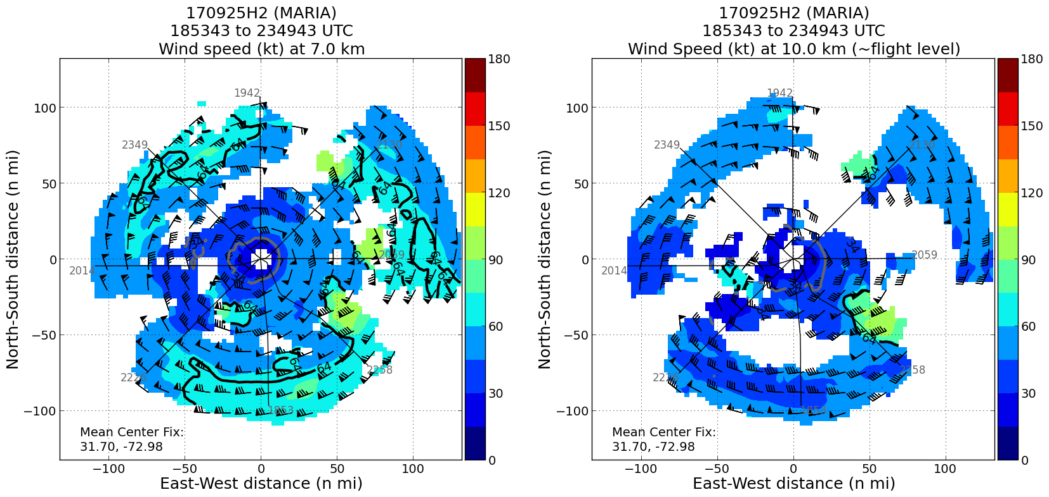
20170925H2 before applying proper Nyquist velocity to slave (aft) velocities

Slide 11
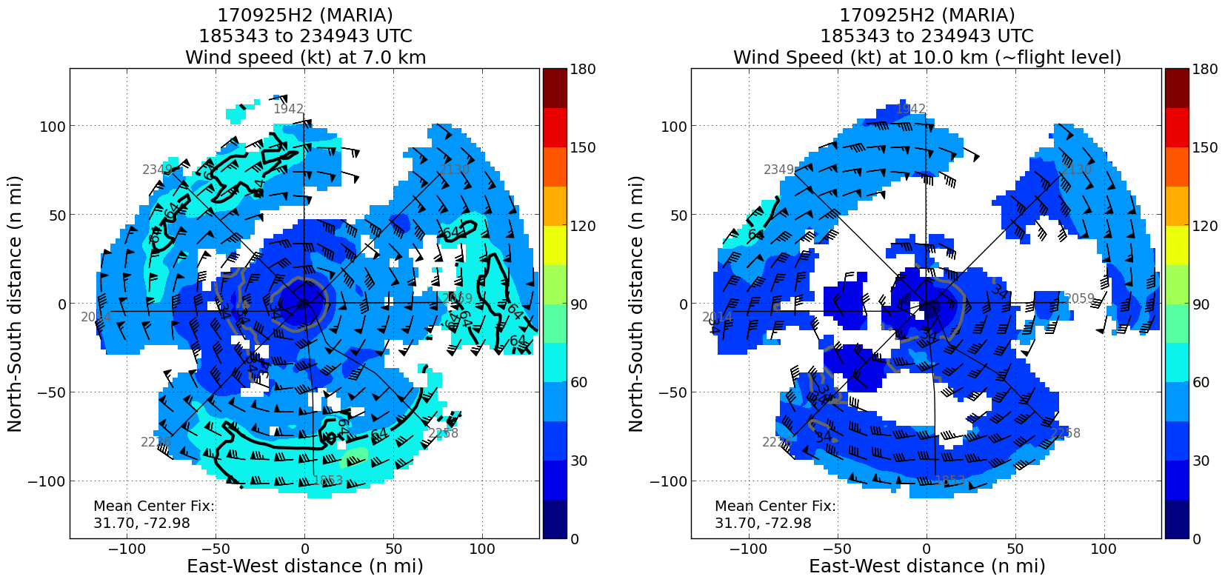
20170925H2 after applying proper Nyquist velocity to slave (aft) velocities

Slide 12
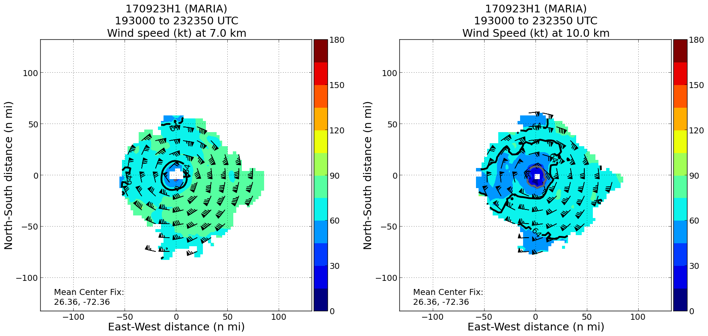
20170925H2 before applying proper Nyquist velocity to slave (aft) velocities

Slide 13
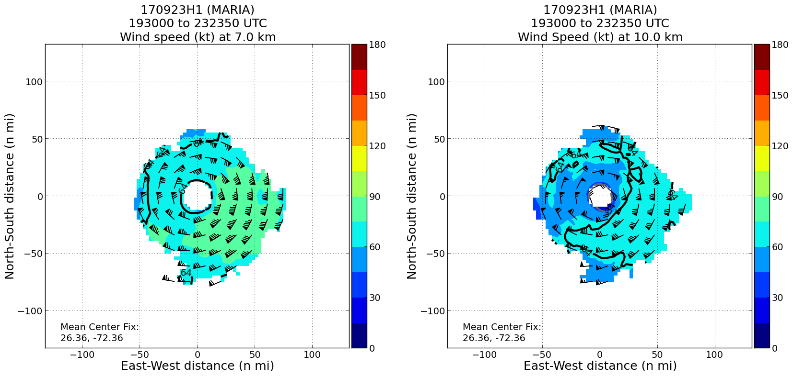
20170925H2 after applying proper Nyquist velocity to slave (aft) velocities

Slide 14






Impact of assimilating aircraft reconnaissance observations in operational HWRF on improving hurricane forecast for 2017 Atlantic high-impact storms
Banglin Zhang¹, Jason Sippel², Bin Liu¹, Mingjing Tong³, Zhan Zhang¹, Vijay Tallapragada¹and Avichal Mehra¹
¹EMC/NCEP/NWS/NOAA, College Park, MD 20740
²AOML/OAR/NOAA, Miami, FL 33149
³GFDL/OAR/NOAA, Princeton, NJ 08540-6649
August 15, 2017
Notes:
14
14

Slide 15
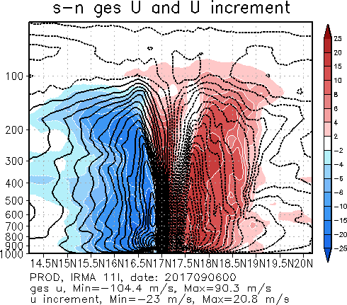
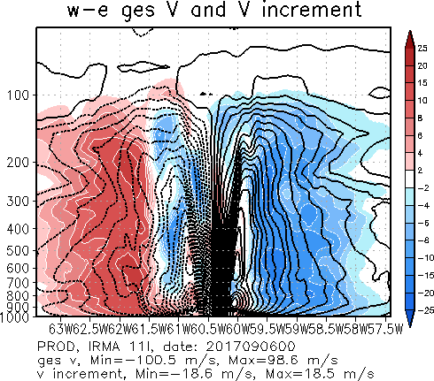
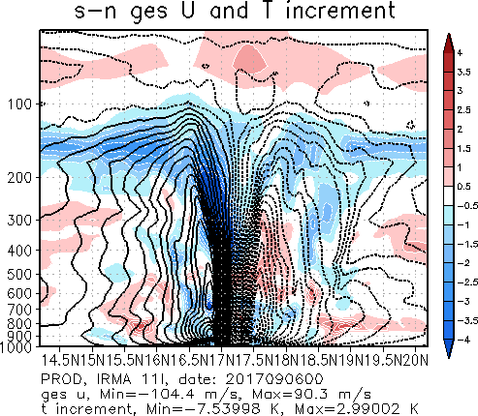
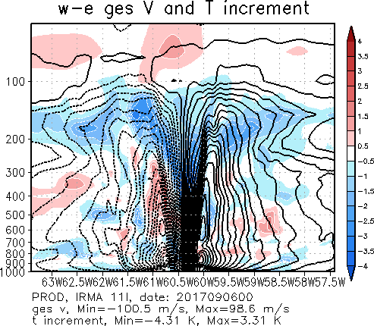
Analysis increments at 20170906_00Z
With TDR

Slide 16
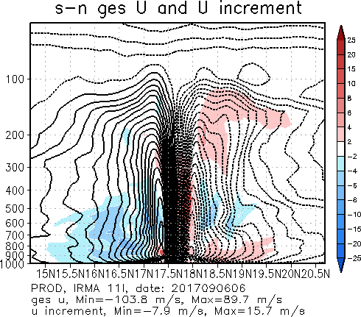
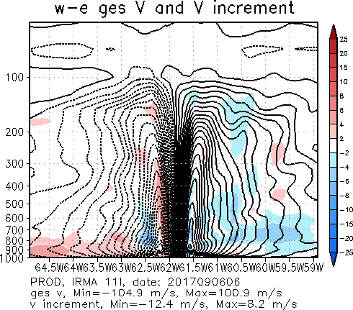
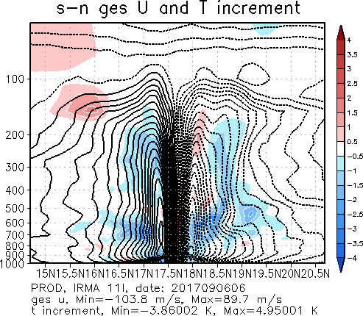
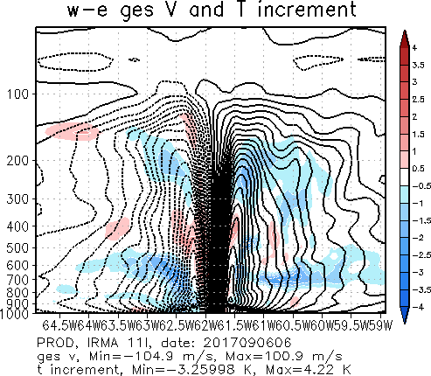
Analysis increments at 20170906_06Z
No TDR

Slide 17
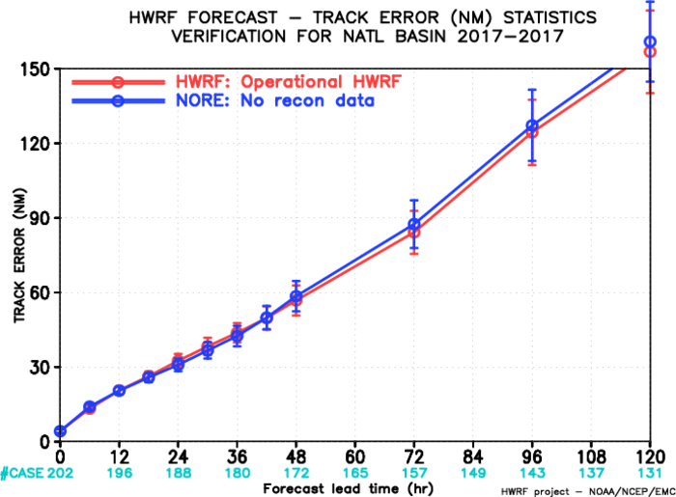
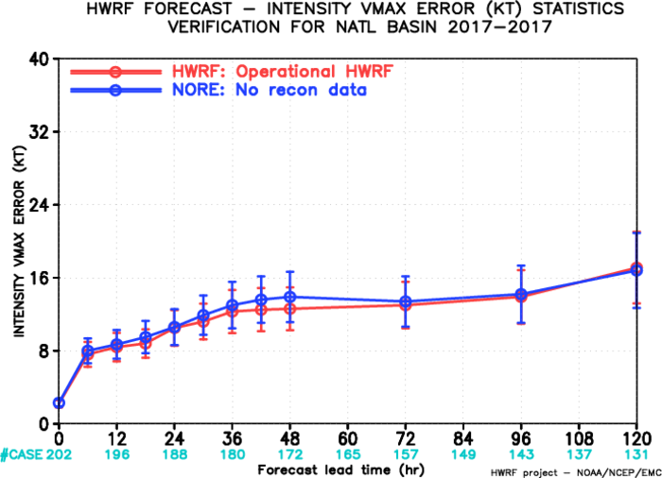
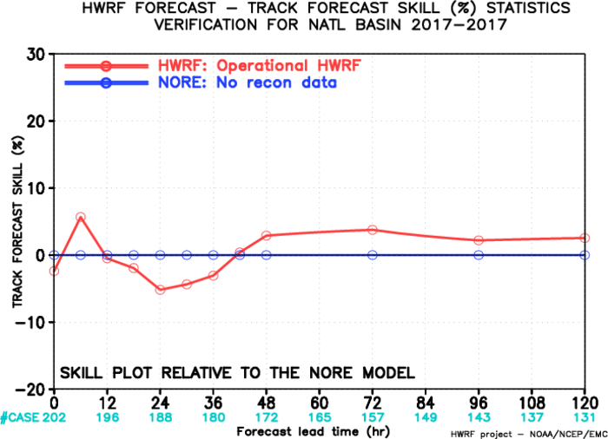
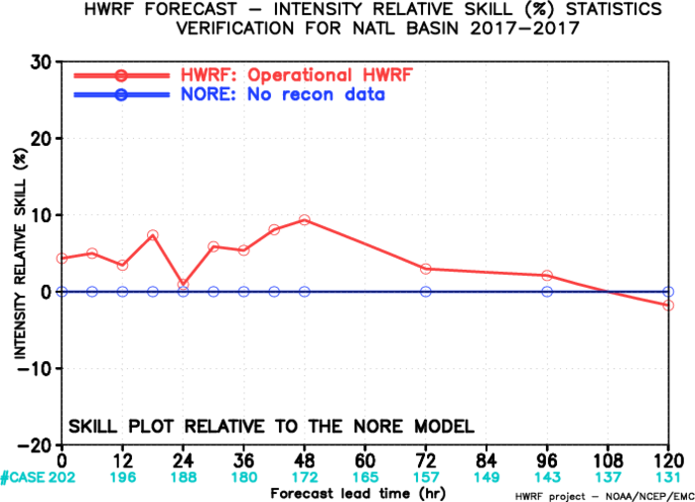
Track/intensity Errors Harvey, Irma, Jose, Maria combined

Slide 18
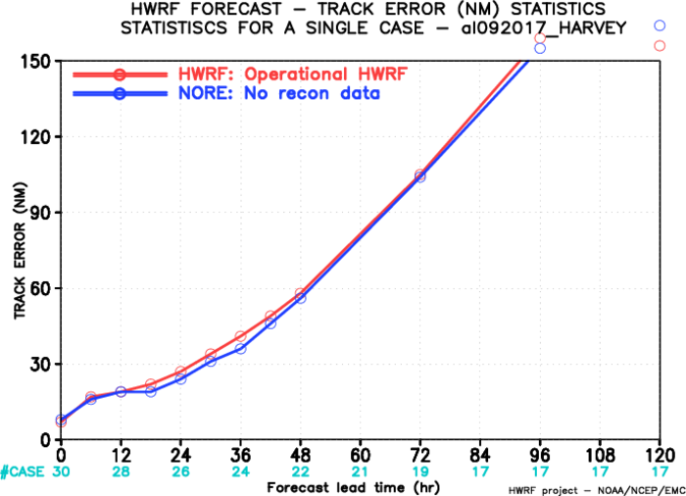
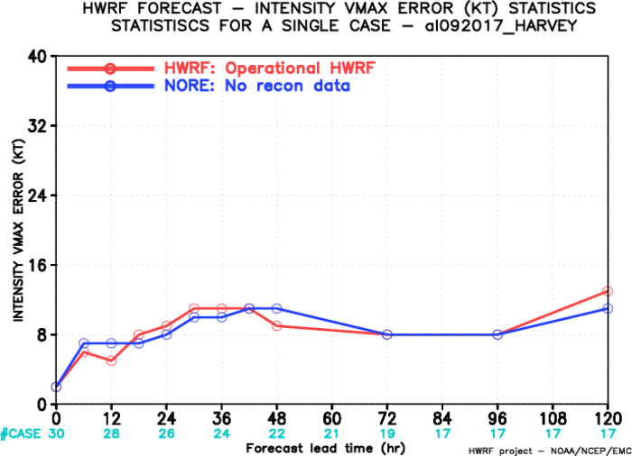
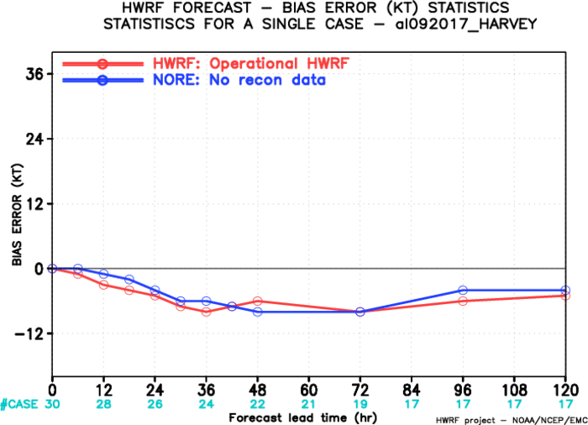
Track/intensity Errors
Stats for hurricane Harvey

Slide 19
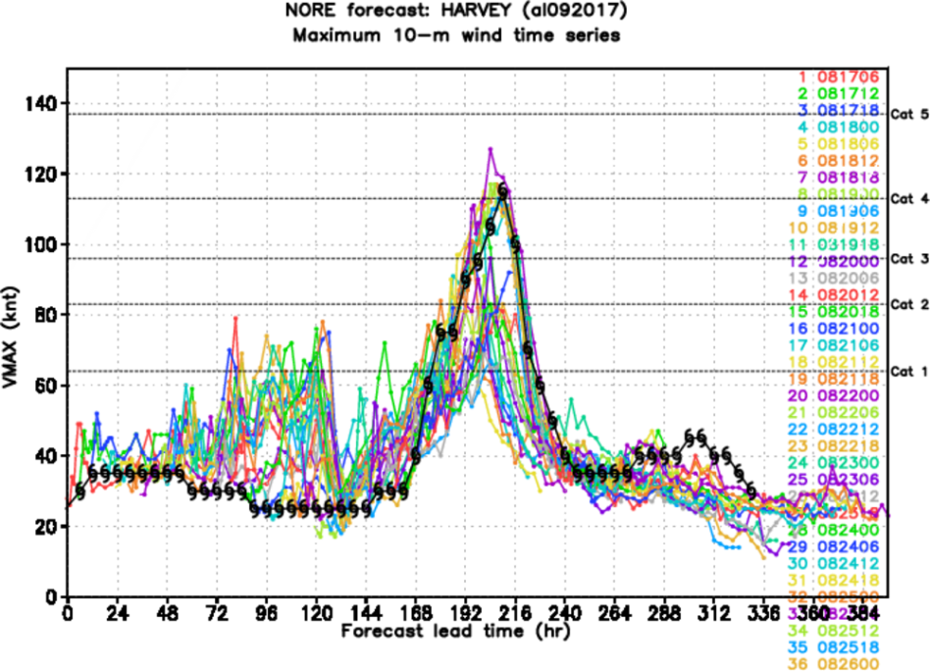
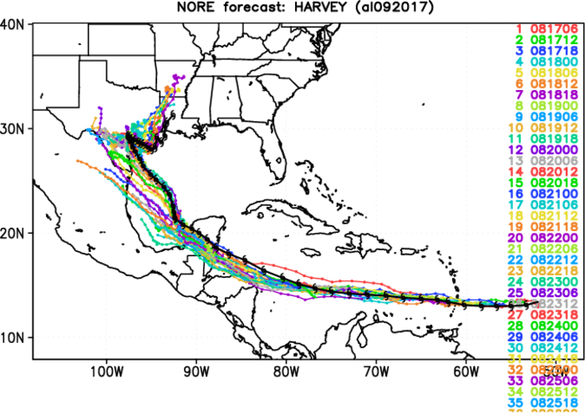
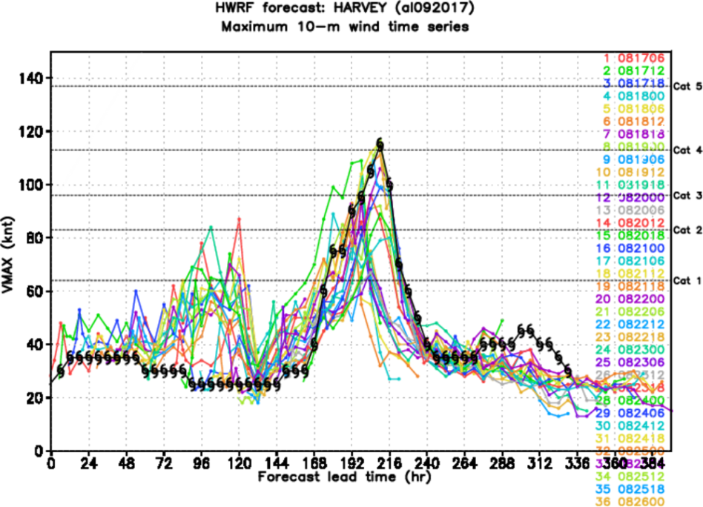
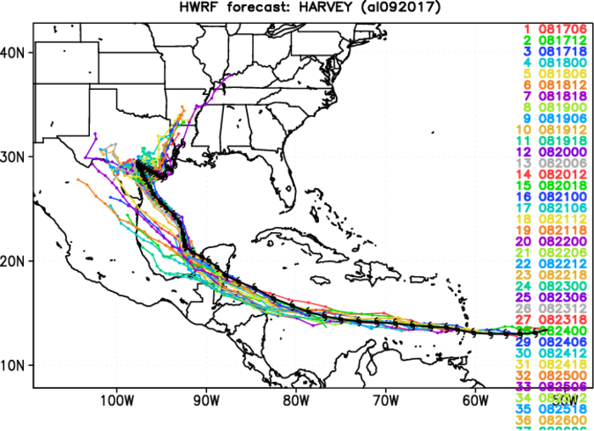
Track/intensity composite Harvey

Slide 20
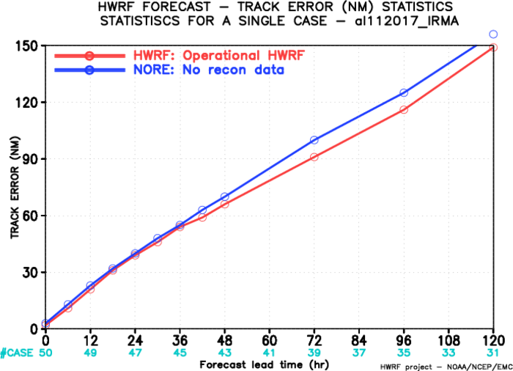
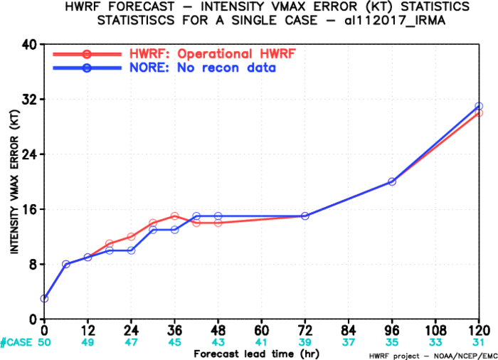
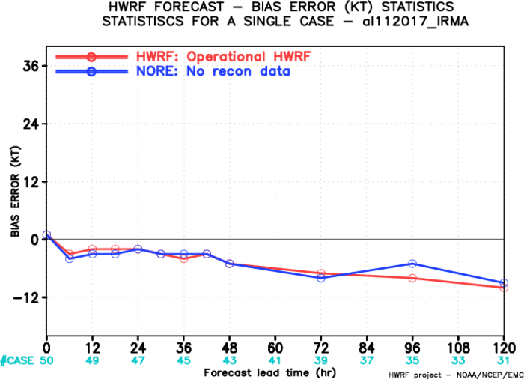
Track/intensity Errors
Stats for hurricane Irma

Slide 21
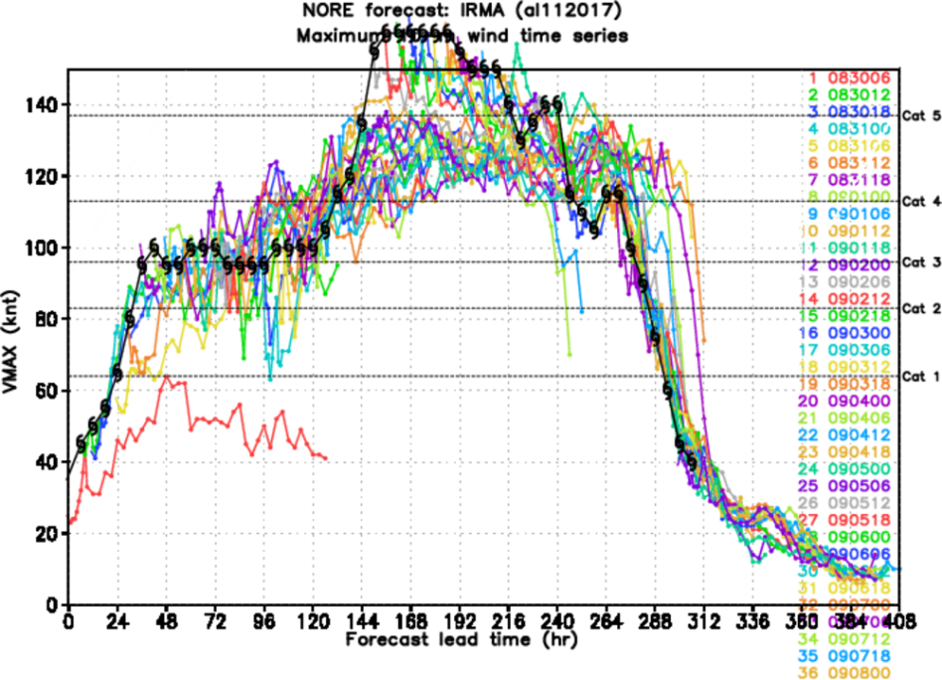
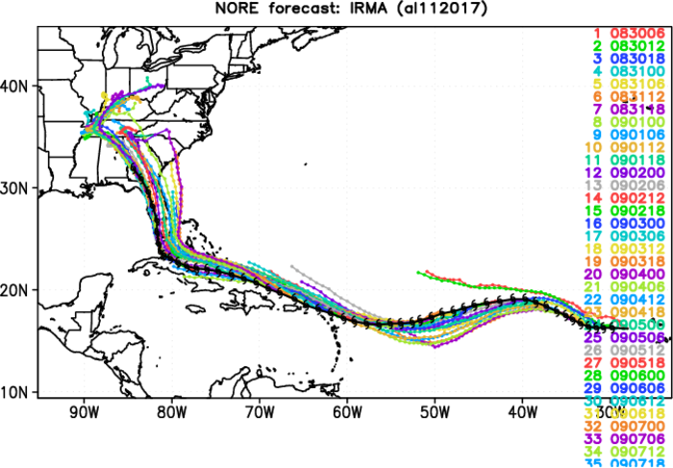
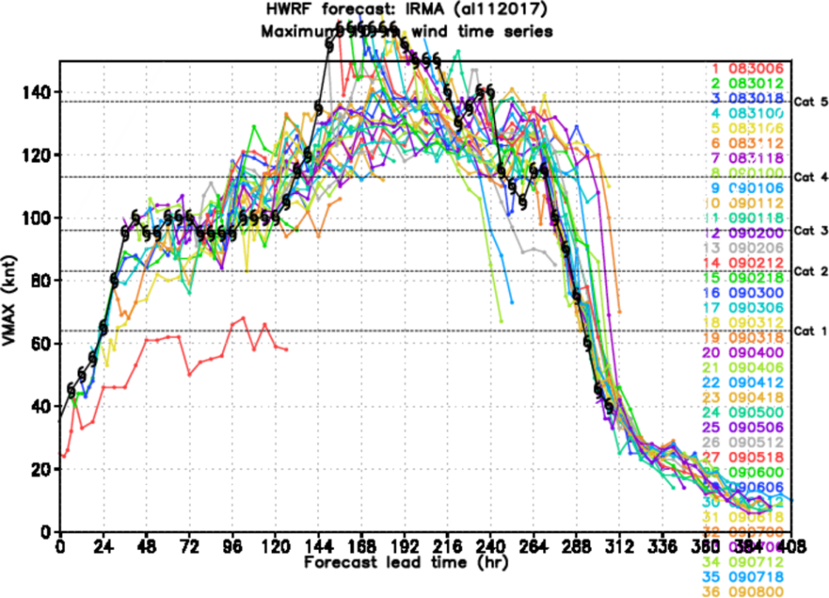
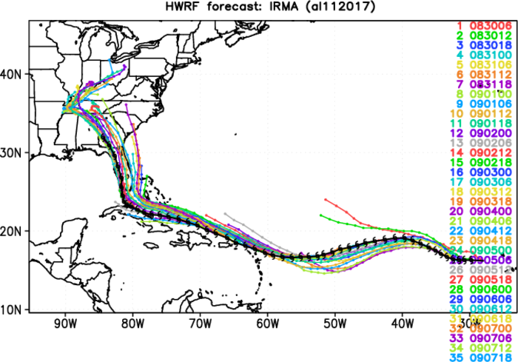
Track/intensity composite Irma

Slide 22
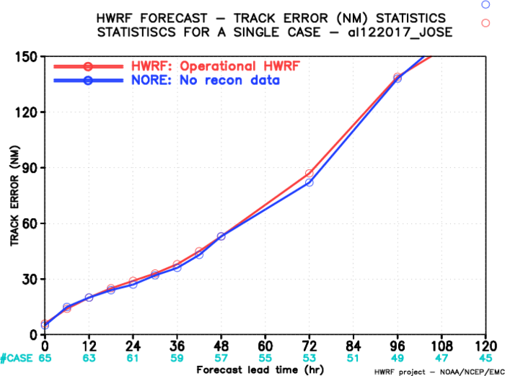
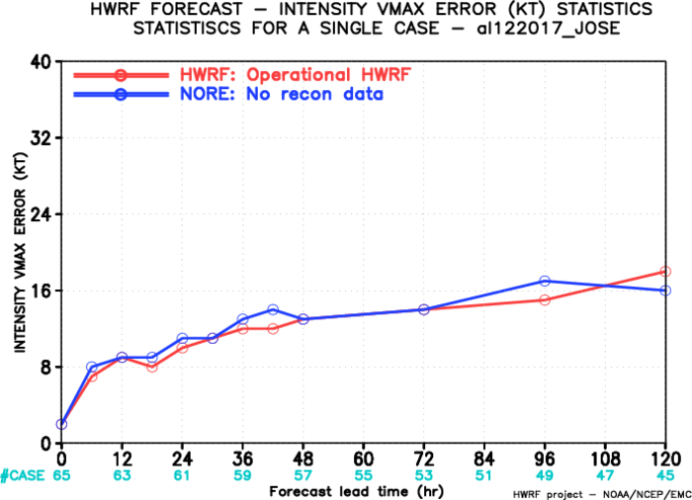
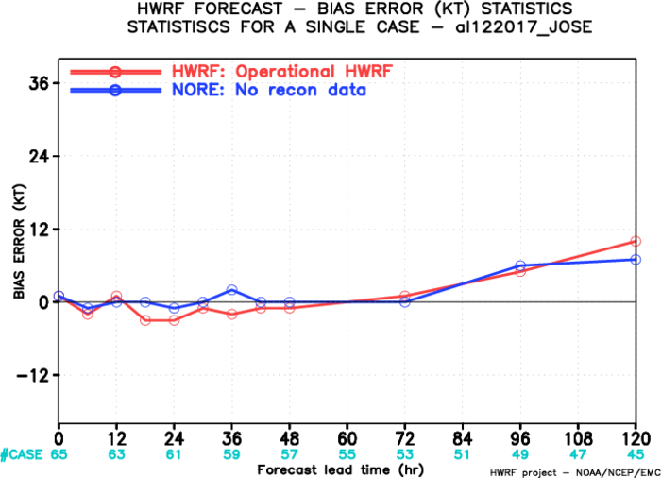
Track/intensity Errors
Stats for hurricane Jose

Slide 23
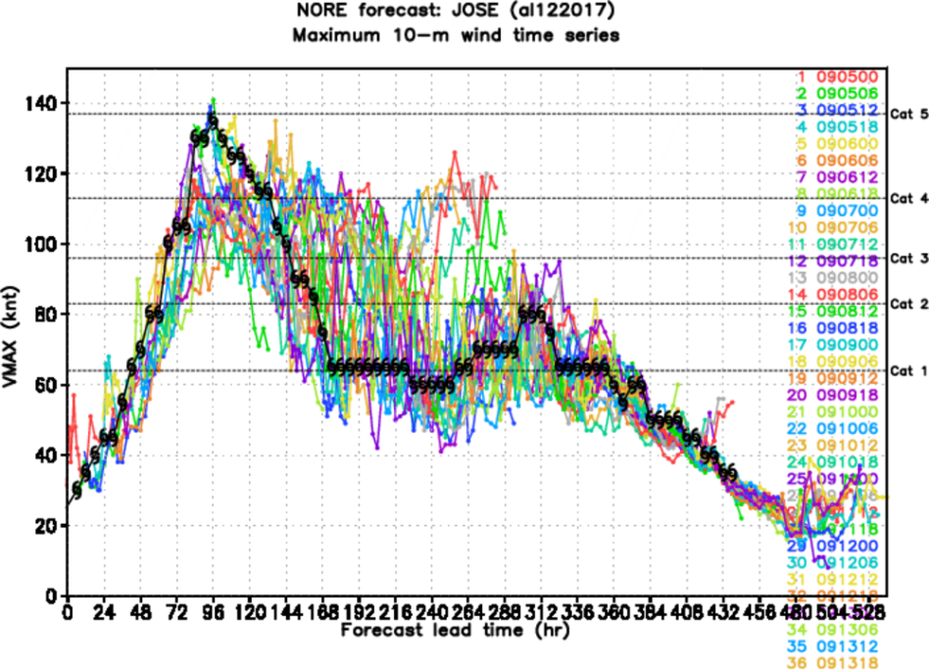
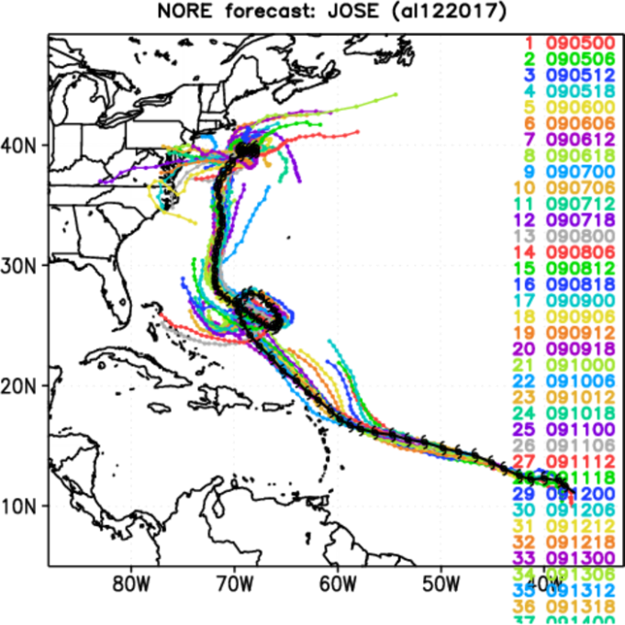
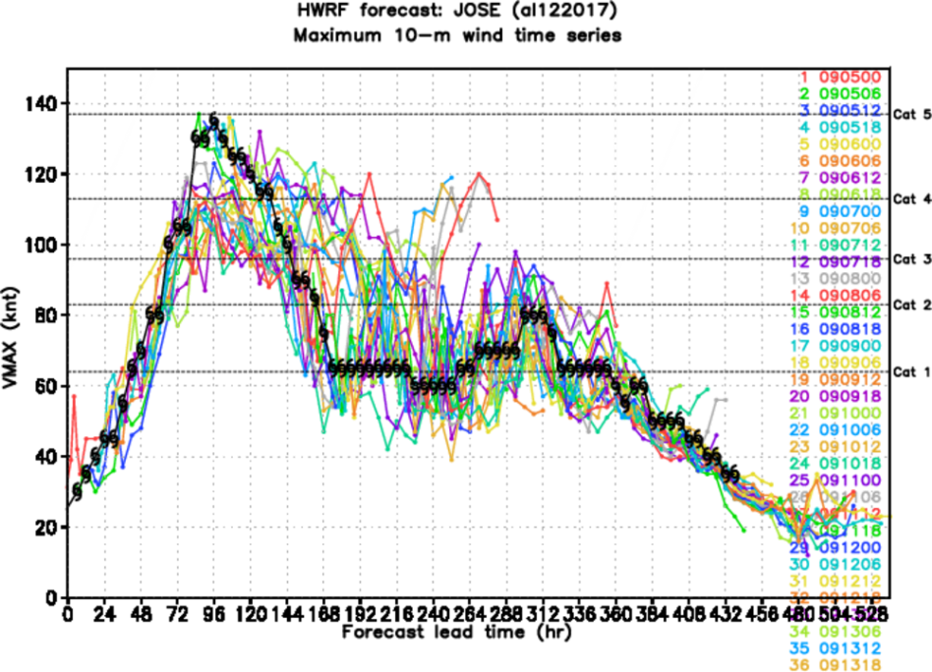
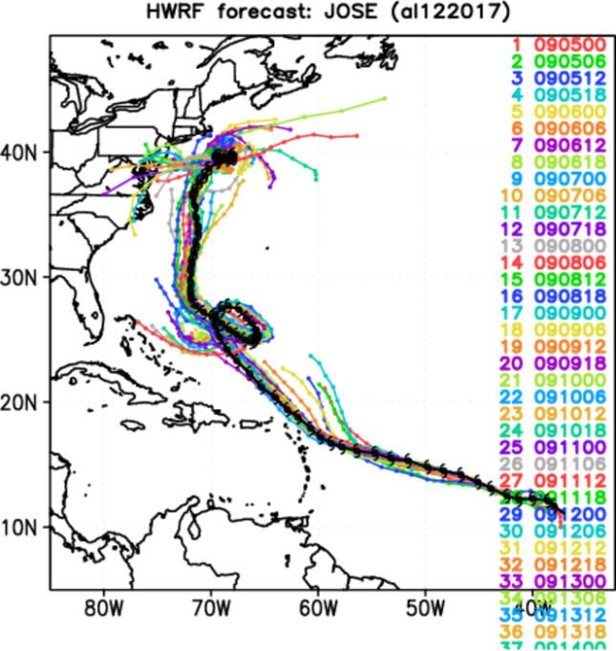
Track/intensity composite Jose

Slide 24
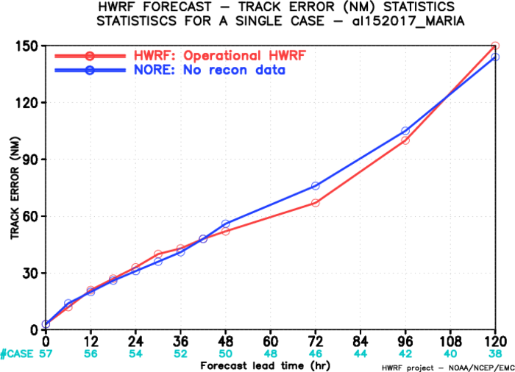
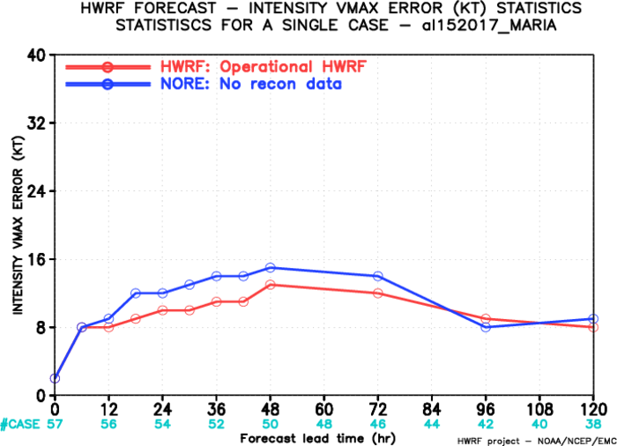
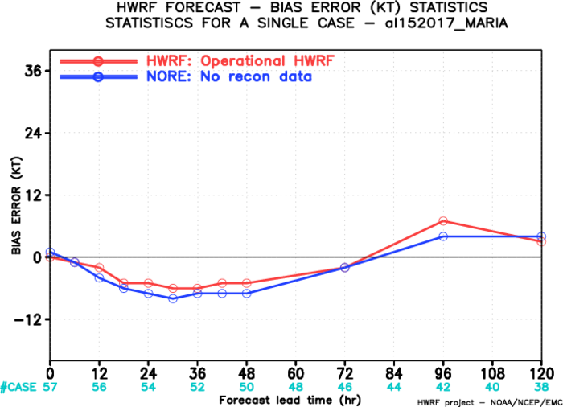
Track/intensity Errors
Stats for hurricane Maria

Slide 25
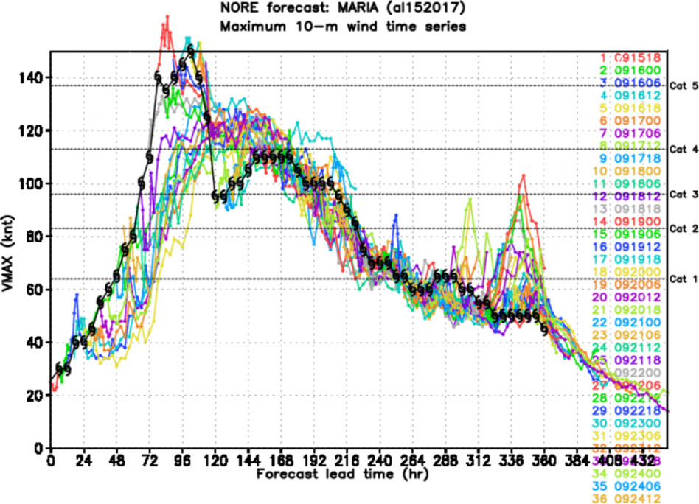
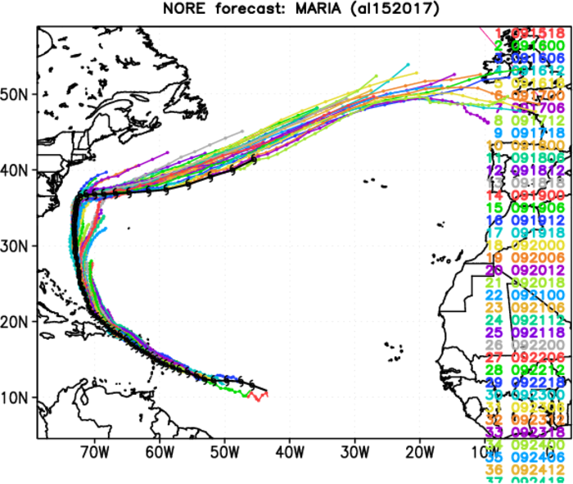
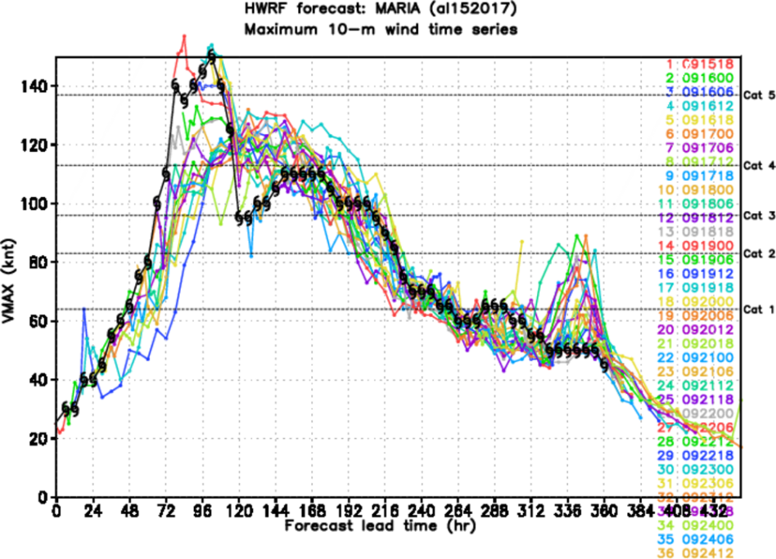
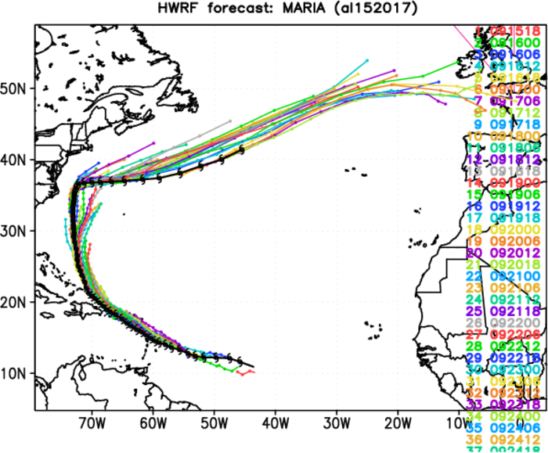
Track/intensity composite Maria

Slide 26
Open Discussion of EMC-tasked Missions
What determines the start/end of an EMC-tasked mission sequence?
How should take-off times be set for back-to-back missions? Synoptic times? C-130 schedule? Science requirements? AOC crew preferences?
Should EMC become more involved in the flight-pattern/expendable planning of EMC-tasked missions? If so, how?
What are the criteria for scrubbing or aborting a mission if EMC objectives will not be met fully? If such criteria are met, what is the procedure?
In terms of operational HWRF forecast impacts, what can be done to assess the value added by traditional recon and TDR data from the P3?
Other issues/questions?

Slide 27
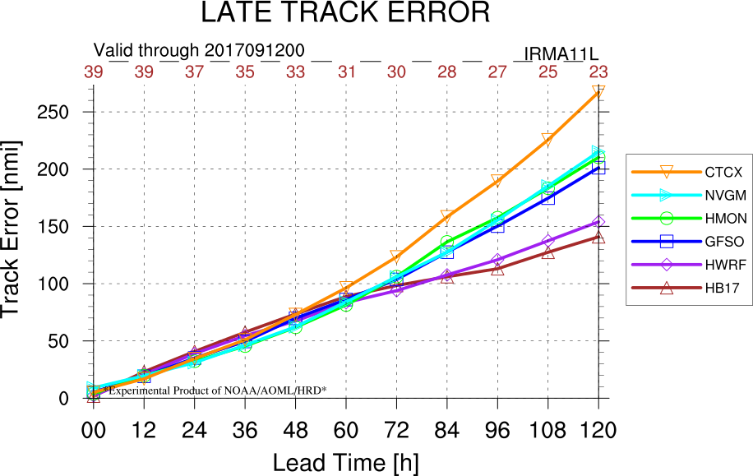
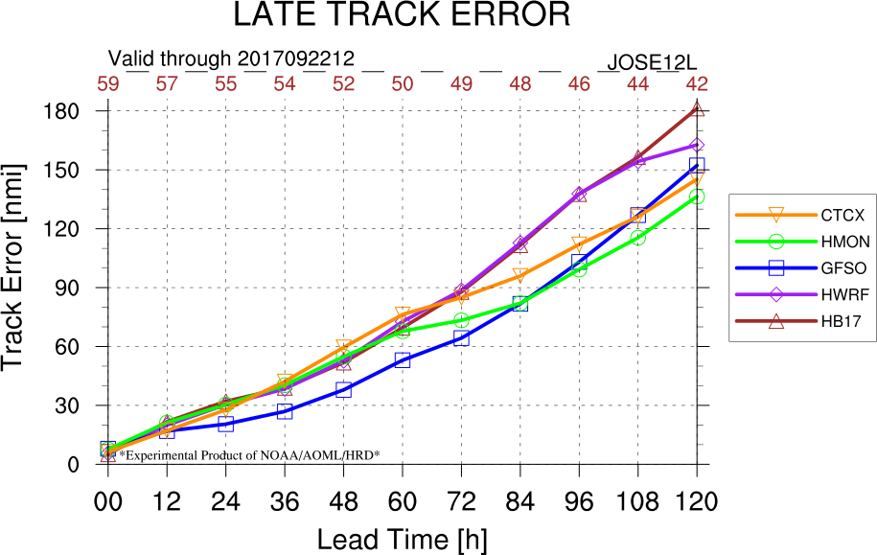
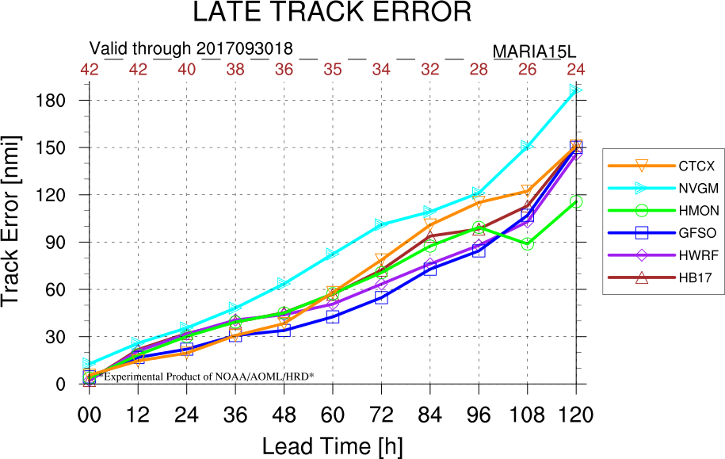



Basin-Scale HWRF Verification
IRMA
JOSE
MARIA
> For Irma, HB17 was the best model at 96+ h
> For Jose, HB17/HWRF were not as good as GFS
> For Maria, HWRF/GFS performed better than HB17
> What was the importance of multi-storm interactions between these TCs?
1. Irma & Jose
2. Jose & Maria
COMBINED

Slide 28

IRMA DATASET
Basin-Scale HWRF output for IRMA is available
20170908_12 forecast (right) has excellent track and radar representation
Why did HB17 adjust west faster than GFS, its parent model?
  Stronger ridge?
Other research ideas?
BEST

Slide 29


GFS tracks were very inconsistent run to run.
HB17 tracks were consolidated around the Best Track as early as 08/00z

