Slide 1
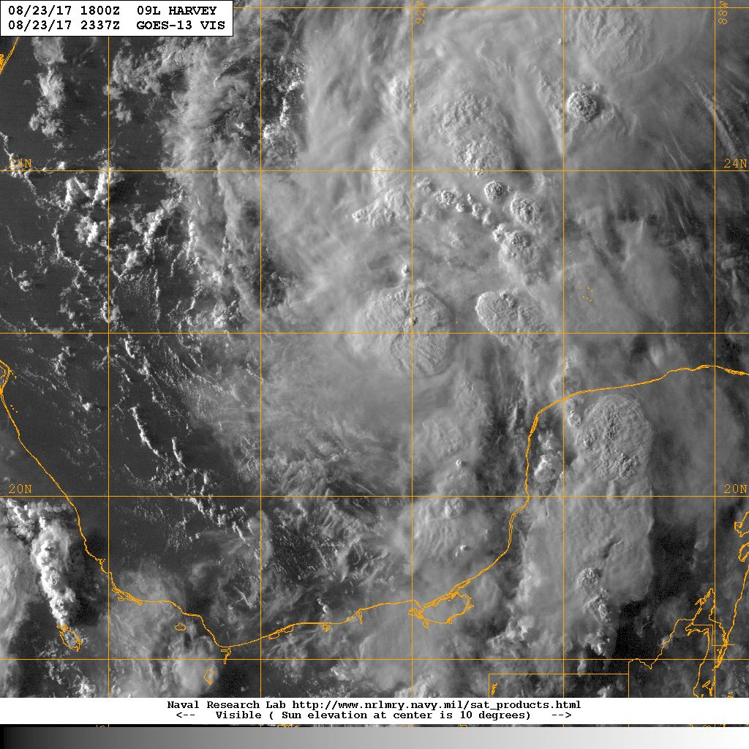
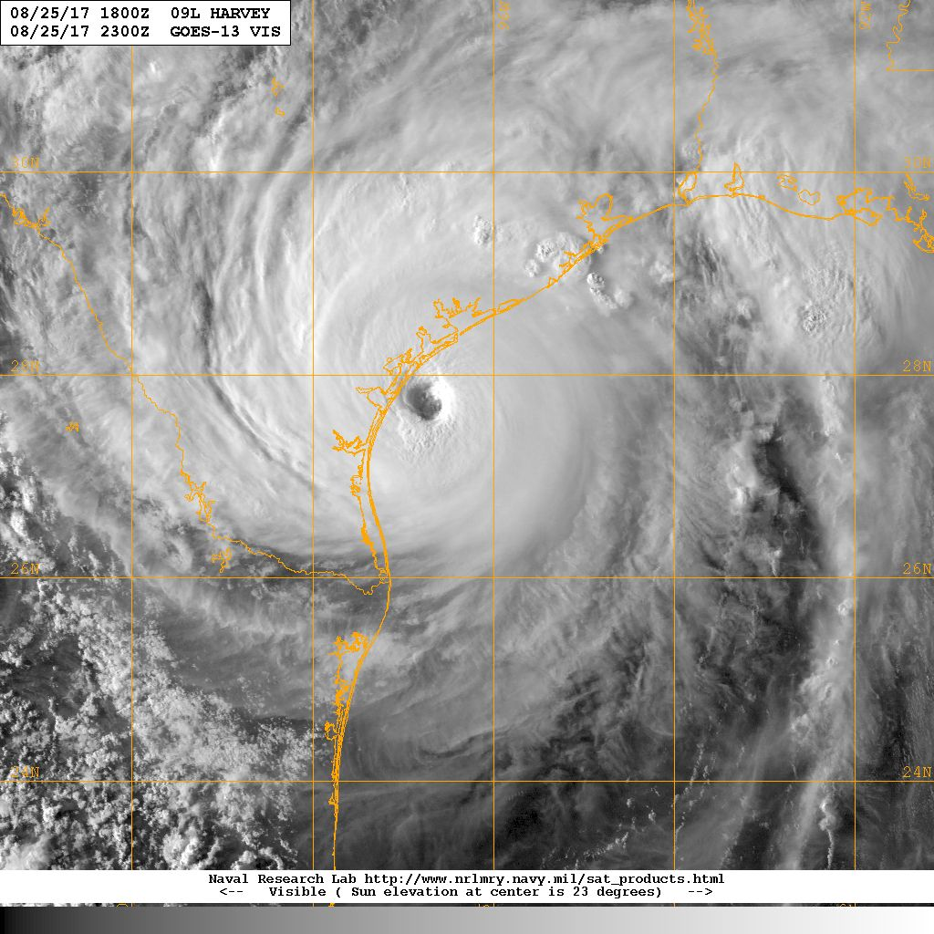
Hurricane Harvey Debrief
00Z 24 Aug
23Z 25 Aug
Flight ops re-cap: 4 Total flight missions
40 P-3 flight hours; 49 GPSsondes; 22 AXBTs
September 1, 2017

Slide 2
Agenda
Missions Overview (Reasor)
Science Discussions
  170824H1 TDR (Rogers)
  170824H2 TDR (Zawislak)
  170825H1 TDR (Rogers)
  170825H2 TDR/OceanWinds (Zawislak)
Additional Field Program Issues
HWRF Basin-scale input (Alaka)

Slide 3
Missions Overview
Purpose: EMC-tasked TDR data collection targeting 06 UTC and 18 UTC HWRF cycles
Target: TD-MH Harvey on 24-25 Aug in the western Gulf of Mexico
Background: TS Harvey developed from a disturbance just east of the Lesser Antilles, struggled to intensify under moderate shear and became a remnant low late 19 Aug. Environmental conditions improved as the low moved across the Yucatan. Upon emerging into the Bay of Campeche, Harvey regained TD status on 23 Aug, then rapidly intensified to a Cat-4 Major Hurricane before making landfall on the Texas coast late on 25 Aug.

Slide 4
Missions Overview (local times)
18 Aug: N42 aborts ferry just short of STX and returns to Lakeland (#3 engine chips light). EMC-tasked mission for 19 Aug scrubbed.
19 Aug: N42 ferries to STX late in the day
20 Aug: EMC cancels tasked missions as Harvey becomes a remnant low
23 Aug: 10AM EMC-tasked mission scrubbed (N42 brake issue); 10PM mission (bad SFMR, bad TDR)
24 Aug: 10AM mission; 10PM mission
25 Aug: 10AM mission

Slide 5
Missions Highlights
Sampled rapidly intensifying storm w/ significant U.S. impact; transmitted recon data for HWRF DA (06Z & 18Z)
Coincident Global Hawk during 1st 10PM flight
CYGNSS coordination during 10PM flights
18th
19th
20th
21st
22nd
23rd
24th
25th

Slide 6
Tropical Depression Harvey
Flight 170824H1
Meteorological highlights
Harvey was a tropical depression in the western Gulf of Mexico
Experiencing light to moderate SW shear
Moist low-level environment, dry midlevel on SW (upshear) side of storm, but pretty far-removed
Deep convection developing DSR, linear band extending upwind
Mission “high”lights
10 GPS dropsondes – 6 HFIP at turn points, 3 NHC at center, 1 Ocean Winds on NE side
6 AXBTs, 3 failed
Global Hawk, G-IV missions occurring during this flight
Coordinated outbound leg to NE with CYGNSS overpass for Ocean Winds
Major problem with TDR – aft antenna did not get velocities. No TDR analyses, no superobs transmitted to EMC.
Problem with SFMR – failed during mission

Slide 7
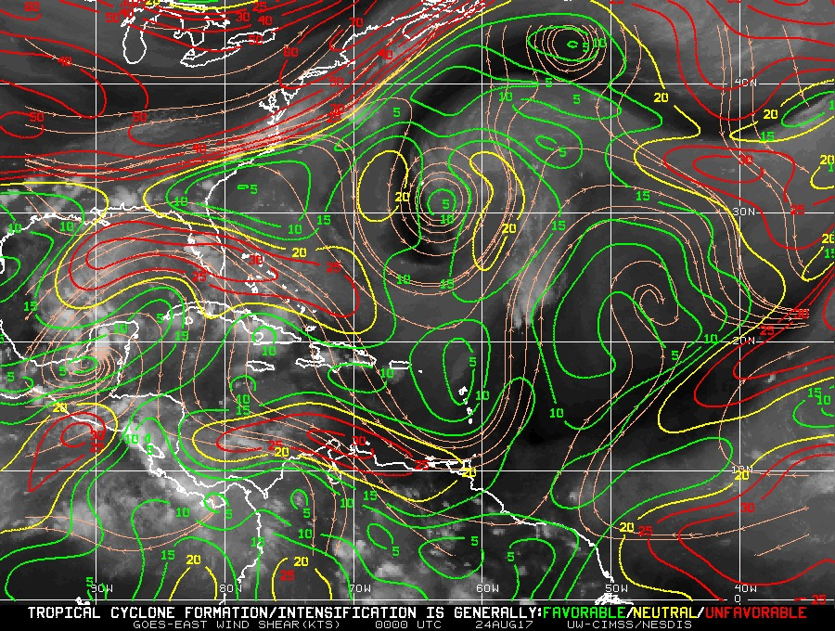
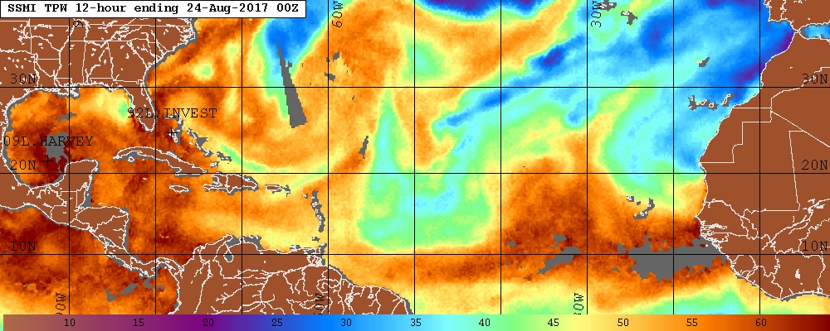
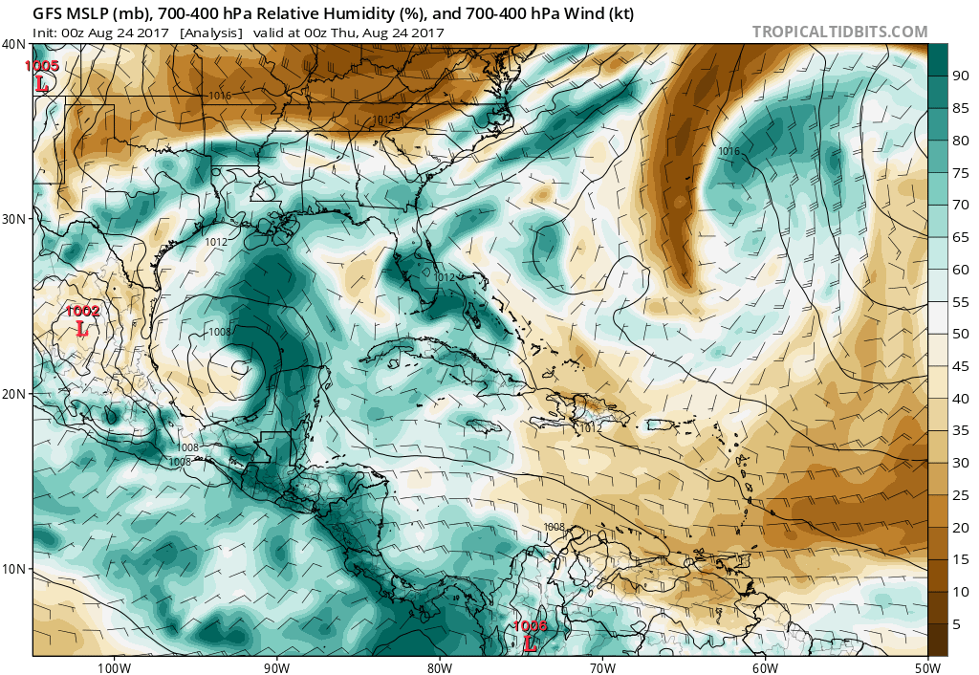
Environmental conditions
CIMSS 850-200 hPa shear 00 UTC Aug 24
TPW 00 UTC Aug 24
Midlevel humidity and winds 00 UTC Aug 24

Slide 8
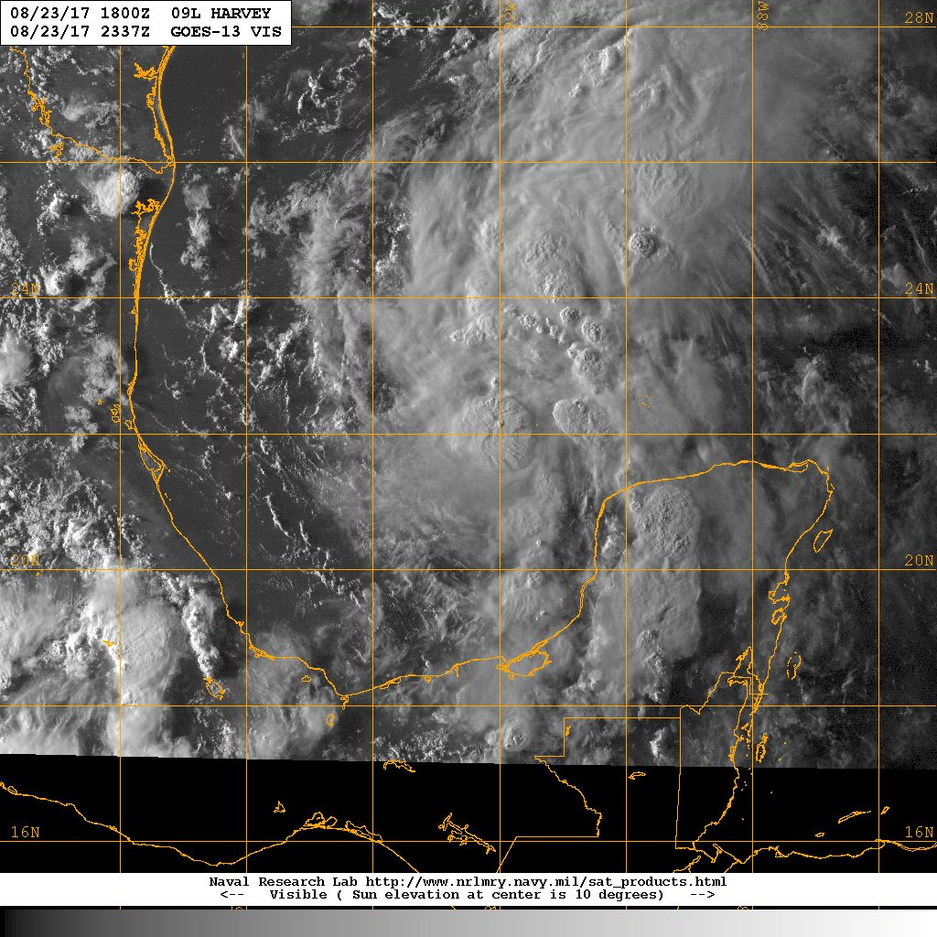
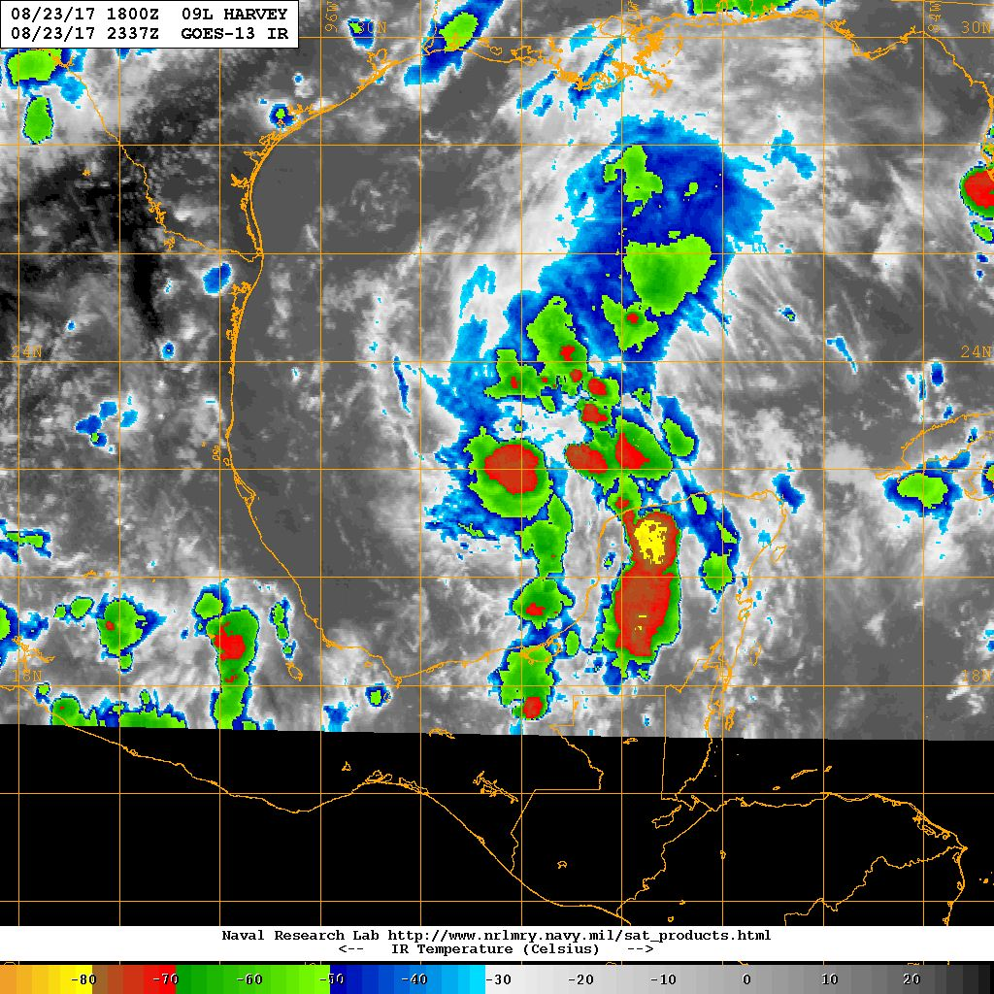
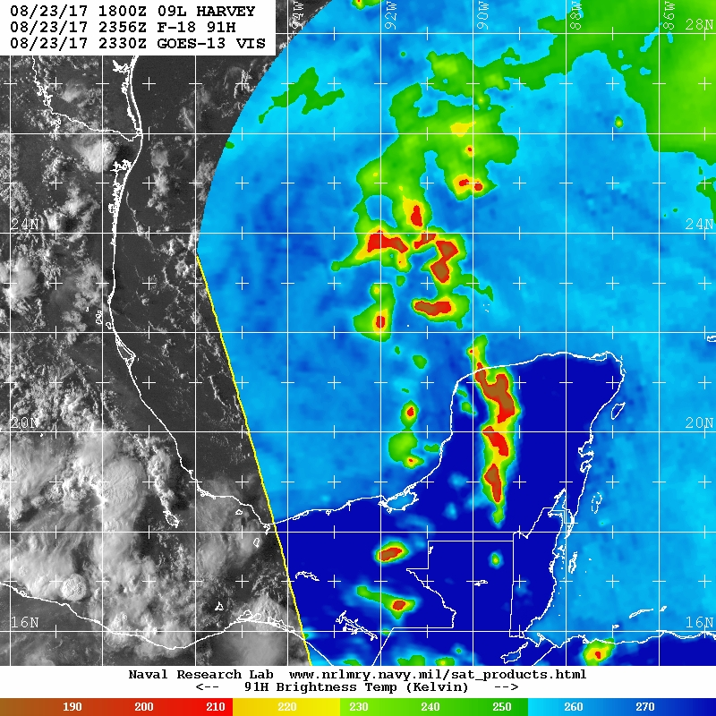
Satellite presentation
GOES-13 Vis valid 2337 UTC Aug 23
GOES-13 IR valid 2337 UTC Aug 23
F-18 91 GHz valid 2356 UTC Aug 23

Slide 9
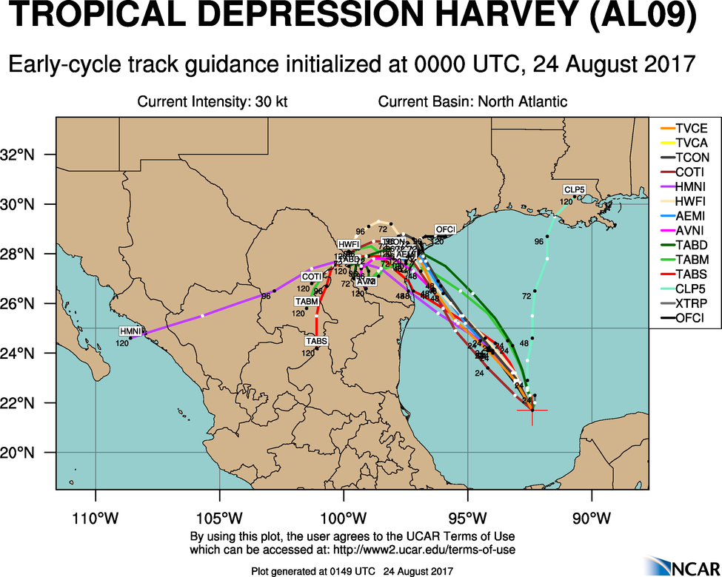
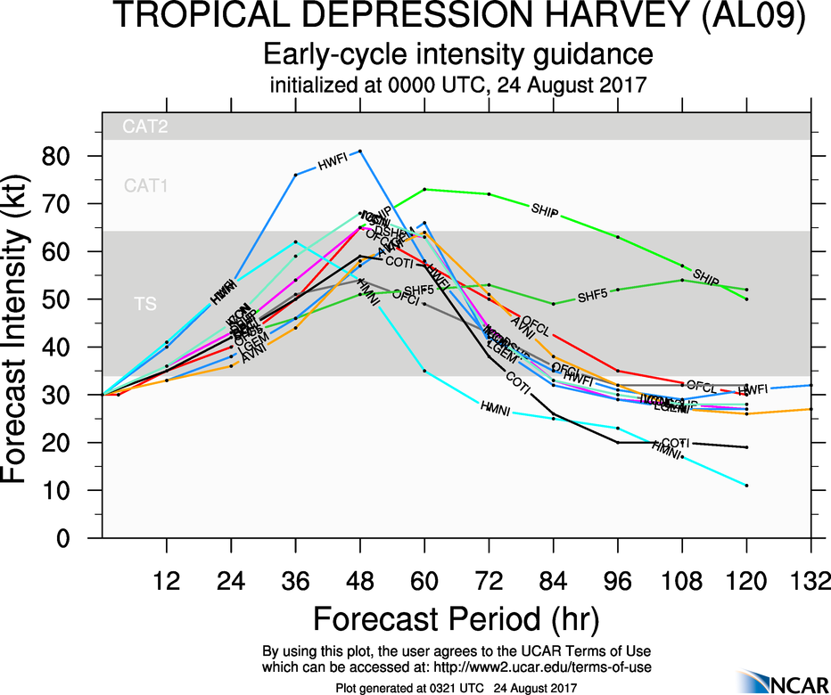
Model guidance

Slide 10
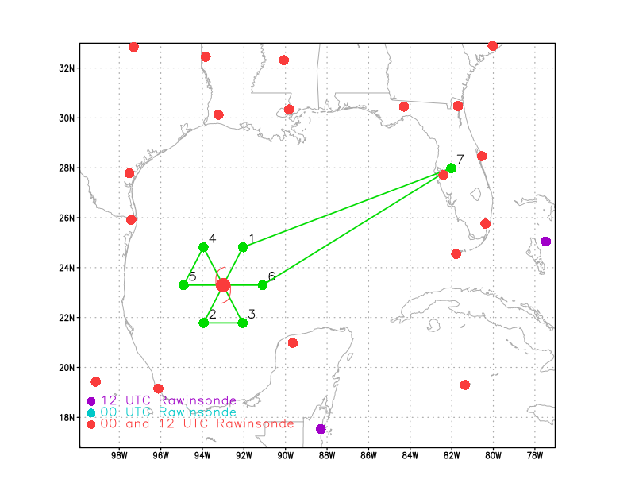
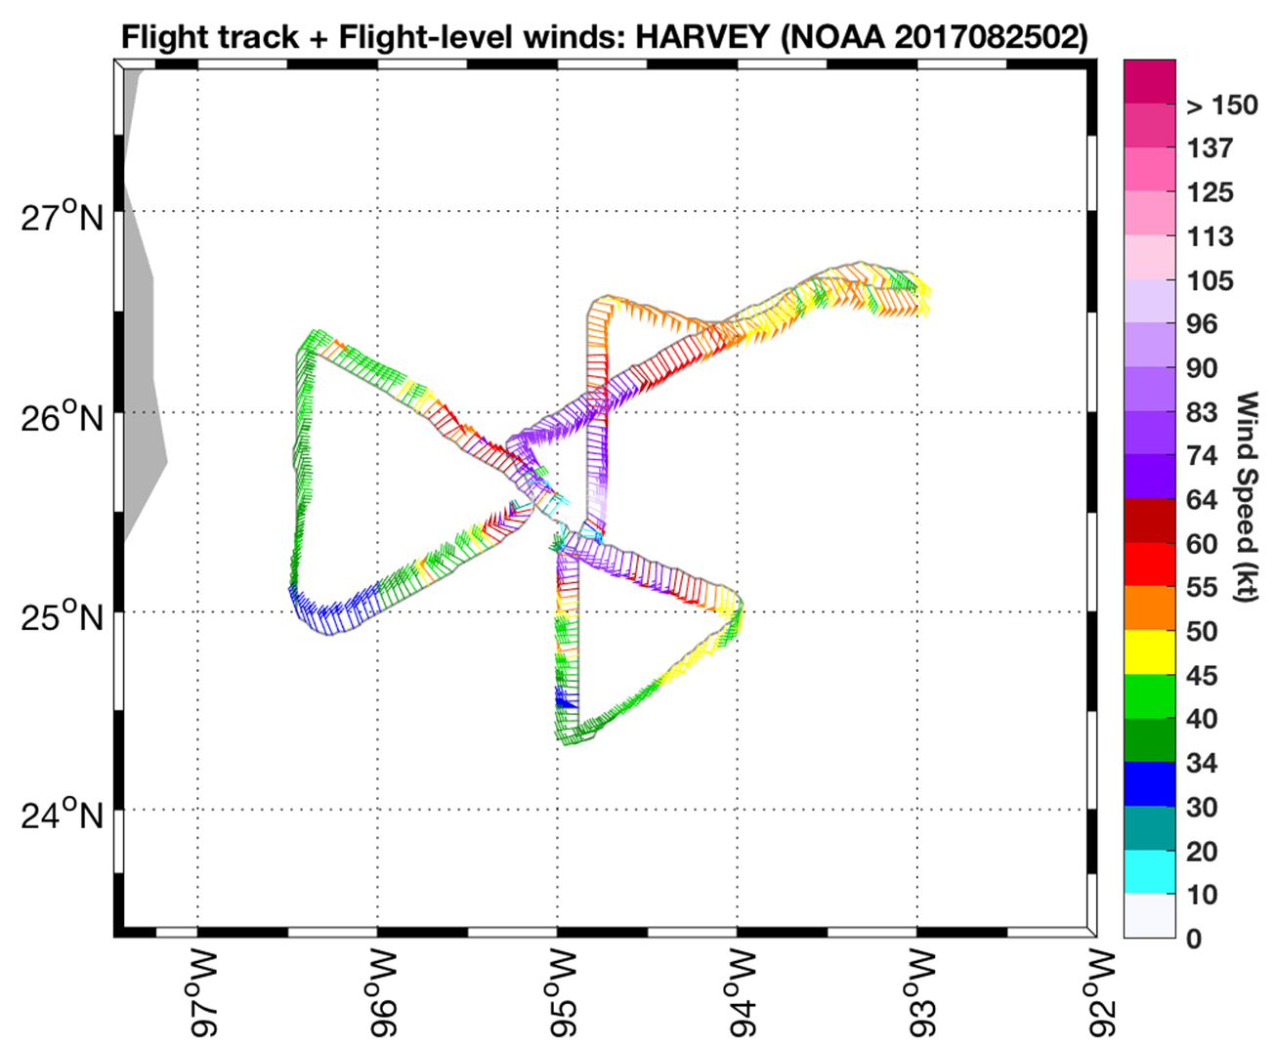
Flight tracks
Planned flight track for 170824H1
Actual flight track for 170824H1

Slide 11
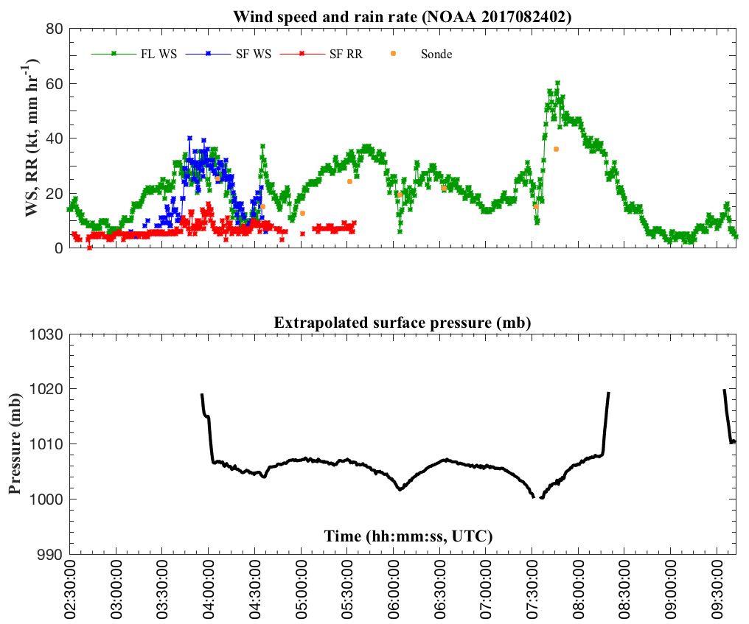
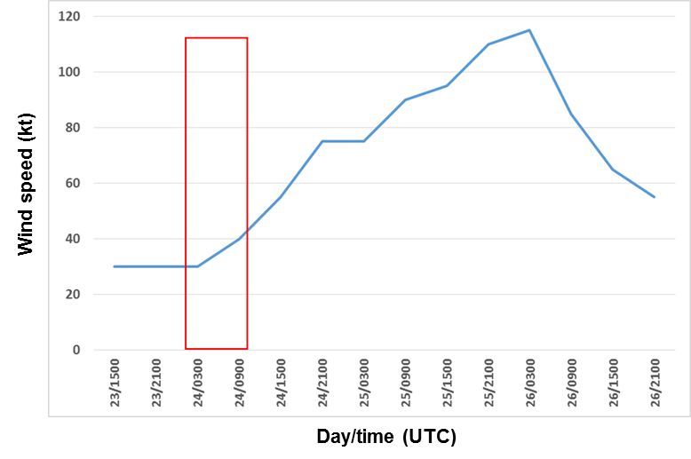
Flight-level data

Slide 12
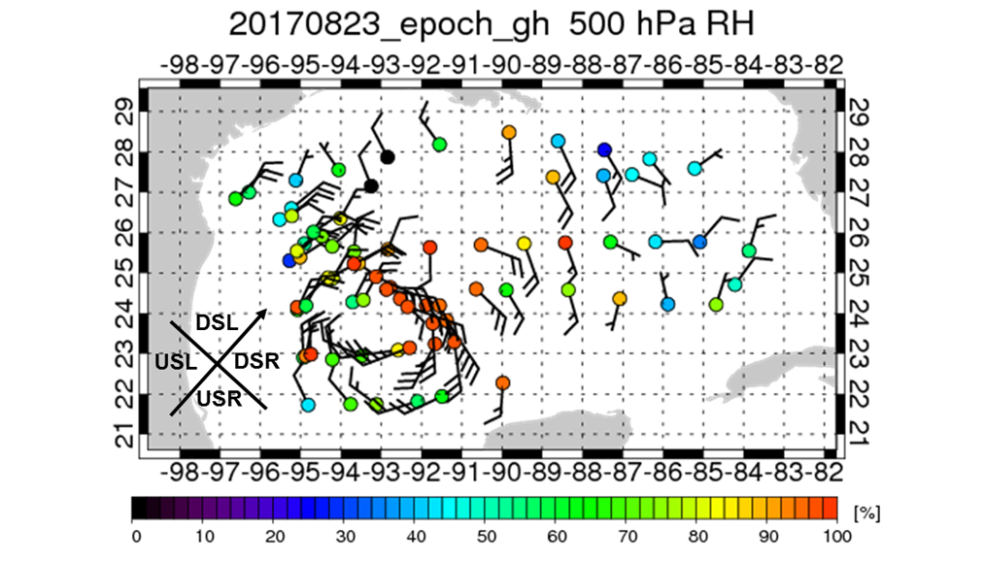
Dropsonde environment

Slide 13
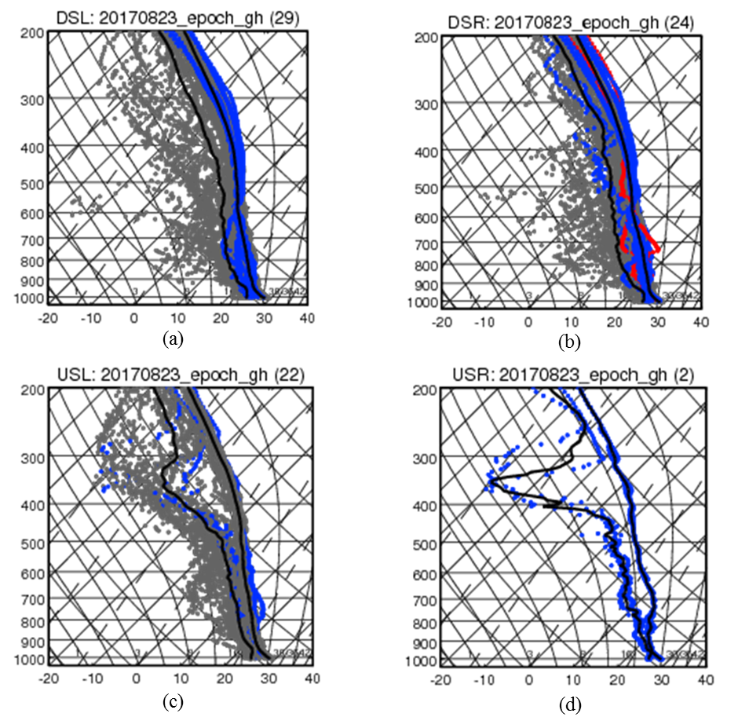
Shear-relative profiles

Slide 14
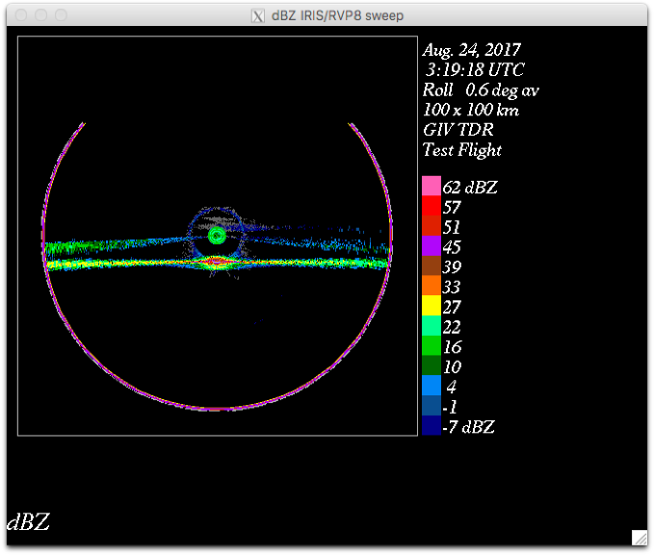
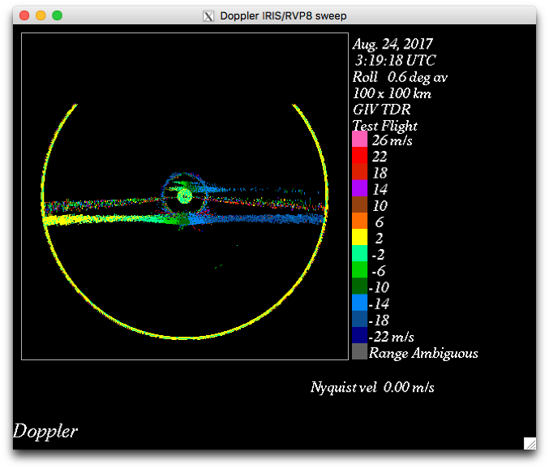
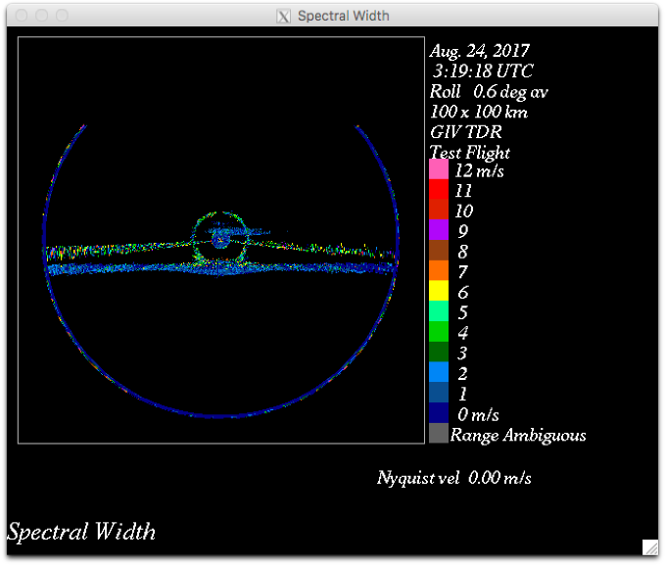
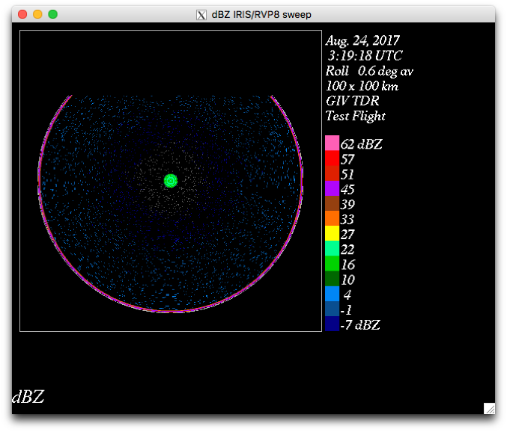
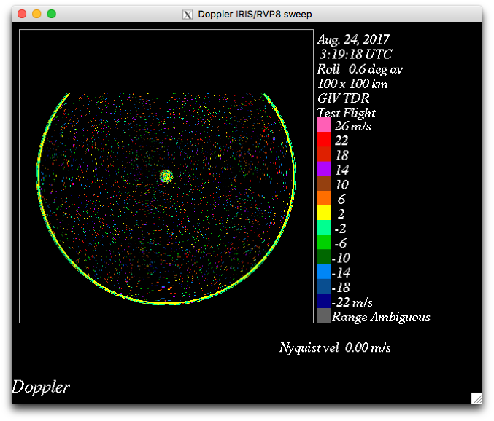
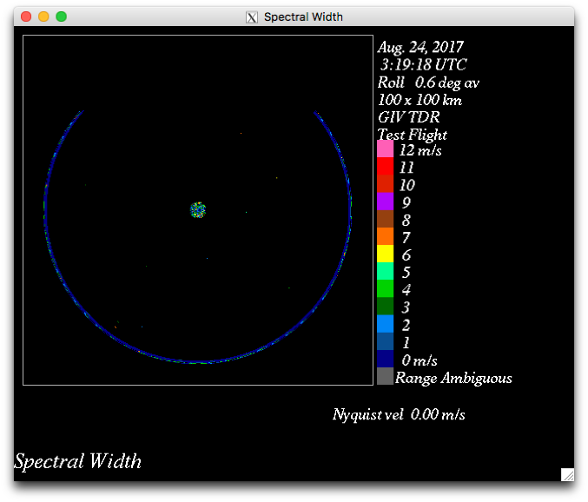
0319 UTC 20170824 (ferry out) master (above) and slave (below) reflectivity, radial velocity, and spectral width

Slide 15
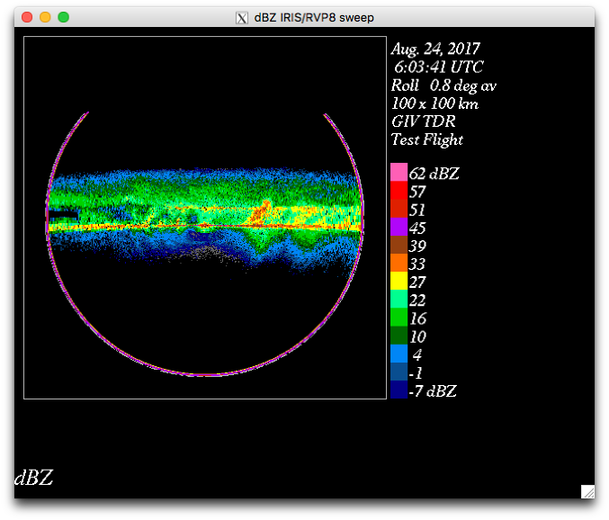
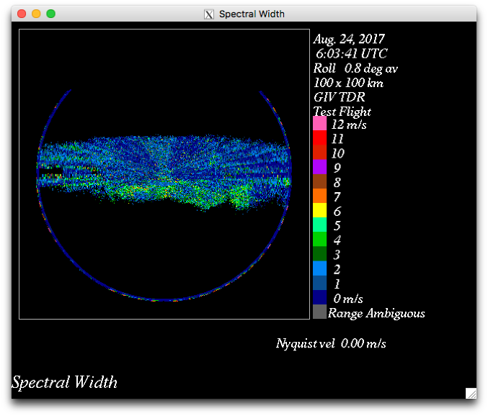
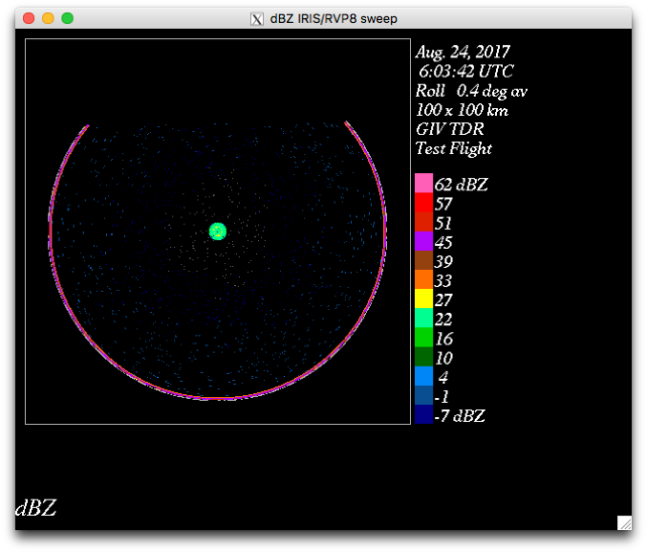
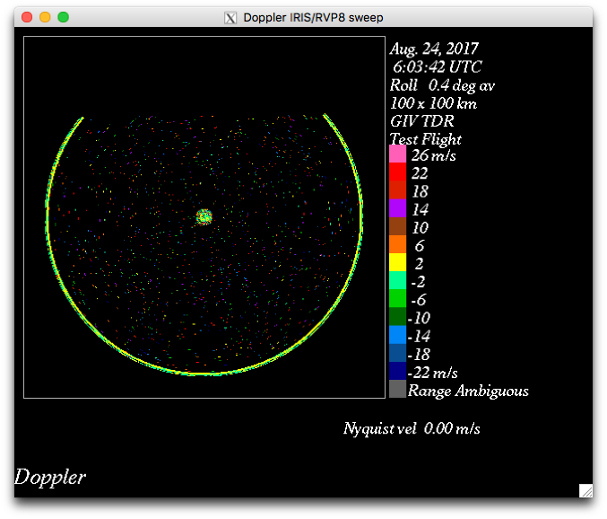
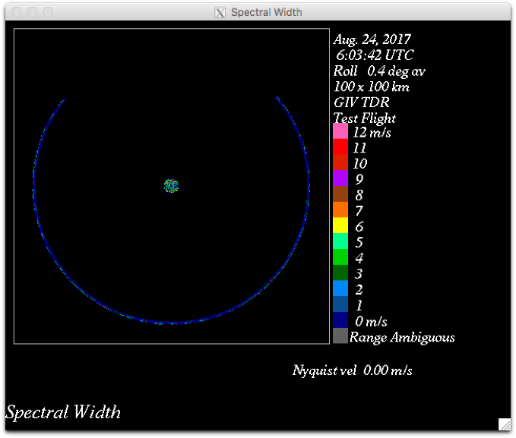
0605 UTC 20170824 (in storm_master (above) and slave (below) reflectivity, radial velocity, and spectral width

Slide 16
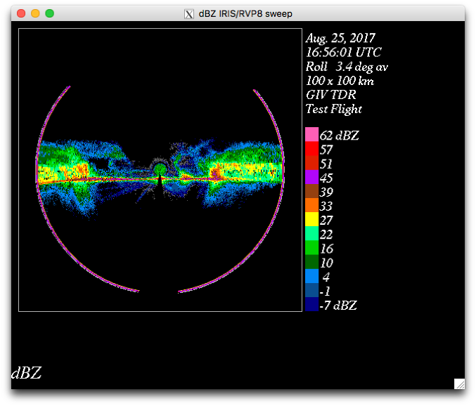
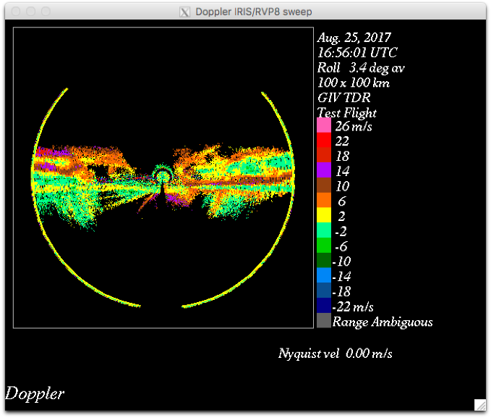
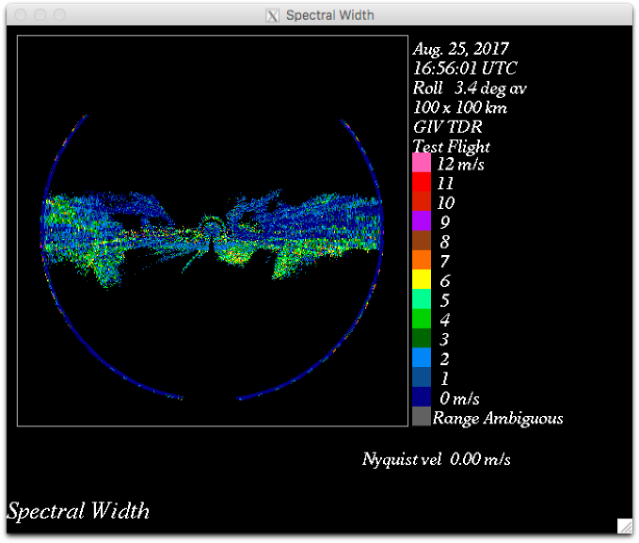
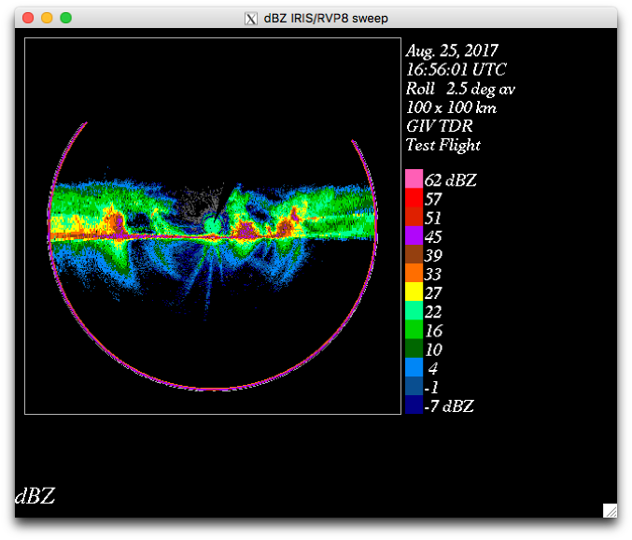
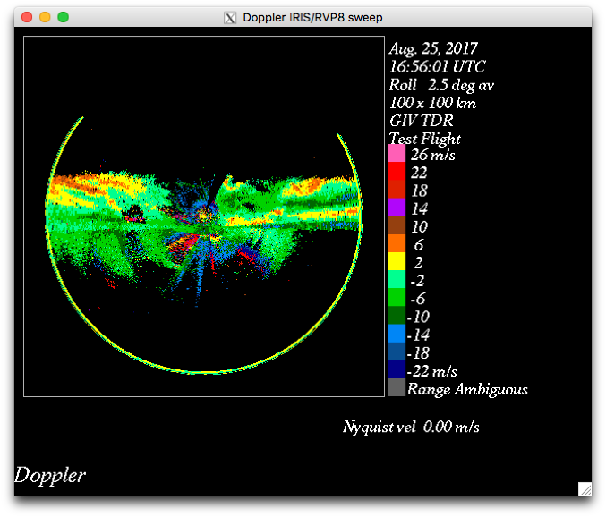
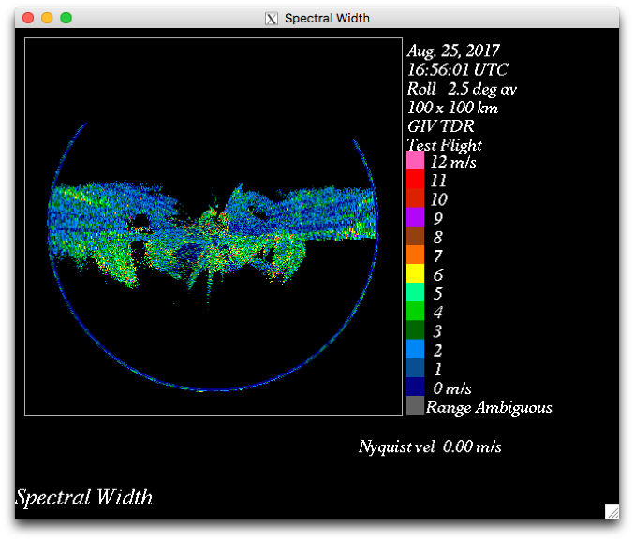
1656 UTC 20170825 master (above) and slave (below) reflectivity, radial velocity, and spectral width

Slide 17
Cause of problem on 20170824H1 still unknown
Appears to be a possible random issue
Possibly an issue with the fact that slave processor is a prototype, to be replaced later
Mitigation for now is to check the TDR slave fore and aft and to make sure they are similar
Also compare fore (master) and aft (slave) file sizes…should be within 20-30 % of each other

Slide 18
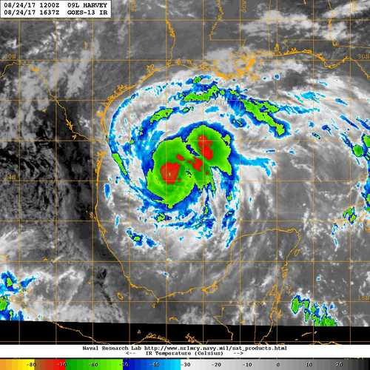
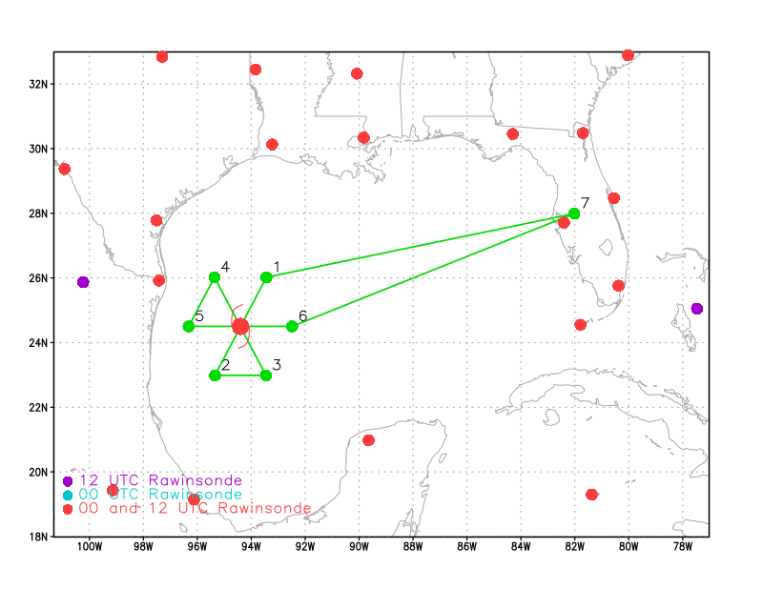
20170824H2 AL09 HARVEY (TDR)
LPS: Zawislak
Radar: Nguyen
Dropsonde: Klotz
Ground Radar: Reasor
Observer: Ryglicki (NRL)
NESDIS: Chang
Takeoff: 1435 UTC, Landing 2222 UTC
Butterfly, 7 kft
Dropsondes at turn points and each center pass
AXBT at turn points
Fix responsibility on each pass
982 mb / 55 kt
MOTION (9 kt)
SHIPS SHEAR (8 kt)
1637Z (Arrival at IP)

Slide 19
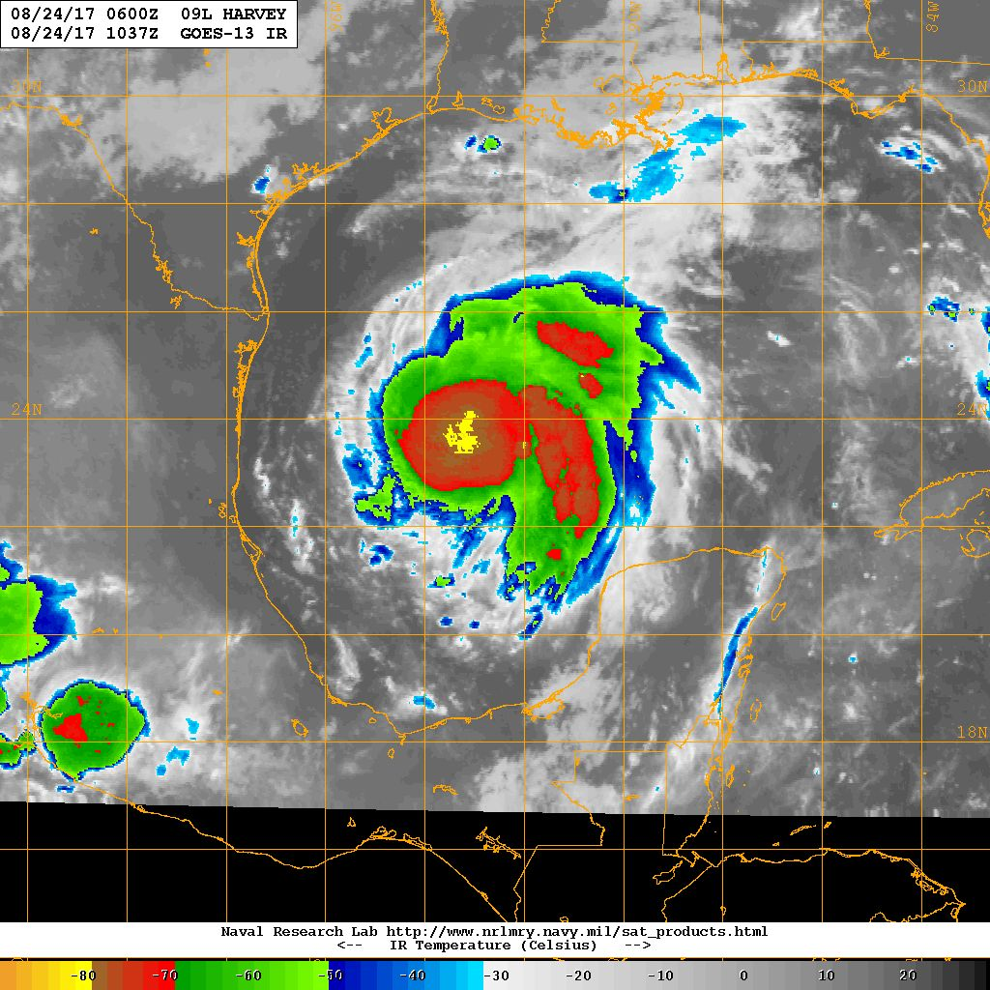
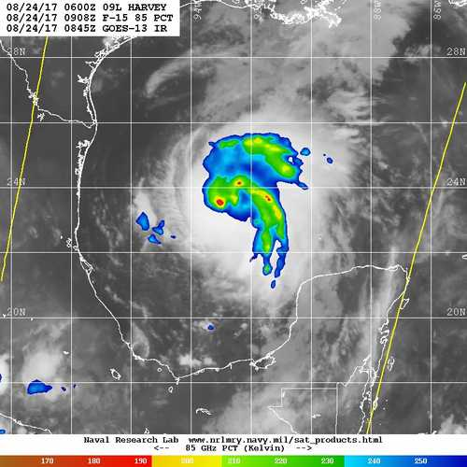
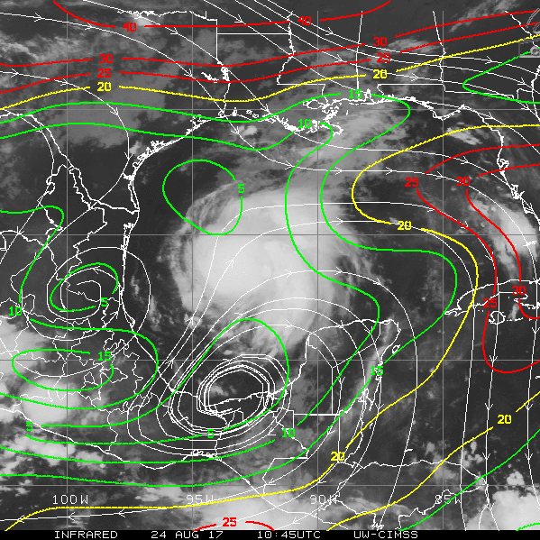
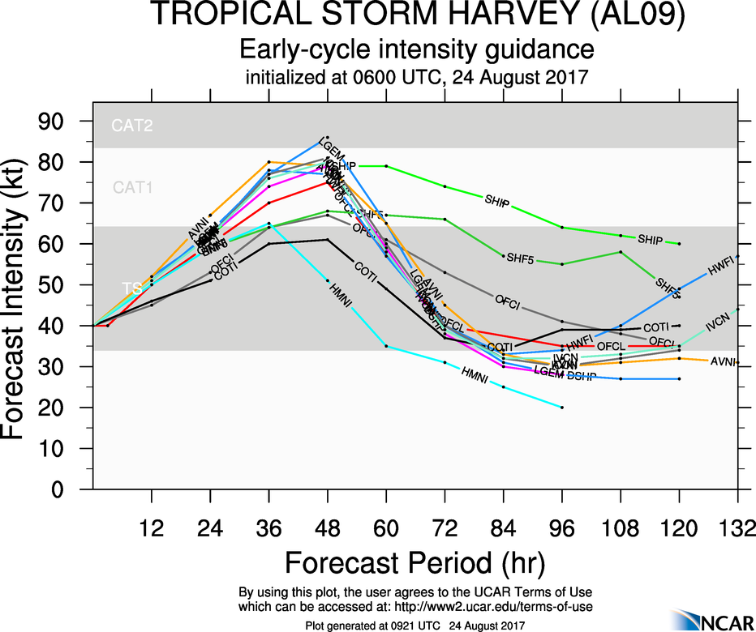
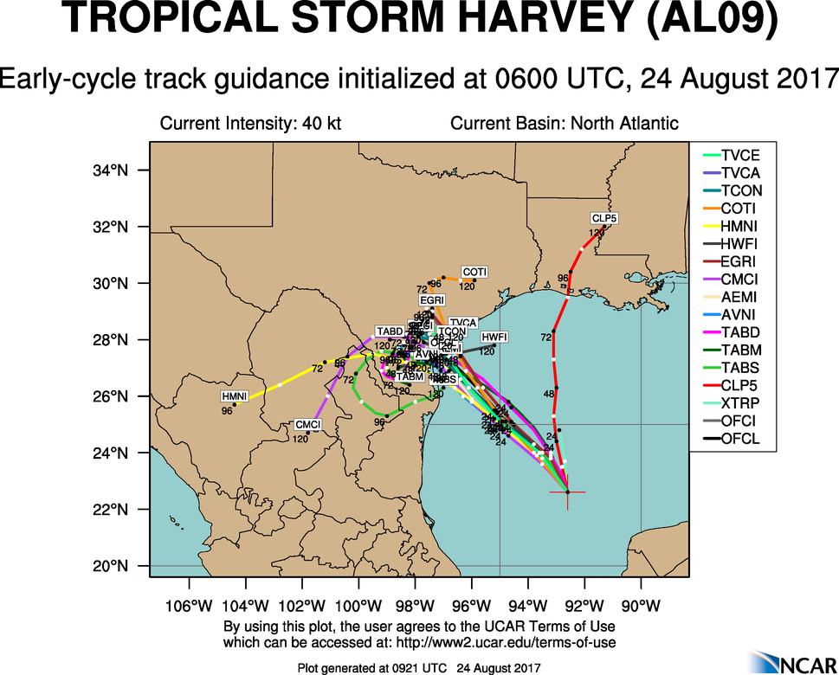
20170824H2 AL09 HARVEY (TDR)
1036Z (4 h prior to T/O)
0908Z (5.5 h prior to T/O)
1045 Z Shear

Slide 20
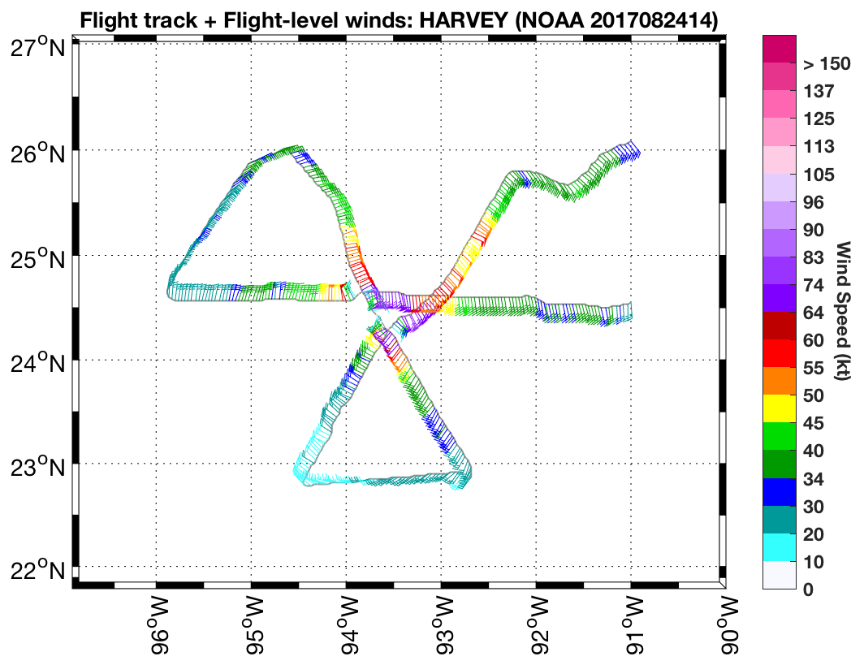
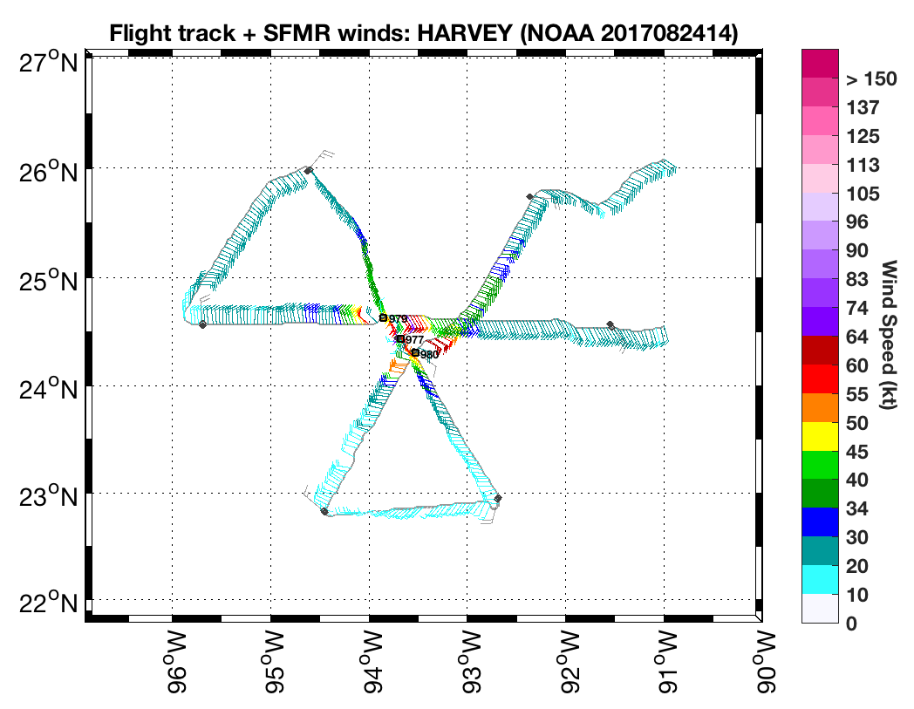
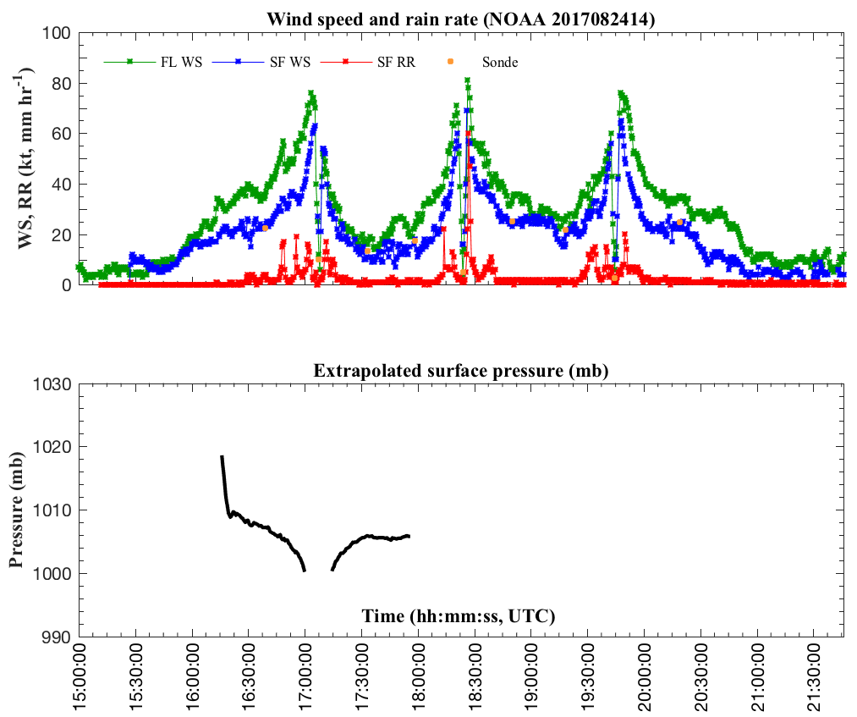
20170824H2 AL09 HARVEY (TDR)

Slide 21
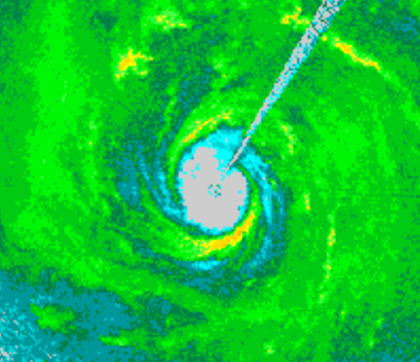
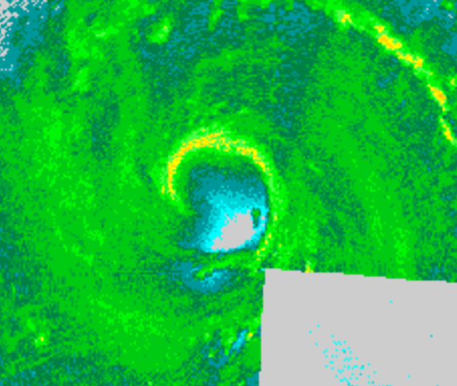
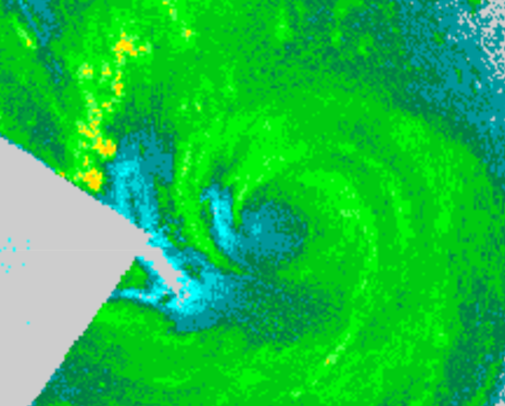
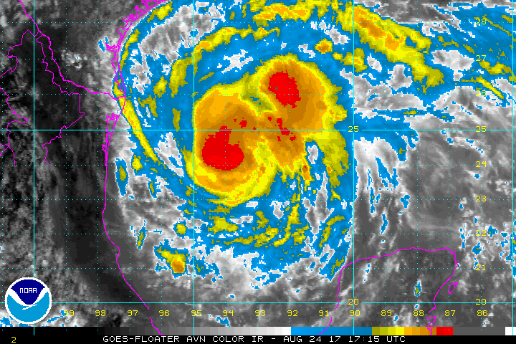
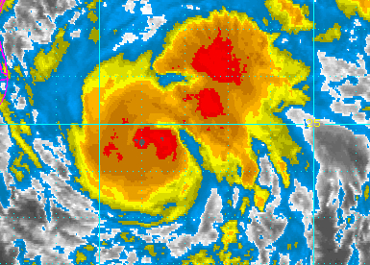
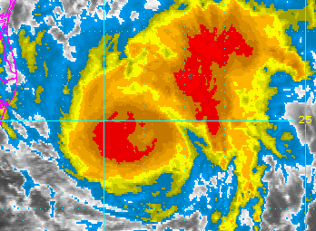
20170824H2 AL09 HARVEY (TDR)
1707 UTC
1817 UTC
1937 UTC
1715 UTC
1815 UTC
1945 UTC

Slide 22
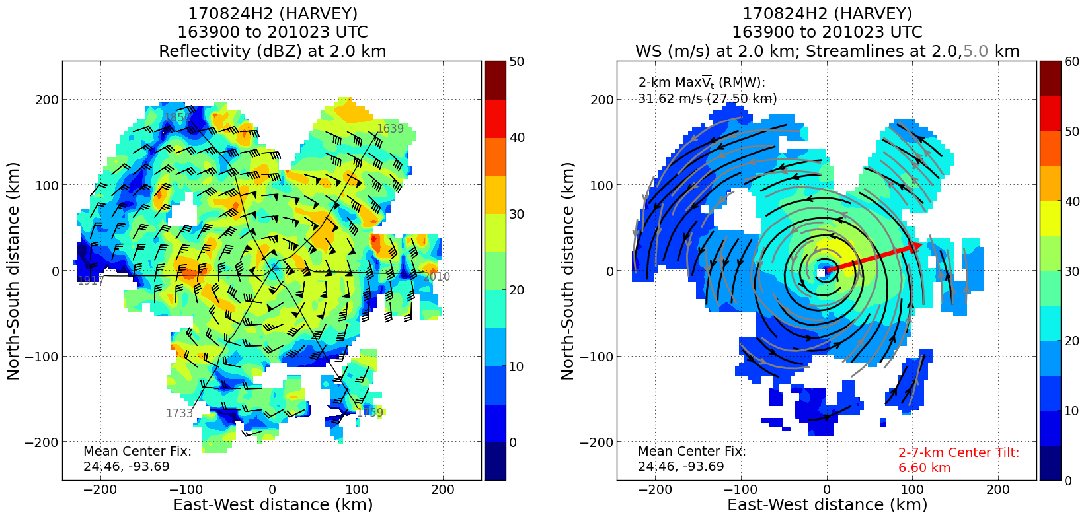
20170824H2 AL09 HARVEY (TDR)

Slide 23
20170824H2 AL09 HARVEY (TDR)
850 hPa RH
SHEAR

Slide 24

20170824H2 AL09 HARVEY (TDR)
Summary
T/O: 982 mb / 55 kt (on-station, 65 kt) L/D: 977 mb / 75 kt
Occurred within an RI event, though intensity did not change much during mission (peak SFMR sfc. wind 70 kt, FL 80 kt)
Center Passes: 1707 UTC, 1817 UTC, and 1944 UTC
3 TDR analyses
Increase in azimuthal precipitation symmetry prior to mission, intensifying
Retained symmetry, potentially sampled the evolution of a convective burst as it moved around the eyewall
Problems
Not a problem…aft radial velocity
SFMR was substituted prior to the flight
(calibration unknown)
Bad data from 4 of 6 AXBTs
Expendables:
9 Dropsondes (6 HFIP, 3 NHC)
6 AXBTs

Slide 25
Hurricane Harvey
Flight 170825H1
Meteorological highlights
Harvey was a hurricane in the western Gulf of Mexico
Experiencing moderate SW shear
Moist environment, upper-level low had retrograded and weakened
Pronounced banding features
Indications of an outer wind maximum, potential secondary eyewall formation
Good dataset to examine the structural variability of a spiral rainband that could potentially become a secondary eyewall in the next 12 h
Mission “high”lights
TDR issue fixed prior to day mission
3 TDR analyses, superobs transmitted to EMC
SFMR worked (was replaced prior to day mission)
10 GPS dropsondes – 6 HFIP at turn points, 3 NHC at center, 1 Ocean Winds on NE side
6 AXBTs, 4 failed
Coordinated outbound leg to NE with CYGNSS overpass for Ocean Winds

Slide 26




Environmental conditions
CIMSS 850-200 hPa shear 00 UTC Aug 25
TPW 00 UTC Aug 25
Midlevel humidity and winds 00 UTC Aug 25

Slide 27



Satellite presentation
GOES-13 Vis valid 2345 UTC Aug 24
GOES-13 IR valid 2345 UTC Aug 24
F-17 91 GHz valid 0038 UTC Aug 25

Slide 28


Model guidance

Slide 29


Flight tracks
Planned flight track for 170824H1
Actual flight track for 170824H1

Slide 30


Flight-level data

Slide 31


Radar-derived reflectivity and winds
Radar reflectivity (shaded, dBZ) at 2 km
Wind speed (shaded, m/s) at 2 km

Slide 32


Vertical cross sections
Radar reflectivity (shaded, dBZ)
Wind speed (shaded, m/s)
Potential outer wind max

Slide 33


20170825H2 AL09 HARVEY (TDR/OCEAN WINDS)
LPS: Zawislak
Radar: Nguyen
Dropsonde: Klotz
Ground Radar: Reasor
Observer: Sippel
NESDIS: Chang/Jelenak
Guest: Chris Ruf
Takeoff: 1401 UTC, Landing 2317 UTC
Figure-4, 8-10 kft
Dropsondes at turn points and each center pass, max winds
AXBT at turn points
Fix responsibility on both passes
949 mb / 95 kt
MOTION (9 kt)
SHIPS SHEAR (8 kt)
1715Z (Just after arrival at IP)

Slide 34


20170825H2 AL09 HARVEY (TDR/OCEAN WINDS)
1045 Z Shear

Slide 35

20170825H2 AL09 HARVEY (TDR/OCEAN WINDS)

Slide 36

20170825H2 AL09 HARVEY (TDR/OCEAN WINDS)

Slide 37

20170825H2 AL09 HARVEY (TDR/OCEAN WINDS)

Slide 38

20170825H2 AL09 HARVEY (TDR/OCEAN WINDS)

Slide 39



20170825H2 AL09 HARVEY (TDR/OCEAN WINDS)
1656 UTC
1816 UTC

Slide 40

20170825H2 AL09 HARVEY (TDR/OCEAN WINDS)

Slide 41

20170825H2 AL09 HARVEY (TDR/OCEAN WINDS)

Slide 42
20170825H2 AL09 HARVEY (TDR/OCEAN WINDS)
850 hPa RH

Slide 43

20170825H2 AL09 HARVEY (TDR/OCEAN WINDS)
Summary
T/O: 947 mb / 95 kt End: 941 mb / 115 kt
Second RI event, separated from previous event by ERC
Center Passes: 1656 UTC, 1816 UTC
2 TDR analyses (7 total max wind radial legs)
Broadening of the wind field, eye clear/increase size
Opportunity to examine evolution of wind/precip with “the fest” (all legs were within azi. 030-060°
Problems
Not a problem…aft radial velocity
Bad data from 3 of 4 AXBTs
Expendables:
20 Dropsondes (4 HFIP, 2 NHC, 14 NESDIS)
4 AXBTs

Slide 44
Landfall Teams
Forrest Masters (UF): FCMP rolling out with two 15 m instrumented towers (5 levels of ultrasonics). UF Update. Deployed two instrumented towers: T2: Port Lavaca and T3: Aransas County Airport
John Shroeder (TTU): StickNet deployments. Working from Corpus northward. Expect to deploy 14 units.
Mike Biggerstaff (OU): Deploy with SR2... the dual-pol radar. SMART radar set up at 28.14804N 97.41012W. Ops started at 2130 UTC.

Slide 45
Lessons Learned & Action Items
Convey any mission-critical issues immediately to Flight Director.
Radar scientist is responsible for monitoring the status of radars during the course of a mission. Toggle between fore and aft real-time displays of velocity during ferry and while on station.
10PM takeoff not ideal for AOC crew: commuting a challenge and no daylight during flight
Reserve GOV during peak season (Silver Caravan now reserved for HRD through October)
Anything else?

Slide 46


2017 Basin-Scale HWRF
Hurricane Harvey Preliminary Evaluation
Gus Alaka & the HRD Modeling Team September 1, 2017

Slide 47


2017 Basin-Scale HWRF
Hurricane Harvey Preliminary Evaluation
HB17 produced the best
Late Track Forecasts
CTCX & OFCL were good too
HB17 produced low
Late Intensity Error
HWRF & OFCL were good too

Slide 48

2017 Basin-Scale HWRF
Hurricane Harvey Preliminary Evaluation
HB17 produced the best
Late Track Forecasts
CTCX & OFCL were good too
HB17 produced small
Late Intensity Bias
OFCL was good too

Slide 49


Slide 50

2017 Basin-Scale HWRF
Hurricane Harvey Preliminary Evaluation
Assimilating Data for an RI Case
“Good” RI forecast for TC Period 2
Successfully assimilated TDR and HDOB data starting on 2017082500
Future Research: What was the impact of these data?
This is an excellent R.I. dataset for
HRD Research
TDR
HDOB

Slide 51


2017 Basin-Scale HWRF
Hurricane Harvey Preliminary Evaluation
“Invest Harvey” Forecasts
Crucial period before Harvey reached Yucatan
Many models predicted regeneration of Harvey
HB17 was split between:
  Early regeneration (top)
  No regeneration (bottom)
Model research into this issue is critical

