Slide 1
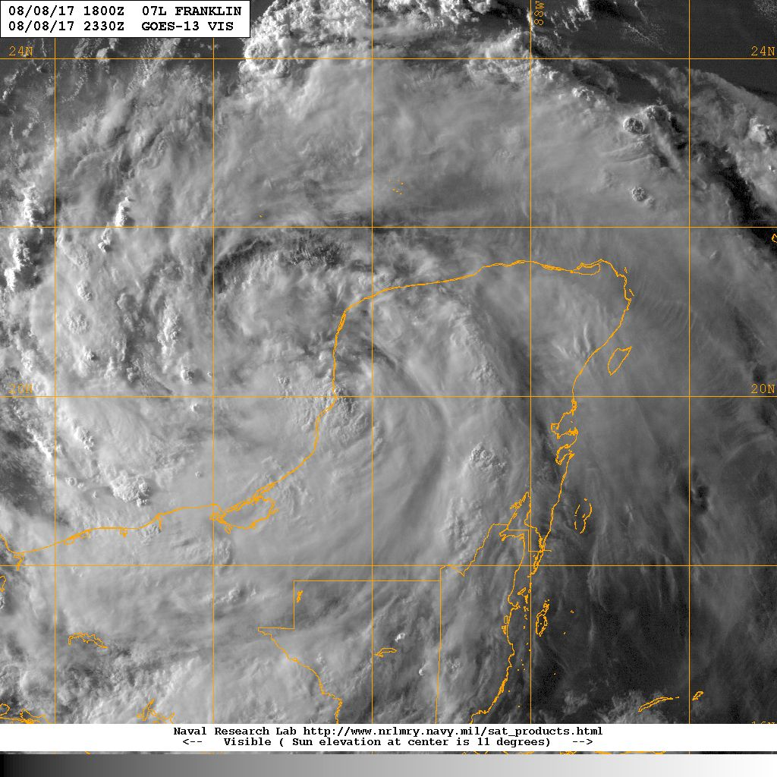
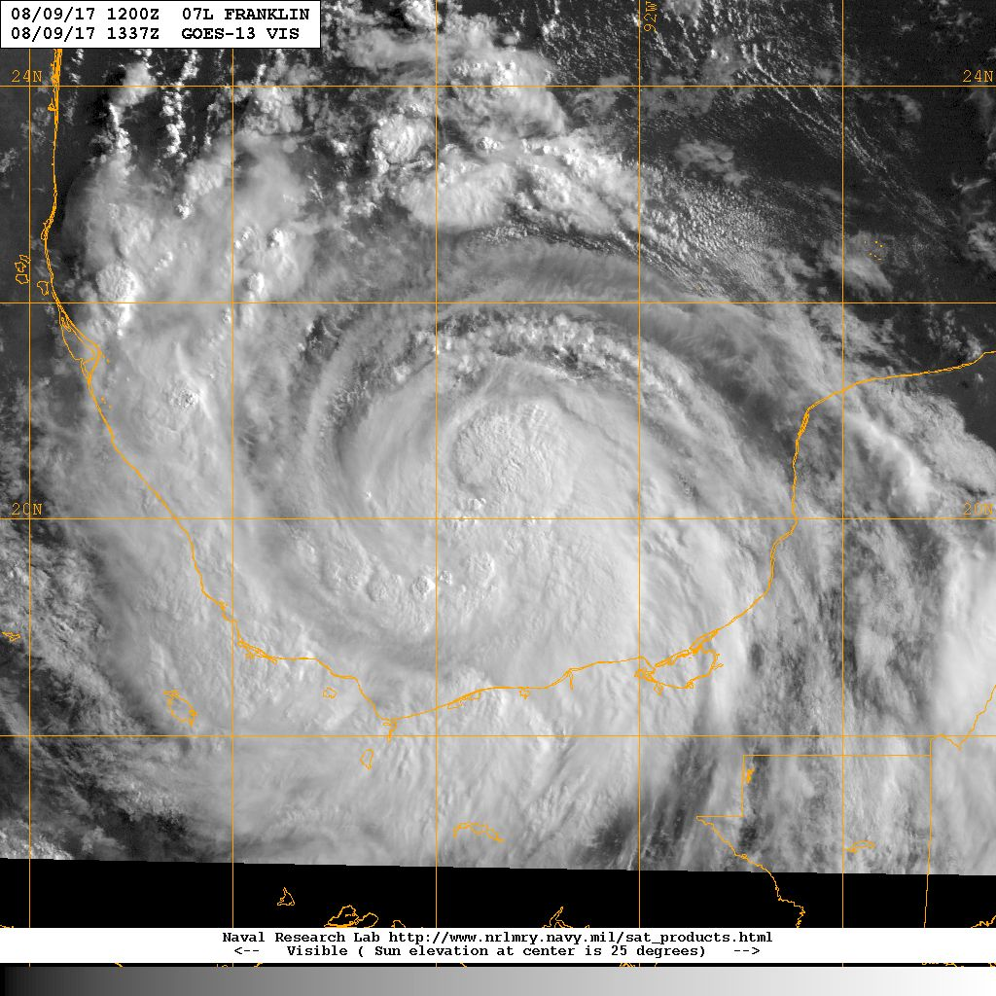
Hurricane Franklin Debrief
8 Aug
9 Aug
Flight ops re-cap: 2 Total flight missions
14.5 P-3 flight hours; 8 GPSsondes; 8 AXBTs
August 15, 2017

Slide 2
Agenda
Missions Overview (Reasor)
Science Discussions
170808H1 TDR (Zawislak)
170809H1 TDR (Rogers)
EMC input (Sippel/Banglin)
Additional Field Program Issues

Slide 3
Missions Overview
Purpose: EMC-tasked TDR data collection targeting 00 UTC and 12 UTC HWRF cycles
Target: TS Franklin on 8-9 Aug off western Yucatan coast in the Bay of Campeche
Background: Franklin developed within a broad area of low pressure in the NW Caribbean, became a TS late on 6 Aug, and made landfall on the E Yucatan coast early on 8 Aug. After entering the Bay of Campeche, Franklin intensified 30-40 kts to a 75-kt H before landfall on the Mexican coast early on 10 Aug.

Slide 4
Missions Overview
8 Aug: N42 (6PM/22UTC) TDR ← 2-h delay to allow center to move further off land
9 Aug: N42 (4AM/8UTC) TDR

Slide 5
Missions Highlights
Sampled early stages of rapid intensification
Coordinated w/ Global Hawk during 2nd flight
7th
8th
9th
10th

Slide 6
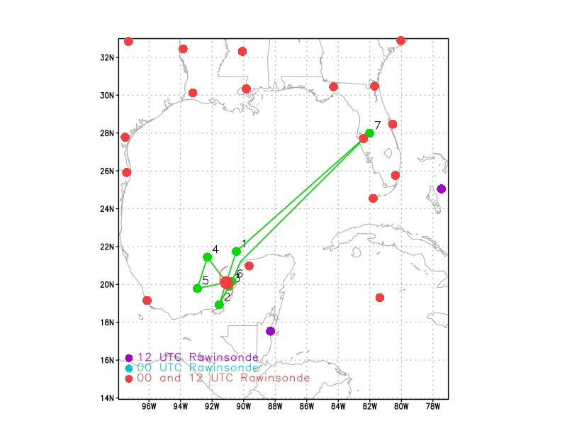
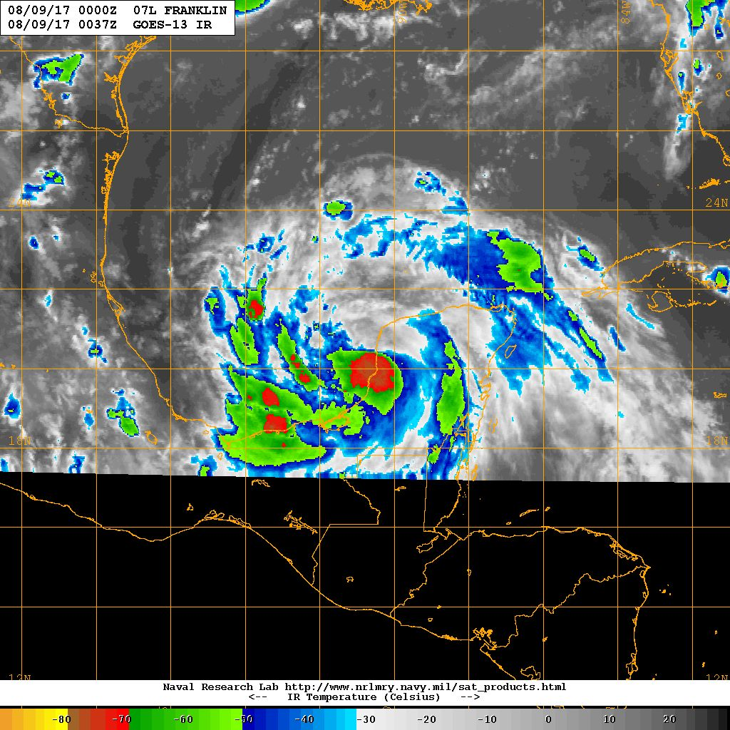
20170808H1 AL07 TS FRANKLIN (TDR)
LPS: Zawislak
Radar: Zhang
Dropsonde: Sellwood
Takeoff: 2200 UTC, Landing 0437 UTC
Butterfly, 10 kft
Dropsondes at turn points and each center pass; AXBT (4) at Pts. 1, 2, 4, 5
1002 mb / 35 kt
MOTION (10 kt)
SHIPS SHEAR (8 kt)
0037 UTC (First Pass)

Slide 7
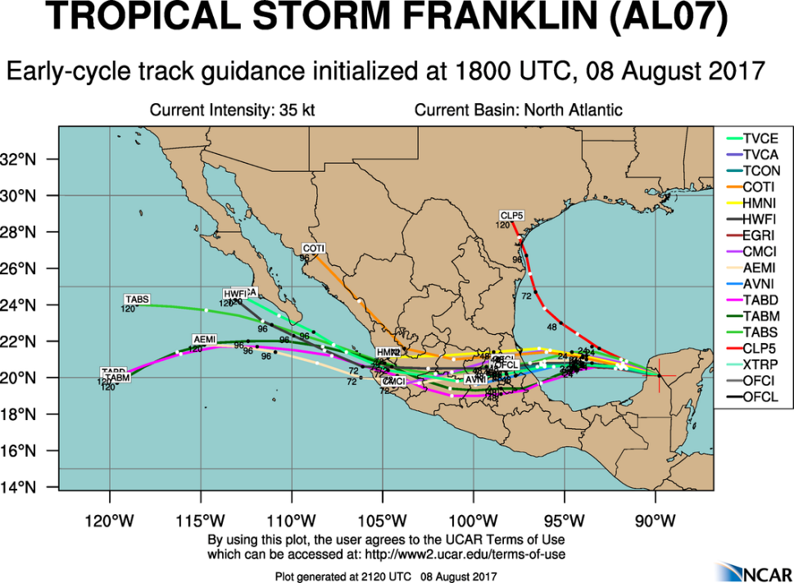
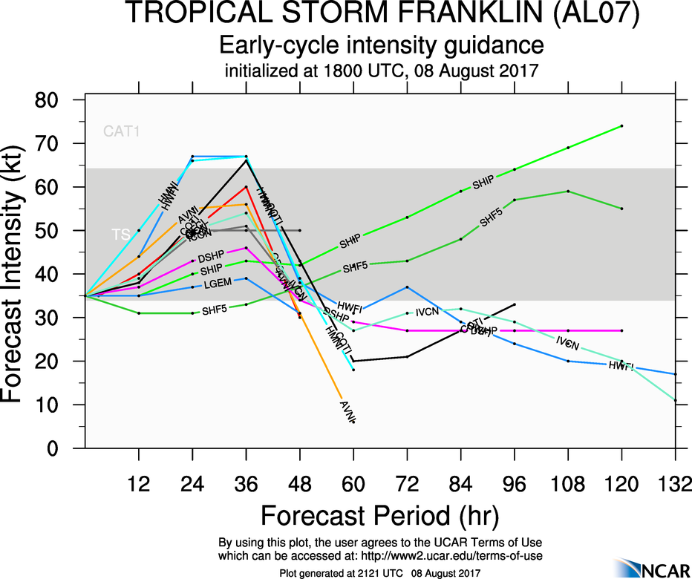
20170808H1 AL07 TS FRANKLIN (TDR)

Slide 8
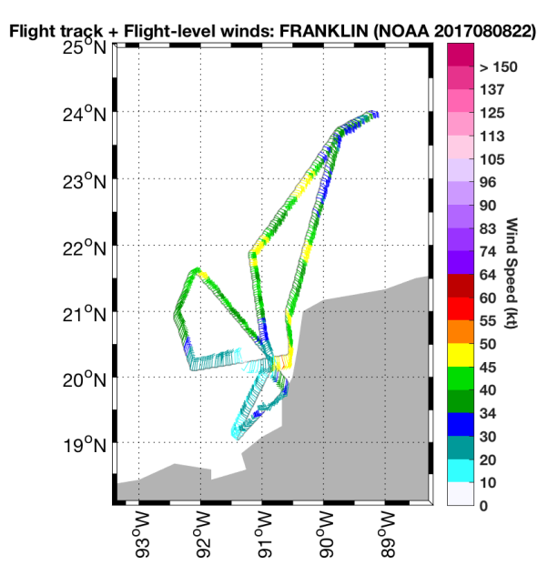
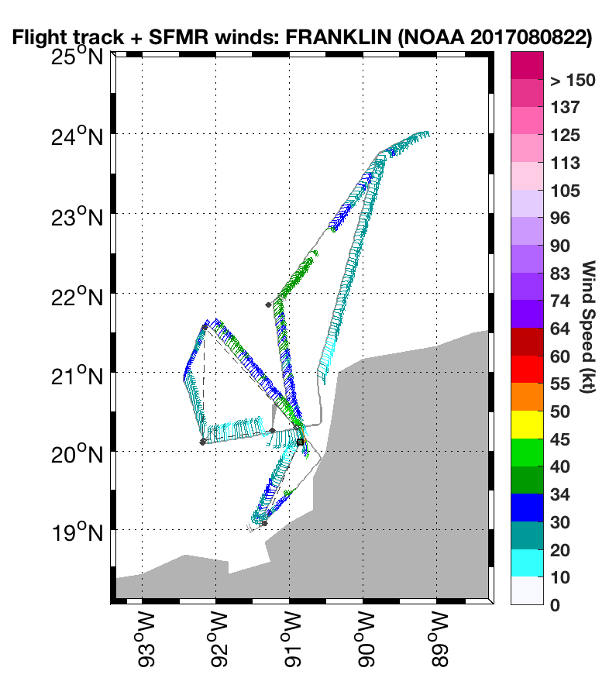
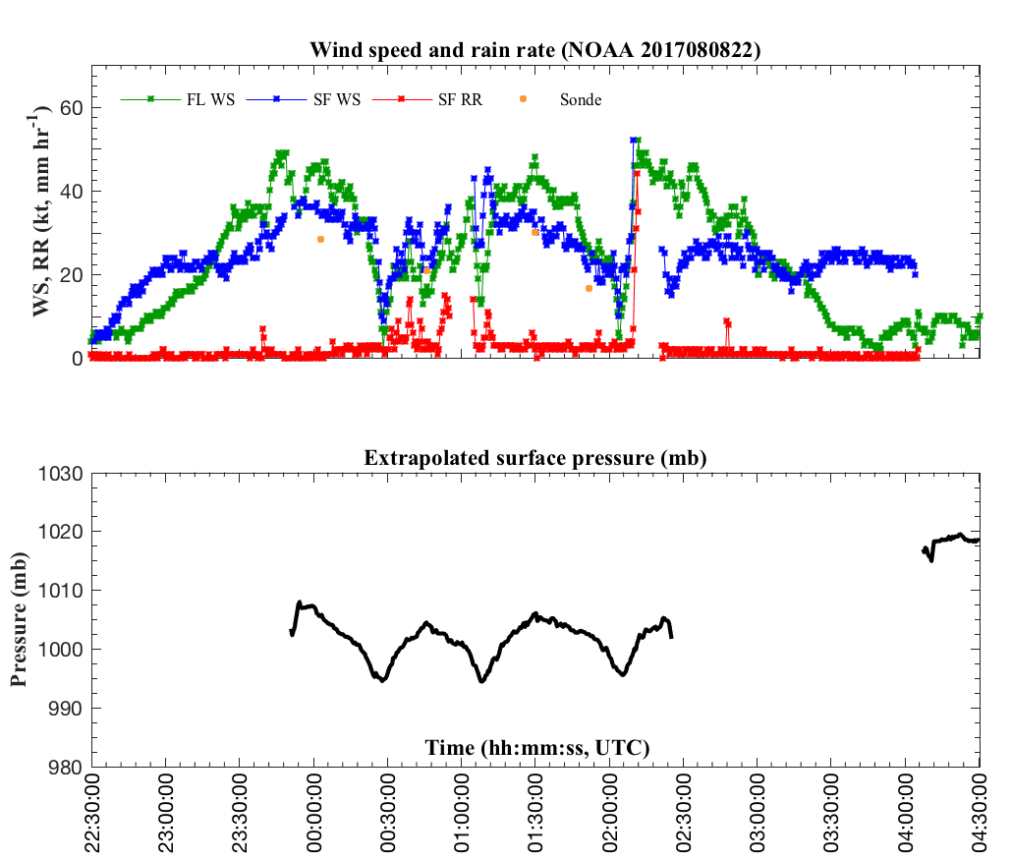
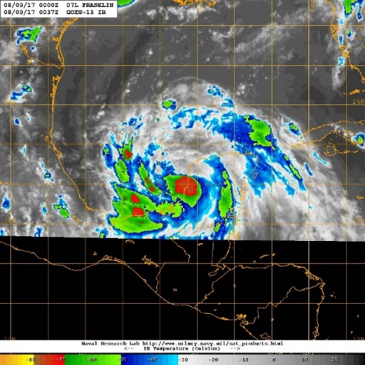
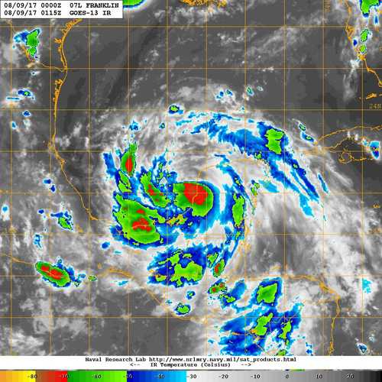
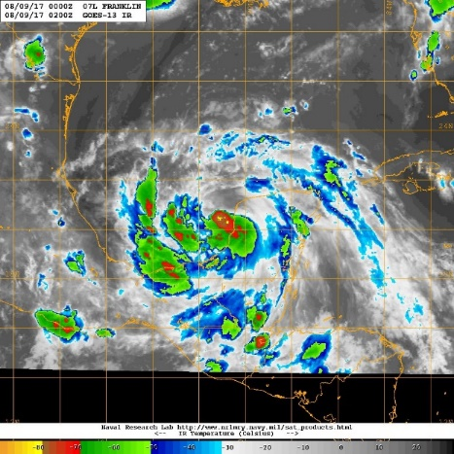
20170808H1 AL07 TS FRANKLIN (TDR)
0037 UTC
0115 UTC
0200 UTC

Slide 9
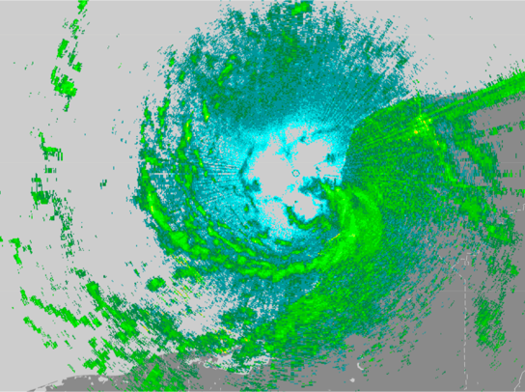
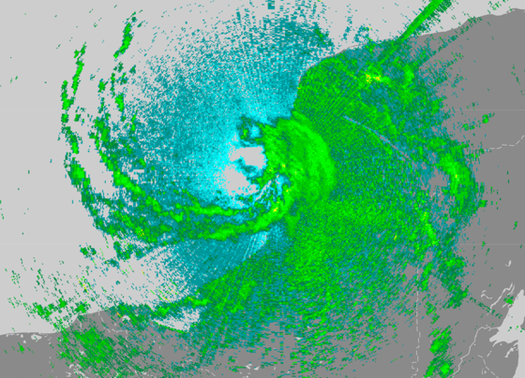
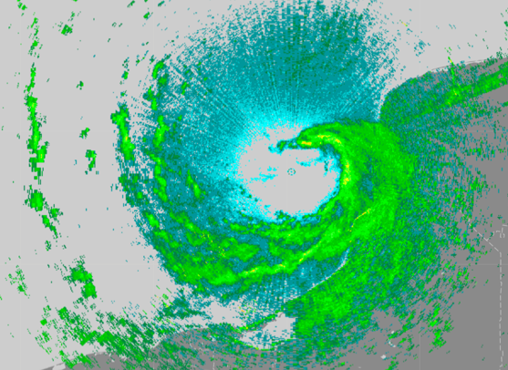
20170808H1 AL07 TS FRANKLIN (TDR)
0022 UTC
0102 UTC
0203 UTC
0037 UTC
0115 UTC
0200 UTC

Slide 10
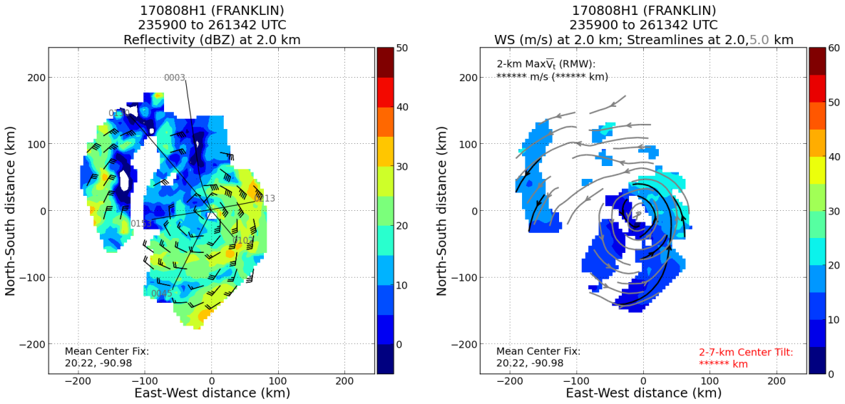
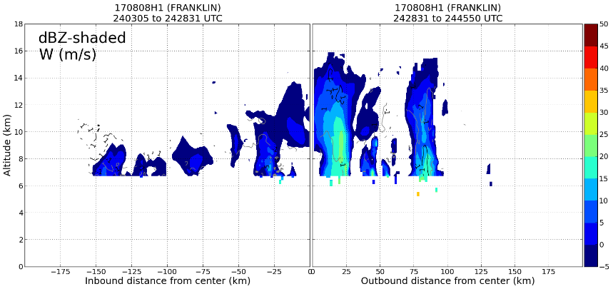
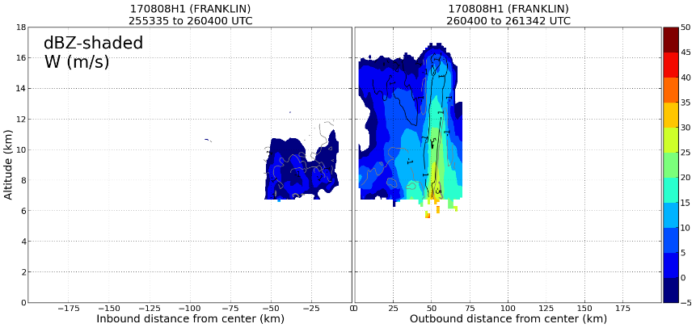
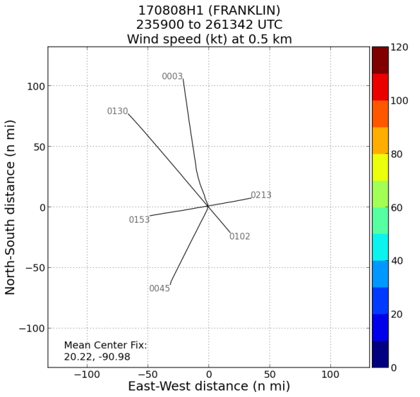
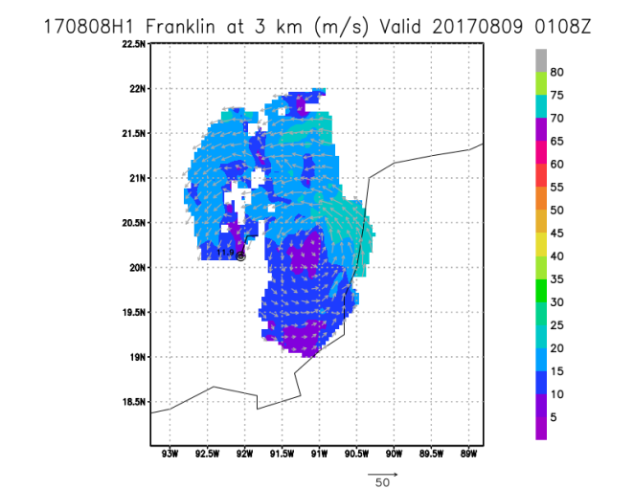
20170808H1 AL07 TS FRANKLIN (TDR)
PASS 1: 0028 UTC
PASS 3: 0203 UTC

Slide 11
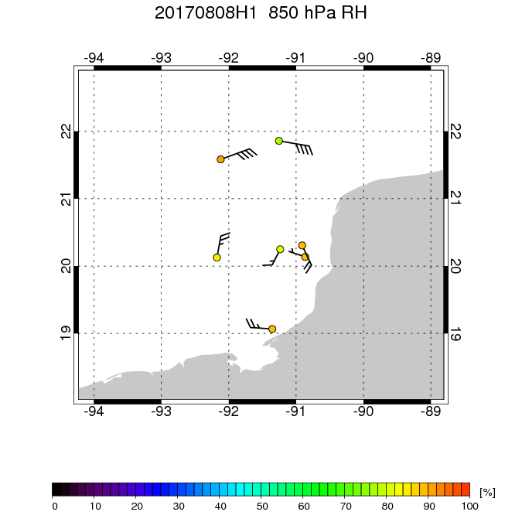
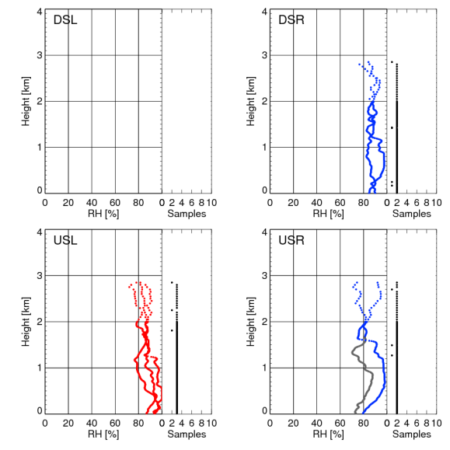
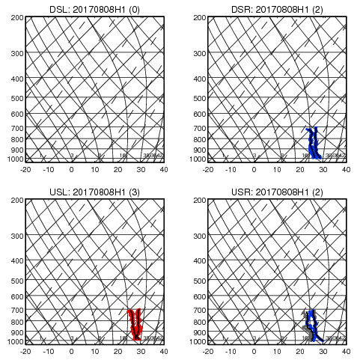
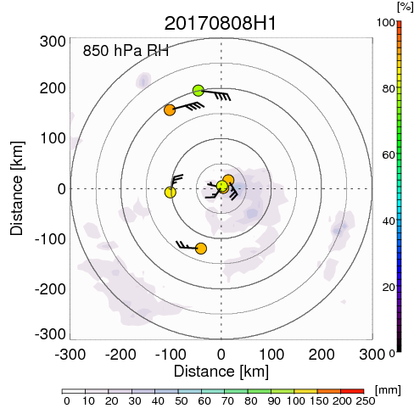
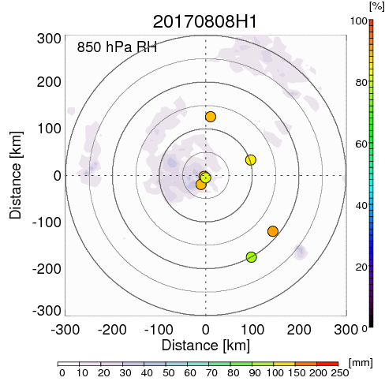
20170808H1 AL07 TS FRANKLIN (TDR)
SHEAR
OUTPUT FROM TC-DROPS

Slide 12
Dropsonde Issues
20170808H1 AL07 TS FRANKLIN (TDR)
New Version of ASPEN requires AVAPS operator to input value for pressure correction (difference between sonde measured and aircraft measured cabin pressure)
Typical values are < 0.5mb
Default value from factory testing is used otherwise
5 out of 7 drops had large default pressure corrections resulting in bad height estimates and too low surface pressures
Can be corrected by adding a cancelling correction value in ASPEN
Better to check with AVAPS operator before flight to ensure that correct offsets are put into D-file

Slide 13
EXAMPLE: Center drop 0108Z 20.32N 90.82W
Surface pressure is 6mb lower than closest USAF center drop
Incorrect pressure offset value of 8mb was maintained in D-file
Data reprocessed with 0mb offset agrees with flight level and USAF (note heights)
Time | Pres | Tdry | RH | Wdir | Wspd | Alt
sec | mb | deg C | % | deg | m/s | m
-1 | 696.7
-1 | 696.7 |  |  | 130.7 | 6.2
-1 | 696.7 | 13.3 | 86.3
7.6 | 700 | 13.7 | 84.7 | 133 | 5.7 | 3002
103.8 | 792.9 |  |  | 156.9 | 9.3
160 | 850 | 20.5 | 88
160 | 850 | 20.5 | 88 | 154.9 | 11.1 | 1338
160 | 850 |  |  | 154.9 | 11.1
203.2 | 895.3 |  |  | 153.1 | 14.2
230.6 | 925 | 23.5 | 97.9 | 149 | 14.1 | 599
240 | 935.5 |  |  | 144.2 | 14.4 | 500
279.6 | 980.6 |  |  | 142.8 | 14.7 | 83
282.2 | 983.7 |  |  | 142.7 | 15.1
286.8 | 989 |  |  | 149.1 | 10.9
286.6 | 989.9 |  |  | 138.8 | 13.6 | 10
287.5 | 989.9 | 27.3 | 94 |  |  | 0
 | 1000 |  |  |  |  | -91
Time | Pres | Tdry | RH | Wdir | Wspd | Alt
sec | mb | deg C | % | deg | m/s | m
-1 | 696.7 |  |  | 130.7 | 6.2
-1 | 696.7 | 13.3 | 86.3
-1 | 696.7
2.5 | 700 | 13.5 | 85.6 | 131.6 | 6 | 3070
152.3 | 850 | 20.2 | 89.1
152.3 | 850 |  |  | 155.1 | 11.2
152.3 | 850 | 20.2 | 89.1 | 155.1 | 11.2 | 1408
203.5 | 903.6 |  |  | 153.1 | 14.2
223.2 | 925 | 23.1 | 96 | 149.5 | 13.8 | 670
239.6 | 943.1 |  |  | 144.2 | 14.4 | 500
279.5 | 988.5 |  |  | 142.8 | 14.7 | 83
282.2 | 991.7 |  |  | 142.7 | 15.1
286.8 | 997 |  |  | 148.9 | 10.8
286.6 | 997.9 |  |  | 138.9 | 13.6 | 10
287.5 | 997.9 | 27.3 | 94 |  |  | 0
 | 1000 |  |  |  |  | -19
ORIGINAL
CORRECTED

Slide 14
20170808H1 AL07 TS FRANKLIN (TDR)
Summary
Start: 1002 mb / 35 kt End: 995 mb / 45 kt
Center Passes: 0028 UTC (Fix), 0108 UTC, 0204 UTC
Proximity to land and clearance within a warning area were challenges to a good TDR pattern
3 radar analyses
Shakedown
Problems
Missing data in 3D radar analyses
Application of pressure correction to dropsondes caused bad height and lower surface pressure estimates
Bad data from 2 of 4 AXBTS (no response from one, data below 150 ft in another)
Expendables:
7 Dropsondes (4 HFIP, 3 NHC)
4 AXBTs

Slide 15
Additional Issues
Large gap in vertical profile analysis is something we’ll have to live with until AOC figures out a way to deal with radar issues between the aircraft and 3-km range.
Glitch in (updated) radar software involving cross-over at 00 UTC caused analysis to bomb.
This caused John Hill’s EMC translate script to crash.
Main issue with radar software was ultimately addressed.
Result was delayed processing & transmission of the TDR data.
TDR data appeared to make it into 00 UTC cycle of HWRF
Thanks to John Gamache, Jun Zhang, and John Hill for working quickly to resolve issue
John Gamache modified surface-removal code post-flight to deal with new radar system. More data was retained beneath the aircraft on next flight, but more noise was permitted.
Fully automated real-time radar graphics creation, ftp, and email notification worked. The ftp to HRD web page portion was delayed. Thanks to Russell for since decreasing the checking interval.

Slide 16
Tropical Storm Franklin
Flight 170809H1
Meteorological highlights
Franklin was an intensifying tropical storm in Bay of Campeche
Experiencing light N shear at beginning, becoming moderate by end of flight
Moist environment around storm, dry air far-removed in northwest quadrant (USL)
Spiral banding features at beginning, becoming more wavenumber-1 as shear increased
Appreciable deep convection left of shear, particularly USL
Little or no tilt from 2-7 km altitude
RH generally symmetrically-distributed in near-environment, dry upshear outside 200 km
PBL theta-e lowest DSL, highest USR and DSR
Mission highlights
1 GPS dropsonde at center
4 AXBTs, 2 failed
Good coordination with Global Hawk on first inbound north-south leg

Slide 17
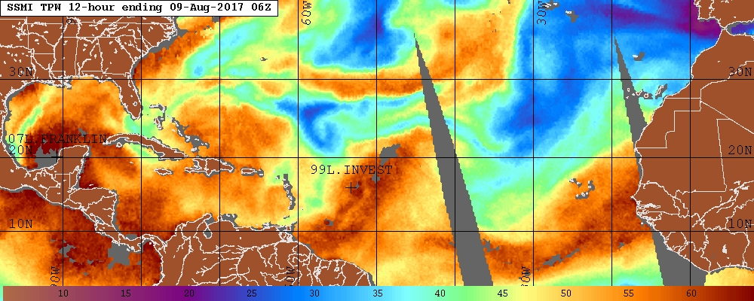
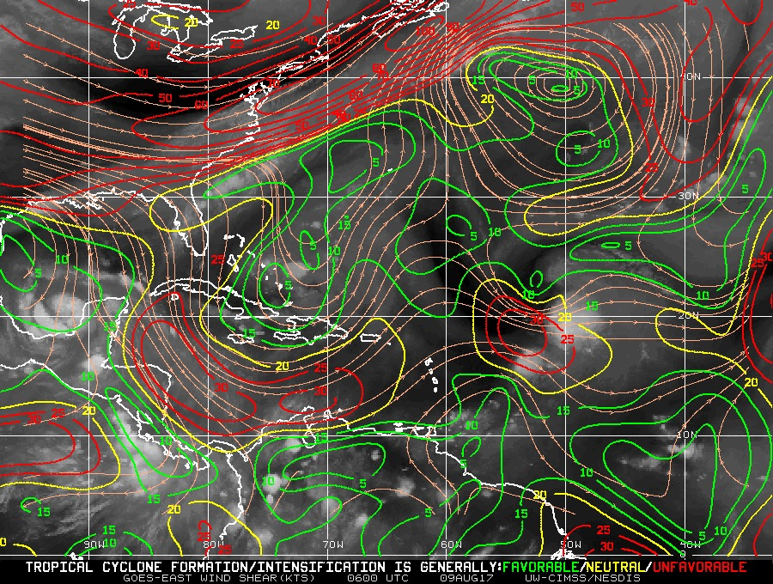
Environmental conditions
CIMSS 850-200 hPa shear 06 UTC Aug 9
TPW 06 UTC Aug 9

Slide 18
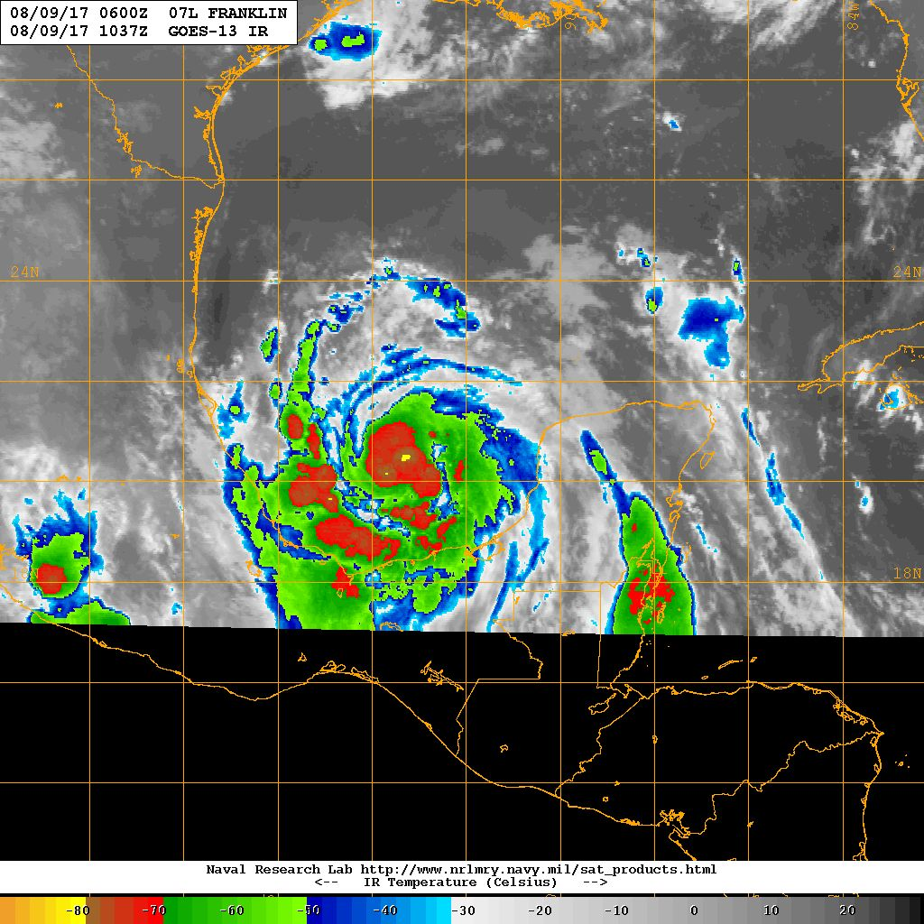
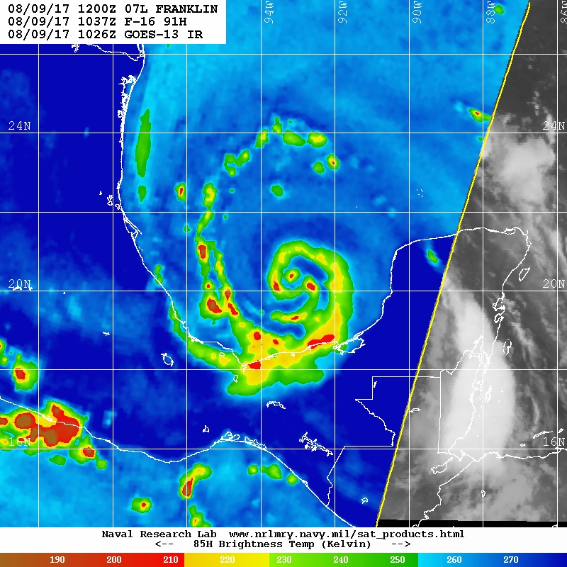
Satellite presentation
GOES-13 IR valid 1037 UTC Aug 9
F-16 91 GHz valid 1037 UTC Aug 9

Slide 19
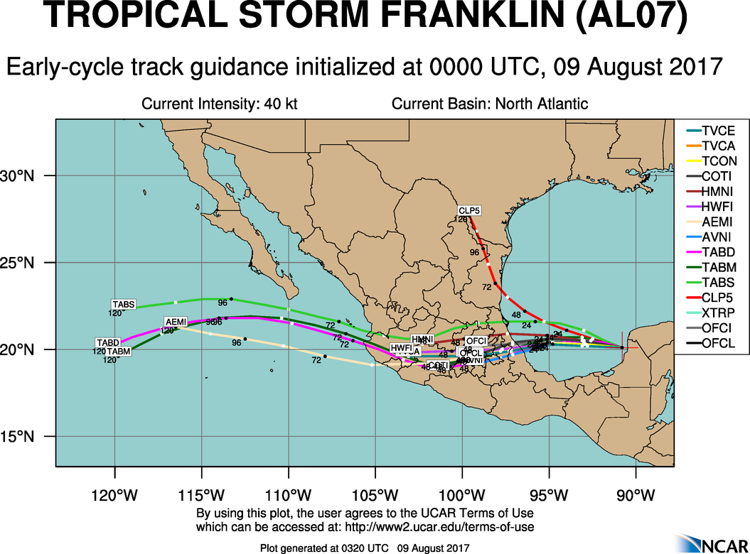
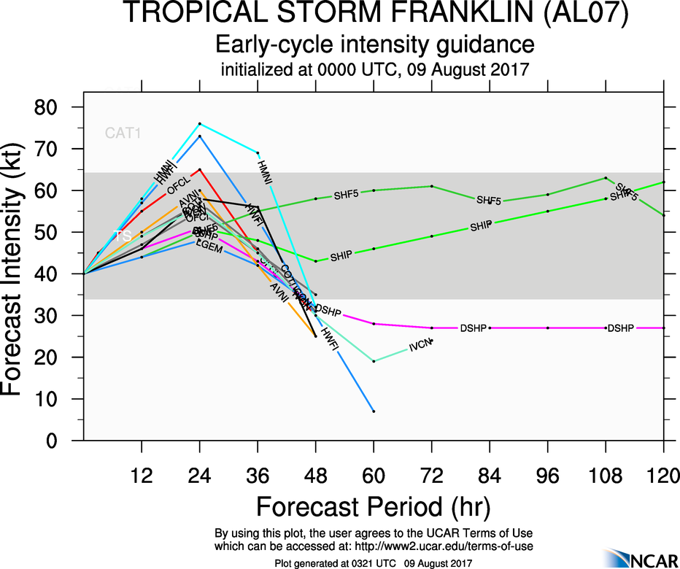
Model guidance

Slide 20
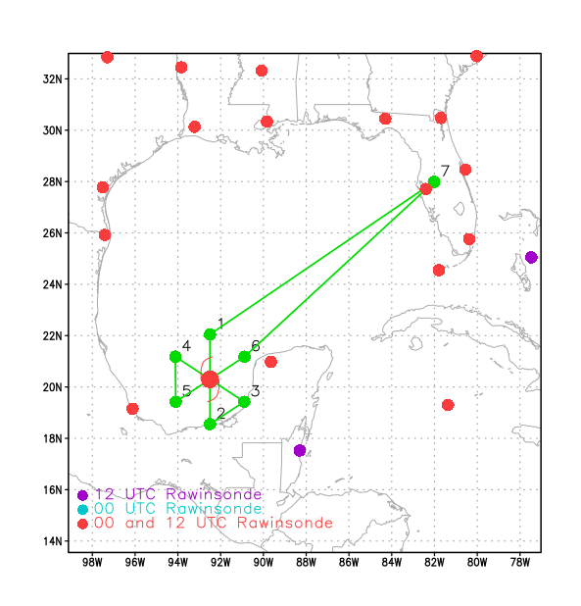
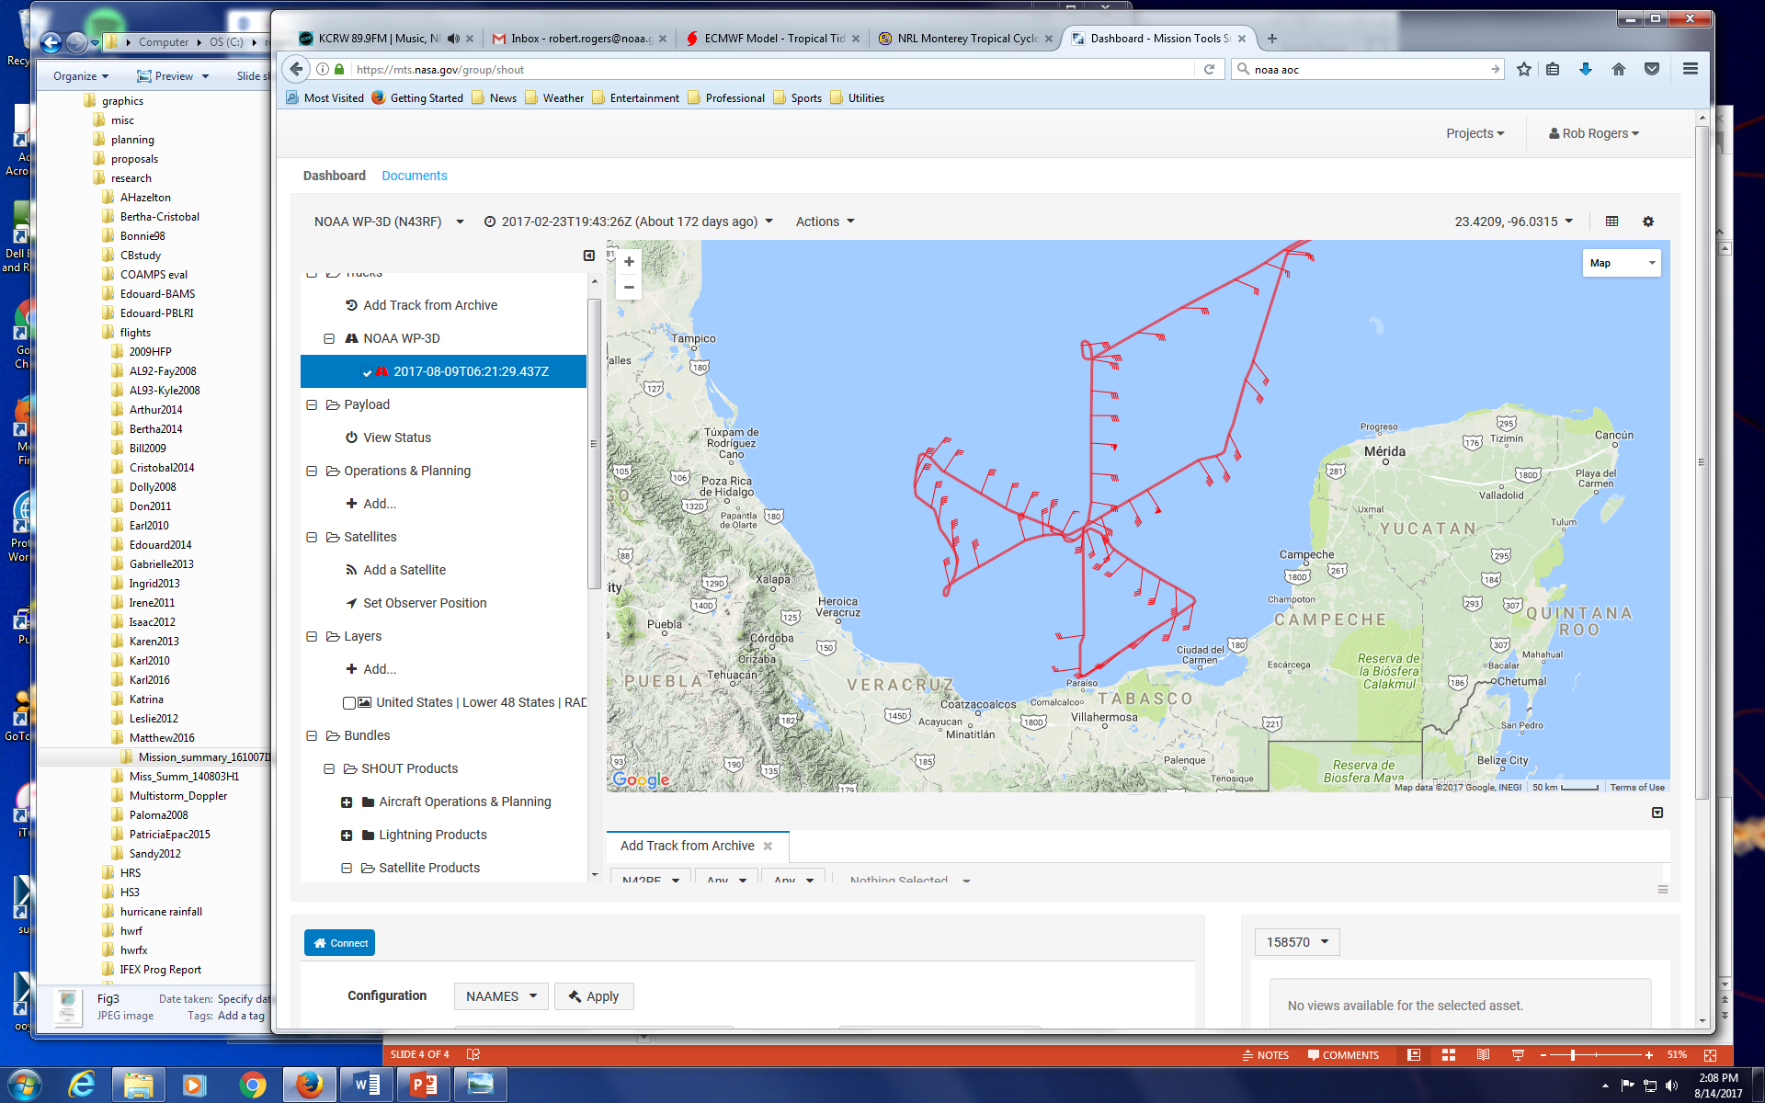
Flight tracks
Planned flight track for 170809H1
Actual flight track for 170809H1

Slide 21
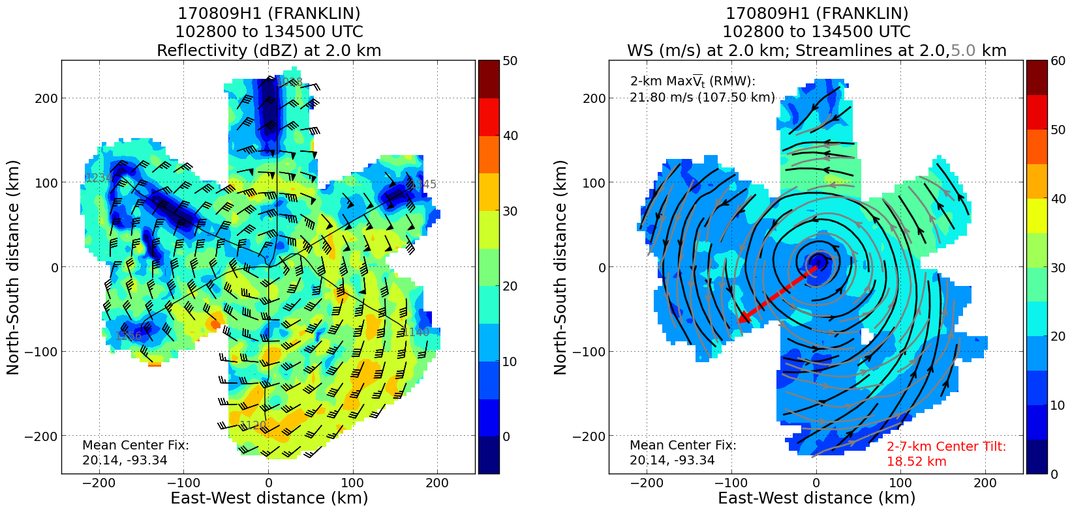
Vortex tilt and reflectivity distribution
Reflectivity distributed around storm, but primarily DSL
Little inner-core tilt, some suggestion of a tilt at larger radii (crossing streamlines)

Slide 22
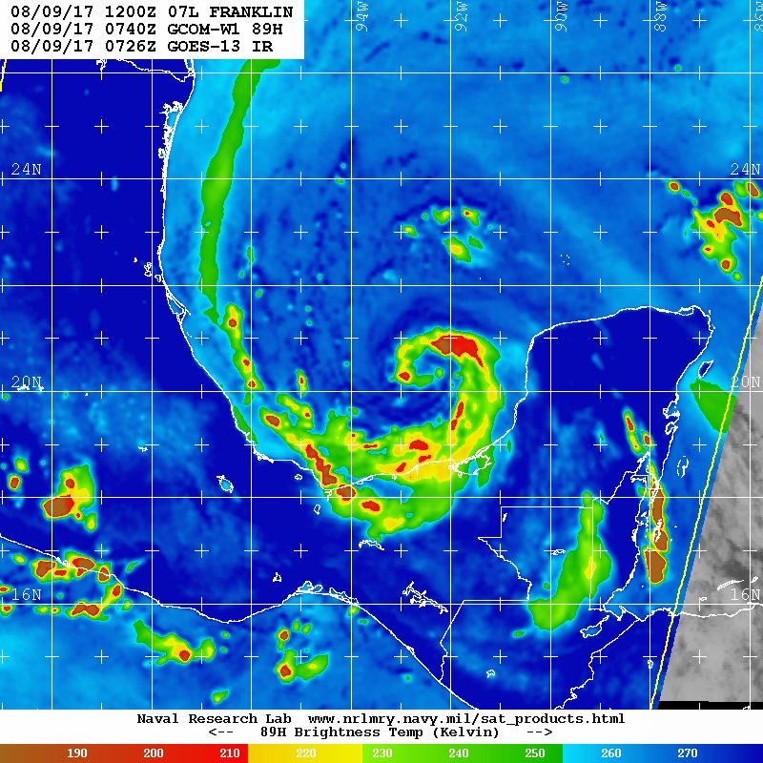
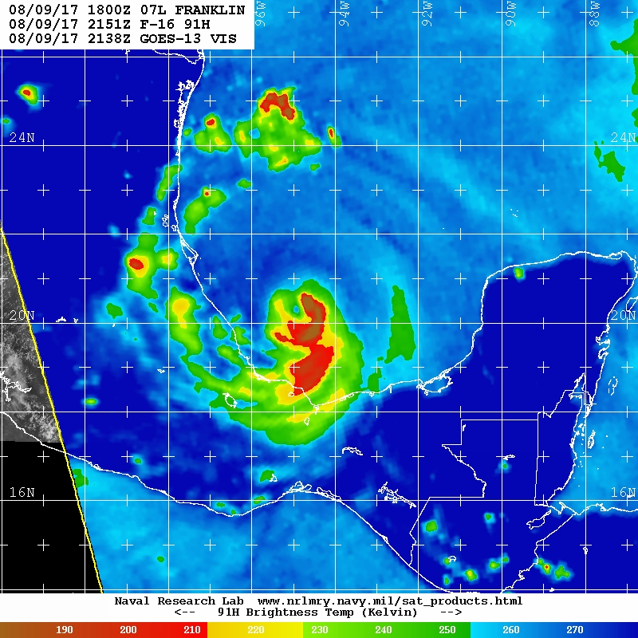
Precipitation structure evolution
06 UTC SHIPS:
~8 kt from 351
12 UTC SHIPS:
~14 kt from 003
18 UTC SHIPS:
~18 kt from 006
Spiral structure before start of mission, strong ice scattering signature USL
Wavenumber-1 maximum in scattering DSL, some USL as shear reaches 18 kt

Slide 23
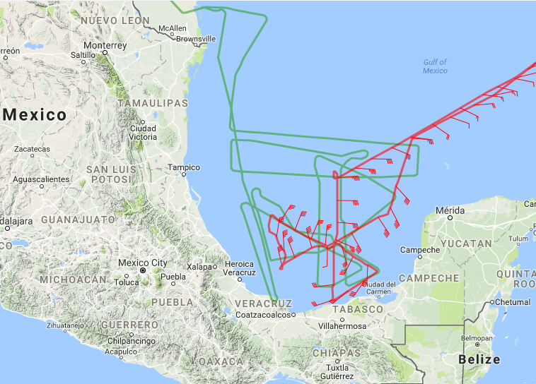
Coordination with Global Hawk
Green – GH
Red – P3
Nearly vertically stacked

Slide 24
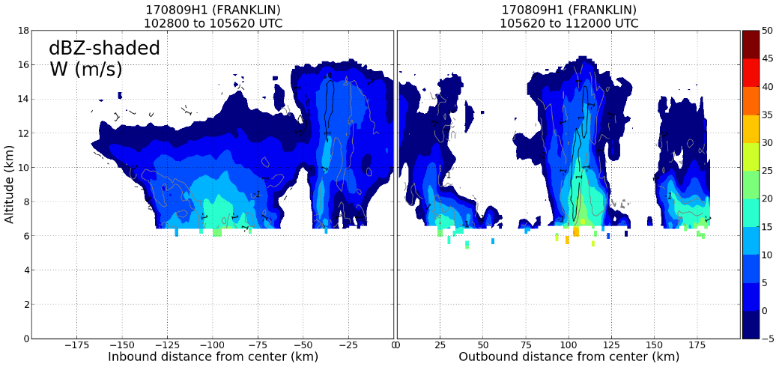
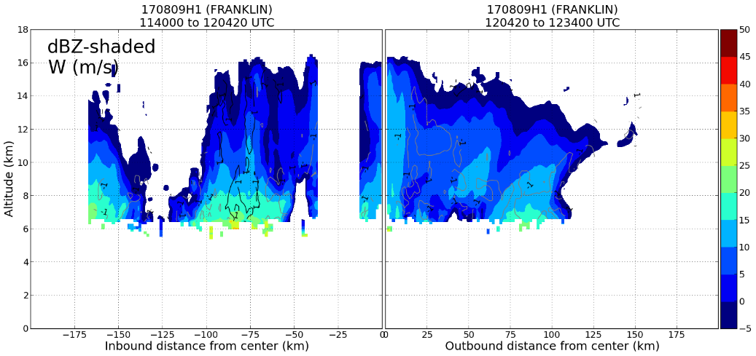
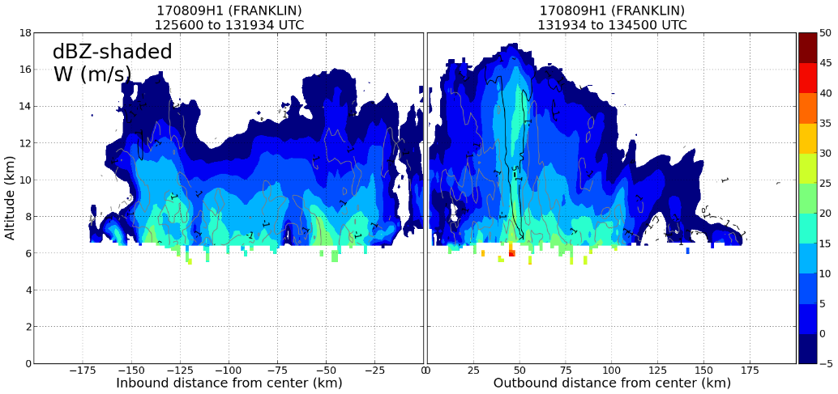
Precipitation structure and distribution
US
Spiral?
Spiral?
DS
US
USR
USL
Precipitation in all quadrants
Highest echo top USL, potentially revealing variable structure along band spiraling inward
DSR
DSL
DSL
Spiral?
USR
DS
DSR
Spiral?
USL

Slide 25
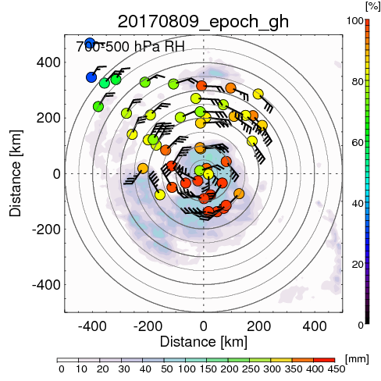
Deep layer thermodynamic structure
USR
USL
DSR
DSL
14 kt
12 UTC SHIPS
Generally near-saturated downshear
High humidity upshear, > 70%
Dry air (RH < 30%) far-removed USR

Slide 26
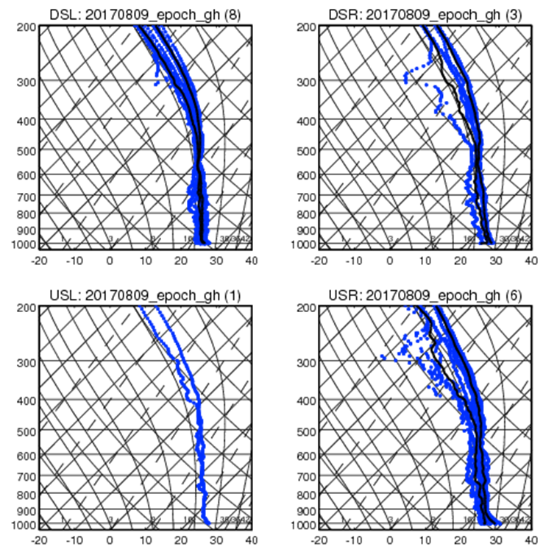
Deep layer thermodynamic structure
Near environment (50-200 km radius) skew-T’s
Moist profile in all quadrants

Slide 27
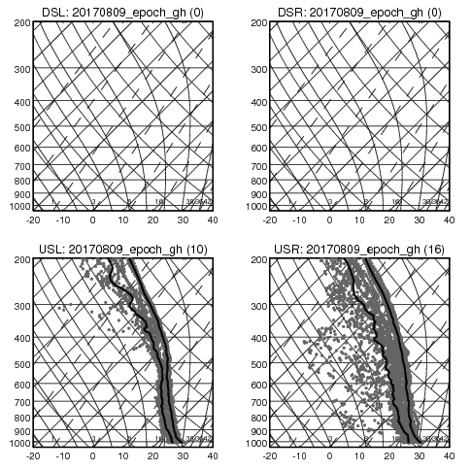
Deep layer thermodynamic structure
Far environment (> 200 km radius) skew-T’s
No drops downshear (over LAND)
Driest profiles USR, associated with band of dry air seen on TPW

Slide 28
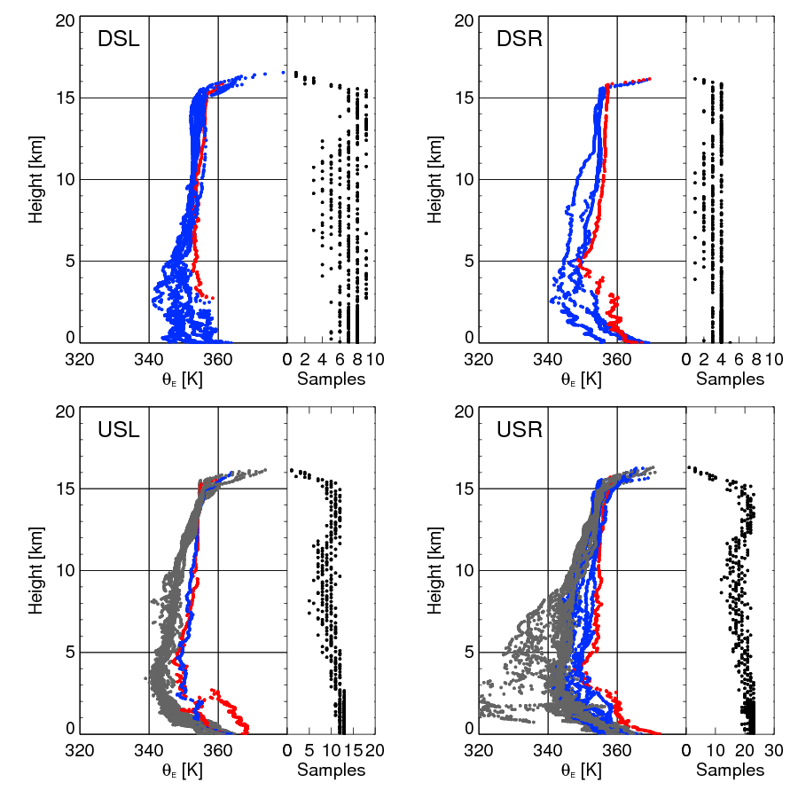
Deep layer thermodynamic structure
Red: inner core (< 50 km)
Blue: near environment (50-200 km)
Grey: far environment
(> 200 km)
Lowest PBL theta-e in near environment DSL; highest USR, DSR

Slide 29
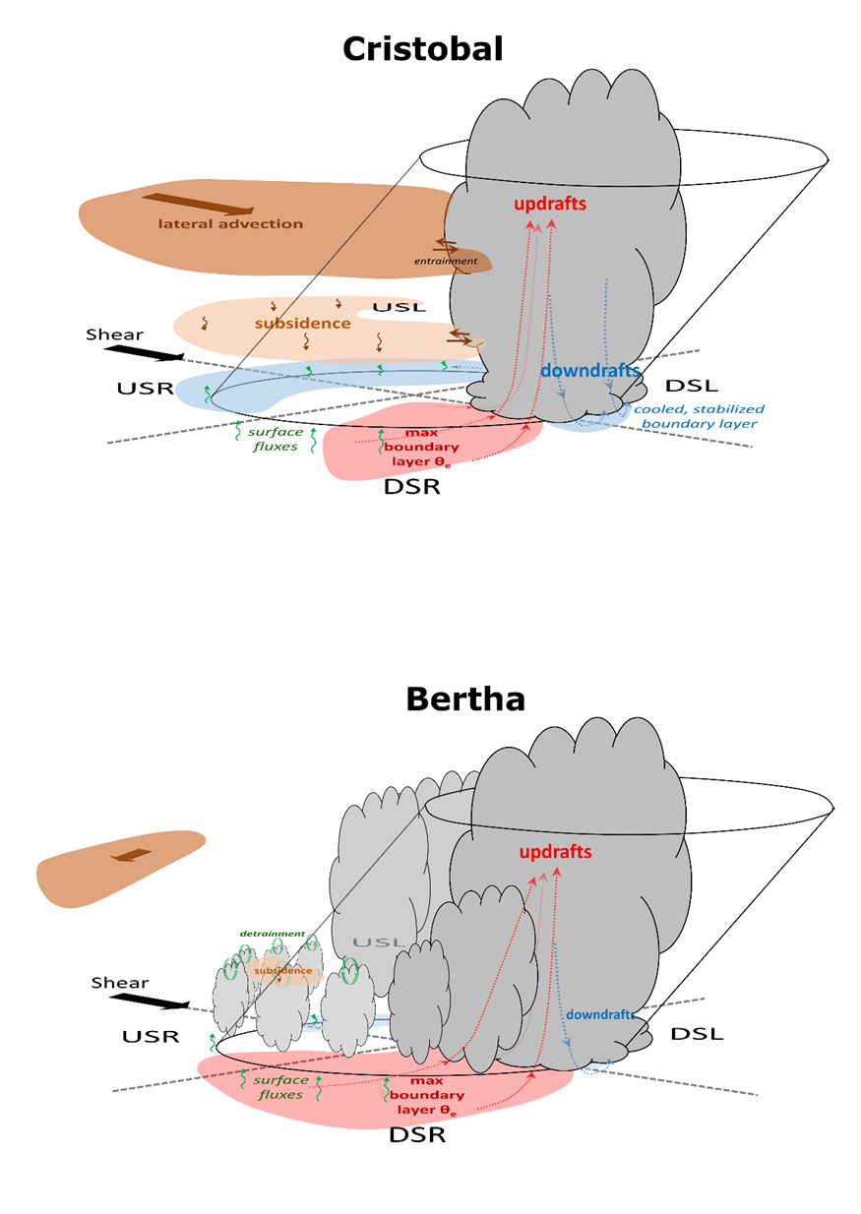
Schematic of thermodynamic structure and precipitation distribution for intensifying vs. non-intensifying TCs
non-intensifying
intensifying
Adapted from Nguyen et al. (2018)
For Franklin:
No indication of dry air upshear in near-environment
Precipitation in all quadrants, including deep convection USL
Some PBL cooling DSL, highest theta-e right of shear
Observations of Franklin most similar to “intensifying” schematic

Slide 30






Franklin 07L Forecasts by HWRF
Avichal Mehra, Zhan Zhang, Bin Liu and Banglin Zhang
EMC/NCEP/NWS/NOAA, College Park, MD 20740
Jason Sippel
AOML/OAR/NOAA, Miami, FL 33149
August 15, 2017
Notes:
30
30

Slide 31
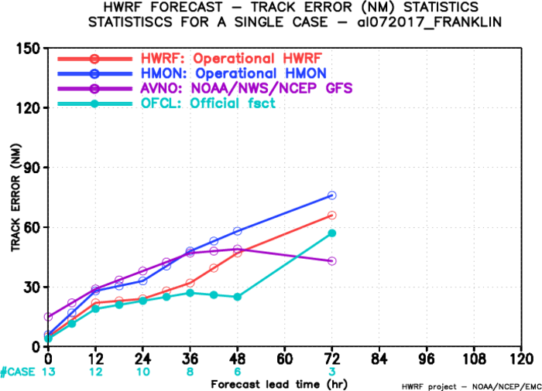
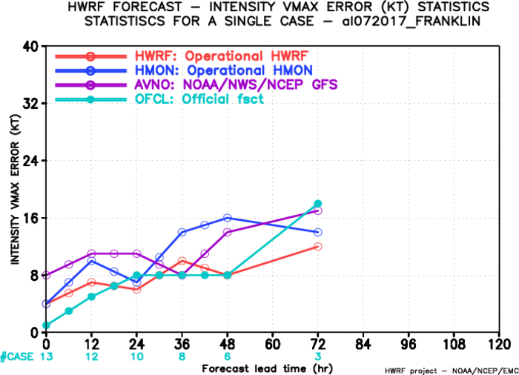
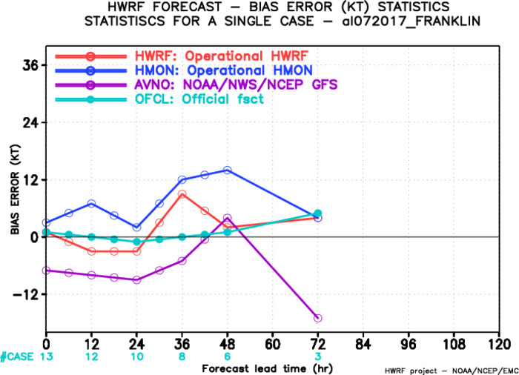
Track/intensity Errors
track
HWRF forecast errors are smaller than HMON
intensity
bias

Slide 32
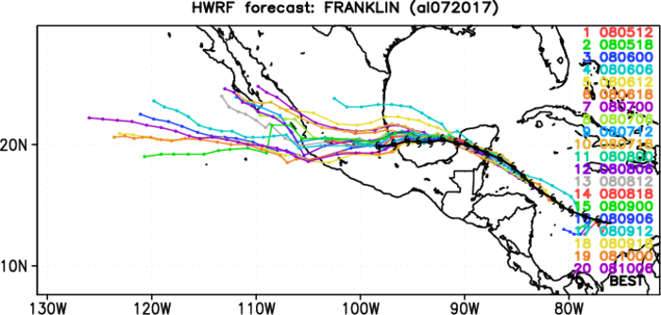
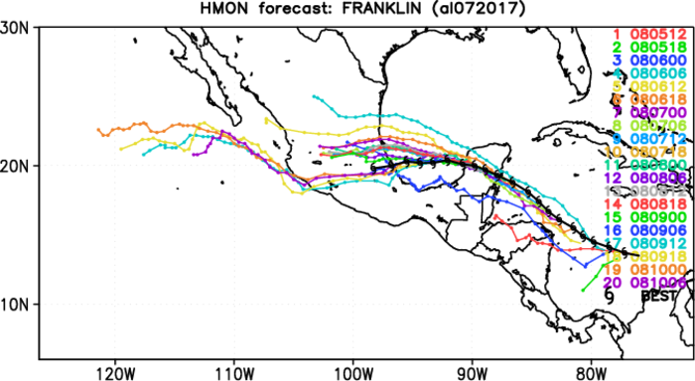

Track composite

Slide 33



Intensity composite

Slide 34
Recon assimilated in HWRF
Dropsondes (C-130/P3/GH)
FL data (C-130/P3)
TDR (P3)

Slide 35




Analysis increments at 20170807_06Z
No recon

Slide 37




Analysis increments at 20170807_12Z
No recon

Slide 39




Analysis increments at 20170807_18Z
C-130 FL data & drops

Slide 41




Analysis increments at 20170808_00Z
C-130 FL data & drops

Slide 43




Analysis increments at 20170808_06Z
Flight-level data?

Slide 47




Analysis increments at 20170900_00Z
With TDR, drops, FL data

Slide 49
Summary
HWRF performance is good for Franklin Forecast
Big increments when inner-core reconnaissance observations assimilated, reducing vortex strength and forecast bias

Slide 50
1st Lakeland Deployment
About a 4-h drive door-to-door
Good midway point for driver swap-out is Ft. Drum Plaza (not Yeehaw Junction!)
Residence Inn pros: 8-min drive to AOC, manager’s reception, kitchen in room, decent breakfast, walking distance to plenty of restaurants/sandwich shops (potential con: availability of gov’t rate rooms)
Go to AOC before missions start to get entry cards for crews (1 per crew) and get laptops authorized for AOC wi-fi (upstairs & downstairs)
Should we continue with 1 van for both crews or go back to separate vans?

