Slide 1
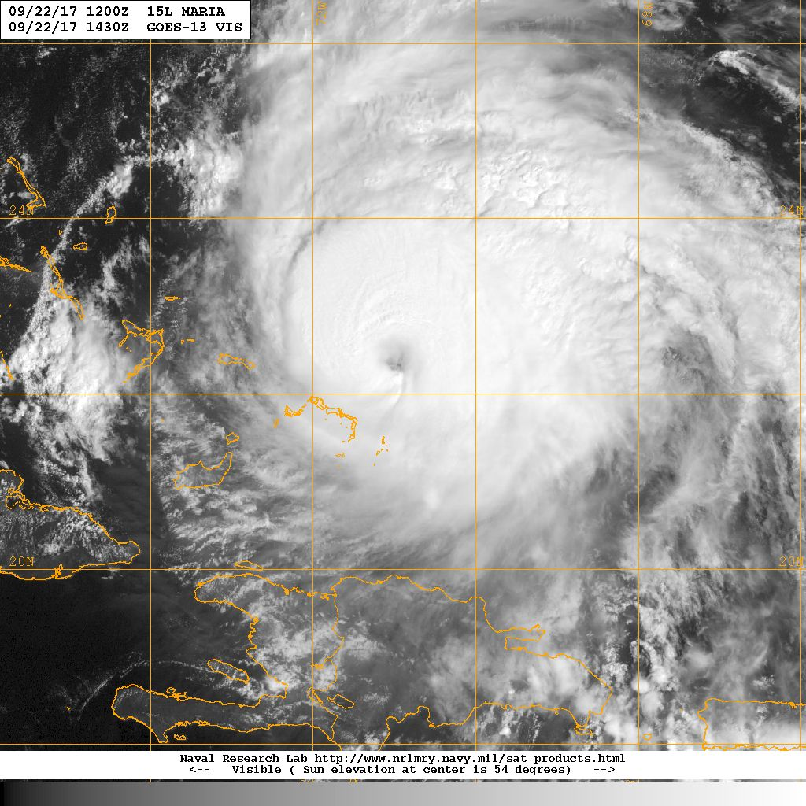
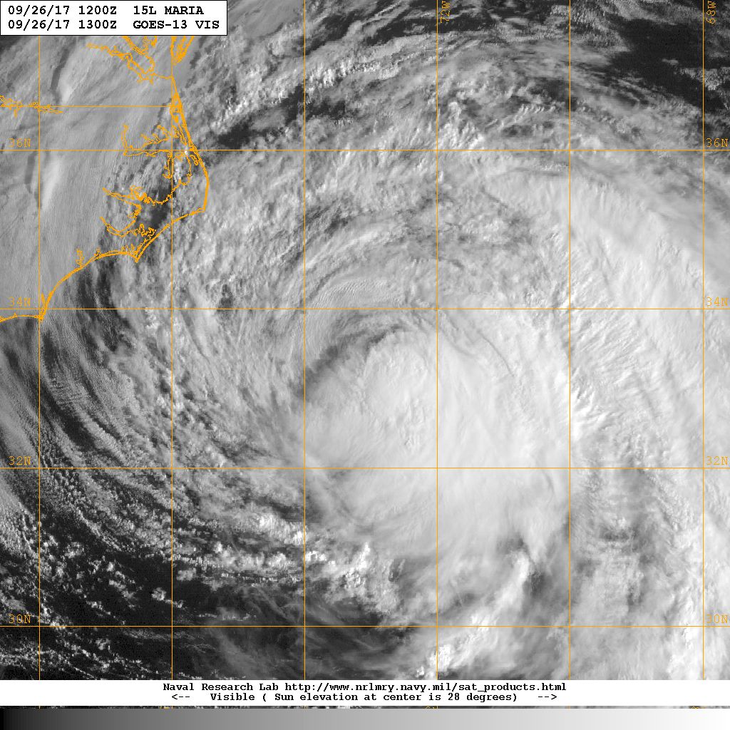


Hurricane Maria Debrief
15Z 22 Sep
13Z 26 Sep
Flight ops re-cap: 3 research and 5 EMC missions
~64.5 P-3 flight hours; >43 GPSsondes; >34 Irsondes; >27 AXBTs
4 G-IV Synoptic surveillance missions
October 4, 2017

Slide 2
Agenda
Missions Overview (Reasor)
Science Discussions
  170922H1 Coyote/DWL (Cione)
  170923H1 Coyote/DWL (Cione)
  170924H1 EMC (Reasor)
  170924H2 Coyote/DWL (Cione)
  170925H1 EMC (Reasor)
  170925H2 EMC (Reasor)
  170926H1 EMC (Reasor)
  170926H2 EMC (Reasor)
Additional Field Program Issues

Slide 3
Missions Overview
Purpose: Coyote/DWL research; EMC-tasked TDR data collection targeting all HWRF cycles
Target: MH-H Maria on 22-26 Sep as it moved north of the Bahamas and then approached the N Carolina coast
Background: Maria rapidly intensified to Cat-5 just before landfall on Dominica, remained a strong major hurricane on 20 Sep at landfall on Puerto Rico, and weakened to Cat-3 as missions began on 22 Sep.
Mission Highlights: Launched 6 Coyote UAS over 3 days in a strong hurricane; collected DWL data in a hurricane; transmitted recon data for HWRF DA (all cycles)

Slide 4
Missions Overview (local times)
22 Sep: 1PM mission
23 Sep: 1PM mission
24 Sep: 1AM mission (no HRD); 1PM mission
25 Sep: 1AM mission (no HRD); 1PM mission (no HRD)
26 Sep: 1AM mission (no HRD); 1PM mission (no HRD)

Slide 5

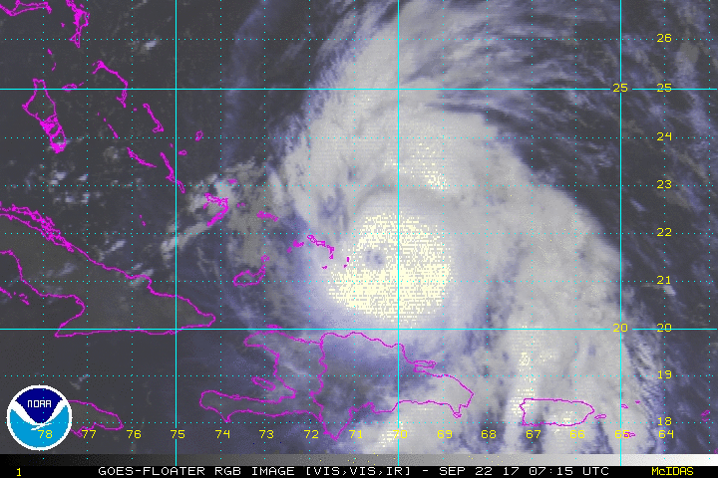
Hurricane Maria
20170922H1
Storm Info
11am: Cat 3 958mb 110kt
22.3N 71.0W mvg NW @ 7kt
Eye 13Z Open W C38
RMW ~ 23nm
Notes:
5

Slide 6

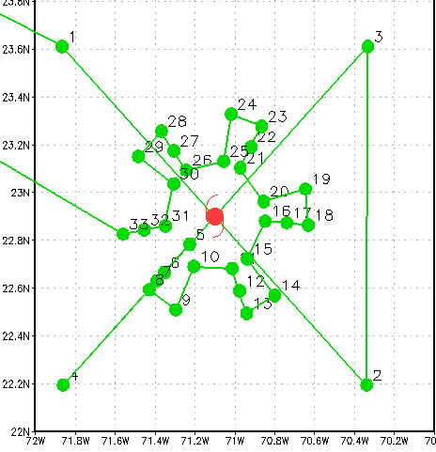
Mission Flight Plan
Mission Info
Research Coyote / DWL / TDR
Altitude: 10ft PA
Pattern:
  Fig 4 60nm legs (TDR/DWL)
  6 passes in/out of eyewall ~25nm legs, 1st one launch coyote in eye & circle
  8 pennies total
Expendables:
  Coyote
  Dropsondes: ~ 17
  BT’s external: 12
Notes:
6

Slide 7

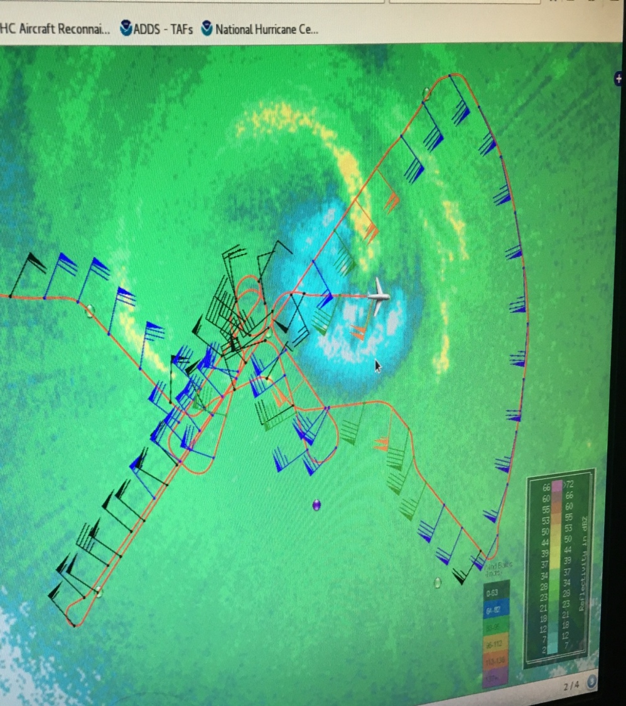
Actual Flights
Actual Expendables:
  Coyote (1)
  IR Dropsondes: 15
  BT’s external: 8
Notes:
7

Slide 8
20170922H1 – DWL 20170922H1 - Coyote
Performed DWL module 2 (partial moat regions). Note: LF too low to confirm moat.
Performed DWL module 5 (high wind regions).
Problems: none
Coyote flight 1 Eyewall Experiment...
Record duration (43 min) for an eyewall mission was observed. We had controlled flight as low as 400 ft (121m) and also set a world record (to the best of my knowledge) for maximum wind speed recorded by a UAS (123MPH). The P3 performed a complementary eye/eyewall pattern that coincided with the UAS track and position. These data were sent in real time to NOAA’s National Hurricane Center. In this particular instance the data were used by NHC forecasters as part of their forecast discussion for Major Hurricane Maria.

Slide 9
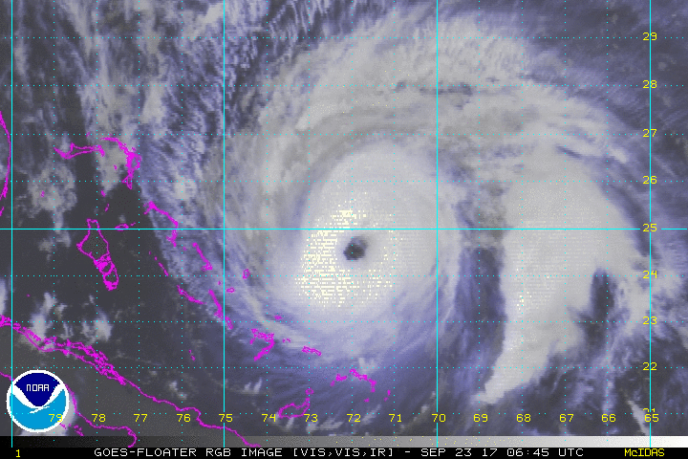
Hurricane Maria
20170923H1
Storm Info
11am: Cat 3 95mb 100kt
25.4N 72.3Wmvg NNW @ 7kt
Eye: 1330Z 30nm Open S, RMW ~ 20nm
RMW ~ 23nm
Notes:
9

Slide 10
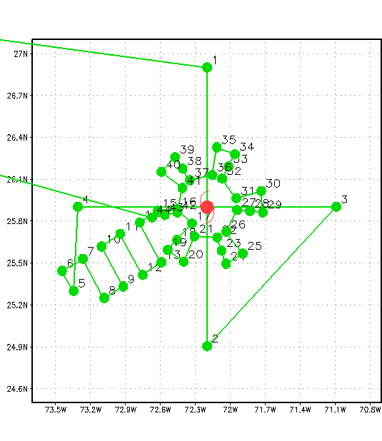
Mission Flight Plan
Mission Info
Research Coyote / DWL / TDR
Altitude: 8-10ft PA
Pattern:
  Fig 4 60nm legs (TDR/DWL)
  Coyote 1, Lawnmower towards center
  Coyote 2 in center, 6 passes in & out around eyewall
  8 pennies total
Expendables:
  Coyote - 2
  Dropsondes: ~ 19
  BT’s external: 15
Notes:
10

Slide 11
Actual Flights
Expendables:
  Coyote - 3
  Dropsondes: 19
  BT’s external: 15
Notes:
11

Slide 12
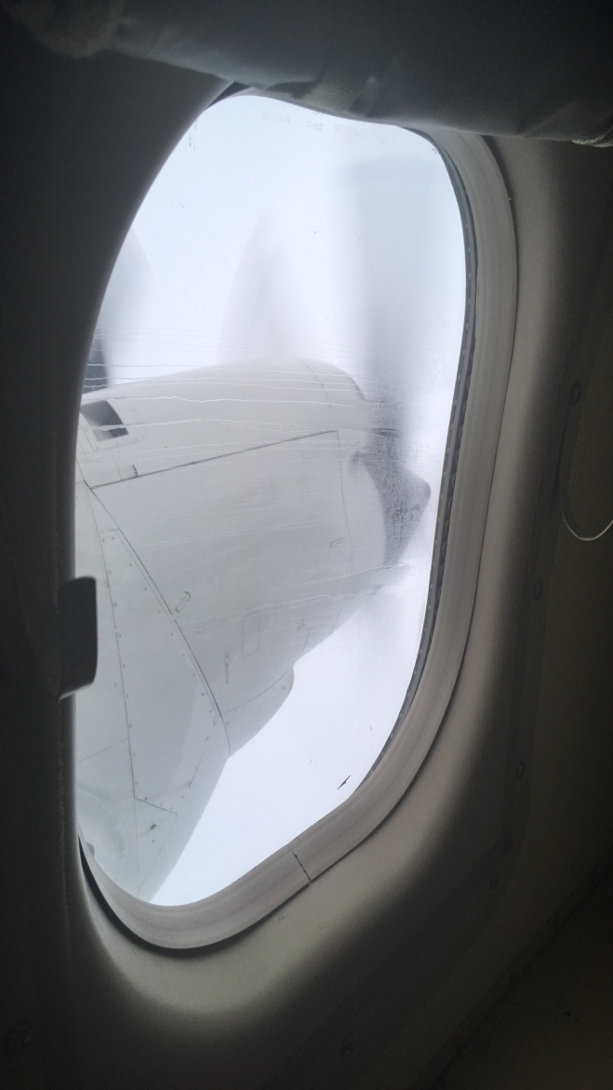
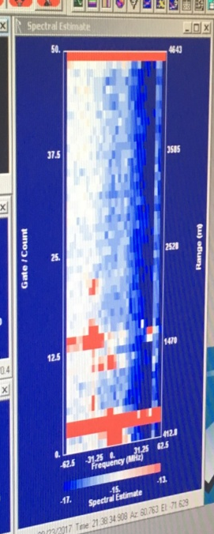
DWL 20170923H1
Performed DWL module 4 (boundary layer)
Performed DWL module 5 (high winds)
Demonstrated partial signal in clouds & light rain. Figure
Problems: AOC unsolicited hard shutdown of hardware

Slide 13
20170923H1 - Coyote Missions 2-4
Coyote flight 2 UAS Inflow Experiment...
Objective was to spiral into the strongest winds of the storm. We started ~50 nmi to the WNW of the storm center while the P3 conducted a lawnmower pattern UAS stepped descents from 4000ft to 1000 ft were conducted during this 33 min mission. This flight is expected elucidate turbulent structure at low altitudes and ultimate improve parameterizations within the very difficult to observe hurricane boundary layer and surface layer enviroments.
Coyote flight 3 Eastern Eyewall Experiment...
Similar to Coyote flight 1 from 9/22, this 32 minute mission traversed ~ ½ of an “eyewall orbit”. Here altitudes as low as 1100-1200ft were recorded (~350m). This flight topped the previous day all time UAS record for wind speed (143 mph) at 340m. Similar to flight 1 on 9/22, these data were used by NHC forecasters as part of their forecast discussion.
Coyote flight 4 Western Eyewall Experiment...
While Coyote 3 traversed ~ the eastern half semi circle of Maria’s strongest low level winds, Coyote 4 captured the western half. Only separated by ~1h, when flights 3 and 4 are combination we have the the first ever eyewall orbit flight (by -any- aircraft, manned or unmanned). This flight was 32 minutes in duration and as with all previous UAS flights mentioned, NOAA’s p3 manned aircraft conducted a flight track that was specifically complementary to the Coyote UAS.

Slide 14
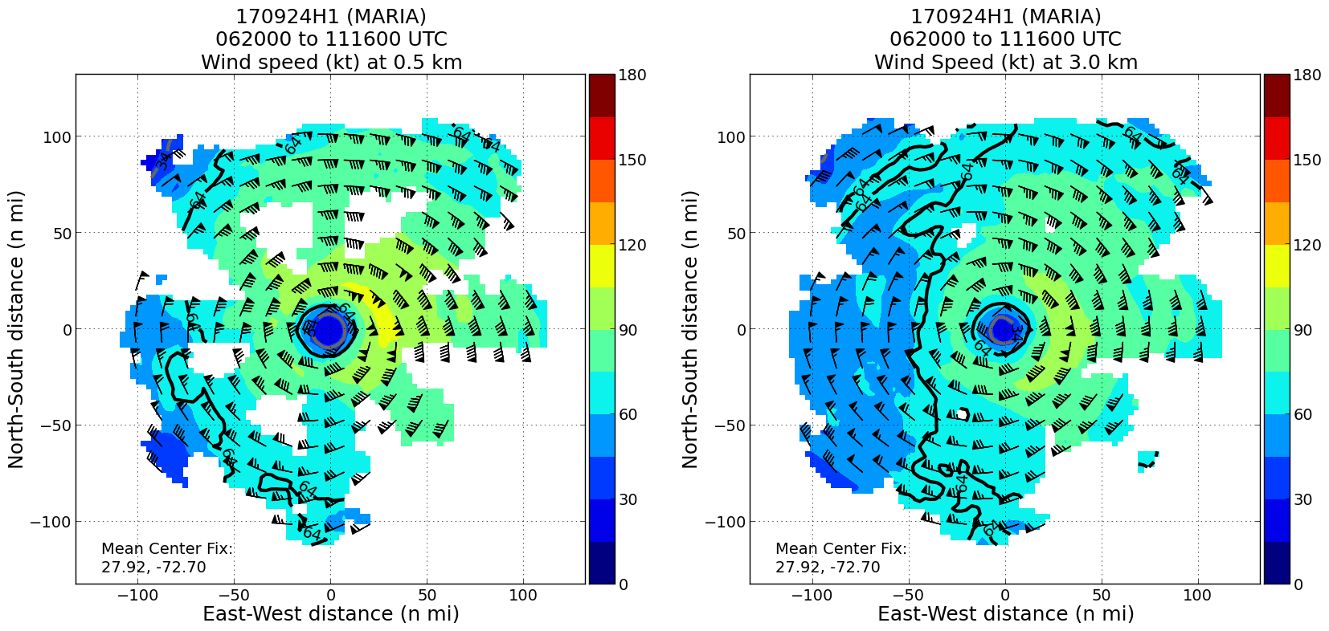
20170924H1
EMC-tasked TDR; Ground radar (Gamache)
14 sondes (7 HFIP, 7 NHC)

Slide 15
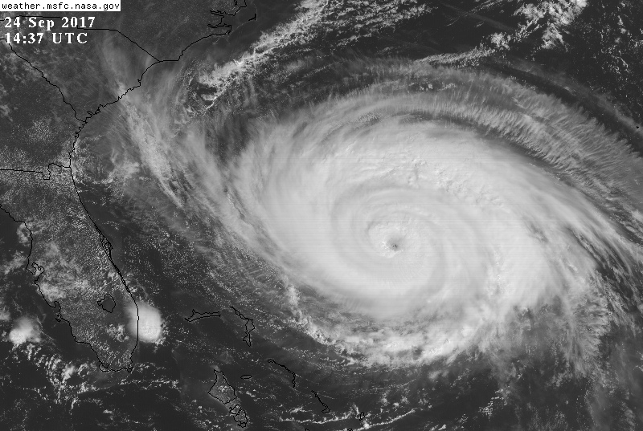
Hurricane Maria
20170924H2
Storm Info
11am: Cat 2 947mb 90kt
28.7N 72.9W mvg N @ 8kt
Eye: 13Z 35nm Closed, RMW ~ 25nm
RMW ~ 23nm
Notes:
15

Slide 16
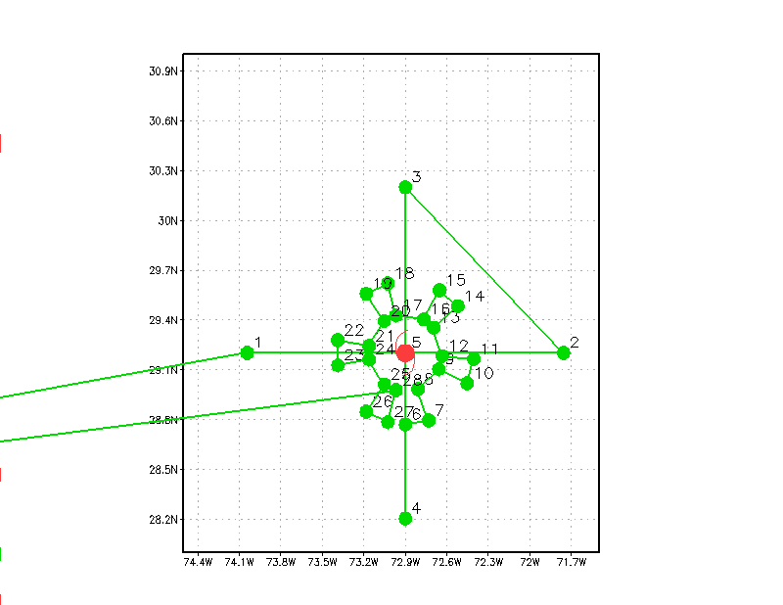

Mission Flight Plan
Mission Info
Research Coyote / DWL / TDR
Altitude: 8-10ft PA
Pattern:
  Coyote in center, 6 passes in & out around eyewall
  Repeat Above
  Fig 4 60nm legs (TDR/DWL)
  14 x as planned
Expendables:
  Coyote - 2
  Dropsondes: ~ 23
  BT’s external: 11
Notes:
16

Slide 17
Actual Flights
Expendables:
  Coyote - 2
  Dropsondes: 25
  BT’s external: 18
Notes:
17

Slide 18
20170924H2 – DWL 20170924H2 - Coyote
Coyote flights 5-6 Guided UAS profiles...
These flights were shorter in duration 10/12 minutes but still collected useful data similar to what a dropsonde might collect as the UAS continuously glided to the surface. Unlike a dropsonde however, the UAS were -guided- from a deployment altitude beginning at 10kft and sampled the transition region between the outer edge of the hurricane eye and the highly turbulent eyewall region at very low altitudes. These missions are important because they can help us better understand this very difficult to observe, critically important ‘transition’ region of the hurricane. Horizontal turbulent exchanges of heat, moisture and momentum in the lowest parts of the hurricane boundary layer between the eye and eyewall regularly occur but are rarely, if ever adequately sampled.
Performed DWL module 4 (boundary layer)
Performed DWL module 5 (high winds).
Problems: Numerous software issues at beginning of flight (able to reboot system mid-flight with no issues); AOC shut off UPS before DWL was brought down

Slide 19
Why Maria Datasets are special?
DWL
Collected data in hurricane force winds (1st time)
Collected boundary layer data in all quadrants of the storm
Collected data in clouds and light rain
These data are necessary for evaluating DWL in hurricane-force winds
These data are necessary for creating algorithms relating signal to wind measurements in various environments
Coyote UAS
First-ever, comprehensive low-altitude UAS dataset collected in a hurricane (3 days, 6 flights)
1st boundary layer UAS data collected of any kind since Edouard (2014)
UAS data was sent in real time to NHC all three mission days (9/22-24)
UAS data was used by NHC forecasters as noted in NHC discussions on 9/22, 9/23
Collected continuous PTHU flight level data in the eyewall (~ orbit on 9/23) on all three days at altitudes as low as 400ft
These highly unique data have the potential to significantly enhance physical understanding of a rarely observed region of the storm, improve situational awareness and provide valuable insights related to (coupled) model evaluation and improvement

Slide 20
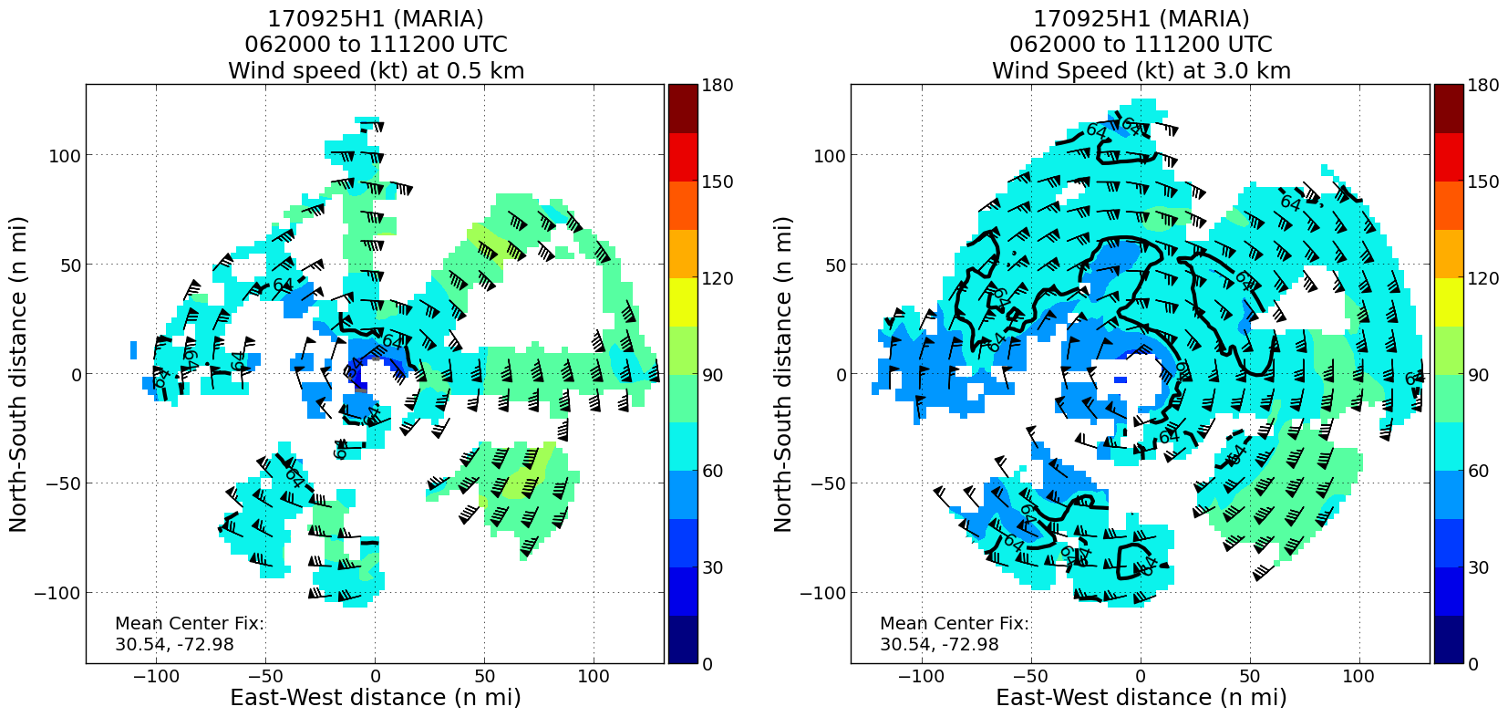
20170925H1
EMC-tasked TDR; Ground radar (Gamache)
9 sondes (5 HFIP, 4 NHC)

Slide 21
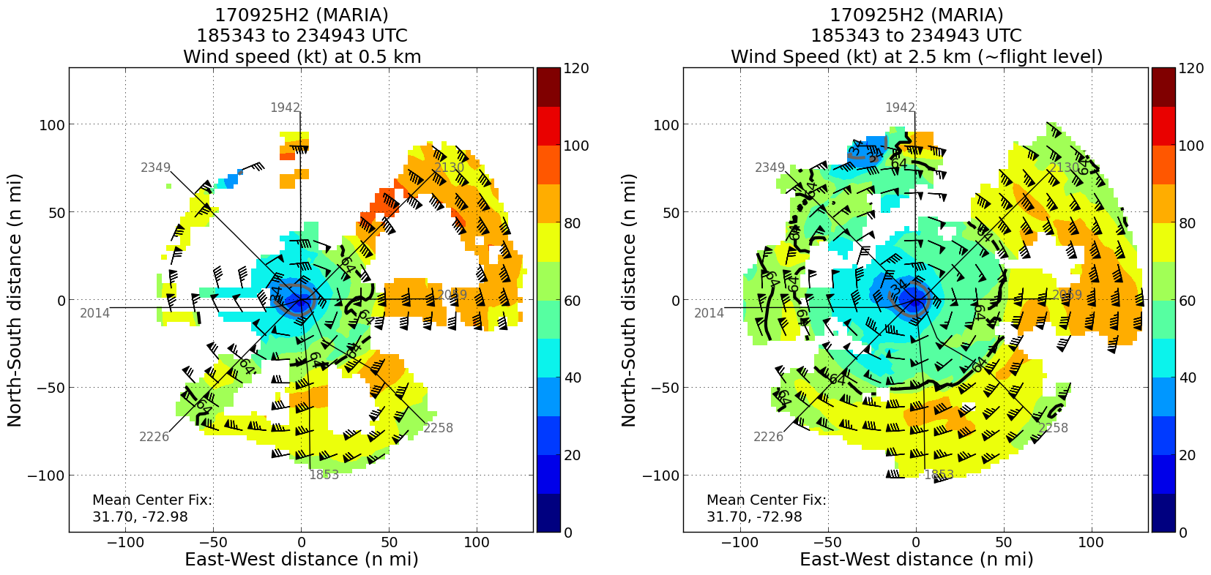
20170925H2
EMC-tasked TDR; Ground radar (Reasor)
5 sondes (4 HFIP, 1 NHC)

Slide 22
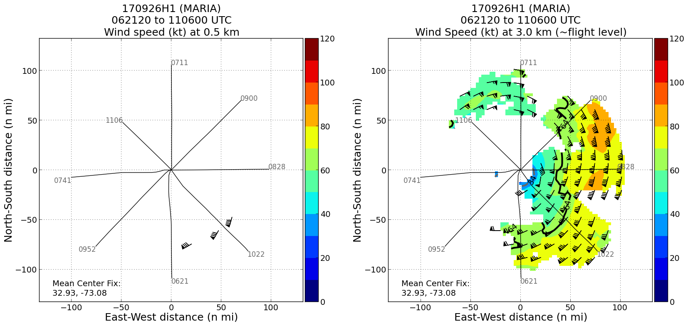
20170926H1
EMC-tasked TDR; Ground radar (Gamache)
8 sondes (4 HFIP, 4 NHC)

Slide 23
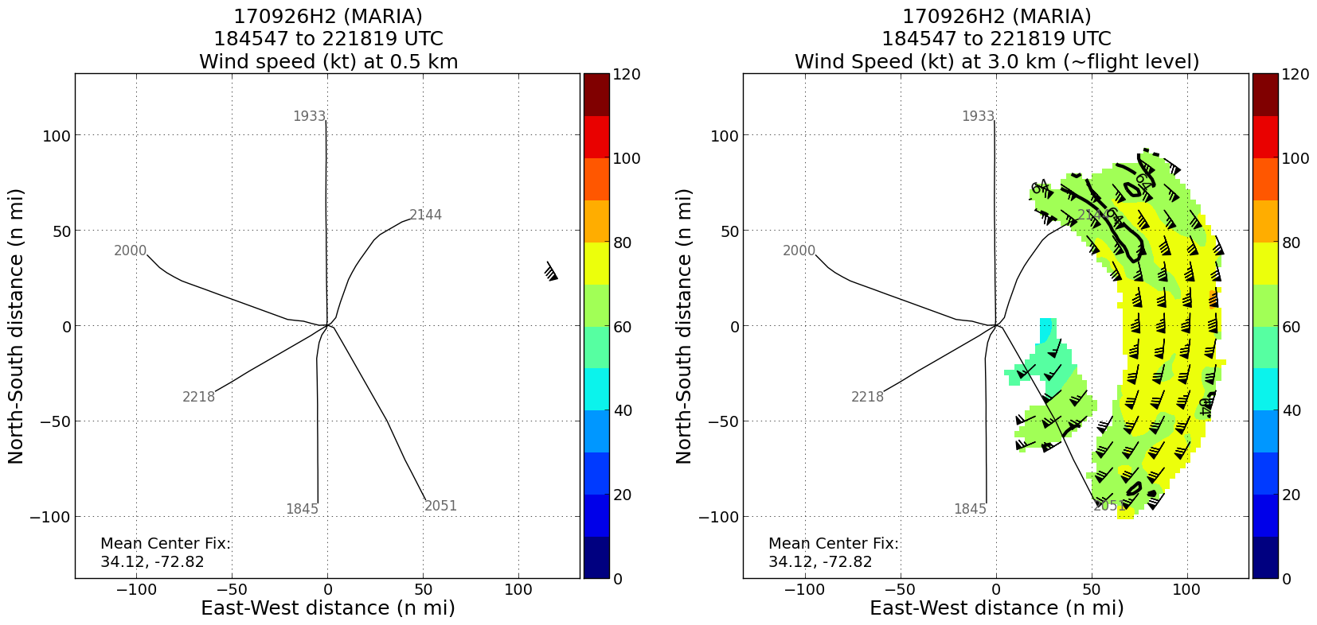
20170926H2
EMC-tasked TDR; Ground radar (Reasor)
7 sondes (3 HFIP, 4 NHC)

