Slide 1
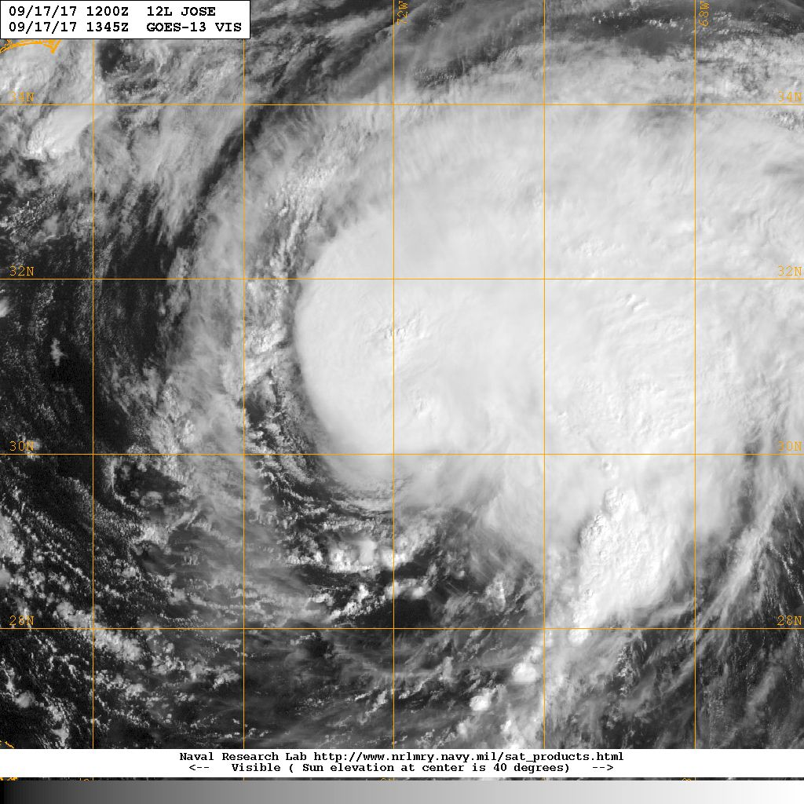
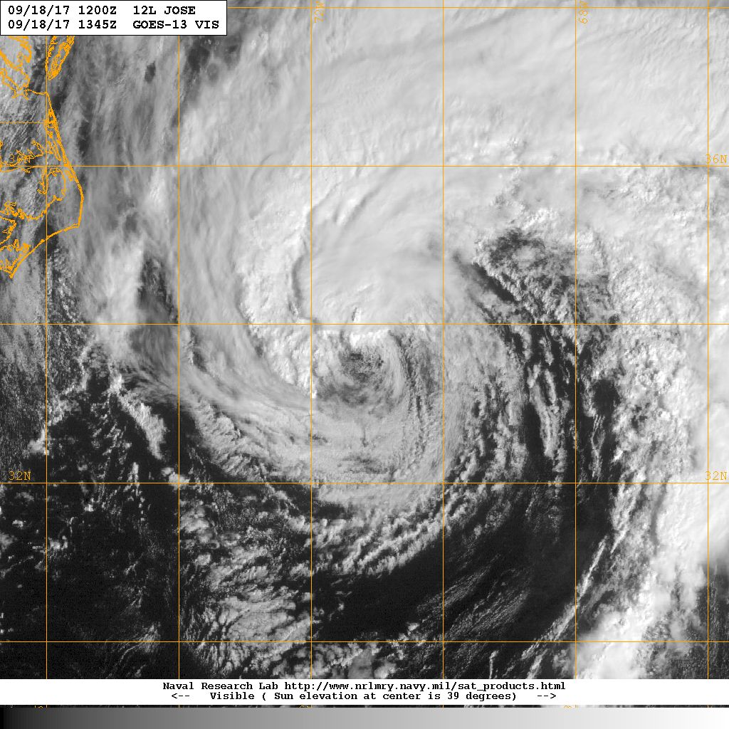


Hurricane Jose Debrief
14Z 17 Sep
14Z 18 Sep
Flight ops re-cap: 2 EMC missions
~16 P-3 flight hours; ~9 GPSsondes; 0 AXBTs
1 G-IV Synoptic surveillance mission
October 4, 2017

Slide 2
Agenda
Missions Overview (Reasor)
Science Discussions
170917H1 TDR (J. Zhang)
170918H1 TDR (Zawislak)

Slide 3
Missions Overview
Purpose: EMC-tasked TDR data collection targeting 00 UTC and 12 UTC HWRF cycles
Target: H Jose on 17-18 Sep as it moved northward to the east of the Carolinas
Background: At one point Jose had been a MH, but then weakened to a TS as it executed a clockwise loop. Jose re-intensified to a H prior to the missions.
Mission highlights: Sampled hurricane w/ *potential* for NE U.S. impact; transmitted recon data for HWRF DA (00Z & 12Z). Tested DWL for first time during 2017 season.

Slide 4
Missions Overview (local times)
17 Sep: 4PM mission
18 Sep: 4AM mission

Slide 5
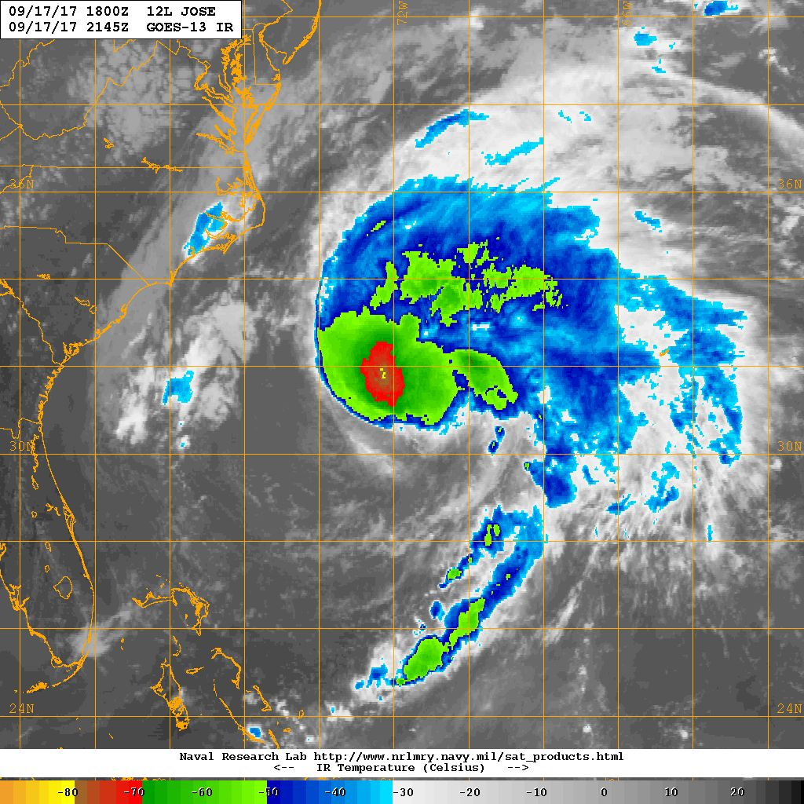
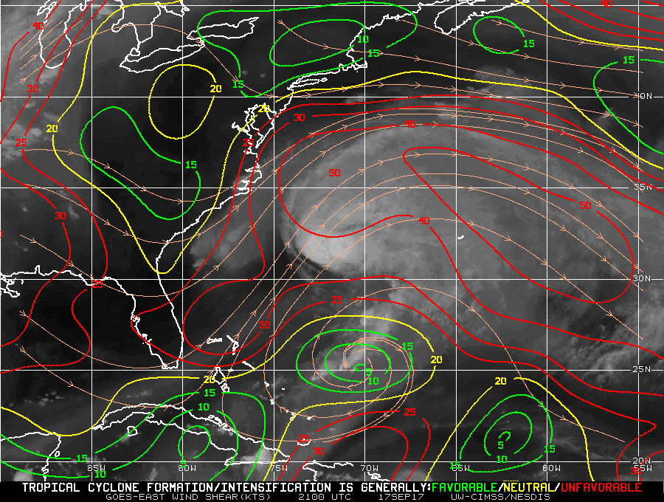
20170917H1 JOSE (TDR mission)
LPS+DWL: Jun Zhang Radar: Robert Black
Dropsonde: flight director Ground Radar: Paul Reasor
80 kt
MOTION (8 kt)
SHIPS SHEAR (~40 kt)
Strong south-westerly shear

Slide 6
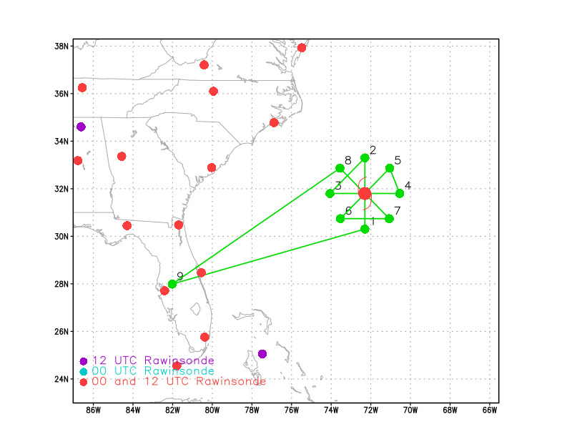
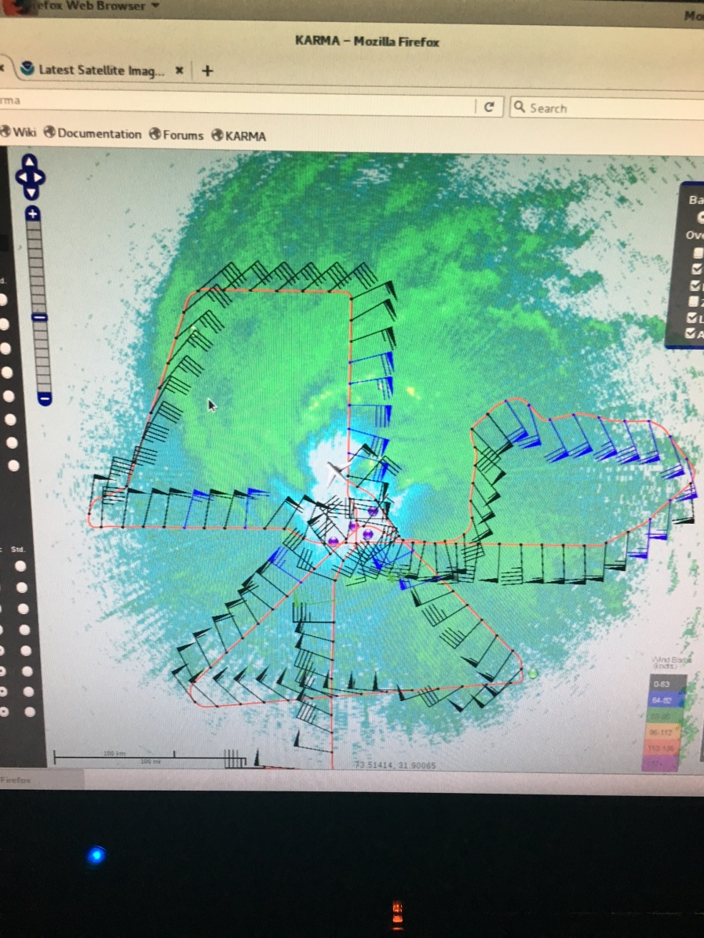
Flight track
Takeoff: 1955 UTC
Rotated Fig. 4, 10 kft, 90 nm
Dropsondes only at the first pass
No AXBT
3 Dropsondes (2 HFIP, 1 NHC)

Slide 7
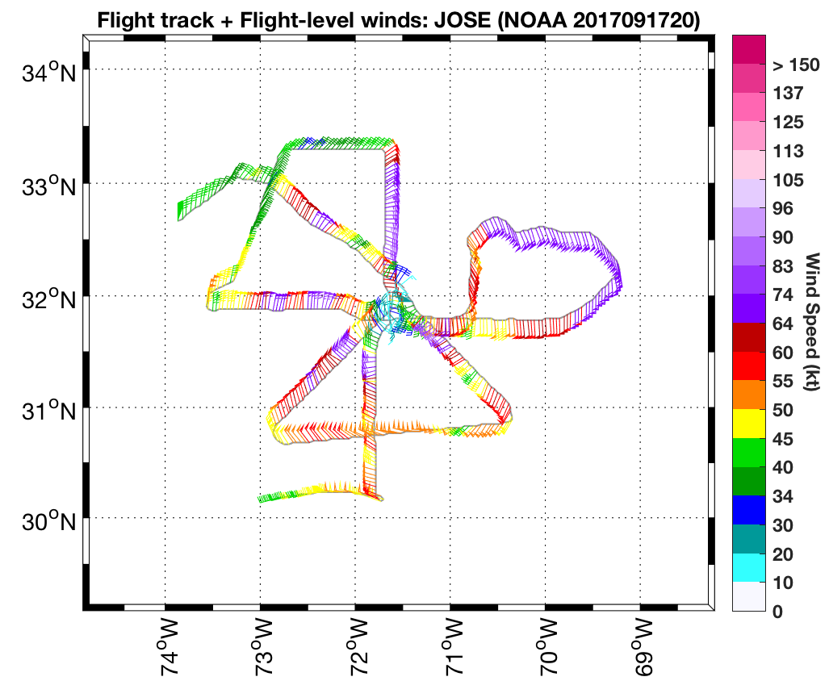

Slide 8
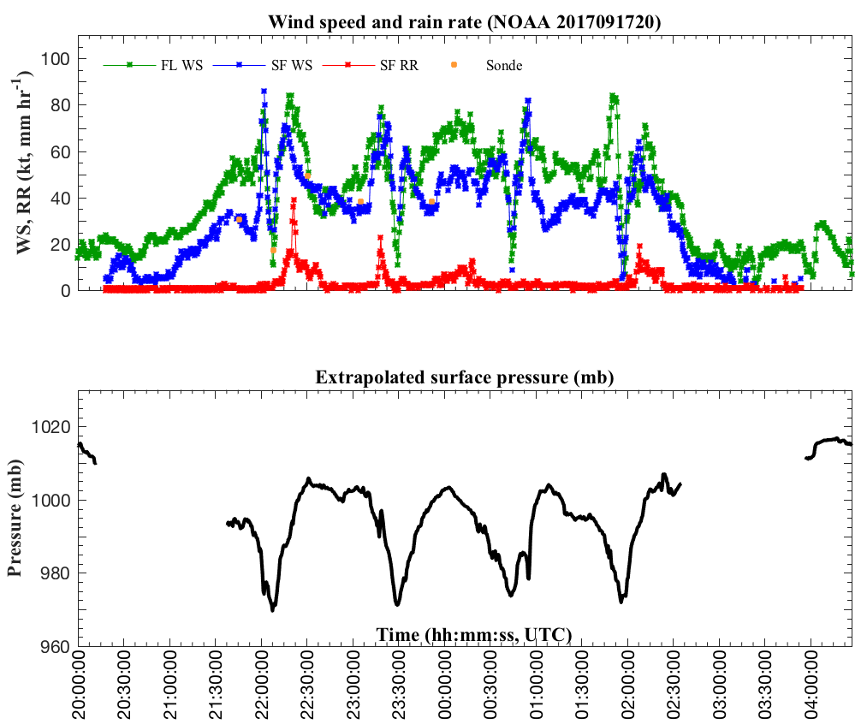

Slide 9
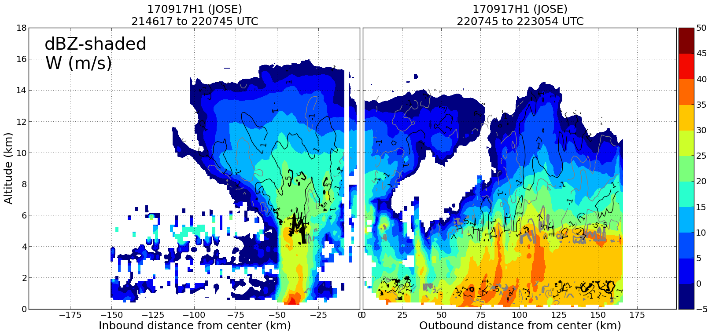

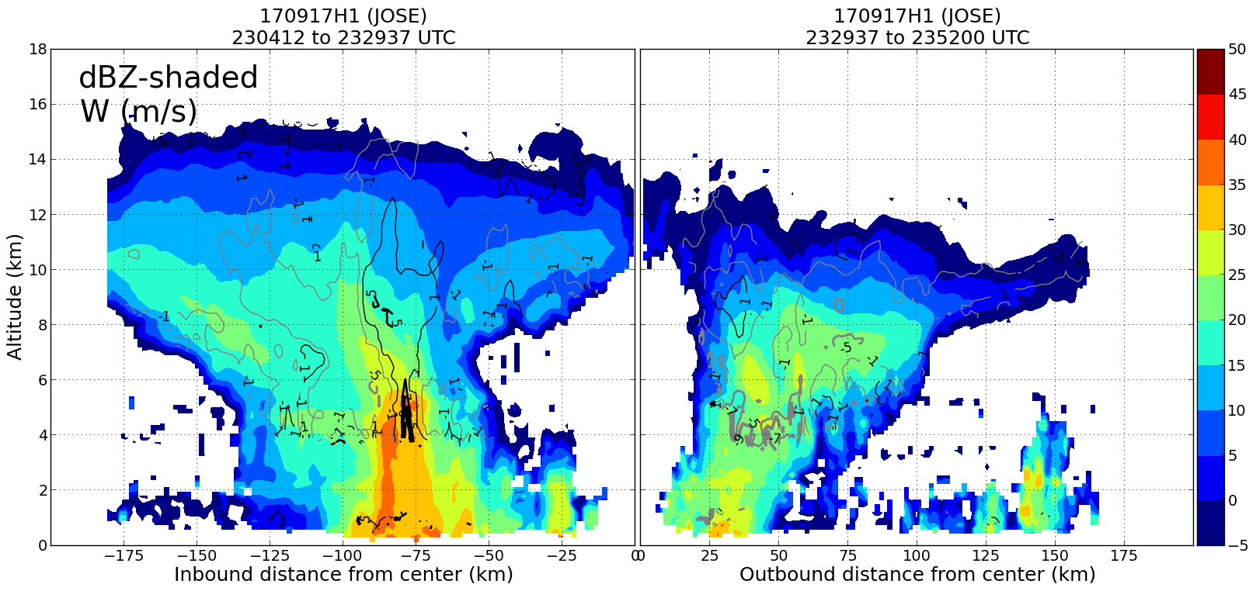
SOUTH (USR)
NORTH (DSL)
WEST (USL)
EAST (DSR)
The downward vertical motion may be strongest on the downshear-right side where the rainfall is weakest.

Slide 10
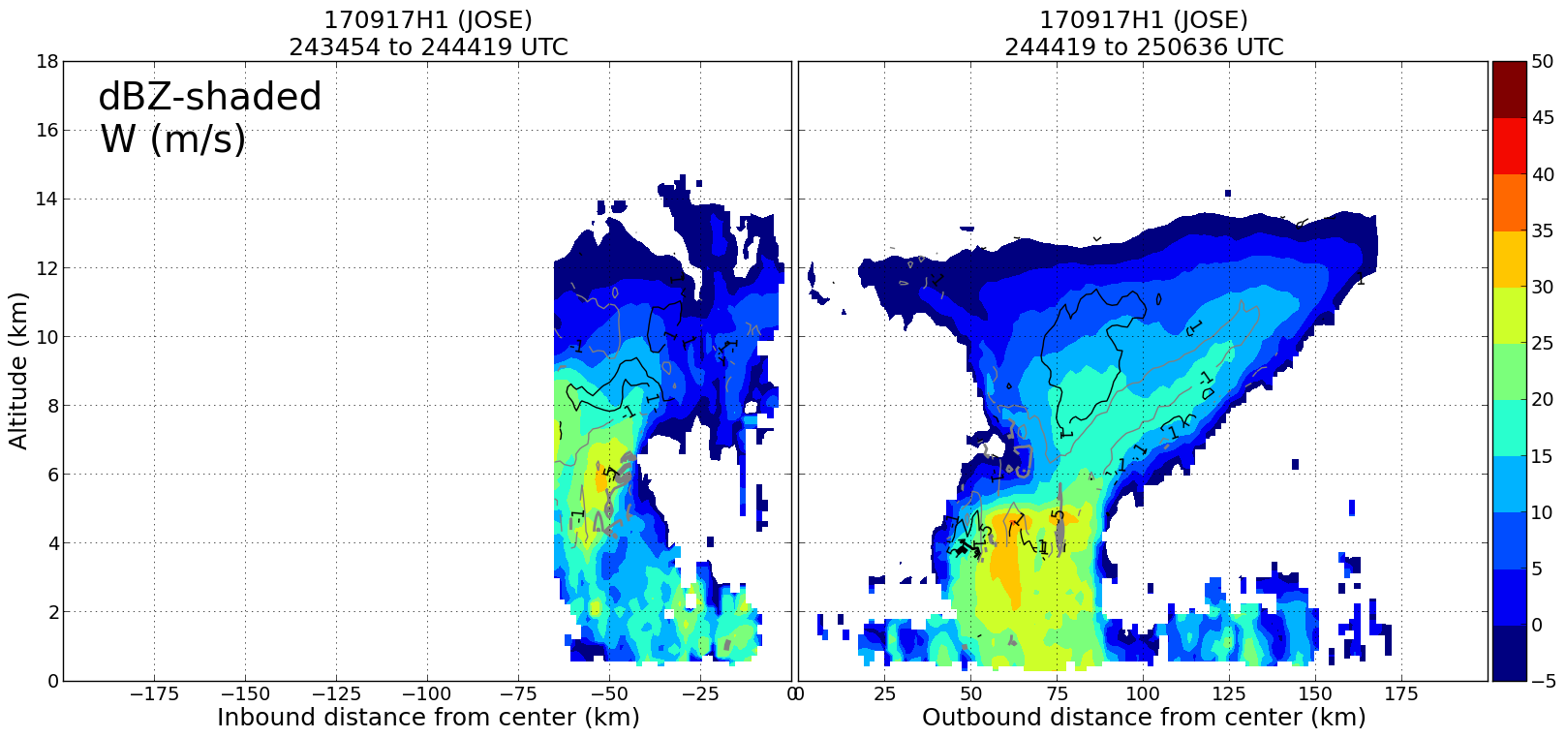
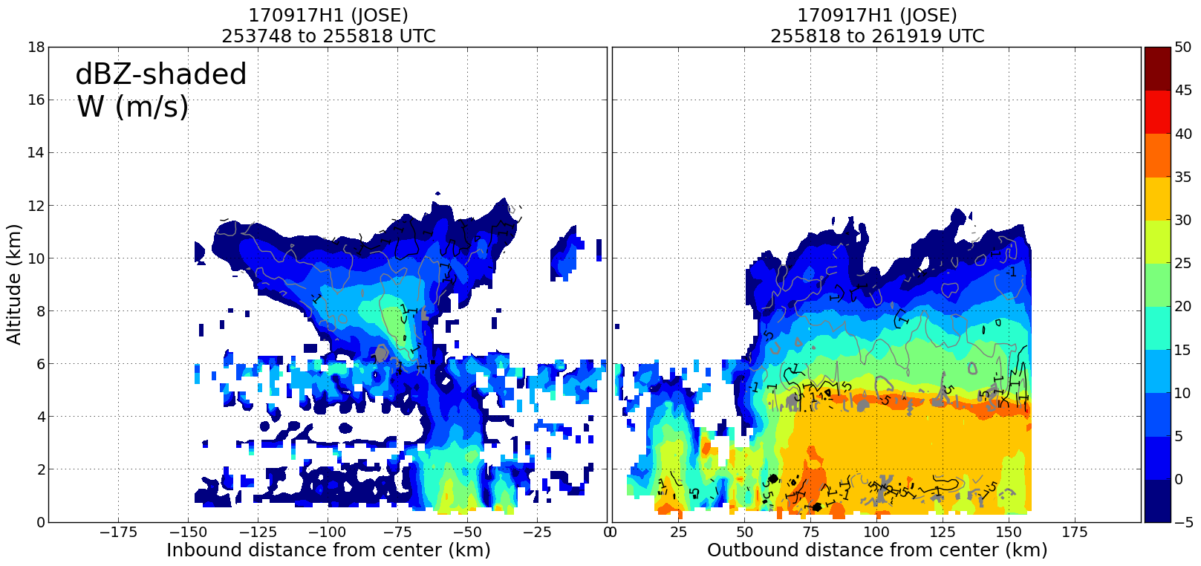
NE (DOWNSHEAR)
SW (UPSHEAR)
The downward vertical motion may be strongest on the downshear side.
The rainfall is largest left of the shear.
The storm center shifted to the east; possible new center forming near the bursts on the down-shear side.
SE (RIGHT, SHEAR)
NW (LEFT, SHEAR)

Slide 11
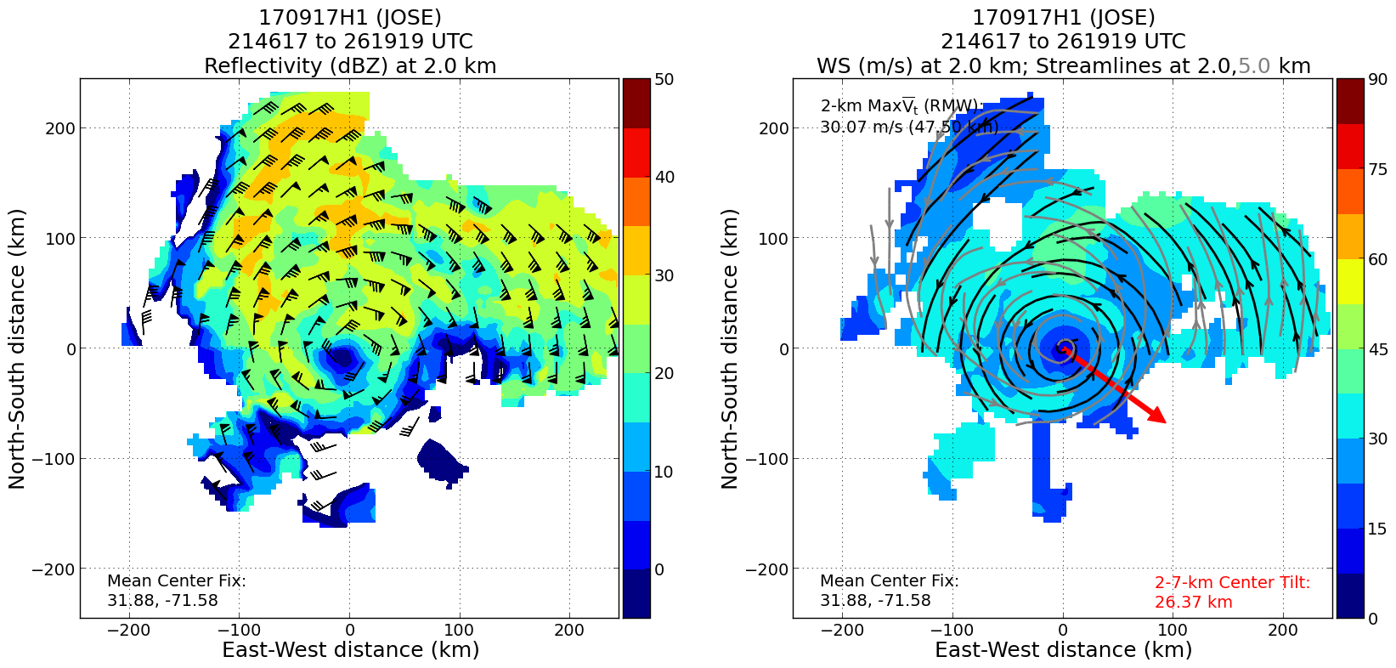
shear
Largest precipitation is located at downshear-left to left of the shear direction.
Vortex tilt seems to be relatively small in such a strong-shear environment.

Slide 12
20170917H1 JOSE (TDR mission)
Some Caveats
TDR analysis encountered problem for the first 2/3 of the mission (disk space, software, turbulence, etc.). Problem was solved in the end and TDR analyses were sent to EMC on time.
DWL scanner could not be initiated due to commination (VNC) problem. DWL scanning at a fixed angle. Data were collected throughout the mission. Working with Dave Emmitt after the flight for 1-2 hours at midnight.
Deep convection (or convective bursts) was avoided on the NE leg. This type of problem was fixed after communicating with flight director. It was a bumpy flight with seat-belt light on for ~ 2-3 hours.

Slide 13
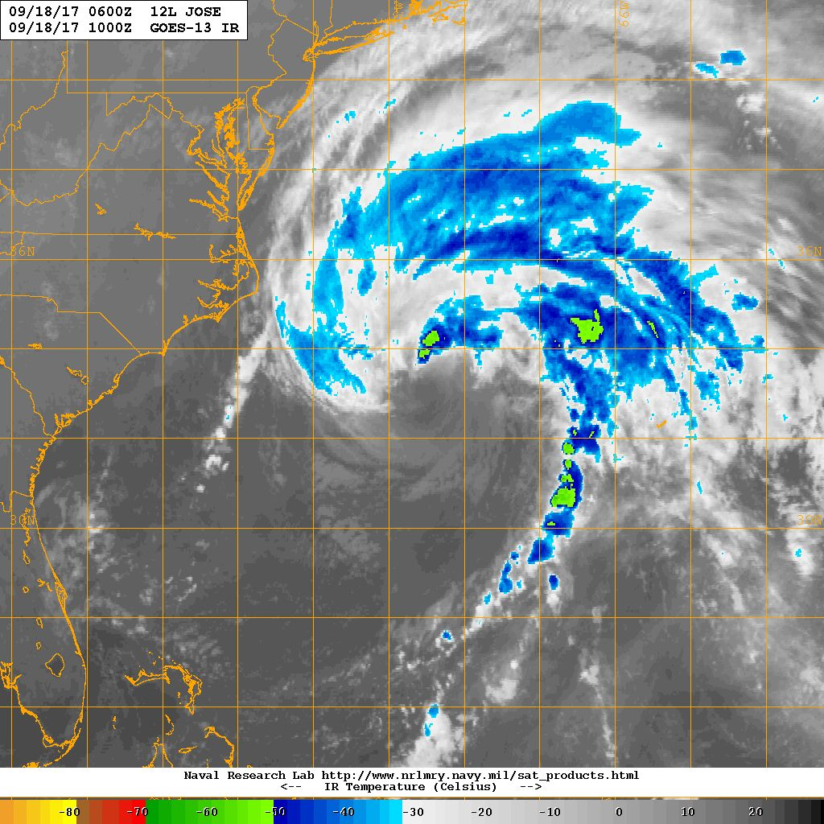
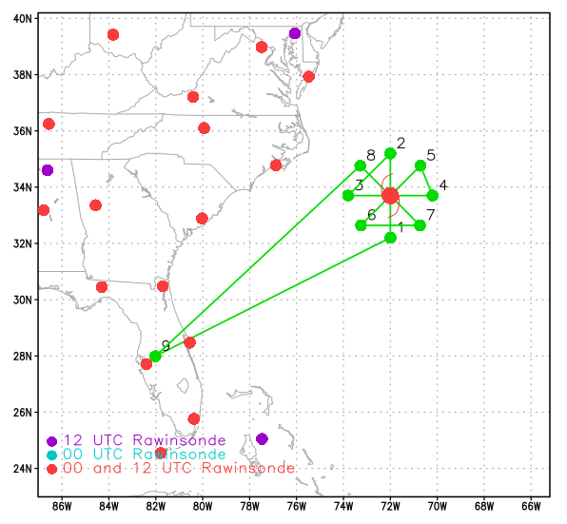
20170918H1 AL12 JOSE (TDR)
LPS: Zawislak
Radar: Zawislak
Dropsonde: Zawislak / Ryan
DWL: Ryan
Ground Radar: Gamache
Takeoff: 0750 UTC, Landing: 1602 UTC
Rotated Fig. 4, 8 kft, 90 nm
Dropsondes at turn points of first Fig. 4; each center pass, if NHC requested
Sonde halfway transit to storm at ferry altitude
972 mb / 80 kt
MOTION (8 kt)
SHIPS SHEAR (37 kt)
0950 UTC (Arrival at IP)

Slide 14
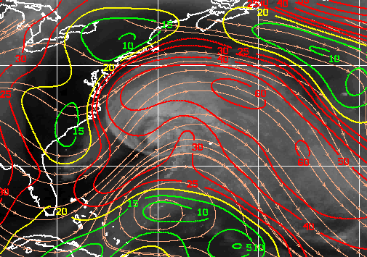
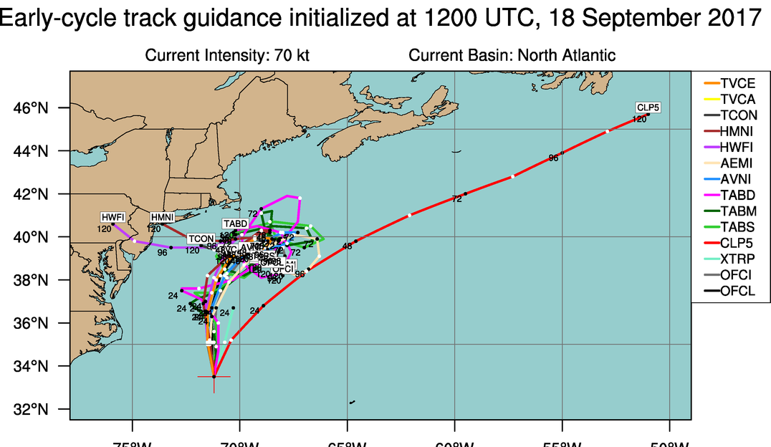
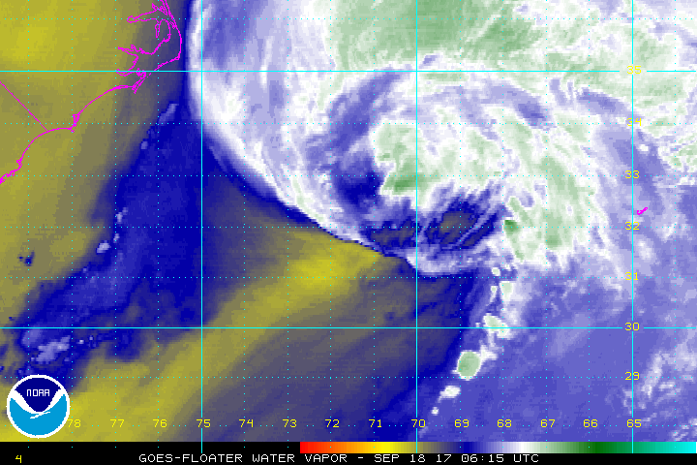
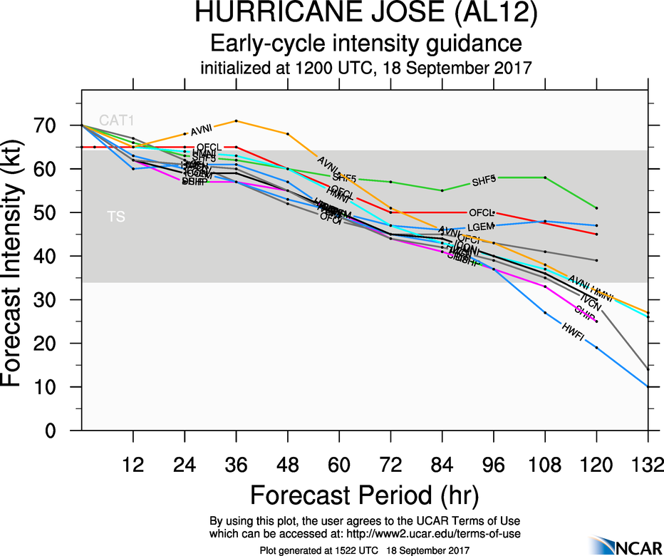
20170918H1 AL12 JOSE (TDR)

Slide 15
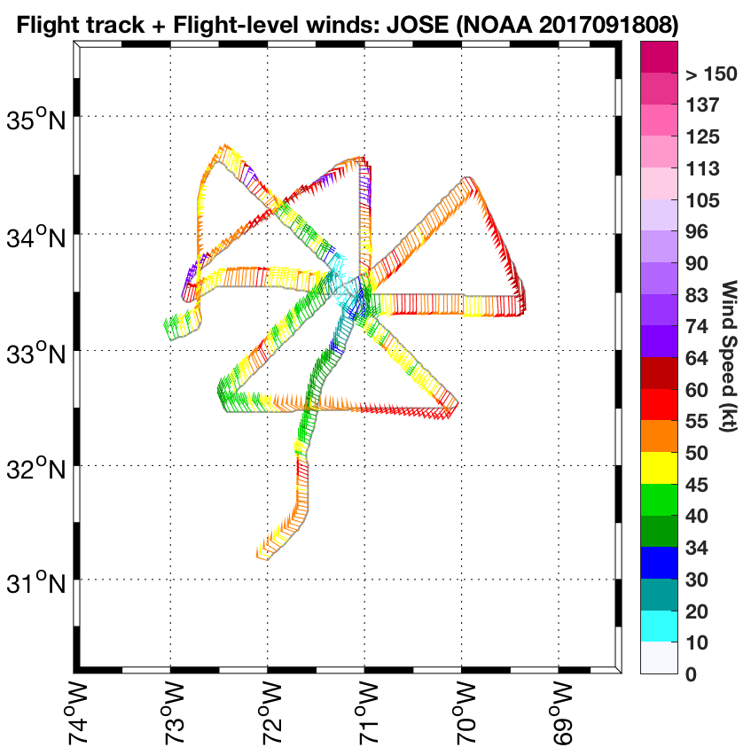
20170918H1 AL12 JOSE (TDR)
Truncation due to airspace

Slide 16
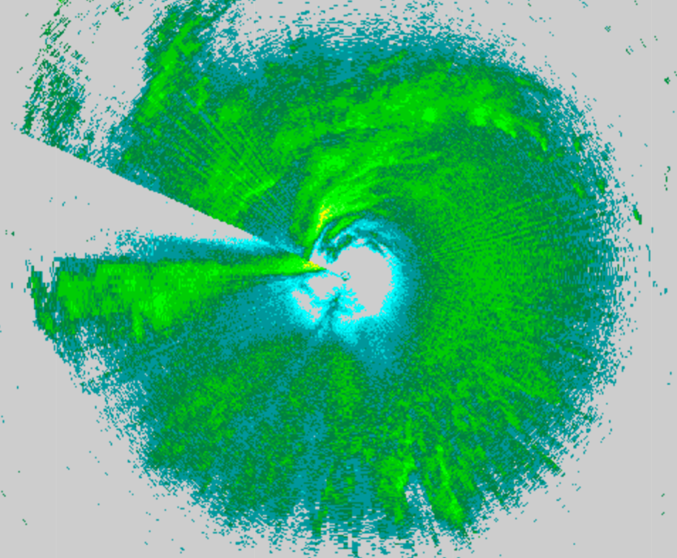
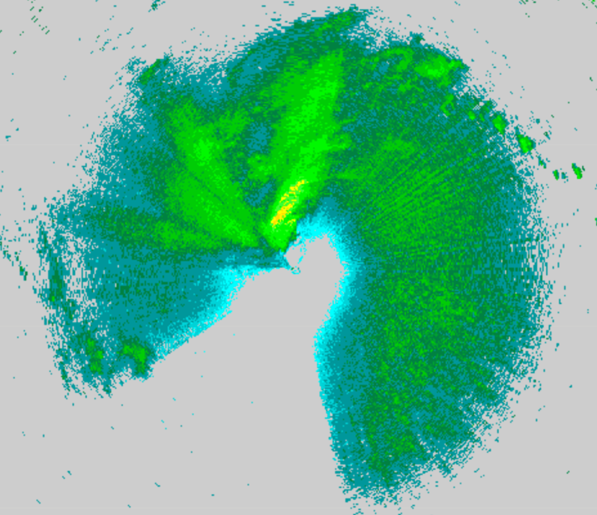
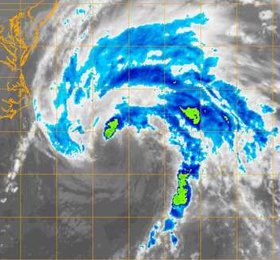
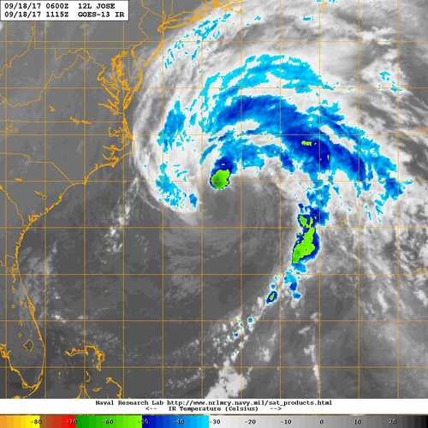
20170918H1 AL12 JOSE (TDR)
1017 UTC
1122 UTC
1030 UTC
1115 UTC

Slide 17
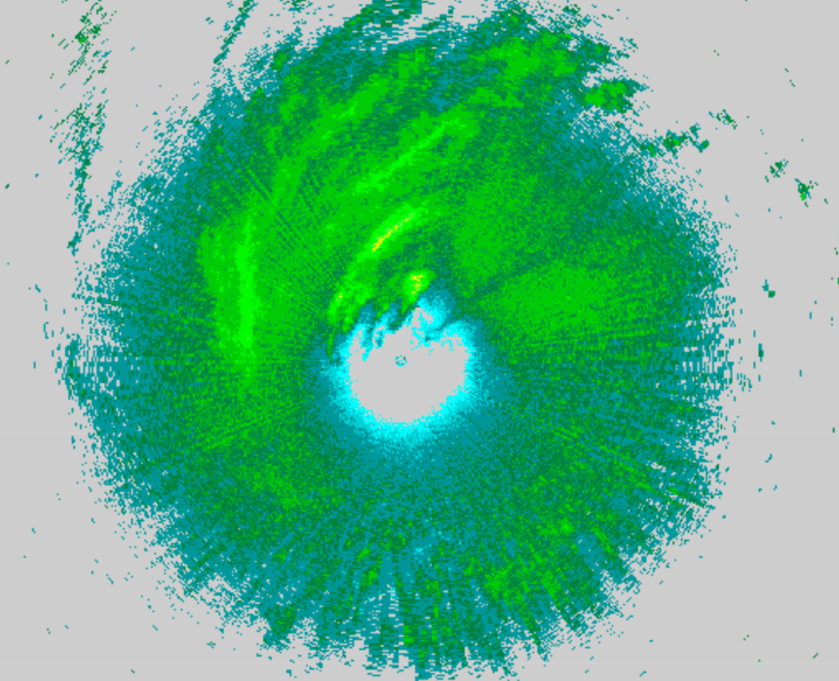
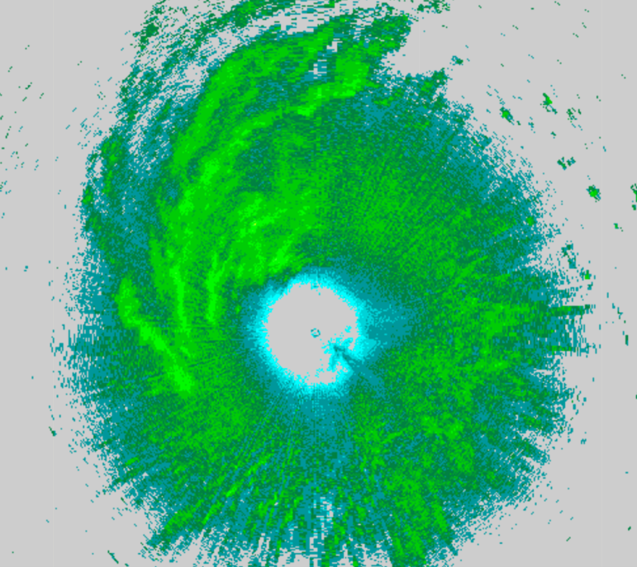
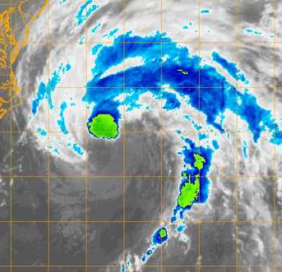
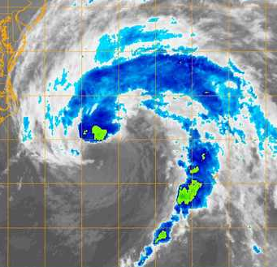
20170918H1 AL12 JOSE (TDR)
1222 UTC
1327 UTC
1215 UTC
1330 UTC

Slide 18
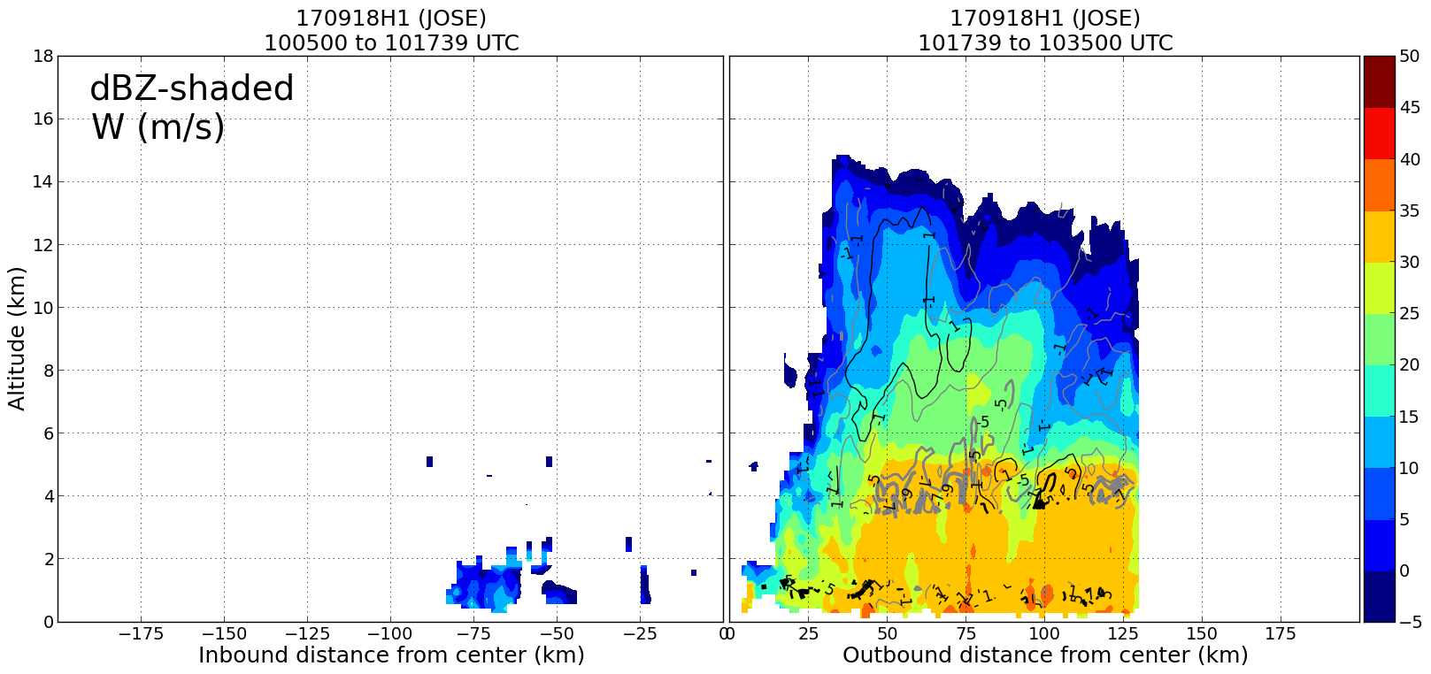
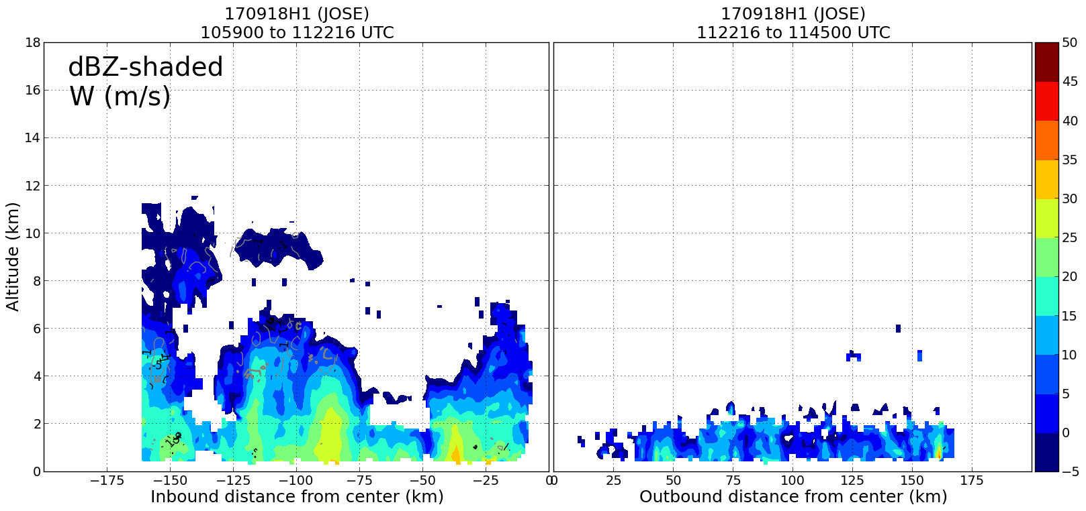
20170918H1 AL12 JOSE (TDR)
SOUTH (USR)
NORTH (DSL)
WEST (USL)
EAST (DSR)

Slide 19
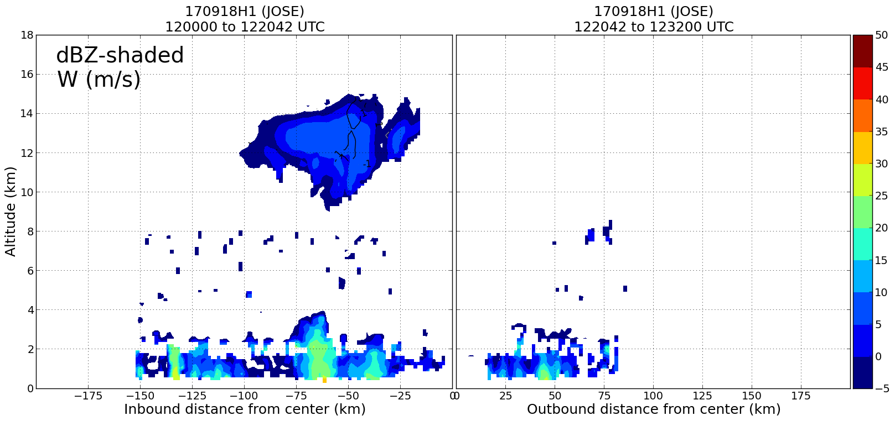
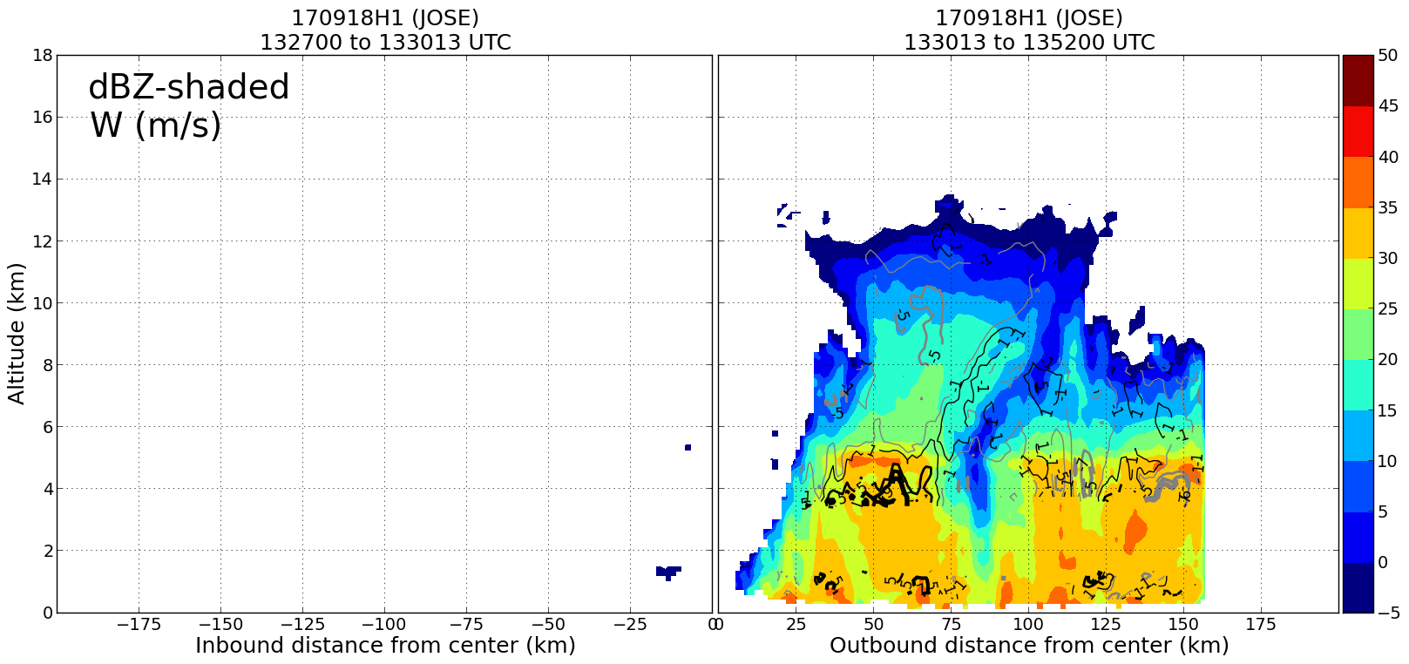
20170918H1 AL12 JOSE (TDR)
NE (DOWNSHEAR)
SW (UPSHEAR)
SE (RIGHT, SHEAR)
NW (LEFT, SHEAR)

Slide 20
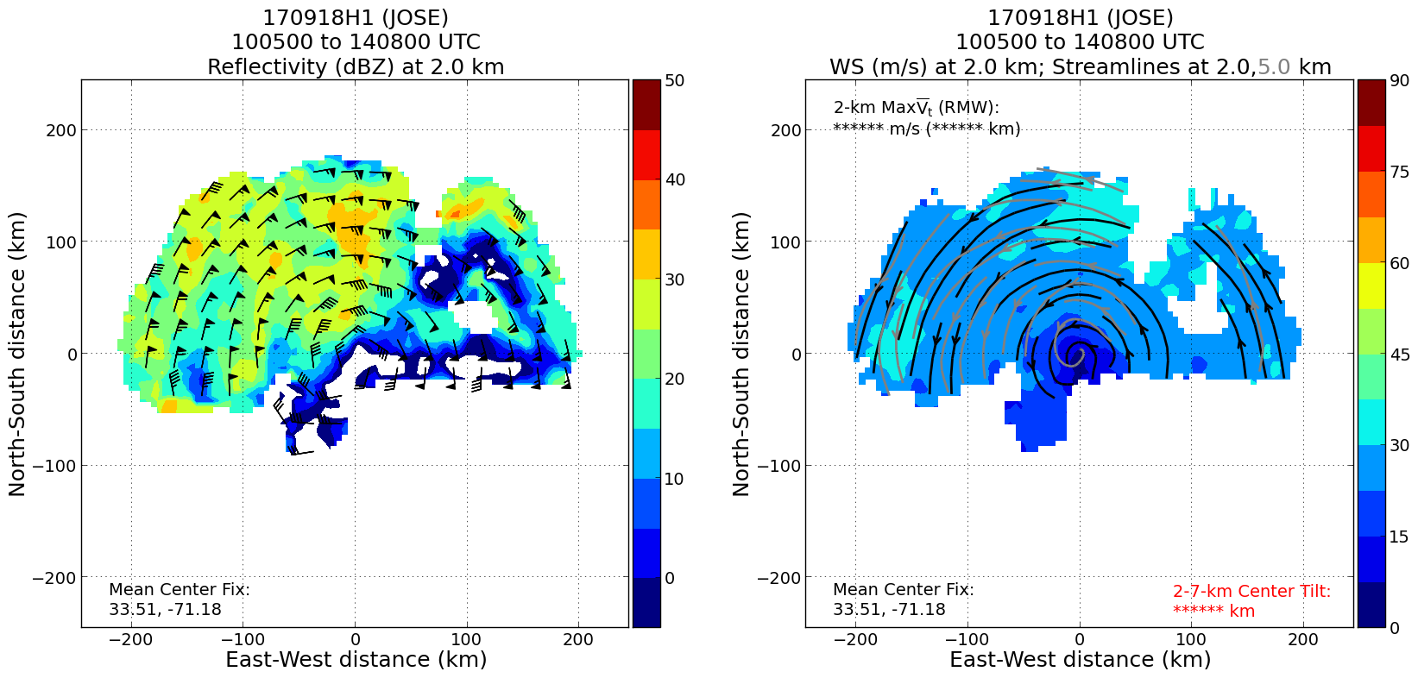
20170918H1 AL12 JOSE (TDR)

Slide 21
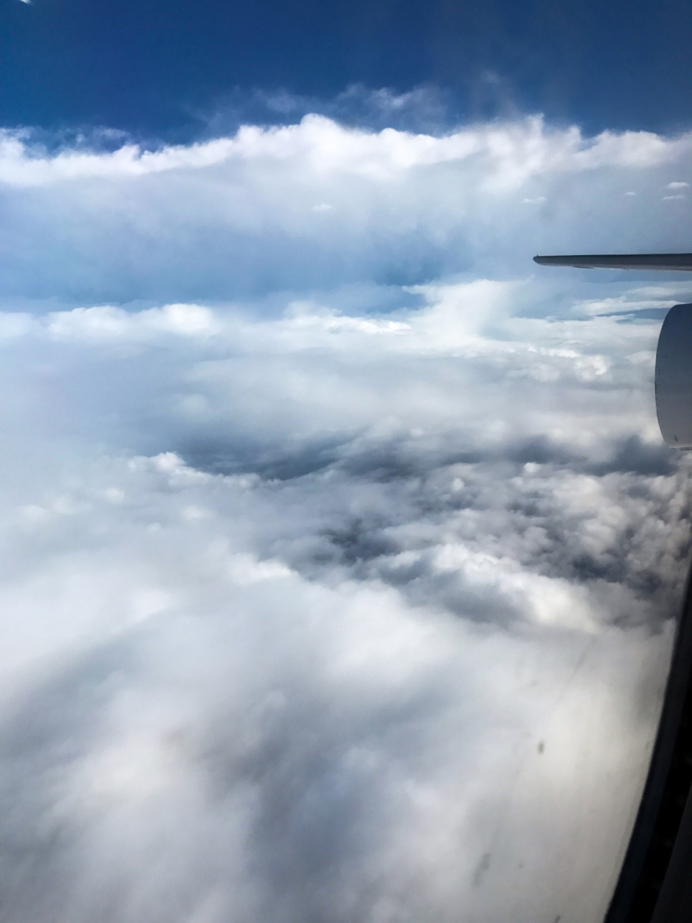
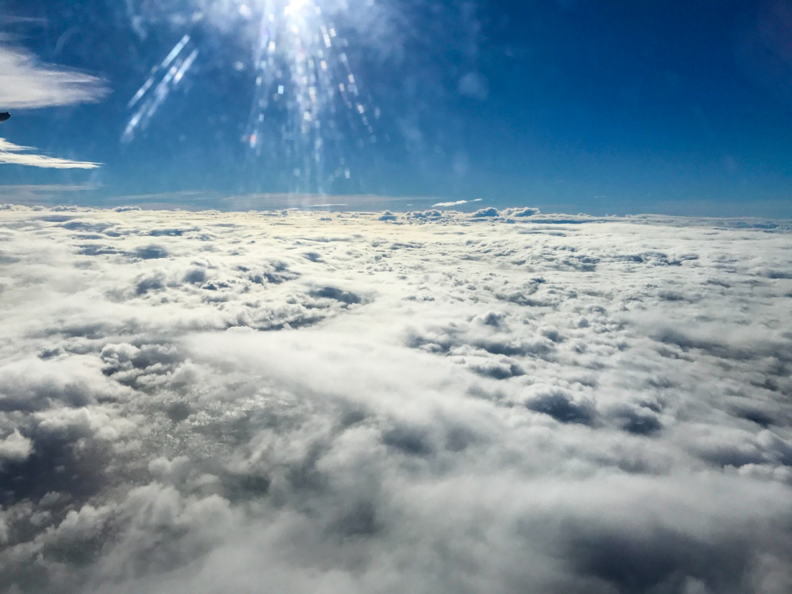
20170918H1 AL12 JOSE (TDR)

Slide 22
20170918H1 AL12 JOSE (TDR)
Summary
T/O: 972 mb / 80 kt L/D: 977 mb / 65 kt
Slow weakening (peak SFMR sfc. wind 58 kt, FL 70 kt)
Highest winds 80-100 nm from center
Center Passes: 1017 UTC, 1122 UTC, 1220, and 1330 UTC
4 TDR analyses (truncation, noise due to lack of precipitation)
Dropsonde on transit to IP at 21 kft, at turn points of 1st Fig. 4, last center (NHC)
Problems
A lot of noise introduced into analyses due to lack of radar returns in eastern, southern regions of the storm
DWL stuck in a fixed scan, but appeared to collect data throughout the mission
Difficulty operating DWL from station 2
Expendables:
6 Dropsondes (5 HFIP, 1 NHC)

