Slide 1
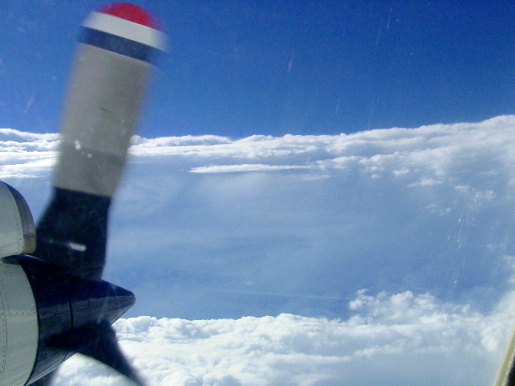

HRD Observations Team Meeting
March 2016

Slide 2
Agenda for 3/17/16
1) Instrument/platform updates 11-11:30AM
- Dropsondes (Aberson)
- DWL (J. Zhang)
- Drifters (Lumpkin)
2) Field program planning updates 11:30-11:40AM
- Logistics updates
- Planned experiment and module submissions?
3) Spotlight talk:
Kathryn Sellwood: "Bringing TC Observations into a Unified Framework using HEDAS Observation Processing Capability" 11:40-11:50AM
4) Spotlight talk:
Jason Sippel and Sergio Abarca (NOAA/EMC): "A possible remedy for biased low-level wind profiles in HWRF" 11:50-noon

Slide 3
Dropwindsonde issues – Aberson
During 2014, a number of sondes were released with IR sensors and large parachutes that slow descent.
ASPEN does not automatically treat the slow descent different from regular standard sondes
AVAPS does not automatically create metadata to distinguish these different sondes.
We are working internally (Jun and Kathryn) to identify and mark the data.
We (Joe C.) will bring up the issue of automatic metadata at the AVAPS meeting next month.
Let me and Joe know of any other issues that should be brought up at the meeting by the end of the San Juan conference.

Slide 4
DWL Status update
Jun Zhang & the DWL team
Funding transfer to Simpson Weather Associate was complete.
The DWL scanner was sent to Beyond Photonics for repair in Boulder.
1) The binding/jamming issue was revisited and problem was found to be related to the tolerance setting.
2) Adjustment was made and the mechanical scanning was tested with good results.
3) Both the chiller and the computer were repaired.
A UPS for the DWL will be required by AOC to eliminate the extensive ramp time problem due to engine start and stop.
The DWL will be shipped to AOC in a few weeks for installation on one of the P3 aircraft.
Data analysis of the DWL wind data is ongoing.

Slide 5

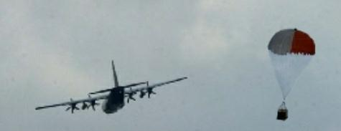



Drifter Observations of
Hurricanes
Rick Lumpkin and Luca Centurioni, NOAA’s Global Drifter Program
Goals:
Provide real time data on the Global Telecommunication System (GTS) for improved weather forecasting by operational centers such as NOAA’s Environmental Modeling Center (EMC).
Observe wind-driven mixing and its impacts on upper ocean heat content.
Validate and calibrate satellite-based products (SST, wind, upper ocean heat content).
Provide data to evaluate coupled ocean-atmosphere models (e.g., HWRF) for improved hurricane intensity forecasting.

Slide 6
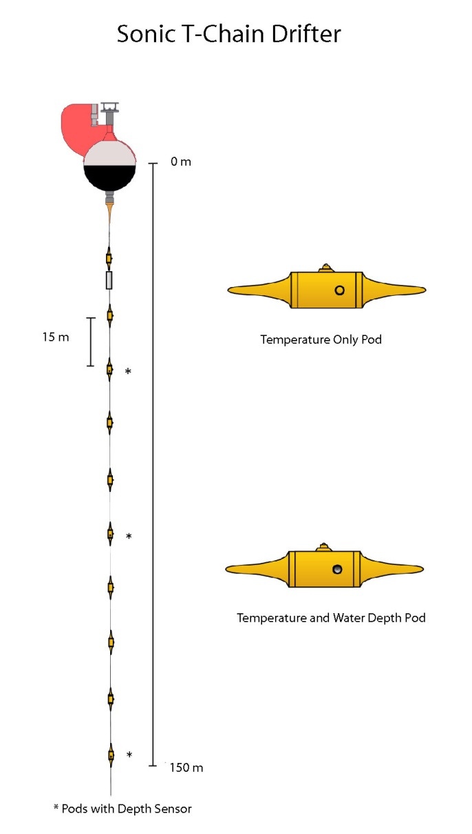
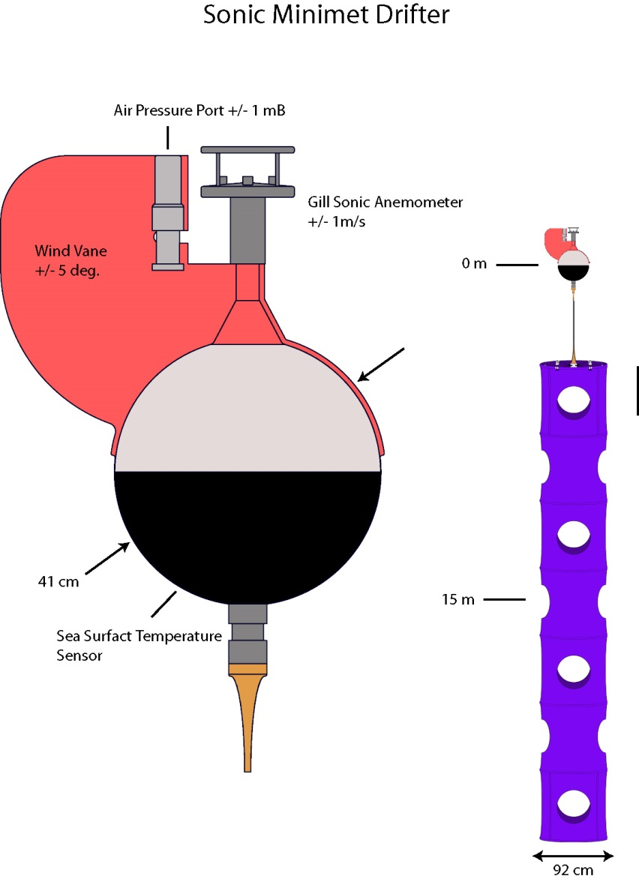
Drifter Schematics
Drifters measure surface and subsurface temperature, wind speed and direction, air pressure, and ocean currents.
Notes:
Minimet: approx. $5k each ?
Thermistor chain: $14.9k each.

Slide 7
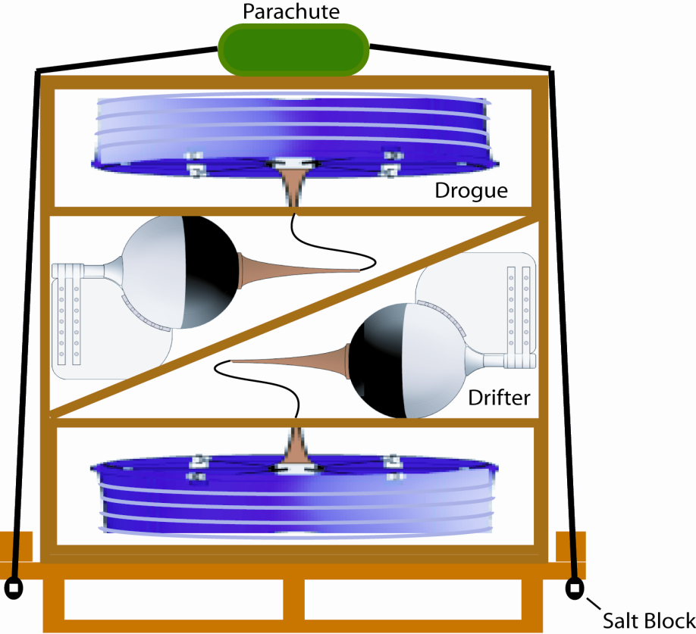
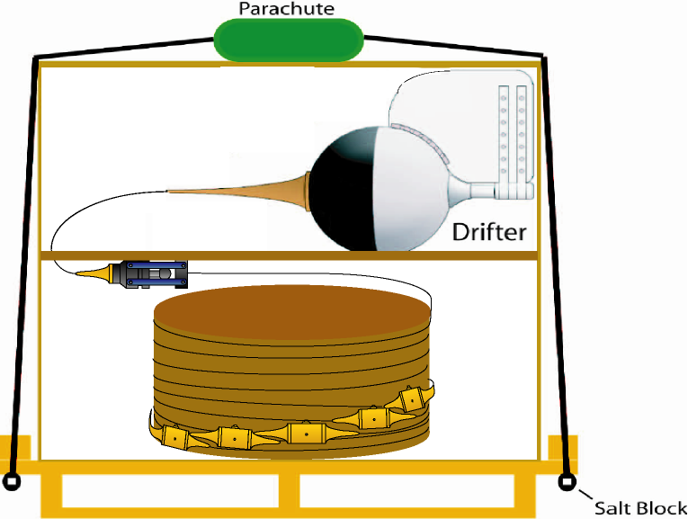
Air-Deployment Packaging

Slide 8
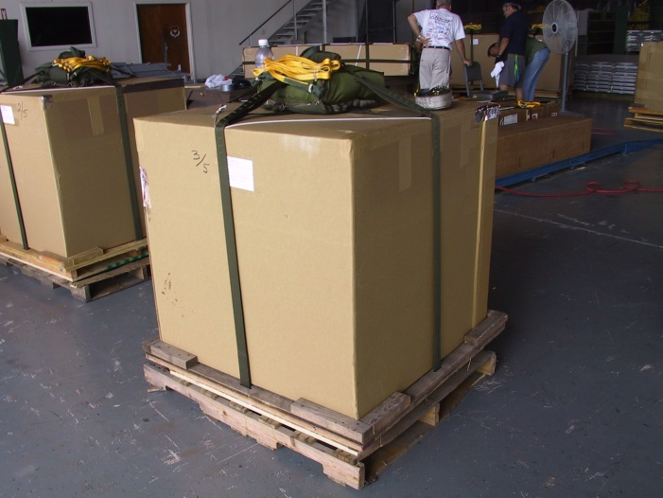
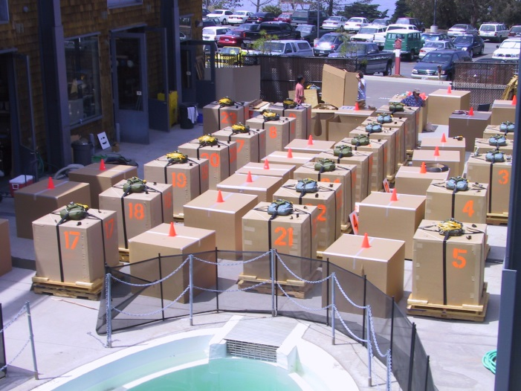
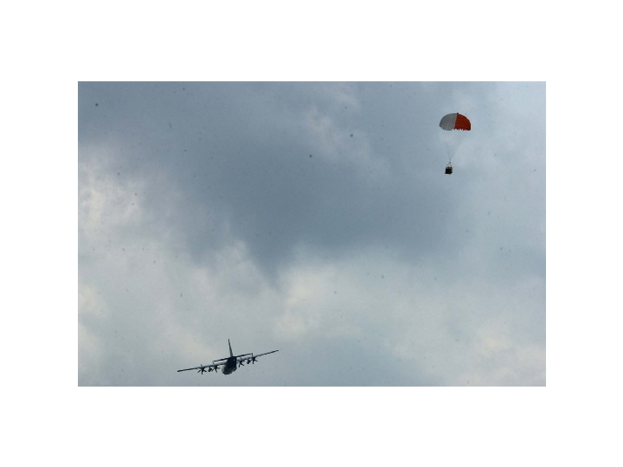
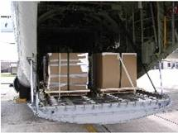
Deployments coordinated via CARCAH, conducted by 53rd Reconnaissance Squadron “Hurricane Hunters”

Slide 9
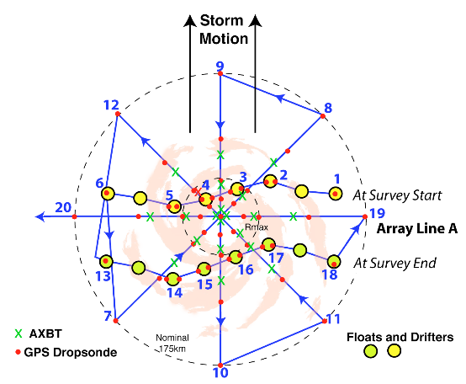
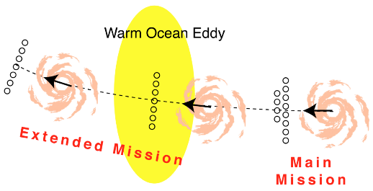
Deployment strategy
Deployed most recently in the Atlantic in the paths of hurricanes Rita (2005), Dean (2007), Gustav and Ike (2008), Isaac (2012), TS Ana (2015).

Slide 10
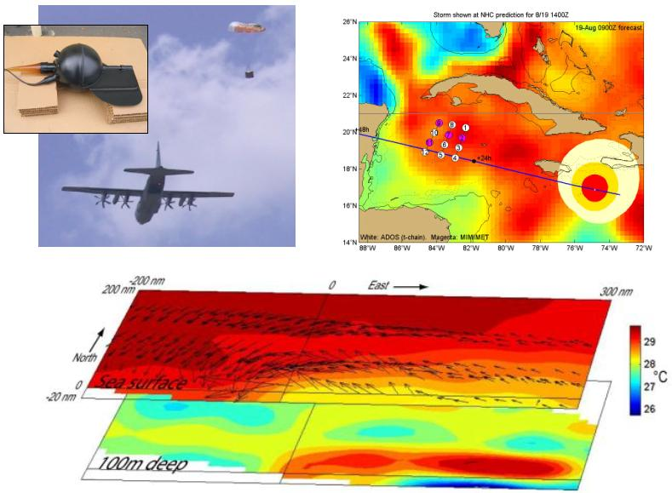
Left: deployments in the path of Hurricane Dean (2007). Below: surface winds and SST (top layer) and temperatures at 100m depth (bottom layer) in a frame of reference moving with the storm.

Slide 11
Plans for 2016
To be staged at Keesler for deployment:
10 Thermistor Chain drifters
10 Minimet drogued drifters

Slide 12
HFP 2016 Logistics
43, 49 are available
42 is expected to return ~mid-June, take ~2 months to get ready for hurricane missions, be ready to fly ~mid-August
Still deciding which instruments to put where, but IWRAP/W-band radar will be together, and get the priority this year (since no IWRAP missions last year)
DWL, WSRA will be on same plane
Coyote can operate from either, but need antennae on each P-3 – AOC currently has one antenna
Still working on Mexican clearance (big thanks to Sonia for doing translations, and Justin Kibbey for taking lead in obtaining clearance)
Proposed experiments and modules for this year due April 15

Slide 13
HFP 2016 Experiments & Modules
Want research targeting more aspects of TC structure, lifecycle
  Mature hurricane sampling (e.g., SEF/ERC research)
  AEW sampling and modeling (e.g., in framework of genesis experiment)
  Missions to conduct from Mexico (e.g., sampling of tropical convection just west of Panama – frequent spurious genesis in GFS)

Slide 14
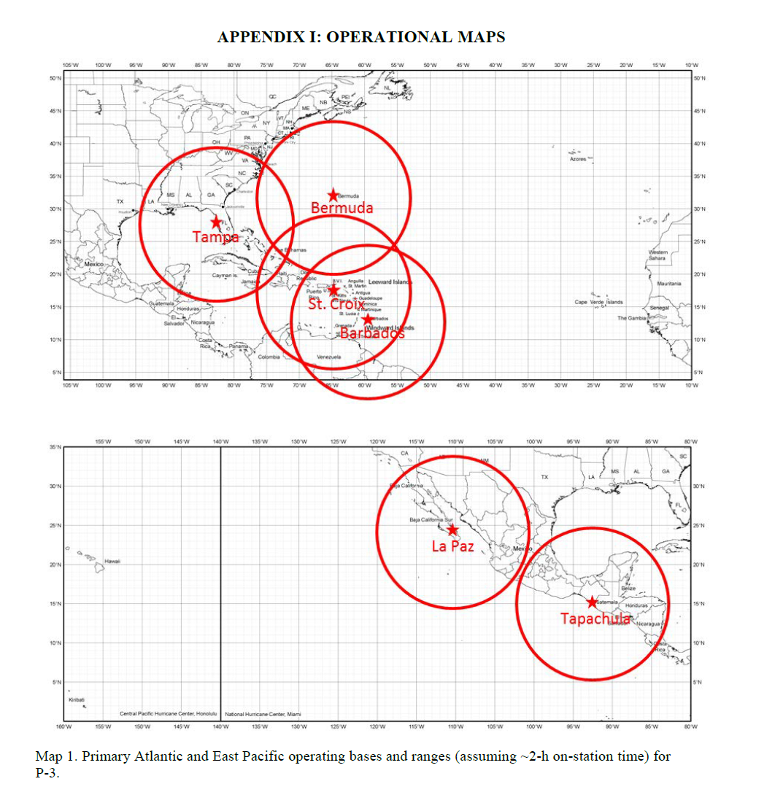
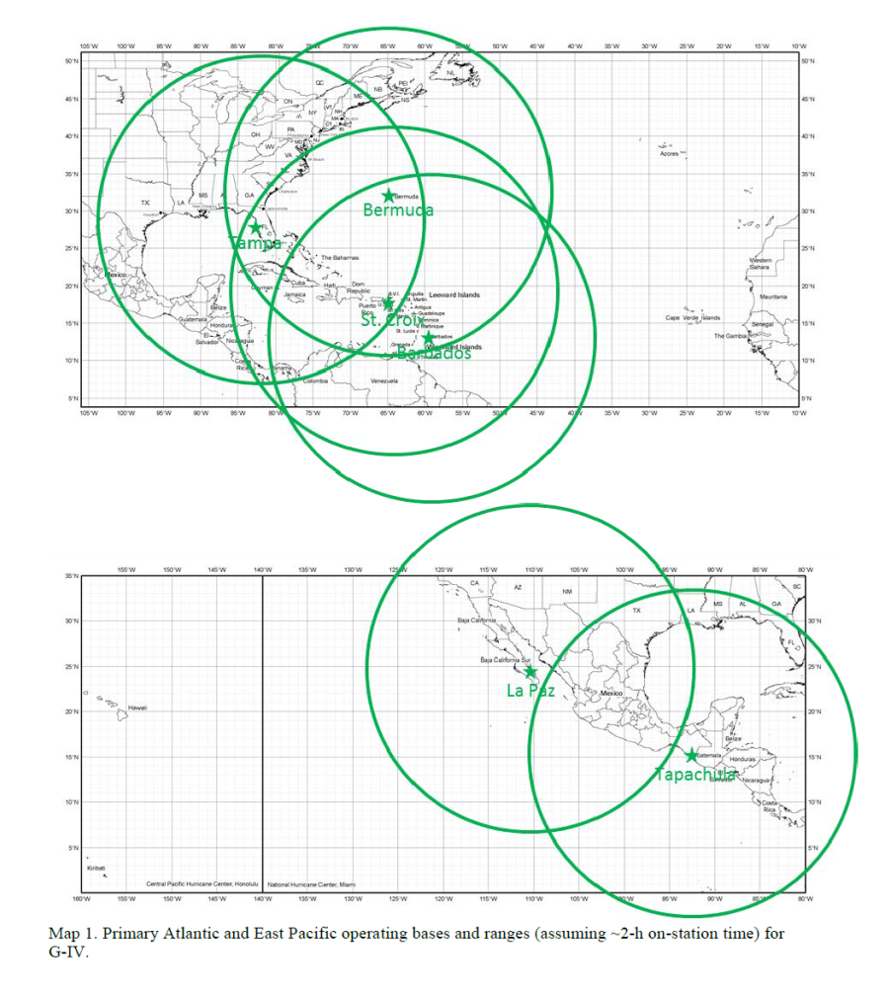
Aircraft ranges (assuming ~2h on station)

Slide 15
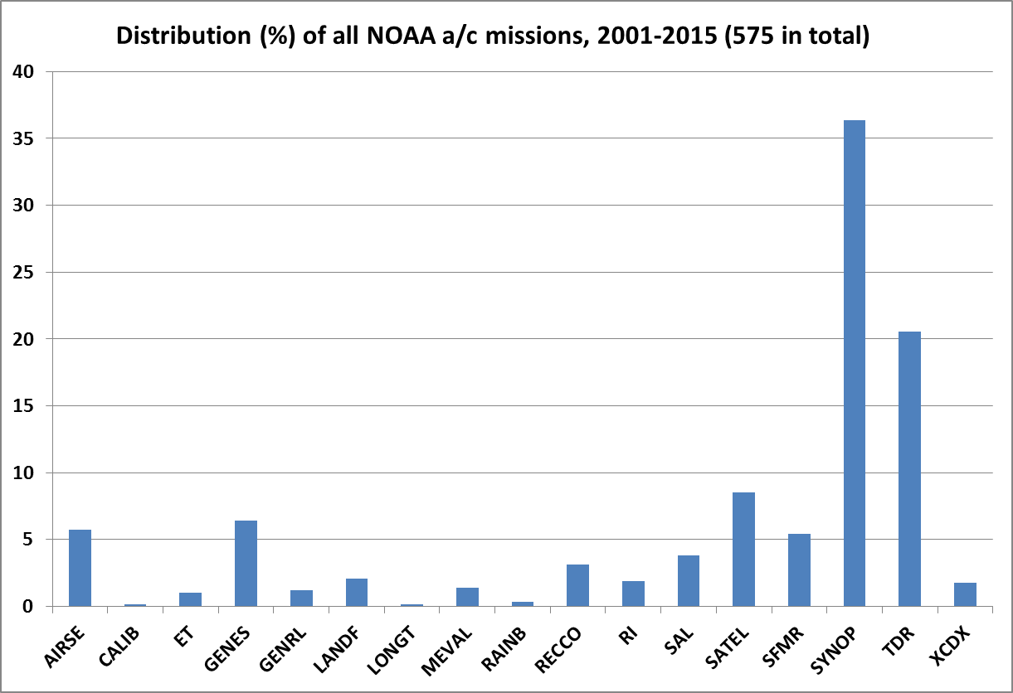
Some summary statistics on HRD aircraft missions
Experiments/modules
in last year’s HFP
1. P-3 TDR
2. G-IV TDR
3. MEVAL
4. DWL SAL
5. DWL PBL
6. Coyote
7. Ocean Winds
8. SFMR High-Incidence
9. RI
10. TC in Shear
11. TC Diurnal Cycle Experiment
12. AIRSE
13. LANDF
14. Convective Burst
15. Warm Core
16. SALEX Arc Cloud
17. Eye-eyewall mixing
18. Offshore Wind
Majority are operationally-tasked (SYNOP, TDR, SFMR)
Of research missions, air-sea and genesis (surprisingly) most frequent
How many experiments/modules do we need?

Slide 16
Bringing TC Observations Together into a Unified Framework Using HEDAS Observation Processing Capability:
Standalone package to process observations
Data Assimilation
Composite analysis
Model evaluation
Compare observations across platforms
Evaluate new observation types
Provide input to visualization software

Slide 17
Functions:
Collect observations across multiple platforms
Read from the native data format for each observation type
Decode and convert observed quantities to standard variables (U V T Q)
Remove flagged data points
Calculate standard latitude/longitude and height/pressure coordinates
Keep track of original data locations, ob numbers and platform
Additional Options:
Filter observations by time and distance from storm center
Choose from any or all of the available data types
Option to randomize observations
Option to place observations into a storm-relative framework
Standalone Fortran software to read and decode most observation types

Slide 18
Current Observation Types:
Aircraft: HDOBS (U, V, T, Q, P, Surface Wind Speed)
TEMPDROP (U, V, T, Q, P)
TDR Superobs (Radial wind, Azimuth, Elevation)
ACARS ( U, V, T, Q, P)
Ground based: RAOBS ( U, V, T, Q, P)
BOUY/SHIPS ( U, V, T, Q, P)
WSR 88D (Superobbed Radial Wind, Ref)
UAS:Coyote (U, V, T, Q, P)
Scanning-HIS, HAMSR ( T, Q)
HIRAD (Surface Wind Speed)
HIWRAP(Radial wind, Azimuth, Elevation)
Satellite: AIRS, AMSU (T, Q retrievals)
COSMIC GPS RO (T, Q retrievals, bending angle)
GOES AMVs ( U, V)

Slide 19
SET OPTIONS
MAIN SCRIPT
SET PATHS
Read Obs.
Type 1
Read Obs.
Type 2
Read Obs
Type 3
Read Obs Type 4
Read Obs
Type 5
Read Obs.
Type n
Filter for time and location
Convert variables
Write out to file

Slide 20
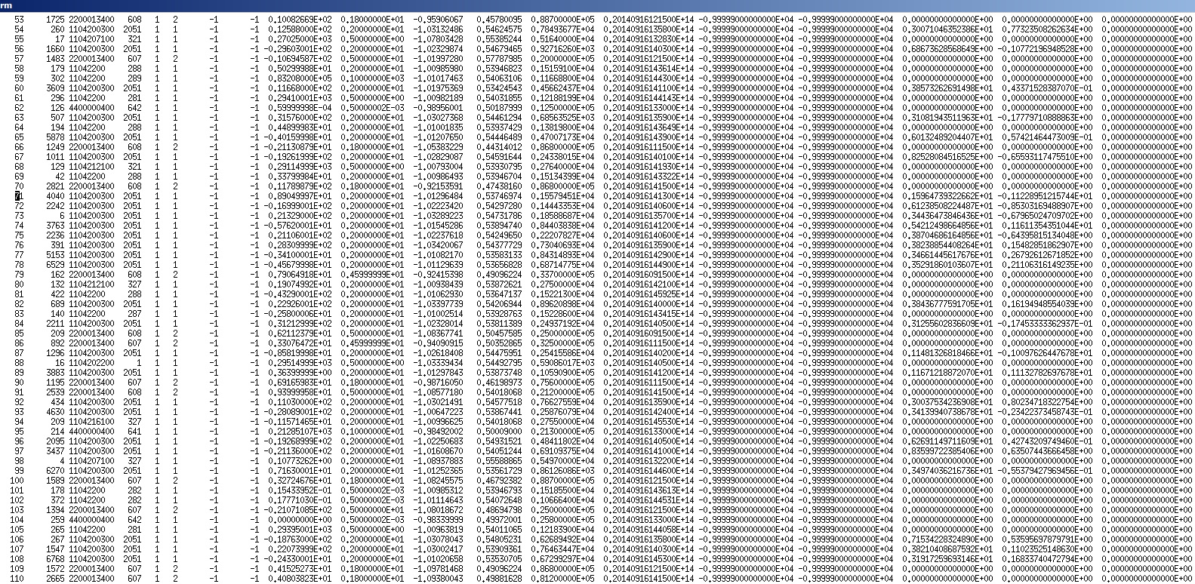
Final Product is an Easy to Read (and plot) ASCII File
Original location
Observation Value
Location (Lat. Lon. Height/Pressure)
Observation Type
Estimated Error
Date and Time of Observation

Slide 21
Data Locations Plotted from Observation File
(Courtesy of Hui Christopherson)
Observations filtered
Within 5 degrees of the
storm center and +- 3
hours from synoptic
time, then plotted
relative to the storm
center.

Slide 22
A possible remedy for biased low-level wind profiles in HWRF
Jason Sippel, Sergio Abarca, and most of HWRF team

Slide 23
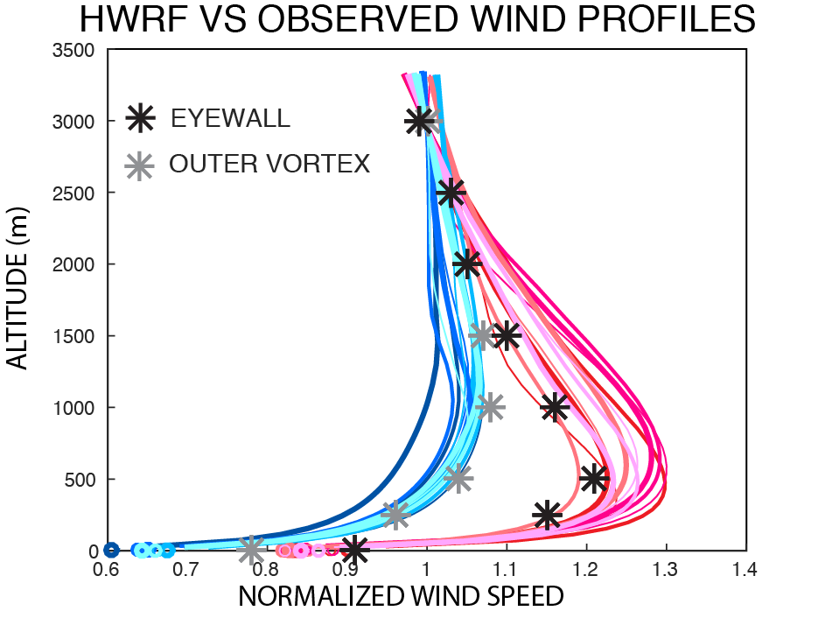
Problem: Near-surface wind speeds are too weak compared to the winds in the PBL (example from H215)

Slide 24
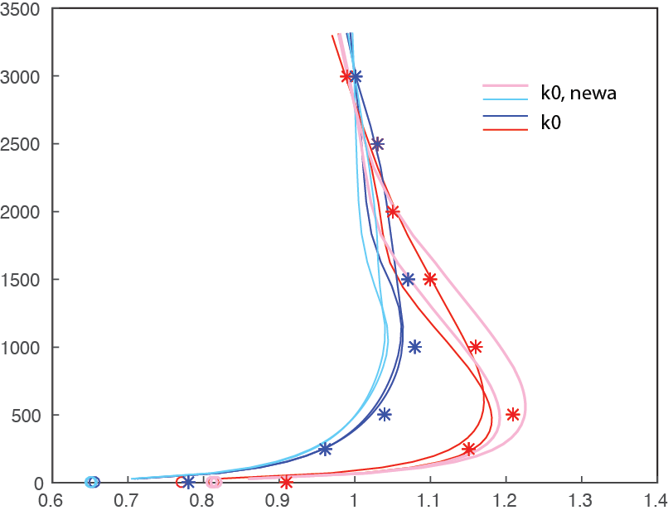
Changing vertical diffusion profile gives modest improvements in wind profiles
Eyewall
Outer vortex
So let’s look at Cd

Slide 25
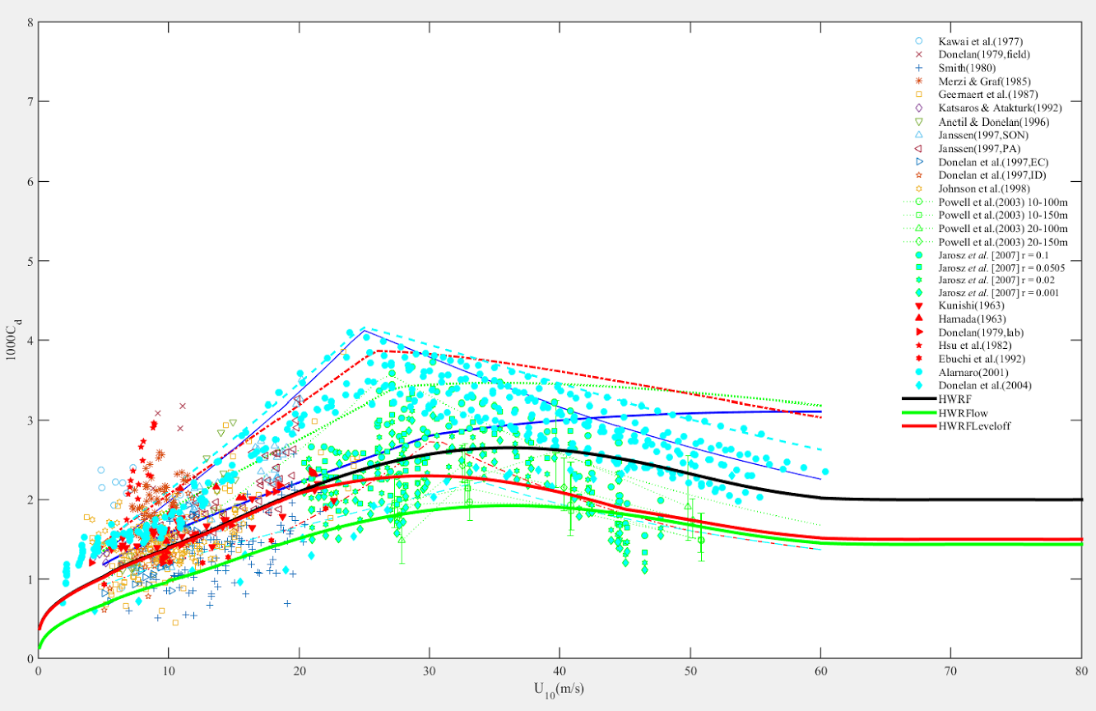
Appropriate Cd values?
Cd varies strongly with wind speed and has large uncertainty
Black line – what we thought was H215

Slide 26
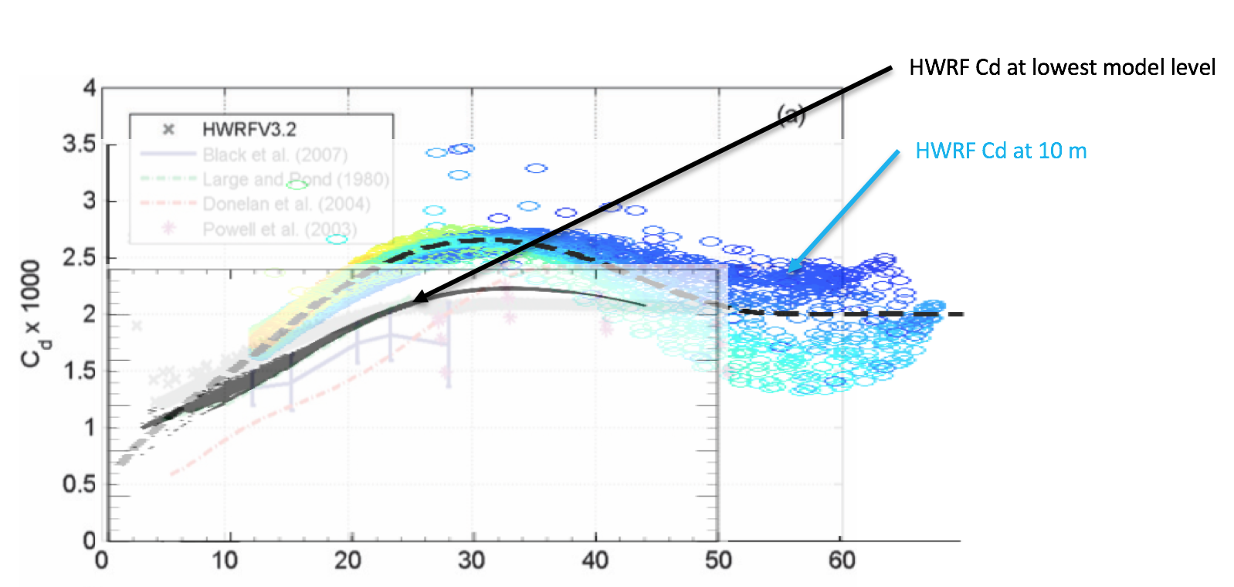
Ck & Cd bug in HWRF
We discovered that HWRF Ck & Cd have been computed on the lowest model level (~20m in Atlantic) but tuned to 10-m obs.
Effectively, Cd in the model has been much higher than previously thought (Ck was a little higher too)

Slide 27
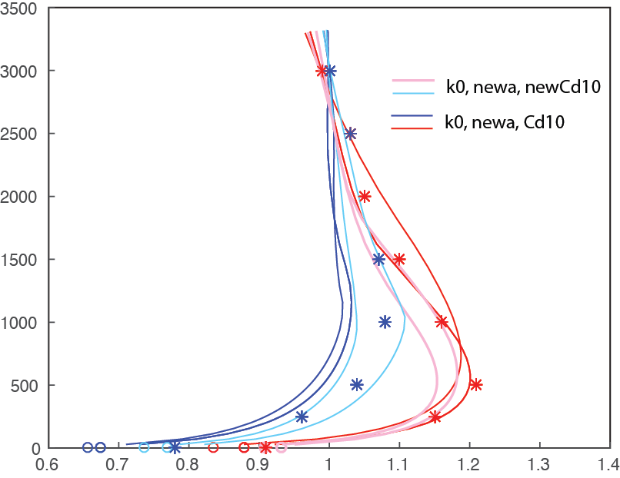
Effect of computing Cd correctly – test with Gonzalo (2014) single cycle
10-m wind ratio in inner core closer to 0.9
Eyewall
Outer vortex
Fixing the Cd computation takes us in the right direction, but the surface winds are still too weak… so let’s try lowering Cd some more.

Slide 28
Changing Cd in HWRF
Red line – “High-Cd” experiment
Green line – “Low-Cd” experiment
Cd is changed through changing Zo and Zot - the effect on Ck was minimal

Slide 29
Effect of lowering Cd – test with Gonzalo (2014) single cycle “Low Cd”
10-m winds are now in excellent agreement with observed wind profiles of hurricanes. This is the first time I’ve seen this with HWRF.

Slide 30
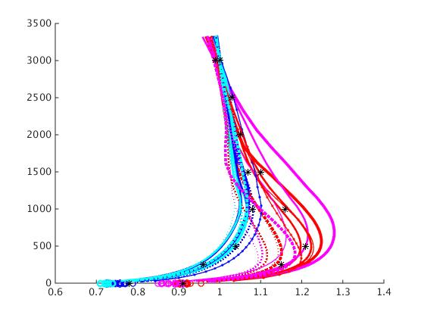
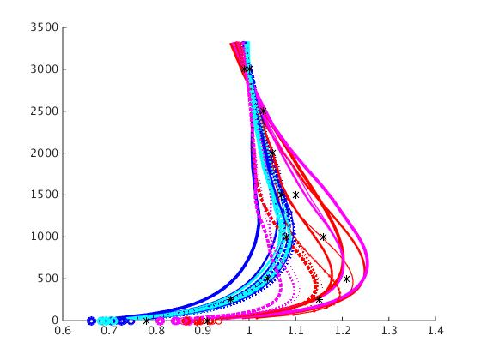
Cycled tests of Gonzalo and Edouard
(Cd, PBL, and convection changes)
Low Cd
High Cd
Eyewall
Eyewall
Outer vortex
Outer vortex
Both experiments have better profiles than H215
10-m winds in low-Cd expt are in excellent agreement with observed wind profiles of hurricanes, both in the eyewall and outer vortex

Slide 31
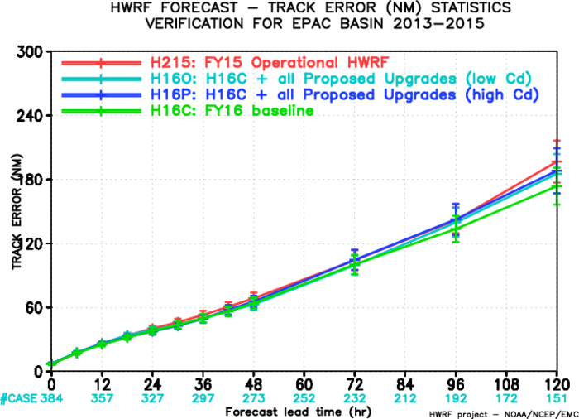
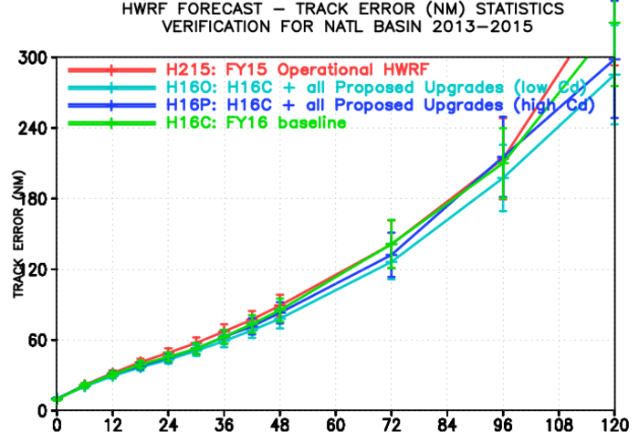
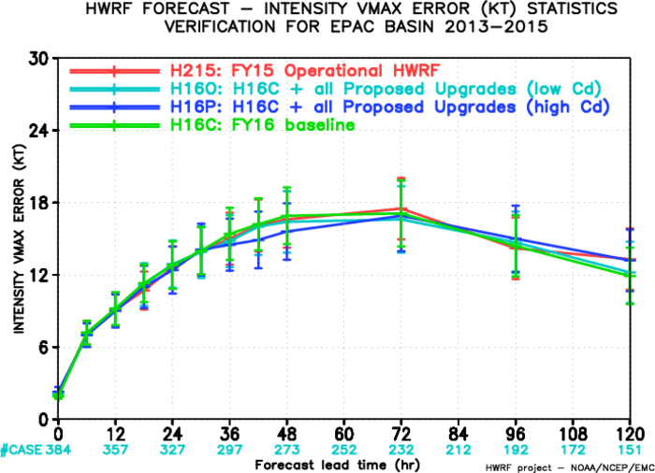
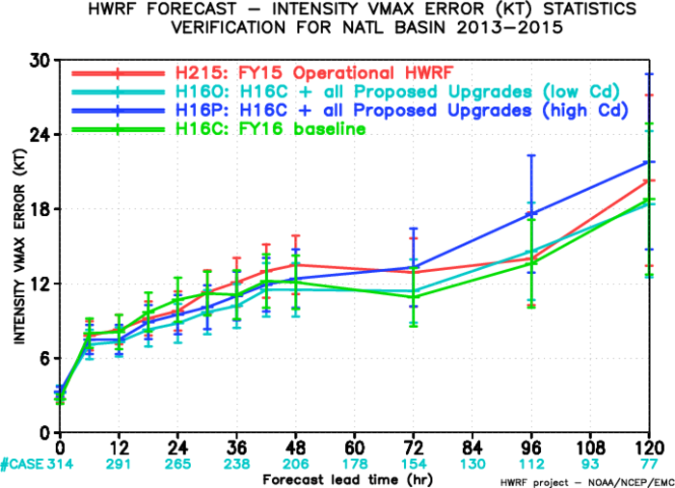
Results from large-scale test
East Pacific
Atlantic
Track
Ignore red and green lines (other physics changes)
Low-Cd slightly better track and intensity in Atlantic
Inensity

Slide 32
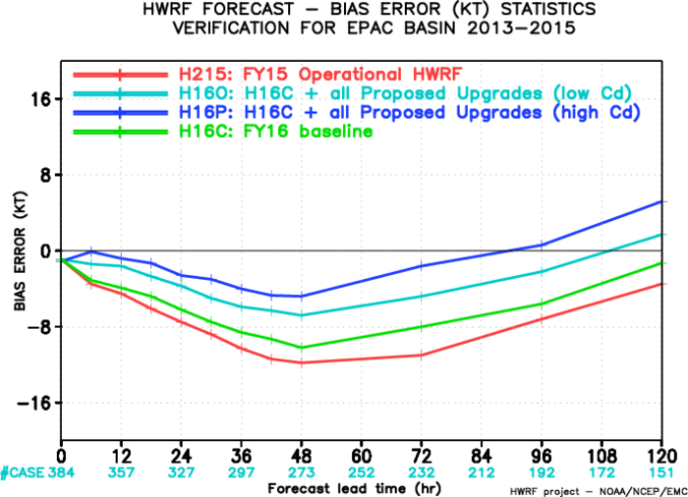
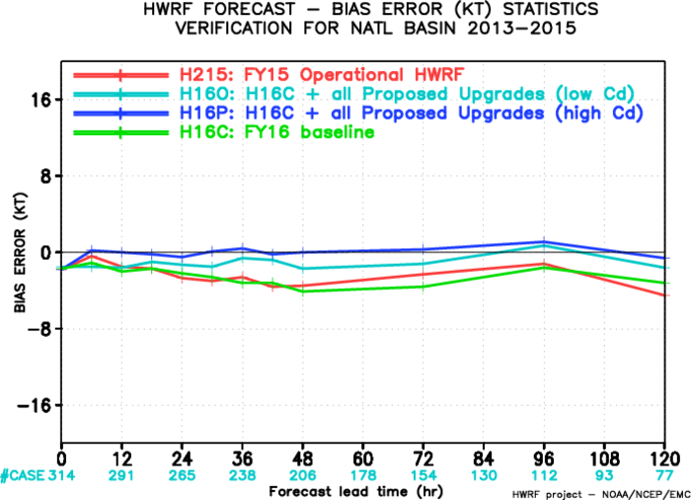
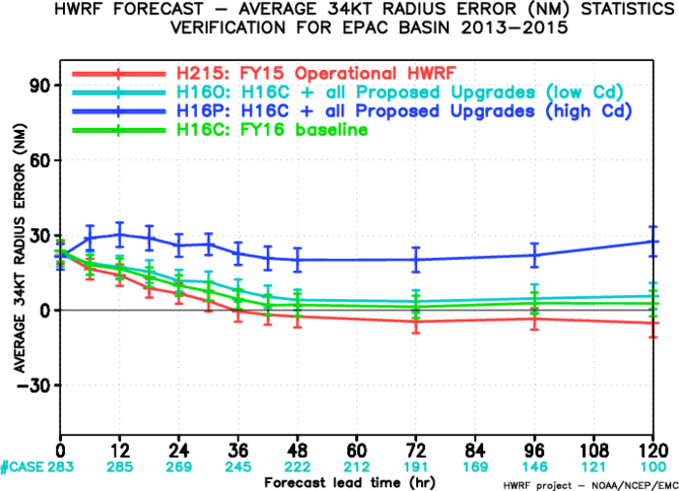
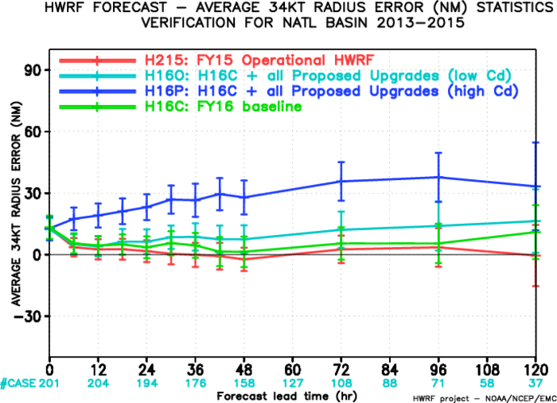
Results from large-scale test
East Pacific
Atlantic
Vmax bias
Ignore red and green lines (other physics changes)
Low-Cd has stronger negative bias but much better size forecast (smaller)
R34

Slide 33
Summary
HWRF is known to have biased wind profiles that cause problems with DA
A bug in HWRF Cd/Ck computations was found and corrected
Lowering Cd to the low end of values supported by observations/literature improves the wind profiles dramatically
With current proposed physics package, low-Cd expt performs slightly better

