Slide 1
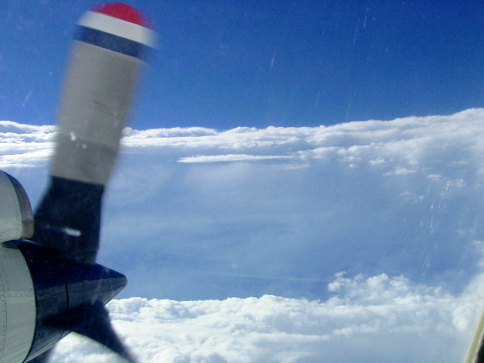
HRD Observations Team Meeting
February 2016

Slide 2
Agenda
1. Purpose and scope of team 11-11:05AM
2. Status updates - Global Hawk: Jason (moved earlier)
Traditional instruments 11:05-11:25AM
- radar (TDR (P3 and G-IV) and LF): Paul
- dropsondes (including IR sondes): Sim
- flight-level: Sonia
- SFMR: Brad
- cloud physics: Bob
- turbulence probes: Jun
- AXBT/CP/CTD: ??
New instruments and platforms 11:25-11:50AM
- DWL: Lisa
- Dual-Pol: Evan
- Coyote: Joe
Archiving: Neal 11:50-11:55AM
3. Field program planning updates 11:55-noon

Slide 3
Purpose of Observations Team
Hurricane Field Program is a unifying element in our activities at HRD
Observations collected during HFP are used in research to
  Evaluate and improve models
  Initialize models
  Improve understanding
These activities can improve the prediction of hurricanes, the key job of HRD
Hold regular (3rd Thursday of every month) meetings to
  Provide status updates on instruments/platforms
  Inform staff of observational capabilities and plans
  Share ideas for research and development activities
  Promote collaboration across teams (i.e., modeling, DA, OSSE groups)
Rogers

Slide 4
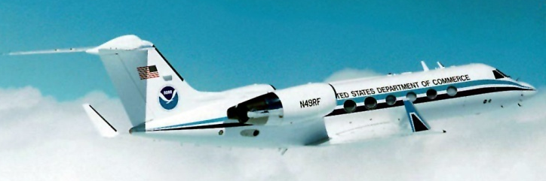
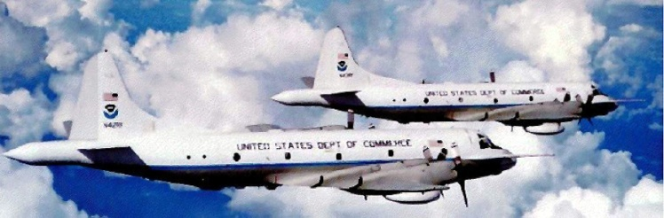
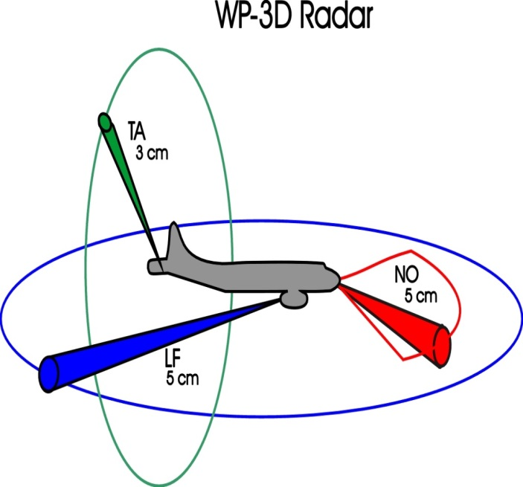
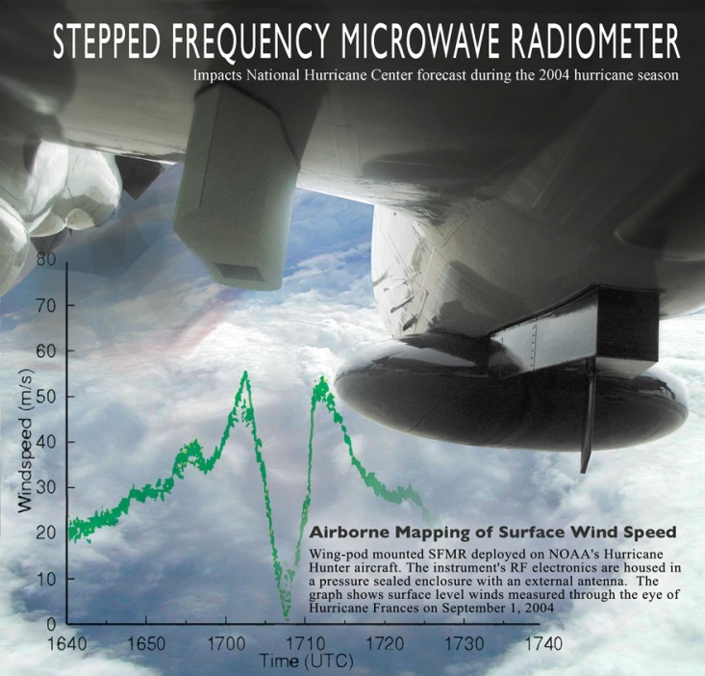
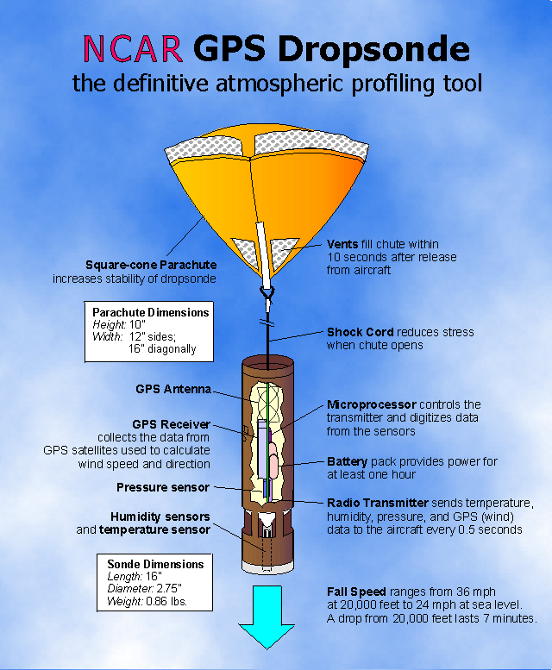
Traditional instruments

Slide 5
Radar Status
Past data archives:
Raw TA RVP5 or RVP8 files
  ftp://seb.noaa.gov/pub/acdata/ (2010+)
  /home/hrd/rvp5_tape on helios (little-endian disk copies of select 1991-2011 RVP5 data tapes)
Raw LF RVP5 or RVP8 files
  RVP5 data stored at HRD on dat tapes and some disc files
  RVP8 data at ftp://seb.noaa.gov/pub/acdata/ (2014+)
EMC-radials: Exact format used by EMC not archived
SuperObs
  ftp://ftp.aoml.noaa.gov/pub/hrd/gamache/FuqingSO/ (2008+)
Real-time TA analysis data
  ftp://seb.noaa.gov/pub/flight/hrd/radar/ (2012+)
  ftp://ftp.aoml.noaa.gov/pub/hrd/gamache/realtime_w/ (2010+ but misc cases <2010 if you hunt around /gamache long enough)
Real-time composite analysis data: HRD website (2008+)
Pre real-time-era single-pass analysis data: Right now, via HRD p.o.c.
Internal HRD-format LF sweep files: HRD website (1999+ but misc cases <1999)
Reasor

Slide 6
Radar Status
Present/future Data:
2016 season (overall, revamped SQI-based QC)
  N43 (1 Jun) – TA RVP8 as in 2015; LF RVP8 as in 2015
  N42 (~15 Aug) – TA RVP900 (better sensitivity); LF RVP8 (new)
  N49 (1 Jun) – Can correct INE post-process, but not real time (new unit didn’t pan out, Charles looking for alternative)
Post 2016 season
  N43 – target induction for re-winging Feb 2017
  N42 – second transmitter/receiver added, motor replacement
2017 season
  N42 – multimode LF radar (SAR, ISAR, Air-to-Air, Moving Track in addition to Weather)
Outstanding issues:
EMC trigger file requirements?
Reasor

Slide 7
Vaisala GPS dropwindsonde
Used since 1996 with various upgrades.
Current (RS92) radiosonde production will end next year with transition to RS41. This uses a single RH sensor instead of two; the sensor is heated to avoid icing, and Vaisala expects RH measurements to be as good as the current system.
HRD has 112 sondes. HFIP has 322 sondes. (434 total)
Archive through 2015 (NOAA) and 2014 (AF/DOTSTAR) available on HRD website. Remaining data should arrive soon.
New instrument: IR sonde (lead: Joe Cione). Measures SST in addition to regular sonde measurements. Larger chute than regular sondes for high-resolution sampling in vertical.
Tested in Edouard. ~180 available for use
Aberson

Slide 8
Aspen quality-control software (Aberson)
Still a work in progress. I have been working with NCAR on
improvements and bug fixes. Main current issue is a memory leak in Mac version. Many processing issues remain.
Make sure you have current version. Aspen website is poorly designed so that the versions are not in chronological order, so user needs to manually find correct version.
New version this year will hopefully allow NOAA to transmit data in BUFR format. Other agencies will not be able to use this ability.
Do not use in batch mode. Large errors (about 10% of sondes) are not found this way, and erroneous data are kept.
Charlie Martin, chief software developer, has officially retired. A replacement has not been hired.
Aberson

Slide 9
Crude classification of flight-level sensors
 | P-3 | G-IV
Inertial | Yes | Yes
GPS | Yes | Yes
Blended Inertial-GPS | Yes | No
Analog | Yes | Yes
2016 UPDATE
AOC detected voltage drifting over time on the analog boards.
For 2 years, AOC built and tested their own in-house analog solution.
Success! Currently, old analog boards are being replaced.
Increase of analog resolution from 25Hz to 100Hz.
Real-time partial FL data available at http://seb.noaa.gov/pub/flight/aamps_ingest/iwg1/
(1Hz, source for the NASA MTS information)
Otero

Slide 10
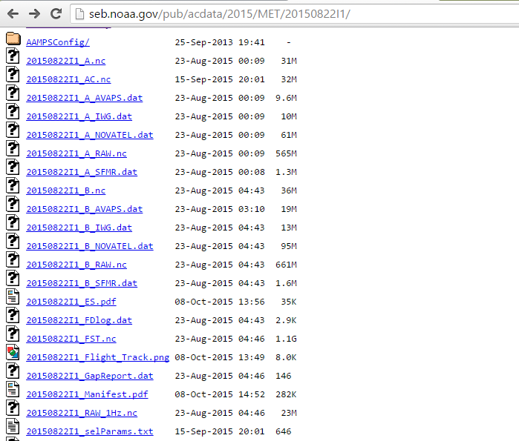
Post-flight FL data available at http://seb.noaa.gov/pub/acdata/YYYY/MET
1-second average Netcdf
quality-controlled by Flight Director
The data system restarted in middle of this mission;
hence, 2 sets of raw files: *_A*, *_B*
High-resolution Netcdf of sensor data
at original recording rate (BIG!)
1-second average Netcdf of sensor data + derived quantities;
foundation for a Flight Director QC product
Otero

Slide 11
General SFMR QC and archiving procedure
SFMR data are collected during all NOAA and Air Force Reserve TC missions
For NOAA flights (and if HRD personnel onboard), the files should be transferred to USB drive – these are then processed upon return to Miami
Raw data are also accessible through AOC’s site (seb.noaa.gov/pub/acdata/YYYY/SFMR/) – dependent on how quickly they load the data (variable)
For Air Force Reserve, raw data are obtained after the season or on a case by case basis (ex. Patricia from last season)
For QC, I convert each case into a standard ASCII file, run through my SFMR code, and produce the files available on the HRD website
  This QC file contains 1 Hz data that are smoothed with a 10-sec running mean
  Also, a “goodness-of-fit” value is provided to describe the condition of the brightness temperatures used to resolve wind speed and rain rate – i.e. poor fit or not enough channels (min. 3) = poor wind/rain data.
  Note: AFRC SST values can be problematic, so if you want to process those data from the raw file, come talk to me after the meeting.
Klotz

Slide 12
Available SFMR data: Past and present (and future)
Data up through 2015 are available on the HRD site (AFRC not available yet for 2015) – variable formats, however
2015 data: obtained using updated algorithm configuration (Klotz and Uhlhorn 2014) – file contains 21 variables – we added all 6 TBs, air temperature, SST…
2010-2014: obtained using previous algorithm (Uhlhorn et al. 2007), files contain 21 variables as with 2015
2008-2009: also obtained using U07 algorithm, but files only contain basics: lat/lon, wind speed, rain rate, altitutde,…
Pre-2008: These data were processed prior to my arrival at HRD but contain 12 basic variables
Note: No AFRC data before 2008, and I generally only use data from 2010 - present
Klotz

Slide 13
Application of SFMR data
Forecasting: Operational centers use SFMR data for making their forecasts and updating the best track for a particular storm
Research: Algorithm updates
      Validation of other data sources (scatterometer, WSRA, HIRAD, IWRAP, etc.)
      Two-dimensional analysis – evaluation of TC structure
DA/modeling: HEDAS
        Comparison of surface wind analyses between model & obs.
Klotz

Slide 14
Cloud Microphysics Measurements
(Droplet Measurment Technologies - DMT)
CAS – Cloud Aeosol Spectrometer – 0.65μm – 50 μm
CDP – Cloud Droplet Probe – 3 μm – 50 μm
CIP – Cloud Imaging Probe – 0.025 mm – 1.6 mm
PIP – Precipitation Imaging Probe – 0.1 mm – 6.4 mm
Cloud Liquid Water: Science Engineering Associates (SEA) Hotwire
Uses Platinum Resistance technique to measure LWC 0 – 10 g m⁻³
Contact me if you want any of these. I also have the very old (1978 – 1992) ice particle info. Not all is intact.
R. A. Black

Slide 15
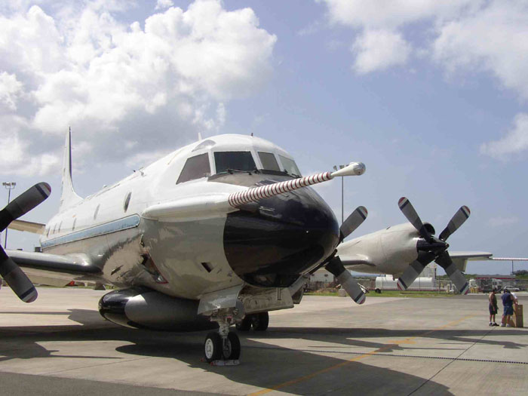
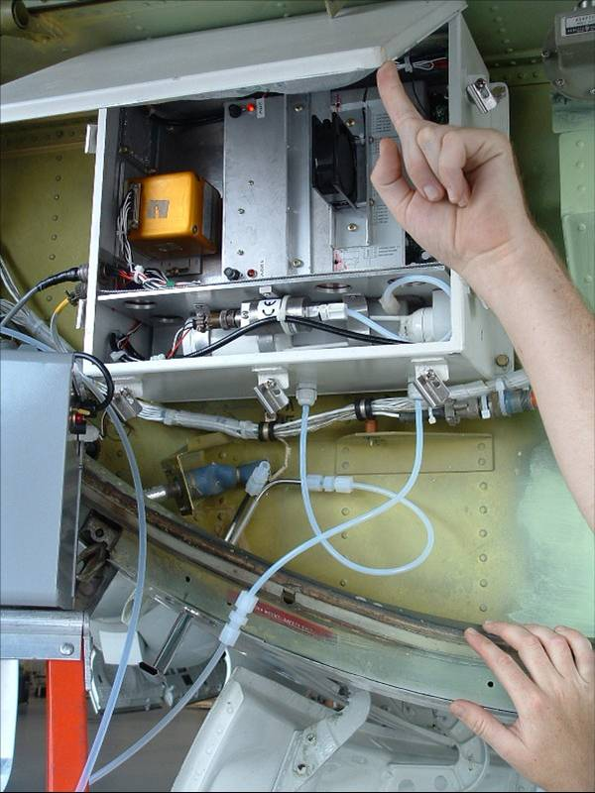
P3 turbulent flux instrumentation
- BAT (“Best Aircraft Turbulence”) probe on boom
- Rosemount Gust probes in radome and fuselage
- Inertial navigation, GPS systems in fuselage
- LICOR LI-7500 hygrometer (modified)
- Rosemount temperature sensors
↓ BAT
←LICOR head
J. Zhang

Slide 16
Past and ongoing Research Area
Observations:
Surface exchange coefficients (e.g., Drennan et al. 2007JAS; French et al. 2007JAS; J. Zhang et al. 2008GRL)
Hurricane boundary layer rolls (e.g., J. Zhang et al. 2008BLM)
Turbulence spectra (e.g., J. Zhang 2010QJ)
Dissipative heating (e.g., J. Zhang 2010JAS)
Turbulence kinetic energy budget (e.g., J. Zhang et al. 2009JAS)
Vertical turbulent mixing (e.g., J. Zhang et al. 2011MWR; J. Zhang and Drennan 2012JAS)
Horizontal diffusion (e.g., J. Zhang and Montgomery 2012JAS)
Modeling:
Hurricane model physics evaluation and improvement (e.g., J. Zhang et al. 2012TCRR; Gopal et al. 2013JAS; J. Zhang et al. 2015; 2016MWR)
A simple model for simulating TC boundary layer (e.g., Bryan et al. 2016BLM)
J. Zhang

Slide 17
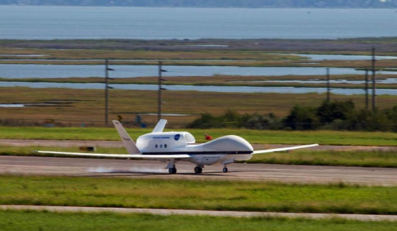

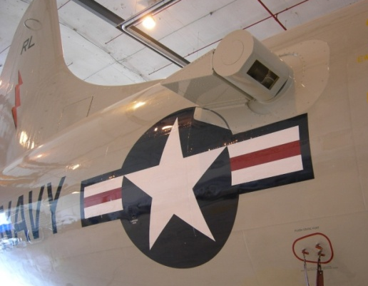
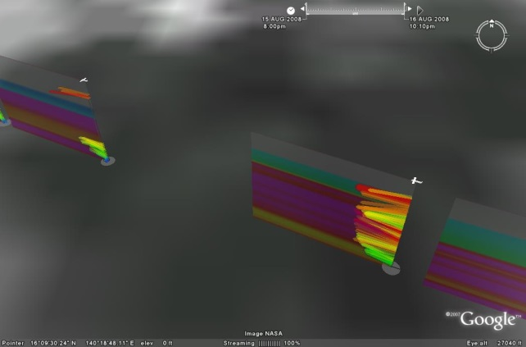
New instruments and platforms

Slide 18
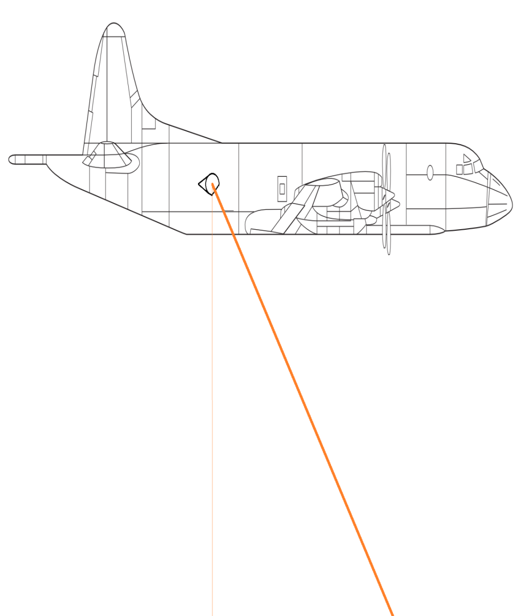
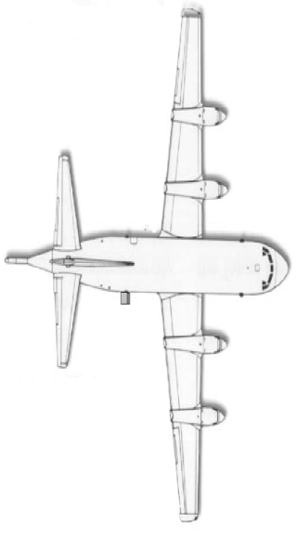
Doppler Wind Lidar (DWL)
DWL flown into Danny and Erika (2015)
2 datasets from the afternoon mission on August 26, 2015
  Line of Sight (LOS) winds
  Wind profiles
Comparison to dropsondes
Experiments on model impact
P3 Orion Side View
30° off nadir
P3 Orion Top View
-10°
+30°
Bucci

Slide 19
DWL Status
Funding transfer to Simpson Weather Associate is ongoing (Jun Zhang has been working with UM business office on this).
The DWL scanner was sent to Beyond Photonoics to figure out the problem (Dave Emmitt traveled to Boulder and worked with the group).
Next step is to fix the rotation stage of the scanner.
Repairs of data system, nitrogen purge system will be next once the funding transfer is completed.
Bucci

Slide 20

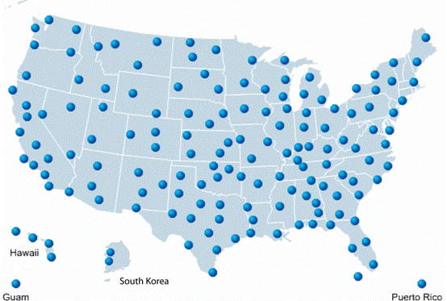
Dual-polarization radar – Evan Kalina
From 2011-2013, every WSR-88D was upgraded to dual-polarization.
Includes 30 coastal radars in hurricane-prone areas, so more data are collected every year
Data archive: http://www.ncdc.noaa.gov/nexradinv/
KMHX
Dual-polarization radar: sensitive to precipitation characteristics in both the vertical and horizontal planes
Detection of particle shape & type, liquid & ice water paths, melting layer hgt, improved rain rate estimates
An example from Hurricane Arthur (2014) in
Morehead City, NC (KMHX)
0.5-degree tilt reflectivity (left)
Ice water path estimate (right)
Kalina

Slide 21
  - Acquire resources for additional Coyote UAS and operational support for 2016
    8 Coyote UAS purchased. 5-6 of these units will be available for use during the 2016. We currently have 2 weeks of in field support with Raytheon
  Resolve/Incorporate critical ‘lessons learned’ issues from Edouard Missions
    Testing in 2015 and 2016 have significant improved communications between UAS and P-3. We now have 50nmi vs 3-5nmi we experienced in Edouard. Increase range attained by P3/UAS antenna optimization, UAS signal amplification and use of 350mHz signal frequency (vs. 900Mhz).
    Improve “systems awareness” by enhancing UAS/P3 real-time data visualization (Feb ‘15).
    Upgrade/improve existing UAS payload package. Optimized existing payload physical configuration, and add a new IR sensor for SST mapping in 2015.
    Coyote Imet Sensors were chamber tested in September of 2015 at NCAR. Little T, Td bias found.
    Standardized a UAS “operational launch sequence” for the P3 in 2016. Results from the recent Clear Air Test conducted at Avon Park on 1/7/16 strongly suggest that future P3 launches should not experience previous complications (2 losses in Edoaurd, Aug. 15 CAT ,etc)
  Make Coyote UAS data available in near-real time to operational centers
    Worked directly with NHC (Landsea) and designed an experimental module for Coyote operations in 2016 (RMW module).
    On 1/17/16 successfully sent low level Coyote UAS wind speed and direction data to the NHC in near-real time. EMC also had direct access to this test data as well.
Coyote Update and Operational Readiness for 2016
21
Cione

Slide 22
Archiving
HRD data products list:
  http://www.aoml.noaa.gov/hrd/data_sub/products.html
Dorst

Slide 23
HFP plans for 2016
Two P-3’s, G-IV should be available throughout the season
Adequate flight hours for research and operational missions
Working to get clearance to conduct research missions from Mexico
  Likely means will have to deploy to Mexico for some period
Rethink experiments
  Deadline of April 15 for submissions
  We have OSSE capability to simulate flight patterns, test impact on Nature run (Kelly has examples of this)
Rogers

Slide 24
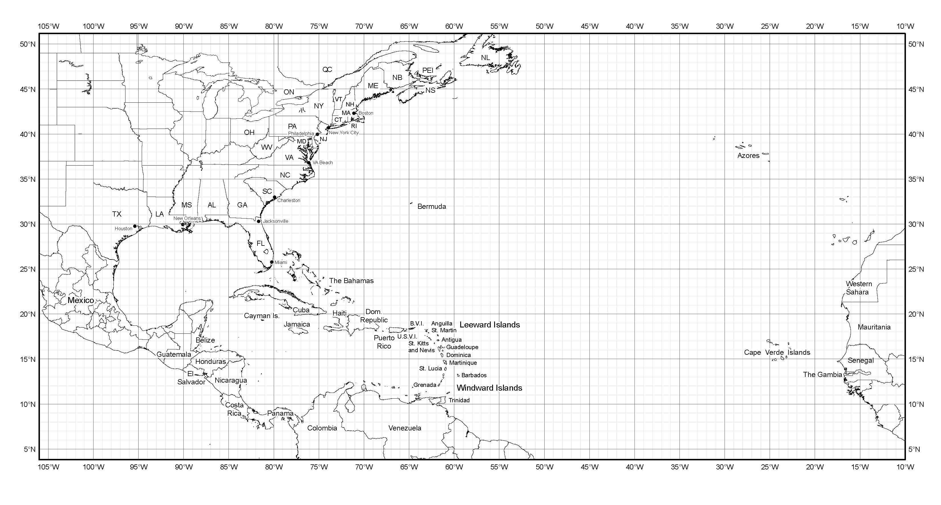
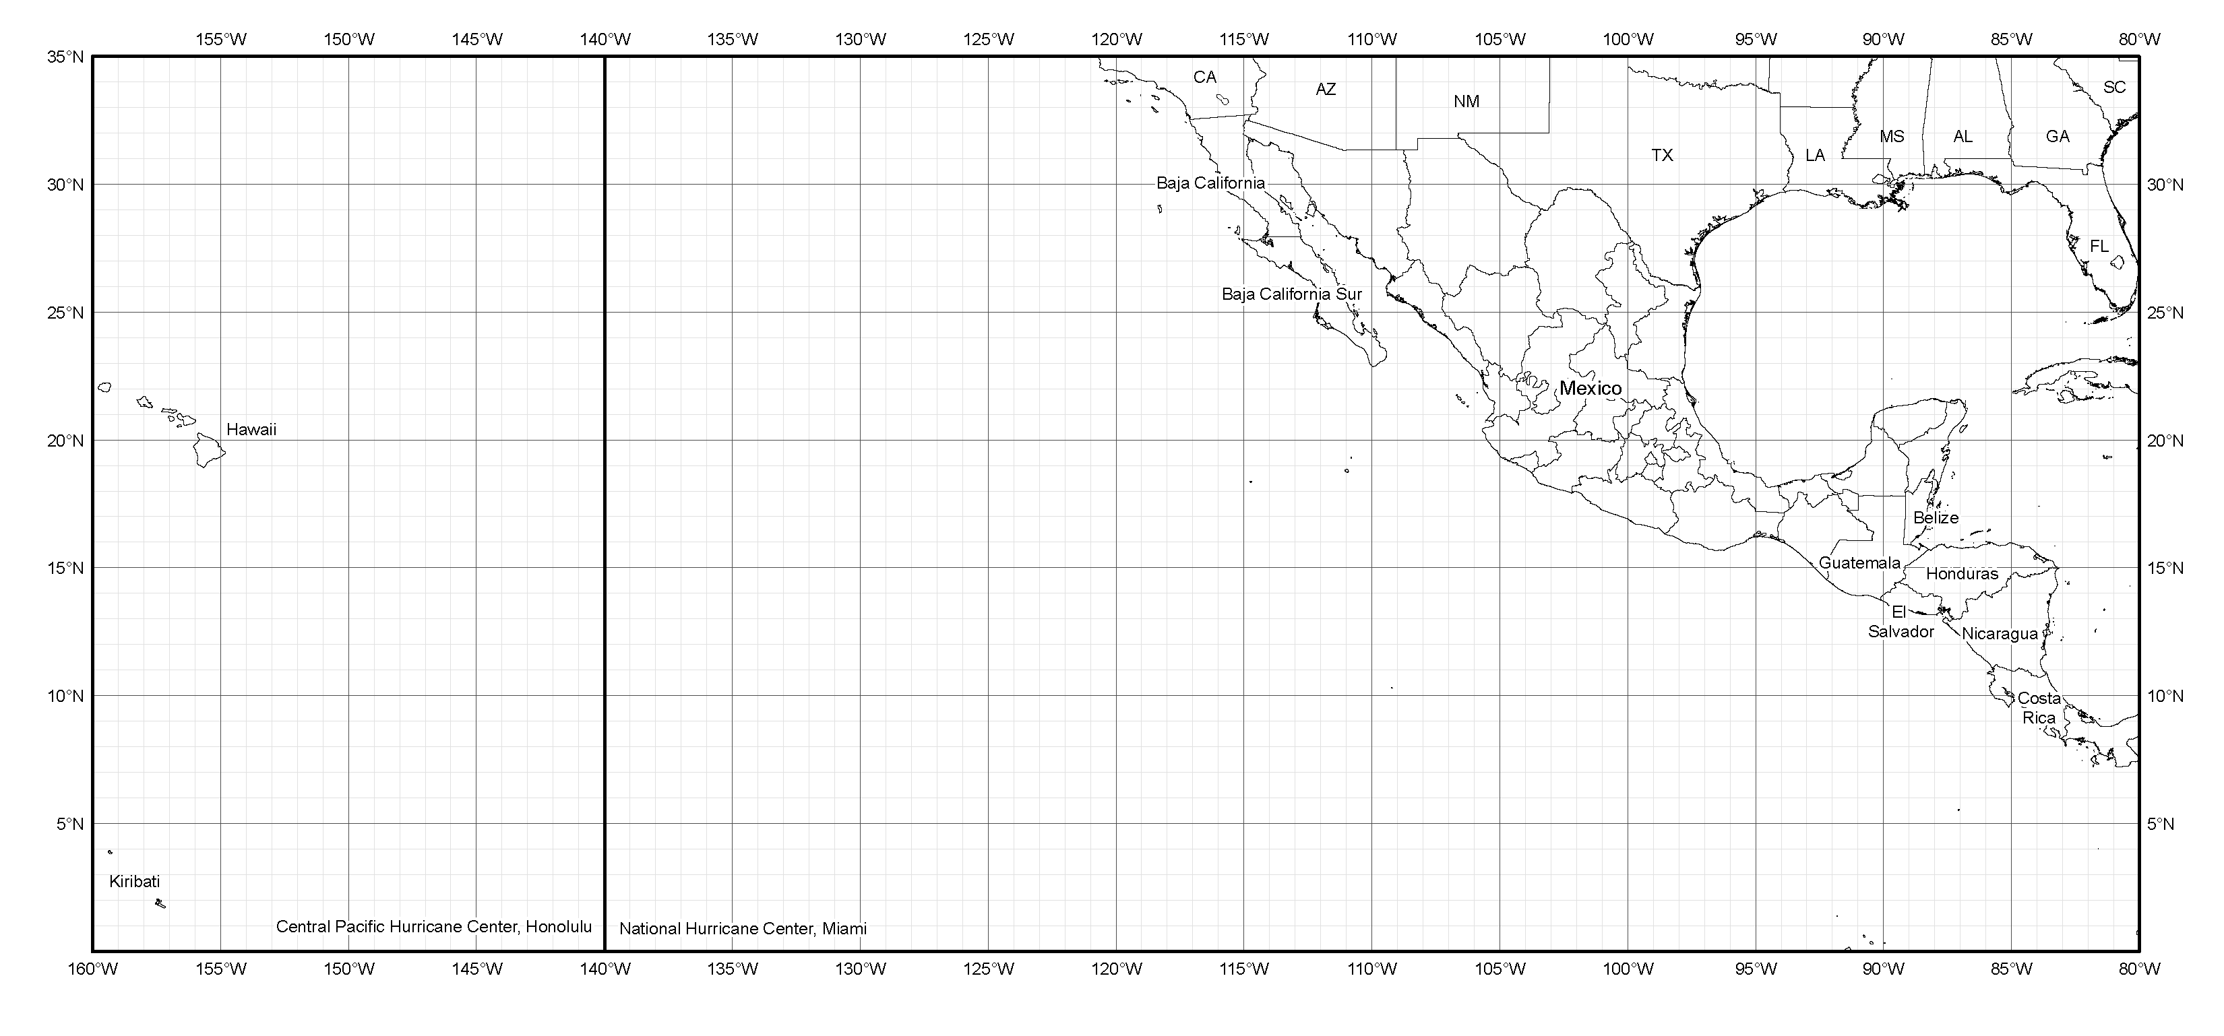
P-3 Geographic Coverage
Range for ~2-h on-station time
Bermuda
Tampa
St. Croix
Barbados
La Paz
Acapulco
Tapachula
Rogers

Slide 25
G-IV Geographic Coverage
Range for ~2-h on-station time
Bermuda
Tampa
St. Croix
Barbados
La Paz
Tapachula
Rogers

