Slide 1
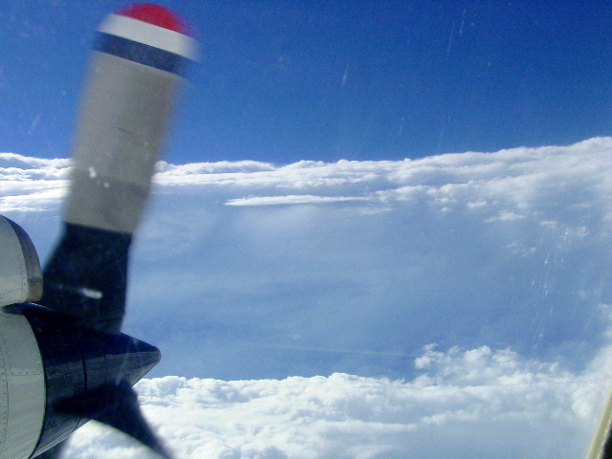
HRD Observations Team Meeting
April 2016

Slide 2
Agenda for 4/28/16
1) Instrument/platform updates 10:30-10:50AM
- AVAPS users meeting update (Aberson)
- Cloud physics (R. Black)
2) Field program planning updates 10:50-11:10AM
- Logistics updates – aircraft availability, instrumentation plans
- Mexican clearance
- Planned experiment and module submissions due Friday
3) Talk:
Brad Klotz: "Performance of the revised SFMR algorithm: 2015 Season in Review" 11:10-11:20AM
4) Talk:
Jonathan Vigh (NCAR/RAL): "The Extended Flight Level Dataset for Tropical Cyclones (FLIGHT+)“ (presented by Rob) 11:20-11:30AM

Slide 3
Composites of hydrometeor concentations from microphysics probe data
Progress with the R-Z means of the non-geo-referenced FL microphysics data
Got it all done. Collaborator J Wen Bao wanted individual storms – Got them last week, except for 840924H – need to re-do that one from the beginning.
Next up: PECAN analysis start up. Got a start at annotating images. Some difficulties need to be overcome.
R. A. Black

Slide 4
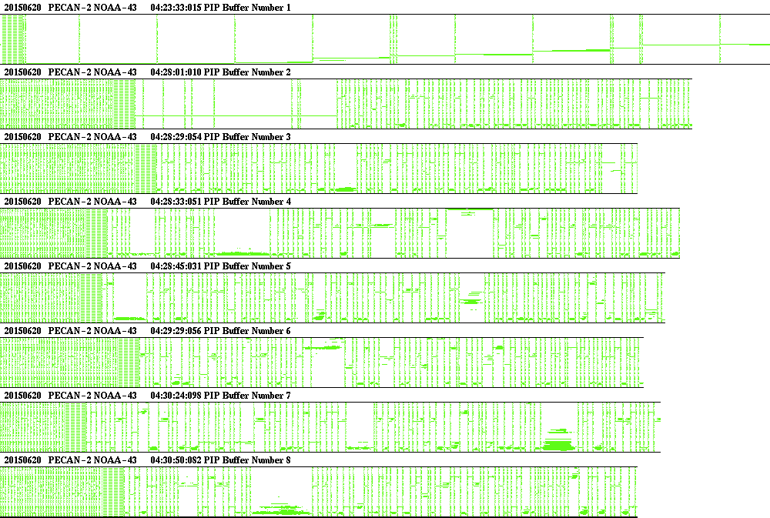
Sample image data

Slide 5
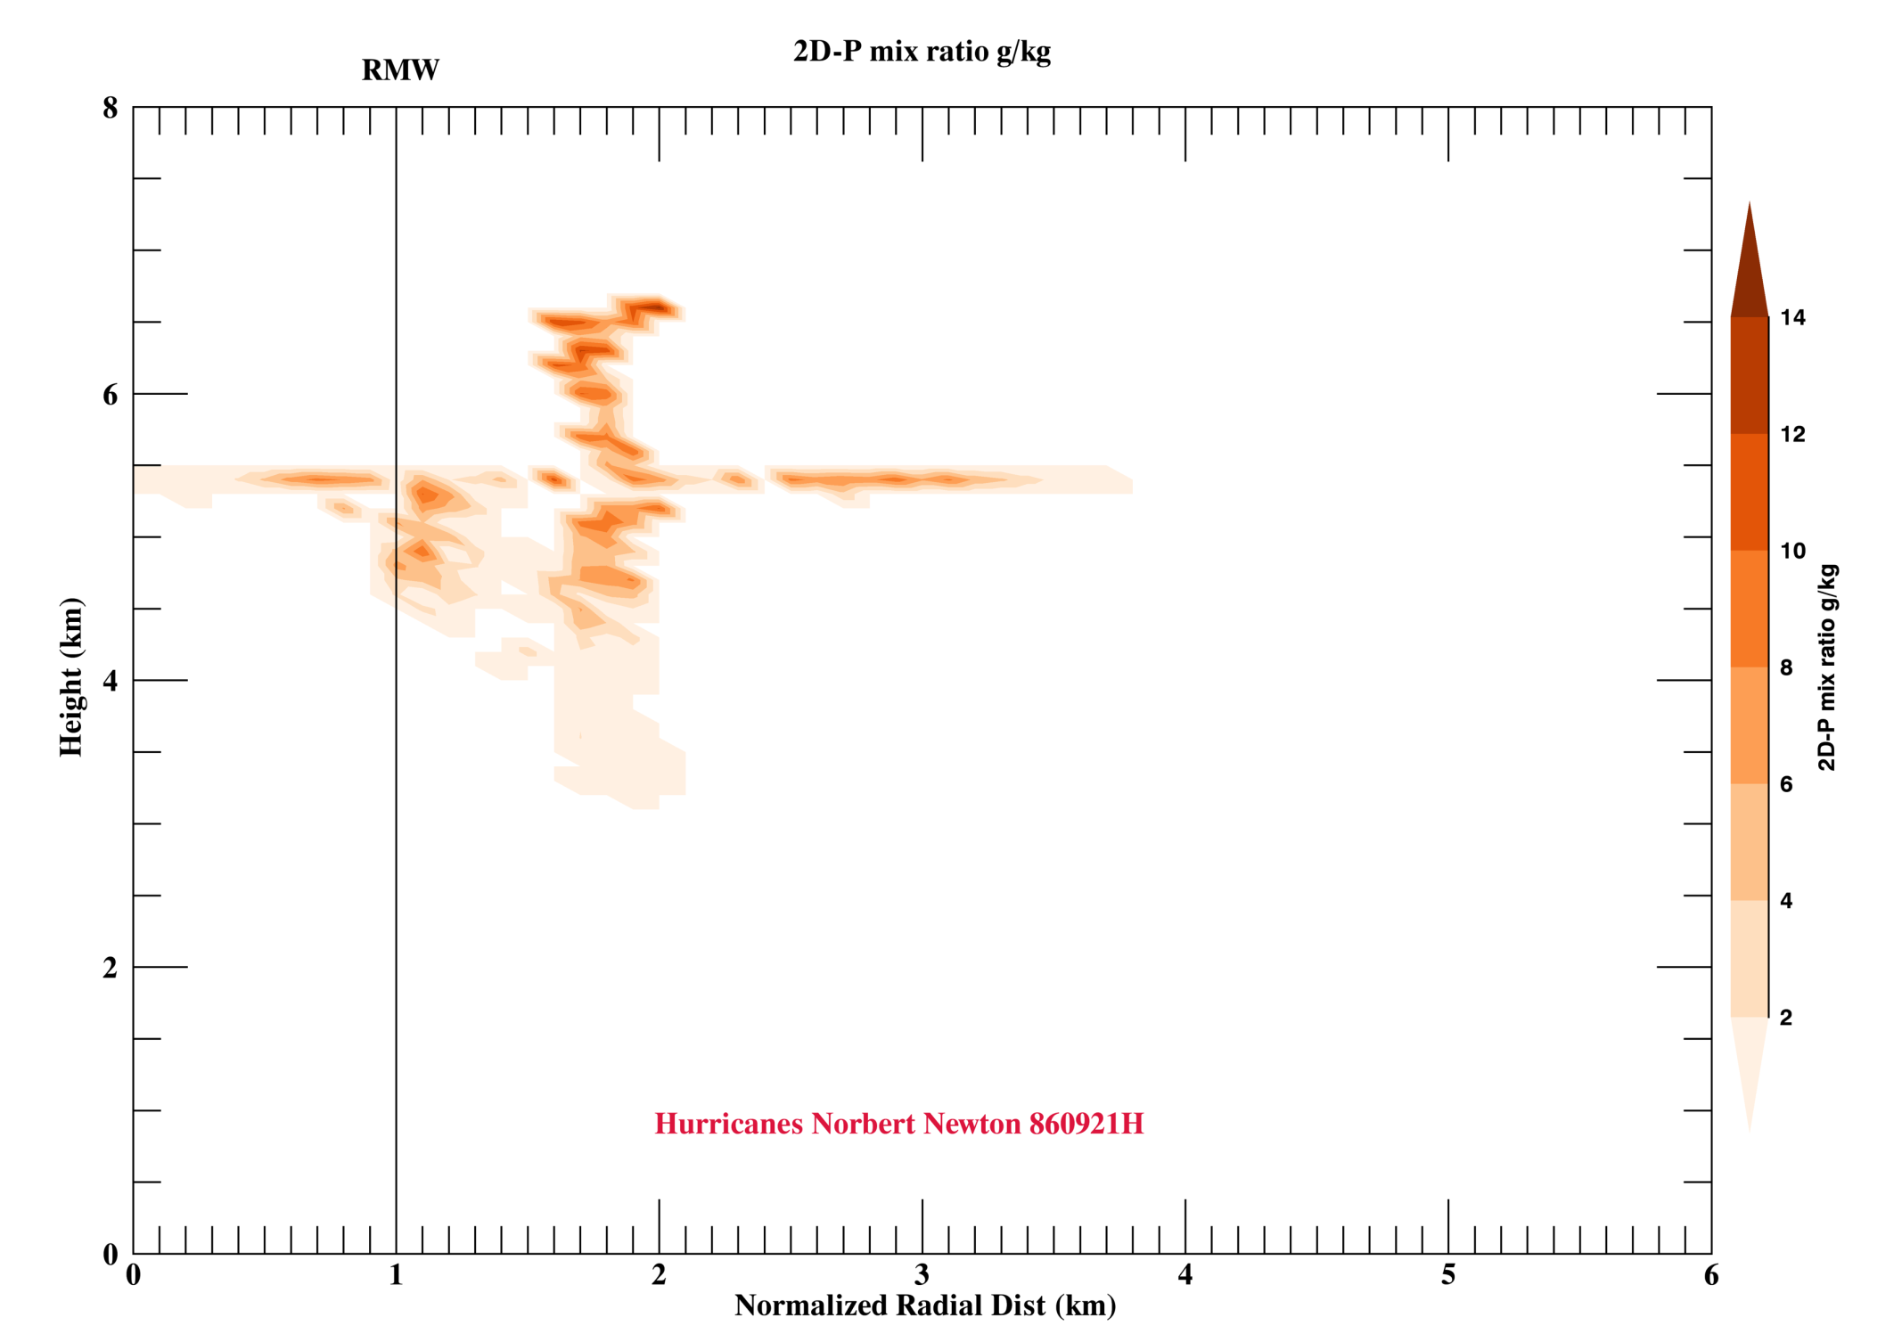
Composite of precipitating hydrometeor concentrations

Slide 6
HFP 2016 Logistics
43, 49 are available
42 is not expected to be available until October 1
Plan on one P-3 for this season
Discussions on which instruments will be on for first half of season, and which for second half (IWRAP/W-band together; DWL/WSRA together; Coyote can fly with either group)
Still working on Mexican clearance, need collaboration letter from CONAGUA (Mexican Weather Service); no luck yet
Proposed experiments and modules for this year due April 29
HFP-specific meeting TBD…..

Slide 7
HFP 2016 Experiments & Modules
Want research targeting more aspects of TC structure, lifecycle
  Mature hurricane sampling (e.g., SEF/ERC research)
  AEW sampling and modeling (e.g., in framework of genesis experiment)
  Missions to conduct from Mexico (e.g., sampling of tropical convection just west of Panama – frequent spurious genesis in GFS)

Slide 8
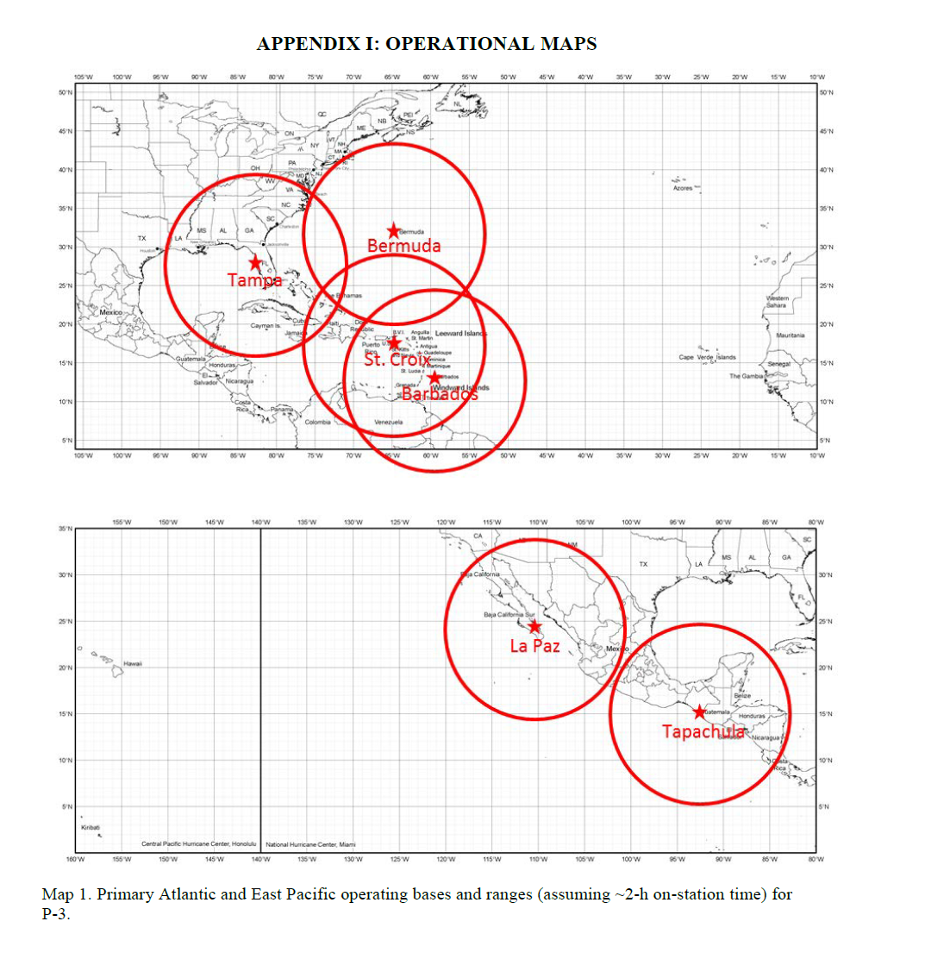
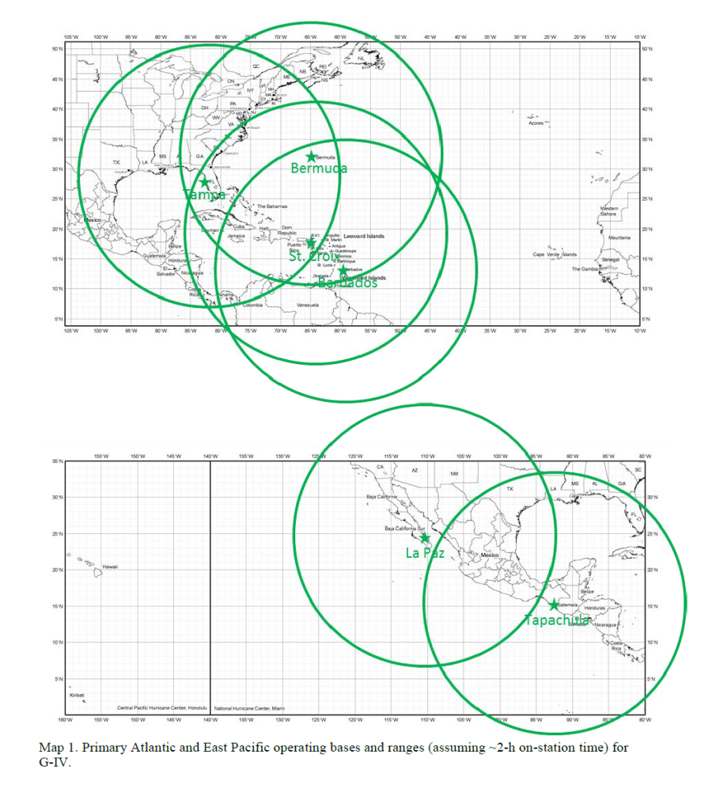
Aircraft ranges (assuming ~2h on station)

Slide 9
Performance of the revised SFMR algorithm: 2015 season in review
Brad Klotz (University of Miami/CIMAS, NOAA/HRD)
HRD Observations Team Meeting
28 April, 2016

Slide 10
Background
As described in Klotz and Uhlhorn (2014), we developed an update to the SFMR algorithm designed to reduce or eliminate the high wind speed bias in rainy conditions
Additionally, adjustments were made to the rain portion of the algorithm to account for signal absorption problems – the root cause of the high wind bias.
The Joint Hurricane Testbed approved the transition to all SFMR (NOAA and AFRC), and the new algorithm (now current) was operational for the 2015 hurricane season

Slide 11
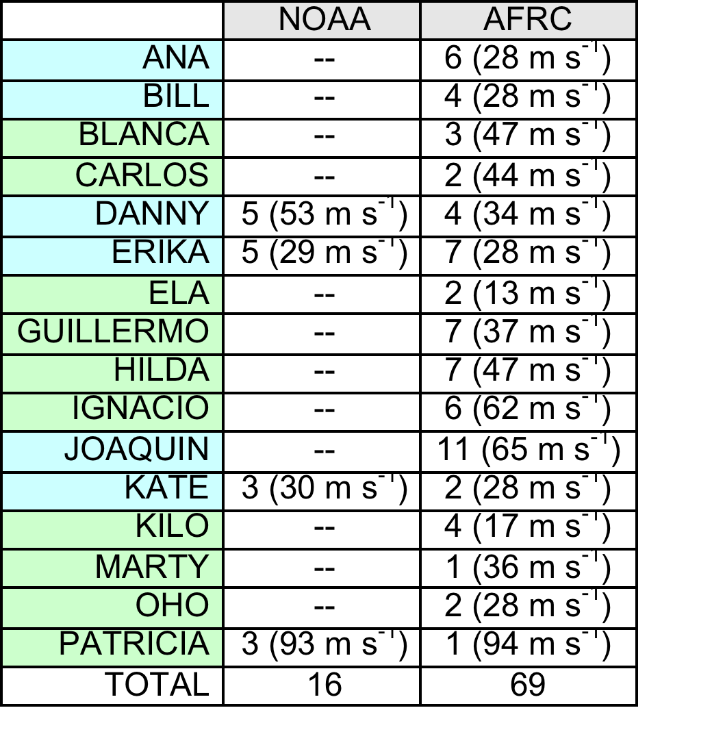
Available cases for 2015
A total of 85 missions were conducted during the season, with a majority being flown by the AFRC
North Atlantic
Northeast/Central Pacific

Slide 12
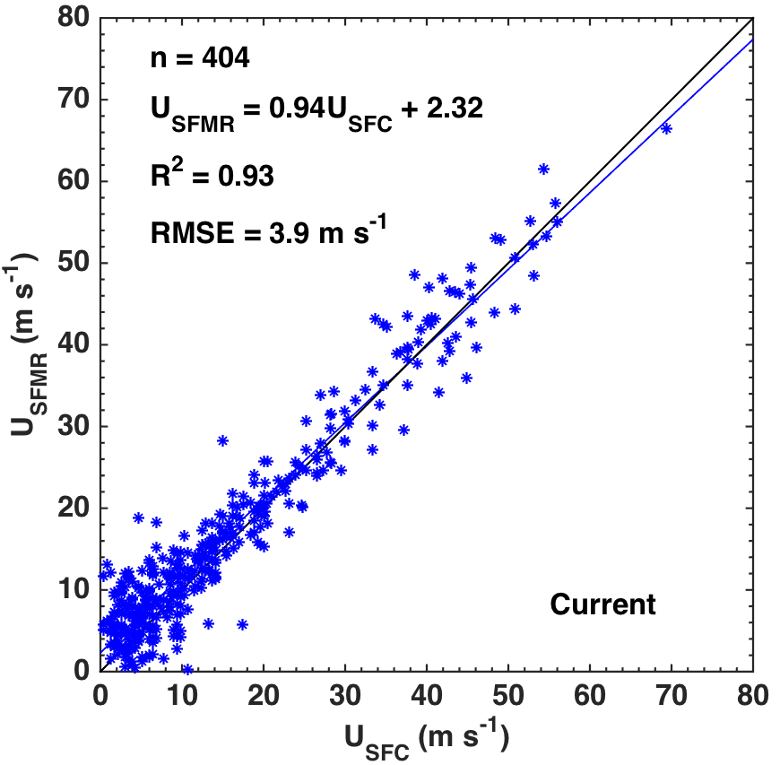
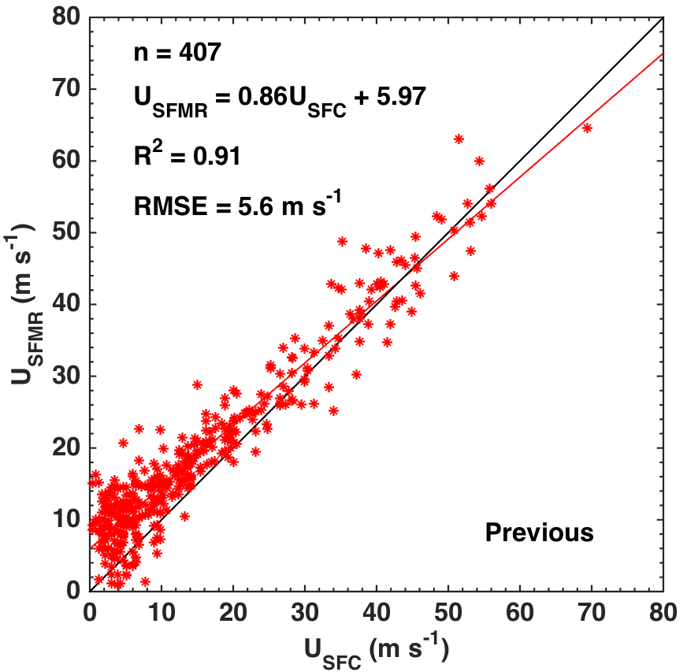
Current vs. Previous Algorithm Results
SFMR wind speeds evaluated against the dropsonde surface adjusted wind speed (U_{SFC})

Slide 13
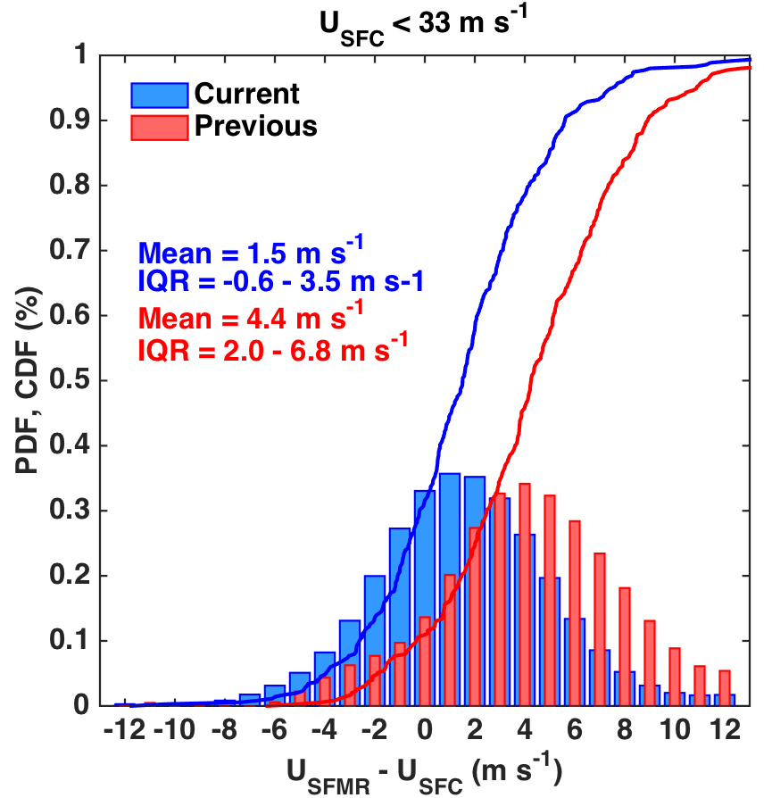
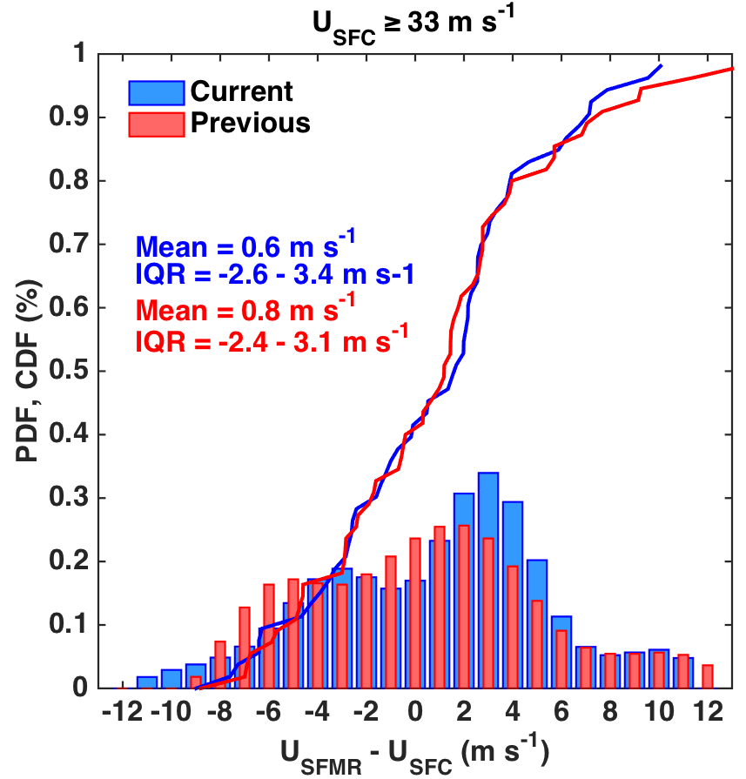
Current vs. Previous Algorithm Results
An average bias reduction of ~ 3 m s⁻¹ is produced from the current algorithm at low wind speeds while only a slight change occurs at the high wind speeds

Slide 14
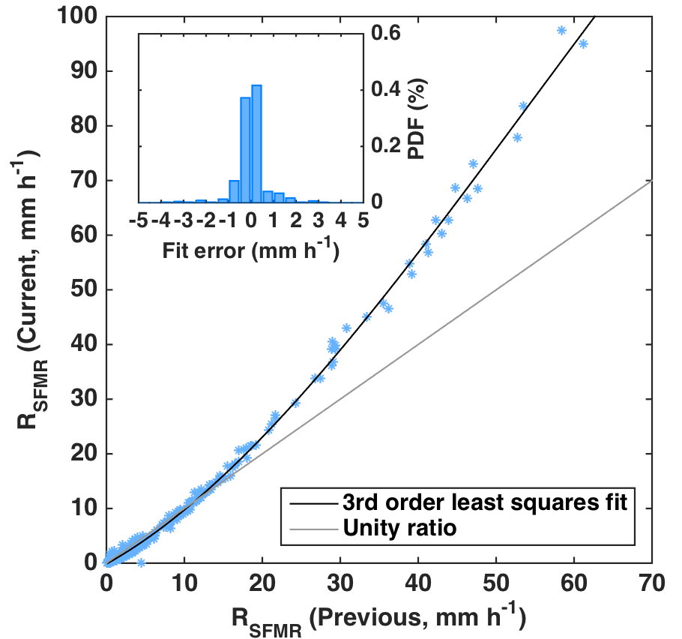
Current vs. Previous Algorithm Results
Previous algorithm rain rates were scaled to the current version using a 3rd order least squares fit

Slide 15
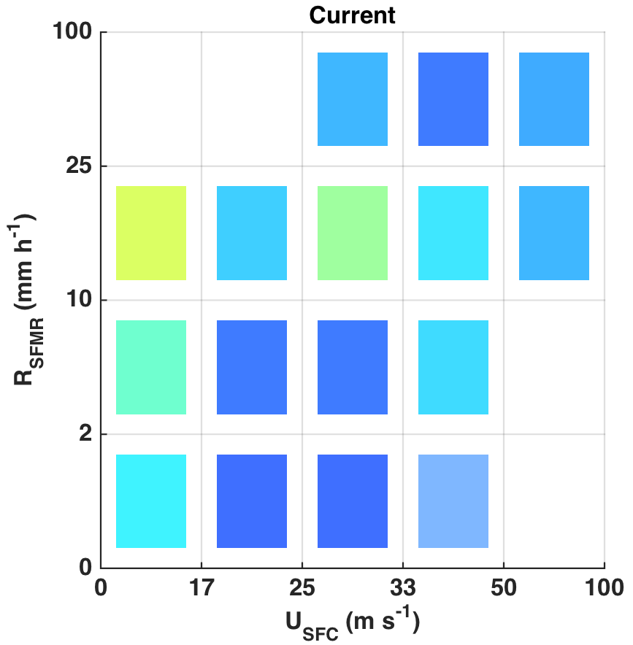
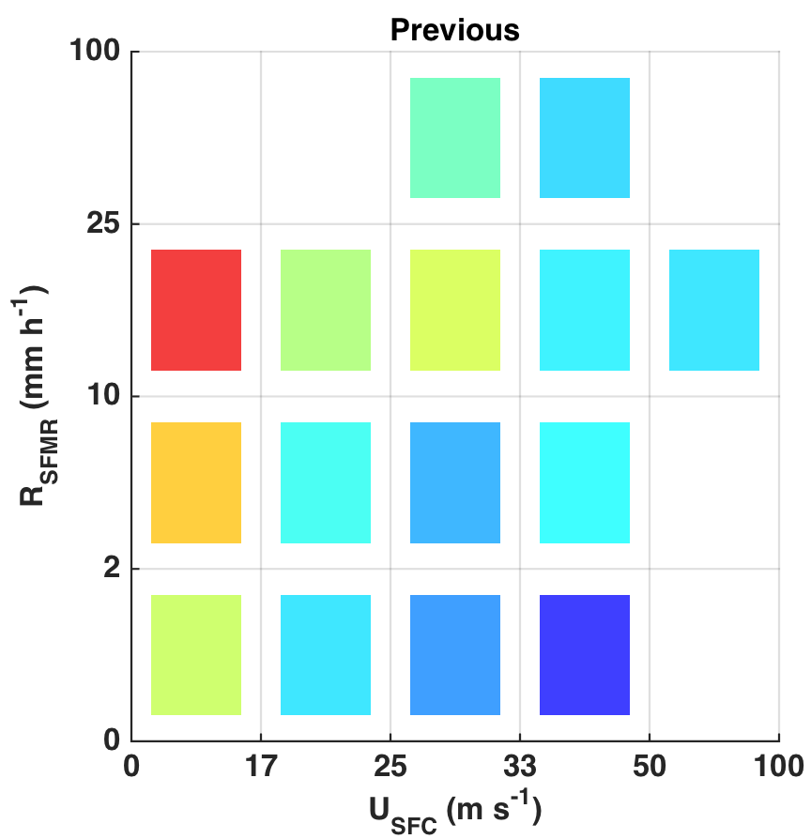
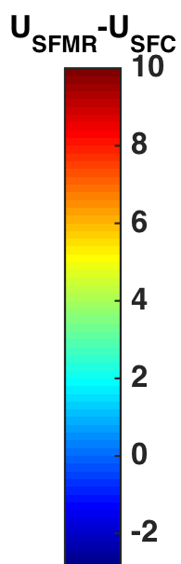
Current vs. Previous Algorithm Results
The wind speed bias is significantly reduced in rainy conditions compared to the obvious overestimation of the winds with the previous algorithm

Slide 16
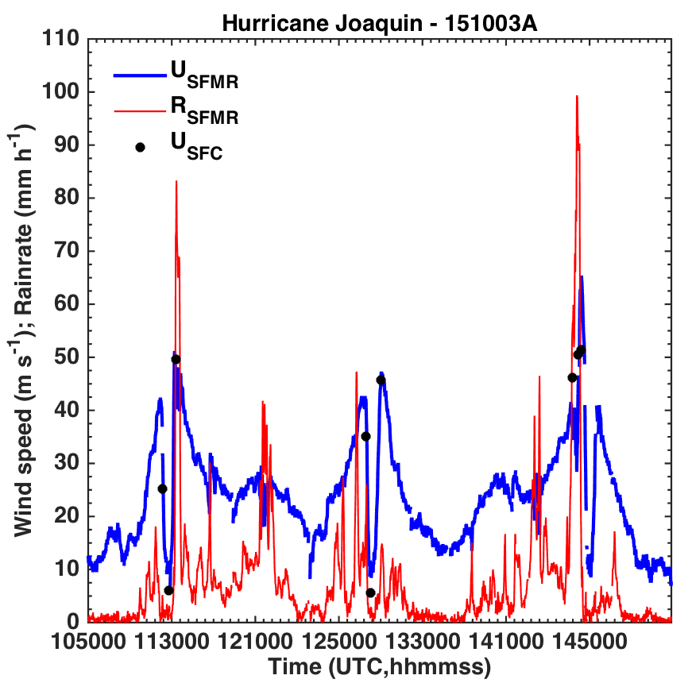
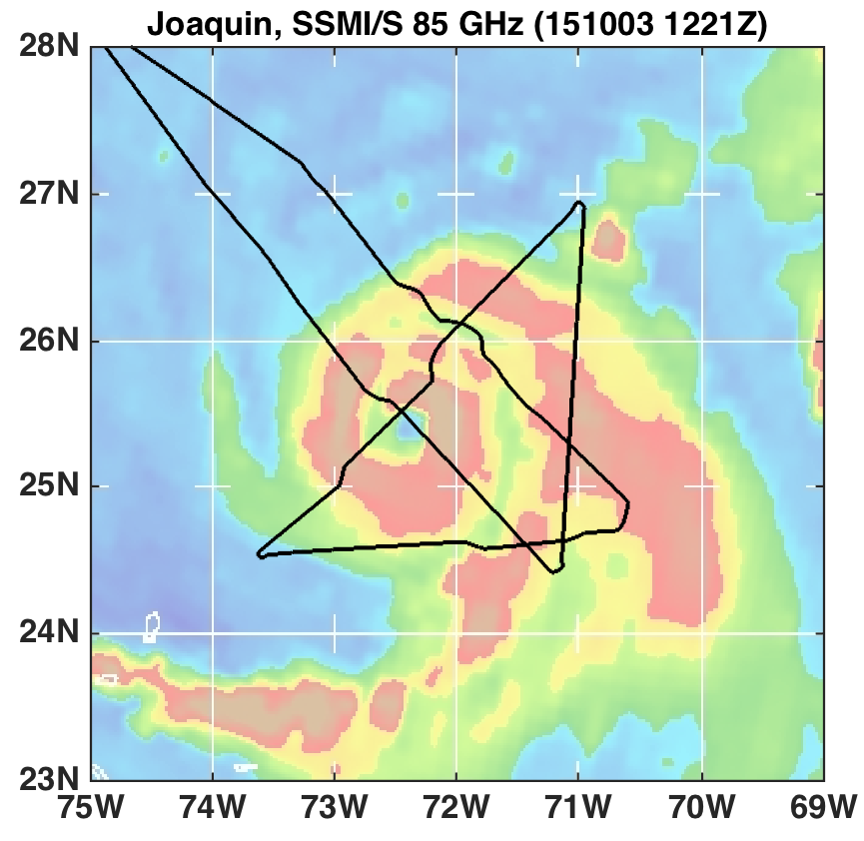
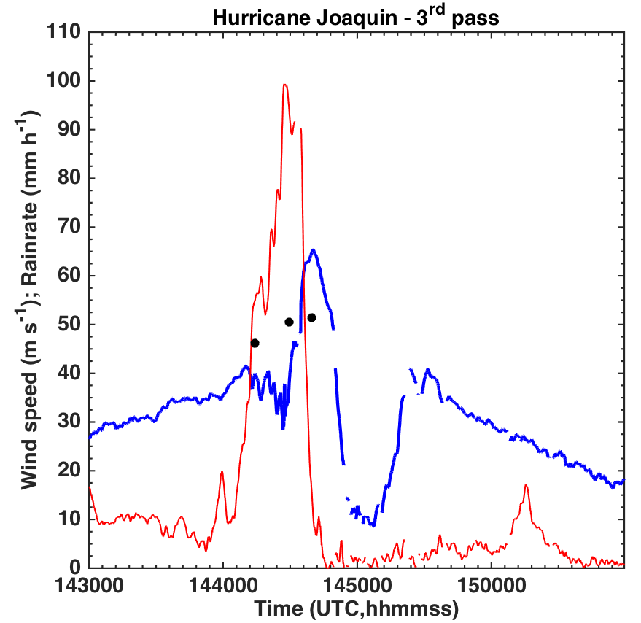
An Interesting Case: Joaquin
Morning AFRC flight from 3 October
3rd pass had a wind spike that caused forecasters to question its validity

Slide 17
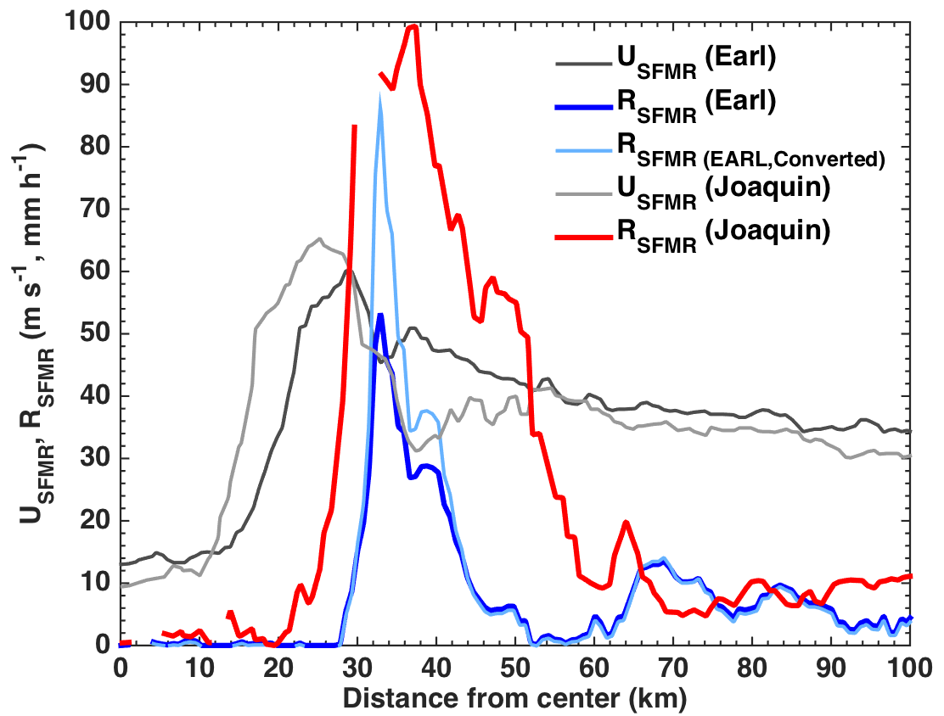
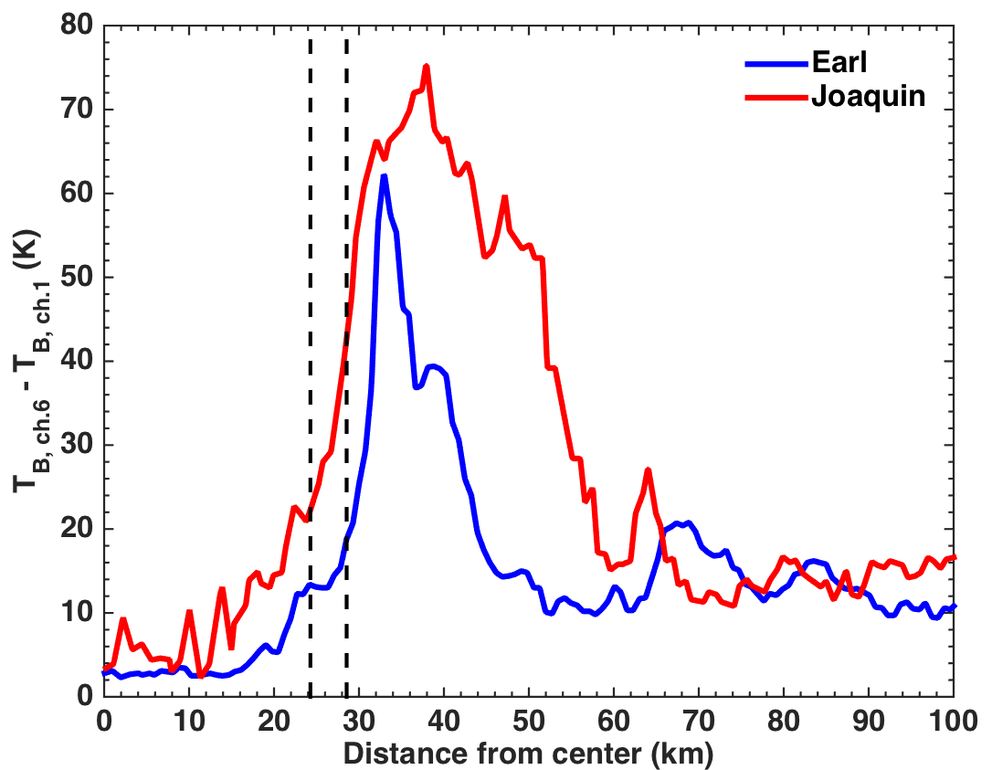
An Interesting Case: Joaquin
2nd pass from 02 September Hurricane Earl mission (similar strength, location, SST, etc.) used to compare to Joaquin
A 3.5 K difference between Joaquin’s and Earl’s respective T_{B} differences at the maximum wind is consistent with previous results indicating a 1 K (m s⁻¹)⁻¹ change at high wind speeds. In addition, a noise estimate of ~0.8 K makes Joaquin’s maximum wind speed reasonable

Slide 18
Summary & Conclusions
JHT approved the transition of an algorithm update for SFMRs that became operational in 2015
Statistical comparisons reveal that the updated algorithm produces improved results compared to the previous version
The impacts from rain on the wind speed have been significantly reduced or eliminated in the current version
Reprocessing past data with the current algorithm will be an important task to provide data consistency on our website
  In the process of hiring an undergraduate summer intern to help with this task

Slide 19

The Extended Flight Level Dataset for Tropical Cyclones (FLIGHT+)
Jonathan L. Vigh
Joint Numerical Testbed Program, RAL/NCAR
10:30 AM Thursday, 28 April 2016
HRD Monthly Research Updates Meeting
Notes:
This is a “beginning of project” presentation.

Slide 20
FLIGHT+ Contributors and Funding
Contributors
  Jonathan Vigh (NCAR/RAL/JNTP)
  Neal M. Dorst (NOAA/AOML/HRD)
  Christopher L. Williams (NCAR/RAL/JNTP)
  Eric W. Uhlhorn (AIR Worldwide)
  Bradley W. Klotz (NOAA/AOML/HRD)
  Jonathan Martinez (University of Hawaii-Manoa)
  Hugh E. Willoughby (Florida International University)
  Frank D. Marks, Jr. (NOAA/AOML/HRD)
  Daniel R. Chavas (University of Purdue)
Funding
  NASA/TCSP Grant NNG06GA54G (2008-2010)
  NSF Grants ATM-0332197 and ATM-0837932 (2008-2010)
  NCAR Advanced Study Program, Department of Energy, and National Science Foundation (2010-2012)
  Development Testbed Center Visitor Program (2012-2015)
  The Bermuda Institute of Ocean Sciences (BIOS) Risk Prediction Initiative (RPI2.0), through support from the RPI member companies (2013-2016)

Slide 21
Citations
Software:
  The NCAR Command Language (Version 6.4.0) [Software]. (2016). Boulder, Colorado: UCAR/NCAR/CISL/VETS. http://dx.doi.org/10.5065/D6WD3XH5.
Computing support:
  Computational and Information Systems Laboratory. 2016. Yellowstone: IBM iDataPlex System (Climate Simulation Laboratory). Boulder, CO. National Center for Atmospheric Research. http://n2t.net/ark:/85065/d7wd3xhc.
Data:
  Flight Level Data. NOAA/AOML Hurricane Research Division. http://www.aoml.noaa.gov/hrd/data_sub/hurr.html
  Amante, C. and B.W. Eakins, 2009. ETOPO1 1 Arc-Minute Global Relief Model: Procedures, Data Sources and Analysis. NOAA Technical Memorandum NESDIS NGDC-24. National Geophysical Data Center, NOAA. http://dx.doi.org/10.7289/V5C8276M [accessed 03 June 2014]

Slide 22
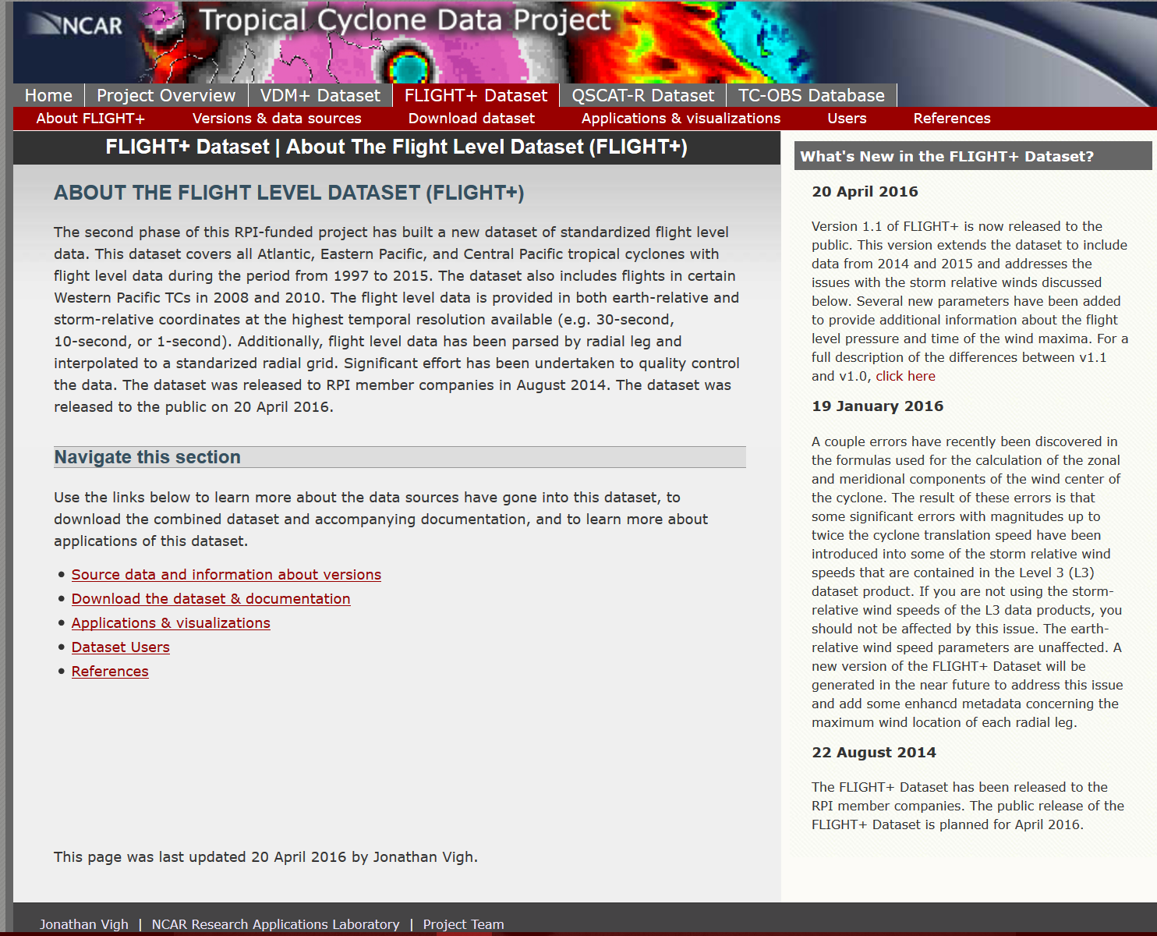
http://verif.rap.ucar.edu/tcdata/flight/
FLIGHT+ Dataset released 20 April 2016

Slide 23
Problems with aircraft data
Many formats
  At least 6 distinct Air Force formats since 1997
  8 NOAA formats since 1997
  Different variable names used in the different formats
  Many, many variables in the NetCDF files – which ones to use?
Varying sampling rates (1-sec to 1-min)
Varying degrees of quality control and/or formatting issues
Data not in storm-relative coordinates
  no radius information for parametric wind models
Summary: Aircraft data are messy!
The Willoughby-Rahn Flight Level Dataset ameliorates many of these issues, but that dataset ends in 2002.
Notes:
Relationship between flight level winds to surface wind speeds is uncertain

Slide 24
SOLUTION: Extended Flight Level Dataset for Tropical Cyclones (FLIGHT+)
Goal: Create a high quality, modern, standardized dataset of all available U.S. Air Force Reserve and NOAA Hurricane Hunter flight level data
  Include processing to make the dataset more accessible for fundamental research and wind risk applications

Slide 25
FLIGHT+ Dataset Overview
Readers coded up for ~20 distinct data formats
Standardized variable names
Primary navigational and meteorological parameters included
Provides full high resolution data at the native sampling rate (e.g. 1-sec, 10-sec, 30-sec)
Automatic parsing of radial legs
Radial legs provided on a 100-m radial grid
User-friendly NetCDF output
  Readable by Matlab, IDL, NCL, etc.
  All data and metadata included in same file (one per storm)
  Flexible but defined data structure – no rigid file formats
Full quick-look visualizations provided for visual QC
Detailed metadata provided for the location of each radial leg wind maximum (time/lat/lon/radius/azimuth/flight level pressure)

Slide 26
Summary of Quality Control Measures Related to Formatting Issues
Issue | Action
Unrealistically high flight level wind speed values (e.g., > 80 m/s in a tropical storm or weak hurricane) | Inspect data file. If unreasonable, change wind speed value to missing value (-99); if many values are bad, then remove block of data with high wind speeds
Odd flight duration…date/time stamp non-sequential or include a “jump” | Change date/time stamp of affected lines or delete block of data if duplicate time information is present
Unrealistic latitude/longitude values or location jumps | Change lat/lon to correct values (if apparent) or delete block of data with bad lat/lon values
Data file missing a column in certain lines | Delete block of data with missing column data
Data file has extra 1's in a column right after the date, causing mistranslation of subsequent columns | Clean using clean_bad_column.ncl to remove superfluous 1’s
Jonathan Vigh and Christopher Williams spent several hundred hours doing QC
Updated/cleaned files provided back to HRD for inclusion in the storm catalog

Slide 27
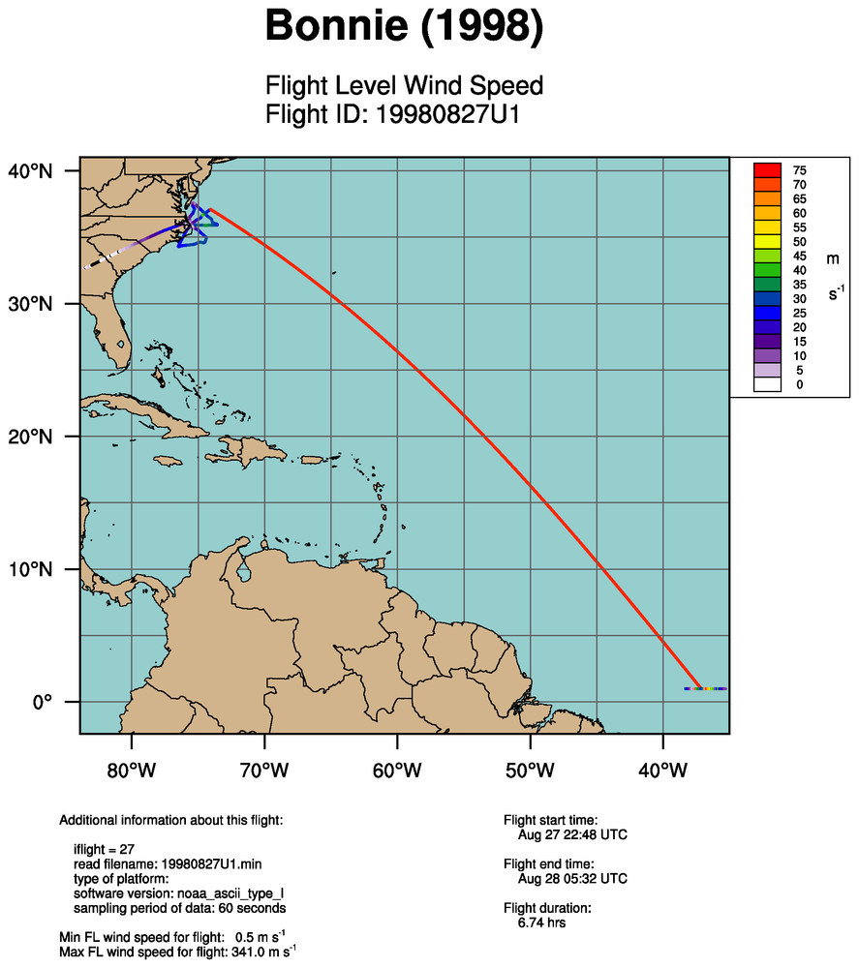
Example showing bad lat/lon data due to data or formatting issues

Slide 28
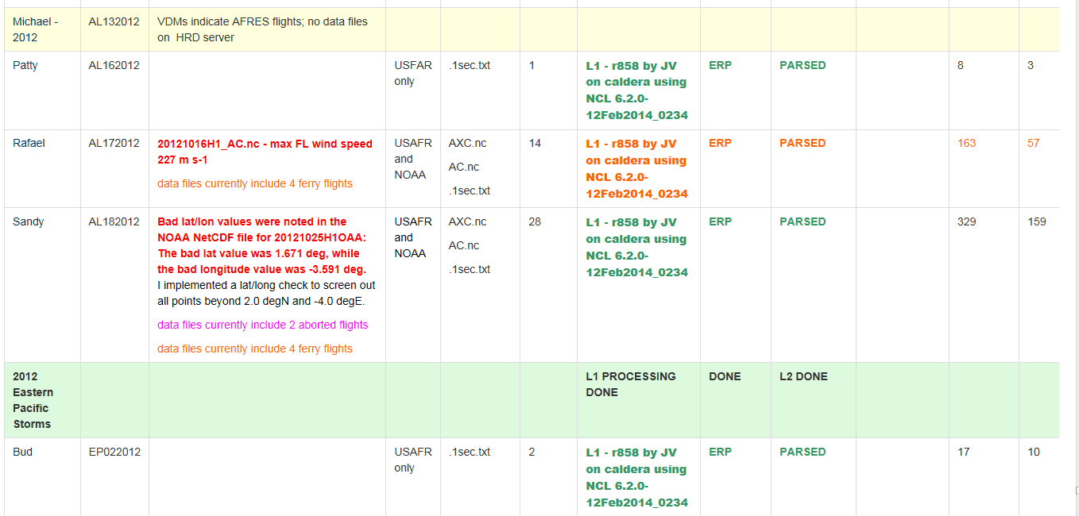
Data Provenance
https://wiki.ucar.edu/display/flight/Summary+of+Flight+Level+Data+Processing+by+Storm
# of good
radial legs
# of flights

Slide 29
Stepped Frequency Microwave Radiometer (SFMR) Problems
FLIGHT+ includes SFMR wind parameters from flight level files
SFMR retrievals fail when:
  Over shallow water
  Over land
  When the aircraft rapidly changes heading (e.g. turning at the outer termination points of radial legs)
  When the aircraft rolls
Solution:
  Implement QC measures to screen out bad data
    Mask SFMR values when the water depth below plane < 5 m
      ETOPO1 dataset (~1 km grid spacing) is used to examine cell directly beneath plane as well as the 4 adjacent cels
    Screen out SFMR values when rate of change of true heading is > 2 deg/sec
    Screen out SFMR values when

Slide 30
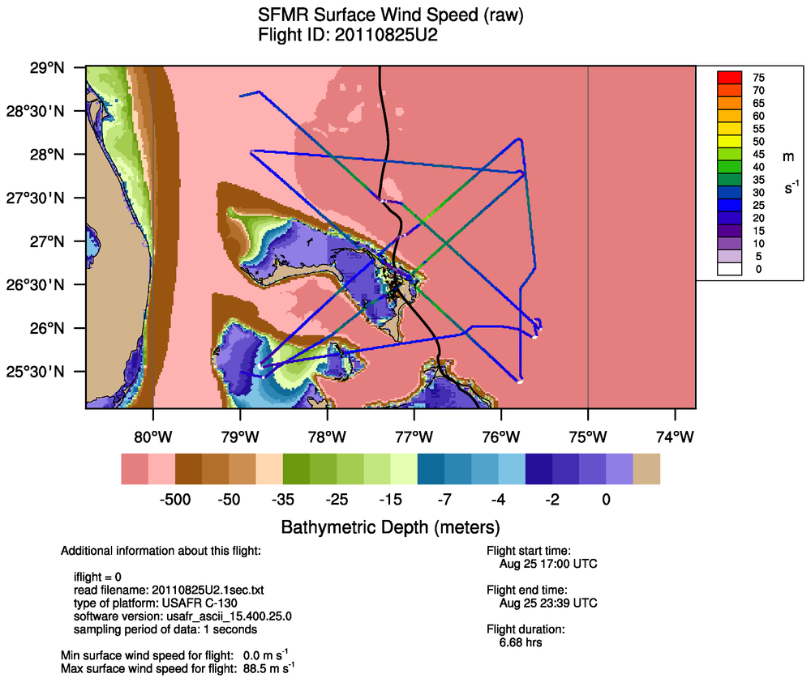
Irene (2011)
Before QC, the maximum SFMR surface wind speed for this flight was 88.5 m/s

Slide 31
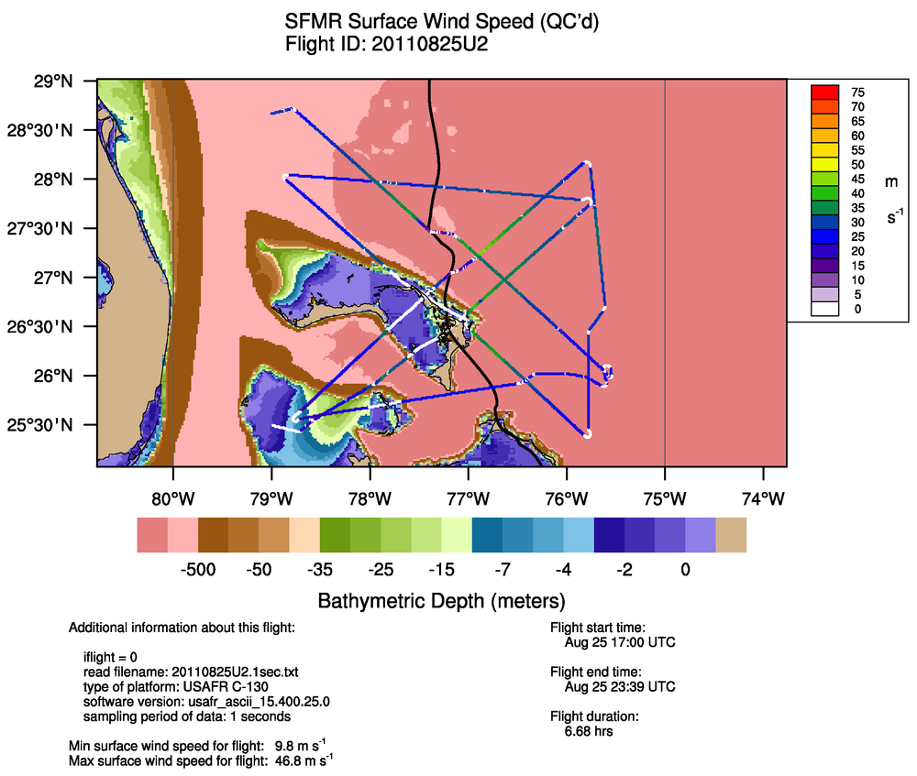
Irene (2011) with masking
After QC, the maximum SFMR surface wind speed for this flight was 46.8 m/s

Slide 32
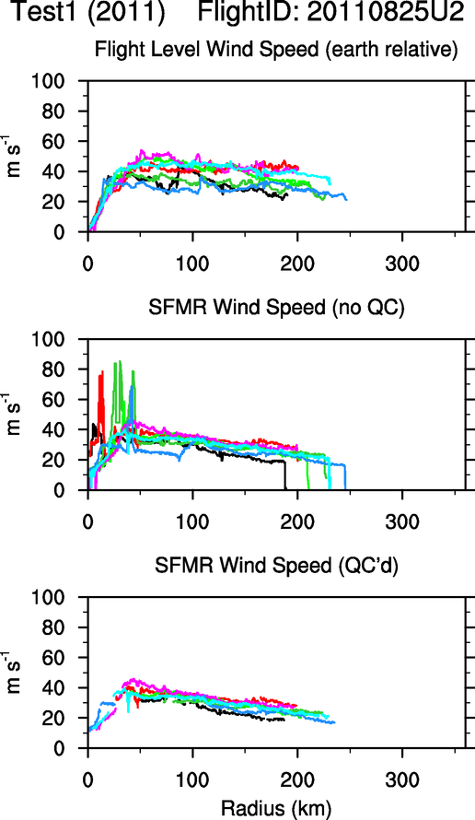

Slide 33
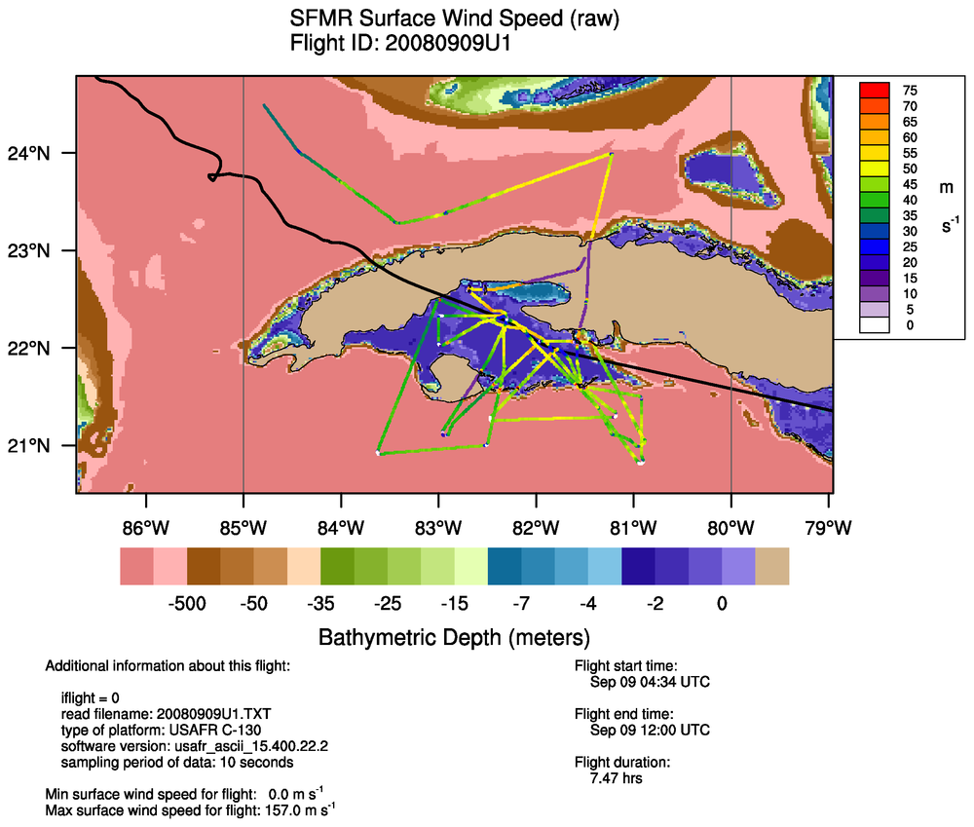
Ike (2008)
Before QC, the maximum SFMR surface wind speed for this flight was 157.0 m/s

Slide 34
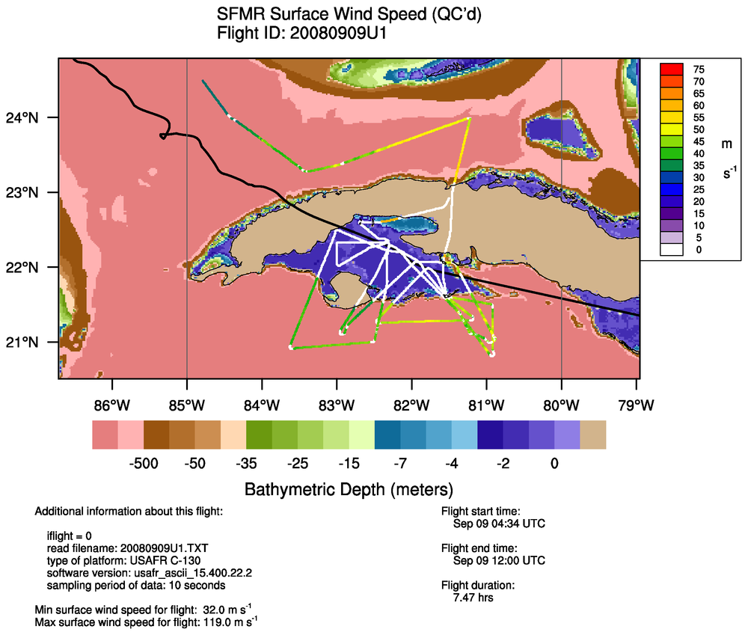
Ike (2008) with masking
After QC, the maximum SFMR surface wind speed for this flight was 119.0 m/s
It appears there are substantial calibration issues in 2007-2008.

Slide 35
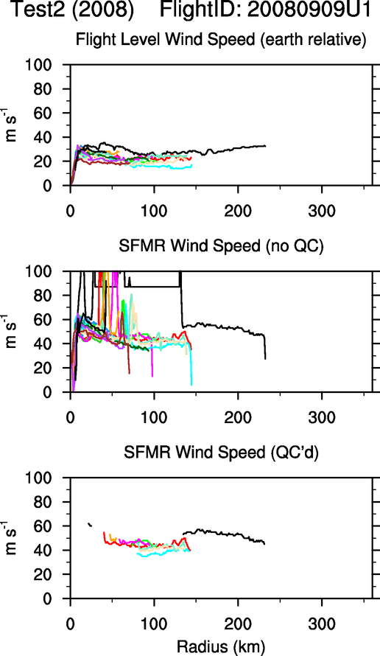
Unrealistic wind profiles even after QC measures

Slide 36
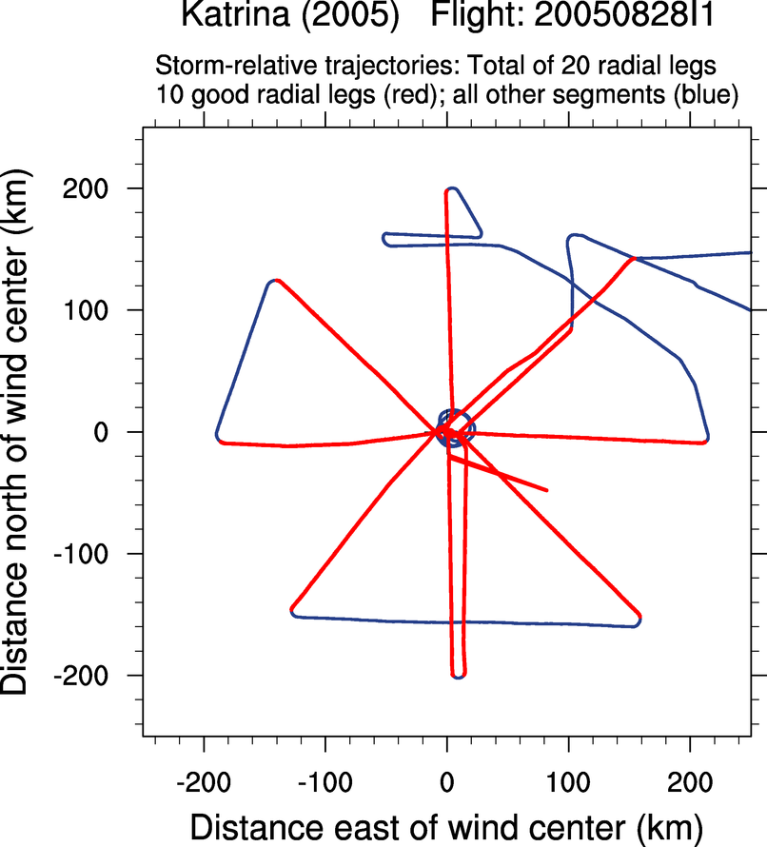
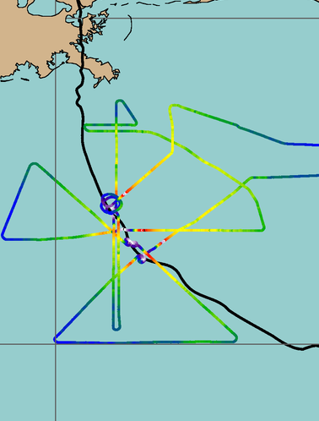
Processing to make flight level data more usable
Earth-relative trajectory

Slide 37
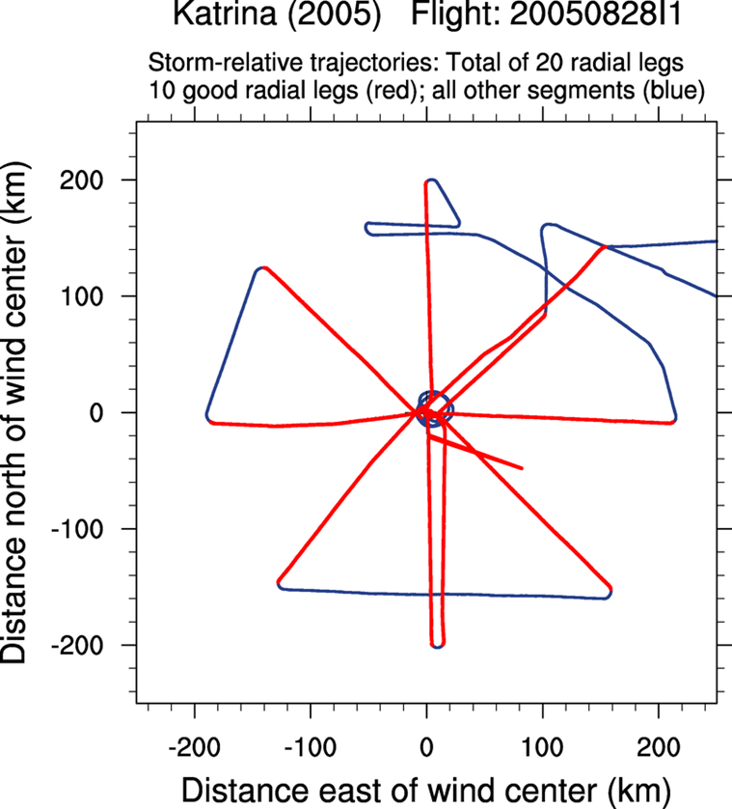
Transform to storm-
relative coordinates by
subtracting the moving
storm center (at flight level)
from each observation
An algorithm has been
devised to parse the “good”
radial legs that pass in
relatively straight lines near
the storm center

Slide 38
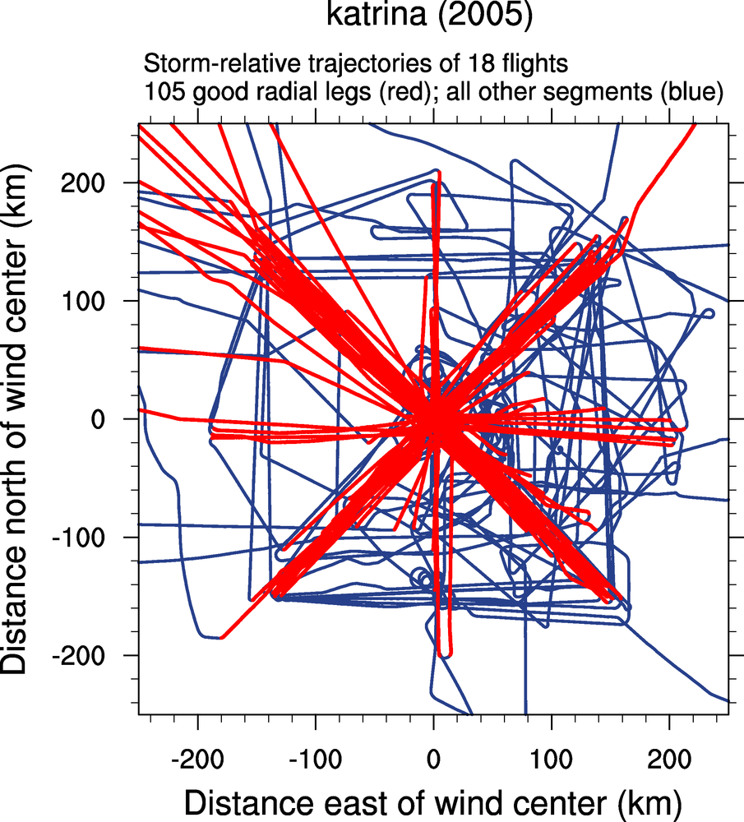
105 good legs identified
out of 234 candidate legs
Algorithm appears to
be about 98-99% accurate
Allows for years worth
of data to be processed
without labor-intensive
hassle of picking where
radial legs begin and end

Slide 39
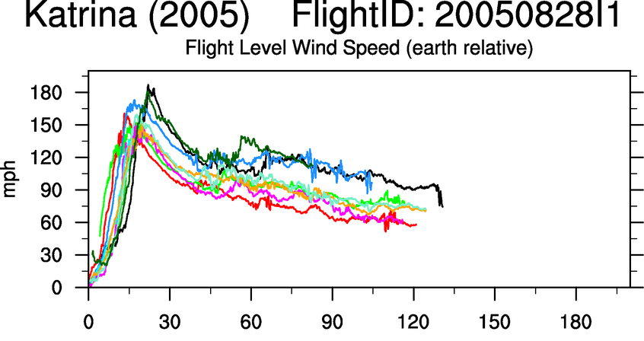
Processing to Radial Legs
Notes:
Please pardon the English units – some of these plots were made for presentation to industry.

Slide 40
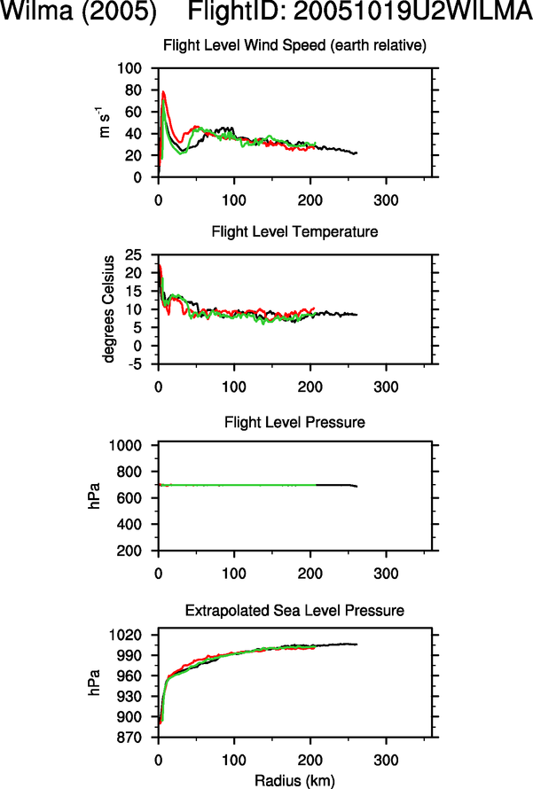
Earth-relative wind speed ->
Flight level temperature ->
Flight level pressure ->
Verifies that the leg was flown on a
near-constant pressure surface
Extrapolated sea level pressure ->
Can be used to compute gradient wind

Slide 41
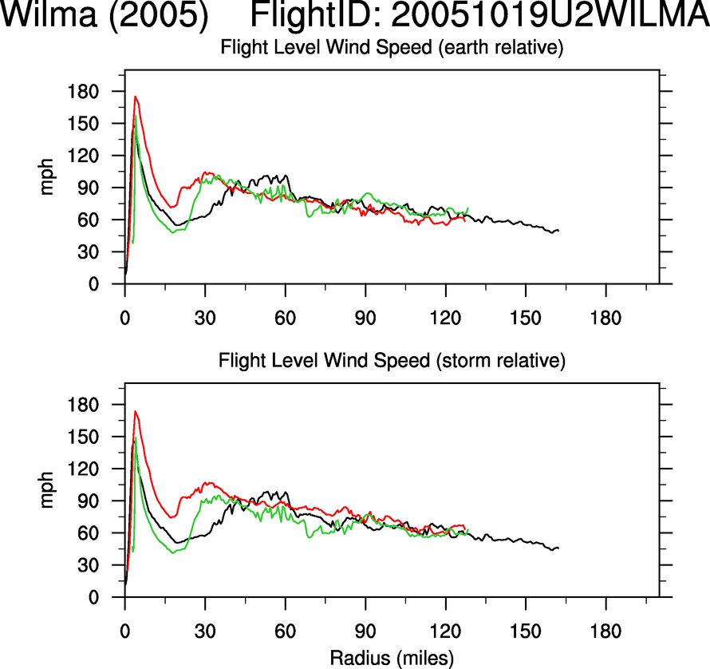
Earth-relative
Storm-relative

Slide 42
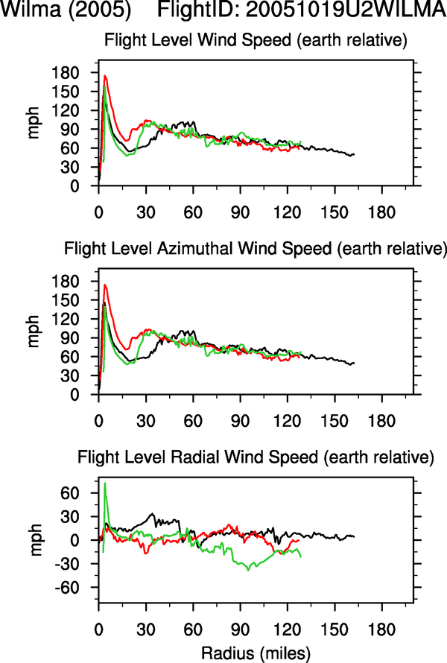
Earth-relative wind speed ->
Azimuthal wind speed ->
Radial wind speed ->

Slide 43
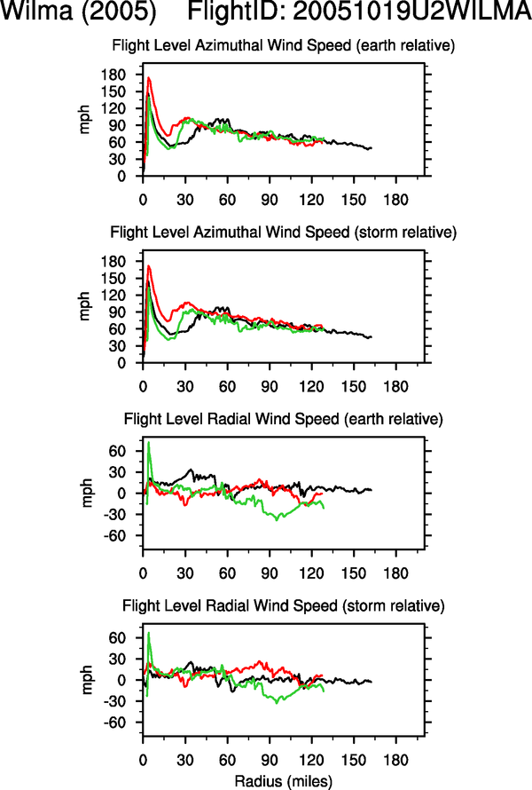
Earth-relative azimuthal wind speed ->
Storm-relative azimuthal wind speed ->
Earth-relative radial wind speed ->
Storm-relative radial wind speed ->

Slide 44
FLIGHT+ Dataset Coverage
Dataset coverage
  237 storms from 1999 to 2015
  Atlantic, Eastern Pacific, Central Pacific, Western Pacific
  ~7000 “good” radial legs
    Because flight level pressures is missing in most AFRES flights prior to 2005, only ~4800 “good” radial legs have flight level pressure

Slide 45
Next Steps (pending funding)
    Calculate a proxy flight level pressure for the AFRES flights that are missing this parameter prior to 2005
    Incorporate post-processed SFMR wind data into the dataset (in collaboration with Brad Klotz)
    Implement real-time processing of wind center tracks to provide research-grade views of data on P3s
    Revisit issue of flight level -> surface reduction factors
    Undertake process studies on inertial stability and rapid intensification (the original goal that sparked this project)

Slide 46
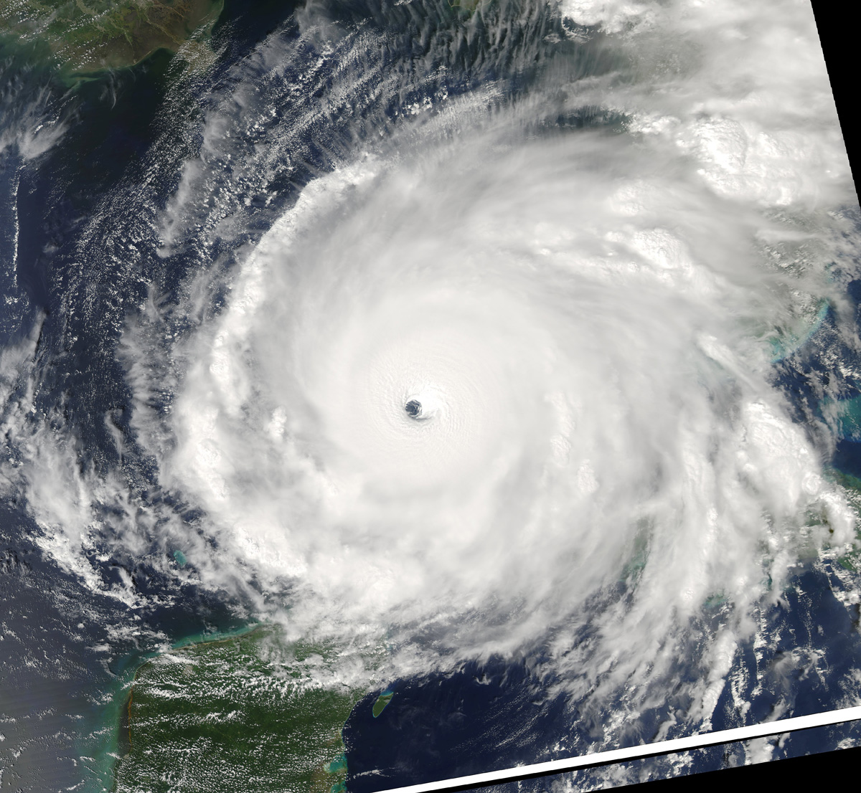
Feedback and Discussion
Collaboration with HRD scientists is welcomed for any
aspect of this project!
Please send questions and feedback
to Jonathan at jvigh@ucar.edu
For more info and data, see the FLIGHT+ web page:
http://verif.rap.ucar.edu/tcdata/flight/
Thanks to:
NOAA Aircraft Operations Center,
Hurricane Research Division,
and the 53rd Air Force Reserve
for bravely collecting data

